Slide 1
Hamiltonian dynamics and (exo)planetary system
Hervé Beust
Institut de Planétologie et d’Astrophysique de Grenoble
FOST team

Slide 2
The N - body problem / Kepler’s laws
= Finding the motion of N points masses attracting each other following Newton’s law
Small N (≲100): Celestial Mechcanics : We describe the motion of each mass.
Large N: Stellar dynamics : Only statistical properties are described
No exact solution unless for N=2 ⇒ Kepler’s laws
Kepler’s laws :
The solar system planets move on ellipses. The Sun resides at one focus of the ellipse.
The swept areas are proportional to time.
The squares of the orbital periods are proportional to the cubes of the semi-major axes.
Kepler’s law describe the motion of Solar System planets, extrasolar planets, binary stars with a reasonable accuracy

Slide 3
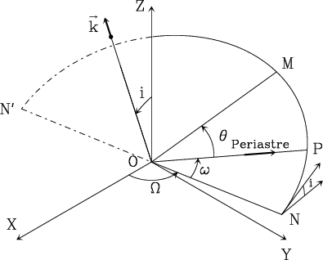
Orbital elements
a = semi-major axis
e = eccentricity
i = inclination
= Longitude of ascending node
= Argument of periastron
t_{p} = Time of periastron passage

Slide 4
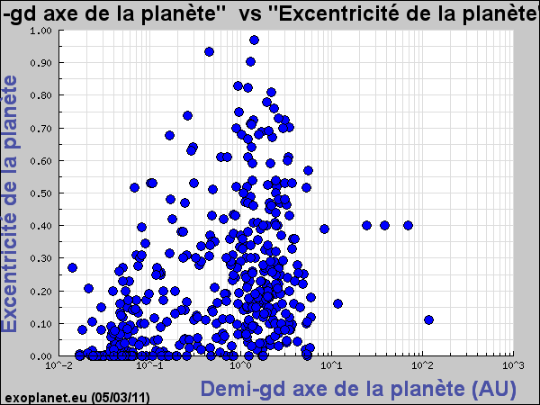
Eccentricities and inclinations
In the Solar System, eccentricities and inclinations of planets are small : The whole system is ~ planar and moves regularly !
This is not the case for extrasolar systems !
Planet | Mercury | Venus | Earth | Mars | Jupiter | Saturn | Uranus | Neptune | Pluto
e | 0.2056 | 0.0068 | 0.0167 | 0.0933 | 0.048 | 0.056 | 0.046 | 0.010 | 0.2488
i (degrees) | 7.00 | 3.39 | 0 | 1.85 | 1.31 | 2.49 | 0.77 | 1.77 | 17.15

Slide 5
The perturbed Keplerian motion
In many situations, the celestial bodies achieve a motion close to a Keplerian motion.
For instance, the Solar System planets of the solar system would follow pure Keplerian orbits pure if they only felt the Sun’s attraction.
In fact, they feel further attraction from all the other planets. But the Solar attraction dominates ⇒ The motions can still be described using Keplerian orbits that evolve slowly change ⇒ Celestial Mechanics
More generally, a perturbed Keplerian motion obeys a differential equation like
The osculating Keplerian motion is the one the body would follow is the perturbation suddenly vanished.

Slide 6
Fundamentals of classical Hamiltonian mechanics
Consider a dynamical system is described with n generalised coordinates (q_{i}) _{1≤ i ≤n} .
T and U are the kinetic and potential energy. The Lagrangian is L = T-U
To each coordinate q_{i} a conjugate momentum p_{i} is associated , defined as:
Si q_{i} is a length, p_{i} is a impulsion. If q_{i} is an angle, p_{i} is an action = a piece of angular momentum (conjugate action-angle variables).
The Hamiltonian is defined as
Then the equations of motion read
We also have dH/dt=−∂L/∂t. H is constant if it does not explicitly depend on the time. It corresponds to the total energy H=T+U

Slide 7
Canonical transformations
A canonical transformation = Change of conjugate coordinate set (q_{i}, p_{i}) _{1≤ i ≤n} to a new one (q’_{i}, p’_{i}) _{1≤ i ≤n} in such a way that the equations of motion still assume a Hamiltonian form in the new set of variables
The Hamiltonian may change ! A transformation is canonical if
Goal : Finding a canonical transformation ensuring that in the new variables, the Hamiltonien only depends on part of the variables. For example H(-,-,-,p₁,p₂,p₃) . In that case
That is the ideal case. Then the problem is solved. But this is not always possible…

Slide 8
Hamiltonian formulation of the Keplerian problem
Problem : Can we find a new set of canonically conjugate variables where the formulation of the Keplerian problem is very simple ? Yes, via a series of canonical transformations starting from the standard positions – impulsions conjugate variable.
Guideline : The orbital elements (a,e,i,Ω, ω, t_{p}) may be regarded as « coordinates » in phase space like the positions – impulsions variables.
To each set corresponds a set of elements (a,e,i,Ω,ω,t_{p}), constant in the Keplerian case, variable otherwise. This is the osculating orbit.
Difficulty : The orbital elements are not canonically conjugate. But some combinations of them are. Delaunay’s elements

Slide 9
Secular perturbations : averaging, expanding
The canonical equation cannot in general be solved in closed form. Approximations are necessary to investigate the long-term evolution: averaging and expansion.
A usual technique : averaging the perturbation over the orbital period. This is equivalent to retaining only the first term in a Fourier series
This can be viewed as a canonical transformation (Von Zeipel).
More generally, if there are several independent rapid variables, averaging is taken over all of them.
The analytical study often requires a series expansion and truncation of the perturbation before averaging. There are two methods :
Expansion using Legendre polynomial (spherical harmonics), when orbits with very different sizes are involved: r, r’, with r≪r’
Expansion using Laplace coefficients, where the orbits have comparable sizes, but have small eccentricities and inclinations (First a Fourier expansion, and then an expansion in ascending powers of eccentricites and inclinations)

Slide 10
Planetary theories
A planetary theory is a model for the secular evolution of planetary orbits a There is no general solution !
Usual assumptions :
Perturbations remain small (= no close encounters)
Eccentricities and inclinaisons remain small.
Simplest theory : Laplace-Lagrange (~1800): The perturbation is truncated to second order in eccentricities and inclinations.
This leads to a linear differential system, which solution is a combination of harmonic oscillators with characteristic fundamental frequencies (periods ~10⁵ years).
The semi-major axes are secular constants (consequence of averaging)
The eccentricities and inclinations fluctuate, and the orbits slowly precess
Accurate over ~1 million years
To achieve better accuracy : Higher order theories (Le Verrier, Bretagnon, Laskar)
Similar results, but weak chaos is found !

Slide 11
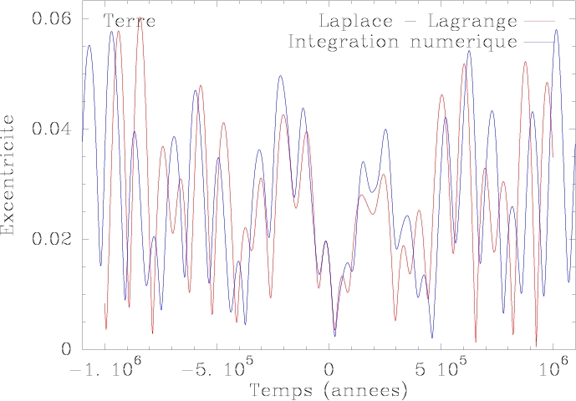
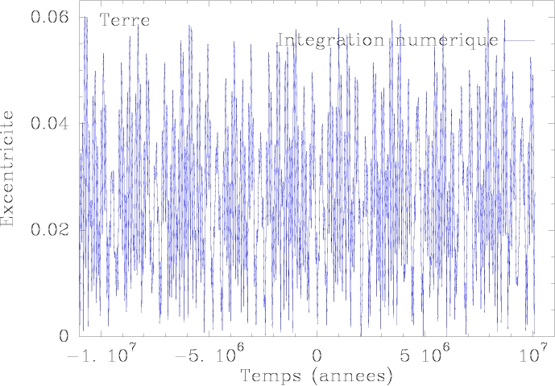
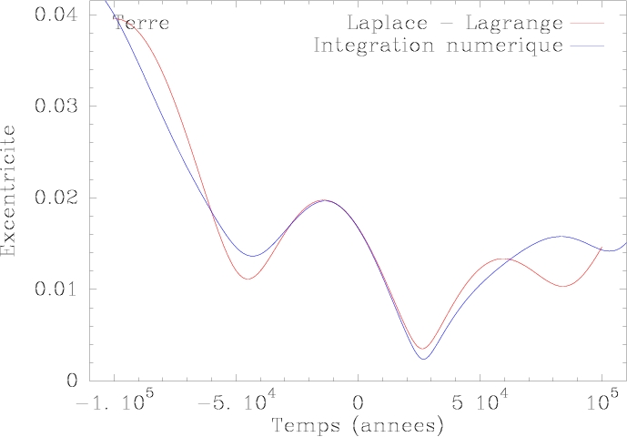
Exemple : evolution of the osculating eccentricity of the Earth’s orbit
The Earth eccentricity fluctuates between 0 and 0.06.
This has an impact on the terrestrial climate.
Unpredictible over a timescale of ~1 billion years a Chaos !

Slide 12
Mean motion resonances
A frequent configuration : Many orbital periods in the Solar System achieve simple rational ratios:
Planets
5 periods of Jupiter = 2.013 periods of Saturn
3 periods of Neptune = 1.99 periods de Pluto
Jupiter’s satellites
2 periods of Io = 1 period of Europe
2 periods of Europe = 1 period of Ganymede
Saturn’s satellites
2 periods of Mimas = 1 period of Tethys
2 periods of Encelade = 1 period of Dione
4 periods of Titan = 3 periods of Hypérion
Extrasolar systems
Gliese 876 (resonance 3:2), etc

Slide 13
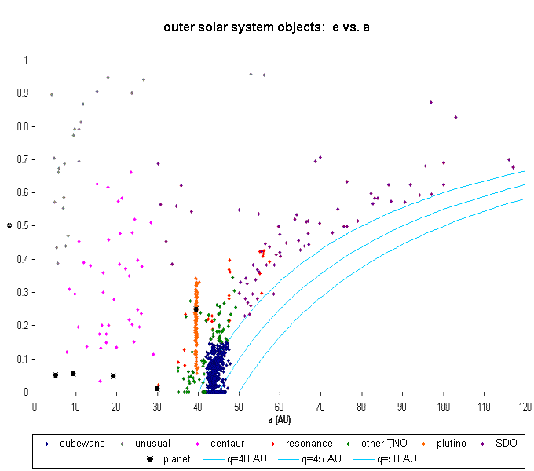
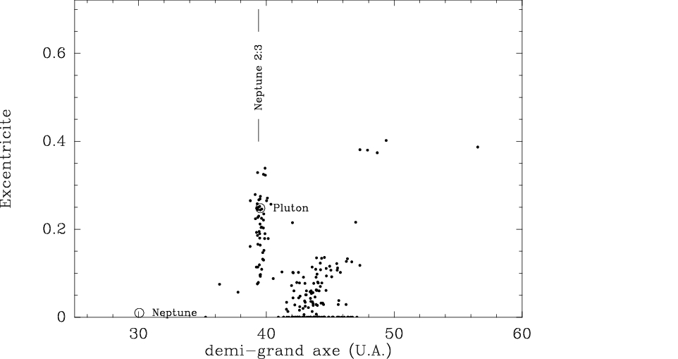
Mean motion resonances (II)
These are not fortuitous but preferred configurations !
Some resonances concentrate objects. Example: 2:3 resonance 2:3 with Neptune (Plutinos)

Slide 14
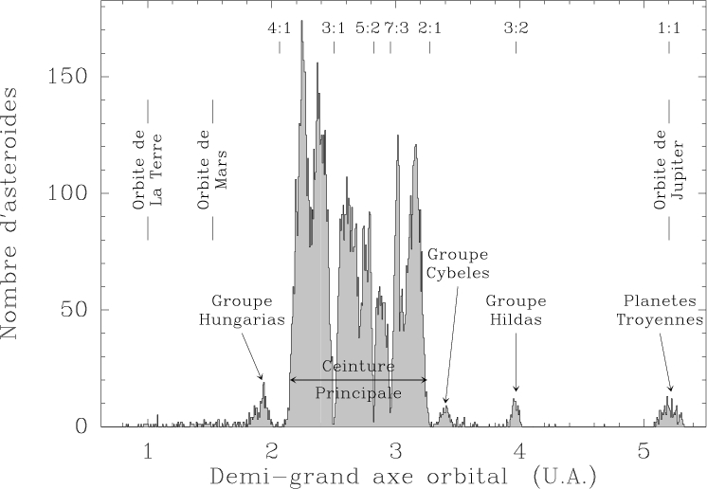
Mean-motion resonances (III)
Resonances with Jupiter
But some others are void of bodies : Kirkwood gaps

Slide 15
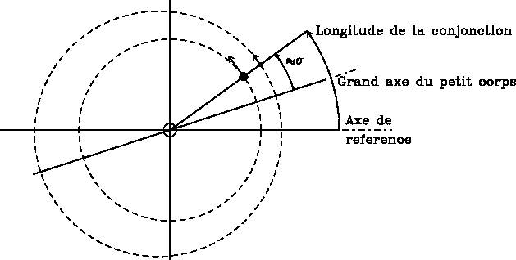
Mean-motion resonances : theoretical background
More generally, we describe a (p+q) : p mean motion resonance
|q| is the order of the resonance = the number of conjunction positions.
We define the critical angle of the resonance ≈ the longitude of the conjunction
σ changes slowy due to the resonant motion. It corresponds roughly to the longitude of the conjunction.
The Hamiltonian cannot be averaged independently over both orbits ⇒ We first perform a canonical transformation introducing σ before averaging
A resonant orbit is characterized by a librating motion of σ around an equilibrium position ⇒ The resonance is self-sustained

Slide 16
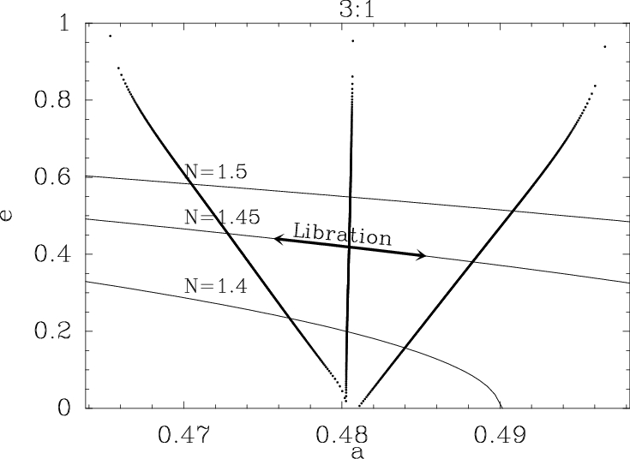
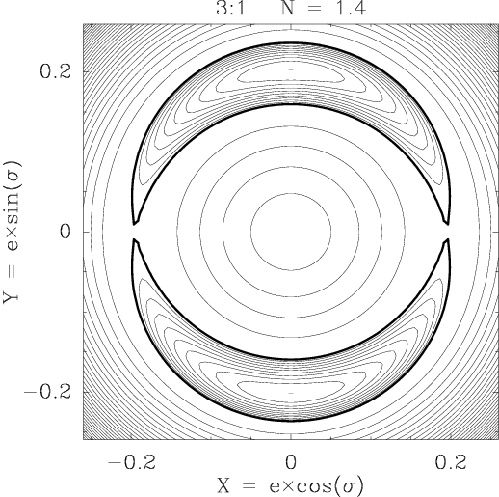
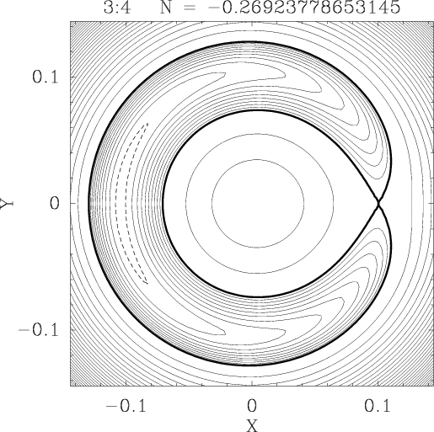
Examples of phase space portraits
3:4 and 3:1 resonances
If the planet eccentricity e’=0, there is a secular constant of motion
For any value of N, the Hamiltonian has only one degree of freedom left ⇒ 2D phase space portaits (Computer generated level curves of Hamiltonian )
(X = e cosσ, Y = e sin σ)
Region of resonant orbits in (a,e) space : Characteristic V-shape

Slide 17
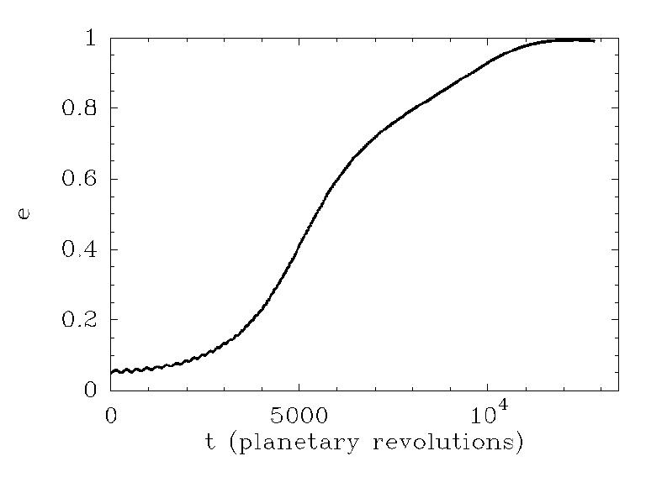
Destabilising resonance
4:1 resonance, but perturbing planet with eccentricity e’=0.05
The particles’s eccentricity grows up to ~1 ! Non-linear effect
Explains why some resonances (Kirkwood gaps) are empty.
Main source of Earth-crossing asteroids in the Solar System
More active in the Early Solar System history;
Presumably active today in the young extrasolar system of β Pictoris.

Slide 18
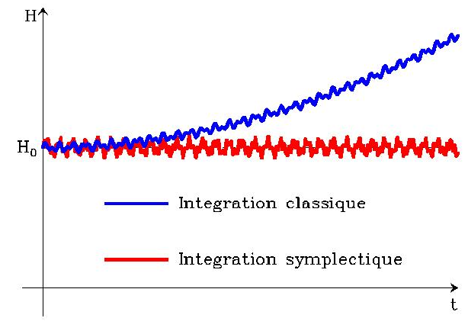
Numerical methods for dynamical investigation of planetary systems : Symplectic integration
Numerical integrator = Code to numerically integrate the equation of motions in a planetary system
Modern integrators = Symplectic integrators : fast and stable !
Classical methods (Runge-Kutta…) do not keep Hamiltonian=cst
A symplectic scheme preserves exactly H or a nearby Hamiltonian. Under regularity conditions,the error on H is shown to be bound.
Basic hypothesis of symplectic integration: H=H_{A}+H_{B} where H_{A} and H_{B} can be integrated exactly.
Recipe (most popular 2nd order scheme) : Integrate
H_{B} during τ/2
Η_{Α} during τ ⇒ We exactly solve
Η_{Β} during τ/2.
Better : if we have H_{B}≪H_{A} (H_{B}/H_{A}∼ε) then ⇒ We can integrate with a large time-step

Slide 19
Standard symplectic schemes
Simplest example : T+U method (kinetic + potential)
Conjugate cartesian variables q_{i}=x,y,z.. p_{i}=mv_{x},mv_{y},mv_{z}…
T = T(−,p_{i}) et U=U(q_{i} ,−) ⇒ T and U are integrable separately
⇒Symplectic scheme with H_{A}=T, H_{B}=U.
But we do not have H_{B}<<H_{A}
Second exemple: MVS/WHM method
Hypothesis : (m_{i}≪ m₀ for all i = 1,…,n-1) (planetary system)
H_{A} = Sum of separate Keplerian Hamiltonians (integrable …)
H_{B} = Remainder = Mutual perturbations = H_{B}(q_{i},−) (integrable too)
Condition H_{B}≪ H_{A} is fulfilled if
Body #0 is much more massive than the others (Sun !)
The relative distance remain large enough (=no close encounters)
Third example : HJS method
The splitting of H is done according to the hierarchical structure of the stellar system.
Adapted for hierarchical stellar systems

Slide 20
When close encounters occur ?
When two planets get too close to each other, we have important et rapid perturbations. The H_{B}≪ H_{A} requirement is no longer fulfilled.
Natural idea : Reducing the timestep when this occurs
BUT : To be really symplectic, an integration scheme needs the timestep to be constant (H_{integ}=f(τ)) ⇒ difficulty !
We drop symplecticy during the time of the close encounter ( RMVS code, Levison & Duncan)
We modify the splitting H_{A}+H_{B} smoothly during the encounter (MERCURY code, Chambers)
We split all potentials in concentric nested circles, and we attribute a timestep to each slice (SyMBA code, Duncan, Lee & Levison).

Slide 21
Application 1: « Nice » model (Early Solar System history) (Morbidelli, Levison, Gomes, Tsiganis, 2006)
Observational fact : ~800 million years after its fomation, there was a sudden increase of cratering activity in the Solar System : the Late Heavy Bombardment (LHB) . Remained a mystery until recently
« Nice » model :
The giant planets were formerly much closer to the Sun (< 20 AU)
As they eject planetesimals, Jupiter slowly migrates inwards and the other giants migrate outwards.
Then Jupiter and Saturn fall in 2:1 resonance. This excites their eccentricities
Uranus and Neptunes get strongly perturbed and ejected at their present-day locations
They appear in the middle of the early Kuiper belt and scatter a lot of bodies. Some of them get inward ⇒ LHB !
Apart from the LHB itself, this scenario explains the residual eccentricity of the giant planets.
..\films\Solar_System_Sim.mov ..\films\lhbae2.avi

Slide 22
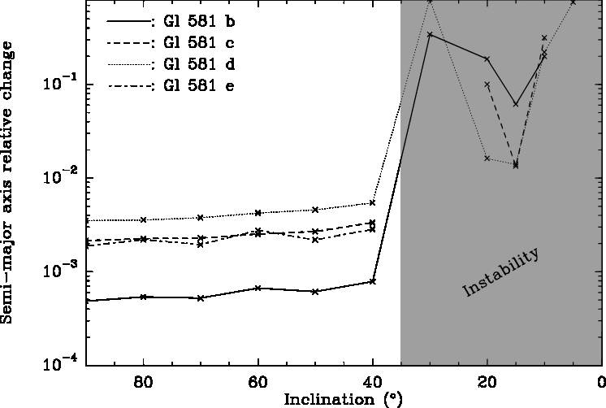
Application 2 : The Gliese 581 system (4 Planets, one « habitable »)
1.9 M⊕,0.028 AU / 15.9 M⊕, 0.041 AU / 5.4 M⊕,0073 AU / 6.0 M⊕, 0.205 AU
Excentricity of planet #3
Over 10000 years and over 100 million years

Slide 23
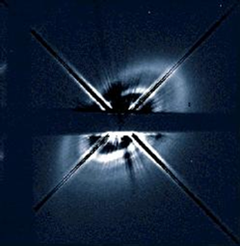
Application 3 : Perturbation of disks by companions
HD 141569 : A dust disk surrounding a young massive star, with spirals and two nearby passing stars (+ a planet inside)
G Tauri : a quadruple system : confinement of a disk around the main binary

Slide 24
Application 3 : Perturbation of disks by companions
HD 141569 : A dust disk surrounding a young massive star, with spirals and two nearby passing stars (+ a planet inside)
G Tauri : a quadruple system : confinement of a disk around the main binary

Slide 25
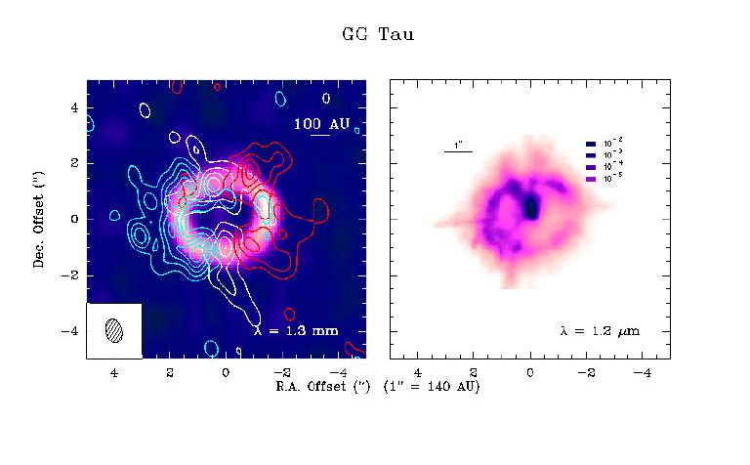
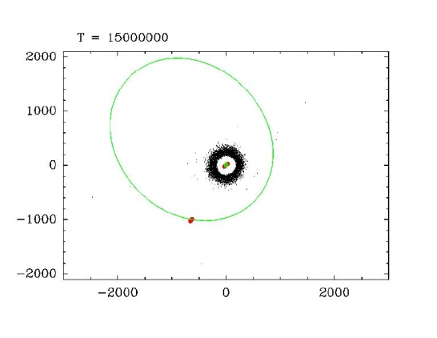
Application 3 : Perturbation of disks by companions
HD 141569 : A dust disk surrounding a young massive star, with spirals and two nearby passing stars (+ a planet inside)
G Tauri : a quadruple system : confinement of a disk around the main binary

Slide 26
Hamiltonian formulation of the Keplerian problem
The Keplerian Hamiltonian in Delaunay’s elements reads
H only depends on one single momentum, L ! The the three momenta L,G,Θ are constant, as well as the coordinates Ω et ω. There is only one equation left
With dM/dt = n and L = (μa)^{1/2}, we are back to Kepler’s third law n²a³ = μ.
Whenever the inclination and/or the eccentricity are small, Delaunay’s elements are not regular. We introduce Poincaré’s elements

Slide 27
The HJS method(Hierarchical Jacobi symplectic, Beust 2003)
The splitting of H is done according to the hierarchical structure of the stellar system.
= Sum of Keplerian Hamiltonians corresponding to centers of mass orbiting other centers of mass
= What’s left
The condition is fulfilled irrespective of the various masses, once the nested orbits are very different in size.
..\films\spiral1.avi ..\films\spiral2.avi
..\Mes images\hd141569_s1.jpg ..\Mes images\hd141569_s2.jpg

Slide 28
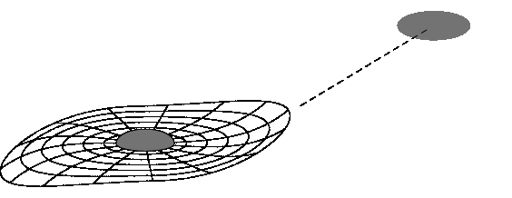
Dynamique dans les systèmes multiples
Les systèmes multiples ne sont pas plans : ils sont très sujets à la résonance de Kozai.
Exemple : excentricité élevée de certaines planètes
Un disque (ou un système planétaire) autour d’une étoile dans une système binaire est tronqué par interaction avec le compagnon.
Ces disques sont aussi déformés par les compagnons stellaires ≈ effets de marée

