Slide 1


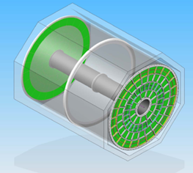
Readiness of the TPC
What is left before final design?
Mechanics
Electronics
optimisation of parameters
Gating
Technology choice
How and when
Construction
P. Colas

Slide 2
Mechanics

Slide 3
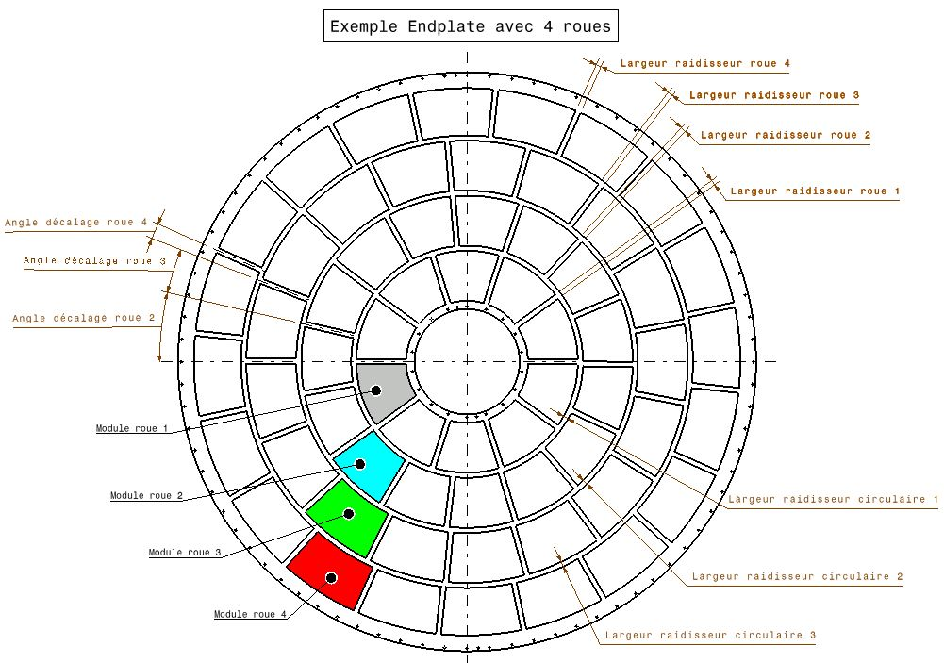
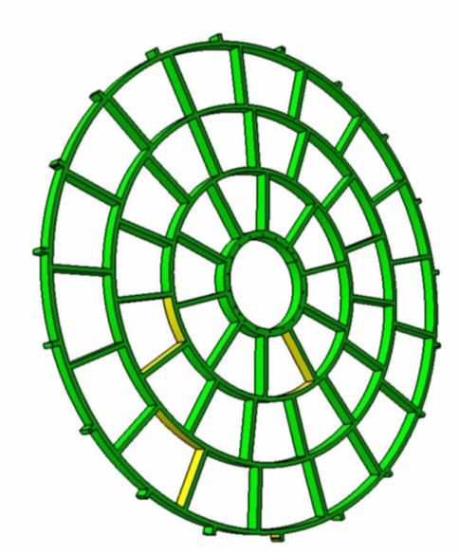
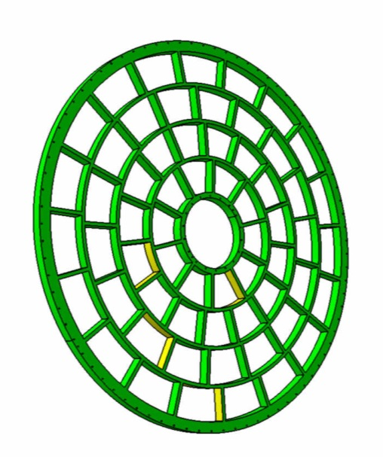
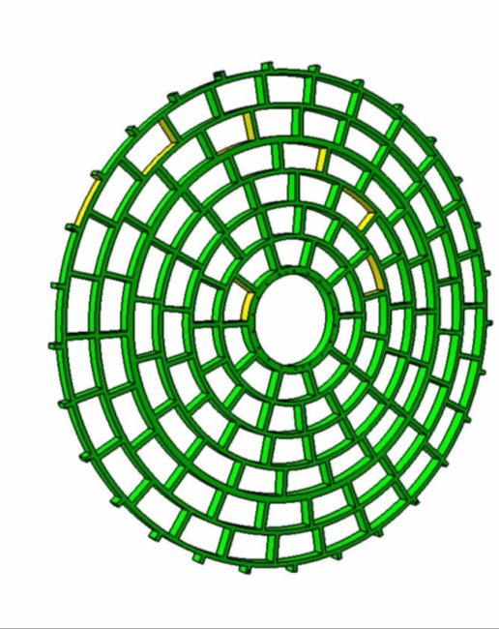
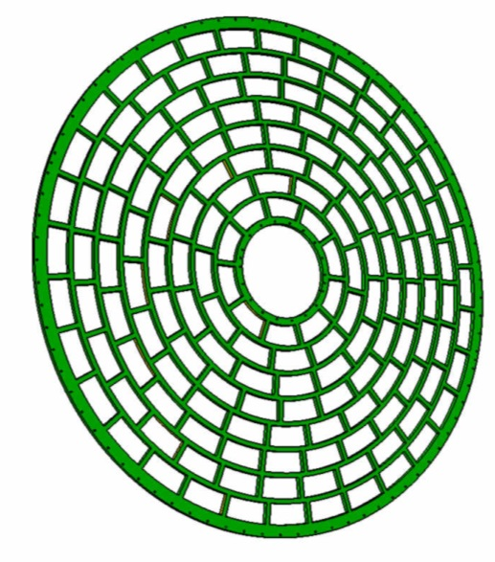
3| Options for the future ILD-TPC
Changing the
modules’ dimensions?
  3 wheels 4 wheels 6 wheels 8 wheels
  42 modules 61 modules 110 modules 171 modules

Slide 4
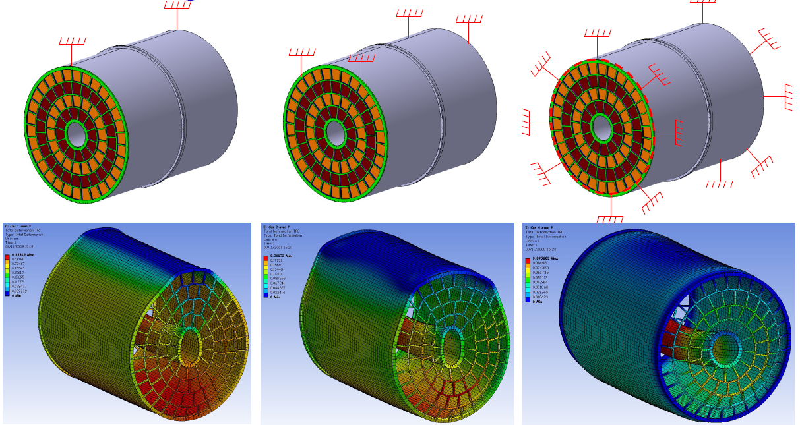
3| Options for the future ILD-TPC
Full TPC analysis:
Self-weight and mounting (2 tons)
Overpressure (ΔP = 3 mbar)
2 x 370 kg (Al)
2 x 530 kg (G11)
265 kg (NIDA)
~200 μm
[courtesy of M. Carty]

Slide 5
Electronics
Task force being gathered. Preliminary conclusions.
1.) List: Parameters driven by physics
Preamplifier: input capacitance (5-20 pF)
shaping peaking time (60-200 ns) Martin Ljunggren MSc
sensitivity (1-10 mV/fC)
polarity (negative)
dynamic range (SALTRO: 150 fC, AFTER: 120,240,600fC) dE/dx
linearity error <1% for full dynamic range dE/dx
noise (<600 electrons)
Shaper: restoring to baseline at least 1 μs for Micromegas (not to lose the signal on side pads)
ADC: number of bits (8-10) Wenxin's thesis (Saclay), Liangliang's thesis (Lund) for spatial resolution
sampling frequency (20 - 40 MHz)
Time of continuous readout: ~800 μs (full bunch train)

Slide 6
Electronics
2.) List system driven by other considerations
Input leakage current compensation (if too high -> noise, but may be necessary, e.g. for protection diodes)
pad density (determined by geometry)
Power consumption: 4 mW/channel (without power pulsing) -> 20 W per Module (5000 channels) -> 1 kW per endcap with power pulsing

Slide 7
optimization
Module size
  Small number of large modules easier to align and to build, but size limited
Pad size
  3x7mm good at large radii (for Micromegas)
  Down to 1x4 could be necessary at small radius for 2-track separation
Radius (under discussion these days)

Slide 8
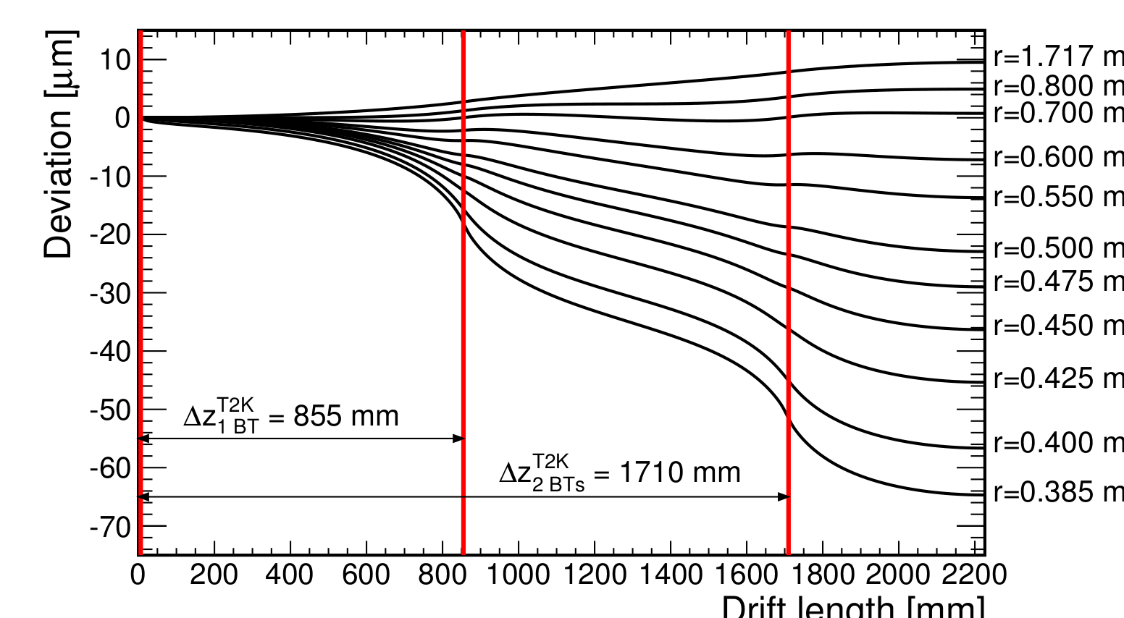
Gating
Detailed studies showed that gating is necessary to mitigate distortions due to space charge, even if IBFxGain ~ 1, because of the high density ion sheet due to bunch trains.
Under study

Slide 9
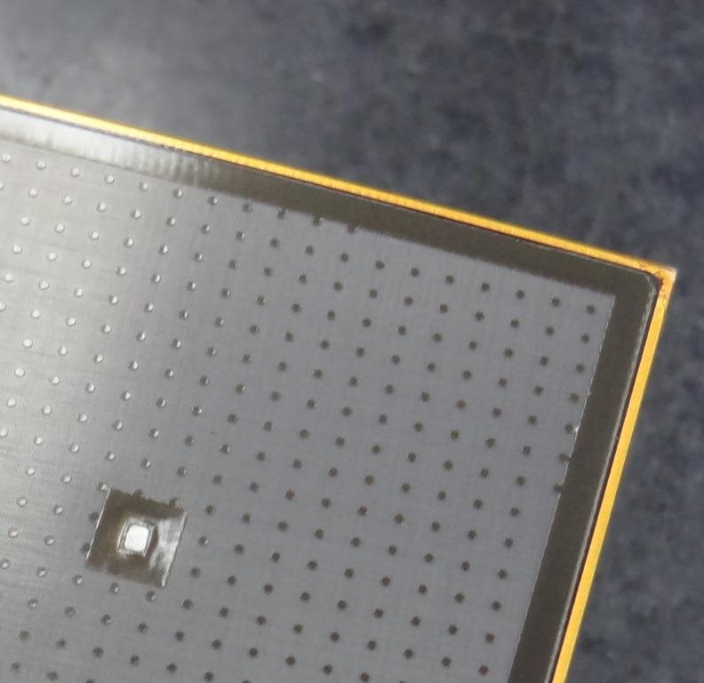
Mitigation of distortions at the boarders
For Micromegas: reconcile the grounding of the resistive layer with the field homogeneity.

Slide 10
Technology choice
To be done early enough to concentrate efforts
Criteria to be defined in the next 2 years
This must include practical aspects as well as aging aspects.
For instance, detailed simulation of Micromegas resistive foil effect

Slide 11
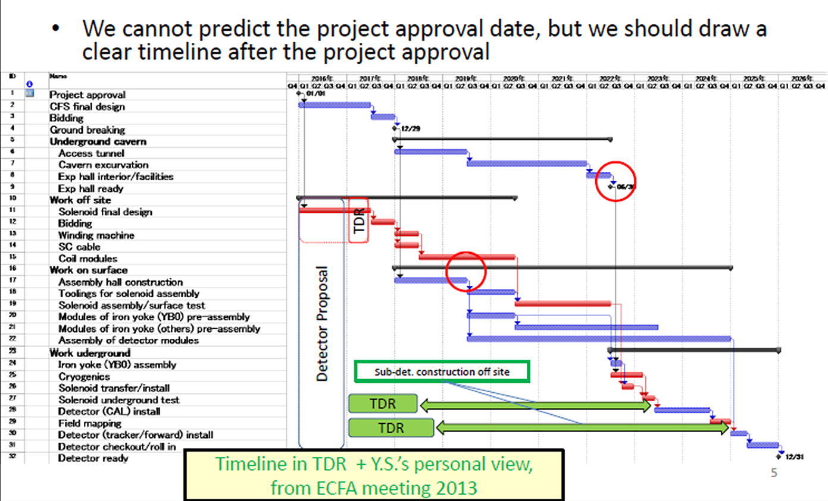
Construction

