Slide 1


ATF2: Accelerator Test facility
A.Jeremie
LAPP: A.Jeremie
LAL: P.Bambade, Shan Liu , S.Wallon, F.Bogard, O.Blanco, P.Cornebise, I. Khvastunov, V. Kubytskyi
And fruitful work with KEK, KNU, IFIC, IHEP, UK and CERN colleagues (not listed)

Slide 2
What was done by the French teams around ATF2
Introduction
Vibrations and GM feedforward
IP-BPM and chamber
Beam-halo evaluation : diamond sensor
Conclusion Outlook

Slide 3
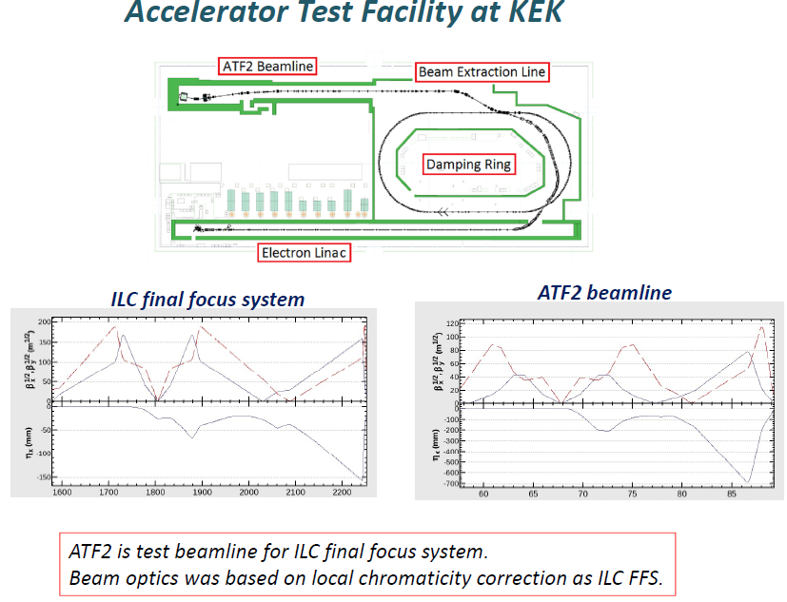
Goal 1: 37 nm beam at the focal point in a stable and reproducible manner
Goal 2: Stable trajectory (Δ<2nm) and ILC-like intra-train feedback
Shintake monitor

Slide 4
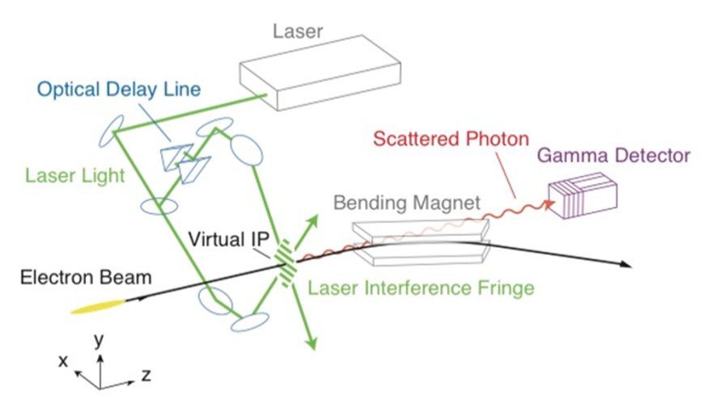
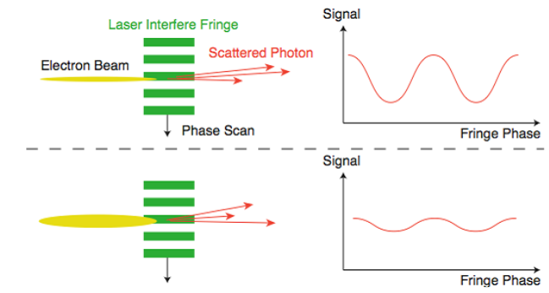
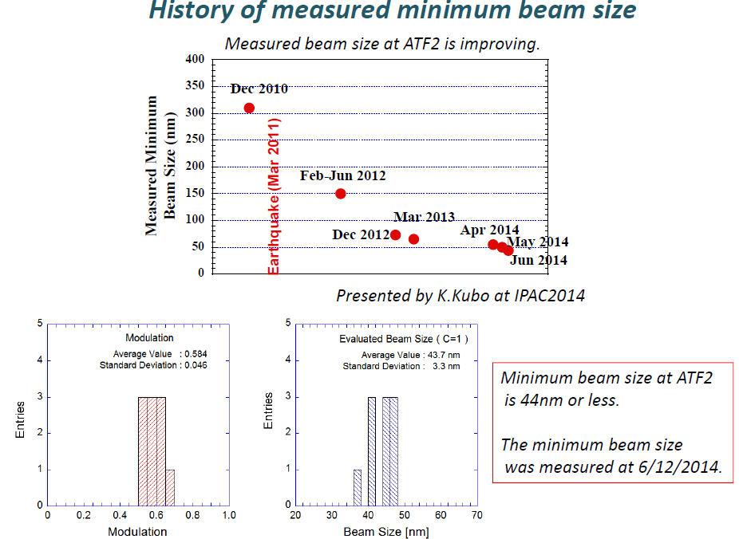
“Routinely” produce 45 nm beams at ATF2!
Shintake Monitor: essential for beam tuning
Focused beam
Less focused
Modulation of photon rate by Compton diffusion on interference fringes
44nm beam size: Already a record!
Big step towards ILC feasibility!

Slide 5
What was done by the French teams around ATF2
Introduction
Vibrations and GM feedforward
IP-BPM and chamber
Beam-halo evaluation : diamond sensor
Conclusion Outlook

Slide 6
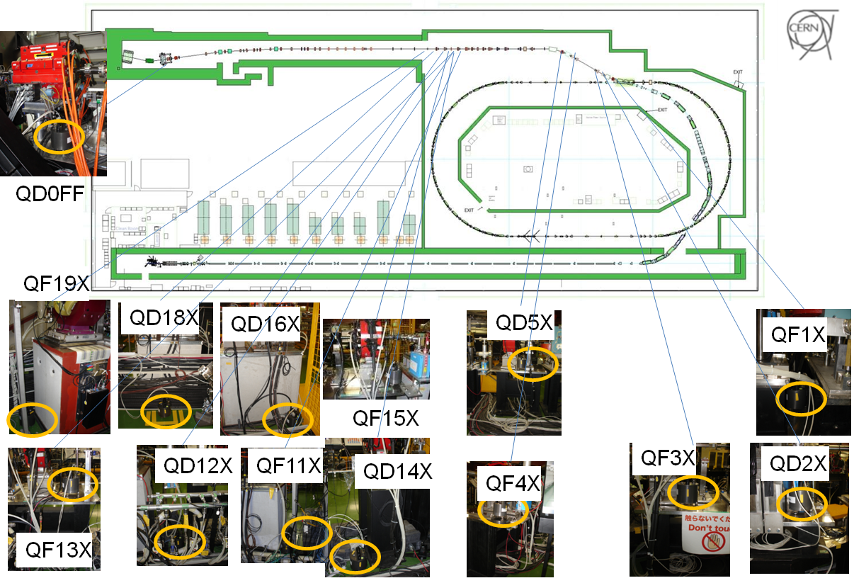
14 Guralp 6T sensors all along ATF2
Guralp 6T: 0,5Hz-100Hz, two directions connected (vertical and horizontal can be placed parallel or perpendicular to beam direction), mainly in Extraction line, 2 sensors easily relocated

Slide 7
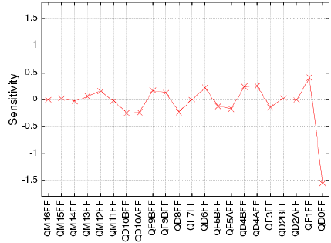
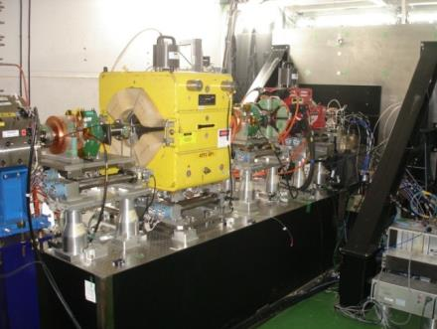

What magnets need studying?
QF1FF
IP
QD10FF pair
Tolerance (vertical) | QD0FF | QF1FF (old support and magnet) | QF1FF (new magnet and support)
7 nm (QD0) 20 nm (QF1) | 4.8 nm | 6.3 nm | 30nm
QD0FF
The most sensitive magnet is QD0FF, then comes QF1FF (which was recently changed and needs to be studied) then QD10FF pair

Slide 8
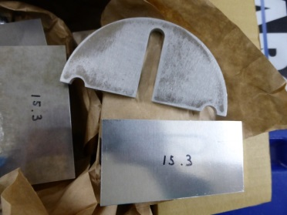
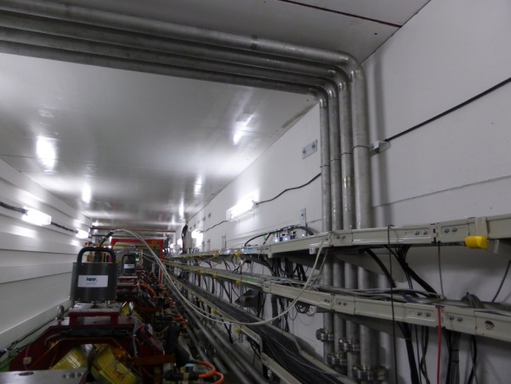
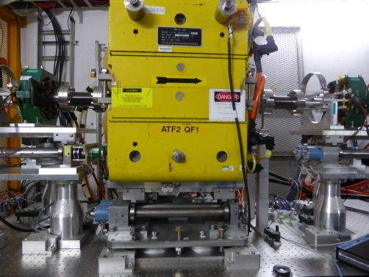
Relative displacement at 1Hz
QD10FF/floor | Vertical (nm) | Horizontal (nm)
No cooling No shims | 7,3 | 98
Cooling No shims | 18 | 150
Cooling Shims | 15 | 100
Shims help but not significantly
Cooling has dramatic effect
QF1FF/tabletop | Vertical (nm) | Horizontal (nm)
No cooling No shims | 20 | 150
No cooling Shims | 15 | 95
Cooling Shims | 16 | 120
More stable support gives better vibration behaviour
Support can benefit from upgrade study

Slide 9
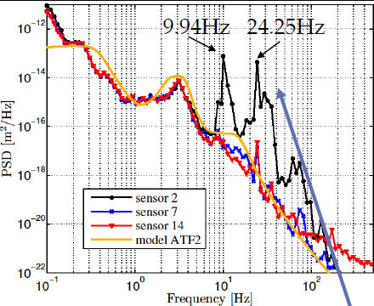
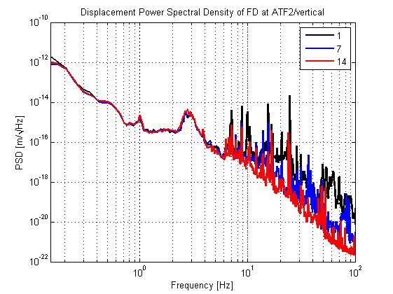
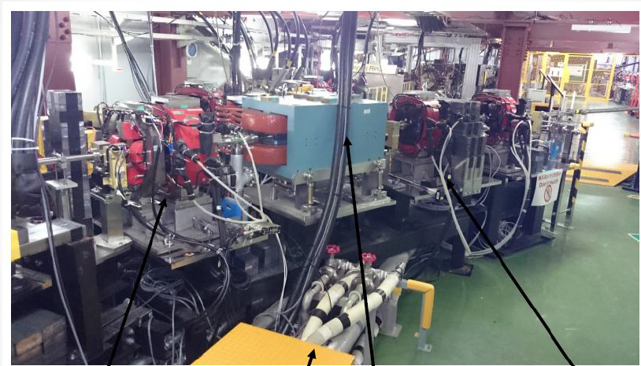
Another vibration source identified
Sensor 1 still noisy, but vibration improvement
After pipe repositioning
Sensor 2
This pipe has been placed so as to avoid touching girder
Unfortunately these cannot be changed easily in a quick fix
Step after step: vibration source identification

Slide 10
ATF2 GM feedforward test
Goal
  Predict Ground Motion (GM) effect on beam trajectory with GM sensors
  Compare with BPM reading
Motivation
  Probably the first time GM sensors are compared to BPMs
  Demonstrate feasibility of a feedforward based on GM sensors
  Feedforward would allow trajectory correction based on GM sensors (get independant information between pulses)
  Possible big savings by relaxing mechanical quadrupole stabilisation specifications at CLIC
  Global scheme instead of local mechanical correction

Slide 11
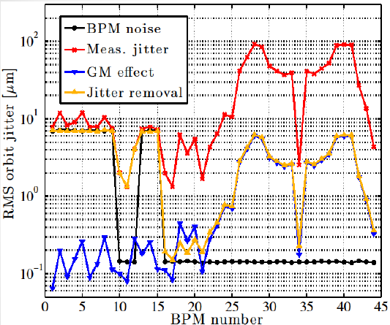
First results
GM effect small compared to orbit jitter: difficult experiment at ATF2
Incoming jitter can be measured by BPMs and removed from downstream BPM measurements
Low resolution BPMs at beginning
One can expect the GM effect can be detected by BPMs after jitter removal.
Typical “best” BPM (☺) in vertical direction
BPM measurement with jitter removal vs BPM position predicted from GM sensor measurement: nice correlation!
Still need to evaluate if by removing strong vibration sources, this correlation remains
GM sensors powerful detecting vibration sources
Novel GM mitigation technique: promising!

Slide 12
What was done by the French teams around ATF2
Introduction
Vibrations and GM feedforward
IP-BPM and chamber
Beam-halo evaluation : diamond sensor
Conclusion Outlook

Slide 13
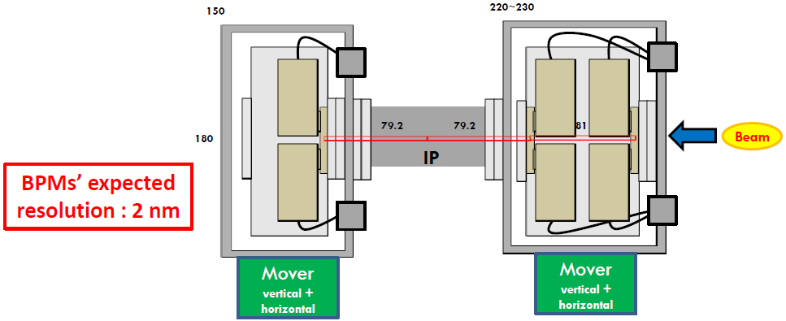
New IP-BPMs and chamber
In addition to the Beam Size monitor (Shintake Monitor), we also have Beam Position Monitors (BPM) around IP
C
B
A
A precise mover system (piezo movers PI and Cedrat) has been designed
→ precise remote mechanical alignment of IP-BPMs (since in vacuum chamber)
→ mechanical calibrations of IP-BPM scale factors with required precision (instead of moving the beam as before); their calibration, reproducibility and linearity below 10⁻⁴

Slide 14
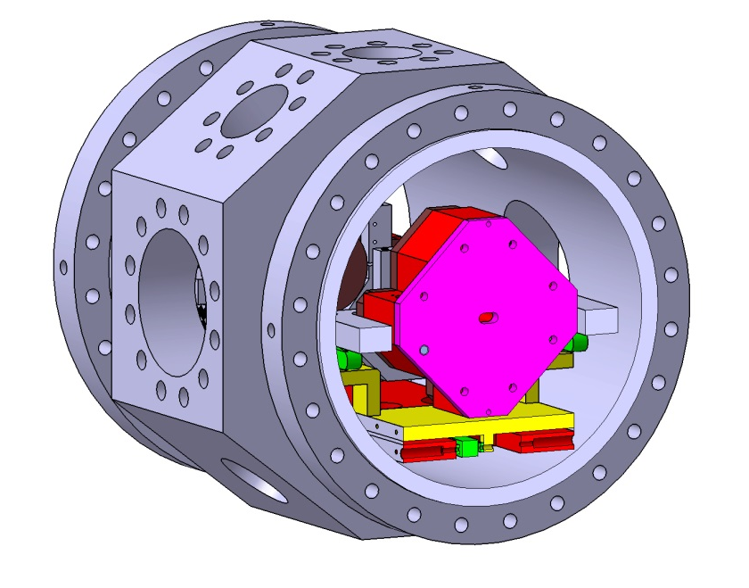
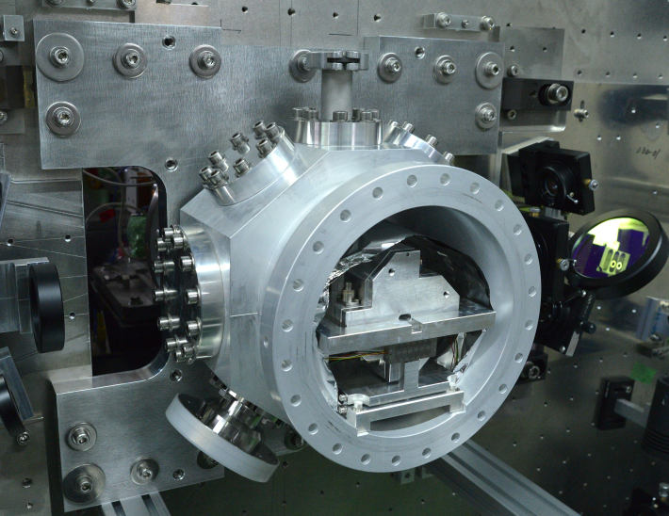
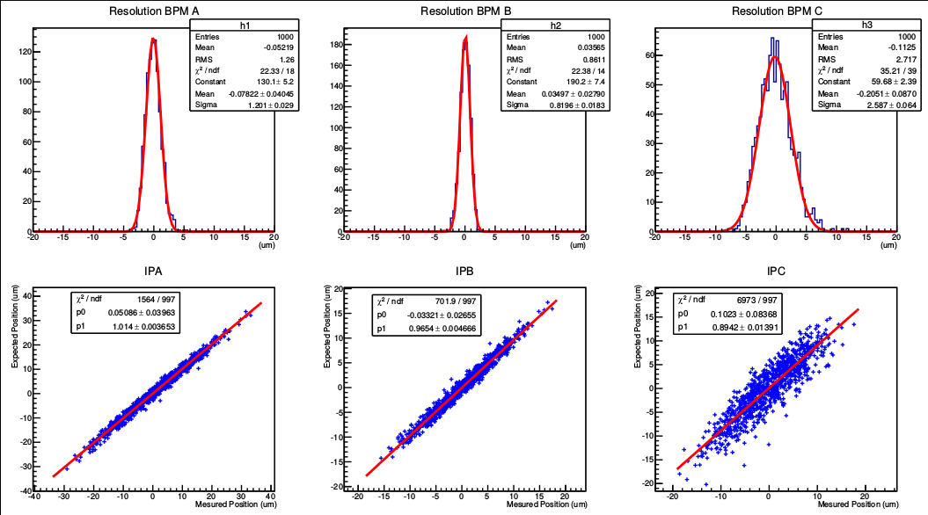
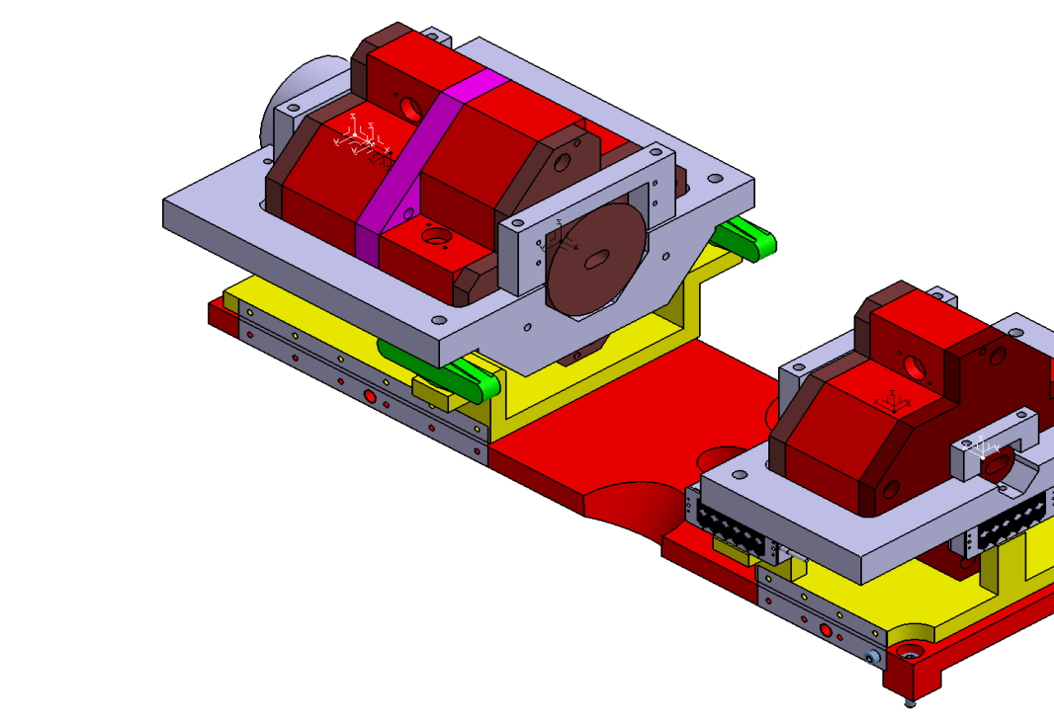
BPMs displacement system (inside chamber)
One piezo-actuators/block for BPM lateral displacement
~300um
3 piezo-actuators/block for BPM vertical displacement ~300um
res≈26nm
IP
Measured versus predicted bunch position
14

Slide 15
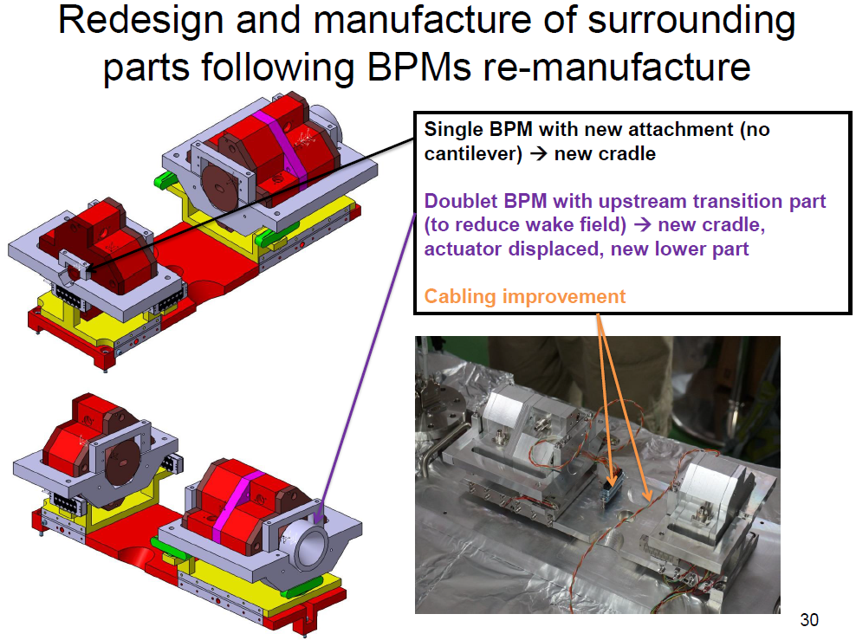

Slide 16
IPBPM alignments after recent re-installation
200um vertical
misalignment
correction
0.75mrad pitch
angle correction
A
B
C
A
B
C
Beam direction
IPB-YI’
After the vertical misalignment correction about 200um.
IPA-YI’
IPB-YI’
IPC-YI’
13.75um
IP
Beam direction
200um
230um
IP
167um
18.75um
39um
We re-calculated the vertical misalignment
after 1.5mrad pitch angle correction with 900um shift up!
The average misalignment was 200um.
Beam direction
IPA-YI’
IPC-YI’

Slide 17
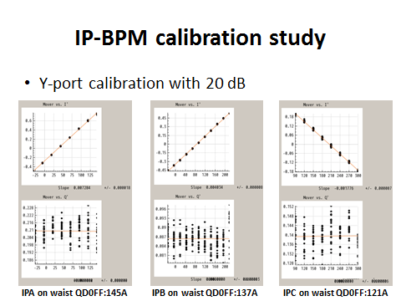
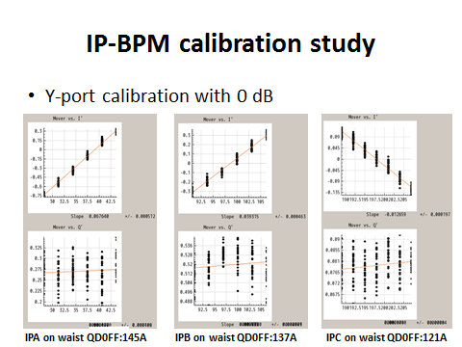
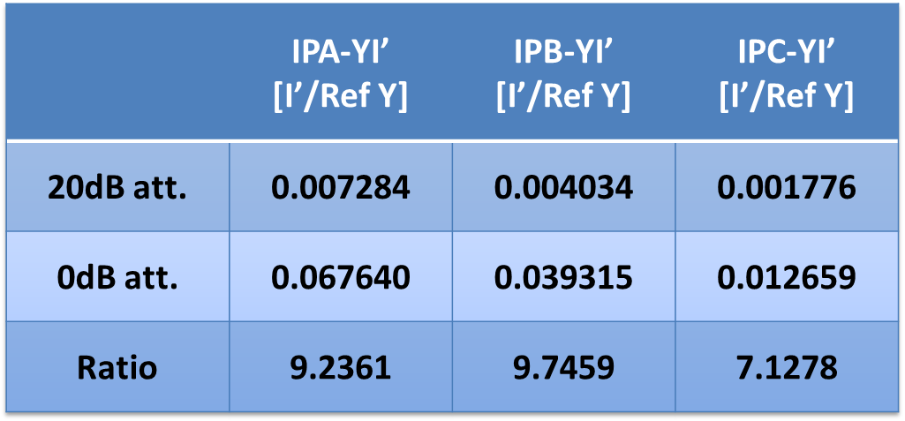
IP-BPM calibration
IP-BPM misalignment corrected so that beam passes through all 3 BPMs
IP-BPM calibration done
=> New IP-BPMs and improved IP-chamber operational!

Slide 18
What was done by the French teams around ATF2
Introduction
Vibrations and GM feedforward
IP-BPM and chamber
Beam-halo evaluation : diamond sensor
Conclusion Outlook

Slide 19
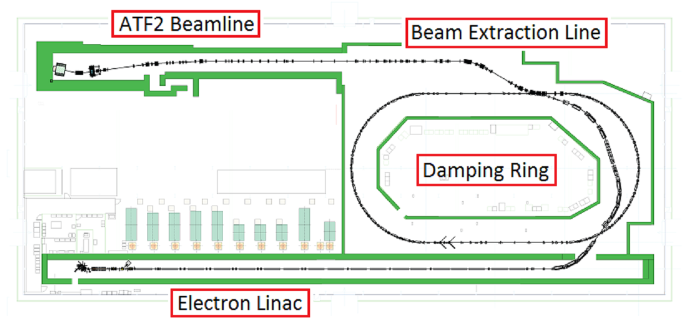
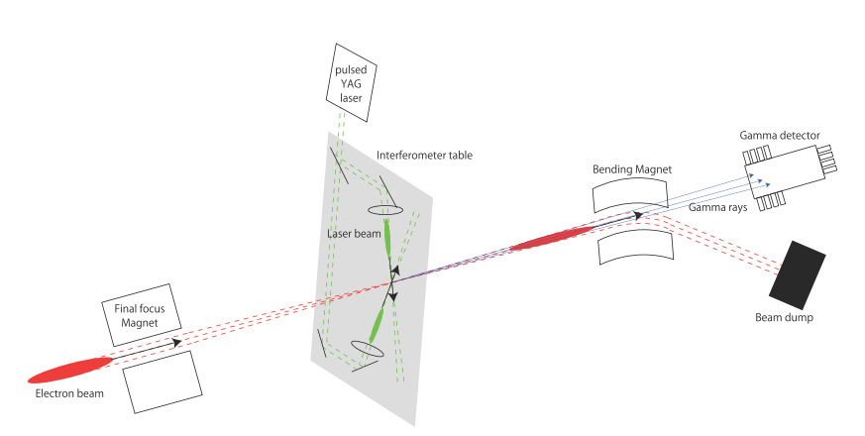
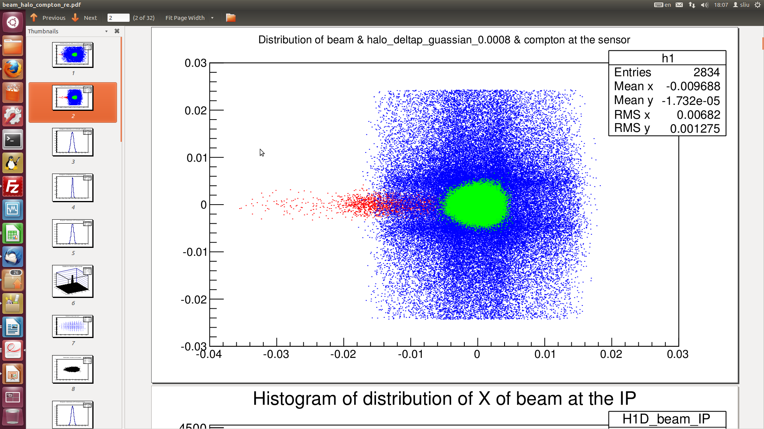
Accelerator Test Facility (ATF) @ KEK
S. LIU, P. BAMBADE et al., LAL-CNRS/IN2P3
low energy (1.3GeV) prototype of the final focus system for ILC and CLIC
Goals of ATF2
goal 1—achieving the 37 nm design vertical beam size at the IP;
goal 2—stabilizing the beam at that point at the nanometer level;
Diamond Sensor
Beam Halo -> major background for IPBSM !!!
δp/p₀=0.0008
Interaction Point
Beam Size Monitor (IPBSM)
Beam
Halo
Compton
Compton
DS scan
In Vacuum Diamond Sensor (DS)
Scan beam halo transverse distribution → investigate & control ATF2 beam halo
Probe Compton recoil electron→ investigate the higher order contributions to the Compton process

Slide 20
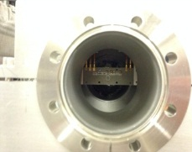
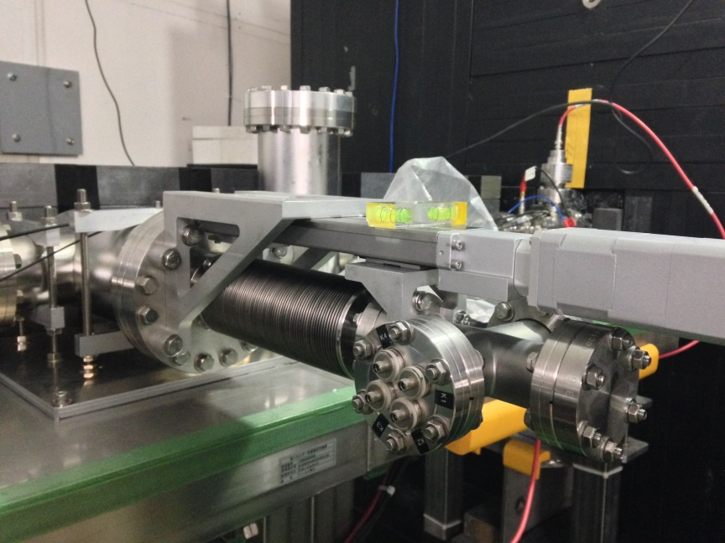
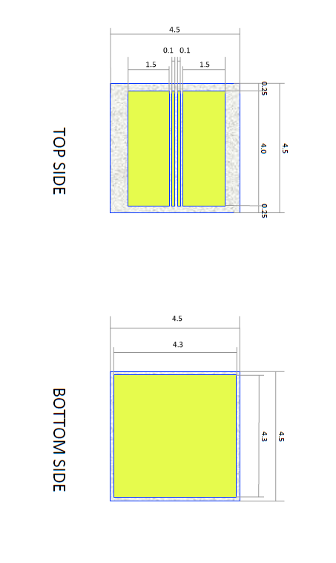
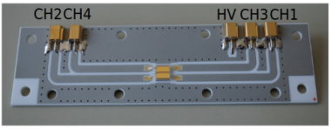
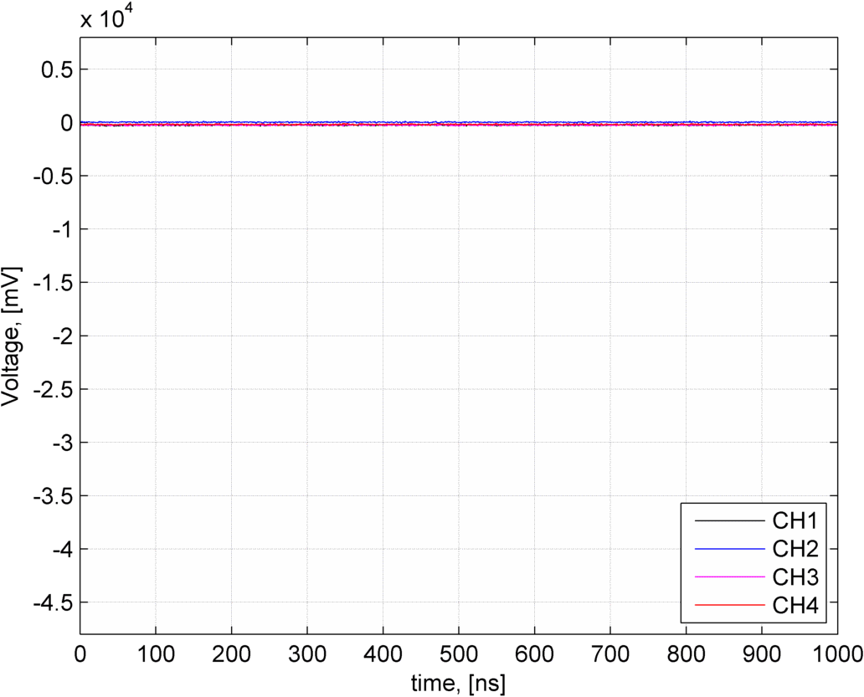
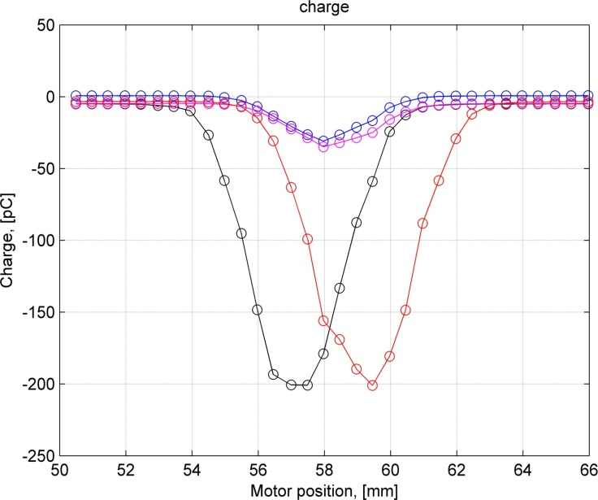
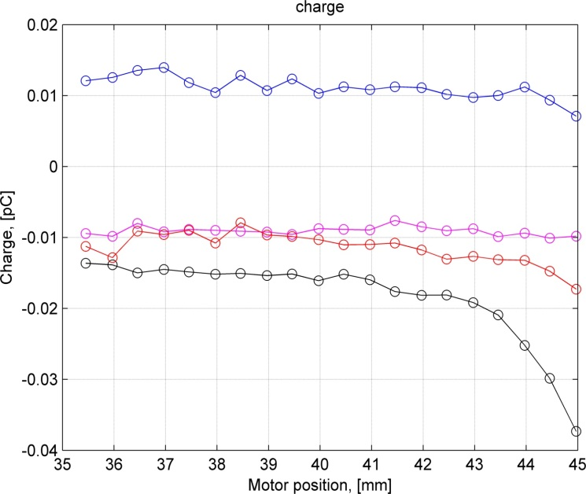
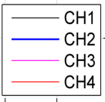

The first Diamond Sensor is installed horizontally at ATF2.
The main purpose is to measure the beam halo distribution.
Installed at ATF2 in Nov. 2014
@CIVIDEC
Initial Waveform
Beam Core Scan
Beam Halo Scan
Preliminary
Preliminary
Total Beam intensity: 1.2*10⁹
Voltage on DS: -40V
Total Beam intensity: 1.2*10⁹
Voltage on DS: -40V
Total Beam intensity: 5.2*10⁹
Voltage on DS: -400V

Slide 21
The first Diamond Sensor is installed horizontally at ATF2.
The main purpose is to measure the beam halo distribution.
Installed at ATF2 in Nov. 2014
@CIVIDEC
Initial Waveform
Beam Core Scan
Beam Halo Scan
Diamond Sensor operational and taking data in horizontal scan!
Preliminary
Preliminary
Total Beam intensity: 1.2*10⁹
Voltage on DS: -40V
Total Beam intensity: 1.2*10⁹
Voltage on DS: -40V
Total Beam intensity: 5.2*10⁹
Voltage on DS: -400V

Slide 22
What was done by the French teams around ATF2
Introduction
Vibrations and GM feedforward
IP-BPM and chamber
Beam-halo evaluation : diamond sensor
Conclusion Outlook

Slide 23
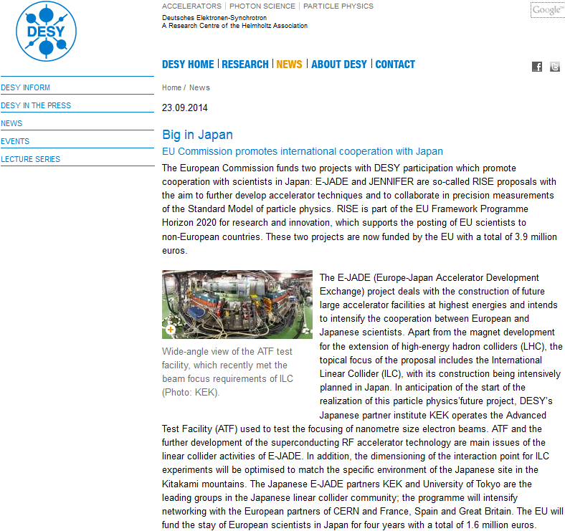
French teams involved in ATF2 have signed E-JADE

Slide 24
Conclusion Outlook
Contribute significantly to ATF2 Goal 2
  GM measurements and mitigation, aim at GM feedforward test , Halo measurements, Contribute to ATF2 beam size reduction and stabilisation with IP-BPMs
Contribute to ILC and CLIC
Successful in several Collaborations and great opportunity with E-JADE further harvest fruitful exchange with KEK experts
Publications and conferences
Training of students on a working accelerator (preparing future)
Getting precious experience to contribute to future machines and experiments!

Slide 25
extras

Slide 26
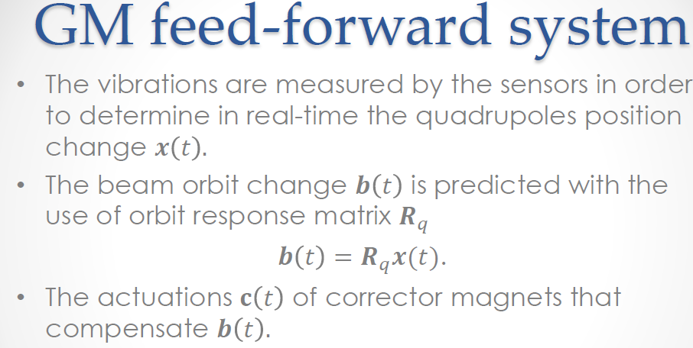

Slide 27
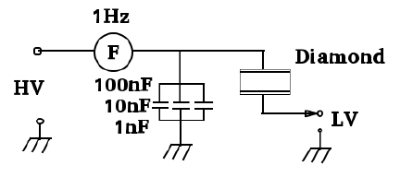
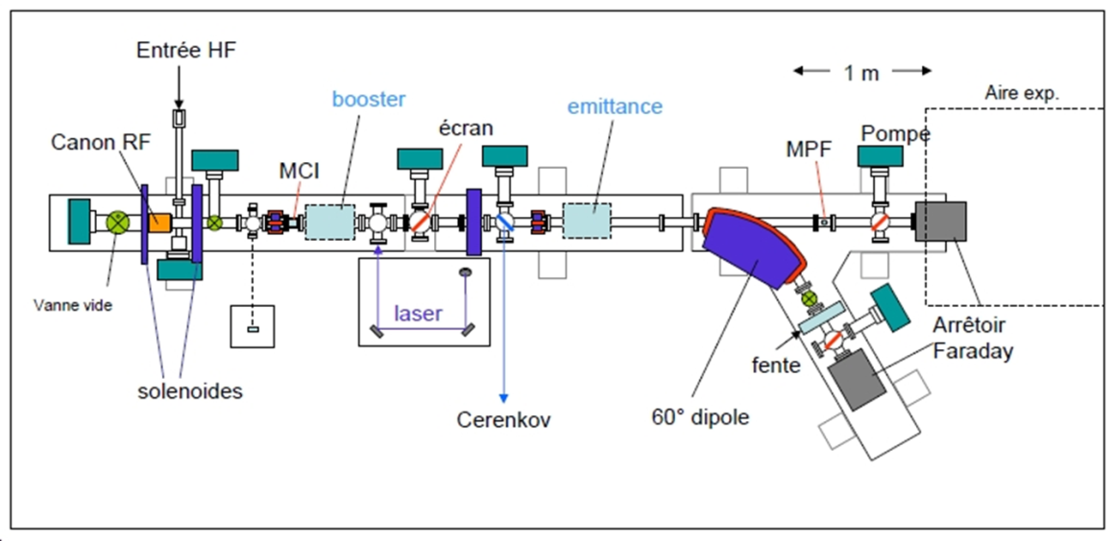
Diamond Detector Features
ADVANTAGES
Property Diamond Silicon
Density (g m⁻³) Band gap (eV) Resistivity (Ω cm) Breakdown voltage (V cm ⁻¹) Electron mobility (cm² V⁻¹ s⁻¹) Hole mobility (cm² V⁻¹ s⁻¹) Saturation velocity (μm ns⁻¹) Dielectric constant Neutron transmutation cross-section(mb) Energy per e-h pair (eV) Atomic number Av.min.ionizing signal per 100 μm (e) | 3.5 5.5 >10¹² 10⁷ 1700 2100 141 (e⁻) 96 (hole) 5.6 3.2 13 6 3600 | 2.32 1.1 10⁵ 10³ 1500 500 100 11.7 80 3.6 14 8000
• Large band-gap⇒ low leakage current
• High breakdown field
• High mobility⇒ fast charge collection
• Large thermal conductivity
• High binding energy⇒ Radiation hardness
Fast pulse ⇒ several ns
Test of fast remote readout (fast heliax coax cable + high BW scope) with particles at end of beam line, using existing single crystal 4.5x4.5mm CVD diamond pad sensor
In-vacuum single crystal CVD diamond sensor profile scanner -> for PHIL and ATF2 diagnostic (“plug compatible” design)
Diamond detector test at PHIL

Slide 28
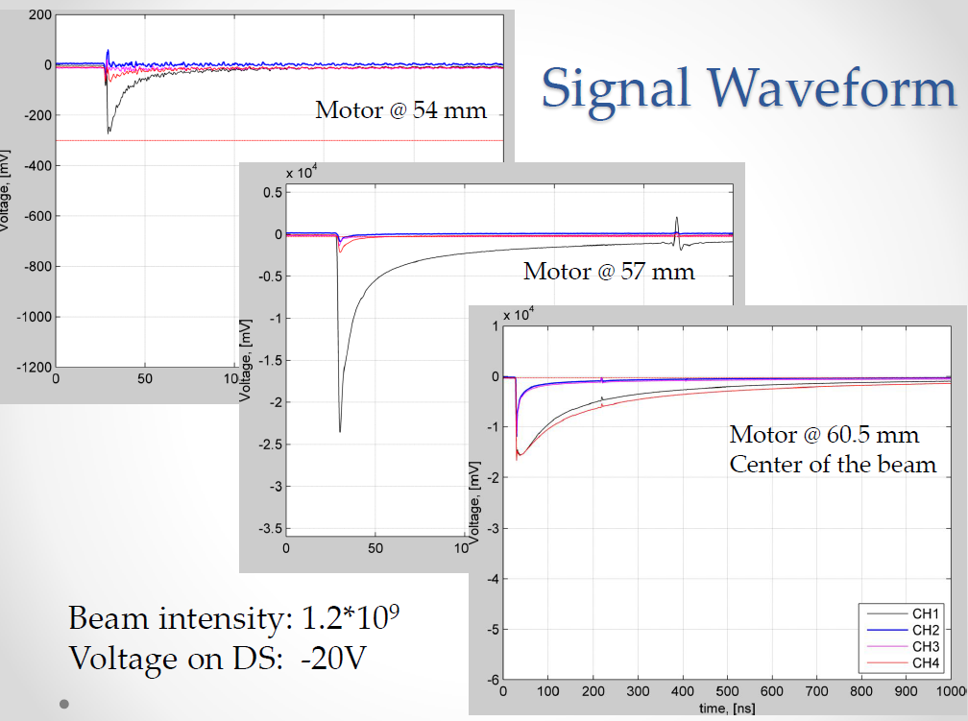

Slide 29
