Slide 1

Nouveau concept de source de puissance 12 GHz pour CLIC
-
Third JCL (Journées Collisionneur Linéaire)
LPSC – Grenoble
-
2 Décembre 2014
F. Peauger, J. Plouin, B. Dalena, A. Mollard,
Chancé, L. Boudjaoui
CEA/IRFU/SACM
Notes:
Thanks Igor for invitation

Slide 2
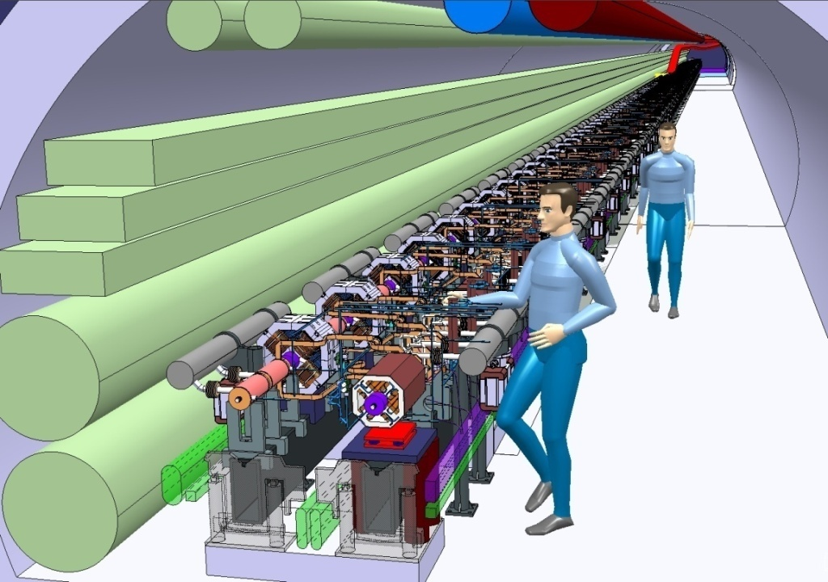
CLIC tunnel
Two beam acceleration concept where a high intensity drive beam is decelerated in order to produce RF power for the main beam acceleration
Single tunnel, no active elements inside
High frequency 12 GHz and high gradient 100 MV/m

Slide 3
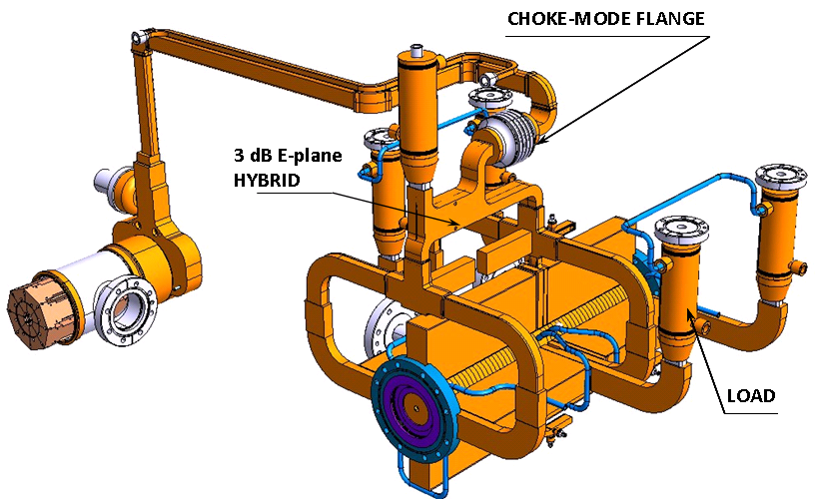
12 Ghz two beam acceleration in CLIC
Waveguide network
high power
precise phase length
x 32500 for 500 GeV
x 120750 for 3 TeV
PETS with ON/OFF mechanism
high-power
low longitudinal and transverse impedance
necessary to react to breakdown and/or failure
RF power 120 MW
Drive Beam 100 A decelerated
Accelerating structure
high-gradient
length = 0.4 m
micron precision
transverse wake-field suppression
Main Beam 1 A
accelerated
We do not propose any alternative solutions to the PETS

Slide 4
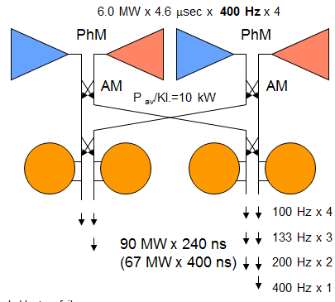
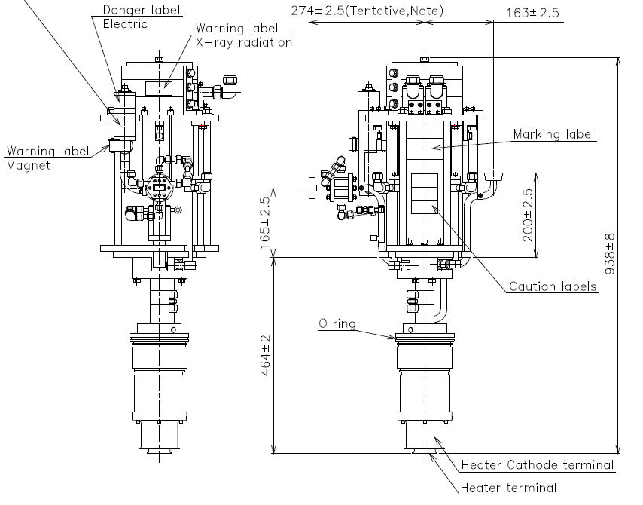
MASSIVE conditionning and TESTING CAPABILITIES of 12 GHz ACCELERATING STRUCTURES
The XBOX3 test stand at CERN will use four Medium Power X-band klystrons recombined and compressed to produce a 50 MW power level
TOSHIBA klystrons parameters
Frequency: 12 GHz
Peak power: 6 MW
Beam Voltage: 150 kV
Beam current: 90 A
Average power: 12.4 kW
Efficiency: 47.5%
I. Syratchev, G. McMonagle, N. Catalan Lasheras
We propose to design a new 12 GHz klystron with very high efficiency:
→ 70% for 12 MW output power
It will double the testing capability of an XBOX3 type test stand

Slide 5
A strong motivation with a more general interest
Propose and start long term technological R&D on high power RF systems, a key sub-system in an accelerator
Energy efficiency is highly important for future accelerators
  Reduction of power consumption and operation cost
  Limitation of the CO₂ emission (social benefit)
  → mandatory for approval of new projects
Focus on RF source (klystron) efficiency only
loss
loss
Loss (40%)
wall plug
AC/DC power converter (modulators)
RF power source (klystrons, IOT,…)
useable RF
loss
Φ & loss
beam
E. Jensen
Notes:
On se propose de démarrer une activité de R&D technologique dans le domaine de la RF de puissance qui est un element clef dans un accelerateur et qui consomme enormement d’energie.
L’idée et donc de réduire la consommation electrique de ces systemes et en meme temps de limiter l’impact sur l’environnement.

Slide 6
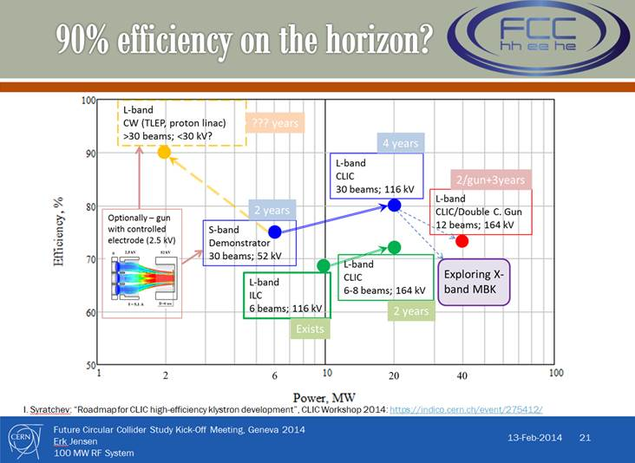
A strong motivation with a more general interest
Some important projects (XFEL, ESS, CLIC-drive beam, FCC…) search for “green technologies” and so require ultra-high efficiency RF sources
A road map to reach the 90% efficiency horizon have been established at different frequencies
This project is also an occasion to acquire knowledge and experience on RF sources “in-lab design” and why not “in-lab fabrication” in Europe

Slide 7
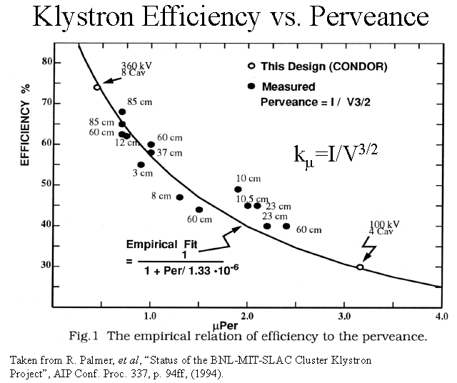
What Limit the EFFICIENCY in a Klystron ?
The last 15 years was only focused on low perveance devices
ie. Multibeam klystrons (XFEL/ILC, CLIC Drive Beam)
Our proposal is to explore and invente new concepts for the higher perveance devices:
Simplify the modulator and the tube fabrication technology
But deal with very high space charge

Slide 8
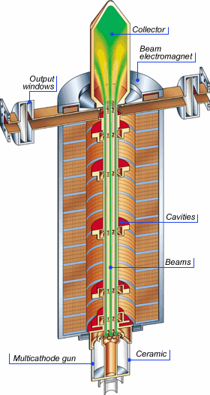
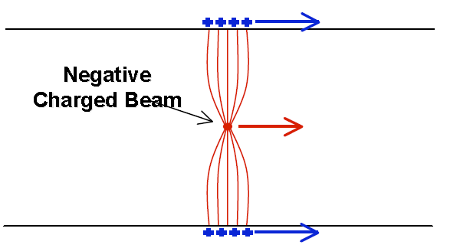
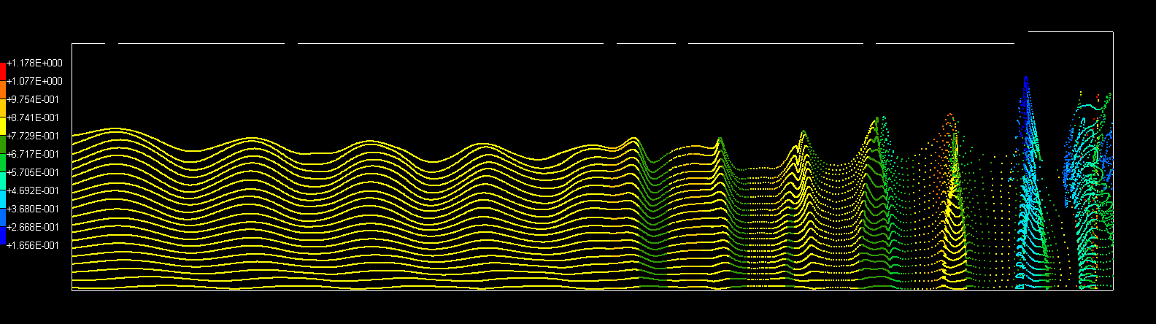
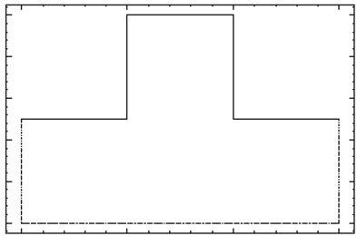
Reminder: What is a klystron?
It is a vacuum microwave electron tube amplifier where:
The input cavity prebunch slightly a DC beam provided by an electron gun
The intermediate cavities develop an RF voltage induced by the beam loading (image charges). These induced voltage intensify the bunching process.
The beam is strongly decelerated in the output cavity and a high RF power is created
The decelerated beam is collected in a collector
The beam is focused by an axial magnetic field (solenoid)
Image: courtesy of Thales Electron Devices
Image charges
RF out
RF in
Axial electron velocity
S. Berger - Thales, XB2008 workshop, Cockcroft Institute, UK

Slide 9
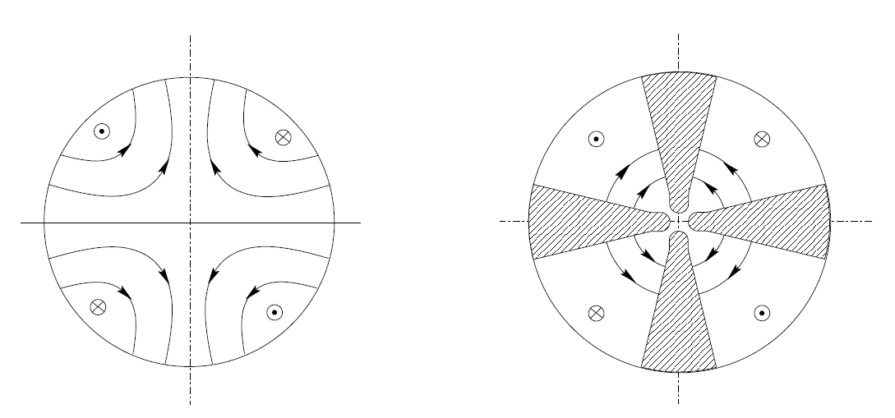
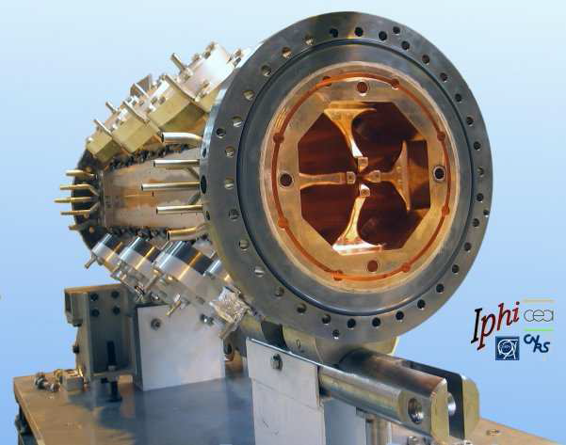
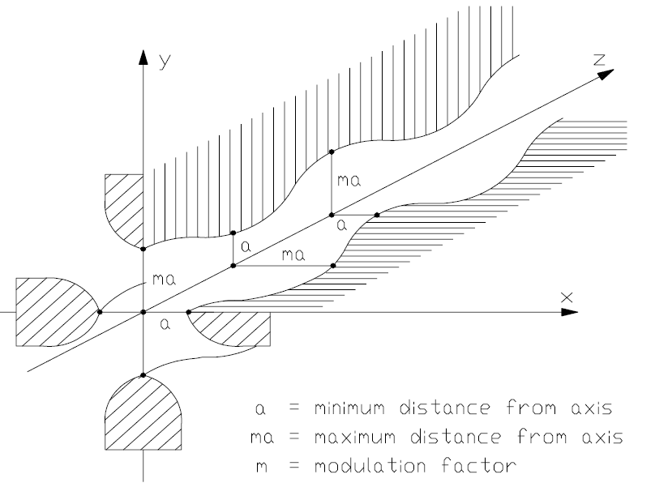
A parallel with RFQs for proton linac
An RFQ cavity is used in proton linac injector to bunch, focus and accelerate a continuous beam from few tens of keV to few MeV.
It allows a beam transport in space charge regime (high intensity beams is possible) with very low beam losses.
TE₂₁₀ mode
longitudinal modulation on the electrodes creates a longitudinal component in the TE mode that bunch and accelerate the beam
βλ
In the IPHI RFQ (3 MeV, 6m, 352 MHz), around 350 cells are used to bunch the beam

Slide 10
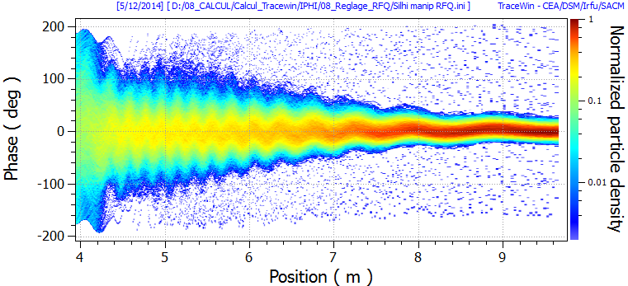
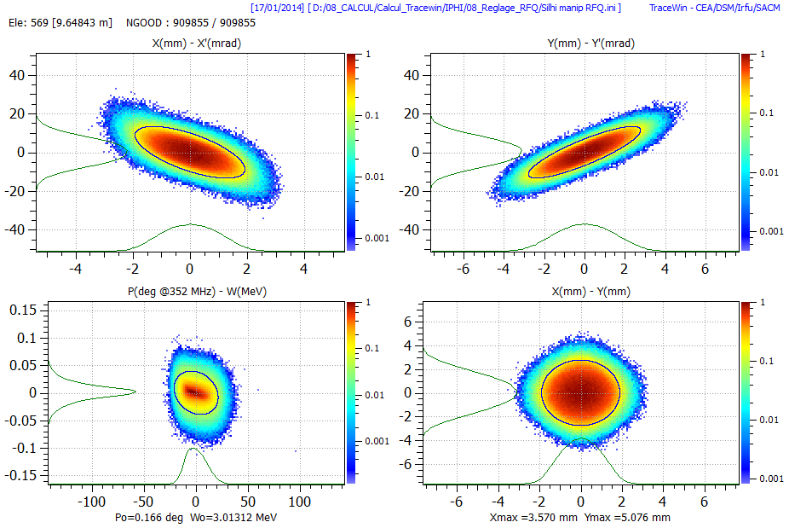
Phase space distribution in an RFQ
The bunching process in an RFQ is adiabatic (« gentle » buncher)
The RFQ preserve the beam quality, has a high capture (~90%) compare to a discrete bunching model (50%)
Along the 6m RFQ:
At the RFQ exit:
Energy dispersion dW (MeV)
Phase (deg)

Slide 11
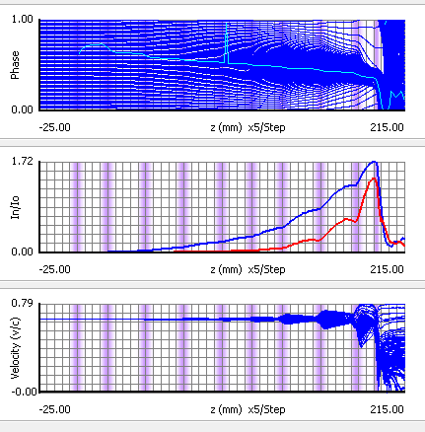
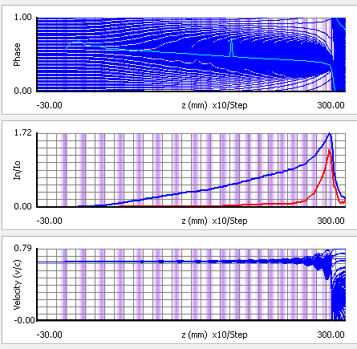
Increasing the number of cavities in a klystron
10 cavities
Efficiency 67.2 %
Length 197 mm
20 cavities Efficiency 78 %
Length 285 mm
→ Reduction of velocity spread of the beam

Slide 12
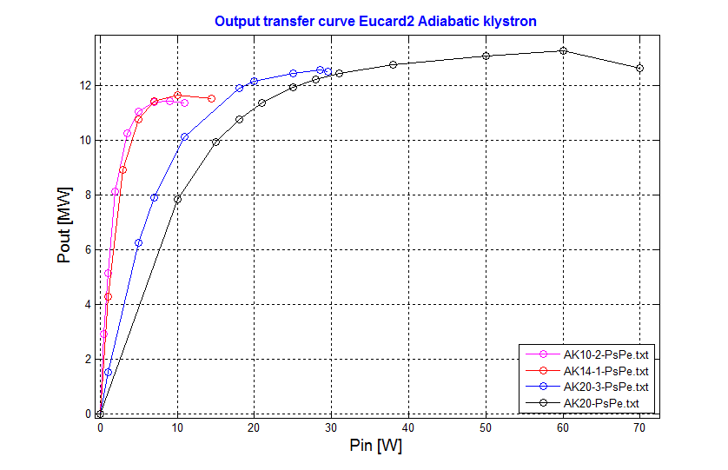
Expected performances with 4 different designs
Name | Numbers of cavities | R/Q [Ohm] | TTF | Efficiency | Overall length [mm]
AK10-2 | 10 | 20 to 50 | 0.683 | 67.2 % | 197
AK14-1 | 14 | 20 | 0.683 | 68.5 % | 221
AK20-3 | 20 | 27.4 | 0.688 | 74 % | 285
AK20 | 20 | 12 | 0.72 | 78 % | 285
70% efficiency
→ bunch the beam with a large number of small kicks instead of a small number of larger kicks
→ succession of quasi-equilibrium states
→ quasi-adiabatic bunching
A new tube is born !
the Kl-adi(adiabatic)-stron =« KLADISTRON »

Slide 13




Our sponsors
Contribution exceptionnelle de la France au CERN
AT4 – CLIC (2008 – 2014)
Achat du code de simulation PIC 2D / 3D (MAGIC)
Achat de sous ensembles (canon collecteur) d’un klystron existant à 4,9 GHz chez Thales
WP12: Innovative RF Technologies
2013 - 2017
« In this sub-task, CEA will develop and search for innovative concepts of X band RF power sources and components. The objective is to propose affordable and reliable solutions for future testing capabilities for the CLIC accelerating structures. The task includes the design and the fabrication of prototype RF devices to demonstrate the feasibility of the new concepts proposed. »
Thales electron Devices – Vélizy – RFMS
Fabricant de Tubes Electroniques Hyperfréquences
->Financement de 50% d’une bourse de thèse CTCI sur la période 2014-2017

Slide 14
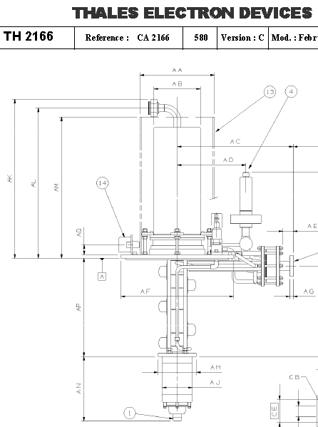
How to demonstrate the feasibility of the adiabatic concept
Buy an existing “cheap” THALES klystron:
TH2166 – 4,9 GHz – 25 kV - 4,5 A
Pout = 50 kW
6 cavities
Perveance = 1 µA/V^1,5
Efficiency = 45 %
Replace cavities by an adiabatic bunching structure
Kladistron 4,9 GHz
Goal efficiency =60%
Pout = 68 kW
If necessary, modify solenoid (if longer bunching structure)

Slide 15
Beam / RF interaction simulation tools
AJDISK
(SLAC)
1D
free
?
Frequency domain
2D
MAGIC
PIC time domain
2D/3D
TRACEWIN
(CEA)
Tracking
2D/3D
Cluster
CST
PIC time domain
3D
Preliminary design
Design consolidation
Emittance growth, matching, halo and error studies (new use for klystron!)
WARP
(LBNL)
PIC time domain
2D/3D
Free, open source
Cluster
Remaining budget from the French exceptionnal contribution to CERN allowed us to buy one MAGIC licence
Collaboration with THALES will be extremely helpfull to benchmark with their homemade codes
Full verification of the performances and
oscillation study

Slide 16
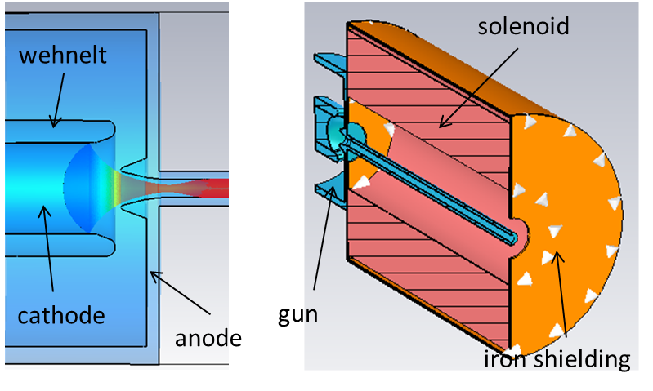
12 GHz klystron Electron gun design and focusing solenoid
Simulation done using the CST-Particle Studio code
Benchmark to be perfromed with the THALES codes
Electron beam
170 keV – 100 A
Lyes BOUDJAOUI (Master 2 internship in 2014)
Figure 4: Beam created by the electron gun

Slide 17
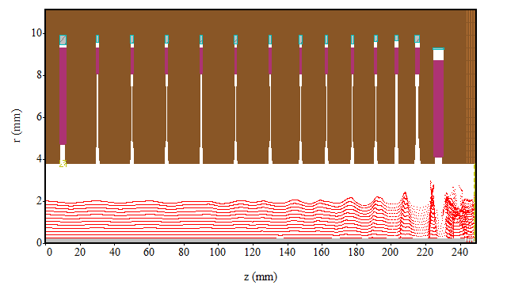
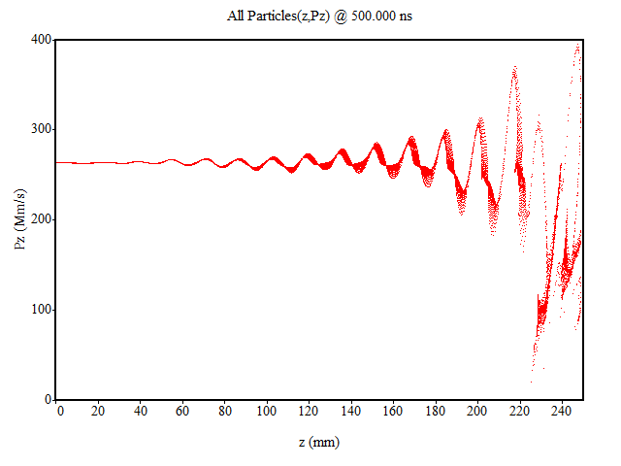
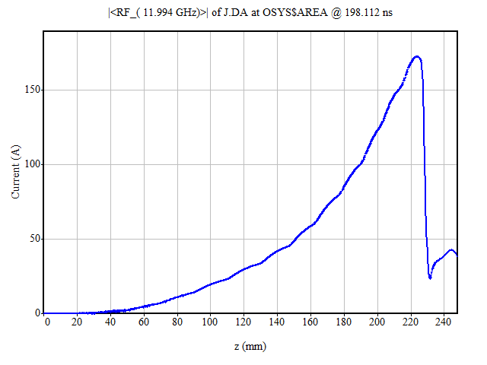
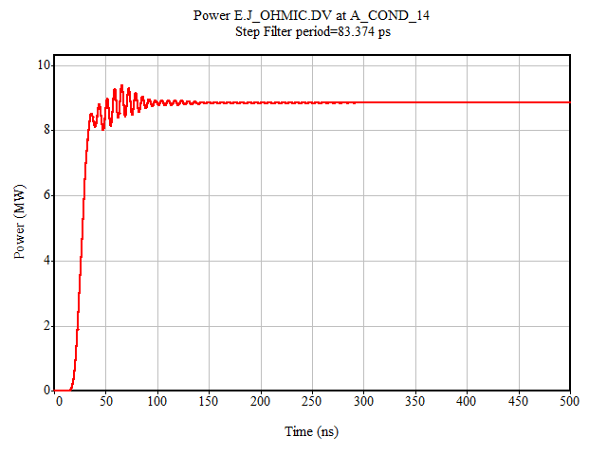
Beam/RF interaction simulatioN
Simulation done using the MAGIC2D code on a 14 cavities structure
Efficiency to be improved with output cavity optimisation
Electron beam:
170 kV – 100 A
Radius = 2.1 mm
Bz = 0.35 Tesla
Output RF power:
Pout = 8.8 MW for Pin = 15 W
Efficiency = 51.7 %
Gain = 57.7 dB
Oscillations damped after 150 ns
Franck PEAUGER, Barbara DALENA (Irfu/SACM)
Figure 4: Beam created by the electron gun

Slide 18
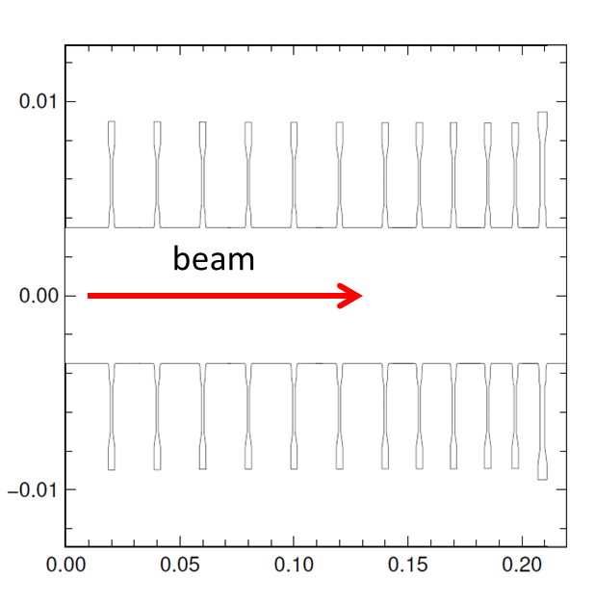
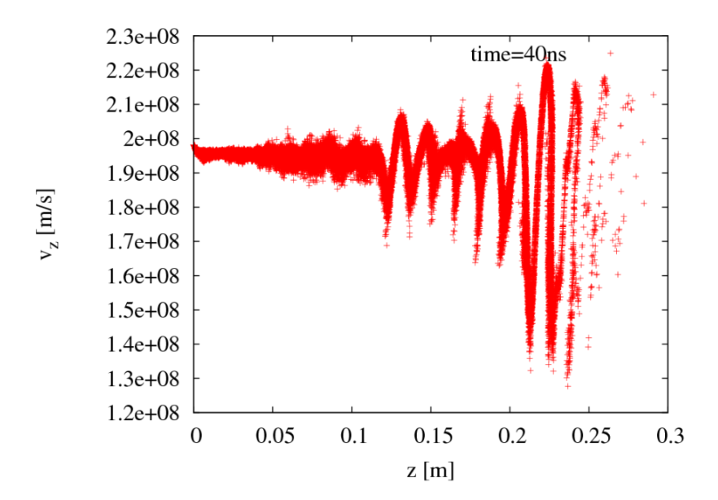
Beam velocity simulation during bunching
Simulation done using the WARP code
New Python class specially developed for klystrons (work in progress)
Barbara DALENA (Irfu/ SACM)
Figure 4: Beam created by the electron gun

Slide 19
The kladistron development planning
2014
2015
2016
2017
12 GHz
Kladistron
η = 70%
Prf = 12 MW
Preliminary design
Detailed design and drawings
Fabrication & Test
Choice of the number of cavities
If additionnal ressources available
PhD student (Antoine Mollard)
4.9 GHz
Kladistron
η = 60%
Prf = 68 kW
Design
Tests
Fabrication
Superconducting solenoid ?
Superconducting RF structure ?

Slide 20
Conclusion
New concept of high efficiency klystrons proposed
Based of beam dynamic knowledge already present in SACM (RFQ)
Development plan established in collaboration with an world leading industrial
Additional ressources needed to complete the fabrication of the 12 GHz kladistron

Slide 21
Extra slides

Slide 22
CLIC 3 TeV layout
Drive Beam Generation Complex
Main Beam Generation Complex

Slide 23
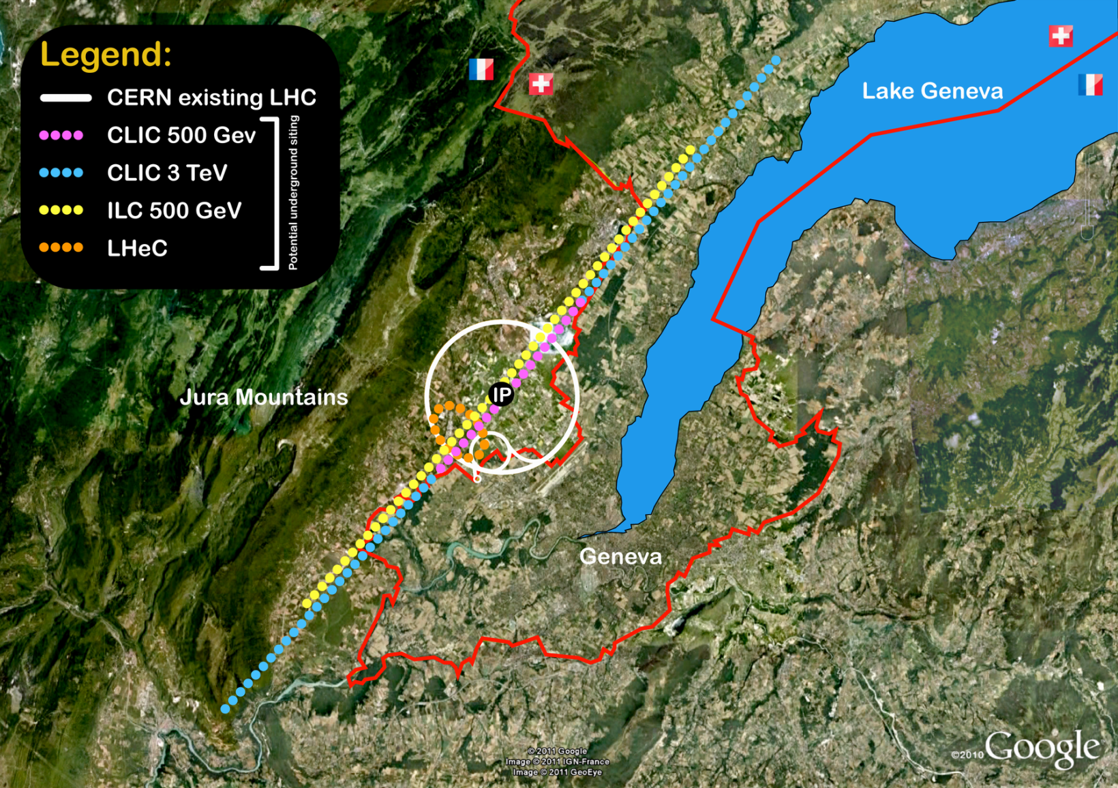
CLIC site at CERN
14 km, ~100 m deep
31 km, ~100 m deep

Slide 24
CLIC main parameters
Center-of-mass energy | ILC 500 GeV | CLIC 500 G Nominal | CLIC 3 TeV Nominal
Total (Peak 1%) luminosity | 1.8(1.5)·10³⁴ | 2.3(1.4)·10³⁴ | 5.9(2.0)·10³⁴
Repetition rate (Hz) | 5 | 50 | 50
Loaded accel. gradient MV/m | 31.5 | 80 | 100
Main linac RF frequency GHz | 1.3 (SC) | 12 | 12
Bunch charge10⁹ | 20 | 6.8 | 3.72
Bunch separation ns | 554 | 0.5 | 0.5
Beam pulse duration (ns) | 1312 | 177 | 156
Beam power/linac (MWatts) | 10.2 | 4.9 | 14
Hor./vert. norm. emitt (10⁻⁶/10⁻⁹) | 10/35 | 2.4 / 25 | 0.66/20
Hor/Vert FF focusing (mm) | 11/0.4 | 8/0.1 | 4 / 0.07
Hor./vert. IP beam size (nm) | 474/ | 202/ 2.3 | 40 / 1.0
BDS length (km) | 2.23 (1 TeV) | 1.87 | 2.75
Total site length (km) | 31 | 13.0 | 48.3
Wall plug to beam transfer eff. | 9.4% | 7.5% | 6.8%
Total power consumption MW | 163 | 270 | 589

