Slide 1

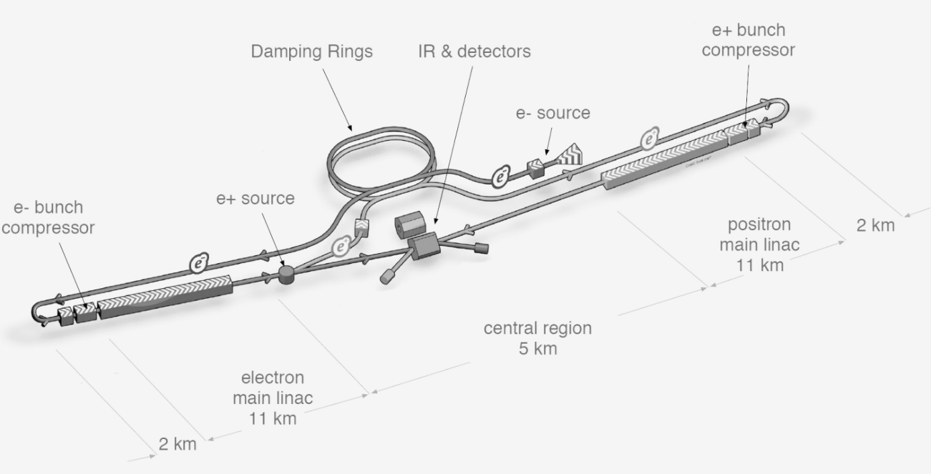

ILC
the Green
Towards
Sustainable colliders
Energy for Innovation and Innovation in Energy

Slide 2
Content
Green-ILC project
Saving and recovery
Renewable energies
Accelerator Energy Consumption Calculation
Cooperation

Slide 3
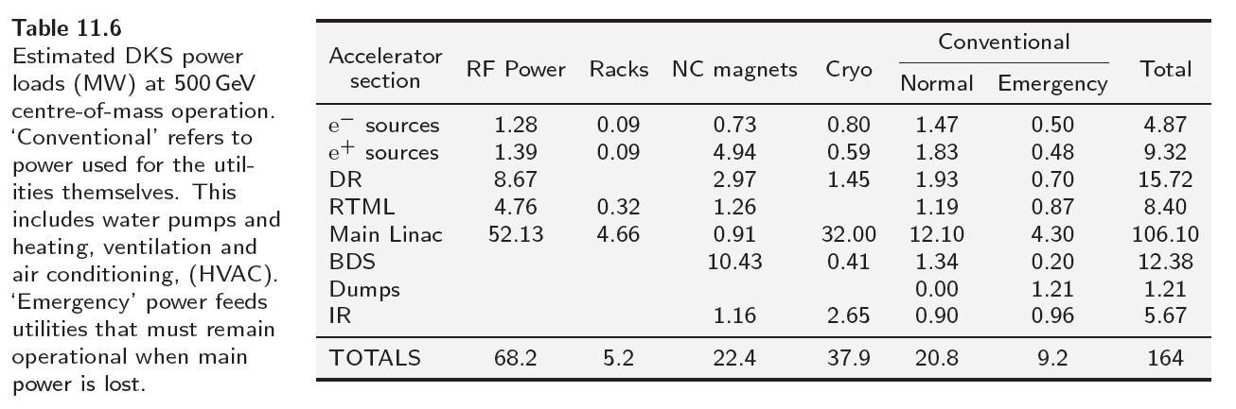
ILC baseline energy budget
164 MW @ 500 GeV
MW
Rank: 1 6 3 2 4 5
% : 42 3 15 23 13 5
Wall-plug to beam power efficiency is 9.6 %

Slide 4
Power and Energy
LHC-CERN ~ 180 MW - 1.35 TWh/year, 50% Geneva electr. consumption (~ 250,000)
FCC-ee : 354 MW @ 350 GeV (top ring and pre-injection not included)
FCC-hh : 468 MW @ 100 TeV (pre-injection NOT included (+100 MW ??) (P. Collier)
ILC: 164MW @ 500GeV – 300MW @ 1TeV (TDR)
ILC lab. (Experiment, Computing, Buildings) => 180 MW @ 500 GeV, 320 MW @ 1 TeV.
TDR takes a large margin: 300 MW 500 MW
(240 MW @ 500 GeV, RDR estimation)
ILC 500 GeV 18% of Iwate prefecture electricity consumption, ~ Morioka (300,000)
ILC 1 TeV 32%
180$/MWh 2011 for industry (JP OECD 2013 report, special discount?, price volatility (2024))
CERN (2011, ~ 70 $/MWh), ESS (Sweden, 110 $/MWh)
Yearly electricity running cost: 500 GeV ~ 240 M$ (10 years, ~25% of ILC capital cost)
1 TeV ~ 430 M$ (scaling on power)
HEP future: To be Green … or not to be !!

Slide 5
H. Hashiguchi, Nikken Sekkei, Co. Ltd., A. Enomoto, KEK (2012)
Electrical Power System
Load Requirements (Capacity)
+about 60MVA
margin
Total 300MVA including margin
Notes:
・３００ＭVAはアメリカのデータ等を参照して２５％の余裕を見た電力条件

Slide 6
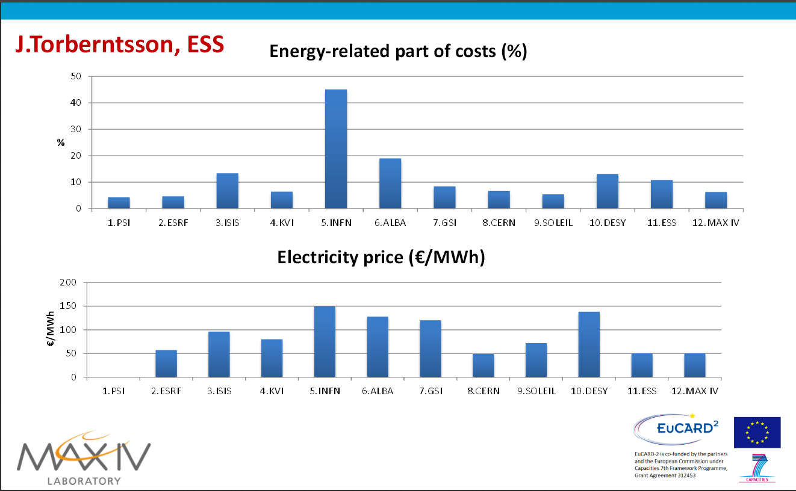
Presentation May, 2014… Data date ??
JP

Slide 7
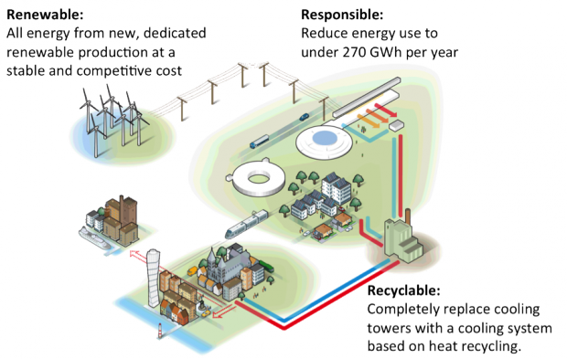
The Green ESS
European Spallation Source -- 4R
Reliable
stable electricity and
cooling supplies
Wind Power:100 MW
Machine: 278 GWh/y
Cooling: 265 GWh/y

Slide 8

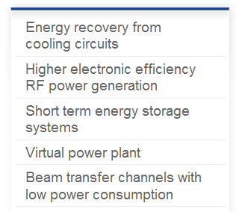
EnEfficient WG
ESS, T. Parker
CERN, E. Jensen
KIT, M. Sanders
GSI, J. Stadlmann
GSI, G. Spiller
Make it global project (ICFA ?)

Slide 9
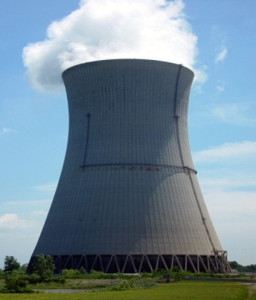
Green-ILC Objectives
ILC : lower running cost, better operational flexibility, eco-friendly
Revisiting all ILC components, in terms of:
Energy Saving: improving efficiency … 90% (if not 100%) lost as heat waste
Operational saving
Energy Recovery and Recycling
Renewable energies:
Renewable energy production, best for ILC and ILC site
Energy Storage (recovery, intermittency)
Distribution and Management: Smart Grid
Energy for: societal needs and world economy,
Needs for Energy Basic Research
Synergies: HEP expertise (SC, HF magnets, beams, computing), photon, neutron factories
Technology innovation and large scale infrastructure managment
ILC as a test bench: Pilot plants for ILC

Slide 10
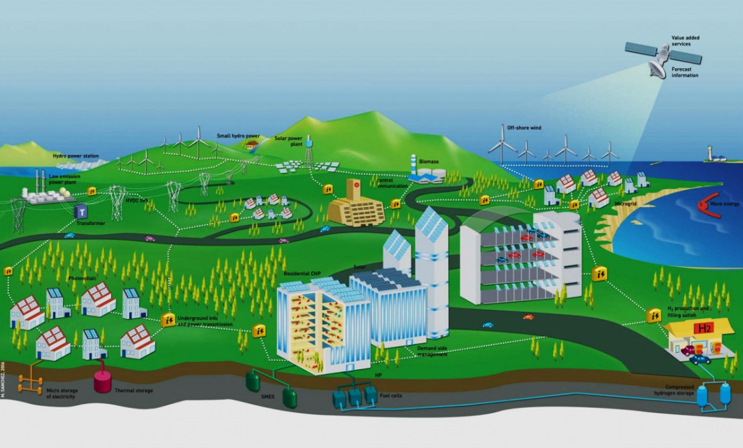
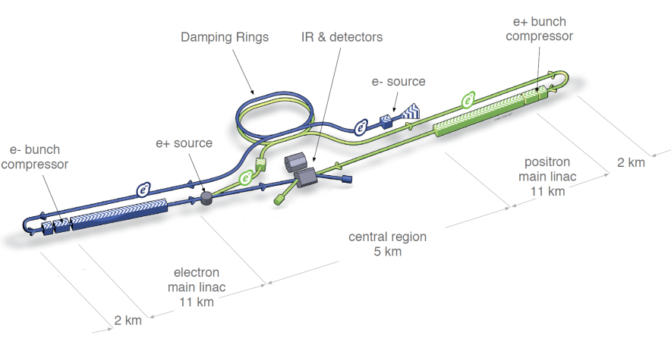
Global organization for Green ILC
ILC Energy Center
ILC High-Energy
Research Center
ILC Sustainable Energy Research Center
Industry
Fundamental Research
Basic Research
HEP Applications
Application R&D
Pilot Power plant for ILC
Electrons, photons, neutrons factories
HPC/GRID Computing
High-Energy community
Energy community

Slide 11

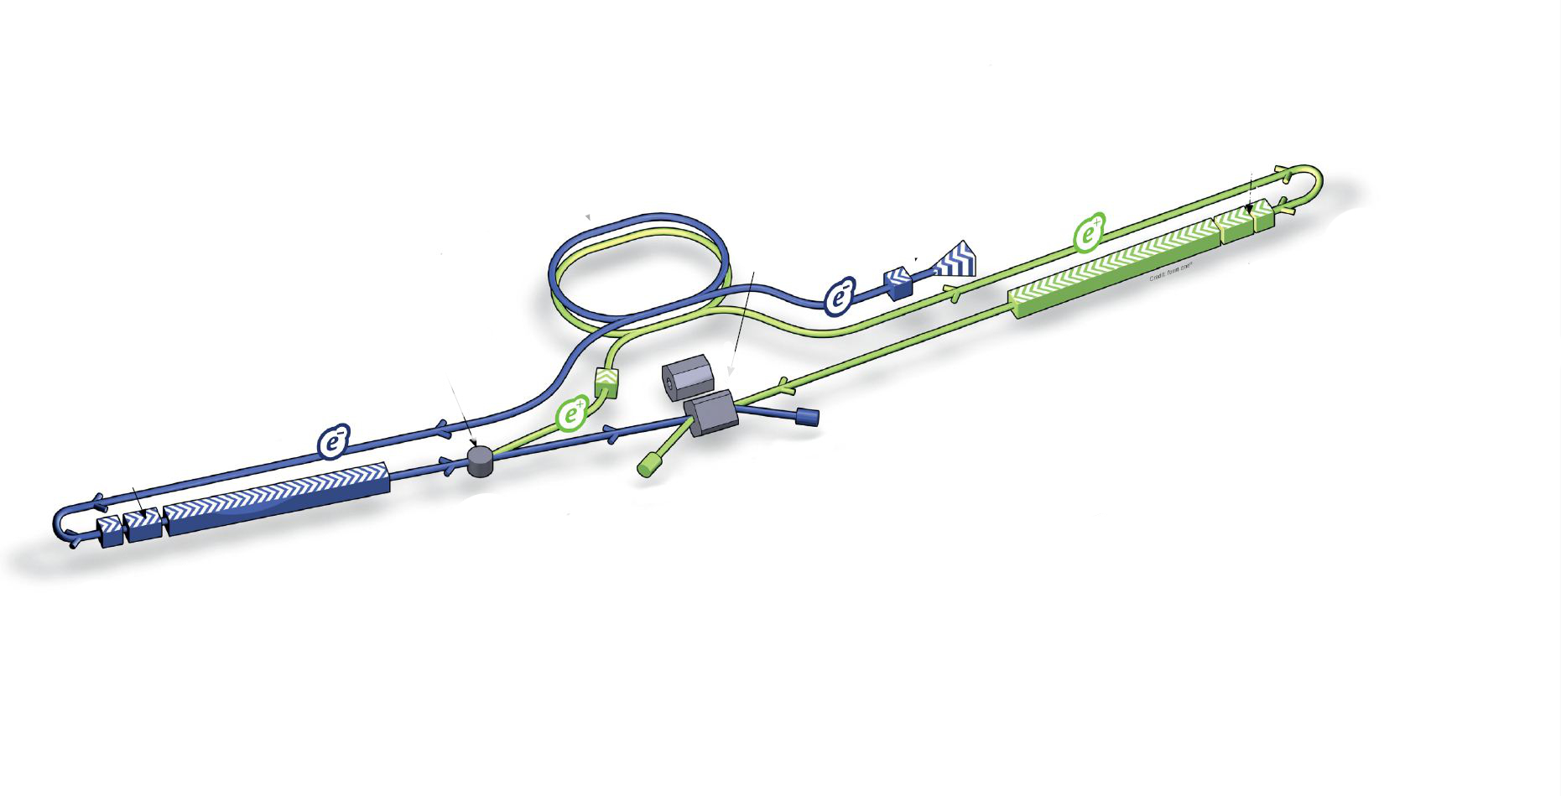

ILC Energy center (artistic) view
Forecast and data management
Pumped Hydro (LN2)
Wind turbine
Off-shore wind
Solar Power Plant
Biomass
Geothermal Plant
SPA
Smart GRID
Ocean power
Wave/stream energy
Photovoltaic and thermal
Photovoltaic
LN2, He, H2 storage
Solar roads
Courtesy of:

Slide 12
Energy Saving and recovery
Klystron:
  Better efficiency: from 60% to 80%
  Energy recovery on the electron beam (Hitachi)

Slide 13
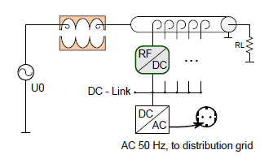
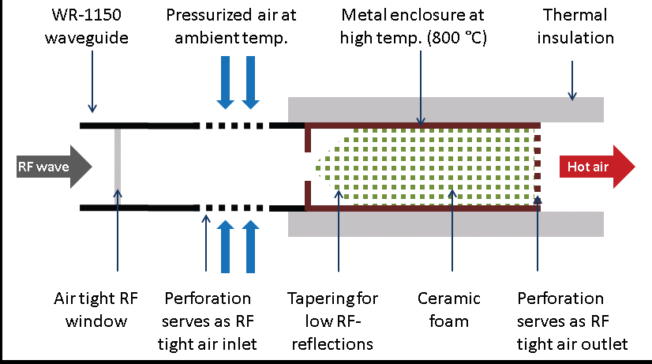
Recover non-used RF power: Smart RF loads
Idea 1) – reconvert to DC power!
Idea 2) – use high-T loads!
1) http://accelconf.web.cern.ch/AccelConf/IPAC10/papers/wepd090.pdf
2) http://accelconf.web.cern.ch/AccelConf/IPAC2012/papers/thppc023.pdf

Slide 14
Energy Saving and recovery
Klystron:
  Better efficiency: from 60% to 80%
  Energy recovery on the electron beam (Hitachi)
Cavities: 2 Magnetic shields -> Increase cavity Q₀
-> decrease cryo -> save 62 ME (10 years running)
(O. Napoly AWLC 2014 and JLC 2013)

Slide 15
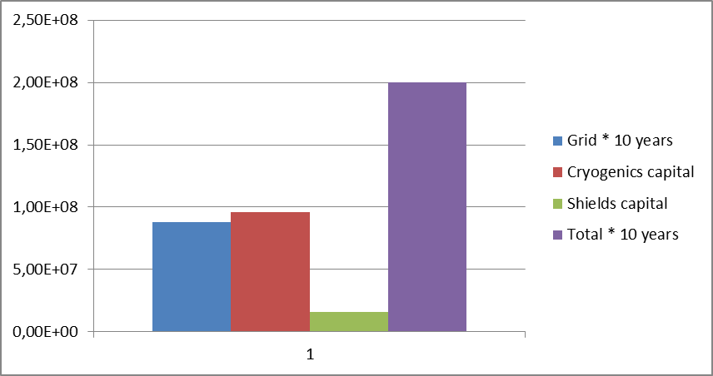
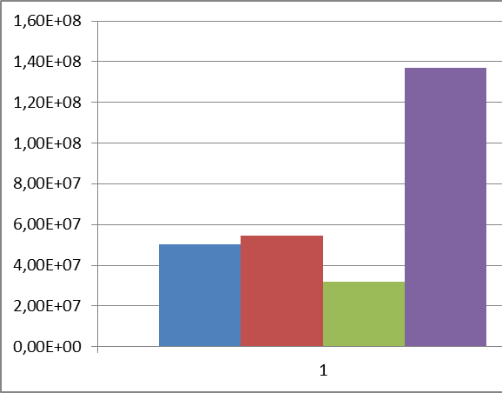
Cryonomics
If I am allowed to extrapolate the 75% increase of Q₀ shown by E. Kako with a double magnetic shielding, to ILC cavities with Eacc = 31.5 MV/m
and with the assumptions: grid power = 0,15 € /kWh@300 K
CoP(2K) = 700 W/W
magnetic shield = 1000€ / cavity
    cryogenics = 1 M€/100 W@2K
P_{dyn.} = 9.6 kW@2K , 6.7 MW @ 300 K
P_{dyn.} = 5.5 kW@2K , 3.8 MW
€
€
Q0 = 8 10¹⁰ (RDR )
Q0 = 1.4 10¹⁰
Saving 62 Meuros on cavity cooling (10 years)

Slide 16
Energy Saving and recovery
Klystron:
  Better efficiency: from 60% to 80%
  Energy recovery on the electron beam (Hitachi)
Cavities: 2 Magnetic shields -> Increase cavity Q₀
-> decrease cryo -> save 62 ME (10 years running)
(O. Napoly AWLC 2014 and JLC 2013)
Beam dumps
  Wakefield deceleration for beam dump, project and test

Slide 17
Pros/cons
J. Fujimoto (KEK)
 | Water dump | Gas dump
length | 10 m | 1000 m
Window pressure | 10 bar static, 0.5 bar dyn. | 1 bar static, 0.01 bar dyn
Window diameter | 30 cm | 8 cm
Hydrogen gas producing | Several liter/sec @ 20 MW | no
Tritium production | 300 TBq | 30 TBq ( in Iron)
Component Activity | 1.2 mSv/h | ~ 1 … 10 mSv/h

Slide 18
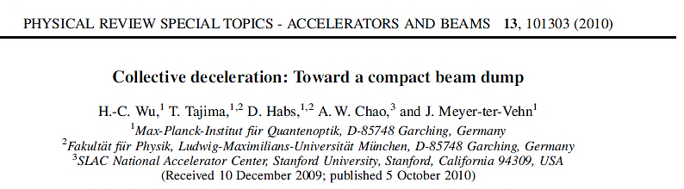
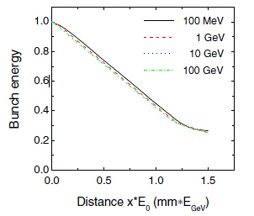
Plasma Deceleration Dumping
Linear Collider WS
Tokyo Nov. 15 2013
A. Suzuki (KEK DG)
Use Collective Fields of Plasmas for Deceleration
10 cm for 100 GeV
The deceleration distance in the underdense plasma is 3 orders of magnitude smaller than the stopping in condensed matter.
The muon fluence is highly peaked in the forward direction.

Slide 19
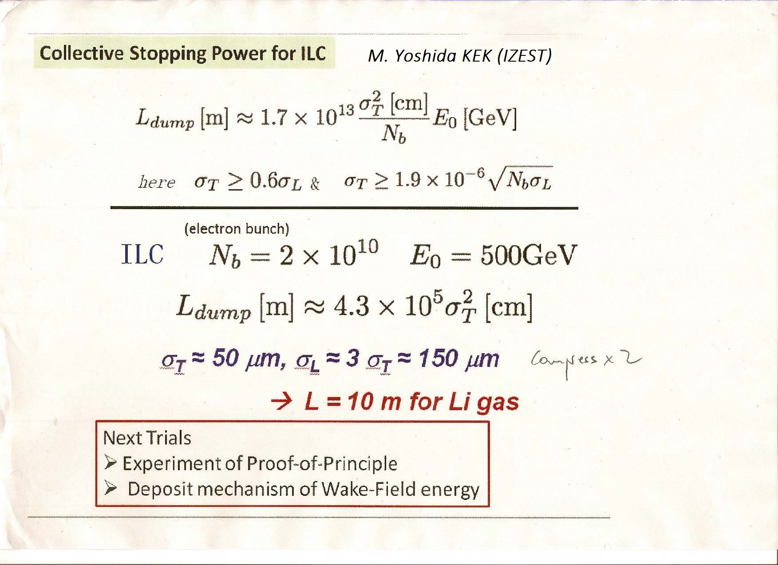

Application for a grant (MEXT, JSPS) for 2015

Slide 20
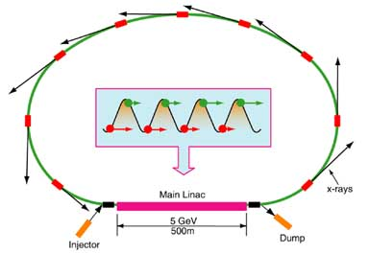
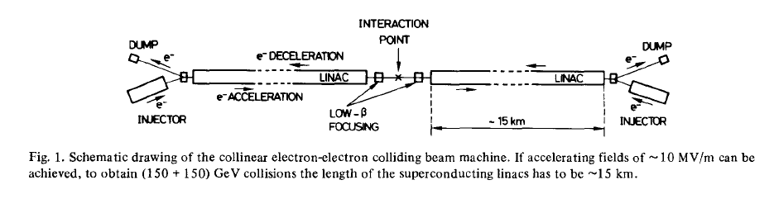
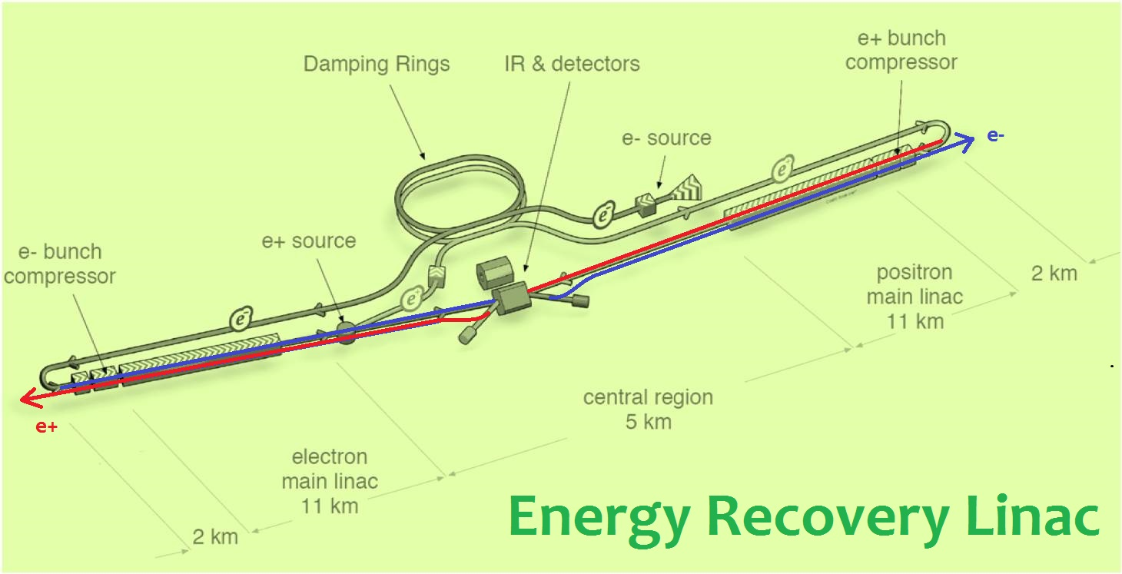
ILC-ERL
You should be joking!
U. Amaldi, Phys. Lett, 61B,v3 1976
or CLIC concept

Slide 21
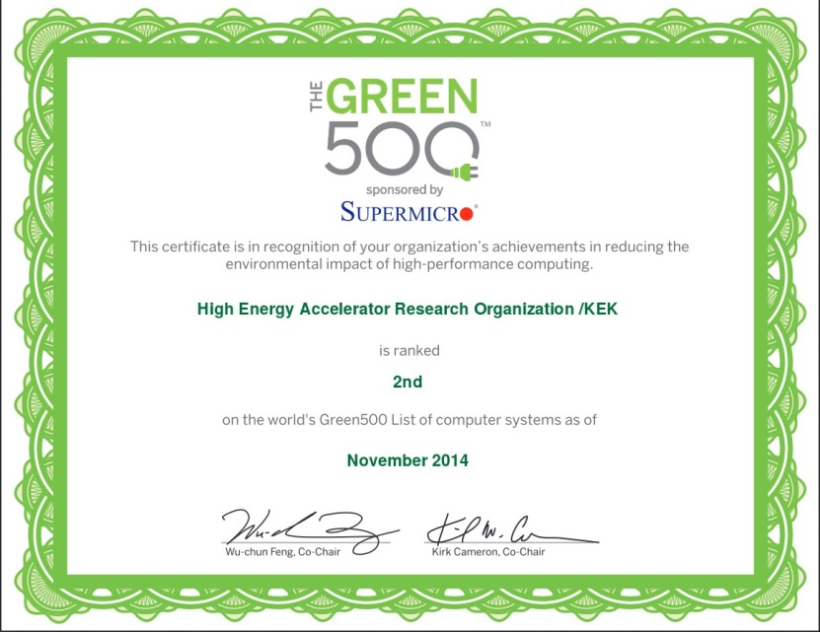
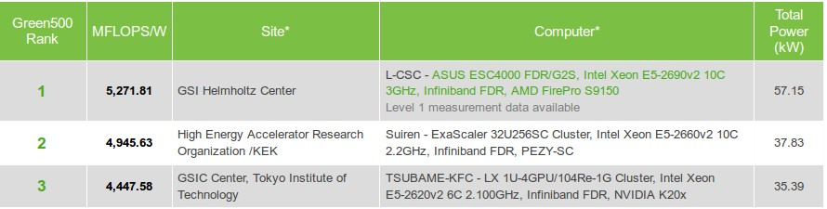
Energy Saving and recovery
Klystron:
  Better efficiency: from 60% to 80%
  Energy recovery on the electron beam (Hitachi)
Cavities: 2 Magnetic shields -> Increase cavity Q₀
-> decrease cryo -> save 62 ME (10 years running)
(O. Napoly AWLC 2014 and JLC 2013)
Beam dumps
  Wakefield deceleration for beam dump, project and test
Suiren, KEK computer ranking 2nd
in the GREEN500 Nov. 2014 listing
  ~ 5 GFLOP/S/W for a 0.185 PFLOP/S machine

Slide 22

Accelerator Energy Consumption Calculation Package
AECC
Integrated Power and Energy consumption calculation package for colliders
Integrating existing computing tools for the various subsystems
Implementation of analytical scaling formulae (for hot and cool colliders)
Input from accelerator design/simulation packages
Testing various staging and operation scenarios
First meeting KEK
Dec. 2014
Amaterasu
Goddess of the sun and of the Universe
Mother of all Energy
And a famous Manga figure

Slide 23
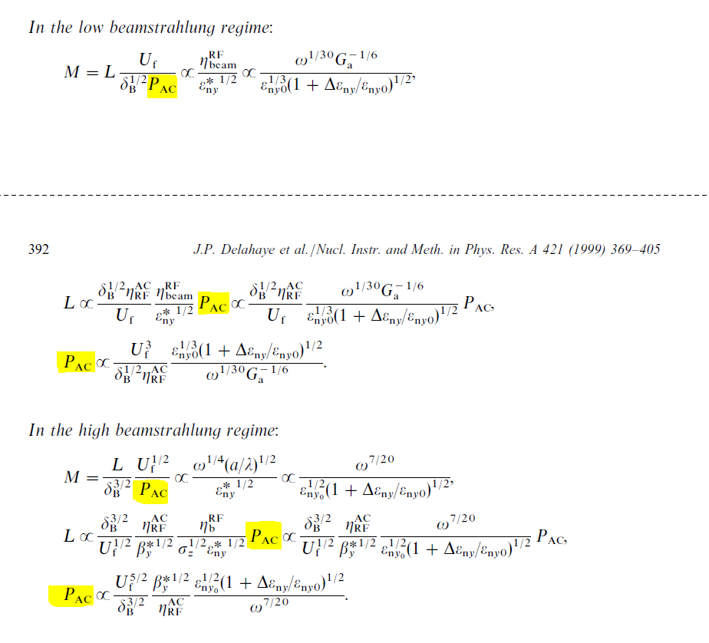
Scaling laws for e+/e- linear colliders
J.P. Delahaye, G. Guignard,T. Raubenheimer, I. Wilson
U_{f}= E_{beam}
δ_{B} =% loss by beamstrahlung
η^{AC}_{RF}=wall plug power to beam power
Would be nice to compare with actual data..

Slide 24
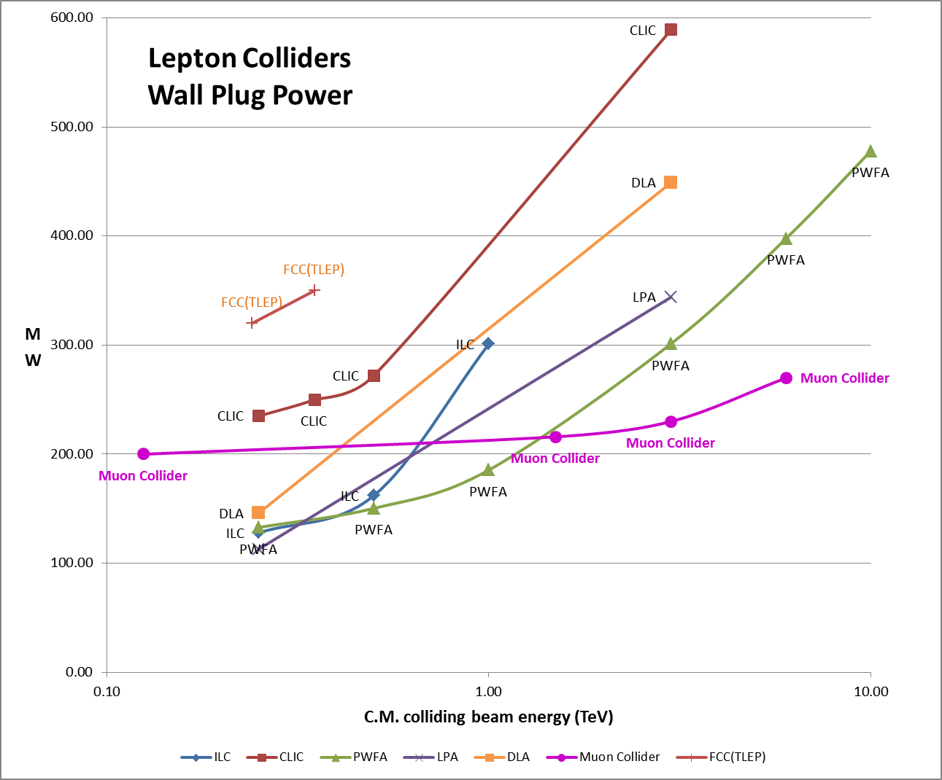
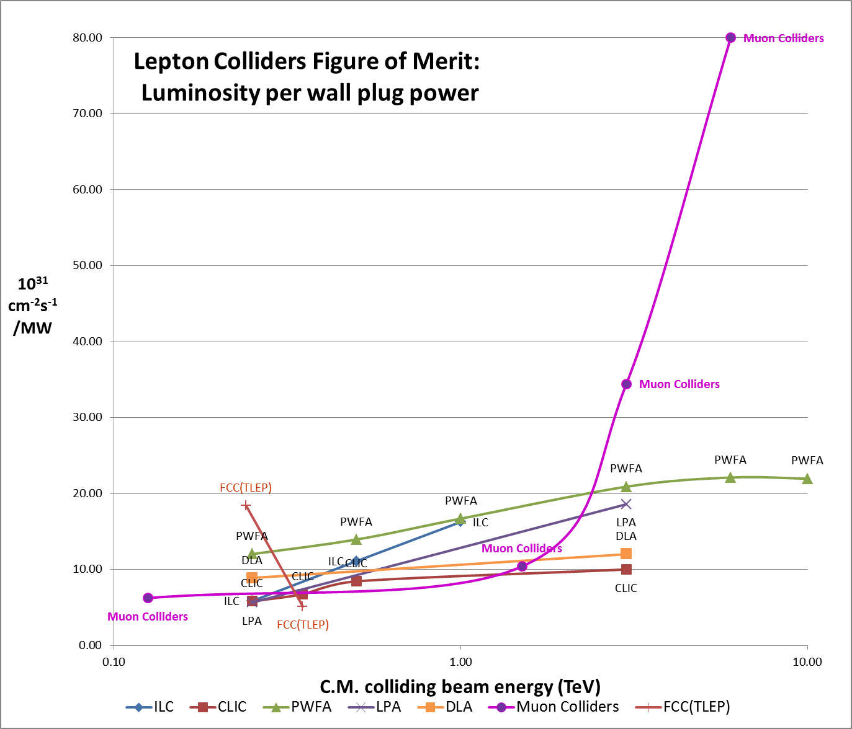
Muon Colliders extending high energy frontier with potential of considerable power savings
Jean Pierre Delahaye
SLAC

Slide 25
Green ILC -- 3rd pillar
Sustainable Energies
1) Energy Production:
  Study the pros/cons of various sources: solar, wind, geothermal, sea, …, smr,…
    Availability, Price, Flexibility, Potential for improvement, Environmental impact
  Find the best energy mix to cover ILC specific needs ? 24/7, long shutdowns, …
  Match ILC component to the energy sources specifics:
    RF power converter: PhotoVoltaic, fuel cells (DC)
    Cryocooler or asynchronous liquefactors ?
2) Energy Storage: HEP, experts in some of these technologies
  Liquid Helium, Nitrogen, SMES(Sc Magnetic Energy Storage), Flywheel, Pumped hydro, Compressed air, Batteries, …
3) Distribution: Local Smart GRID:
Full scale multi-sourced, AC/DC, GRID management and control
  Smooth and rapid switching between energy sources, including conventional supply
  Energy Monitoring, Management and forecast: production, storage and backup

Slide 26
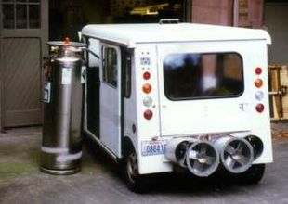
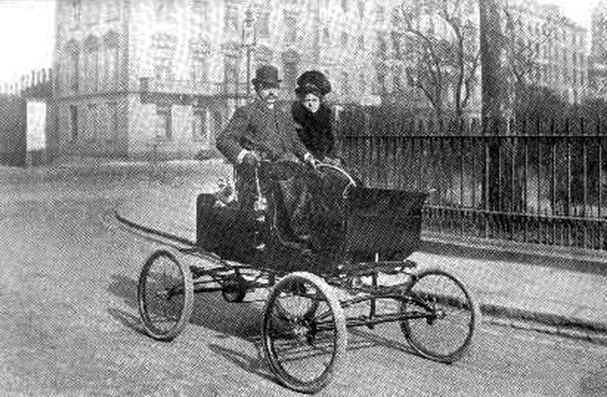
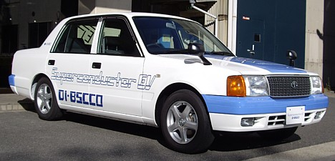
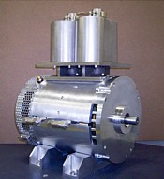
An LN2 Economy for ILC
  ILC cryogenics ~ 38 MW (23% of ILC total AC power)
    In current design all cooling is done with LHe. LN2 as a primary coolant -> - 20 MW
    LN2 cooling: HTc (MgB2) power transmission lines, NC magnets, electronics/computers,
    LN2 could be used to recycle low grade heat waste (including beam dumps)
    And produce electricity with high-pressure gaz turbine
  LN2 could be produced by sustainable energies
    Close to or at the ILC site (wind, solar, geothermal energy)
    Wind energy: from electricity or direct liquefaction
  LN2 Energy storage
    With the heat waste, turbine produce electricity when needed. 70% efficiency
First LN2 car
Sumimoto
Liquid air energy network

Slide 27
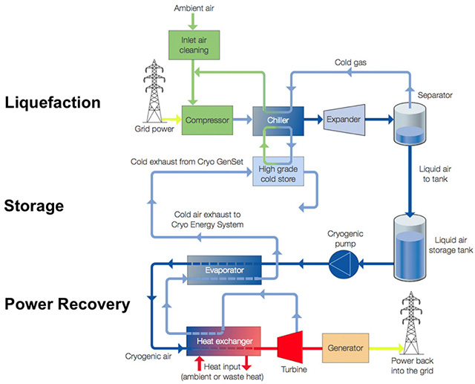
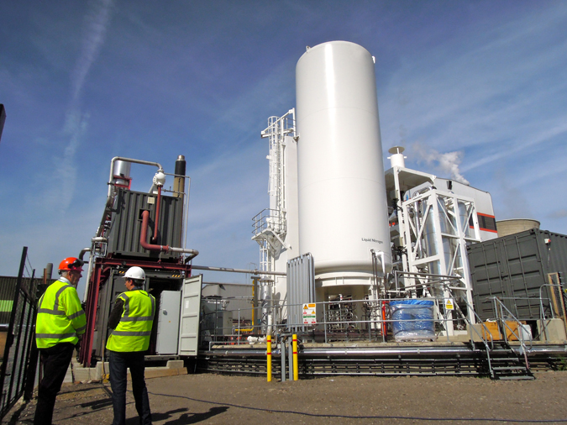
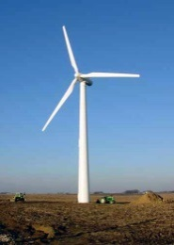
LN2 as energy storage
Highview Power Storage (UK)
Expected Efficiency up to 70% using heat waste (~ 115 C)

Slide 28
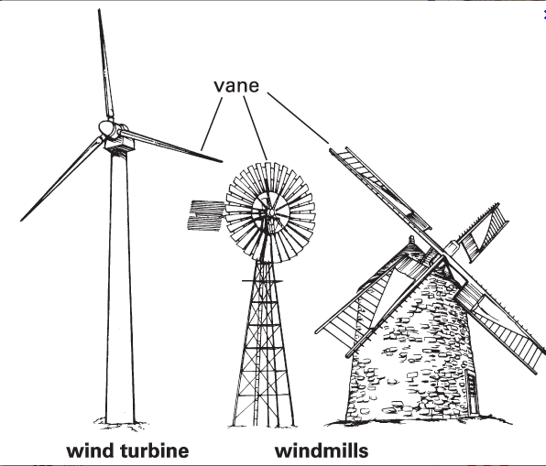

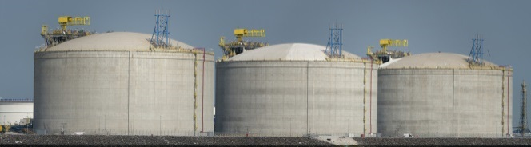
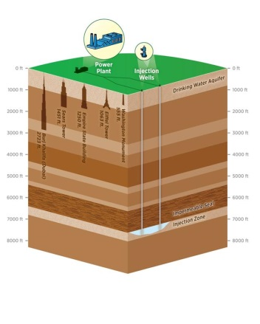
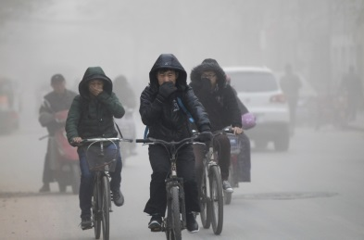
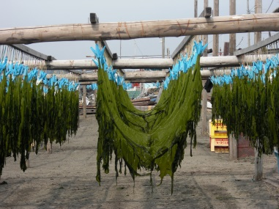
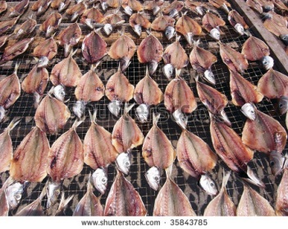
LN2 process cycle
Cryocooler may save 50% electrical power
Cooling NC magnets
HTc power Transmission lines
Cooling electronics and computers
Compressor/liquefier Inside
LN2
Energy storage
LO2, LAr, SCO2
LN2
heat waste
Dry ice
Turbine → electrical generator
To Industry
For Cooling or Sequestration
N2 gas applications
Electricity Back to ILC/GRID
i.e. Drying and preservation industry
Air cleaning !!!

Slide 29
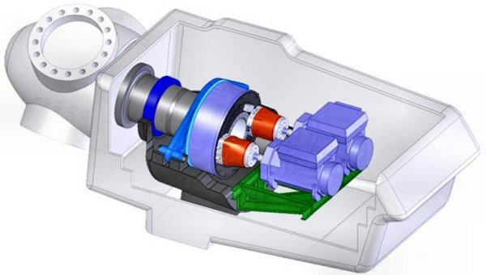
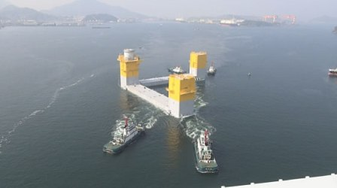
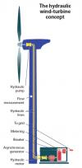
Hydraulic Wind engine
“Liquid nitrogen economy” update:
The Fukushima Offshore Wind Consortium project update:
November 2014: 7MW first large scale hydraulic wind engine (MHI, Artemis)
Many technical advantages:
Smaller, lighter nacelle
Less mechanical parts and vibration
Hydraulic accumulator
  Larger wind speed range
  No electrical frequency converter
Easier maintenance at ground level
Good for the LN2
“Base” based LN2 liquefier
Many mills to one liquefier
Hybrid: LN2 and electricity

Slide 30
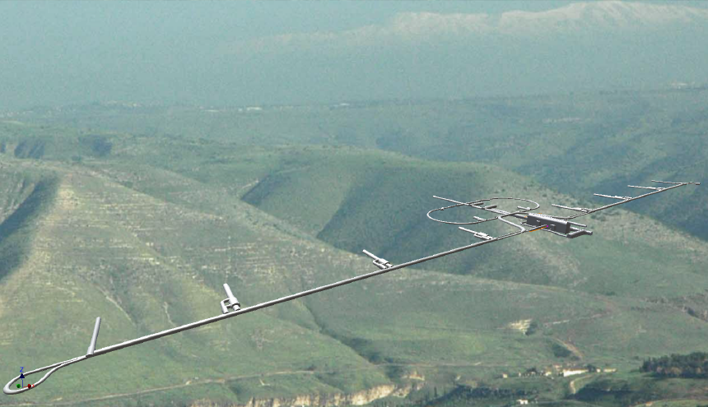


Asian Site Conventional Facility – Introduction
(Site) Mountainous green field not far from big towns, accessible with existing roads.
(Facility) Smaller surface structures and underground structures.
Granite
Damping Ring
Ring To Main Linac (RTML)
Detector Hall
PM+10
PM+12
PM+13
PM-ab
PM+8
Surface Structures
e+ ML
Existing surface road
PM-8
e- Source
PM-12
PM-10
PM-13
e+ Source
(Slope <7%)
Access Tunnel
Access Hall
PM-X
(Slope <10%)
(Center Campus)
e- Main Linac (ML)
Existing road
RTML turn-around
(The background photo shows a similar site image but does not show the real site.)

Slide 31
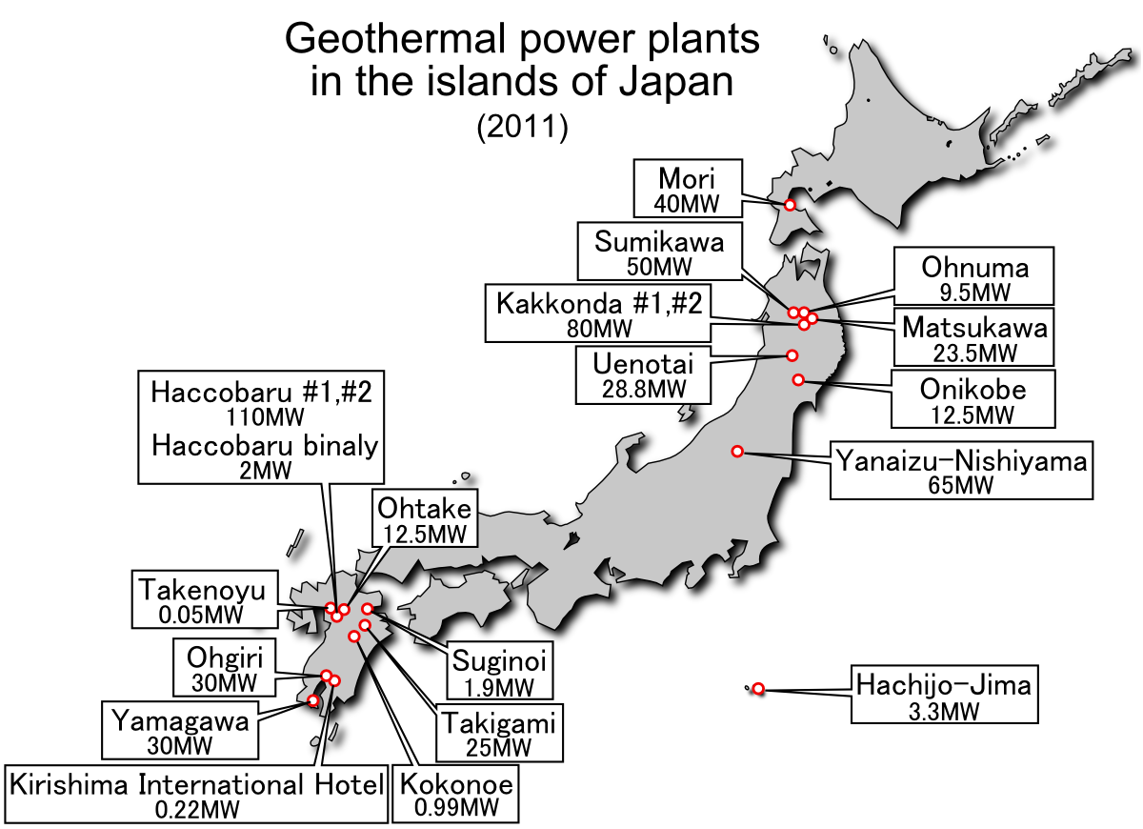

Slide 32
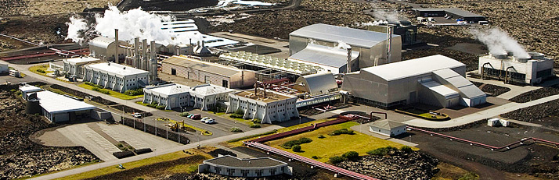
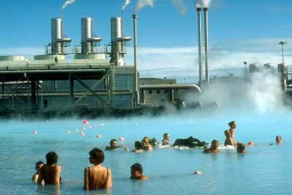
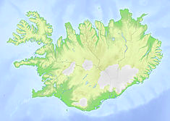
Geothermal Energy and SPA center
  Iceland Svartsengi
    Geothermal plant: electricity 75 MW, thermal 150 MW
    37 years of operation
    600 m drill 240 C + 1000m and 2000m steam wells
    Hot drinking water to the city
Swartsengi Power plant and Blue lagoon

Slide 33
Collaborations
First joint Green-Session Belgrade/Beijing ILC, CLIC, FCC, CepC, SppC
“HEP future: to be green or not to be”
ICFA proposal (A. Suzuki KEK DG)
“Sustainable accelerator/collider panel” (decision Feb. 2015)
Industry participation
    Japan AAA “Green-ILC” every 2-3 month meeting
    Air Liquide
Green-ILC available at interactions.org http://newsline.linearcollider.org/archive/2014/20141030.pdf
Comprehensive paper in preparation (Co-authors, H. Hayano, T. Saeki, A. Suzuki, D.P-G, ….)
Website: http://green-ILC.in2p3.fr (LAPP)

Slide 34
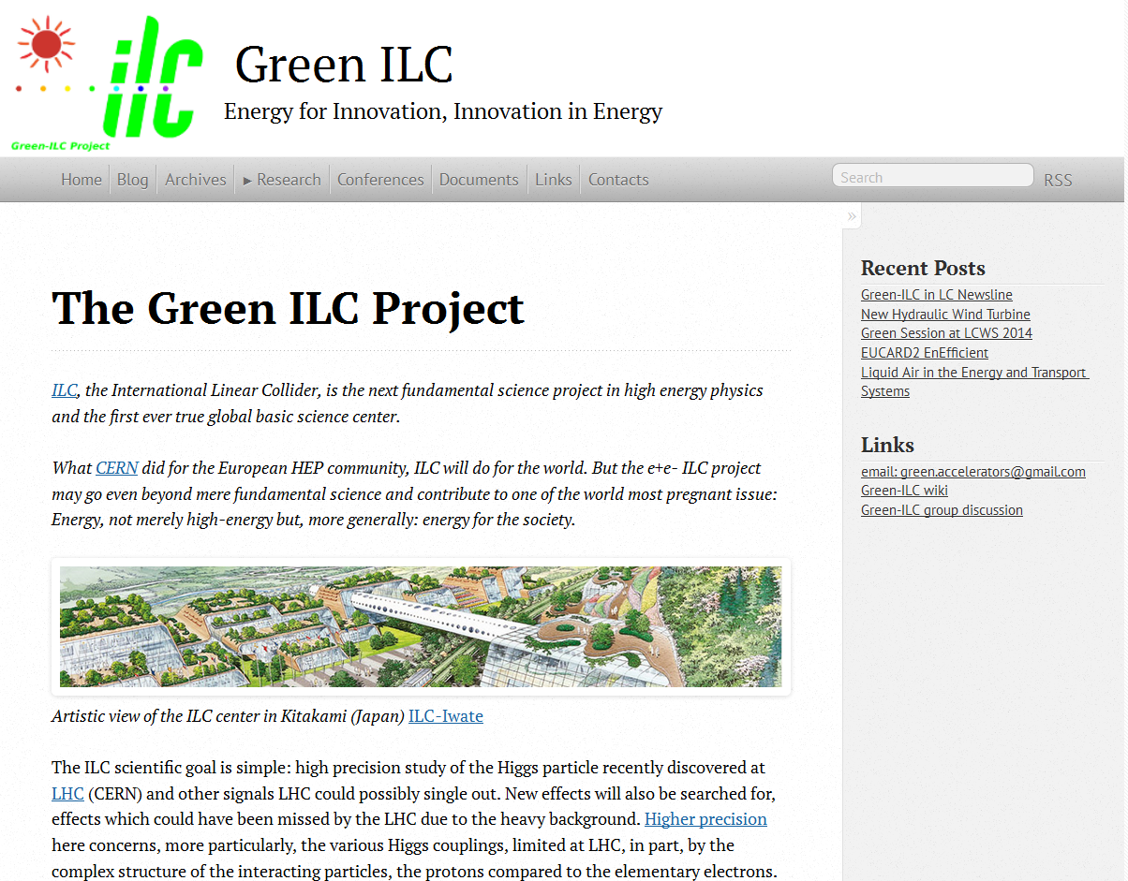
http://green-ILC.in2p3.fr

Slide 35
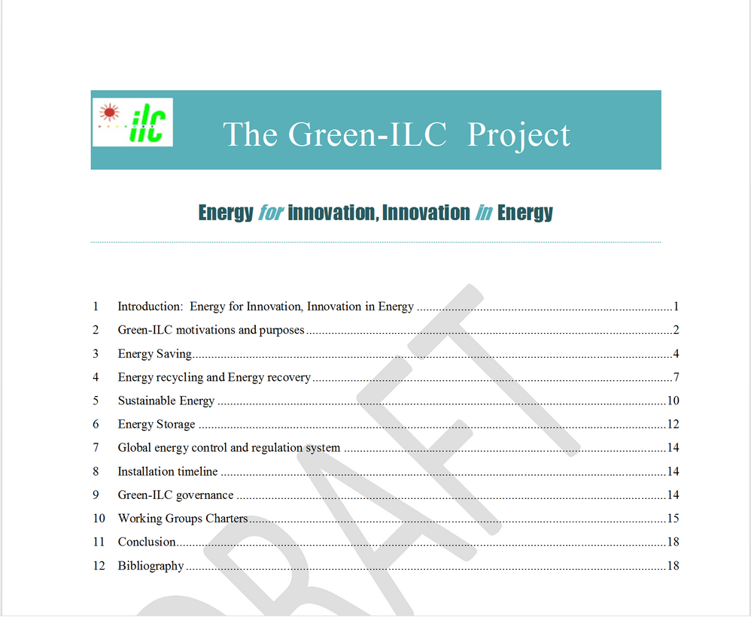

Slide 36
Thank you

