Slide 1
POLARIZED AND UNPOLARIZED POSITRON SOURCES FOR LINEAR COLLIDERS
Robert CHEHAB
IPNL/IN2P3/CNRS
This talk is associated to the memory of Vladimir M.Strakhovenko from BINP-Novosibirsk who participated in most of the theoretical investigations on positron sources with his colleagues from LAL and IPNL.

Slide 2
POLARIZED AND UNPOLARIZED POSITRON SOURCES FOR LINEAR COLLIDERS
OUTLINE
* Introduction
* Polarized positrons
* Unpolarized positrons (hybrid source)
* Summary and conclusions

Slide 3
POLARIZED AND UNPOLARIZED POSITRON SOURCES FOR LINEAR COLLIDERS
1-INTRODUCTION
* Strong needs in positron sources for future e+e- colliders
* Linear colliders require very high intensities for the positron beams
* Polarized e+e- at the interaction point of a LC enhance the efficient polarization helping in identifying new particles and bringing more precision with the reduction of background. If polarized electrons are more easily obtained using AsGa photocathodes (with high degree of polarization) sources of intense polarized positrons remain a challenge. An intense effort is going on this topics.
* Unpolarized high intensity positrons are usually obtained with conventional targets and intense incident electron beams. However, the poor quality of the positron beams obtained in this manner pushed us to investigate positron sources using channeling in oriented crystals.
* We present, here, some investigations on polarized positrons and on the “channeling” option for the unpolarized positrons.

Slide 4
POLARIZED AND UNPOLARIZED POSITRON SOURCES FOR LINEAR COLLIDERS
2-POLARIZED POSITRON SOURCES
The longitudinally polarized positrons at the interaction point of a LC are generated by the materialization of circularly polarized photons in an amorphous target. In order to generate these photons in the appropriate energy range (some MeV to tens of MeV) three methods are considered:
- Radiation of high energy electrons in a helical magnetic undulator
- Compton backscattering of circularly polarized laser photons on energetic e- beams
- Polarized bremsstrahlung from longitudinally polarized e- in amorphous targets.

Slide 5
POLARIZED AND UNPOLARIZED POSITRON SOURCES FOR LINEAR COLLIDERS

Slide 6
POLARIZED AND UNPOLARIZED POSITRON SOURCES FOR LINEAR COLLIDERS
From S.Riemann (LCWS 2014)
➔ ILC

Slide 7
POLARIZED AND UNPOLARIZED POSITRON SOURCES FOR LINEAR COLLIDERS
From S.Riemann (LCWS 2014)
➔ ILC

Slide 8
POLARIZED AND UNPOLARIZED POSITRON SOURCES FOR LINEAR COLLIDERS
From S.Riemann (LCWS 2014)
➔ ILC

Slide 9
POLARIZED AND UNPOLARIZED POSITRON SOURCES FOR LINEAR COLLIDERS
R & D on positron system for ILC undulator baseline : from S.Riemann (LCWS 2014)

Slide 10
POLARIZED AND UNPOLARIZED POSITRON SOURCES FOR LINEAR COLLIDERS
2-2 COMPTON BACKSCATTERING PHOTONS FOR POSITRONS
The scattered photons have λ=λ_{laser} /2γ²(1+cosθ_{γ} ) ; laser photons are circularly polarized. The laser wavelength is about 1 μm. The electron beam energy is of some GeV. In order to improve the available laser power at the interaction point, an optical cavity is used.
The laser wavelength is 10⁴ times smaller than the undulator one (~ cm); the electron beam energy to create the same energy photons is 100 times smaller

Slide 11
POLARIZED AND UNPOLARIZED POSITRON SOURCES FOR LINEAR COLLIDERS
Two 4-mirror cavities have been installed at ATF/KEK: LAL-Orsay cavity in 2010 and a similar one from KEK-Hiroshima in 2011. There are two flat and two spherical mirrors; spherical mirrorr radius➔ minimizes the waists of the cavity modes. This tetrahedron geometry reduces the polarization instabilities at very small level.
F.Zomer et al.

Slide 12
POLARIZED AND UNPOLARIZED POSITRON SOURCES FOR LINEAR COLLIDERS
A collaboration LAL-KEK started with the objective of testing the generation of Compton photons in the 4-mirror cavity at ATF
F.Zomer et al.

Slide 13
POLARIZED AND UNPOLARIZED POSITRON SOURCE FOR LINEAR COLLIDERS
Recent results (2013) were obtained at ATF
F.Zomer et al.

Slide 14
POLARIZED AND UNPOLARIZED POSITRON SOURCES FOR LINEAR COLLIDERS
TEST AT ATF: successful tests have been operated at ATF.
After improvements in the optical system (laser, mirrors,..) runs were operated in december 2013. The results gave a flux of Compton photons: 500 to 1500γ/ crossing bucket at maximum. : or 5x10⁸ to 1.5x10⁹ γ/sec; that corresponds to: 0.8x10⁻⁷ to 2.5 x10⁻⁷ γ/e- . The experiment was using one bucket of 1 nC with a collision frequency of 1 MHz. The collisions lasted during 4 hours.
The effect of the Compton interaction is clearly seen on the figure.
Beam lifetime with and without Compton interaction.
F.Zomer et al.

Slide 15
POLARIZED AND UNPOLARIZED POSITRON SOURCES FOR LINEAR COLLIDERS

Slide 16
POLARIZED AND UNPOLARIZED POSITRON SOURCES FOR LINEAR COLLIDERS
3-POLARIZED POSITRONS WITH POLARIZED BREMSSTRAHLUNG PHOTONS
This method for producing polarized positrons was, first, described almost simultaneously by Bessonov & Mikhailichenko and by Potylitsin. It has been considered for an experiment at JLab with a W target (1 mm thick) on which was impinging a longitudinally polarized electron beam of 8.25 MeV. The electron source was an AsGa photocathode. Positron polarization exceeding 50 % has been measured by the Compton Transmission Polarimeter method (measurement of asymetries between two directions of polarization in magnetized iron).

Slide 17
POLARIZED AND UNPOLARIZED POSITRON SOURCES FOR LINEAR COLLIDERS
AN EXAMPLE OF UNPOLARIZED POSITRON SOURCE FOR LINEAR COLLIDERS: THE HYBRID POSITRON SOURCE USING CHANNELING
A COLLABORATION INVOLVING PHYSICISTS AND ENGINEERS FROM
LAL, IPNL, CERN AND KEK
X.Artru, I.Chaikovska, R.Chehab, M.Chevallier, O.Dadoun, K.Furukawa, H.Guler, T.Kamitani, F.Miyahara, M.Satoh, P.Sievers, T.Suwada, K.Umemori, A.Variola

Slide 18
POLARIZED AND UNPOLARIZED POSITRON SOURCES FOR LINEAR COLLIDERS
UNPOLARIZED POSITRON SOURCES USING CHANNELING RADIATION IN CRYSTALS
CHANNELING RADIATION IN AXIALLY ORIENTED CRYSTALS IS A POWERFUL SOURCE OF PHOTONS USEFUL TO PRODUCE HIGH INTENSITY POSITRON BEAMS (Exp. WA 103 @ CERN, exp. @KEK.). Separating the crystal-radiator from the amorphous converter, where only the photons are impinging, lower the deposited energy in the latter. Moreover, substituting a granular target for a compact one, improve the power dissipation.

Slide 19
POLARIZED AND UNPOLARIZED POSITRON SOURCES FOR LINEAR COLLIDERS
SIMULATIONS ON A HYBRID SOURCE WITH GRANULAR CONVERTER (H.Guler/LAL)

Slide 20
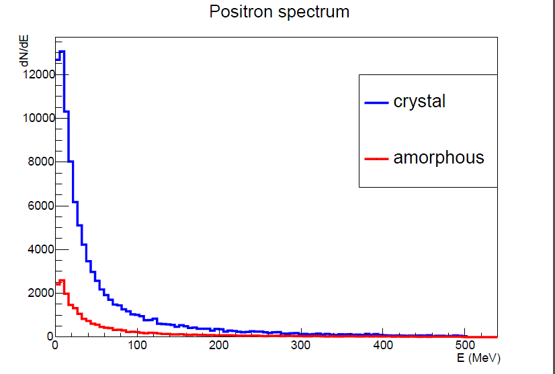
POLARIZED AND UNPOLARIZED POSITRON SOURCES FOR LINEAR COLLIDERS
COMPARED PHOTON AND POSITRON SPECTRA FOR HYBRID-GRANULAR SOURCE WITH ORIENTED AND RANDOM ORIENTATION OF THE CRYSTAL
The γ and e+ spectra for the 2 cases :oriented (blue) and random (red) Enhancements in photon and positron yields for the oriented crystal (crystal) w.r.t. the random (amorphous) are clearly seen. For the photon spectrum the vertical scale is E.dN/dE in order to take into evidence the 1/E behaviour of bremsstrahlung. This kind of source provides a large number of soft photons and hence, soft positrons too. In the energy domain 5 to 15 MeV, the enhancement ➔ 3 between crystal and amorphous.

Slide 21
POLARIZED AND UNPOLARIZED POSITRON SOURCES FOR LINEAR COLLIDERS

Slide 22
POLARIZED AND UNPOLARIZED POSITRON SOURCES FOR LINEAR COLLIDERS
ENERGY DEPOSITED AND PEDD (Peak Energy Deposition Density)
In order to determine the PEDD , 4 targets have been built at LAL.. They have been sent at KEK for the beam test.

Slide 23
POLARIZED AND UNPOLARIZED POSITRON SOURCES FOR LINEAR COLLIDERS

Slide 24
POLARIZED AND UNPOLARIZED POSITRON SOURCES FOR LINEAR COLLIDERS
APPLICATION TO ILC: PEDD and Thermal stresses have been estimated for ILC
The PEDD has been calculated: it is less than 2 GeV/cm3/e-; and leads to less than 32 J/g per macropulse: this is below the limit of 35J/g derived from SLC target analysis.

Slide 25
POLARIZED AND UNPOLARIZED POSITRON SOURCES FOR LINEAR COLLIDERS
SUMMARY & CONCLUSIONS
R&D are going on for polarized positron sources for two options: the undulator baseline and the Compton backscattering. The main effort is put on the target reliability for the undulator as, due to a strong photon collimation, the density of the deposited energy in the target is quite high. Concerning the Compton option, intense developments are linked to the laser and to the optical cavity.
The perspective to have, since the beginning , a polarized positron source pushed on the investigations on unpolarized positron sources to be used before the polarized one could be available. A research made mainly at KEK is considering a purely conventional source putting the effort on the minimization of the target heating with various cooling solutions.
Continuing the efforts on unpolarized positron sources using channeling radiation in oriented crystals to generate a high intensity photon beam and an amorphous converter to create the e+e- pairs, a “franco-japanese” team associated to a CERN fellow is developing a solution with a granular converter. Such solution allows a significant decrease of the energy deposition density and presents good perspectives. Tests are in preparation.

Slide 26
POLARIZED AND UNPOLARIZED POSITRON SOURCES FOR LINEAR COLLIDERS
ACKNOWLEDGEMENTS
Thanks to Dr. Hayg Guler from LAL whose simulation results for the hybrid source have been presented here. Thanks also to Dr. Sabine Riemann from DESY and Prof. Fabian Zomer from LAL for providing informations on the polarized sources.

Slide 27
POLARIZED AND UNPOLARIZED POSITRON SOURCES FOR LINEAR COLLIDERS
PROPOSITION OF P.SIEVERS FOR RADIATION COOLING OF THE BASELINE SOURCE
Water cooling in the bottom part (stainless steel)
Radiation cooling requires big surface ➔ 1 m² (in red ) ; wheel rotation velocity: 100 m/s

Slide 28
POLARIZED AND UNPOLARIZED POSITRON SOURCES FOR LINEAR COLLIDERS
BACK-UP SLIDES-2
S.Riemann/LCWS14

Slide 29
POLARIZED AND UNPOLARIZED POSITRON SOURCES FOR LINEAR COLLIDERS
COOLING OF THE GRANULAR CONVERTER:
A rotating wheel with a velocity of 4m/s and a diameter of 1 m is considered. The W spheres are embeded in copper which is cooled. Windows crossed by the beam are in Ti.
From P.Sievers (POSIPOL 2014)

