Slide 1
Model-independent
WIMP searches
at ILC
with single photon
Andrii Chaus (CEA/DESY),
Jenny List (DESY),
Maxim Titov (CEA)
3rd “Journées Collisionneur Linéaire” Grenoble, France
December 1-3, 2014

Slide 2
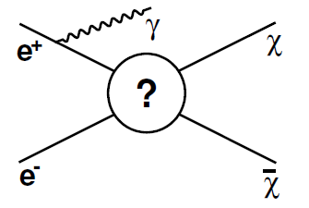
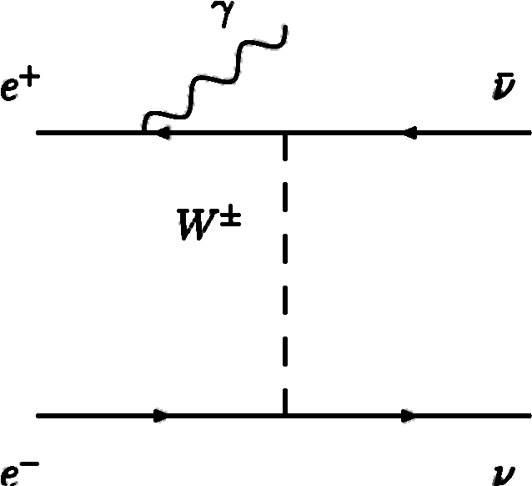
Model - Independent WIMP Searches
Search for direct WIMP pair production (with ISR
photon) at colliders:
e+e- → χχγ
Main background: e+e- → ννγ
ILC Study:
- Observation / exclusion reach
- Effects of luminosity / beam polarization
Interpretation of the results using two
theoretical approaches
ILC/LHC Comparison
Comparison with theory-level studies (M. Perelstein et al, JHEP 1305 (2013) 138)
for polarized and unpolarized beams → good agreement observed & sensitivity
improved by advanced statistical treatment
→ see talk Jenny List, 2014 LCWS Meeting, Chicago, May 10-14, 2014

Slide 3
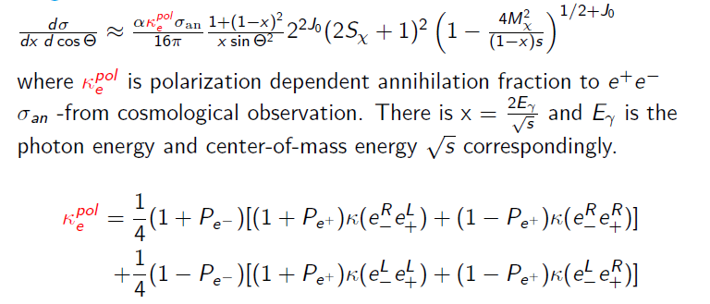
Theory: Cosmological Approach
Signal cross section:
A. Birkedal et al. [hep-ph/0403004]
Signal cross section derivation:
Annihilation cross section σ_{an} determined by Ω_{DM}
Crossing symmetry: σ_{an} → σ (e+e-→χχ )
Inclusion of ISR photon: σ (e+e-→χχ)

Slide 4
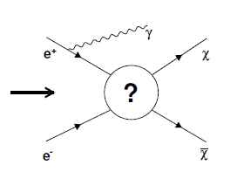
Theory: Effective Operator Approach
Parametrize “?” (coupling of WIMP to electron and positron) as:
POLARIZATION DEPENDENCE:
Double differential cross-section for Vector operator:
For axial-vector and scalar s-channel operators:

Slide 5
Theoretical Approaches: Cosmological vs Effective Operator
COSMOLOGICAL APPROACH
FREE PARAMETERS:
Mχ – WIMP mass
Sχ – WIMP spin
κ_{e} - fraction of WIMP pair
annihilation into e+e- (s ~ κ_{e} ^{pol})
J – angular momentum of dominant
partial wave
EFFECTIVE OPERATOR APPROACH
FREE PARAMETERS:
Mχ – WIMP mass
Sχ – WIMP spin = ½
Λ – energy scale of New Physics
(σ ~ 1/Λ⁴)
Choice of operator (vector; axial;
scalar, s-channel)
From Cosmological observation: σ_{an}

Slide 6
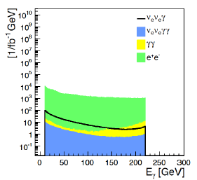
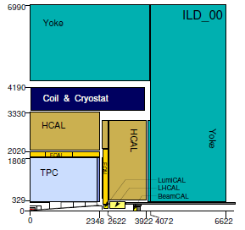
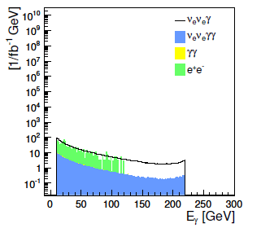
Detector Simulation and Reconstruction
Monte Carlo (used LOI):
SM: ILD 00 SM DSTs
at 500 GeV
Signal:
reweighting of ννγ process
Event reconstruction:
Particle Flow: Pandora algorithm
At least one photon with Eγ > 10 GeV
and |cos(Θ)| < 0.997
No track with p_{T}^{track} > 3 GeV
E_{vis} – E_{γ} < 20 GeV
Beam Calo veto on high energetic e/ γ
Before
selection
After all
selection
cuts applied

Slide 7
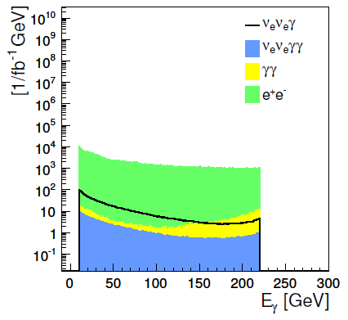
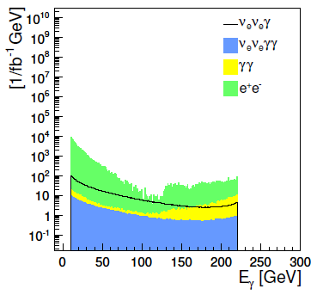
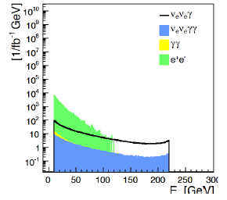
Selection Cuts and Irreducible Background
Irreducible background:
Radiative Bhabha’s:
e+e- → e+e- γ
Mimicks signal if e+e- is not
detected
Crucial to apply veto from
BeamCal
Forward e+/e-tagging
capabilities are very
important
Smaller crossing angle
would be advantageous
Note: current study based
on RDR beam parameters
1. Preselection
2. After cut
p_{T}^{track} <3 GeV
3. After
E_{vis}–E_{γ}<20 GeV,
but before
BeamCal veto
4. After all
selection
cuts applied

Slide 8
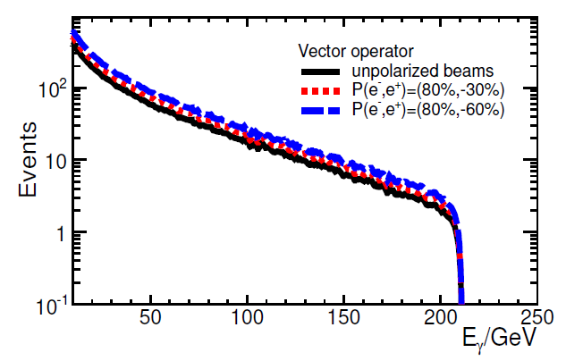
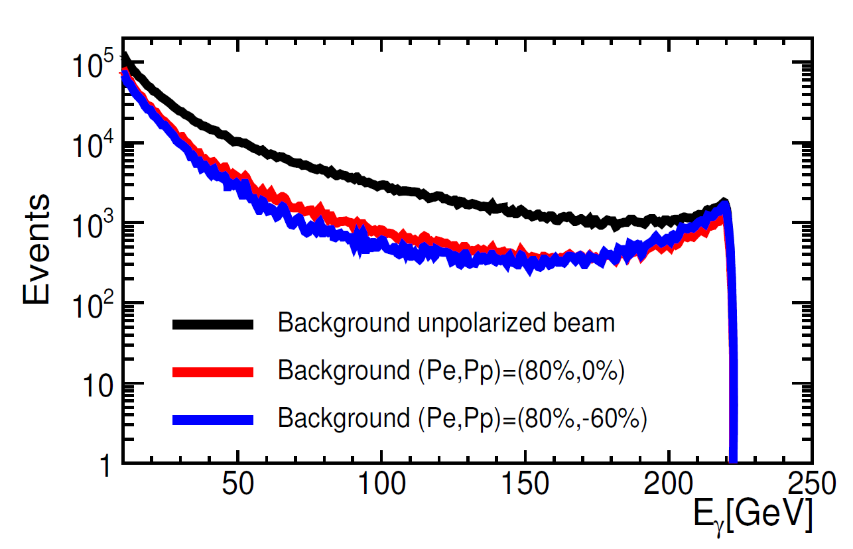
Signal and Backgrounds
SIGNAL EVENTS:
→ no significant difference in shape
between polarized and unpolarized
beams (vector-operator, Λ = 1580 GeV)
Sum of all background processes: ννγ, γγ, e+e-:
Using electron polarization number of ννγ
background events can be suppressed by 80%:
Number of signal events for different
polarizations/operators (Mχ = 100 GeV)
Breakdown of different backgrounds for
several e-/e+ polarizations:

Slide 9
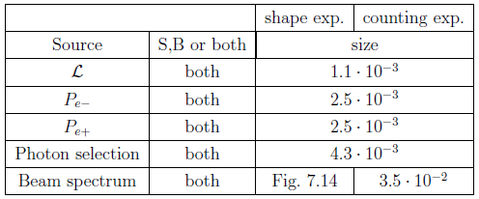
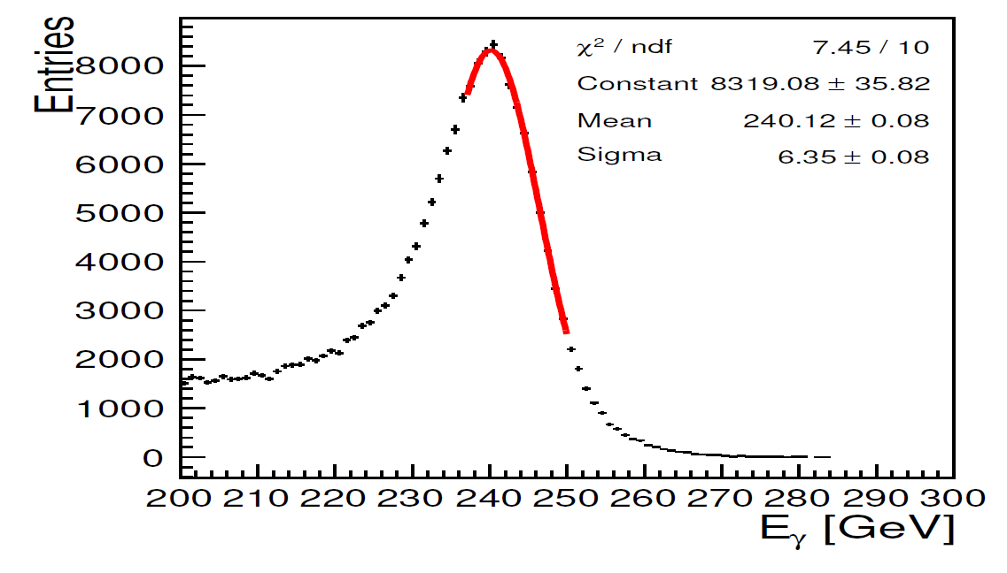
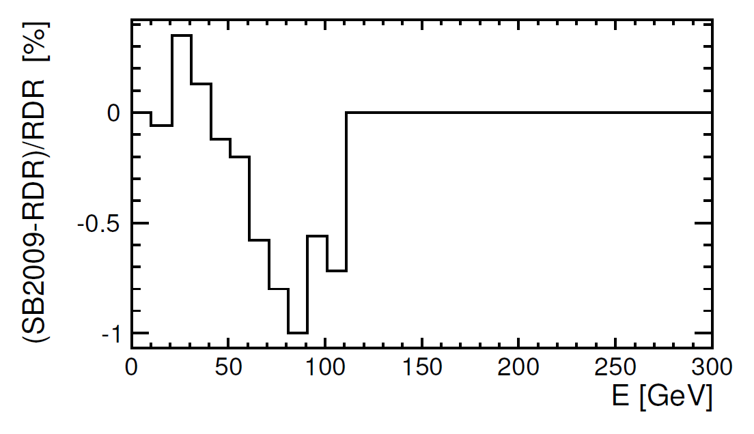
Systematic Uncertainties
Different sources are considered:
Luminosity: δL/ L = 0:11% (arXiv:1304.4082)
Polarization: δP/P = 0.25% per beam
Beam energy spectrum: full difference between the RDR and SB2009 beam parameters (3.5 % total or shape info)
Photon reconstruction efficiency: assume statistics of control sample e+e- → Zγ → μμγ (δε/ε = 0.43% from normalization to radiative Z-return)
Systematic uncertainties
(all uncorrelated):

Slide 10
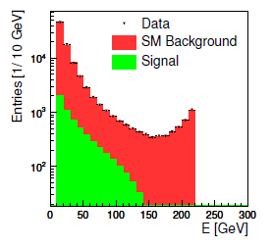
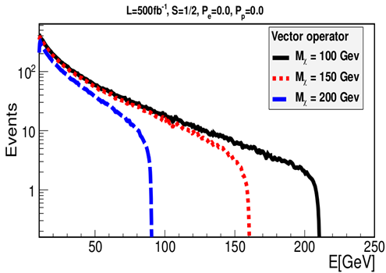
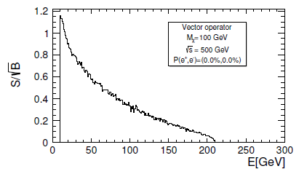
Exploiting Shape Information
Photon spectrum for different WIMP masses
Significance in each E_{γ} bin:
Counting experiment:
Total number of signal S and background B events
Significance S/sqrt (B)
Fractional event counting:
Si/sqrt(Bi) per bin
Weight events according to significance of their bin
Gains over counting experiment when significance
depends on observable

Slide 11
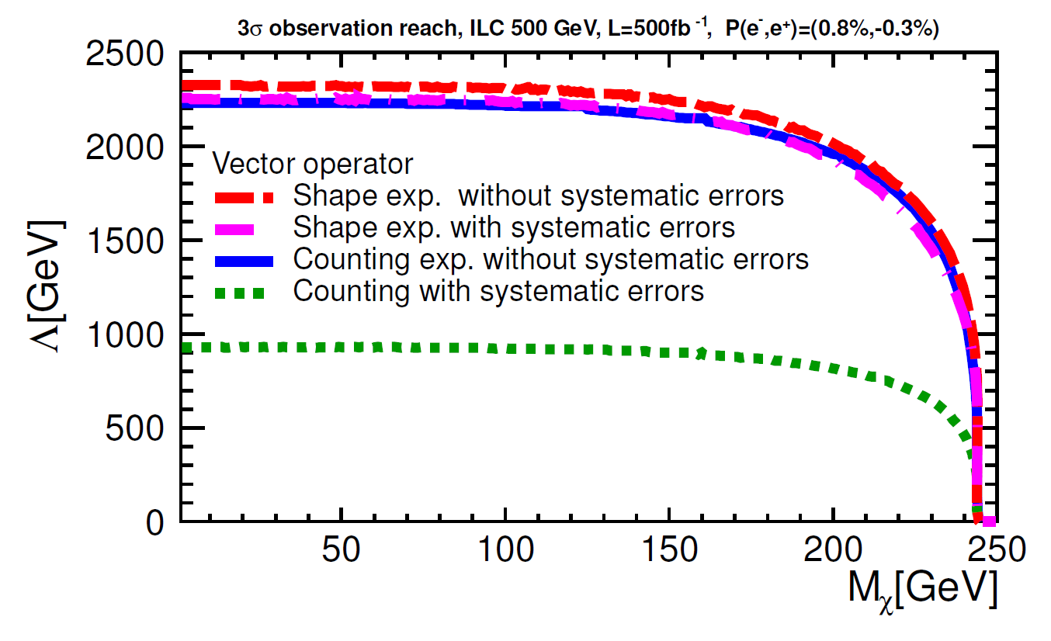
Exploiting Shape Information
Consider systematic uncertainties in weight definition (P. Bock,JHEP 0701(2007)080,Eq.36
Equivalent approach: fitting of nuissance parameters
Limits are set using Modified Frequentist Approach: CLs = CL_{S+B}/CL_{B}
Use of discriminating variable (shape information) in CL calculation
drastically reduces impact of systematic uncertainties!

Slide 12
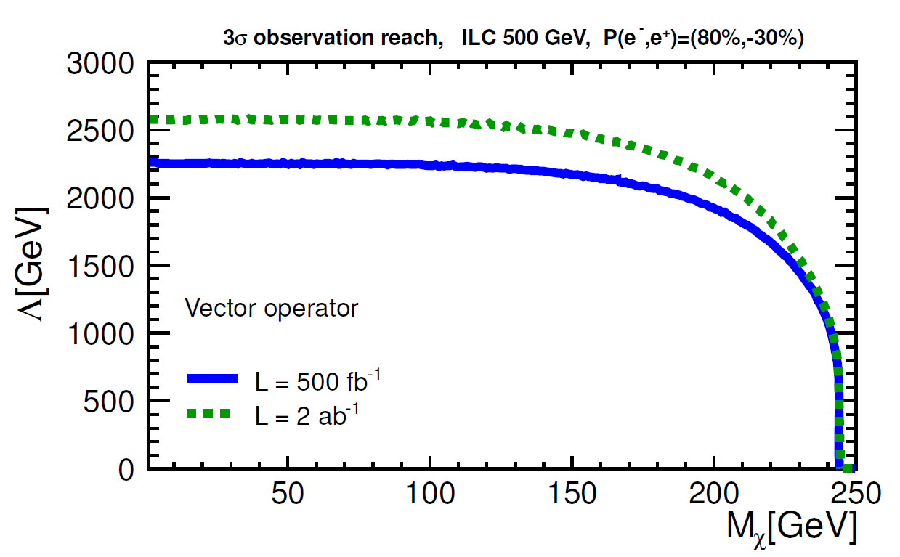
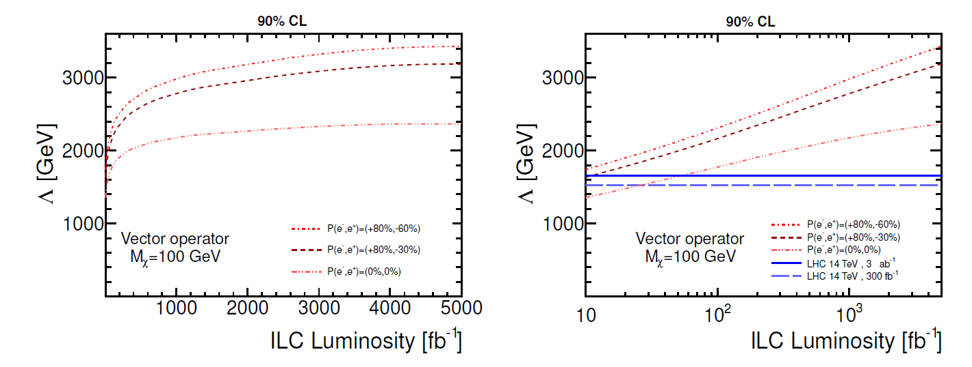
Effect of Integrated Luminosity
Increased reach in Λ with luminosity:
3σ Observation:
→ 500 fb⁻¹ → 2 ab⁻¹: gain 10% (Sχ =1/2,
vector operator) → less than sqrt(N)
due to systematics
90% CL Exclusion:
→ significant improvement up to L ~ 1 ab⁻¹
→ positron polarization helps to increase
reach in Λ by 200-400 GeV

Slide 13
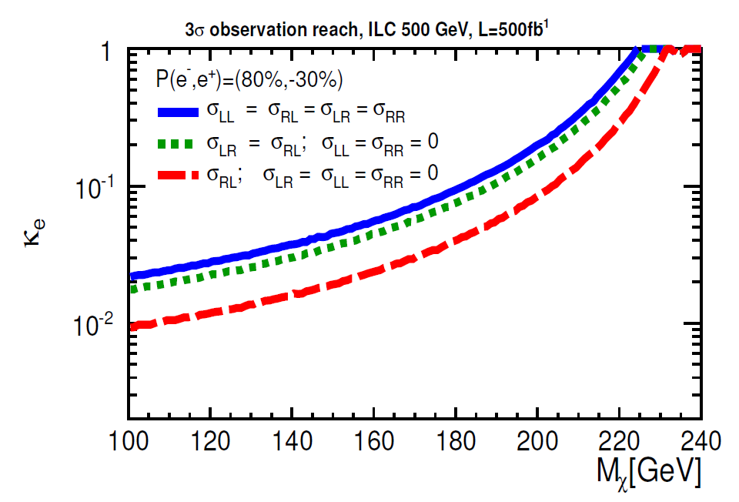
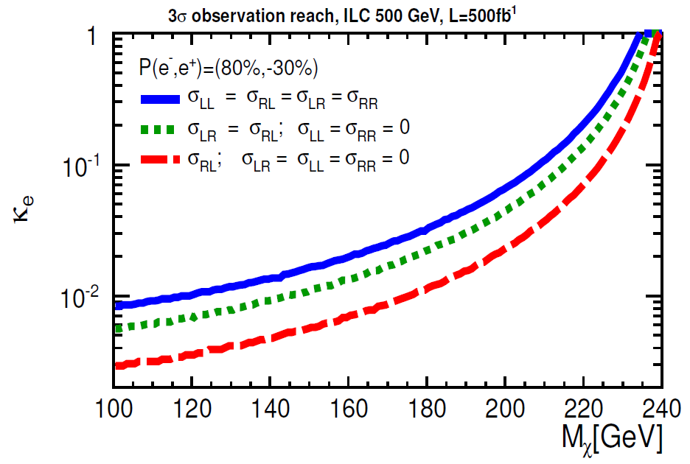
3σ Observation – Cosmological Approach
3 different assumptions on
chirality of WIMP-SM interaction
- Solid line: WIMP couplings are independent from electron/positron helicity
- Dotted line: helicity and parity conserving
model: σ_{LR} = σ_{RL}
- Dashed: WIMPs couple to right-handed
electron and left-handed positron
P(e-; e+) = (+80%;-30%)
Two possible WIMP spins:
Sχ =1 and Sχ =1/2 (WIMP
branching ratio is smaller)
Sχ =1/2
ILC can observe WIMP signal
if annihilation fraction (κ_{e})
to e+e- is at least ~ 0.3 - 1 %
Sχ =1

Slide 14
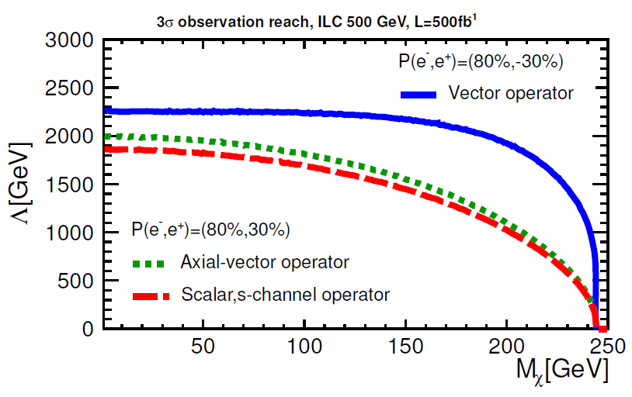
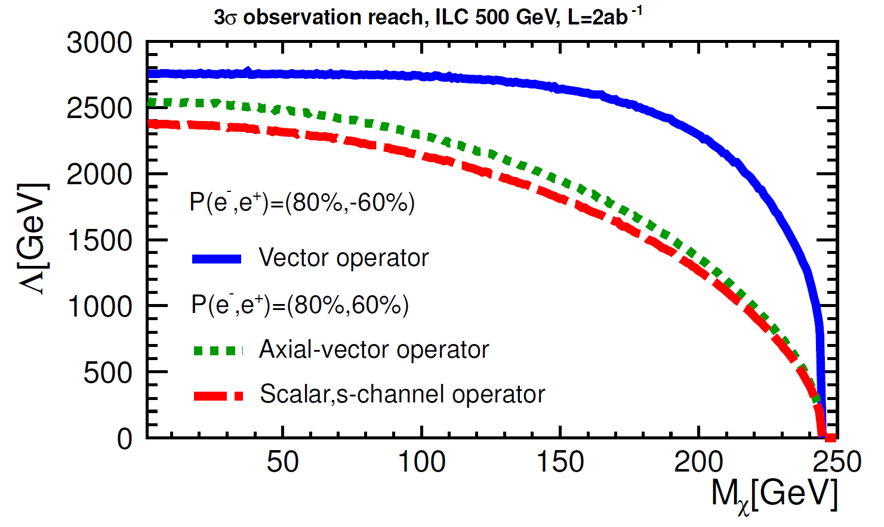
3σ Observation – Effective Operators Approach
Using fixed luminosity and “the most optimal” polarization configuration:
3 different operators (all for Sχ =1/2):
- Vector,
- Axial-vector,
- Scalar (s-channel)
«Pessimistic» scenario: 500 fb ⁻¹
P(e-; e+) = (+80%;30%)
«Optimistic scenario: 2 ab⁻¹
P(e-; e+) = (+80%;60%)
ILC can observe signal
up to Λ ~ 2 – 2.5 TeV

Slide 15
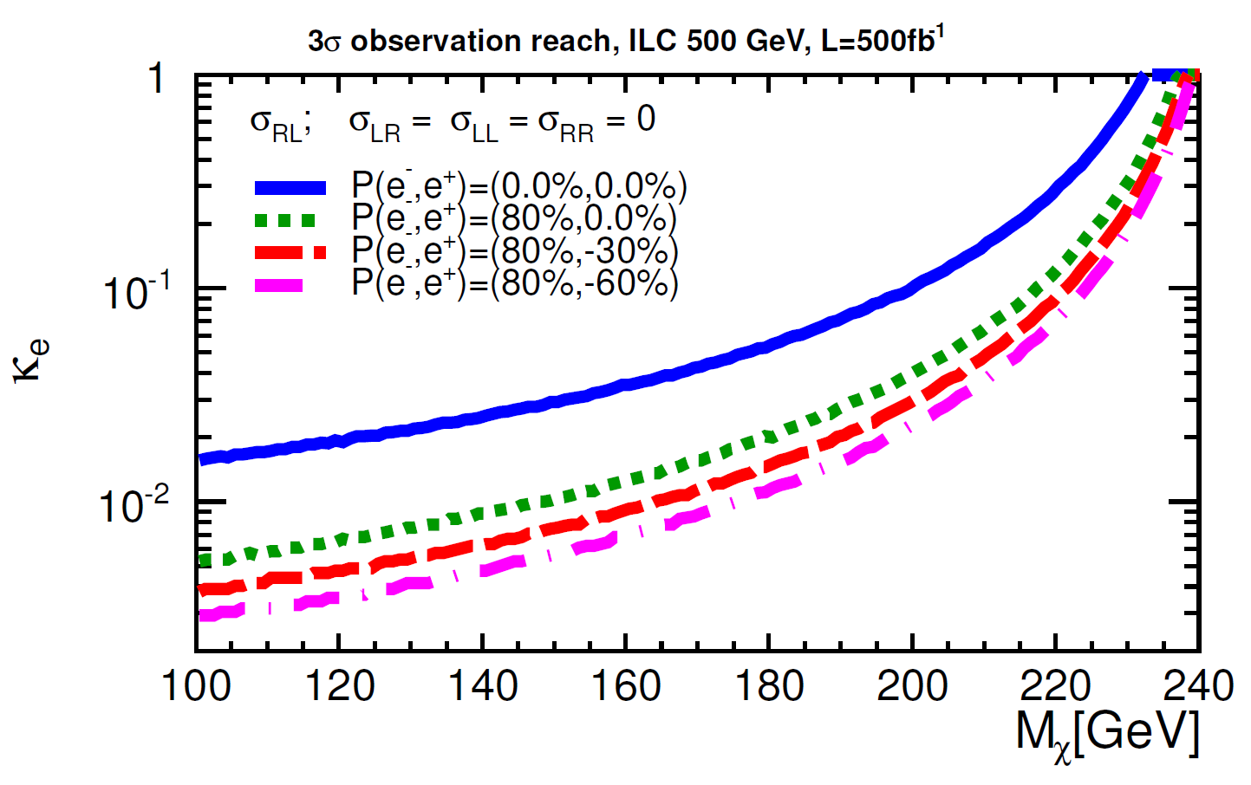
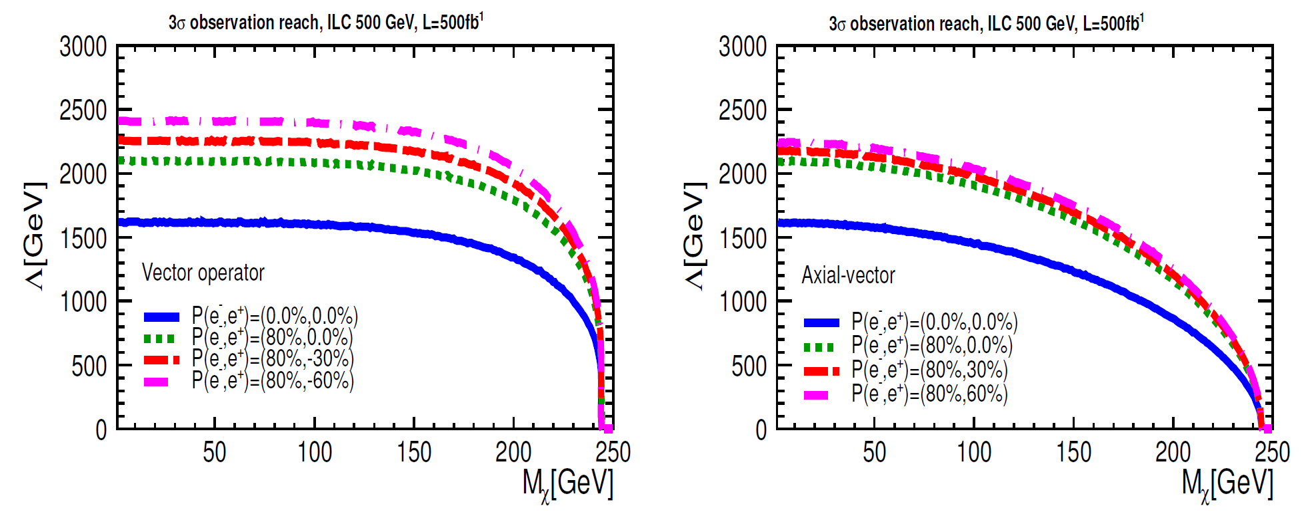
Effect of Beam Polarization
P(e-) = +80% reduces SM νν-background
by 1/10 (bkg. dominates by Bhabhas)
→ 70% improvement in sensitivity
Choose sgn (P(e+)) according to type of interaction, e.g.:
- Sgn (P(e+)) = - for σ_{RL} in κ approach
(Sχ = 1, p-wave)
- Sgn (P(e+)) = + for axial-vector operator
- Sgn (P(e+)) = - for vector operator
(Sχ = 1/2)
Flipping sgn(P(e+))
allows to
determine
type of
operator!

Slide 16
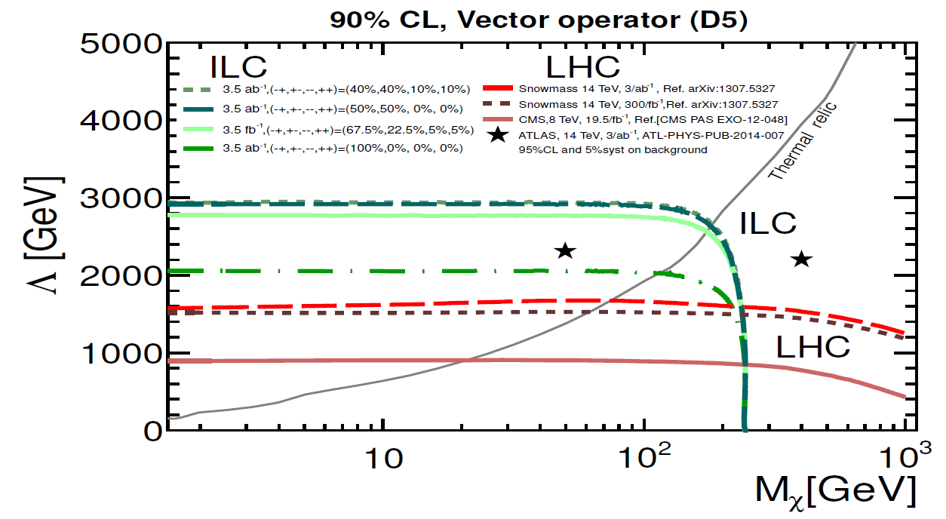
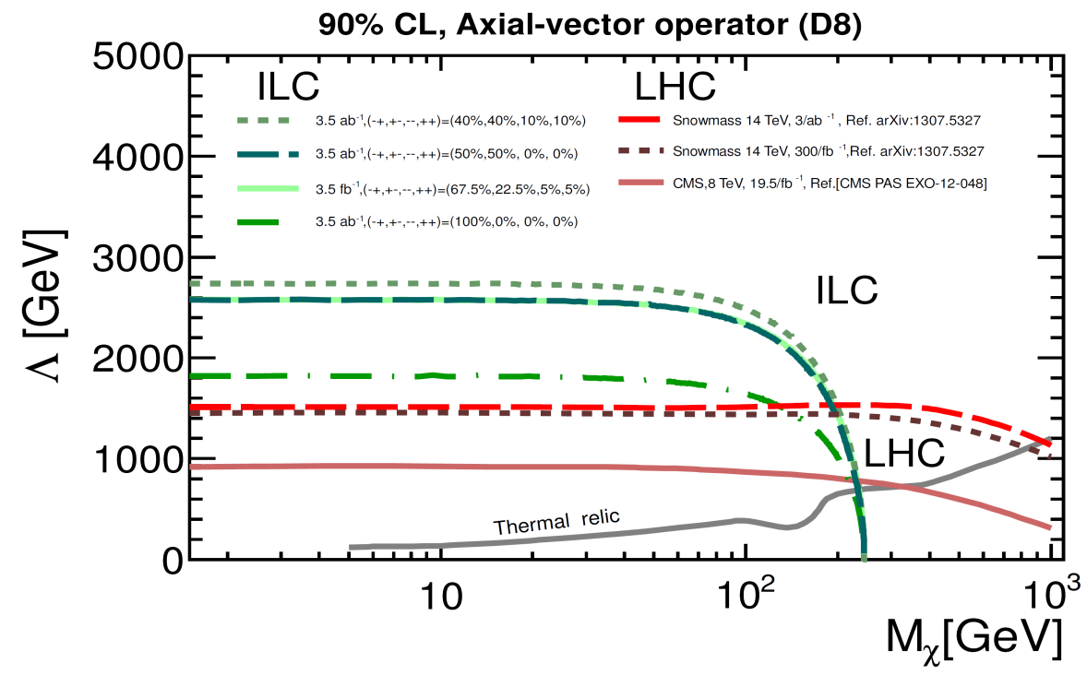
Comparison of ILC / LHC Projections
LHC/ILC Complementary:
LHC (ILC) limits assume pure
coupling to hadrons (leptons),
respectively
ILC can place limit on Λ up to ~3 TeV
Vector operator (« spin
independent »), Sχ =1/2
Axial-vector operator (« spin dependent »), Sχ =1/2
ILC results are presented for L=3.5 ab⁻¹,assuming luminosity sharing between different polarization configurations

Slide 17
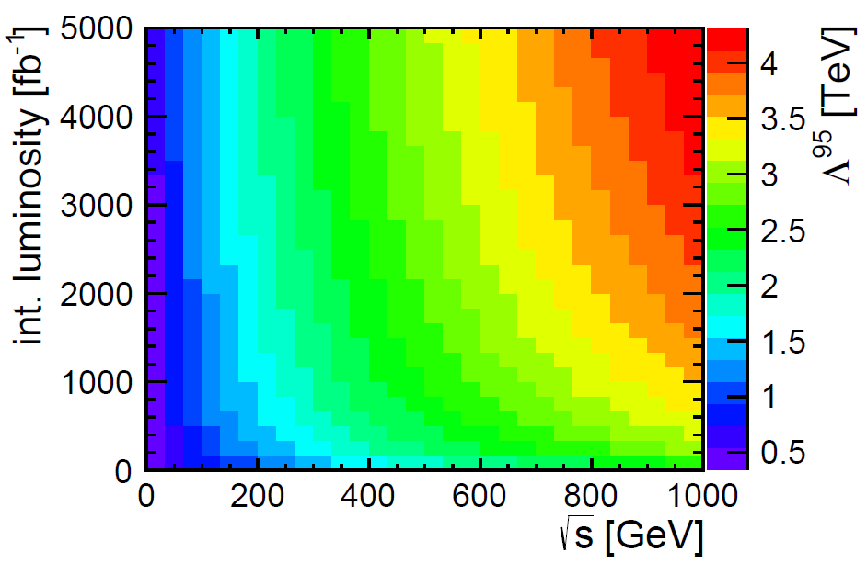
Extrapolation of the ILC Exclusion Limits
Using 90% CL exclusion reach for E = 500 GeV, L = 3.5 ab⁻¹, Mχ = 10 GeV for vector operator and assuming split of luminosity running (LR=40%,RL=40%,LL=10%,RR=10%)
→ extrapolate exclusion limit (Λ⁹⁰) as the function of integrated luminosity and
ILC center-of-mass energy
90
Working point
in the current analysis
Moritz Habermehl (DESY)

Slide 18
Summary and Outlook
ILC provides orthogonal and independent information, by probing WIMP-lepton interaction, regardless whether LHC discovers or excludes dark matter candidates:
→cosmological approach: annihilation fractions of 0.3-1% sufficient to observe WIMPs
→ operator approach: reach up to 2 - 3 TeV for sqrt(s) = 500 GeV
The power of having both beams polarized demonstrated
→ Positron polarisation essential to determine type of operator
ILC
LHC

