Slide 1
Sensitivity analysis in burnup calculations with Monte Carlo
A. Bidaud et al.

Slide 2
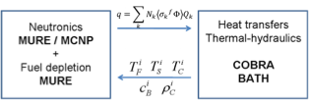
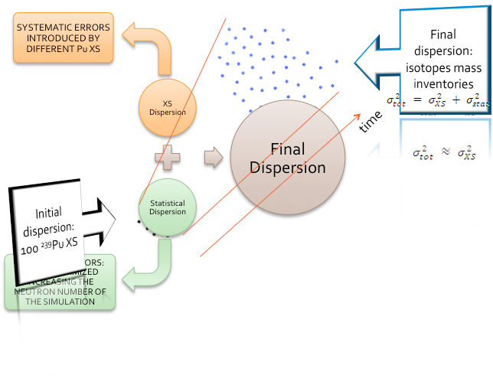
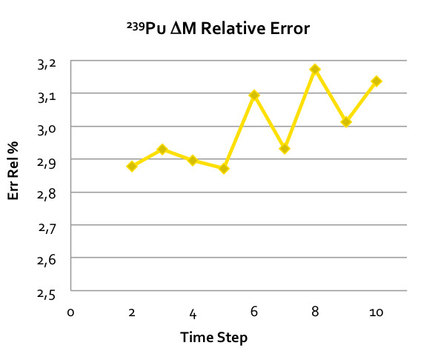
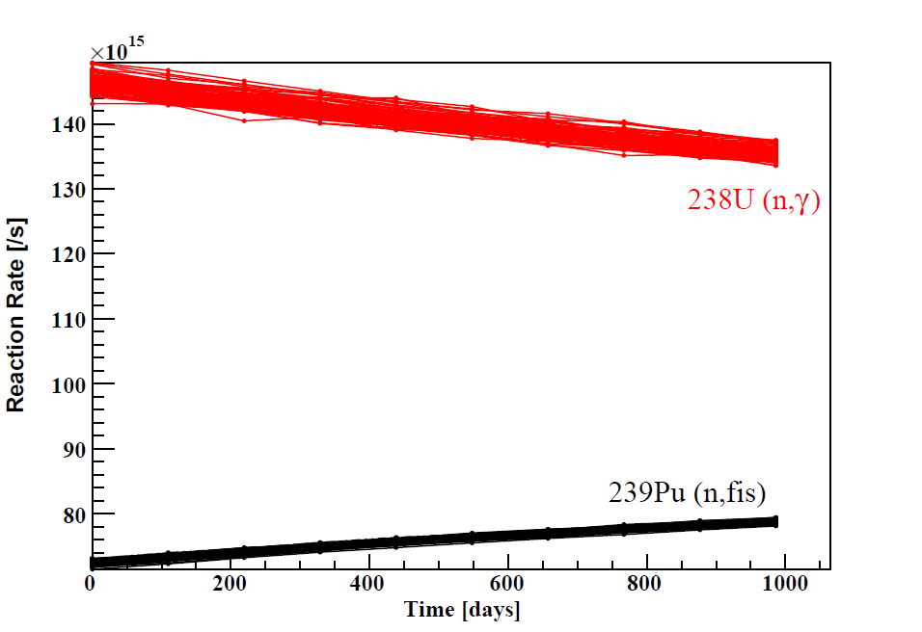
Total Monte Carlo Method

Slide 3
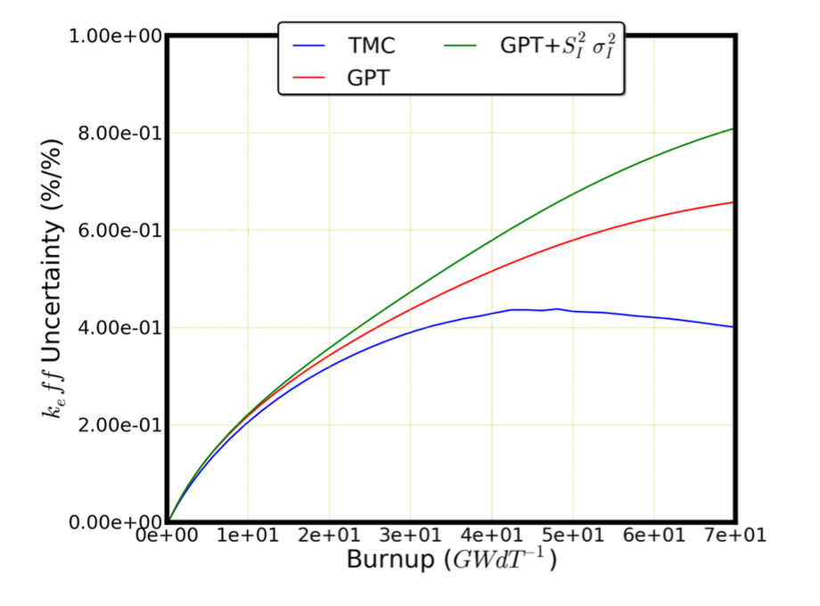
Uncertainty methods comparison
GPT + covariances
(deterministic ?)
Total Monte Carlo (MC ?)
Steady state calculations sensitivities
Rare but for keff (ex : SCALE/TSUNAMI3D) ! Potential 0+
Ex : DRAGON (thanks EDF funded PhD @ LPSC) !
CASMO (M. Pusa @ VTT), ERANOS… !
SERPENT (THX Manuele)
Steady state calculations uncertainties
Potential +++ ! Potential ++ (limited by stats)
Evolution calculations sensitivities
Potential +++ ! Potential 0+
Fully coupled Nuclide/neutron (Almost never done) !
!
Evolution calculations uncertainties
Potential +++ ! Potential ++(limited by stats)
Practical 0 ! Practical ++
Keff uncertaintyfrom Pu239 ND uncertainties
P. Sabouri et al. Nuclear Data Sheets. Volume 118, April 2014, Pages 523–526

Slide 4
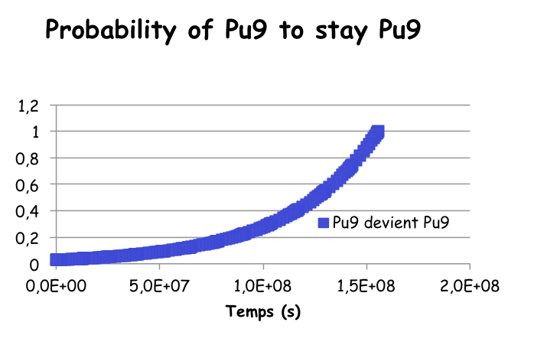
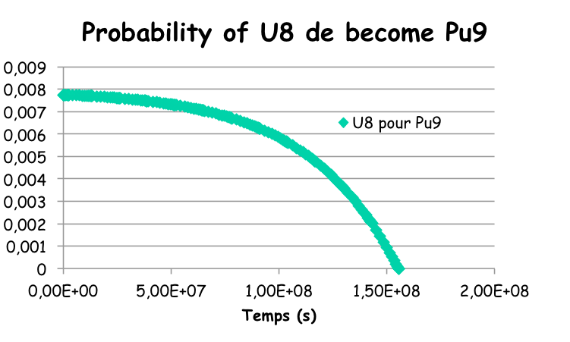
Meeting with the stars
Direct BU equation
A constant matrix over time intervals integrating ΣΦ calculated with constant flux (but renormalized for constant power at time intervals
Be N*(t) = the probability for nucleus N_{i t}dto become a target nucleus at t=t_{final}
Burn up equation with inverted time arrow

Slide 5
Comparison of Adjoint method with direct calculations
Final quantities can be related to initial quantities
Direct vs Perturbation (PWR UOX Geometry) :
Application = Finding the origin of used fuel nuclides
 | 233U | 234U | 235U | 236U | 238U | 237Np | 238Np | 239Np | 236Pu | 237Pu | 238Pu | 239Pu | 240Pu | 241Pu | 242Pu | 241Am | 242Am* | 243Am | 243Cm | 244Cm | 245Cm
U235 | 0,83 | 0,81 | 1,00 | 1,00 | 0,00 | 0,85 | 0,85 | 0,00 | 0,84 | 0,83 | 0,72 | 0,01 | 0,01 | 0,00 | 0,00 | 0,00 | 0,00 | 0,00 | 0,00 | 0,00 | 0,00
U238 | 0,17 | 0,19 | 0,00 | 0,00 | 1,00 | 0,15 | 0,15 | 1,00 | 0,16 | 0,17 | 0,28 | 0,99 | 0,99 | 1,00 | 1,00 | 1,00 | 1,00 | 1,00 | 1,00 | 1,00 | 1,00

Slide 6
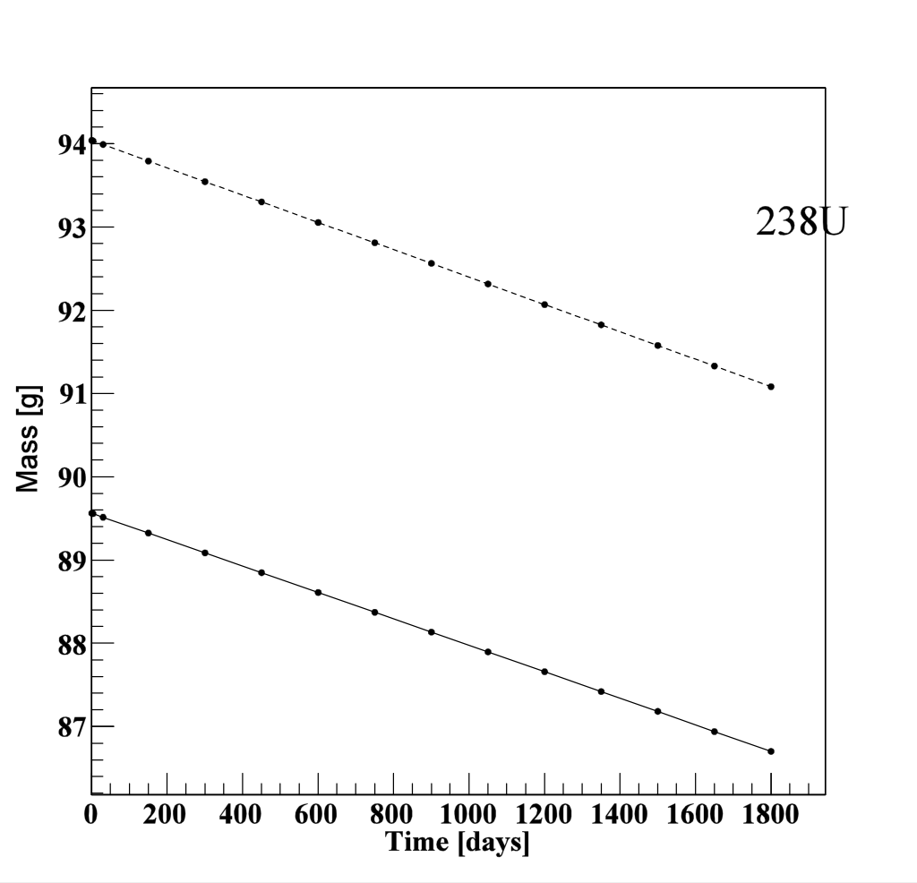
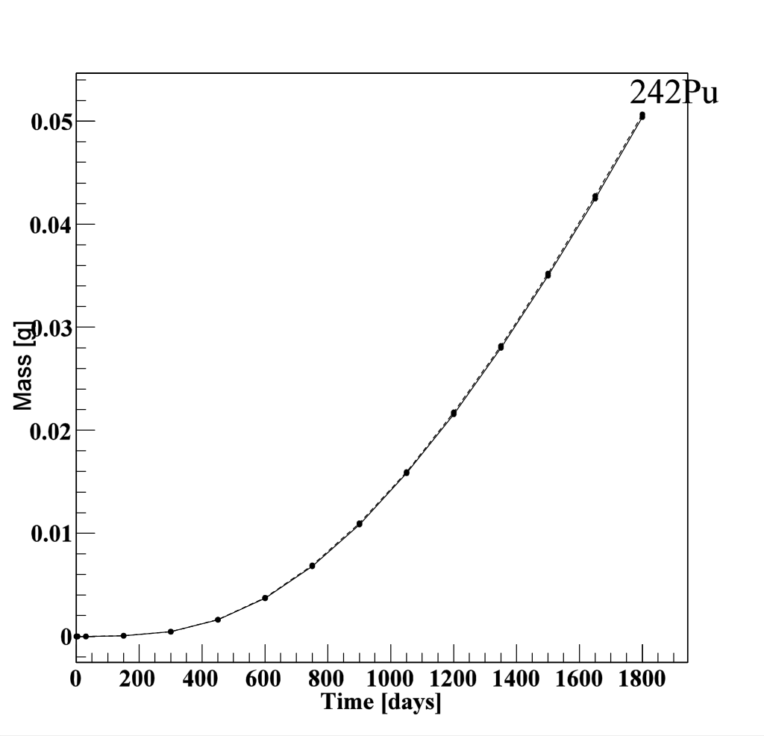
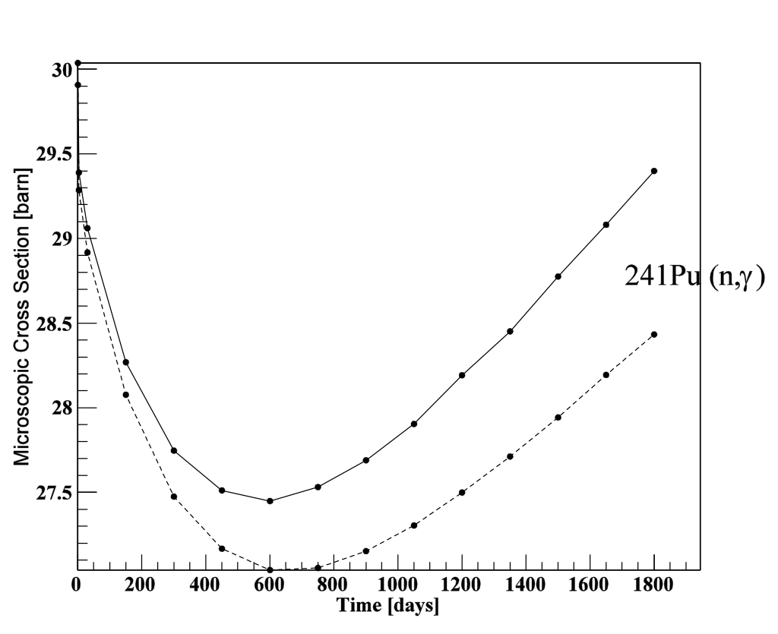
Sensitivities to initial conditions
 | GPT/MURE | GPT/DRAGON
233U | 6,80E-01 | 4,31E-01
234U | 1,22E+00 | 1,65E+00
235U | 1,89E-04 | 1,83E-04
236U | -3,08E-03 | -3,13E-03
238U | 9,90E-01 | 9,89E-01
237Np | 1,17E+00 | 2,41E+00
238Np | -7,66E-01 | -6,85E-01
239Np | 1,68E+00 | 1,66E+00
236Pu | 9,11E-01 | 2,21E+00
237Pu | 3,62E+00 | 9,82E-01
238Pu | 2,82E+00 | 5,30E+00
239Pu | 9,04E-01 | 9,16E-01
240Pu | 1,22E+00 | 1,26E+00
241Pu | 1,42E+00 | 1,41E+00
242Pu | 1,01E+01 | 1,09E+01
241Am | 1,16E+00 | 1,19E+00
242Am* | 9,93E-01 | 1,00E+00
243Am | 1,02E+01 | 9,81E+00
243Cm | 3,27E+00 | 3,11E+00
244Cm | 1,33E+02 | 3,86E+01
245Cm | 3,87E+00 | 3,56E+00
GPT vs direct (CI U8+1%)
OK for U8 and direct daughters (U8, Pu9, Am1)
Sensitivities >0,1 are bolded
NOT a statistical effect (cf Dragon)
Pu241 Daughters catastrophy
Spectral changes change everything

Slide 7
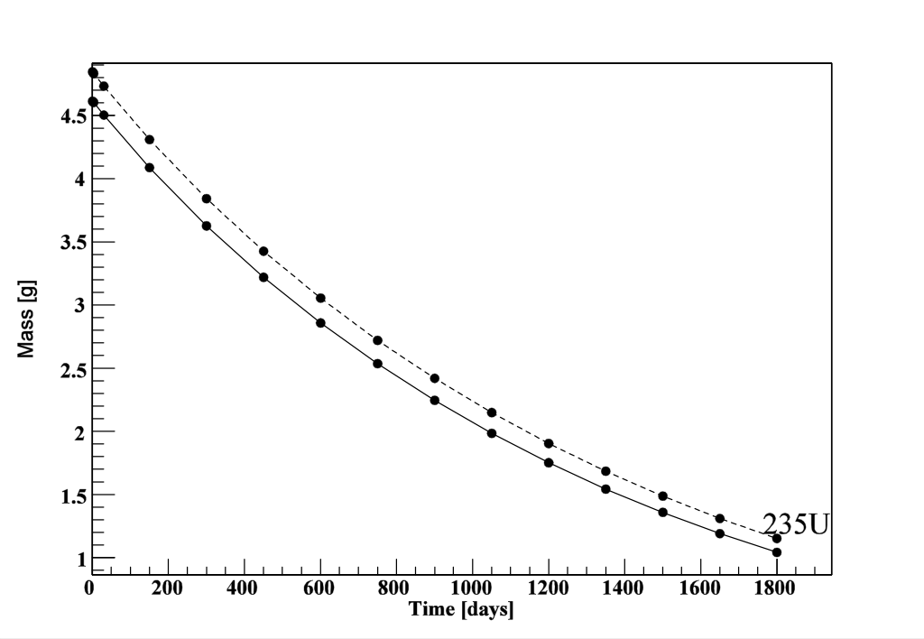
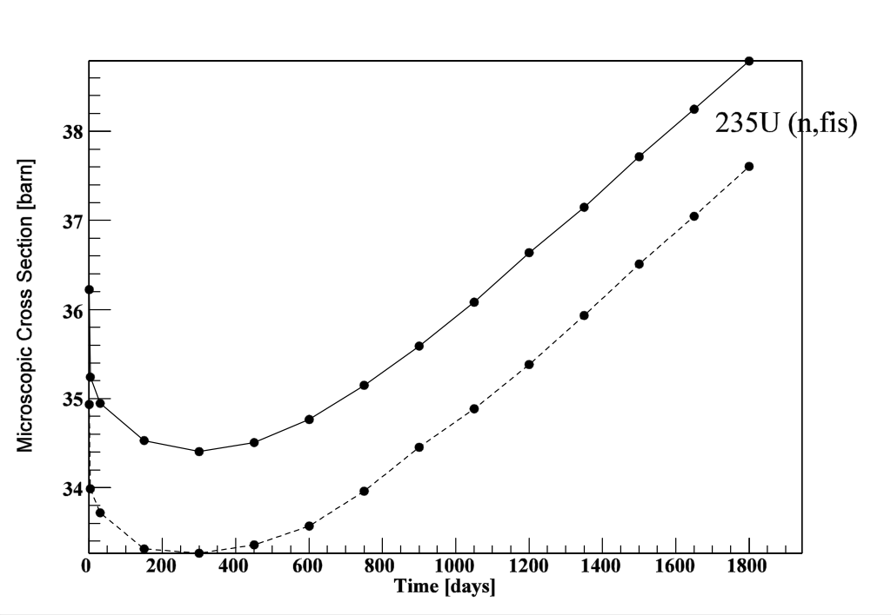
U235 catastrophy
Ratio GPT/Direct
 | GPT/MURE | GPT/DRAGON
233U | 1,28E+00 | 5,06E-01
234U | 9,33E-01 | 8,71E-01
235U | 4,73E-01 | 4,83E-01
236U | 1,16E+00 | 1,16E+00
238U | 2,34E-03 | 3,86E-03
237Np | 1,72E+00 | 1,38E+00
238Np | 6,45E+00 | 2,68E+00
239Np | -6,92E-04 | -7,76E-04
236Pu | 1,98E+00 | 1,33E+00
237Pu | 2,34E+00 | 1,74E+00
238Pu | 3,64E+00 | 1,94E+00
239Pu | 2,79E-02 | 2,49E-02
240Pu | -4,74E-02 | -4,69E-02
241Pu | 5,36E-02 | 2,82E-02
242Pu | -2,60E-03 | -2,79E-03
241Am | 1,26E-02 | 8,90E-03
242Am* | 6,17E-03 | 4,34E-03
243Am | -1,23E-03 | -1,48E-03
243Cm | -2,42E-03 | -2,71E-03
244Cm | -5,67E-04 | -6,67E-04
245Cm | -4,37E-04 | -6,99E-04
XS decreases by 3% if U235 increased by 5%

Slide 8
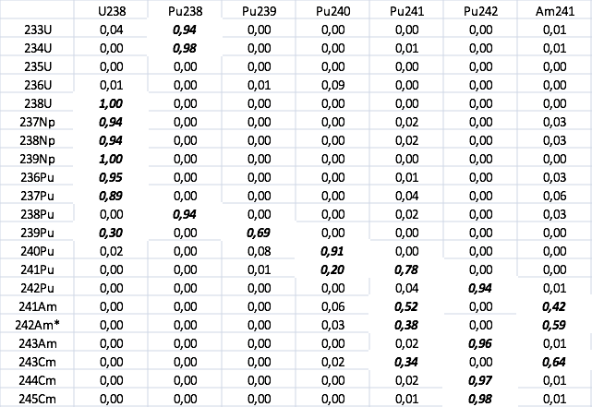
Is it better in fast spectrum ?
XS believed to be less inventory dependent
MOX fuel, breeder in infinite lattice geometries
Globaly : weak sensitivities because breeder with divertified initial fuel (many isotopes).

Slide 9
Intial fuel sensitivities in SFR - Na
 | u8 | pu9 | pu0 | PU1 | Pu2 | am241
233U | -3,19E+00 | -1,70E+03 | -7,54E+02 | -5,01E+01 | -7,11E+05 | -2,96E+01
234U | 3,04E+01 | 2,71E+02 | 4,86E+01 | 4,89E+00 | 4,98E+03 | 7,58E-01
235U | 1,09E+02 | 6,76E+01 | 5,07E+04 | 8,24E+03 | 3,15E+06 | 4,74E+01
236U | -2,67E+01 | -9,84E+01 | 1,90E-01 | -3,19E+04 | -1,20E+04 | -1,56E+02
238U | 1,01E+00 | 2,07E+09 | 9,36E+06 | 2,94E+06 | 8,42E+03 | 2,14E+05
237Np | 8,63E-01 | -3,17E+03 | -1,95E+01 | -4,86E+00 | -1,09E+05 | -3,71E+00
238Np | 5,33E-01 | -9,50E+03 | -5,50E+01 | -1,42E+01 | -1,51E+05 | -3,67E+00
239Np | 7,26E-01 | -2,03E+09 | -7,26E+06 | -8,09E+05 | -3,07E+03 | 2,49E+04
236Pu | 6,96E-01 | -1,26E+04 | -6,78E+01 | -1,58E+01 | -4,69E+05 | -9,89E+00
237Pu | 4,03E-01 | -1,30E+04 | -6,00E+01 | -8,94E+00 | -5,29E+04 | -4,33E+00
238Pu | 1,09E+01 | 1,53E+02 | 1,23E+01 | 2,08E+00 | 1,45E+03 | 7,44E-01
239Pu | 8,98E-01 | 9,23E-01 | -7,09E+03 | -5,73E+02 | -1,06E+03 | 3,23E+00
240Pu | 6,99E-02 | 7,35E-01 | 9,96E-01 | -8,18E+01 | -1,69E+01 | -1,33E+02
241Pu | 4,11E+00 | 4,87E+00 | 1,00E+00 | 1,01E+00 | 1,07E+01 | 1,89E+02
242Pu | 6,23E+02 | 1,56E+02 | 1,46E+00 | 9,67E-01 | 1,02E+00 | 1,72E-01
241Am | 2,18E+02 | 6,22E+01 | 1,27E+00 | 1,06E+00 | 1,40E+02 | 1,00E+00
242Am* | -3,39E+03 | -6,97E+02 | -1,64E+00 | 6,78E-01 | -1,26E+03 | 9,95E-01
243Am | -7,84E+04 | -1,64E+04 | -5,60E+01 | -5,63E+00 | 9,88E-01 | -1,63E-01
243Cm | -1,78E+04 | -2,72E+03 | -8,68E+00 | 4,19E-02 | -2,58E+02 | 9,77E-01
244Cm | -4,72E+05 | -8,32E+04 | -2,35E+02 | -1,94E+01 | 9,56E-01 | -5,91E-01
245Cm | -1,63E+06 | -2,42E+05 | -5,83E+02 | -4,00E+01 | 9,33E-01 | -1,27E+00

Slide 10
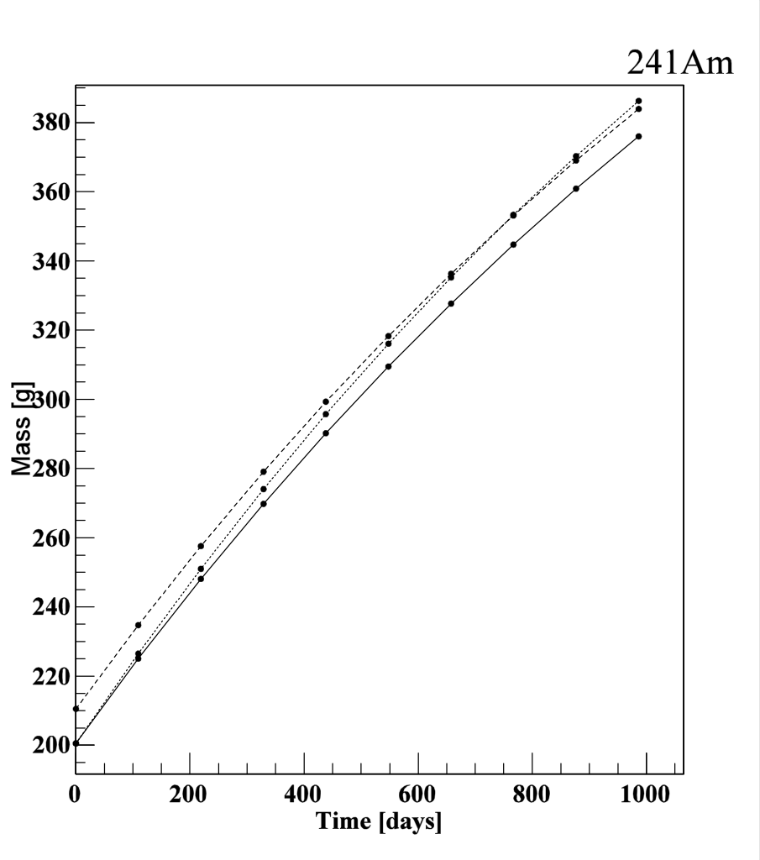
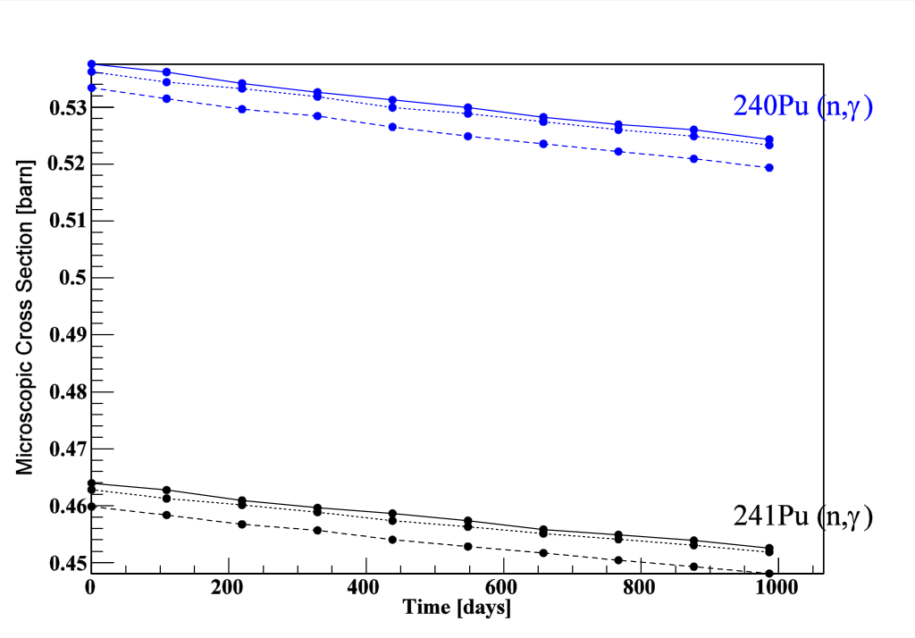
Exemple of accident : Cm243 from Pu241
XS decreases by 0,15 when Pu 241 increases by 1

Slide 11
Conclusions
Scientific evidence : coupling neutron and nuclide field is mandatory (even in fast spectrum)
Tools available :
Burn up equation GPT is available in MureGui
Generalysed ND static sensitivities of SERPENT (thanks Manuele)
Jan Hajnrych starting M2 thesis = coupling SERPENT & MURE
Next Scientific challenges ?
Real ND are correlated, Real life reactors are not made of 1 assembly at 1 temperature : Keff = 1 (for sure), thermohydraulics do make strong feedbacks, fuel is shuffled.
Are these facts decreasing or increasing ND impact ?
More interdisciplinarity is needed
More collaborations toward fully coupled codes WITH uncertainty calculations

Slide 12
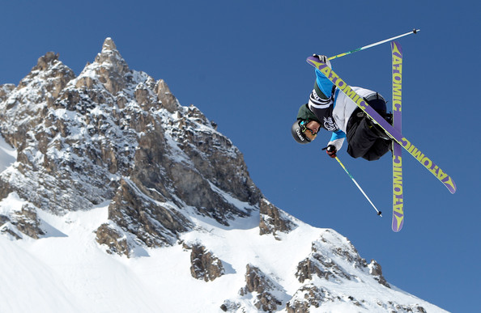
Thank you
Looking forward to seeing you soon
closer from the stars
Or on skis
Or with skis in the sky

