Slide 1
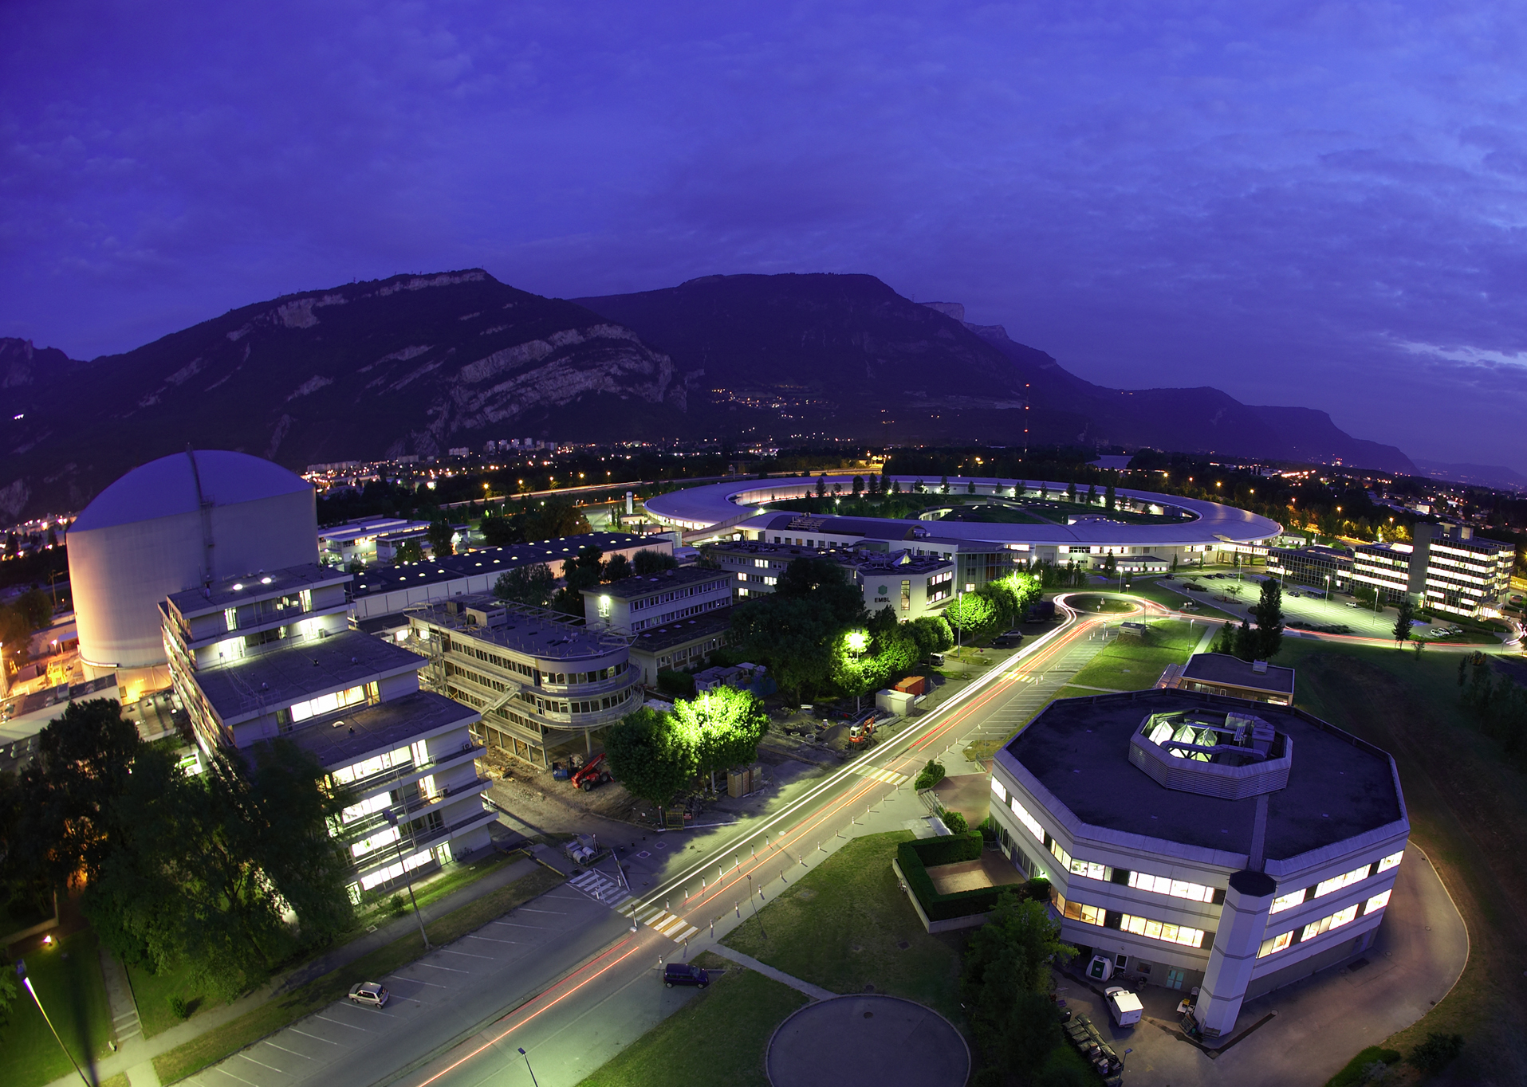

Probing Dark energy with neutrons
Guillaume Pignol
Habilitation à diriger les recherches,
13 May 2015

Slide 2

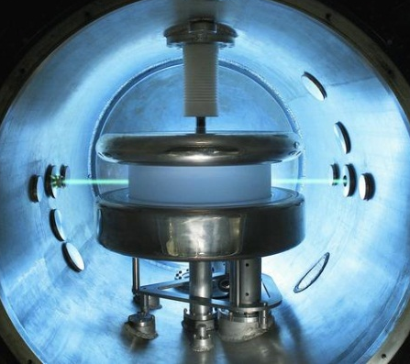
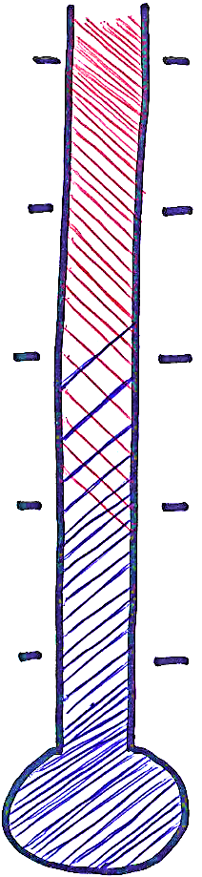
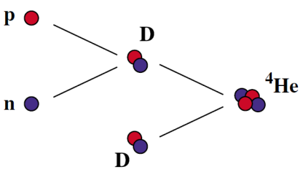
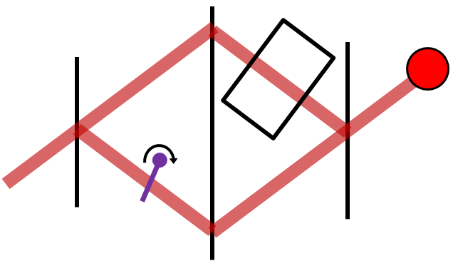
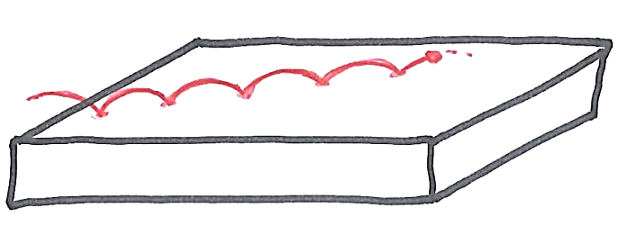
neutrons and the Universe
10¹⁵ GeV
Inflation ends?
Search for the neutron electric dipole moment to explain the matter-antimatter asymmetry
Baryogenesis
100 GeV
Electroweak
transition
1 MeV
Nucleosynthesis
Measuring the neutron lifetime to predict the primordial production of light elements
1 eV
Decoupling of CMB
neutron interferometry
bouncing neutrons
Dark energy
1 meV
Today

Slide 3
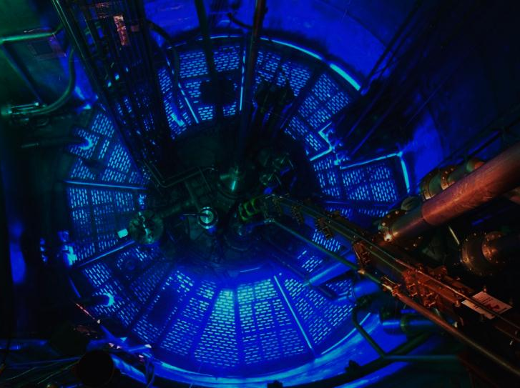
Outline
1 Neutrons, nucleosynthesis, baryogenesis
2 Dark Energy, the chameleon
3 Bouncing neutrons with GRANIT
4 Neutron interferometry experiment

Slide 4
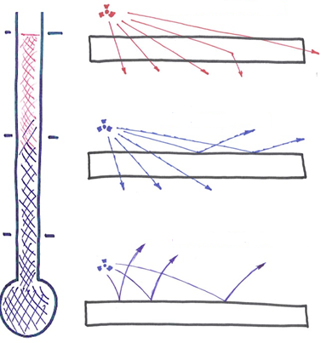
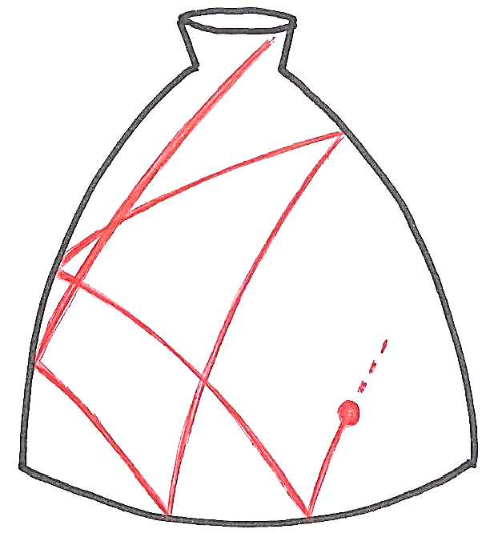
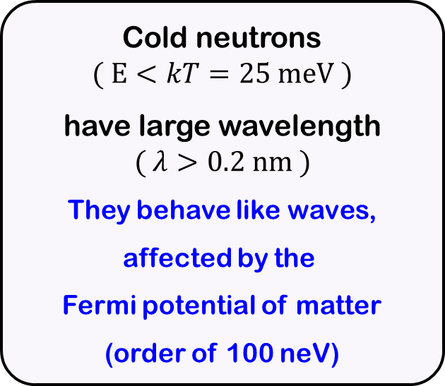
Neutron optics, cold and ultracold neutrons
Thermal neutrons
Cold neutrons
$$( E<kT=25 meV )$$
have large wavelength
$$( λ>0.2 nm )$$
They behave like waves,
affected by the
Fermi potential of matter
(order of 100 neV)
Cold neutrons
Ultracold neutrons
Neutrons with energy < 100 neV,
are reflected by material walls they can be stored in material bottles.

Slide 5
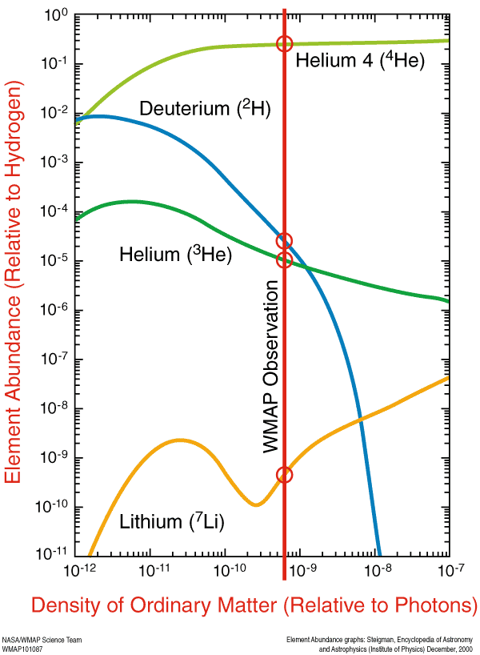
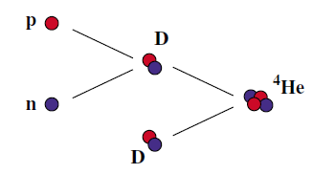
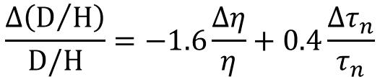


Big Bang nucleosynthesis
[Planck (2014)]
$$η_{CMB}=\left(6.05±0.07\right)×{10}^{−10}$$
[Deuterium abundance from Lyα, Cooke et al (2014)]
$$η_{BBN}=\left(6.0±0.1\right)×{10}^{−10}$$
BBN calculations need to know the neutron lifetime:
$$\frac{Δ\left(D/H\right)}{D/H}=−1.6\frac{Δη}{η}+0.4\frac{Δτ_{n}}{τ_{n}}$$

Slide 6
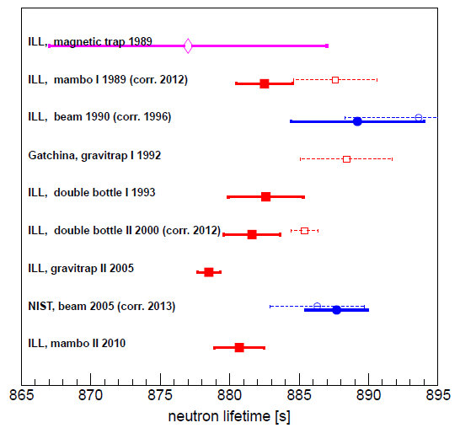
Current status on the neutron lifetime
The 2015 situation
There is a 3.8 σ discrepancy
between the bottle method combination and the beam method combination.
To be continued…

Slide 7
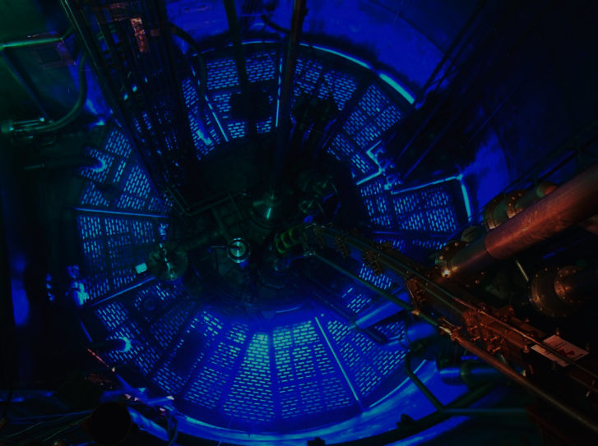
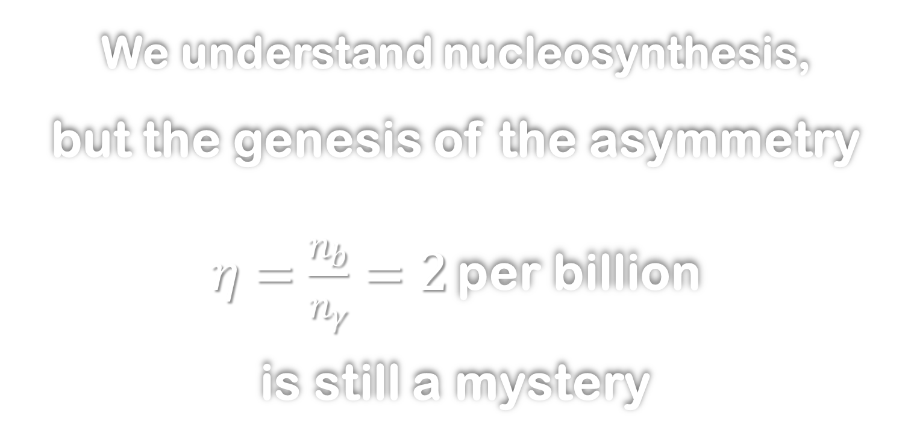
We understand nucleosynthesis, but the genesis of the asymmetry $η=\frac{n_{b}}{n_{γ}}=2$per billion is still a mystery

Slide 8

Baryogenesis: three Shakarov conditions
1 Departure from thermal equilibrium
at the electroweak phase transition?
2 Violation of B conservation
ok with SM sphaleron transitions
3 CP violation
requires new physics beyond the electroweak scale,
accessible by the next generation of EDM experiments

Slide 9
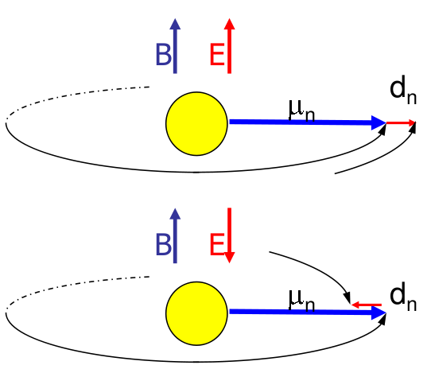
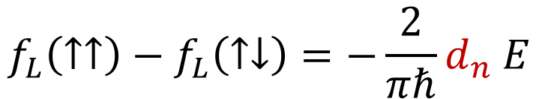
Principle of the nEDM measurement
$$\hat{H}=−μ_{n} B {\hat{σ}}_{z}−d_{n} E{ \hat{σ}}_{z}=πℏ f_{L}{ \hat{σ}}_{z}$$
$$f_{L}\left(↑↑\right)−f_{L}\left(↑↓\right)=−\frac{2}{πℏ}d_{n} E$$
A non-zero EDM violates T reversal
(thus violates CP symmetry)

Slide 10
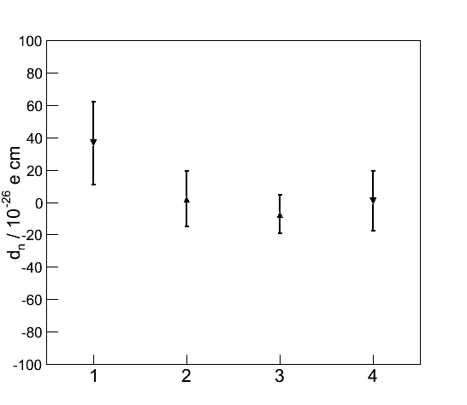

The running nEDM apparatus
Operated at ILL (1998-2004), providing the world limit
$$\left|d_{n}\right|<3×{10}^{−26} e cm (90\%CL)$$
data taking at the PSI UCN source since 2012
2014 data
(30 days, 4 datasets)
Electric field 150 kV / 12 cm
Shielded magnetic environment
Homogeneity < 10⁻³
Time stability < 10⁻⁶
B₀ = 1 µT

Slide 11
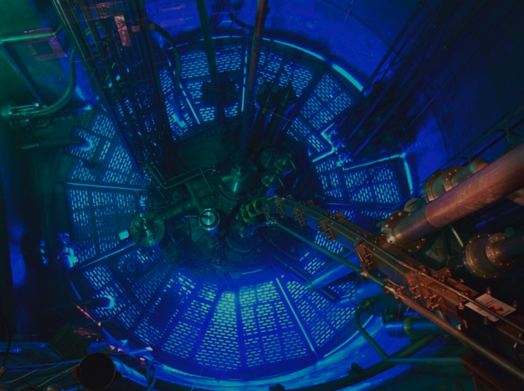
Energy budget of the Universe in ΛCDM
5 % normal baryonic matter
created by baryogenesis
and nucleosynthesis
69 %
Dark
Energy
26% Dark Matter

Slide 12
1 Neutrons, nucleosynthesis, baryogenesis
2 Dark Energy, the chameleon
3 Bouncing neutrons with GRANIT
4 Neutron interferometry experiment

Slide 13
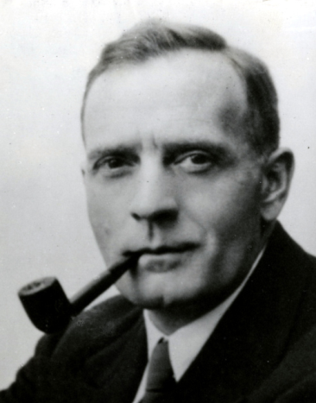
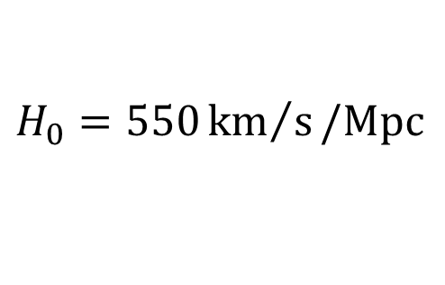
The expansion of the Universe
The Hubble law:
velocity = H₀ x distance
E. Hubble 1929
$$H_{0}=550{km}/s/Mpc$$

Slide 14
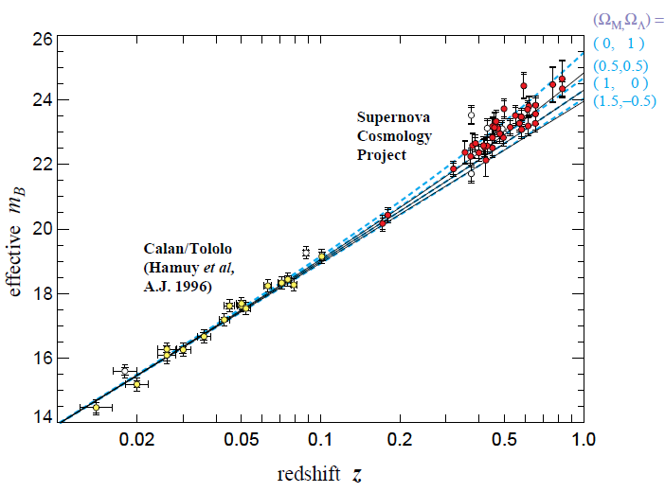
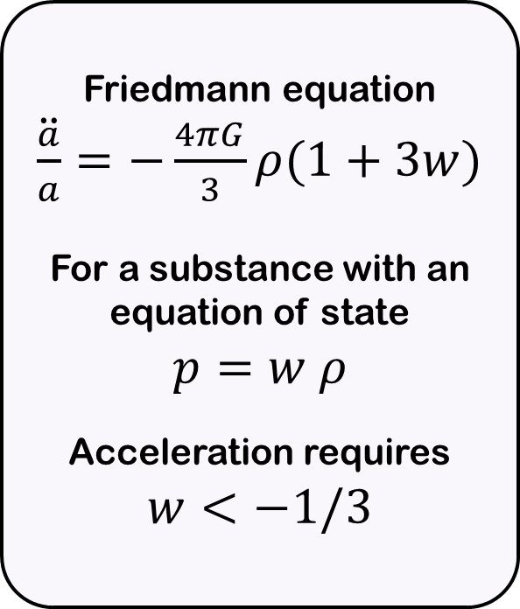
The expansion accelerates
Friedmann equation
$\ddot{\frac{a}{a}}=−\frac{4πG}{3}ρ(1+3w)$
For a substance with an equation of state
$$p=w ρ$$
Acceleration requires
$$w<−1/3$$
S. Perlmuter et al (1999)
+ A. Riess et al (1998)

Slide 15
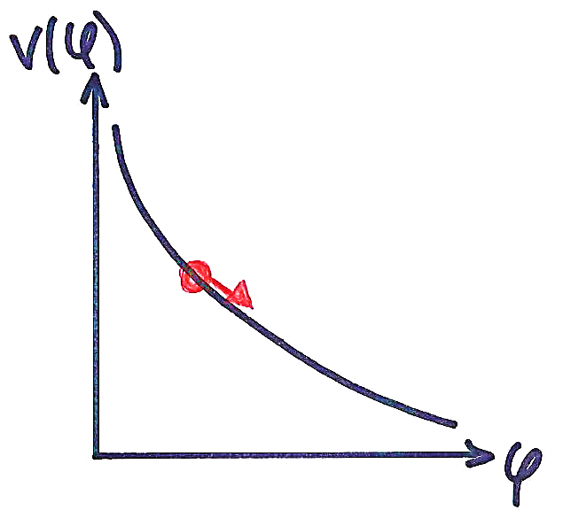
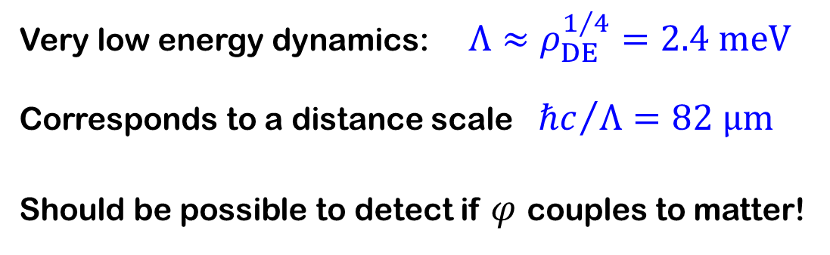

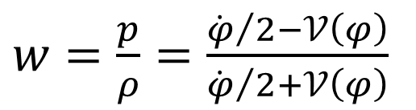
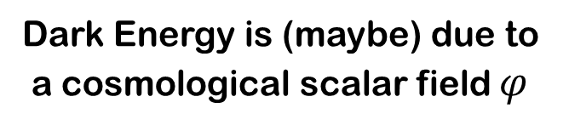

Quintessence as Dark Energy
Ratra-Peebles potential
Dark Energy is (maybe) due to a cosmological scalar field $φ$
$$𝒱\left(φ\right)=\frac{Λ^{4+n }}{φ^{n}}$$
$$\ddot{φ}+3H\dot{φ }+𝒱^{′}\left(φ\right)=0$$
$w=\frac{p}{ρ}=\frac{{\dot{φ}}/2−𝒱\left(φ\right)}{{\dot{φ}}/2+𝒱\left(φ\right)}$
Very low energy dynamics: $Λ≈ρ_{\left.DE\right.}^{1/4}=2.4 meV$
Corresponds to a distance scale ${ℏc}/Λ=82 μm$
Should be possible to detect if $φ$ couples to matter!

Slide 16
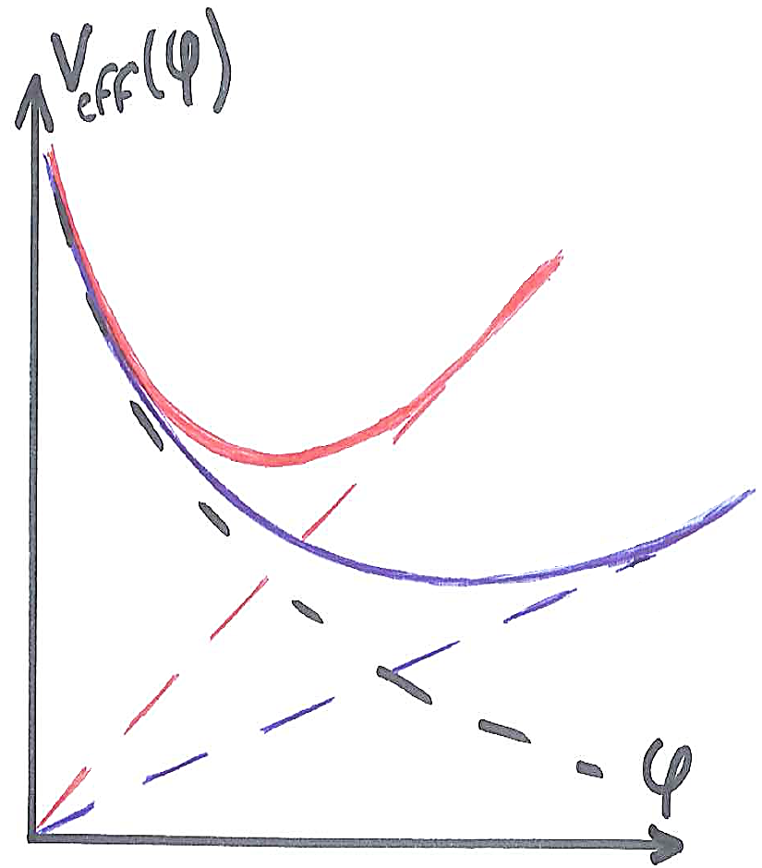

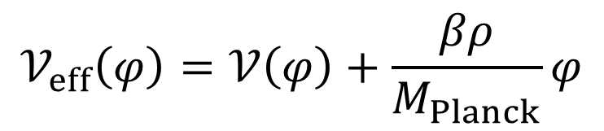

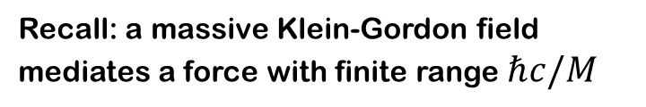
The Khoury-Weltman mechanism
A way to reconcile
gravity tests and cosmology
Recall: a massive Klein-Gordon field
mediates a force with finite range $ℏc/M$
[Khoury & Weltman PRD 69 (2004)]
$$𝒱_{KG}\left(φ\right)=M^{2}{ φ}^{2}$$
High density environment,
high effective mass
Quintessence field coupled with matter:
$$𝒱_{eff}\left(φ\right)=𝒱\left(φ\right)+\frac{βρ}{M_{Planck}}φ$$
Low density environment,
low effective mass

Slide 17

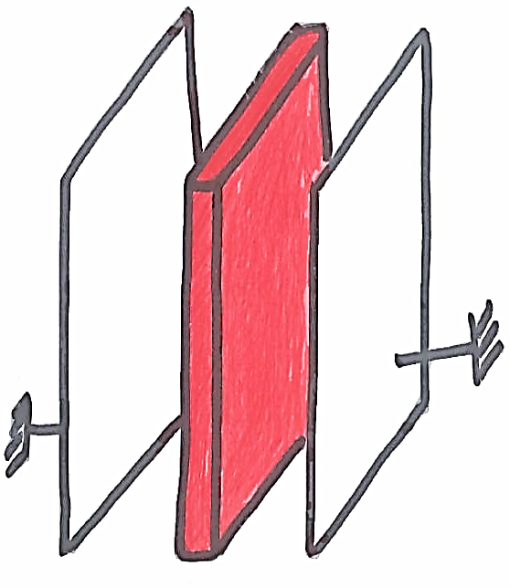
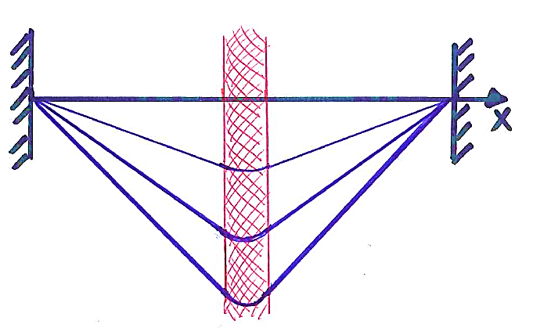



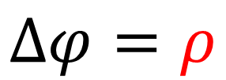
Understanding the chameleon mechanism
Poisson equation for the electric potential
Plate with charge density $ρ$
$$Δφ=ρ$$
$$φ$$
ρ small
ρ large
Electric field $dφ/dx$proportional to $ρ$

Slide 18
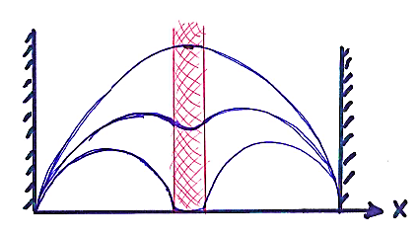

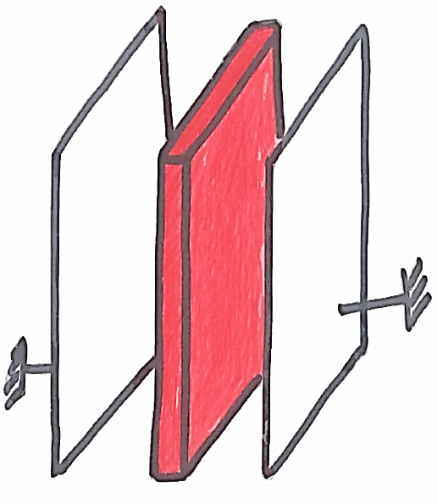

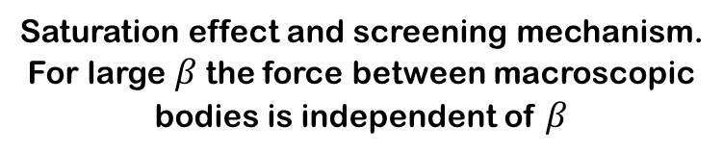
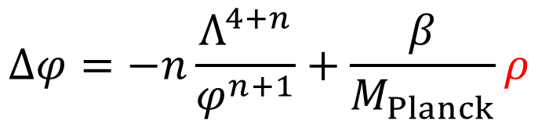

Understanding the chameleon mechanism
Nonlinear equation for the chameleon field
$$Δφ=−n\frac{Λ^{4+n}}{φ^{n+1}}+\frac{β}{M_{Planck}}ρ$$
$$φ$$
Plate with mass density $ρ$
ρ = 0
Large ρ
Saturation effect and screening mechanism.
For large $β$the force between macroscopic bodies is independent of $β$

Slide 19
1 Neutrons, nucleosynthesis, baryogenesis
2 Dark Energy, the chameleon
3 Bouncing neutrons with GRANIT
4 Neutron interferometry experiment

Slide 20
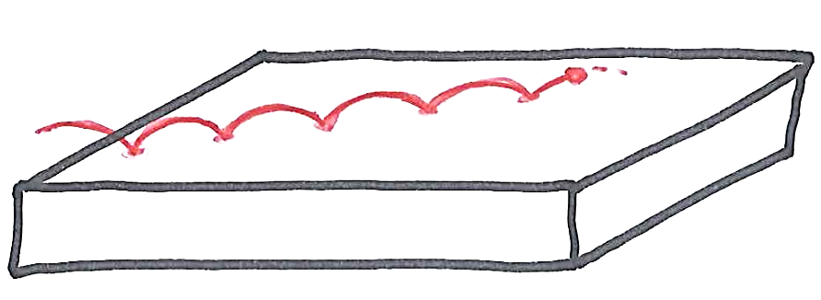
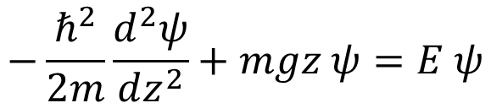
Bouncing neutrons: quantum states
Neutrons with energy < 100 neV
can bounce above a glass mirror.
m g z
Vertical energy (peV)
The vertical motion is a simple quantum well problem
$$−\frac{ℏ^{2}}{2m}\frac{d^{2}ψ}{dz^{2}}+mgz ψ=E ψ$$
Height (µm)

Slide 21
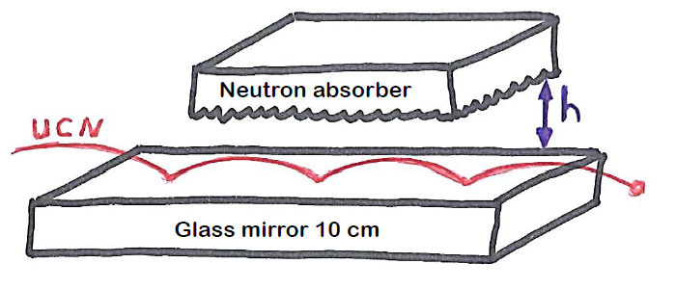
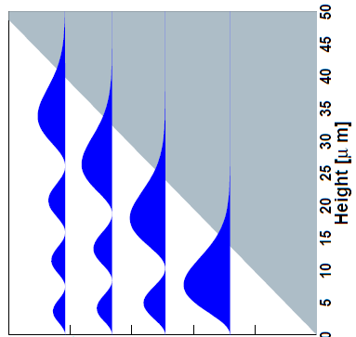
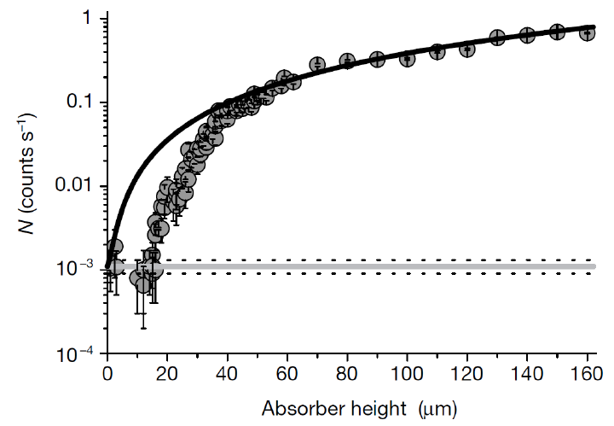
Discovery of the quantum states at ILL Grenoble
Nesvizhevsky et al
Nature 415 (2002)

Slide 22





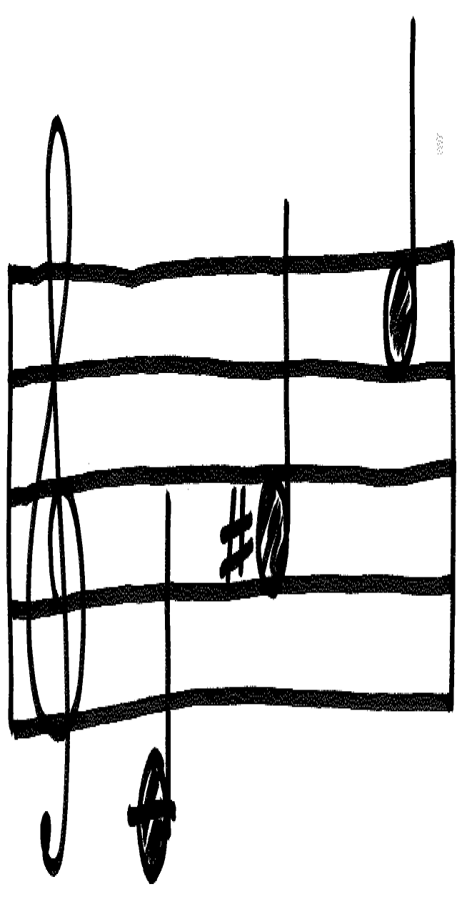
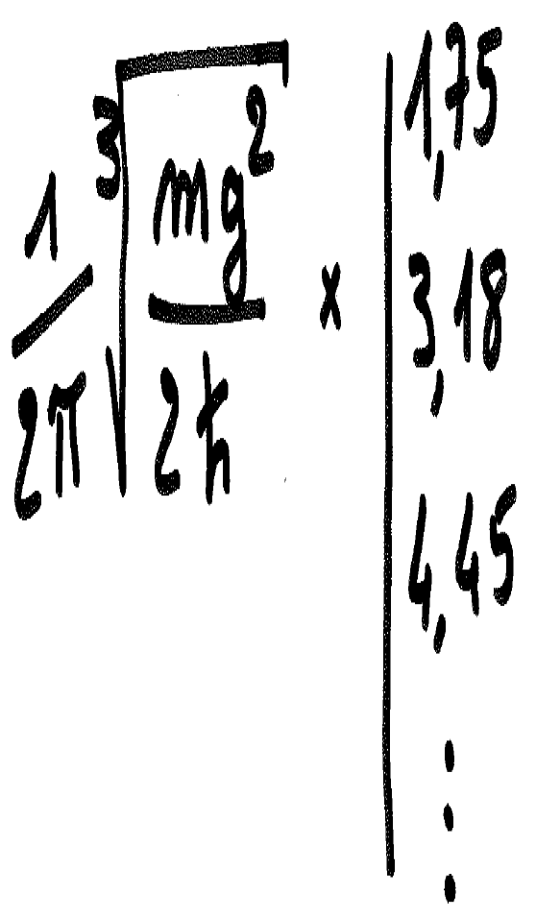
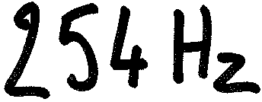
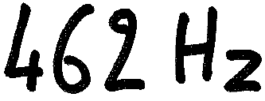
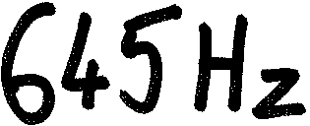

Bouncing neutron: quantum music
$$ΔE=h×f$$

Slide 23
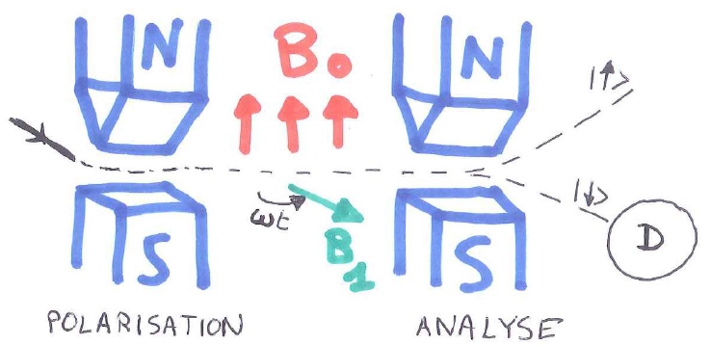





Gravity resonance spectroscopy
Rabi experiment (1939)
Rabi formula
$$P_{2→1}=\frac{\sin^{2}\left(\sqrt{δω^{2}+Ω^{2}} t/2\right)}{1+{δω^{2}/Ω}^{2}}$$
State selection
?
Excitation ${\hat{V}}_{0}cos(ωt)$
$$Ω= \left\langle 2 | \hat{V_{0}} | 1\right\rangle /ℏ$$
D

Slide 24




How to excite resonant transitions?
Mirror vibrations$h\left(t\right)$
$\hat{V}\left(t\right)=−\frac{dh}{dt} \hat{p_{z}}$
2) Magnetic excitation
$$\hat{V}\left(t\right)= ± μ \left|B\right|\left(t\right)≈ ± μ\frac{d\left|B\right|}{dz}\left(t\right) \hat{z}$$

Slide 25

Resonant transitions in GRANIT
step
Magnetic excitation
FILTER
Detector
Mirror 25 cm x 30 cm
simulation

Slide 26

The GRANIT instrument at ILL level C
First UCNs in GRANIT in 2013.
Producing UCNs is a delicate art.
We are getting ready for measuring something interesting…

Slide 27




Searching for a fifth force
Consequences for
the quantum states
Squeezing of the wave functions
Dilatation of the energy spectrum
$$mgz+ ?$$
Vertical energy
Heigth
$$V\left(z\right)=mgz+β\frac{m}{M_{Planck}} φ(z)$$
Chameleon case:
Field profile above the mirror
$φ\left(z\right)=Λ{\left({Λz}/{ℏc}\right)}^{2/{2+n}}$

Slide 28

Bouncing neutron sensitivity to the chameleon

Slide 29
1 Neutrons, nucleosynthesis, baryogenesis
2 Dark Energy, the chameleon
3 Bouncing neutrons with GRANIT
4 Neutron interferometry experiment

Slide 30



Principle of neutron interferometry 1
interferogram

Slide 31



Principle of neutron interferometry 2
$$ξ=−\frac{m}{kℏ^{2}}\int{V\left(x\right) dx}$$
Phase shift due to the sample:
$$V\left(x\right)=β\frac{m}{M_{Planck}}φ(x)$$
neutron potential in a chameleon field:

Slide 32








The chameleon cell
Idea:
the chameleon field in a cell
exists only in vacuum,
it is suppressed
by a small amount of gas
(here helium)
We plot the transverse field profile $φ(y,z)/Λ$
$$p={10}^{−2}mbar$$
$$p={10}^{−3}mbar$$
$$vacuum$$
Numerical solution of the chameleon equation for $n=1$and $β=5×{10}^{7}$

Slide 33


The experiment at the S18 instrument (ILL)
Dedicated vacuum chamber built by the Atominstitut in Vienna
Hartmut Lemmel

Slide 34

Results
We have measured the field profile,
by moving the vacuum cell,
as a function of the
helium pressure

Slide 35

Results

Slide 36


Breaking news
Phys. Lett. B 743, 310 (2015)
Preprint arXiv:1502.03888

Slide 37
The end
10¹⁵ GeV
GUT epoch
100 GeV
Electroweak
transition
1 MeV
nucleosythesis
1 eV
1 meV
Today

