Slide 1
Report from ICFA neutrino panel
D. Duchesneau
June 6th 2016
The Third International Meeting for Large Neutrino Infrastructures
Agenda:
https://kds.kek.jp/indico/event/20176/other-view?view=standard#20160530.detailed
organized by KEK, ICRR, Fermilab, the Astroparticle Physics European Consortium (APPEC), the ICFA Neutrino Panel, the IUPAP Astroparticle Physics International Committee (APPIC) and several worldwide funding agencies
took place at KEK on the 30th and 31st of May 2016

Slide 2
ICFA Neutrino Panel:
Roadmap discussion document
Excerpts from Ken Long’s talk at the KEK meeting on 30/05/16

Slide 3
Contents
The Panel and its mission
Roadmap discussion document
Next steps

Slide 4
The Panel and its mission
ICFA nuPanel: roadmap discussion document
http://icfa.fnal.gov/panels/neutrino_panel/

Slide 5

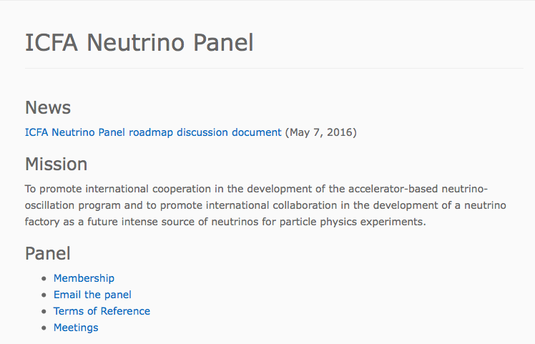

http://icfa.fnal.gov/panels/neutrino_panel/

Slide 6
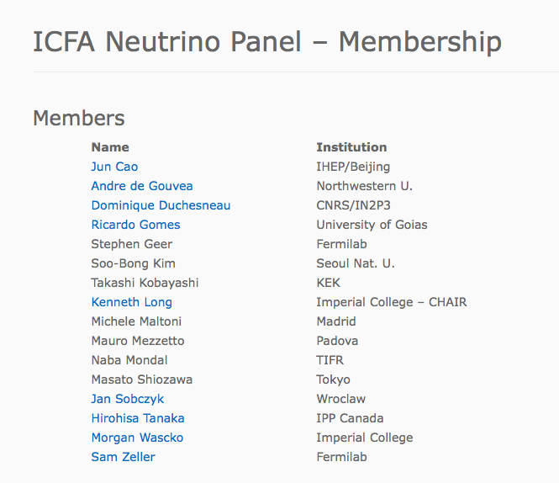
Asia: 5
Americas: 5
Europe: 5
+ chairman

Slide 7
Roadmap discussion document
The terms of reference for the ICFA Neutrino Panel require the Panel to develop a roadmap for the
accelerator-based neutrino-oscillation programme.
ICFA nuPanel: roadmap discussion document
Version May 7th, 2016

Slide 8
http://icfa.fnal.gov/wp-content/uploads/2016-05-07-nuPanel-roadmap-Final.pdf
https://kds.kek.jp/indico/event/20176/material/0/

Slide 9
Discussion document
Documents:
  Approved objectives for experiments in operation
  Approval, construction/exploitation timeline for experiments under consideration
  Proposed timeline for experiments not yet under consideration
Evaluation:
  Evolution of precision of SvM mixing parameters
Panel derived interim:
  Branch points based on evolution of precision
  Recommendations on development of programme

Slide 11
Roadmap goals
Vibrant programme must:
  Have discovery potential & deliver critical measurements in the short and medium term:
    Present and next-generation experiments
    Implies parallel theory and phenomenology programmes
  Develop the capabilities required to out-perform the present and next-generation experiments:
    Implies detector and accelerator R&D programmes

Slide 12
Accelerator-based neutrino community
Complete, consistent census unavailable
Panel assembled partial information:
  Europe:
    ECFA census of European particle-physics community 2009
  The Americas:
    Number of researchers involved in FNAL-based neutrino experiments
    Canadian survey of particle-physics community prepared during 2015 long-range planning exercise
  Asia:
    Asian panel members conducted an ad hoc “mini survey” of the accelerator-based neutrino community

Slide 13
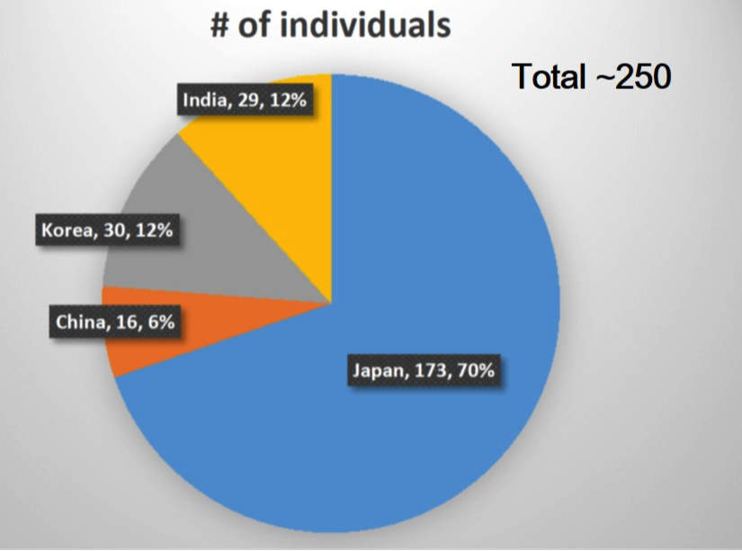
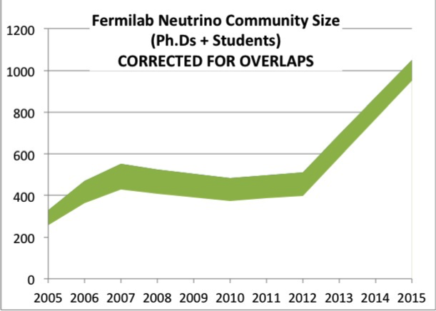
Accelerator-based neutrino community
Asia:
Europe, 2009 ECFA survey:
  Of particle physics community:
    10% (1000) involved in neutrino experiments;
    Of these, 40% (400) involved in accelerator-based programme
Americas:
  Canada, 2015 survey:
    105 involved in neutrino expts
    35 involved in accelerator-based programme

Slide 15
Accelerator-based LBL nu-oscillation programme

Slide 16
Synergy and complementarity
Running experiments:
  T2K & NOvA:
    Complementary: baseline, technology, beam
    Synergy: enhanced discovery potential in combination
Going forward:
  DUNE & Hyper-K:
    Yasuda-san: Complementary approaches, synergy in measurement
On the complementarity of Hyper-K and LBNF
ICFA Neutrino Panel; arXiv:1501.0391

Slide 17
Accelerator-based LBL nu-oscillation programme

Slide 18
Accelerator-based LBL nu-oscillation programme

Slide 19
Sterile-neutrino searches at accelerators

Slide 20
Sterile-neutrino searches at accelerators

Slide 21
Supporting programme
+
+
+
+
+
+ Collaboration lists taken from “parent” collaboration.

Slide 22
Supporting programme

Slide 23
Supporting programme

Slide 24
Supporting programme

Slide 25
Roadmap next steps
Consultation; starts today:
  With collaborations
    Collaborations have checked text
  With neutrino and particle-physics community;
    Mechanism to be defined
  With stakeholders:
    Laboratories and funding agencies
Census:
  Propose to execute through simple questionnaire:
    Adopt format similar to recent ECFA & ApPEC surveys
      Well trodden, successful path
  Data-gathering mechanism, to be defined

Slide 26
Roadmap next steps
Formal opportunities for presentation/feedback:
  Neutrino 2016:
    London, 4—9 July 2016
Finalise roadmap through autumn 2016:
  Propose:
    Deliver final roadmap document at Feb17 ICFA meeting
Beyond the ICFA Neutrino Panel:
  How to maintain and enhance what has been done?
  How to recognise breadth of field?
    Neutrino Panel mandate is accelerator-based programme

Slide 27
Backup
ICFA nuPanel: roadmap discussion document

Slide 28
Census
Propose to execute through simple questionnaire:
  Adopt format similar to recent ECFA & ApPEC surveys
    Well trodden, successful path
Proposed timetable:
  09Jul16: finalise questionnaire (Neutrino ’16)
  10Aug16: revise after stakeholder feedback (ICHEP ’16)
  Mid Sep16: launch data gathering
  Wk 1 Nov16: receive data form stakeholders
  Wk 1 Dec16: circulate digest of results to stakeholders
  End Dec16: finalise census section of roadmap doc

