Slide 1
Mass Hierarchy in LBL experiments

Slide 2
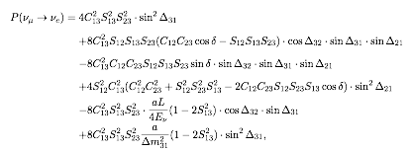
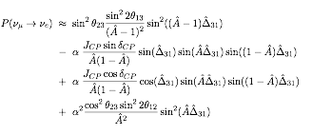
Mass hierarchy in LBL
MH can be determined combining appearance probability of νe and νe-bar
MH effects proportional to L ⇒ longer distance is better
2 experiments are running and will collect large amount of data by 2020
T2K (295 km) will collect 7.8x10²¹ POT by 2020
NOVA (810 km) will collect 3.6x10²¹ POT by 2020
Leading term ➔ θ13
CPV term
Matter effects
∝distance

Slide 3
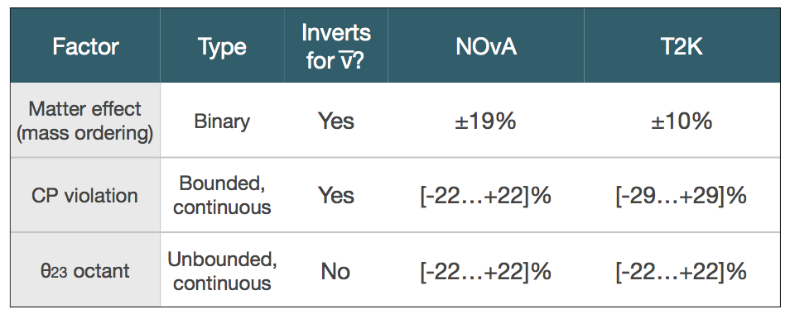
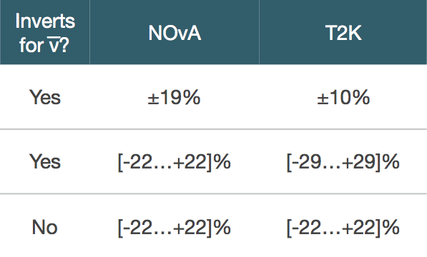
Effect of oscillation parameters on appearance event rate
νμ → νe expected events
(NH, δCP=-π/2, sin²θ23=0.5)
T2K: 31.1/E21 POT
NOVA: 21.5/E21 POT
νμ → νe expected events
(NH, δCP=-π/2, sin²θ23=0.5)
T2K: 3.7/E21 POT
NOVA: ~7.6/E21 POT
-
-
NOVA has larger MH effects than T2K due to the longer baseline
T2K has larger effects due to CP
Combination of the two might be very valuable!

Slide 4
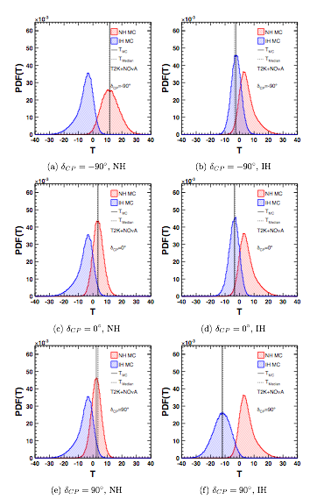
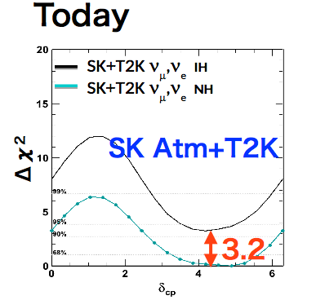
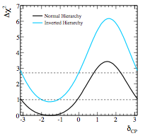
MH Today
Δχ² = χ²(NH) - χ²(IH)
T2K only, ν only
Abe, K., et al. Physical Review D 91.7 (2015): 072010
Analyses of data of T2K+reactors, NOVA+reactors, T2K+SK all point to δCP ~ -90° and NH
⇒ best possible value to determine MH with LBL
Updates are expected for Neutrino2016
⇒ T2K inclusion of ν-bar data (same POT as ν data)
⇒ NOVA will double its statistics in ν mode
PTEP 2015 (2015) no.4, 043C01

Slide 5
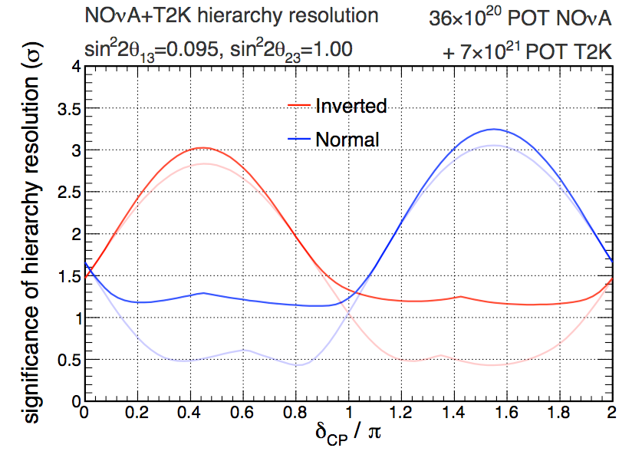
MH in 2020 (Long baseline)
Capability to determine MH in LBL strongly depend on the true values of CP and MH
If the current favored values are the true values MH will be determined at >3σ by LBL experiments in 2020
Current
favored values
M. Messier, Third International Meeting
for large neutrino infrastructure

Slide 6
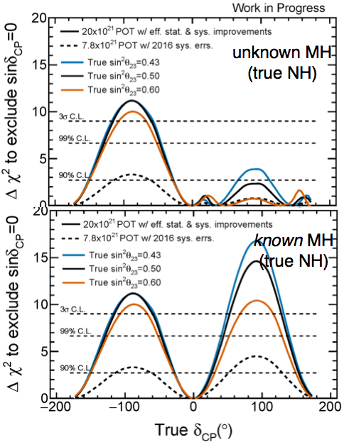
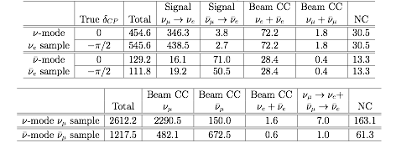
Bonus slide: CP violation with T2K-II
T2K is also proposing to extend its physics run up to 2026 to collect 20x10²¹ POT (T2K-II)
If CP is (close to) maximally violated this will allow to exclude sin(δCP)=0 at more than 3 sigma before next generation of LBL experiments (Dune and Hyper-K) will start their data taking
MH unknown

