Slide 1
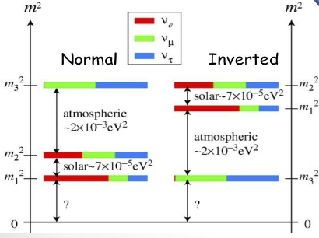
Prospects for Mass Hierarchy measurements
D. Duchesneau
Several experiments are expected to contribute to MH determination
Worldwide effort
Atmospherics:
Orca, Pingu,
HyperK, INO
Neutrino Beam:
Running: T2K, Nova
Future: DUNE, HyperK
Reactor: JUNO
GDR Neutrino
Grenoble June 6th 2016

Slide 2
Reactors

Slide 3
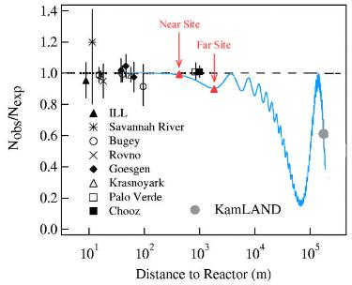
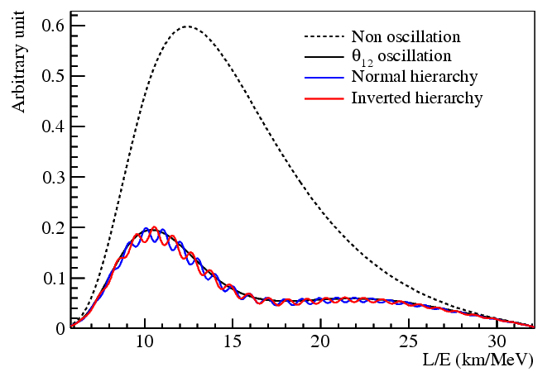
Determine MH with Reactors
4 MeV ‾ν_{e}
Precision energy spectrum measurement
interference between P₃₁ and P₃₂
φ: Relative measurement
Further improvement with Δm²_{μμ} measurement from accelerator exp.
$∆m_{ee}^{2}$: Absolute measurement
Jun CAO KEK 31/05/16

Slide 4
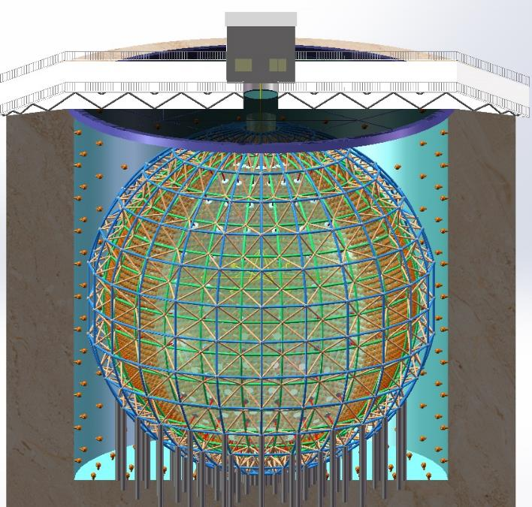
Rich Physics Program
JUNO has been approved in Feb. 2013. ~ 300 M$.
A multiple-purpose neutrino experiment
20 kton LS detector
3% energy resolution
700 m underground
Rich physics possibilities
Reactor neutrino for Mass hierarchy and precision measurement of oscillation parameters
Supernovae neutrino
Geoneutrino
Solar neutrino
Atmospheric neutrino
Exotic searches
Neutrino Physics with JUNO, J. Phys. G 43, 030401 (2016)
Jun CAO KEK 31/05/16

Slide 5
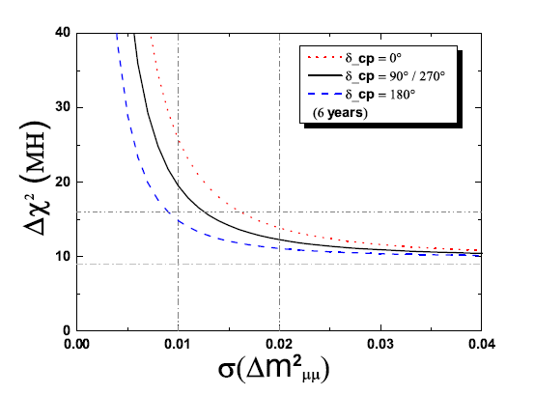
JUNO Sensitivity on MH
Jun CAO KEK 31/05/16
PRD 88, 013008 (2013) | Relative Meas. | w/ absolute Δm²
Statistics only | 4σ | 5σ
Realistic case | 3σ | 4σ
JUNO MH sensitivity with 6 years' data:
 | Ideal | Core distr. | DYB & HZ | Shape | B/S (stat.) | B/S (shape) | |Δm²_{μμ}|
Size | 52.5 km | Real | Real | 1% | 6.3% | 0.4% | 1%
Δχ²_{ΜΗ} | 16 | - 3 | -1.7 | - 1 | - 0.6 | - 0.1 | + (4-12)

Slide 6
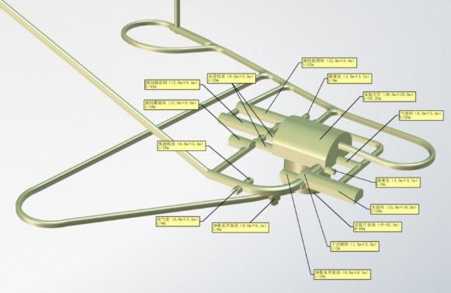
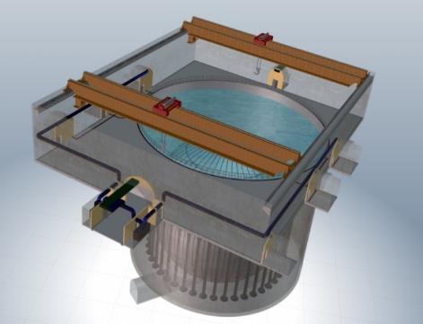
JUNO Schedule and Progresses
Ground breaking in Jan. 2015
900 m slope tunnel excavated out of 1340 m
330 m vertical shaft excavated out of 611 m
Schedule:
Civil preparation：2013-2014
Civil construction：2014-2017
Detector component production：2016-2017
Detector assembly & installation：2018-2019
Filling & data taking：2020
Future Plan
Run for 20-30 years
Likely, double beta decay experiment in 2030
Jun CAO KEK 31/05/16

Slide 7
Atmospherics
Other investigation techniques:
Atmospheric neutrinos: looking at the effect of matter effect in the νμ and νe rate

Slide 8
Thomas Eberl KEK 31/05/16

Slide 9
Thomas Eberl KEK 31/05/16

Slide 10
Thomas Eberl KEK 31/05/16

Slide 11
Start data taking: 2020
Start construction: 2019
Thomas Eberl KEK 31/05/16

Slide 12
HYPER-K
Start of data taking First Tank expected in 2026
Masato Shiozawa KEK 30/05/16

Slide 13
Expect construction of tunnel to begin by end of this year.
–Tunnel and experimental hall : 3-4 years,
–One module per year (total 3)
Gobinda Majumder KEK 31/05/16

Slide 14
Can start taking data in 2024
Gobinda Majumder KEK 31/05/16

Slide 15
Neutrino beams

Slide 16
Mark Messier KEK 30/05/16

Slide 17
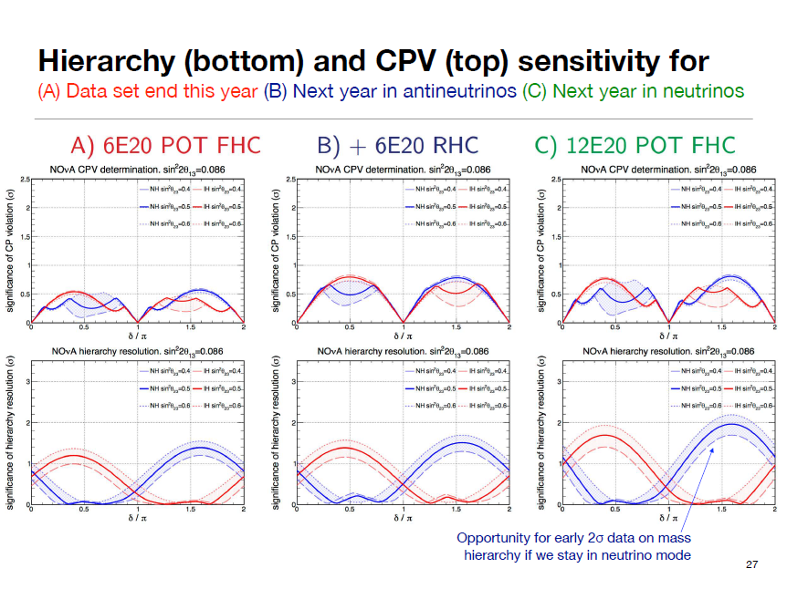
Mark Messier KEK 30/05/16

Slide 19
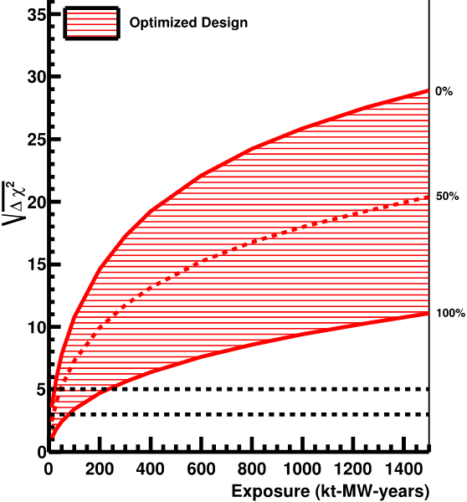
DUNE:
MH at 3 sigma in < 1 year
MH at 5 sigma from 2- 5 years (230 kt MW year) depending on deltaCP

Slide 20
Summary:
Reactors:
JUNO : start 2020, 6 years => MH at 3 sigma in 2026
RENO 50: start 2022, 10 years => MH at 3 sigma in 2032
Atmospherics:
Orca: start 2020, 3 years = > MH at 3 sigma in 2023
Pingu: start 2020, 4 years => MH at 3 sigma in 2024
INO: start 2024, 5 years => MH at > 3 sigma in 2029
HYPER K: start 2026, 3 years => MH at 3 sigma in 2029
Neutrino beams:
Nova: running, in 3 years may reach 2 sigma in 2018
When combined with T2K may reach 3 sigmas by 2020 (see Claudio’s slides)
DUNE: start 2026, 2-5 years => MH at 5 sigma
Be careful: different assumption on theta23 octant
different observables with reactors

