Slide 1
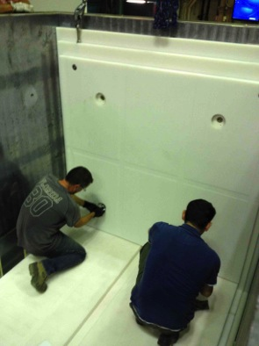
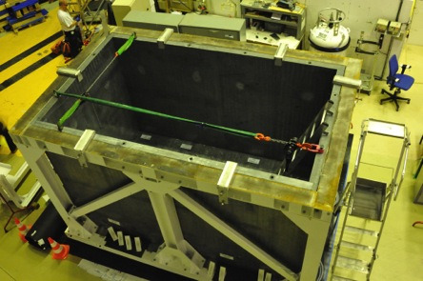
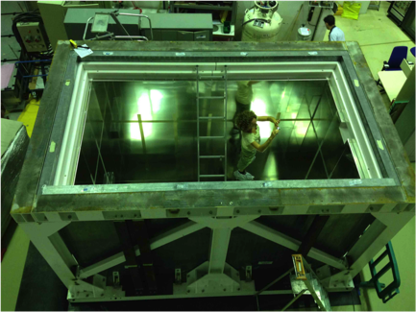
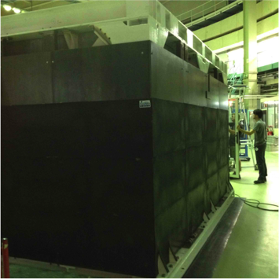
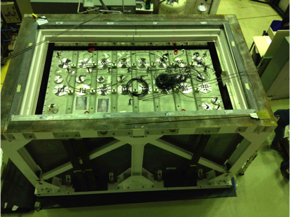
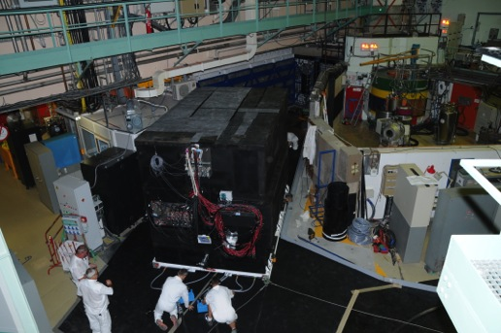
STEREO collab. Meeting
LPSC Grenoble October 11-13, 2016

Slide 2
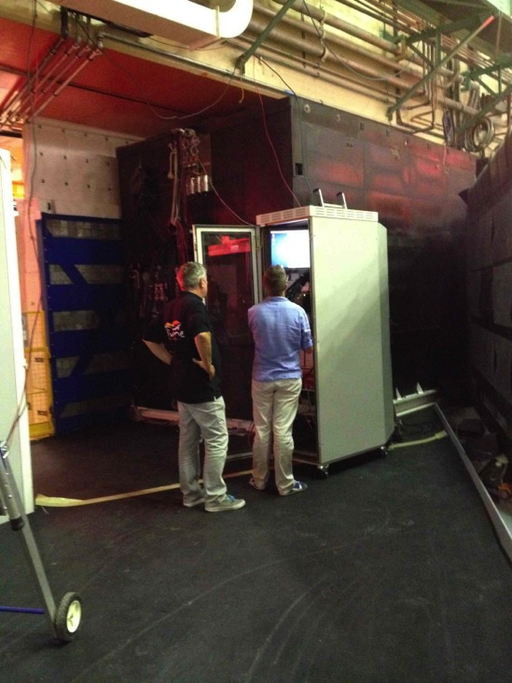
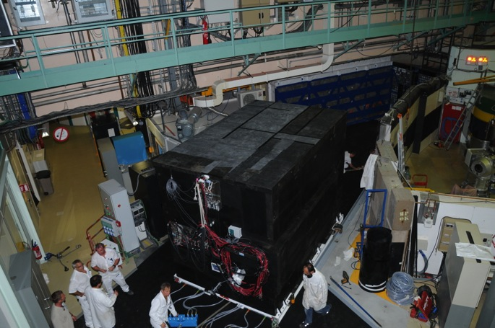
Stereo moved in !
20 m flight on air cushions… at the end of a long and demanding installation path.
Technical teams did an outstanding work on site to keep the installation planning since the delivery of the PE shielding on August 19.
See Anne’s talk

Slide 3
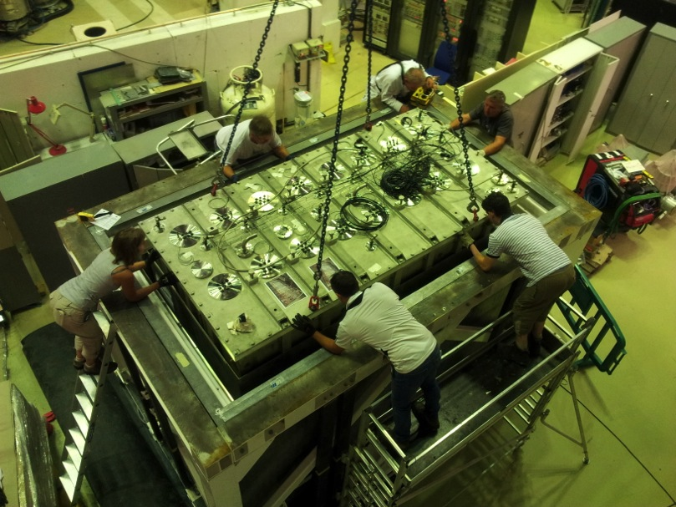
Special Thanks to Anne
Central coordination work for the installation on site

Slide 4
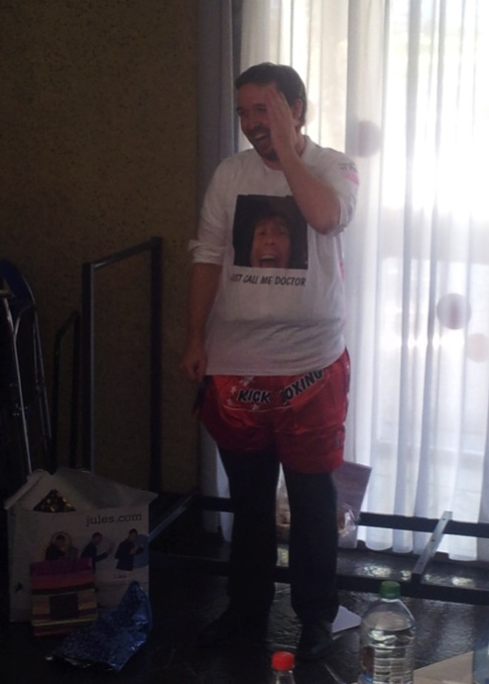
PhD Students and postdocs
Congratulations to our first Stereo doctors:
Stéphane Zsoldos – Sept 30, 2016
Luis Manzanillas – Oct 10, 2016
Thanks for your work on Stereo
and best wishes for your future projects
Welcome to Elena, Stefan, Julia, Laura, Adrien!

Slide 5
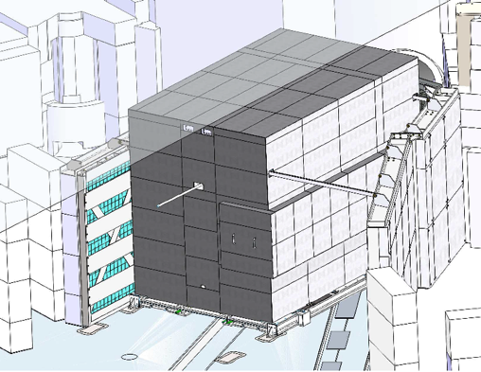
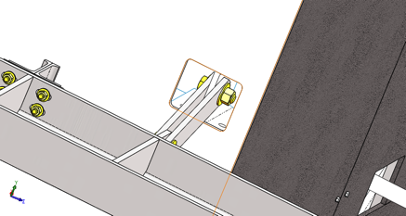
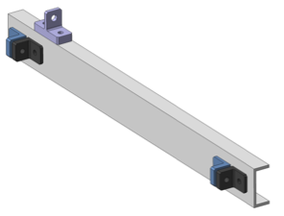
Missing mechanics
Missing mechanics to connect Stereo to the floor and to the side walls
Connection to the IN20 wall
Designed
Under fabrication at the ILL workshop
Bolted to the floor instead of welded for easier dismounting:
Validated by NECS
Under fabrication
Connection to the D19wall
Issue of misplaced attach points at the top of the D19 wall (10 cm shift)
New designed being worked out by ILL, NECS and Saclay
On the critical path

Slide 6
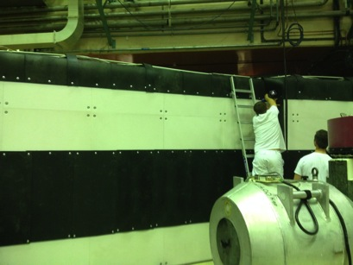
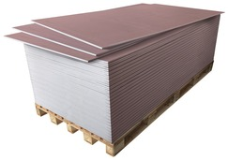
Safety file
Seismic study validated
Review by a fire expert from IRSN (Institut de Radioprotection et de Sureté Nucléaire):
Fire hazard of the IN20 considered as not acceptable
Extra fire protection of the IN20 polyethylene required
Concept of two layers of standard plasterboard accepted
Positive report from IRSN but still not sent to the ASN…
ASN signatures for final agreement on the critical path
Ongoing work to finalize all the required ILL documentation
(updated LOMC, alarm report to the control room, procedures)
Placoflam©: 13 mm fireproof plasterboard
See Véronique’s talk

Slide 7
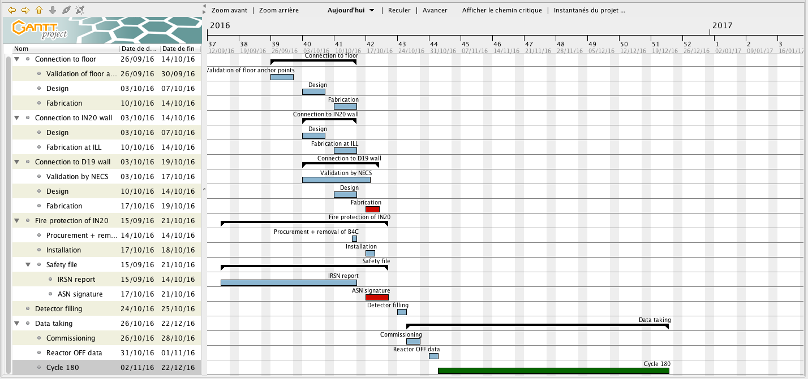
Planning

Slide 8
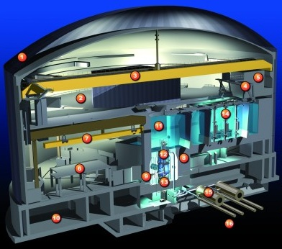
Important reactor off data
Water level in the reactor pool and in the first part of the water channel are often lowered during the long winter stops.
This affects the cosmic background seen by Stereo.
Most of the reactor OFF data have to be taken during the short inter-cycles and (part of) the summer stop.
2 to 3 weeks of reactor OFF only (Christmas break +few days) for the analysis of the 2 first cycles.
Impact on the sensitivity
H6 tube will be removed in spring 2017, probably not replaced.
See Felix’s talk

Slide 9
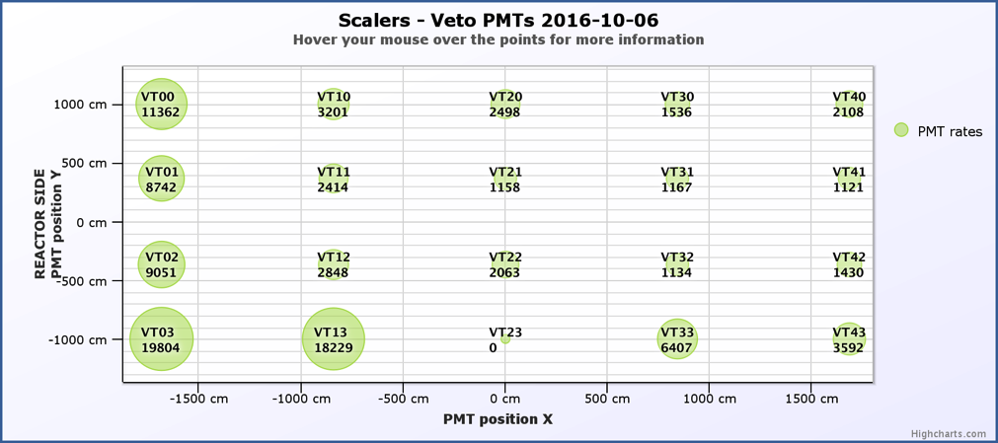
We are taking data
The muon veto has been filled with water and is taking data since early October
Background issue to be discussed in this meeting
Need to define the required extra shielding and to organize better the analysis task force
High single rate seen by the veto PMTs induced by IN20 and D19 experiments.

Slide 10
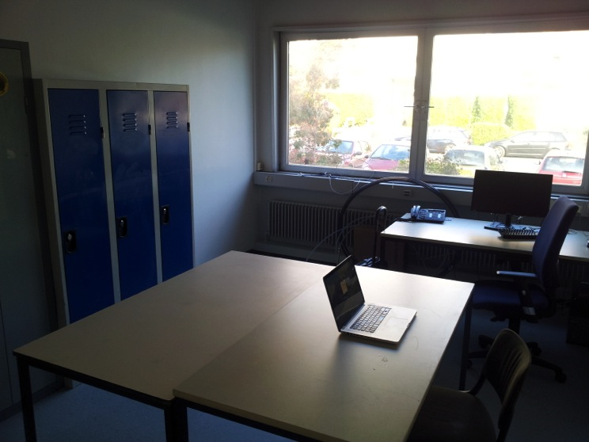
Organization of data taking and analysis
We need an efficient commissioning
Minimal calibration, low thresholds setting to be compatible with reactor ON data.
Take as much as possible reactor OFF data for physics
Shift training at the end of this meeting
Switch to shift (training) mode next week?
Stereo office, ILL1 – room 52
(still need few chairs, a blackboard… and operational heating)

