Slide 1
Projet SAMOFAR
Coordinateur scientifique : Jan Leen Kloosterman (TU DELFT)
Manager : Karin van der Graaf (TU Delft)
WP1 : Integral safety approach and system integration
E. Merle (CNRS/IN2P3/LPSC)
WP2 : Physical and chemical properties required for safety analysis
O. Benes (JRC)
WP3 : Experimental proof of shut-down and decay heat removal concepts
M. Ricotti (CIRTEN)
WP4 : Accidental Transients
D. Lathouwers (TU Delft)
WP5 : Safety evaluation of the chemical plant
S. Delpech (CNRS/IN2P3/INO)
WP6 : Training, education and dissemination of results
J.L. Kloosterman (TU Delft)
WP7 : Project management
K. Van der Graaf (TU Delft)

Slide 2
Principal objectif du WP5
Etudier de la chimie du traitement du sel combustible, proposer un design pour l’unité de retraitement et étudier les besoins en sûreté de l’unité.
Partenaires du WP5:
- CNRS
- ITU
- CEA
- CINVESTAV

Slide 3
Schéma de traitement
Matière fissile, Np et déchets
Bullage de gaz
Etape 1
Etape 3
déchets
déchets
Fluoration
Désextraction Ln dans LiCl-LiF et précipitation Ln₂O₃
Xe, Kr, …
Métaux nobles
Extraction U, Np, Pu, I, Tc, Te Nb, Mo, Se …
Cœur du réacteur
Etape 2.A
Etape 2.B
Extraction réductrice
An
(Bi-Li₁)
Extraction réductrice
Ln
(Bi-Li₂)
LiF-ThF₄-(UF₄-UF₃)
Etape 5
Etape 2.C
Etape 4
Contrôle du potentiel redox et composition U/Th
Désextraction An
dans
LiF-ThF₄ propre
Régénération de la composition des sels et des phases métalliques

Slide 4
WP5
Task 5.1 Evaluation of nuclide inventory at various stages in the chemical plant (CNRS, ITU)
A reprocessing scheme has been established in the EVOL project. The different steps have been validated both by bibliographic study and experimental determinations. The determination of the nuclide inventory at various stages of the chemical plant requires the knowledge of basic data such as activity coefficients and redox potential values.
This task is dedicated to the determination of fundamental data such as activity coefficients both in metallic and salt phases (CNRS, ITU), the calculation of the separation/extraction efficiencies and the elemental inventory.
The experimental validation of the reductive extraction between LiF-ThF₄/Bi-Li will be done and the extraction kinetic will be studied for actinides (ITU) and lanthanides (CNRS).

Slide 5
WP5
Task 5.2 Coupling of neutronic and reprocessing efficiencies (CNRS)
The reprocessing efficiencies (Task 5.1) have to be coupled with the neutronics in order to determine the stage number of each reprocessing step, especially for the reductive extraction. The increase of the extraction stages can lead to an improve efficiency. The size of the chemical plant will depend on the number of stages.
The fuel salt purity level (against fission products) required by neutronic calculations (realized in the WP1) helps to define a design for the chemical plant in relation with WP1 (CNRS).
Task 5.3 Evaluation of Re-criticality issues (CNRS, CEA)
Calculation of criticality based on the nuclide inventory to avoid fissile concentration in a part of the chemical plant (in relation with task 5.1) (CNRS, CEA).

Slide 6
WP5
Task 5.4 Design and safety of the chemical plant (CNRS, CEA, ITU)
The radioprotection of the chemical plant will be calculated based on the nuclide inventory at each stage of the reprocessing (in relation with task 5.1, 5.3 and 5.4) (CEA, CNRS, ITU).
Two reprocessing steps require gas flows. The on-line reprocessing which consists in injection of He the reactor core to extract the gaseous fission products and the noble metal. Management of the gas and of the elements extracted by this step has to be studied from safety point of view. Calculations of residual heat, radioactivity decrease in the tanks and size of the tanks have to be performed (CNRS, CEA). The second step which requires gas flow is the fluorination step. Fluorine is injected in the molten salt to extract U, Np and several FP. The gas extracted is adsorbed on NaF traps heated at different temperatures to perform the separation. The gases are separated and reduced by reaction with hydrogen gas. The separation efficiency of this step will be determined based on the experimental feedback from ORNL available.

Slide 7
WP5
Task 5.5 Material issues (CNRS, CINVESTAV)and KI (collaboration)
The compatibility of materials in the several structures of the chemical plant will be assessed in this task. Recommendations on the material structure will be given especially for the fluorination plant, the reductive extraction line and the lanthanide oxide precipitation tank. Ni-based alloys with ZrO₂ coatings will be studied to evaluate their compatibility with non active fluoride molten salts (CINVESTAV) and active salts (CNRS). For compatibility with liquid Bi pools, studies to evaluate the resistance of Mo will be done (CNRS, KI).

Slide 8
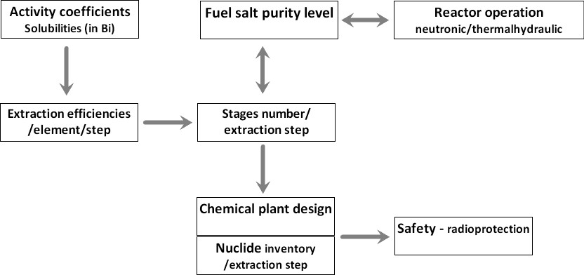
Méthodologie

Slide 9
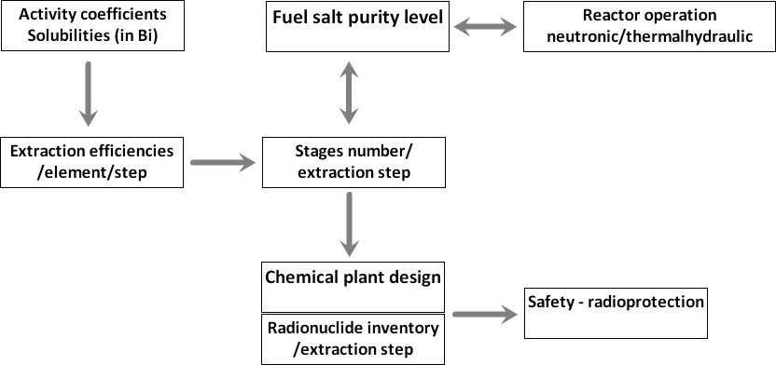
Méthodologie
CNRS
CNRS - ITU
CNRS - CEA

Slide 10
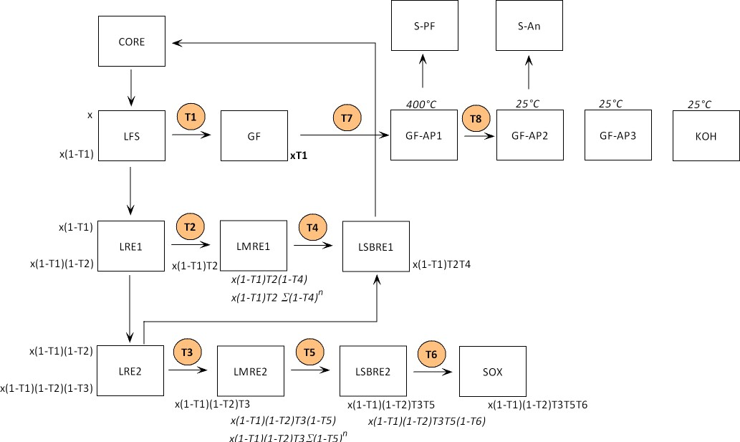
Méthodologie

Slide 11
Méthodologie pour le calcul de l’inventaire
Estimation des fonctions de transfert d’une phase à une autre pour tous les éléments du cœur.
- Bibliographie (rapports ORNL)
- Partie expérimentale (choix de certains éléments majeurs)
- Détermination de données fondamentales (coefficients d’activité, potentiels redox)
- Etudes cinétiques

Slide 12
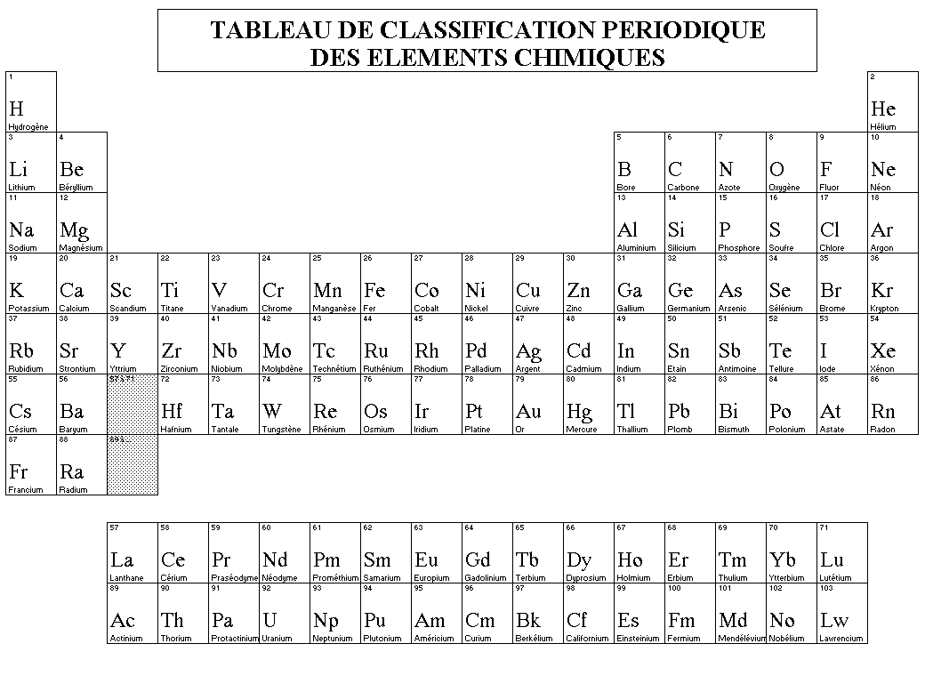
∗
∗
∗
∗
∗
∗
∗
00
00

Slide 13
THANKS FOR YOUR ATTENTION

