Slide 1
A physically realist framework for quantum mechanics
Alexia Auffèves (CNRS Grenoble)
Nayla Farouki (CEA Grenoble)
Philippe Grangier (CNRS Palaiseau)
Lapp & Lapth, Annecy, June 13, 2017
Notes:
En gras: présentes

Slide 2
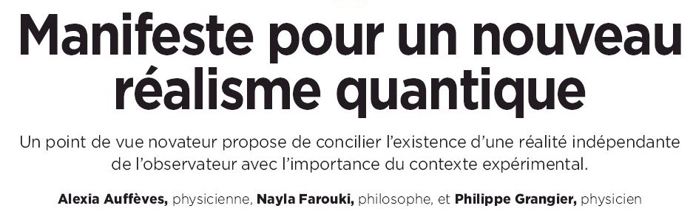
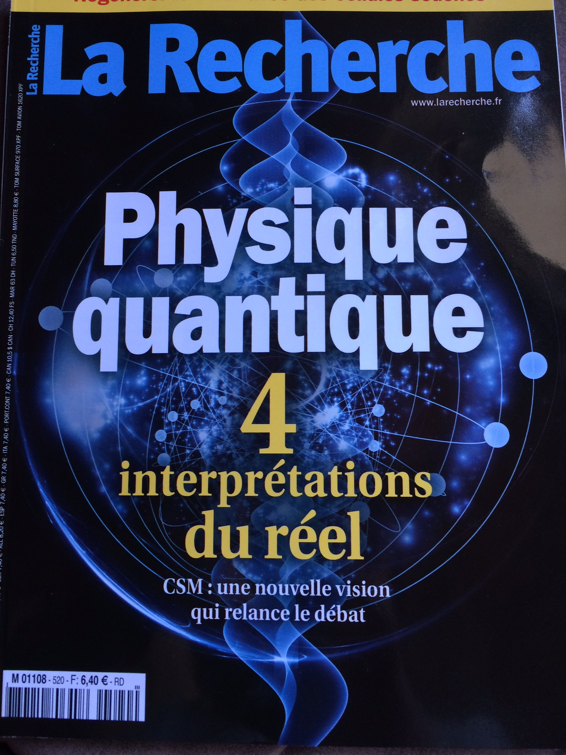
1 philosopher, 2 physicists, 1 motivation
Introduce the « quantum stuff » with words, not maths
« Ontology first, formalism second! »
Notes:
Publicité. Interprétations. Tous d’accord sur le formalisme, bcp moins sur ce qu’il signifie.
Nayla => pas une interprétation, mais un point de vue, une approche, etc…car on n’interprète pas le formalisme. On part des phénomènes, puis des concepts. Et on peut déjà dégager bcp de caractéristiques du monde quantique, sans avoir écrit une seule équation.

Slide 3
A few words
Ontology Defines what exists [metaphysics, speculation]. Ontology is postulated
Epistemology Defines what can be known
Realism Statement that things exist, even if unobserved
State Mode of existence of a thing
Objectivity Statement that things have a state (even if even unobserved), and I can know it
Notes:
Il va être bcp question de réalisme et d’ontologie, dc définitions

Slide 4
Outline
Introduction: What is a physical state? => The « quantum problem »
Rebuilding a quantum ontology
Revisiting quantumness
Recovering the quantum formalism
Conclusions. Outlook.
Notes:
Longue intro: comprendre pourquoi réalisme et MQ ont des rapports si complexes, et où on en est aujourd’hui. Je ne vais pas détailler les différentes interprétations, mais surtout expliciter les ingrédients de l’ontologie quantique ordinaire, que l’on applique presque sans s’en rendre compte.

Slide 5
What is a physical state (in classical physics)?
The natural world
S
Statement of objectivity :
There are systems = isolable entities of the natural world
A system has a state (even if unobserved) and I can know it

Slide 6
What is a physical state (in classical physics)?
The natural world
State :
YNNYNN…
S
The physical state = an ID card
A set of answers to a set of questions

Slide 7
What is a physical state (in quantum physics)?
P(Y,N,N,Y,N,N,…)
Context
S
Quantum systems are interfaced by an experimental context
Access to the full ID card randomly perturbed
I cannot know the system state ☹
« Quantum problem »

Slide 8
« Realism » vs « anti-realism»
The full physical state = the « classical state » exists, but is not accessible because of practical reasons
Quantum mechanics is not complete
Probabilities are due to ignorance of underlying reality
The classical state is not accessible for irreducible reasons
The classical state does not exist
QM is complete
The wave function is the ultimate description of the system’s state

Slide 9
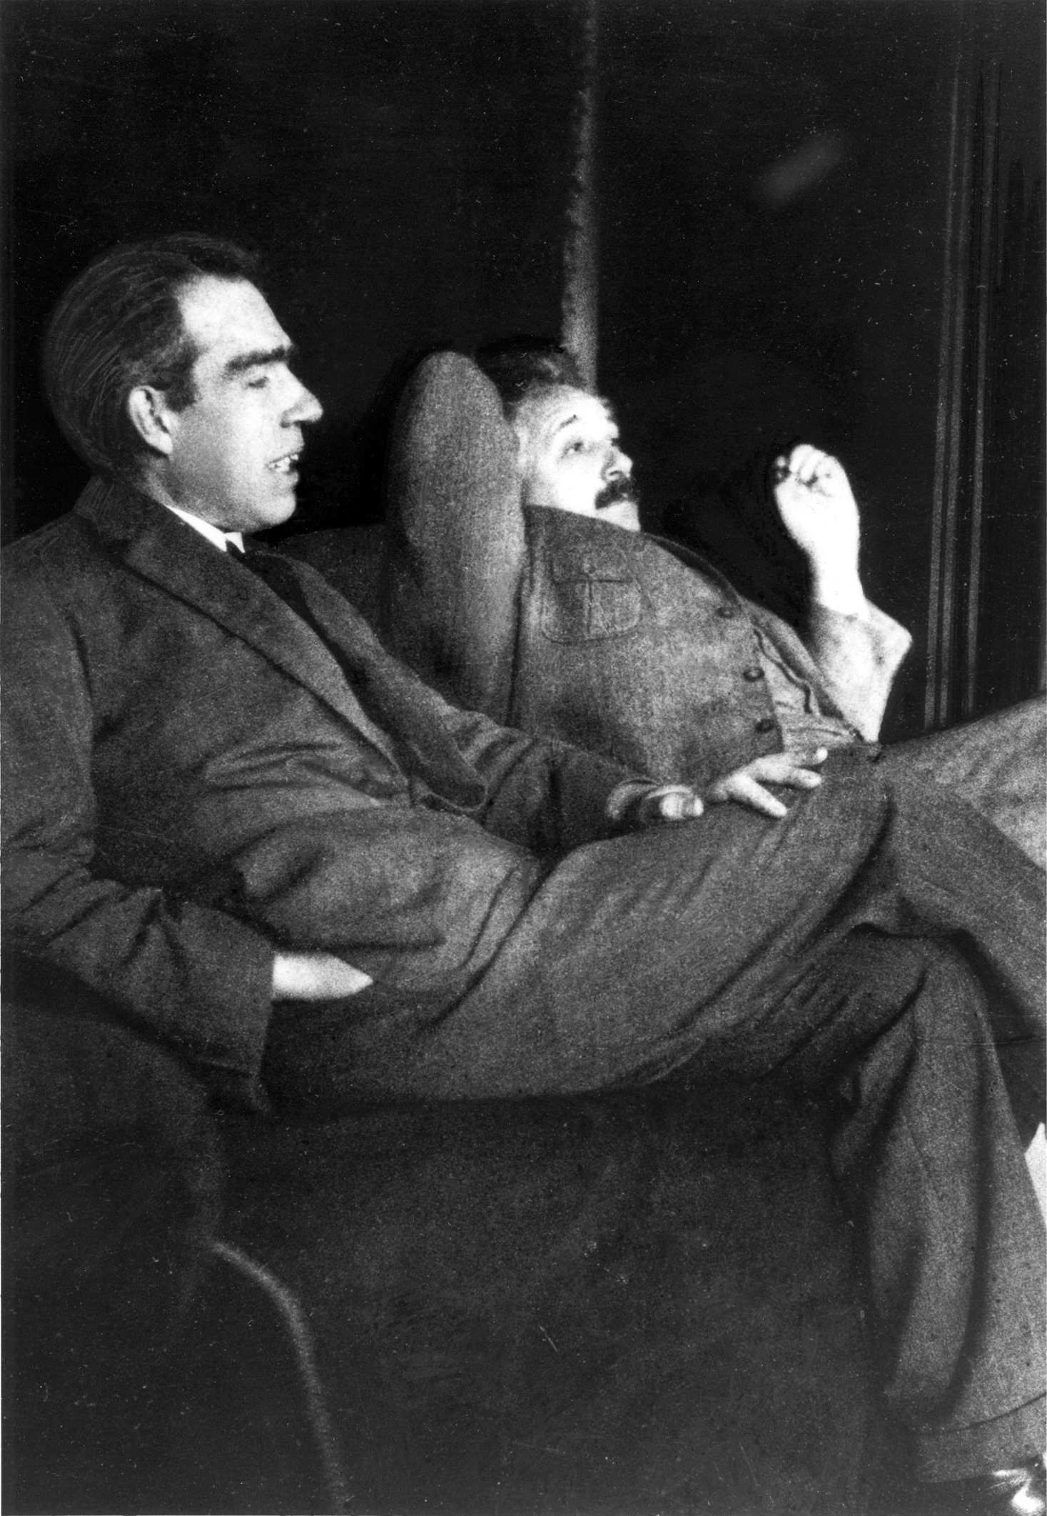
« Realism » vs « anti-realism»
The full physical state = the « classical state » exists, but is not accessible because of practical reasons
Quantum mechanics is not complete
Probabilities are due to ignorance of underlying reality
The classical state is not accessible for irreducible reasons
The classical state does not exist
QM is complete
The wave function is the ultimate description of the system’s state

Slide 10
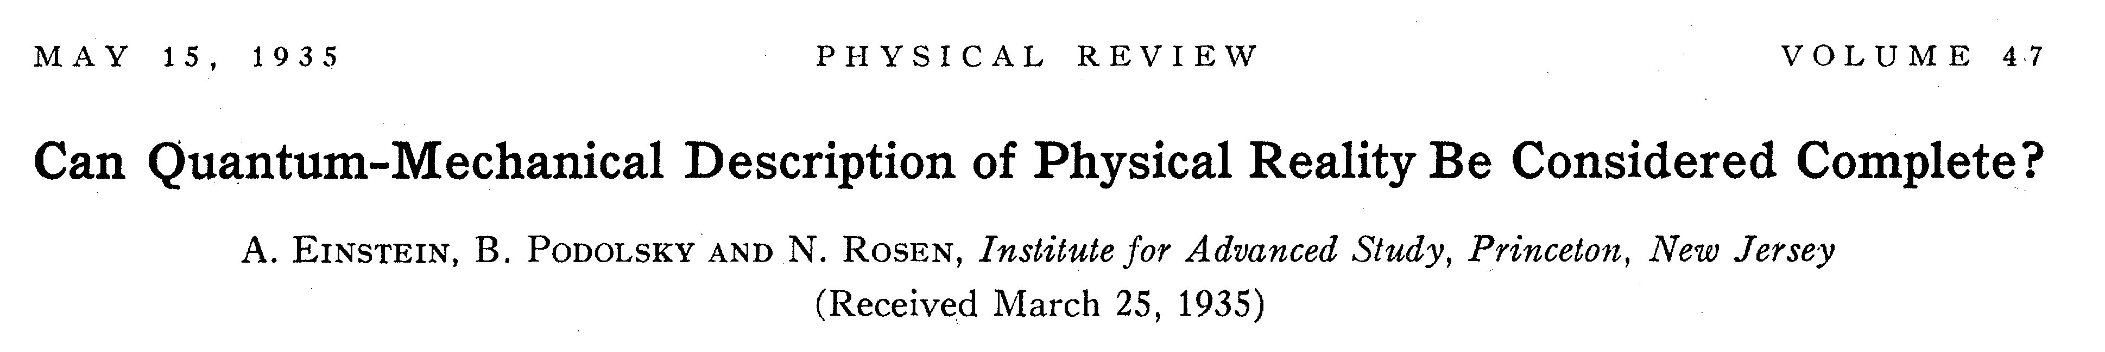


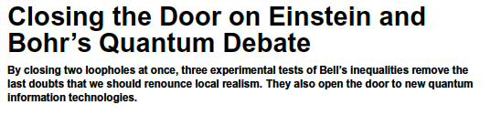
A.Aspect, P. Grangier et G. Roger, Phys. Rev. Lett. 47, 460 (1981)
A.Aspect, P. Grangier et G. Roger, Phys. Rev. Lett. 49, 91 (1982)
A. Aspect, J. Dalibard et G. Roger, Phys. Rev. Lett. 49, 1804 (1982)
B. Hensen, et al, and R. Hanson, Nature 526, 682 (2015)
M. Giustina, et al, and A. Zeilinger, Phys.Rev.Lett. 115, 250401 (2015)
L. Shalm, et al, and S. Nam, Phys.Rev. Lett. 115, 250402 (2015)

Slide 11
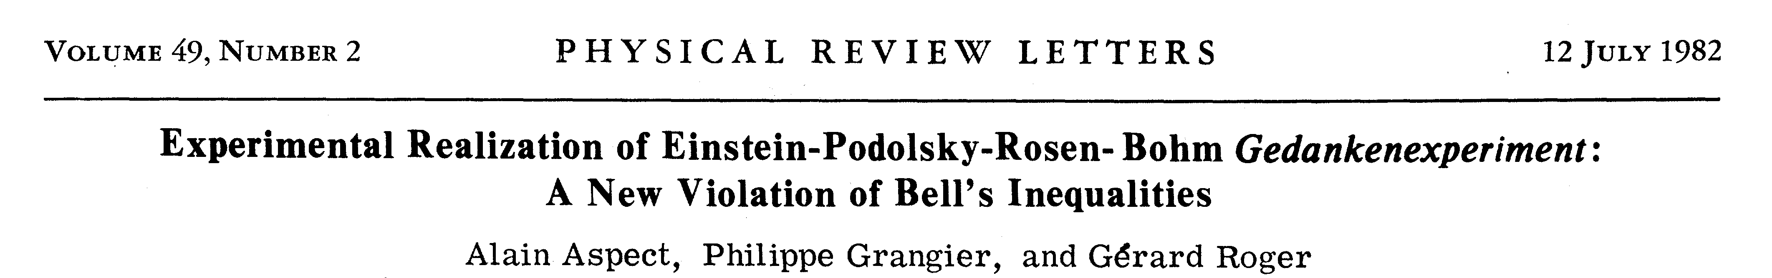
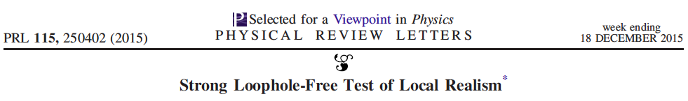
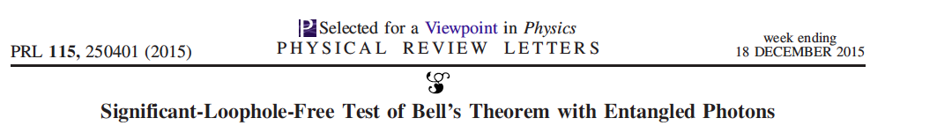

What have we renounced to?
Local realism
Classical states
What are we getting accustomed to?
Quantum states
« Ordinary quantum ontology »

Slide 12
« Ordinary quantum ontology »
Quantum system: A single photon
Quantum state: The photon’s polarization
« Question »: Measurement in {H_{θ} ; V_{θ}}
« Answer »: Random projection on H_{θ} or V_{θ}
H_{θ}
V_{θ}
The full « ID card » = The polarization for each θ angle has no physical meaning
=> End of the classical state
H
D
D

Slide 13
« Ordinary quantum ontology »
Quantum system: A single photon
Quantum state: The photon’s polarization
Realism and objectivity look safe: The photon and its state exist, even if unobserved ☺
But…
Measuring in the wrong basis irreversibly perturbs the state
I cannot know the state of a single quantum system: « Hidden reality »
The quantum problem is still there ☹
Notes:
On s’est habitué au problème quantique, qui est celui d’une réalité cachée par nos appareils de mesure. Inconfort philosophique.

Slide 14
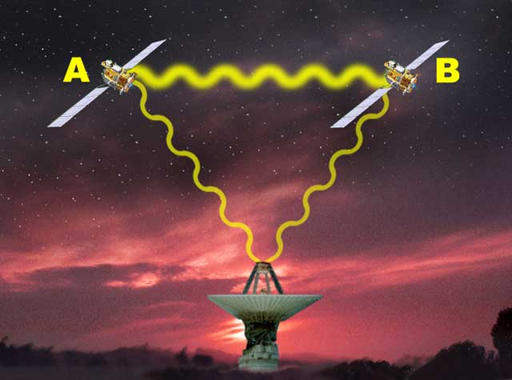
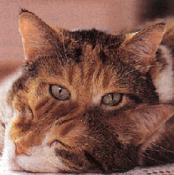
Ordinary discomfort zones
Systems
« |ψ> »
Contexts
« Ô »
Quantum reality
Hidden
Weird :Superposition, Non-locality, spooky action…
Unitary evolution
Classical contexts
Quantum-classical boundary
Randomness
Non-unitary evolution
Notes:
Troisième inconfort. Avant: dichotomie dans les objets, maintenant, dichotomie dans les lois quantiques. Unitaire vs non-unitaire. Déterministe vs aléatoire.
Bilan: Pour être heureux, on aimerait bien se débarrasser des appareils de mesure qui cachent la réalité, ont l’air d’avoir une description différente et ont une action apparemment différente sur l’évolution du système.
Nous: on va au contraire construire sur la mesure. La mesure devient le levier sur lequel soulever le monde..

Slide 15
Outline
Introduction: What is a physical state? => The « quantum problem »
Rebuilding a quantum ontology
Revisiting quantumness (with CSM)
Recovering the quantum formalism
Conclusions. Outlook.

Slide 16
Our methodology
Knowing that
Ontology is never demonstrated, but postulated
Postulates can be based on intuitions
Intuitions are based on custom
We shall
Deconstruct classical intuitions
Rebuild a new ontology of states, by induction from quantum phenomenology
Notes:
On rend le processus conscient

Slide 17
Genealogy of a classical state
Operational approach :
One builds a state by asking the system a set of questions and filling its ID card
Each question is asked within a given context*
Context 1
ID card :
Y₁
S
*Context: Around the system

Slide 18
Genealogy of a classical state
Operational approach :
One builds a state by asking the system a set of questions and filling its ID card
Each question is asked within a given context
Context 1
Context 2
ID card :
Y₁N₂
S

Slide 19
Genealogy of a classical state
Operational approach :
One builds a state by asking the system a set of questions and filling its ID card
Each question is asked within a given context
Context 1
Context 2
ID card :
Y₁N₂N₃
S
Context 3

Slide 20
Genealogy of a classical state
Classical phenomenology
I can obtain repeatably the same answers to the same questions
ID card :
Y₁N₂N₃
S
Context 3

Slide 21
Genealogy of a classical state
Classical phenomenology
I can obtain repeatably the same answers to the same questions
Context 2
ID card :
Y₁N₂N₃
S

Slide 22
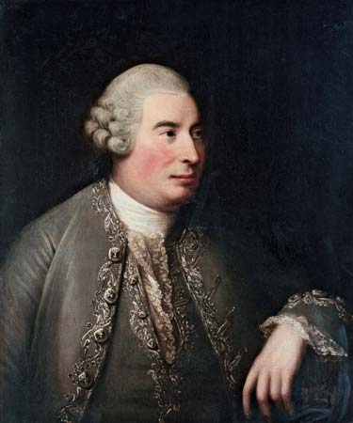
Genealogy of a classical state
Repeatability -> Certainty (Psychology)
The ID card (Operational) -> State (Ontology)
One explains the repeatable answers by a permanent cause : the existence of a state
David Hume (1711-1776)
Context 1
Context 2
State :
Y₁N₂N₃
S
Context 3

Slide 23
Genealogy of a classical state
In the classical world, the state does not depend on the ordering of the questions :
I can forget the contexts, (even forget the questions), and attribute the state to the system alone
Context 1
Context 2
State :
Y₁N₂N₃
S
Context 3

Slide 24
Genealogy of a classical state
In the classical world, the state does not depend on the ordering of the questions :
I can forget the contexts, (even forget the questions), and attribute the state to the system alone
State :
Y₁N₂N₃
S

Slide 25
Genealogy of objectivity
This is usually considered the core of objectivity: the state of the system exists, even if unobserved
Nobody
here
State :
Y₁N₂N₃
S

Slide 26
Genealogy of objectivity
Our definition of objectivity = the existence of states pertaining to the system alone, derives from the classical phenomenology = intuitions built in the classical world
Nobody
here
S
State :
Y₁N₂N₃

Slide 27
Genealogy of classical realism
Our definition of objectivity derives from our classical experience
Such intuitions have deep roots: We perceive classical phenomena continuously, and for free
Nobody
here
State :
Y₁N₂N₃
S

Slide 28
Quantum phenomenology
The ID card = the answers may depend on the ordering of the questions
Context 1
ID card :
Y₁
S
Context = Measuring apparatus
Notes:
Par exemple: penser au photon et à sa polarisation

Slide 29
Quantum phenomenology
The ID card = the answers may depend on the ordering of the questions
Context 1
Context 2
ID card :
Y₁N₂
S

Slide 30
Quantum phenomenology
The ID card = the answers may depend on the ordering of the questions
Context 1
Context 2
ID card :
Y₁N₂N₁ ☹
S

Slide 31
Option 1 : Ordinary realist
The state pertains to the system alone, the context perturbs the state
Context 1
Context 2
ID card :
Y₁N₂N₁ ☹
S

Slide 32
Option 2 : Anti-realist
There are no states, only preparations and measurements
Context 1
Context 2
ID card :
Y₁N₂N₁ ☹
S

Slide 33
Option 3 : New realist
« Certainty tracking » : one can obtain repeatably the same answer, within the same context
One can upgrade the ID card into a state, within a given context
Context 1
ID card :
Y₁Y₁Y₁Y₁ ☺
S
Notes:
Traquer la certitude, pour avoir un précurseur d’état = une carte d’identité dont les items sont certains et répétables!

Slide 34
Postulate 1 : C-S-M
In quantum physics, the « quantum state » pertains both to the system AND the context
To differenciate it from a classical state (which does not depend on any context), we further call the quantum state a modality
C-S-M ontology «Context-System-Modality»
Auffèves and Grangier, Foundations of Physics 46:121–137 (2016)

Slide 35
Postulate 1 : C-S-M
Whithin a given context, modalities are mutually exclusive
Two modalities pertaining to two different contexts are not necessarily exclusive : they can be incompatible
A given modality can pertain to more than one context (Extra-contextuality of modalities)
Notes:
REALITY IS NO MORE HIDDEN!!!

Slide 36
Example
System : A single photon
Context : A PBS with neutral axes {H,V}.
Modality : « transmitted » or « reflected »
A photon has no state by itself. A photon + polarizer has, and it is a modality.
The modality is objective, but contextual
There are no coherent superpositions of states. There are modalities in other contexts (|H>+|V> = |H₄₅>)

Slide 37
From ordinary quantum ontology to CSM
Ordinary quantum ontology
Non-contextual states
Exist even unobserved
Hidden and weird
C
S
|ψ>
CSM
States-phenomena
Actual and certain
Exist even unobserved
Contextual objectivity
C
S
Modality
Grangier, P., EJP 23(3), 331 (2002)
Grangier, P., Int. J. Quantum Inf. 3(1), 17–22 (2005)
Notes:
La modalité-phénomène est réelle, pas psi!

Slide 38
Impact on ontology vs epistemology
Classical realism
The thing is what exists « below » the states [Ontology]
A state pertains to the thing only [Epistemology]
S
State 1
State 2
Ontology and epistemology have the same object
CSM
The system is what exists below the modalities [Ontology]
A modality pertains to the system and a context [Epistemology]
C₁
S
C₂
M₁
M₂
Ontology and epistemology have different objects

Slide 39
Postulate 2 : Quantization
A system is characterized by a fixed, discrete number N of exclusive modalities.
N is independant of the context.
N = 6
S
C

Slide 40
Postulate 3 : Continuity
A context is classical = Its state does not depend on another context, and is described by a continuous parameter θ.
N = 6
S
C

Slide 41
Summary
Postulate 1 (Contextuality): Modalities pertain to a system and a context
Postulate 2 (Quantization): A system is characterized by a fixed number N of exclusive modalities.
Postulate 3 (Continuity): A context is classical, its state is described by a continuous parameter θ.
Ontological postulates induced from the quantum phenomenology

Slide 42
Outline
Introduction: What is a physical state? => The « quantum problem »
Rebuilding a quantum ontology
Revisiting quantumness (with CSM)
Recovering the quantum formalism
Conclusions. Outlook.
Notes:
Maintenant nous avons une ontologie. On va revisiter les zones d’inconfort, simplement pour voir ce qui change. Notons qu’on a déjà résolu la question de l’inconfort philosophique, au prix de la contextualité des états. Maintenant on va se balader dans les zones d’inconfort physique.

Slide 43
Back to ordinary discomfort zones
Systems
« |ψ> »
Contexts
« Ô »
Quantum reality
Hidden ✔
Superpositions ✔
Non-locality, spooky action
Unitary evolution
Classical contexts
Quantum-classical boundary
Randomness
Non-unitary evolution
Notes:
Troisième inconfort. Avant: dichotomie dans les objets, maintenant, dichotomie dans les lois quantiques. Unitaire vs non-unitaire. Déterministe vs aléatoire.
Bilan: Pour être heureux, on aimerait bien se débarrasser des appareils de mesure qui cachent la réalité, ont l’air d’avoir une description différente et ont une action apparemment différente sur l’évolution du système.
Nous: on va au contraire construire sur la mesure. La mesure devient le levier sur lequel soulever le monde..

Slide 44
Back to ordinary discomfort zones
Systems
« |ψ> »
Contexts
« Ô »
Quantum reality
Hidden ✔
Superpositions ✔
Non-locality, spooky action ?
Unitary evolution
Classical contexts
Quantum-classical boundary?
Randomness ?
Non-unitary evolution
Notes:
Troisième inconfort. Avant: dichotomie dans les objets, maintenant, dichotomie dans les lois quantiques. Unitaire vs non-unitaire. Déterministe vs aléatoire.
Bilan: Pour être heureux, on aimerait bien se débarrasser des appareils de mesure qui cachent la réalité, ont l’air d’avoir une description différente et ont une action apparemment différente sur l’évolution du système.
Nous: on va au contraire construire sur la mesure. La mesure devient le levier sur lequel soulever le monde..

Slide 45
From classical to quantum states
Universality of contextuality
States always show up in a given context
Reality is always contextual
C
S
Classical reality
Contexts are there, but can be forgotten
« Soft » contextuality
Quantum reality
Contexts are needed to define a state
« Hard » contextuality
Quantization of
modalities

Slide 46
Proof: building a modality
Ask questions to the system to define its ID card
Context 1 : 2 repeatable answers => 2 exclusive modalities
Context 1
θ₁
2 modalities :
Y₁ or N₁
S
N=2

Slide 47
Proof: building a modality
Ask questions to the system to define its ID card
Context 2 : 2 repeatable answers => 2 exclusive modalities
Context 2
θ₂
2 modalities :
Y₂ or N₂
S
N=2

Slide 48
Proof: building a modality
Back to Context 1 : Can I predict the answers with certainty?
Context 1
θ₁
Context 2
θ₂
4 modalities?
Y₁Y₂ or Y₁N₂
or N₁Y₂
or N₁N₂
S
N=2

Slide 49
Proof: building a modality
The answers cannot be predicted, otherwise there would be 4 exclusive modalities
=> Violation of the quantization postulate
Context 1
θ₁
Context 2
θ₂
4 modalities?
Y₁Y₂ or Y₁N₂
or N₁Y₂
or N₁N₂
S

Slide 50
Proof: building a modality
Contextuality + Quantization postulate
« Hard contextuality »
Non commutation of the questions
Context 1
θ₁
Context 2
θ₂
4 modalities?
Y₁Y₂ or Y₁N₂
or N₁Y₂
or N₁N₂
S

Slide 51
Proof: building a modality
Contextuality + Quantization postulate
Unpredictable answers
Quantum randomness
Context 1
θ₁
Context 2
θ₂
4 modalities?
Y₁Y₂ or Y₁N₂
or N₁Y₂
or N₁N₂
S

Slide 52
Proof: building a modality
Contextuality + Quantization
Less predictable answers than possible questions
Non-commutation
Hard contextuality
Unpredictable answers
Quantum randomness
Core quantum features

Slide 53
Back to ordinary discomfort zones
Systems
« |ψ> »
Contexts
« Ô »
Quantum reality
Hidden ✔
Superpositions ✔
Non-locality, spooky action
Unitary evolution
Classical contexts
Quantum-classical boundary?
Randomness ✔
Non-unitary evolution
Notes:
Troisième inconfort. Avant: dichotomie dans les objets, maintenant, dichotomie dans les lois quantiques. Unitaire vs non-unitaire. Déterministe vs aléatoire.
Bilan: Pour être heureux, on aimerait bien se débarrasser des appareils de mesure qui cachent la réalité, ont l’air d’avoir une description différente et ont une action apparemment différente sur l’évolution du système.
Nous: on va au contraire construire sur la mesure. La mesure devient le levier sur lequel soulever le monde..

Slide 54
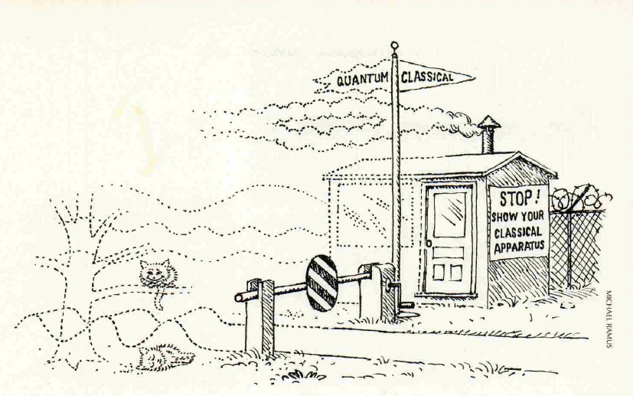
Revisiting the quantum-classical boundary
Decoherence and the transition from quantum to classical, Zurek 1991
Decoherence, einselection and the quantum origins of the classical, Zurek 2003

Slide 55
Revisiting the quantum-classical boundary
Emergence of the classical (Bottom-up approach)
Starting point: Hilbert space
Final point: End of the measurement postulate

Slide 56
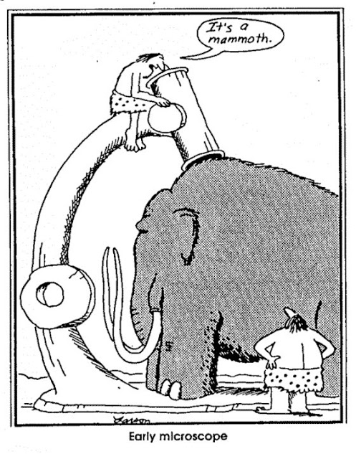
CSM and the classical-quantum boundary
Classical context (θ)
System
N quantized modalities

Slide 57
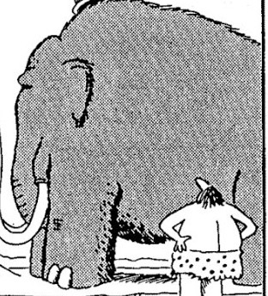
CSM and the classical-quantum boundary
Classical context (θ)
System
N quantized modalities
There are quantum effects, because:
There are less predictable answers (N) than questions (θ)
Need for a system and a context

Slide 58
CSM and the classical-quantum boundary
Top-down approach
The context is always already there
The system will never « swallow the context »
No emergence of the classical (from the quantum)

Slide 59
Back to ordinary discomfort zones
Systems
« |ψ> »
Contexts
« Ô »
Quantum reality
Hidden ✔
Superpositions ✔
Non-locality, spooky action ?
Unitary evolution
Classical contexts
Quantum-classical boundary ✔
Randomness ✔
Non-unitary evolution
Notes:
Troisième inconfort. Avant: dichotomie dans les objets, maintenant, dichotomie dans les lois quantiques. Unitaire vs non-unitaire. Déterministe vs aléatoire.
Bilan: Pour être heureux, on aimerait bien se débarrasser des appareils de mesure qui cachent la réalité, ont l’air d’avoir une description différente et ont une action apparemment différente sur l’évolution du système.
Nous: on va au contraire construire sur la mesure. La mesure devient le levier sur lequel soulever le monde..

Slide 60


Spooky action and non-locality
Alice
Bob
EPR source
Ordinary quantum ontology:
Alice and Bob share an EPR pair of photons
Alice’s measurement => Wave packet reduction
Simultaneous projection on |H_{A}> and |V_{B}>
« Spooky action »

Slide 61
CSM and wave packet reduction
« Coherent superposition » => A modality in another context
U_{i}
« Wave packet reduction » => Random change of modality when the context is changed
C_{u,} θ_{u}
C_{v,} θ_{v}
S
V_{j}

Slide 62
The CSM view on EPR
U_{i} =EPR state
C_{u} = global context
C_{u,} θ_{u}
C_{v,} θ_{v}
S
V_{j} =factorized state
C_{v} = local contexts
V_{j}
« Alice’s measurement » = Change of context = Random change of modality
After the measurement: the context is at Alice’s, and the system is at Bob’s

Slide 63
The CSM view on EPR
Alice
Bob
EPR source
Non-locality = A consequence of the bipartite nature of reality
No spooky action

Slide 64
Outline
Introduction: What is a physical state? => The « quantum problem »
Rebuilding a quantum ontology
Revisiting quantumness
Recovering the quantum formalism
Conclusions. Outlook.

Slide 65
Back to ordinary discomfort zones
Systems
« |ψ> »
Contexts
« Ô »
Quantum reality
Hidden ✔
Superpositions ✔
Non-locality, spooky action ✔
Unitary evolution
Classical contexts
Quantum-classical boundary ✔
Randomness ✔
Non-unitary evolution
Notes:
Troisième inconfort. Avant: dichotomie dans les objets, maintenant, dichotomie dans les lois quantiques. Unitaire vs non-unitaire. Déterministe vs aléatoire.
Bilan: Pour être heureux, on aimerait bien se débarrasser des appareils de mesure qui cachent la réalité, ont l’air d’avoir une description différente et ont une action apparemment différente sur l’évolution du système.
Nous: on va au contraire construire sur la mesure. La mesure devient le levier sur lequel soulever le monde..

Slide 66
The fundamental quantum event
N modalities {u_{i}}
Random change of modality when the context is changed
C_{u,} θ_{u}
C_{v,} θ_{v}
S
N modalities {v_{j}}
Goal of the theory: Describe the event
Auffèves and Grangier, Scientific Reports 43365 (2017)

Slide 67
The fundamental mathematical object
Stochastic probability matrix
{u_{i}}
P_{v1|u1}
P_{v2|u1}
P_{v3|u1}
Π(v|u)=
P_{v1|u2}
P_{v2|u2}
P_{v3|u2}
{v_{j}}
P_{v1|u3}
P_{v2|u3}
P_{v3|u3}
Goal of the theory: Model Π(v|u)

Slide 68
Extra-contextuality of modalities
U_{i}
P_{vj|ui} solely depends on U_{i}
and V_{j}
C_{u,} θ_{u}
C_{v,} θ_{v}
S
V_{j}

Slide 69
Step 1: Rewrite Π
Π(v|u)=
P_{vj|ui} = Tr[P_{i} Σ⁺P_{j}Σ]
Σ = [P_{vj|ui}^{1/2} exp(iφ_{vj|ui}) ]
φ_{vj|ui} arbitrary phases
P_{v1|u1}
P_{v2|u1}
P_{v3|u1}
P_{v1|u2}
P_{v2|u2}
P_{v3|u2}
P_{v1|u3}
P_{v2|u3}
P_{v3|u3}
P_{k}=
k column
Goal: put constraints on these phases
0
0
0
0
0
0
0
0
1
k line

Slide 70
Step 1: Rewrite Π
Π(v|u)=
P_{vj|ui} = Tr[P_{i} Σ⁺P_{j}Σ]
Σ = [P_{vj|ui}^{1/2} exp(iφ_{vj|ui}) ]
P_{v1|u1}
P_{v2|u1}
P_{v3|u1}
P_{v1|u2}
P_{v2|u2}
P_{v3|u2}
Σ (C_{u}, C_{v})
Contexts pertain to a continuous group
Σ = 1 if no change of context
Σ -> 1 if C_{v} -> C_{u}
P_{v1|u3}
P_{v2|u3}
P_{v3|u3}
P_{k}=
k column
0
0
0
0
0
0
0
0
1
k line

Slide 71
Step 1: Rewrite Π
Π(v|u)=
P_{vj|ui} = Tr[P_{i} Σ⁺P_{j}Σ]
Singular values decomposition
P_{v1|u1}
P_{v2|u1}
P_{v3|u1}
P_{v1|u2}
P_{v2|u2}
P_{v3|u2}
P_{v1|u3}
P_{v2|u3}
P_{v3|u3}
P_{vj|ui} = Tr[P’_{i} RP’’_{j}R]
{P’_{i}}; {P’’_{j}} projectors
R real diagonal positive
P_{k}=
k column
0
0
0
0
0
0
Σ = URV⁺, Σ⁺ = VRU⁺
P’=UPU⁺, P’’=VPV⁺
U,V unitaries
0
0
1
k line

Slide 72
Step 2: Call ontology for help
P_{vj|ui} = Tr[P’_{i} RP’’_{j}R]
Depends on C_{u} and C_{v}
Identity for stochastic matrices
P_{vj|ui} = Tr[P’_{i} RP’’_{j}R]
R, P’_{i} , P’’_{j} depend on U_{i} and V_{j} only
R, P’_{i} , P’’_{j} invariant when
C_{u} -> C_{u}’ and C_{v} -> C_{v}’ keeping U_{i} and V_{j} unchanged
Extra-contextuality of modalities

Slide 73
Step 3: Chase the contradiction
Wanted: R(U_{i},V_{j})
Tr[R²P’_{k}]=N
Tr[R²]=N
For each k
Tr[(R²-1)P’_{k}]=0
N linear equations
D=Det [|U_{m,n}|²]
Either R=1, or D=0
Suppose R(C_{u} , C_{v}) ≠1 => D(C_{u} , C_{v})=0
C_{u} -> C’_{u} ; C_{v} -> C’_{v} => D≠0 => R(C’_{u} , C’_{v})=1
R depends on the whole contexts
ABSURD => R=1

Slide 74
Step 4: Unitary matrices
P_{vj|ui} = Tr[P_{i} Σ⁺P_{j}Σ]
Σ = [P_{vj|ui}^{1/2} exp(iφ_{vj|ui}) ]
Σ = URV⁺, Σ⁺ = VRU⁺
U,V unitaries
R=1 => Σ = Σ⁺= Σ⁻¹
Real matrices?
Continuity of contexts
Continuous path relating identity and permutation
Σ = complex, unitary matrix

Slide 75
And finally: Usual quantum formalism
P_{vj|ui} = Tr[P_{i} Σ_{v|u}⁺P_{j}Σ_{v|u}]
P_{vj|ui} = Tr[Σ_{v|u}P_{i} Σ_{v|u}⁺P_{j}]
U_{i}
V_{j}
U_{i}, V_{j} = Rays in a Hilbert space
Change of context = Σ_{v|u} unitary
Probabilities follow Born’s rule

Slide 76
Outline
Introduction: What is a physical state? => The « quantum problem »
Rebuilding a quantum ontology
From classical to quantum
Recovering the quantum formalism
Conclusions. Outlooks.

Slide 77
Back to ordinary quantum ontology
Systems
« |ψ> »
Contexts
« Ô »
Quantum reality
  Superpositions
  Unitary + deterministic
Classical contexts
Quantum-classical boundary?
Non-unitary + Random
Notes:
Avec l’inconfort philosophique, viennent des inconforts d’ordre physique (auxquelles on s’habitue aussi – on s’habitue à tout!)
Inconfort sur les objets de la théorie quantique.
1. La réalité quantique « cachée », avec des caractéristiques hautement « non classiques »
2. Dichotomie entre cette réalité cachée et les contextes classiques qui l’entourent.

Slide 78
Back to ordinary quantum ontology
Systems
« |ψ> »
Contexts
« Ô »
First source of intuition: Classical realism
States « ψ » pertain to systems alone

Slide 79
Back to ordinary quantum ontology
Systems
« |ψ> »
Contexts
« Ô »
Second source of intuition: Statistical physics
Reality is hidden, below
The classical emerges from the quantum

Slide 80
Back to ordinary quantum ontology
Systems
« |ψ> »
Contexts
« Ô »
Third source of intuition: Formalism
Quantum mechanics starts with maths
Formalism = the reality we get accustomed to

Slide 81
C-S-M: Inversion of norms
Ontology vs formalism
Phenomena vs « ψ »
Non-unitarity vs unitarity
Quantization vs interferences
Classical vs quantum
Randomness vs determinism

Slide 82
Ontology first, formalism second
Quantum phenomenology
Ontological postulates
Contextuality/Quantization/Continuity
Core quantum features
Randomness, Non-locality
Formalism
Hilbert spaces
Notes:
Publicité. Interprétations. Tous d’accord sur le formalisme, bcp moins sur ce qu’il signifie.
Nayla => pas une interprétation, mais un point de vue, une approche, etc…car on n’interprète pas le formalisme. On part des phénomènes, puis des concepts. Et on peut déjà dégager bcp de caractéristiques du monde quantique, sans avoir écrit une seule équation.

Slide 83
Phenomena first, « ψ » second
Phenomenon
Modality
Context
S
The CSM approach of reality is based on certainty and actuality
What is real is the modality-phenomenon.
Ψ is a potentiality

Slide 84
Non-unitarity first, unitarity second
Fundamental quantum event = the change of probability (Non-unitary)
Unitary transformations describe the change of context
U_{i}
C_{u,} θ_{u}
C_{v,} θ_{v}
S
V_{j}

Slide 85
Quantization first, interferences second
The random change of modality is due to quantization
To describe context changes, unitary matrices are needed => complex numbers => interferences
U_{i}
C_{u,} θ_{u}
C_{v,} θ_{v}
S
V_{j}

Slide 86
Classical first, quantum second
Quantum effects pop up, because there are less repeatable answers (N) than possible questions (θ)
Top-down approach
The basis: the classical

Slide 87
Randomness first, determinism second
Epistemological randomness
Information loss due to coarse-graining
Bottom up approach
From microscopic to macroscopic
Ontological randomness
Unpredictability due to quantization
Top down approach
From macroscopic to microscopic

Slide 88
Some outlooks
Get CSM out of the lab!
Context -> Environment
Control
Rebuild quantum thermodynamics on quantum randomness
O
S
M
Rethink epistemology vs ontology, given contextual objectivity
C₁
S
C₂
M₁
M₂

