Slide 1
Connector for SSD
Michael Riegel 2018 Grenoble

Slide 2
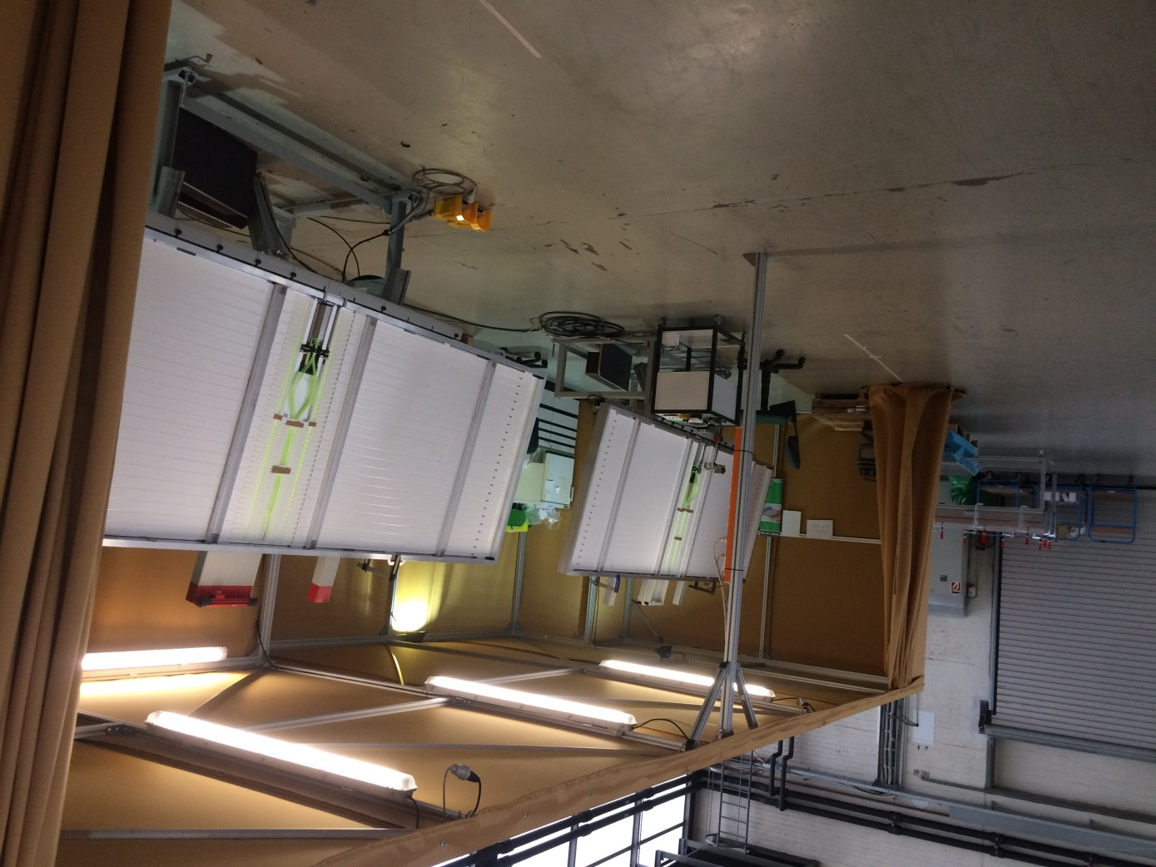
Inner Production in Karlsruhe
-More than 100 SSDs
-Tilting table
-2 workers and one student

Slide 3
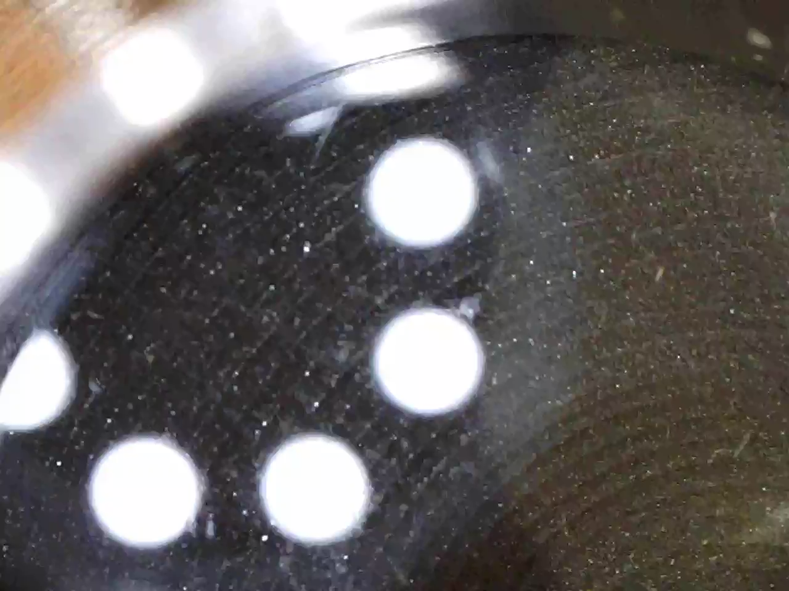
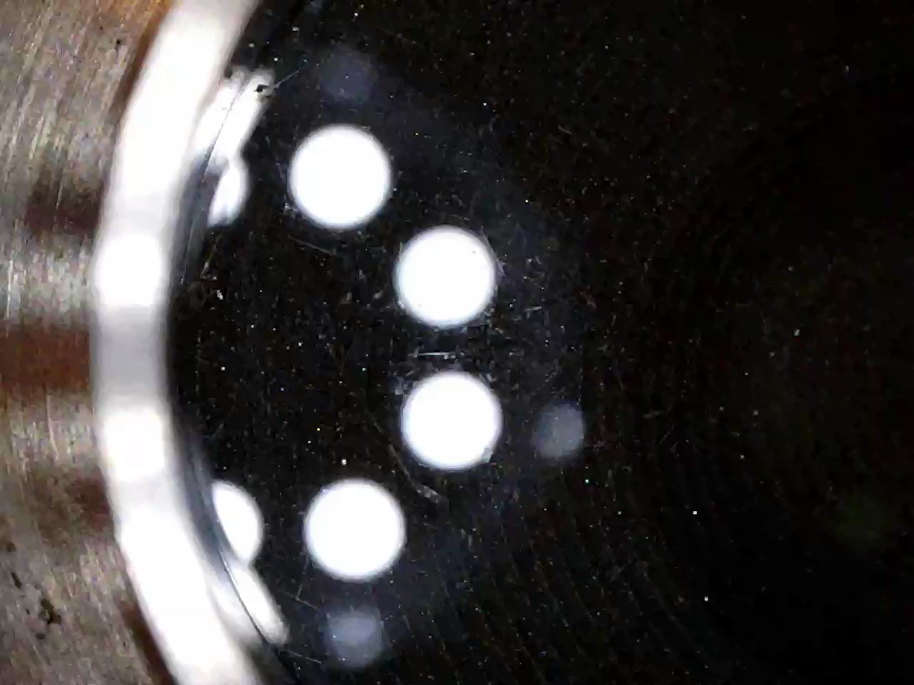
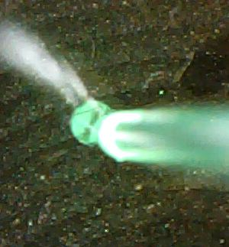
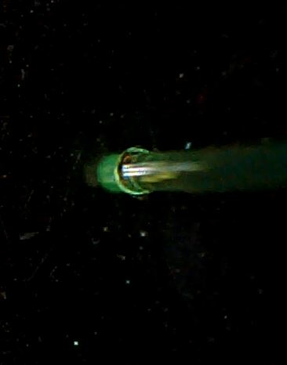
Metling melt the fibre at 140°C on borosilicate disk
Black-
Line
Halo

Slide 4
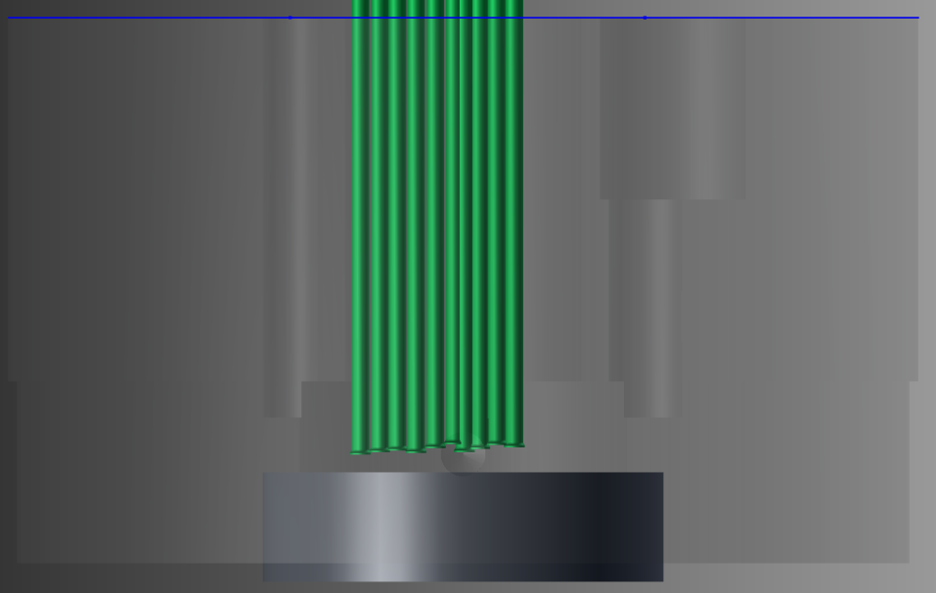
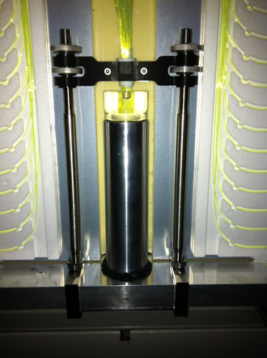
Alignment
Gap ~1,5mm
Contact to the window disc
If some fail search with pocket lamp

Slide 5
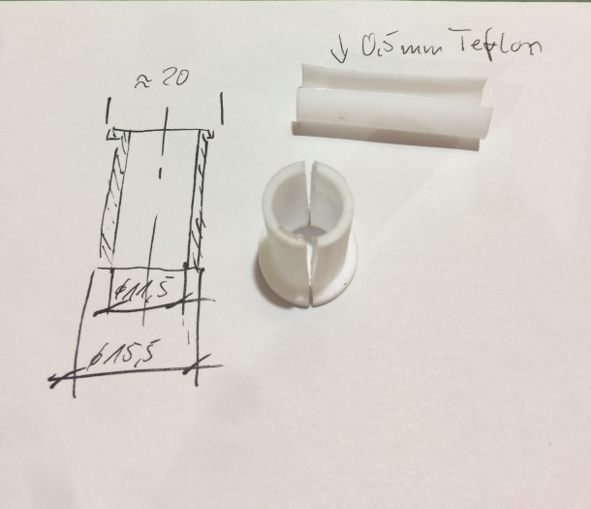
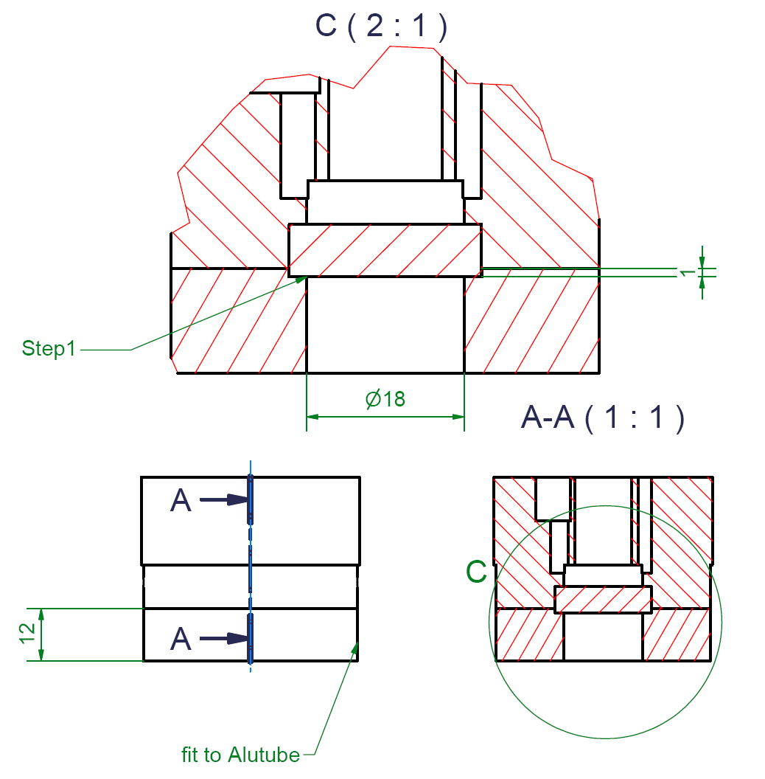
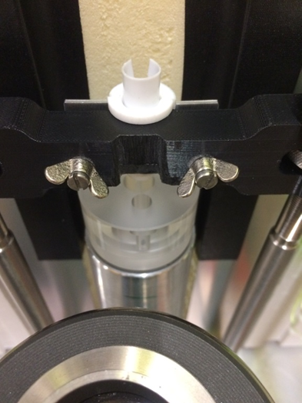
Alignment

Slide 6
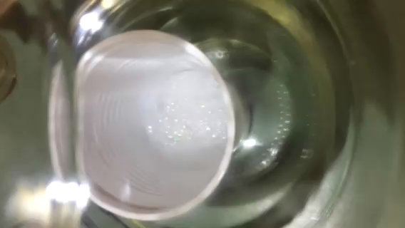
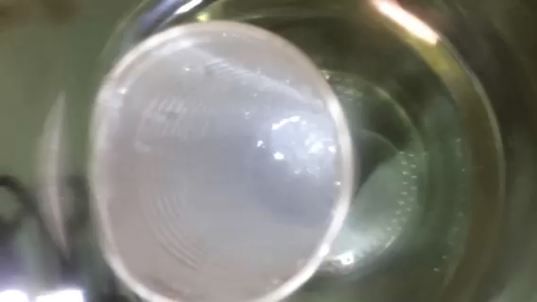
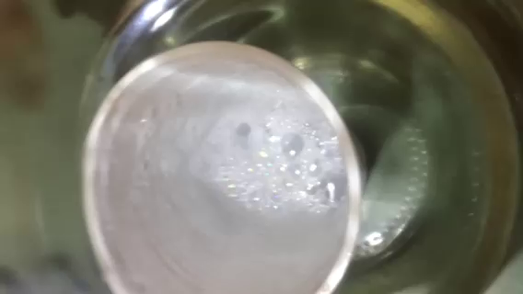
Degas ~ 900 mbar ( oil rotary vane pump)
1
3
2 - collapsing

Slide 7
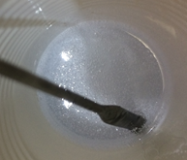
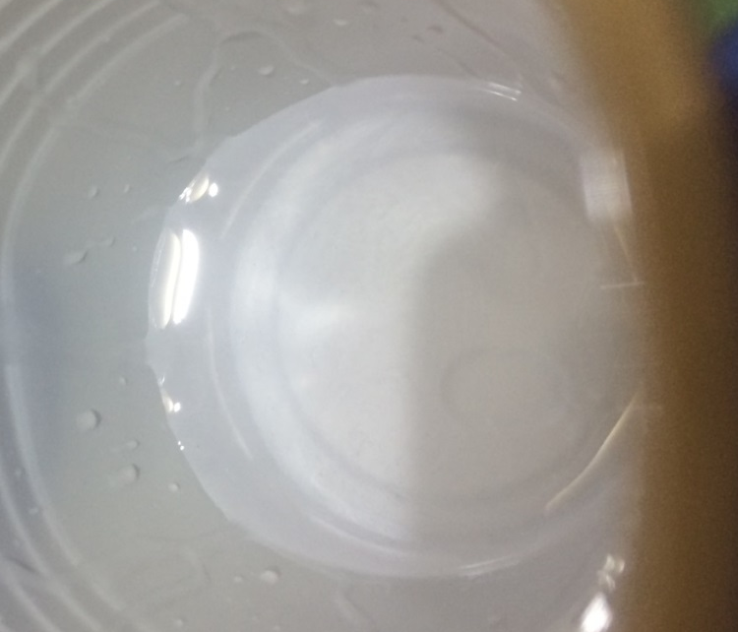
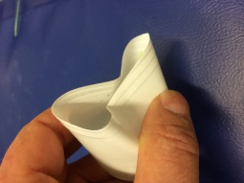
Degas and Glueing
After mixing
After degasing
Glueing: Don´t stop filling until filling hole is filled

Slide 8
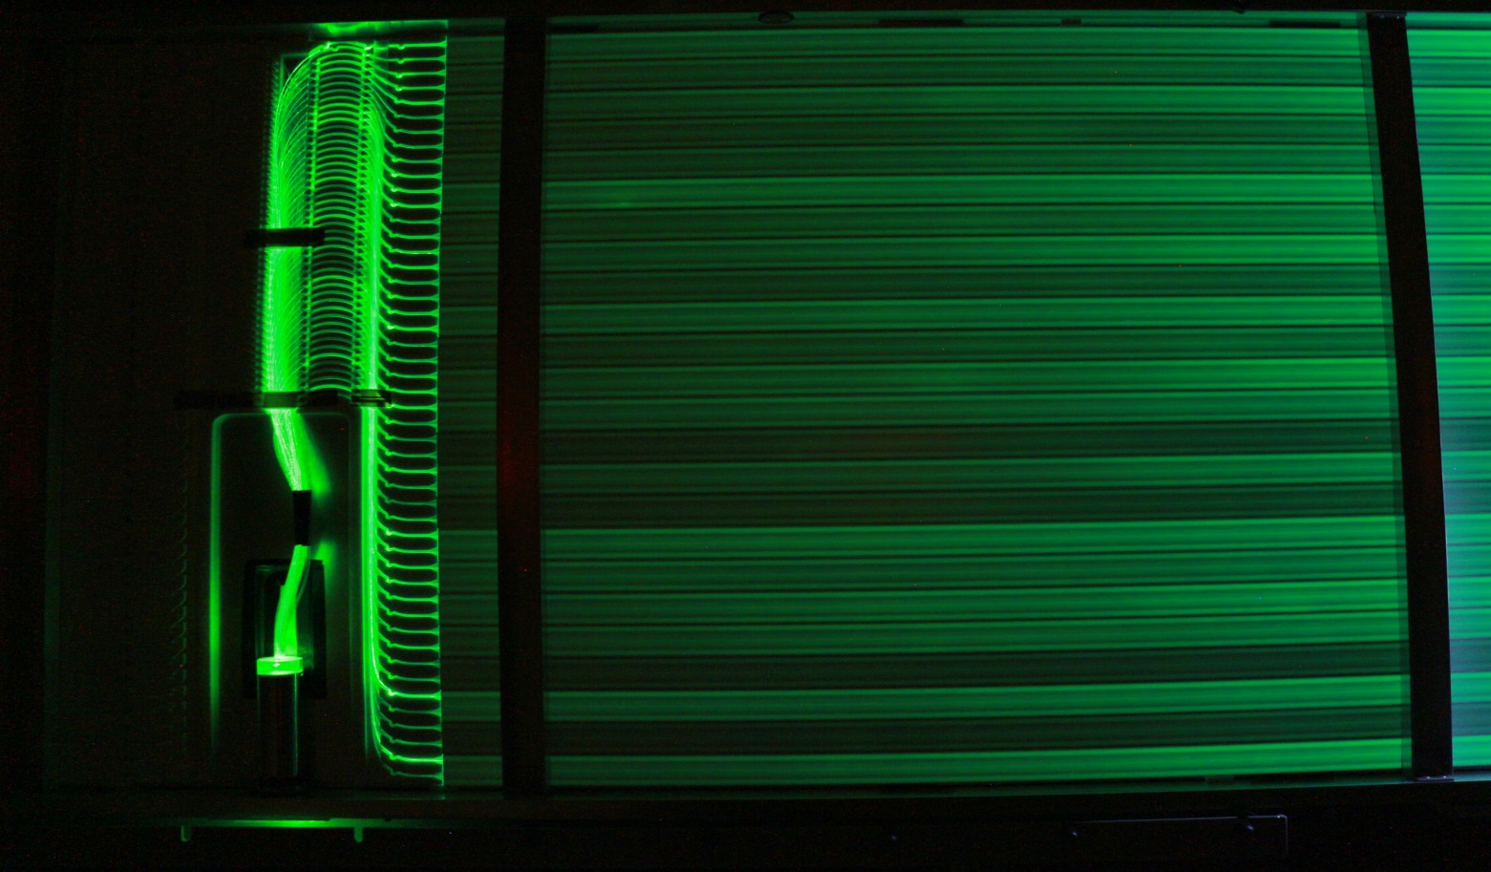
Danke

Slide 9
