Slide 1
AugerPrime SSD Production at Nikhef in Nijmegen
Sijbrand de Jong
Most of the real work has been done by
Gerben Wulterkens (engineer at Radboud University)
Lesley Room & Eithel Delle (techs at Radboud University)
Thanks to Auke Korporaal (Nikhef Amsterdam) for preparing the drawings &
Arno Engels (Radboud University) for designing the mounting frame

Slide 2
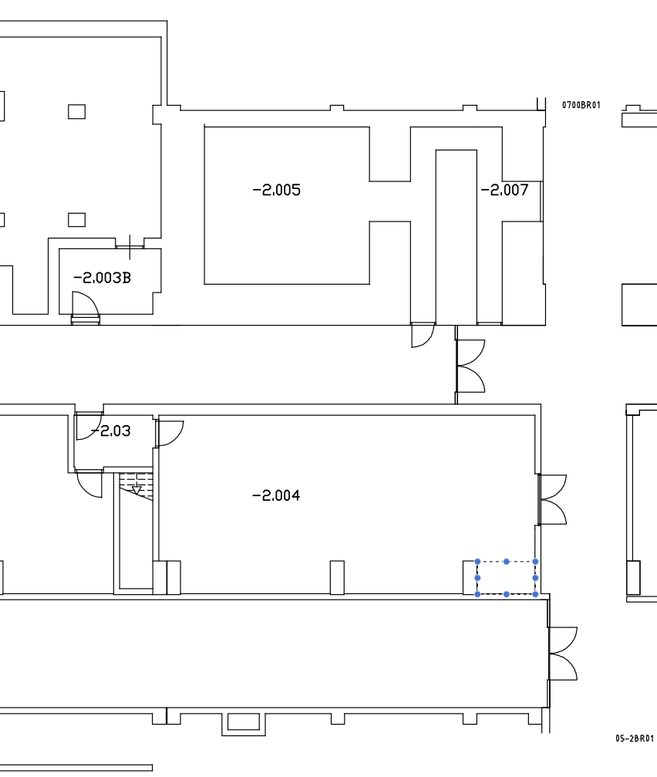
Assembly room
Parts storage
Assembly table
Assembly table
Test stand
Parts storage
Sandwich panels
Welded frames
Sandwich panels
Top cover plates

Slide 3
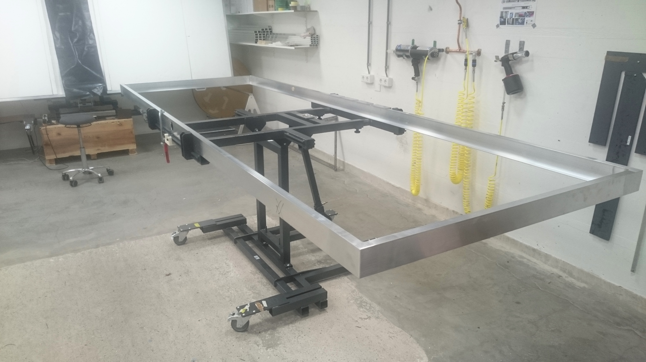
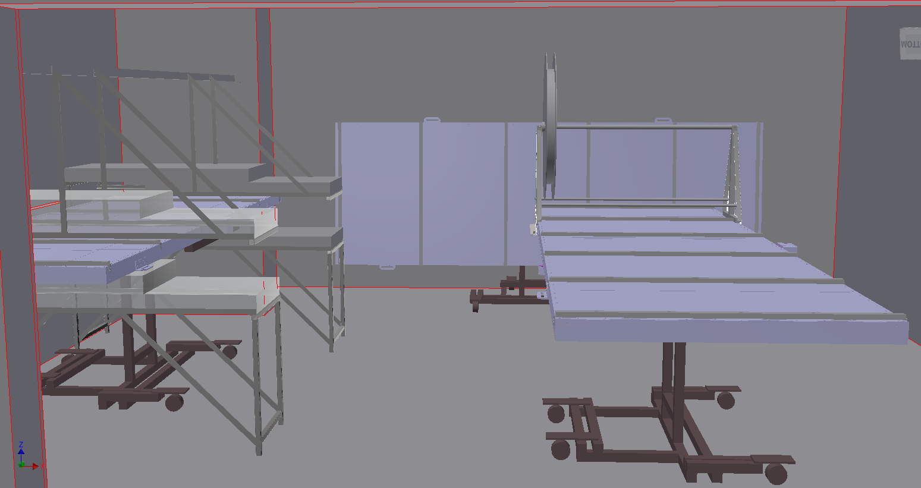
Assembly room: as we foresee it to be used
Cookie
Gluing
station
Frame - bottom plate &
scintillator filling
assembly station
Test station

Slide 4
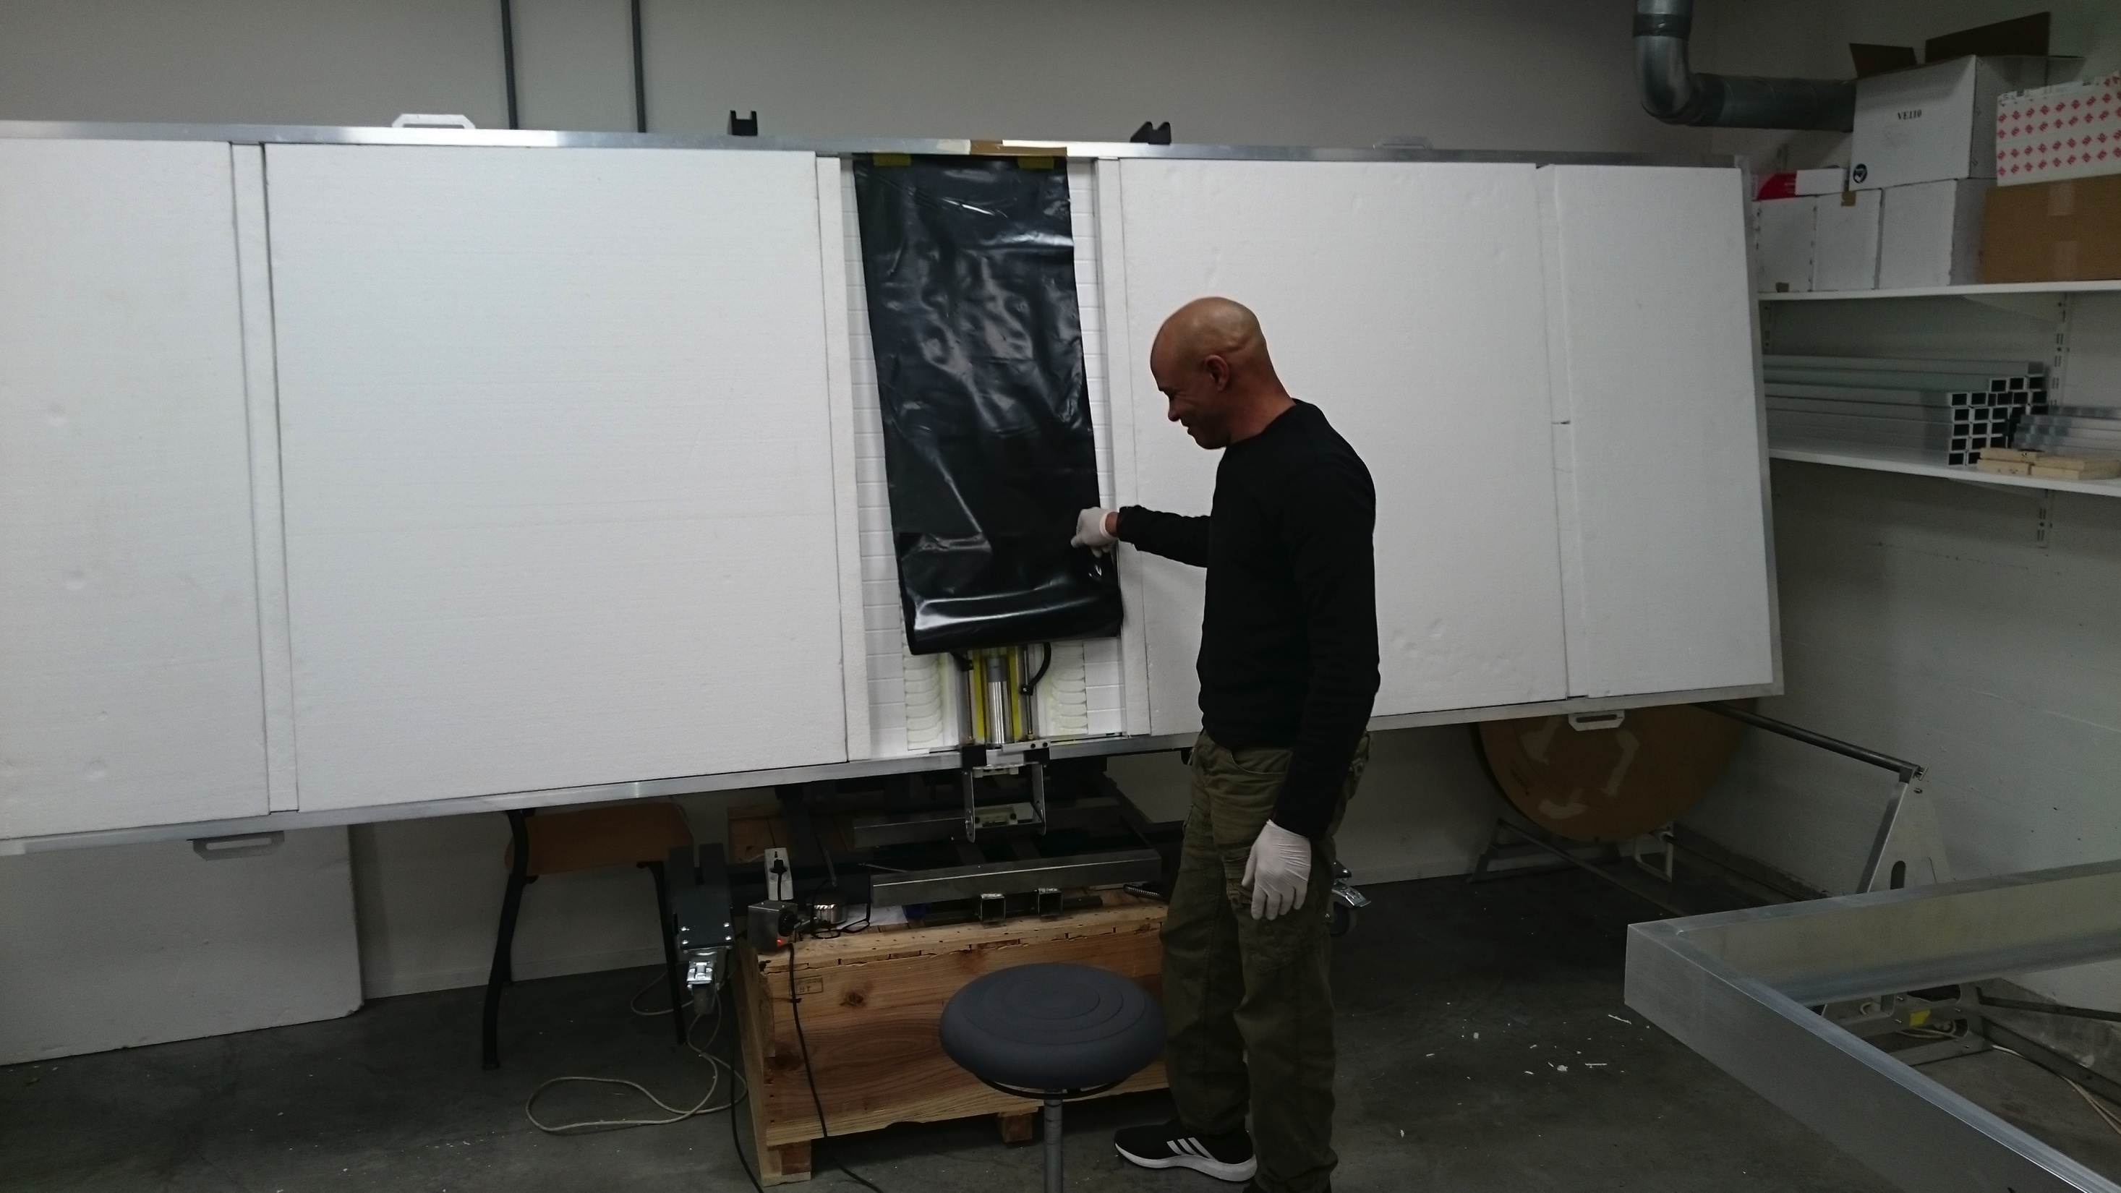
Assembly room: as we foresee it to be used
Cookie
Gluing
station
Frame - bottom plate &
scintillator filling
assembly station
Test station

Slide 5
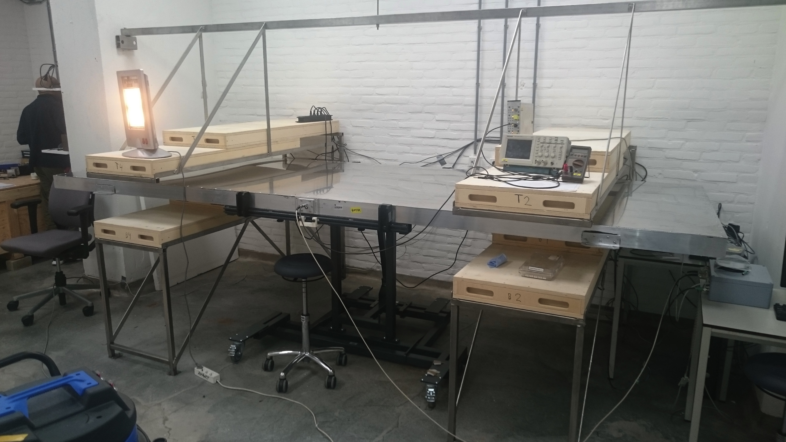
Assembly room: as we foresee it to be used
Cookie
Gluing
station
Frame - bottom plate &
scintillator filling
assembly station
Test station

Slide 6
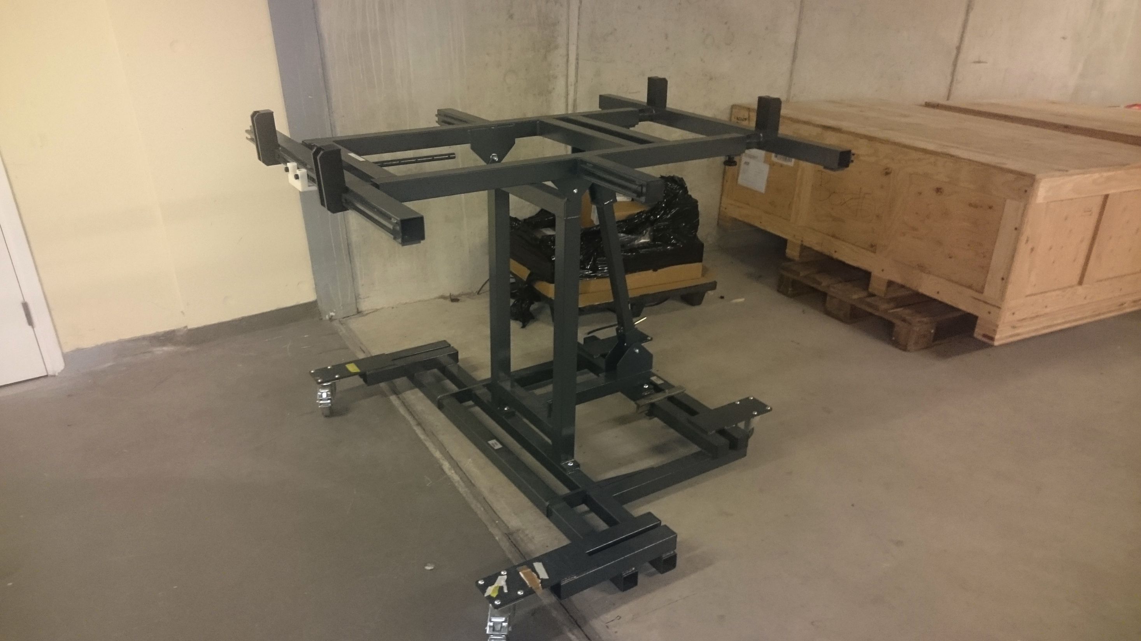
Assembly room: as we foresee it to be used
Cookie
Gluing
station
Frame - bottom plate &
scintillator filling
assembly station
Test station

Slide 7
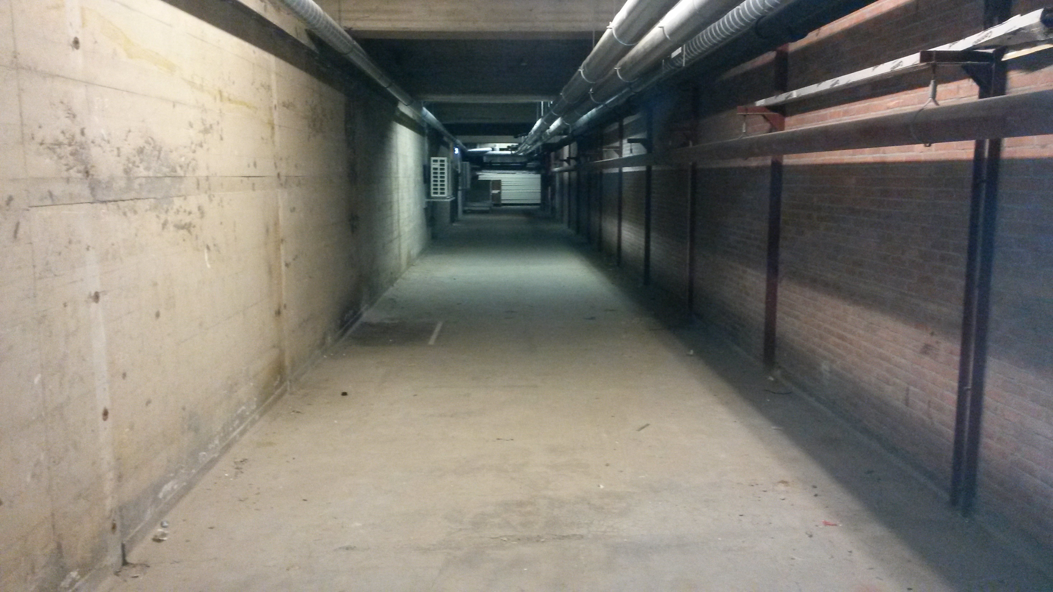
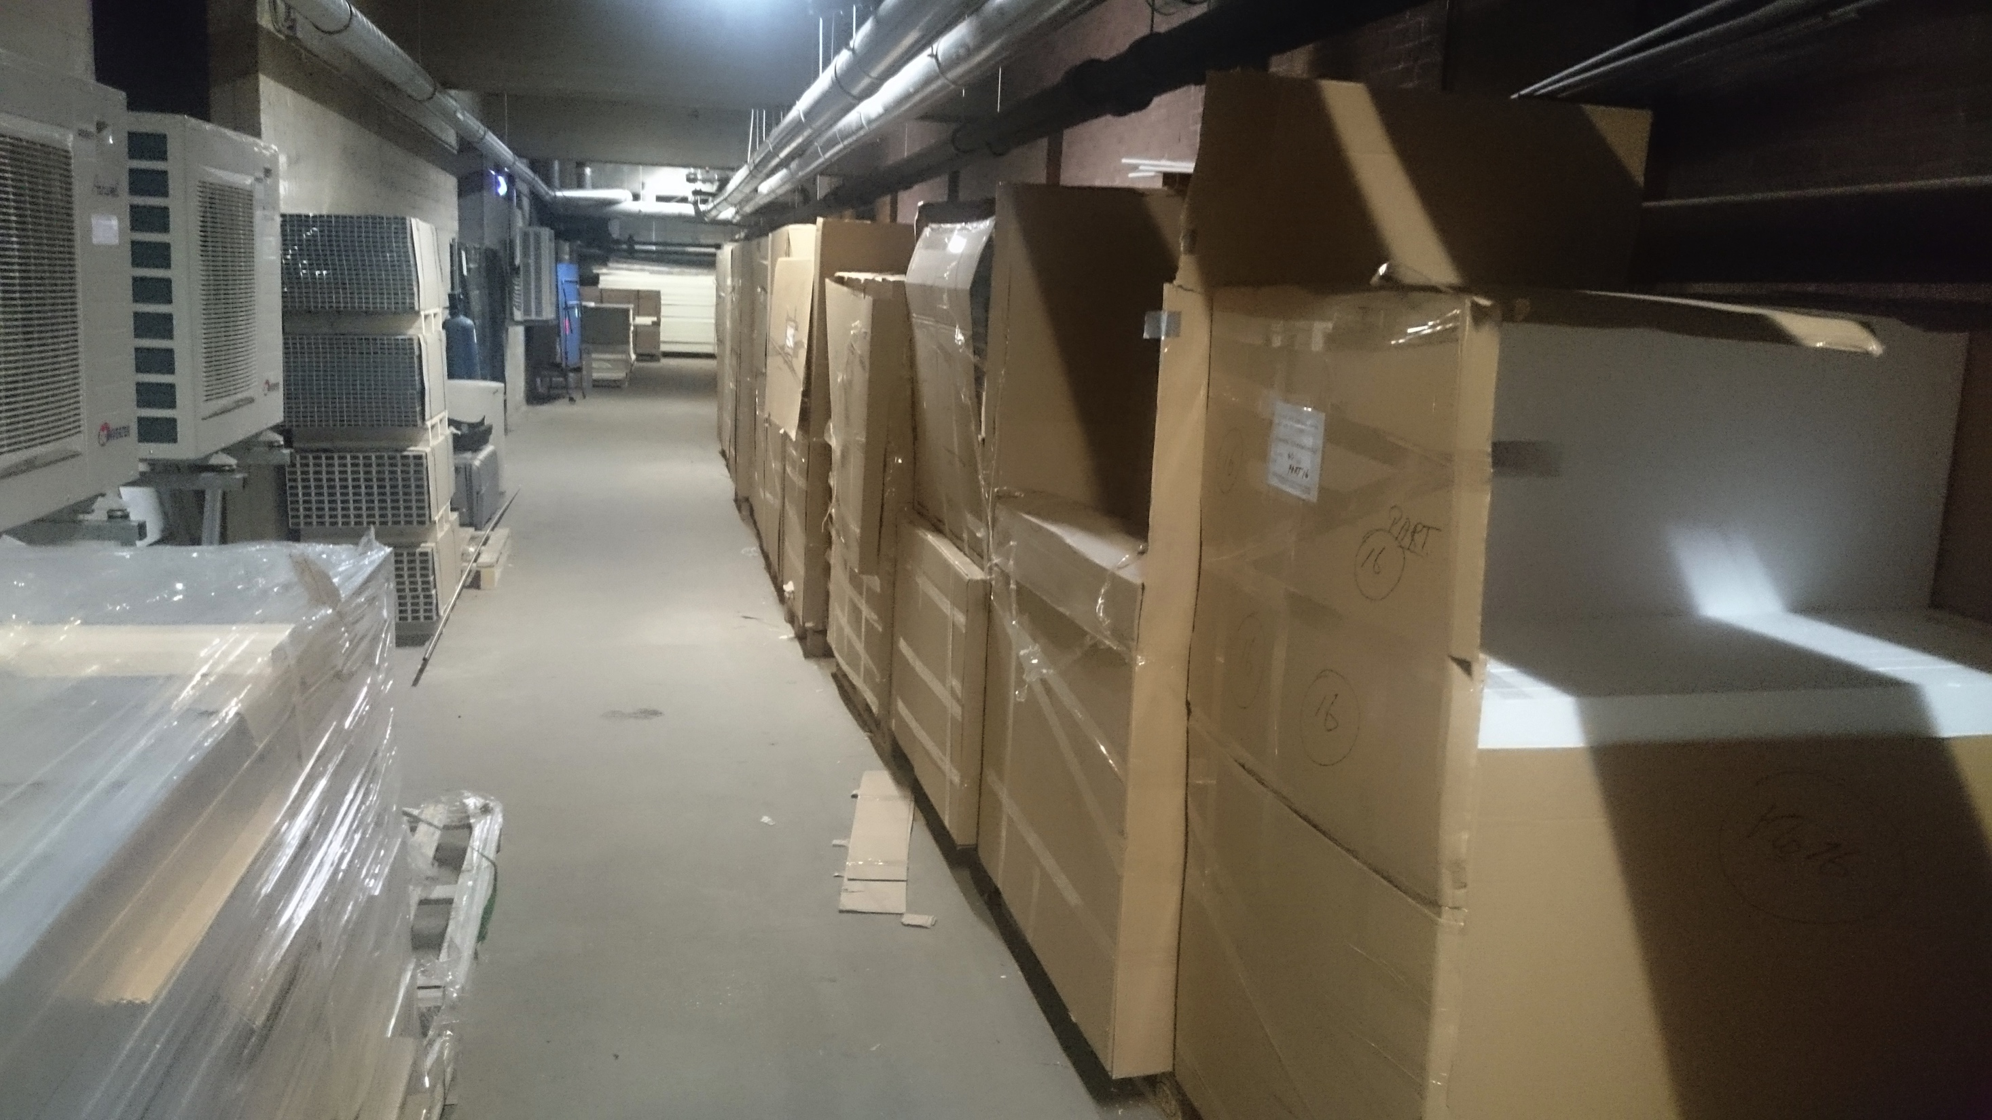
Storage space next to assembly room

Slide 8
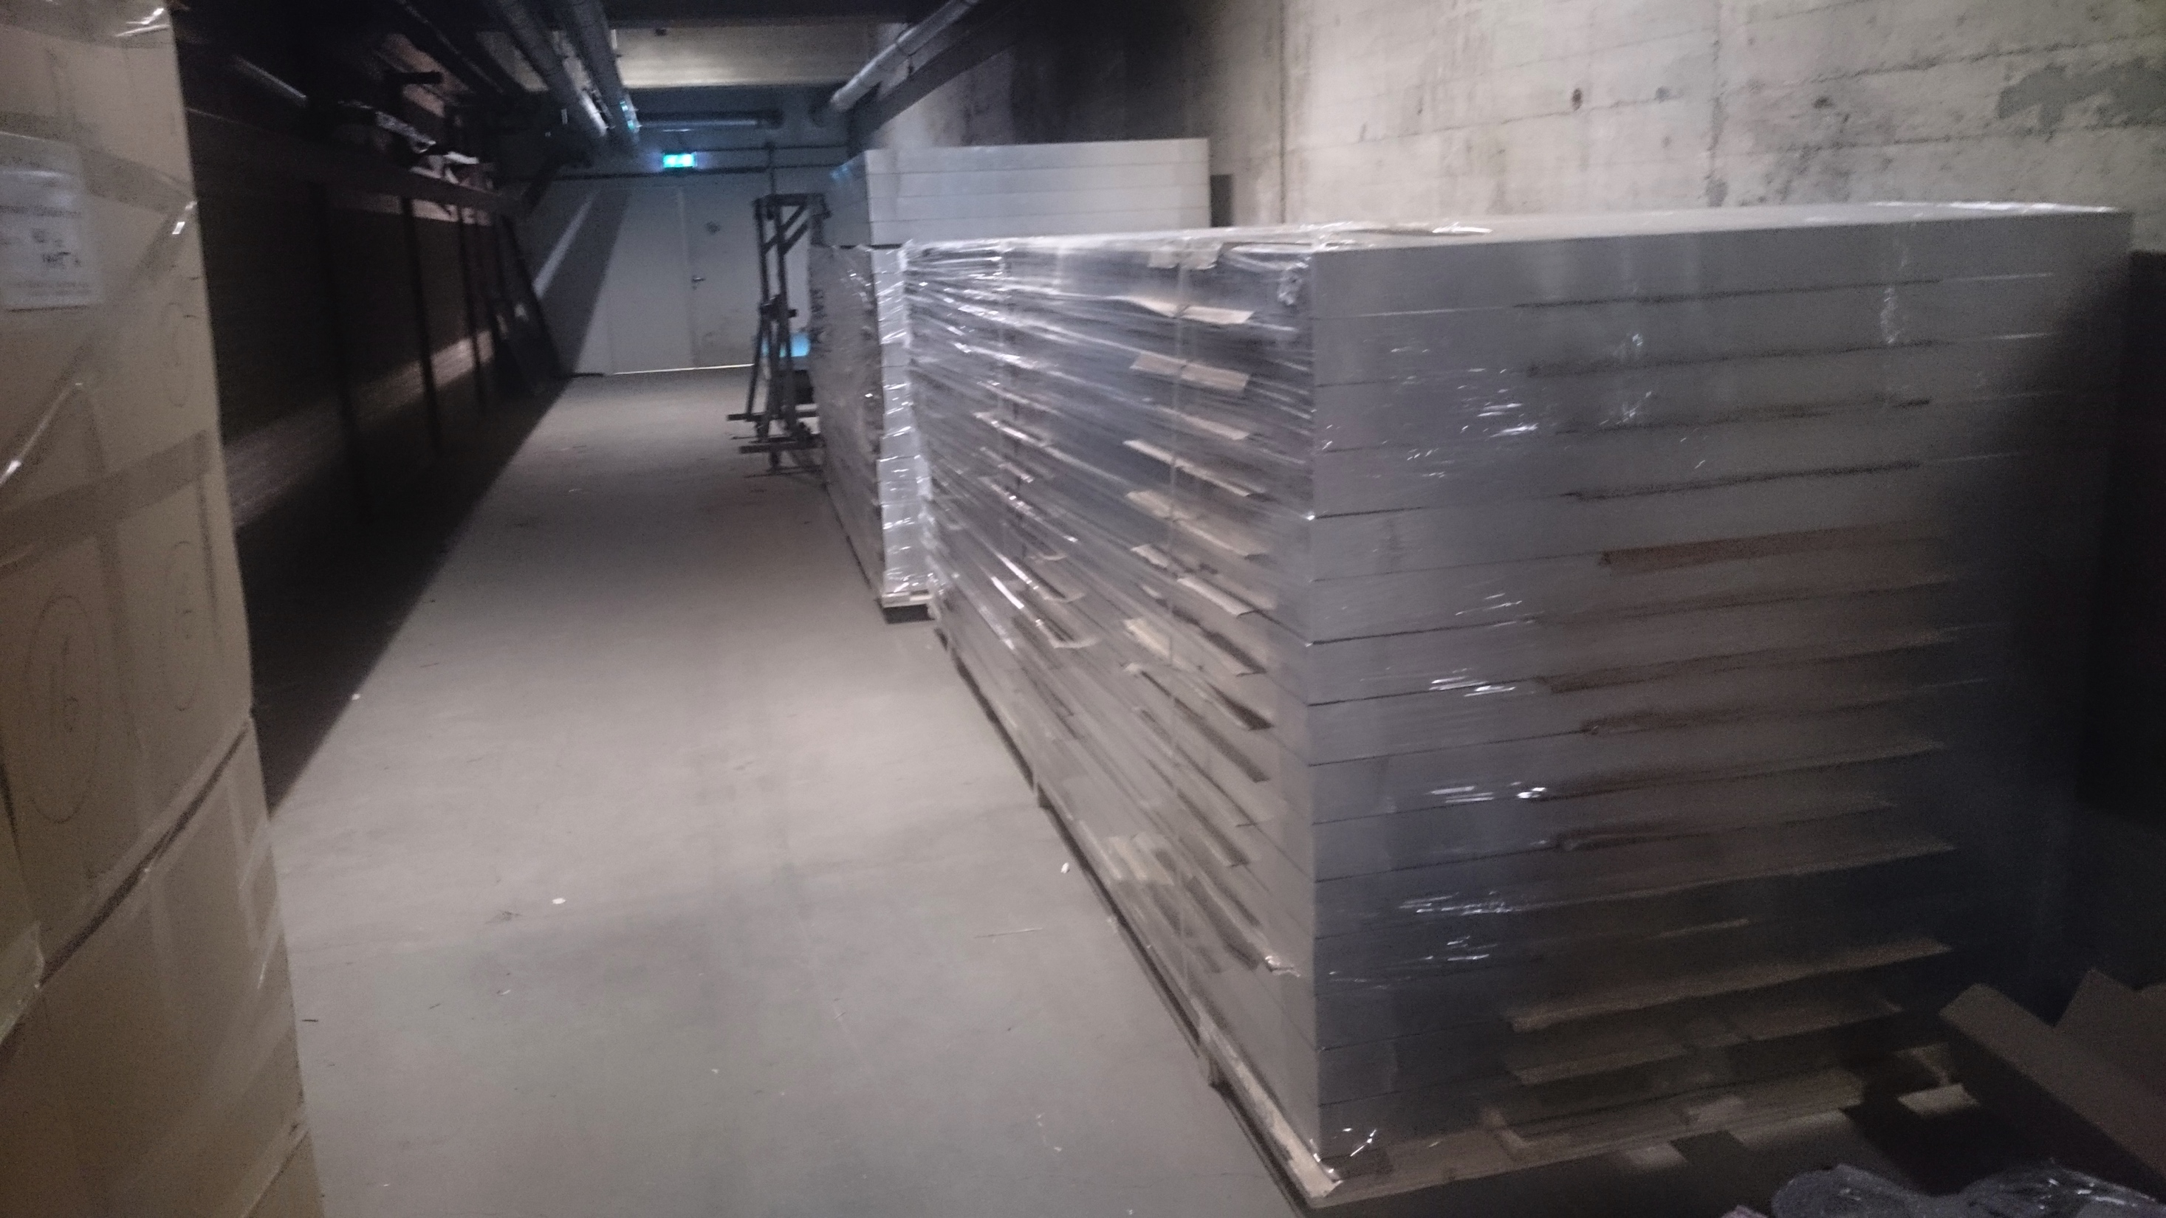
Storage space next to assembly room

Slide 9
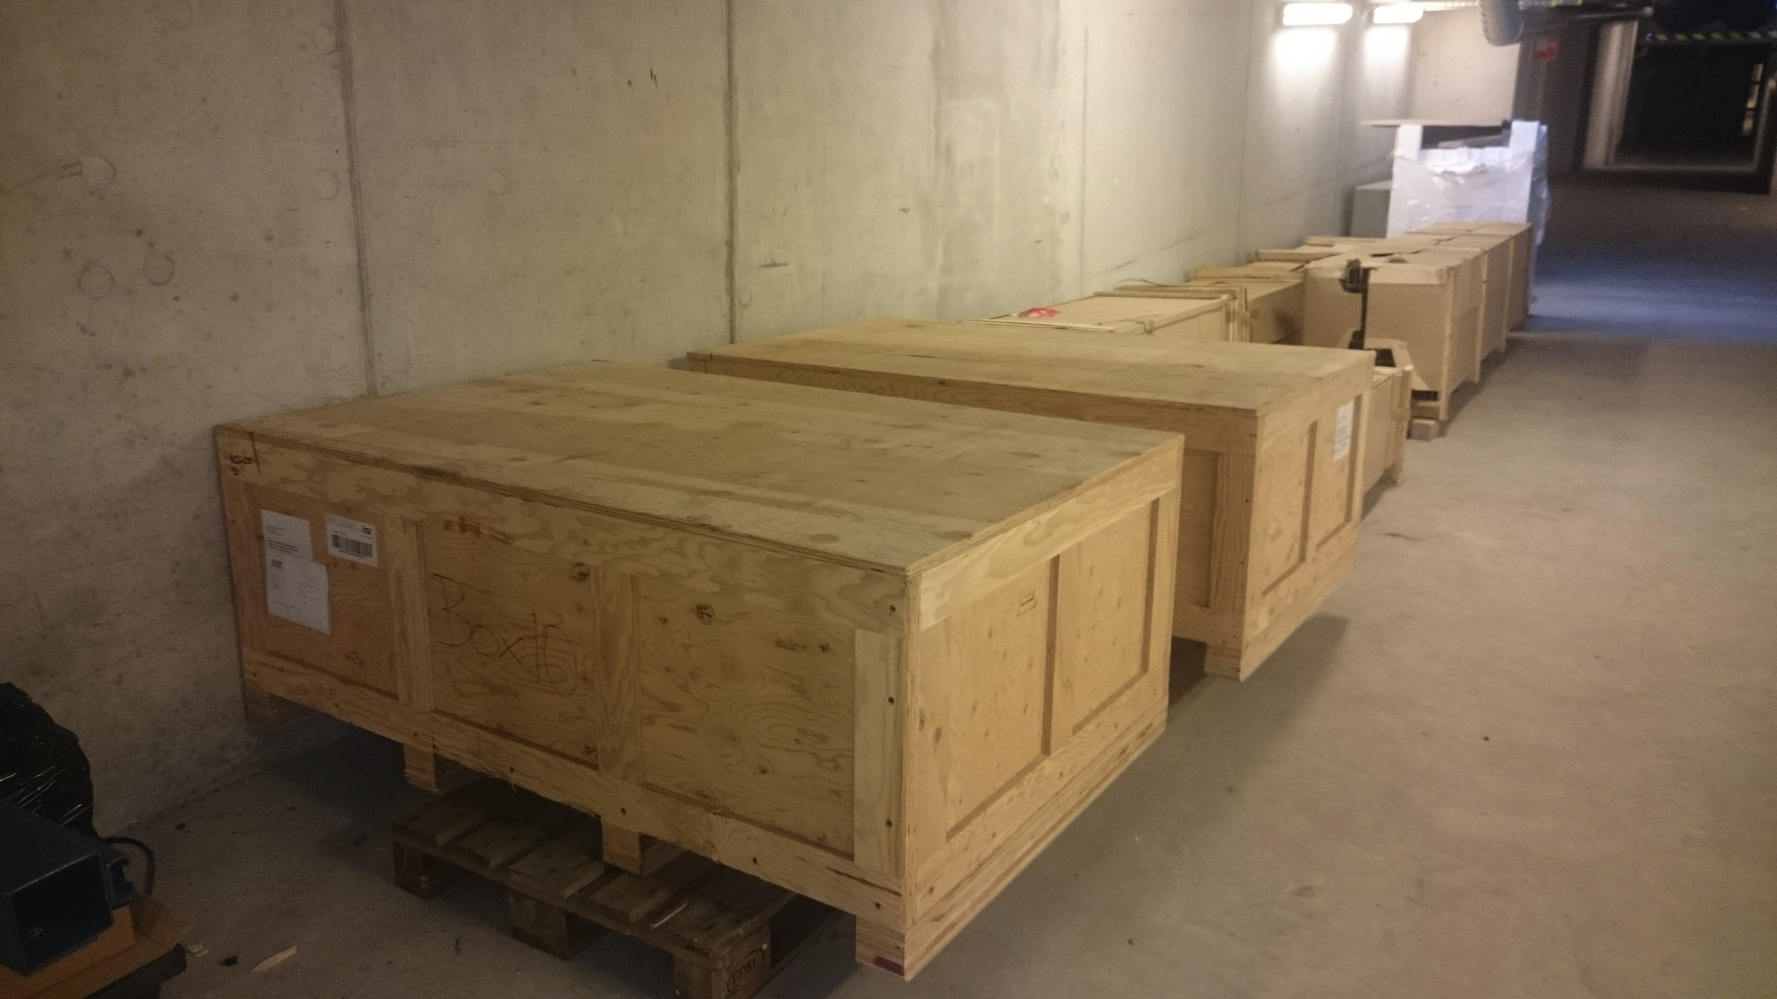
Storage space next to assembly room

Slide 10
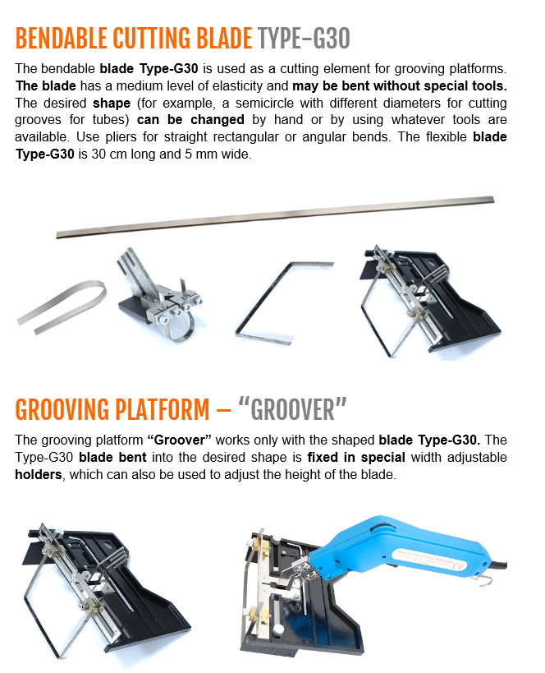
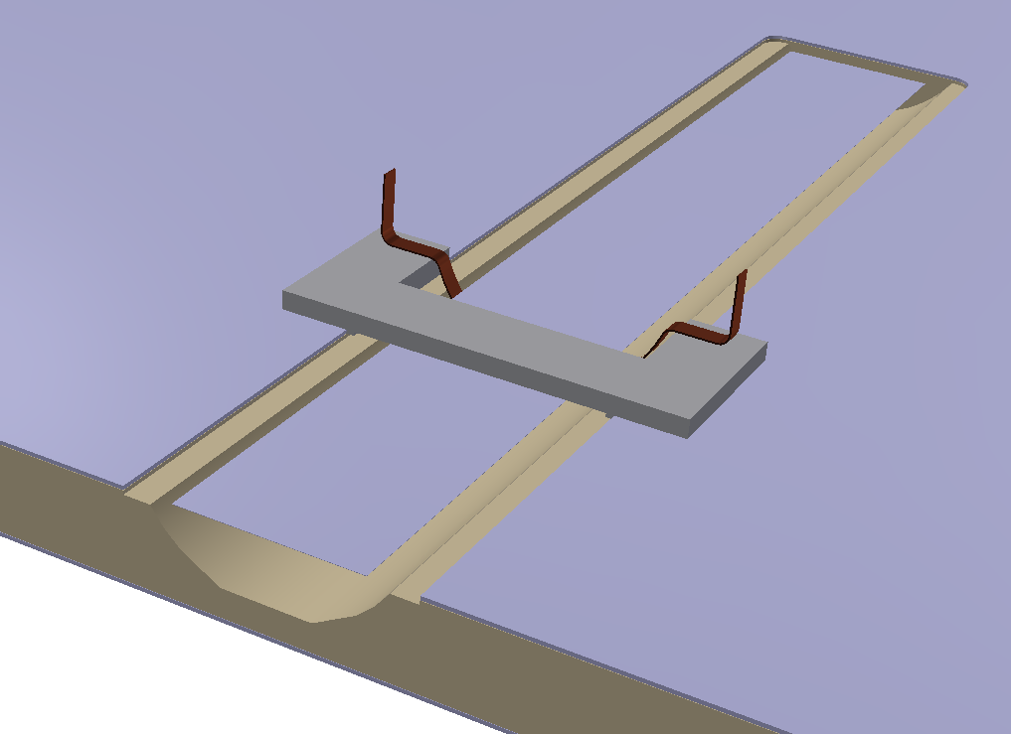
Storage space: do sandwich plate cut-out here
Cut metal sheet
with a router
Cut foam
with a hot blade

Slide 11
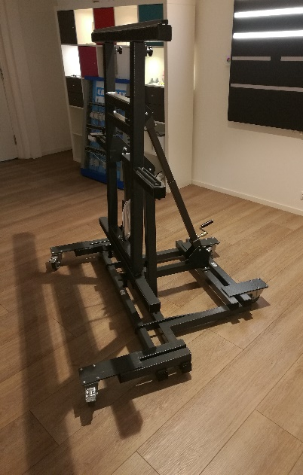
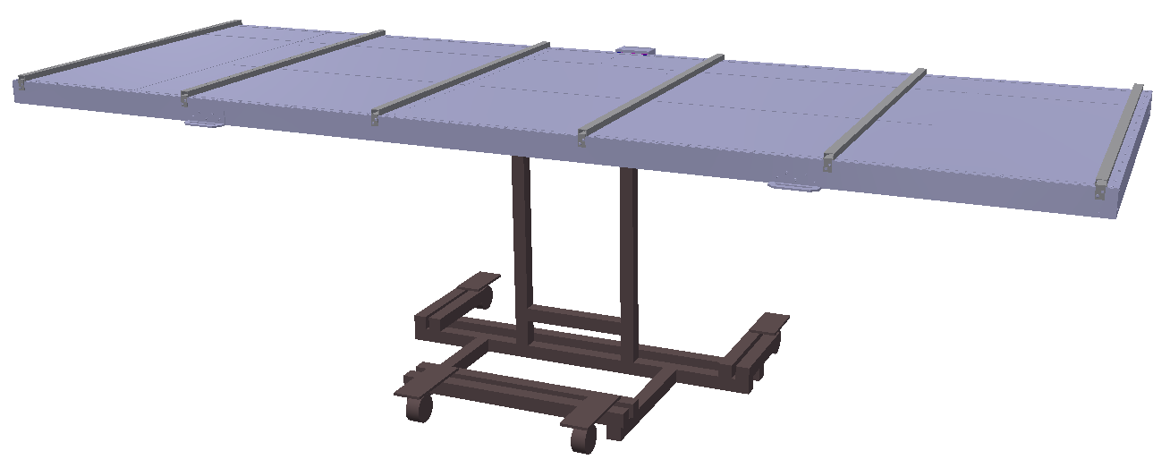
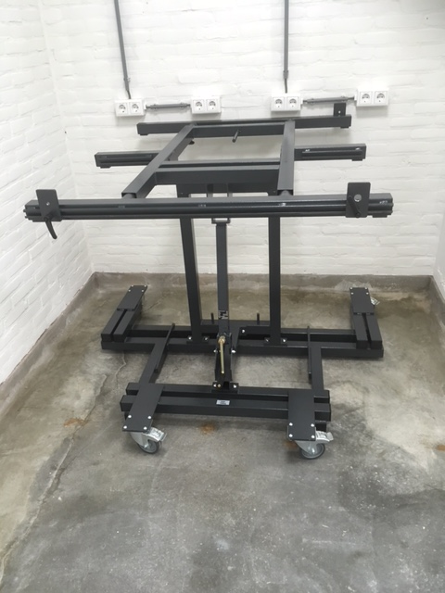
3 Klemko assembly tables
Stay with the same module throughout production
Vertical position up to 89º
reasonable
working
height for
cookie
gluing

Slide 12
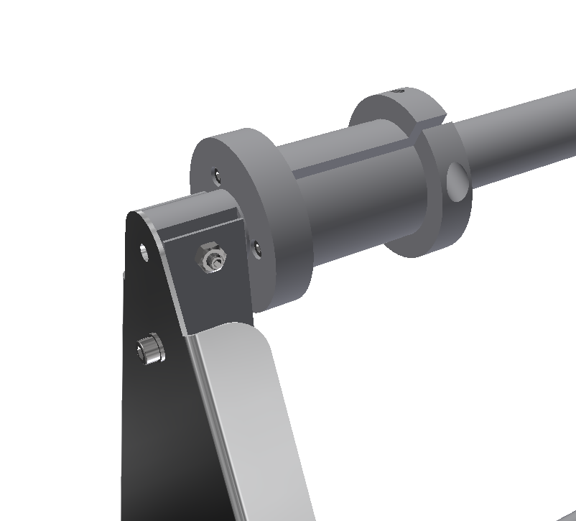
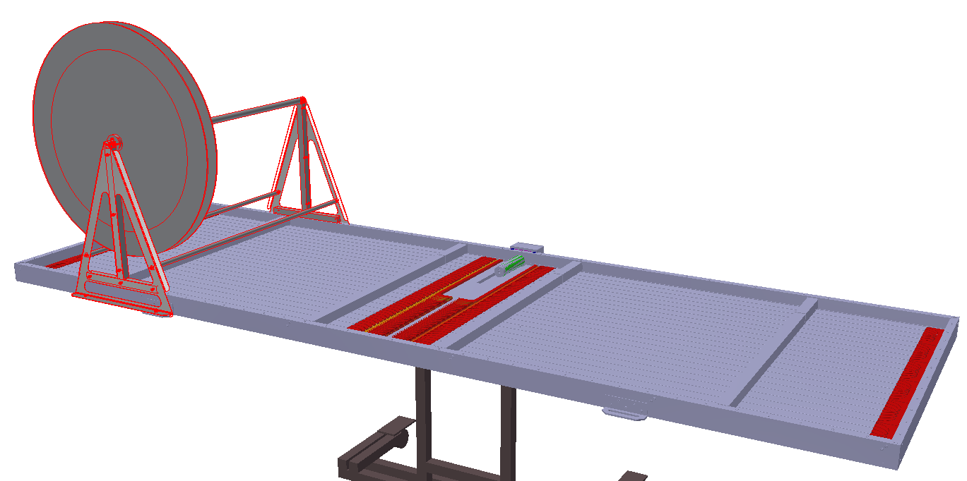
Fiber roll support
Adjustable friction on axis
to avoid excess fiber to
come off the roll, while
keeping small pulling force

Slide 13
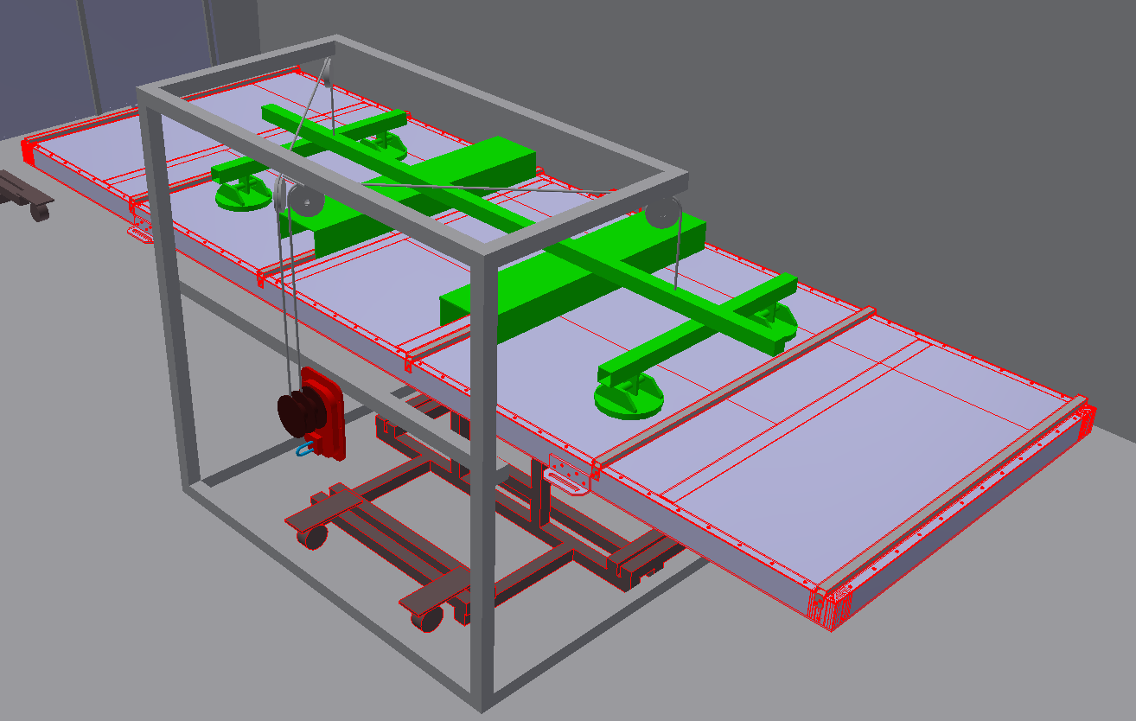
Top plate and module lifting device
Top plate with
suction tools
Controlled lowering
of the top plate
to touch from the
middle moving out

Slide 14
Top plate and module lifting device
Also used with
slings to lift the
finished modules
for stacking
for storage and
into sea container
Not drawn:
but will be on wheels

Slide 15
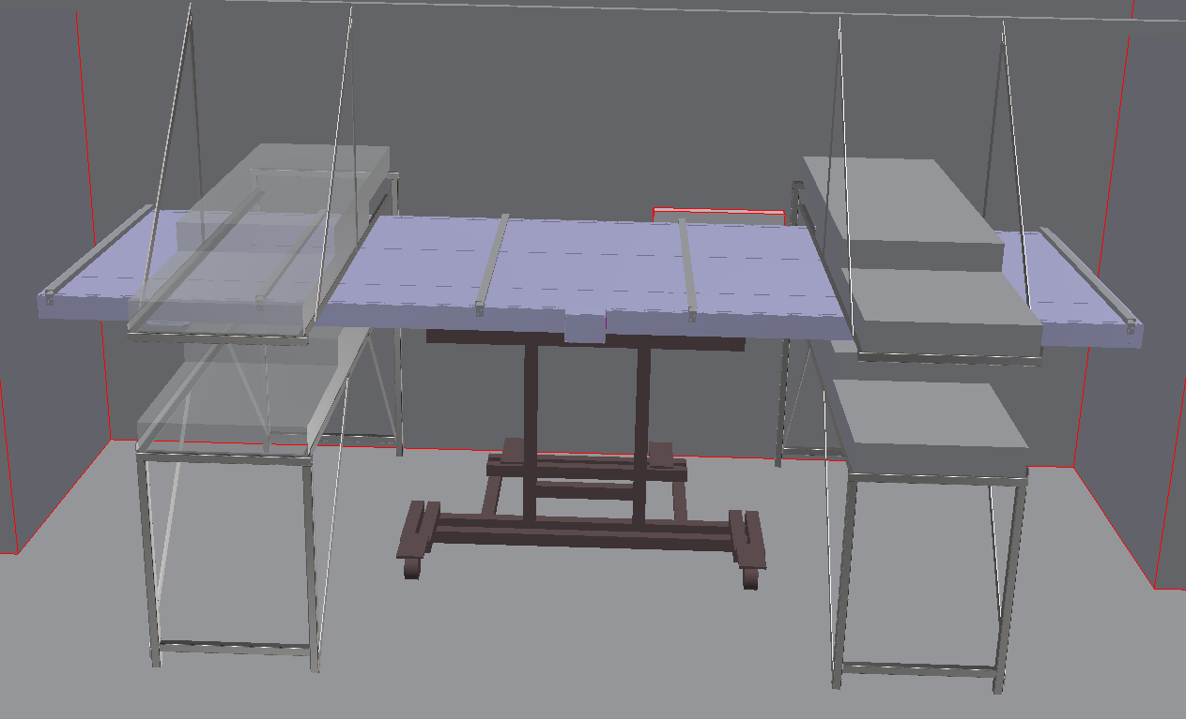
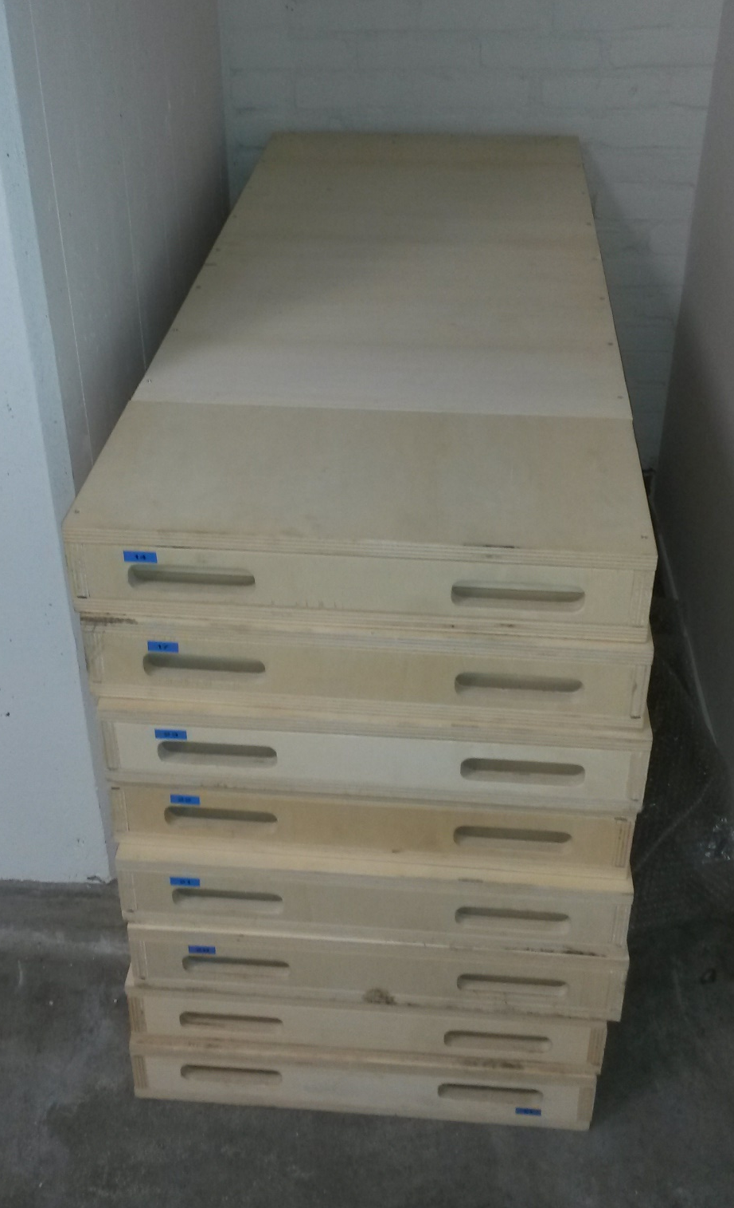
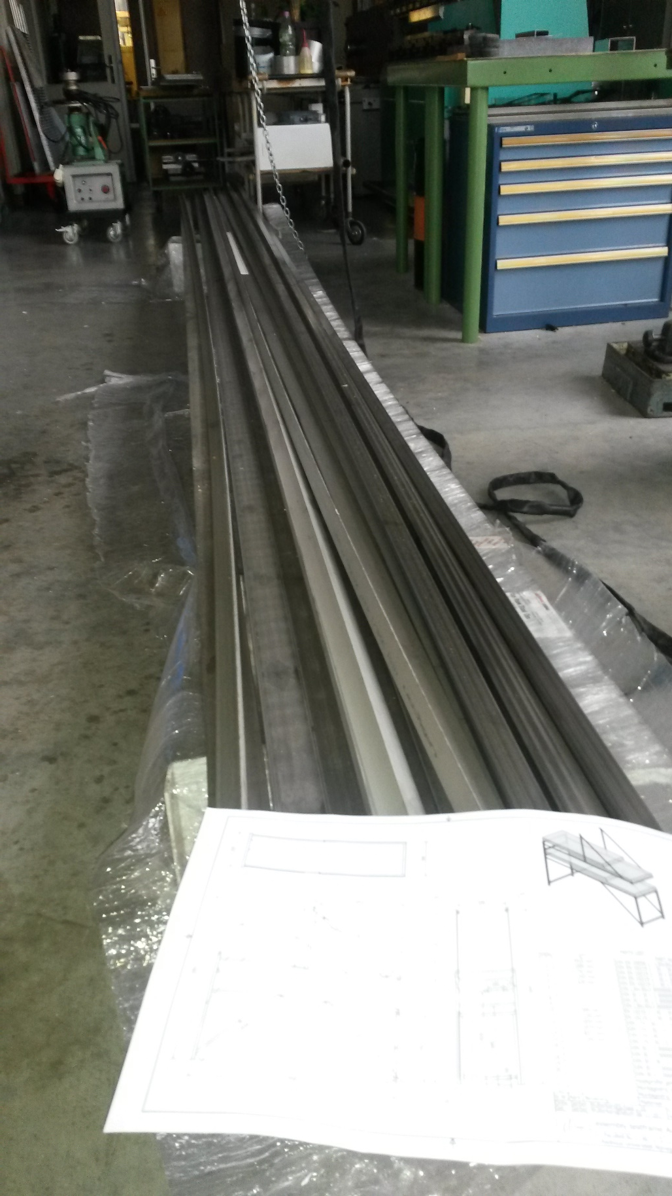
Test station
50x100 cm scintillator
modules left over from
an earlier (outreach!)
project
Work in progress

Slide 16
Test station
Test both scintillator sides
Several width zones, but no single bar resolution
Aim at 1% relative statistical resolution
Absolute positioning of module in test stand
=> Can say what efficiency is of each module w.r.t. our best module
No absolute efficiency:
Check module that was measured in this set-up in the KIT telescope ?

Slide 17
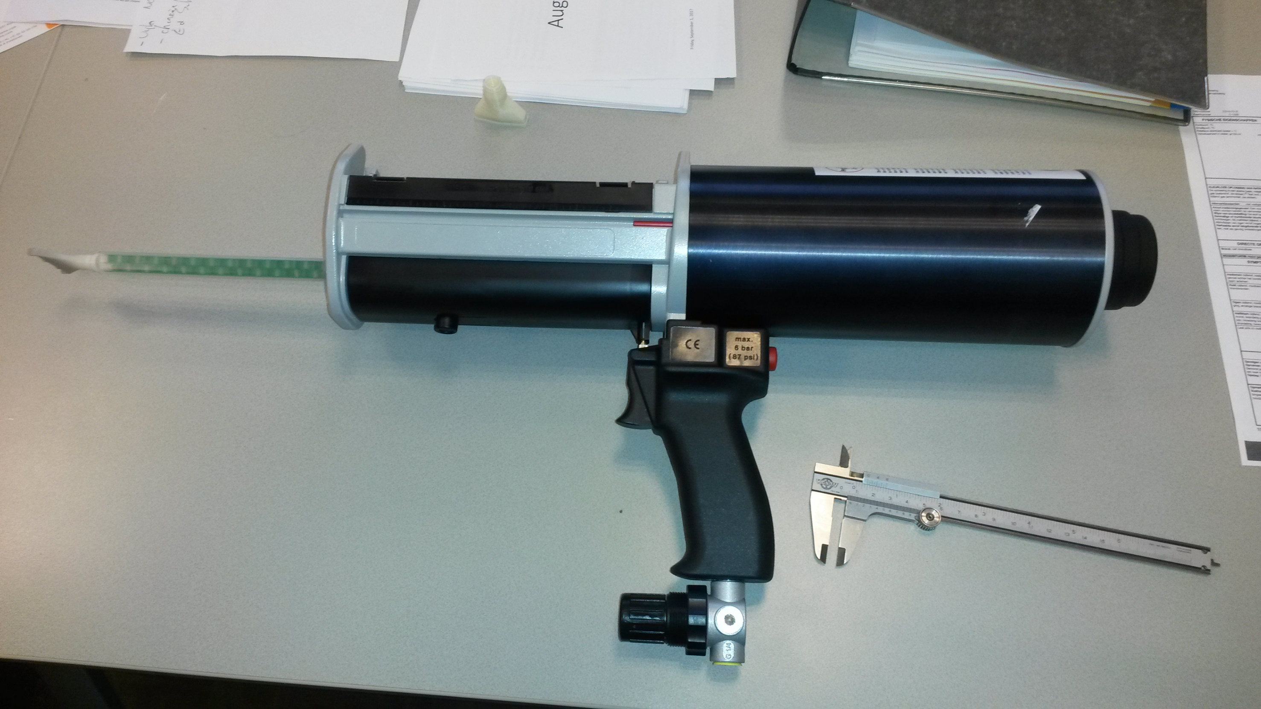
Glue dispension
Work in progress

Slide 18
Estimated module production schedule
Aim for cruising speed at 3 modules/week
This takes 2.2 FTE
Day 2
Day 4
Day 1
Day 3
Day 5
Outer frame & bottom plate
(steps 1, 2 & 3)
Scintillator, foam & cross
Beams (steps 4 & 5)
Fibers
(steps 6)
Fiber melting and Cookie
(steps 7 & 8)
Top foam, plate, ext. ribs,
PMT (steps 9, 10, 11 & 12)
Test and to container
(steps 13 & 14)

Slide 19
Estimated module production schedule
Aim for cruising speed at 3 modules/week
Production start in 2nd week of January 2018
More time needed for:
Buying/manufacturing of tooling
Buying small materials (rivets, XPS/EPS panels/fillers, optical cement,…)
Assemble first module as slow trail
Xmas holidays
First three weeks at slower than cruising pace
Cruising speed from February 2018
Sea containers with 45 modules expected ready for shipment at:
End of June 2018
Mid of December 2018
End of May 2019

Slide 20
Mounting frames
Sturdy version
Welded angles
Box profile long beam
Suitable for later
radio upgrade mount

Slide 21
Mounting frames
Public tender for 1300 frames + option for 400
Published 28 August 2017
Vault with offers opened 9 October 2017
2 offers received: bad surprise, both with prices much higher than anticipated
Decision on tender to contenders on 20 October 2017
Deadline for appeal 10 November 2017
Appeal received
still negotiating, but deadline moved to 17 November
May loose another 3 weeks in worst case
Date of first batch delivery unclear

Slide 22
Nikhef financial situation for SSD
Pledged 450 k€ (520 US$ at 11/11/2017 exchange rate)
Assembly space and tooling (O(25 k€) from a separate budget
Reserve 105 k€ for 2 FTE technician for 1.5 years
(Dutch technician = 70 k€/yr, Nikhef contributes 105 k€ from other resources)
Present estimated cost for 1300 mounting frames: 412 k€
There seems to be a mechanism for restoring monetary unitarity
(450=517+KIT as Higgs boson)

