Slide 1

Kraków SSD Test Facility
Wawrzyniec Gaj, Paweł Halczyński, Andrzej Kotarba, Jaromir Ludwin, Damian Wojas
DAI - Division of Scientific Equipment and Infrastructure Construction

Slide 2
Outline
Mechanical Construction
Electronics
Measurement
Summary

Slide 3
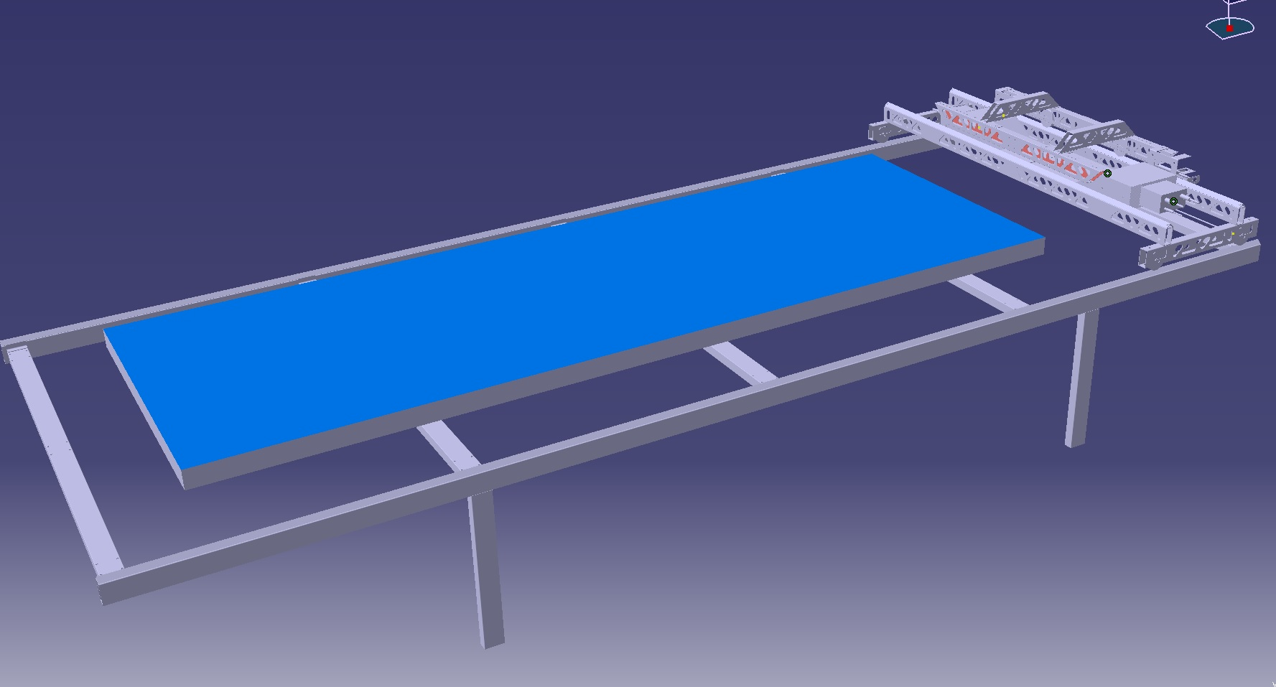
Mechanical Construction
Movable carts with scintillator counters
SSD
Table

Slide 4
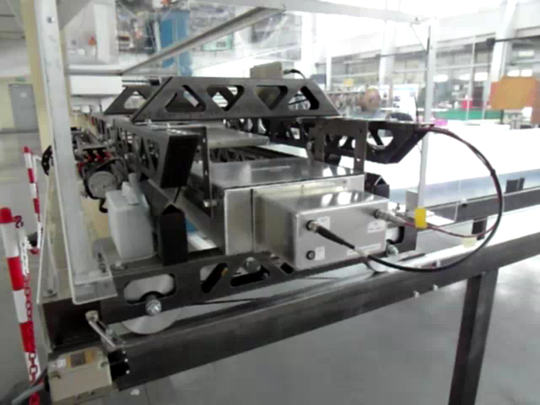
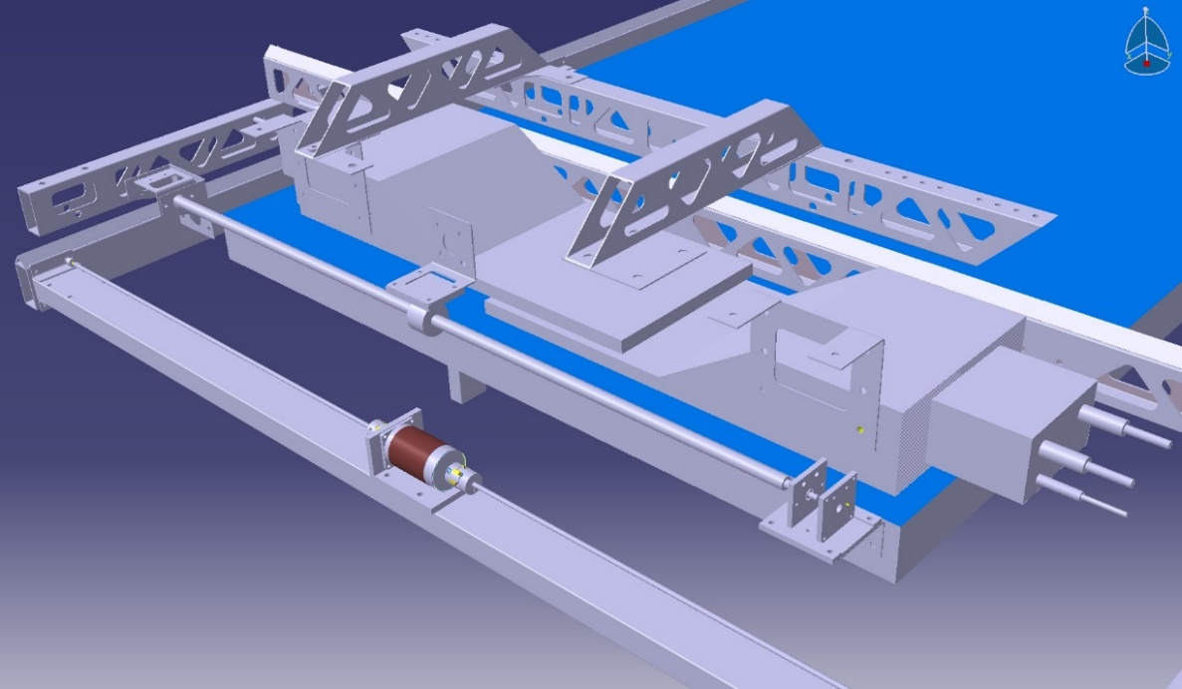
Two movable trolleys are driven by stepper motors in X and Y axes with precision below 1 mm.
The scintillation counters can be adjusted one from another in the horizontal and vertical directions.
Active surface of the each scintillation counter’s is 25 cm x 25 cm.
SSD
Counter 1
Counter 2

Slide 5
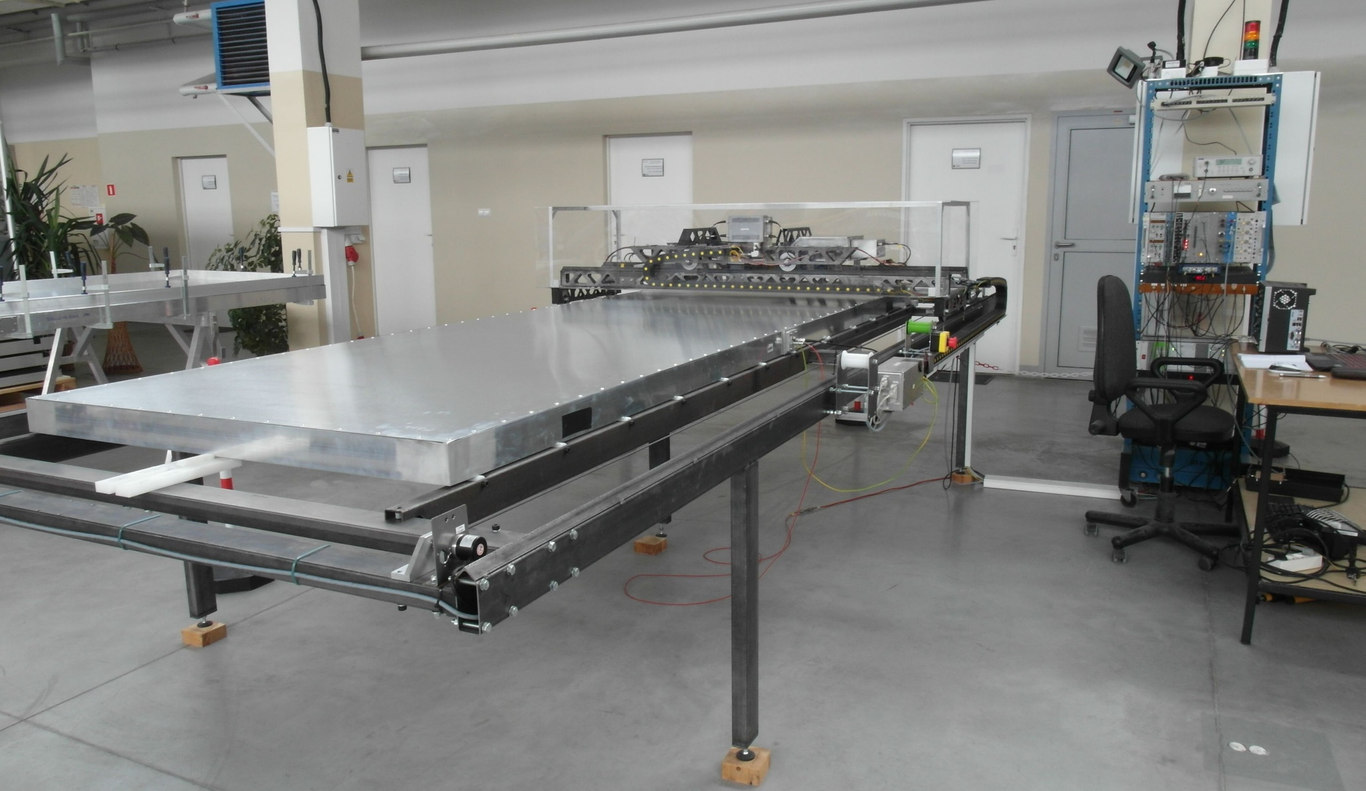

Slide 6
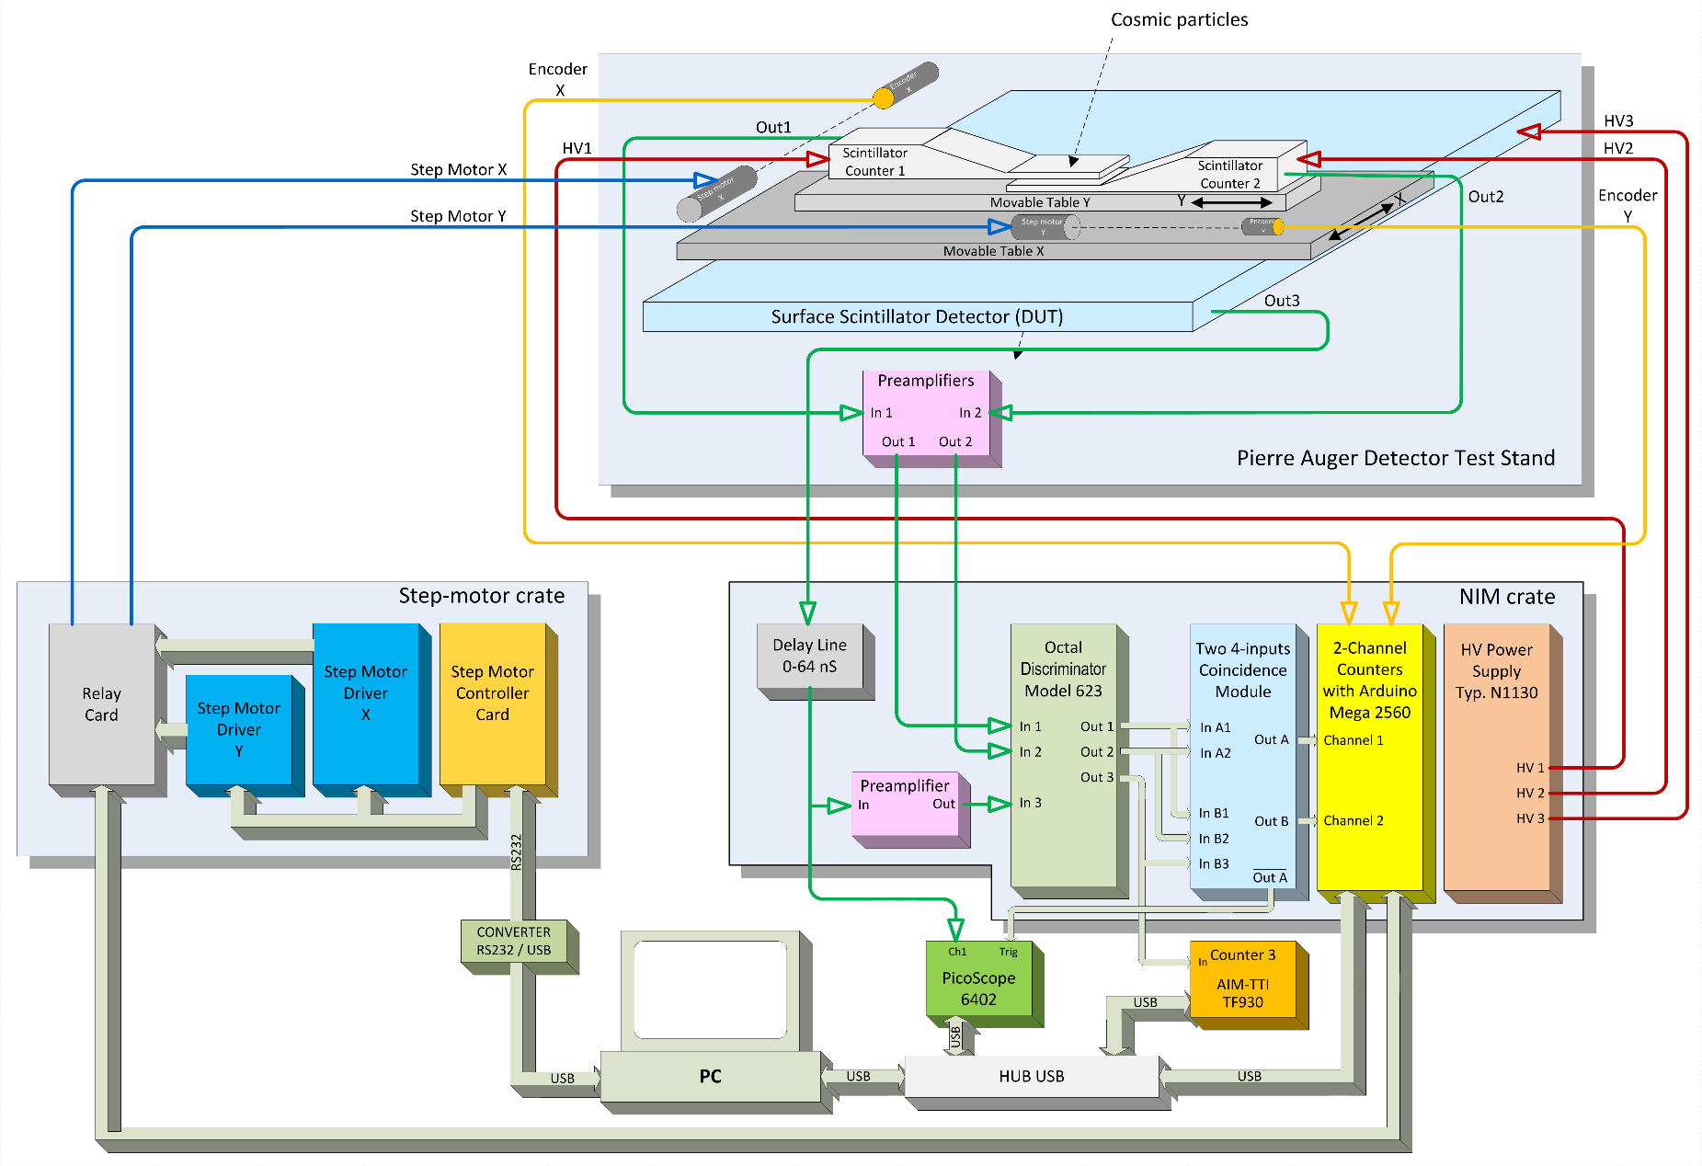
Electronics
AugerPrime SSD meeting, 28-29 March 2018, LPSC Grenoble, France

Slide 7
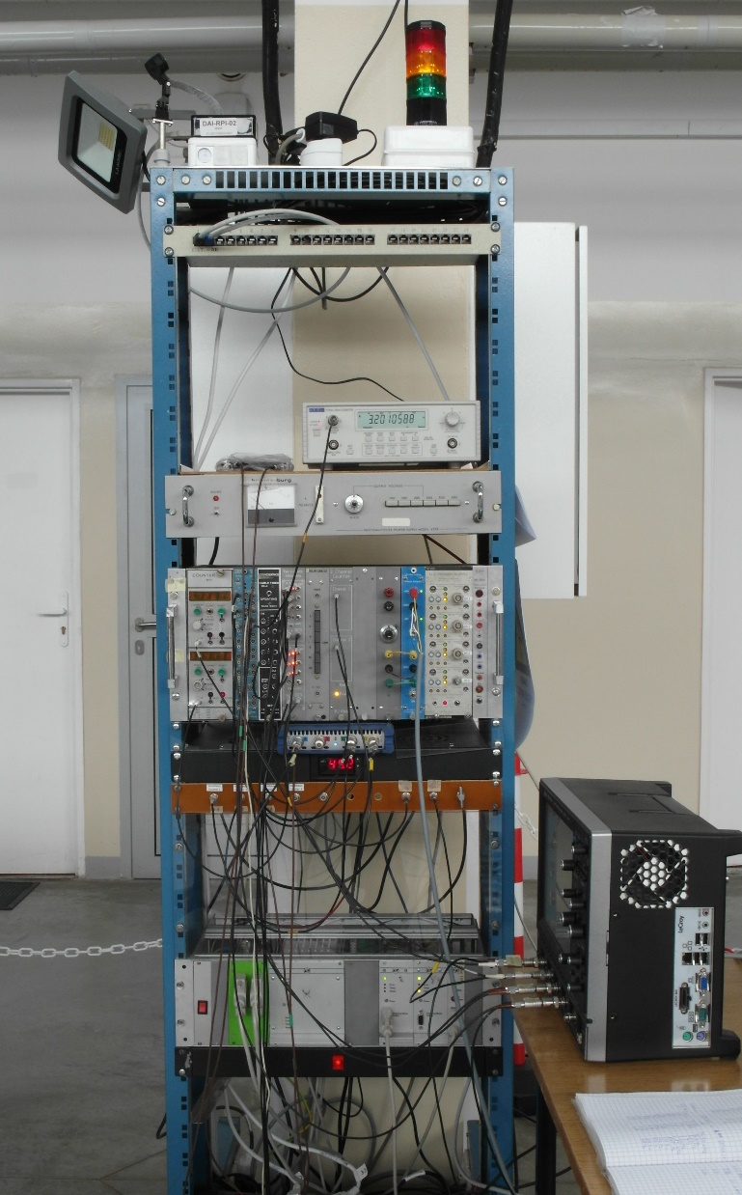
Two preamplifiers are installed near movable counters for amplification analog signals from scintillation Counter 1 and Counter 2,
Electronics rack consists of NIM crate with electronics modules and stepper motor crate with drivers, control and inteface cards,
PicoScope 6402, SSD signal is connected to channel A with input range +/- 50 mV,
PicoScope is triggered by coincidences: Counter 1 + Counter 2 and can be also switched to coincidence Counter 1 + SSD or only from SSD signal.

Slide 8
Measurement
The measurement system is controlled by few LabView applications (main and supporting programs)
The system is flexibile for configuration measurement points on the SSD surface.
Whole SSD surface can be tested.
For good statistics, minimum a few thousand triggers are needed.
During SSD measurement by coincidence Counter 1 and Counter 2 a rate of counting is about 8 Hz.

Slide 9
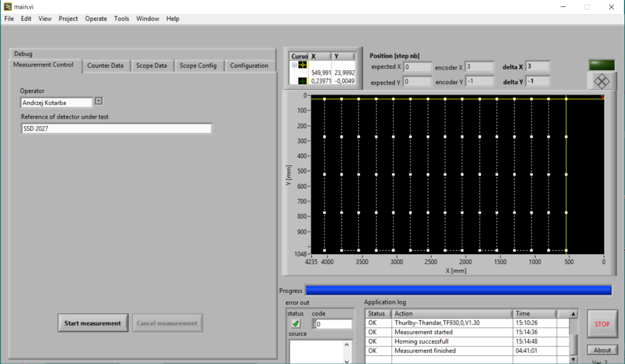
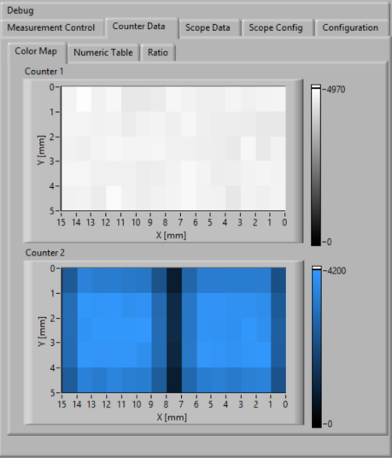
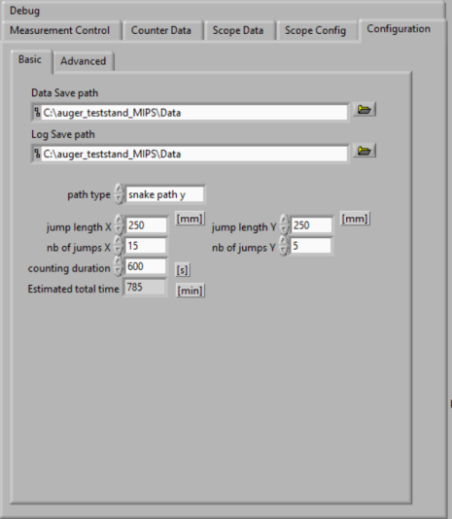

Slide 10
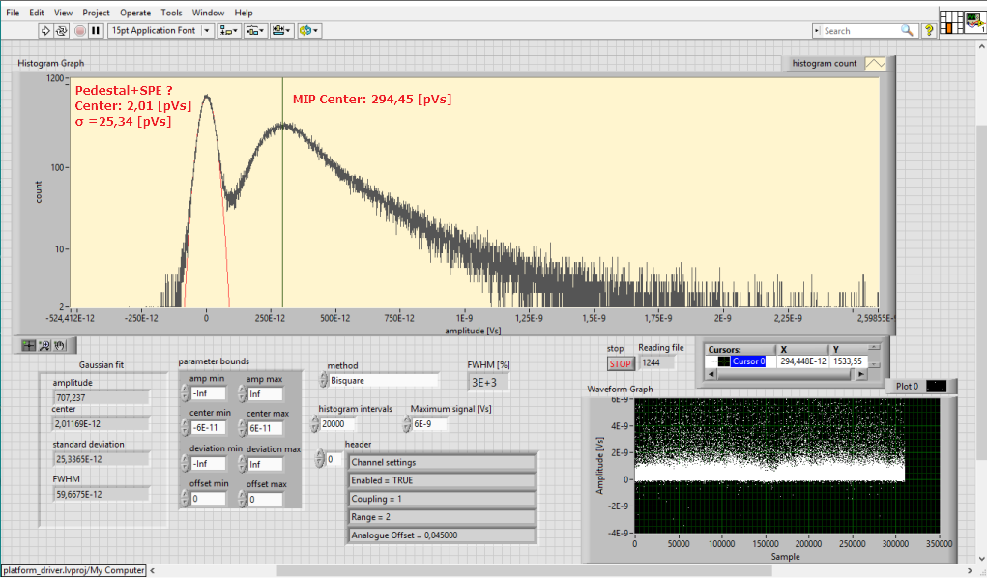

Slide 11
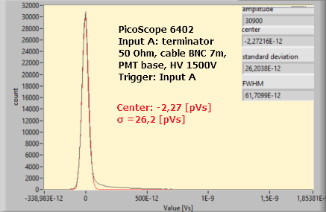
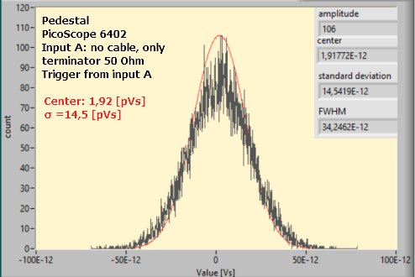
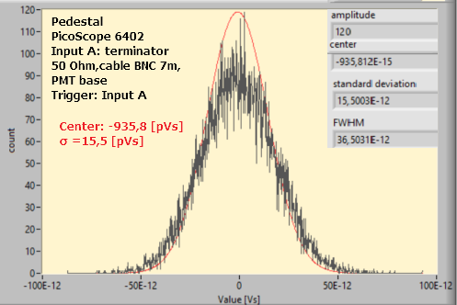
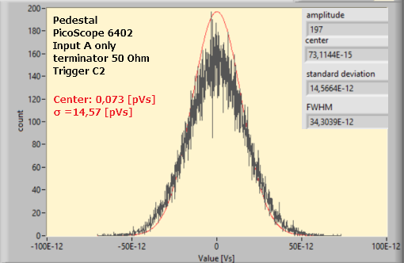

Slide 12
Summary
Measurement system is constructed for automatic SSD test,
Many options for selecting SSD measurement points,
Measurement system is controlled by LabView applications,
MIP peak is visible,
Problems with the exact selection of the SPE signal value. Too large standard deviation of the pedestal (probably interference in power from other devices, old LEMO cables),
Standard deviation on standalone PicoScope 6402 with terminated input A, without cables is ~15 pVs (pedestal),
Source of interferences are being investigated.

Slide 13
Thank you very much for your attention

