Slide 1
AugerPrime SSD Testing at Nikhef in Nijmegen
Sijbrand de Jong
Most of the real work has been done by
Charles Timmermans (Nikhef and Radboud University) and
Daniel Szálas-Motesiczky (electronics engineer @Radboud University)

Slide 2
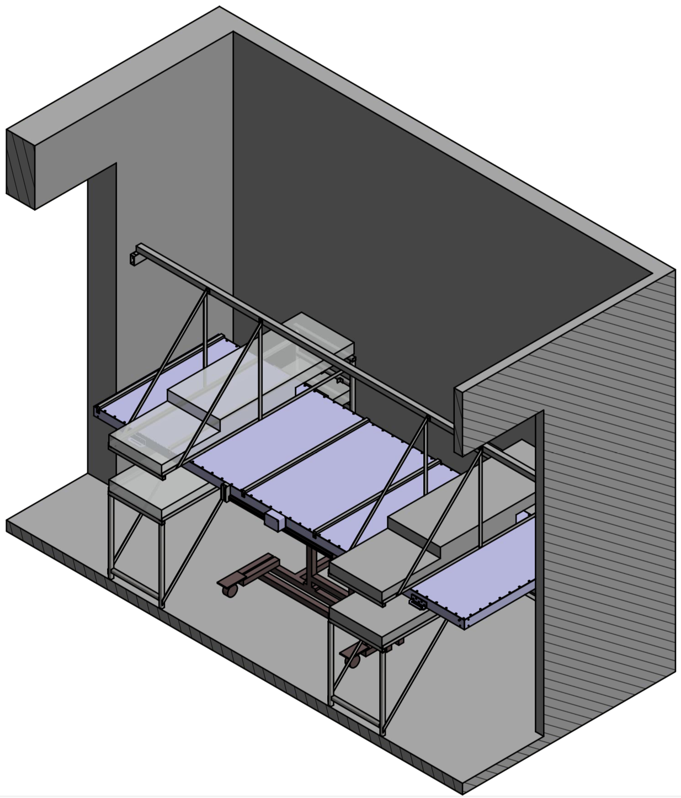
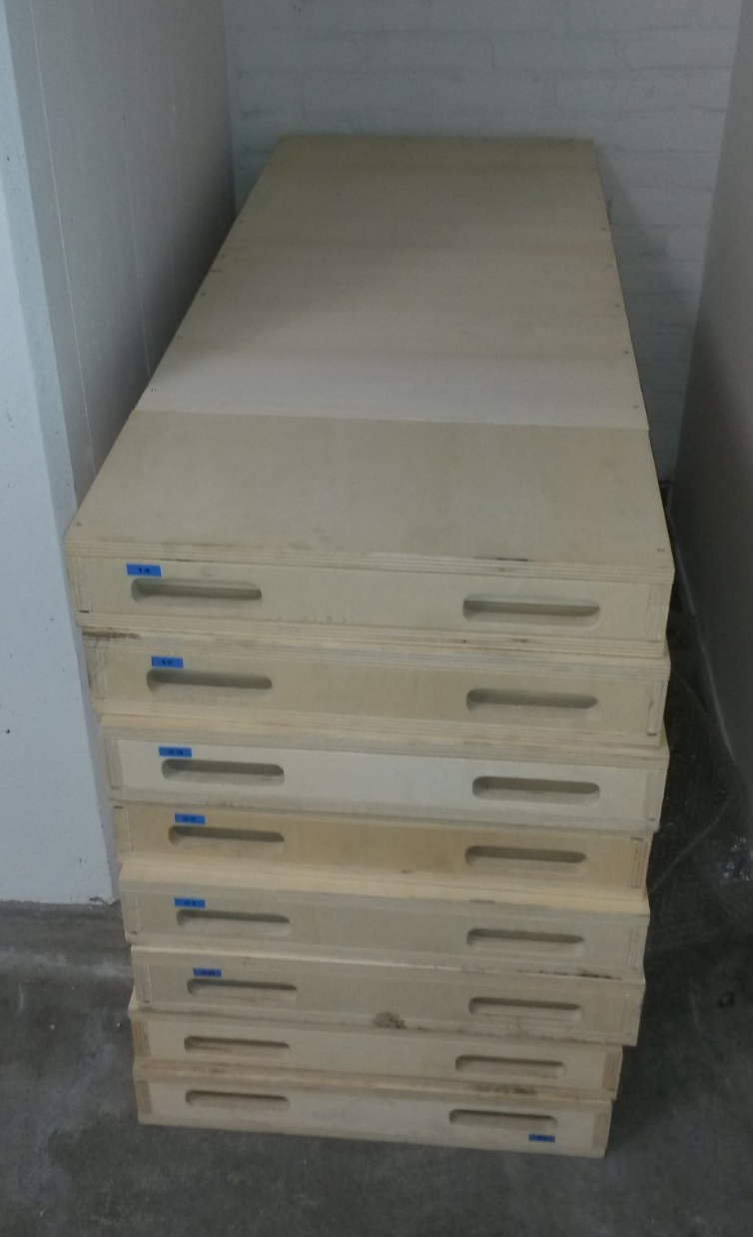
Test station
50x100 cm scintillator
modules left over from
an earlier (outreach!)
project

Slide 3
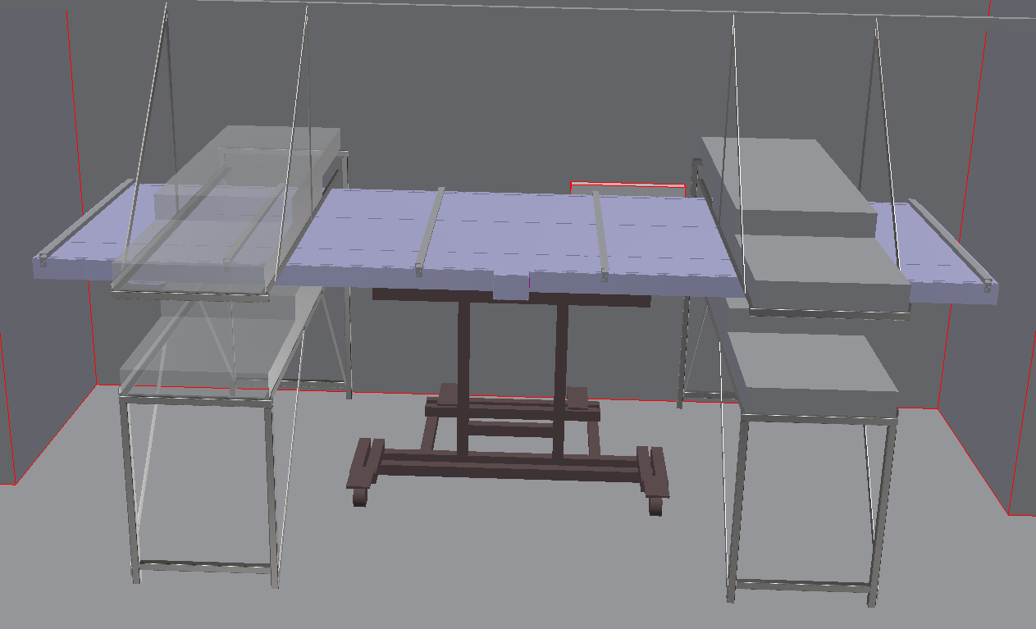
Test station
Test both scintillator sides
Several width zones, but no single bar resolution
Aim at 1% relative statistical resolution
  Absolute positioning of module in test stand
  => Can say what efficiency is of each module w.r.t. our best module
No absolute efficiency:
Check 2 modules that wer measured in this set-up in the KIT telescope

Slide 4
Test station

Slide 5
Test station
1 2 3 Trigger

Slide 6
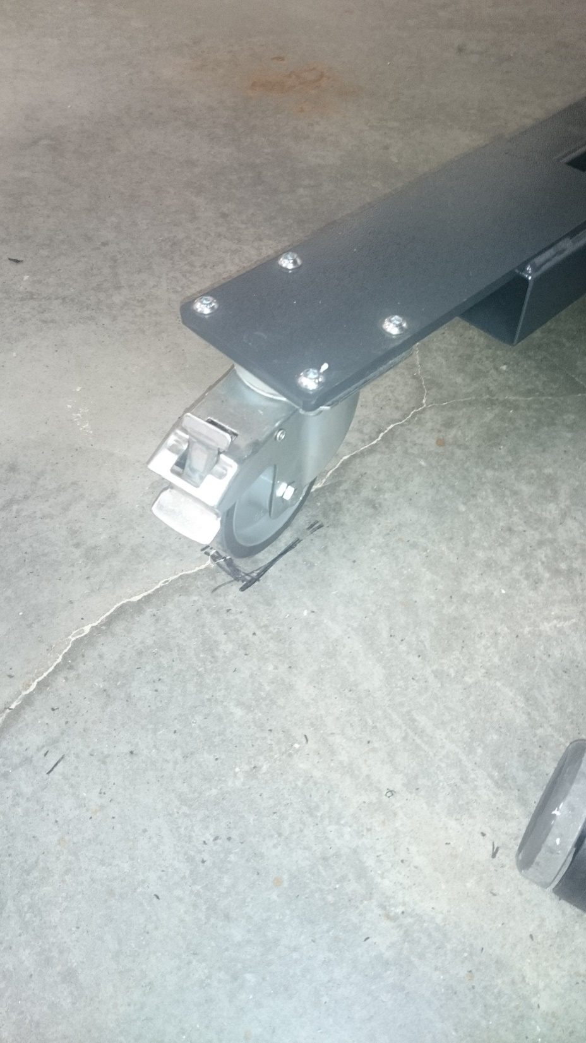
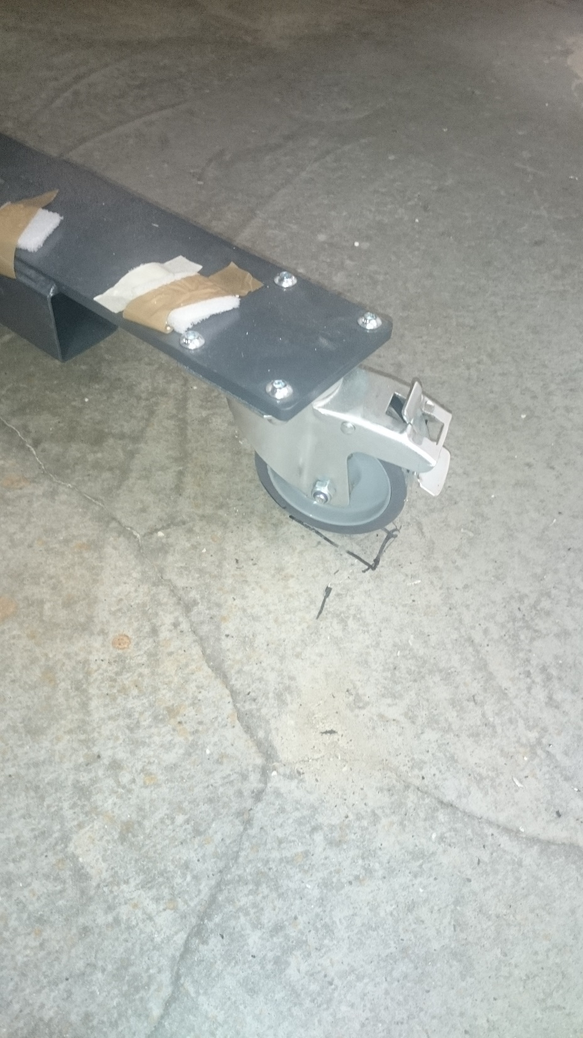
Test station

Slide 7
PMT assembly
1 Wuppertal PMT assembly available
HV externally generated at 800 V

Slide 8
Test station results

Slide 9
Test station results

Slide 10
Test station results

Slide 11
Test station results

Slide 12
Test station results

Slide 13
Test station results

Slide 14
Test station reults

Slide 15
Test station results

Slide 16
Test station results

Slide 17
Test station results

Slide 18
Test station results
Change of silicon pad

