Slide 1
Pure CH4 vs Ne/CH4 mixture
Interest
Safety
Gilles Gerbier
Queen’s University
6th NEWS-G Collaboration meeting 11-13th june 2019 Grenoble

Slide 2
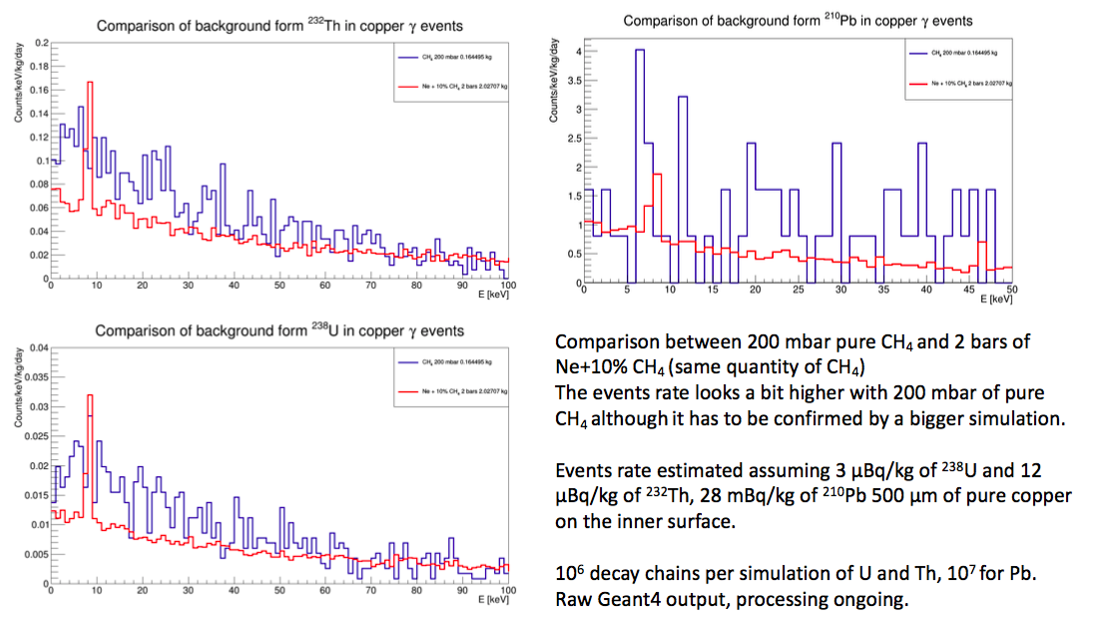
Background rate in mix and pure CH4

Slide 3
Interest
Consider 2b of Ne/CH4 at 90/10 and 200mb of pure CH4
For same mass of H, avoid interactions on Neon => less background evts/ kg.d of H
Input from Alexis B about evt rate dru in both gas in evts/kg.d.keV
Overall gain in S/B of 15
Ie back free limit in mix obtained after 44/20 = 2.2 days for 0.04 kg.d
Ie back free limit in pure obtained after 20/1.31 = 15 days for 0.62 kg.d
Gas | voume sph | Pressure b | Fraction CH4 | mass H | mass Ne | mass CH4 | mass total | deltat t d | Rate back dru | Nevts back/kev | Back in ROI 0.1 keV | Nevts signal | S/B | Ratio of S/B | Exposure H kd.d
Ne/CH4 | 1149.76 | 1.50 | 0.06 | 18.48 | 1447.47 | 73.91 | 1521.38 | 44.00 | 3.00 | 200.82 | 20.08 | 220.00 | 1.10 |  | 0.81
CH4 | 1149.76 | 0.20 | 1.00 | 41.06 | 0.00 | 164.25 | 164.25 | 20.00 | 4.00 | 13.14 | 1.31 | 222.22 | 16.91 | 15.44 | 0.82

Slide 5
Run in Saclay

Slide 6
CH4 safety issues

Slide 7
Exhaust
First fill with N2
N2, 4765 l
4.4 % CH4
Pump
260 l + 884 l
Second empty with input of N2
200 mb CH4 + 680 mb N2
From 100 % to
23 %

Slide 8
Pros/cons
Calibration
³⁷Ar (Multiple fills ? )
Rely on neutron recoil spectrum (E0 of exponential)
QF … Do high quality data mean true answer ?

