Slide 1
NEWS-G – Implementation at Modane
Grenoble
June 11th, 2019
Michel ZAMPAOLO
Modane Underground Laboratory
(Laboratoire souterrain de Modane France)

Slide 2
Outline
Copper sphere
Technical data
Tests during and after fabrication
Status of lead shielding
Shop test assembly
Possible improvements

Slide 3
Copper sphere design
One flange made of copper plated stainless steel (plating by explosion)
Copper nozzle machined from C10100 bar
2 hemispheres spinned from sheets of copper

Slide 4
Copper sphere technical data
Inside diameter of the sphere : 1350 mm
Total height: 1650mm
Diameter of the nozzle : 60mm-
CF flange Ø 63- 316 SS
Grade of copper: C10100 as per ASTM B152
Producer of the copper: Aurubis (Germany)
Wall thicknesses: from 9 to 15 mm
Operating pressure: vacuum to 1 bar g
Pressure test: minimum 2 bar g
Vacuum test : helium

Slide 5
Copper sphere – fabrication tests
Material certificates
Ultrasonic test of the cladding by Nobel clad
Report of the thicknesses after spinning
Hydraulic pressure test :
- with demineralised water
- pressure : 4 bar g
- duration: 20min minimum
Vacuum test :
- at few 10⁻⁶ mbar abs
- with helium leak detector
- leak rate: 10⁻⁹ mbar.l/s
- vacuum losses, valve closed: less than 2.10⁻⁸ mbar/s
Dimensional report:
- sensor location: at less than 10mm from the center of the sphere

Slide 6
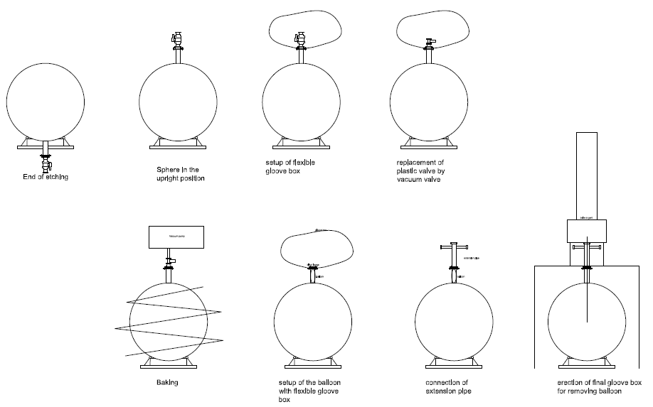
Copper sphere operation

Slide 7
Copper sphere installation
Present satus of the sphere in LSM: no shielding; glove box is connected.
External etching to be done before the full final assembly

Slide 8
Copper sphere design

Slide 9
Lead shielding– design
6 main pieces of lead shielding
22cm very low activity lead
3cm roman lead
SS enclosure12mm

Slide 10
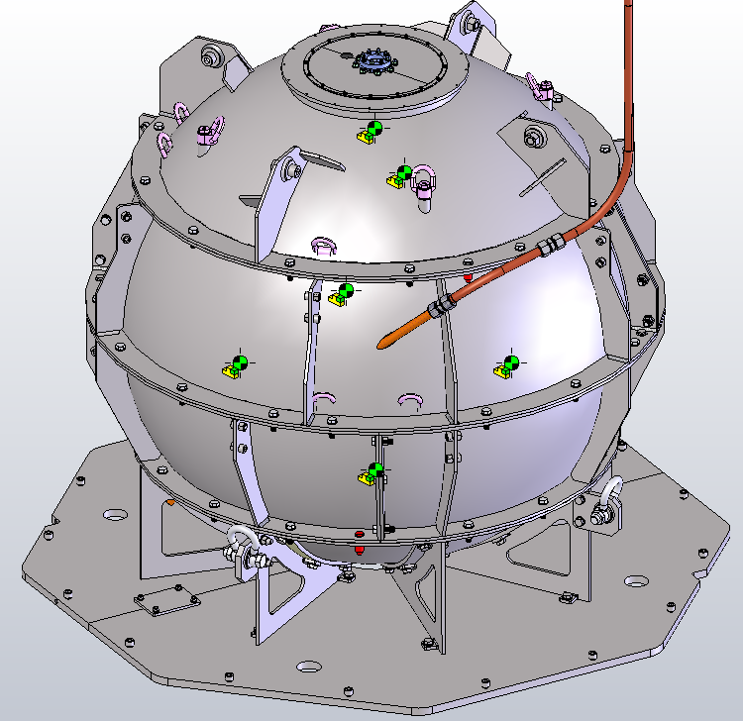
Lead – shop test assembly
The lead is poured in the SS and is integral with it. Roman lead is bolted on the low activity lead. Each one of the 6 sets is machined
1-Full assembly of lead pieces at the foundery workshop in June 2019
2-Shop test assembly in Underground lab in Modane: lead + sphere in June and July:
- checking of the clearance between sphere and lead: 9 to 16mm
- leakage test of the SS envelop with N₂ at 5mbar: less than 2l/min.

Slide 11
Machining of lead shielding
Lead pieces have been machined in a workshop at 100 km from Modane

Slide 12
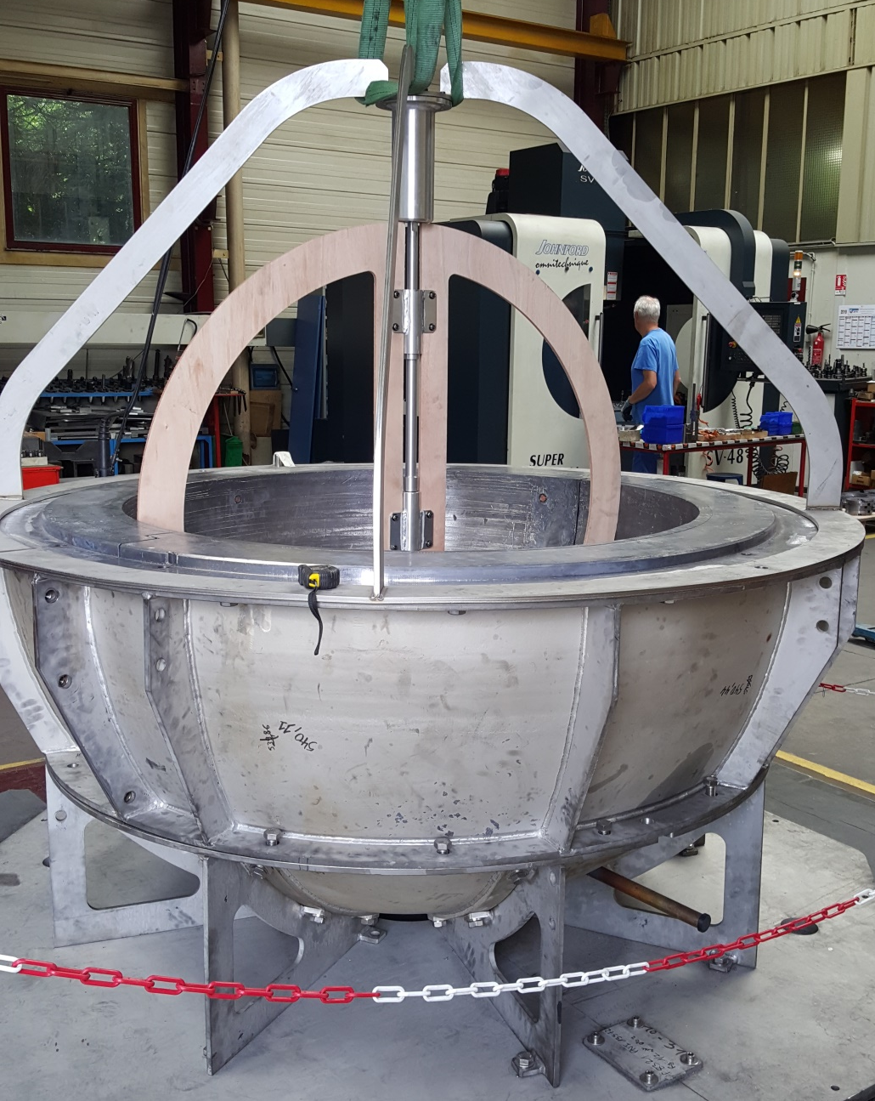
Lead – shop test assembly at the Founderies
Assembly of south hemisphere of lead
Checking of inside surface of lead with a wooden frame simulating the copper sphere
Positionning of the tool for centerlining the sphere- centring pins.
Delivery schedule:
South next week
North last week of june

Slide 13
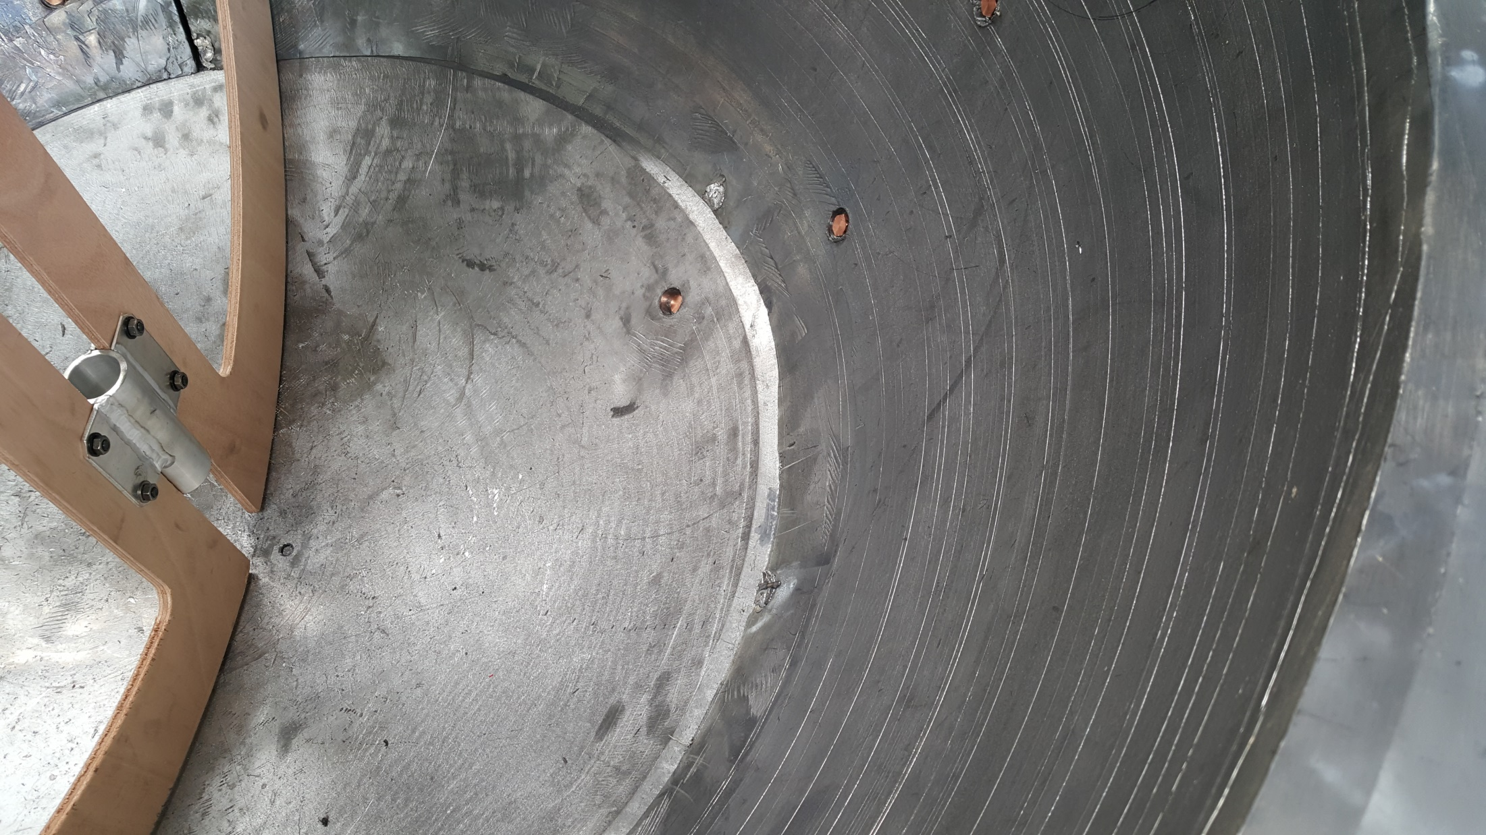
Lead – shop test assembly at the Founderies

Slide 14
Handling
Example of adjusment of length of chains for handling half equator

Slide 15
Centering of the copper sphere
Tool for tuning of the sphere inside the lead

Slide 16
Final assembly in Modane lab in July 2019

Slide 17
HDPE for final assembly

Slide 18
Circular water tank 3mx3m

Slide 19
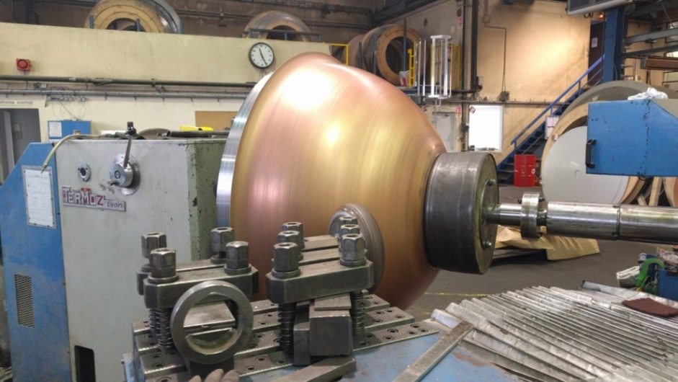
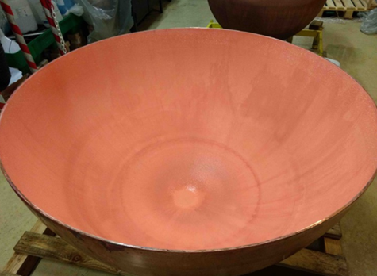
Improvements for the future
Have a straight part of the dished ends: 30 to 50mm. Postpone the machining of the hemispheres to the time of the assembly by welding
Raw copper specification: get a higher annealing of the material
Add a feeding pump in the etching loop
Think about all the testings to be done before assembly of different parts of the sphere. Reduce the cosmic ray exposure time.
Machining of the inside surface of lead for cleanliness

Slide 20
Thank you for your attention

