Slide 1
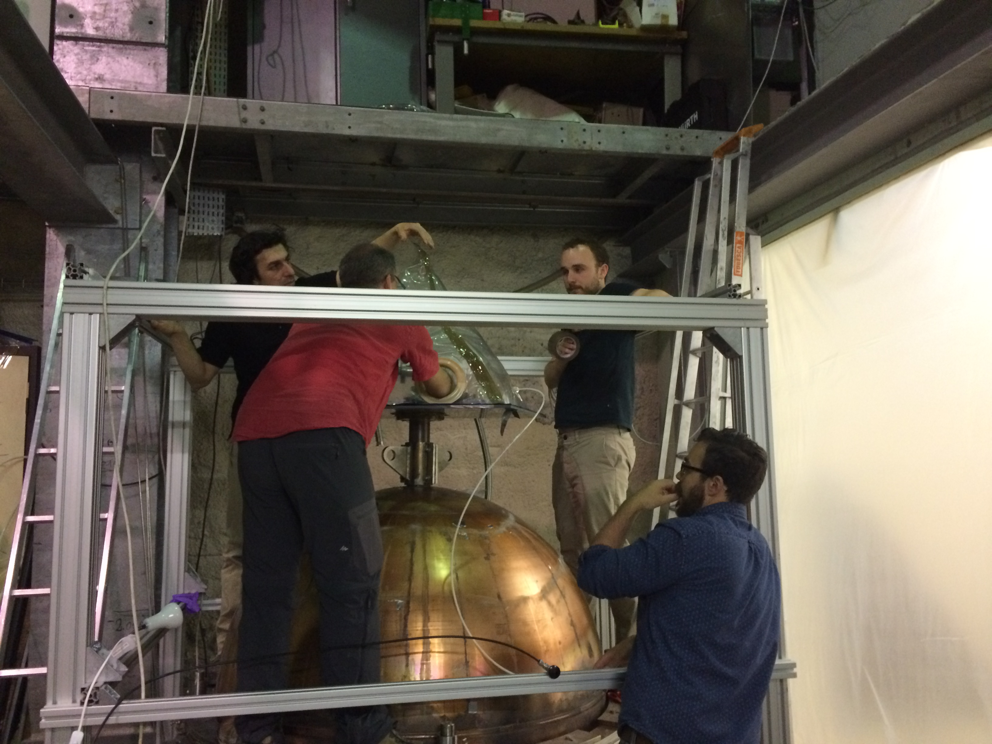
Implementation at LSM:
First DAQ operations

Slide 2
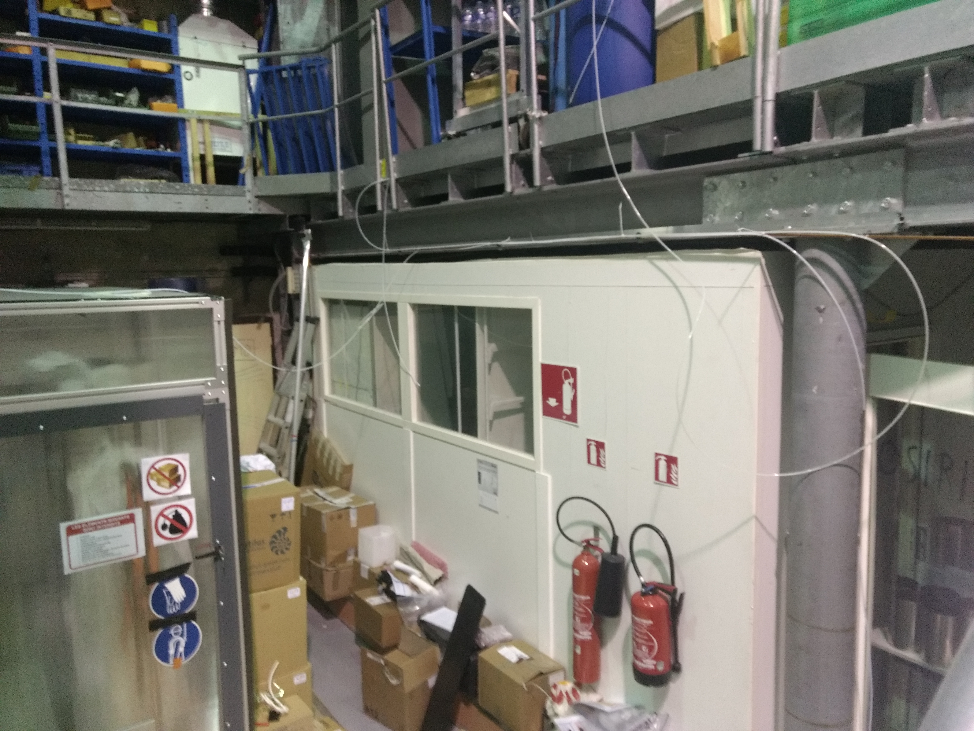
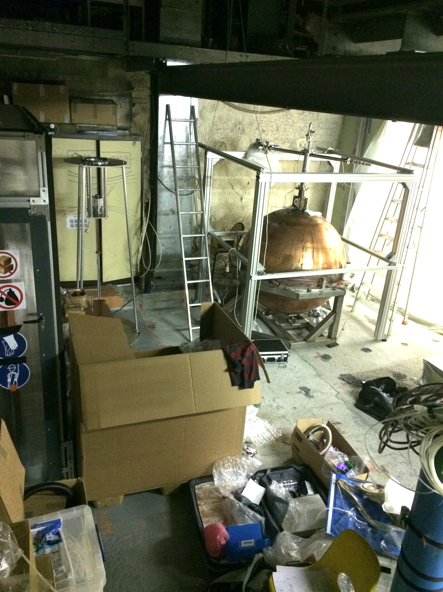
Changes on the LSM topology
before..
after!

Slide 3
Status of mechanics
The container is in use (with no permanent drill);
The glovebox is in place (but not correctly fixed);
The rod is in use (but too short, and may block).
A remark:
At Saclay, after Patrick soldered the sensor, it took half an hour to mount the rod, insert it through the glovebox and start physical data taking;
At LSM, it took several days (~1 week), and we were even not sure if we had already physical signals.
Excepted of the sensor, all is at LSM since may 15th, and 1 month later there are still issues on the rod.
How could we avoid to waste so much time?

Slide 4
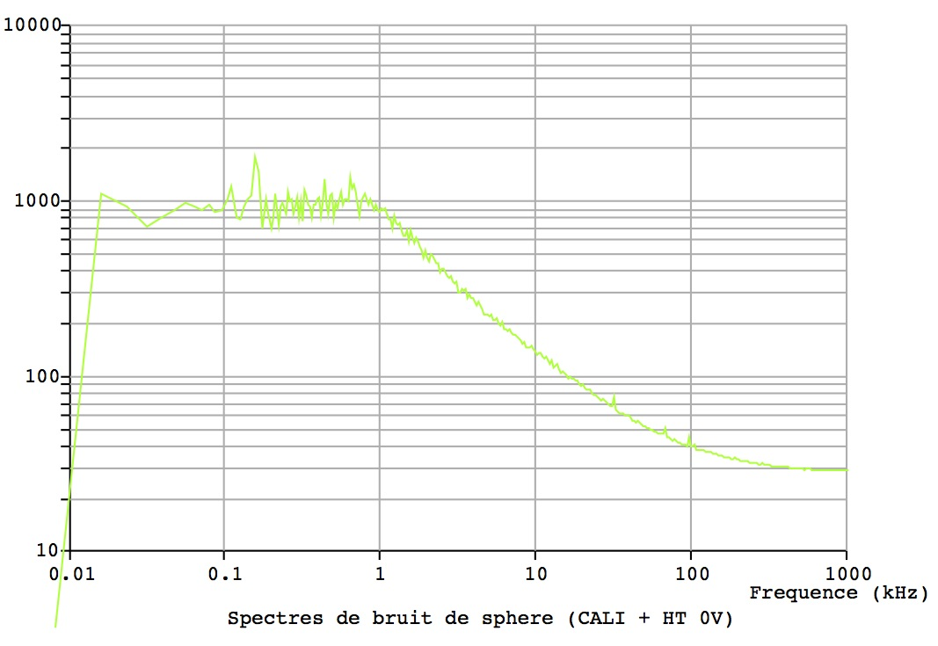
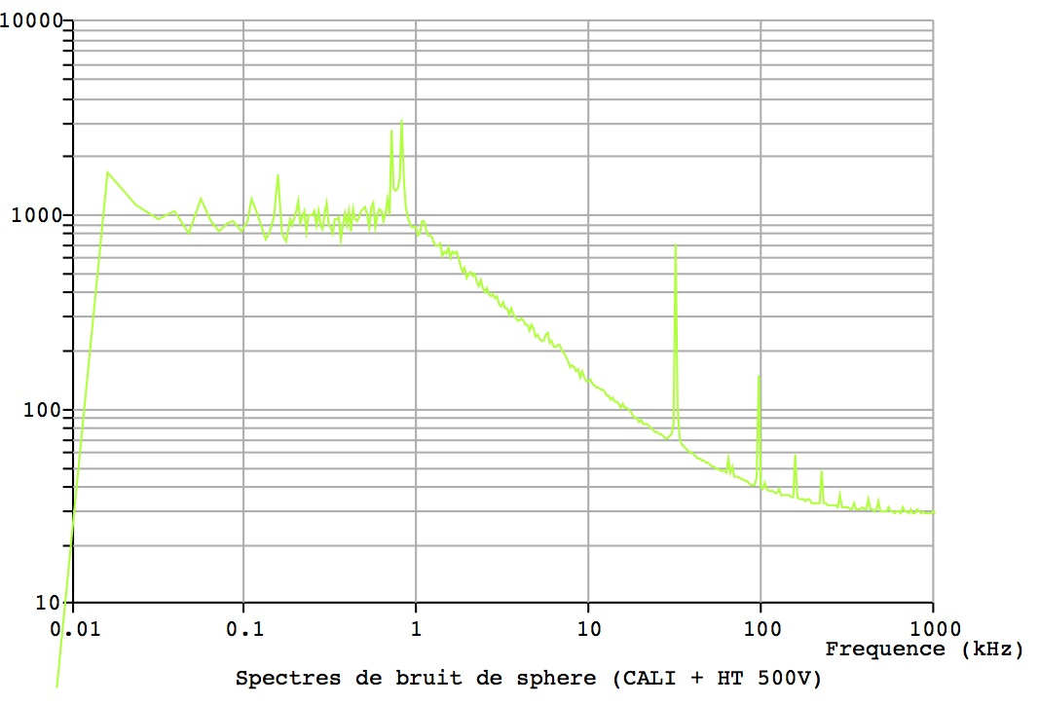
Electronic noise study (reference: the Sedine)

Slide 5
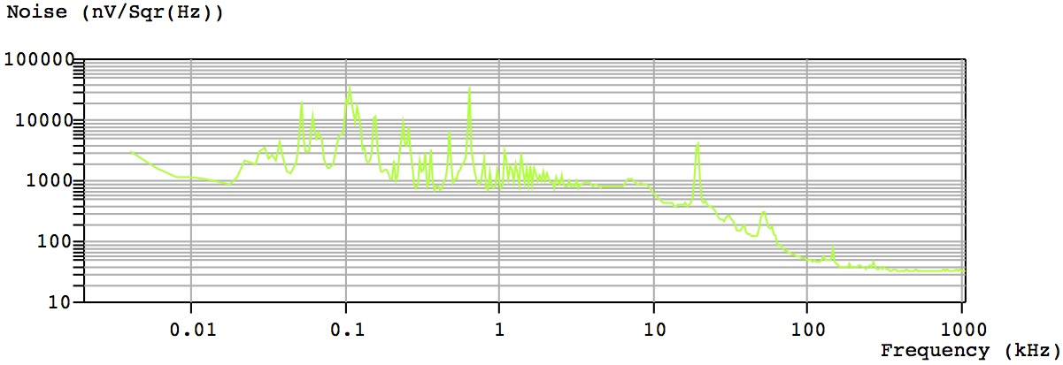
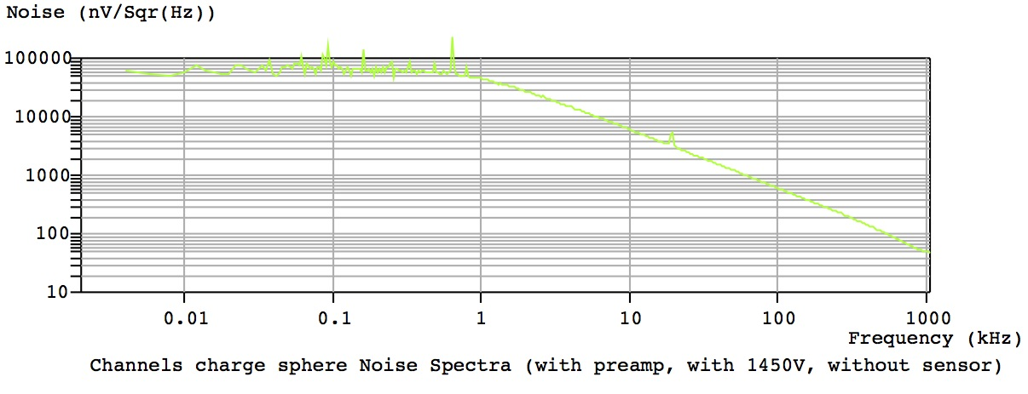
Electronic noise study: current status
Noise spectrum with preamp, 0V

Slide 6
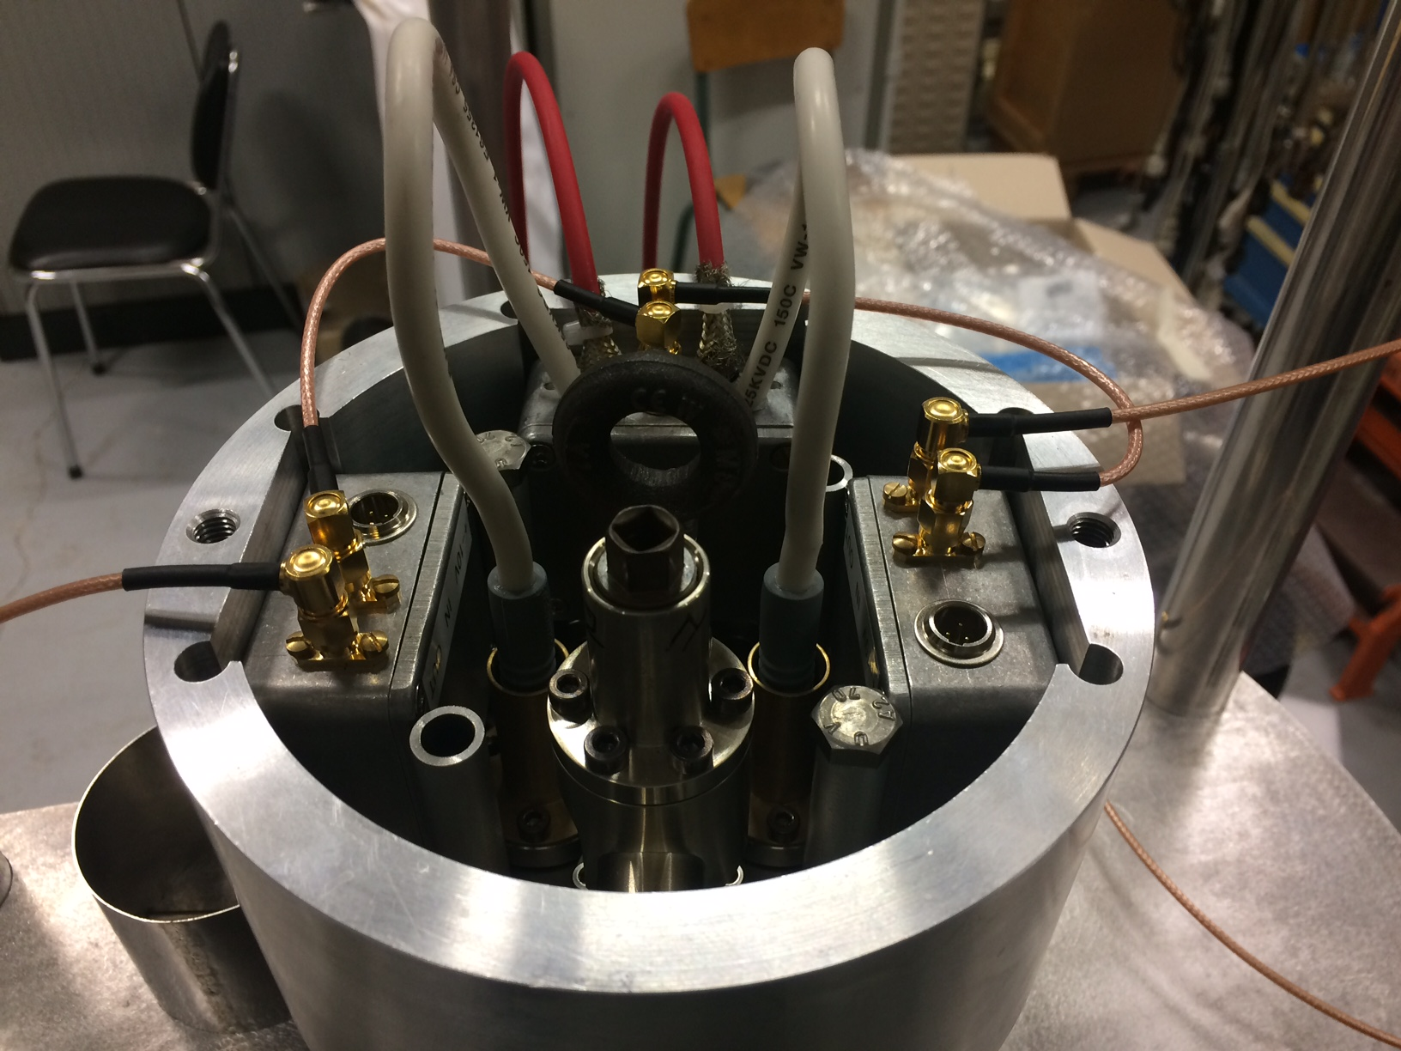
Electronics box
HV input
sensor signal to preamp
HV2 output
preamp box
(tested)
preamp box
(tested)
Amplified signal to CALI
HV box
distributes voltages
houses the coupling capacitors

Slide 7
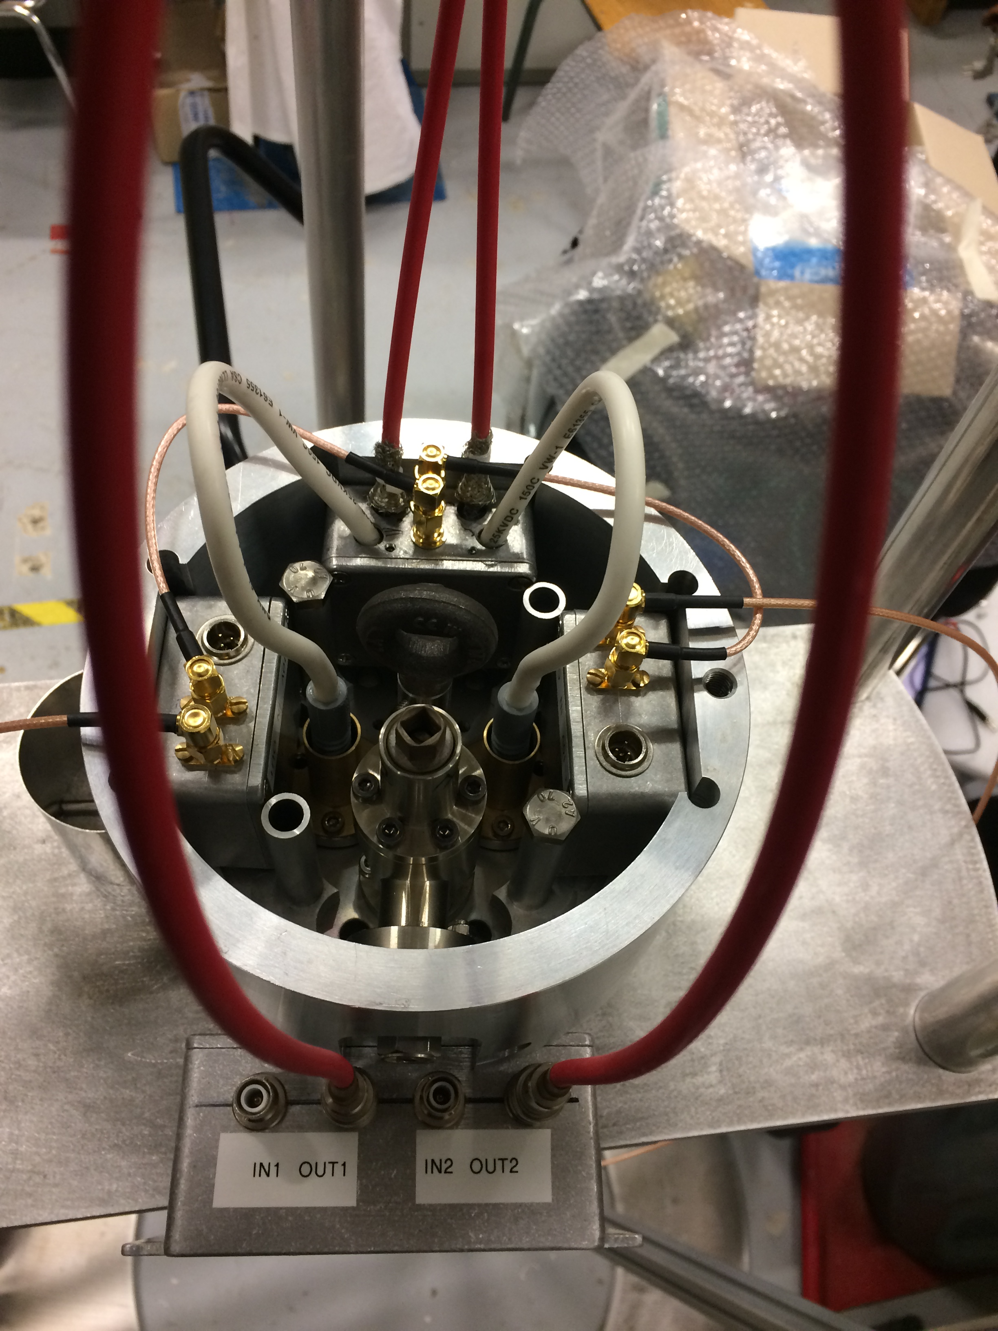
Actions for electronics
There may have sparks inside the HV box.
removed it,
by the way, soldered the “broken” cable,
and put more of insulating gel inside.
The electronic noise from the preamp is too high by a factor ~10.
put a shorter HV cable (note: already shielded);
added an full aluminum sheet, tighted with a serflex on the electronics box;
To do: try to use 9V-batteries instead, just to check whether
we have to find better power supplies (just more modern?)
or if the problem is more on the cables.
The HV power supplies bring even x3 (iSeg) or x6 (CAEN) more noise.
put a shorter HV cable (note: all are already shielded);
grounding improvement of the inox glovebox/filter box, towards the electronics box/sphere.
Changed the filter path from #1 to #2.
+ removed the connection to the sensor:
The so-called “sparks” are still there!

Slide 8
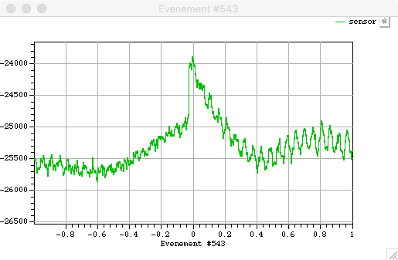
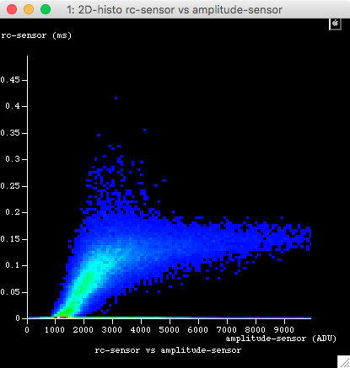
Data study
Runs (starting on tf07s004)
Deriv. > 500ADU over 0.050 ms
Cut on rise time > 0.030 ms
Event:
Duration 2 ms
Pretrigger 1 ms
Baseline computed within (0.2 … 0.8) ms
Rise time computed on (50 … 90) % of the amplitude
tf07s004: 1600 V
Sparks? Not sure at all! Let say “spikes”
Initial plot of the event decay:
mainly shorter than the Cremat decay (0.140 ms)

Slide 9
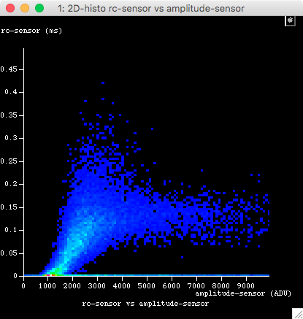
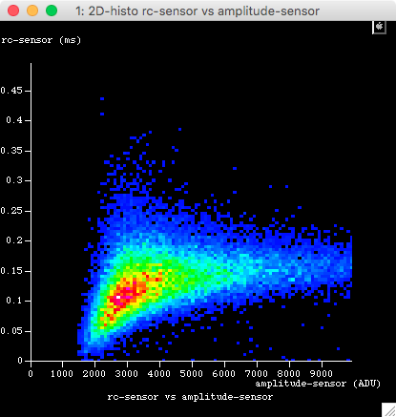
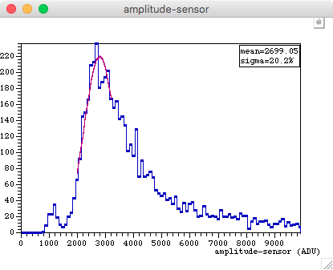
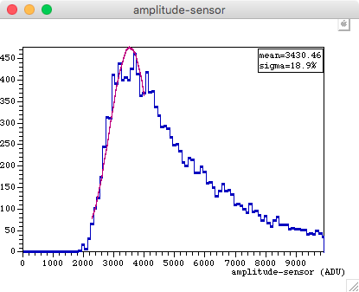
Searching for some evidence of physical events (V↗)
tf07s005: 1600 V
Threshold 500 ADU
tf07s007: 1650 V
Threshold 2000 ADU
2.16Hz
1.58Hz
Increase: 27%

Slide 10
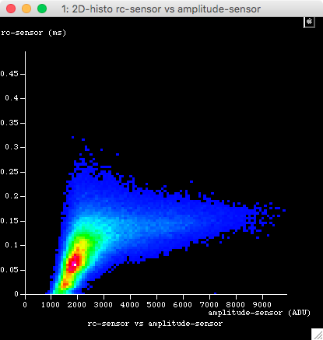
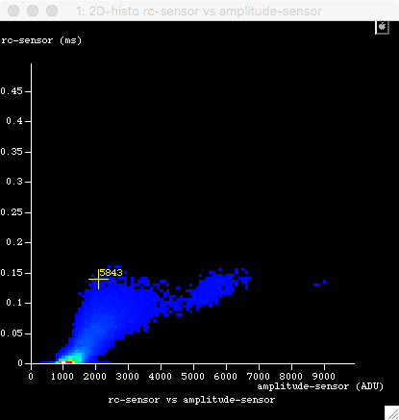
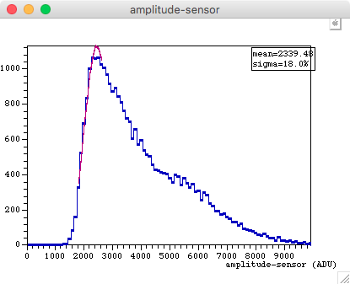
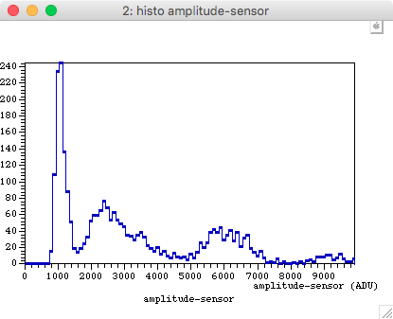
Searching for some evidence of physical events (V↘)
tf08s000: 1550 V
Threshold 1000 ADU
tf10s000: 1350 V
Threshold 500 ADU
(registered 1600 V)
0.66 Hz
0.05 Hz
decrease: 15%

Slide 11
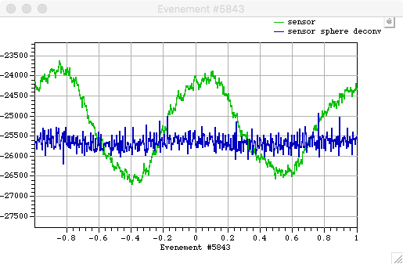
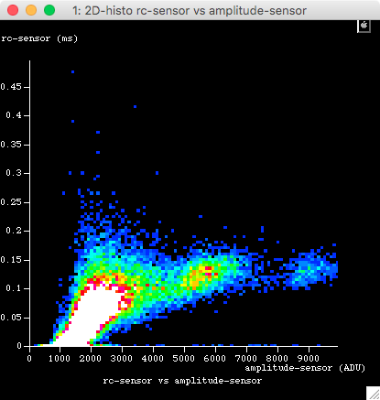
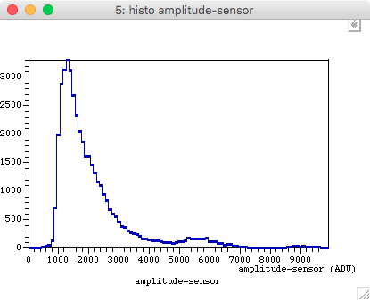
Data at rather low voltage
tf10s000: 1350 V
Threshold 500 ADU
Event at rc=0.140
0.73Hz
Without cut

Slide 12
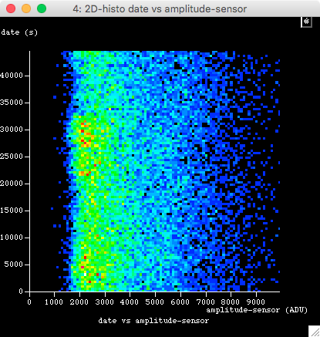
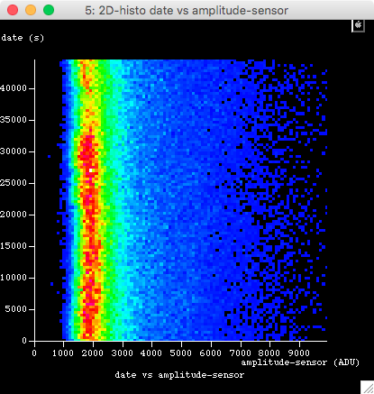
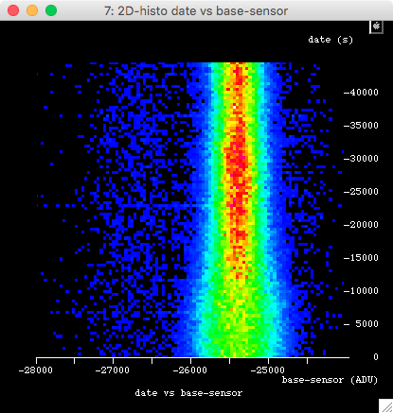
Stability
tf08s000: 1550 V
Threshold 1000 ADU
(registered 1600 V)
With cut rc>0.140
Without cut
Without cut
amplitudes
Base lines

Slide 13
Conclusions
We have huge noise, compared to Sedine (same location, same power supply, same preamp);
We have spikes, which origin is not understood;
The biplots show populations at high amplitude, to be explained;
Not all are physical, if not none…
Taking data not that useful, if there is nothing inside!
Event reconstruction too naïve at this stage (mainly due to the electronic noise);
Before further studies, we should define reliable observables according to the event shape;
Tango to be used “on line” for fast data quality checks.
Anyway, the first test is to compare without/with sensor (and source) with HV > 1650V
If we get a new population, then concentrate to this one by appropriate cuts;
If not…
Are we sure of the sensor?
Are we sure of the gas inside the sphere?
…

Slide 14
End of the document

