Slide 1
SNOLAB reviews of
EAC – march12th 2019
TDR – april 11th 2019
IR-1 -
Gilles Gerbier
6th NEWS-G Collaboration meeting 11-13th june 2019 Grenoble

Slide 2
EAC External Advisory Committee
Meets every 6 months
Report due 4 weeks before
Questions to the project
Presentation asked or not by EAC chair
Spring meeting : March 11th

Slide 3
Questions by EAC
If I understood correctly from the schedule, the quenching factor measurements at Grenoble and TUNL were scheduled to be completed last August.
What is the current status? Are there any indications yet whether the measurements will meet the requirements?
When do you expect decisive results?
In the section on “Ultra-high-purity copper” you state that the background estimate for the 1.4m vessel is 1.5 events/kg/day/keVee, mainly from Pb²¹⁰. How are this and other backgrounds taken into account in the sensitivity plots of Figs 1 and 2?
Are there definite plans and schedule to construct the 60cm ultrapure Cu sphere and to replace the 1.4m sphere with it? What improvement in sensitivity can you reach with it? How long would this run take?

Slide 4
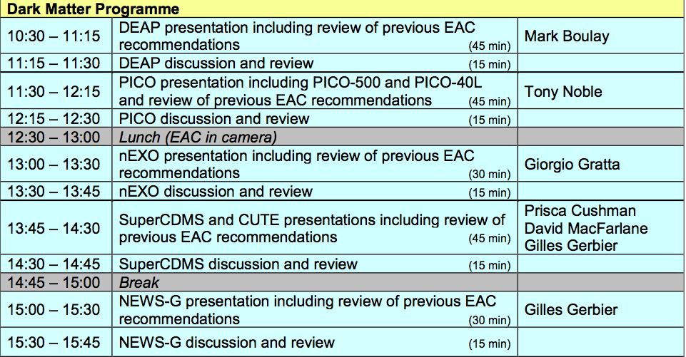

Slide 5
Outcome
No recommendation
Change name of NEWS-G to Achinos

Slide 6
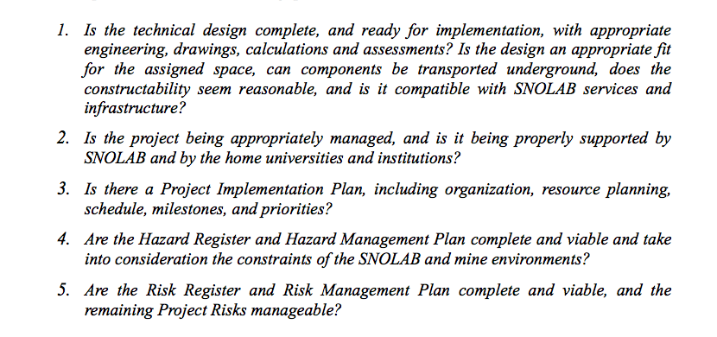
April 11th

Slide 7
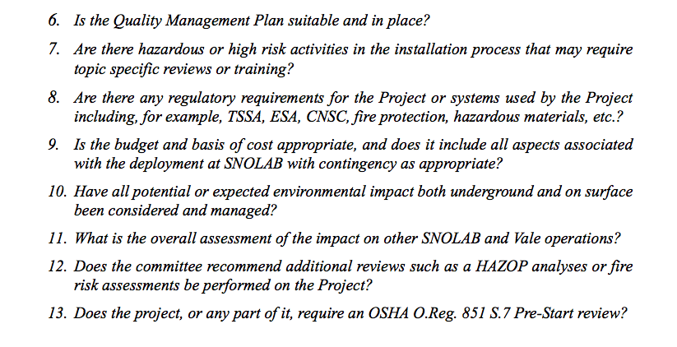
TDR 2

Slide 8
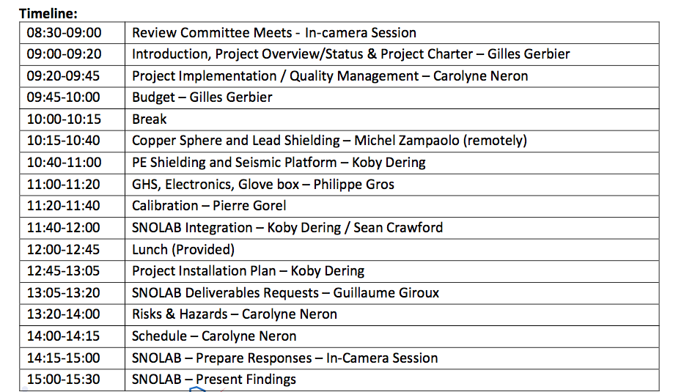
TDR
Full day of april 11th
Koby D, Sean C, Carolyne N, Julie McD, Guillaume G, Philippe G, Pierre G, Michel Z (remote), GG

Slide 9
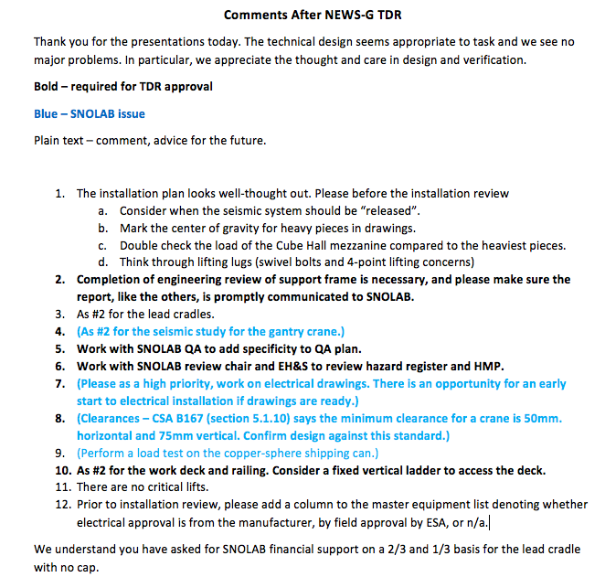
Outcome

Slide 10
Installation Review – May 22nd
Crane, Seismic Platform, electrical
Mostly SNOLAB deliverables
2h all Ok

Slide 11
To come
IR n
Operation Readyness Review end year

