Slide 1
6th collaboration meeting Introduction
NEWS-G collaboration status
News since dec2018
Some items to pay special attention & new projects
Agenda, some details
Gilles Gerbier
Queen’s University
6th NEWS-G Collaboration meeting 11-13th june 2019 Grenoble

Slide 2
NEWS-G collaboration
Queen’s University Kingston – G Gerbier, P di Stefano, R Martin, G Giroux, S Crawford, M Vidal, G Savvidis,
A Brossard, P Vazquez dS, , K Dering, J Mc Donald, M Chapellier, P Gros, A Rolland, C Neron, JF Caron, L Balogh
Copper vessel and gas set-up specifications, calibration, project management
Gas characterization, laser calibration, on smaller scale prototype
Simulations/Data analysis
IRFU (Institut de Recherches sur les Lois fondamentales de l’Univers)/CEA Saclay -I Giomataris, M Gros,, T Papaevangelou, JP Bard, JP Mols
Sensor/rod (low activity, optimization with 2 electrodes)
Electronics (low noise preamps, digitization, stream mode)
DAQ/soft
LSM (Laboratoire Souterrain de Modane), IN2P3, U of Chambéry - M Zampaolo, A DastgheibiFard
Low activity archeological lead
Coordination for lead/PE shielding and copper sphere
Thessaloniki University – I Savvidis, A Leisos, S Tzamarias
Simulations, neutron calibration
Studies on sensor
LPSC (Laboratoire de Physique Subatomique et Cosmologie) Grenoble - D Santos, JF Muraz, O Guillaudin
Quenching factor measurements at low energy with ion beams
Pacific National Northwest Lab– E Hoppe, R Bunker
Low activity measurements, Copper electroforming
RMCC (Royal Military College Canada) Kingston – D Kelly, E Corcoran
37 Ar source production, sample analysis
SNOLAB –Sudbury – P Gorel, S Langrock
Calibration system/slow control
University of Birmingham– K Nikolopoulos, P Knights, I Katsioulas, R Ward
Simulations, analysis, R&D
University of Alberta : MC Piro, D Durnford
Gas purification, data analysis
Associated labs : TRIUMF - F Retiere
April 2019

Slide 3
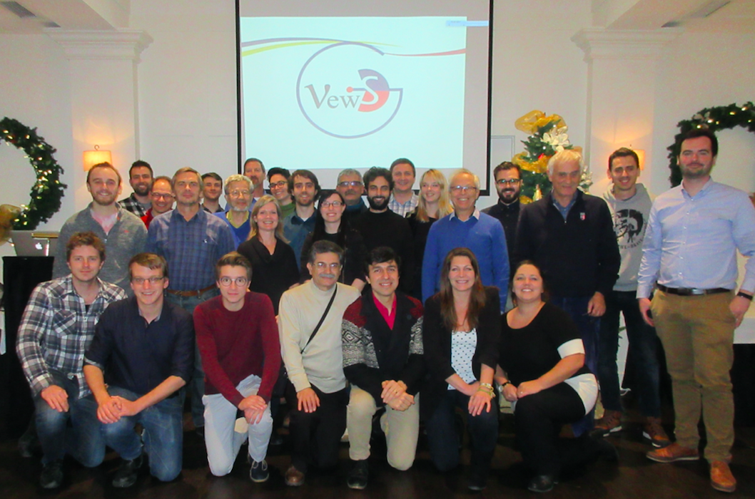
NEWS-G Collaboration
5th collaboration meeting in Kingston University on dec 2018

Slide 4
Some updates wrt dec 2018
Papers
Laser paper : Q Arnaud /NEWS-G https://doi.org/10.1103/PhysRevD.99.102003
SNOLAB Steps
Scientific Committee review at SNOLAB (march 19)
First TDR
Project status
… to come

Slide 5
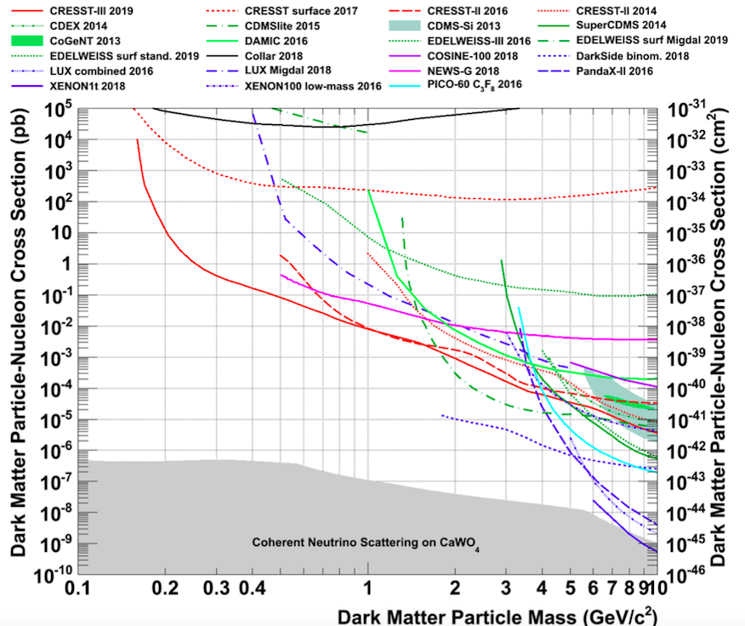
Status on WIMP search (From CRESST)

Slide 6
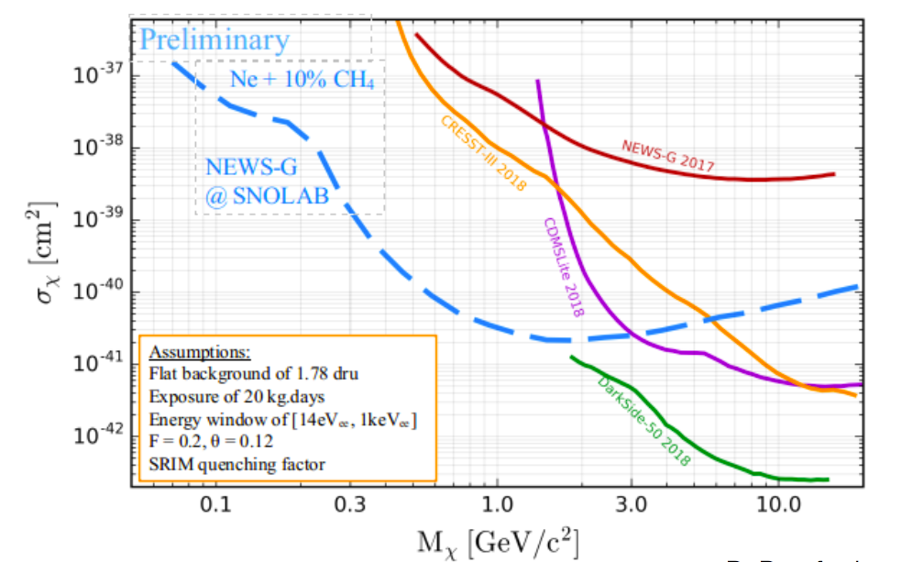
Where do we go ?

Slide 7
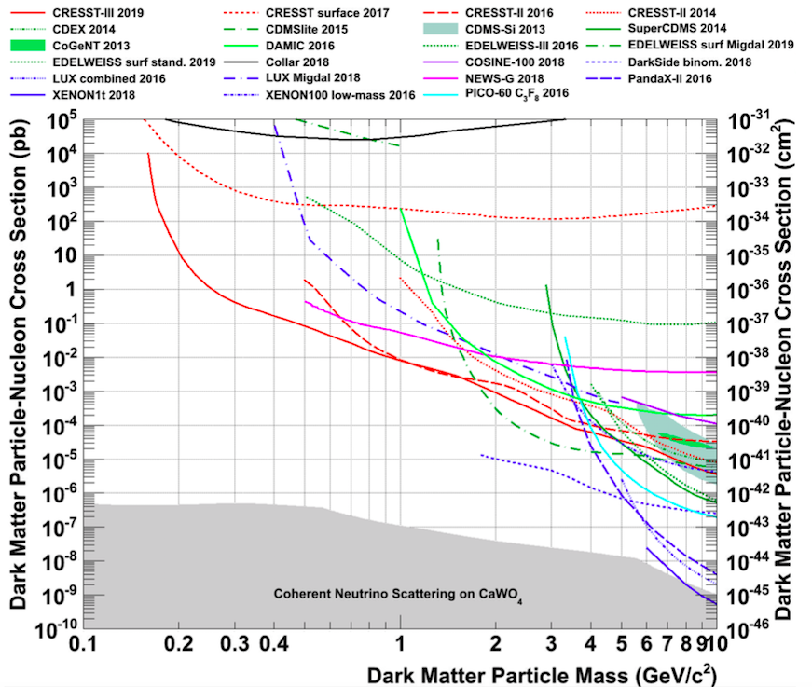
Goal of NEWS-G –first step : “low mass” WIMP’s (0.1 – 3 GeV)
Low atomic mass targets (Ne, CH4, He)
to match mass of “light” WIMP’s
First result at LSM
Only competitor is CRESST
Goal of 140 cm with Ne/CH4 90/10
20 kg.d, 0.5 e threshold

Slide 8
Special attention at this meeting
Dec 2018 issues/challenges wrt NEWS-G ‘’SNOGLOBE”
Change in design of PE final shield : done
²¹⁰Pb in archeological lead : done
Building of SNOLAB PE shield at U of Alberta : on going
Single electron sensitivity : large progress
+ Neutron beam line at Queen’s : started
+ QF at TUNL news
… : data in hand down to 0.3 keV nr
Coming challenges
LSM run : strategy for CH4
R2D2 /NEWS-G
Beyond present 140 cm sphere

Slide 9
LSM run : strategy for CH4
200 mb pure CH4 run could improve considerably our sensitivity see Dan and GG pres
Weight Ne and H goals (note that C will come for free)
Address possible delay at SNOLAB => extend run at LSM ?

Slide 10
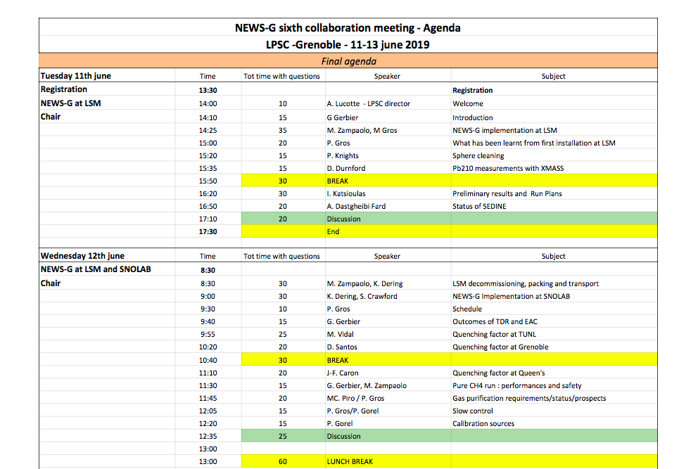
Agenda 1

Slide 11
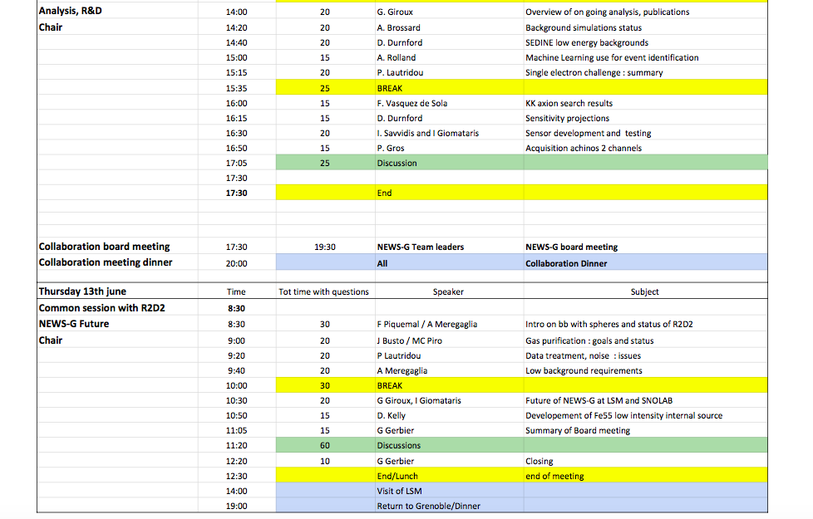
Agenda 2

Slide 12
How to keep timing with discussions periods
Please respect timing
15 mins = 12 + 3
20 mins = 15 +5
25 mins = 20 +5
Organisational questions : See Jean Francois, Ali

