Slide 1
R&D on ACHINOS
I. Giomataris, I. Savvidis
The single ball and the multi-ball ‘ACHINOS’ structure
were developed in Saclay in collaboration with University of Thessaloniki

Slide 2
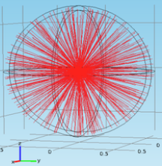
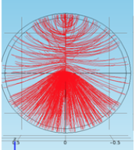
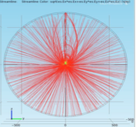
Sensor Development
Ideal radial field
Single wire
With umbrella corrector
To maximize the usable volume in the detector:
Add a field corrector close to ball (umbrella)
Umbrella materials
Pure conductor: Sparks from the anode ball
Pure insulator::Charging up and unstable operation
Resistive materials: Spark suppression
2018
Thin glass tube
2019
Thin glass tube
Simplified grounded umbrella

Slide 3
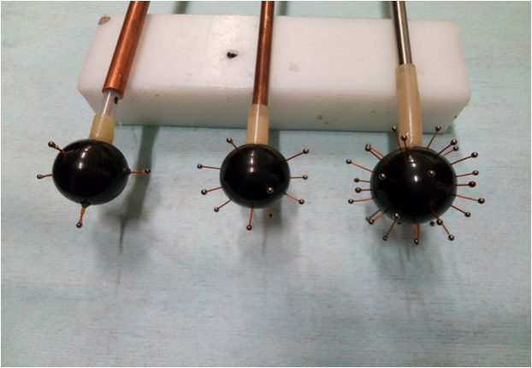
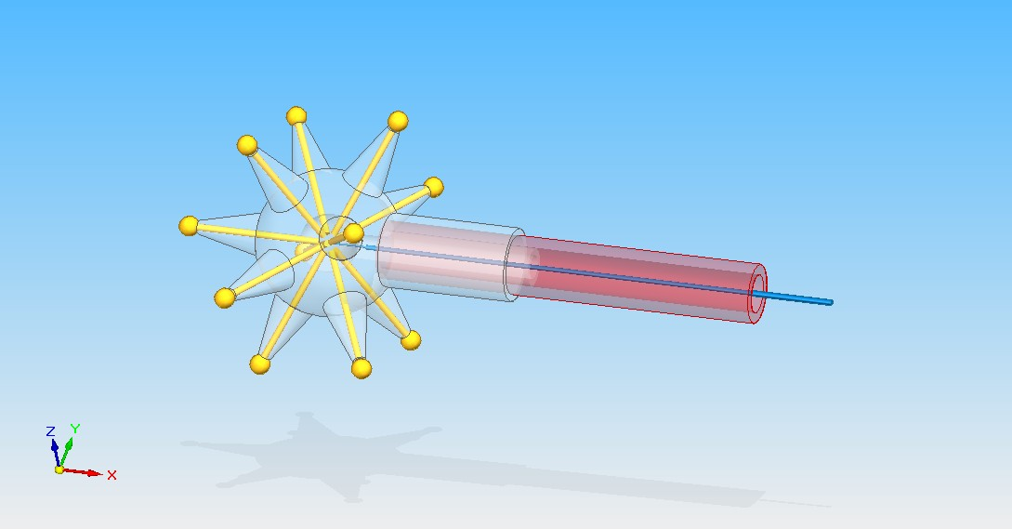
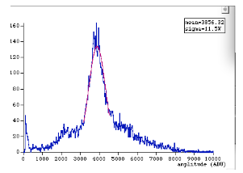
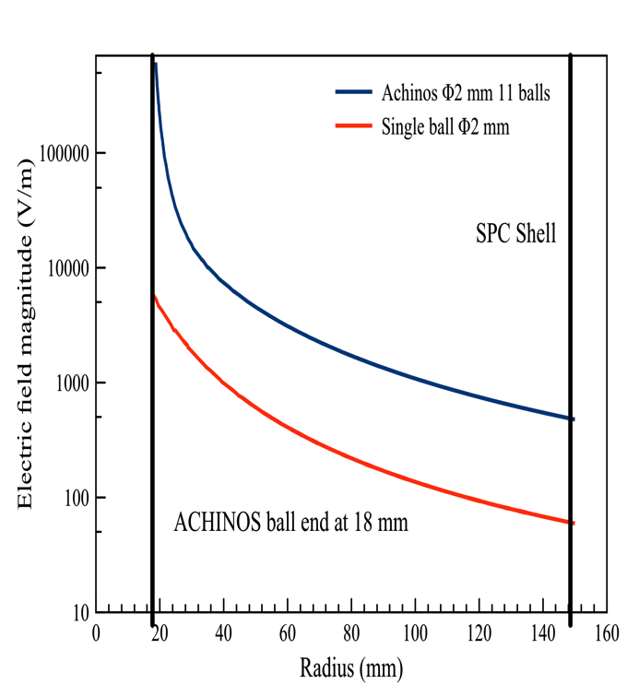
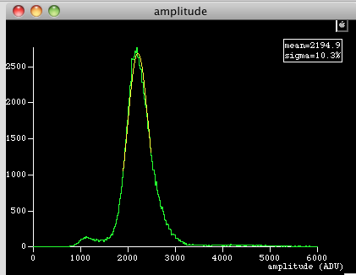
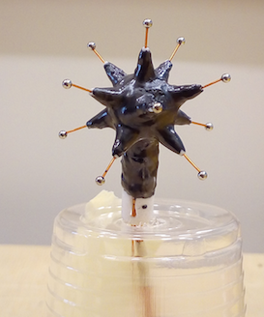
From single to multi-ball ‘ACHINOS’ structure
A. Giganon et al., JINST, vol. 12, 07 2017
Using 3D printer
Single ball
Multi-ball on bakelite
Advantages
- Amplification tuned by the ball size:
1mm diameter for high pressure
-Volume electric field tuned by the size
of the ACHINOS structure
- Detector segmentation: 3D TPC like
Without bias voltage
No uniform response
ACHINOS
With bias voltage
Single ball
Challenges
Uniformity of response
Bias voltage
Spark protection

Slide 4
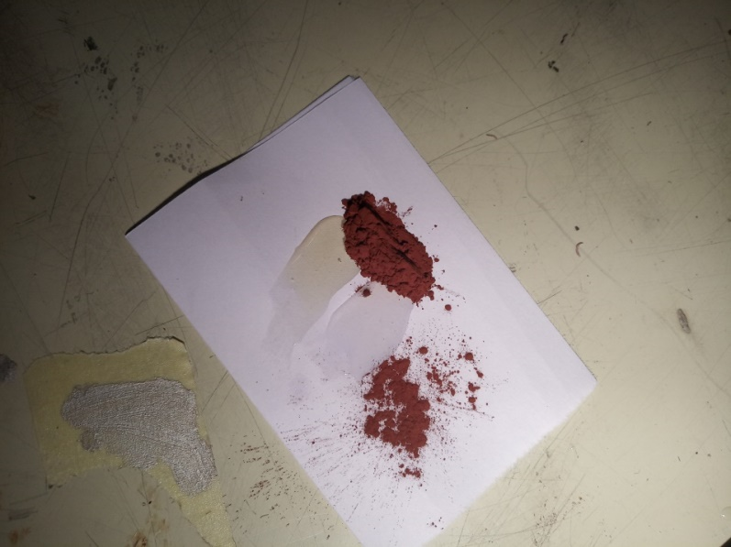
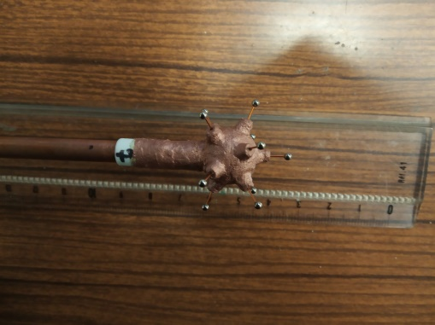
11 balls ACHINOS with copper powder charged glue
d=4mm
Araldite glue
Cu powder
10-50% (w/w)

Slide 5
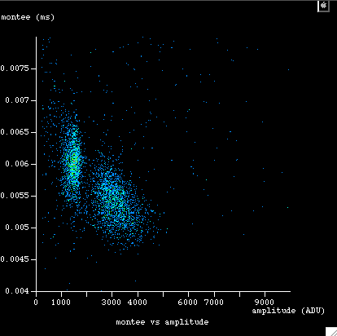
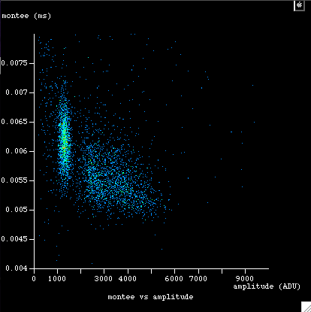
Homogeneity issue - Gain variation on a single ball - Gain variations between balls
Achinos#2 : HV1=1450, HV2=0, P=500mbar (Ne + 10% CH4
Independent peaks from different balls

Slide 6
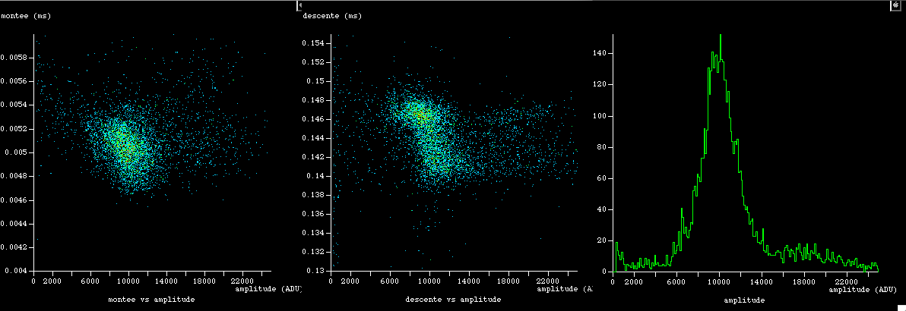
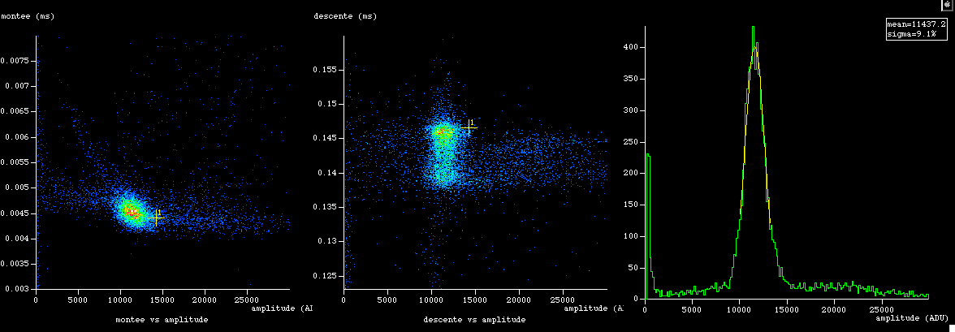
Homogeneity improvements
Peak from
6 front balls
Peak from
5 back balls
Achinos#9
HV1=1650, HV2=0
Achinos#10
HV1=1600, HV2=0

Slide 7
A simple solution: two different voltages for 5 and 6 balls
Two read-out possibility
HV5 voltage on 5 back balls
HV6= voltage on 6 front balls

Slide 8
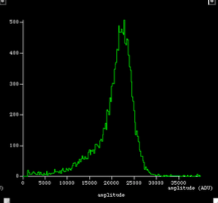
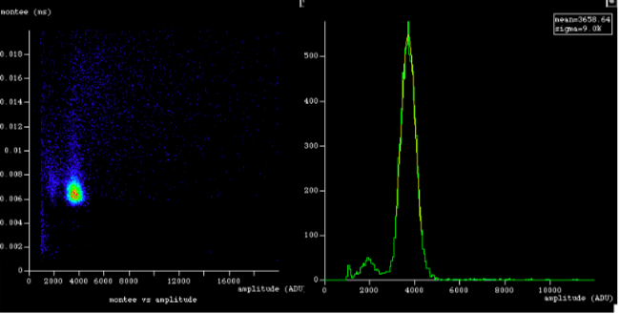
ACHINOS compared to a single ball:
uniformity needs improvements
ACHINOS Ar+2%
300 mbar
Single ball 3mm Ar+2%
300 mbar

Slide 9
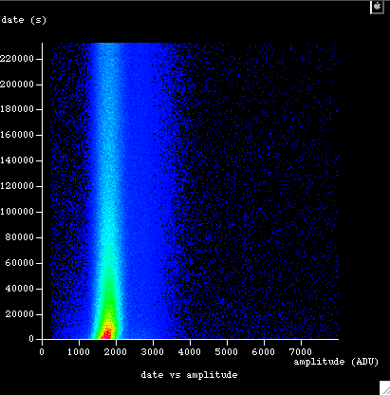
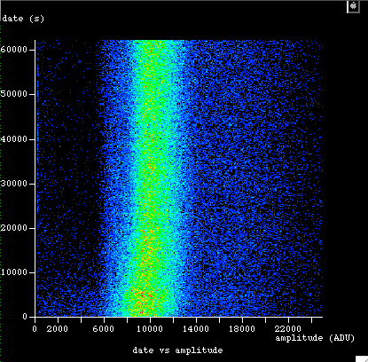
P=500mbar Ne + 10% CH4
Stability issue, improvements
Achinos#8:
HV1=1400, HV2=0
Achinos#8 HV1=1650,
HV2=0

Slide 10
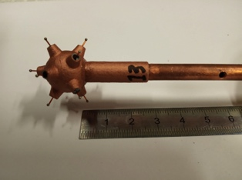
A serious problem:
robustness of charged glue layer
At high voltages because of discharges
it becomes conductor!!!
Using 1 mm ball (lower applied voltage) at moderate pressure this technology could be used
However at high-pressure, high-gain conditions long term stability is not assured
copper charged glue

Slide 11
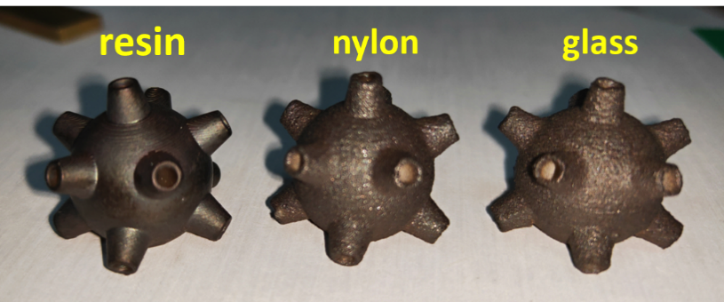
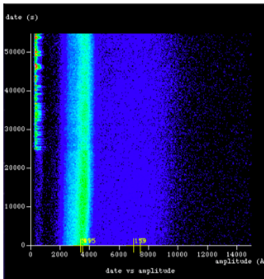
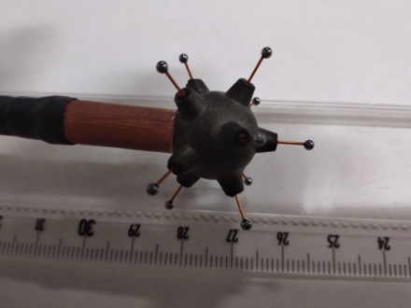
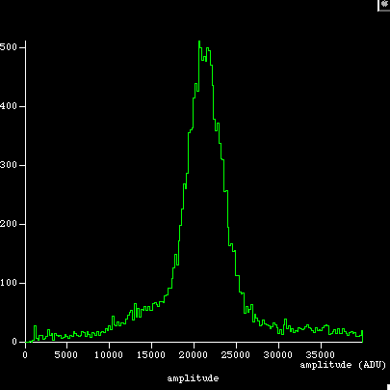
New development
DLC layer (collaboration with USTC)
It is a fantastic technical solution:
Robust, stable, precise

Slide 12
Summary
The development of DLC layer
is a major technical break through
for the ACHINOS structure

Slide 13
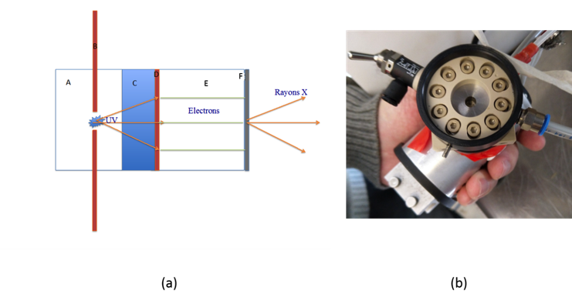
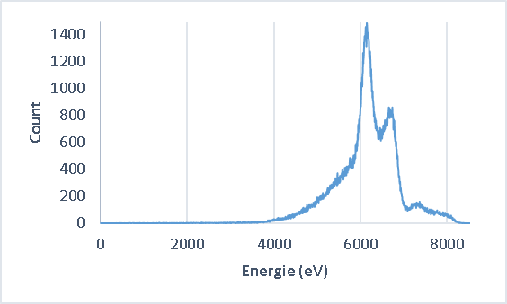
Low background X-ray pulsed generator
Continuous calibration during data taking is possible
thanks to the fast trigger (<1 ns)
Light weight device with selected radiopure materials
Low power (1 mwatt): portable system with battery
Non need of security certification.

