Slide 1
Design for Fe-55 Source
D.G. Kelly, E.C. Corcoran, P. Samuleev and T. Mumby
NEWS-G Collaboration Meeting
Grenoble
11-13 June 2019

Slide 2
Fe-55 Source: Activity
Fe-55: half-life 2.70 years, decay 5.95 keV
Activity
1 mBq effective activity
Accuracy ± 50%
Physical
Sealed
Isotropic, anisotropic, both

Slide 3
Fe-55 Source: Physical
Location
Rod
Removable – accessed from bottom
Size
Rod diameter: 6 mm…consistently?
Concentric source diameter: 10 mm

Slide 4
Fe-55 Source: Physical
Materials
Aluminium
High purity (5N in 10 mm and 12 mm Ø)
Others
Commercial Al alloy
Copper
Steel?
Carbon-based: epoxy

Slide 5
Design
Sleeve
Grubb screw(s)
Annular well(s)/channel for source
Add source, seal with epoxy
Grubb screw(s)
1 mm depth
channel or
1 mm holes

Slide 6
Fe-55 Source: Commercial
Nominal 3.7 kBq Fe-55 solution in 5 mL
Readily available: $1,200
0.1 M FeCl₃ solution
Use
Dilute in high purity aq. HNO₃
Add Fe(III) carrier
Electroplate

Slide 7
Fe-55 Source: Commercial
Nominal 3.7 kBq Fe-55 solution in 5 mL
Why not simply…
Dilute (1 in 100) x 3
Drop 1 μL in place and allow to dry
Seal with epoxy
Good question!

Slide 8
Fe-55 Source: NAA
Natural iron not ideal source
Fe-59: 45.1 day half-life
Fe-59: 1099 and 1292 keV gammas, plus several others down to 143 keV

Slide 9
Fe-55 Source: NAA
Isotopically enriched Fe-55
> 99.85 enriched Fe₂O₃ (powder)
> 99.70 enriched metal (granules)
Purchased: 2 x 100 mg, $2,000
Irradiation
1 mg metal, 5x10¹¹cm⁻²s⁻¹, 9 sec, 1 Bq activity
↓ mass Fe-54, ↓ flux, Cd shield, attenuate in place

Slide 10
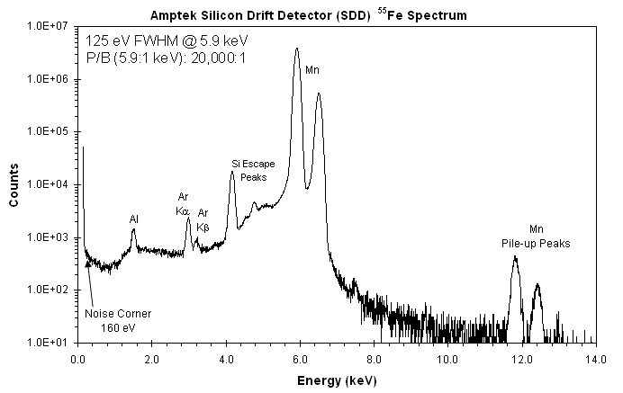
Detection
5.9 keV too low for HPGe
Not quantitative

Slide 11
Fe-55 Source: Attenuation
MCNP
Simple model to consider effects of…
Sleeve
Epoxy
Additional materials

Slide 12
Conclusion
Access to Fe-55 simple: purchase or activate
Low activity
Easier with aqueous Fe-55
Sealing
Easier with activated metal or oxide

