Slide 1
The Helium-3 Removal System at the PULSTAR SOS Experiment
Christian White
15 Feb 2021

Slide 2
Outline
What is the SOS experiment?
The ³He removal System in the SOS Apparatus
Film Burner
Charcoal Pump
Gas-Gap Heat Switch
Cryogenic Valve
Characterization of the Charcoal Adsorption Pump

Slide 3
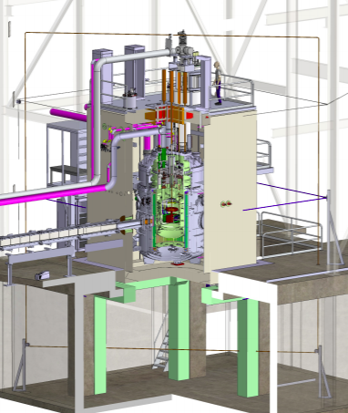
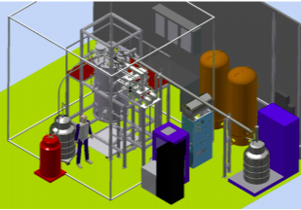
The Systematic and Operational Studies Apparatus at NC State/TUNL
Small scale version of SNS nEDM experiment
Cryogenic turnaround → Weeks vs months
Used to investigate systematics (geometric phase effect) and operational procedures for SNSnEDM
No Electric Field
PULSTAR SOS at NCSU/TUNL
SNS nEDM at ORNL
Notes:
New pictures on review website.

Slide 4
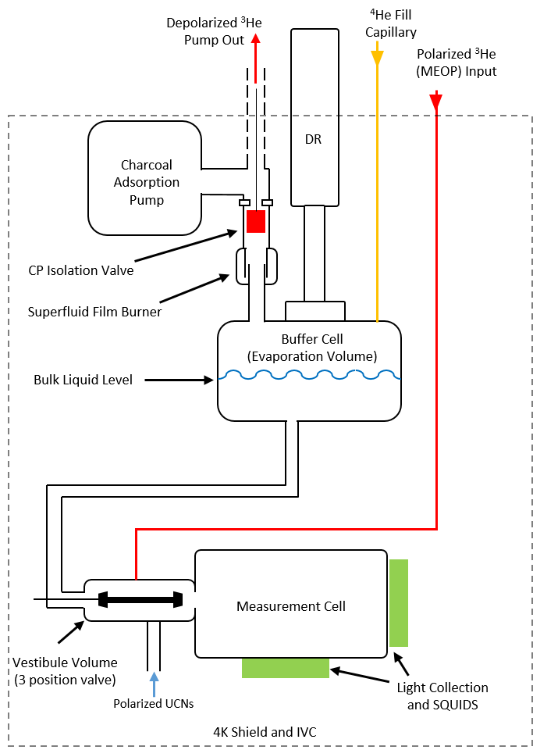
Schematic of the SOS Experiment
Single measurement cell (same size as SNS) full of superfluid helium
Polarized ³He (MEOP) and ultracold neutrons (NC state source) introduced into cell for measurement
After measurement, ³He flushed upward toward buffer cell and removed by a charcoal adsorption pump

Slide 5
³He Removal in SOS Experiment
³He can be selectively removed because of high vapor pressure
Three Main Components
Superfluid Film Burner
Cryogenic Isolation Valve
Charcoal adsorption pump

Slide 6
Design Requirements for ³He Removal
Powerful pump (charcoal adsorption) near liquid helium surface (pumping speed limited by geometry)
Ability to cool a large amount of charcoal to 4K
Ability to regenerated pump and remove gas when saturated
Gas capacity for at least 1-2 weeks between regeneration

Slide 7
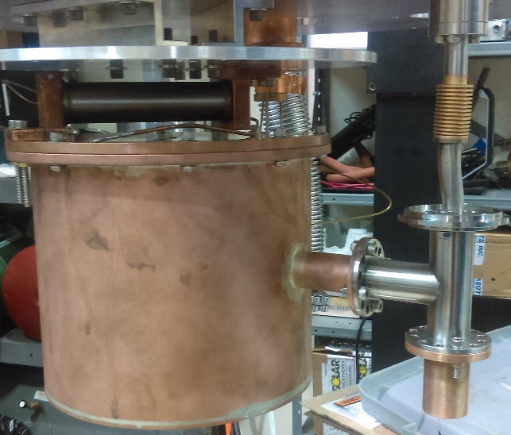
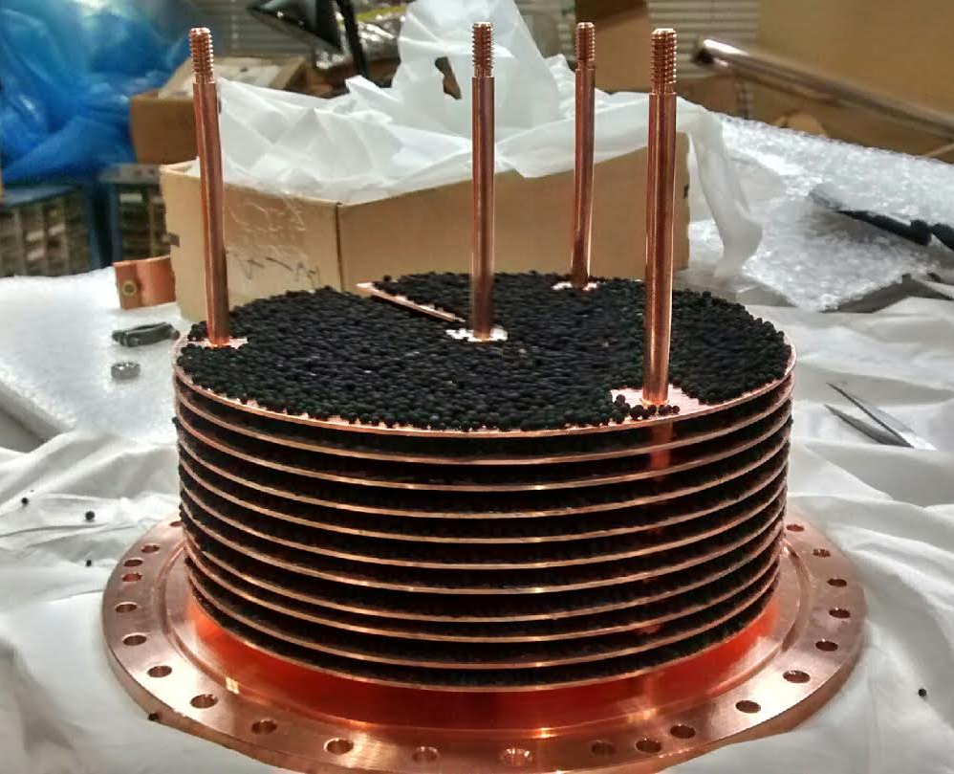
Charcoal Pump Design
Heat switch, linking to 4K
Brazed Copper can with top and side flange
20 copper plates
Charcoal epoxied to one side with DP190
Separated by spacers
Total of 0.4kg of activated charcoal
Capacity of 5.5mols helium
Worst case is 0.03 mols/hour – 165 hours of run time without regeneration
Goal is to regenerate weekly
Charcoal Pump
Charcoal Pump in Test Setup
Mounting Charcoal Plates

Slide 8
Thermal Cycling to Regenerate Pump
Pump will operate at 4K linked to liquid He bath.
Need to raise to >25K to expel all gas when saturated
Need to heat pump without boiling off too much helium → Heat Switch
Need to isolate pump from system when regenerating → Cryogenic Isolation Valve
Heat Switch
Isolation Valve Location

Slide 9
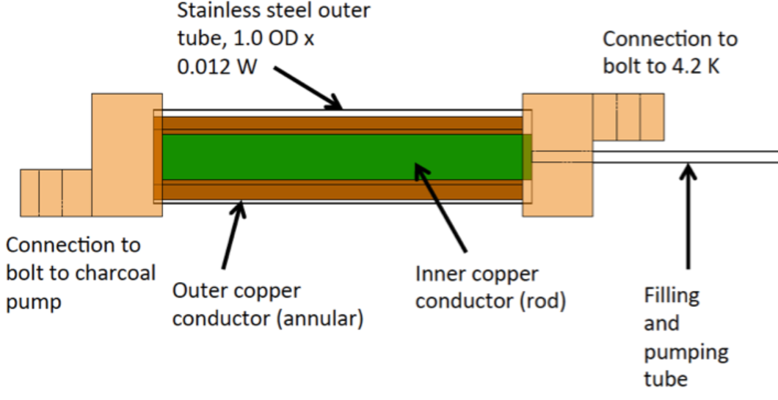
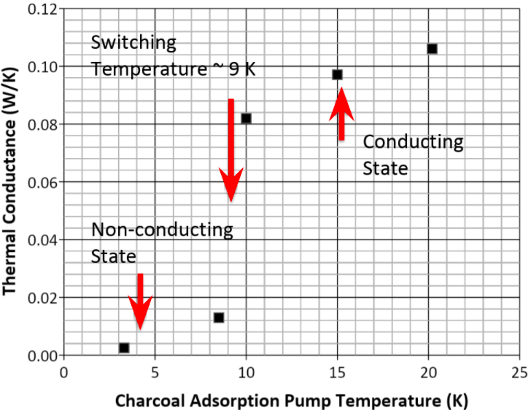
Gas Gap Heat Switch
Uses thermal conduction across a small gap filled (or not filled) with helium to provide (break) the thermal connection to the 4K bath
Small charcoal adsorption volume can remove helium in gap between two copper pieces
Switch is on when charcoal is warm, off when cold.
Heat Switch
Small Charcoal Pump with Heater and Link to 4K
Heat Switch in Test Setup

Slide 10
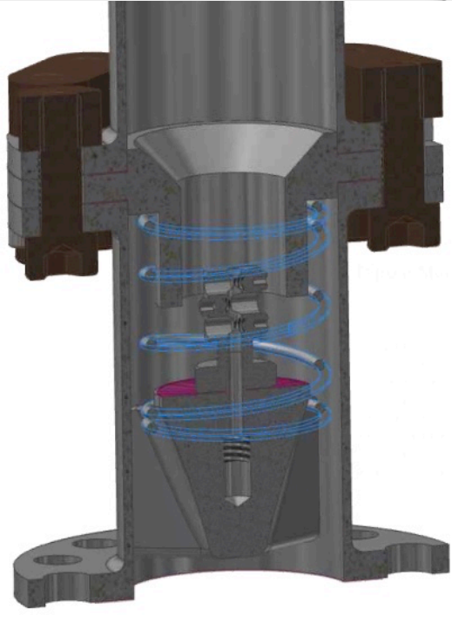
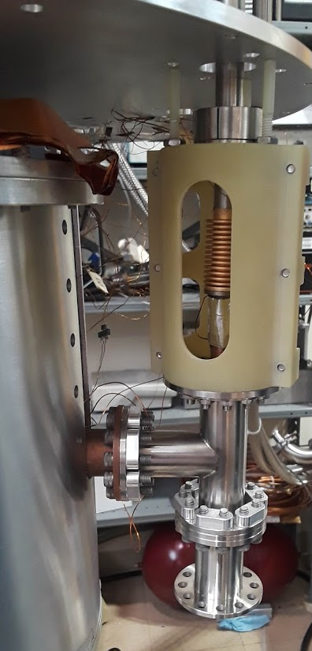
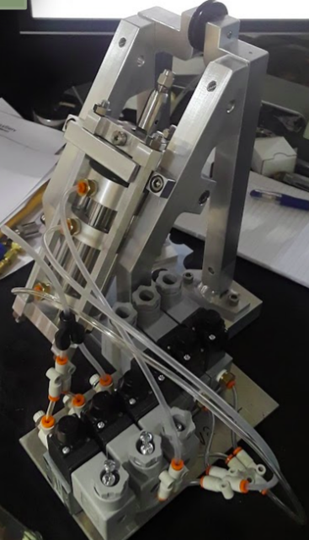
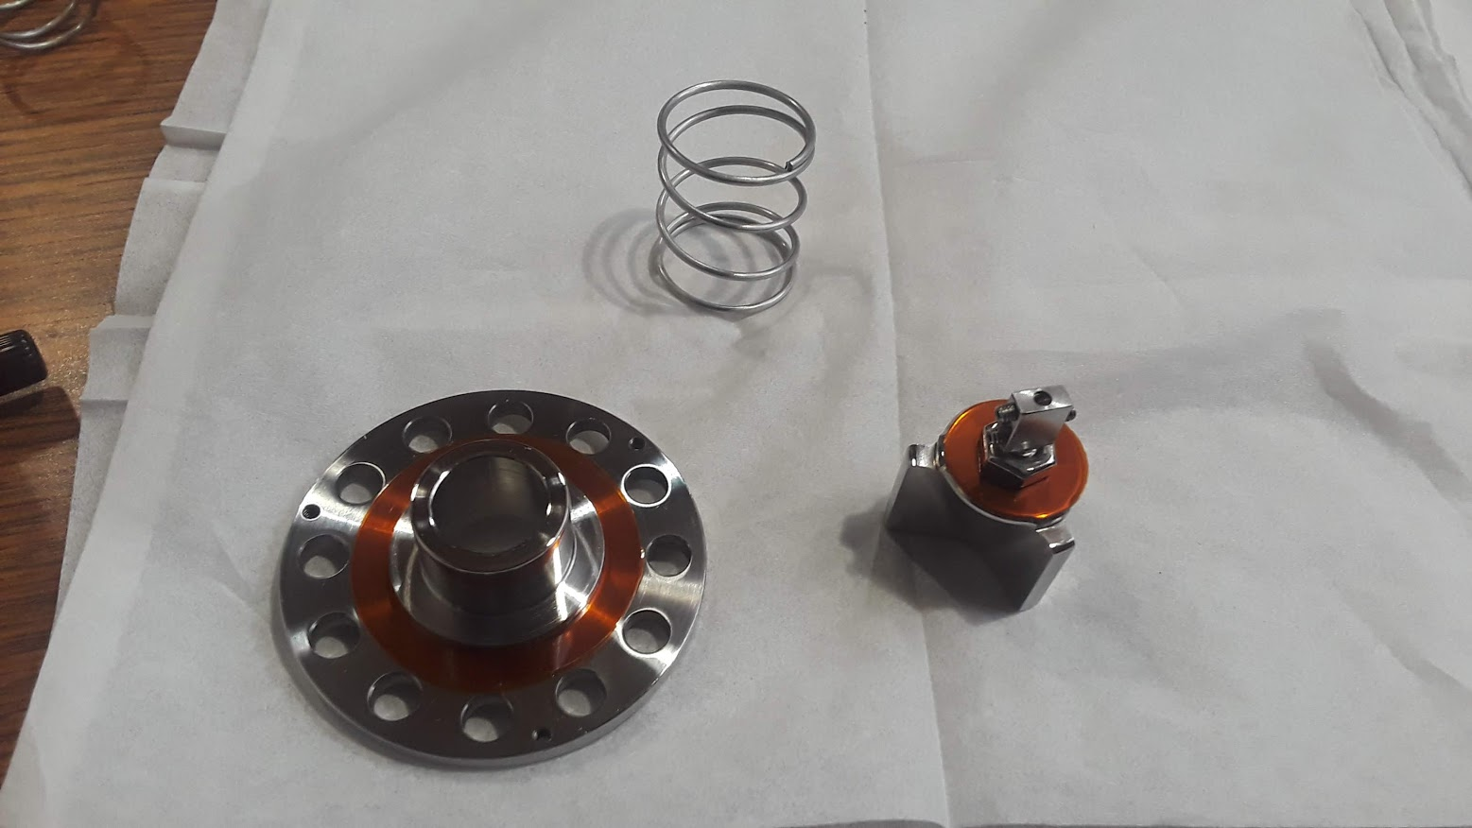
Cryogenic Isolation Valve
Valve Seat
Valve Body
Pneumatic Actuator
In test setup
100 lb. closing force

Slide 11
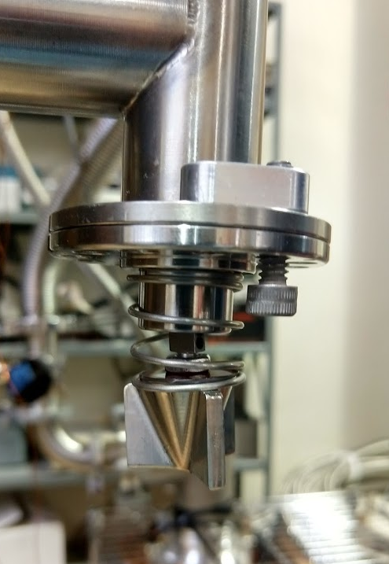
Cryogenic Isolation Valve
1cm stainless steel valve
Open during normal operation, closed during pump regeneration
Polishing + Lapping + Kapton gaskets = 10⁻³ to 10⁻² mbar*L/s
Epoxying gasket to valve body and allowing to cure under force = 10⁻⁵ mbar L/s
Notes:
Actuator Pictured

Slide 12
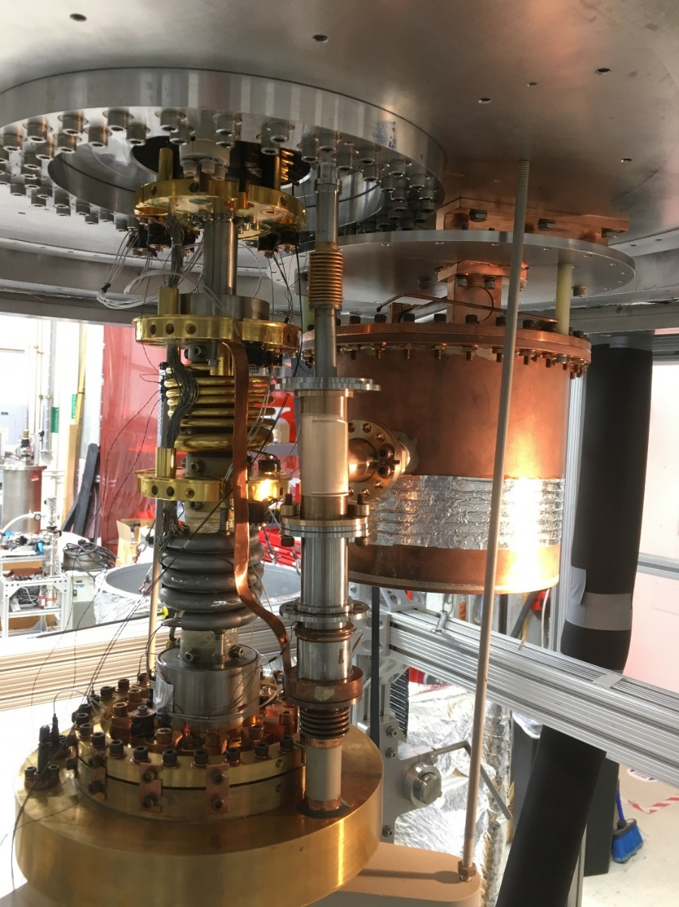
Fully Assembled View
Heat Switch
Charcoal Pump
Valve
Film Burner
Buffer Cell

Slide 13
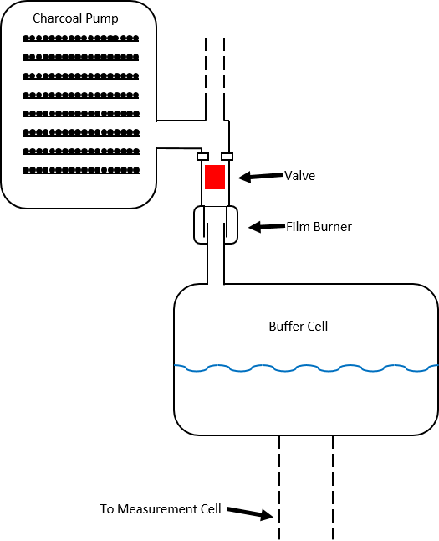
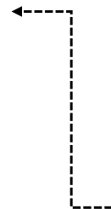
Pumping speed. Temperature Dependence
³He concentration after run ~10⁻¹⁰ → Goal after removal ~10⁻¹²
Need at least 3-4 removal times ($τ$)
$$\frac{n_{3 gas}}{n_{3 liquid}}≈{\left(\frac{m^{∗}}{m}\right)}^{\frac{3}{2}}e^{−\frac{2.8K}{T}}$$
$$P_{3 }=n_{3 gas}∗k_{B}T$$
$${\dot{N}}_{3 tot}=\frac{N_{3 liq}}{V_{liq}} C_{3}{\left(\frac{m^{∗}}{m}\right)}^{\frac{3}{2}}e^{−\frac{2.8K}{T}}$$
$${\dot{Q}}_{3}=P_{3}C_{3}, {\dot{N}}_{3 tot}=\frac{{\dot{Q}}_{3}}{k_{B}T}$$
Estimated C ≈ 0.20 l/s
$${ N}_{3liq}≈N_{3tot}$$
m*= ³He quasiparticle mass =2.4m
2.8K = Binding energy of ³He to bulk LHe
C = Conductance to pump from geometry (l/s)
$$τ=\frac{V_{liq}}{C_{3}}{\left(\frac{m}{m^{∗}}\right)}^{\frac{3}{2}}e^{\frac{2.8K}{T}}≈70 minutes @ 0.4K$$
$$17 minutes @ 0.5K$$

Slide 14
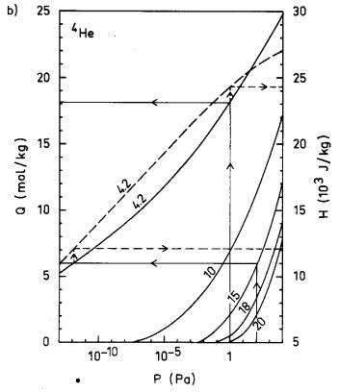
Adsorption Capacity of Activated Charcoal
⁴He concentration 10 orders of magnitude higher, so it will dominate saturation despite higher SVP of ³He
At 10⁻⁵mbar (SVP of ⁴He at 0.5K), capacity of 0.4kg charcoal is ~5.5mol @4.2K

Slide 15
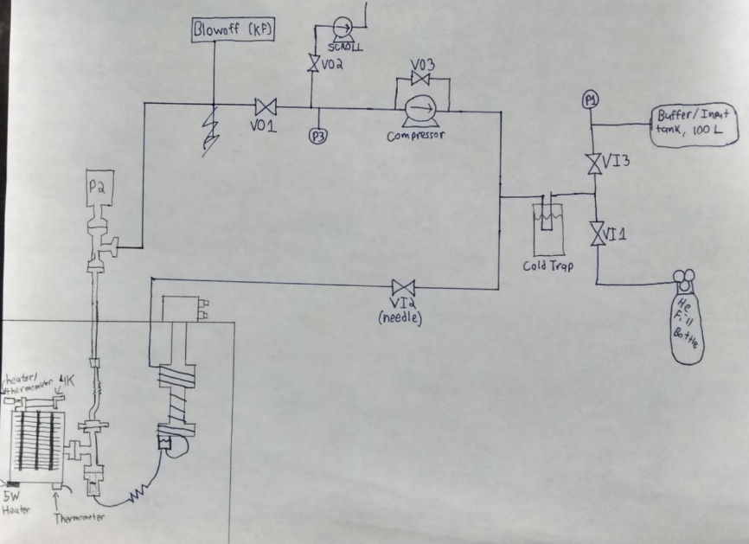
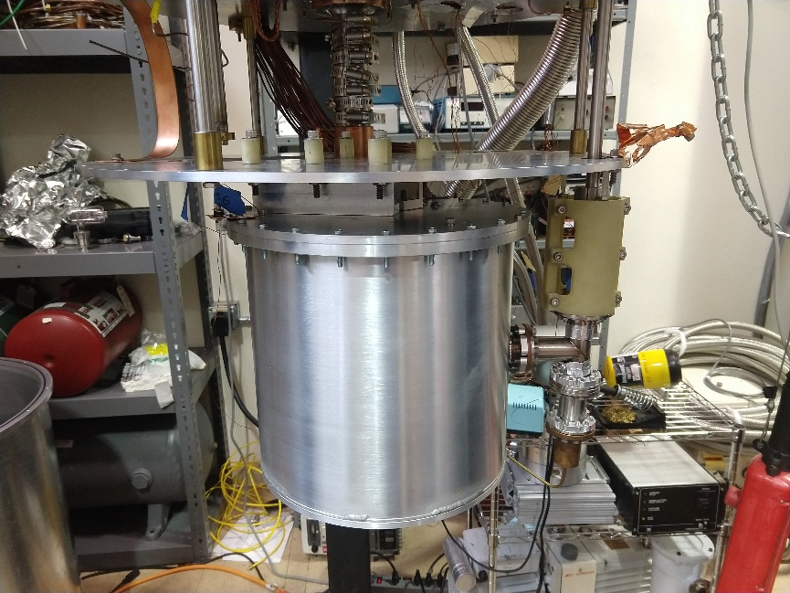
Pump Adsorption Capacity Tests - Procedure
Cooled pump with cryocooler (reached 7.8K)
Filled a 100L buffer tank with ⁴He.
Allowed a large puff of gas into the charcoal pump
Pump will heat up as it adsorbs, when temperature reached equilibrium again, record pressure and amount of helium used.
Repeat until pump is saturated

Slide 16
Pump Adsorption Capacity Tests - Data
4.2K and 10K curves from Salmelin shown, with interpolated 7.8K (test setup)
Data follows curve above 10⁻⁴ mbar, but below….
Trouble pumping below background of 10⁻⁵ mbar (on gauge, 10⁻⁴ when adjusted to ⁴He)

Slide 17
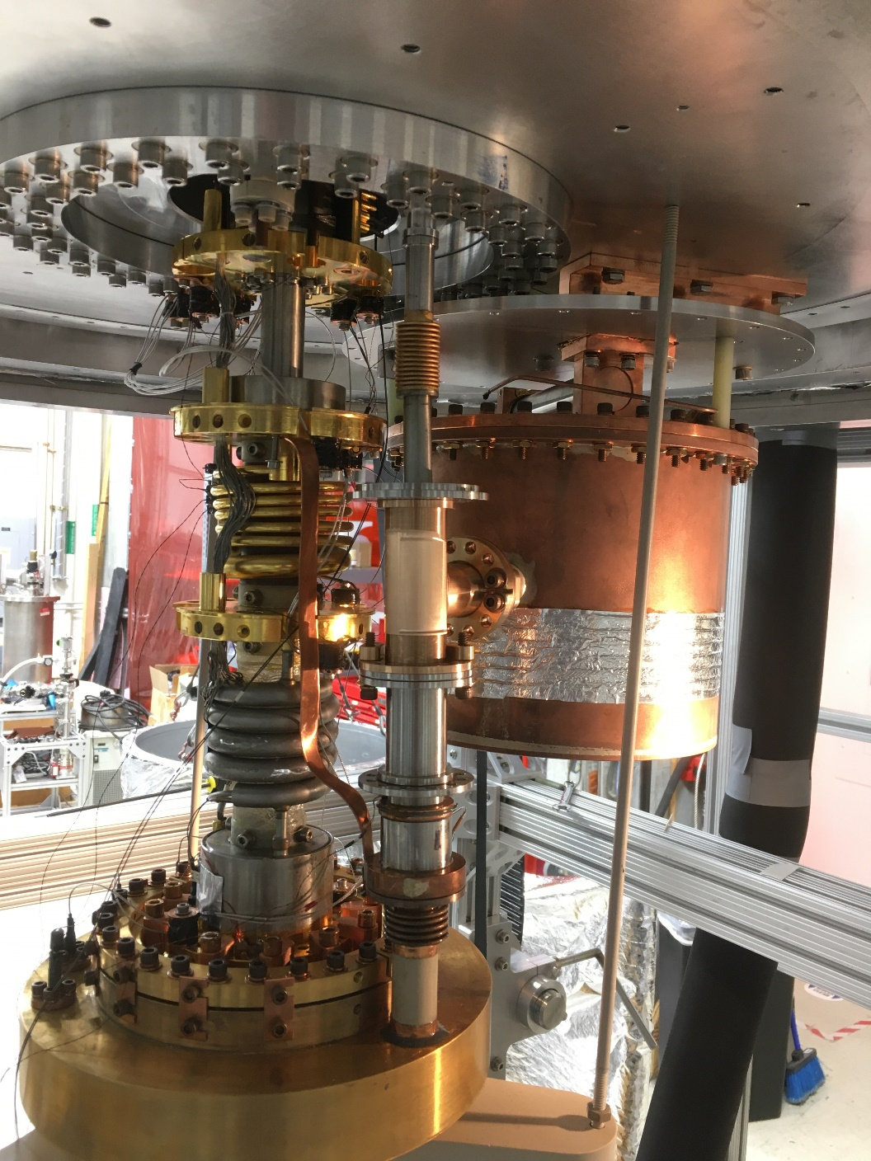
Summary and Outlook
Helium-3 removal system complete and ready to be tested in main apparatus
Cryogenic valve are operational to leak rate of 10⁻⁵ mbar*L/s
Charcoal pump capacity behaves as expected
Entire ³He removal system has been installed in SOS apparatus; cooldown expected by early March.

Slide 18
Thank you!

Slide 19
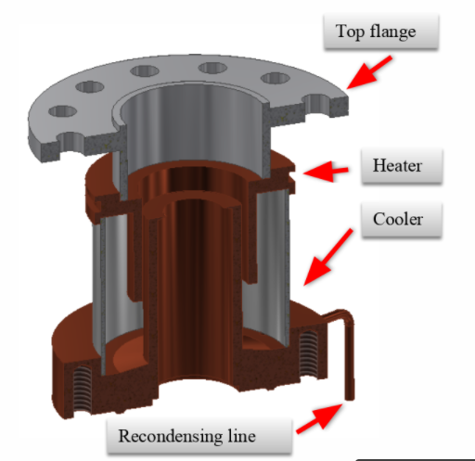
Helium Film Burner

