Slide 1
Atomic Beam Source for the nEDM@SNS Experiment
Mark Broering for MIT ABS team on behalf of nEDM@SNS
Les Houches nEDM 2021 Conference
February 18th, 2021

Slide 2
Outline
Background
Overall goal of the experiment
How the atomic beam source, as part of the ³He services, helps to achieve this
Polarized ³He experimental requirements
Atomic beam source apparatus
Needle nozzle configuration
Simulations
Measurements
Microchannel (MC) plate nozzle configuration
Simulations
Measurements

Slide 3
The Target Cells
Electric Field
nEDM@SNS goal: achieve a sensitivity to the neutron electric dipole moment at or below $d_{n}≈3×{10}^{−28} e∙cm$.
Neutrons are down-scattered to UCNs in two acrylic target cells containing superfluid helium.
Spin polarized ³He is also injected into the volume where both species precess freely.
Neutron-³He capture cross-section is spin dependent.
Spin dressing techniques* are used to ensure the capture rate depends on the nEDM.
*Raymond Tat talk on spin dressing on Friday.
Image credit: Takeyasu Ito, personal communication (original modified)
Magnetic Field

Slide 4
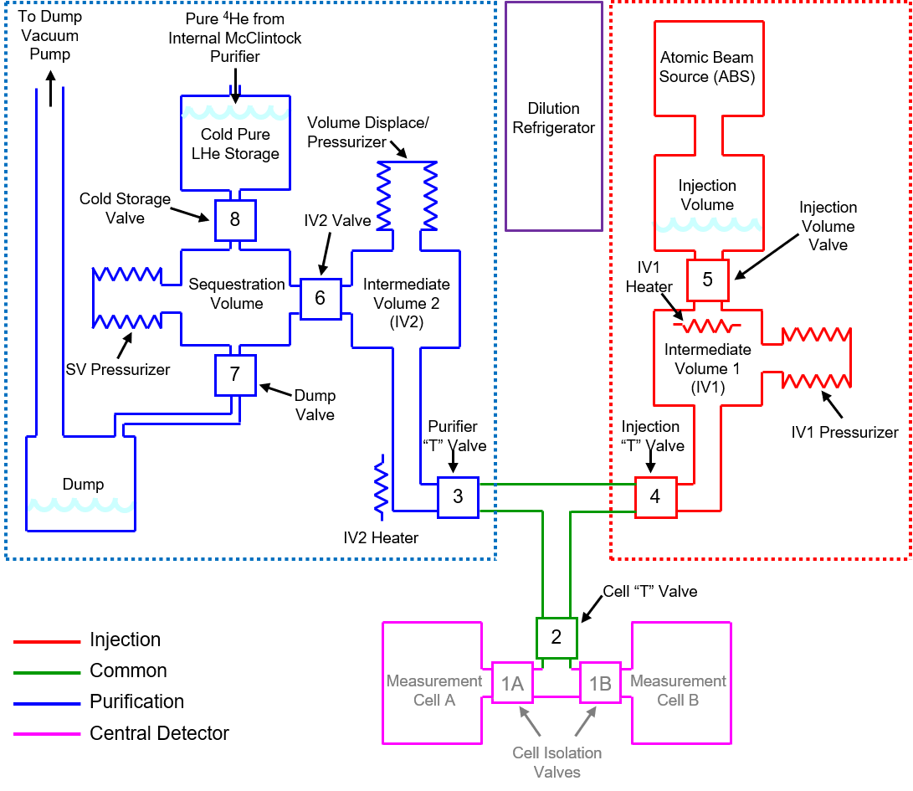
³He Services
Diagram of the ³He services subsystem.
Red: ³He polarization and injection system.
Concerned with the first three items:
Atomic beam source (ABS), ABS interface, and the injection volume.
ABS spin polarizes the ³He at ~1K with some background leakage.
ABS Interface guides spin polarized helium to injection volume.
Contains carbon pumps to reduce the amount of background ³He.
At the injection volume, the ³He mixes with the superfluid ⁴He.
ABS Interface

Slide 5
³He Services
Diagram of the ³He services subsystem.
Red: ³He polarization and injection system.
Concerned with the first three items:
Atomic beam source (ABS), ABS interface, and the injection volume.
ABS spin polarizes the ³He at ~1K with some background leakage.
ABS Interface guides spin polarized helium to injection volume.
Contains carbon pumps to reduce the amount of background ³He.
At the injection volume, the ³He mixes with the superfluid ⁴He.
ABS Interface
ABS Interface

Slide 6
Polarized ³He
Experiment requires ³He polarized to >=95%.
This is difficult to achieve with optical pumping techniques.
Therefore, an atomic beam source using a permanent magnet quadrupole was designed.
This system needs to provide polarized ³He to the measurement cells with a flux of ~10¹⁴ atoms/s.
It is currently horizontal, but ultimately will be vertical.

Slide 7
Atomic Beam Source Schematic
Cold head cools ³He to ~1K.
If gas touches any walls, it warms up.
Skimmers catch atoms that have no chance of making it through the quadrupole while cold.
Skimmers create “soft” separation between chambers.
Quadrupole “collimates” atoms in one polarization state, pushes others radially away.
RGAs measure beam profiles.
Not to scale
Beam Direction

Slide 8
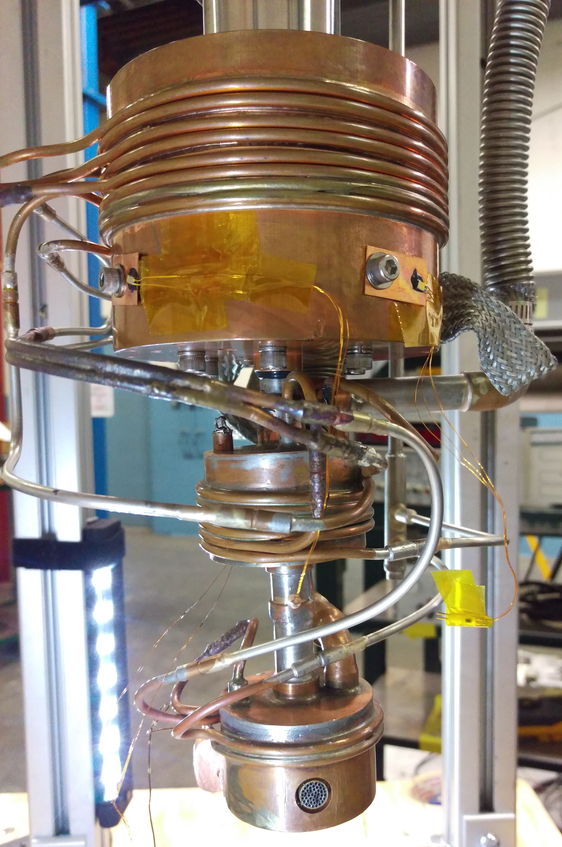
Component Images
Quadrupole
Heat Shield
Skimmer
Needle Nozzle

Slide 9
Original Configuration
Originally, there were large amounts of background gas exiting the quadrupole.
Background is potentially unpolarized.
Saw that there was no direct pumping on the inside of the heat shield (copper colored).
Background gas was just as likely to go downstream as to enter a pump.
Pumps
Pump

Slide 10
Reconfigured Pumping
Moved a pumping port to the bottom.
Added heat shield extension.
Heat shield is now a separate volume.
This change increased the signal gas to background gas by a factor of ~3.

Slide 11
Needle Nozzle Simulations
Too computationally intense to fully simulate.
Assume beam is always in molecular flow.
Ignore background gas.
Stop tracking particles that collide with walls.
Track transmission, determine what fraction of particles are “lost” in each chamber
Needle Nozzle:
Transmission: ~0.01%
Simulated polarization of transmitted particles: >99.9%
Plot tracking particles in the spin state accepted by the magnetic field.

Slide 12
Needle Nozzle Measured Profiles
Beam profiles were taken by both the upstream (US) and downstream (DS) residual gas analyzers (RGAs).
Beam profiles were taken for multiple ³He inlet pressures.
Extract signal to background from the beam profile.
Sample profile at upstream RGA measured for a 240 mtorr ³He inlet pressure provided to the needle nozzle (measured at room temperature).

Slide 13
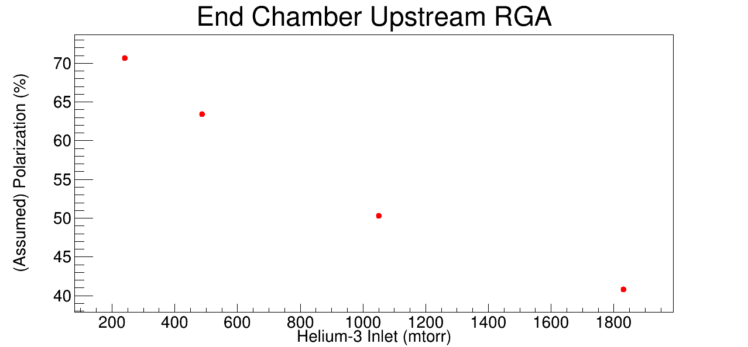
Needle Nozzle Signal to Background
Signal divided by total (%) at upstream RGA.
New maximum: ~70%.
Previous maximum: ~40%.
Reconfiguring the pumping massively increased the signal to background.
We would like to increase it further though.

Slide 14
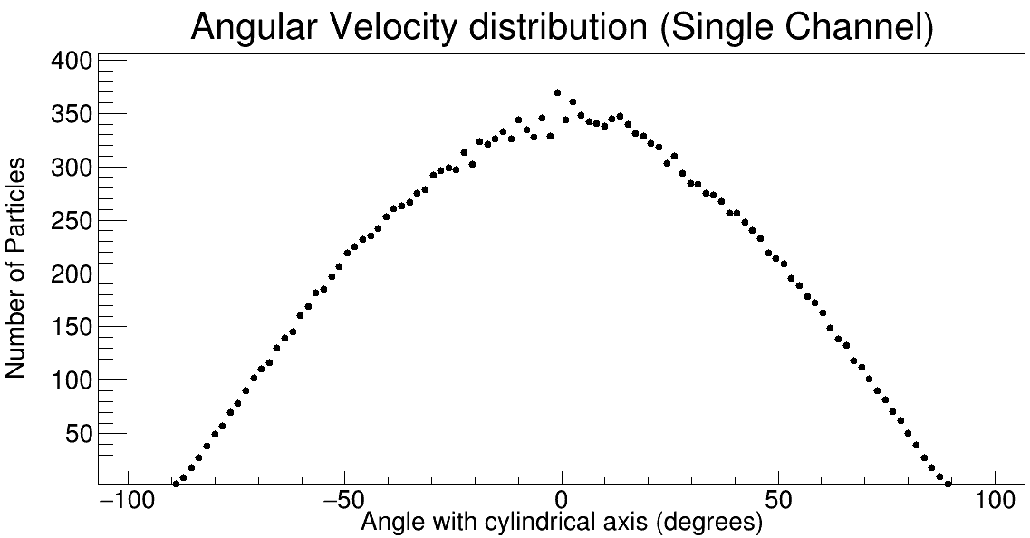
Microchannel Plate?
Angular distributions some distance from nozzle:
Above: Experimentally measured distribution for multi-capillary array with channel dimensions comparable to a microchannel (MC) plate (F Rugamas et al 2000 Meas. Sci. Technol. 11 1750).
Different symbols indicate different nozzle pressures
Below: A general cos(theta) distribution which is the kind of distribution governing the hypodermic needle nozzle at operating pressures. (from simulation)
MC plate should have a far sharper peak than the old nozzle.

Slide 15
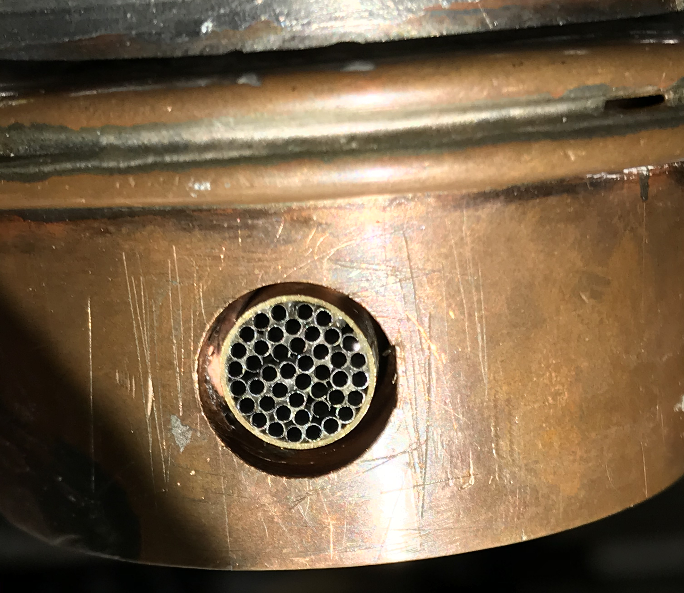
Microchannel Plate Nozzle
More pointed distribution improves system in two ways:
Reduces necessary minimum operating pressure
Reduces fraction of gas available to be converted into background
MC plate nozzle
Simulated Transmission: 0.25%
Simulated Polarization: >99.9%
MC Plate
Needle Nozzle

Slide 16
MC Plate Initial Results
Signal divided by total (%) at upstream RGA for MC plate.
Did not initially see much improvement.
Check nozzle alignment.

Slide 17
Check MC Plate Alignment
Able to crudely change nozzle alignment.
Horizontally translated the nozzle, keeping distance from quadrupole fixed.
Were able to slightly increase the signal to background.
Comparing to simulations, this suggests that the nozzle has an angular misalignment <1 degree.

Slide 18
Skimmer Optimization
Once the nozzle is properly aligned it may be necessary to change the skimmers.
The original skimmers are less effective with the new nozzle.
Atoms lost to Quadrupole, already being in the second to last chamber, are most likely to become background gas.
Maximizing the Transmission/Rejection ratio, in the quad, will likely improve the signal to background.
Original Nozzle with Original Skimmers
MC Plate Nozzle with Original Skimmers
Position | Fraction of Gas
Lost on Skimmer 1 | 95.871%
Lost on Skimmer 2 | 3.947%
Rejected by Quad Field | 0.0984%
Transmitted by Quad Field | 0.0098%
Position | Fraction of Gas
Lost on Skimmer 1 | 85.409%
Lost on Skimmer 2 | 12.272%
Rejected by Quad Field | 1.491%
Transmitted by Quad Field | 0.258%
From Simulations

Slide 19
Summary and Future Work
A ³He atomic beam source has been tested and modified.
Currently working to further reduce the background being emitted.
Most recent attempt involves a new nozzle with a more pointed velocity distribution.
This new nozzle has some alignment issues which are being explored as of this presentation.
Future optimizations for the skimmers may further reduce background.
These require major changes, which can most efficiently be performed as part of rotating the apparatus into a vertical orientation.

Slide 21
Needle Nozzle Simulated Profiles
Simulated profile is similar to a Gaussian distribution but is not one.

