Slide 1
nEDM@SNS Light Collection System
Vince Cianciolo (ORNL), for the nEDM@SNS Collaboration

Slide 2
System Goal
nEDM@SNS continuously measures neutron spin direction
Two measurement techniques (free precession and spin dressing)
Both techniques take advantage of the fact that
  n³He capture cross section highly spin-dependent
  Capture products (proton, triton) produce scintillation light (~ 5,000 EUV photons) in liquid helium
The goal of the light collection system is to detect a sufficient number of these photons to distinguish signal from background events and provide a measure of the average electric field without introducing electrical or magnetic noise
See next talk (D. Loomis) for simulation of system performance

Slide 3
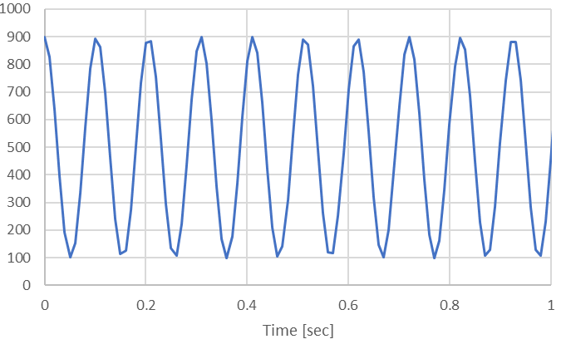

Illustration – Free Precession
Neutrons and 3He precess in the magnetic holding field
In ³He rest frame the neutron precession frequency is greatly slowed down
When the spins are parallel/(anti-parallel) the cross section is small (large)
The n/³He capture event rate varies sinusoidally at the difference between ω₃ and ω_{n}
B
n
³He
$$R\left(t\right)∝\cos{(\left(ω_{3}−ω_{n}\right)}t)$$

Slide 4
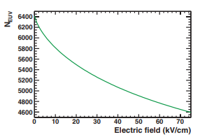

Light Production
Mono-energetic reaction ($n+{}_{}^{3}{He→p+t+764 \text{keV}}$)
  Good energy measurement allows for rejection of background events (neutron β decay, activation γ’s, cosmic rays), all of which have a broad range of energy deposition.
Strong light yield
  Energy-dependence provides convenient measurement of <E> (S. Clayton, T.M Ito)
    $\frac{σ_{E}}{E}=\left(\frac{N_{UV}}{E}\right)\left(\frac{1}{{∆N}_{UV}/∆E}\right)\left(\frac{1}{\sqrt{N_{PE}N_{EVT}}}\right)\sim \frac{1.2}{\sqrt{N_{EVT}}}$ (sub-% in < 1 minute)
    Calibration w/ pulsed LED, α-source, 0-field runs
T. M. Ito et al., Phys. Rev. A85, 042718 (2012)
See also:
T.M. Ito and G.M. Seidel, Phys. Rev. C88, 025805 (2013)
N.S. Phan et al., Phys. Rev. C102, 035503 (2020)

Slide 5
System Overview
1.3x1.3 mm² silicon photomultipliers mated to each fiber;
operating temperature ~ -60C to suppress dark rate
Processing electronics implement a “photon counting” technique to maximize efficiency, minimize voltage/temperature gain variation, and eliminate cross-talk.
Room-temperature vacuum vessel
Clear fibers
Wavelength-shifting fibers
Measurement cells
Transient digitizers record arrival time of each individual photon
0.4K LHe fiberglass vessel

Slide 6
Light Collection Begins with the Measurement Cell
80 nm scintillation light quickly absorbed…
  So, coat inside of cell with wavelength-shifter (deuterated to preserve neutrons)
Light produced in a challenging environment (0.4K, E=75 kV/cm)
  Surround cell with polymer mirror
  Capture the light in wavelength-shifting fibers mounted between cell and ground electrode
Fibers arranged to provide information on position in beam direction
V.M. Gehman et al., J. Inst. 8, P04024 (2013)
...
Side view
Each fiber reads out a 2mm strip in the beam direction
192 fibers (384 fiber ends) per cell
Beam’s eye view

Slide 7
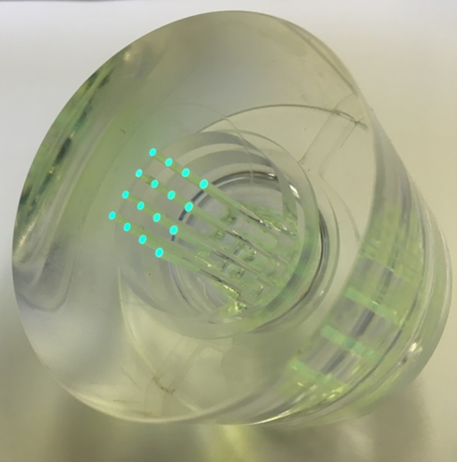
Fiber Light Guides
To avoid penetration of Faraday cage and magnetic contamination readout electronics located outside Cryovessel
  Fiber length ~ 8 m
  Warm and cryogenic vacuum feedthroughs
Transition to clear fibers at cryogenic feedthrough
  Attenuation length, ease of assembly
Kapton gasket
To SiPMs
Acrylic disk w/ array of blind holes
Pot fibers w/ Stycast 1266
LHe Volume Penetration
Diamond polish to expose fibers
From cells
16-fiber feedthrough

Slide 8
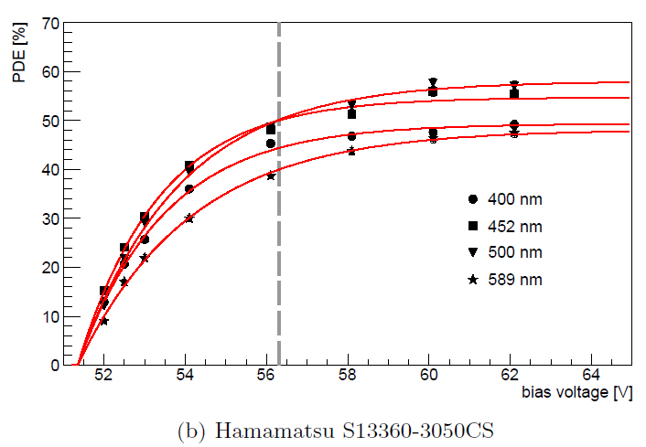
Silicon Photomultipliers
(A.N. Otte et al., NIM A846, 106 (2016))
Hamamatsu S13360 well-characterized
  High efficiency; increased by 25% for 75 um voxels
  Maximizing bias voltage increases photon detection efficiency and reduces voltage-dependence, but increases cross-talk
  Strong dependence of breakdown voltage (and therefore gain) on temperature
  Large dark rate at room temperature, but highly suppressed at low temperature

Slide 9
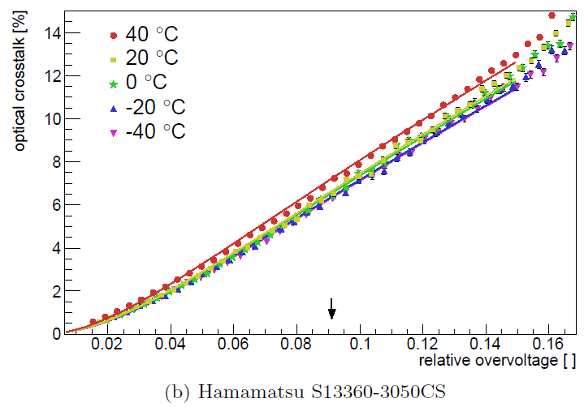
Silicon Photomultipliers
(A.N. Otte et al., NIM A846, 106 (2016))
Hamamatsu S13360 well-characterized
  High efficiency; increased by 25% for 75 um voxels
  Maximizing bias voltage increases photon detection efficiency and reduces voltage-dependence, but increases cross-talk
  Strong dependence of breakdown voltage (and therefore gain) on temperature
  Large dark rate at room temperature, but highly suppressed at low temperature

Slide 10
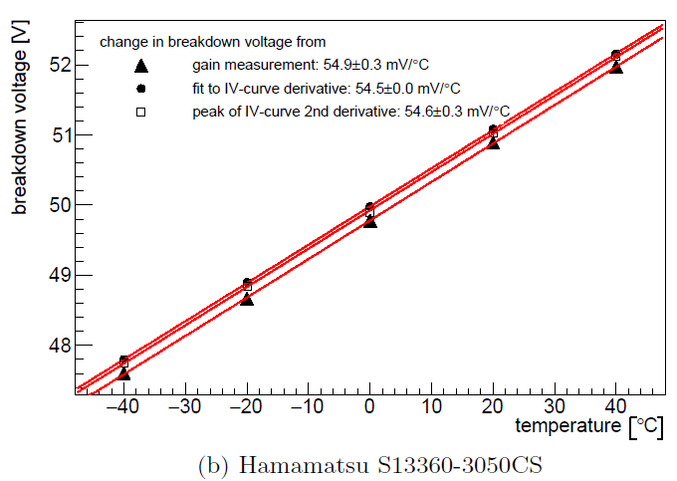
Silicon Photomultipliers
(A.N. Otte et al., NIM A846, 106 (2016))
Hamamatsu S13360 well-characterized
  High efficiency; increased by 25% for 75 um voxels
  Maximizing bias voltage increases photon detection efficiency and reduces voltage-dependence, but increases cross-talk
  Strong dependence of breakdown voltage (and therefore gain) on temperature
  Large dark rate at room temperature, but highly suppressed at low temperature

Slide 11
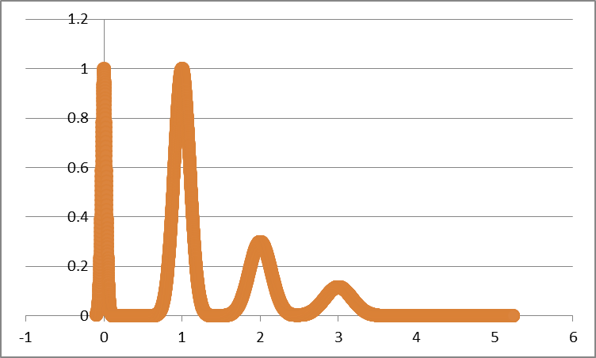
Photon Counting
Apply sub-photoelectron threshold; generate a fixed-amplitude output for signal above that
  Loss in efficiency if a SiPM sees >1 photon in an event, but expect ~ 16 photons/capture event; 384 SiPMs/cell, so loss is small
  Eliminates cross-talk and thus allows operating at maximal bias voltage
  Also eliminates V/T-driven gain-dependence
Multiplex 16 SIPMs into each readout channel; square wave w/ amplitude ∝ # SiPMs fired
signal
1 PE
out
V_thresh
Simulated 1 PE analog response
Discriminator
signal
.
.
.
Σ
out
x16
V_thresh
Discriminator
signal
out
V_thresh
Discriminator

Slide 12
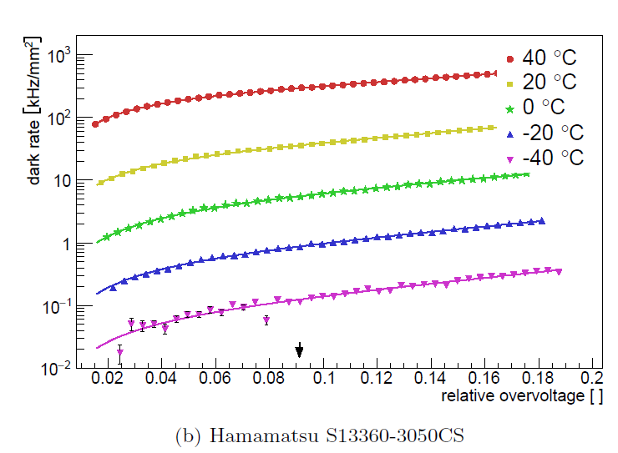
Silicon Photomultipliers
(A.N. Otte et al., NIM A846, 106 (2016))
Hamamatsu S13360 well-characterized
  High efficiency; increased by 25% for 75 um voxels
  Maximizing bias voltage increases photon detection efficiency and reduces voltage-dependence, but increases cross-talk
  Strong dependence of breakdown voltage (and therefore gain) on temperature
  Large dark rate at room temperature, but highly suppressed at low temperature

Slide 13
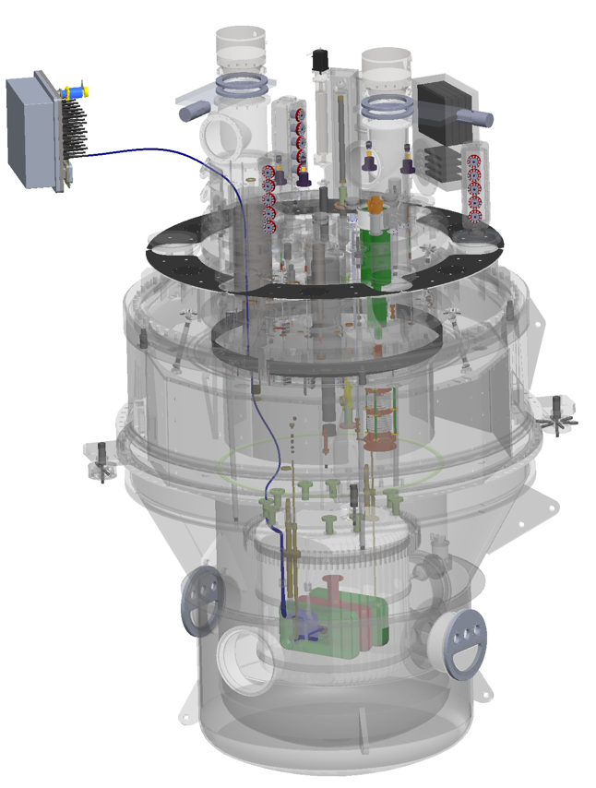
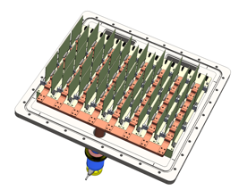

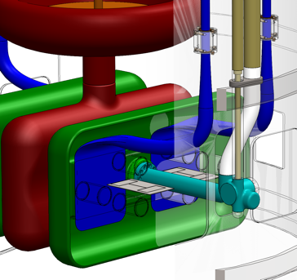
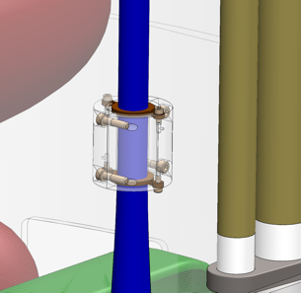
System Overview, Reprise
Readout electronics cooling module
Light collection calibration source (E-field monitor)
Fibers dressed on measurement cell GND side wall.

Slide 14
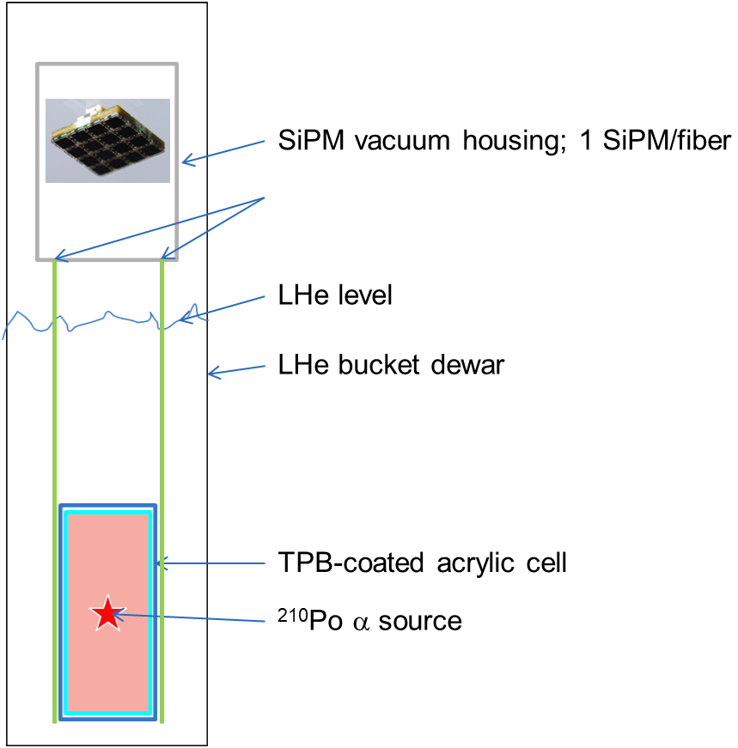
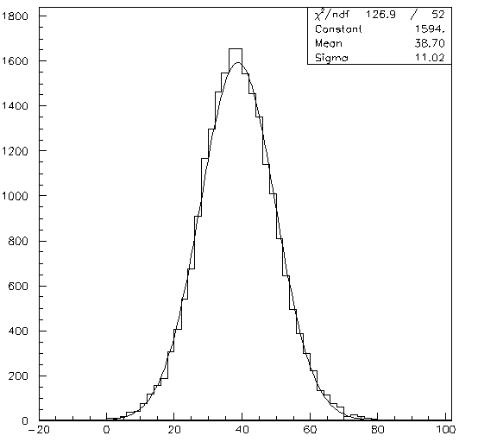
Prototype Results
Small-scale prototype using a 5 MeV α source observed 39 photoelectrons
Simple scaling factors (TPB coverage, SiPM photon detection efficiency, n/α photon yield) suggests final system will see ~19 PE; detailed simulations find ~16 PE (next talk, D. Loomis)
Events
#PE

Slide 15
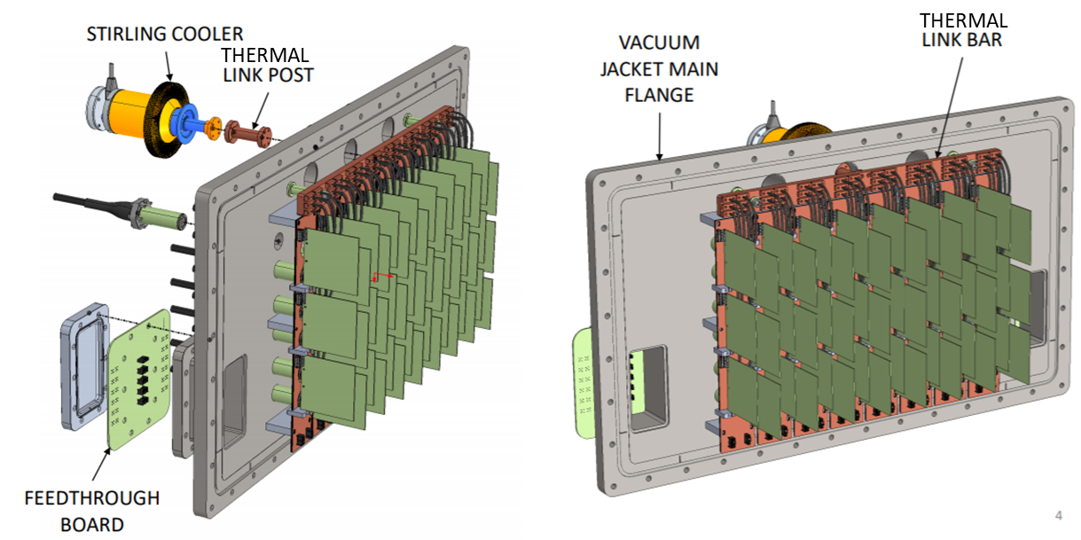
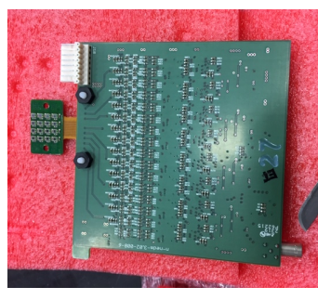
Status
SiPM processing boards in hand; successfully tested
Cooling module design complete

