Slide 1
Creation of a Low Current Superconducting Switch
Clark Hickman

Slide 2
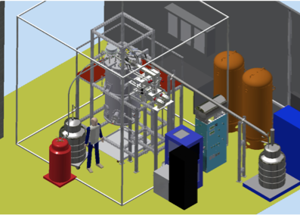
SOS@PULSTAR
Systematic and Operational Studies for nEDM@SNS
Smaller scale, faster cooldown time
Study spin manipulation of neutrons and Helium
Study correlation functions
Test measurement cells
Operational Studies

Slide 3
The B₀ Coil
Extremely precise magnetic environment is needed in order to measure nEDM to the desired uncertainty
B₀ coil must be on the level of < 3 ppm/cm
Must also be stable to one part in 10⁷ over the measurement time (for free precession mode)
Power supplies are not able to reliably provide necessary stability
Solution: Persistent Current Mode
General idea: A loop of superconducting wire will have a current that never decays or varies once started coil must be on the level of < 3 ppm/cm
Low current: 10 mA

Slide 4
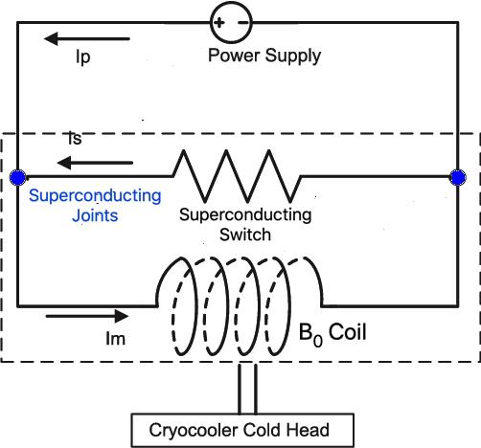
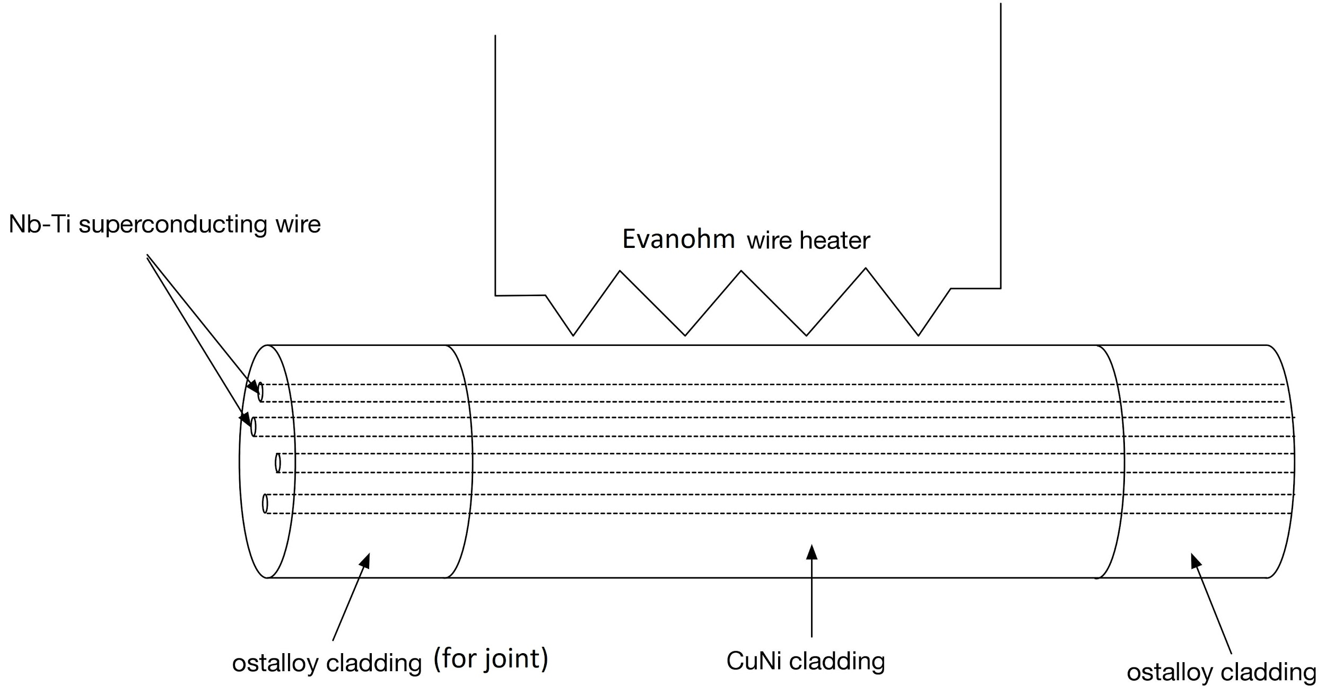
Superconducting Switch
General idea: A loop of superconducting wire will have stable current and produce stable magnetic field
A switch is necessary to close the loop after inducing current
Heating wire used to heat…
CuNi resistive wire wrapped around SC wire (NbTi)
Modified from C. Cui, et al., 2016.
Source: Kent Leung

Slide 5
Superconducting Switch
General idea: A loop of superconducting wire will have stable current and produce stable magnetic field
Steps
Turn on external power supply to induce current
Heater on to open switch
Modified from C. Cui, et al., 2016.
Source: Kent Leung

Slide 6
Superconducting Switch
General idea: A loop of superconducting wire will have stable current and produce stable magnetic field
Steps
Heater off
Switch is closed, B₀ coil is now superconducting loop
Modified from C. Cui, et al., 2016.
Source: Kent Leung

Slide 7
Superconducting Switch
General idea: A loop of superconducting wire will have stable current and produce stable magnetic field
Steps
Ramp down power supply until off
Modified from C. Cui, et al., 2016.
Source: Kent Leung

Slide 8
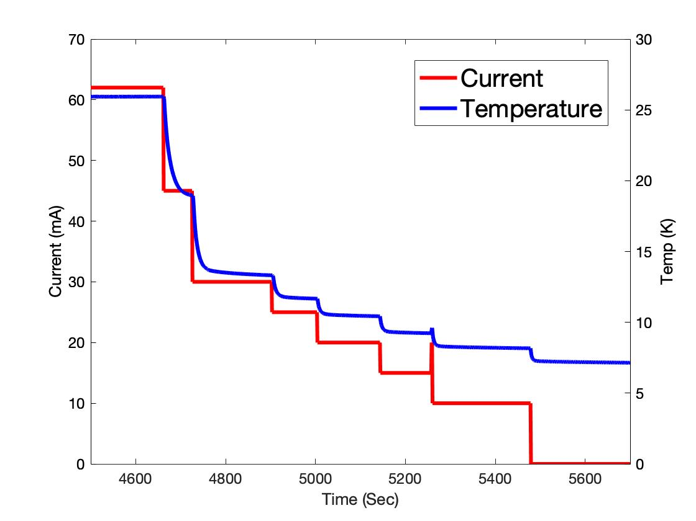
Heater Test
Evanohm wire has a high resistivity and works well as a heater
Tested in cryocooler to determine how temperature responds changes in current
Critical temperature of NbTi (switch superconductor) is 9.2 K
For switch, heat load will be greater, but similar control should be attainable

Slide 9
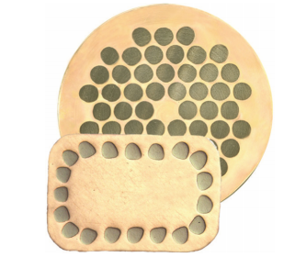
Superconducting Joint
CuNi wire is often used for applications like superconducting switches
CuNi is highly resistive cladding
Surrounds NbTi superconductor
Joints are usually primary source of resistance in superconducting applications
And NbTi oxidize in air
Solder replacement method
CuNi matrix cross-section with NbTi filaments
Source: Brittles, et al., 2015

Slide 10
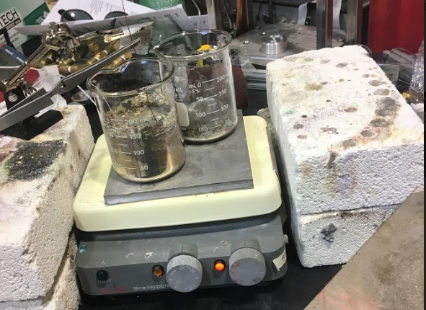
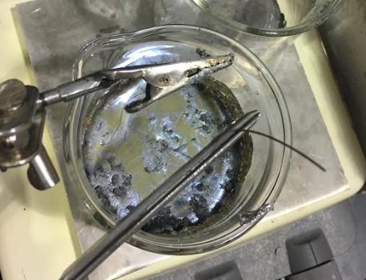
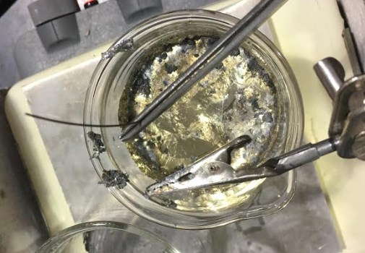
Joint Production
Replace CuNi matrix with Sn at 400 °C
Then transfer to superconducting solder (Ostalloy 203)
Finally, create joint

Slide 11
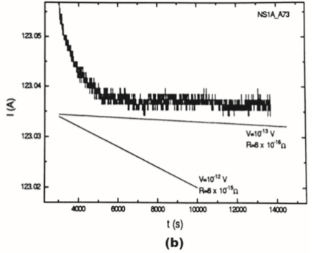
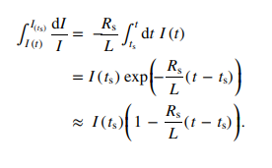
IRT Method
Example of High Current IRT Measurement
Source: G.D. Brittles, 2015.
Induce a current in SC coil magnetically
Use inducing coil to create flux through SC coil (closed with joint)
Submerge in LHe to make coil superconducting
Turn off inducing coil
Observe decay
IRT Measurement
Source: G.D. Brittles, 2015.

Slide 12
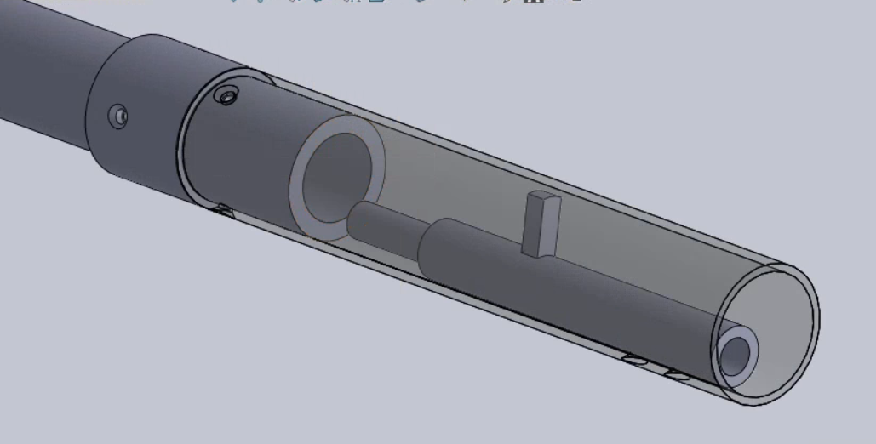
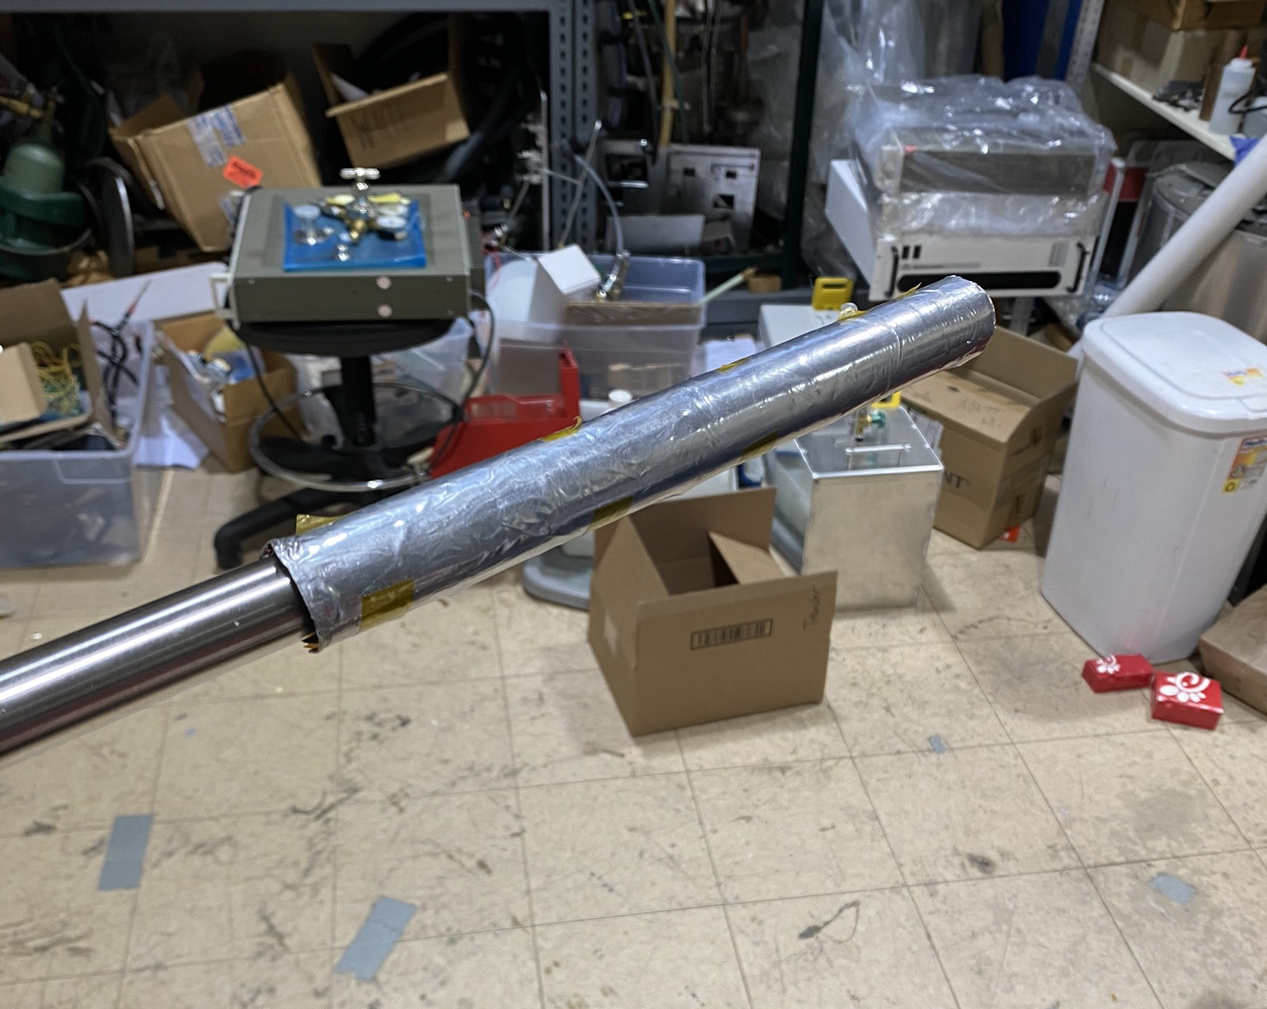
Preparing for SC Joint Test

Slide 13
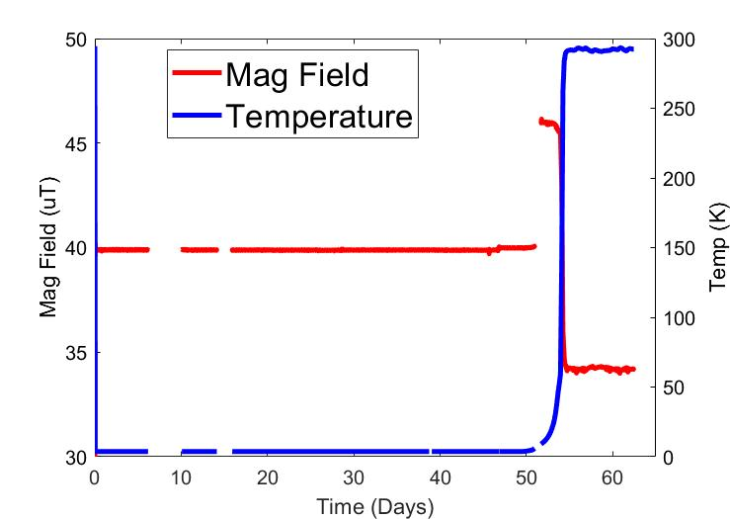
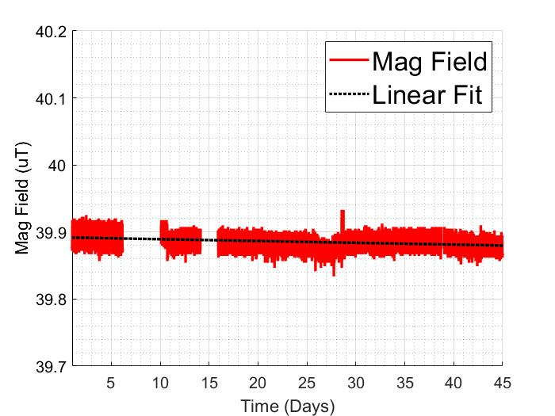
Single Joint Test Results
R = 3.1 x 10⁻¹⁶ Ω
R ~ 10⁻¹⁵ - 10⁻¹⁶ Ω meets time stability requirements

Slide 14
Conclusion and Next Steps
Superconducting switch is necessary to maintain temporal stability of B₀ coil
Heater and joint have already been tested
Design switch
Close with two joints to SC loop
Build and test
Using IRT Method
We’re concerned about potential “settling” preventing or delaying a stable low current
(Eventually) Integrate into B₀ coil for SOS@Pulstar and nEDM@SNS

Slide 15
Acknowledgements
I’d like to thank my colleagues at NCSU for their feedback and guidance as I presented my work to them
I’d like to especially thank Adam Dipert for his help setting up the SC joint test
Thank you to US DOE for funding support

Slide 16
References
C. Cui, et al. IEEE Trans of Appl Superconductivity, 26 (4), 2016.
G.D. Brittles, et al. Superconducting Sci Tech, 28, 2015.

Slide 17
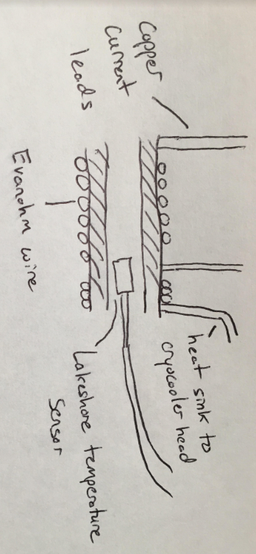
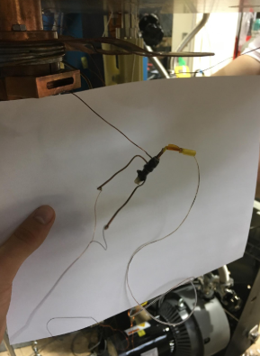
Backup Heater Slide
Heat Sink
Evanohm was chosen as heater wire because it’s small volume made it easier to work with and nullified it’s higher magnetic susceptibility
9 cm of Evanohm used, 26.0 Ω (62.0 mA for 0.1 mW)
Current leads
Temperature sensor inside alumina pipe
Epoxy over Evanohm wire

Slide 18
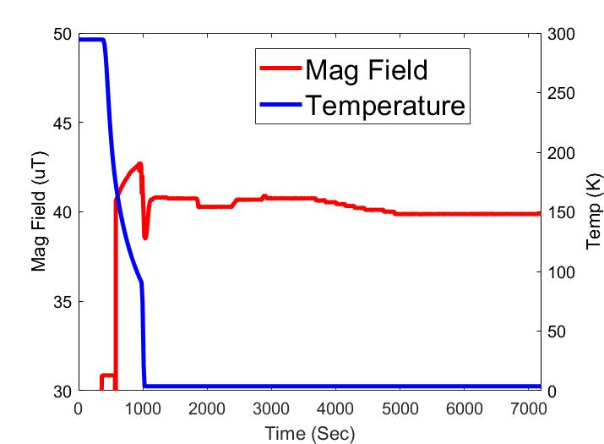
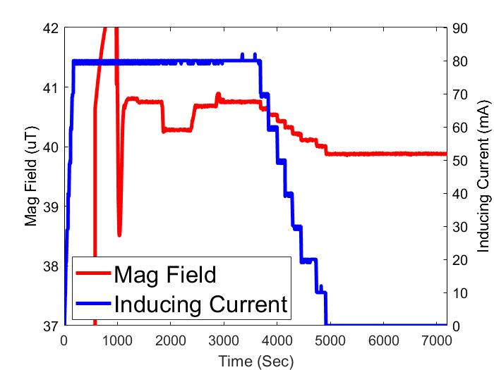
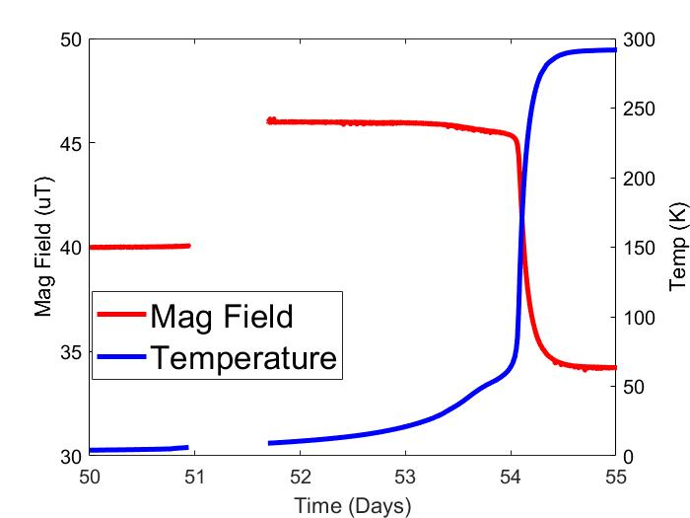
Backup Data Slide

Slide 19
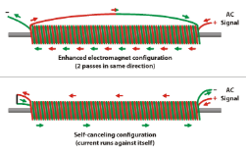
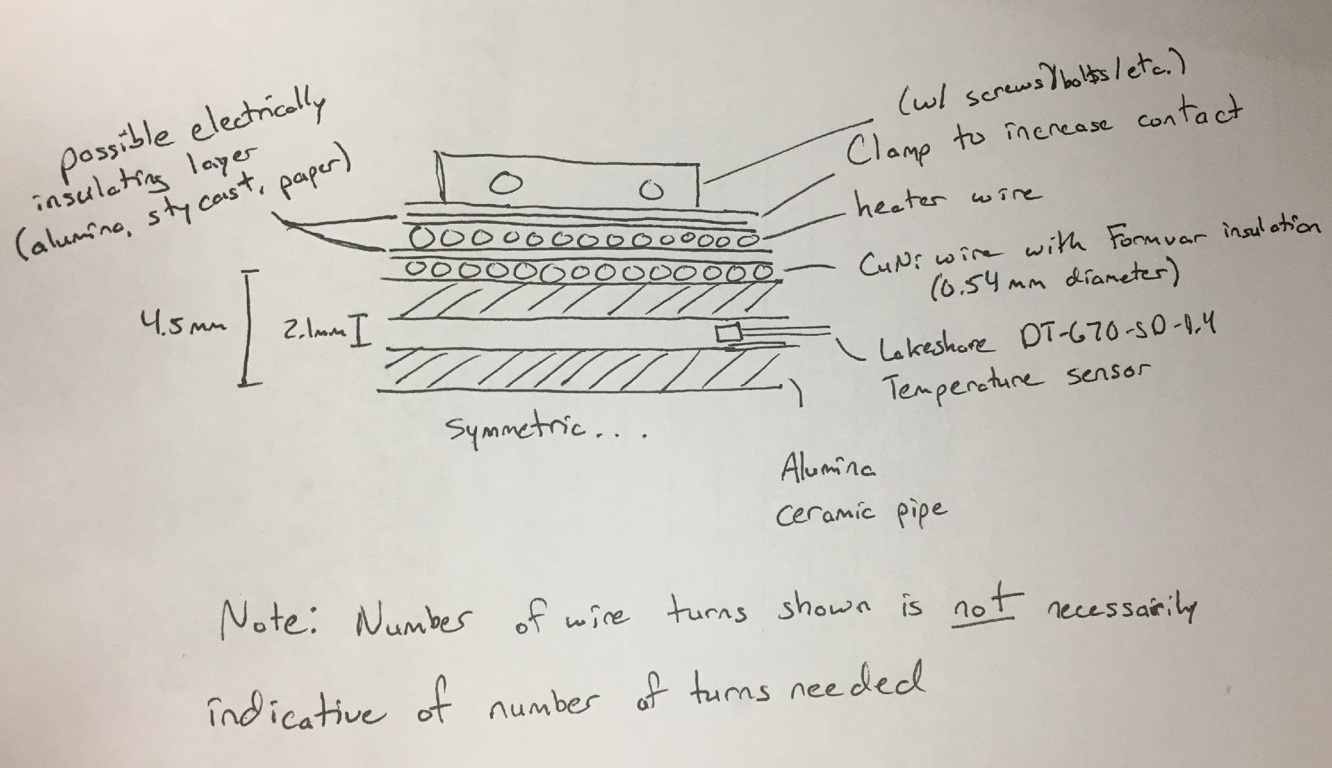
Potential Switch Design
Source: Schumann Frequency Generator with Scalar Coil, http://christopherbradshaw.net/The_Project_Bin/Schumann%20Frequency%20Oscillator%20with%20Scalar%20Coil.html

