Slide 1
Good Practices Concerning Samples

Slide 2
Sample measurement at LSM, it’s :
1000 Samples / year
21 Detectors in the lab 10 different representatives
Ge room’s reorganisation in progress
New LSM staff organisation
Underground entrance

Slide 3
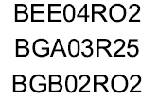
Samples numbering
Capital letters & underscores for space and dash
→
0O ? → 0=Ø O=Θ
→
Saphir Louis - N1
Saphir Louis - N2

Slide 4
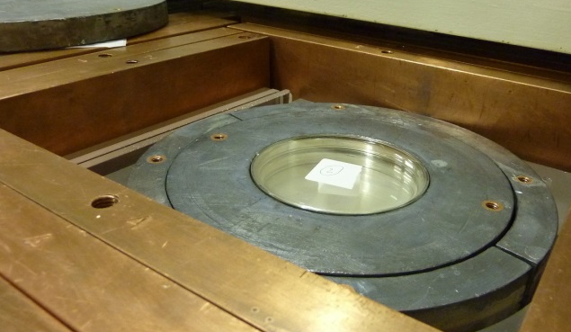
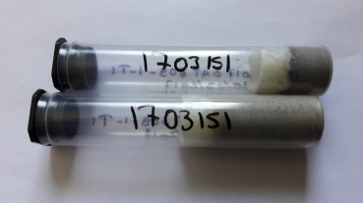
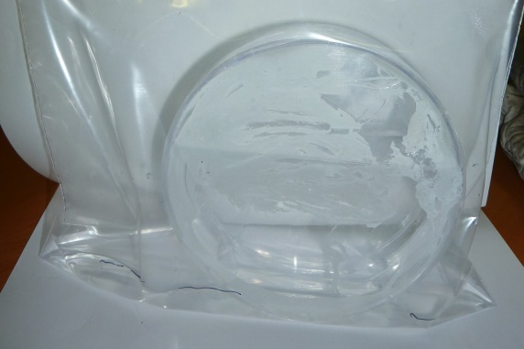
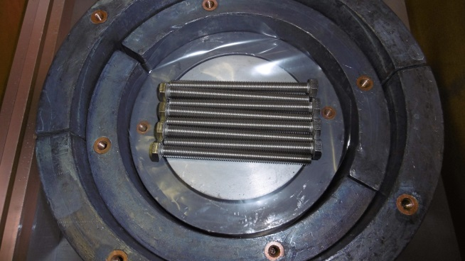
Packaging
Use Petri boxes or tubes
suitable for detector size
✗ No loose samples
✗pls pack them individually
Close your samples Airtightly
✗ No liquids
✗ No corrosive glues
Center your samples in the box
Write observations into BadGe

Slide 5
Delivery
Send delivery notes
Put samples into ascending order
Send an email to badge@lsm.in2p3.fr

Slide 6
Samples follow ups
For every message : badge@lsm.in2p3.fr
Searches into BadGe
Sample’s state
Nitrogen filling record…

Slide 7
Measurement’s planning
Regularly checks
Respect samples names already written down into BadGe
3 possible programs:
Sample
Source
Background

Slide 8
Measurement organisation
Organisation now only by owner
Proposal of organisation by carrot or any higher level order
Storage in boxes

Slide 9
Shipment
Organisation of regular shipment
Difficulties should be solved
At a number of carrot , at fixed time…

Slide 10
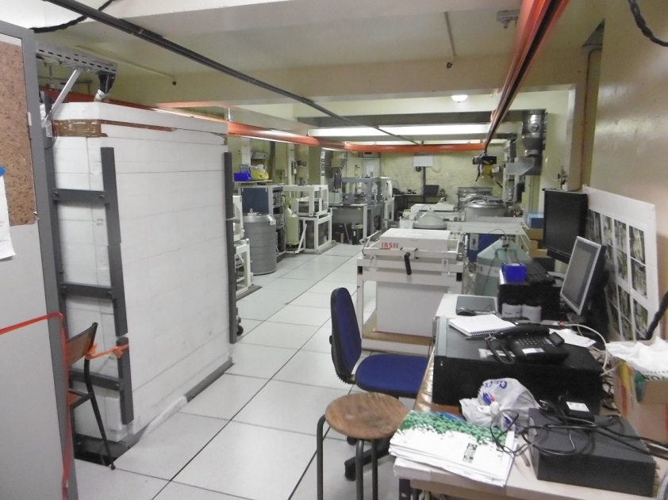
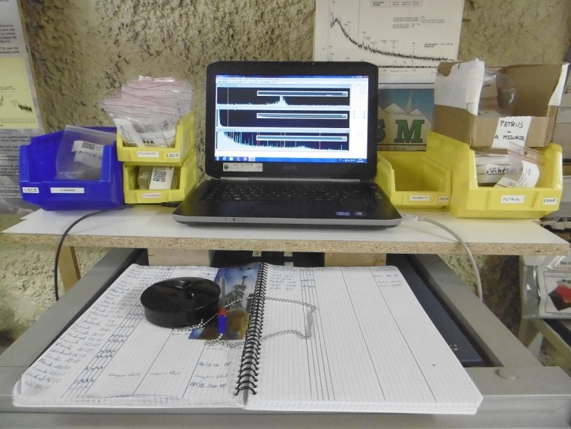
LSM storage
The main Ge room is full, so :
Don’t send too much samples in advance
Think about asking sample returns as soon as possible after measurements

Slide 11
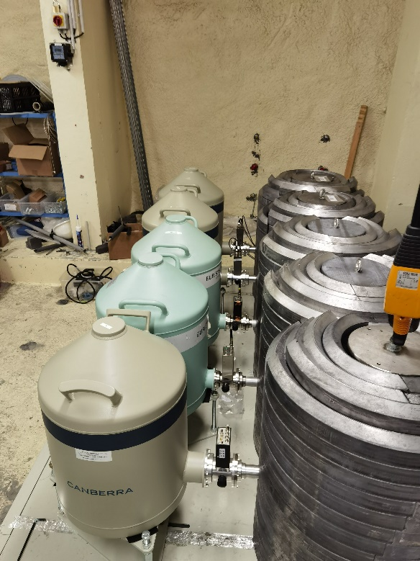
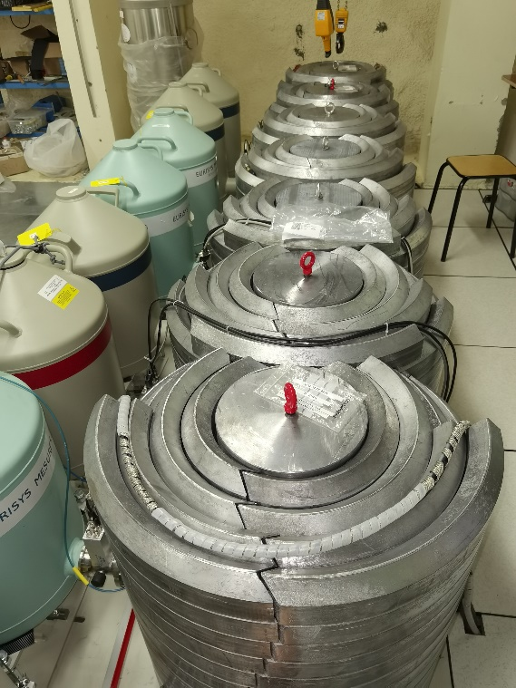
Anticipate
Radioactive sources needs
LSM attendances
Germanium movings to PARTAGe

Slide 12
Conclusion
Organisation of the sample to be improved
Organisation of shipments to be improved or rethink
PARTAGe is growing slowly but steadily
End of COVID years I hope will accelerate everything

