Slide 1
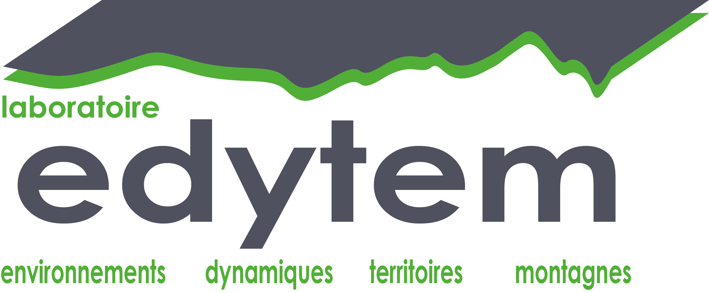
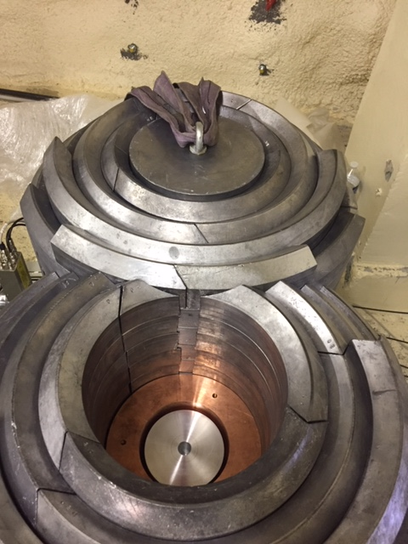
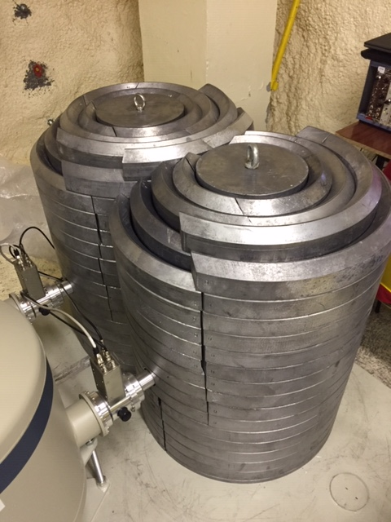
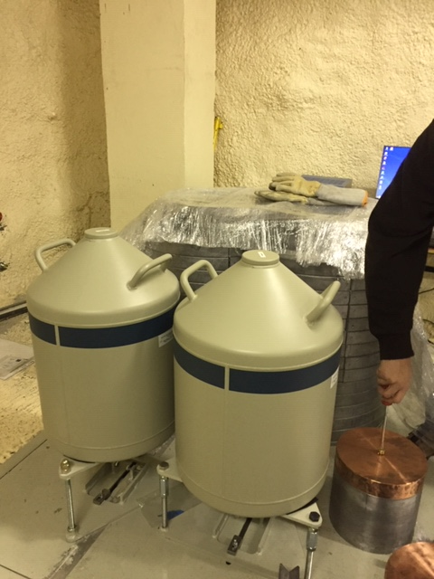
16/12/2021
LSM Germanium Meeting 2021
Syrah and Grenache detectors
SAGeWell detector (Mirion) : 400cc, 0.73keV (122keV), 1.34keV (661keV), 1.77 (1332keV)

Slide 2
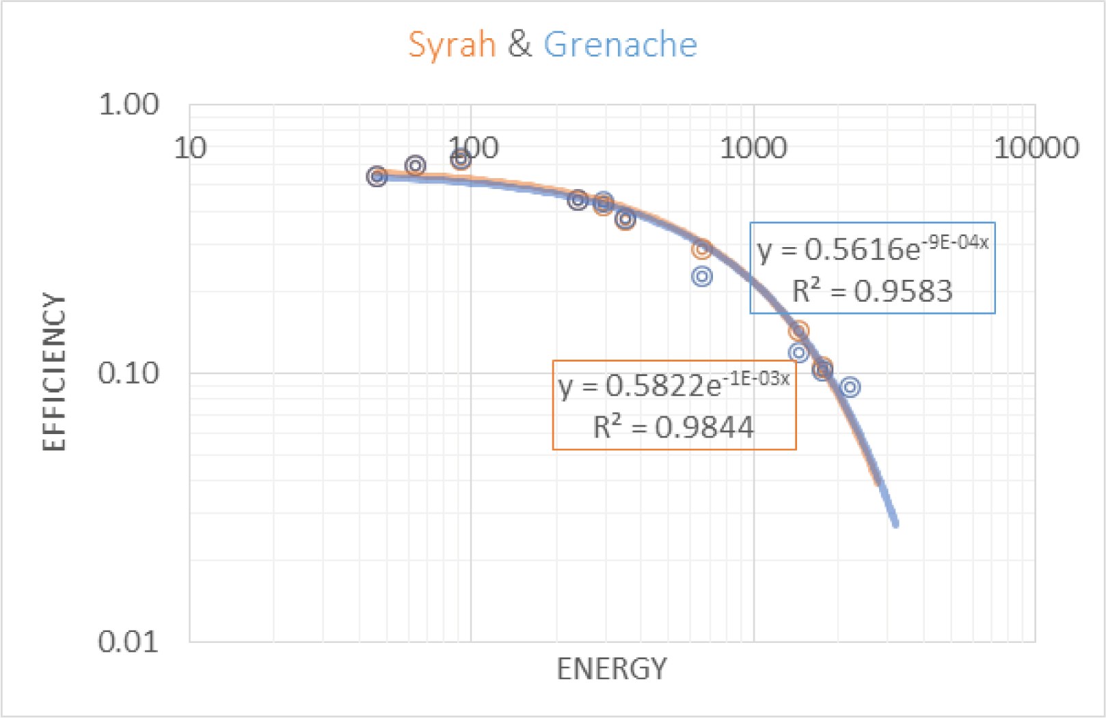
EDYTEM detectors
Both detectors are fully operational.
The calculated efficiency curves show that they are real twins!
There are no more data transfer problems thanks to the new remote connection (Putty, VNC viewer)
Thanks to Guillaume!!!

Slide 3
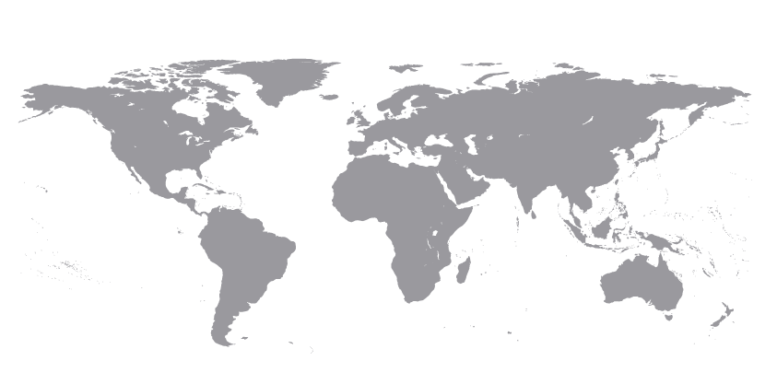
Activity indicators
Mutualised instruments
20 worldwide sedimentary sequences measured on the detectors during 2021.

Slide 4
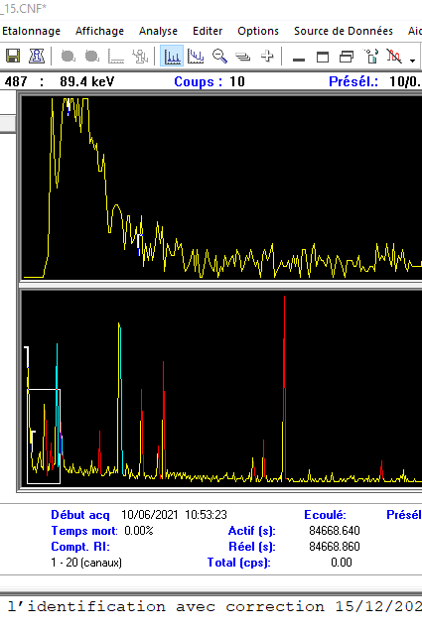
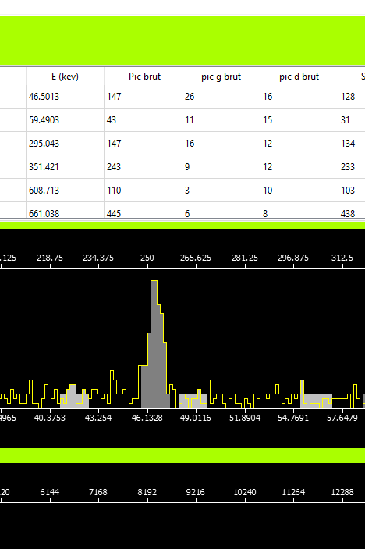
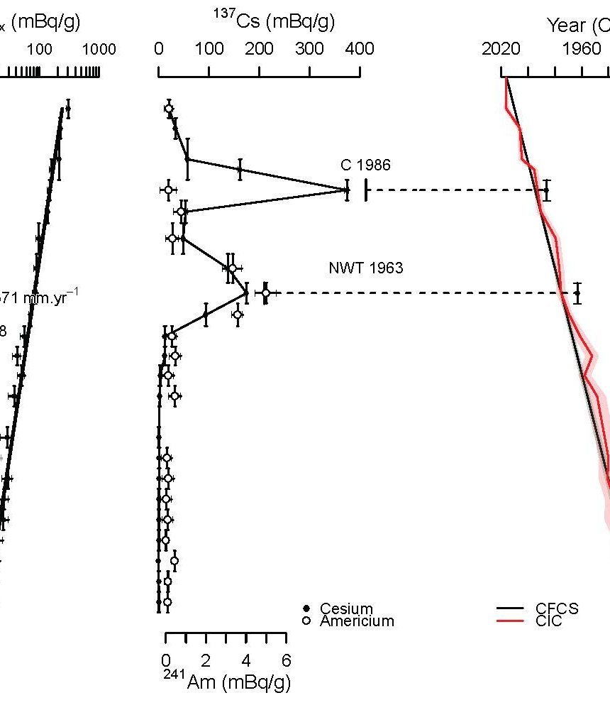
Spectrum and data processing
Spectrum transformation using G2K
Peak integration using ANAGRAM
Age-modelling SERAC (Bruel & Sabatier, 2020)

Slide 5
Some results….
Sabatier et al., 2021 ES&T
Sabatier et al., 2021 ES&T
Jouffroy-Bapicot et al., 2021 QSR
Rapuc et al., 2021 QSR

Slide 6
Review paper about 210Pb/137Cs fallouts from sedimentary cores : Foucher et al., 2021 ESSD
MNWT
5
573 articles published between 1977 and 2020, reporting the collection of 1351 individual dating sediment cores
Chernobyl

Slide 7
Review paper about 210Pb/137Cs fallouts from sedimentary cores : Foucher et al., 2021 ESSD
Some examples of events detected in sediment cores
¹³⁷Cs inventory in the sediment cores covered in the database and location of some of the main sources of ¹³⁷Cs

Slide 8
Valorisation 2021
6 publications
Rapuc, W., Bouchez, J., Sabatier, P., Genuite, K., Poulenard, J., Gaillardet, J., Arnaud, F. Quantitative evaluation of human and climate forcing on erosion in the Alpine Critical Zone over the last 2,000 years. Acceptted to Quaternary Science Reviews 268, 107127, https://doi.org/10.1016/j.quascirev.2021.107127
Jouffroy-Bapicot I., Pedrotta T., Debret M., Zanchetta G., Sabatier P., Field S., Roberts N., Tinner W., Walsh K., Vannière B. Olive groves around the lake. A ten-thousand-year history of a Cretan landscape (Greece) reveals the dominant role of humans in making this Mediterranean ecosystem. Quaternary Science Reviews 267, 107072, https://doi.org/10.1016/j.quascirev.2021.107072
Guédron, S., Tolu, J., Delaere, C., Sabatier, P., Barre, J., Heredia, C., Brisset, E., Campillo, S., Bindler, R., Fritz, S. C., Baker, P. A., Amouroux, D. (2021). Reconstructing two millennia of copper and silver metallurgy in the Lake Titicaca region (Bolivia/Peru) using trace metals and lead isotopic composition. Anthropocene 34, 100288, http://dx.doi.org/10.1016/j.ancene.2021.100288
Sabatier, P., Mottes, C., Cottin, N., Evrard, O., Comte, I., Piot, C., Gay, B., Arnaud, F., Lefevre, I., Develle, A.L., Deffontaines, L., Plet, J., Lesueur-Jannoyer, M., Poulenard, J. Glyphosate Resurrects Chlordecone. Environmental Science and Technology. https://doi.org/10.1021/acs.est.0c05207
Bruel, R., Girardclos, S., Marchetto, A., Kremer, K., Crouzet, C., Reyss, J.L., Sabatier, P., Perga, M.E. (2021). Lakes in the Anthropocene are more vulnerable to climate variability, Journal of Paleolimnology, 65:353–368, https://doi.org/10.1007/s10933-021-00176-y(0123456789
Biguenet, M., Sabatier, P., Chaumillon, E., Chagué, C., Arnaud, F., Jorissen, F., Coulombier, T., Geba, E., Cordrie, L., Vacher, P., Develle, A.L., Chalmin, E., Soufi, F., Feuillet, N. 1600 years-long sedimentary record of tsunamis and hurricanes events in the Lesser Antilles (Scrub Island, Anguilla). Sedimentary Geology, 105806, /10.1016/j.sedgeo.2020.105806
8 international and 4 national conferences
FORMATION
5 PhD students
3 masters students

Slide 9
What for 2022?
Automated spectrum processing
Detectors efficiency
Collaborations
Using G2K routines and R routines to link .csv reports to SERAC modelling
Test on variable samples geometry
-> detector sensitivity, efficiency, procedure and worflows on small sample quantities?

