Slide 1
Low level measurements of environment samples with HPGe detectors at LSM
Anne de Vismes Ott, Sébastien Aubry, Séverine Bonnot, Neila Mohara, Christophe Ardois

Slide 2
Introduction
Institute for Radiation Protection and Nuclear Safety
Laboratory of Environmental Radioactivity Metrology
Activity determination in environmental samples
Environment surveillance
Radioecology studies
Emergency preparedness
Research and development : materials and methods improvements
Member of the IAEA Network of Analytical Laboratories for the Measurement of Environmental Radioactivity (ALMERA) and the CELLAR collaboration
Gamma ray spectrometry
Accreditation since 1999
1500-2000 measurements/year

Slide 3
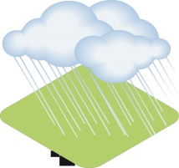
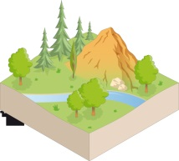
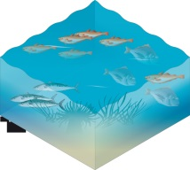
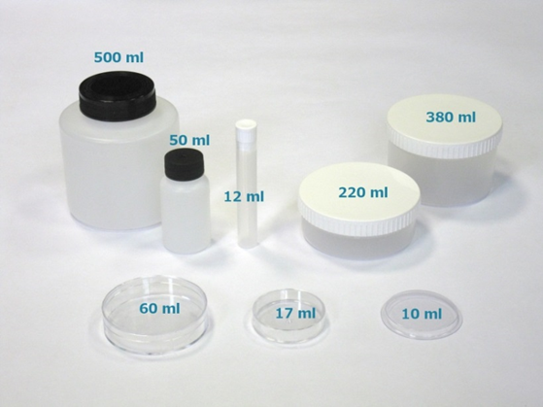
Introduction
Specificities
wide range of measurements :
Samples (solid): fauna, flora, waters, soils, sediments, aerosol filters…
Radionuclides:
Naturally occurring radionuclides: cosmogenic (⁷Be, ²²Na...) and telluric (⁴⁰K, U & Th natural decay series)
Artificial radionuclides
present at trace levels in the French environment: ⁶⁰Co, ¹³⁷Cs, ¹²⁹I…
potentially released in case of incident or accident: ¹³¹I, ¹³⁴Cs, ¹⁰⁶Rh…
Counting geometries depending on the sample availability
Detectors: coaxial, planar, semi-planar, well-type…
low level radioactivity
 Bq  mBq / sample

Slide 4
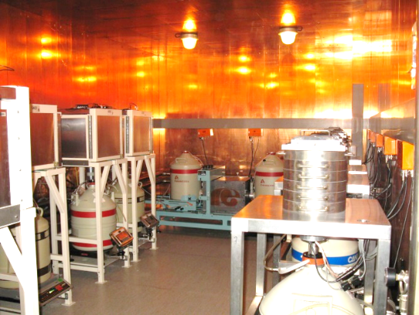
22 High Purity Germanium detectors
Shallow underground laboratory in Orsay
10 m w.e.: 2^{d} basement, 3 m slab of borated concrete
Shielded room: 10 cm Pb + 5 mm Cu
12 low background:
6 BEGe5030 + 1 BEGe6530 (Canberra) + 5 Profile-FX (Ortec)
High relative efficiency > 50%
Good resolution: 0.6 keV @ 46 keV ; 1.7 keV @1460 keV
6 with anti-cosmic devices
Anti-Compton system: 1 XtRa (Canberra) + NaI(Tl)
Multi-detector Léda: 2 BEGe5030 (Canberra) + NaI(Tl)
1 SAGe well-type detector: good resolution (Canberra)
Laboratoire Souterrain de Modane (LSM)
Deep underground laboratory
1700 m rock: 4800 m w.e.
Ultra low background detectors
2 coaxial
2 well-type detectors of large volume (450 and 844 cm³ )
de Vismes Ott A. et al. (2013) Radioprotection, Vol. 44, n◦ 5, pp 613–618
Paradis H. et al. (2016) App. Radiat. Isot., Vol. 109, pp 487-492
Paradis H. et al. (2017) App. Radiat. Isot., Vol. 126, pp.179-184

Slide 5
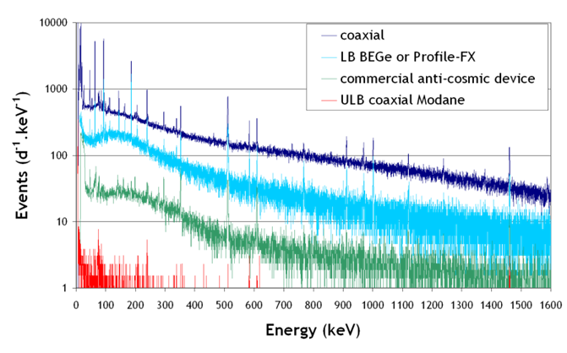
Background

Slide 6
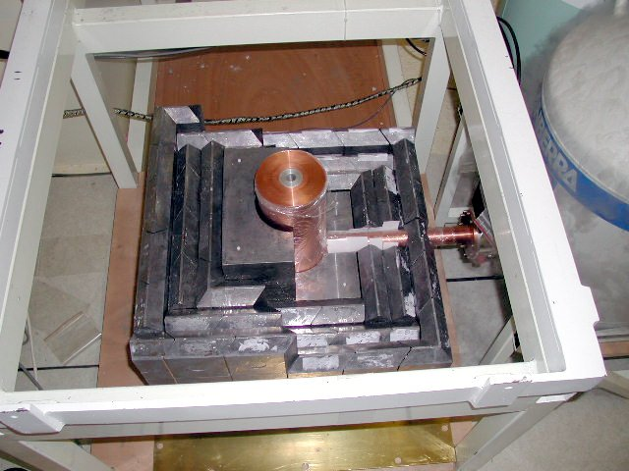
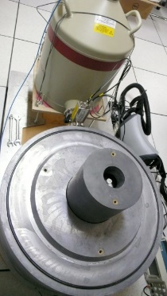
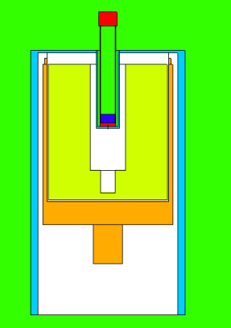
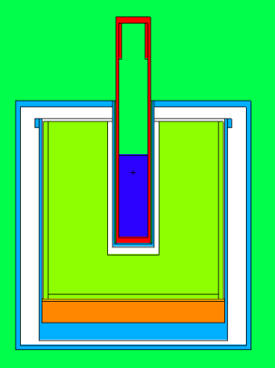
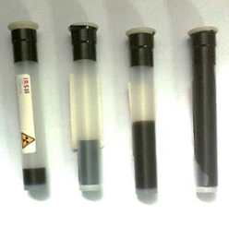
Ultra low background well type detectors
Low activity and small quantity
High efficiency
Low background
High versatility
Detection efficiency calculated for each sample
ε = f (detector, radionuclide, material, filling height, mass)
Monte Carlo simulation: MCNP-CP
Extension of MCNPX (A. Berlizov, IAEA)
Evaluated Nuclear Structure Data File
Corrections on the detection efficiency:
True Coincidence Summing (TCS) effect: decay scheme and measurement configuration (detector + geometry)
Self-attenuation effect: sample material (density + composition)
Models
fitted with measurements of standard sources
validated with measurements of reference materials
XXL
PPT

Slide 7
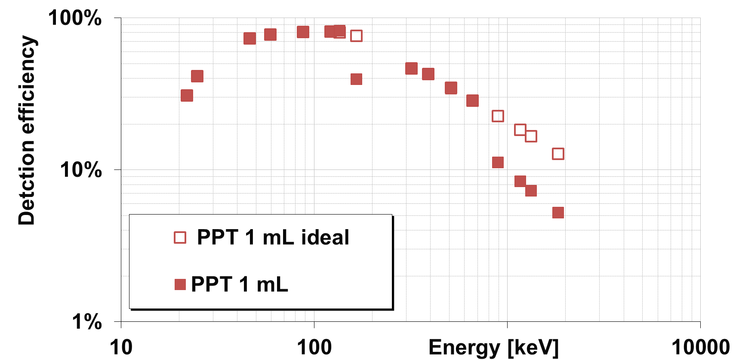
Example
ε ~ 80%
FC_{TCS}=2-2.4
High efficiency (80%) at low energy
TCS effect : a factor of 2 for Co-60 and Y-88

Slide 8
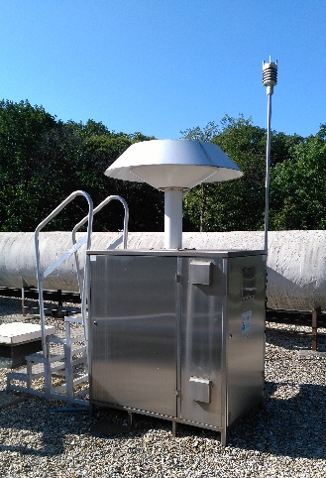
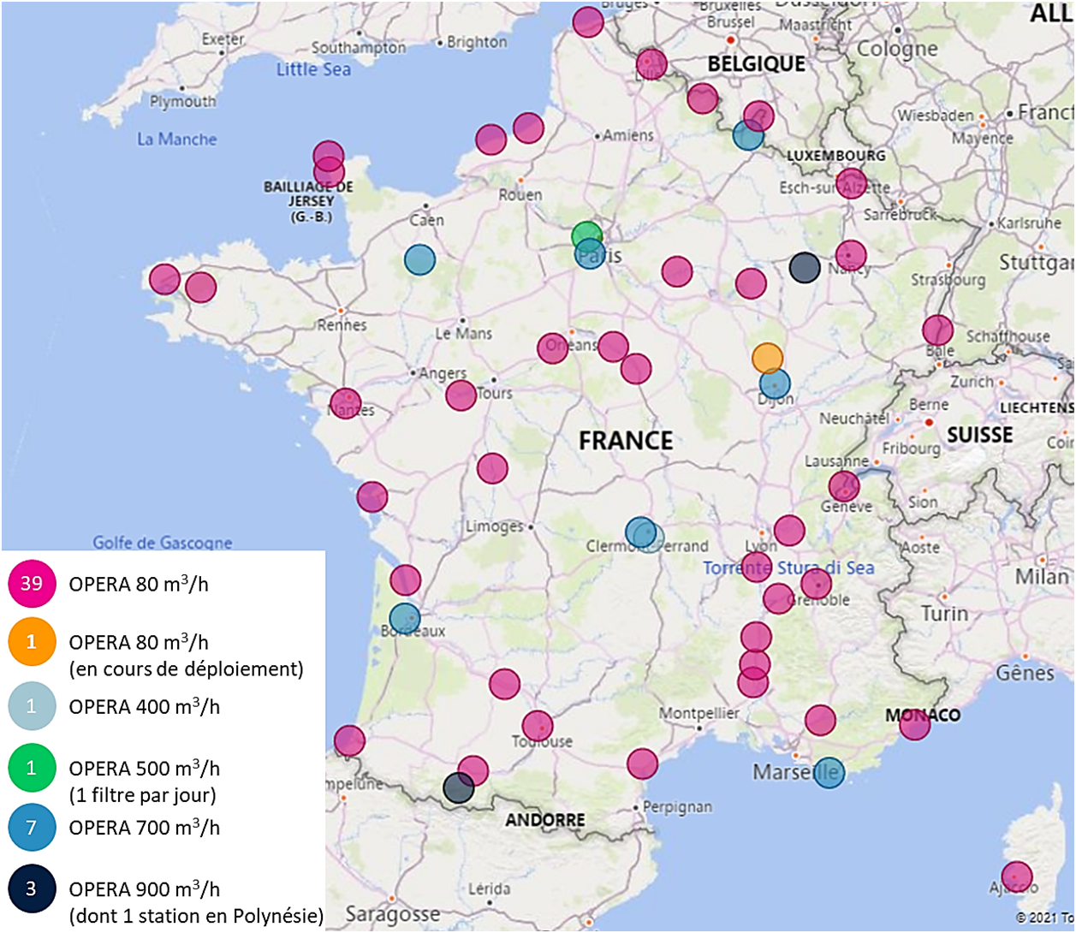
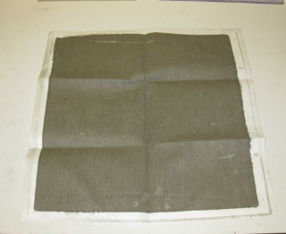
Atmospheric samples: aerosol filters
TGD (Orsay)
Aerosol filters
OPERA-Air network
High volume air samplers; weekly sampling
→ volume ~ 100 000 m³
Lowest ¹³⁷Cs activity concentration in the air: Alençon (oceanic influence), Puy-de-Dôme and Pic-du-Midi (high altitude)
Measurements on coaxial detectors in Modane for 2-4 days
¹³⁷Cs activity:
0.5–100 mBq
Detection limits :
¹³⁷Cs ~ 40 nBq.m⁻³
aerosol
filter
10 mL

Slide 9
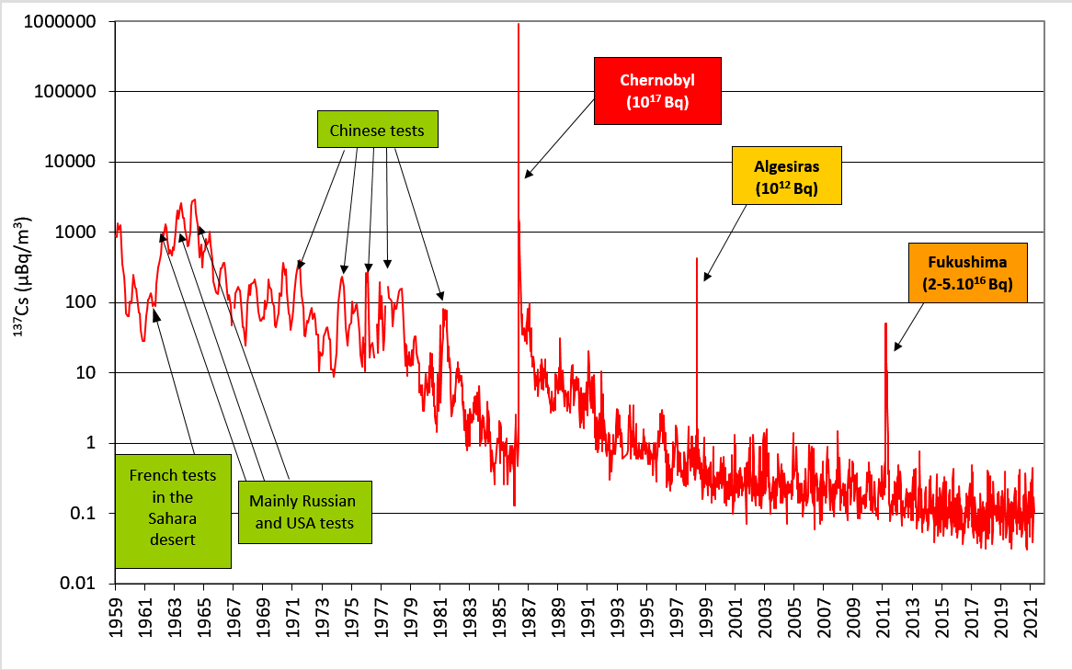
Atmospheric samples: aerosol filters
OPERA-Air network : multiple purpose
Aim of radiological environment surveillance
Baseline of the ¹³⁷Cs activity concentration in the atmosphere
Detections resulting from low-magnitude incident releases to accident releases at remote places
In case of emergency
Rapid and reliable information to the population
Low level measurement to help source term assessment
Role as a research network
Data for transfer studies : contaminated air masses from Fukushima accident
Improvement of the deposition calculation codes
Fukushima accident
¹³¹I in 2017
¹⁰⁶Rh in 2017
de Vismes Ott, A. et al. (2013) J. Environ. Radioact., 125, pp. 6-16
Masson, O. et al. (2018) Environ. Sci. Technol. 2018, 52, 8488−8500
Masson, O. et al. (2019) PNAS 116 (34) 16750-16759

Slide 10
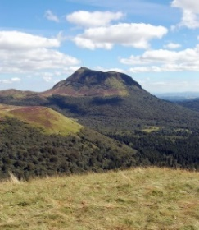
Atmospheric samples: fallout
Cloud water samples in Puy de Dôme (1465 m)
monthly sampling
Volume < 1 L ➔ dry residue mass ~ 1-100 mg
¹³⁷Cs activity < 1 mBq /sample
¹³⁷Cs activity concentration in the cloud waters: 1-5 mBq.L⁻¹
Rain water samples in Clermont-Ferrand (645 m)
monthly sampling; dry residue
Volume: 20 – 300 L
¹³⁷Cs activity ~ 1 mBq /sample
¹³⁷Cs activity concentration in the rain waters: 10 - 150 µBq.L⁻¹
Results
Study of the scavenging efficiency of precipitations
below the cloud base (i.e. washout mechanism)
in addition to the rainout mechanism (i.e. in the cloud).
Improved capability in modeling radionuclide deposition in case of a nuclear accident
in foggy conditions at lowland locations
in cloudy conditions at high altitude locations.
Bourcier, L. et al. (2014) J. Environ. Radioact., , 128, 15-19
Masson O. et al.(2015) Atmospheric Research, 151, 45-51
Tav J. et al. (2018) Aerosol and Air Quality Research, 18: 103–113

Slide 11
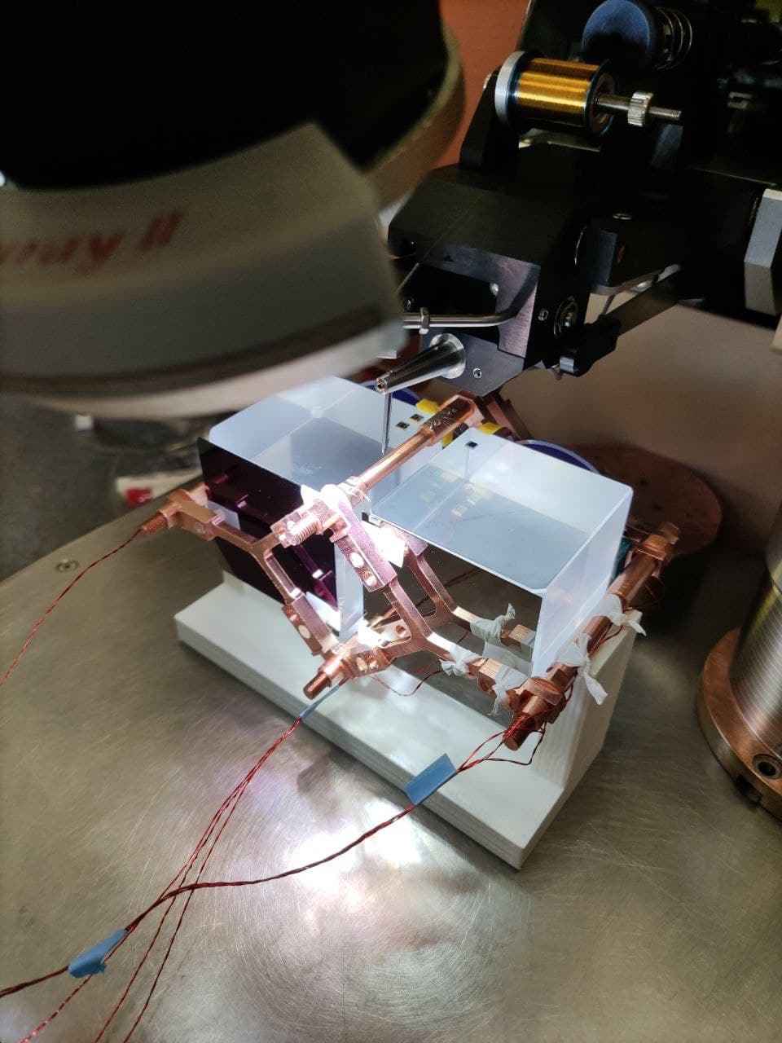
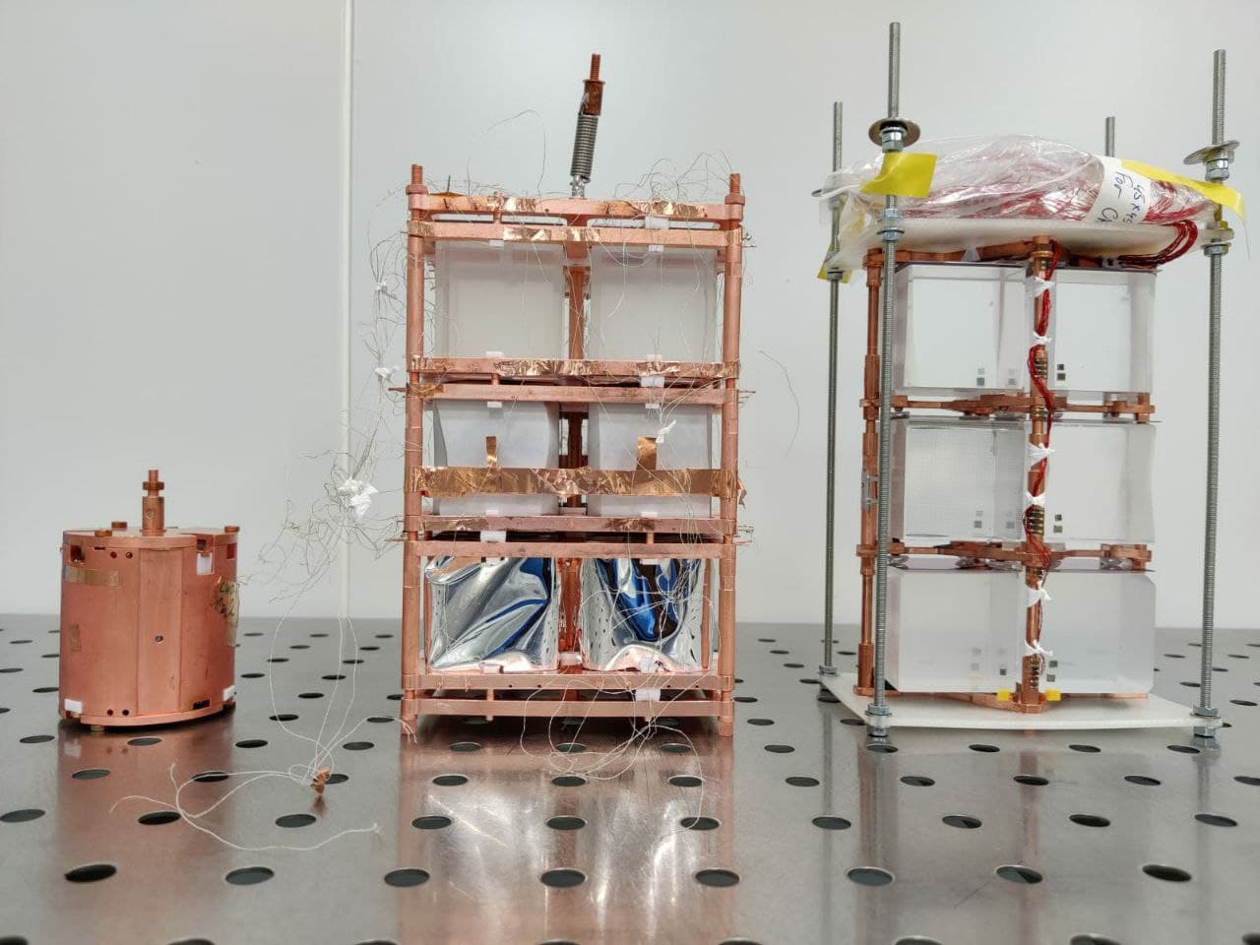
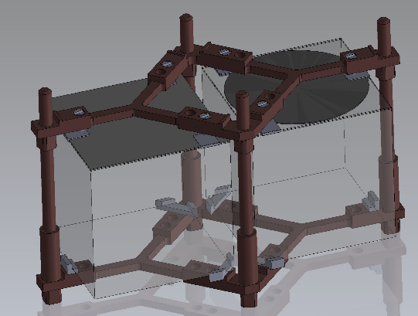
Some times… some “exotic” samples…
Material for 3D printer
Wire spool of PLA (polylactic acid)
60 mL geometry
Coaxial detector LYS
560 000 s (~ 1 week)
Detection efficiency transfer (Gespecor)
Results
Detection limits (ISO 11929; α = β = 2.5 %) : 10→130 mBq/kg
3D printing is becoming a very useful option for small pieces in the sets-up of rare event searches
The radiopurity of this particular material for 3D printing allows to use it in the alternative tower structure design of the CUPID experiment, the next generation neutrinoless double beta decay experiment.
3D printed pieces

Slide 12
Partage
Our experience
All our 4 detectors moved in the new Partage shield in 2021

Slide 13
52E (Hermine)
07/04/2021
Bi-214: 0.5→ 5 d⁻¹
X 10
No more nitrogen flushing…
Total : 250 → 350 d⁻¹

Slide 14
LYS
Partage
Bi-214: ~ 15 d⁻¹

Slide 15
XXL
Bi-214: 5→ 10 d⁻¹
X 2
07/04/2021
Partage
No more nitrogen flushing…
Total : 550 → 700 d⁻¹

Slide 16
PPT
19/03/2021
Partage
Total : 300 → 900 d⁻¹
x 3
Electronics issues !

Slide 17
Conclusion
4 HPGe detectors at Laboratoire Souterrain de Modane
Well-type detectors
High efficiency
Ultra low background
Wide versatility
Coaxial detectors
Need of standard sources for the efficiency calibration of the new coaxial detector (LYS)
Detection efficiency transfer by simulation (Gespecor) in case of “exotic” sample
Partage
Many electronics issues:
Computers
Acquisition electronics : analogical, digital (DSA1000)…
Reactivity of LSM staff !
Increase of the background due to radon contribution
Waiting for the tent…

Slide 18
Thanks to LSM staff for their technical support
Thanks to my IRSN colleagues for their ever more challenging samples : Olivier Masson, Céline Duffa, Frédérique Eyrolle, Olivier RadakovicH…
Thank you for your attention

