Slide 1
mm Universe 2023
3rd edition · 26-30 June 2023
LPSC Grenoble · France

Slide 2
Welcome in Grenoble
and at LPSC
Laboratory for Subatomic Physics and Cosmology
CNRS & Université Grenoble Alpes (UGA)

Slide 3
95 talks !
mm Cosmology (CMB & clusters)
Thermal & kinetic SZ
Galaxy cluster physics (SZ, X, visible)
Galaxy formation in the early Universe
Nearby galaxies
Galactic star formation
From dust to planets
mm instruments
Simulations
…

Slide 4
To all speakers
Please
upload your slides on indico
if it doesn’t work, send them to me
keep at least 5 minutes for questions
in your allocated time-slot

Slide 5
Local Organizing Commitee
A. Catalano
D. Cherouvrier
C. Hanser
J. F. Macías Pérez
F. Mayet (chair)
A. Moyer
M. Muñoz-Echeverría
J. Paquien
L. Perotto
S. Savorgnano
C. Vannier

Slide 6
Local instructions
Entrance is at the main gate
Wearing your mm Universe badge will accelerate the process
Main gate closes at 2:30 pm (except today)
You should enter before…
To exit LPSC: use the door just below the stoop.
LPSC is a restricted area
You should not wander around…

Slide 7
Rooms
Sessions will take place in
  the amphitheatre
  room 9
Room labelled « Grande salle du conseil »
is avalaible all day long if you need to work..

Slide 8
Coffee Breaks and Lunches
Coffee breaks & lunches will be served at LPSC
in the room downstairs (Cafeteria)
(just follow the signs)
Lunches also include vegetarian menus.

Slide 9
Conference reception, dinner & Picture
Tuesday 12:00: conference picture in front of LPSC
Wednesday 06:00 pm : conference reception (@ LPSC)
Wednesday 08:00 pm : conference dinner
if you have paid for it …
at the restaurant le Bouillon A (2 tram stops from LPSC)
no choice in the evento → vegetarian menu

Slide 10
Wifi
Eduroam (best choice)
LPSC-GUEST
→ choose the name of one of the LOC members

Slide 11
mm Universe poster, goodies and so on
include an original artwork by
Miren Muñoz-Echeverría
see alo her talk on mass bias on Thursday…

Slide 13
Proceedings
The conference proceedings
will be published in Web Of Conferences
in the European Physical Journal
http://www.epj-conferences.org
Deadline: 15/9/2023
More details will be given later

Slide 14
Conference series
mm Universe is a conference series created in 2019 at LPSC.
The two first editions were mainly focused on NIKA2
although opened to the entire scientific community.
Then, the series evolved, and the name has been changed,
in order to include
all observations of the Universe at mm wavelength,
at all scales from stellar to cosmological one
and also multi-wavelength studies.

Slide 15
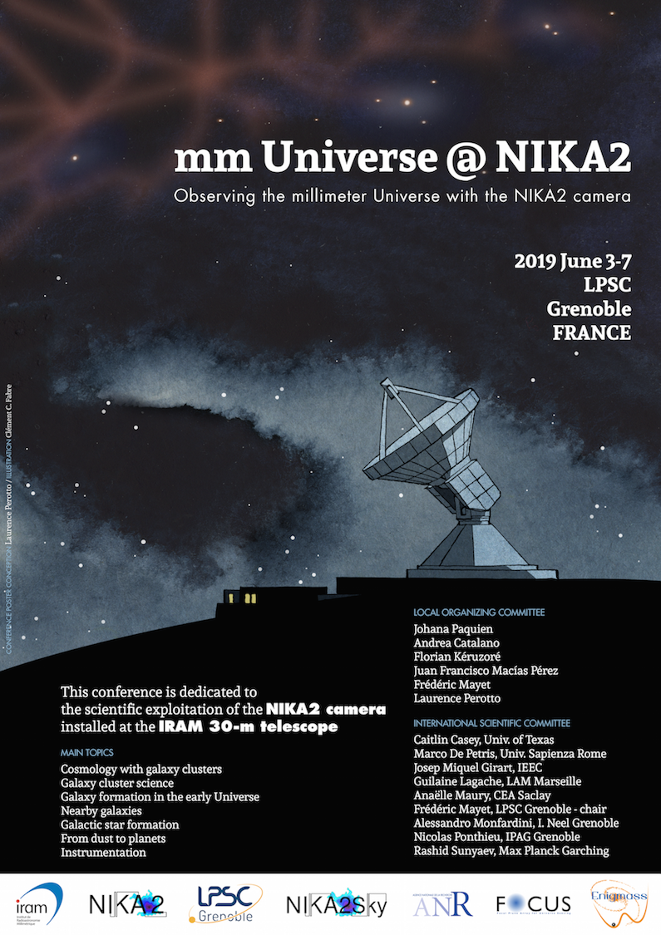
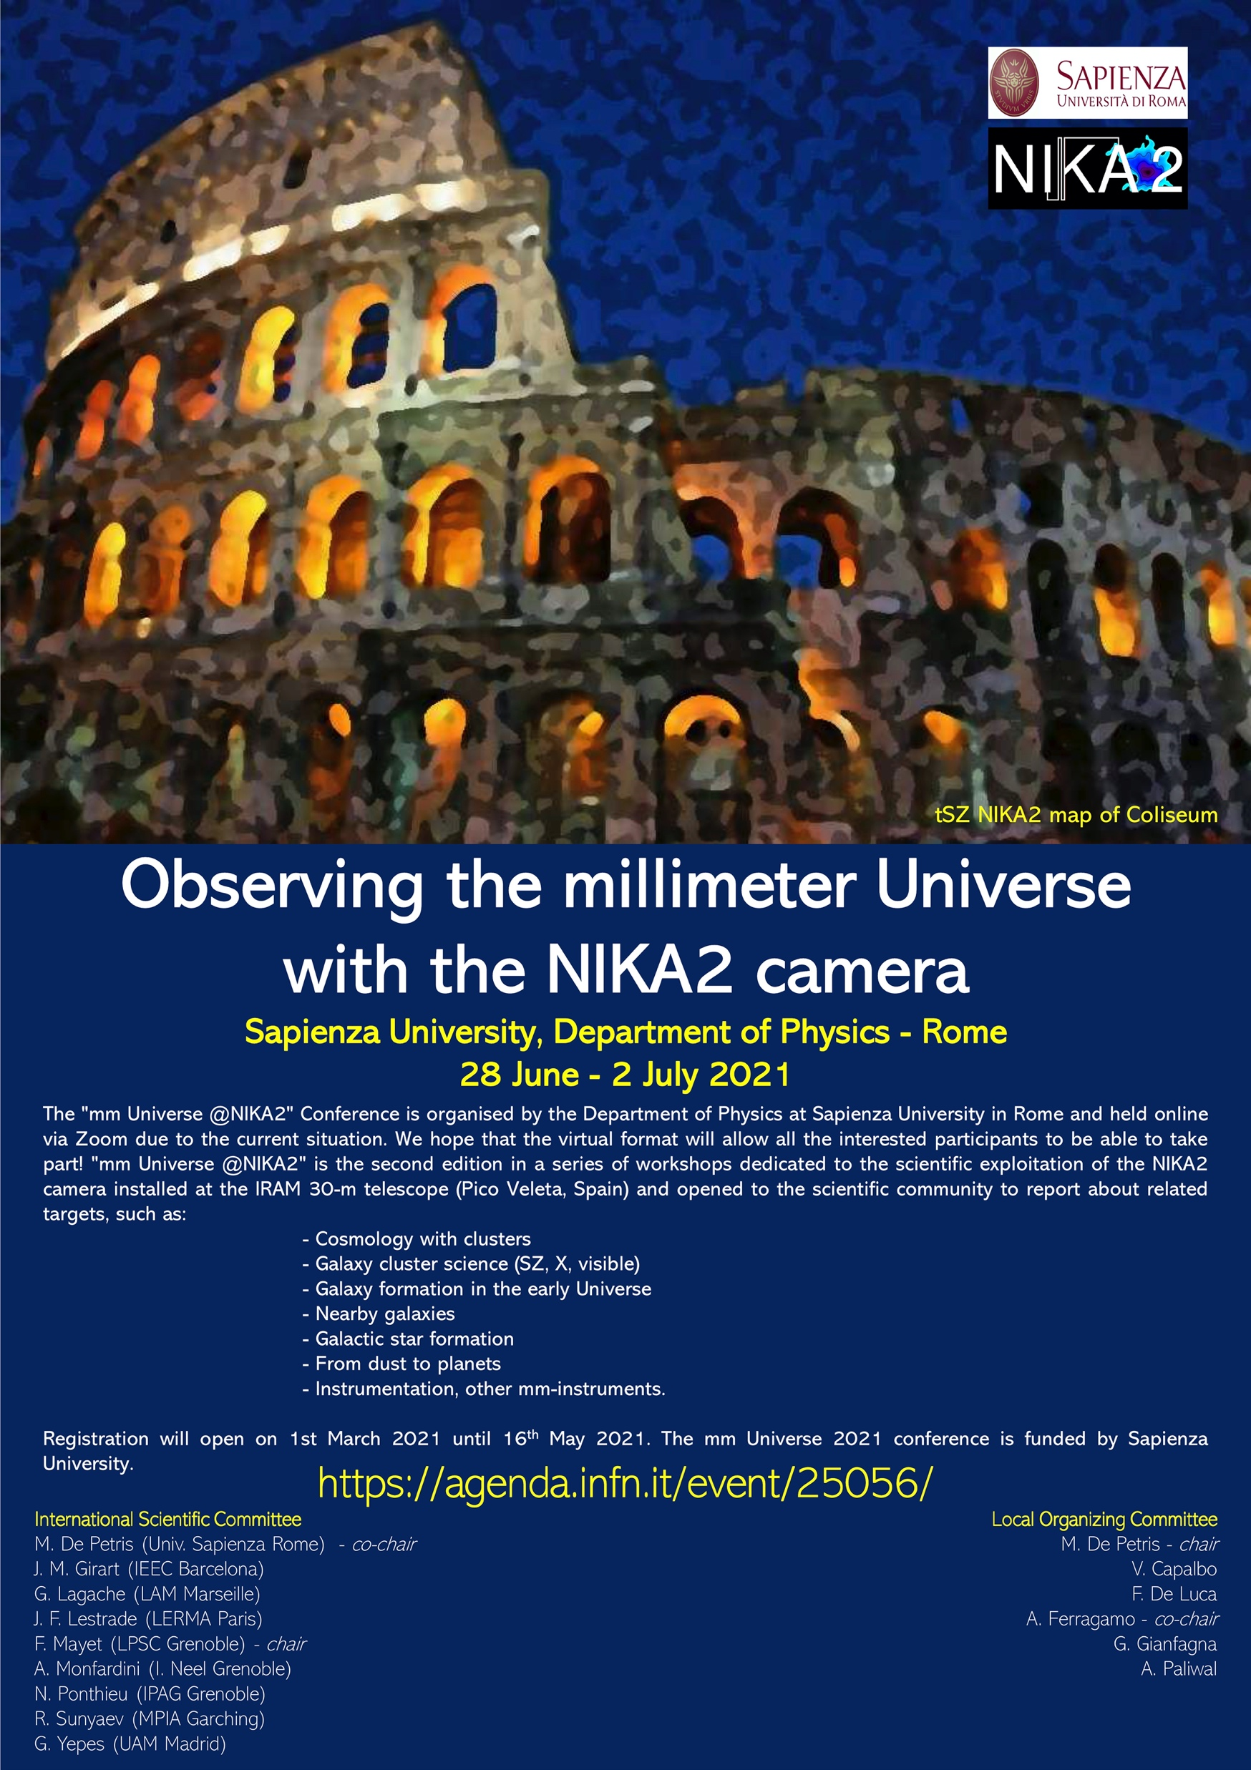
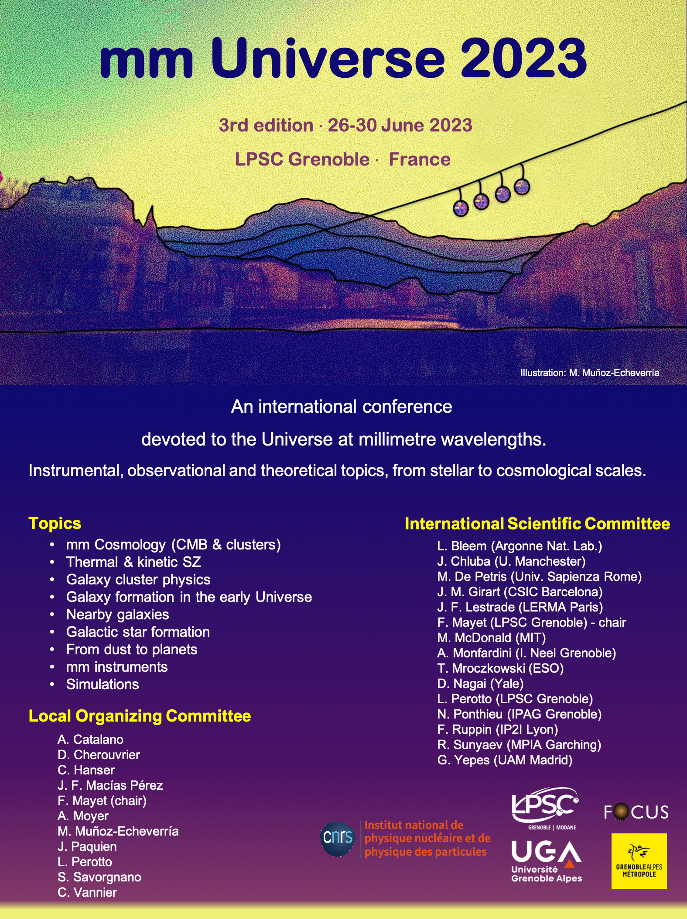
Grenoble 2019
Rome 2021
Grenoble 2023

Slide 16
mm Universe 2025
Call for volunteers to
host the next edition in June 2025.
If you are interested, contact me.
This will then be discussed
within the International Scientic Commitee

Slide 17
International Scientific Commitee
L. Bleem (Argonne Nat. Lab.)
J. Chluba (U. Manchester)
M. De Petris (Univ. Sapienza Rome)
J. M. Girart (CSIC Barcelona)
J. F. Lestrade (LERMA Paris)
F. Mayet (LPSC Grenoble) - chair
M. McDonald (MIT)
A. Monfardini (I. Neel Grenoble)
T. Mroczkowski (ESO)
D. Nagai (Yale)
L. Perotto (LPSC Grenoble)
N. Ponthieu (IPAG Grenoble)
F. Ruppin (IP2I Lyon)
R. Sunyaev (MPA Garching)
G. Yepes (UAM Madrid)

Slide 18




Fundings
mm Universe conference acknowledges financial support from

Slide 19
on behalf of the LOC,
Enjoy the conference

