Slide 1



Anomalies in Particle Physics
Andreas Crivellin
University of Zurich &
Paul Scherrer Institut
DIS, Grenoble, 08.04.2024

Slide 2
Outline
Based on the Nature Physics Review arXiv:2309.03870
Introduction
Status and explanations of the Anomalies
  a_{µ}: Anomalous magnetic moment of the muon:
  X17: 17 MeV anomaly in excited nuclei decays
  β: Anomalies related to β decays
  ν_{e}: Electron neutrino anomalies
  b→sµµ & b→cτν: Semi-lepton B meson decays
  m_{W}: W mass
  eµ(+b): Multi-lepton anomalies
  YY: New resonances at 95GeV, 152GeV and 650GeV
  jj(-jj): Di-di-jets
  pp→ee: non-resonant di-electrons
Conclusions & Outlook
Andreas Crivellin

Slide 3
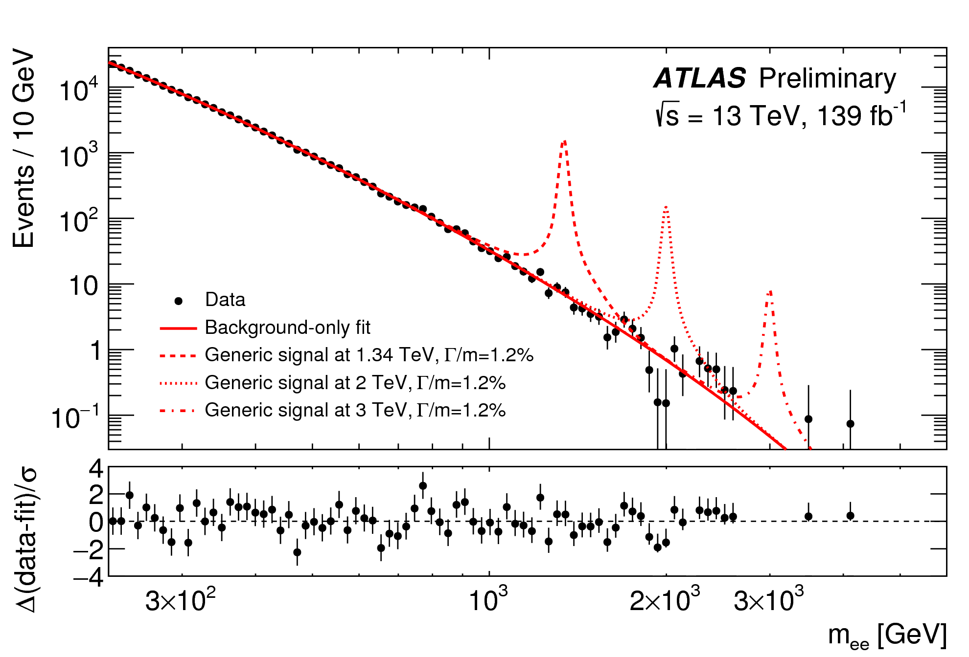
Direct Searches for New Physics
Searches for resonances in the spectrum
Direct information on the mass
Limited by the available energy of the collider
Andreas Crivellin

Slide 4
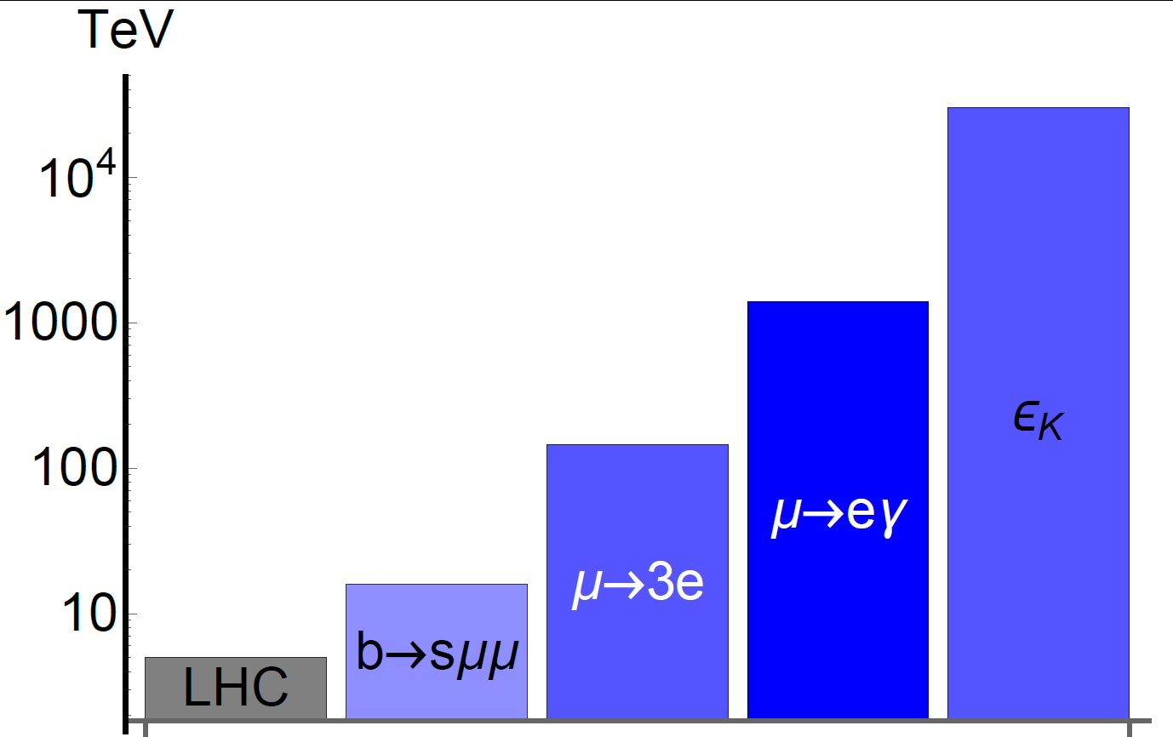
Indirect Searches for New Physics
Perform high-statistics measurements to search for the quantum effects of new particles
Experiment
Flavour observables
Standard Model
Direct searches
New Physics
Flavour observables can be sensitive to higher energy scales than collider searches
Andreas Crivellin

Slide 5
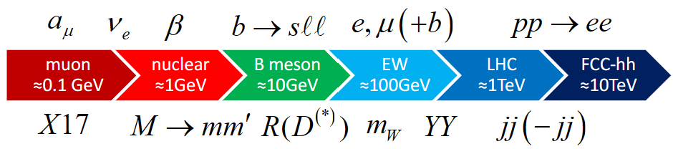
Anomalies

Slide 6
What is an Anomaly?
In general:
Deviation from an established rule
Here:
Deviation from a SM prediction
Our criteria:
  Combined significance of at least 3σ
  (after trail factors)
  Experimental signature should include more than a single channel or be measured or experiment
  Be described by a theoretically robust model (without violating other constraints)
Andreas Crivellin

Slide 7
X17 and neutrino anomalies
X17: e⁺e⁻ excess in excited Be, He and C decays
Consistent with a 17MeV particle (axial, vector) (>6σ)
Nuclear or detector effect?
LSND & MiniBooNE electron excess (4.8σ)
Gallium anomaly suggests electron neutrino disappearance (≈5σ)
Nuclear effects?
No simple NP explanations works when including other constraints
Shedding light on X17: community report: Eur.Phys.J.C 83 (2023) 3, 230
2303.05528
2109.08157

Slide 8
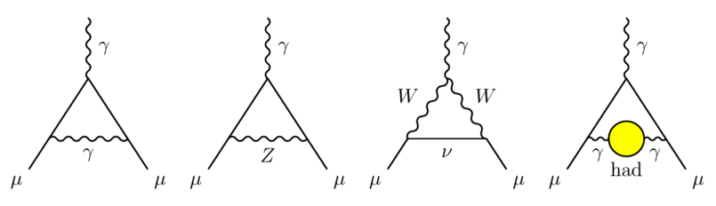
Muon Anomalous Magnetic Moment (a_{μ})
Theory prediction challenging (hadronic effects)
Need NP of the order of the SM EW contribution
Lattice closer to the SM
New measurement from CDM-3 compatible with SM
Electron g-2 requires LFUV
T. Aoyama et al., arXiv:2006.04822
xσ deviation from the SM prediction

Slide 9
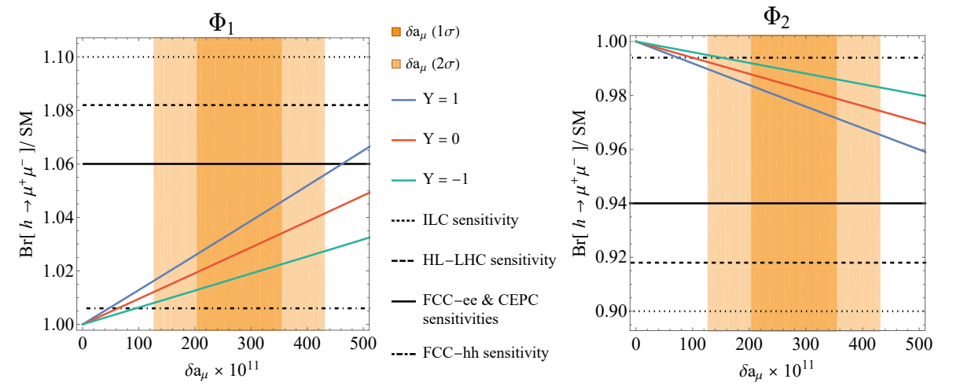
a_{μ} explanations
MSSM: tan(ß) enhanced slepton loops
Scalars: Light scalar with enhanced muon couplings
Z’: Very light with τμ couplings (m_{τ} enhancement)
Leptoquarks: m_{t}/m_{µ} enhanced effects
Chiral enhancement or very light particles
8

Slide 10
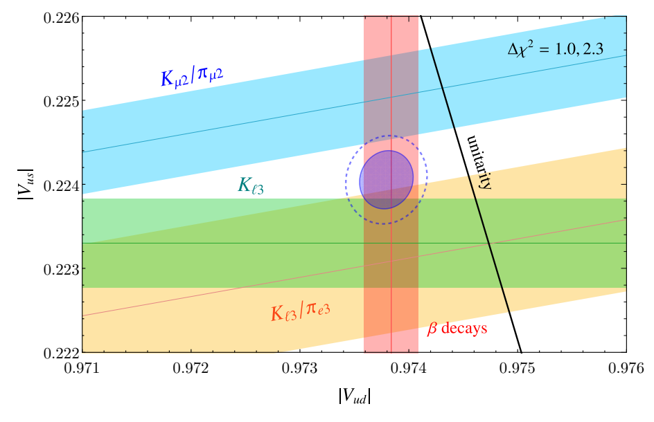
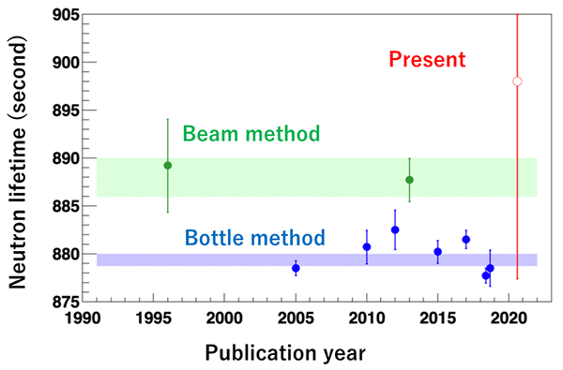
β-decay anomalies (β)
Deficit in first row <
CKM unitarity
Tension between
from K_{l3} vs K_{l2}
Vector-like quarks?
Tension in neutron lifetime
beam vs bottle (≈4σ)
Dark neutron decays?
Systematic problems in β decays measurements?

Slide 11
Hadronic meson decays (M→mm`)
Br[B→D⁽*⁾K] & Br[B_{s}→D_{s}K] (≈5σ)
Polarization in B_{q}→K*K*
CP violation in B→Kπ (≈3σ)
CP violation in D→KK vs D→ ππ (≈4σ)
Hadronic uncertainties?
NP explanations:
  Z`
  KK gluons
  di-quarks
Challenged by LHC searches
1202.2866
2103.10332
Is the SM prediction under control?

Slide 12
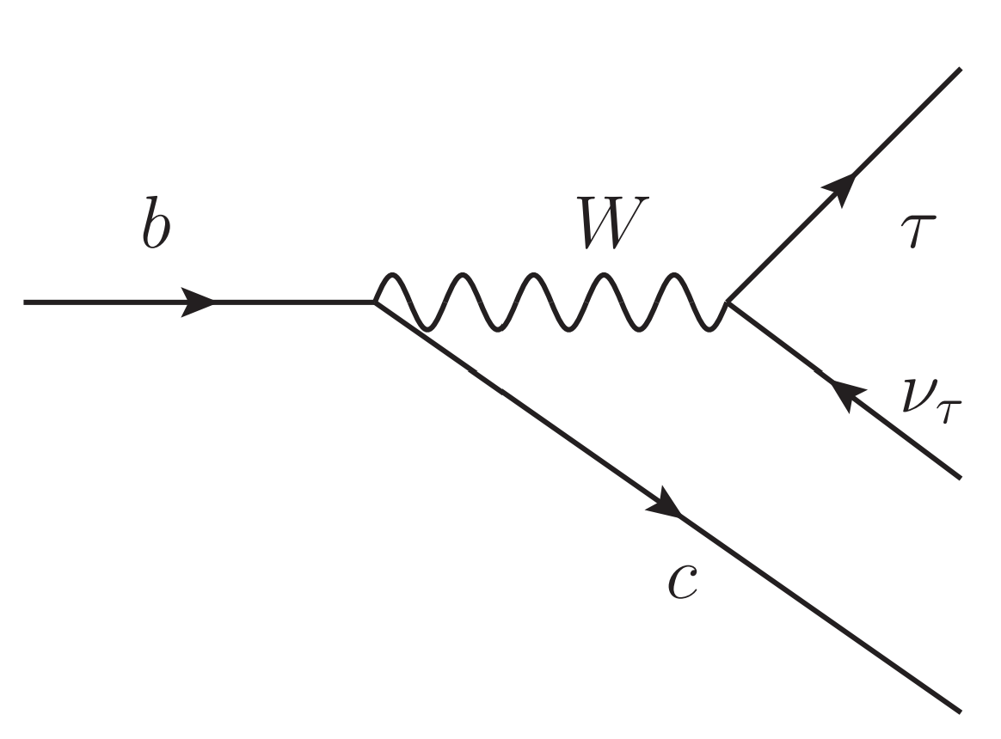
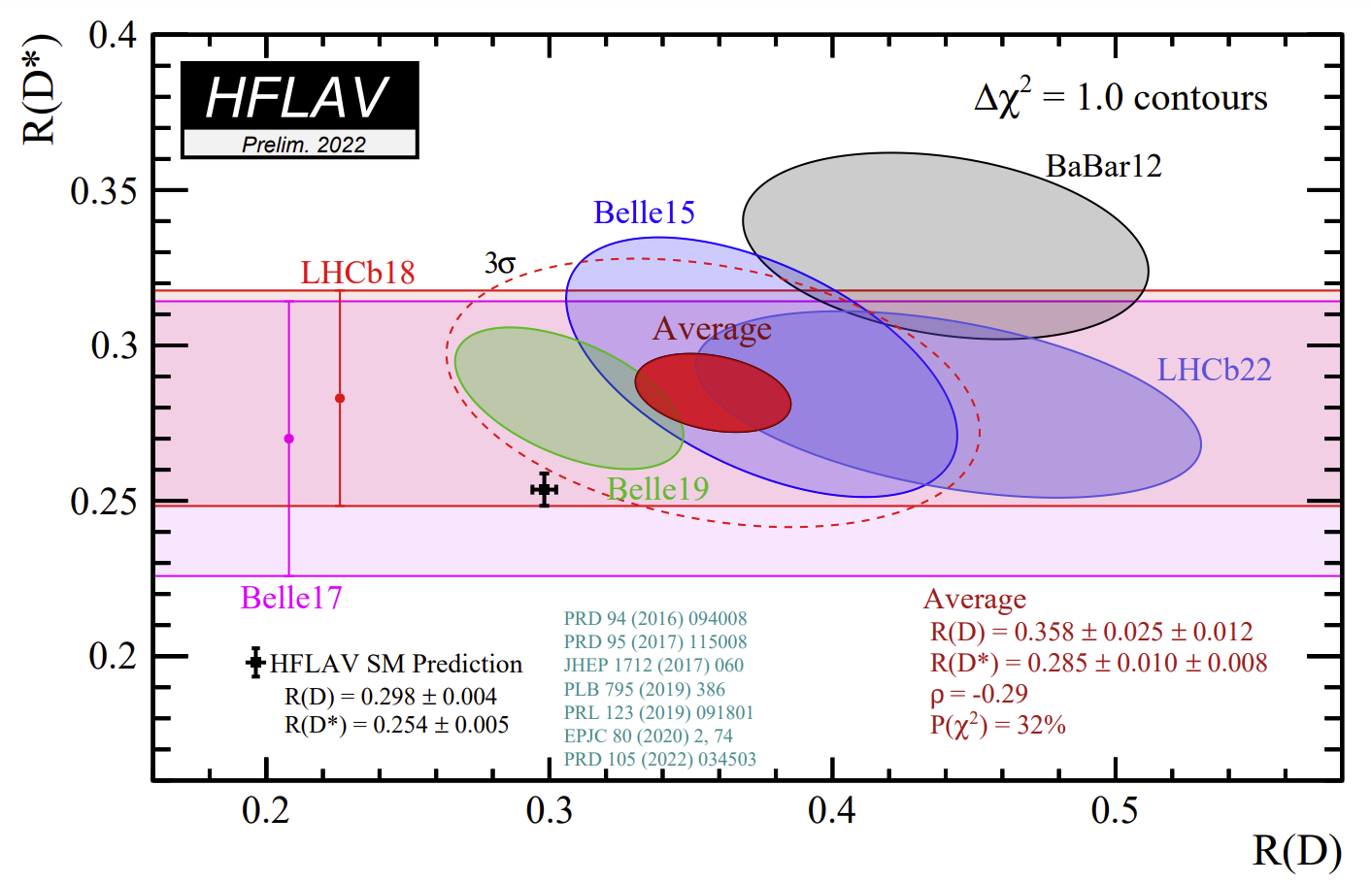
R(D ⁽*⁾)=Br[B→D ⁽*⁾τν]/Br[B→D ⁽*⁾lν]
Tree-level decays in the SM
Explanations: H⁺ or Leptoquark
>3σ, large NP effects needed

Slide 13
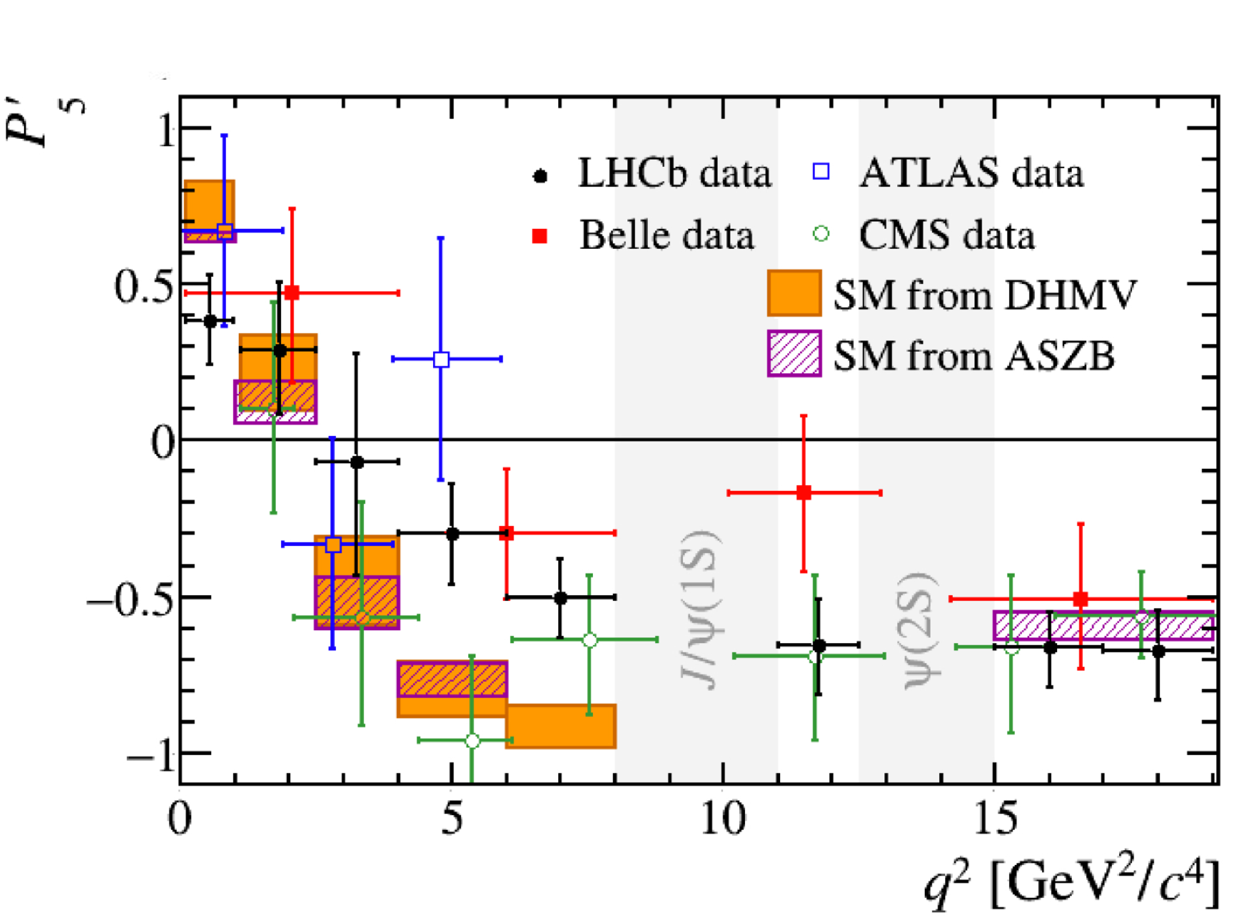
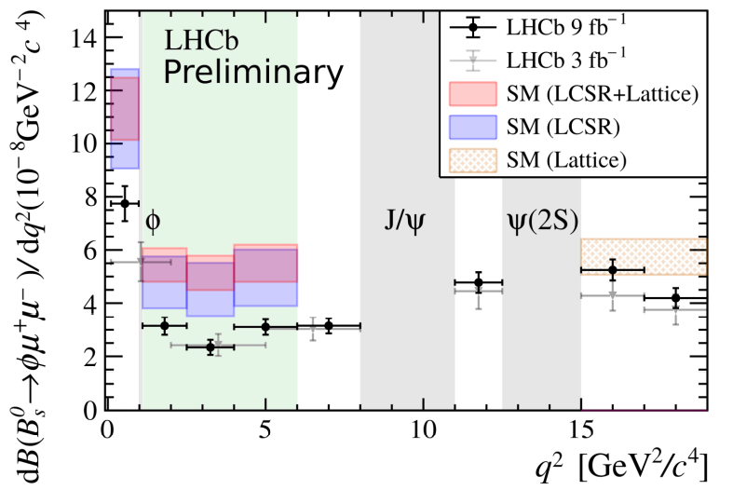
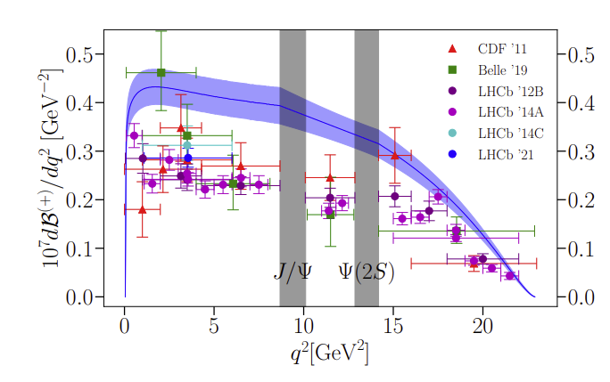
b→sμ⁺μ⁻ Processes
≈4σ deficit in the Br
using lattice QCD and LCSR
Signs for NP in angular
observables
writescience.wordpress.com
Br’s≈20% below SM expectations, combined >5σ
Andreas Crivellin

Slide 14
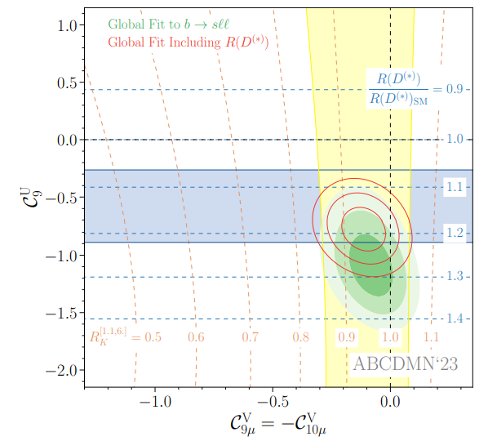

b→sµ⁺µ⁻ explanations
Leptoquarks with tau-loops
Di-quarks (tau loops)
Z’
AC, C. Greub, D. Müller,
F. Saturnino, PRL 2018
Possible connection to R(D) & R(D*)

Slide 15
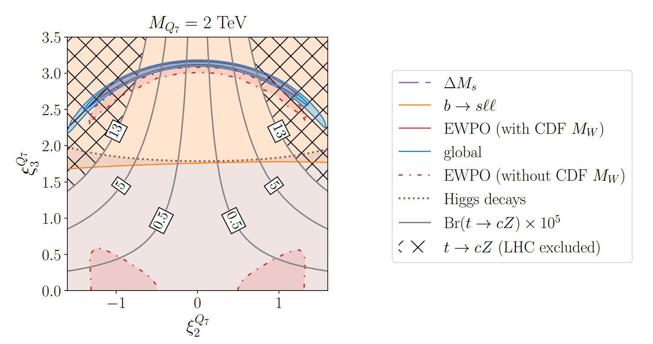
W mass
Loop effects of
fermions or scalars
with sizable Higgs
couplings
Z-Z’ mixing
SU(2) triplet scalar
Leptoquarks
2HDM
A.C., M. Kirk, T. Kitahara, F. Mescia, arXiv:2204.05962
3.7σ, possible relation to t→cZ

Slide 16
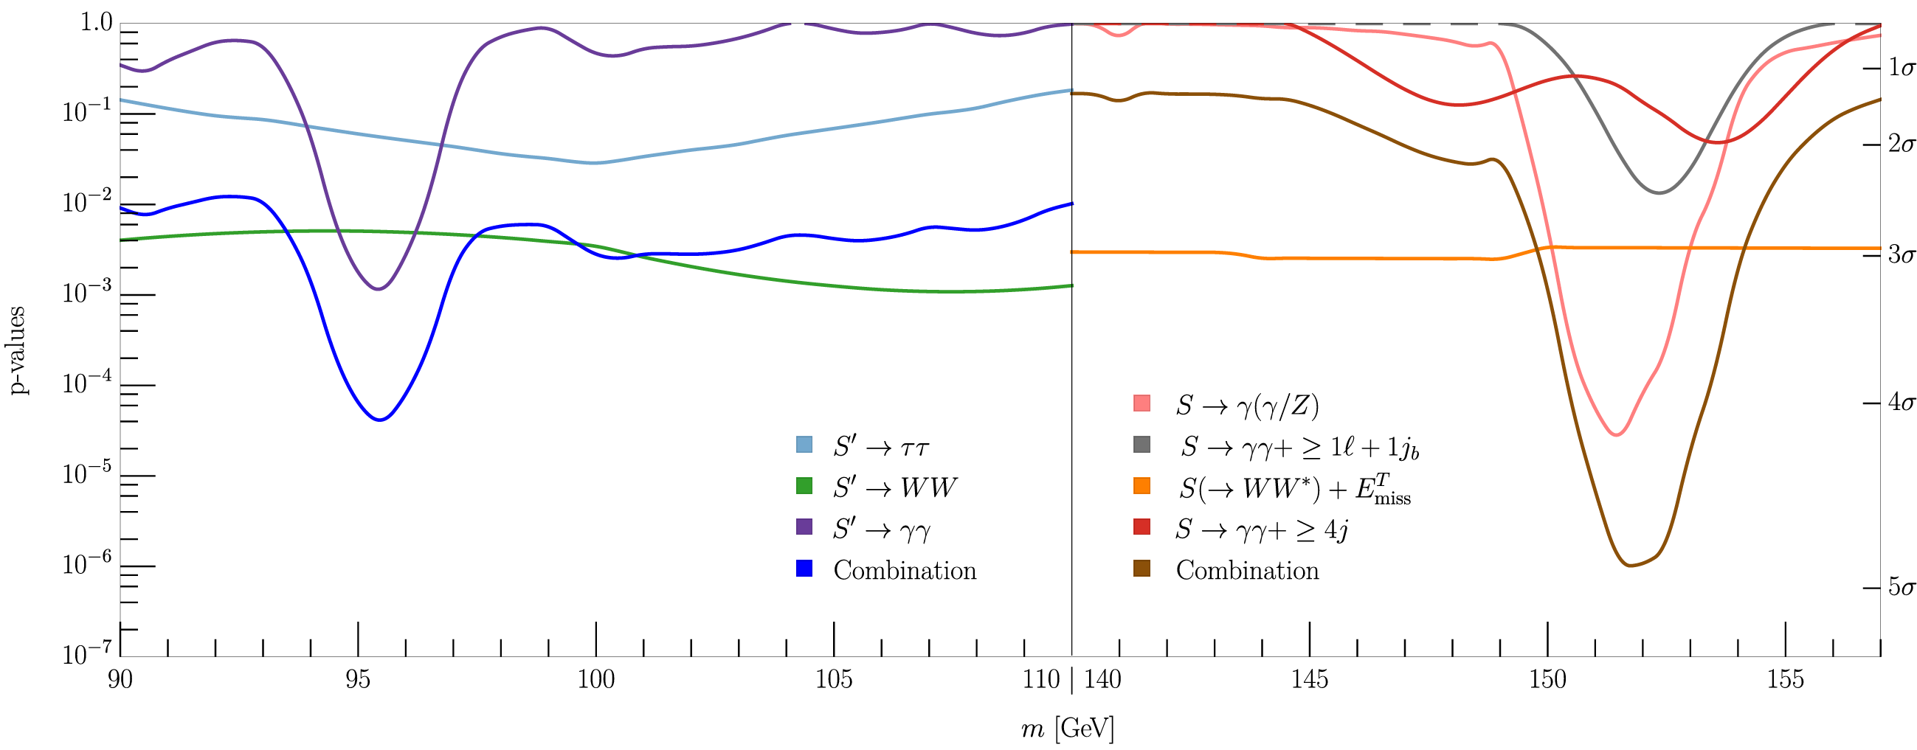
Hints for new Scalars at 95 GeV & 151.5 GeV
95 GeV: Only inclusive searches at LHC
151.5 GeV: SM Higgs γγ and Zγ side-bands in associated production channels (no sign in ZZ)
Details in my talk tomorrow at 12:20!!!
S. Bhattacharya, G. Coloretti, A. Crivellin, et al. arXiv:2306.17209
3.8σ & 4.7σ global significance

Slide 17
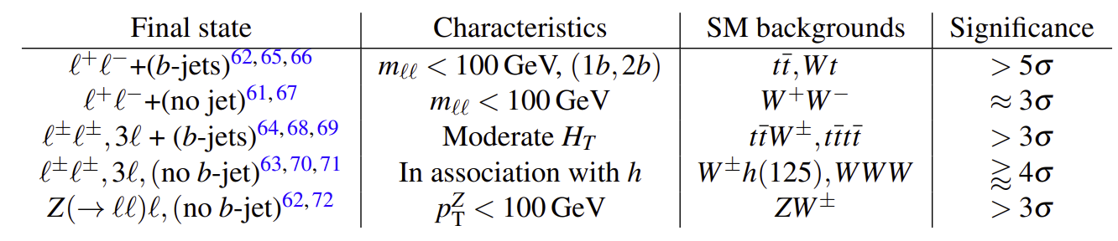
Multi-lepton Anomalies (eµ(+b))
Deviations from the SM predictions in LHC processes involving two or more leptons, with and without (b-)jets
1711.07874 found m_{S}=150±5GeV
Here focus on:
  WW (eµ+MET+0j)
  Top-quark differential distributions (eµ+MET+>1b)
A.C., B. Mellado, arXiv:2309.03870
Buddenbrock et al. arXiv:1901.05300
O. Fischer et al. arXiv: 2109.06065
Statistically significant, motivate new EW scale scalars
Andreas Crivellin
B Meson Decays and Lepton Flavour Universality Violation

Slide 18
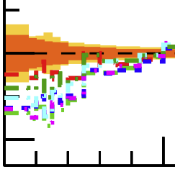
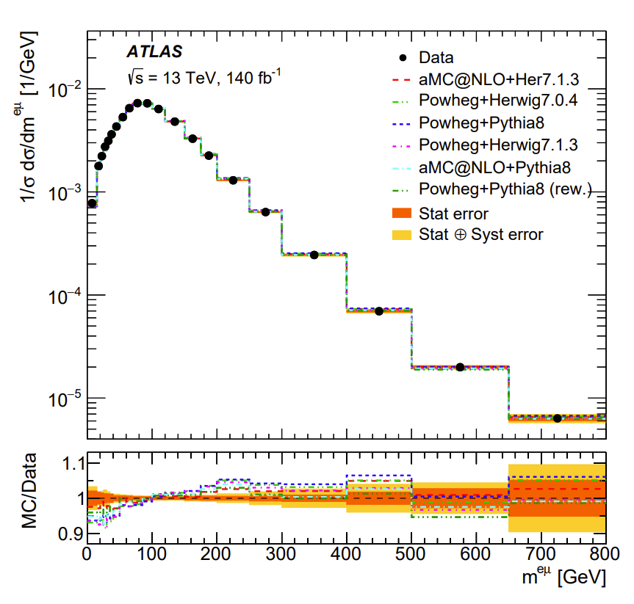
Differential Top-Quark Distributions
2303.15340
ATLAS:
“No model can
describe all measured
distributions within their uncertainties.”
New Physics pollution of this SM measurement?

Slide 19
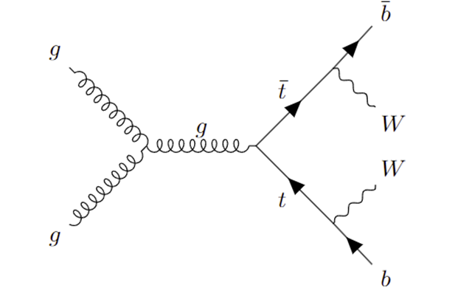
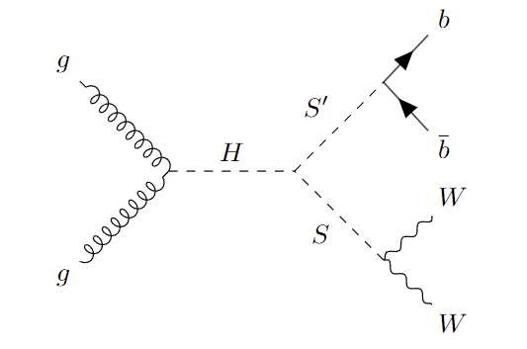
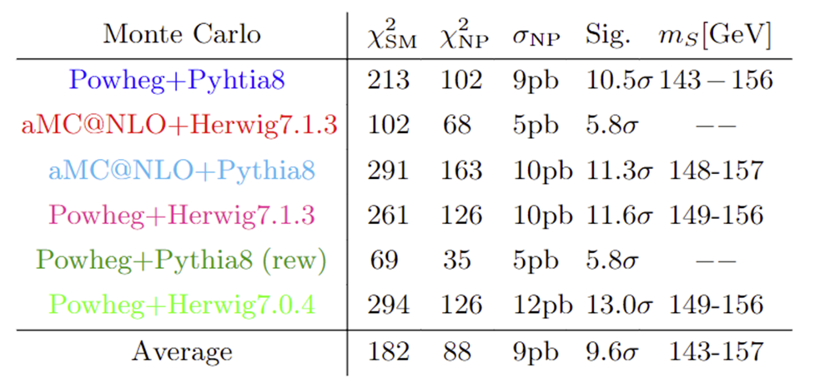
New Physics in Top-Quark Distributions
SM
NP
Related to the 95GeV and 152GeV hints?

Slide 20
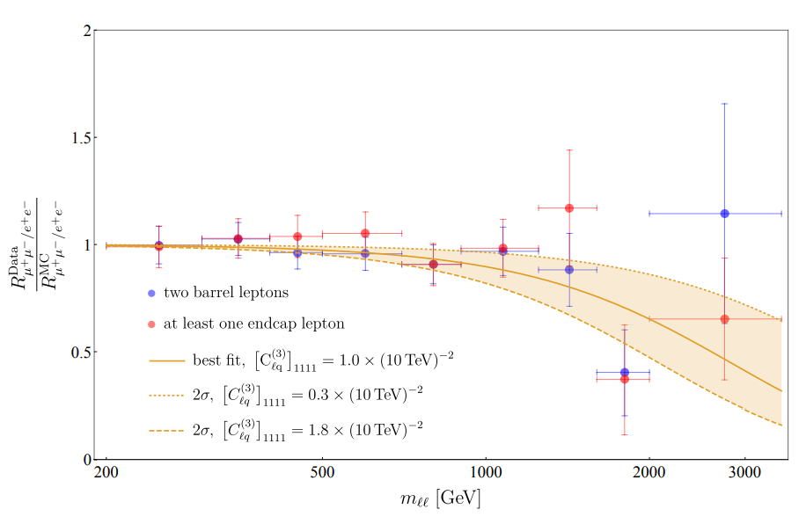
Non-Resonant Di-Leptons
CMS: arXiv:2103.02708
Excess in
di-electrons at
m_{ee}>1800GeV
Observed 44
events, expected
29.2 ± 3.6 events
Also ATLAS (2006.12946) and HERA (1902.03048) observe slightly more electrons than expected.
No excess in muon data
Explanations: Leptoquarks, Z‘
≈3σ hint for LFUV

Slide 21
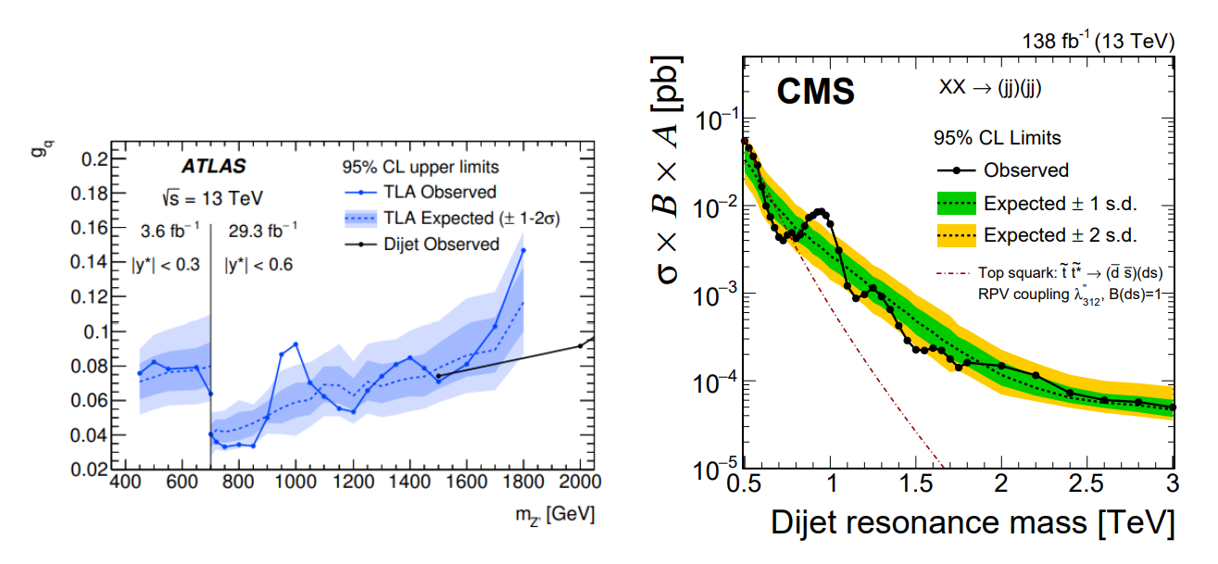
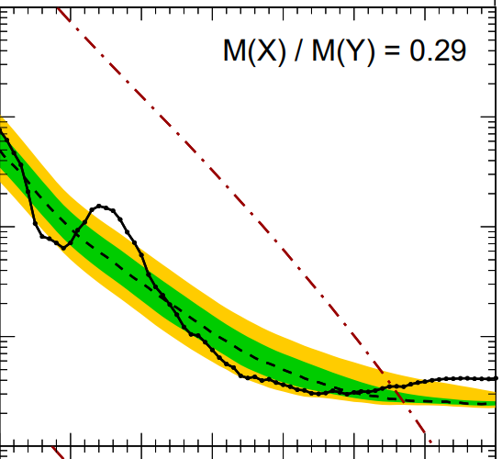

Di-(Di-)Jets
ATLAS excess in di-jets searches
Agrees with the di-jet mass
of the CMS analysis
Y→XX
Global
signifi-
cance
3.6σ
New
2.4TeV particle in RS setup
Di-quarks, new heavy gluons?

Slide 22
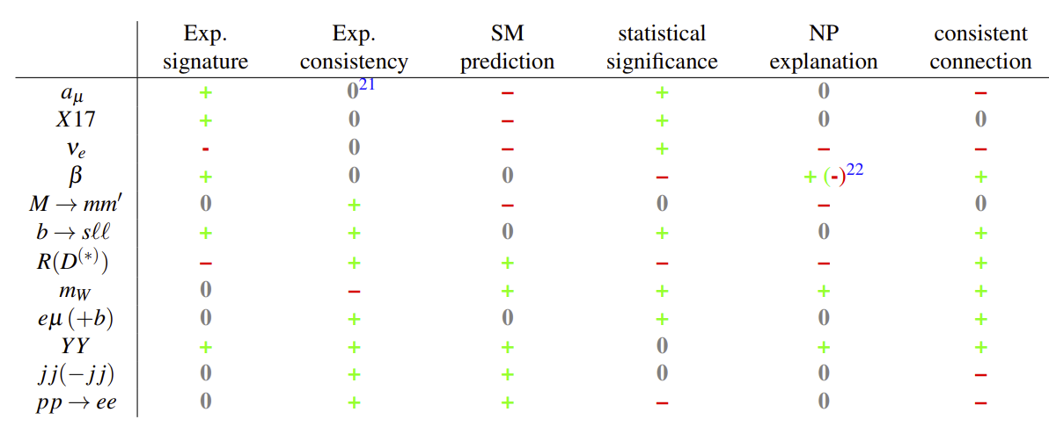
Summary
My favourite: narrow resonance at 152 GeV
(parallel talk tomorrow at 12:20)
Hints with different strength and weaknesses

Slide 23
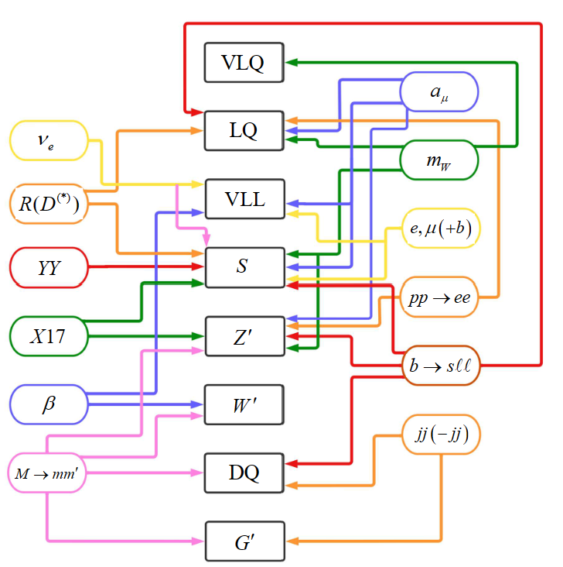
Conclusions
Intriguing
anomalies
emerged in
the last years
which point
towards
new
particlesc
The Standard Model is crumbling

Slide 24
Backup

Slide 25
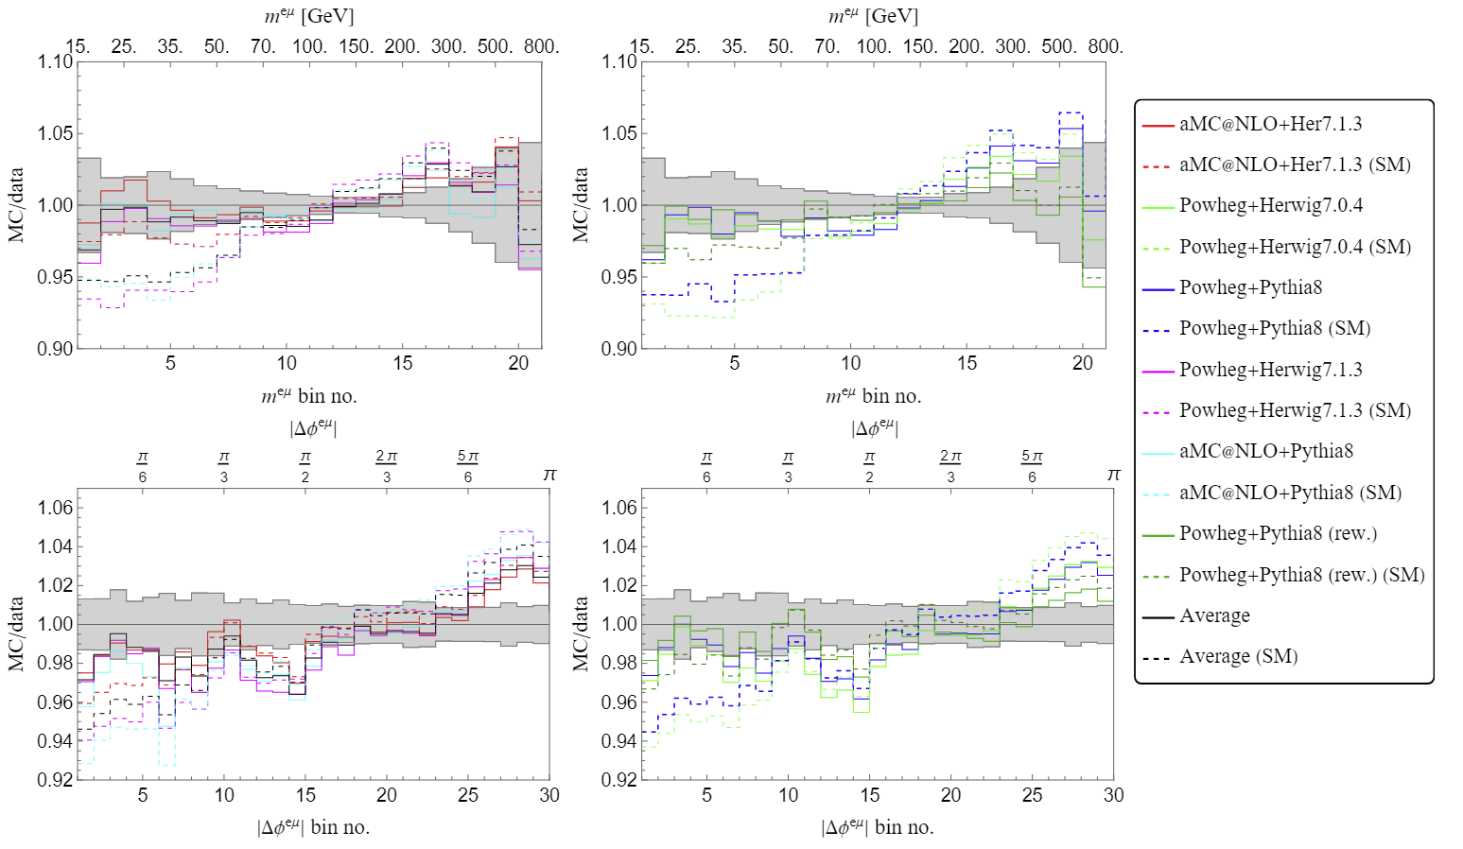
Simplified Model: H→SS’ →WWbb
Fix m_{S}=152GeV and m_{S’}=95GeV by the hints for narrow resonances. Weak m_{H} (270GeV) dependence.
Agreement with data significantly improved

Slide 26
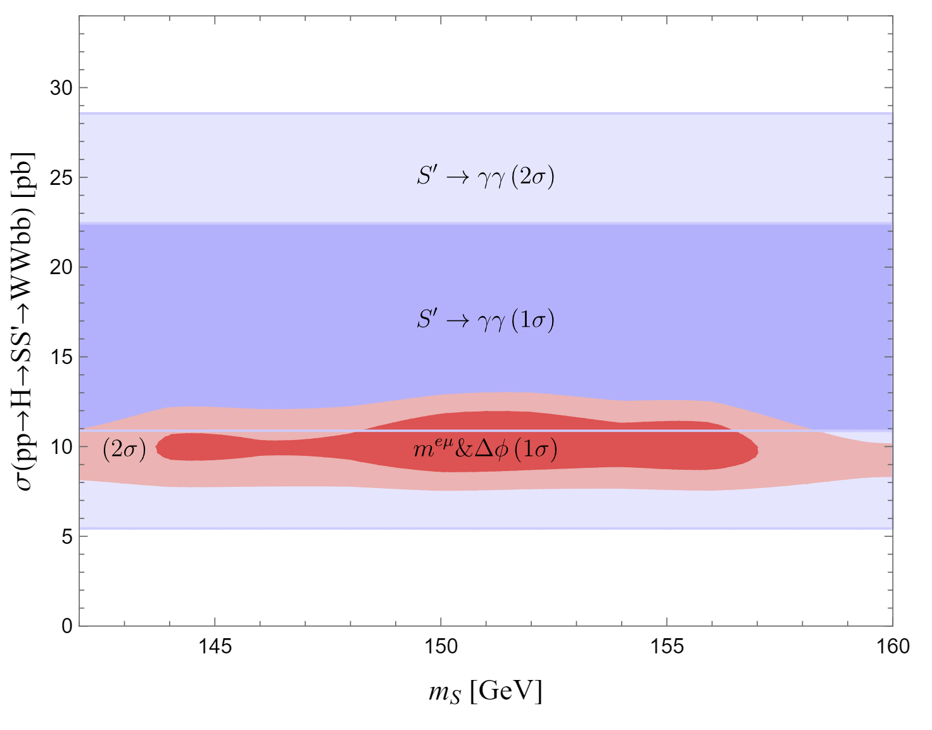
Singlet+Triplet Model and S’(95)→γγ
S’(95): Singlet
decays
dominantly
to bb
S(152):Triplet
with Y=0,
motivated by
the W mass,
decays dominantly to WW
Agreement with 95GeV→γγ signal strength
Independent, but consistent with 152GeV excess

Slide 27
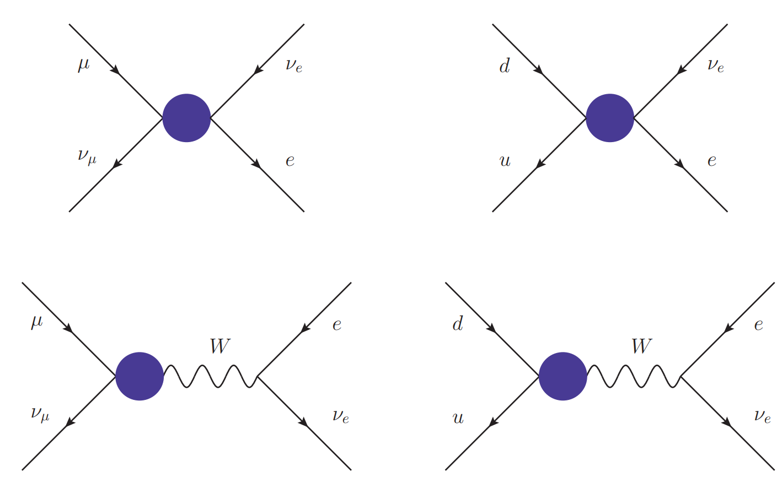
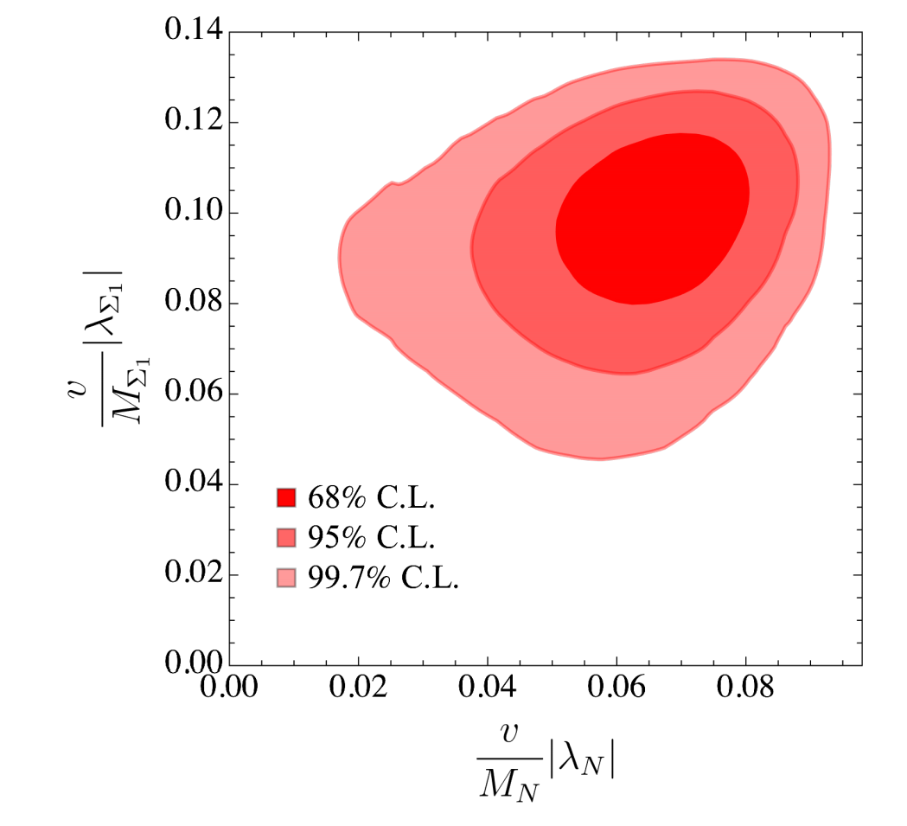
Cabibbo Angle Anomaly and EW Fit
LQs
W‘
W-W‘ mixing
Vector-like
leptons
Z‘
Singly charged
scalar
Vector-like
quarks
AC, F. Kirk, C. Manzari,
M. Montull JHEP, 2008.01113
>5σ improvement over SM hypothesis with VLLs

Slide 28
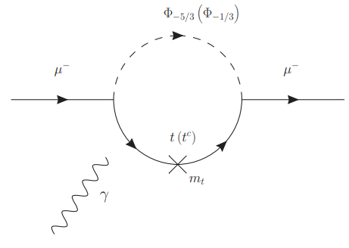
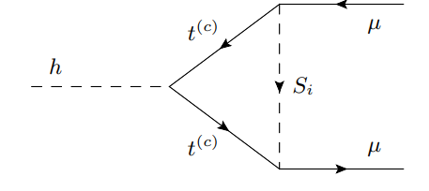
Leptoquarks in a_{μ}
Chirally enhanced effects via top-loops
Mt effect in
enhanced effect in
enhanced effect in
Correlations with h→μμ and Z→μμ
8

Slide 29
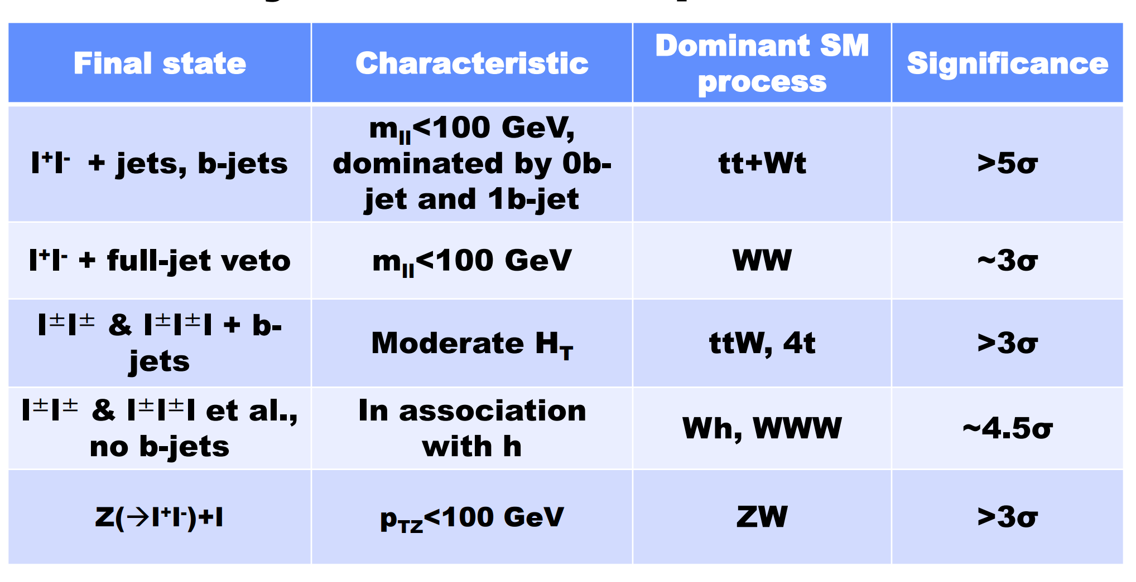
Outlook: Multi Lepton Anomalies
Talk of Bruce Mellado, ICNFP 2021, Crete
Leptons + jets + missing energy

Slide 30
Implications for FCC-ee
pp→e⁺e⁻
ΔA_{FB}
Z→bb
R(D⁽*⁾)
e⁺e⁻→ff
1.5x10¹²
b
5x10¹²
Z
3x10¹¹
τ
VLQ, VLL
LQ
W’
Z’
VLL
CAA
b→sμμ
a_{μ}
τ →µνν
Andreas Crivellin

Slide 31
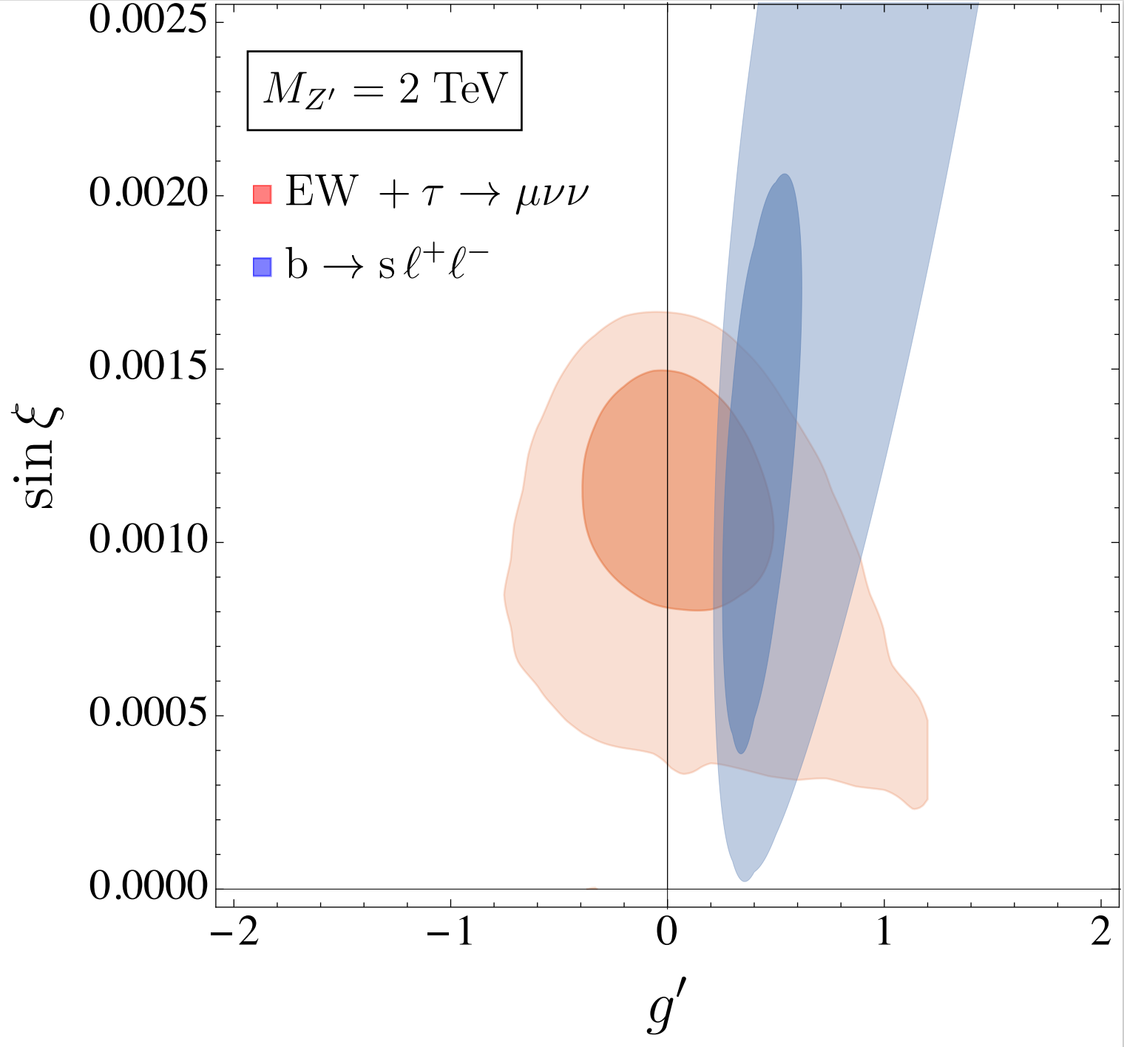
b→sℓℓ, W mass and Z’ mixing
Z-Z’ mixing can leads to a shift in the predictions of
the W mass and
can explain the
tension in
the EW fit
LFU effect
in b→sℓℓ
AC, M. Alguero,
C.A. Manzari,
J. Matias
2201.08170
Interesting correlations between b→sℓℓ and the EW fit
8

Slide 32
Outlook: Physics at Future Colliders
Flavour Anomalies require NP at the TeV scale
This new particles in general also affect EW precision observables
Flavour is directly linked
to the Higgs boson
Direct Searches at HL-LHC, HE-LHC, FCC-pp
2006.10758
Z decays at CLIC
and FCC-ee
LQ in Higgs decays
CLIC, FCC
Flavour Anomalies (if confirmed) strengthen the physics case for future colliders significantly
Andreas Crivellin

Slide 33
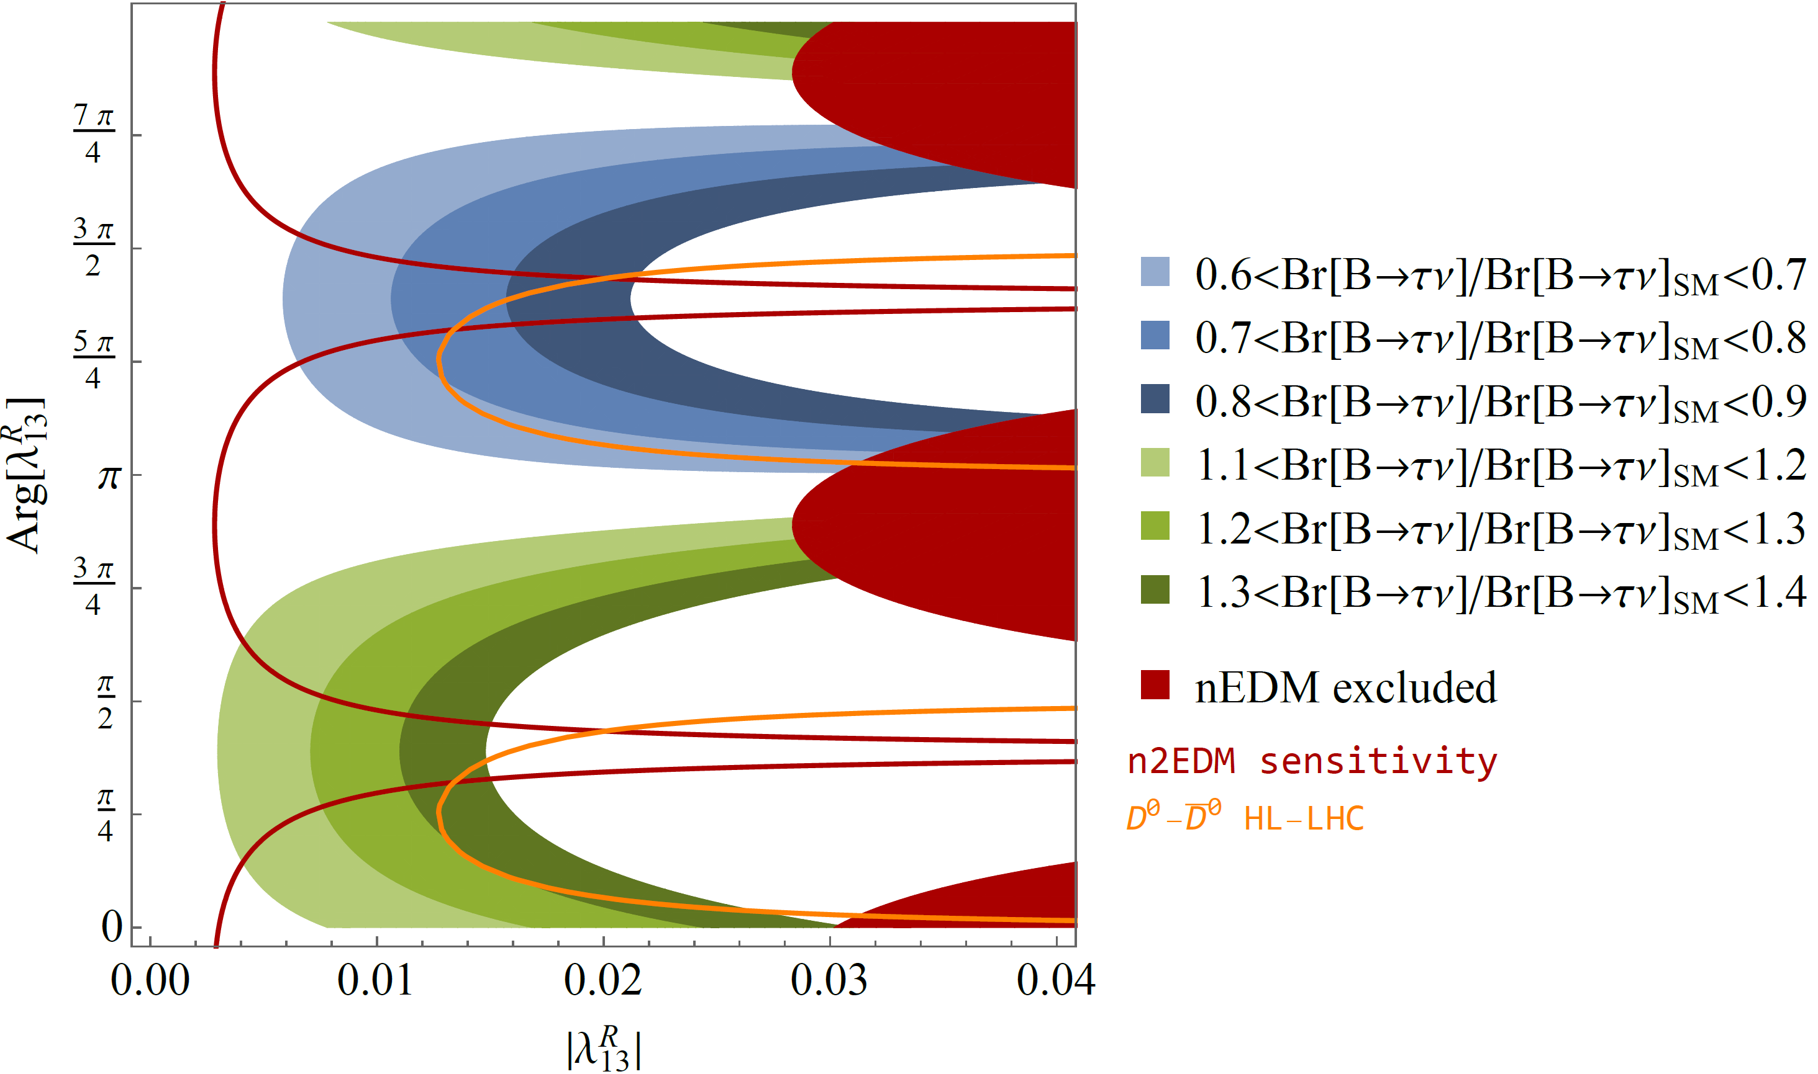
Correlations the neutron EDM with S1
W. Dekens, J. de Vries, M. Jung,
K. K. Vos, arXiv:1809.09114
AC, F. Saturnino
arxiv:1905:08257
1905:08257
J. Aebischer, AC, F. Saturnino, 1905.xxx
Effect in B predicts measurable nEDM effect

Slide 34
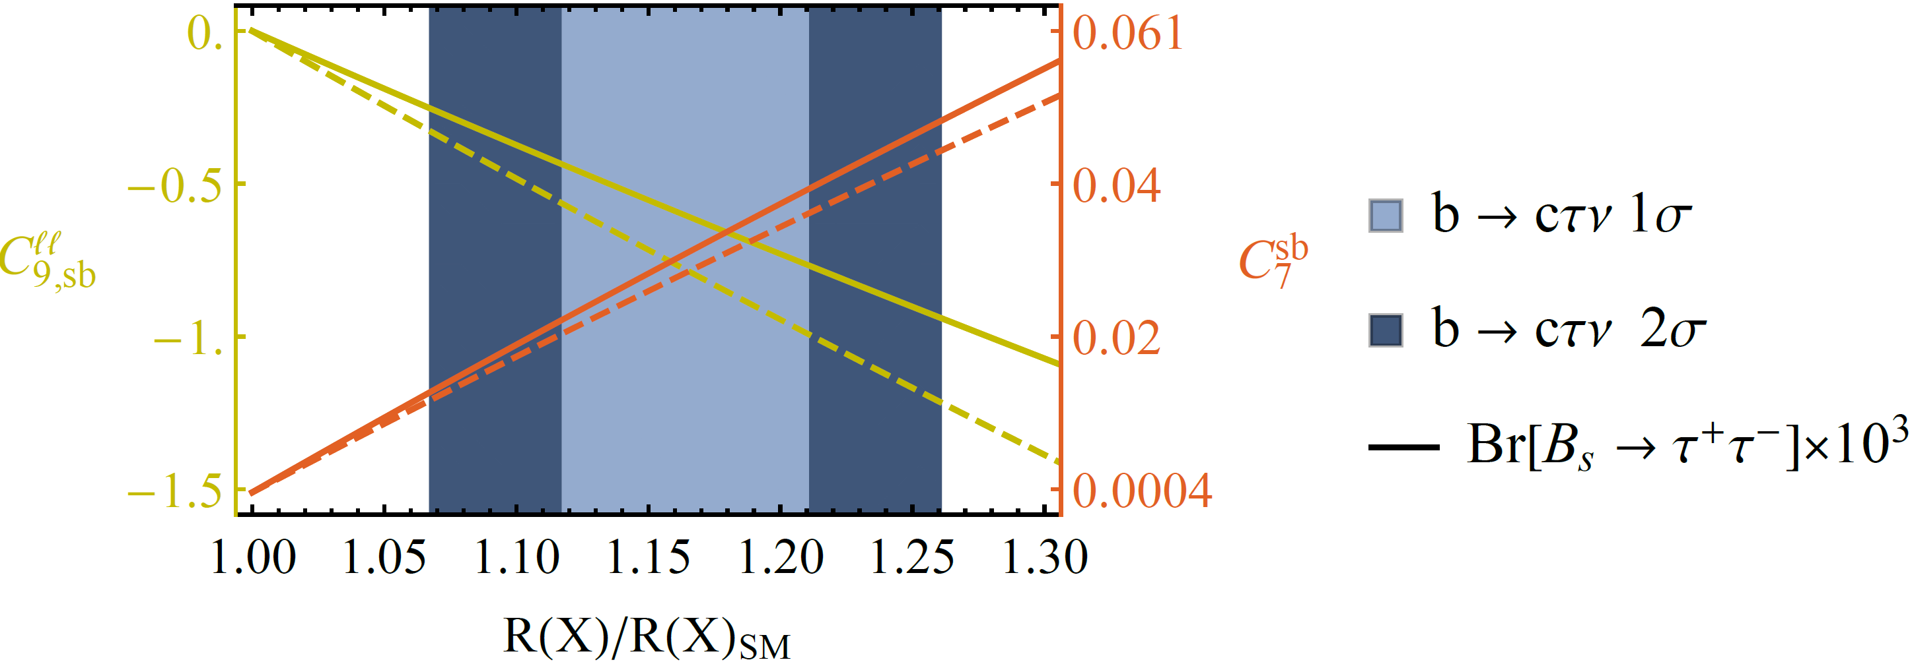
Important Loop-Effects
Explanation of b→cτν requires large bτ and sτ couplings (follows from SU(2) invariance)
AC, C. Greub, D. Müller,
F. Saturnino, PRL 2018
Large loop effects in b→sμμ

Slide 35
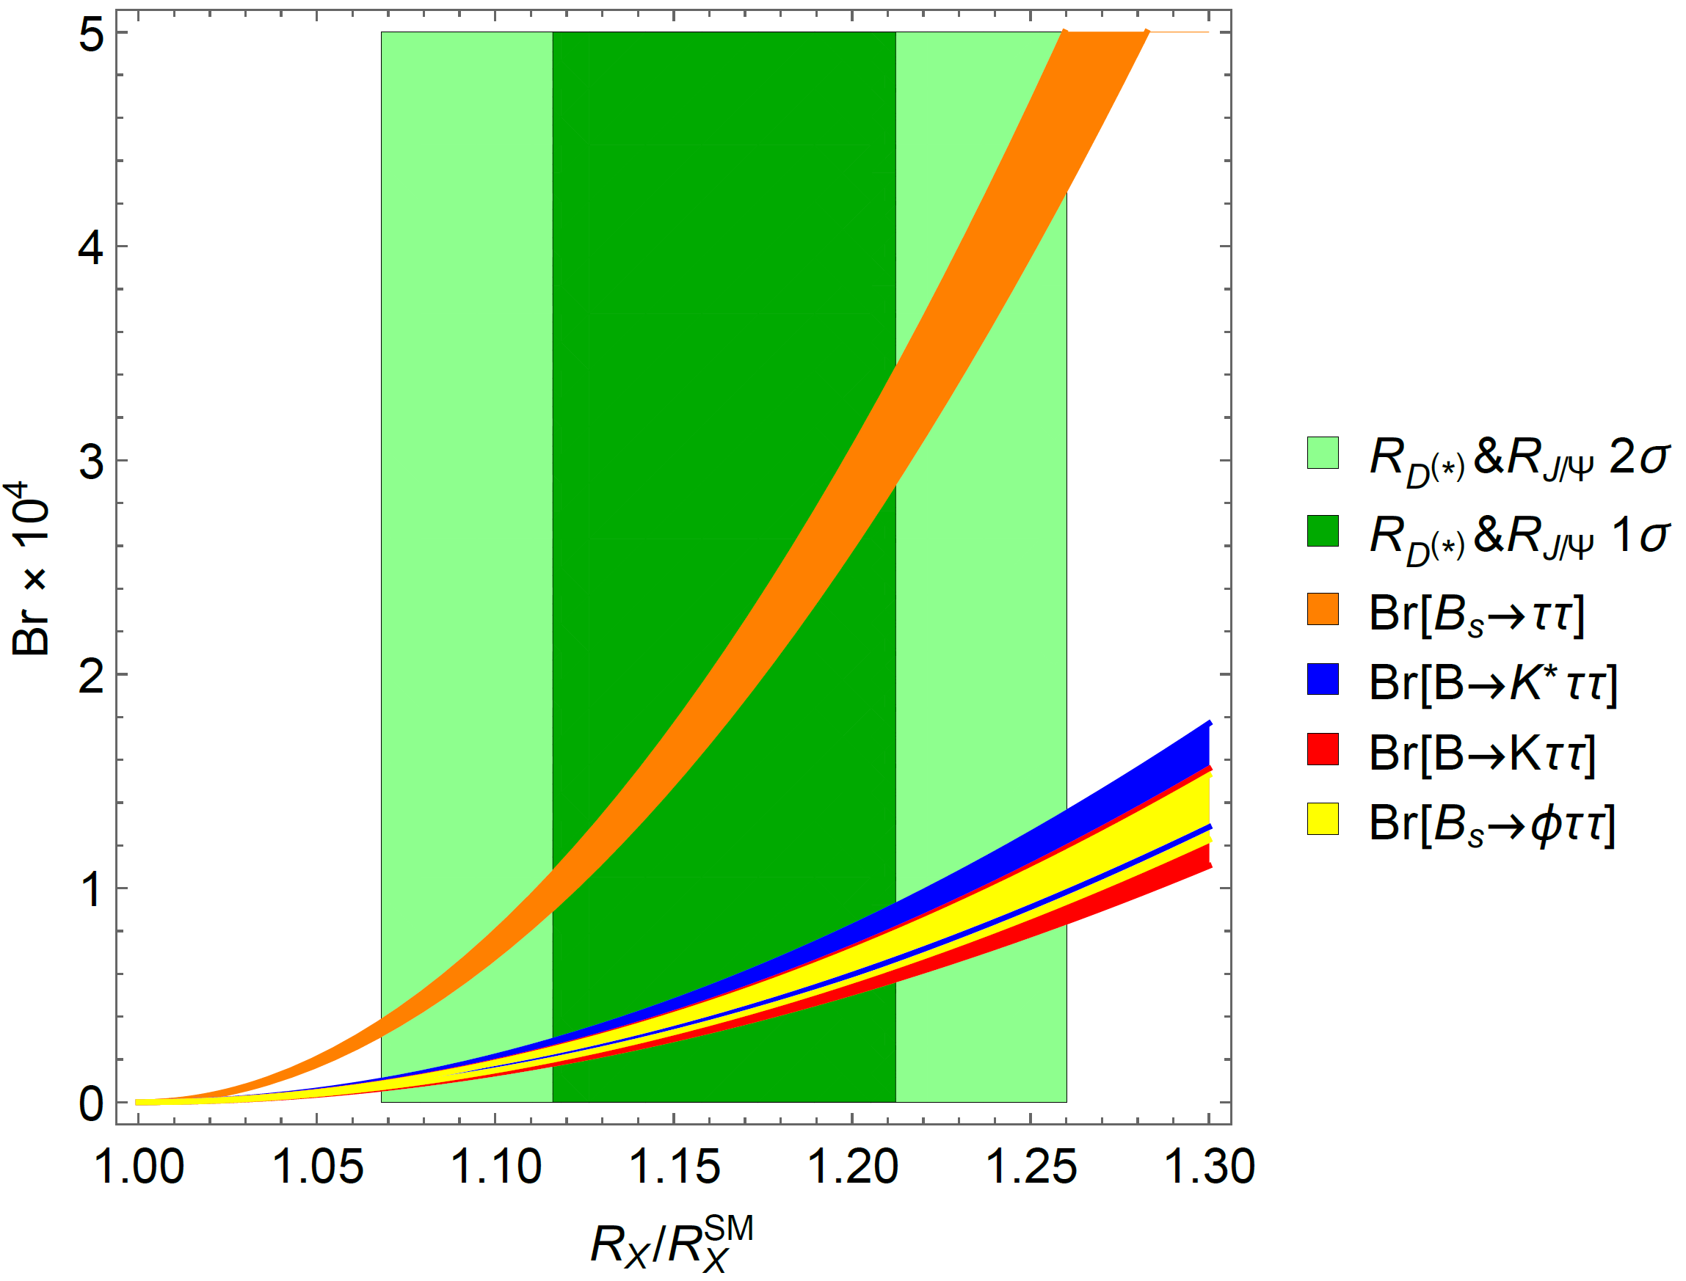
R(D⁽*⁾) and b→sττ
Large couplings to the second generation
b→sττ
very strongly enhanced
B. Capdevila, AC, S. Descotes-Genon, L. Hofer and J. Matias, PRL.120.181802

Slide 36
Important Loop-Effects
Explanation of b→cτν requires large LQ-bτ and LQ-c-ν_{τ} couplings
Via SU(2) invariance this
leads to large effects in
b→sττ processes
Closing the tau-loop gives a LFU
effect in b→sll
Effect goes in the right direction
AC, C. Greub, D. Müller,
F. Saturnino, PRL 2018
M. Algueró, B. Capdevila, S. Descotes-Genon, P. Masjuan, J. Matias, PRD, 2019
Explanation of b→cτν leads to
loop effects in b→sμμ

Slide 37
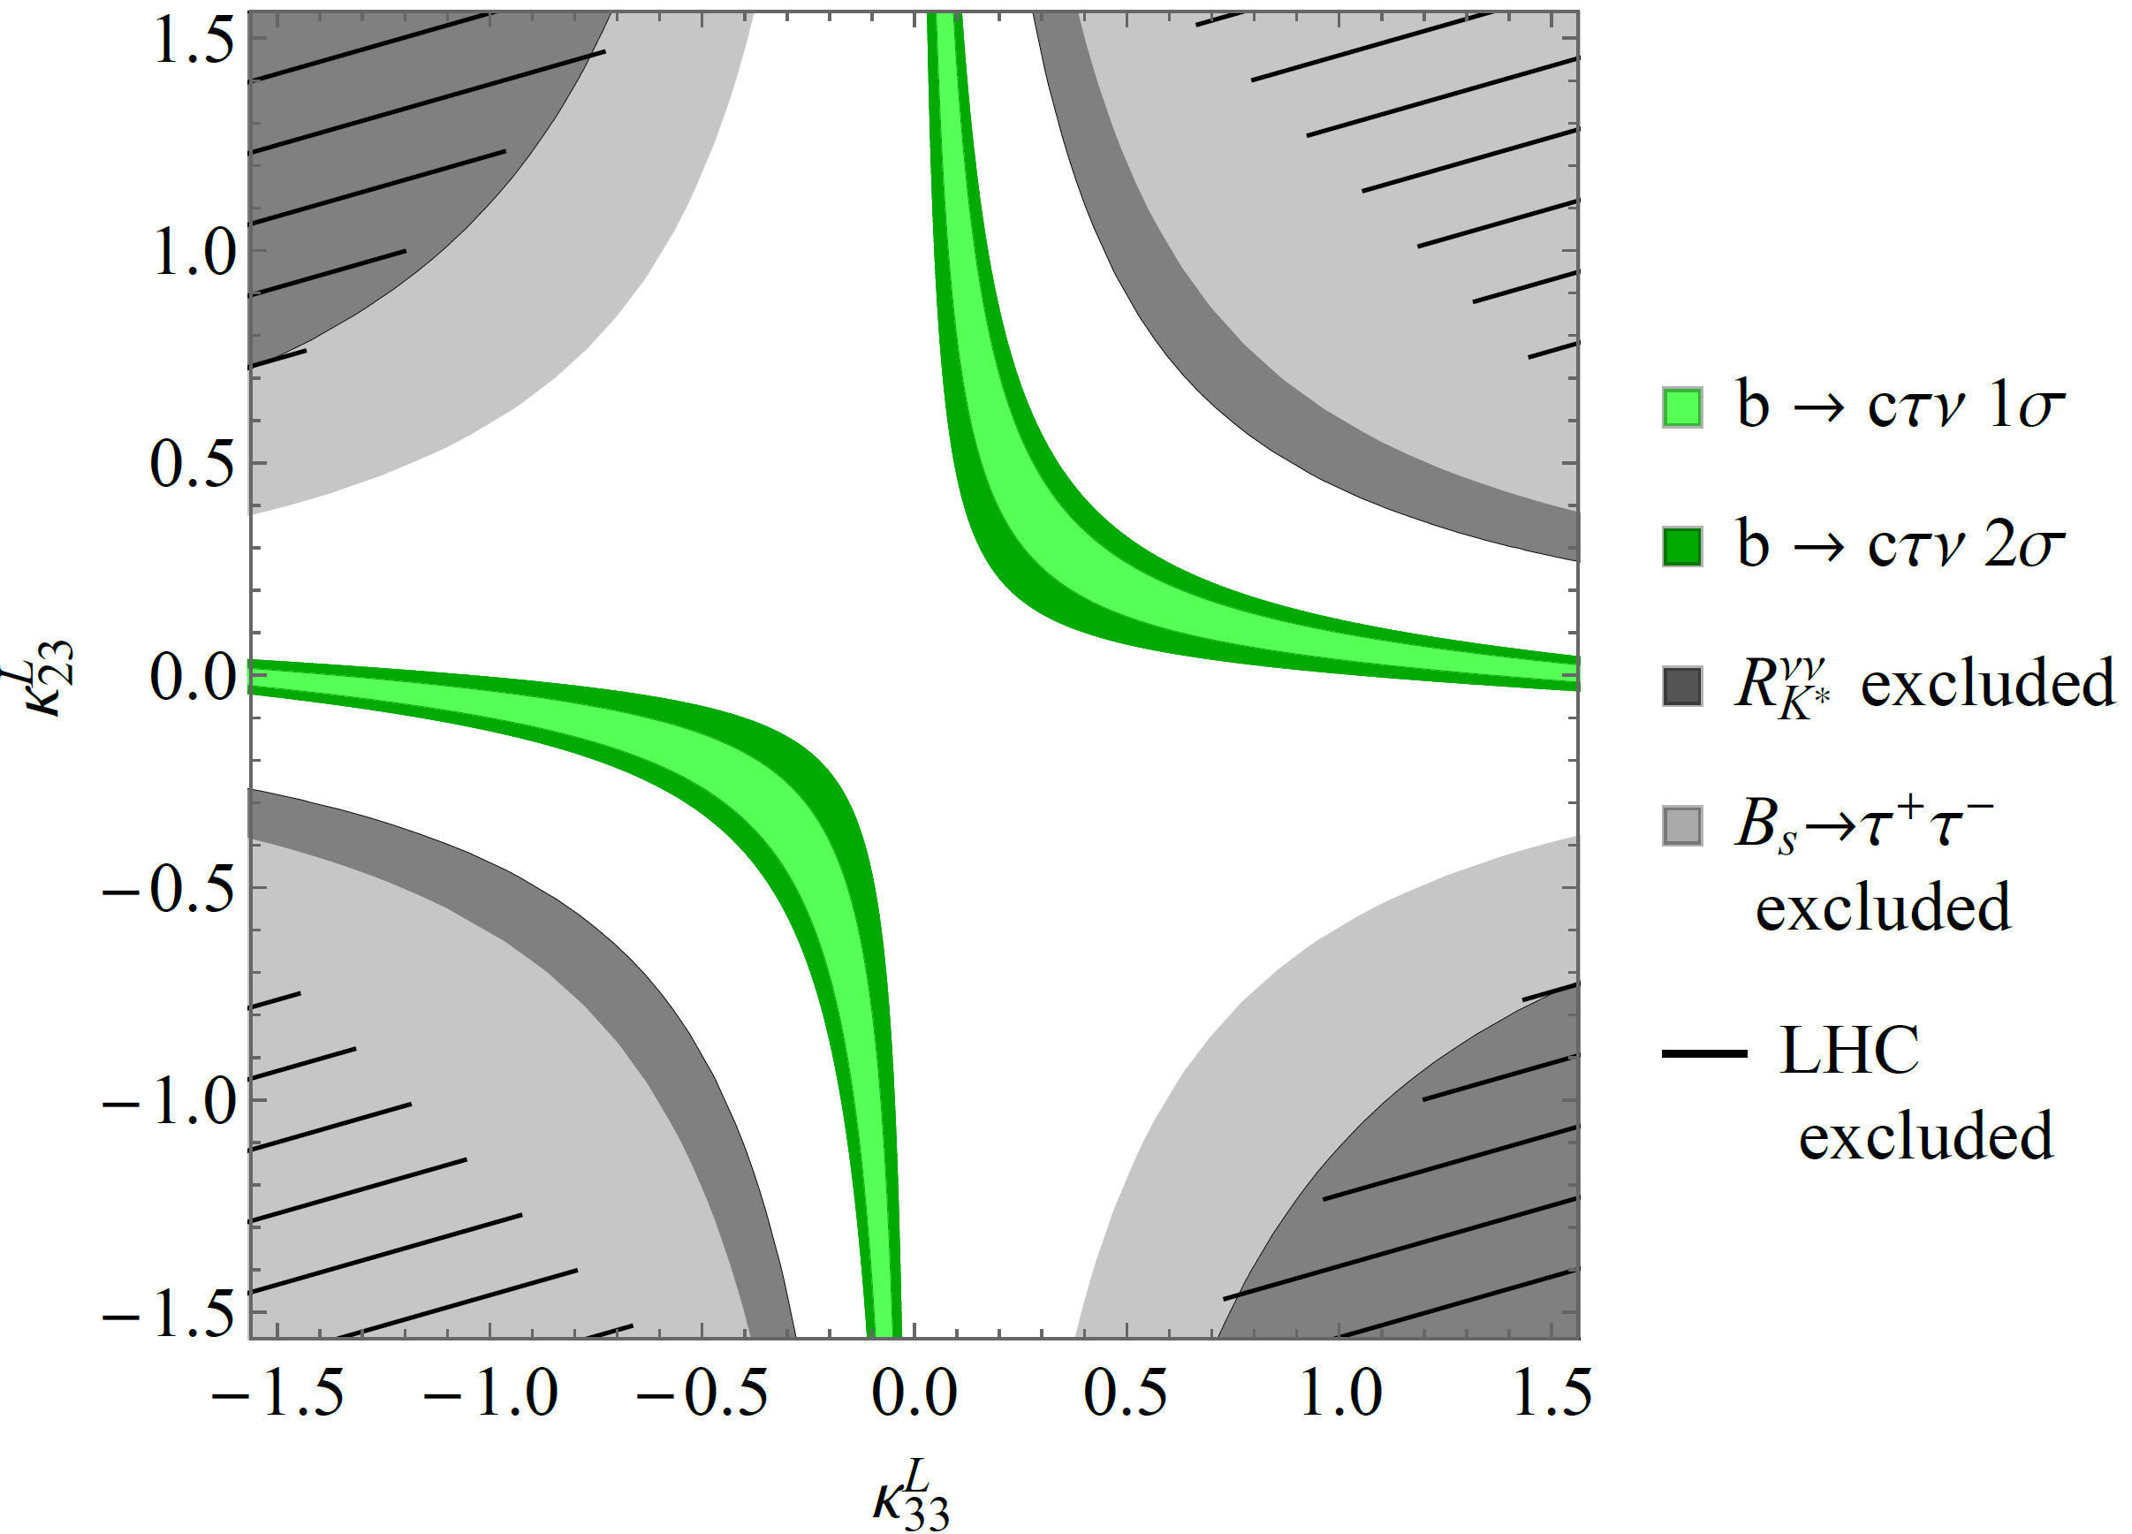
Vector LQ Phenomenology
Compatible with constraints for generic couplings

Slide 38
Possible UV completions
SU(4)×SU(3)’×SU(2)_{L}×U(1)_{Y} + Vector-like fermions
L. Di Luzio, A. Greljo, M. Nardecchia, arXiv:1708.08450
SU(4)×U(2)_{L}×SU(2)_{R} + Vector-like fermions
L. Calibbi, AC, T. Li, arXiv:1709.00692
SU(4)×SU(4)×SU(4)
M. Bordone, C. Cornella, J. Fuentes-Martin, G. Isidori, arXiv:1712.01368
SU(4)×SU(2)_{L}×SU(2)_{R} including scalar LQs and
light right-handed neutrinos
J. Heeck, D. Teresi, arXiv:1808.07492
SU(8) might even explain ɛ’/ɛ
S. Matsuzaki, K. Nishiwaki and K. Yamamoto, arXiv:1806.02312
SU(4)×SU(2)_{L}×SU(2)_{R} in RS background
M. Blanke, AC, arXiv:1801.07256
Good solution, but challenging UV completion

Slide 39
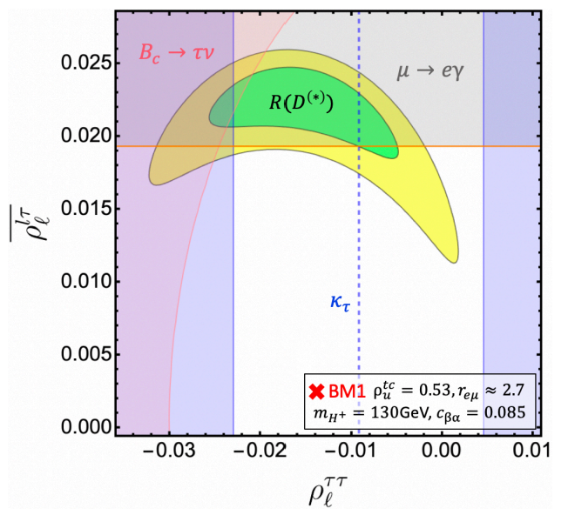
R(D) & R(D*)
H⁺: Only small region in parameter space left
W’: Strong constraints from direct LHC searches
Leptoquark: Strong signals in qq→ττ searches
2311.03430
Possibly related to b→sll
8

Slide 40
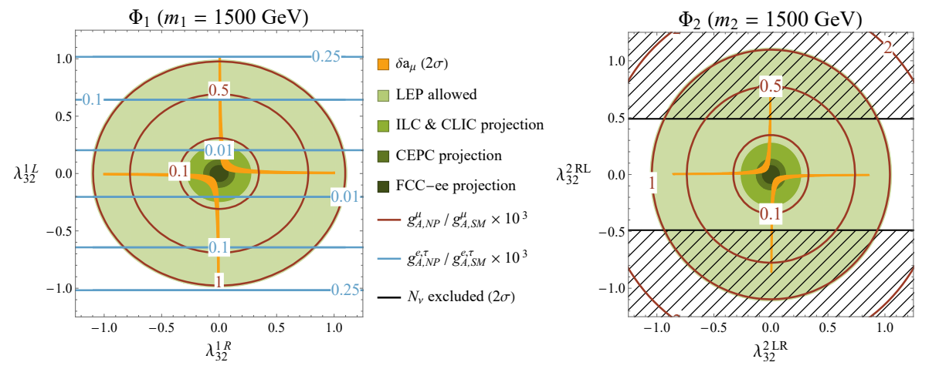
a_{μ} vs Z→μμ
Chirally enhanced effects via top-loops
Left-, right-handed muon-top coupling
E. Leskow, A.C., G. D'Ambrosio,
D. Müller 1612.06858
A.C, C. Greub, D. Müller, F.Saturnino, 2010.06593
Z→μμ at future colliders
8

Slide 41
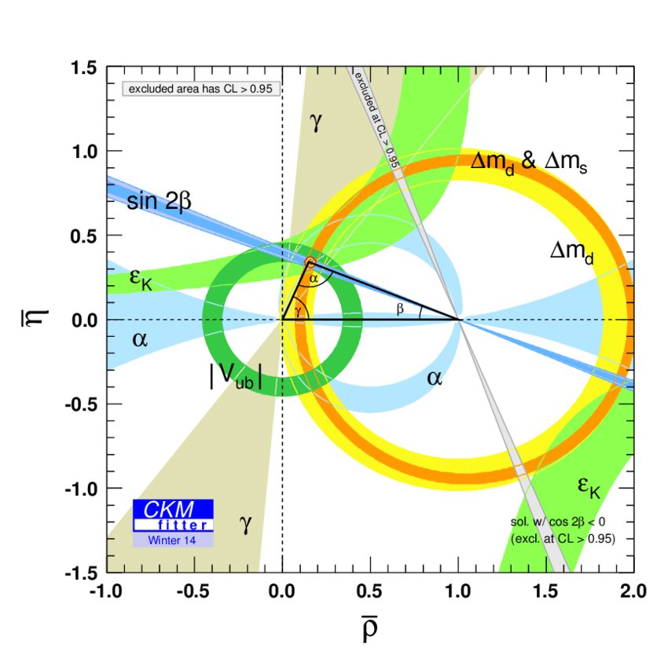
Global Fit to the CKM Matrix
Tree-level determinations of CKM elements (with light leptons) agree with ΔF=2 processes
Picture of CKM Flavour violation established, but sub leading NP possible
Still room for New Physics effects of O(10%)
Andreas Crivellin

Slide 42
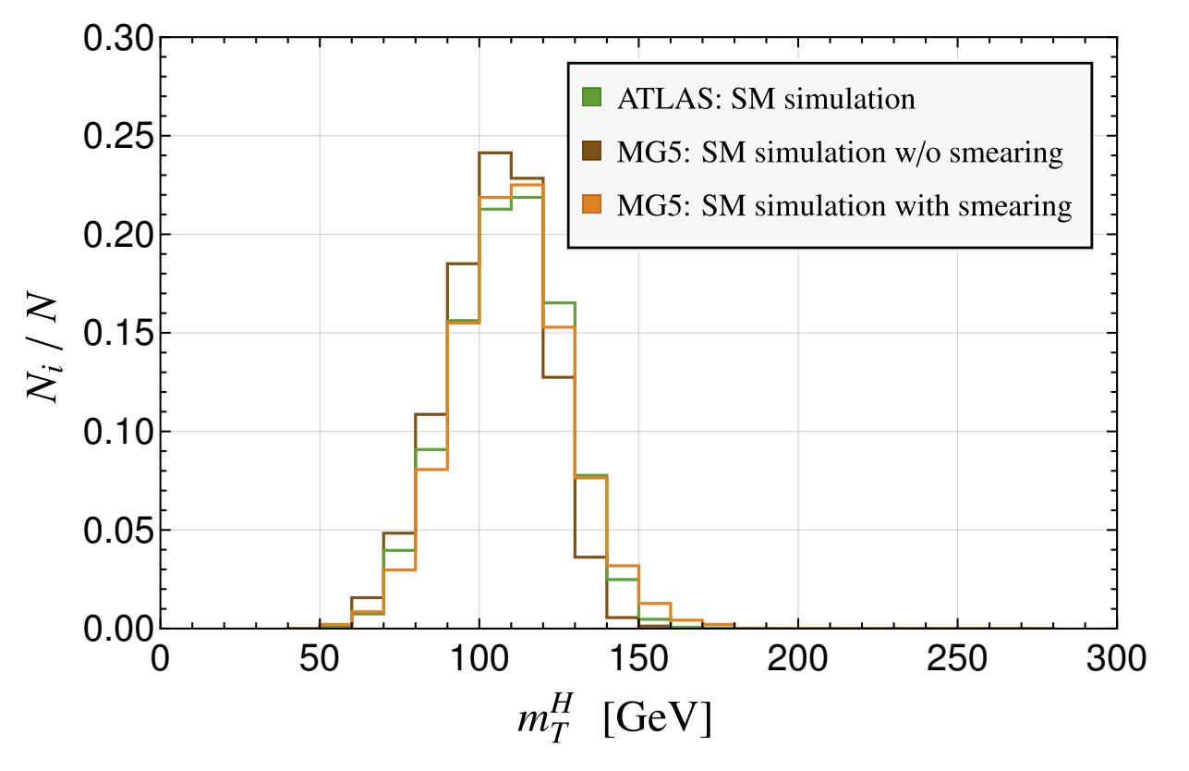
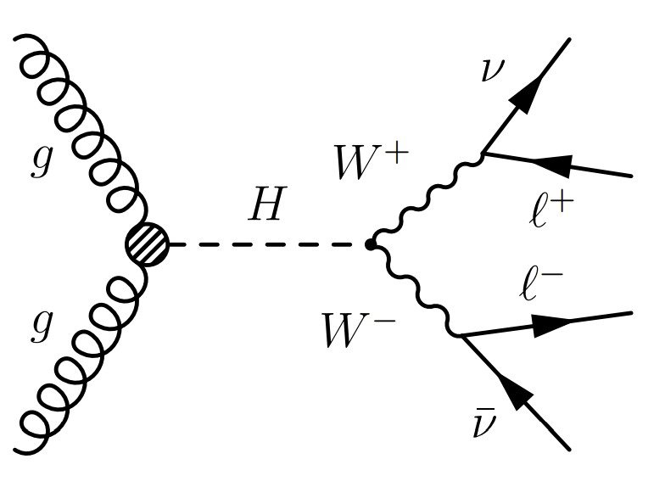
Simulation and Setup
Opposite sign, different flavour leptons with full jet veto
New scalar H produced via gluon fusion
Correcting for fast simulation by tuning signal vial smearing to the SM Higgs signal
Simulation validated

