Slide 1
Measurement of groomed event shapes
erhtjhtyhy
Henry Klest
Argonne national laboratory
DIS2024

Slide 2
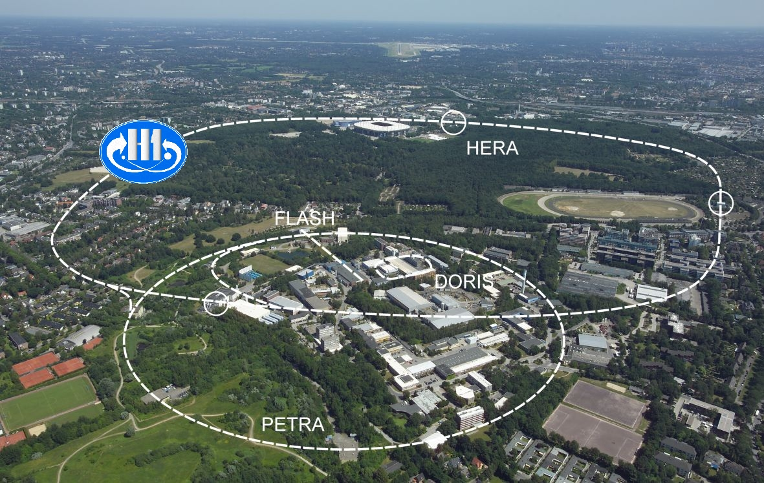
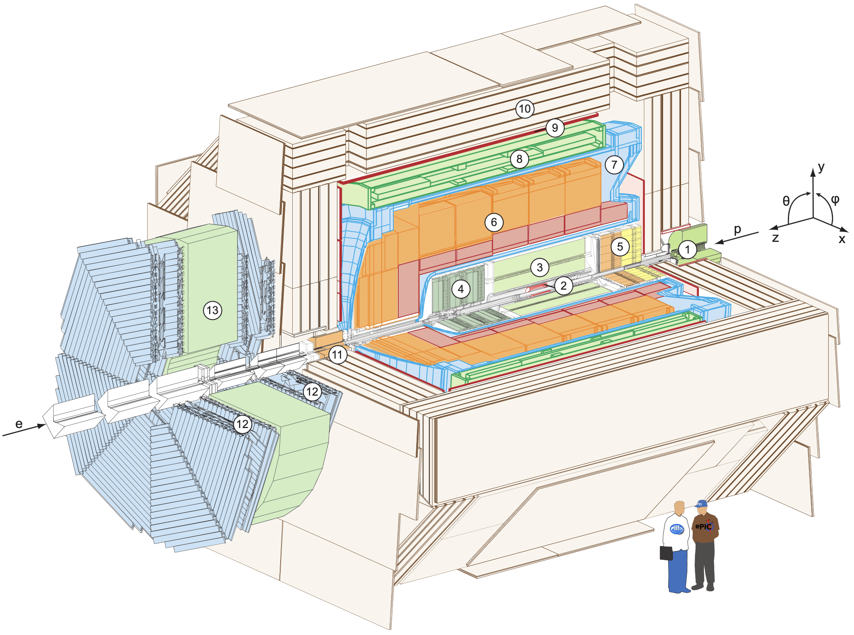
HERA & H1
Electron + proton collider at DESY
27.6 GeV e^{-,+} on 920 GeV protons
Ran from 1992-2007
Delivered ~800 pb⁻¹, mostly to the two general purpose experiments, H1 and ZEUS
H1 Detector
Hermetic general-purpose detector
Drift chamber + silicon tracking
High-resolution LAr calorimeter
Ideal detector for jet studies!
Notes:
HERA Injected by PETRA, collider that discovered the gluon
Nature didn’t have new particles in store for HERA, HERA Legacy dominated by contributions to QCD

Slide 3
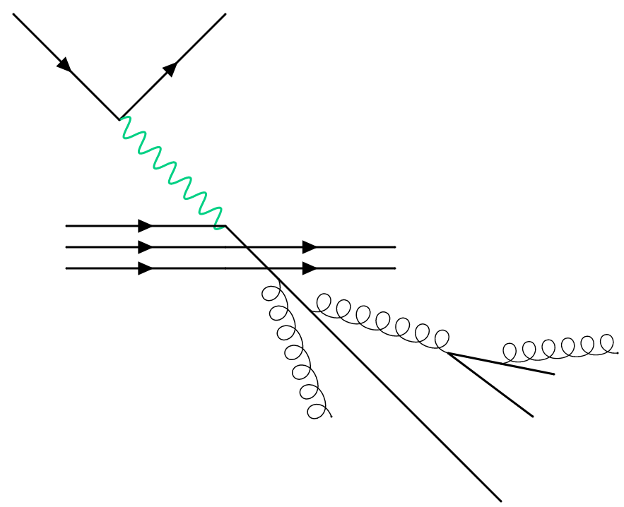
Jets In $e+p$
Both direction and energy of struck parton are known from scattered electron (to leading order)
Such detailed information unavailable in p+p and even e⁺e⁻
Unique access to TMDs, soft gluon emission, hadronization effects
Q²
x

Slide 4
Jets In $e+p$
Significant theory progress in both jets and hadron structure since HERA shutdown in 2007
As we heard in the previous talk!
Worthwhile to revisit HERA data!
Q²
x

Slide 5
The Breit Frame
Figures from Y. Makris
Revisiting the Role of Grooming in DIS ArXiv: 2101.02708
With x_{B} and exchanged boson 4-vector known, can Lorentz boost to Breit frame
Event is divided into two “hemispheres”
Current hemisphere H_{C} (p_{z} < 0)
Contains mostly radiation associated with struck parton
Remnant hemisphere H_{R} (p_{z} > 0)
Contains mostly radiation associated with proton remnant

Slide 6
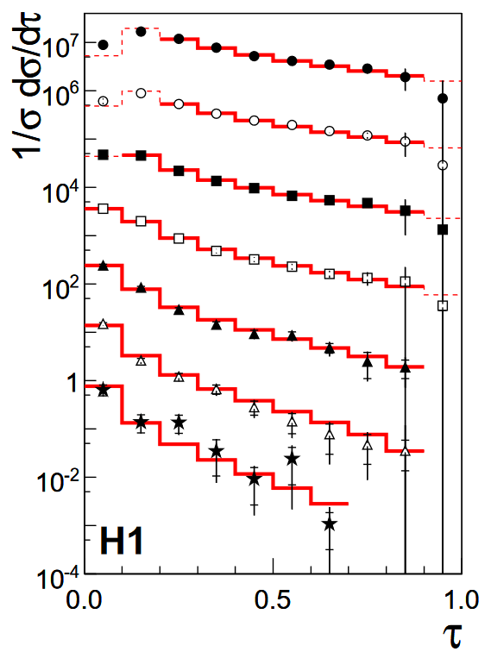
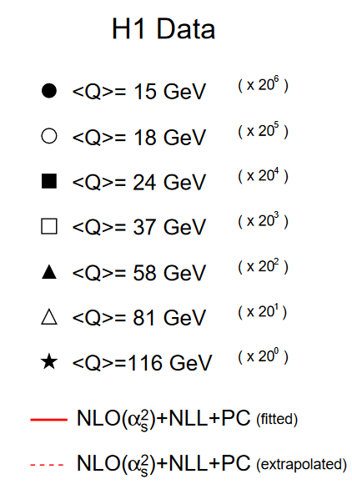
Event Shapes
Inclusive observables where all particles contribute
E.g. Thrust – measures degree of collimation along an axis
Sensitive to QCD across scales
Calculable to high precision in perturbation theory
Fixed-order QCD $→$tail of thrust distribution
Soft-collinear effective theory (SCET) calculations $→$peak of thrust distribution
Measured extensively in e⁺e⁻ and e+p
Used for tuning MCs & measuring $α_{s}$
arXiv/0512014v1

Slide 7
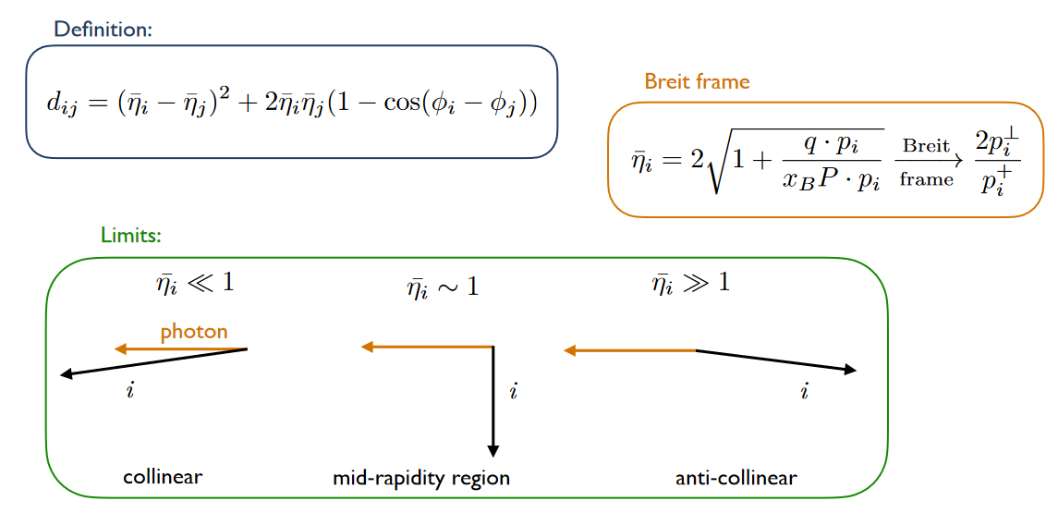
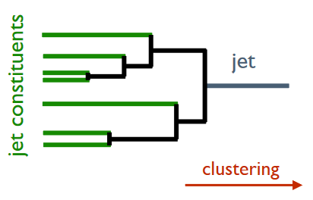
Centauro
arXiv:2006.10751 – M. Arratia, et al.
Figures courtesy of Y. Makris
Jet algorithm with asymmetric clustering distance measure
Suited for clustering Born-level DIS in the Breit frame
Isolates struck parton with high efficiency $→$ application to TMDs
Here Centauro is used to produce a clustering tree for the full event
Fully Clustered Event
Event Constituents

Slide 8
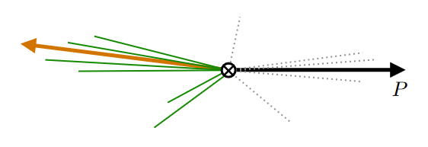
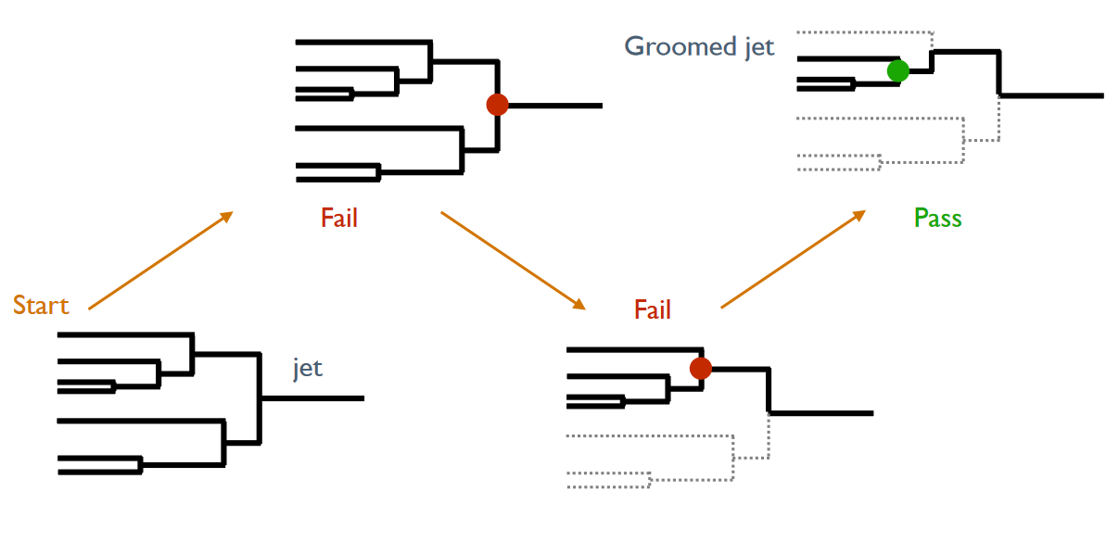
Event grooming in DIS
Groomed event
Full event
Figures courtesy of Y. Makris

Slide 9
Event grooming in DIS
Iteratively de-cluster until grooming condition is passed
Analogous to Soft Drop in p+p
Require both branches to share z somewhat equally
Groomed DIS events are similar to groomed jets!
p+p Soft Drop condition
DIS grooming condition

Slide 10
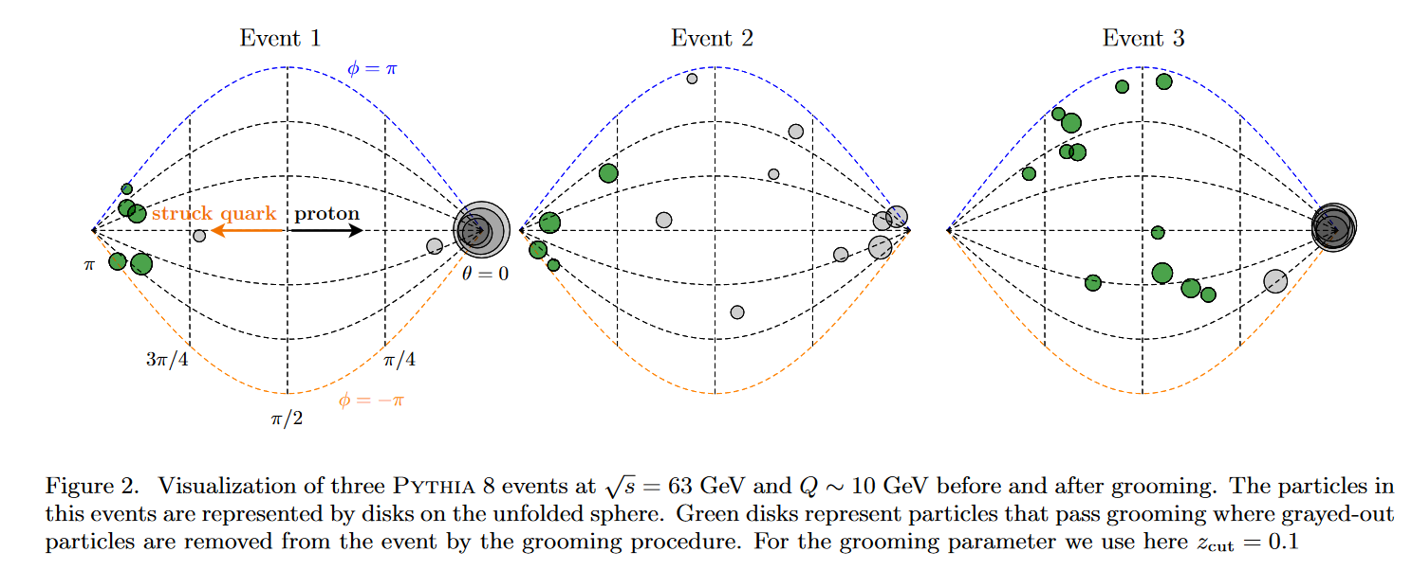
Breit Frame event displays

Slide 11
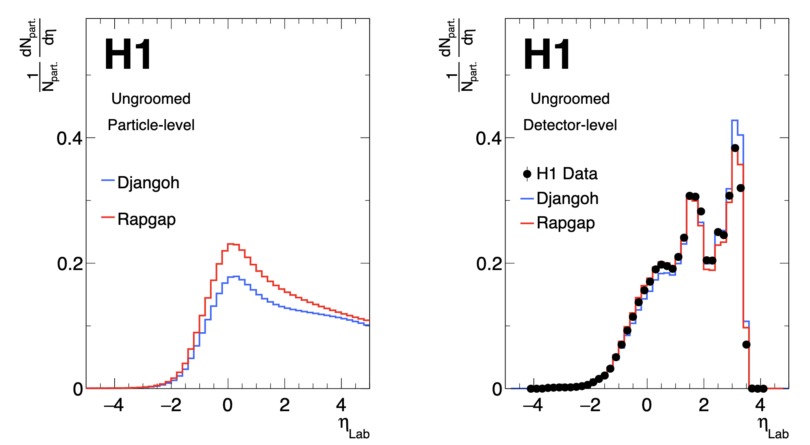
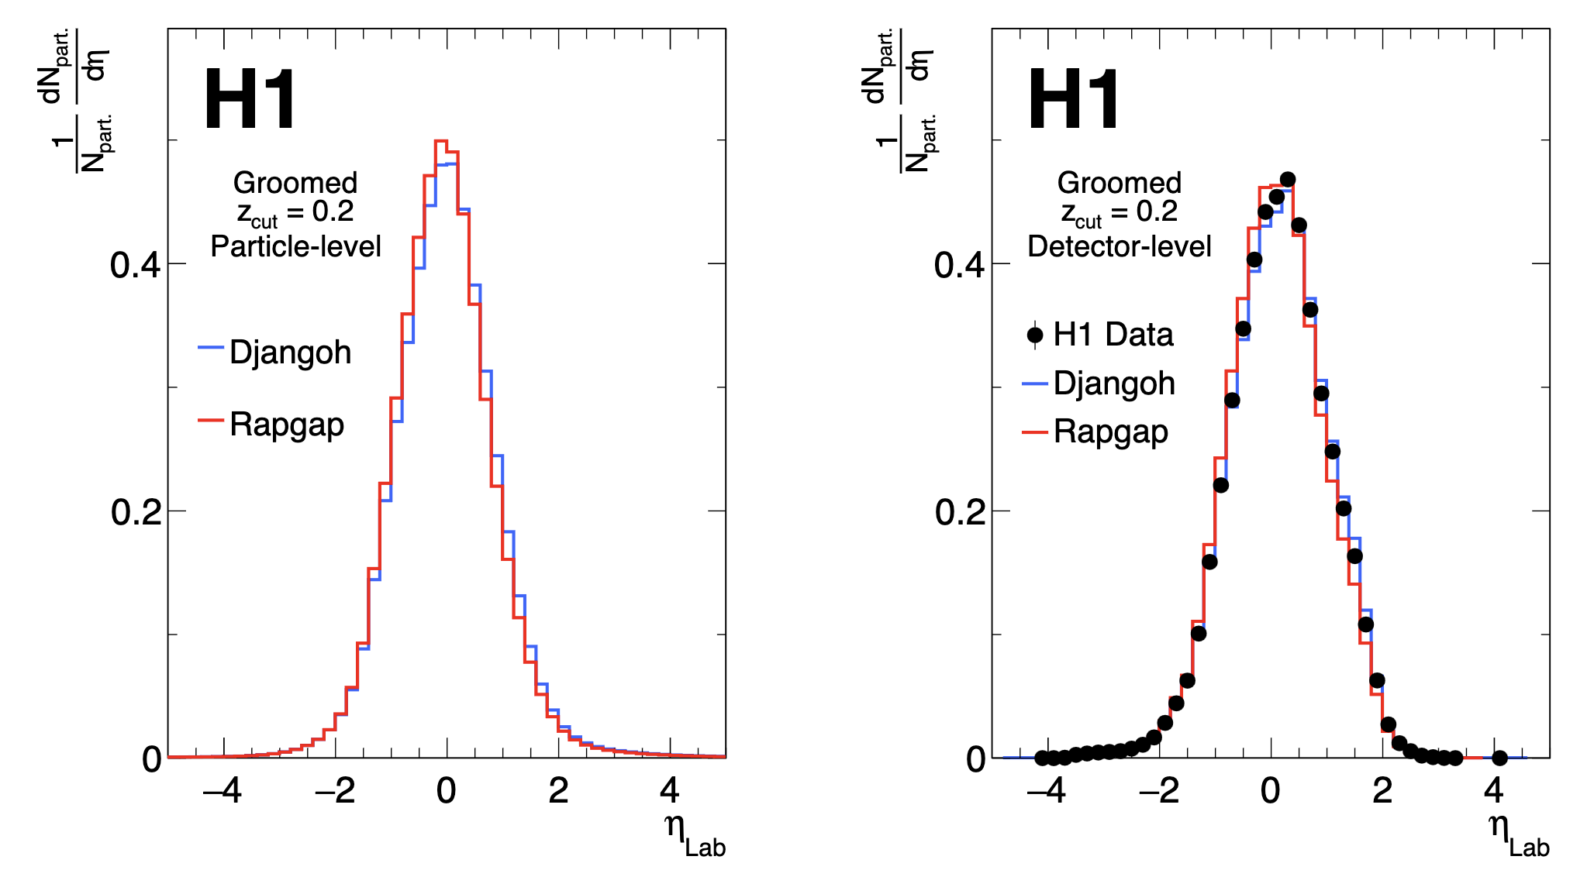
Grooming Benefits
No underlying event, why groom?
Less affected by lab-frame detector acceptance
Mitigate QCD remnant, ISR
Removes theoretically challenging non-global effects arising from hard cuts on e.g. η
Tunable knob to study all of the above
Ungroomed detector-level shows significant difference from particle-level
Detector acceptance, efficiencies
Grooming events brings particle-level and detector-level distributions into much better agreement!
z_{cut} = 0.2
z_{cut} = 0.2

Slide 12
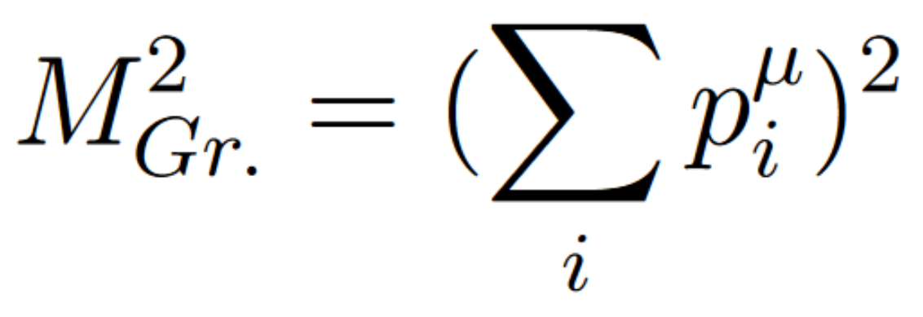
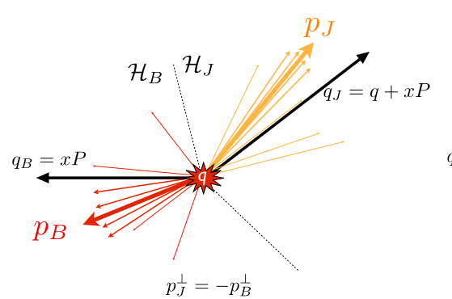
Observables
After grooming procedure, a subset of particles survives
Event shape is calculated with these particles
Two event shapes studied here
Groomed Invariant Mass (GIM)
Plotted in natural log, normalized by 150 GeV²
Groomed 1-Jettiness $τ_{1}^{b}$ (analogous to thrust)
$τ_{1}^{b}→ q_{J}=q+xP$,
$q_{B}=xP$
12

Slide 13
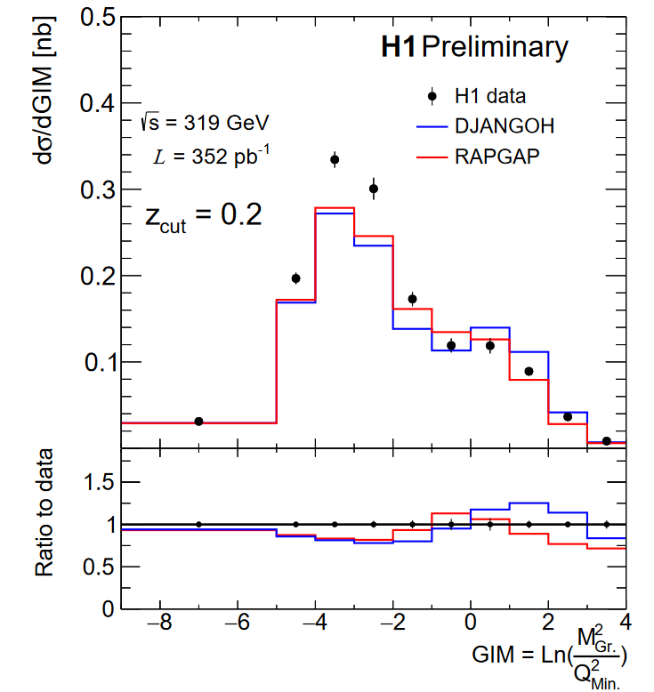
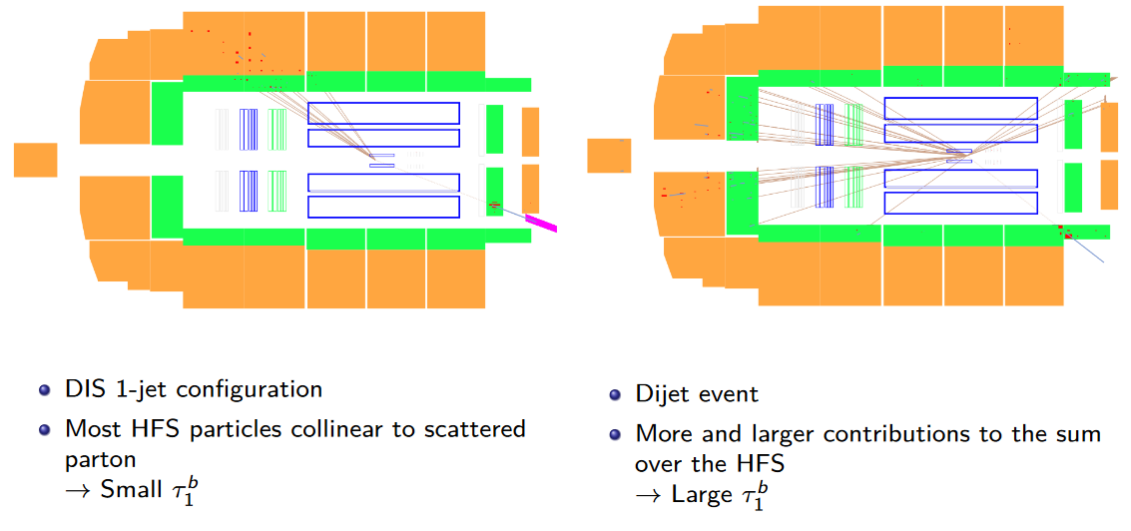
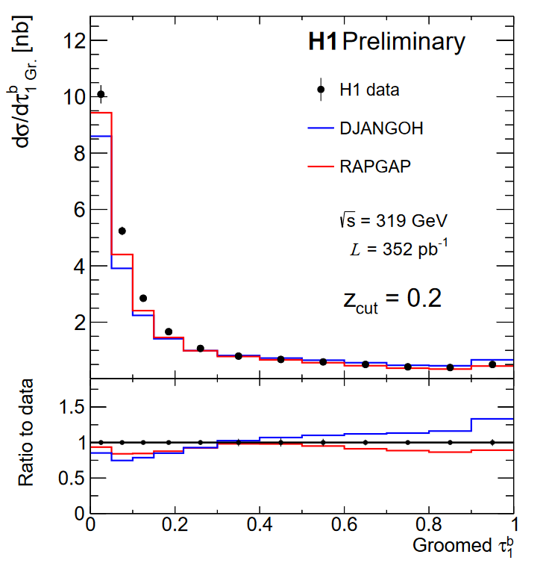
Observables
Non. Pert.
Non. Pert.
$→$Small $M_{Gr.}^{2}$
$→$Large $M_{Gr.}^{2}$
13

Slide 14
Observables
Non. Pert.
Non. Pert.
$→$Small $M_{Gr.}^{2}$
$→$Large $M_{Gr.}^{2}$
14

Slide 15
Observables
Non. Pert.
Non. Pert.
$→$Small $M_{Gr.}^{2}$
$→$Large $M_{Gr.}^{2}$

Slide 16
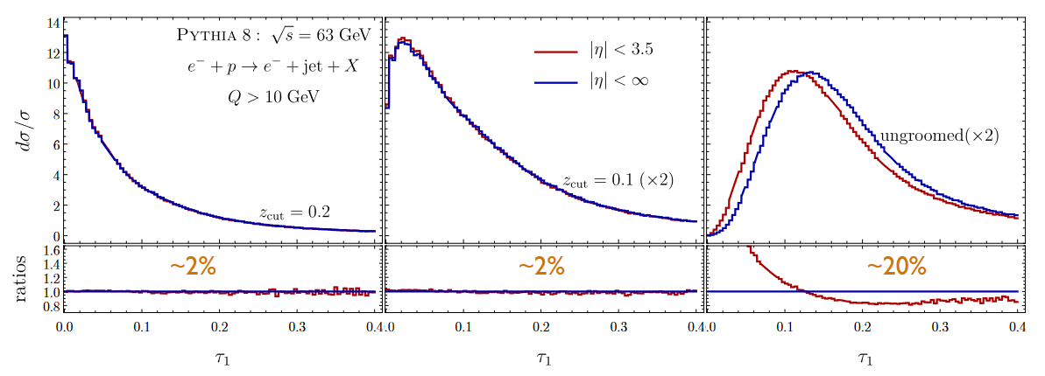
Groomed vs. Ungroomed 1-jettiness
Simulation at EIC energy
Grooming enables precision measurement!

Slide 17
Measurement Phase Space
Q² > 150 GeV²
and
0.2 < y < 0.7
Q² > 150 GeV²
and
0.2 < y < 0.7
Notes:
HFS at ~90 degrees = eta = 0, scattered electron in Lar (>2.7 Rad), relatively high energy > 11 GeV to ensure good reconstruction

Slide 18
Theory predictions
Test MCs from the HERA era (Rapgap, Djangoh) vs. MCs tuned primarily for the LHC
“High Q²” for HERA
But still not so large ($α_{s}$ not so small)
Q ~ 12 GeV, $α_{s}$ ~ 0.17
Expect higher perturbative orders to be important
Sherpa has these included in the most advanced way
Pythia & Herwig ~ LO
Pythia – Version 8.3
DIRE - Dipole shower + multijet merging
POWHEG + Pythia
NLO Parton shower interfaced to Pythia for hadronization
Sherpa (MEPS@NLO)
AHADIC++ - Cluster Fragmentation
Lund – String Fragmentation
NNLO $⊕$NLL $⊕$Had. – (See previous talk!)
Updated version – Sherpa3!
Herwig – Version 7.2
NLO $⊕$PS – AO Shower, subtractive matching
Merging - Dipole shower + multijet merging

Slide 19
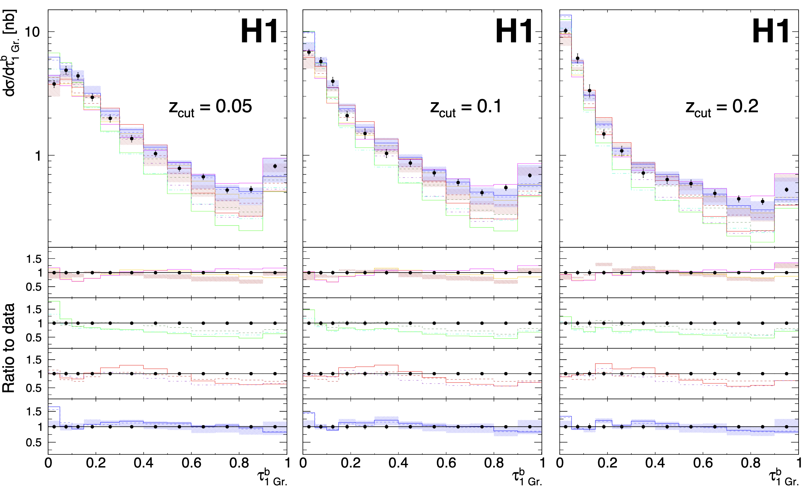
19
Notes:
The unreasonable effectiveness of SHERPA

Slide 20
Results – Groomed $τ_{1}^{b}$
z_{cut} = 0.05
z_{cut} = 0.1
z_{cut} = 0.2
PYTHIA – Version 8.3
VINCIA – Antenna Shower
DIRE - Dipole shower + multijet merging
Herwig – Version 7.2
NLO $⊕$PS – AO Shower, subtractive matching
Merging - Dipole shower + multijet merging
Notes:
The unreasonable effectiveness of SHERPA

Slide 21
Results – Groomed $τ_{1}^{b}$
Rapgap + Djangoh do reasonably well
Herwig, Pythia fail in the tail region
Missing higher orders
Dire + Pythia does very well in the peak region
Sherpa3 completely agrees with the data within the uncertainties
z_{cut} = 0.05
z_{cut} = 0.1
z_{cut} = 0.2
Notes:
The unreasonable effectiveness of SHERPA

Slide 22
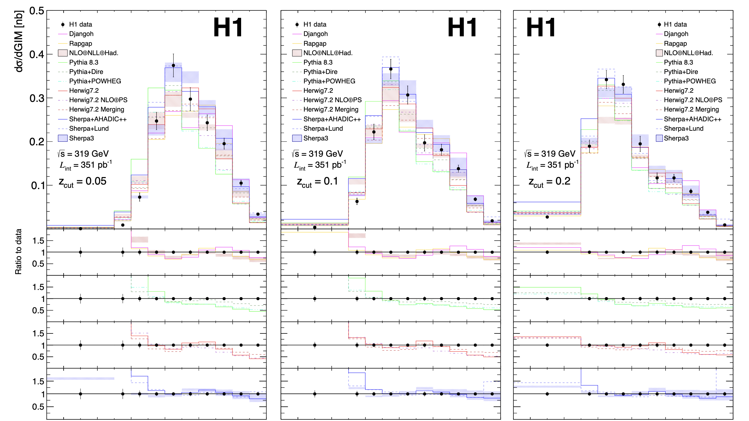

Slide 23
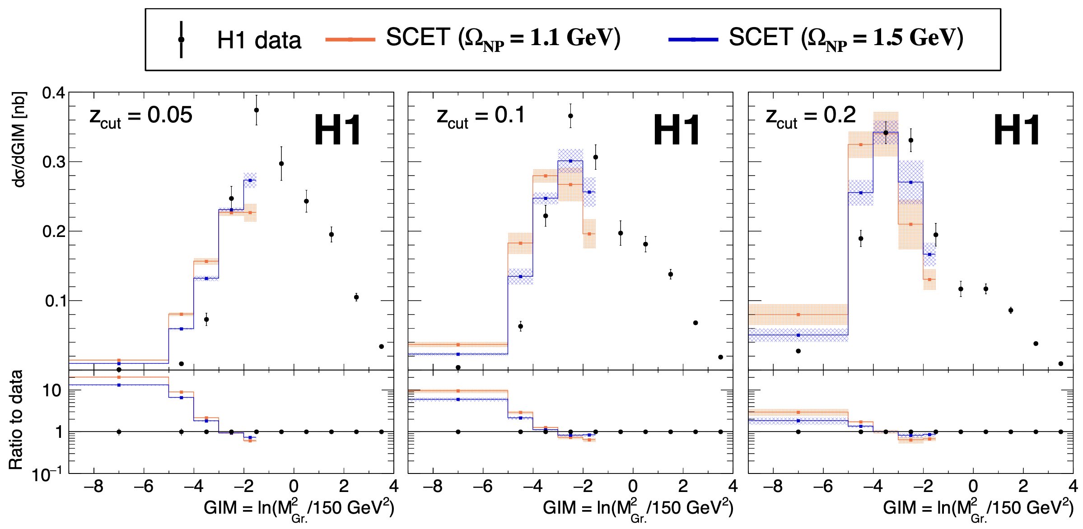
Results - SCET
Analytic - SCET
Evaluated at two values of Ω_{NP}
No fixed-order calculation incorporated
Prediction heavily overpredicts low masses
Without fixed order, no gluon jets
Gluon jets will have higher masses
Agreement improves with increasing z_{cut,} Ω_{NP}
Non-perturbative effects are significant!
Factorization expected to hold for higher z_{cut}

Slide 24
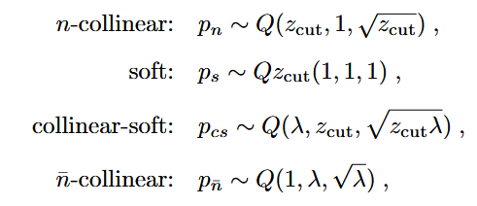
SCET factorization
Jet Direction (Breit η=-$∞$) = $\overline{n}$-collinear direction
Beam Direction (Breit η=-$∞$) = n-collinear direction
Soft Radiation (Isotropic)
Collinear-soft radiation, wide-angle soft radiation mostly along jet direction

Slide 25
Jet Direction (Breit η=-$∞$) = $\overline{n}$-collinear direction
Beam Direction (Breit η=-$∞$) = n-collinear direction
Soft Radiation (Isotropic)
Collinear-soft radiation, wide-angle soft radiation mostly along jet direction
Grooming causes only Jet and Collinear-soft radiation to contribute to shape of distribution in the single-jet (low invariant mass) limit
In Region 1, shape of distribution depends only on jet and collinear-soft functions, which are independent of Q

Slide 26
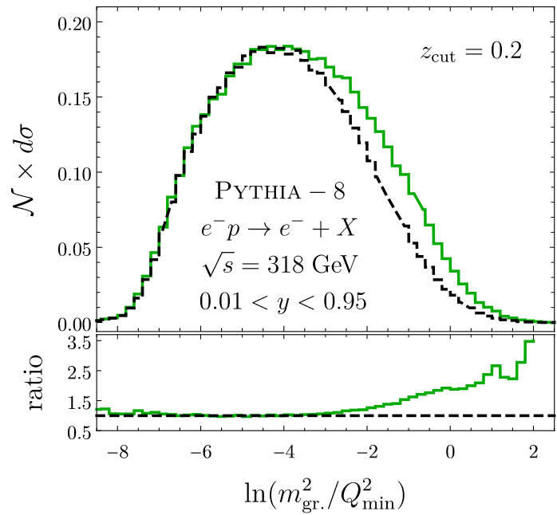
SCET Prediction
Prediction from SCET is that the shape of the spectrum in region 1 should be independent of Q²
Hadronization and soft gluon emission should factorize from the hard scattering in this region
Intra-jet dynamics doesn’t “see” the hard scale
Soft radiation and beam radiation are functions of Q², but should be groomed away here

Slide 27
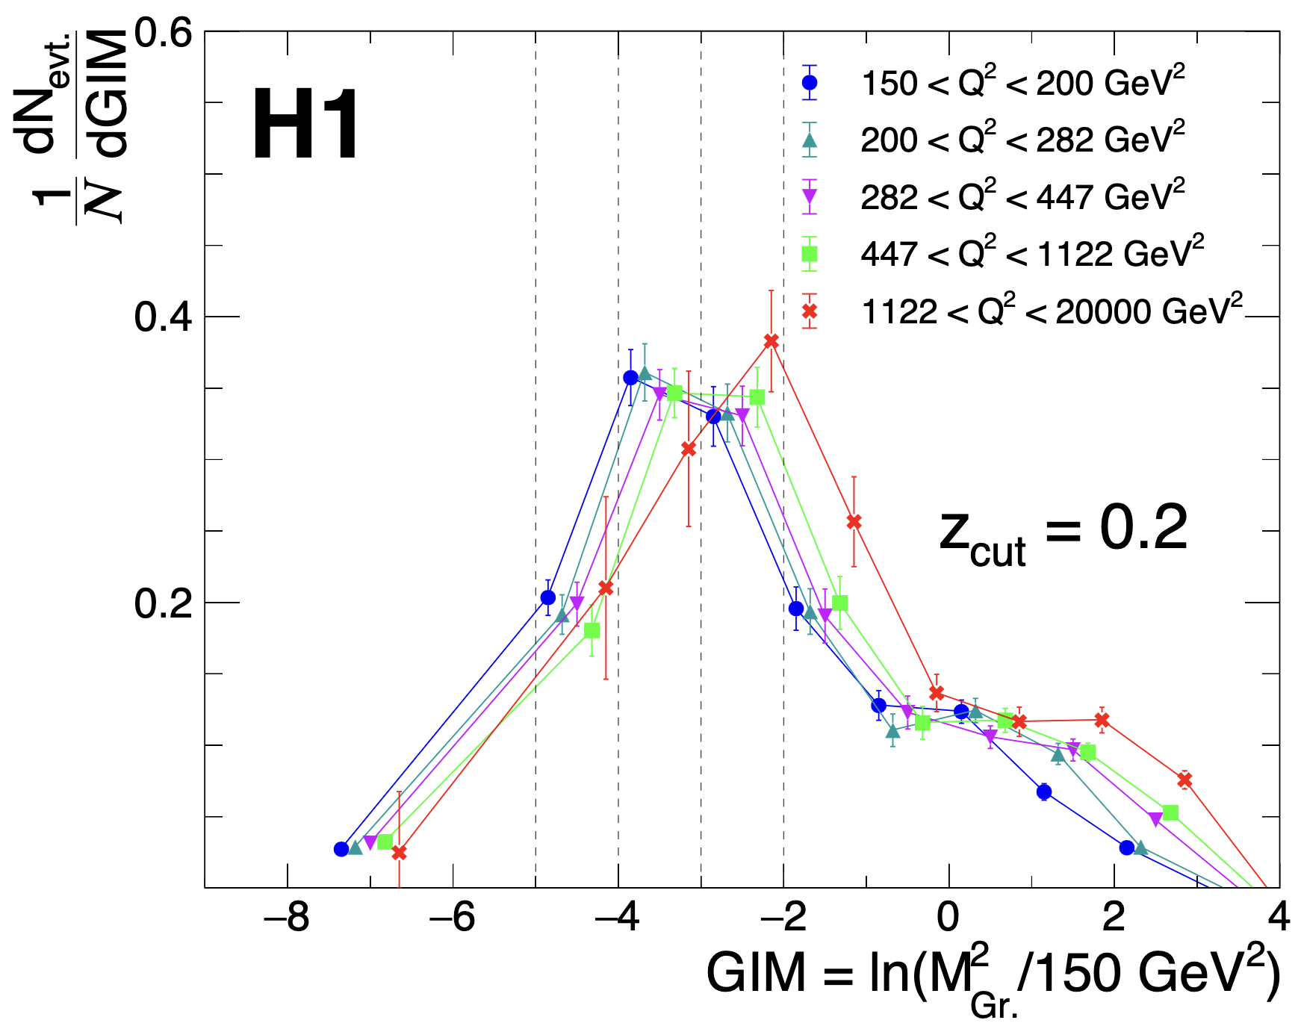
Results - SCET
Distributions are normalized to unity in the region $M_{Gr.}^{2}≲$ 20 GeV²
Plotted for five bins in Q²
Distributions indeed do not depend strongly on Q²!
Additionally, implicitly rules out a strong dependence on x

Slide 28
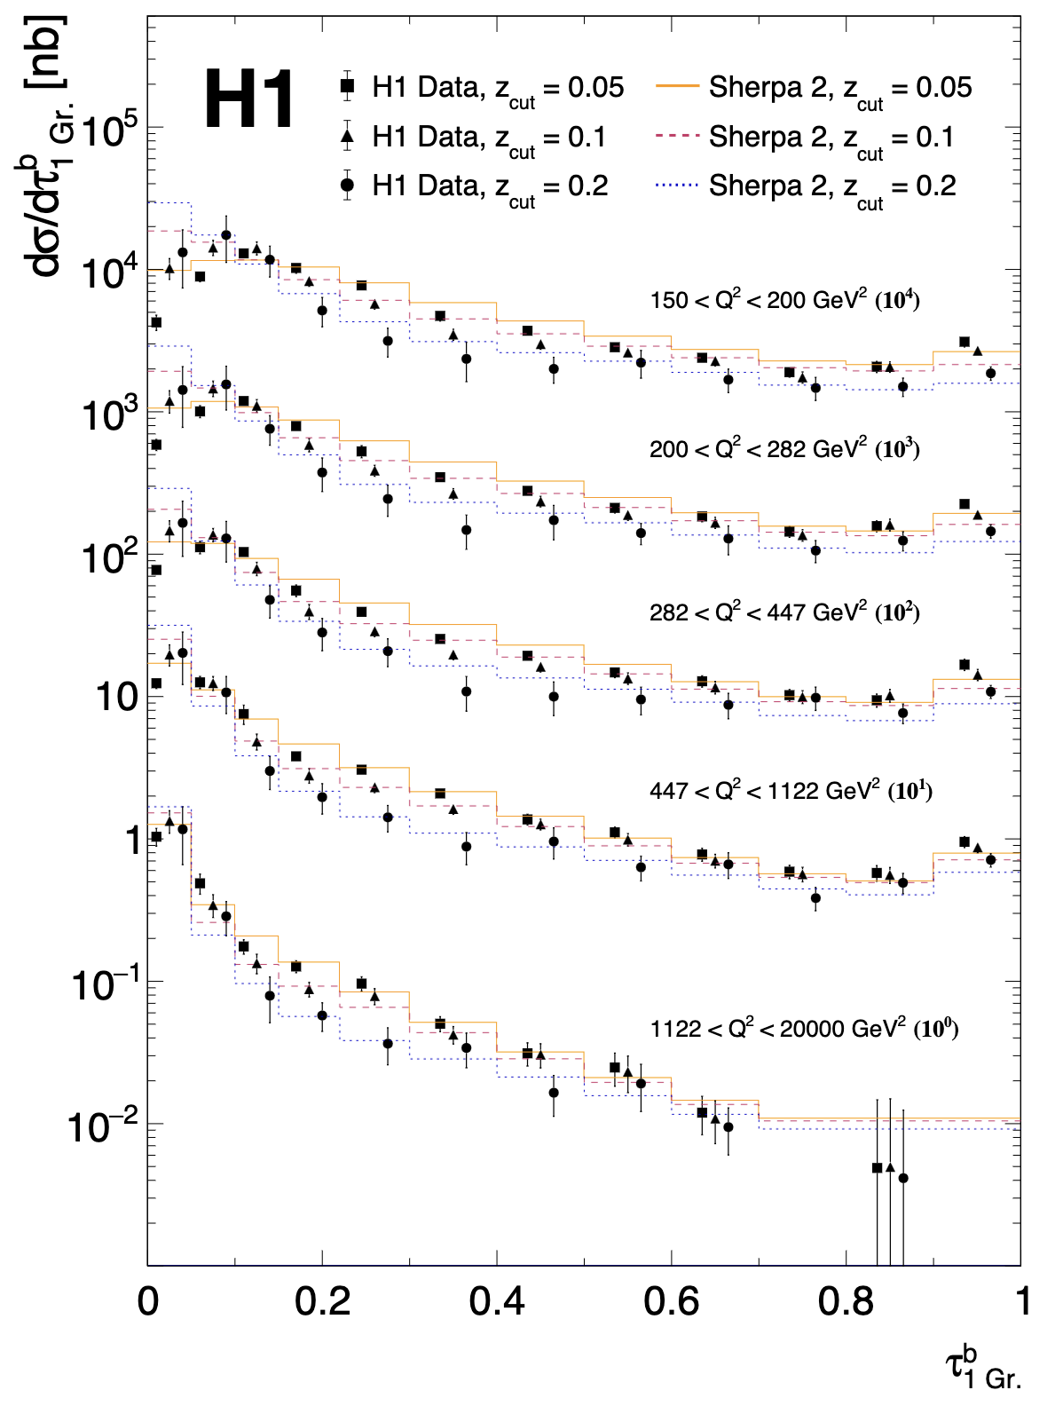
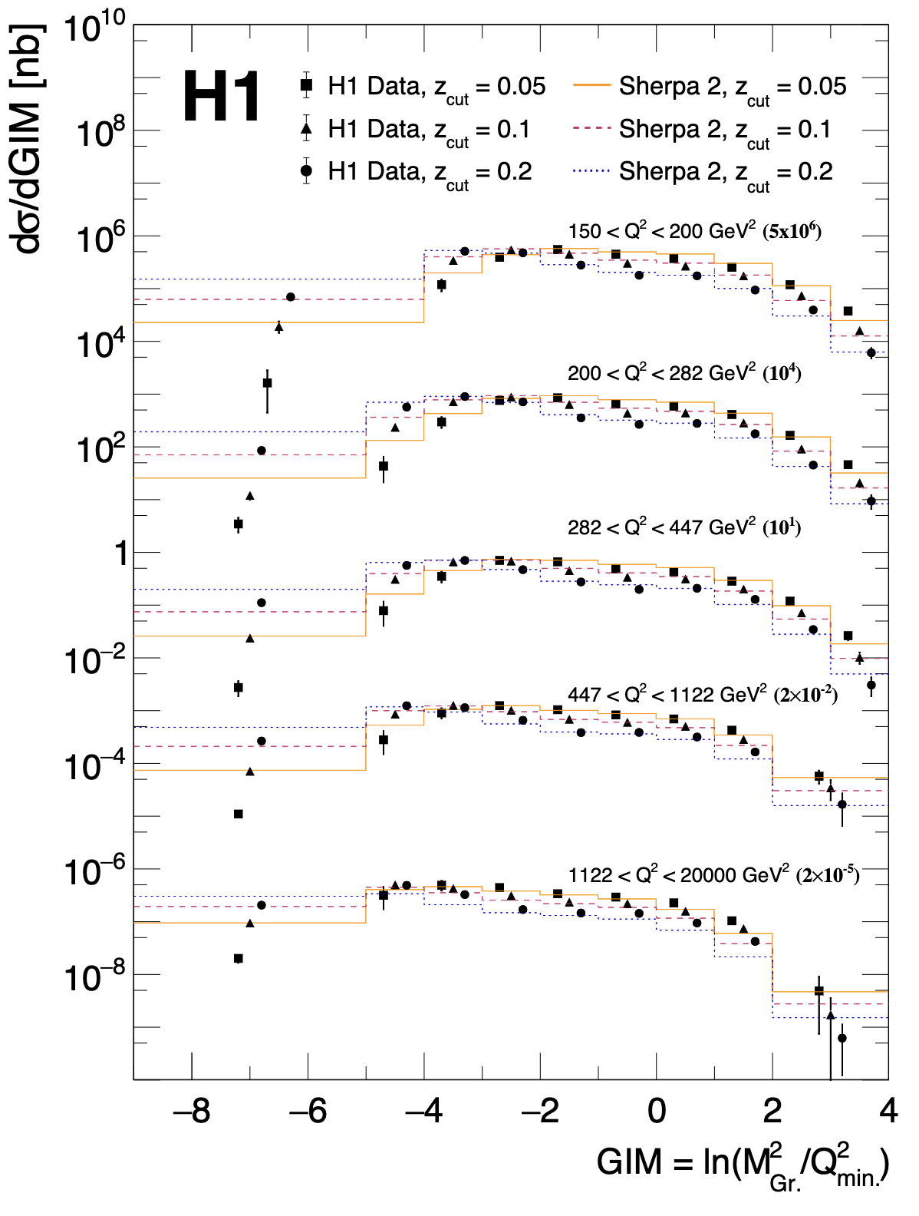
Results – Double-differential
Also results double-differential in Q²
In general, theory predictions compare the same at all the Q² considered here
DIS cross section well described in MCs
HERA data in PDFs!
Could be used for a fit of e.g. $α_{s}$

Slide 29
Conclusion
H1 collaboration has performed the first measurement of groomed DIS event shapes
Grooming alleviates some of the experimental and theoretical challenges associated with event shape observables
Some challenges still remain in the theoretical description of the data
Improvement of DIS MC models will be vital to the success of future DIS experiments!
EIC, JLab 22, LHEC, FCC-eh
New HERA data provides the most leverage for tuning at high energies

Slide 30
Backup

Slide 31
Globalness
Early attempts to reach higher theoretical precision on event shapes in DIS encountered some difficulties
Complication compared to e⁺e⁻ $→$ proton beam remnant
Radiation associated with remnant can enter the current hemisphere and contribute to the measurement
Contribution from “out-of-bounds” radiation spoils the ability to make analytic predictions $→$ large non-global logarithms
Want observables with no hard boundaries! $→$ Event grooming
= Contributes to observable

Slide 32
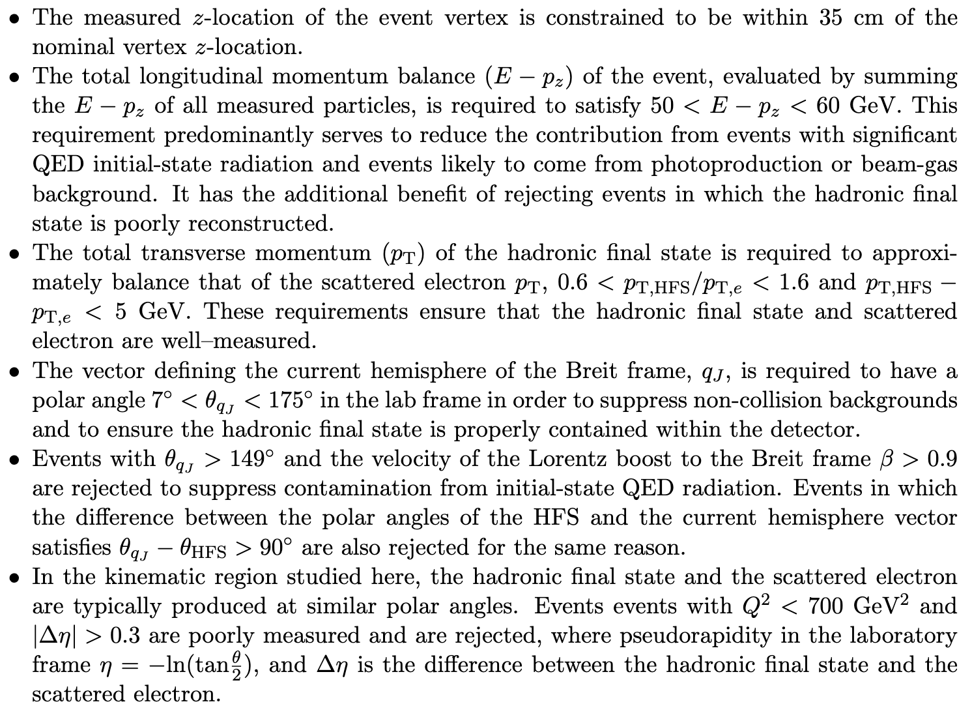
Measurement details
For the data, the fraction of accepted events that pass the grooming cut is:
99.3% for z_{cut} = 0.05
98.4% for z_{cut} = 0.1
92.7% for z_{cut} = 0.2
189,106 events total after cuts
E-P_{z} cut removes 10-15%
Corrected back by QED correction & unfolding
Magnitude of QED correction mostly due to E-P_{z} cut
Notes:
HFS at ~90 degrees = eta = 0, scattered electron in Lar (>2.7 Rad), relatively high energy > 11 GeV to ensure good reconstruction

Slide 33
Grooming Procedure
Cluster whole event using Centauro jet algorithm
Equivalent to setting $R→∞$
Particles close to boson vector $\vec{q}$ clustered first
Particles in remnant hemisphere clustered last

Slide 34
The Breit Frame
To first order (neglecting hadronization and intrinsic k_{T}) p_{T} in the Breit frame is only generated by initial- or final-state emission off the struck parton
Born-level DIS in the Breit Frame
Event p_{T} = 0
DIS Dijets in the Breit Frame
Event p_{T} > 0
Incoming parton
Incoming parton: P_{z} = Q/2
Incoming boson
Incoming boson
Outgoing parton: P_{z} = -Q/2
Current Hemisphere: Struck parton at $η=−∞$
Beam Hemisphere: Proton remnant at $η=∞$
Hadron collider Anti-k_{T} clusters using p_{T}, thus it fails to cluster the LO process in the Breit Frame!
34

Slide 35
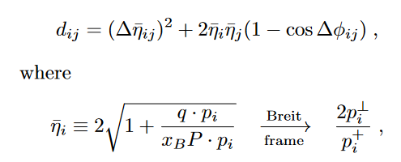
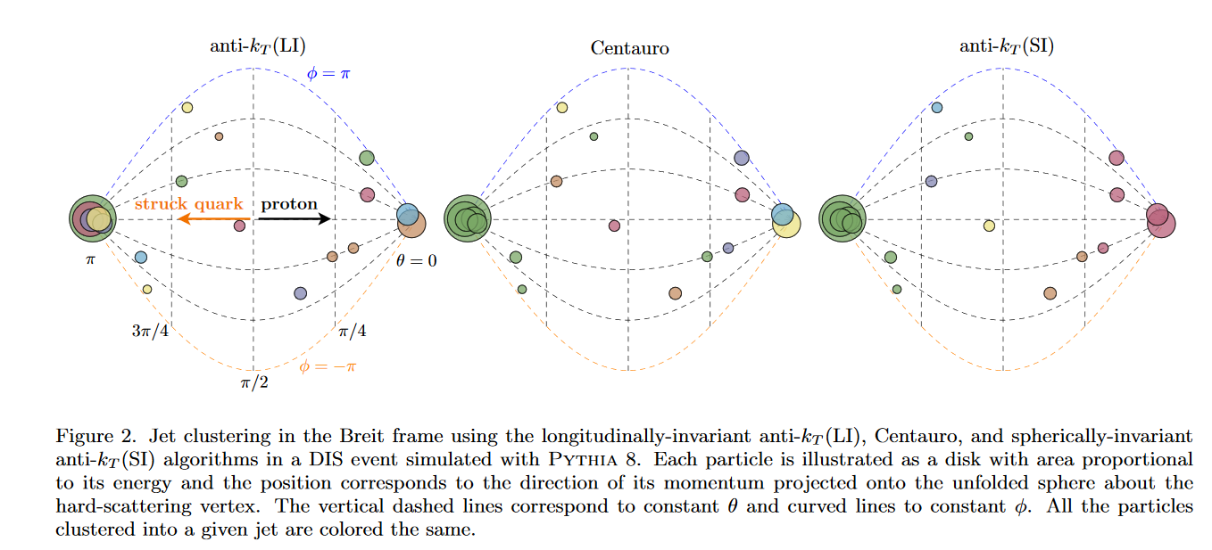
Centauro
arXiv:2006.10751 – M. Arratia, et al.
vs.
vs.
Cluster at π has low P_{T} in Breit frame, smaller d_{ij}
Not longitudinally invariant
Doesn’t preferentially capture struck quark

Slide 36
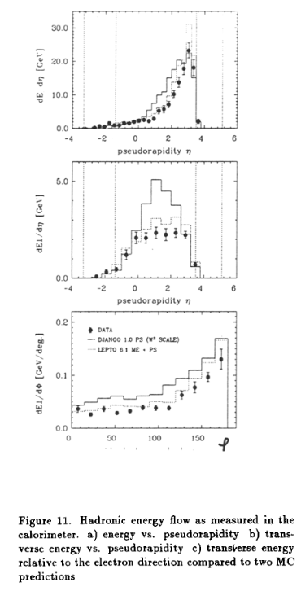
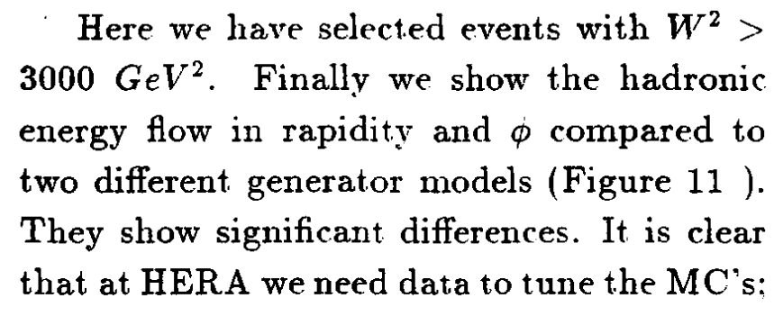
1992
MCs at the beginning of the HERA era
Are we better off today?

Slide 37
Predictions
SHERPA – Version 2.2.12 (MEPS@NLO)
AHADIC++ - Cluster Fragmentation
Lund – String Fragmentation
PYTHIA – Version 8.3
POWHEG – NLO + PS
DIRE – Dipole shower + multijet merging
SHERPA – Version 3
Updated Hadronization model
NLO from OpenLoops
Sherpa dipole shower
Intrinsic k_{T}
NNLO+NLL’
CAESAR Formalism + Sherpa
See talk by Daniel Reichelt
Herwig – Version 7.2
NLO $⊕$PS – AO Shower, subtractive matching
Merging – Dipole shower + multijet merging

Slide 38
