Slide 1
New Higgses at the Electroweak Scale and Differential Top-Quark Distributions
Andreas Crivellin
PSI & UZH
DIS, Grenoble, 09.04.2024

Slide 2
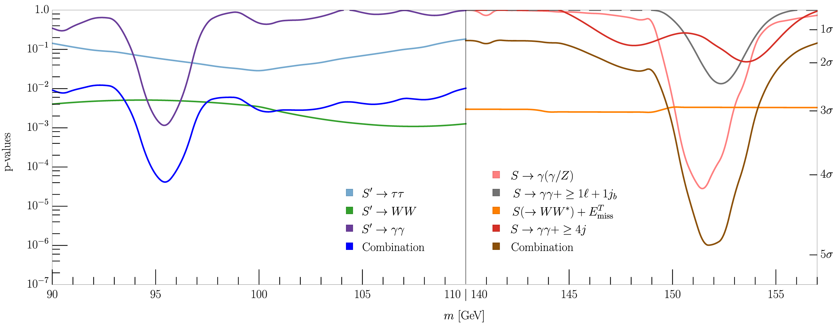
Hints for new Scalars at 95 GeV & 151.5 GeV
95 GeV: Only inclusive searches at LHC
151.5 GeV: SM Higgs γγ and Zγ side-bands in associated production channels (no sign in ZZ)
S. Bhattacharya, G. Coloretti, A. Crivellin, et al. arXiv:2306.17209
3.8σ & 4.7σ global significance

Slide 3
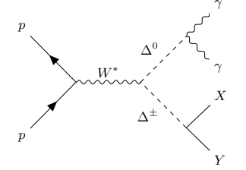
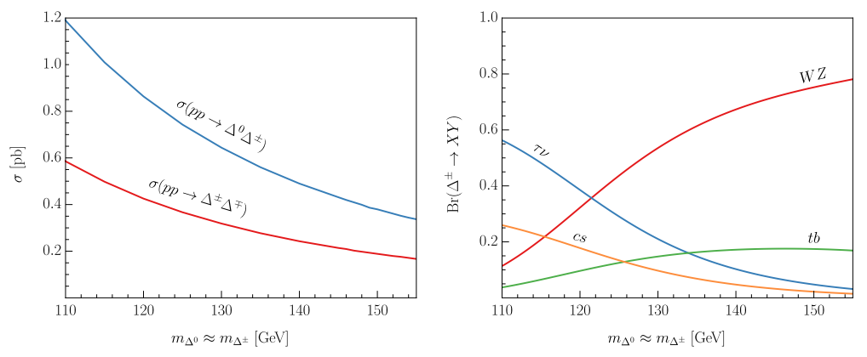
Is the 151.5 GeV Higgs a Triplet (Δ)?
Δ⁰ decays dominantly to WW and only suppressed to ZZ
Positive shift in the W mass as preferred by the EW fit
Drell-Yan production at the LHC

Slide 4
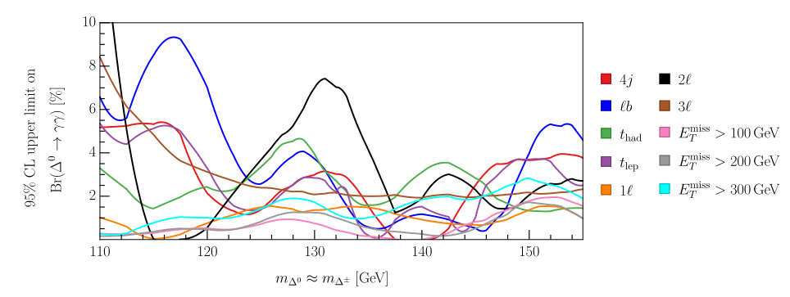
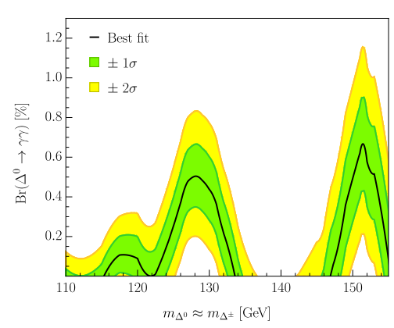
h→γγ+X from ATLAS
JHEP 07 (2023) 176
S. Ashanujjaman, S. Banik, G. Coloretti, A.C. S. P. Maharathy, B. Mellado, 2402.00101
Analysis of h→γγ+X
22 channels (X=l,MET,4j,…)
10 relevant for the triplet
8 of them show excesses
Only mass and Br(Δ⁰→γγ) are relevant free parameters
Triplet consistently explains h→γγ+X excesses

Slide 5
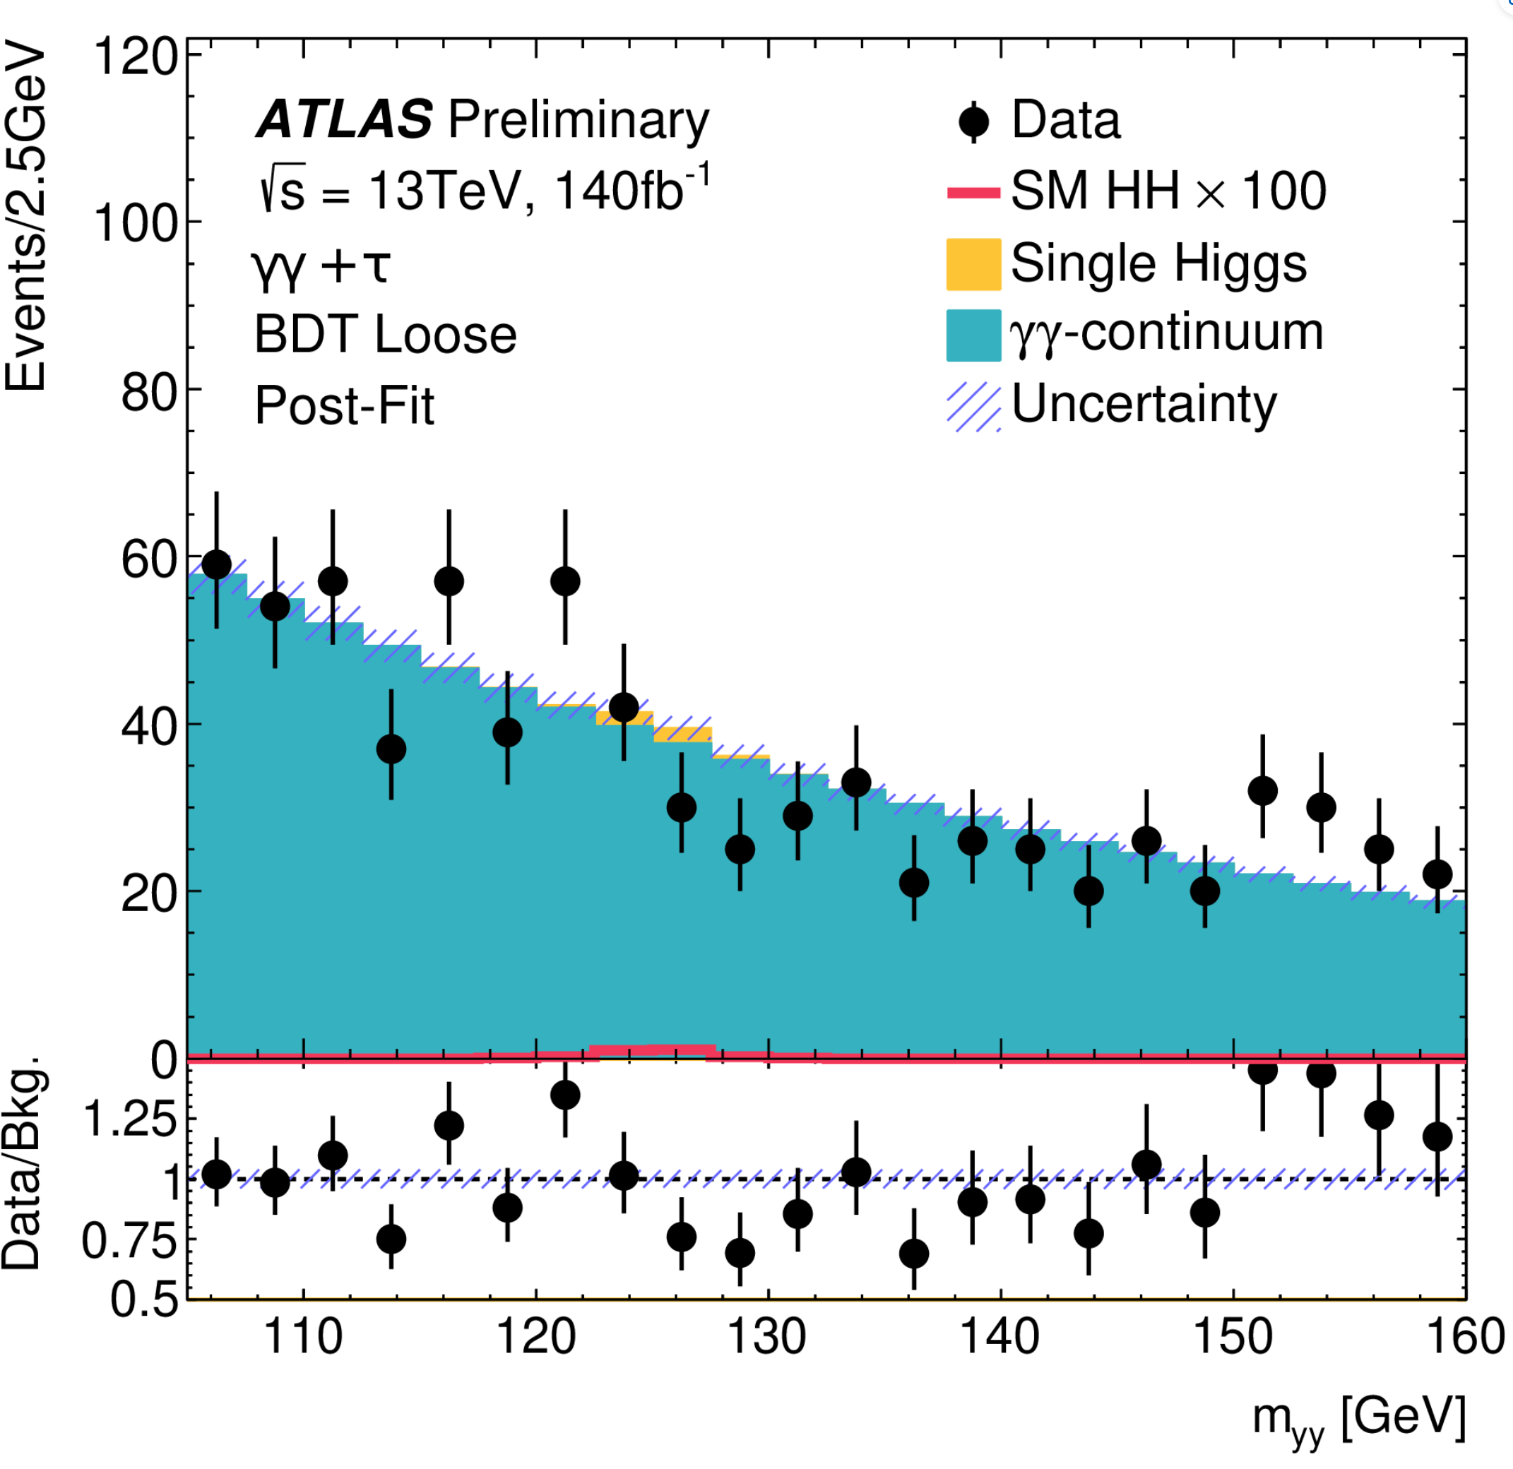
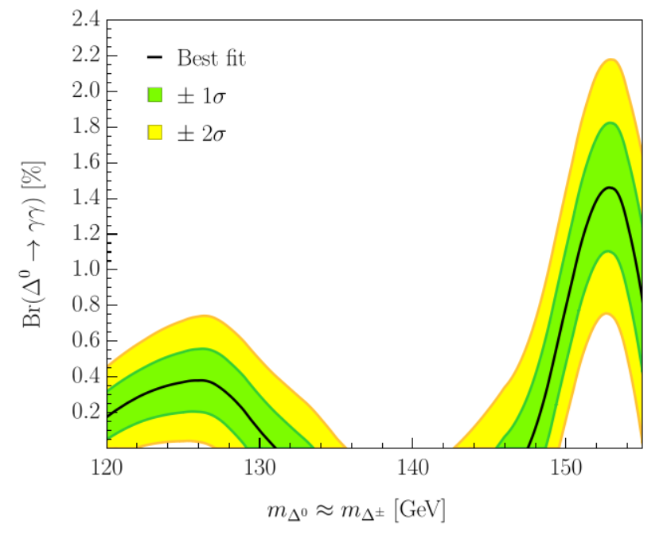
Moriond EW Update (ATLAS)
ATLAS-CONF-2024-005
New excess in γγ+τ
Background refitting further increases significance
Compatible with the triplet

Slide 6
Differential Top-Quark Distributions
ATLAS: “No model can describe all measured distributions within their uncertainties.”
JHEP 07 (2023) 141
2303.15340
angle between the leptons from the W decays
New Physics pollution of this SM measurement?

Slide 7
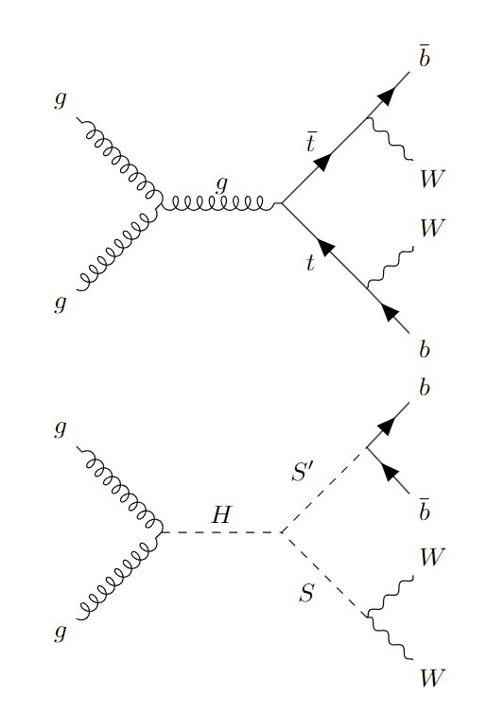
New Physics in Top-Quark Distributions
ATLAS analysis normalized to the total cross section
only sensitive to the shape of NP
NP at small angels can explain deficit at large angles
Associated production of new scalars decaying to WW and bb has a top-like signature
Related to the 95 GeV and 151.5 GeV hints?

Slide 8
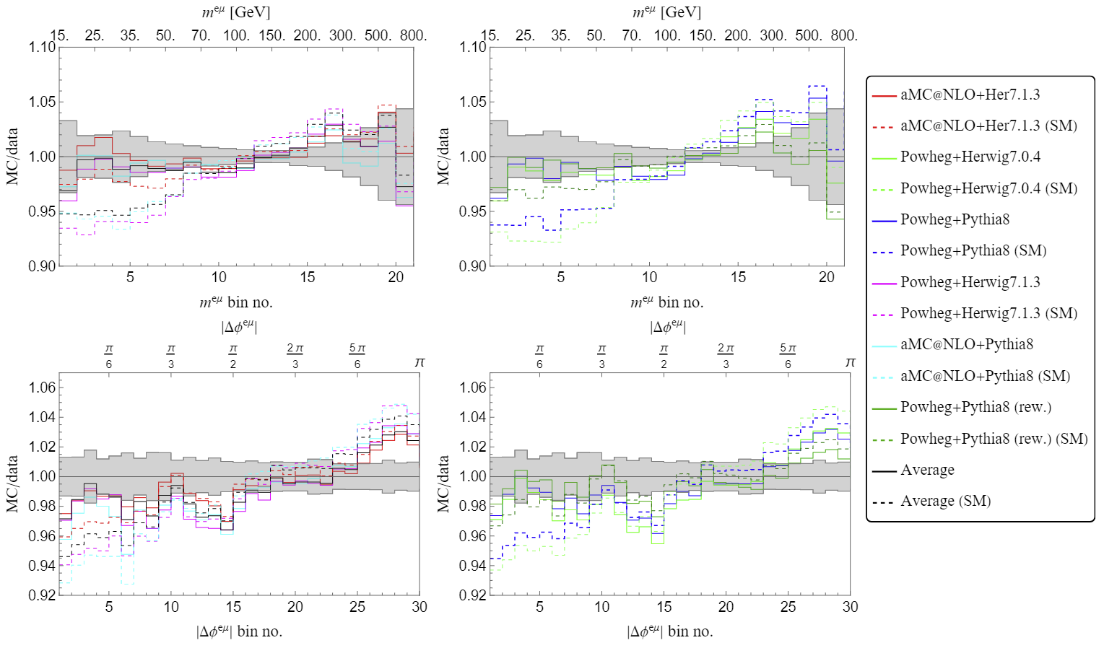
Simplified Model: H→SS’→WWbb
2308.07953
Fix m_{S}=151.5GeV and m_{S’}=95GeV by the hints for narrow resonances. Weak m_{H} (270GeV) dependence.
Also deficit at large Δφ^{eµ} & m^{eµ} explained

Slide 9
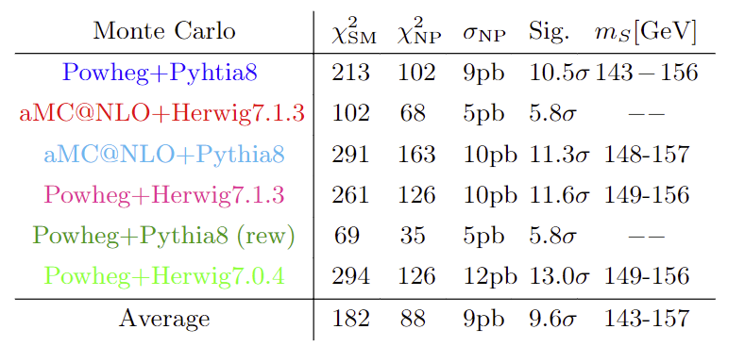
Simplified Model: H→SS’→WWbb
2308.07953
Improvement of SM prediction imperative!
Agreement with data significantly improved (>5σ)

Slide 10
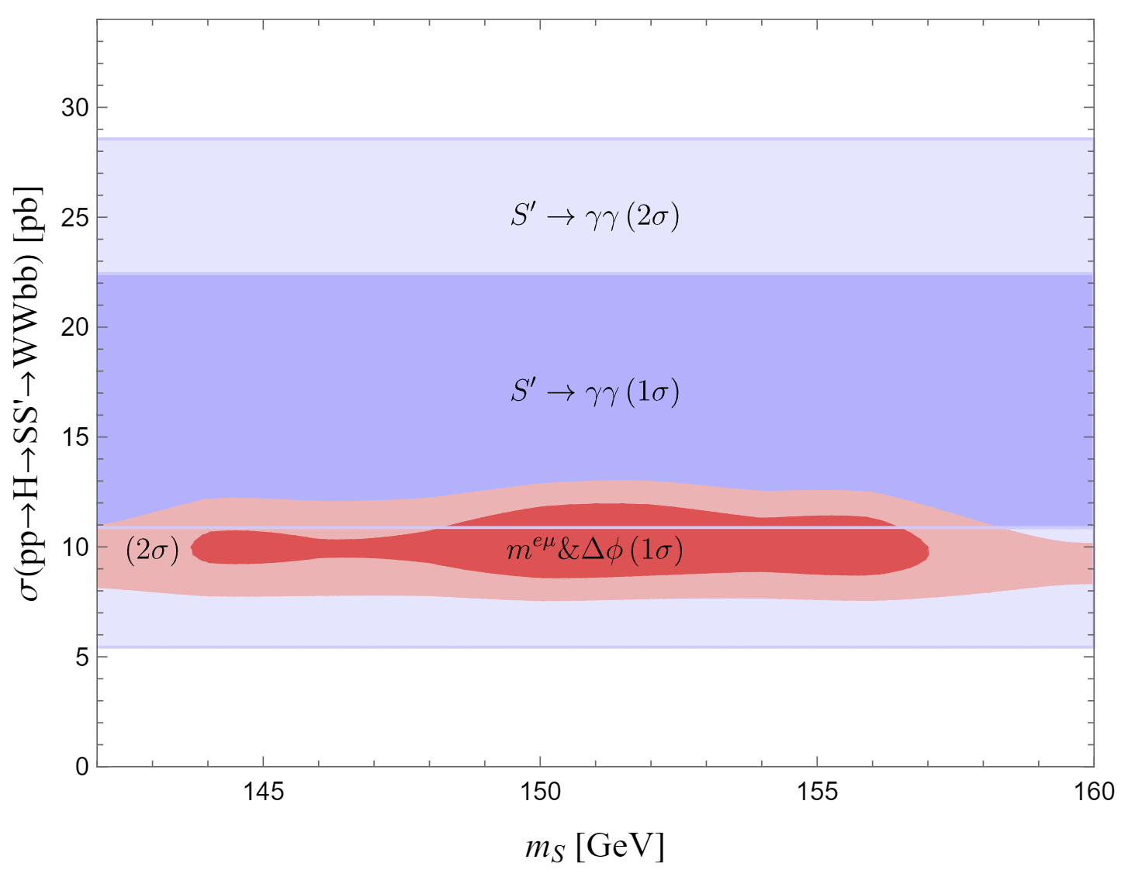
Is 95 GeV a singlet? Relation to 151.5 GeV?
S’(95): Singlet decays dominantly to bb
S(151.5): decays dominantly to WW
Consistent with 95 GeV γγ signal strength &
a mass of S with 151.5 GeV

Slide 11
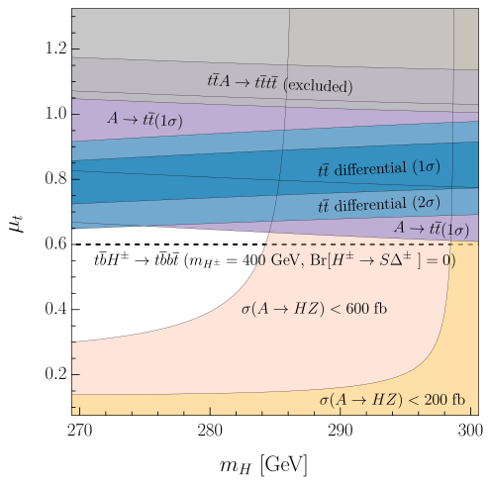
Δ2HDMS and top-quark production
G. Coloretti, A.C. and B. Mellado, 2312.17314
Explains:
Top-quark differential distributions
Di-photon excesses
Resonant top-quark production Elevated 4-top cross section
Combined explanation possible

Slide 12
Conclusions and Outlook
Hints for narrow resonances at 95 GeV & 151.5 GeV
Significant tensions in top quark differential distributions (>5σ)
Can be explained via pp→H→SS’ with masses consistent with the narrow resonances
95 GeV decays to dominantly to bb singlet?
151.5 GeV decays dominantly to WW triplet?
γγ+X excesses consistent with DY production of triplet
New CMS excess in ttZ explained
Most significant hints for new particles at the LHC

Slide 13
Backup

Slide 14
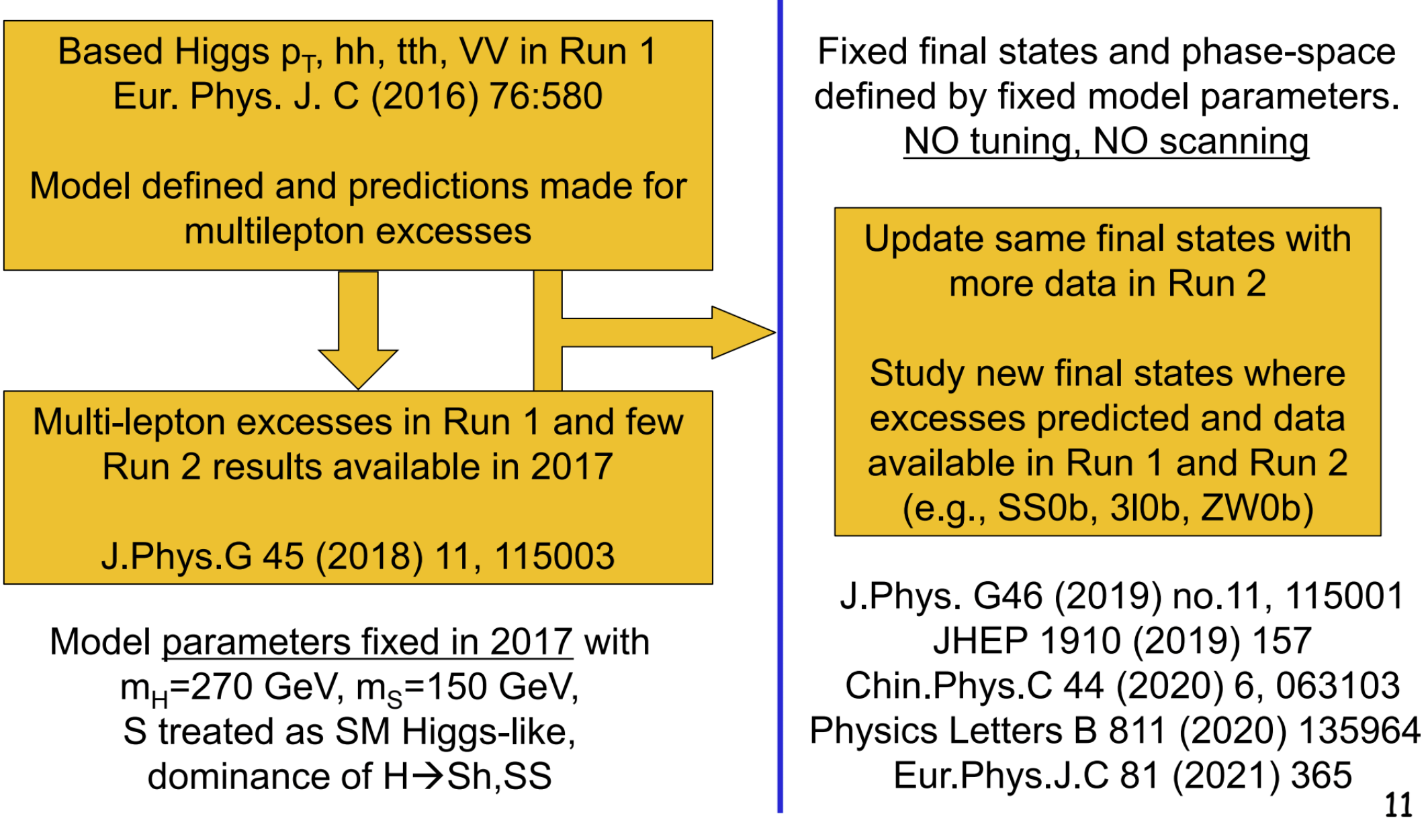
Multi-leptons history
Talk of Bruce Mellado at ZPW 2023

Slide 15
Higgs Sector of the SM
Custodial symmetry
Single Higgs gives rise to all fermion masses
Is the Higgs sector really minimal?
Extensions possible if the effect on the ρ parameter SM-Higgs signal strength is small
Scalars decaying to W bosons and/or produced in associate production weakly constrained
EW scale extension of the SM Higgs sector possible
Andreas Crivellin
B Meson Decays and Lepton Flavour Universality Violation

Slide 16
Multi-lepton Anomalies
Deviations from the SM predictions in LHC processes involving two or more leptons, with and without (b-)jets
1711.07874 found m_{S}=150±5GeV
Here focus on:
WW
Top-quark differential distributions
A.C., B. Mellado, arXiv:2309.03870
Buddenbrock et al. arXiv:1901.05300 O. Fischer et al. arXiv: 2109.06065
Statistically significant, motivate new EW scale scalars
Andreas Crivellin
B Meson Decays and Lepton Flavour Universality Violation

Slide 17
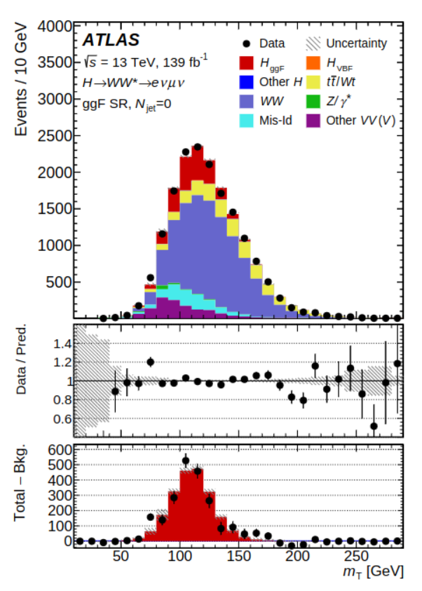
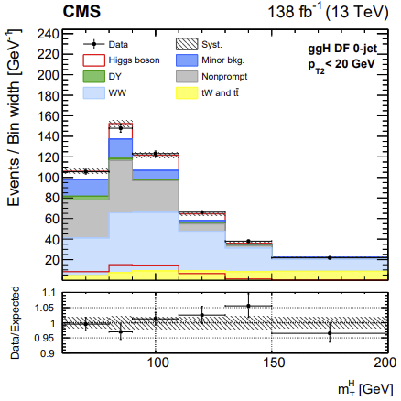
Low mass WW seraches
No dedicated low-mass WW search
Recast SM Higgs analyses
2207.00338
2206.09466
Background fitted
SM Higgs rescaled by 1.16
Room for NP
Andreas Crivellin
B Meson Decays and Lepton Flavour Universality Violation

Slide 18
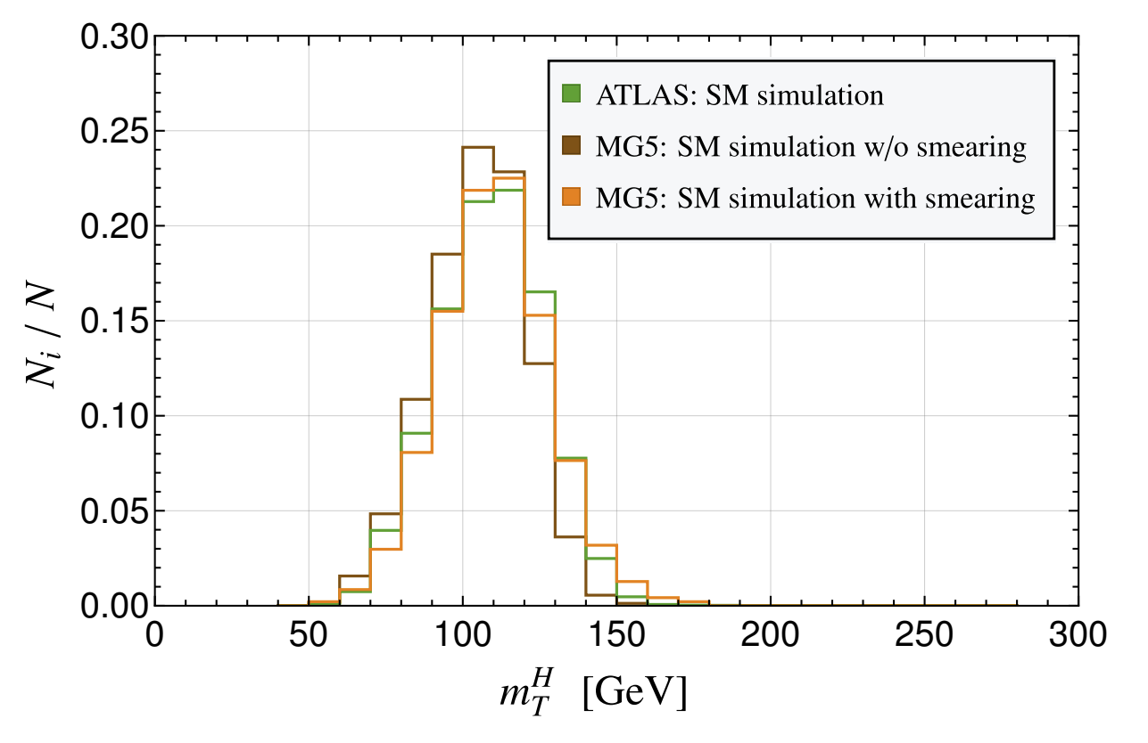
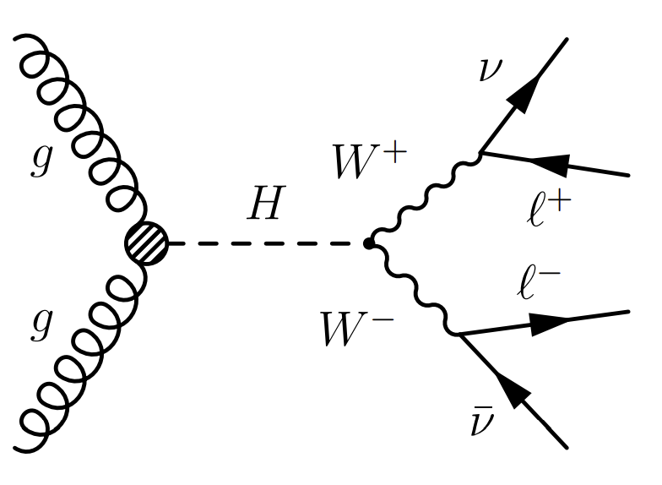
Simulation and Setup
Opposite sign, different flavour leptons with full jet veto
New scalar H produced via gluon fusion
Correcting for fast simulation by tuning signal vial smearing to the SM Higgs signal
Simulation validated

Slide 19
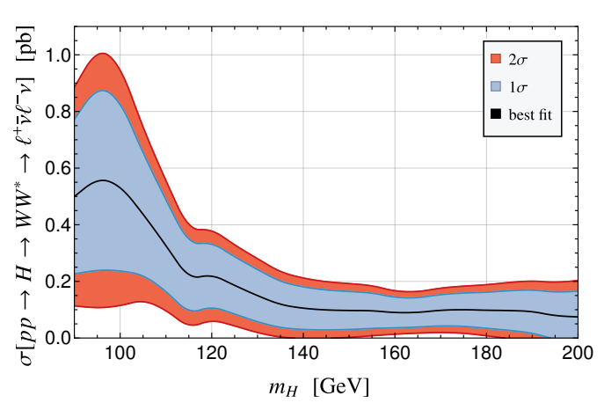
Low mass WW resonances searches
ATLAS and CMS combination
New physics effect preferred over the whole range
G. Coloretti, AC, S. Bhattacharya, B. Mellado, 2302.07276
Transverse mass sensitive to
additional
missing energy from associated
production
Related to 95GeV and 151GeV?

Slide 20
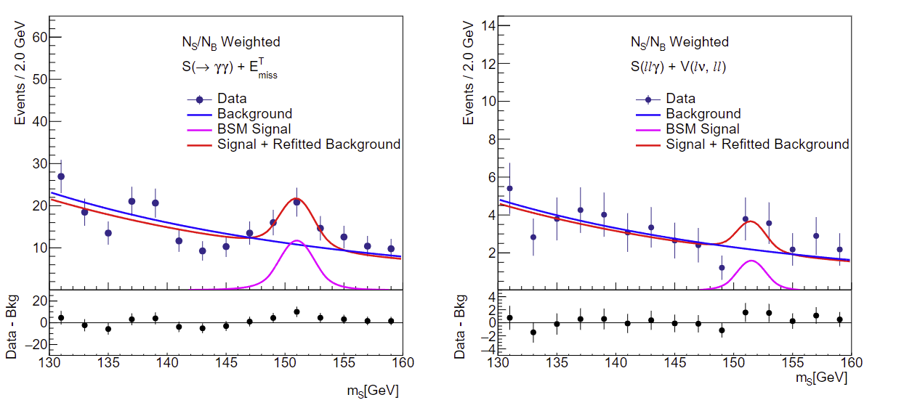
Hints for a 152 GeV scalar
Motivated by the mass range of 1711.07874 (not included)
ATLAS: 2301.10486
Hints for a resonance decaying to photons and Zγ
New Scalar (Higgs) boson? Relation to DM?

Slide 21
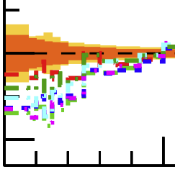
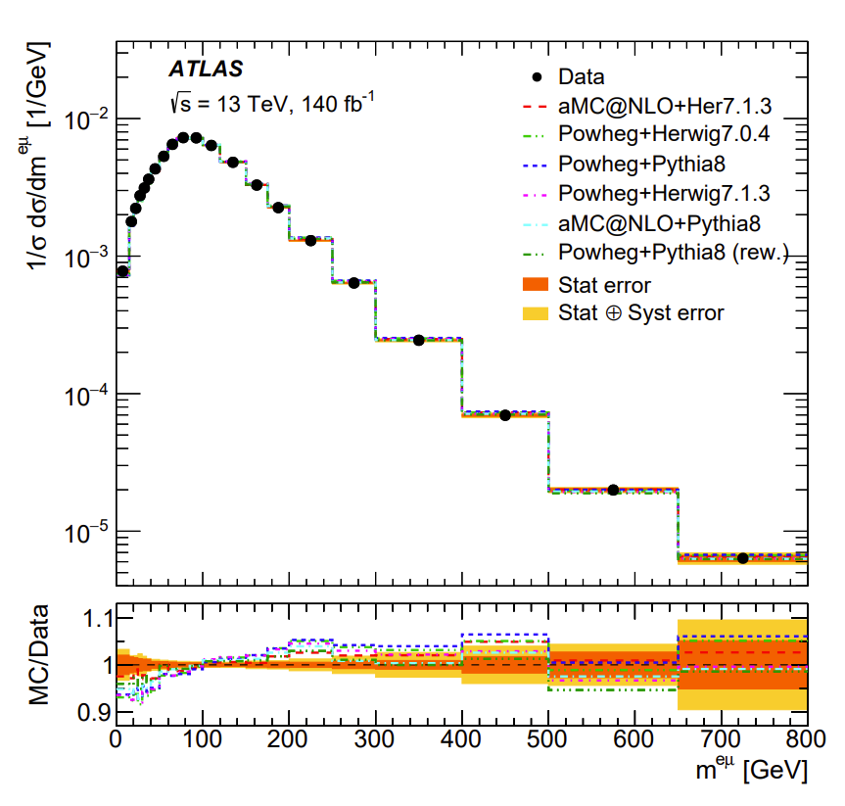
Differential Top-Quark Distributions
2303.15340
ATLAS: “No model can describe all measured distributions within their uncertainties.”
New Physics pollution of this SM measurement?

