Slide 1
CALORIMETRY FOR THE ePIC EXPERIMENT
Henry Klest
Argonne National Laboratory

Slide 2
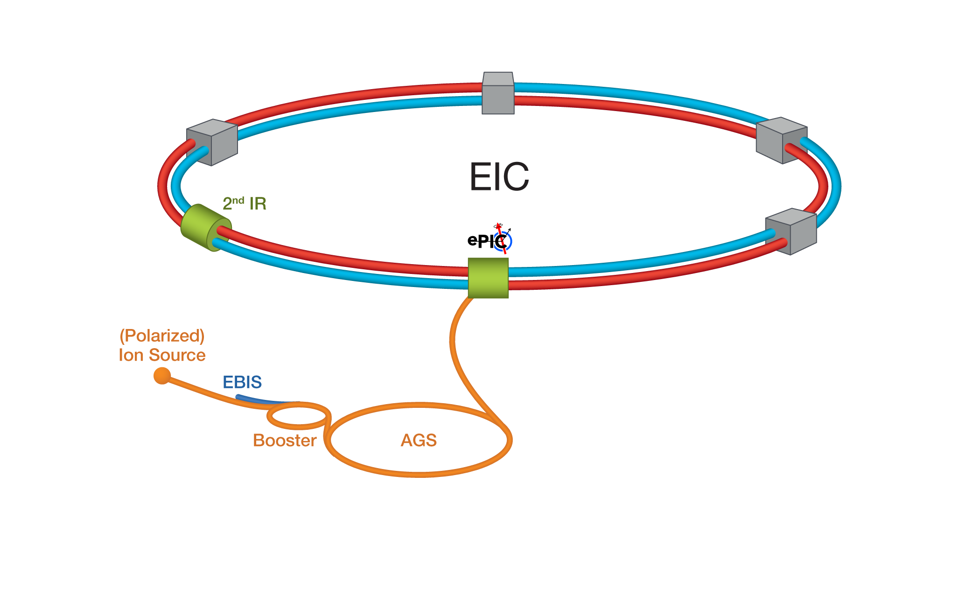
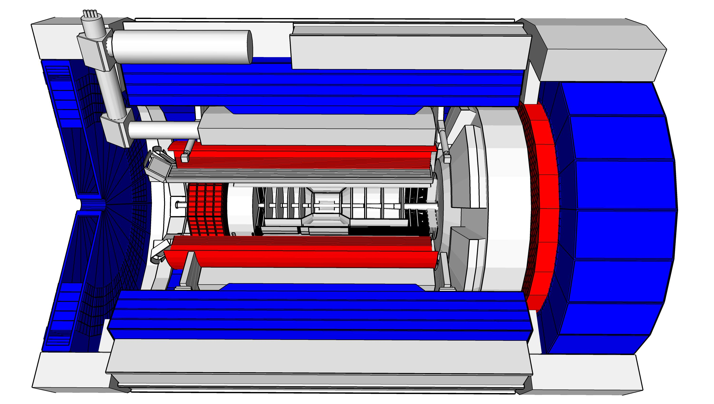
Epic at the EIC
EIC is a high luminosity machine, enabling precise measurements (Shujie’s talk)
Much of the EIC physics lives in percent-level effects
Requires precision in:

Slide 3
Epic at the EIC
EIC is a high luminosity machine, enabling precise measurements (Shujie’s talk)
Much of the EIC physics lives in percent-level effects
Requires precision in:
Particle ID: Chandra’s talk

Slide 4
Epic at the EIC
EIC is a high luminosity machine, enabling precise measurements (Shujie’s talk)
Much of the EIC physics lives in percent-level effects
Requires precision in:
Particle ID: Chandra’s talk
Tracking & Vertexing: Gian Michele’s talk

Slide 5
Epic at the EIC
EIC is a high luminosity machine, enabling precise measurements (Shujie’s talk)
Much of the EIC physics lives in percent-level effects
Requires precision in:
Particle ID: Chandra’s talk
Tracking & Vertexing: Gian Michele’s talk
Far-forward detectors: Michael’s talk

Slide 6
Epic at the EIC
EIC is a high luminosity machine, enabling precise measurements (Shujie’s talk)
Much of the EIC physics lives in percent-level effects
Requires precision in:
Particle ID: Chandra’s talk
Tracking & Vertexing: Gian Michele’s talk
Far-forward detectors: Michael’s talk
Calorimetry: this talk

Slide 7
Epic at the EIC
EIC is a high luminosity machine, enabling precise measurements (Shujie’s talk)
Much of the EIC physics lives in percent-level effects
Requires precision in:
Particle ID: Chandra’s talk
Tracking & Vertexing: Gian Michele’s talk
Far-forward detectors: Michael’s talk
Calorimetry: this talk
Cross-check! – Pawel’s talk

Slide 8
Calorimetry at the Eic
Calorimetry at the EIC has some unique challenges:
Wide variety in CM energy, 5 GeV e⁻ x 41 GeV p/A to 18 GeV e⁻ x 275 GeV p
EIC physics lives at all scales!
Large dynamic range required, hundreds of GeV to tens of MeV
Most challenging constraint is not always simply measuring energy
Electron identification
Very stringent requirements on e/h separation to identify DIS events from the much larger photoproduction background
1-in-10000 rejection of pions in the few GeV range!
Streaming readout
Integration with PID & tracking detectors

Slide 9
Calorimetry at the Eic
p/A
e⁻

Slide 10
Calorimetry at the Eic
“Forward”
Scattered electron
Hadron beam remnant
“Backward”
Hadronic final state

Slide 11
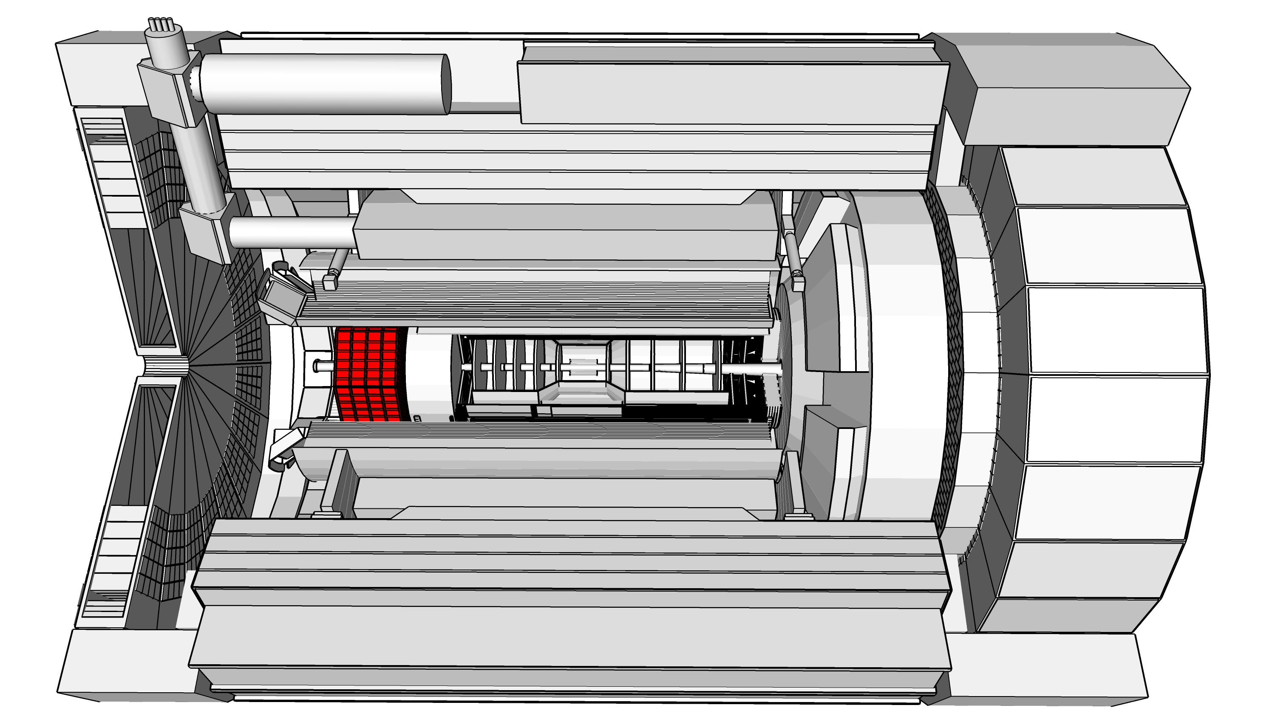
Backward calorimeters
$$−3.6< η<−1.7$$
Low Q², low x
Physics:
gluon saturation, nuclear terra incognita
Challenge:
Measure the electron with high precision at small scattering angles
Separate the scattered electron from the nearby hadrons
Scattered electron
Hadron beam remnant
Hadronic final state

Slide 12
Backward calorimeters
$$−3.6< η<−1.7$$
Low Q², low x
Resolution requirements: EMCal:
$\frac{σ_{E}}{E}\sim \frac{2−3\%}{\sqrt{E}}⊕1−2\%$
HCal:
$\frac{σ_{E}}{E}\sim \frac{100\%}{\sqrt{E}}⊕10\%$
Scattered electron
Hadron beam remnant
Hadronic final state

Slide 13
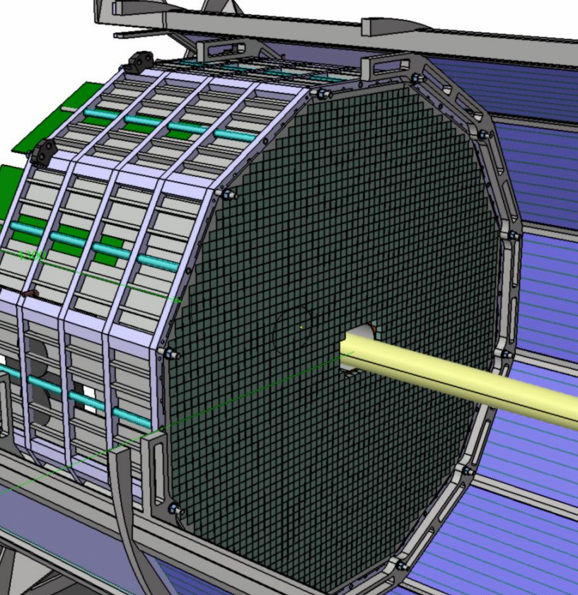
Backward electromagnetic calorimeter
Largest cross section for small electron scattering angles
Captures vast majority of scattered electrons
Often better resolution than tracker in this region
Required energy resolution of $\frac{2\%}{\sqrt{E}}⨂{1−3\%}$
For most electrons, dominated by constant term
Need precise mechanical construction & calibration techniques
1 in 10⁴ pion suppression
Detection of photons above 50 MeV
Radiation hardness

Slide 14
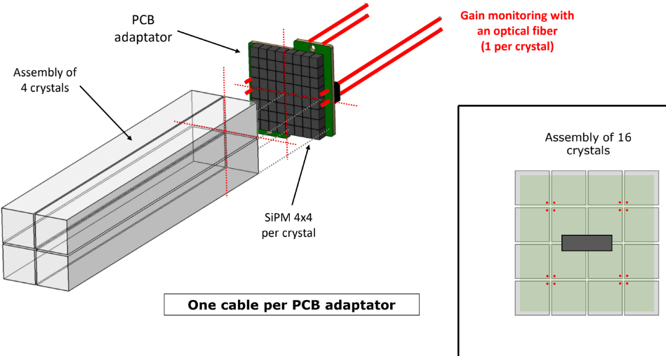
Backward electromagnetic calorimeter
Only realistic option to meet all of these requirements is PbWO₄
High density (small Molière radius), high scintillation light yield, fast scintillation, rad hard
Readout via HPK S14160-3010PS SiPMs

Slide 15
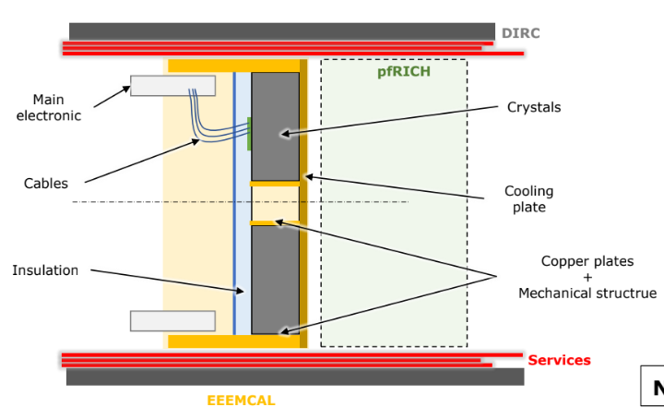
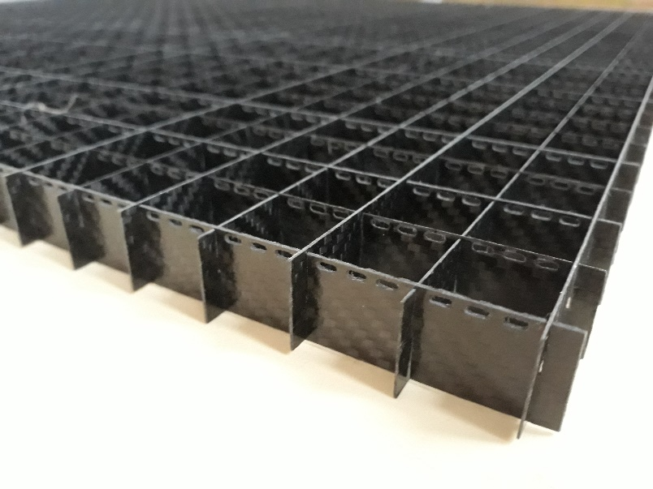
Backward electromagnetic calorimeter
PbWO₄ light yield is a strong function of temperature, ~2% per C°
Big integration challenge, pfRICH electronics sits nearby
Needs temperature stability & monitoring to reach resolution goals
Non-trivial interplay between achieving temperature stability and reducing dead material between the crystals
Crystals held by two 0.5 mm thick carbon fiber frames
One in front 2 cm of a block, one in back 2 cm
Air gap in-between

Slide 16
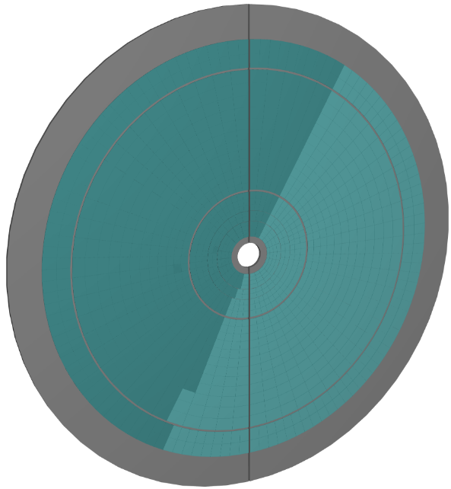
Backward hadronic calorimeter
Experience from H1 & ZEUS, backward HCal useful for improving e/h separation at low-x
Electron & hadrons go in the same direction, substantial overlap in the EMCal
Low-x hadronic final state important for studying gluon saturation, typically backward-going
Hadron energies are low, serves in part as a tail-catcher for the EMCal
Energy resolution requirements not stringent
Position resolution should be good enough to match Hcal clusters to energy deposits in Emcal
Exact design still in progress, some combination of steel + large scintillator tiles & SiPM readout
Similar to BELLE KLM

Slide 17
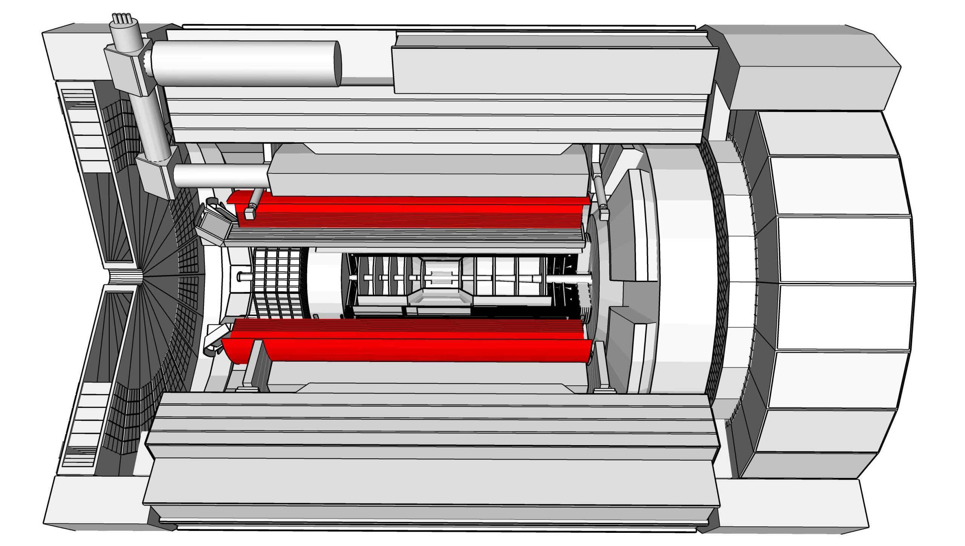
Barrel calorimeters
$$−1.7< η<1.4$$
High Q², Mid x
Example Physics: DVCS, DVMP
Challenges:
Identify components of hadronic final state, e.g. separate $π^{0}$ from ɣ
Identify low energy e⁻ from high y DIS
Contain 30+ GeV energy e⁻ from high Q²
Measure low energy ɣ
Scattered electron
Hadronic final state
17

Slide 18
Barrel calorimeters
$$−1.7< η<1.4$$
High Q², Mid x
Resolution requirements: EMCal:
$$\frac{σ_{E}}{E}\sim \frac{10\%}{\sqrt{E}}⊕2−3\%$$
HCal:
$$\frac{σ_{E}}{E}\sim \frac{100\%}{\sqrt{E}}⊕10\%$$
Scattered electron
Hadronic final state

Slide 19
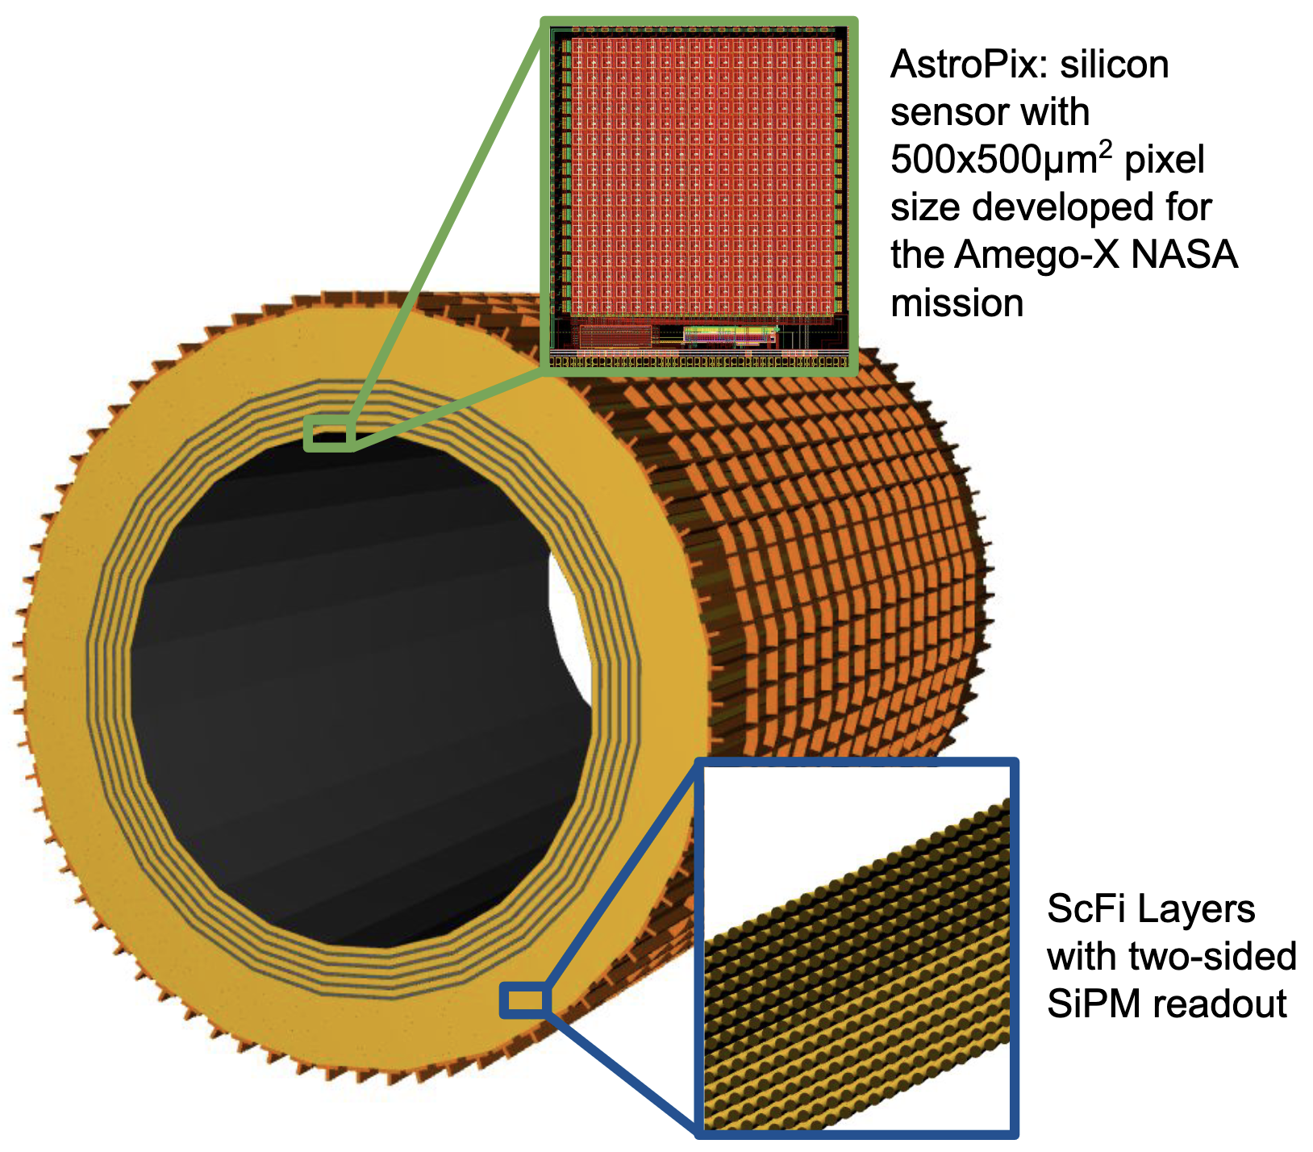
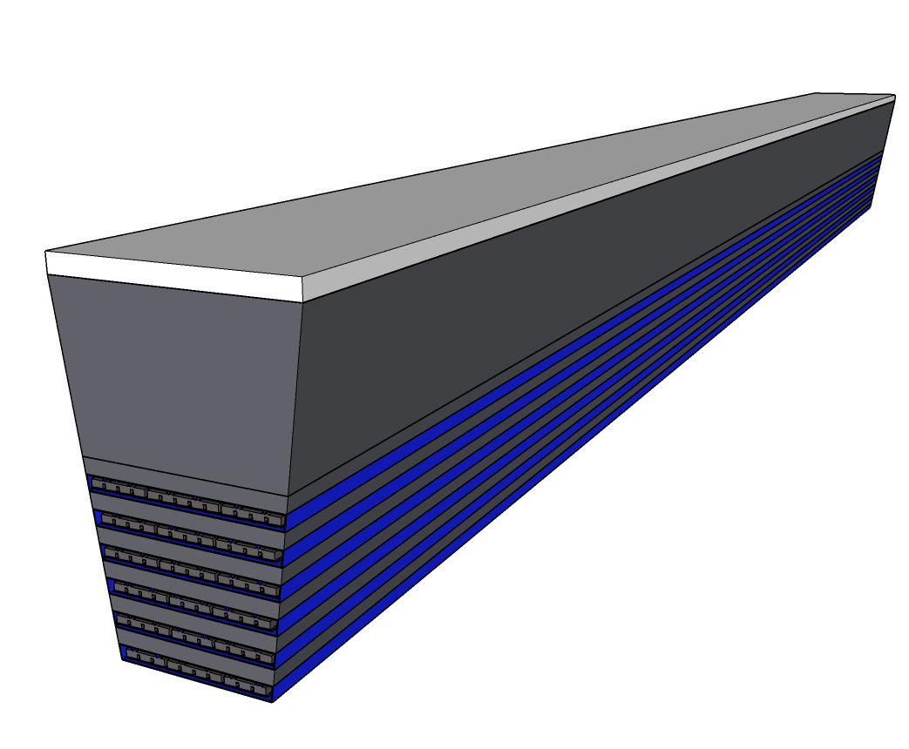
Barrel electromagnetic calorimeter
Hybrid sampling Pb/SciFi + Silicon pixel sensor
4.4 m long scintillating fibers, SiPM readout on both ends
Longitudinally segmented
Similar to KLOE & GlueX
“Time-Projection” calorimeter - $∆t→z$
HGCROC for front-end electronics
Interleaved with layers of AstroPix MAPS silicon pixel sensors
Very low power consumption (few mW/cm²)
500 μm “cube” pixels
Good resolution (~7%) on energy deposited in pixel

Slide 20
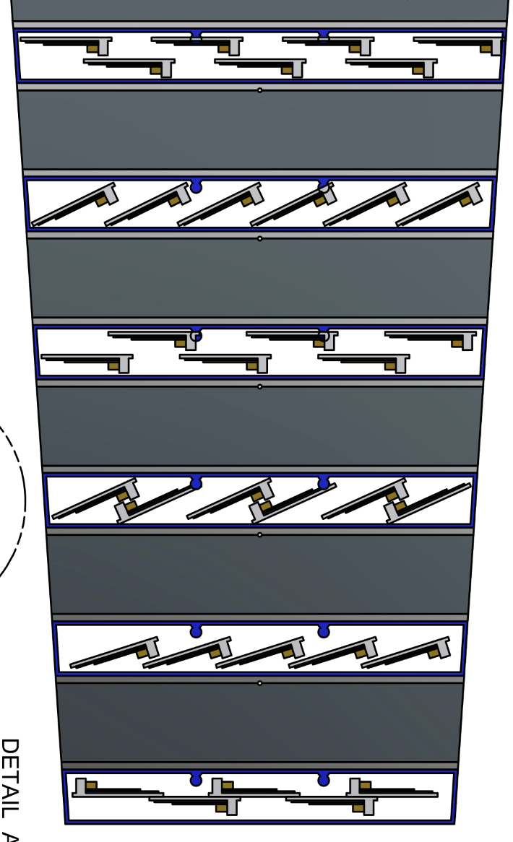
Barrel electromagnetic calorimeter
SiPM Readout Scheme
Light guides to 1.2x1.2 cm SiPMs
AstroPix Tiling Options
~10 cm

Slide 21
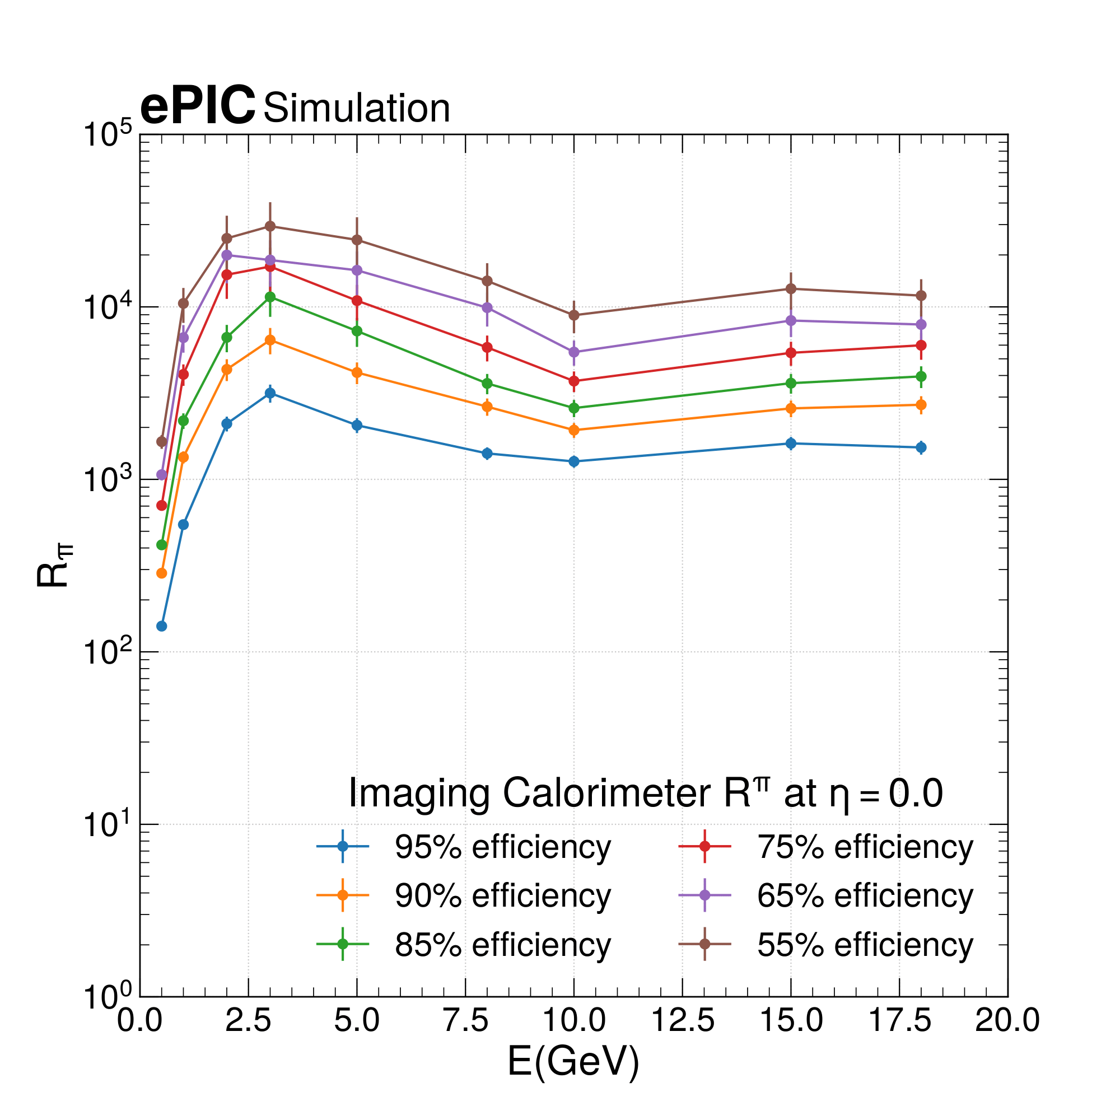
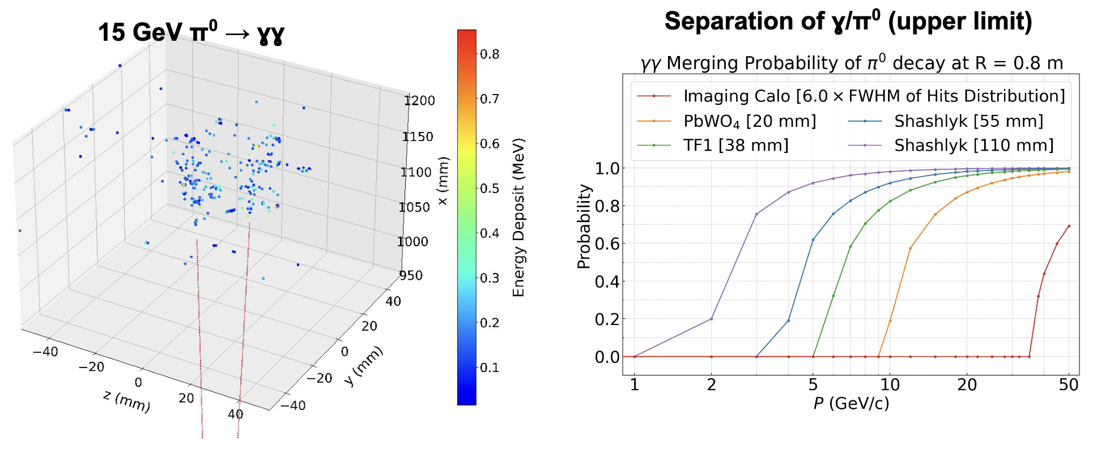
$e/π$ separation factor
Interleaving of AstroPix sensors allow for excellent position resolution
Angular resolution on the order of 0.1 degree
Separate $π^{0}$ from ɣ beyond 30 GeV
Can do vertexing on photons!
Very effective separation of electrons from hadrons based on shower shape discrimination
Still quite effective at ~1 GeV & below

Slide 22
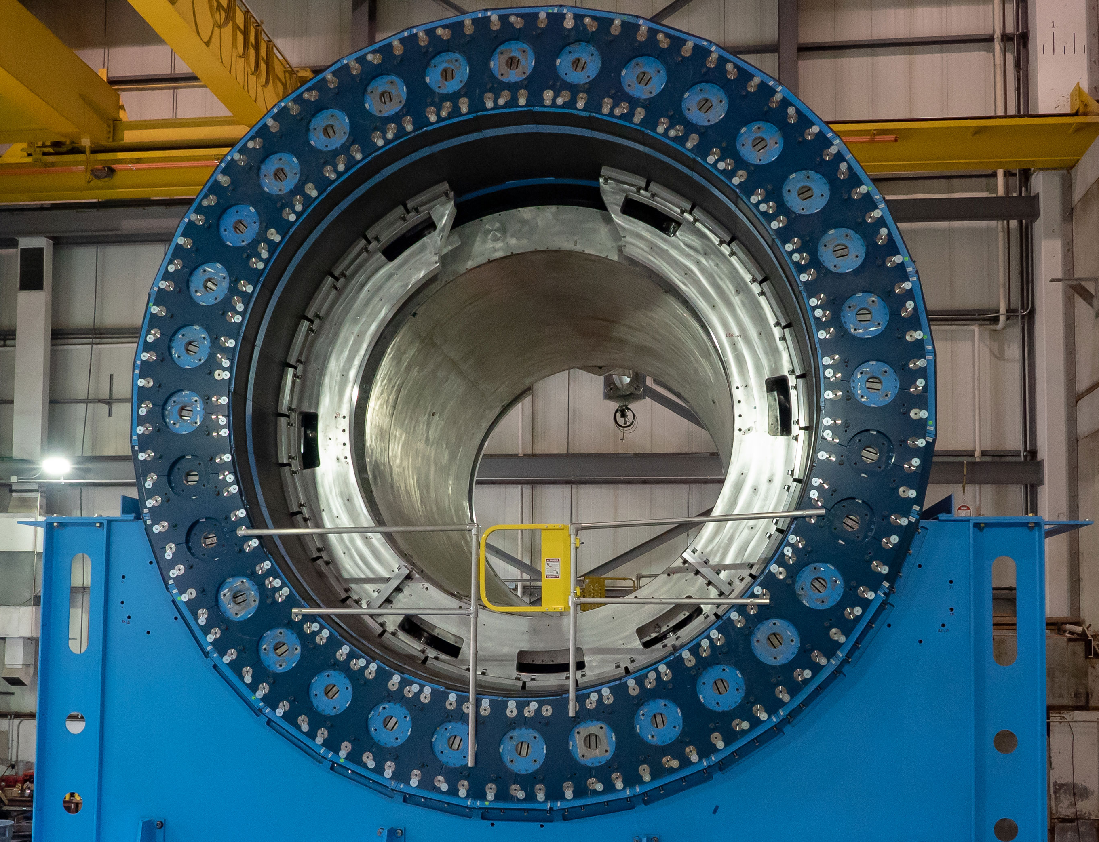
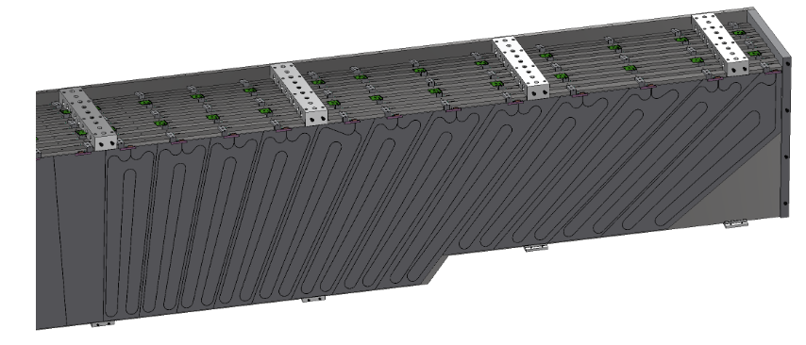
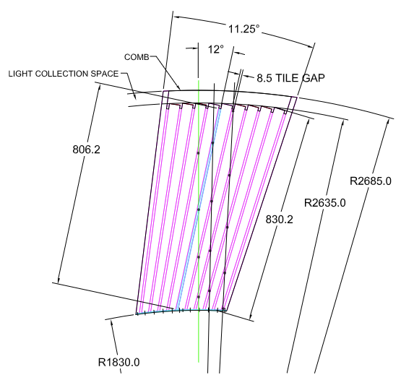
Barrel Hadronic calorimeter
Modest requirements on energy resolution
~ 100%/$\sqrt{E}$
Hadrons in barrel typically low energy (<5 GeV), better measured by tracking
Tag jets with large neutral hadron component
Measure muons from e.g. $J/ψ→μμ$
Reuse from sPHENIX
22

Slide 23
Barrel Hadronic calorimeter
Steel/Scintillator design
Steel plates tiled at an angle to prevent channeling
Straight tracks have a sizable path length through scintillator, good for MIP detection
Readout via HPK S12572 series SiPMs
Refurbish for EIC
Expect minor radiation damage from sPHENIX, can replace SiPMs with HPK S14 series
Upgrade electronics to HGCROC
Increase segmentation by reading out each tile individually
23

Slide 24
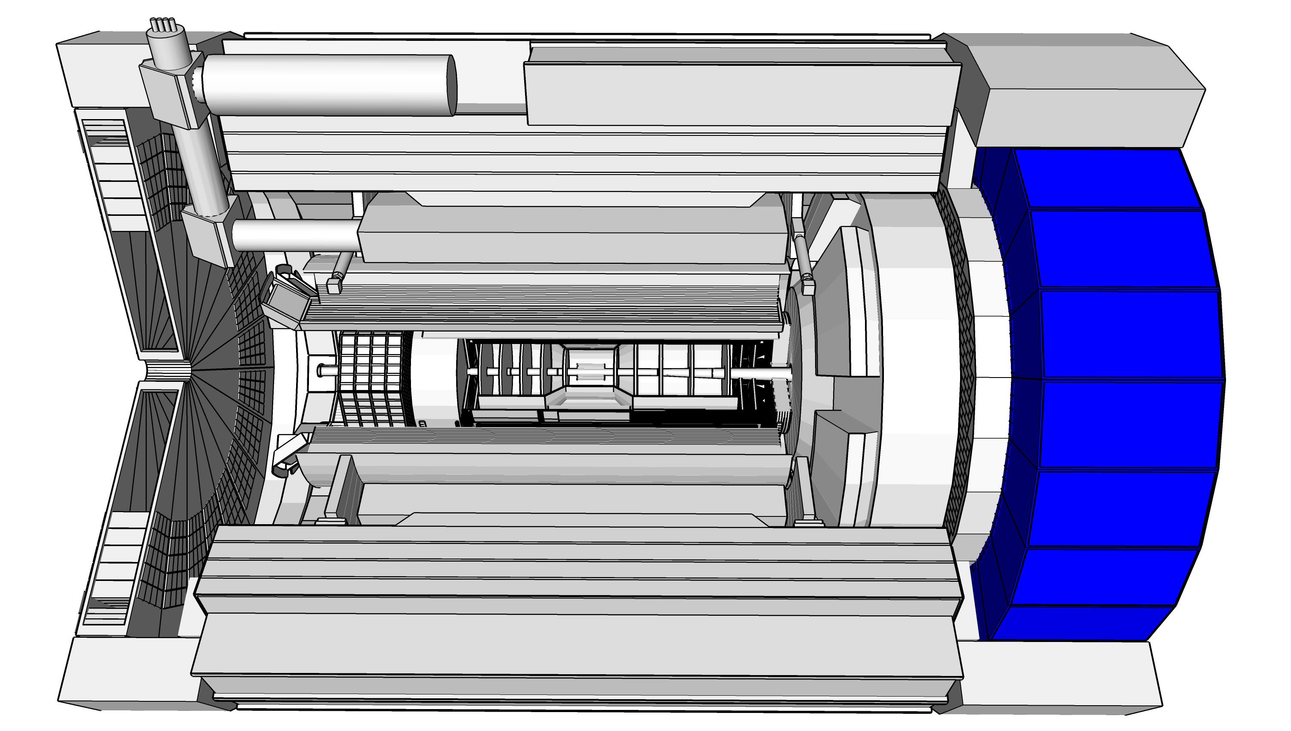
Forward calorimeters
$$1.4< η<4$$
High Q², High x
Example Physics: TMDs, Jets, SIDIS
Challenges:
Contain the highly energetic hadronic final state
Separate clusters in a dense hadronic environment
Highest radiation load near hadron beam
Scattered electron
Hadronic final state

Slide 25
Forward calorimeters
$$1.4< η<4$$
High Q², High x
Resolution requirements: EMCal:
$$\frac{σ_{E}}{E}\sim \frac{10\%}{\sqrt{E}}⊕2−3\%$$
HCal:
$$\frac{σ_{E}}{E}\sim \frac{50\%}{\sqrt{E}}⊕10\%$$
Scattered electron
Hadronic final state

Slide 26
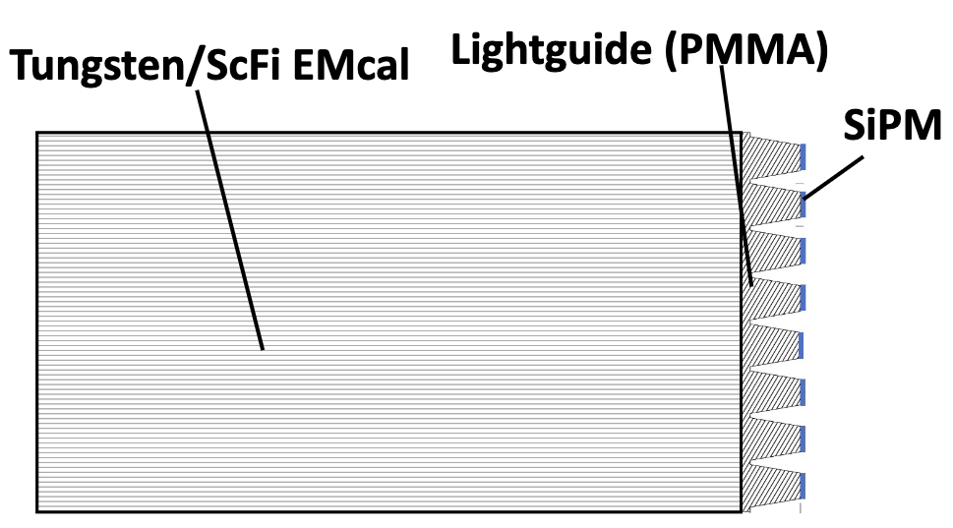
Forward electromagnetic calorimeter
Tungsten + SciFi SPACAL design
Developed through EIC R&D and applied successfully in sPHENIX EMCal
Tungsten powder mixed with epoxy
Position resolution vital to separate $π^{0}$ from ɣ at high energy
Dense absorber (~10 g/cm³)
Readout with many SiPMs to create a small tower size
Uniformity of construction important to reduce constant term
Dominates at high energy
Powder + epoxy enables fine control over spatial distribution of scintillator

Slide 27
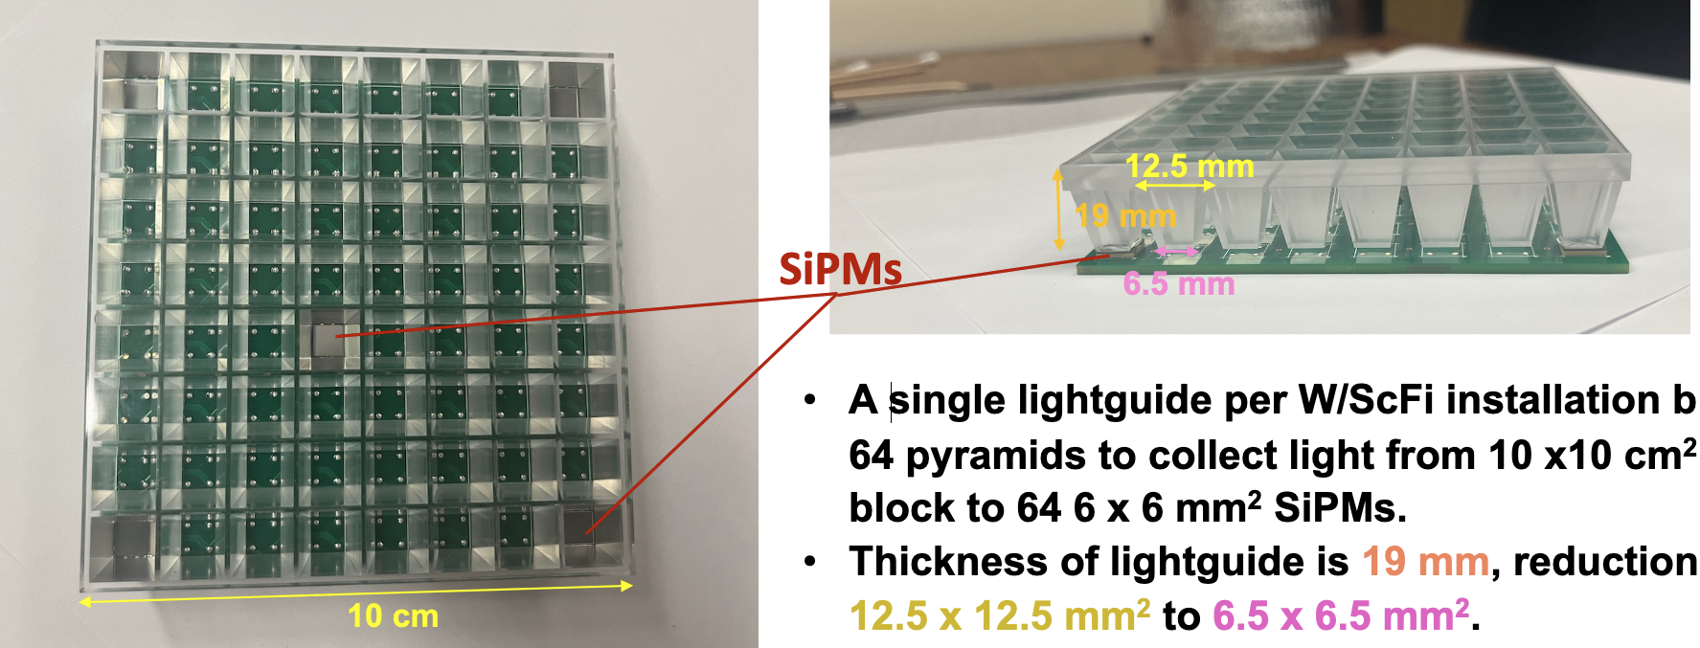
Forward electromagnetic calorimeter
5 cm x 5 cm x 17 cm blocks of absorber + fibers
Four independent towers per block
Each 2.5 x 2.5 cm tower is readout by four 6x6mm HPK S14 series SiPMs
Expected energy resolution ~ $\frac{10\%}{\sqrt{E}}⊕1−3\%$

Slide 28
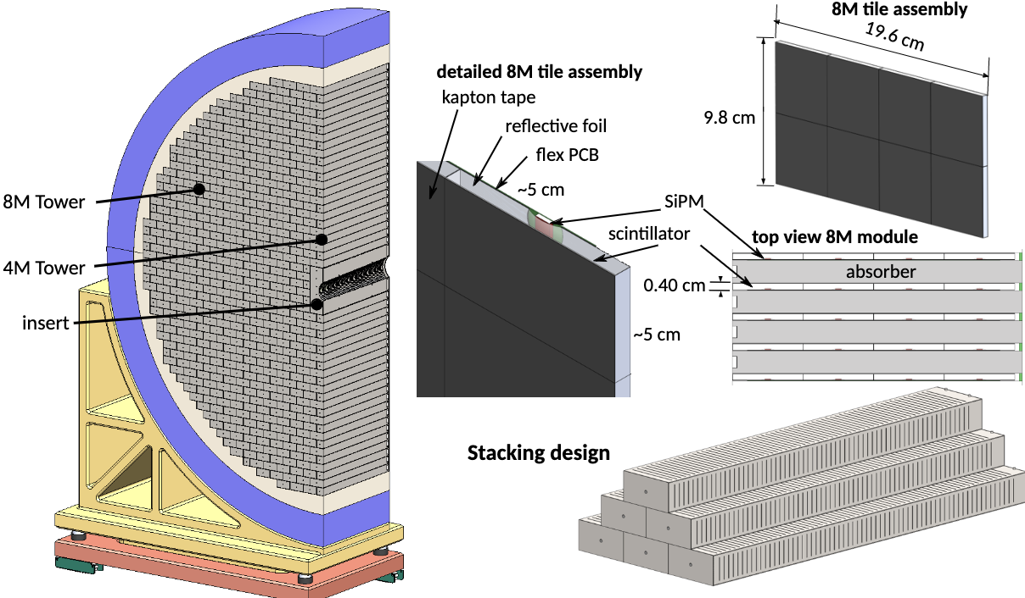
Forward hadronic calorimeter
Steel + Scintillator SiPM-on-tile
Pioneered by CALICE analog HCal
Ideal for particle-flow measurements!
Highly segmented longitudinally, 65 layers per tower
565,760 SiPMs
65 layers ganged into 7 readout channels
Stackable for “easy” construction
Steel as absorber significantly simplifies design, improves material uniformity
Achieves ~6.5 $λ_{0}$
Expected resolution ~ $\frac{45\%}{\sqrt{E}}⊕5\%$
Exceeds requirements defined by Yellow Report!

Slide 29
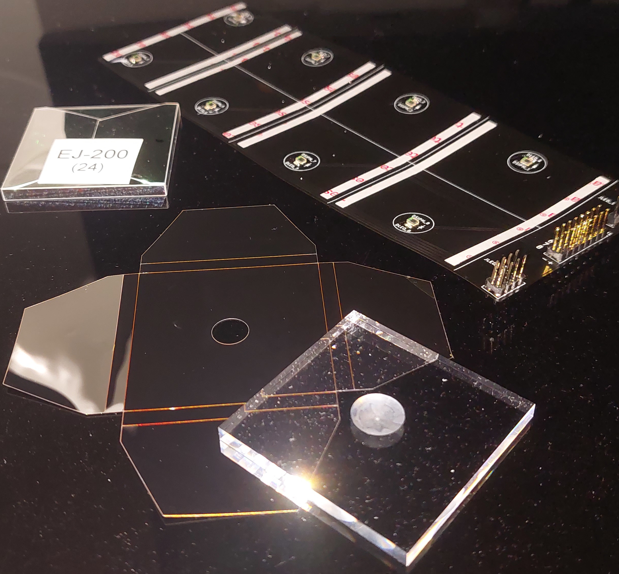
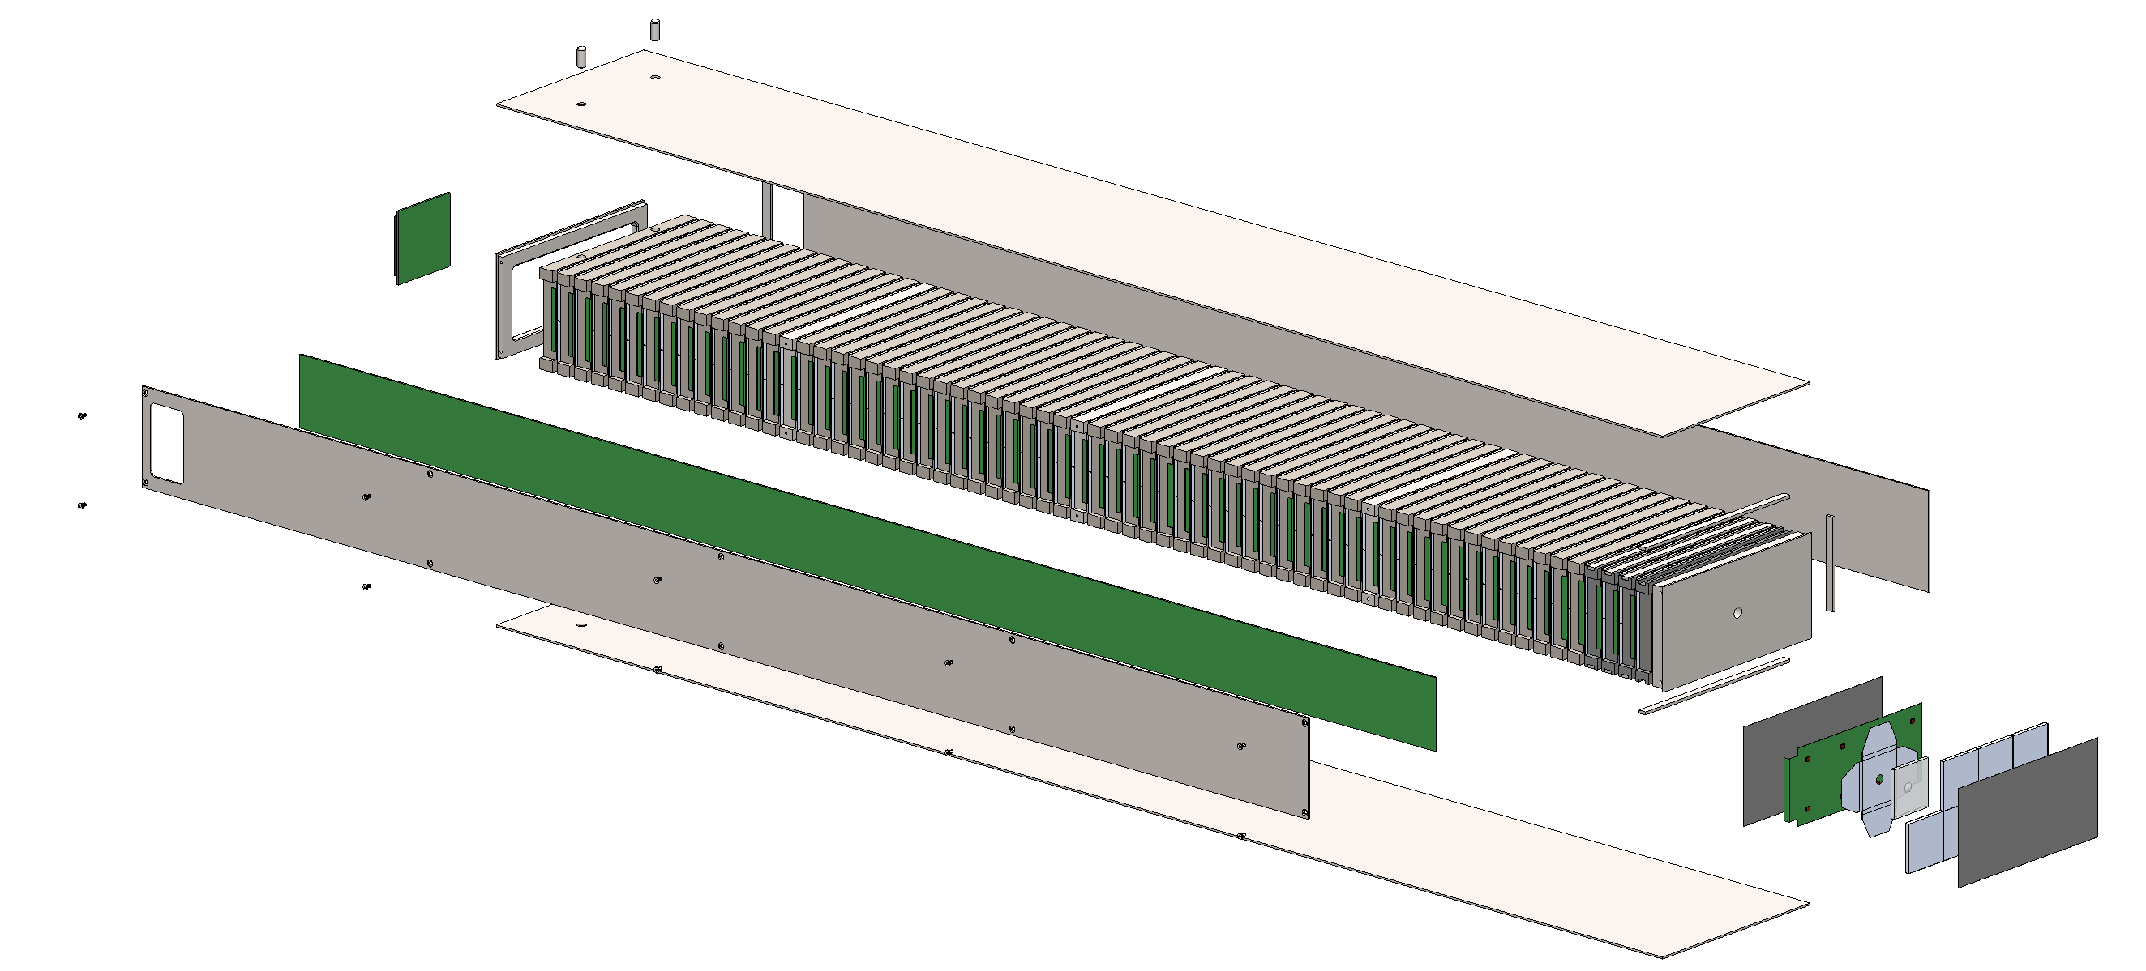
Forward hadronic calorimeter
SiPMs mounted to thin flex PCBs
Signals routed along PCB to periphery
Signals brought to HGCROC at back by a thin flex PCB that runs longitudinally alongside the tower

Slide 30
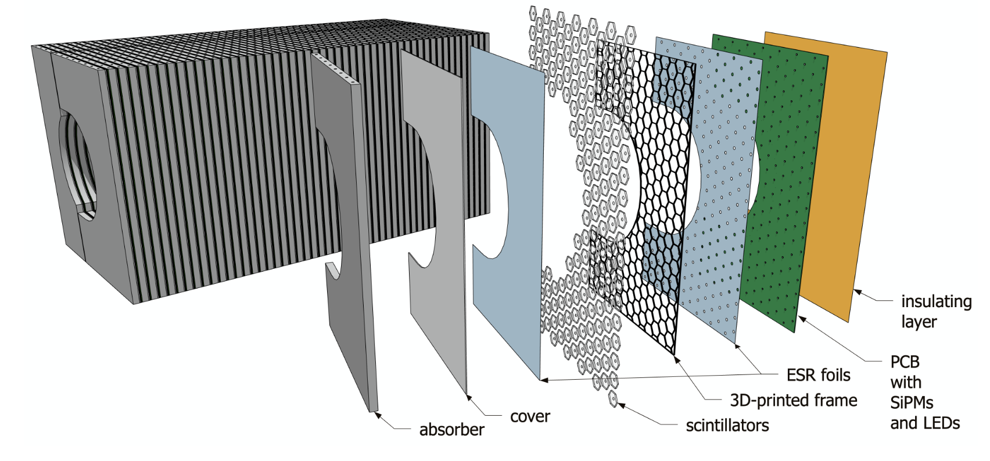
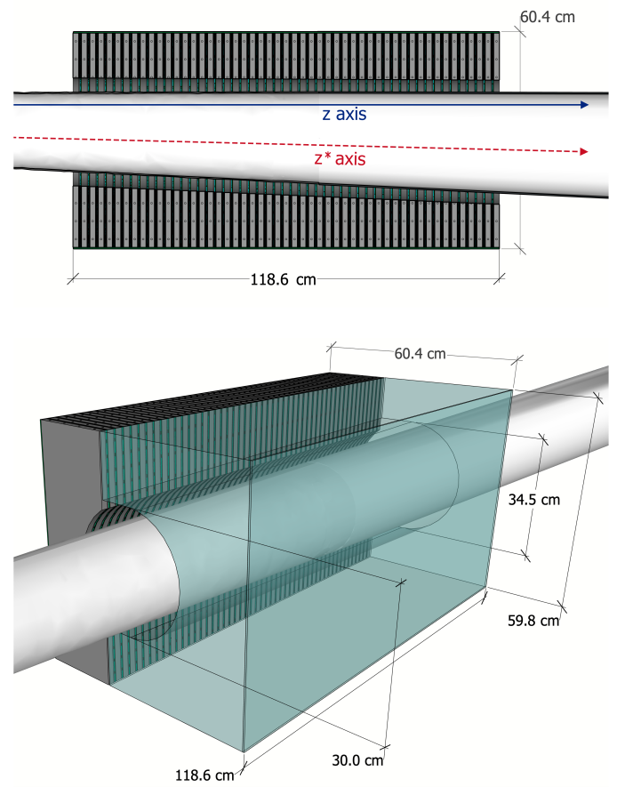
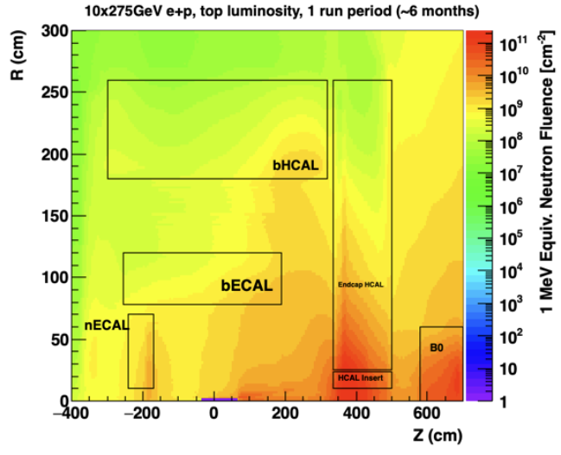
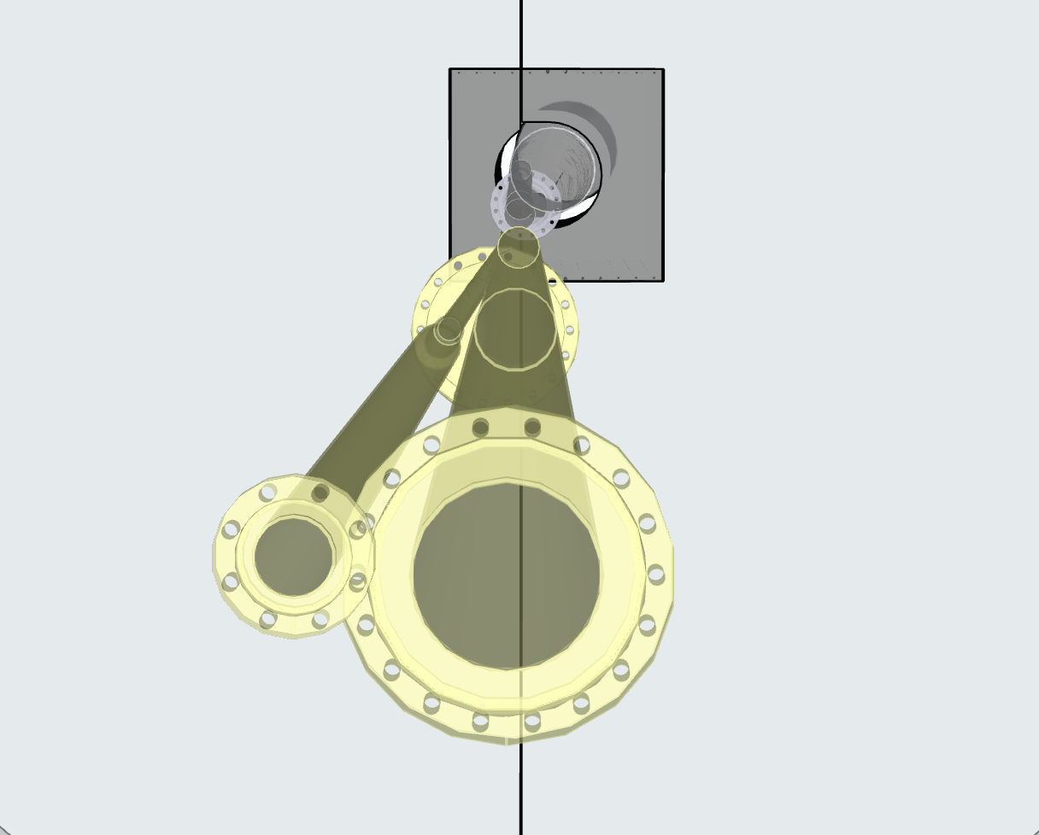
Forward insert calorimeter
Insert to extend central detector acceptance as much as possible in the forward direction
Crucial for containment of hadronic final state for inclusive kinematic reconstruction and rapidity gap diffractive measurements
3.2 < η < 4
Needs to accommodate complex beam pipe geometry
Small hexagonal scintillator tiles for better spatial uniformity & increased light yield
High radiation load
SiPMs will be serviceable
~10¹² neq/cm²/year

Slide 31
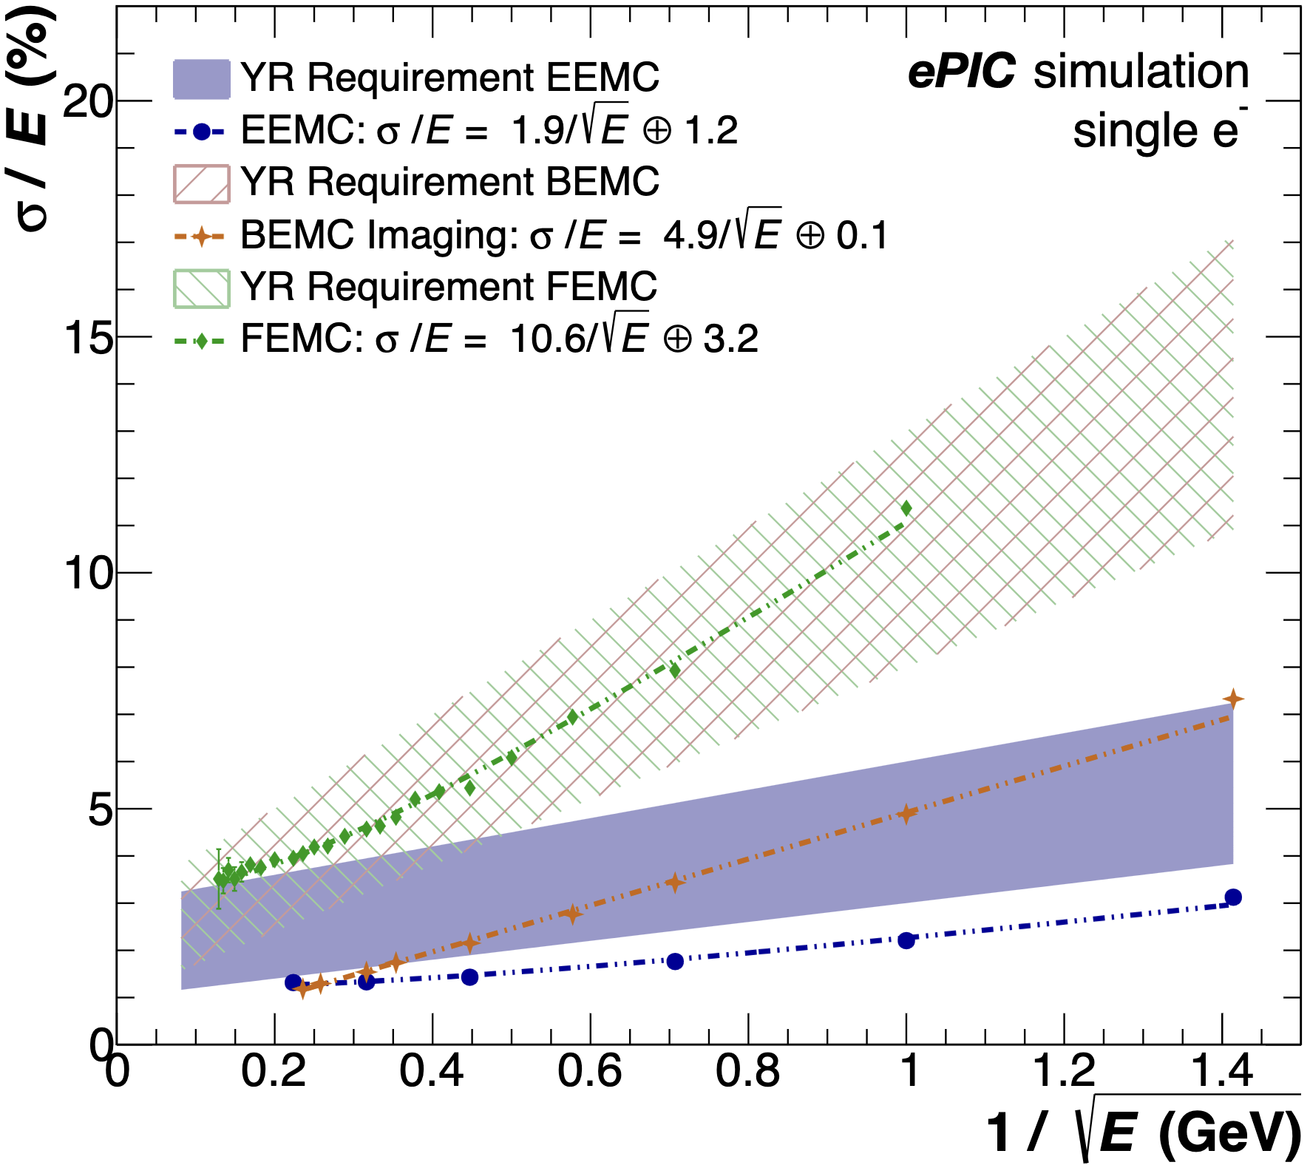
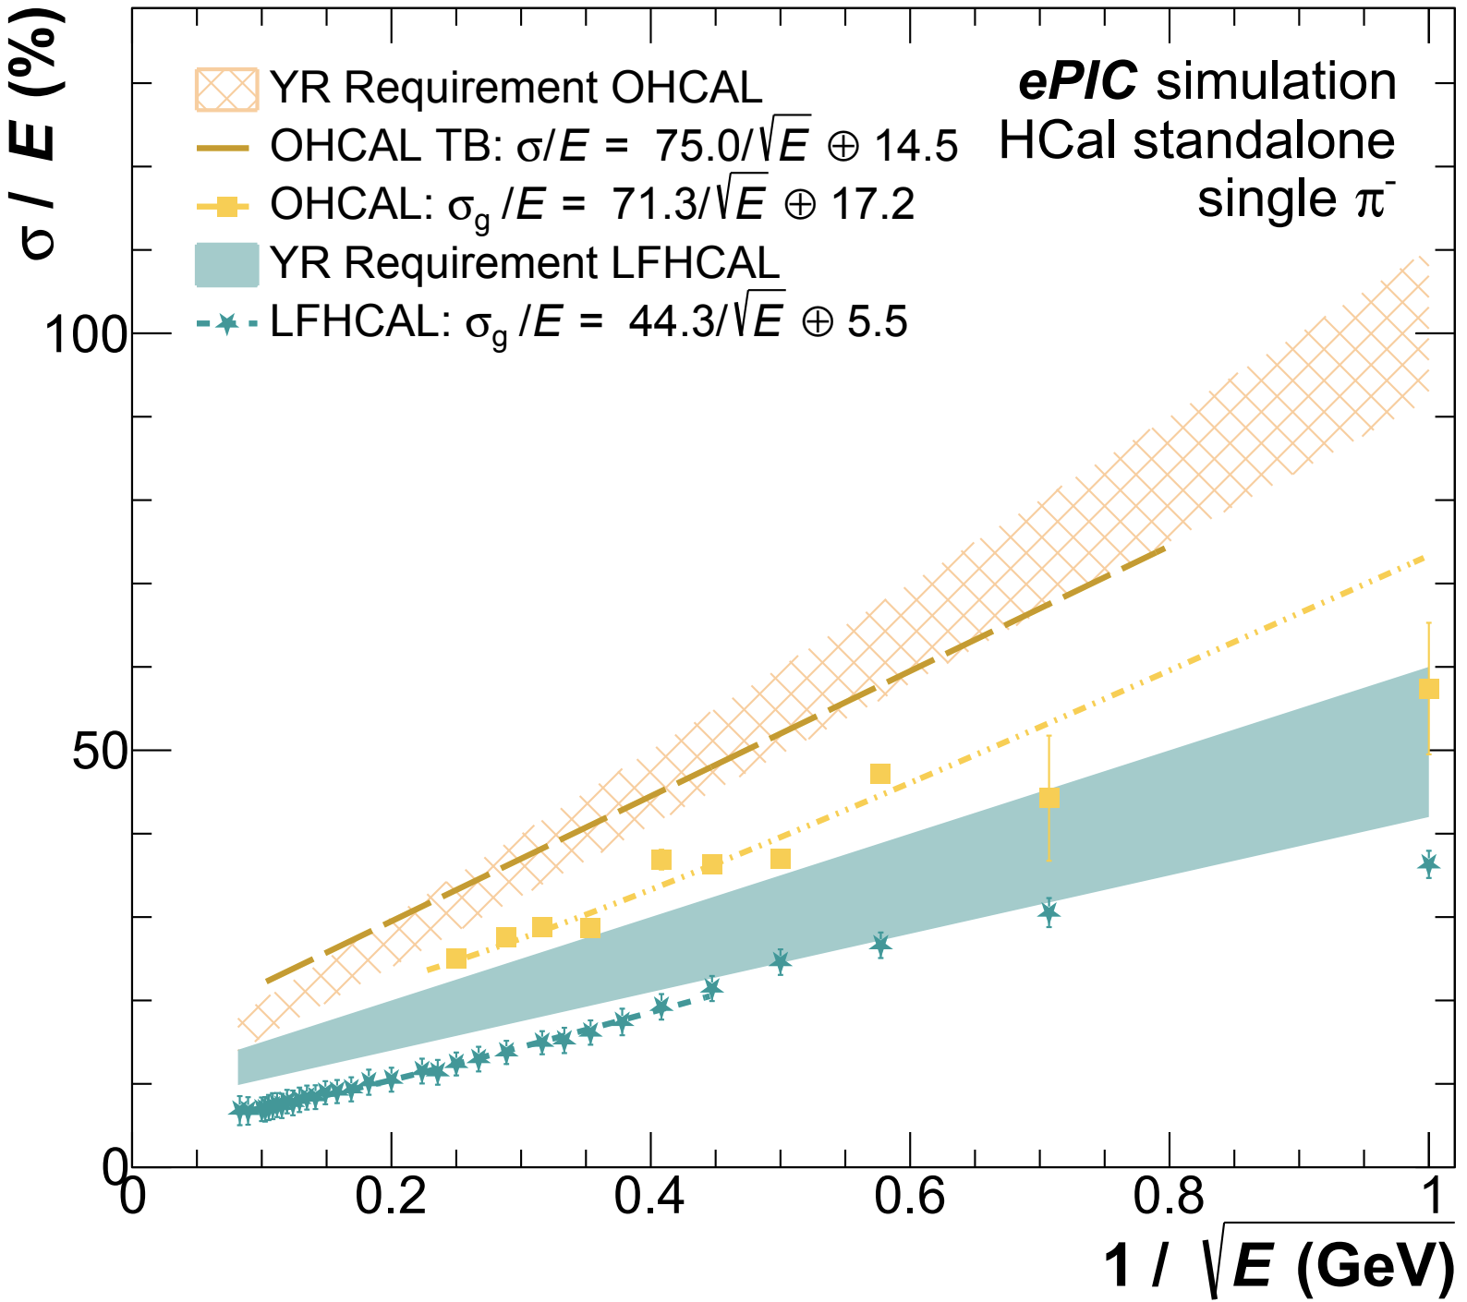
Performance projections
High radiation load
SiPMs will be serviceable
~10¹¹ neq/cm²/year

Slide 32
Conclusion
Calorimetry is a vital component of the EIC detector package
ePIC employs unique calorimetry designs to meet the varied demands of the different detector regions
Designed to meet the multifarious challenges & physics of the EIC!
The ePIC calorimeter designs meet or exceed their performance requirements!
Thanks to everyone who provided the information for this talk!
EIC is scheduled to begin running in 2032
CD3 & Construction to begin in earnest in 2025
ePIC TDR coming soon, stay tuned!
Thank you!

Slide 33
Backup

Slide 34
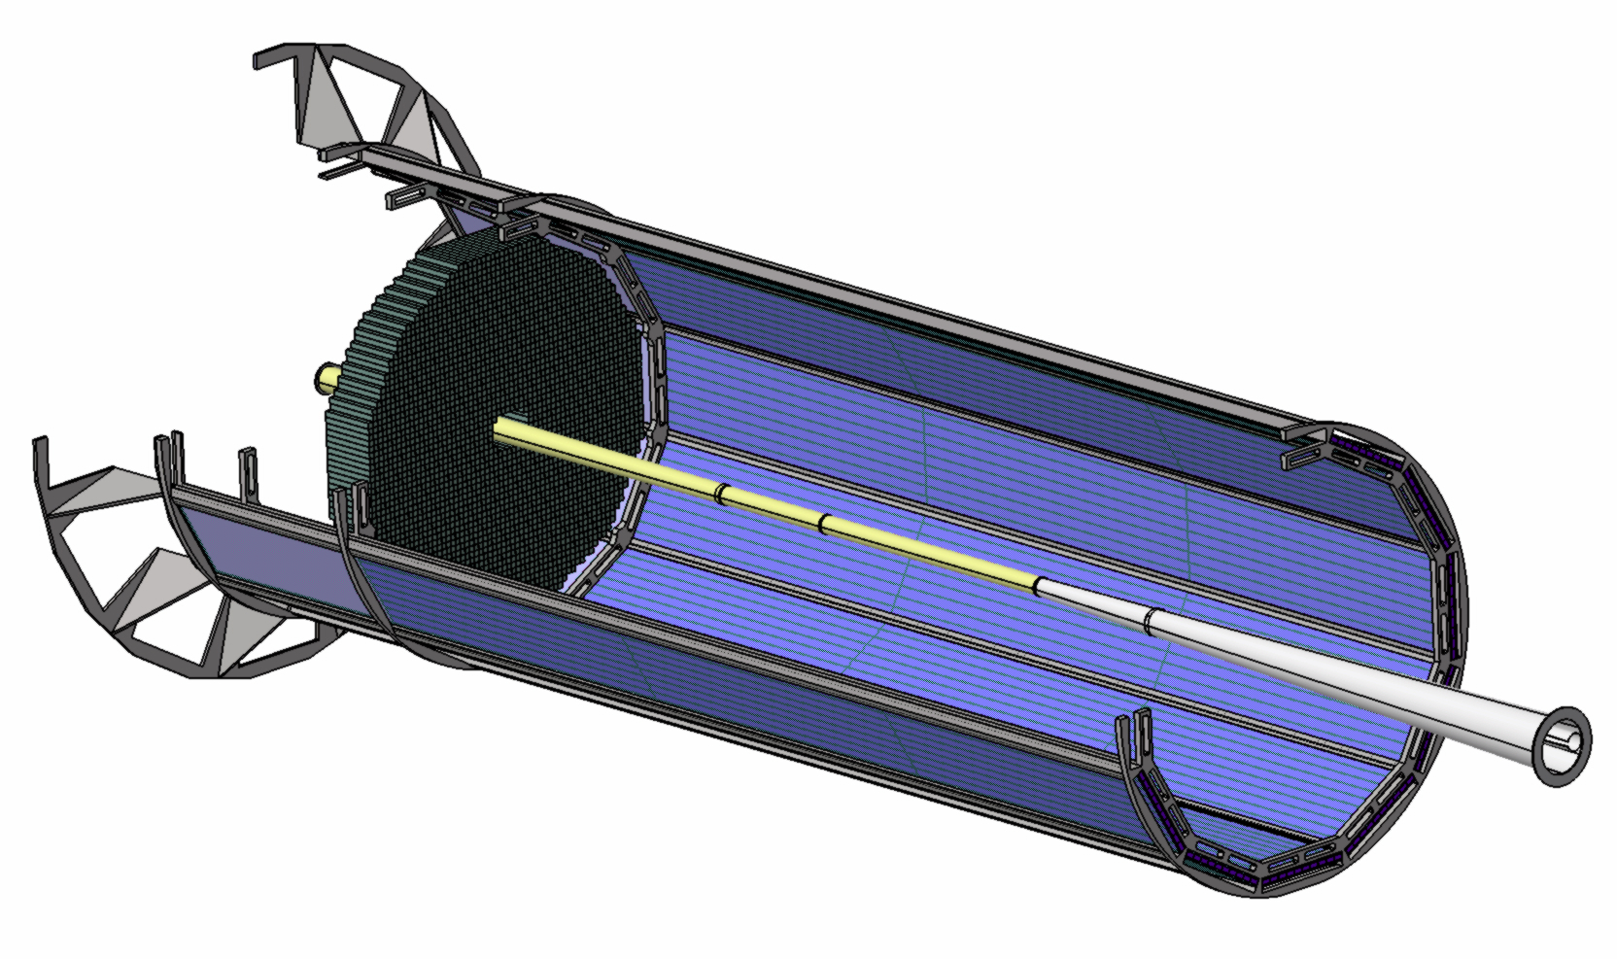
2x2x20 cm³ PWO crystals
0.5-mm-thick C-fiber between crystals along 2 cm in the front & back; 0.5 mm of air elsewhere
EMCAL
BACK
FRONT
174 cm
Interaction point
DIRC
Beam pipe
diameter:

Slide 35
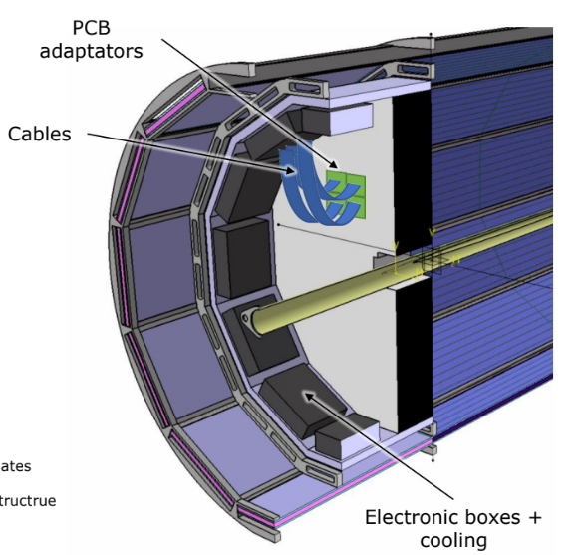

Slide 36
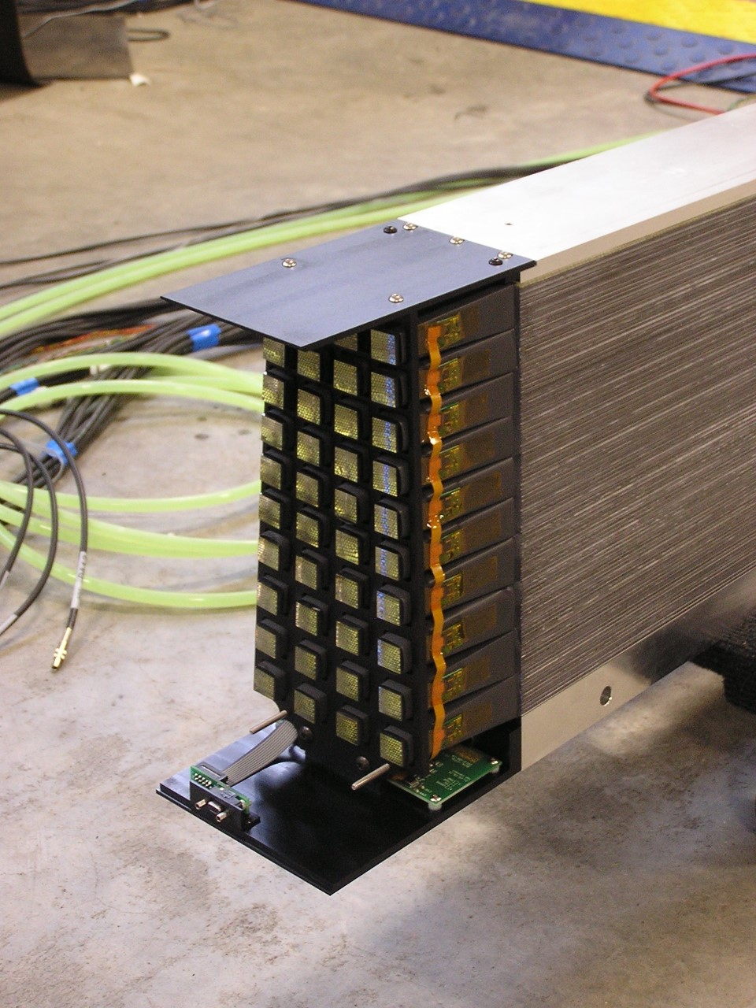
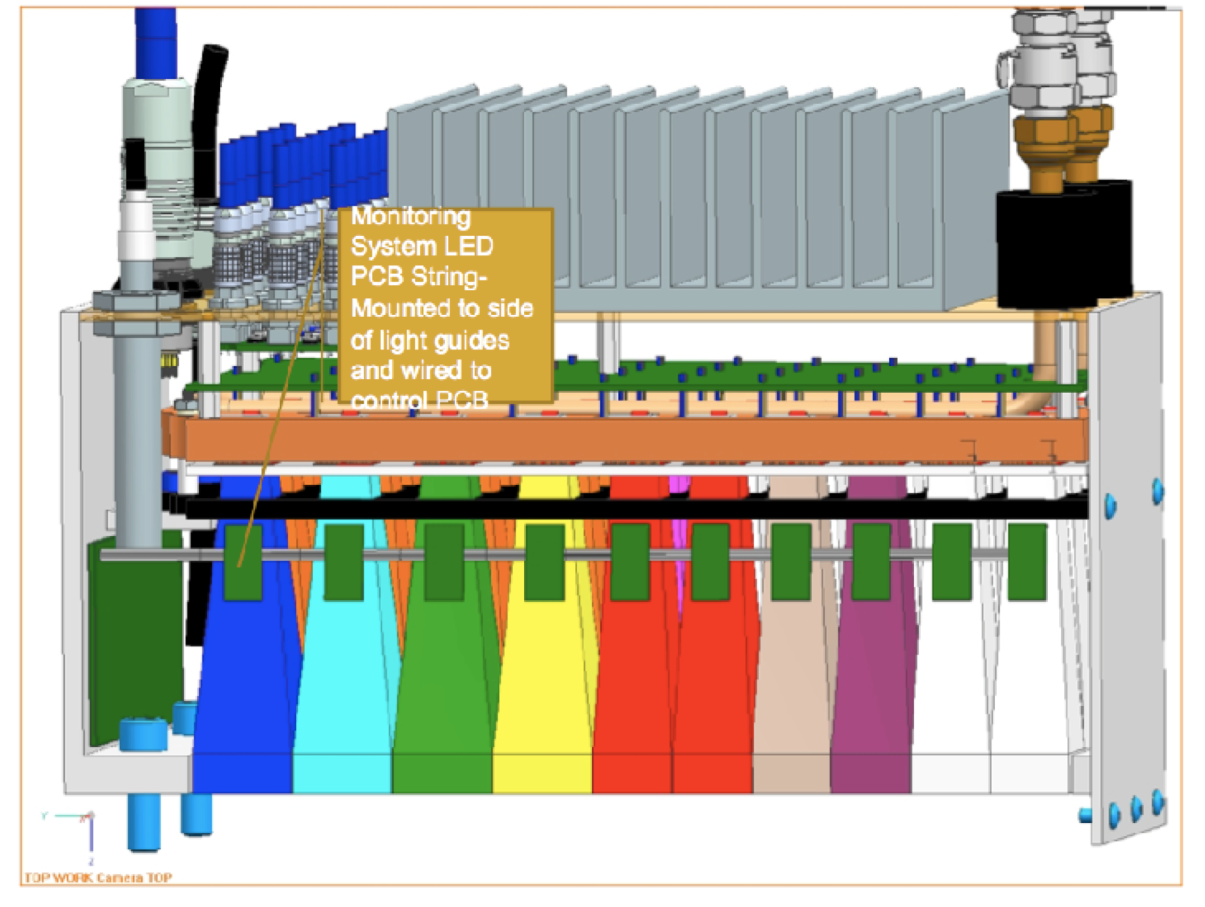

Slide 37
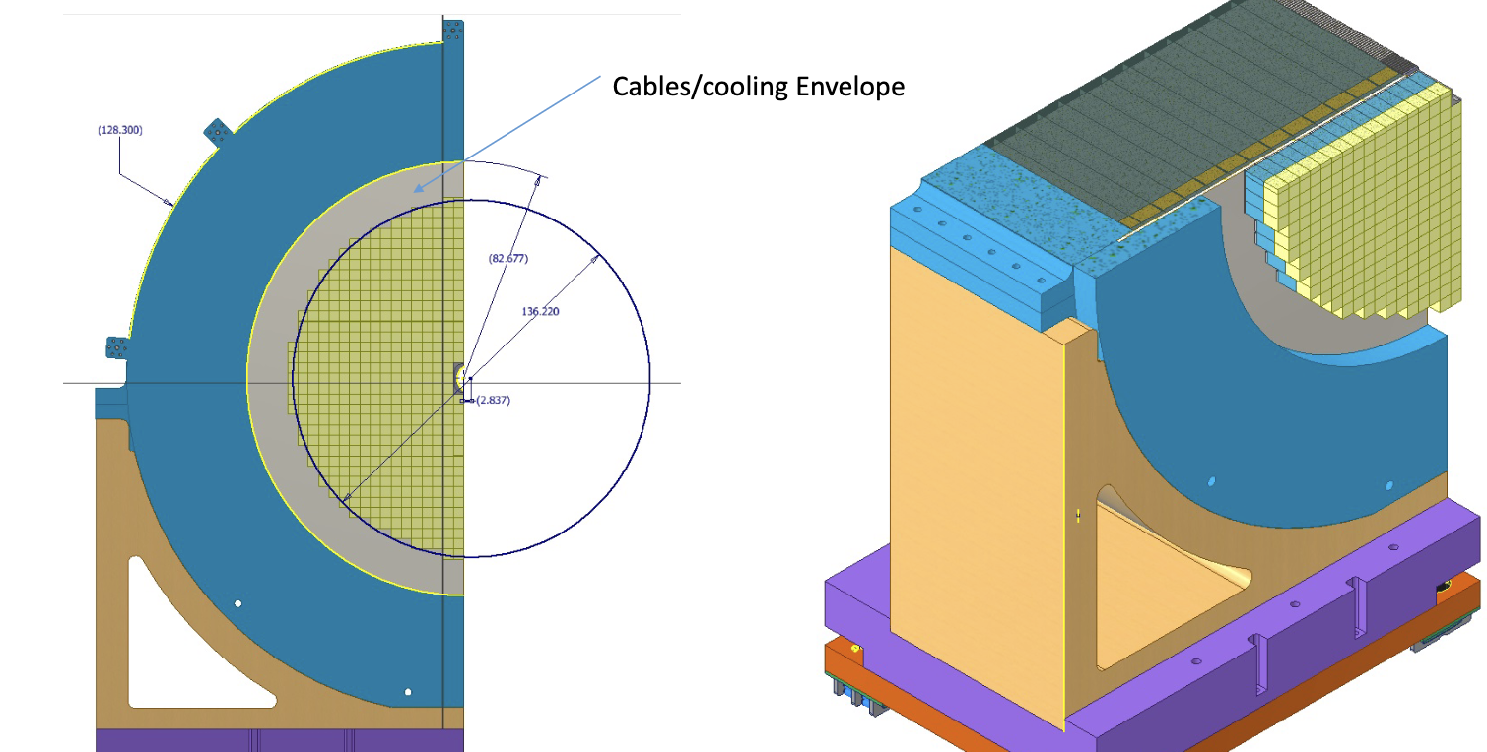

Slide 38
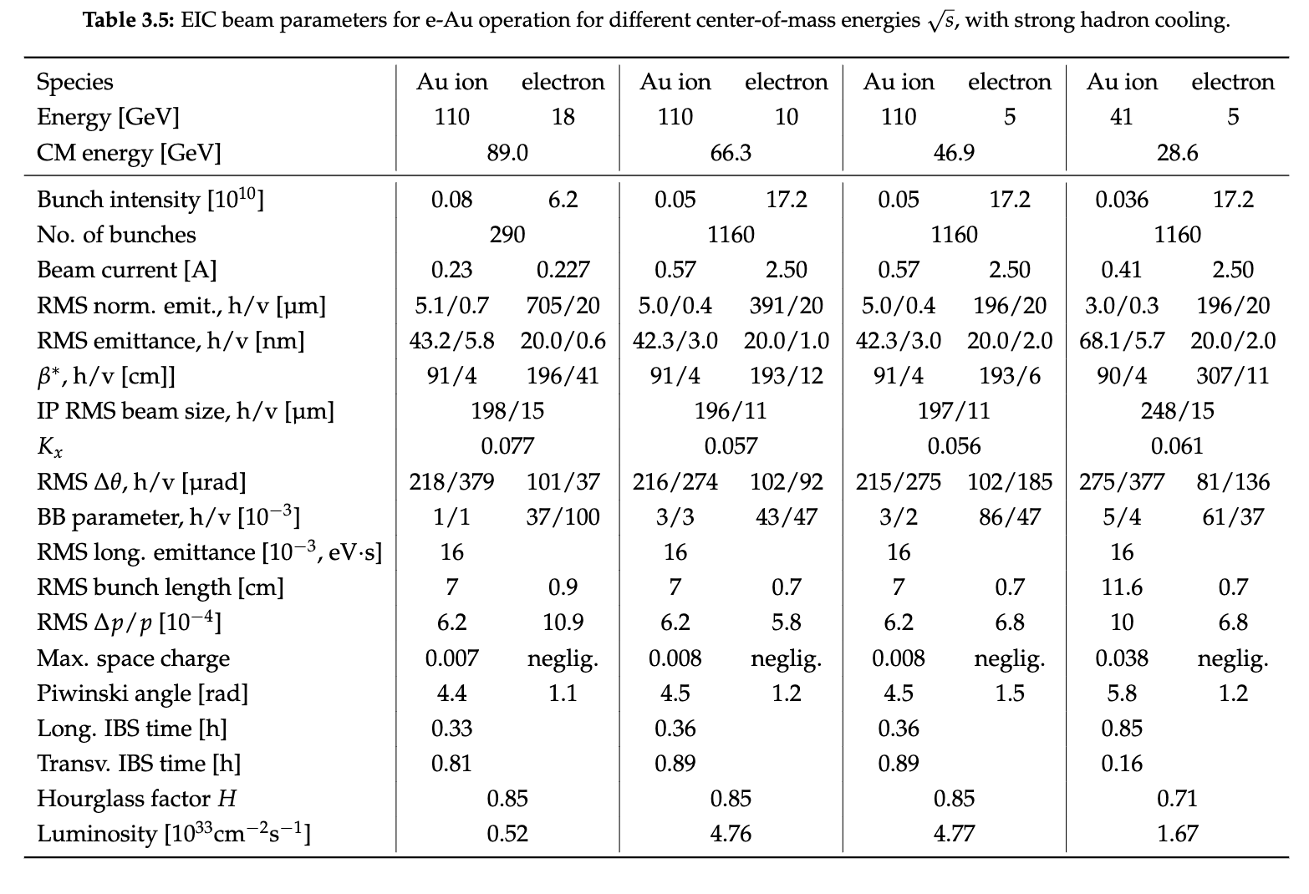

Slide 39
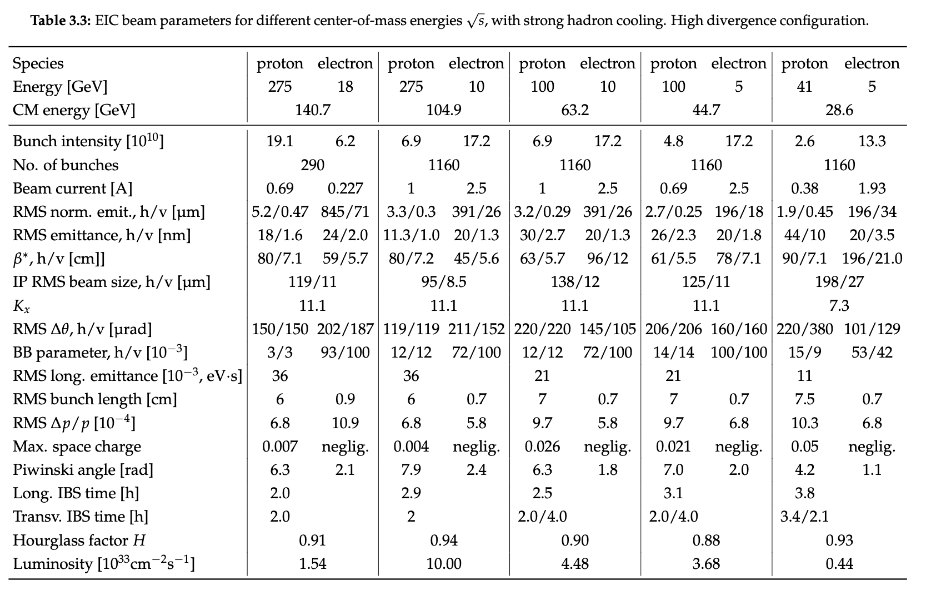

Slide 40
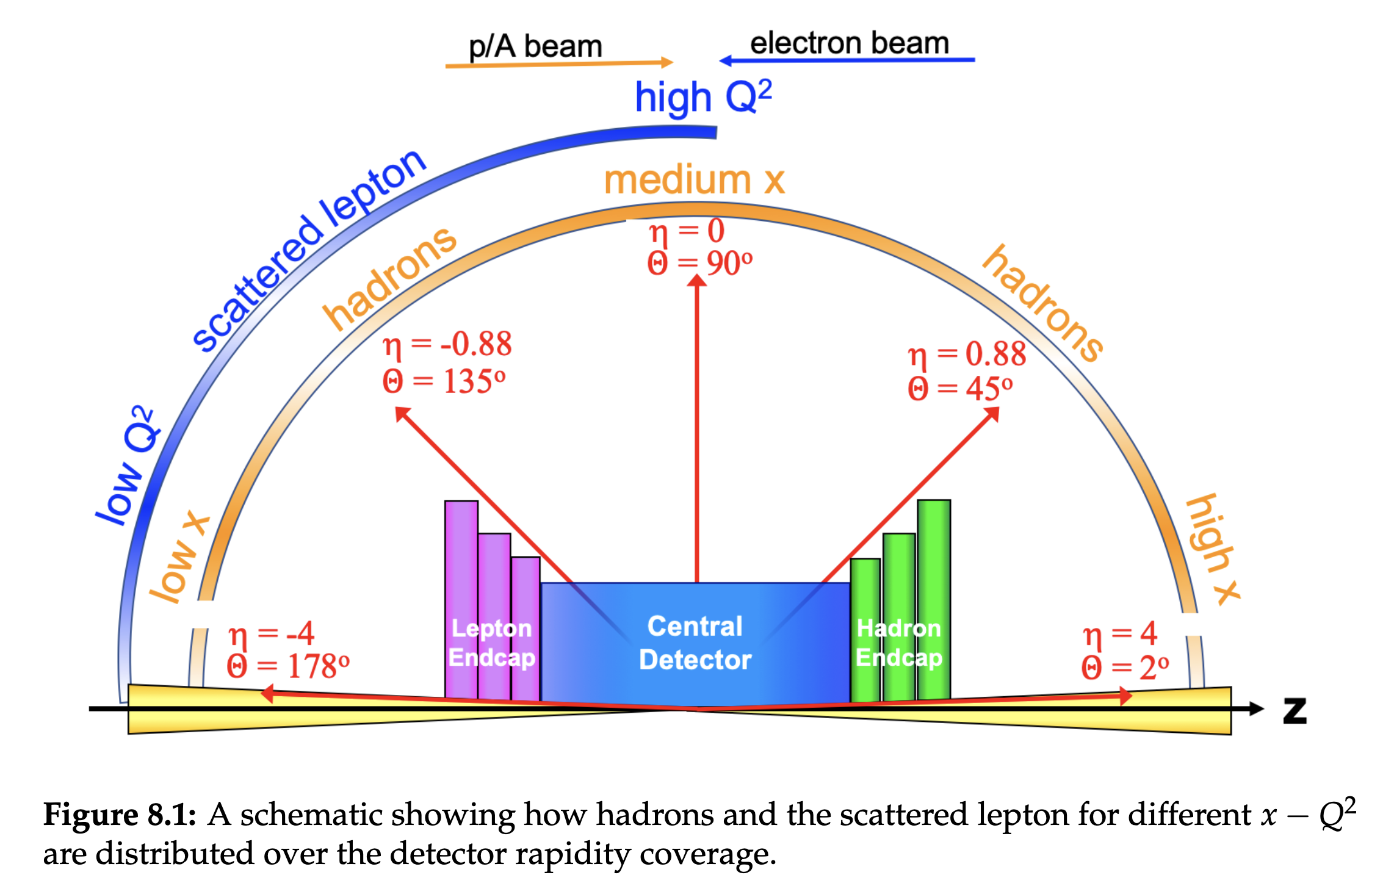
Backup

Slide 42
