Slide 1
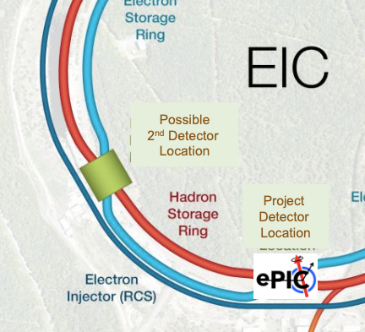
A 2nd detector for the Electron-Ion Collider (EIC)
Pawel Nadel-Turonski
CFNS Stony Brook University
2nd Detector @ IP8
XXXI International Workshop on Deep Inelastic Scattering and Related Subjects, April 8-12, 2024

Slide 2
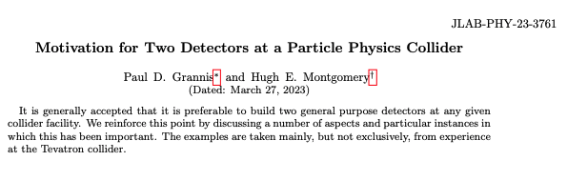
Motivation for two detectors – a HEP perspective
arXiv: 2303.08228
Inspired by their talk at the first EIC 2nd detector workshop, Mont and Grannis wrote a paper on the benefits of two detectors in particle physics.
Example from the Tevatron: Discovery of the top quark (CDF and D0)
The authors also note that although D0 was built 5 years after CDF, both detectors had comparable contributions to the Tevatron physics.
A few other examples
Discoveries
  Discovery of Higgs boson: ATLAS and CMS
  Quark-gluon plasma: RHIC experiments
Mistakes or misinterpretations
  Cold Fusion
  Pentaquarks from the 2000’s

Slide 3
Motivation for a 2nd EIC detector and IR with a 2nd focus
Needed to unlock the full discovery potential of the EIC
  Cross checks of key results are essential!
  Requires a general-purpose collider detector able to support the full EIC program
New physics opportunities
  Take advantage of much-improved near-beam hadron detection enabled by a 2nd focus,
    exclusive / diffractive, recoiling nuclei and fragments from nuclear breakup, etc
  Other capabilities for pursuing ideas beyond the White Paper / Yellow Report
    muons, spectroscopy, BSM, ... - Your input is essential!
Complementary with ePIC
  Possible to reduce combined systematics (as for H1 and ZEUS)
  Particularly important for the EIC where high statistics mean that uncertainties for a large fraction of the envisioned measurements will be systematics limited

Slide 4
Luminosity, acceptance, and systematics
Tomography / imaging requires a high luminosity – but also excellent far-forward acceptance
When the EIC reaches its design luminosity, many measurements in these categories will become systematics limited, greatly benefitting from two detectors.
A 2nd detector with improved forward acceptance will have a large impact on all aspects of the EIC physics program.

Slide 5
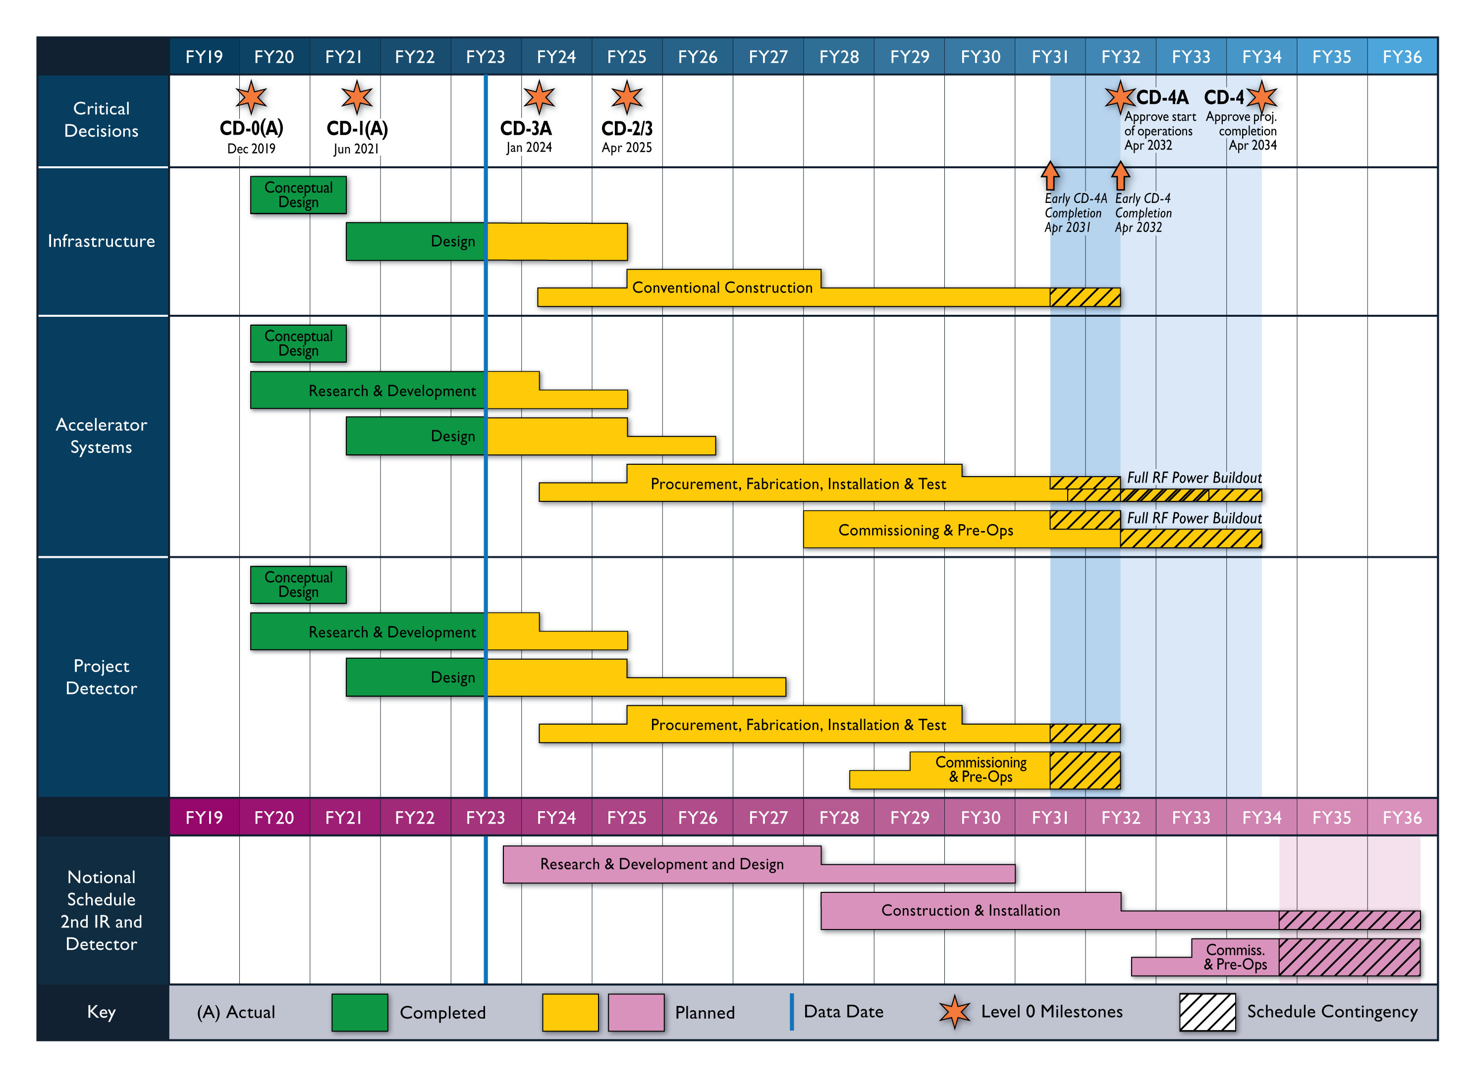
Reference schedule including a 2nd IR and Detector
Jim Yeck, EIC 2nd detector WS, May 2023
Second detector

Slide 6
DOE review by NSAC of new or upgraded facilities for 2024-2034
https://science.osti.gov/np/nsac/Reports
“… I am asking the SC advisory committees to look toward the scientific horizon and identify what new or upgraded facilities will best serve our needs in the next ten years (2024-2034).”
From DOE charge to NSAC
Facilities or upgrades included in the review
Electron-Ion Collider (EIC)
High-Rigidity Spectrometer (HRS) at FRIB
Ton-Scale Neutrinoless Double-beta Decay (TS-NLDBD)
Project 8
Facility for Rare Isotope Beams Energy Upgrade (FRIB400)
Solenoid Large Intensity Device (SoLID) at JLab
Electron-Ion Collider (EIC) Detector II

Slide 7
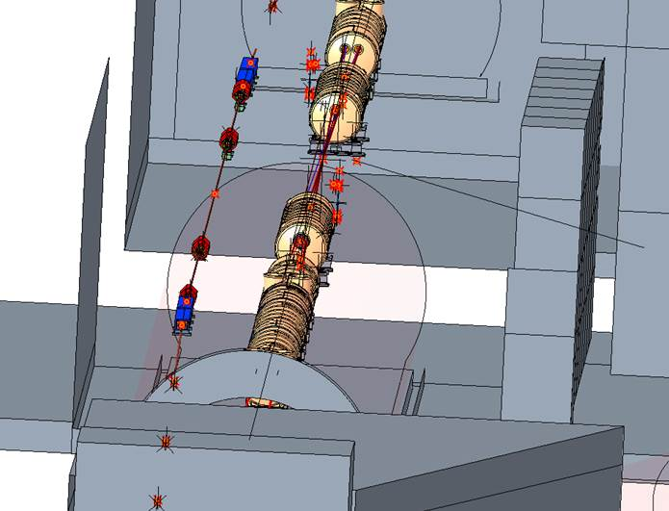
Integration of the central detector with the interaction region (IR8)
Detector space (outer size):
  Longitudinal: +/- 4.5 m around the IP (original BNL spec)
  Transverse: 3 m radius (limited by RCS line)
3 m
Solenoid size:
  Longitudinal: can be shorter than in ePIC, still providing more internal space (2.5-3.0 m coil)
  Transverse: Inner radius will depend of B-field
IR8 will have a far-forward spectrometer with a 2nd focus on the (outgoing) hadron side
  Natural synergies with central detector
RCS line (left) in IR8

Slide 8
A 2nd detector for the EIC
General-purpose detector able to carry out the full EIC physics program.
  Cross checks of discoveries
  Reduced systematic uncertainties from combined data with ePIC (c.f. H1 and ZEUS)
Capabilities would / could include
  Forward recoil / fragment detection with a 2nd focus
    Improves acceptance for low-p_{T} / low-x protons from exclusive reactions.
    Allows tagging of nearly all ion fragments (or vetoing breakup of nuclei)
    Enables detection of rare isotopes (e.g., Z=89-94 not well covered by FRIB)
  High resolution, e.g.:
    B-field up to 3 T (vs 1.7 T in ePIC) for charged particles
    Precision EM calorimetry could be extended into barrel (e.g., DVCS on nuclei and spectrometry)
  Much-improved muon detection
    Unambiguous identification of scattered electron from decay leptons in dilepton production (e.g., DDVCS)
  Improved coverage for 0.1 < Q² < 1 GeV² (gap between endcap and low-Q² tagger)
Generic EIC detector R&D
  Example: extended momentum coverage for PID in the barrel from further DIRC development

Slide 9
Example: double-DVCS
Q²
Q’²
Double DVCS makes it possible to probe GPDs outside of the x = ξ line.
  Measure ξ dependence at low t and moderate Q²
Experimentally, DDVCS is challenging because counting rates are lower than for DVCS or TCS
  Cross section larger in EIC kinematics
Q’ has to be in a mass region without meson resonances decaying into l⁺l⁻
(e.g., in-between the φ (or ρ‘) and the J/ψ)
A 2nd EIC detector could provide a better DDVCS measurement than ePIC or JLab (fixed-target)
  muon ID is necessary in order to distinguish the scattered electron from the DDVCS decay leptons
  low-t acceptance for the recoil proton (2nd focus)
  0.1 < Q² < 1 GeV² coverage for the scattered electron
Note: TCS (Q² = 0) is also an important EIC measurement, but the experimental constraints are a subset of DDVCS

Slide 10
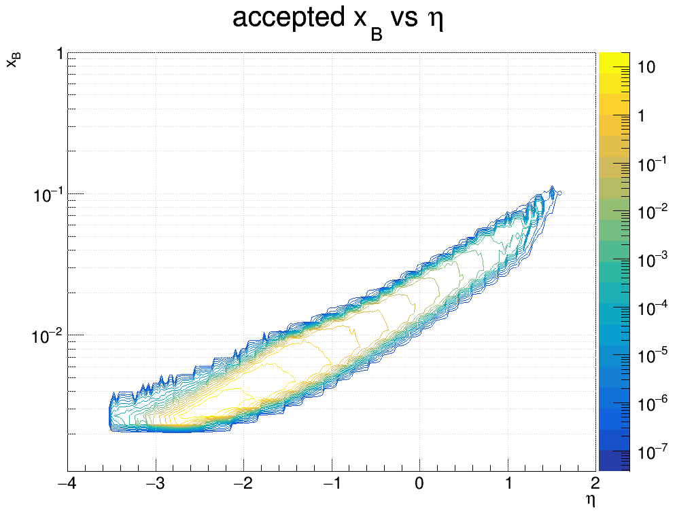
Example: DVCS on nuclei
In DVCS on the proton, both the photon and proton are detected for exclusivity
  t can be determined from the proton
DVCS photon distribution
10x137.5 [GeV/A] ⁴He
In DVCS on the nuclei, the nucleus has to be detected or the breakup vetoed to ensured coherence and exclusivity.
  t is determined from the photon
  (cf. coherent VM production on nuclei)
endcap
barrel
For the best measurement of DVCS on nuclei, the 2nd EIC detector should have:
  low-t acceptance (provided by the 2nd focus)
  high-resolution EMcal coverage in the barrel
C. Hyde

Slide 11
Example of a high-resolution EM calorimeter for the barrel
DVCS photon distribution
10x137.5 [GeV/A] ⁴He
endcap
barrel
A high-resolution EMcal like the one built for PANDA would be ideal for the 2nd detector.
  DVCS on nuclei (extends coverage)
  Spectroscopy (as in PANDA)
C. Hyde

Slide 12
Muon and neutral hadron detection for a 2nd EIC detector
A position-sensitive, radially segmented muon ID system like the KLM from Belle II would be ideal for the barrel and (outgoing) electron endcap
  An Hcal is needed in the hadron endcap.
Most muons will traverse most layers, while pions will stop early: high purity, low mis-ID.
  Each layer with crossing strip is read out individually.
  Works well for low muon momenta
The KLM also measures neutral hadrons
  In the EIC, jets are best reconstructed from tracking and PID
  1/3 of jets contains neutral hadrons
  A KLM can provide the hit position
  Energy and ToF capabilities are part of ongoing R&D
  Complementary to ePIC (sPHENIX) barrel Hcal
Simulation of EIC-KLM from Generic EIC detector R&D

Slide 13
Generic EIC detector R&D
It is expected to be funded at an annual level of $2M, subject to availability of funds from DOE NP.
2023 submissions
Aimed at Detector 2, or upgrades of Detector 1
Proposals accepted from across the world from universities, laboratories, and companies
Features of a proposal that add value: reduce risk, cost effective, increase physics scope, innovative, etc.
https://www.jlab.org/research/eic_rd_prgm

Slide 14
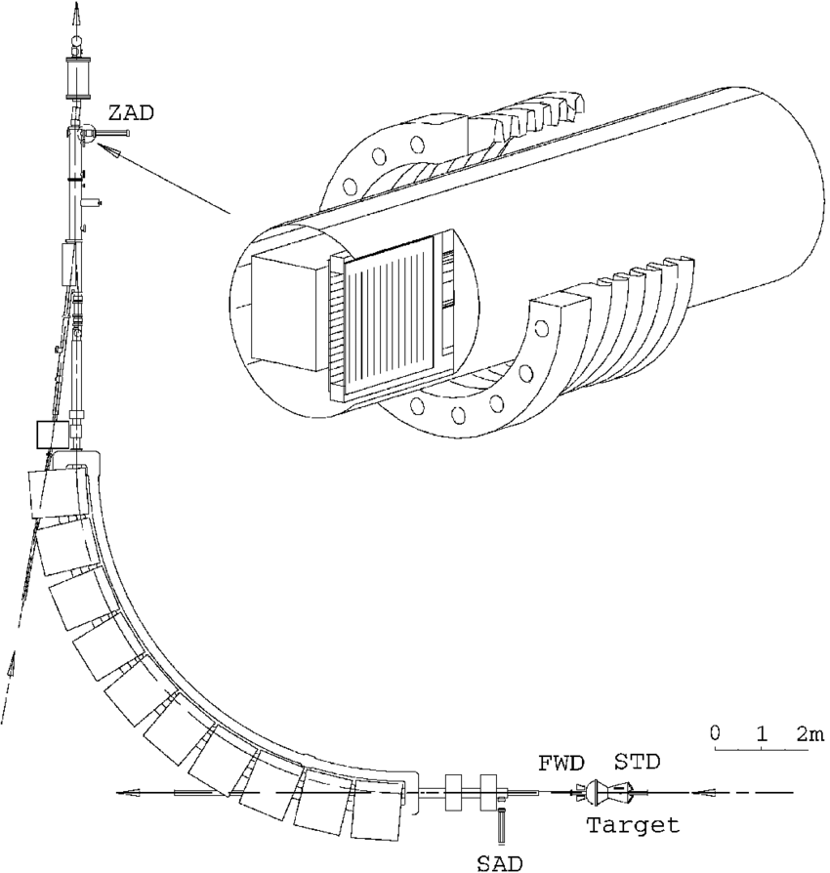
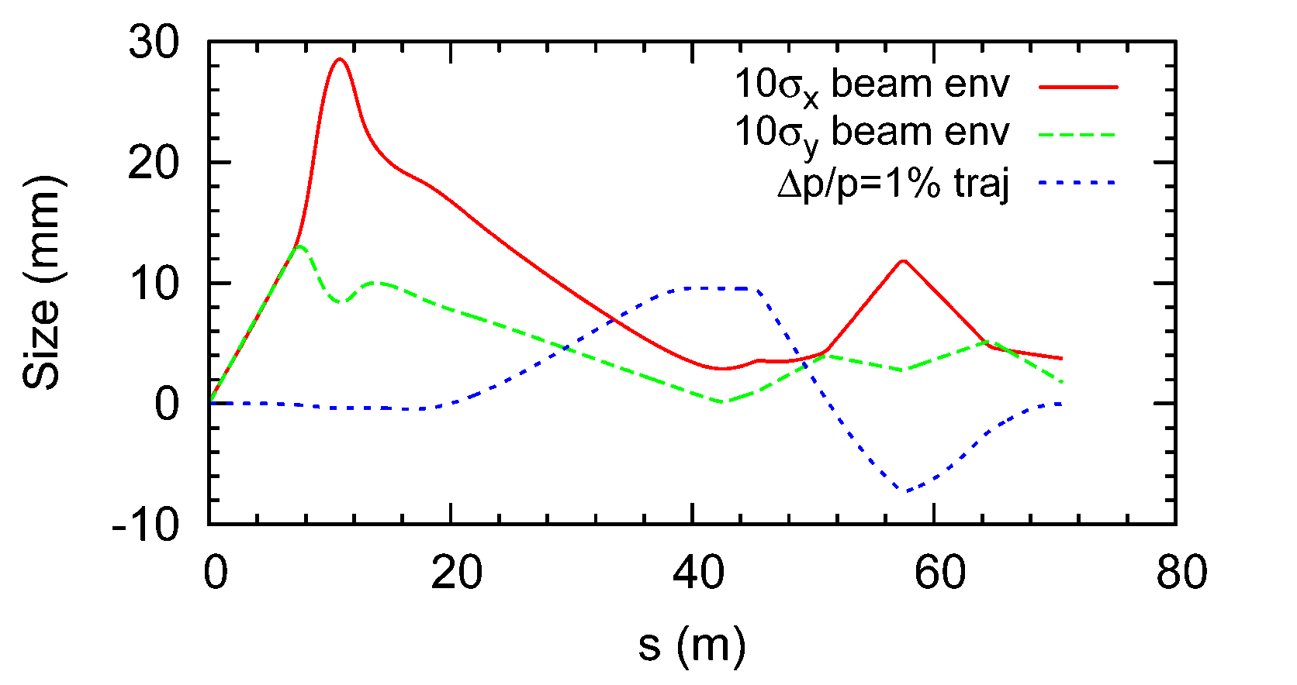
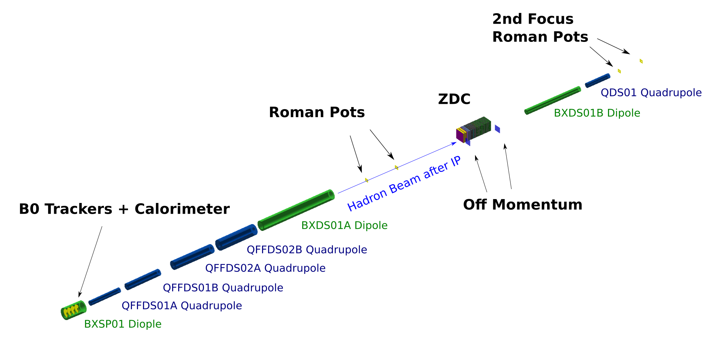
Optics for a 2nd EIC detector were inspired by the CELSIUS ring in Uppsala
trackers
2nd Roman pot
Z-tagger
bellows
The idea of a 2nd focus was adapted (PNT, V. Morozov) for a collider and is now intended for use in IR8.
Roman pots at a 2nd focus in the fixed-target CELSIUS ring at TSL.
dipoles
quads
ZDC

Slide 15





EIC far-forward acceptance with and without a 2nd focus
Ion fragments from ²³⁸U
Exclusive protons
$$p_{⊥}$$
(x_{L} = p’ / p_{beam} ~ 1 – x)
Excluded
Without 2nd focus: (EPIC @IR6)
Detected
Detected
Detected
Excluded
⬅ Z’ vs x_{RP}
$p_{⊥}$vs x_{L}➔
0.9
1
$$x_{L}$$
0
Limited by D and 2nd focus (β₂)
Limited by angular acceptance (β*)
With 2nd focus: (Detector 2 @ IR8)
$$p_{⊥}$$
Order-of-magnitude improvement in forward acceptance
Detected
Excluded
0
0.99
1
$$x_{L}$$
x position ~ A/Z

Slide 16
Example: exclusive coherent scattering on nuclei
For light nuclei, the 2nd focus enables detection with close to 100% acceptance down to p_{T} = 0.
  Clean measurement of 3D structure.
For heavier nuclei, incoherent events can be suppressed with a high efficiency by detecting the fragments (including neutrons and photons) from the breakup.
B. Schmookler et al.
Evaporation
⁴He
Fission
1 fm⁻¹ = 0.2 GeV
1 fm⁻² = 0.04 GeV²
10 fm⁻² = 0.4 GeV²
20 fm⁻² = 0.8 GeV²
Fragments produced in scattering on ²³⁸U

Slide 17
Example: A-1 tagging with a 2nd focus using a ⁹⁰Zr beam
arxiv:2208.14575
generated (BeAGLE)
detected (Geant)

Slide 18
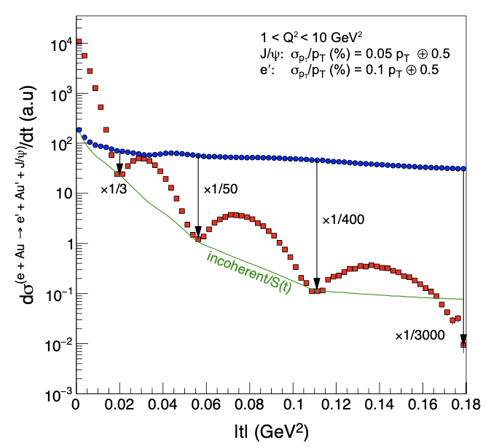
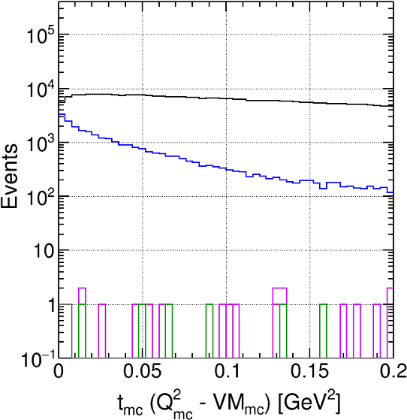
Example: vetoing breakup in coherent using a 2nd focus
Jihee Kim
Reference from EIC YR p.352
Veto inefficiency for incoherent events
Coherent
Incoherent
No veto: all events (100%)
Neutron veto: 5.7%
n + Roman pots: 0.0097%
All detectors: 0.00055%
At the third diffractive minimum, a rejection factor for incoherent event better than 400:1 (0.0025% inefficiency) must be achieved
Fragment detection using the Roman pots at the 2nd focus provides a stronger veto at larger values of t.

Slide 19
EIC UG 2nd detector working group
December 2021 – DPAP review of EIC detector proposals
  The call included a 2nd detector
  While the DPAP did not make a selection of a 2nd detector, it endorsed the idea
July 2022 – the Det II / IP8 WG was formed. Everyone is welcome to join!
  Regular public meetings
  Conveners:
  Charles Hyde (ODU), Sangbaek Lee (ANL), Simonetta Liuti (UVA), Pawel Nadel-Turonski (CFNS/SBU), Bjoern Schenke (BNL), Ernst Sichtermann (LBL), Thomas Ullrich (BNL), Anselm Vossen (Duke/JLab)
Several workshops have also already been organized by the WG
  December 2022: first in a series of CFNS workshops at Stony Brook U. (98 participants)
  May 2023: 1st International workshop on Detector II at Temple U. (115 participants)
  July 2023: Detector II workshop as part of the EIC UG meeting in Warsaw, Poland

Slide 20
Summary
Having two detectors at the EIC would provide the necessary cross checks of discoveries and potentially reduce the systematic uncertainties (cf. H1 and ZEUS)
A 2nd detector could also provide expanded and unique capabilities
A generic detector R&D program is already in place.
The EIC UG 2nd detector WG is pursuing and coordinating ongoing activities.

Slide 21
Thank you!

Slide 22

So what is a 2nd focus and what does it do?
$$σ=\sqrt{βε+{\left(D\frac{Δp}{p}\right)}^{2}}$$
Three are mutually supportive strategies for detecting forward particles
Drift
  A particle scattered at a small angle will eventually leave the beam (which could be far away).
  When using only this method, the scattering angle has to be larger than the angular spread (divergence) of the beam, which is determined by the strength of the focus at the collision point (β*).
Dispersion (D) translates a longitudinal momentum loss into a transverse displacement
  dx = D dp/p , where dx is the transverse displacement at p_{T} = 0
  With D = 0.4 m, dp/p = 0.01, and p_{T} = 0, the transverse displacement for would be 0.4 cm
A 2nd focus can reduce the (10σ) beam size at the detection point
  Enables detectors to be placed closer to the beam – very effective in combination with dispersion
  Without a 2nd focus (IR6): 4 cm (high luminosity / divergence), 2 cm (low luminosity / divergence)
  With a 2nd focus (IR8): 0.2 cm (high luminosity / divergence)

Slide 23

Beam optics and the actual trajectory of a p_{T} = 0 particle (blue)
For optimal detection, the (2nd) focus has to coincide in x and y at the point of maximum dispersion (green line below).
  σ_{x} and σ_{y} should be comparable at the 2nd focus (and thus β_{x} < β_{y} since ε_{x} > ε_{y})
A zero degree particle (blue) briefly emerges from the beam at the 2nd focus about 40 m downstream of the IP where it can be detected
  Particles with a non-zero angle emerge earlier .
$$σ=\sqrt{βε+{\left(D\frac{Δp}{p}\right)}^{2}}$$
The 2nd focus refers to the beam. Scattered particles have their maximum transverse displacement here.
Trajectory in the dispersive (x) plane
V. Morozov

Slide 24
Example: tagging of heavy spectators
Both IR6 and IR8 support tagging of spectator protons from light ions (d, He)
  These spectators have magnetic rigidities that are very different from that of the beam ions
The fragments will also contain rare isotopes
  Gamma spectroscopy possible by measuring boosted forward-going photons in coincidence
  Interest from the FRIB community
    Proton rich Z=89-94 nuclei, etc
A 2nd focus will allow tagging of heavy spectators
  A-1 nuclei up to at least Zr-90
  A-2, etc, for almost any nucleus
B. Schmookler et al.
Evaporation
Fission
Tagging of heavy A-1 spectators enables measurements of reactions on a bound nucleon
Fragments produced in scattering on ²³⁸U

Slide 25
IR magnet layout showing the 2nd focus
Green dipole magnets change dispersion
Blue quadrupole magnets focus the beam, changing its size, expressed through the beta functions (x and y)
Dispersion slope control section
(D’ = 0 at 2nd focus preserves angle)
Main dipole - generates most of the dispersion
Focusing section crating both focuses (IP & 2nd)
Small dipole covering the range between the endcap and Roman pots

