Slide 1

Strong Interaction Physics at the Luminosity Frontier with 22 GeV Electrons at Jefferson Lab
Cynthia Keppel
Deep Inelastic Scattering
April 8-12, 2024
Maison MINATEC, Grenoble, France

Slide 2

22 GeV is a rather new opportunity at Jefferson Lab….
The community did a lot of work (science workshops, accelerator studies, cost estimating, profile development,…) to quickly prepare for the NSAC Long Range Plan
- Critical just to be mentioned favorably!
“To investigate the other XYZP states, higher beam energy is required; the tetraquark candidate Z_{c} states would Z_{c} be copiously produced at a high-luminosity, fixed-target electron machine operating above 20 GeV.”
“The staged upgrade plan for CEBAF foresees...[]…an energy upgrade of CEBAF to more than 20 GeV. Recently, the Cornell Brookhaven Electron Test Accelerator (CBETA) facility demonstrated eight-pass recirculation of an electron beam with energy recovery employing arcs of fixed-field alternating gradient magnets. This exciting new technology could enable a cost-effective method to double the energy of CEBAF, allowing wider kinematic reach for nucleon femtography studies in the existing tunnels and with no new cryomodules required.”

Slide 3
Jefferson Lab Accelerator PHASED Upgrade
A staged upgrade program at the luminosity frontier (up to 10³⁹ e-N /cm²/ s), capitalizing on novel accelerator science and technology
Phase 1: Polarized positrons in a former FEL (“LERF”) with transport to CEBAF (proposed 12 GeV science program)
Phase 2: Recirculating injector energy upgrade to 650 MeV electrons
Replace one set of arcs on each side with new FFA permanent magnet arcs to upgrade to 22 GeV – no new RF needed! No new cryomodules needed!
123 MeV e⁺ and 650 MeV e⁻

Slide 4
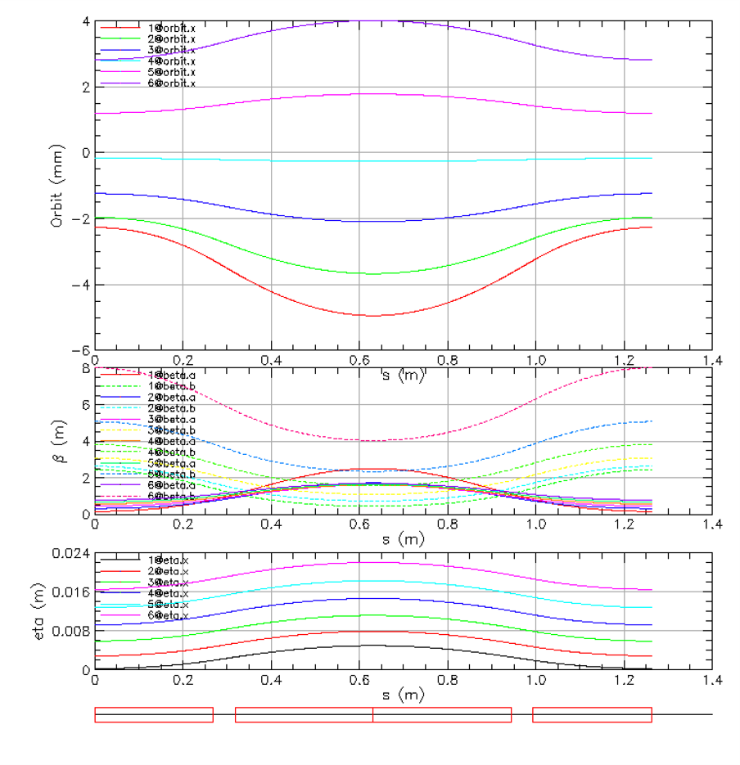
Compact FFA Cell – How Does it Work?
Large momentum acceptance FFA (Fixed Field, Alternating Gradient) cell is configured with combined function permanent magnets capable of transporting multiple energy beams through the same string of magnets (six beams with energies spanning a factor of two)
BD
BD
Focusing Magnet BF
G_{F}= -41.13 T/m
L_{QF}= 1.67 m
B_{F}= -0.812 T
BF
12 cm
1 T
50 T/m
13 cm
Closely spaced orbits for all six beams (~ 1 cm)
Extremally low dispersion (a few mm) in a combined function lattice – virtue of FFA technology
Self similar beta functions for different energy beams
Arc composed of 75 cells, L_{cell} = 3.15 m
BD
BF
BD

Slide 5

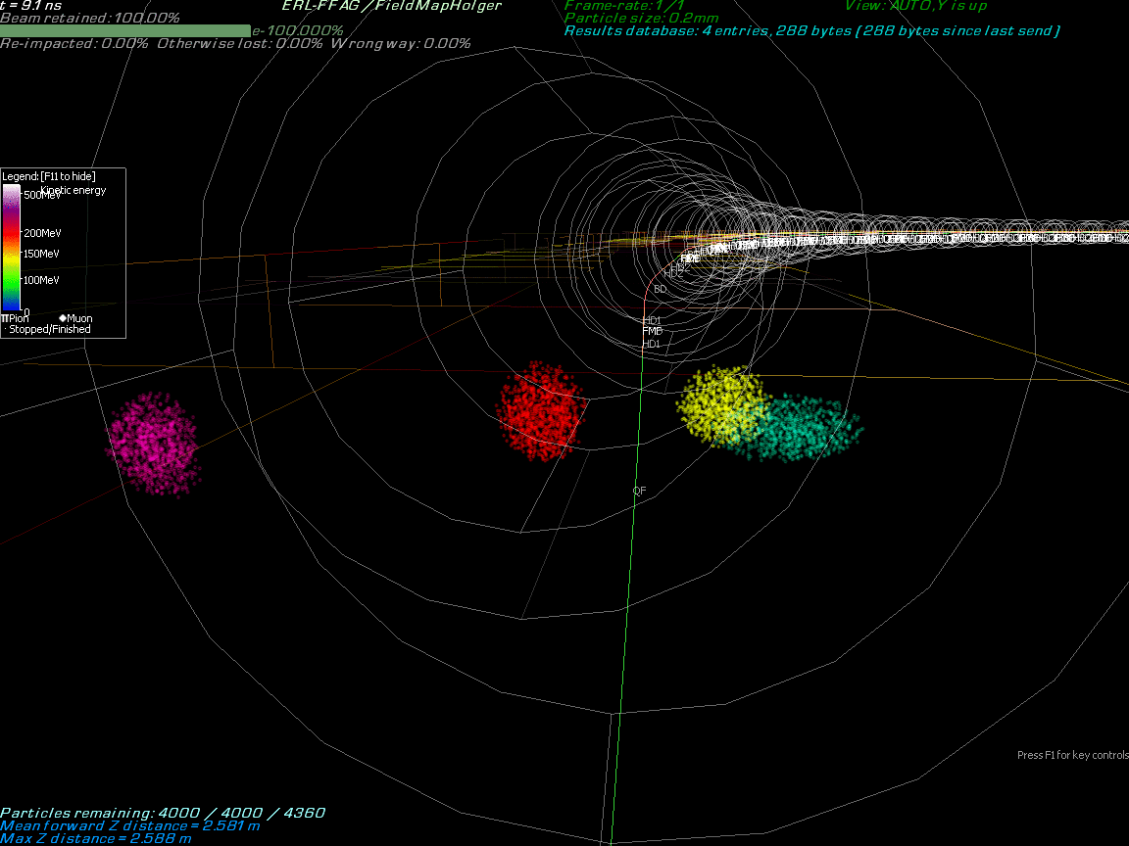
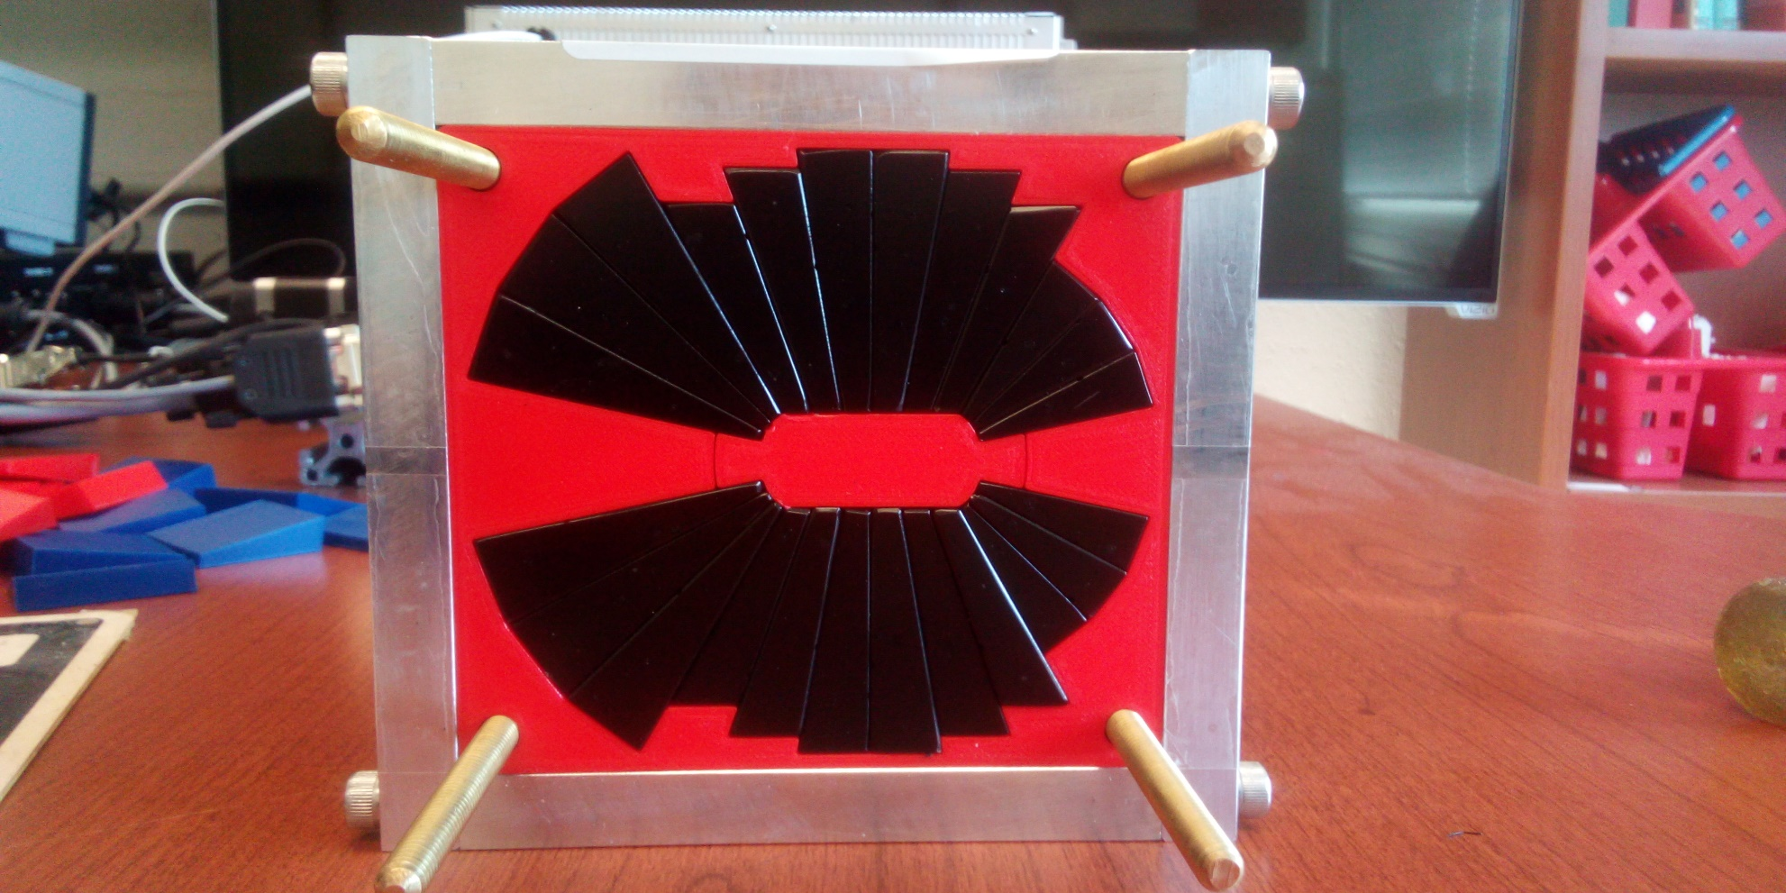
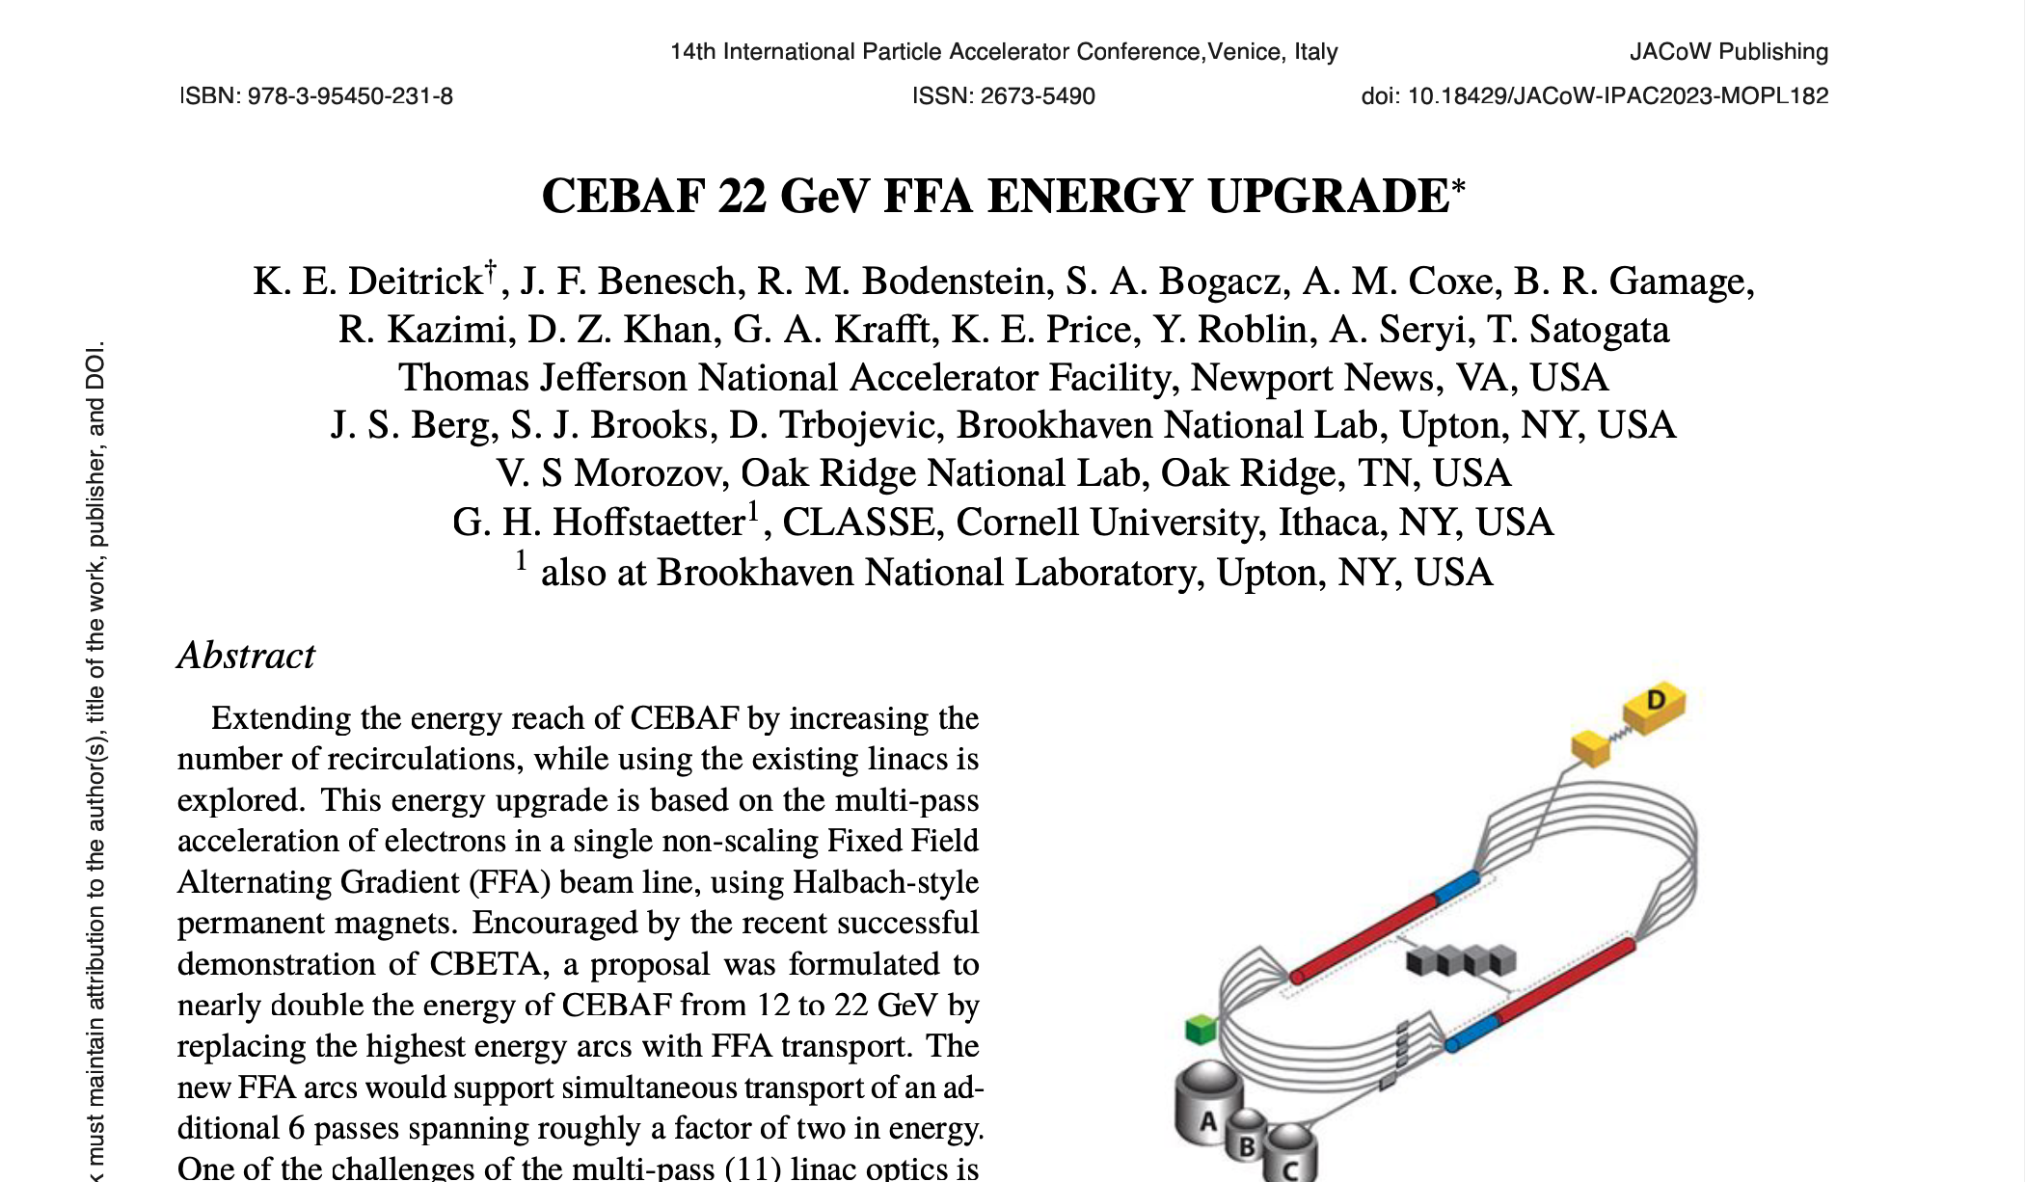
Multi-Energy Beam Dynamics in FFA Arc
2019-2022 the first multi-turn SRF ERL (150 MeV)
Scaling to higher energy at Jlab…
Stephen Brooks, BNL
A prototype open midplane BF magnet was built and evaluated for mechanical integrity. Magnetic measurement confirmed a robust design with >1.5 Tesla in good field region, 10⁻³ field accuracy. JLab LDRD for radiation resilience tests in CEBAF began October 2023.

Slide 6
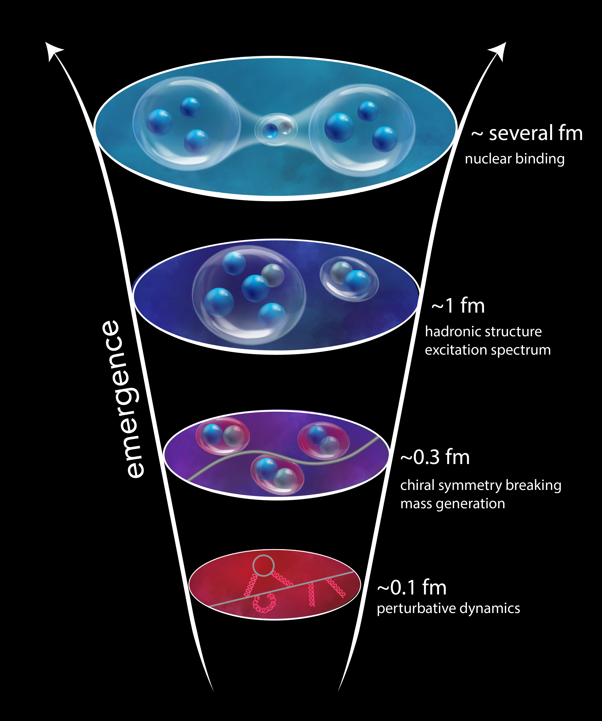
Why CEBAF @ 22 GeV?
“The ability to reduce everything to simple fundamental laws does not imply the ability to start from those laws and reconstruct the universe.” -- More is Different, P. W. Anderson [Science 177, 393 (1972)]
Need to understand strong interaction dynamics from asymptotically free fundamental quark and gluon constituents to the structure of bound nucleons to nucleon-nucleon interactions and the nuclear medium
Complex non-pQCD problem which demands different approaches and measurements to access multiple observables
6
6

Slide 7
What a 22 GeV Upgrade Brings
A NEW territory to explore ➜ cross the critical threshold into the region where cc states can be produced in large quantities, and with additional light quark degrees of freedom
A BETTER insight into our current program ➜ enhancement of the phase space
A BRIDGE between JLab @ 12 GeV and EIC ➜ testing and validation of QCD from lower to higher energy, through multiple phenomena, and with high precision
7
7

Slide 8
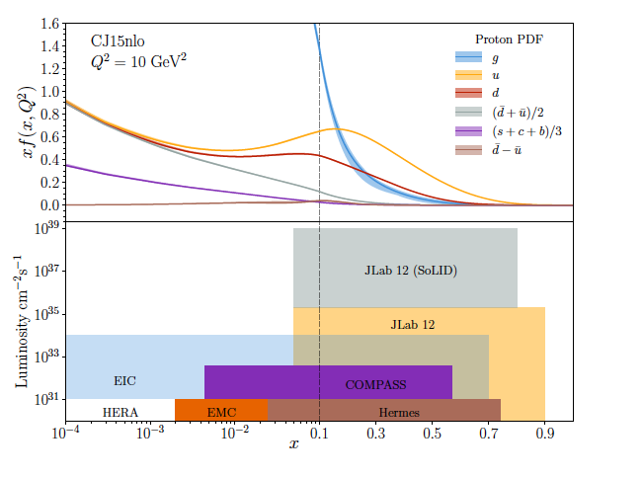
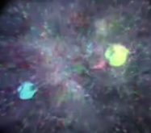
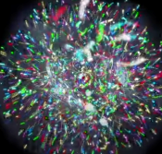
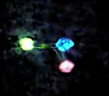
JLab 12 to 22 GeV:
Probing Nucleon Valence Structure at High Luminosity
Partonic structure in the valence region defines the hadron
Baryon number, charge, flavor content, total spin, …
Large x, low Q² evolves to low x, high Q² via pQCD, extract shape and strength from data
Precision measurements (2D,3D) in the valence regime requiring high luminosity are the purview of JLab, providing overlap with EIC
into the low x region
Probability Distribution
Probability Distribution
JLab 22
Luminosity (cm⁻²s⁻¹)
2030s-2040s
Fraction of nucleon momentum
Physics with CEBAF at 12 GeV and Future Opportunities
Prog. Part. Nucl. Phys. 127 (2022) 103985

Slide 9
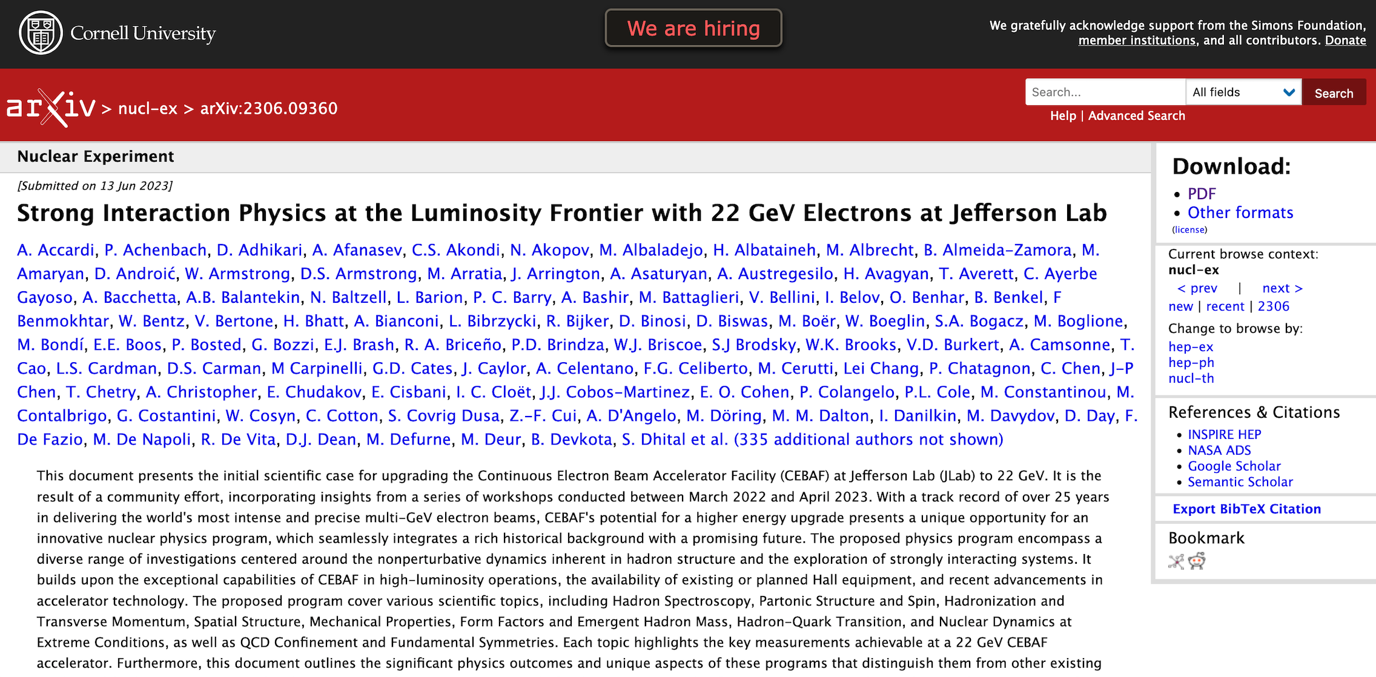
Strong Interaction Physics at the Luminosity Frontier with 22 GeV Electrons at JLab
arXiv:2306.09360v2 [nucl-ex], accepted to EPJA
140+ pages, ~450 authors with many powerful experiments using existing or planned equipment - just a few examples….

Slide 10
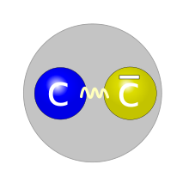
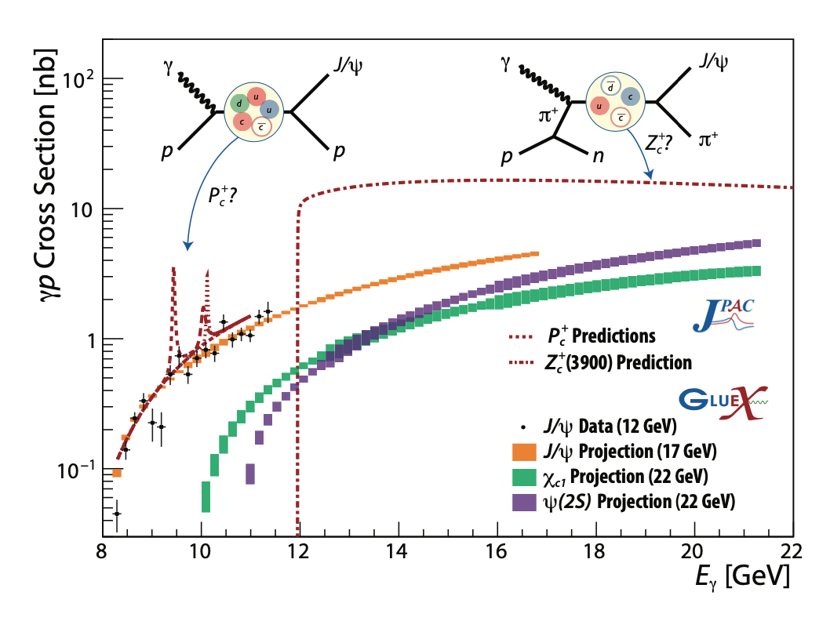
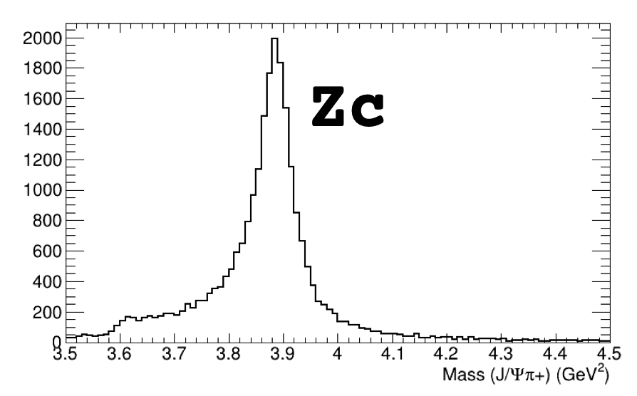
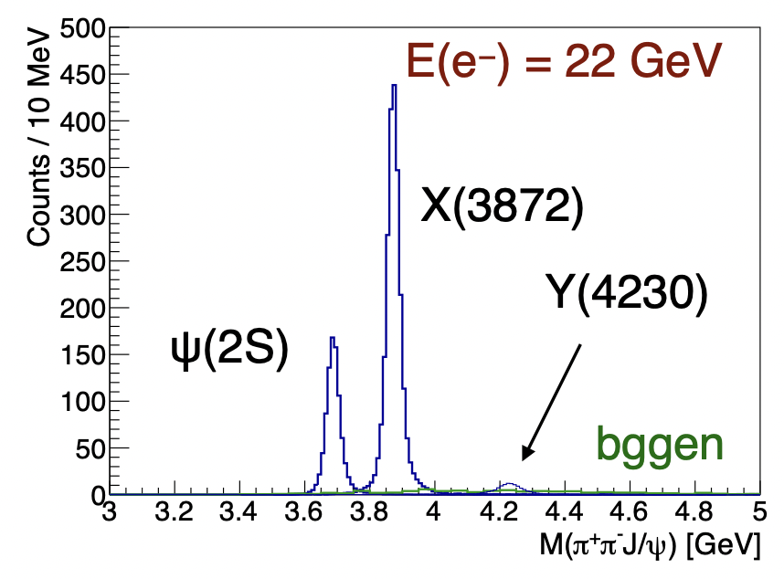
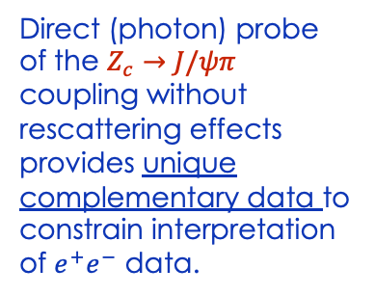

Spectroscopy of Exotic States with charm
Photoproduction of hadrons with charm quarks: a new tool for discovery in QCD
➜ a unique method to probe the gluonic structure of the proton
➜ potentially decisive information about the nature of some 5-quark and 4-quark candidates
Tetraquark candidates, XYZ states, observed in B decays, e⁺e⁻ colliders but their internal structure is not yet understood
Never direcly produced using γ/lepton beams ➞ Polarized photoproduction alternative mechanism to study such states
Direct (photon) probe of the $Z_{c}→J/ψπ$ coupling without rescattering effects provides unique complementary data to constrain interpretation of $e^{+}e^{−}$ data.
Initial simulations demonstrate the capabilities of the existing detectors to measure these reactions
$$γp→Jψπ^{+}n$$
Thresholds crossed and t range opens up at higher energy

Slide 11
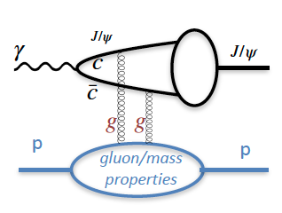
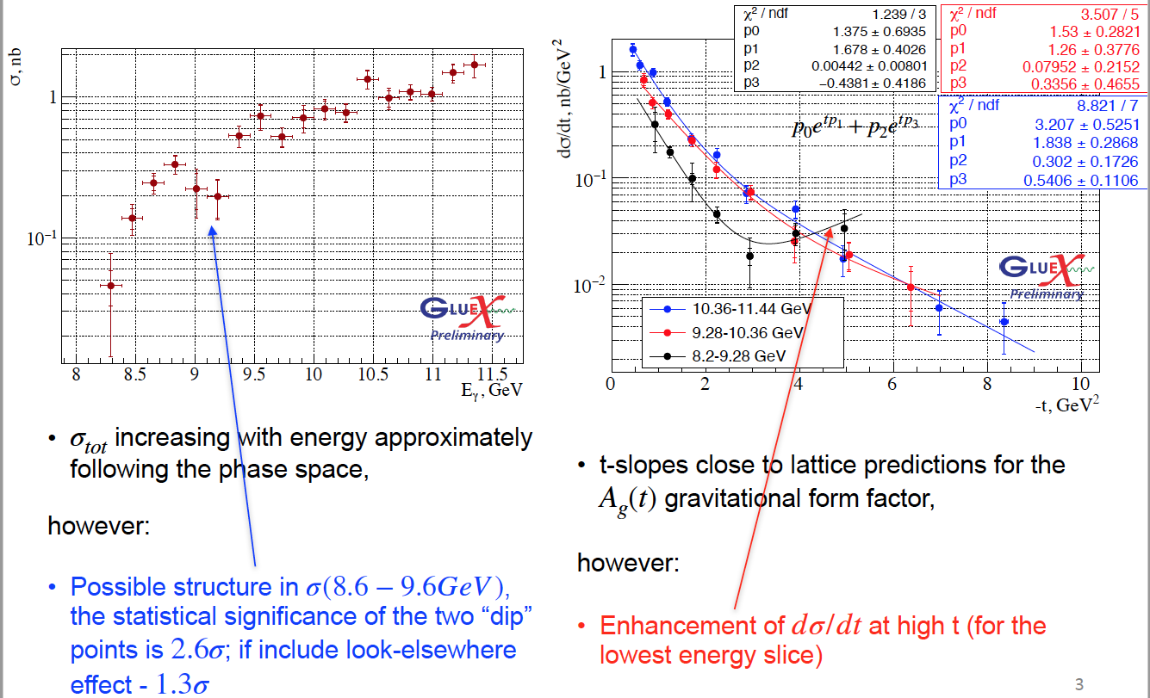
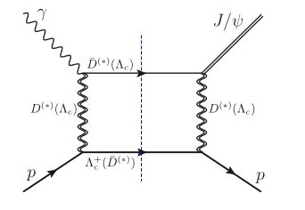
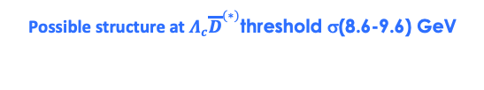
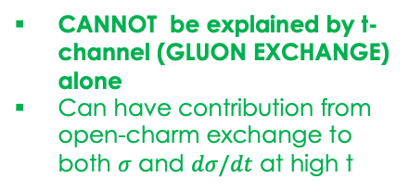
J/ψ photoproduction near threshold
Used to study important aspects of the gluon structure of the proton
gluon GPD, gravitational FF
mass radius of the proton,
anomalous contribution to the proton mass.
..based on some assumptions (mainly 2-g exchange)
Possible structure at $Λ_{c}{\overline{D}}^{(∗)}$threshold σ(8.6-9.6) GeV
CANNOT be explained by t-channel (GLUON EXCHANGE) alone
Can have contribution from open-charm exchange to both $σ$ and $dσ/dt$ at high t
Enhancement of dσ/dt at high t for the lowest energy slice
Can we interpret this as a possible evidence for a s-channel resonance (?) Pc
11
Phys. Rev. C 108 (2023) 2, 025201

Slide 12
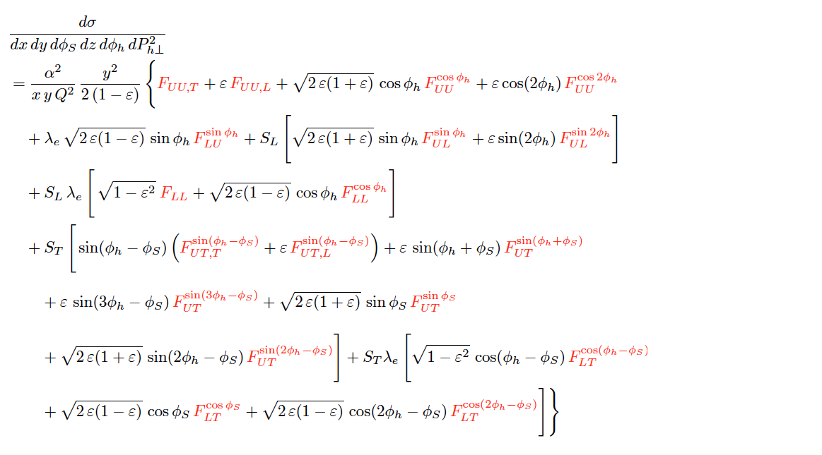
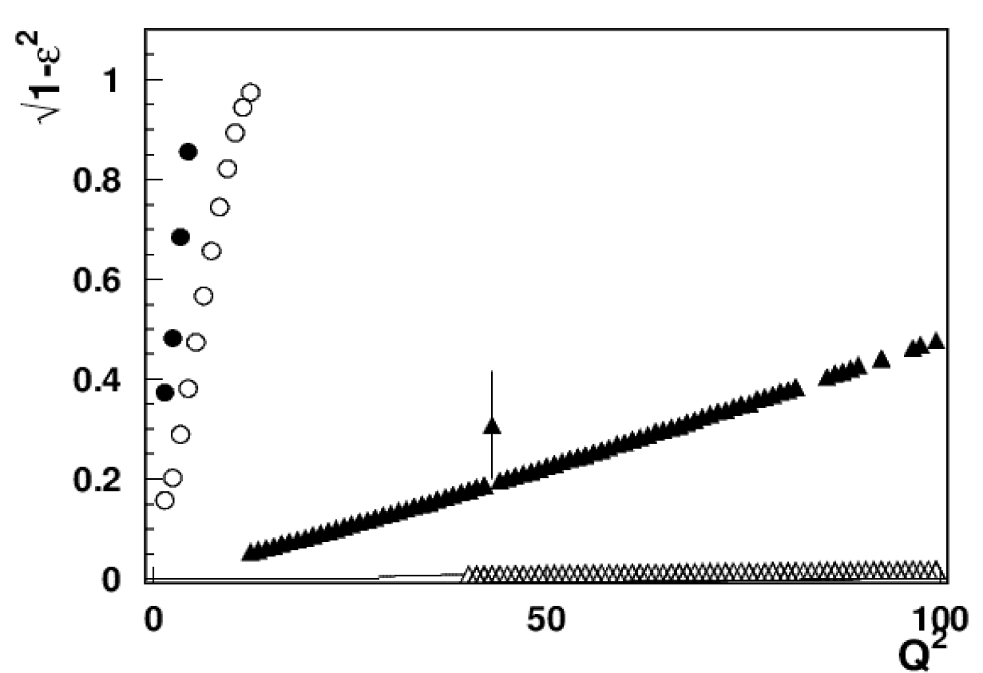
Nucleon Structure in 3D
SIDIS cross section
Separation of SFs highly non-trivial!
σ = f ( x , Q² , z , P_{T})
CLAS12
X=0.3
CLAS24
EIC 5x41
EIC 18x275
A combined 11, 22 GeV and EIC SIDIS program
will increase our ability to measure a variety of SIDIS SFs across an enhanced multidimensional phase space – the only way to test and validate our understanding and interpretation of SIDIS reactions.
12
12

Slide 13
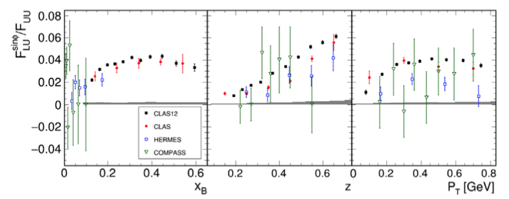
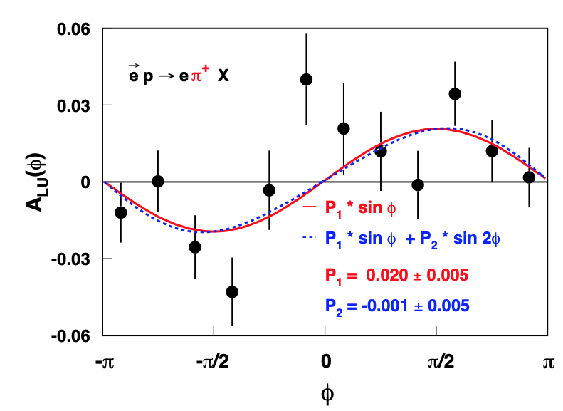
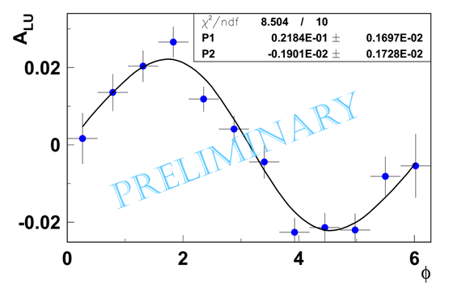
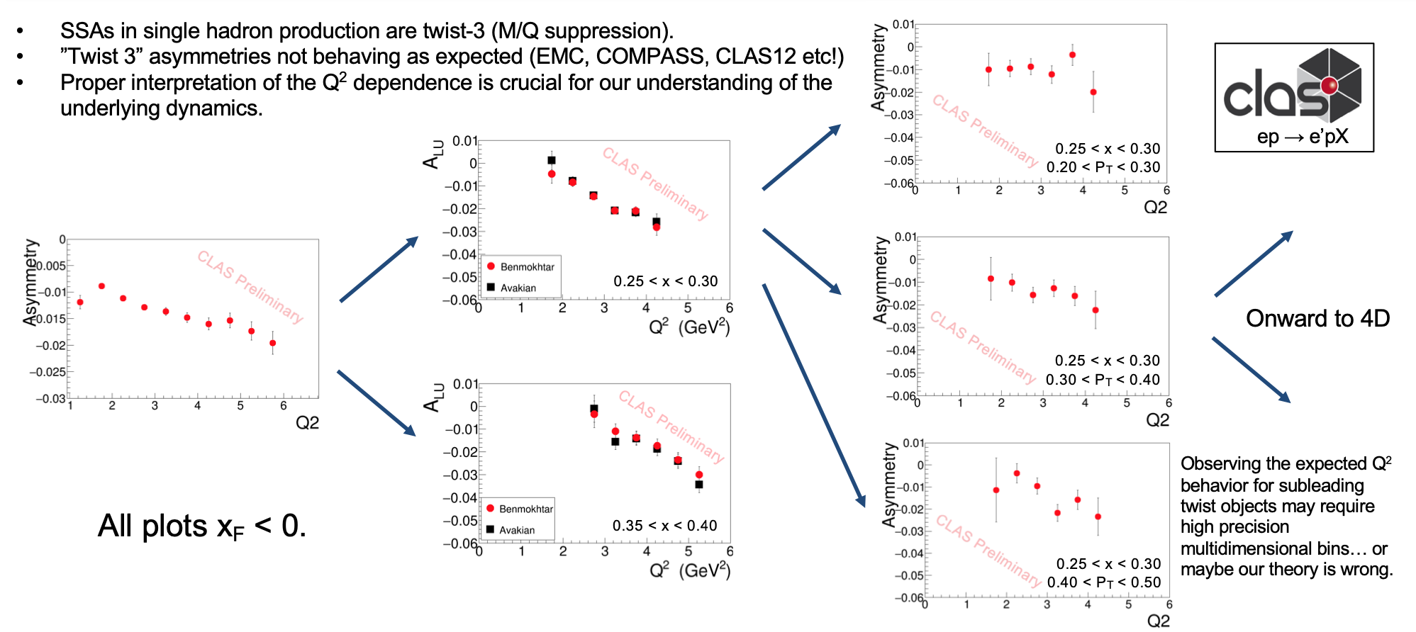
TMDs: High Statistics Crucial!
ep→e’π+ X
HERMES - 1996-2000
JLab – CLAS12 1 day
Phys. Rev. Lett. 128, 062005 (2022). (2022)
F_{LU} contains information on quark- gluon correlations
Phys.Lett.B648:164-170,2007
QCD predicts only the Q² dependence
Studies of the Q² behavior requires high precision and multi-dimensional analysis

Slide 14
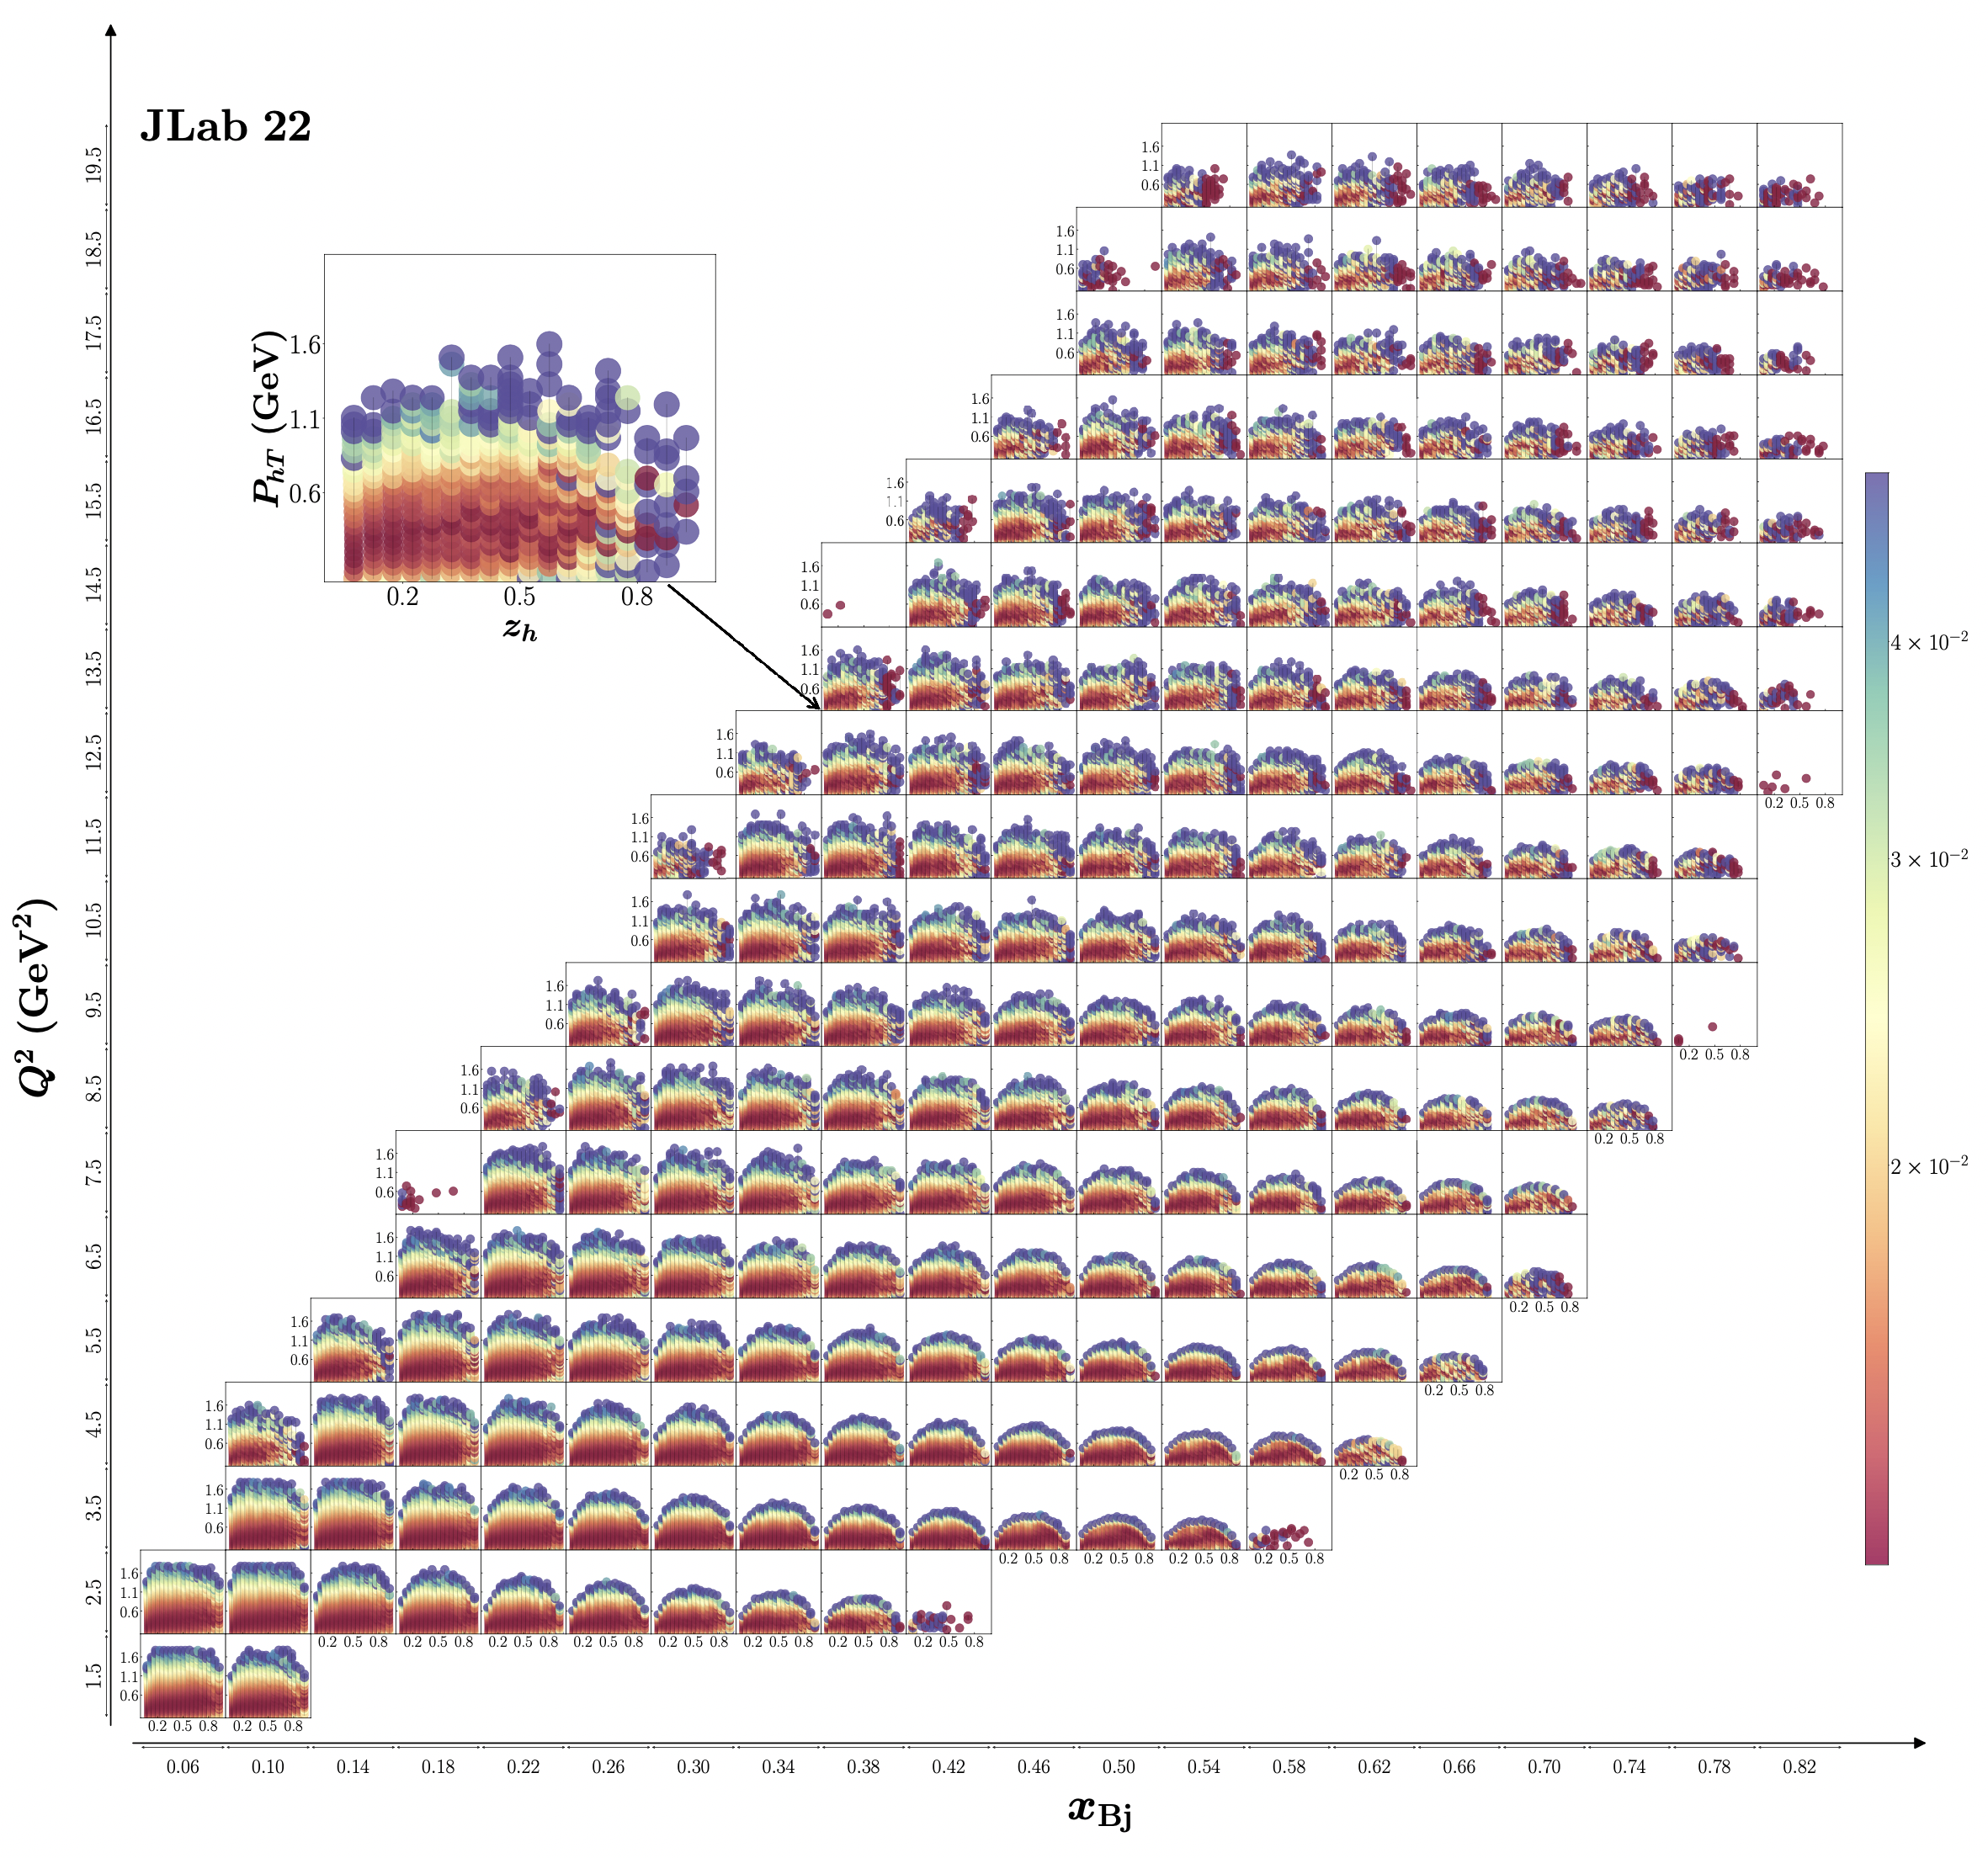
SIDIS Phase Space at 22 GeV
20
Expected uncertainties for SIDIS cross sections in 4D bins
P_{hT}
Significantly increase the kinematic range to validate/test the theory/phenomenology
Multi-dimensional coverage of P_{T} gives access to fine binning of all observables
Projections using the existing CLAS12 simulation/reconstruction chain for 100 days of running with L= 10³⁵ cm²s⁻¹
10⁻²
Q² (GeV²)
z_{h}
1
0
1
x

Slide 15
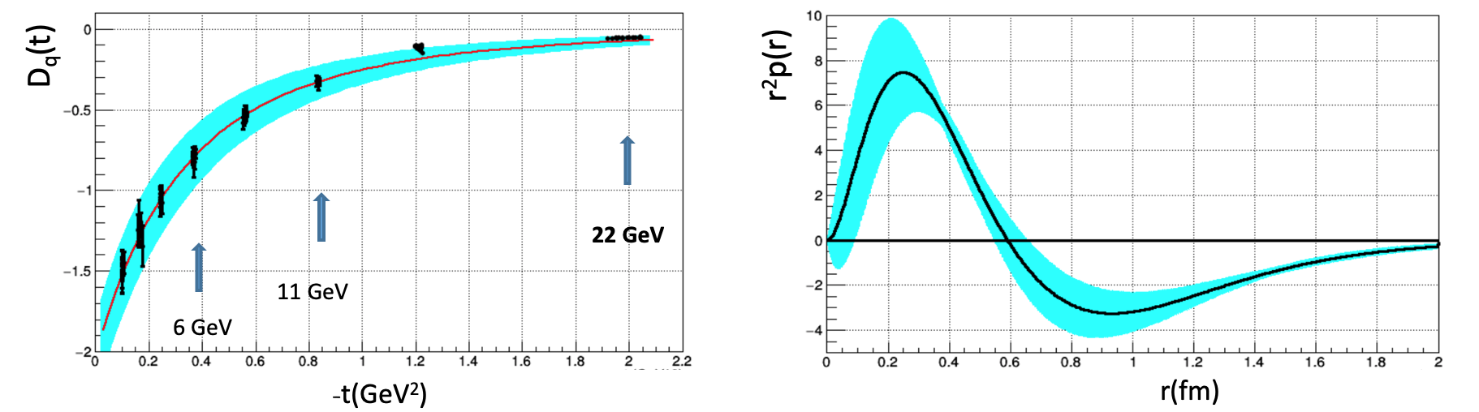
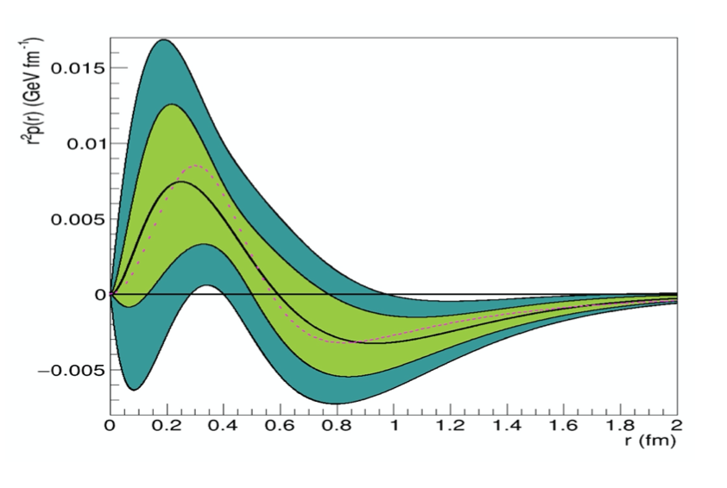
Spacial Structure & Mechanical Properties of the Proton
Form Factors: source of information on hadron structure
Gravitational FFs (GFFs) : describe how energy, spin, and various mechanical properties of hadrons are carried by q/g constituents.
GFF D(t): describes the pressure distribution in the nucleon. It is accessible through measurements of the Compton FFs measured in Deeply Virtual Compton Scattering
Simulation @ 22 GeV
data @ 6 GeV
A large -t range is required to perform the Fourier transform with controlled uncertainties ➜ high luminosity
➜
The 22 GeV beam energy is crucial to this program
22 GeV
15
15

Slide 16
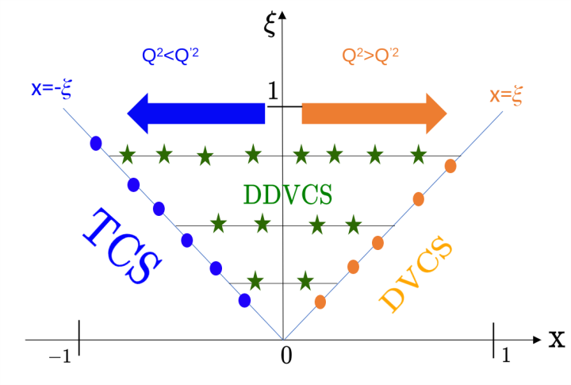
Spacial Structure & Mechanical Properties of the Proton
Form Factors: source of information on hadron structure
Gravitational FFs (GFFs) : describe how energy, spin, and various mechanical properties of hadrons are carried by q/g constituents.
GFF D(t): describes the pressure distribution in the nucleon. It is accessible through measurements of the Compton FFs measured in Deeply Virtual Compton Scattering
Simulation @ 22 GeV
data @ 6 GeV
A large -t range is required to perform the Fourier transform with controlled uncertainties ➜ high luminosity
➜
The 22 GeV beam energy is crucial to this program
Double DVCS (DDVCS): e+p→e′ +(l+l−)+p, l=e or μ
NEVER been measured (very small cross section).➜ JLAB with high luminosity will be the only place to measure this reaction.
22 GeV
16
16

Slide 17
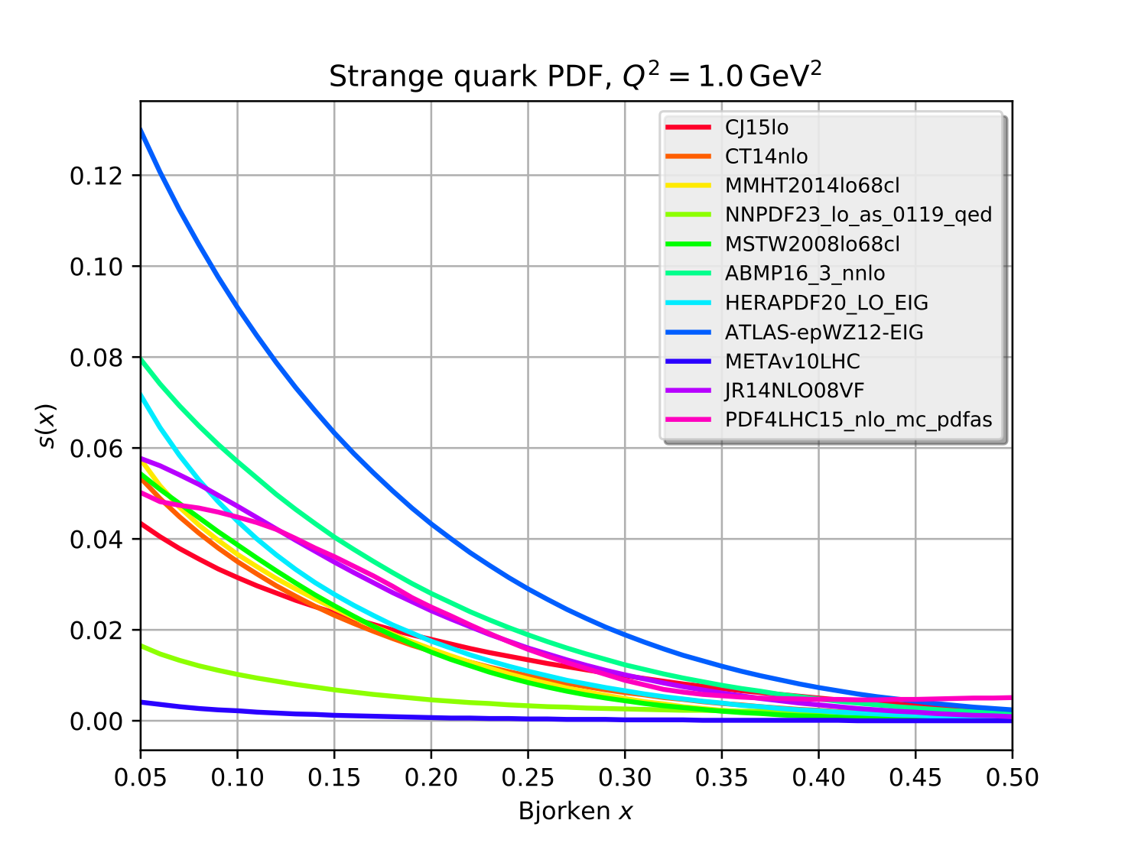
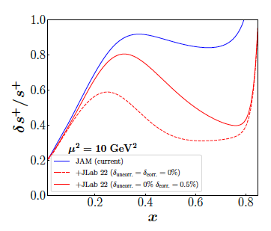
Unambiguous Access to Strange Quarks
Current Situation
Parity-violating DIS
di-muon production in neutrino-nucleus scattering – nuclear corrections introduce significant uncertainty
W and Z rapidity distributions
W+c production
Semi-inclusive K production: choice of fragmentation function negates inclusion in global fits
JLab12 Q² too low for PDF analysis
Parity-violating DIS allows strange contribution to be isolated from combined with p,n data
Valence regime provides strength and shape
Substantial improvement with a reduction in the uncertainty that can reach more than a factor two at large-x
LO
~100 days, 40 μA beam split between 40 cm D and H targets
Order of magnitude differences!
x
17

Slide 18
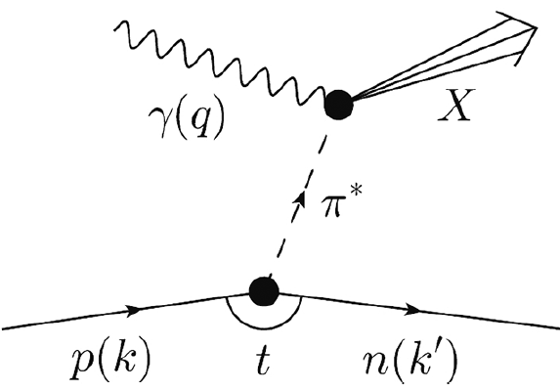
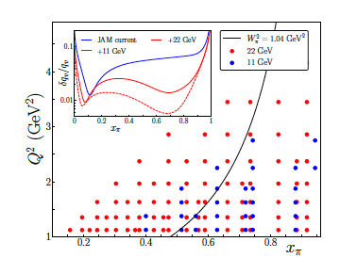
Partonic Structure of Mesons
Meson structure
Tagged deep inelastic scattering (TDIS) provides a mechanism to access the meson structure via the Sullivan process .
A cut of W² π > 1.04 GeV² (to avoid contributions from resonances in a pion analysis,) eliminates most of the data at 11 GeV.
At 22 GeV:
Available phase space significantly increased
➔ large improvement in the determination of the valence structure of the pion
➔ kin. coverage to smaller x_{π} region to probe the sea content of mesons
Overlap the existing π induced DY data
➔ test the universality of PDFs in the mid to large x_{π} region
➔ pion PDF predicted to be broader than the proton PDF
18
18

Slide 19
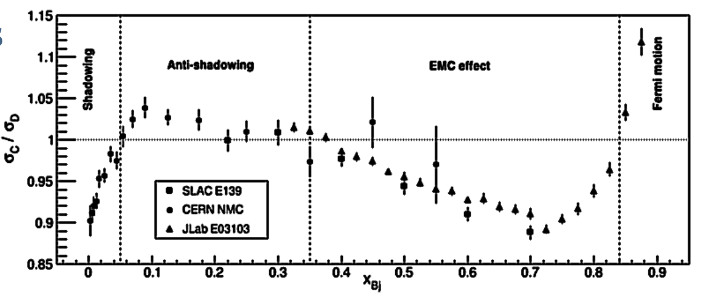
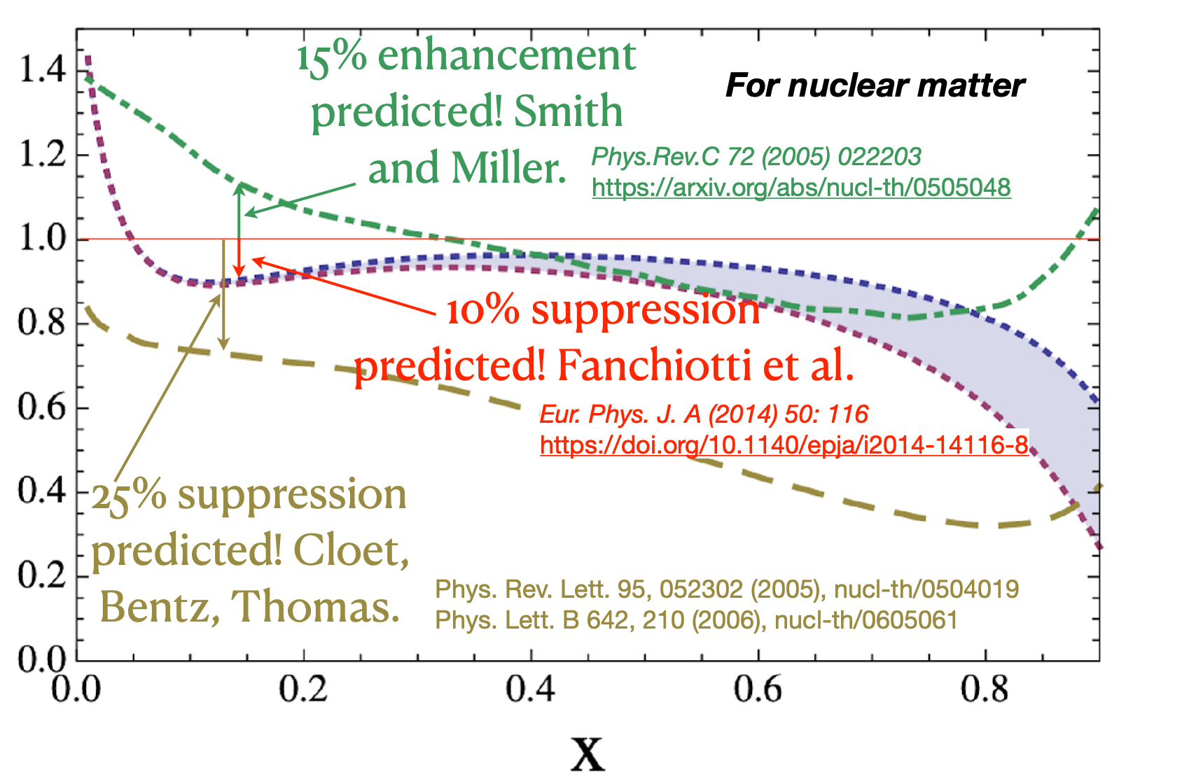
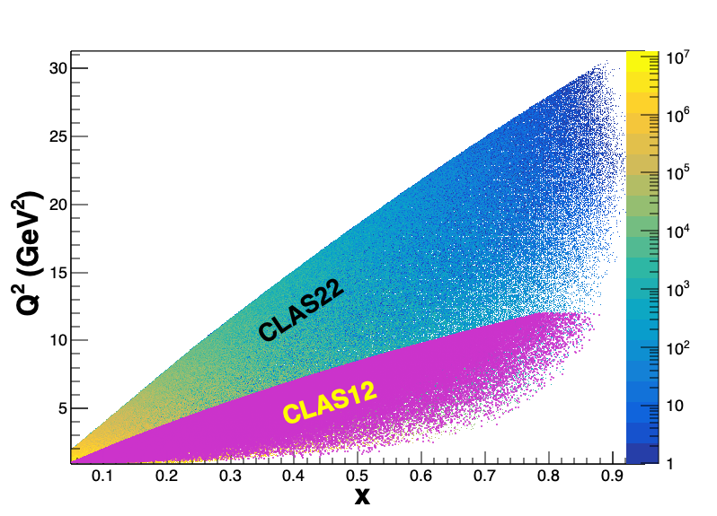
Anti-shadowing: solving a multi-decade puzzle
Small!
With a 22 GeV e- beam JLab can access the anti-shadowing region (x~0.1-0.3) at moderate Q²
Region extremely interesting, near-equally dominated by valence quarks, sea-quarks, and gluons → many many models!!
Anti-Shadowing is the least studied nuclear structure function effect experimentally – small effect requiring precision and high luminosity
  flavor dependence essentially uncharted
  spin dependence essentially uncharted (~50% differences in predictions)
  no tagged measurements
  no L/T separations
Theory predictions for polarized structure function A/D ratios
A rigorous testing ground between shadowing, EMC regimes – models and theory must describe ALL
19

Slide 20
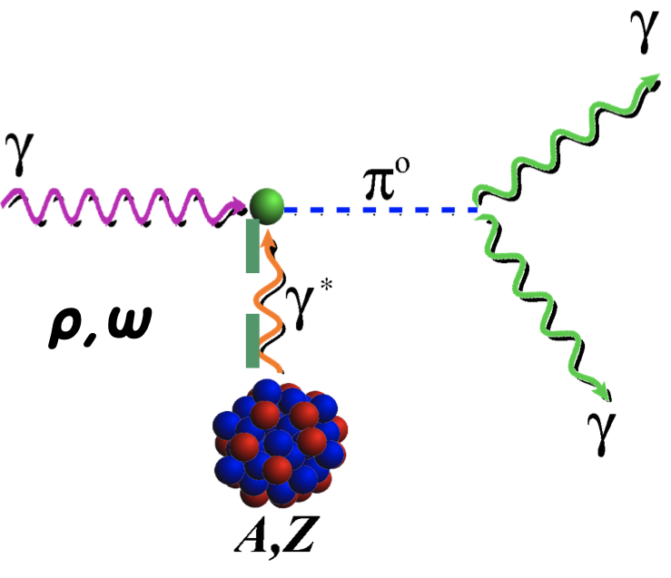
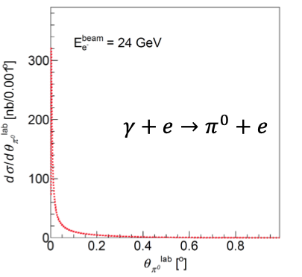
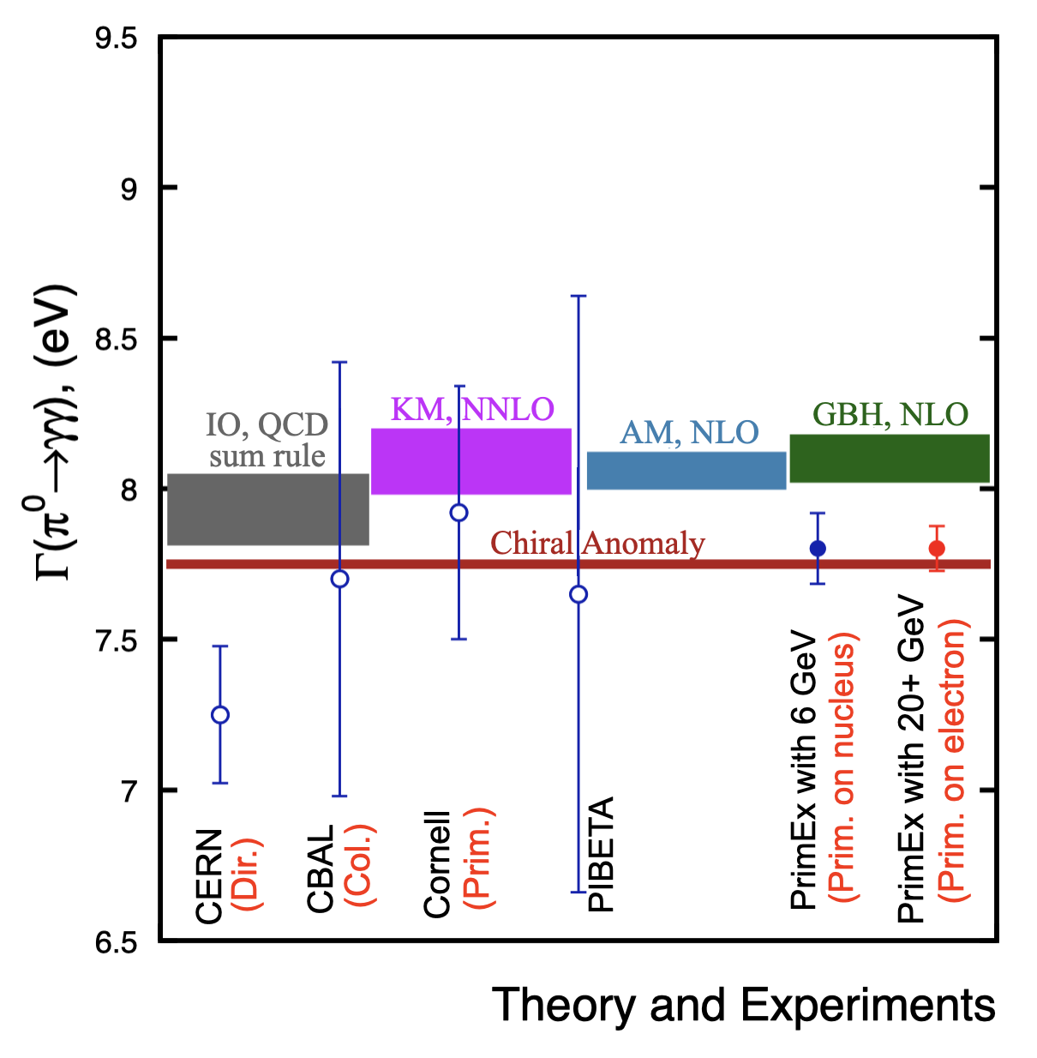
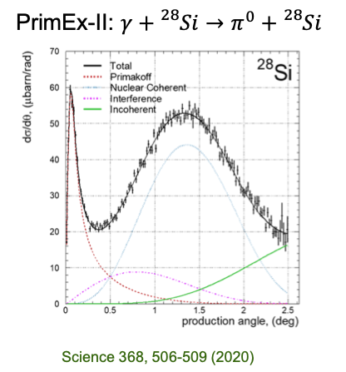
QCD Confinement and Fundamental Symmetries
π⁰ Primakoff production off an electron target
Γ(π⁰ → γγ) can be predicted at ≈ 1% precision
Higher energy will allow for η’
The threshold for photo- or electroproduction of π⁰ off an electron target is 18 GeV
Stringent test of low-energy QCD
Primakoff production off nuclear target
A 22 GeV upgrade will greatly enhance the Primakoff experiments for more massive mesons off nuclear target
first Primakoff measurement of Γ(η′ → γγ) with ∼3.5% precision to study the U(1)A anomaly coupling to the gluon field,
improve the measurement of Γ(η → γγ) to a 2% accuracy to determine the light-quark mass ratio
20
20

Slide 21
Science Outlook
Understanding the strong interaction dynamics of non-pQCD and ``how'' hadrons/nuclei emerge from fundamental QCD principles, is a complex problem
This complexity requires observation of the chromodynamic fields ``at work’’ through multiple observables using different approaches and measurements
With CEBAF at higher energy some important thresholds would be crossed and an energy window which sits between JLab @ 12 GeV and the EIC would be available. This, together with CEBAF uniqueness to run electron scattering experiments at the luminosity frontier, can provide powerful insight into non-pQCD dynamics.
A very strong science case for such an upgrade is emerging – join us at 22 GeV workshop at Frascati December 9-13, 2024
Polarized gluon distribution, longitudinal/transverse separations, hadron formation in nuclei, meson form factors, probing the light quark sea,……. and more!
21
21

Slide 22
Near Term Strategy (next 3 years)
Design focus for energy upgrade the next few years will be on:
  Developing a pre-conceptual design for additional FFA racetrack in the existing CEBAF tunnel to reach the top energy of about 22 GeV (current baseline), more specifically:
    Complete optics design for a pair of FFA arcs, including merger transitions to linacs
    TOF Splitters design for NE and SW arc ends, including momentum compaction compensation and beta matching
    Extraction system design capable of delivering all FFA passes (1-5) to A,B,C (same energy) and one pass above to D
    Finalize multi-pass linac optics based on strongly focusing triplets
    650 MeV recirculating injector design (in the LERF vault)
    Carry out S2E simulation including errors
    Implement a robust correction system
    Complete emittance dilution budget (longitudinal and transverse) via tracking studies

Slide 23
Near Term Strategy (next 3 years) – cont.
Design focus for energy upgrade the next few years will be on:
  Testing resilience of permanent magnets in CEBAF beam environment
  Developing a prototype FFA FODO cell and testing its performance with multi GeV beams at CEBAF, more specifically:
    Orbit mapping for different energies
    Beam based optics measurement and validation
    Validating effectiveness of orbit correction system
  Designing and prototyping special magnets, more specifically:
    Compact Splitter magnets
    Vertical septa for extraction system
    RF separator multi cell cavities

Slide 24
Thank you!
Thank you for listening, and thanks also to the scientific community working on developing this exciting science case
24

Slide 25
More info!
25

Slide 26

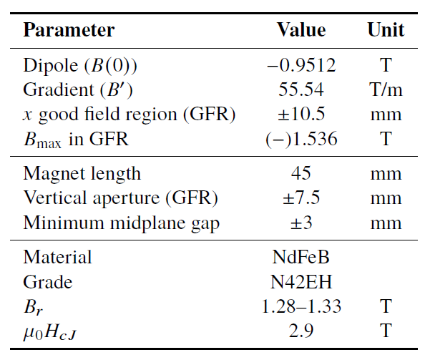

Prototype Magnet
Prototype open-midplane BF magnet successfully built and evaluated for mechanical integrity
>1.5 Tesla measured in good field region
Field accuracy of ${10}^{−3}$
Test of radiation resilience at CEBAF - LDRD project started Oct. 1, 2023

Slide 27
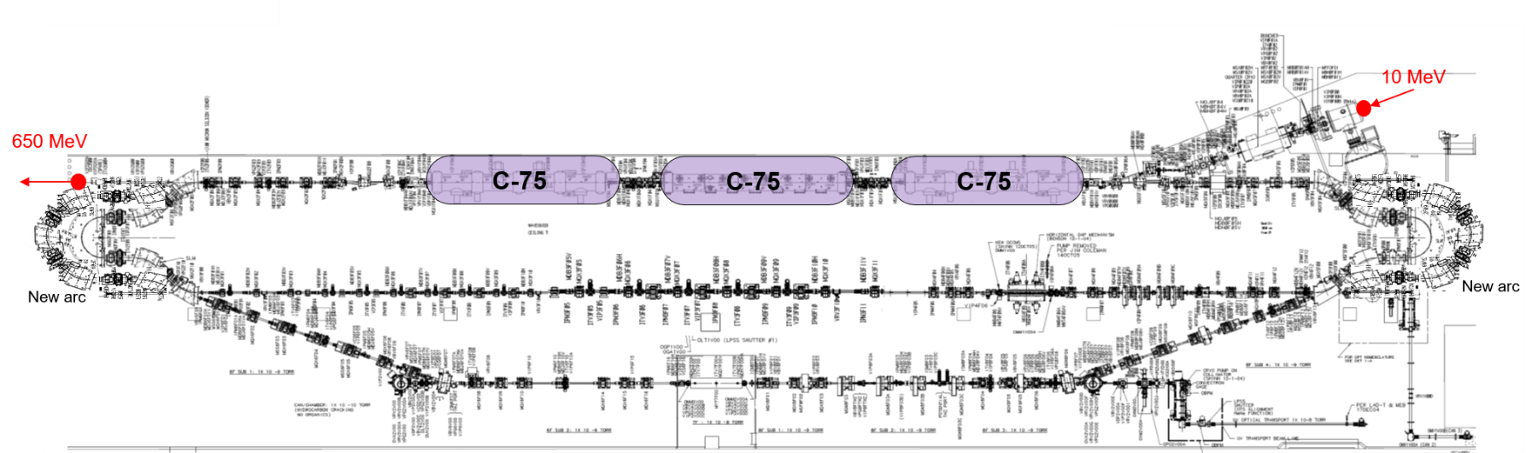
Injector Upgrade − 650 MeV Recirculating Injector based on LERF
With the present 123 MeV injector, the difference in the first and final pass energies in the North Linac is too large (1:175) to effectively control the beam.
650 MeV recirculating injector (3-pass) based on LERF will allow a manageable difference in energies (1:33)

Slide 28


Energy loss, Emittance dilution and Energy spread
  Doubling the energy, while staying within current CEBAF footprint, makes the synchrotron radiation effects of paramount importance.
  Quantum nature of a ‘recoil’ effect on electrons due to photon emission makes significant impact on both the transverse and longitudinal beam dynamics, leading to cumulative emittance growth (transverse and longitudinal).
Energy loss
Emittance dilution
Natural energy spread
Maximize $ρ$, minimize H
  Cumulative emittance dilution (transverse and longitudinal) at 22 GeV (4 CEBAF + 6 FFA passes)
Projected value from the Spr/Rec contribution

Slide 29
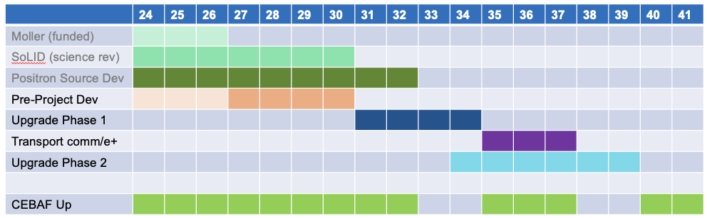
Notional CEBAF & upgrade schedule (FY24 – FY42)
Accelerator and engineering team have worked up an early schedule and cost estimate
  Schedule assumptions based on a notional timing of when funds might be available (near EIC ramp down based on EIC V3 profile)
  For completeness, Moller and SoLID (part of 12 GeV program) are shown; positron source development also shown
29

Slide 30
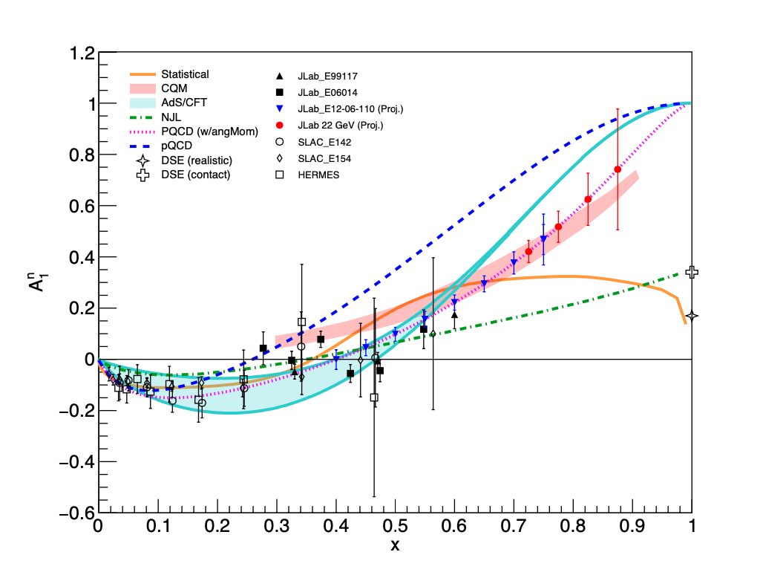
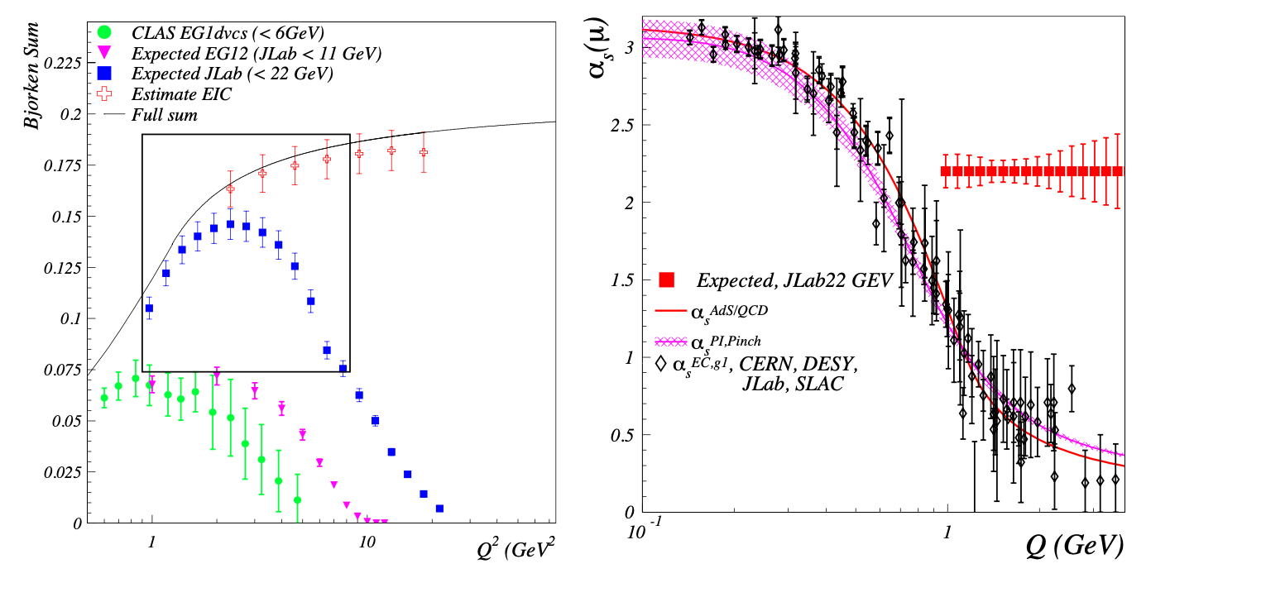
Polarized Structure Functions and α_{s}
Extend the precision and kinematic reach of polarized structure functions
Bjorken Sum Rule
A₁^{n}
The strong coupling constant is a key parameter of the Standard Model
Its current uncertainty is the least precise among all fundamental couplings
α_{s}
Q
1
Q²

Slide 31
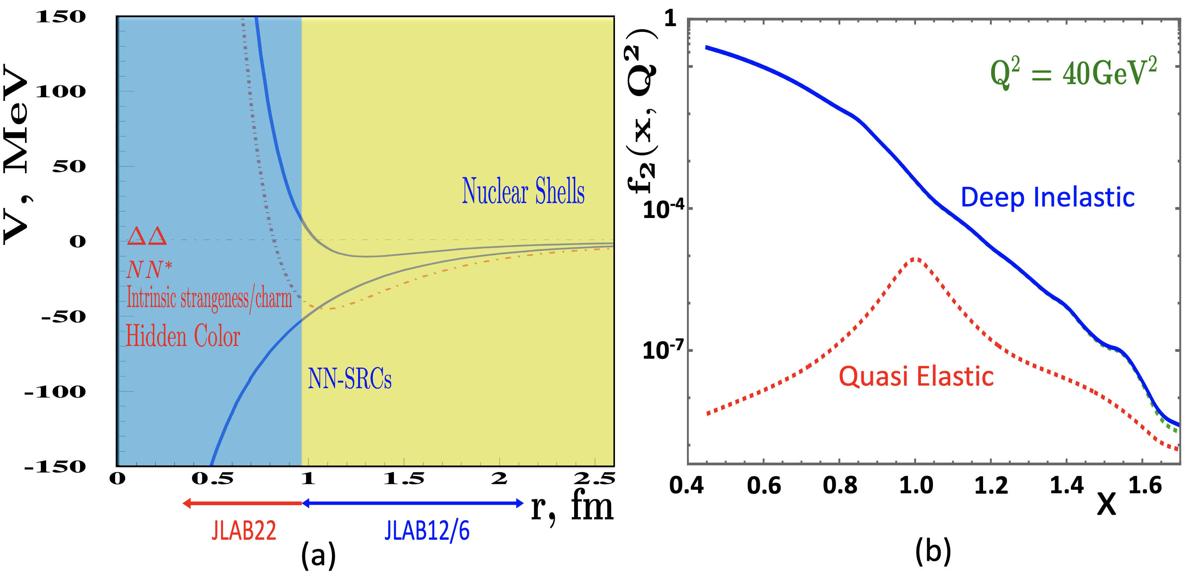
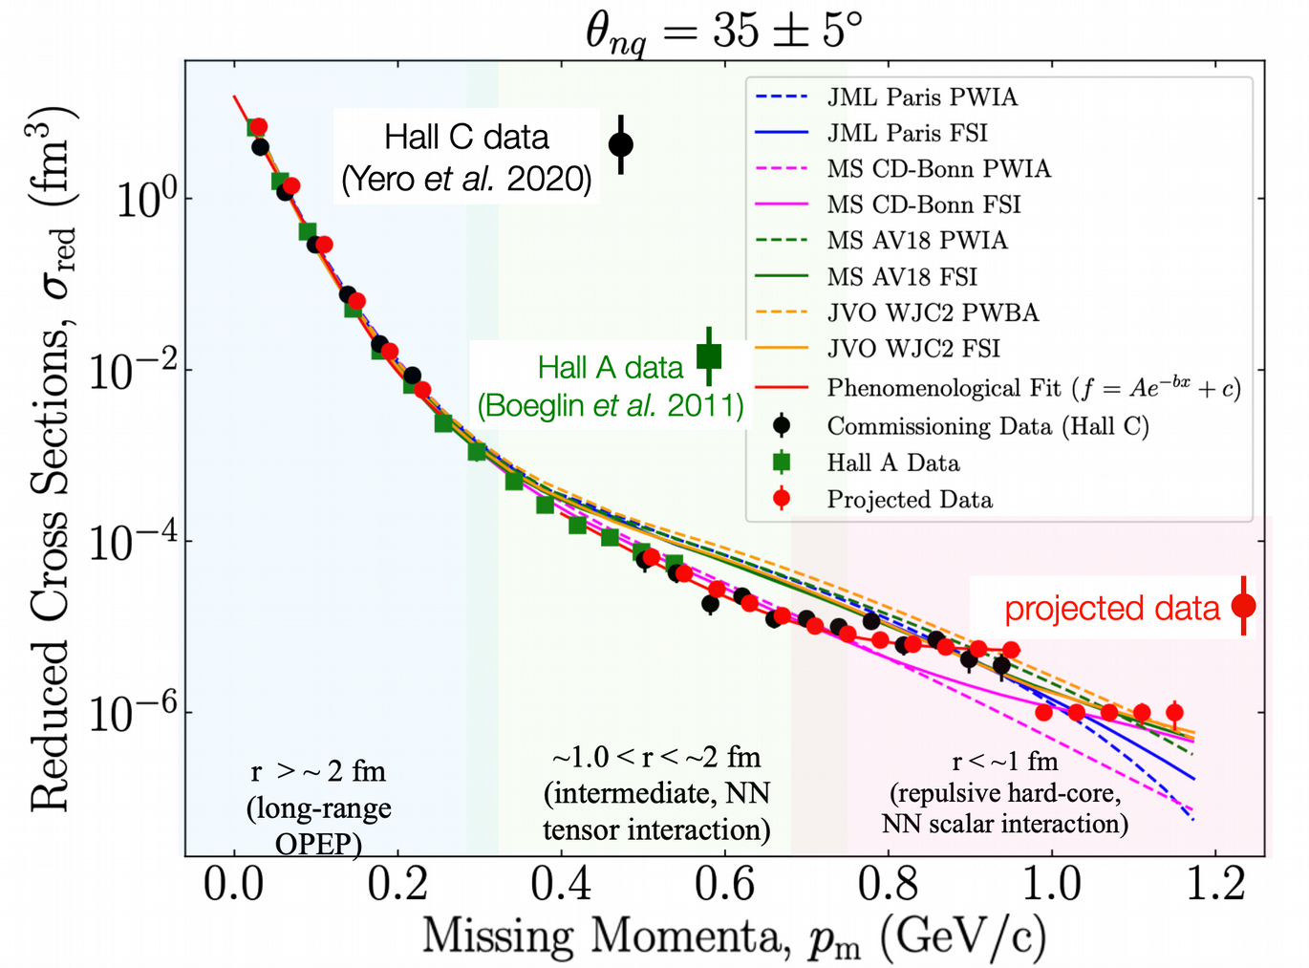
Nuclear Dynamics at Extreme Conditions
The dynamics of the nuclear repulsive core is still poorly understood
A 22 GeV upgrade will provide reach to the nuclear forces dominated by nuclear repulsion
Superfast Quarks
The high Q² reach will allow
  the suppression of quasi-elastic contributions,
  the first-ever study of nuclear DIS structure function at Bjorken x > 1.2 (r∼ 0.5 fm,)
Exploring Deuteron at Very Large Internal Momenta (> 800 MeV/c – non-nucleonic & hidden color components)
non-relativistic theory reproduces data up to pm ∼ 0.7 GeV/c
no model reproduces data (non-nucleonic degrees of freedom?, quarks?) pm > 0.7 GeV/c
31
31

Slide 32
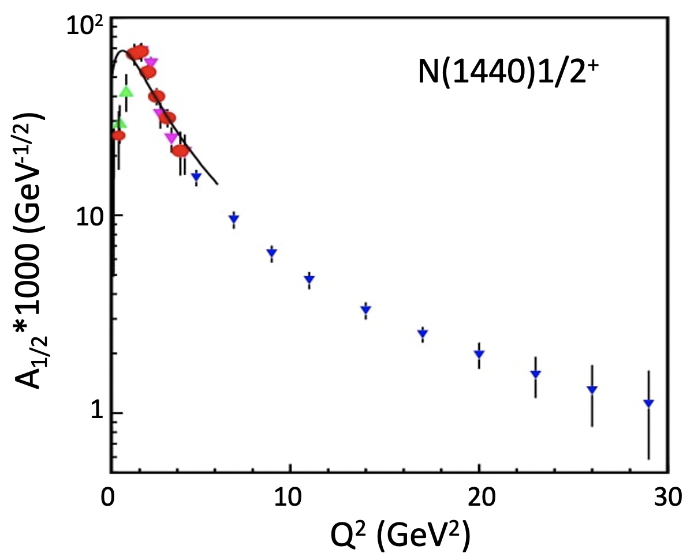

Bound 3 Quark Structure of N∗s and Emergence of Mass
Continuum Schwinger Method
  QCD equations of motion for q/g fields reveal existence of dressed q/g with momentum-dependent masses.
Dressed gluons
Dressed quarks
p _{quark} (GeV)
Q² evolution of the γvpN* electrocouplings could offer an insight into hadron mass generation and the emergence of the N* structure from QCD
15-20%
40-50%
>80%
6 GeV
12 GeV
22 GeV
Simulations indicate JLab22 is the only foreseeable facility to extend these measurements up to 30 GeV²
Q² range(<35 GeV²) where the dominant portion of hadron mass is expected to be generated
32
32

Slide 33




Transport and Upgrade CEBAF to 22 GeV
Remove top pass of Dipoles and Quad girders
All passes of Dipoles and Quad girders move up one level for FFA arc installation
Running girder transport line at aisle side corner of tunnel
Potential to use a “sit-in” style girder for smaller profile
after 6 FFA passes →

