Slide 1
Physics Perspectives with the ePIC Far-Forward and Far-Backward detectors
The XXXI International Workshop on Deep Inelastic Scattering (DIS2024)
10 April 2023
Michael Pitt*
The University of Kansas
* also with the Ben Gurion University of the Negev
On behalf of the ePIC Collaboration
Grant DE-SC0023908

Slide 2
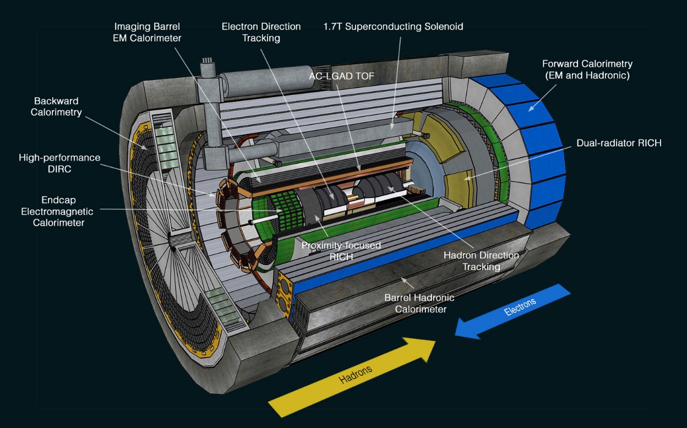
Introduction
The ePIC detector at the Electron-Ion collider (EIC)
https://www.bnl.gov/eic/epic.php
The ePIC experiment, scheduled to start in the early 2030s with the main goal to understand the visible matter
It comprises:
A 10-meter-long cylindrical barrel detector
More about ePIC in Shujie Li talk:
https://lpsc-indico.in2p3.fr/event/3268/contributions/7417/

Slide 3
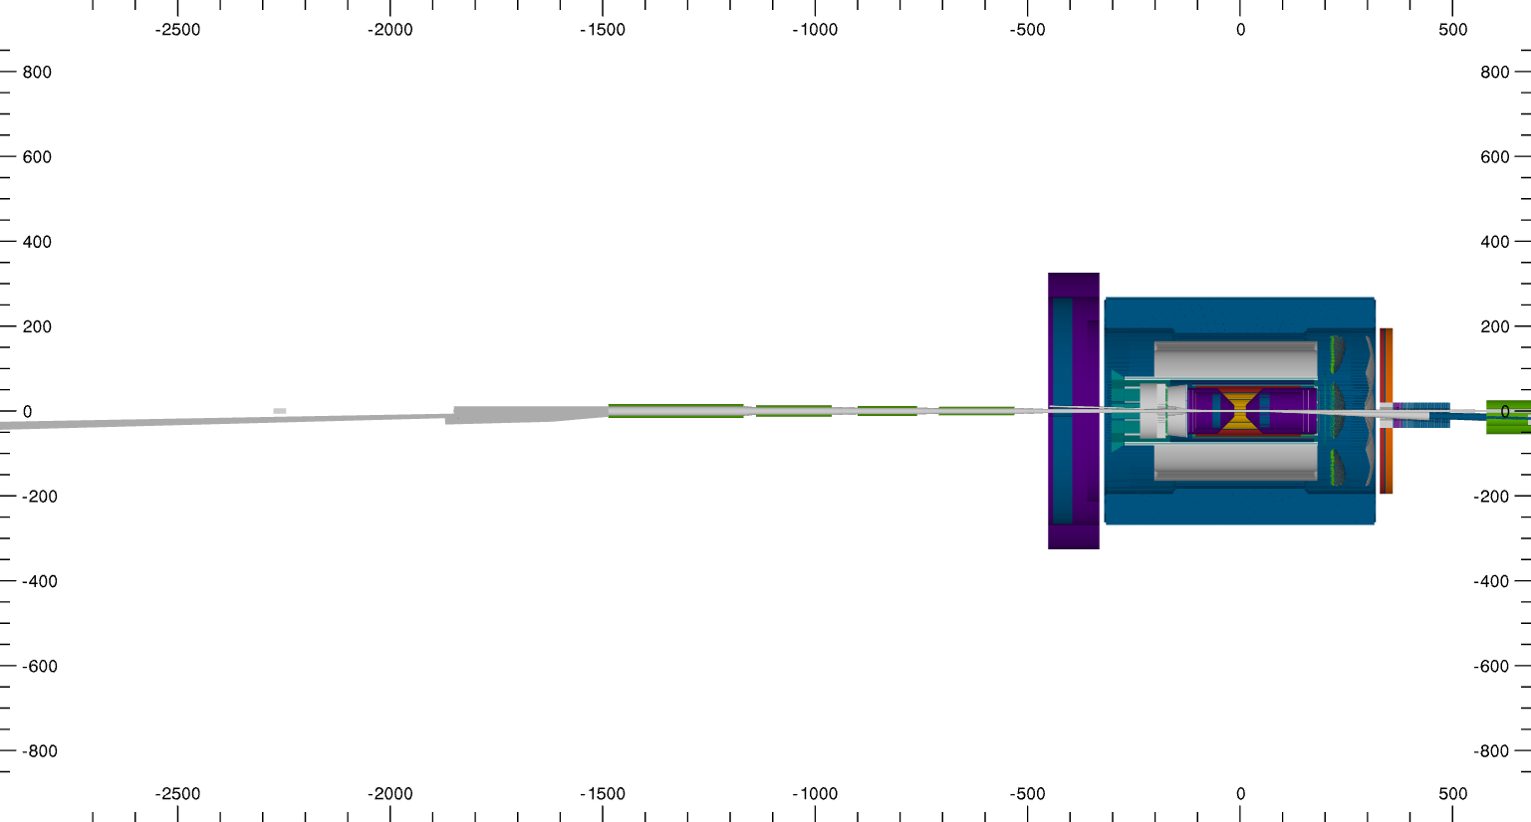
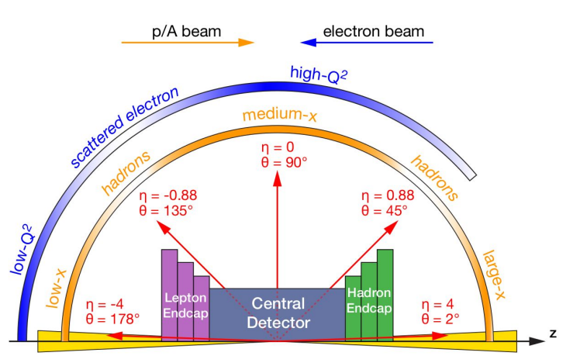
Introduction
The ePIC detector at the Electron-Ion collider (EIC)
The ePIC experiment, scheduled to start in the early 2030s with the main goal of understanding the visible matter
It comprises:
A 10-meter-long cylindrical barrel detector, covering rapidity range from η=-4 to 4
~10 meter
~6.5 meter

Slide 4
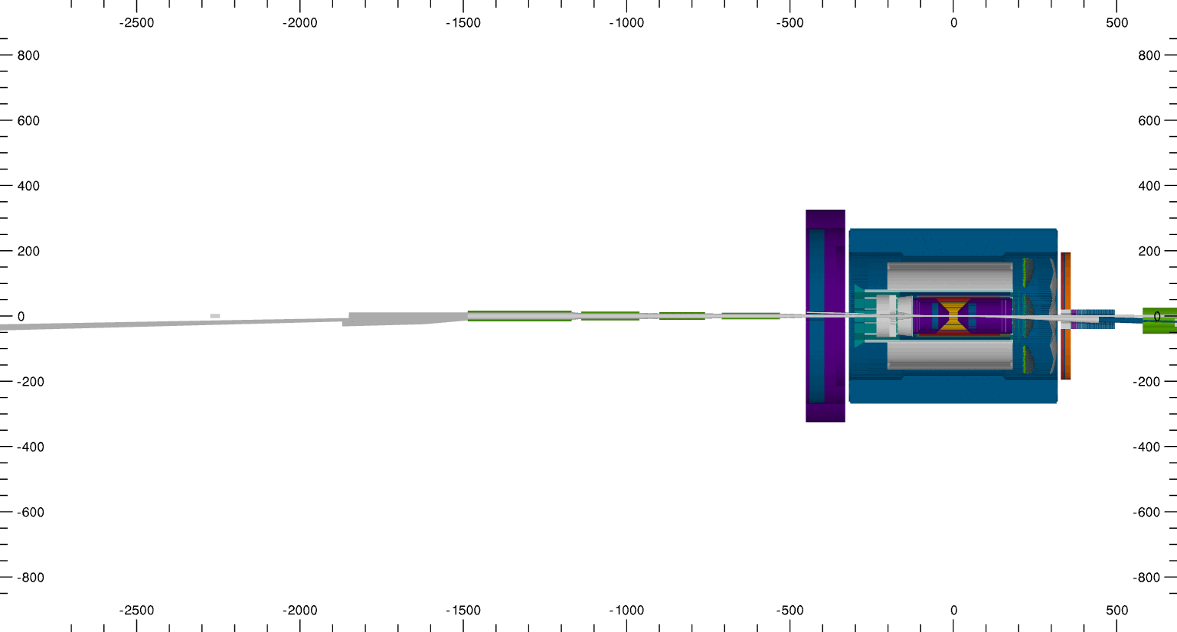
Introduction
The ePIC detector at the Electron-Ion collider (EIC)
The ePIC experiment, scheduled to start in the early 2030s with the main goal of understanding the visible matter
It comprises:
A 10-meter-long cylindrical barrel detector, covering rapidity range from η=-4 to 4
An additional detector array that extends ~50m in each direction aiming for a full coverage
~6.5 meter
~100 meter

Slide 5
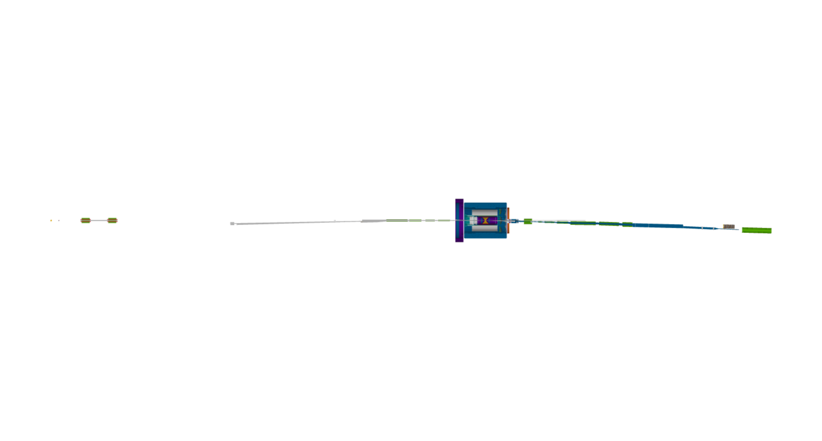
Introduction
The ePIC detector at the Electron-Ion collider (EIC)
The extended detector’s array required to enable primary physics objectives:
The ePIC experiment, scheduled to start in the early 2030s with the main goal of understanding the visible matter
It comprises:
A 10-meter-long cylindrical barrel detector, covering rapidity range from η=-4 to 4
An additional detector array that extends ~50m in each direction aiming for a full coverage

Slide 6
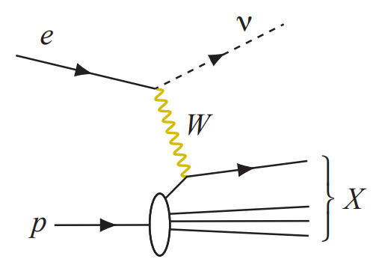
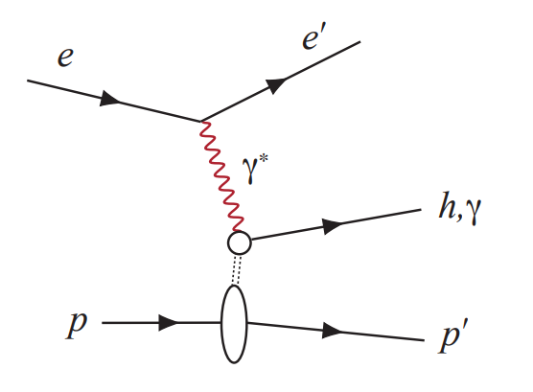
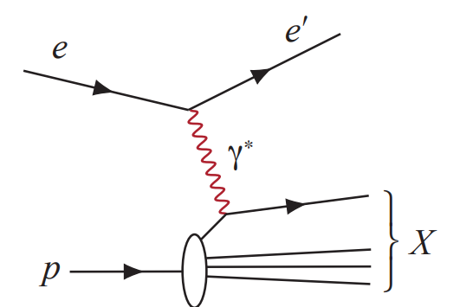
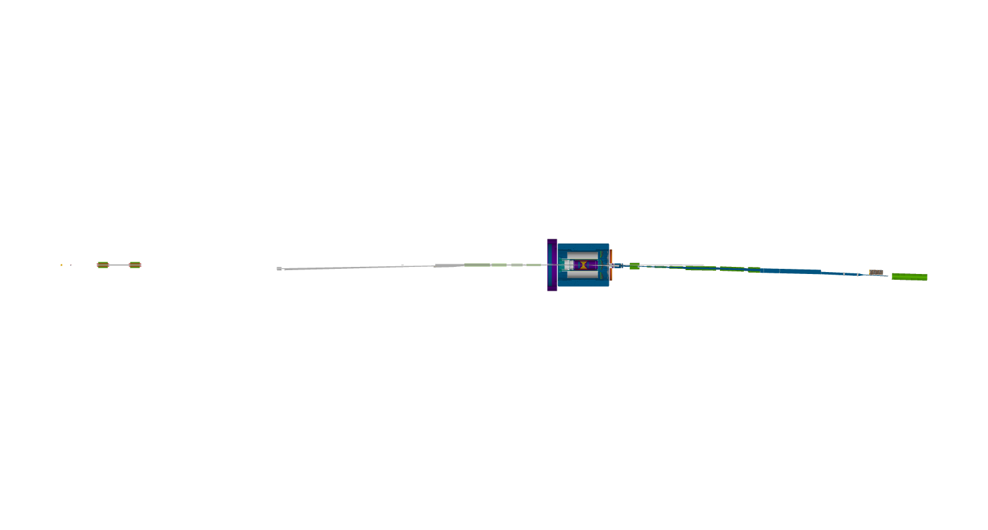
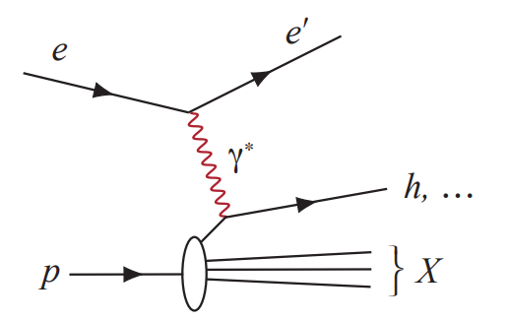
Introduction
The ePIC detector at the Electron-Ion collider (EIC)
The extended detector’s array required to enable primary physics objectives:
NC+CC Inclusive DIS (~1 fb⁻¹)
Semi-Inclusive DIS (~10 fb⁻¹)
Exclusive DIS (~100 fb⁻¹)
Electron beam
Hadron beam

Slide 7
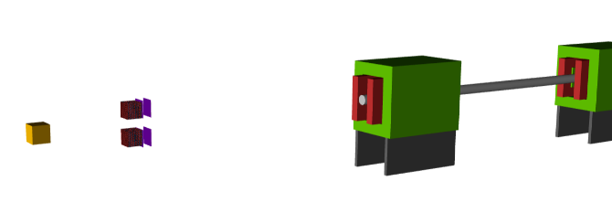
Far-Backward detectors
The ePIC detector at the Electron-Ion collider (EIC)
The extended detector’s array required to enable primary physics objectives:
NC+CC Inclusive DIS (~1 fb⁻¹)
Semi-Inclusive DIS (~10 fb⁻¹)
Exclusive DIS (~100 fb⁻¹)
Electron beam
Hadron beam
Luminosity monitor

Slide 8
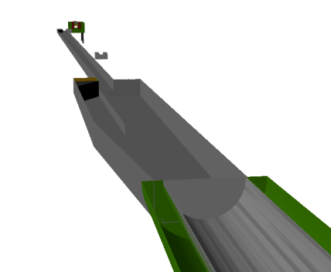
Far-Backward detectors
The ePIC detector at the Electron-Ion collider (EIC)
The extended detector’s array required to enable primary physics objectives:
NC+CC Inclusive DIS (~1 fb⁻¹)
Semi-Inclusive DIS (~10 fb⁻¹)
Exclusive DIS (~100 fb⁻¹)
Electron beam
Hadron beam
Luminosity monitor
Low Q² taggers

Slide 9
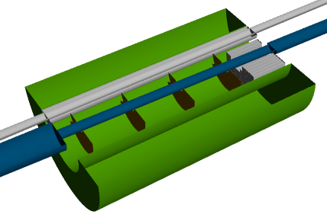
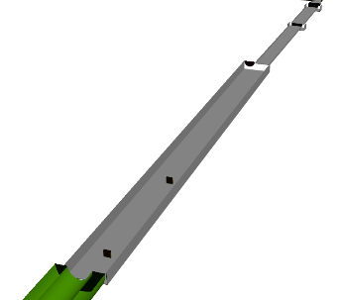
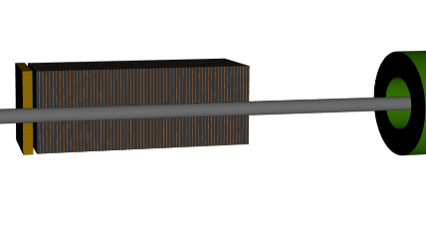
Far-Backward and Far-Forward detectors
The ePIC detector at the Electron-Ion collider (EIC)
The extended detector’s array required to enable primary physics objectives:
NC+CC Inclusive DIS (~1 fb⁻¹)
Semi-Inclusive DIS (~10 fb⁻¹)
Exclusive DIS (~100 fb⁻¹)
Electron beam
Hadron beam
B0 detector
Forward beamline trackers
ZDC
Luminosity monitor
Low Q² taggers

Slide 10
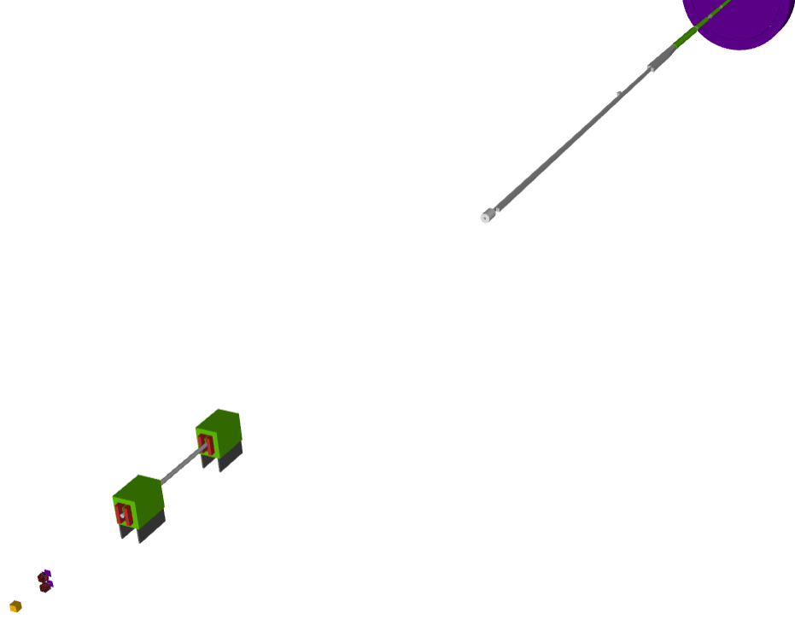
Luminosity monitor
Precise luminosity determination (<1%), from Bremsstrahlung processes ($ep→eγp)$
Brem. photons
Electron beam

Slide 11
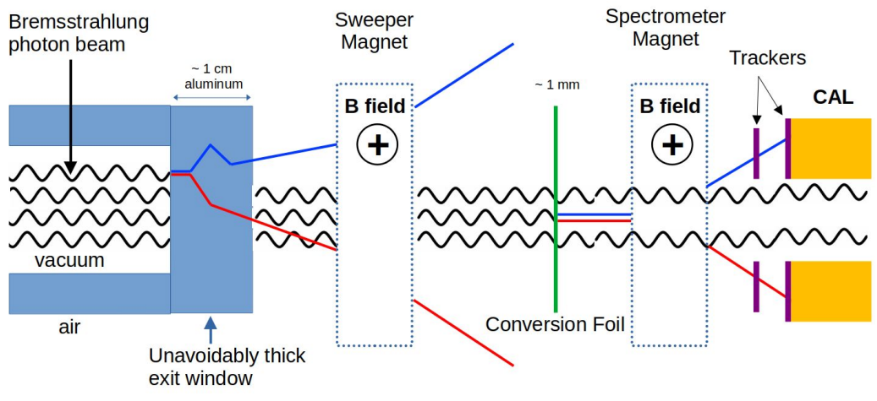
Luminosity monitor
Precise luminosity determination (<1%), from Bremsstrahlung processes ($ep→eγp)$
Exit window: uniform thickness and well-known composition
Brem. photons
Electron beam

Slide 12
Luminosity monitor
Precise luminosity determination (<1%), from Bremsstrahlung processes ($ep→eγp)$
Exit window: uniform thickness and well-known composition
Sweeper magnet: remove pair conversions from the thick exit window
Brem. photons
Electron beam

Slide 13
Luminosity monitor
Precise luminosity determination (<1%), from Bremsstrahlung processes ($ep→eγp)$
Exit window: uniform thickness and well-known composition
Sweeper magnet: remove pair conversions from the thick exit window
Conversion foil: Al 1mm thin → 1% conversion
Brem. photons
Electron beam

Slide 14
Luminosity monitor
Precise luminosity determination (<1%), from Bremsstrahlung processes ($ep→eγp)$
Exit window: uniform thickness and well-known composition
Sweeper magnet: remove pair conversions from the thick exit window
Conversion foil: Al 1mm thin → 1% conversion
Spectrometer magnet: Adjustable magnet (Bdl ~ 1 Tm)
Brem. photons
Electron beam

Slide 15
Luminosity monitor
Precise luminosity determination (<1%), from Bremsstrahlung processes ($ep→eγp)$
Exit window: uniform thickness and well-known composition
Sweeper magnet: remove pair conversions from the thick exit window
Conversion foil: Al 1mm thin → 1% conversion
Spectrometer magnet: Adjustable magnet (Bdl ~ 1 Tm)
Pair spectrometer:
Tracker: AC-LGAD strips with 20um resolution
Calorimeter: Scintillating Fiber, 23X₀
Brem. photons
Electron beam

Slide 16
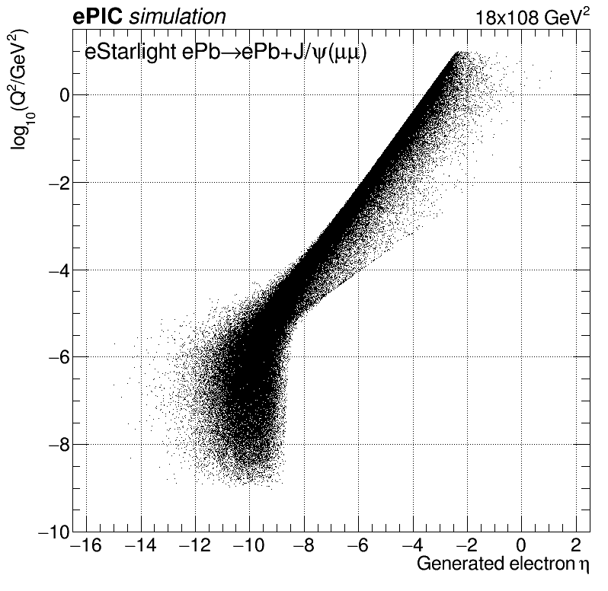
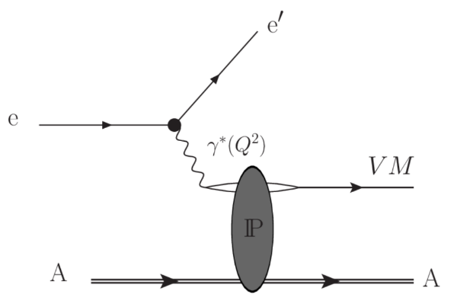
Low Q² electron tagger
Photon virtuality (Q²) is reflected in the scattering angle of the outgoing electron

Slide 17
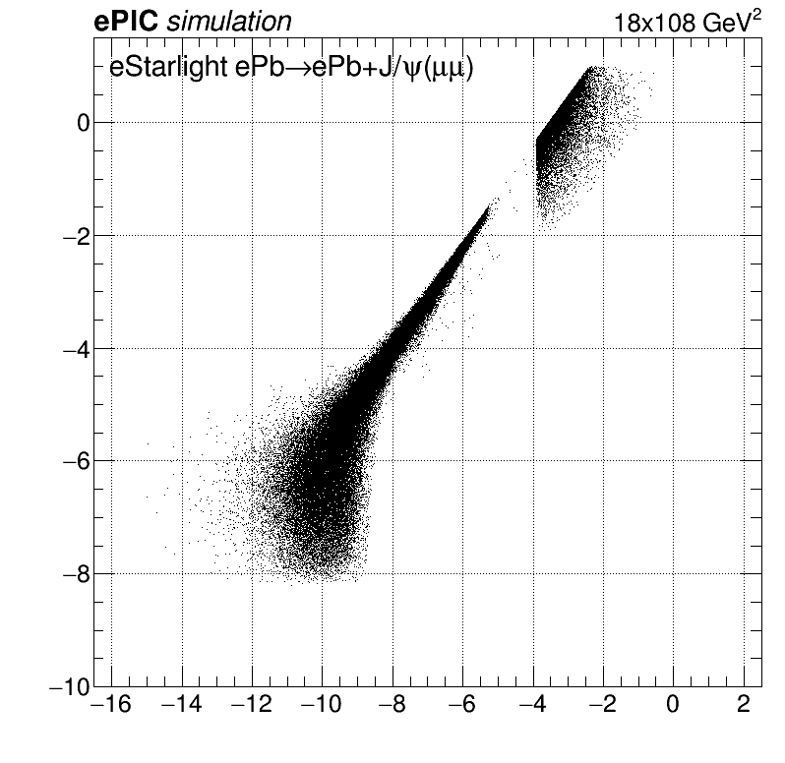
Low Q² electron tagger
Central detector acceptance: Q² > 0.1 GeV² outgoing electrons
Acceptance of
Low-Q taggers
Acceptance of
Central detector (Barrel)

Slide 18
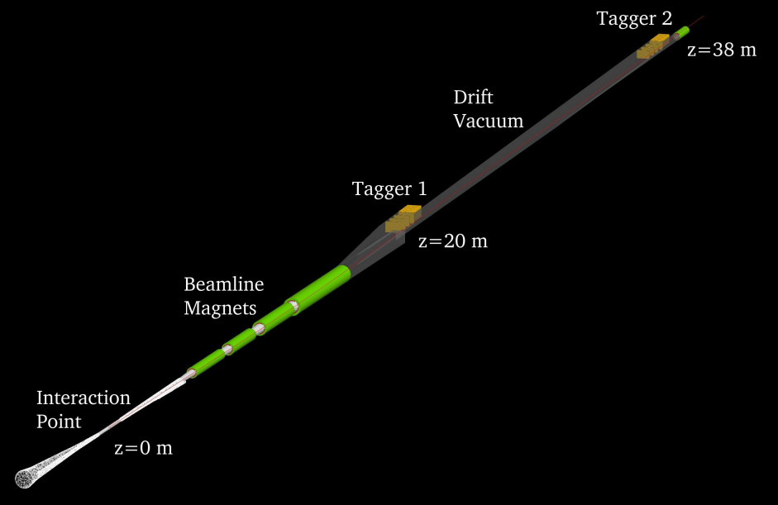
Low Q² electron tagger
Central detector acceptance: Q² > 0.1 GeV² outgoing electrons
Allow quasi real (Q<<1) physics
2 taggers:
Pixel-based 4 trackers (Timepix4), with rate capability of > 10 tracks per bunch
Calorimeters (for calibration)
Challenges: high, non-uniform Brem. background
https://arxiv.org/abs/2305.02079

Slide 19
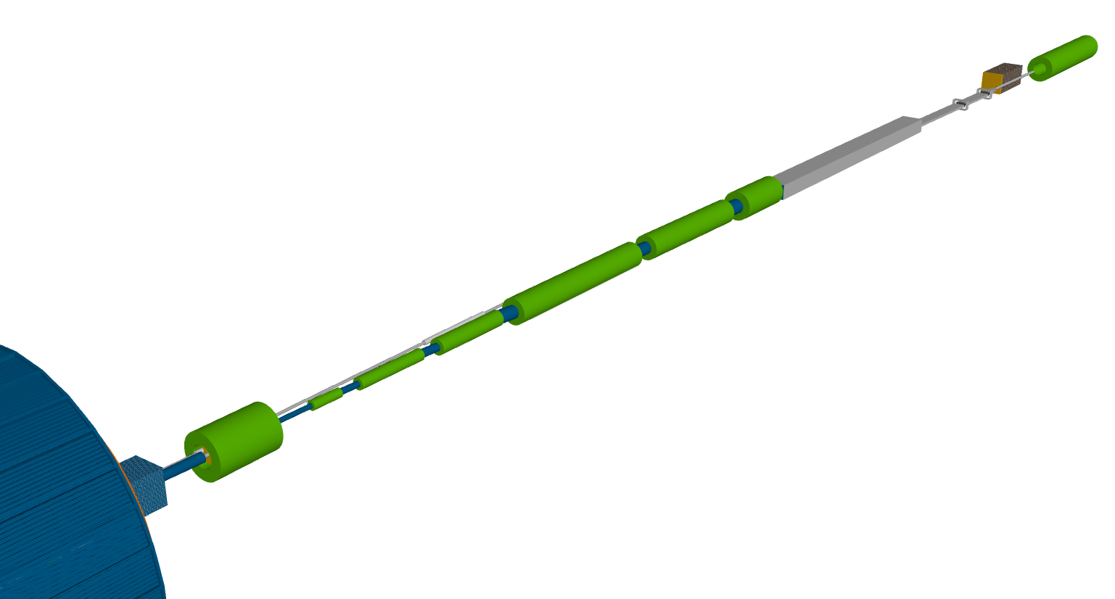
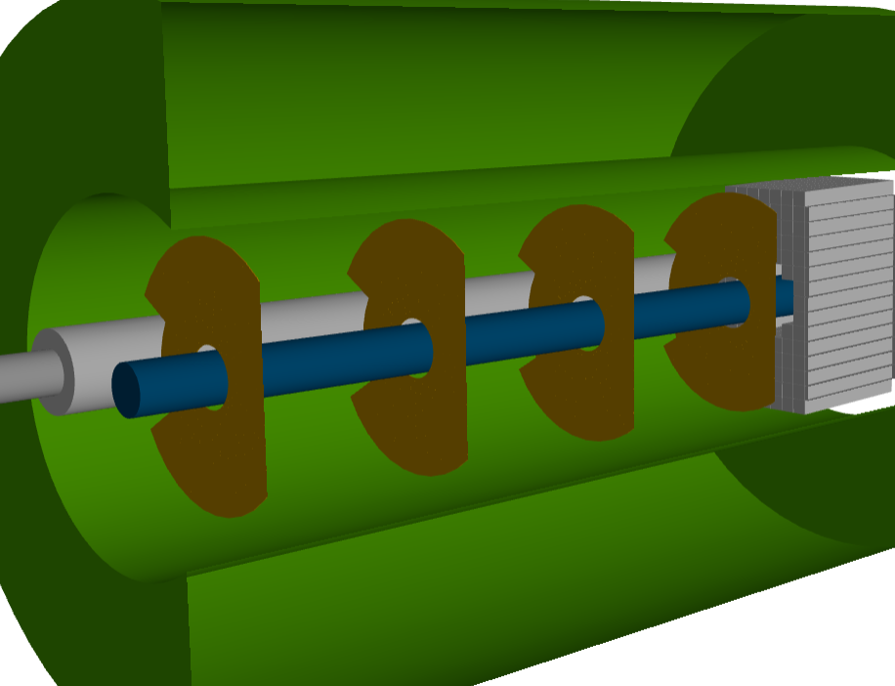
The Far-Forward detectors
Hadron beam
B0 detector
ZDC
B2apf
B1apf
Focusing quadrupoles
Off-momentum Detectors (OMD)
Roman Pots
Forward beamline trackers
Detector | Acceptance
Zero-Degree Calorimeter (ZDC) | 𝜽 < 5.5 mrad (𝜂 > 6)
Roman Pots (2 stations) | 0.0* < 𝜽 < 5.0 mrad (𝜂 > 6)
Off-Momentum Detectors (2 stations) | 0.0 < 𝜽 < 5.0 mrad (𝜂 > 6)
B0 Detector | 5.5 < 𝜽 < 20 mrad (4.6 < 𝜂 < 5.9)
B0pf combined function magnet

Slide 20
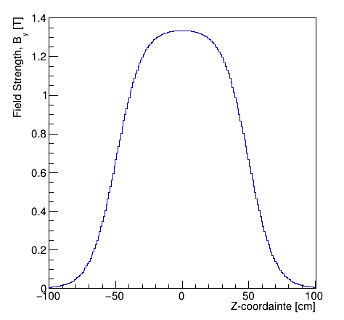
The Far-Forward detectors
B0 detector
Acceptance 5.5 < 𝜃 < 20 mrad
Very low material budget in 5 < η < 5.5
Si Tracker: 4 Layer of AC-LGAD
EM Calorimeter: 20 cm LYSO crystals
Photons:
High acceptance in a broad energy range (> 50 MeV), including ~MeV de-excitation photons
Energy resolution of 6-7%
Position resolution of ~3 mm
Protons:
Momentum resolution (dp/p) of ~ 2-4%
Neutrons:
50% detection efficiency (λ is almost 1)

Slide 21
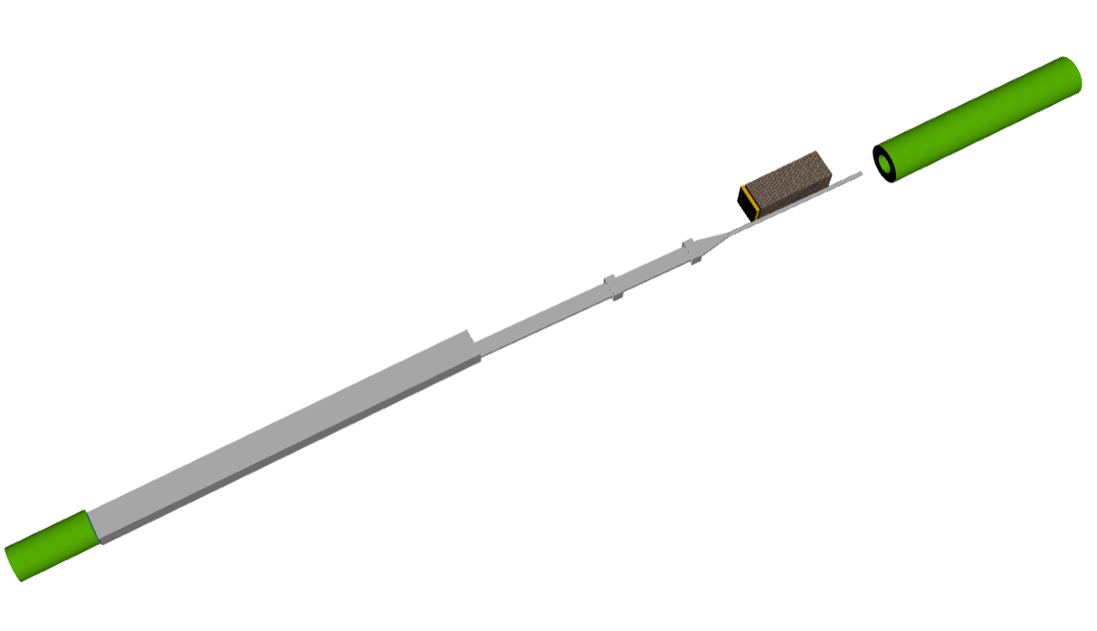
The Far-Forward detectors
Very Forward tracker and calorimeter
B2apf
ZDC
Off-momentum Detectors (OMD)
Roman Pots
B1apf
Forward beamline trackers

Slide 22
The Far-Forward detectors
Very Forward tracker and calorimeter
B2apf
ZDC
ZDC
ZDC
Off-momentum Detectors (OMD)
Roman Pots
B1apf
Forward beamline trackers

Slide 23
The Far-Forward detectors
Very Forward tracker and calorimeter
Off-momentum protons → smaller magnetic rigidity → greater bending in dipole fields
Important for any measurement with nuclear breakup!
B2apf
ZDC
ZDC
ZDC
Protons with ~50-60% momentum w.r.t. steering magnets.
RP
Off-momentum Detectors (OMD)
Roman Pots
Protons with ~35-50% momentum w.r.t. steering magnets.
B1apf
Forward beamline trackers
OMD

Slide 24
The Far-Forward detectors
Very Forward tracker and calorimeter
Off-momentum protons → smaller magnetic rigidity → greater bending in dipole fields
Important for any measurement with nuclear breakup!
B2apf
ZDC
ZDC
ZDC
Longitudinal momentum fraction
$$x_{L}=\frac{p_{Z,proton}}{p_{Z,beam}}$$
Protons with ~50-60% momentum w.r.t. steering magnets.
RP
Off-momentum Detectors (OMD)
Roman Pots
Protons with ~35-50% momentum w.r.t. steering magnets.
B1apf
Forward beamline trackers
OMD

Slide 25
The Far-Forward detectors
Very Forward tracker and calorimeter
Off-momentum protons → smaller magnetic rigidity → greater bending in dipole fields
Important for any measurement with nuclear breakup!
B2apf
ZDC
ZDC
ZDC
Protons with > 60% of the beam momentum can be reconstructed by the Roman pots.
RP
Protons with ~50-60% momentum w.r.t. steering magnets.
RP
Off-momentum Detectors (OMD)
Roman Pots
Protons with ~35-50% momentum w.r.t. steering magnets.
B1apf
Forward beamline trackers
OMD

Slide 26
The Far-Forward detectors
Very Forward tracker and calorimeter
Neutral particles follows a straight line through an exit window to a dedicated Zero Degree Calorimeter (ZDC)
B2apf
ZDC
ZDC
ZDC
neutrons and photons
Protons with > 60% of the beam momentum can be reconstructed by the Roman pots.
RP
Protons with ~50-60% momentum w.r.t. steering magnets.
RP
Protons with ~35-50% momentum w.r.t. steering magnets.
B1apf
OMD

Slide 27
The Far-Forward detectors
Very Forward tracker and calorimeter
Neutral particles follow a straight line through an exit window to a dedicated Zero Degree Calorimeter (ZDC)
B2apf
ZDC
Requirements:
Neutrons:
$50\%/\sqrt{E}+5\%$energy resolution
$3 mrad/\sqrt{E}$position resolution
Photons:
$5\%/\sqrt{E}+3\%$energy resolution
0.5-1mm position resolution
B1apf

Slide 28
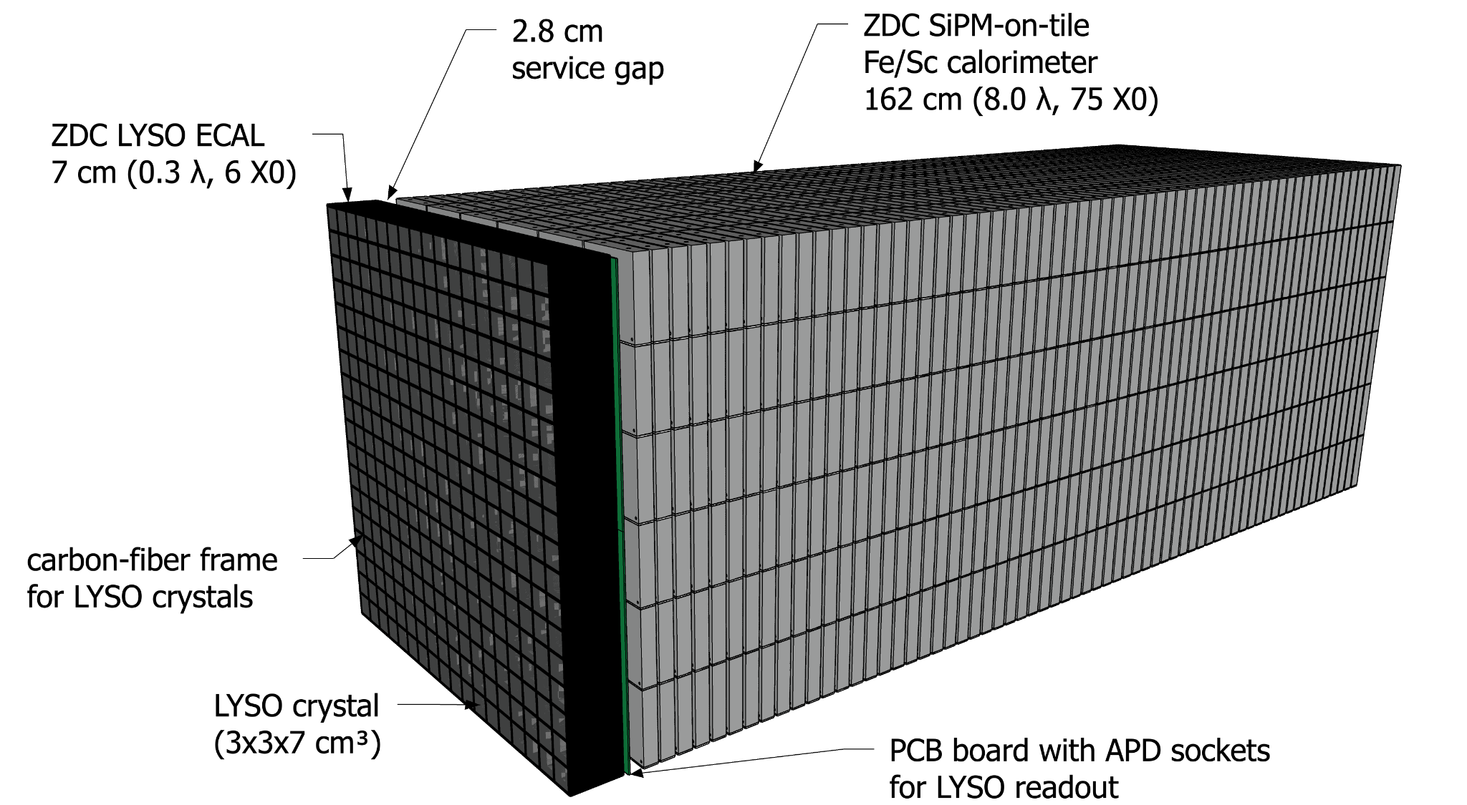
The Far-Forward detectors
Zero Degree Calorimeter (ZDC)
EM section – 20 cm long LYSO or PbWO₄ crystals
LYSO or PbWO₄
2cm x 2cm x 20cm

Slide 29
The Far-Forward detectors
Zero Degree Calorimeter (ZDC)
EM section – 20 cm long LYSO or PbWO₄ crystals
Hadronic section – similar to forward hadron calorimeter (see more on ePIC calorimeters in Henry Klest talk)
LYSO or PbWO₄
2cm x 2cm x 20cm

Slide 30
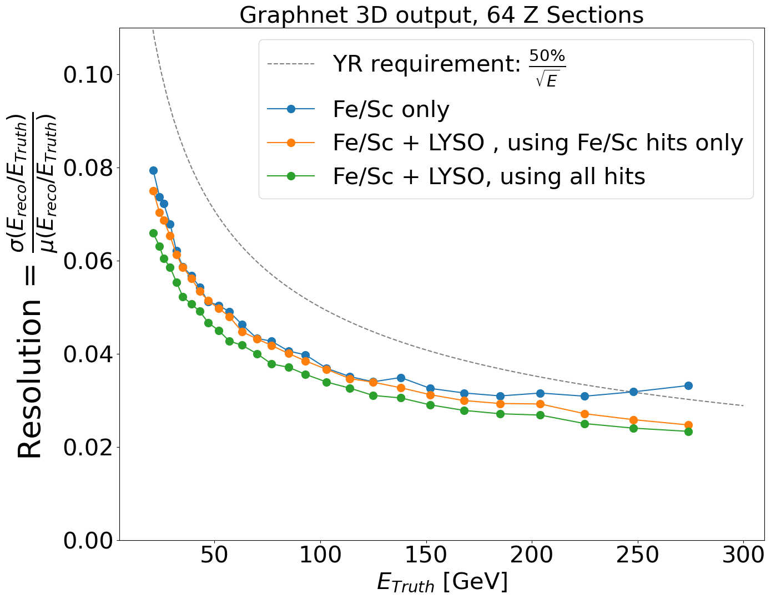
The Far-Forward detectors
Zero Degree Calorimeter (ZDC)
EM section – 20 cm long LYSO or PbWO₄ crystals
Hadronic section – similar to forward hadron calorimeter (see more on ePIC calorimeters in Henry Klest talk)
ML based reconstruction using the HEXPLIT algorithm (2308.06939)
LYSO or PbWO₄
2cm x 2cm x 20cm
Energy Resolution
Angular Resolution

Slide 31
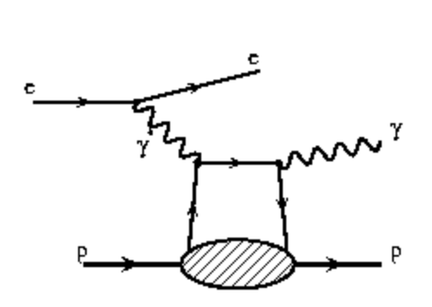
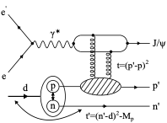
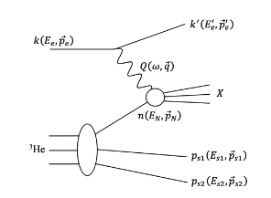
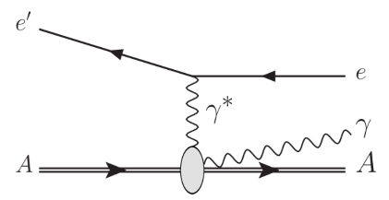
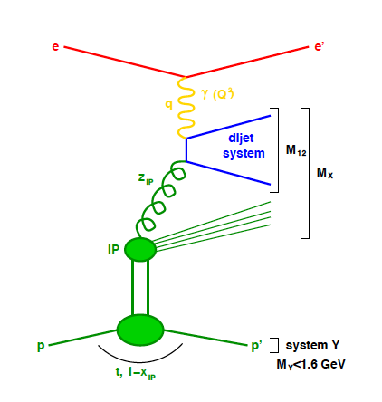
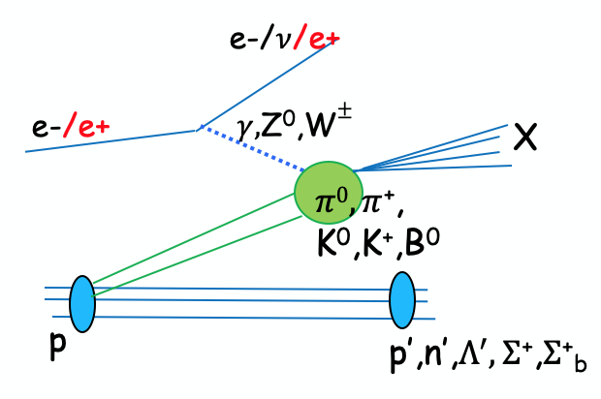
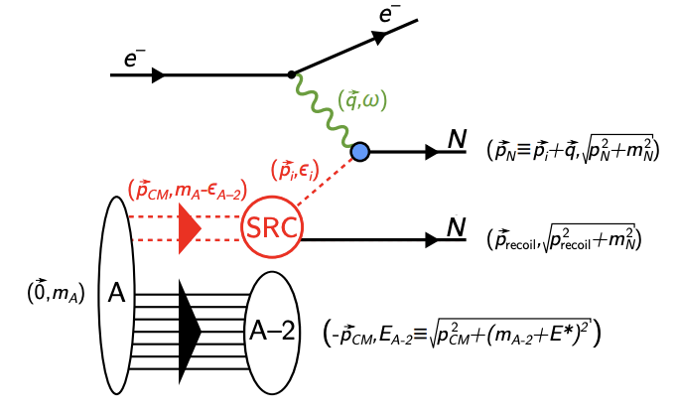
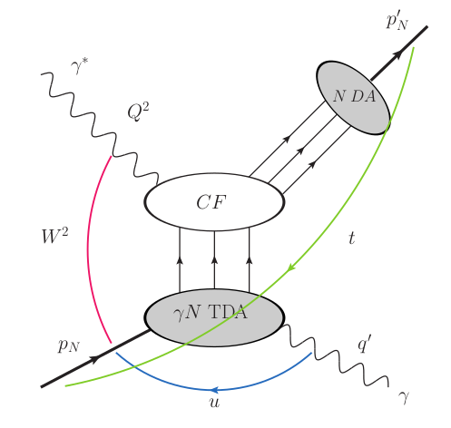
Physics perspectives
Far-Forward and Far-Backward detectors also enable a broader physics program than was initially envisioned, enhancing the EIC's research potential:
e+p DVCS
e+d exclusive J/Psi
with p/n tagging
spectator tagging in light nuclei
coherent/incoherent
VM production in eA
Ion-deexitation in eA collisions
Short-Range Correlations
VM
Proton spin: orbital angular momentum; imaging
Free neutron structure, EMC effect, etc.
Saturation
Nuclear fluorescece
Sullivan process
Quasi-elastic electron scattering
u-channel backward exclusive electroproduction
Diffraction
𝜋/K form factors and structure functions
Short-Range Correlations
Backward-angle colinear factorization
Saturation
Nucleon/Nuclei Structure
Rapidity
gap

Slide 32
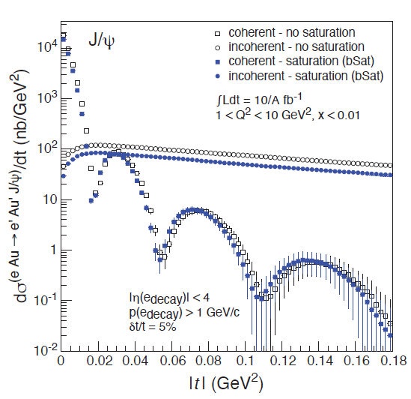
Physics perspectives (examples)
Coherent VM production (Saturation)
Challenge: Large backgrounds (incoherent production processes)
VM
PRC 87 (2013) 2, 024913

Slide 33
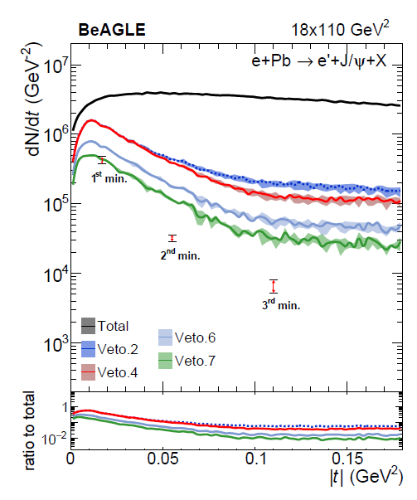
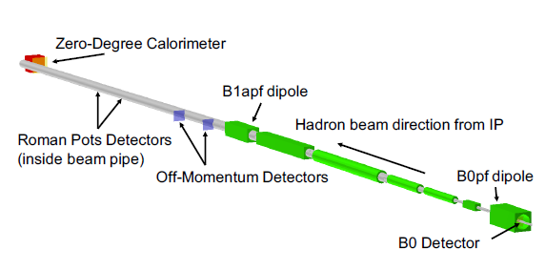
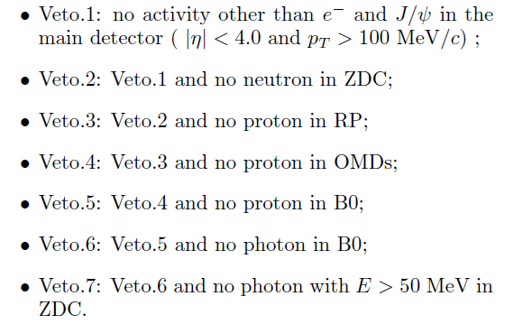
Physics perspectives (examples)
Coherent VM production in eA collisions
Challenge: Large backgrounds (incoherent production processes)
The forward detectors array allows strong background rejection
VM
+
=
PRC 87 (2013) 2, 024913
PRD 104 (2021) 11, 114030

Slide 34
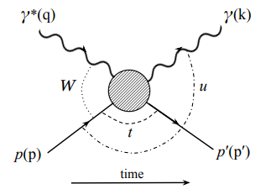
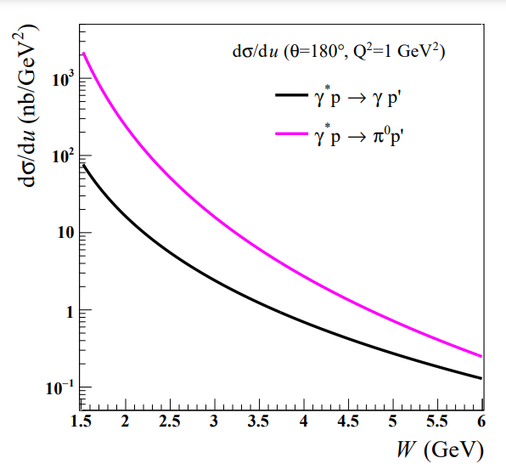
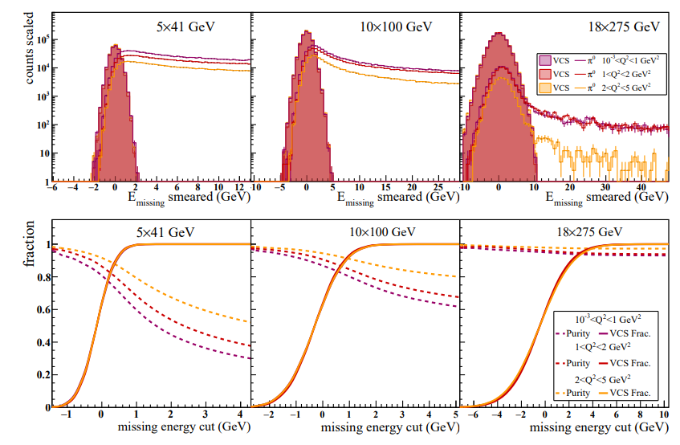
Physics perspectives (examples)
Virtual Compton scattering (u-channel)
Challenge: Large backgrounds from $π^{0}$ production
Background rejection – well-segmented ZDC ($Δx^{γγ}≈70⋅m_{π}/E_{beam}$ [meter])
PRC 108 (2023) 5, 055205

Slide 35
Summary
All Far-Forward and Far-Backward detector acceptances and detector performance are well-understood with currently available information
There is an impressive extension of the nominal physics program¹ foreseen with the current detectors
A large focus has been placed now on simulation studies of various processes in preparation for the ePIC Technical Design Report (TDR)
Coming soon²: the full list of the physics projections for the ePIC detector
¹ EIC Yellow report (Nucl. Phys. A 1026 (2022) 122447)
² Early 2025

Slide 36
Backup

Slide 37
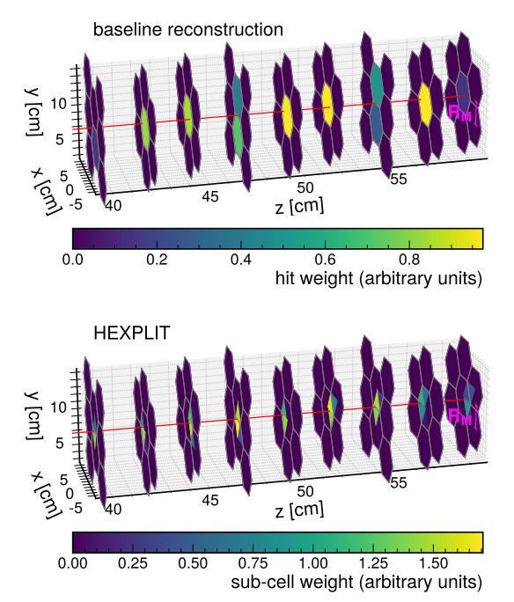
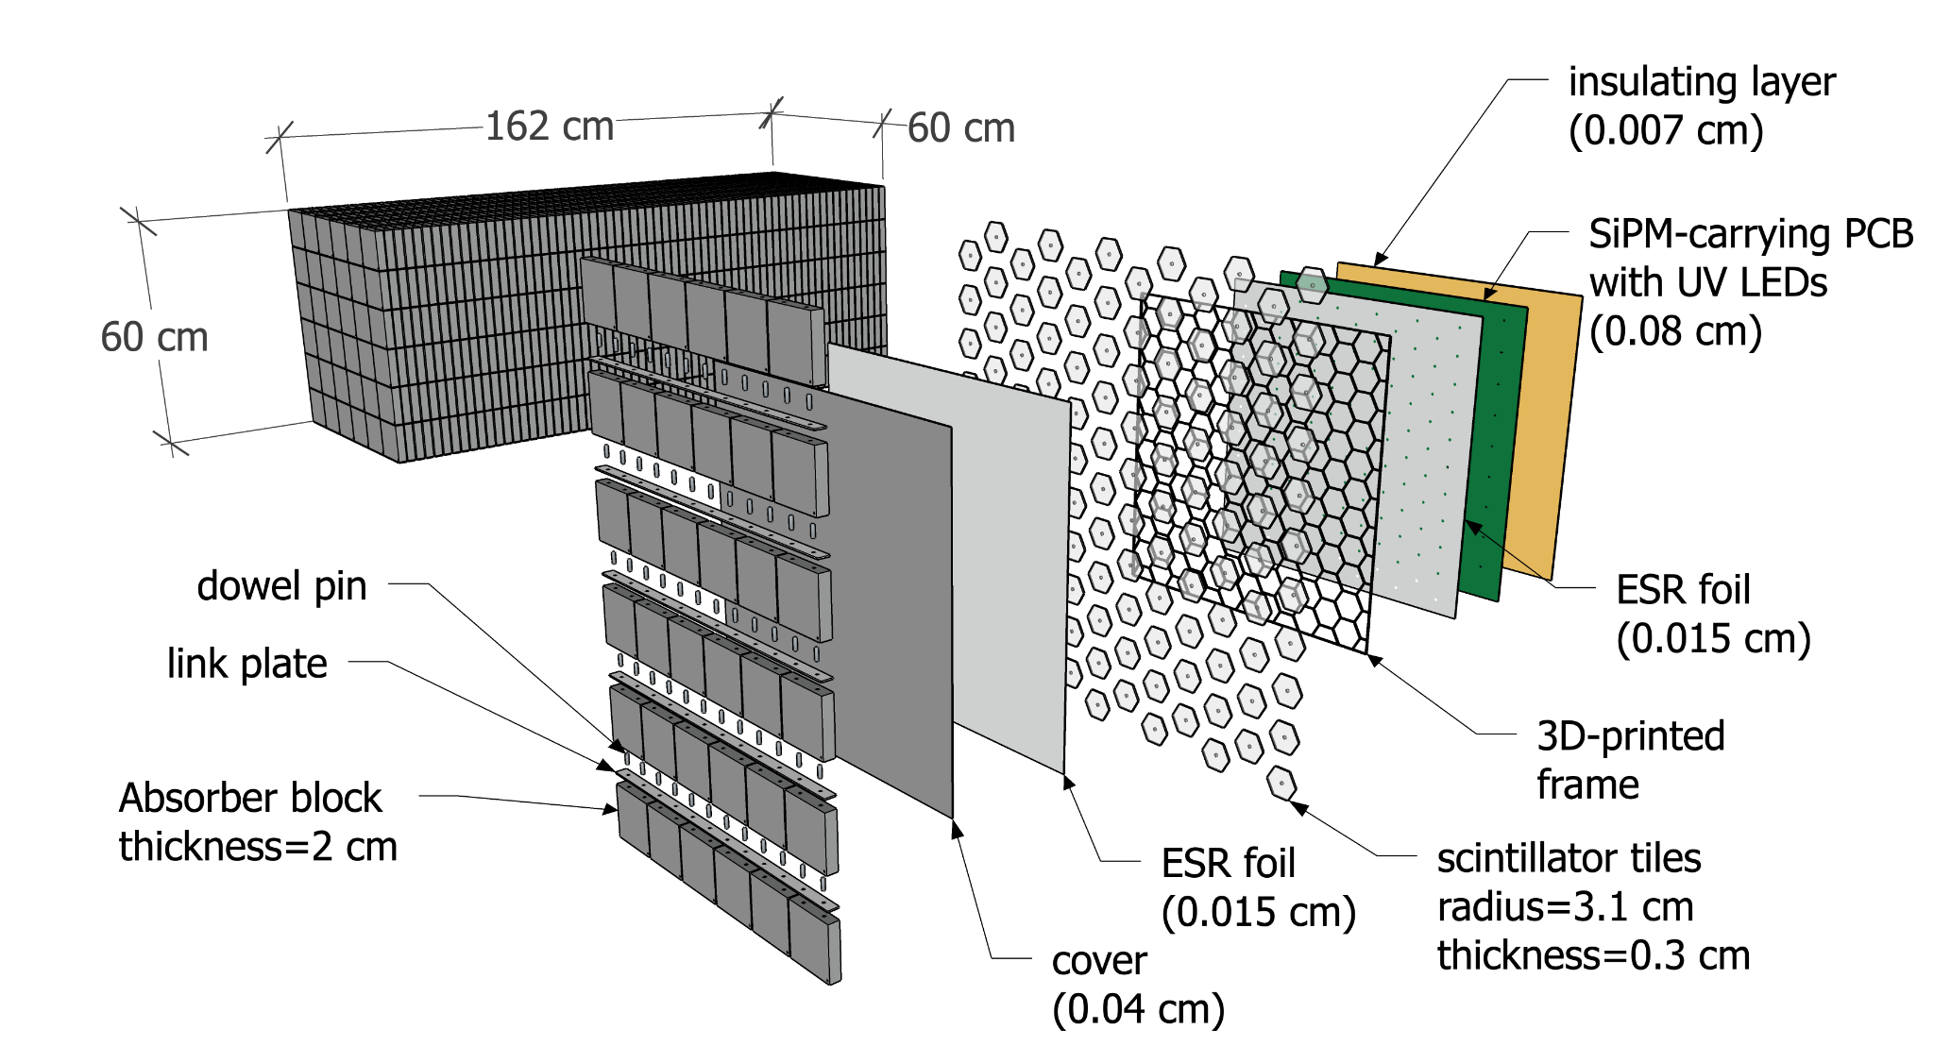
The Far-Forward detectors
Zero Degree Calorimeter (ZDC)
Hadronic section – similar to forward hadron calorimeter (see more in Henry Klest talk)
ML based reconstruction using the HEXPLIT algorithm (2308.06939)

Slide 38
Other DIS talks
EIC, HL-LHC, Forward physics (Mon 14:40)
https://lpsc-indico.in2p3.fr/event/3268/contributions/7216/
Overview of the ePIC Detector (Wed 10:20)
https://lpsc-indico.in2p3.fr/event/3268/contributions/7417/
Particle Identification with the ePIC detector at the EIC (Wed 11:00)
https://lpsc-indico.in2p3.fr/event/3268/contributions/7571/
Calorimetry for the ePIC Experiment (Wed 12:00)
https://lpsc-indico.in2p3.fr/event/3268/contributions/7433/
A 2nd Detector for the Electron-Ion Collider (Wed 12:20)
https://lpsc-indico.in2p3.fr/event/3268/contributions/7439/

