Slide 1
1

Slide 2
MOTIVATION
ALEXANDRA RIDZIKOVÁ CTU PRAGUE
1

Slide 6
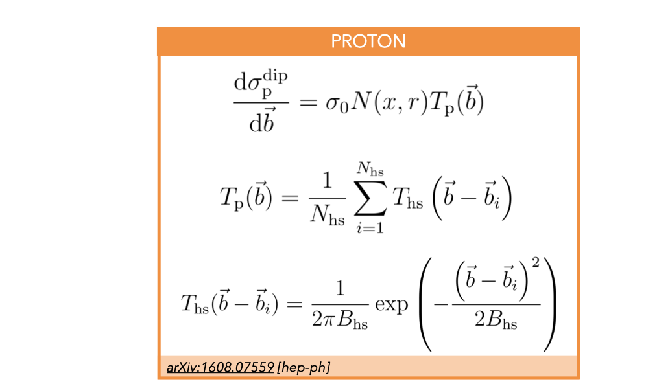

Slide 31
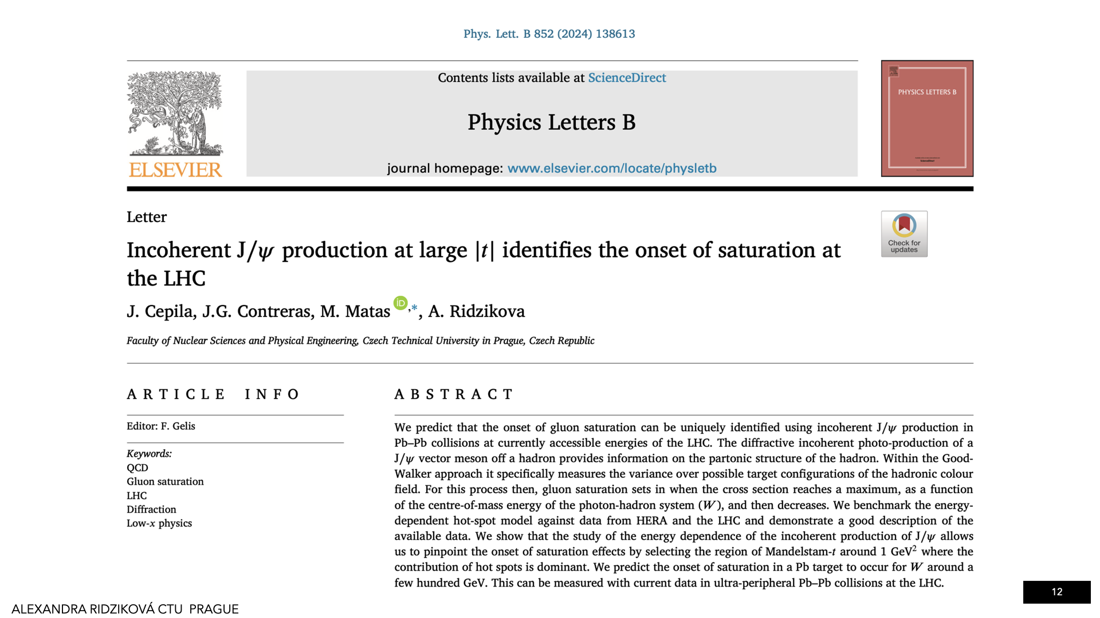

Slide 35
