Slide 1
Development and characterisation of detectors for beam monitoring in radiotherapy
Jayde Livingstone
Equipe Physique Nucléaire et Applications Médicales, LPSC, Grenoble
IUT1 Mesures Physiques

Slide 2


Development and characterisation of detectors for beam monitoring in radiotherapy
2014
2015
2016
2019
2017
2018
2020
2021
2022
2023
2024
Jayde Livingstone
Equipe Physique Nucléaire et Applications Médicales, LPSC, Grenoble
IUT1 Mesures Physiques
Source modelling for virtual imaging
NOVITOM
Nanoscale phase contrast imaging
ESRF
Beamline scientist
(synchrotron radiotherapy)
IMBL, Australian synchrotron
Postdoc: online range monitoring proton therapy
LPSC – IP2I
AI-based classification & segmentation histology
UGA - MOREHISTO
Diamond-based beam monitors
LPSC

Slide 3
Development and characterisation of detectors for beam monitoring in radiotherapy
2014
2015
2016
2019
2017
2018
2020
2021
2022
2023
2024
Jayde Livingstone
Equipe Physique Nucléaire et Applications Médicales, LPSC, Grenoble
IUT1 Mesures Physiques
Source modelling for virtual imaging
NOVITOM
Nanoscale phase contrast imaging
ESRF
Beamline scientist
(synchrotron radiotherapy)
IMBL, Australian synchrotron
Postdoc: online range monitoring proton therapy
LPSC – IP2I
AI-based classification & segmentation histology
UGA - MOREHISTO
Diamond-based beam monitors
LPSC

Slide 4

What is radiotherapy?
Use of radiation radiation (e.g. x-rays, electrons, protons, etc.) to treat a disease
About half of all cancer patients will receive some form of radiotherapy during their treatment
Tumour control
Therapeutic ratio
The goal of radiotherapy is of course to kill cancer cells…
But not at the expense of healthy cells!
The dose to healthy tissue must remain below a threshold for normal tissue complications
Normal tissue complication

Slide 5
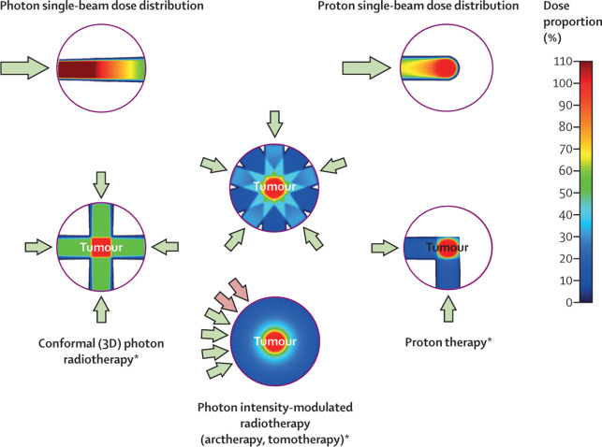
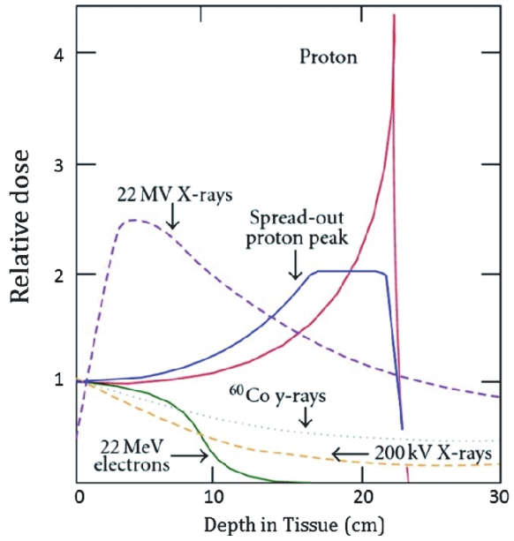
Increasing the therapeutic window
Arjomandy, J. Proton Therapy, 1(1), 2015
Thariat J., et al., Lancet, 22(12), 2021

Slide 6
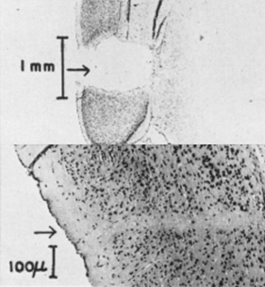
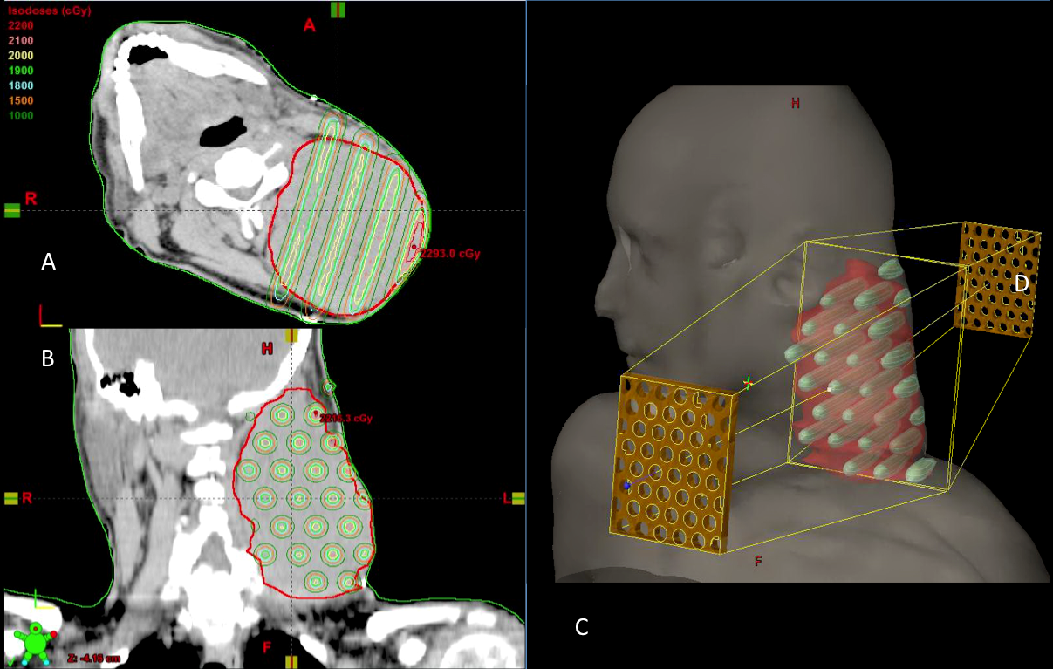
Innovative techniques: spatial fractionation
Dose volume effect
GRID radiotherapy (~cm beams)
Mohiuddin et al., Cureus, 7(12), e417
“Innovative” – first proposed in 1909
Widely used from the 1930s to 1970s
Became obsolete with MV radiotherapy
Limitations
Curtis, H. J., Radiat. Res., Suppl. 7., 1967

Slide 7
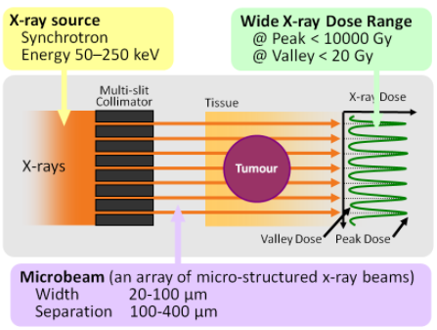
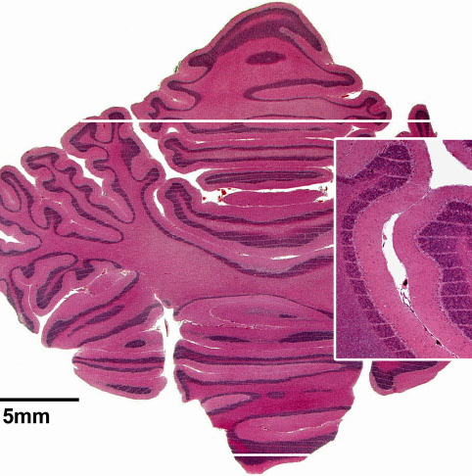
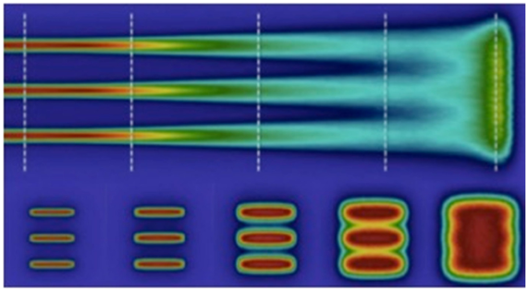
Pushing Spatial fractionation to extremes
Microbeams (~10s of µm)
Minibeams (~several mm)
http://mswebs.naist.jp
www.esrf.eu
Mazal A, et al., Br J Radiol 2020; 93: 20190807
X-rays only: currently confined to synchrotron sources due to spectrum (kV) and high dose rates (10² – 10³ Gy/s) required
X-rays and charged particles (eg. protons) Technically less challenging, lower risk

Slide 8
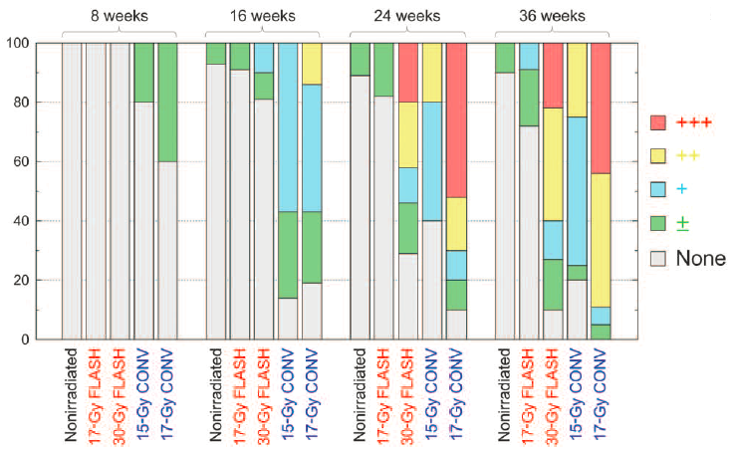
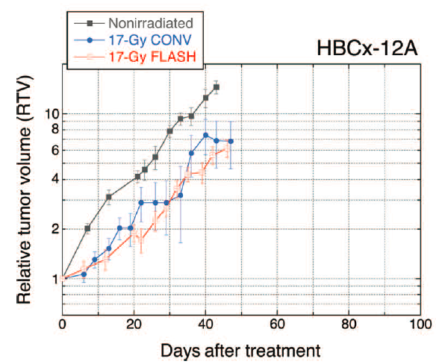
INNOVATIVE TECHNIQUES: FLASH
Lung fibrosis in mice:
Healthy tissue sparing effect at ultra-high dose rates (≥40 Gy/s)
First observed by Favaudon et al. in 2014 using electrons
Extended to x-rays and protons
Could be combined with spatial fractionation
Severe
Moderate
Mild
Minimal
8
Favaudon et al., Sci. Transl. Med., 6, 245ra93, 2014

Slide 9
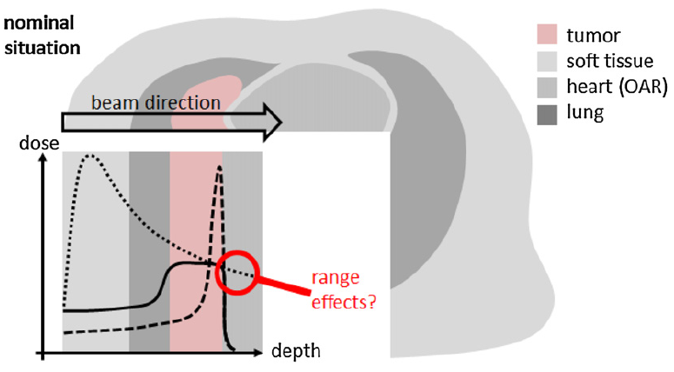
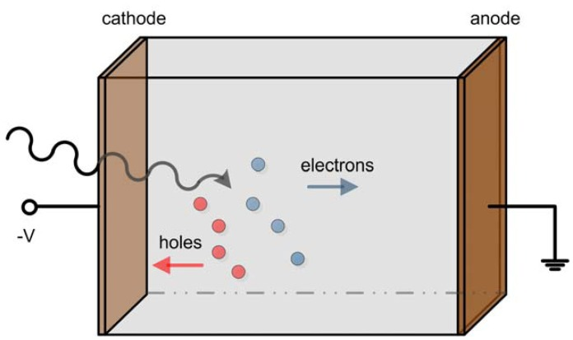
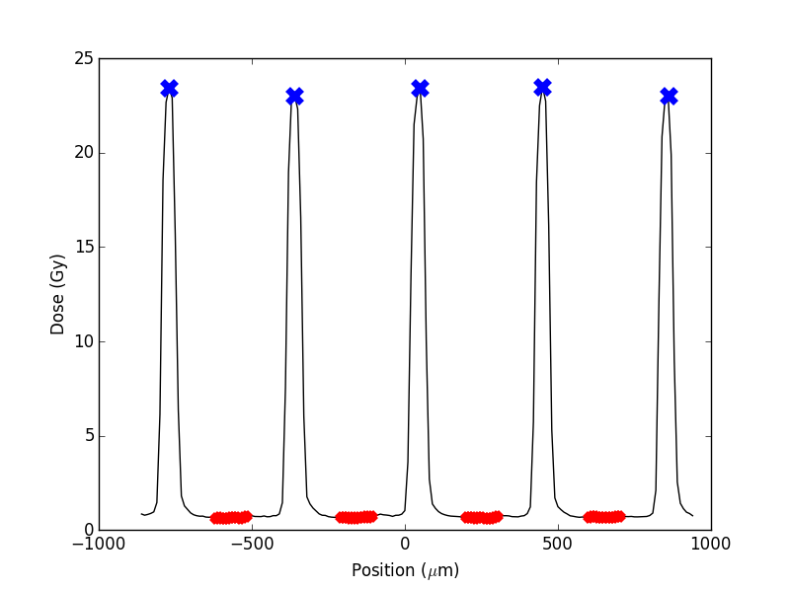
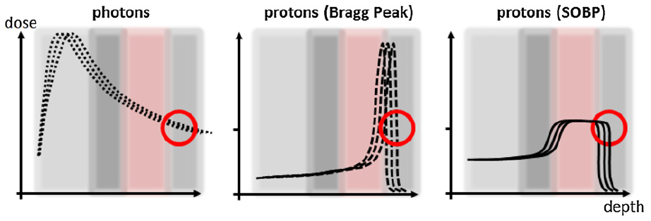
Challenges for treatment planning, delivery and beam monitoring
A) Range uncertainties in proton therapy
B) Beam monitoring in high dose rate environments
C) Micrometric beamlets and high dose gradients
e-h recombination
Radiation induced damage
Knopf et al., Phys. Med. Biol., 58, 2013
Requirements: tissue equivalence, rapidity, radiation resistance, high spatial resolution, dose rate independence, wide dynamic range
Monitoring the transmitted proton beam is not an option
(there is very little to no transmission!)
Secondary radiation detection

Slide 10
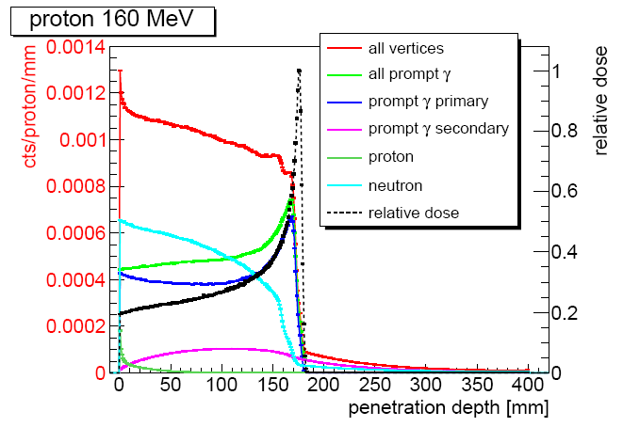
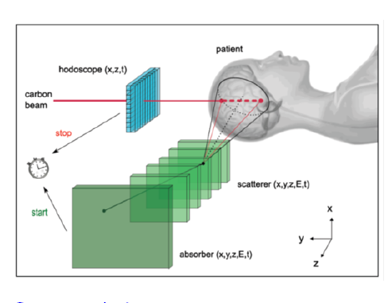
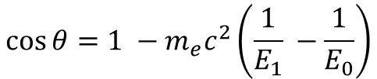
Online range monitoring for proton therapy (postdoc LPSC 2018-2019: CLARYS-UFT)
$$\cos{θ=1 −m_{e}c^{2}\left(\frac{1}{E_{1}} −\frac{1}{E_{0}}\right)}$$
Krimmer et al., NIM A, 878, 2018

Slide 11
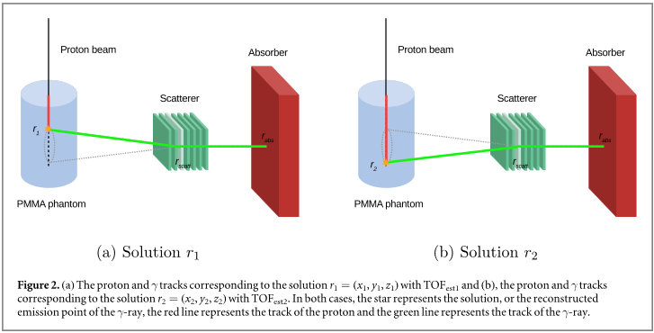
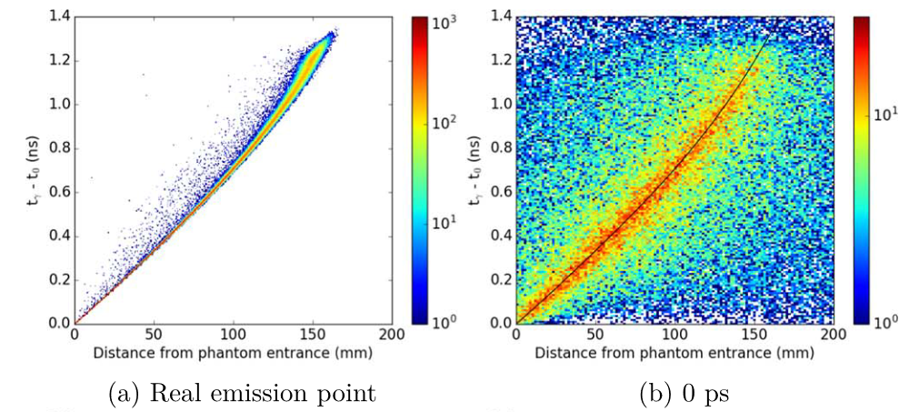
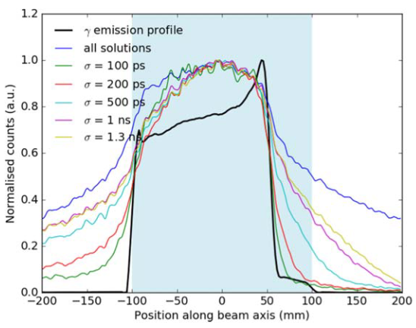
Online range monitoring for proton therapy (postdoc LPSC 2018-2019: CLARYS-UFT)
Livingstone et al., Phys. Med. Biol., 66, 2021
Reconstruction: Compton camera

Slide 12
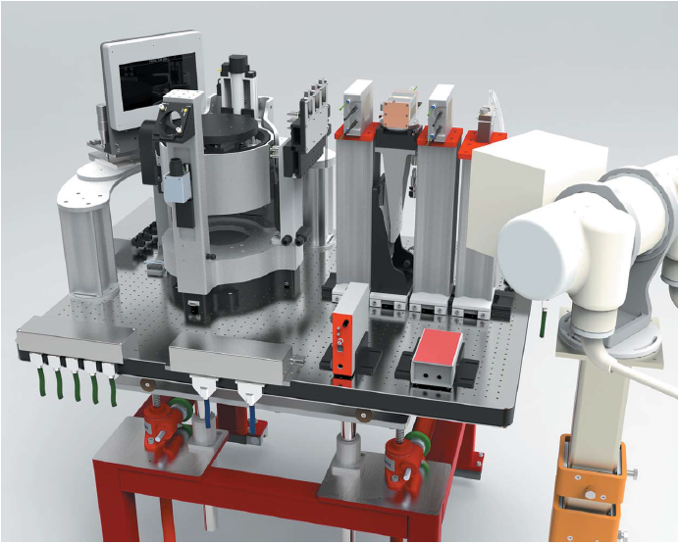
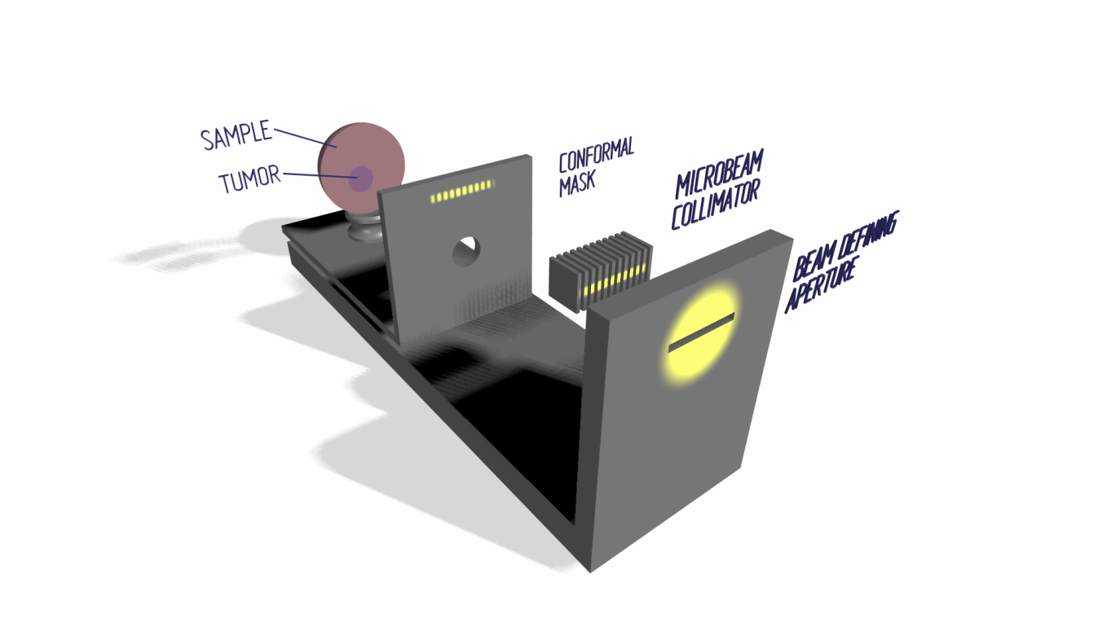
Instrumentation for microbeam radiation therapy
Livingstone, et al., J. Synchrotron Rad., 24., 2017.

Slide 13
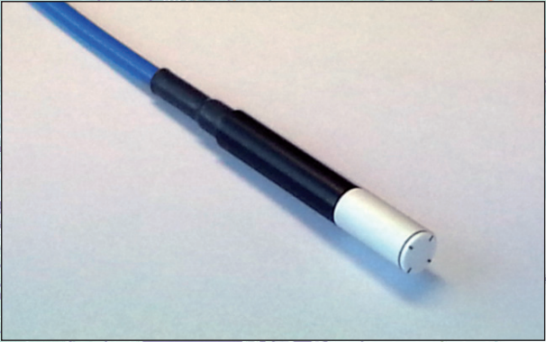
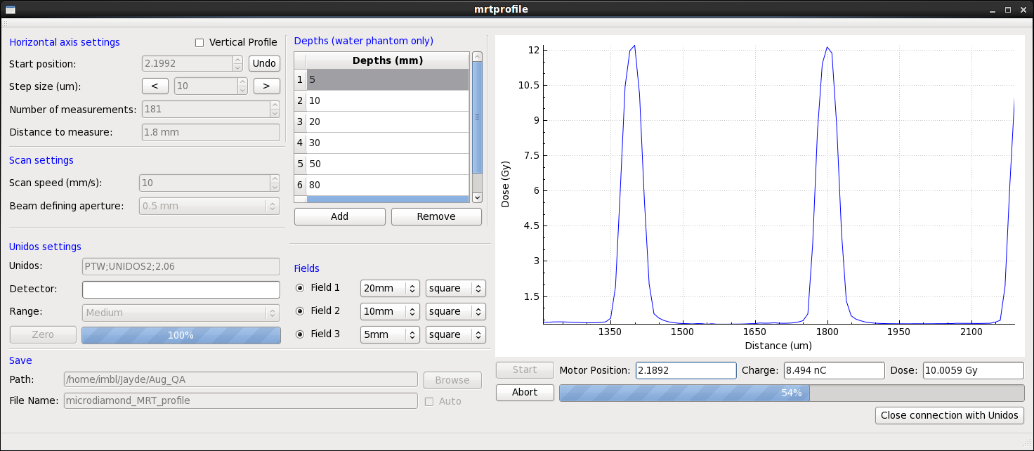
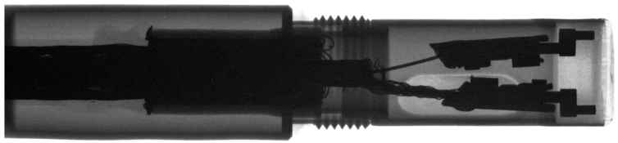

Characterisation of a diamond detector for microbeam radiation therapy
microDiamond (PTW Freiburg, Germany)
Active volume:
2 mm
1 µm

Slide 14

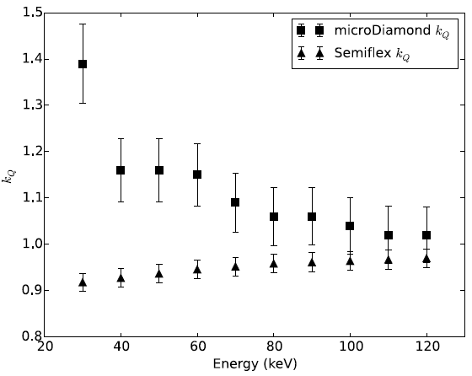
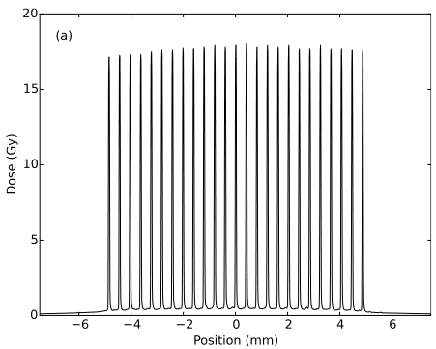
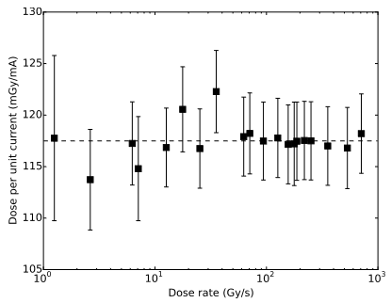
Characterisation of a diamond detector for microbeam radiation therapy
Livingstone et al., Med. Phys., 43, 2016

Slide 15
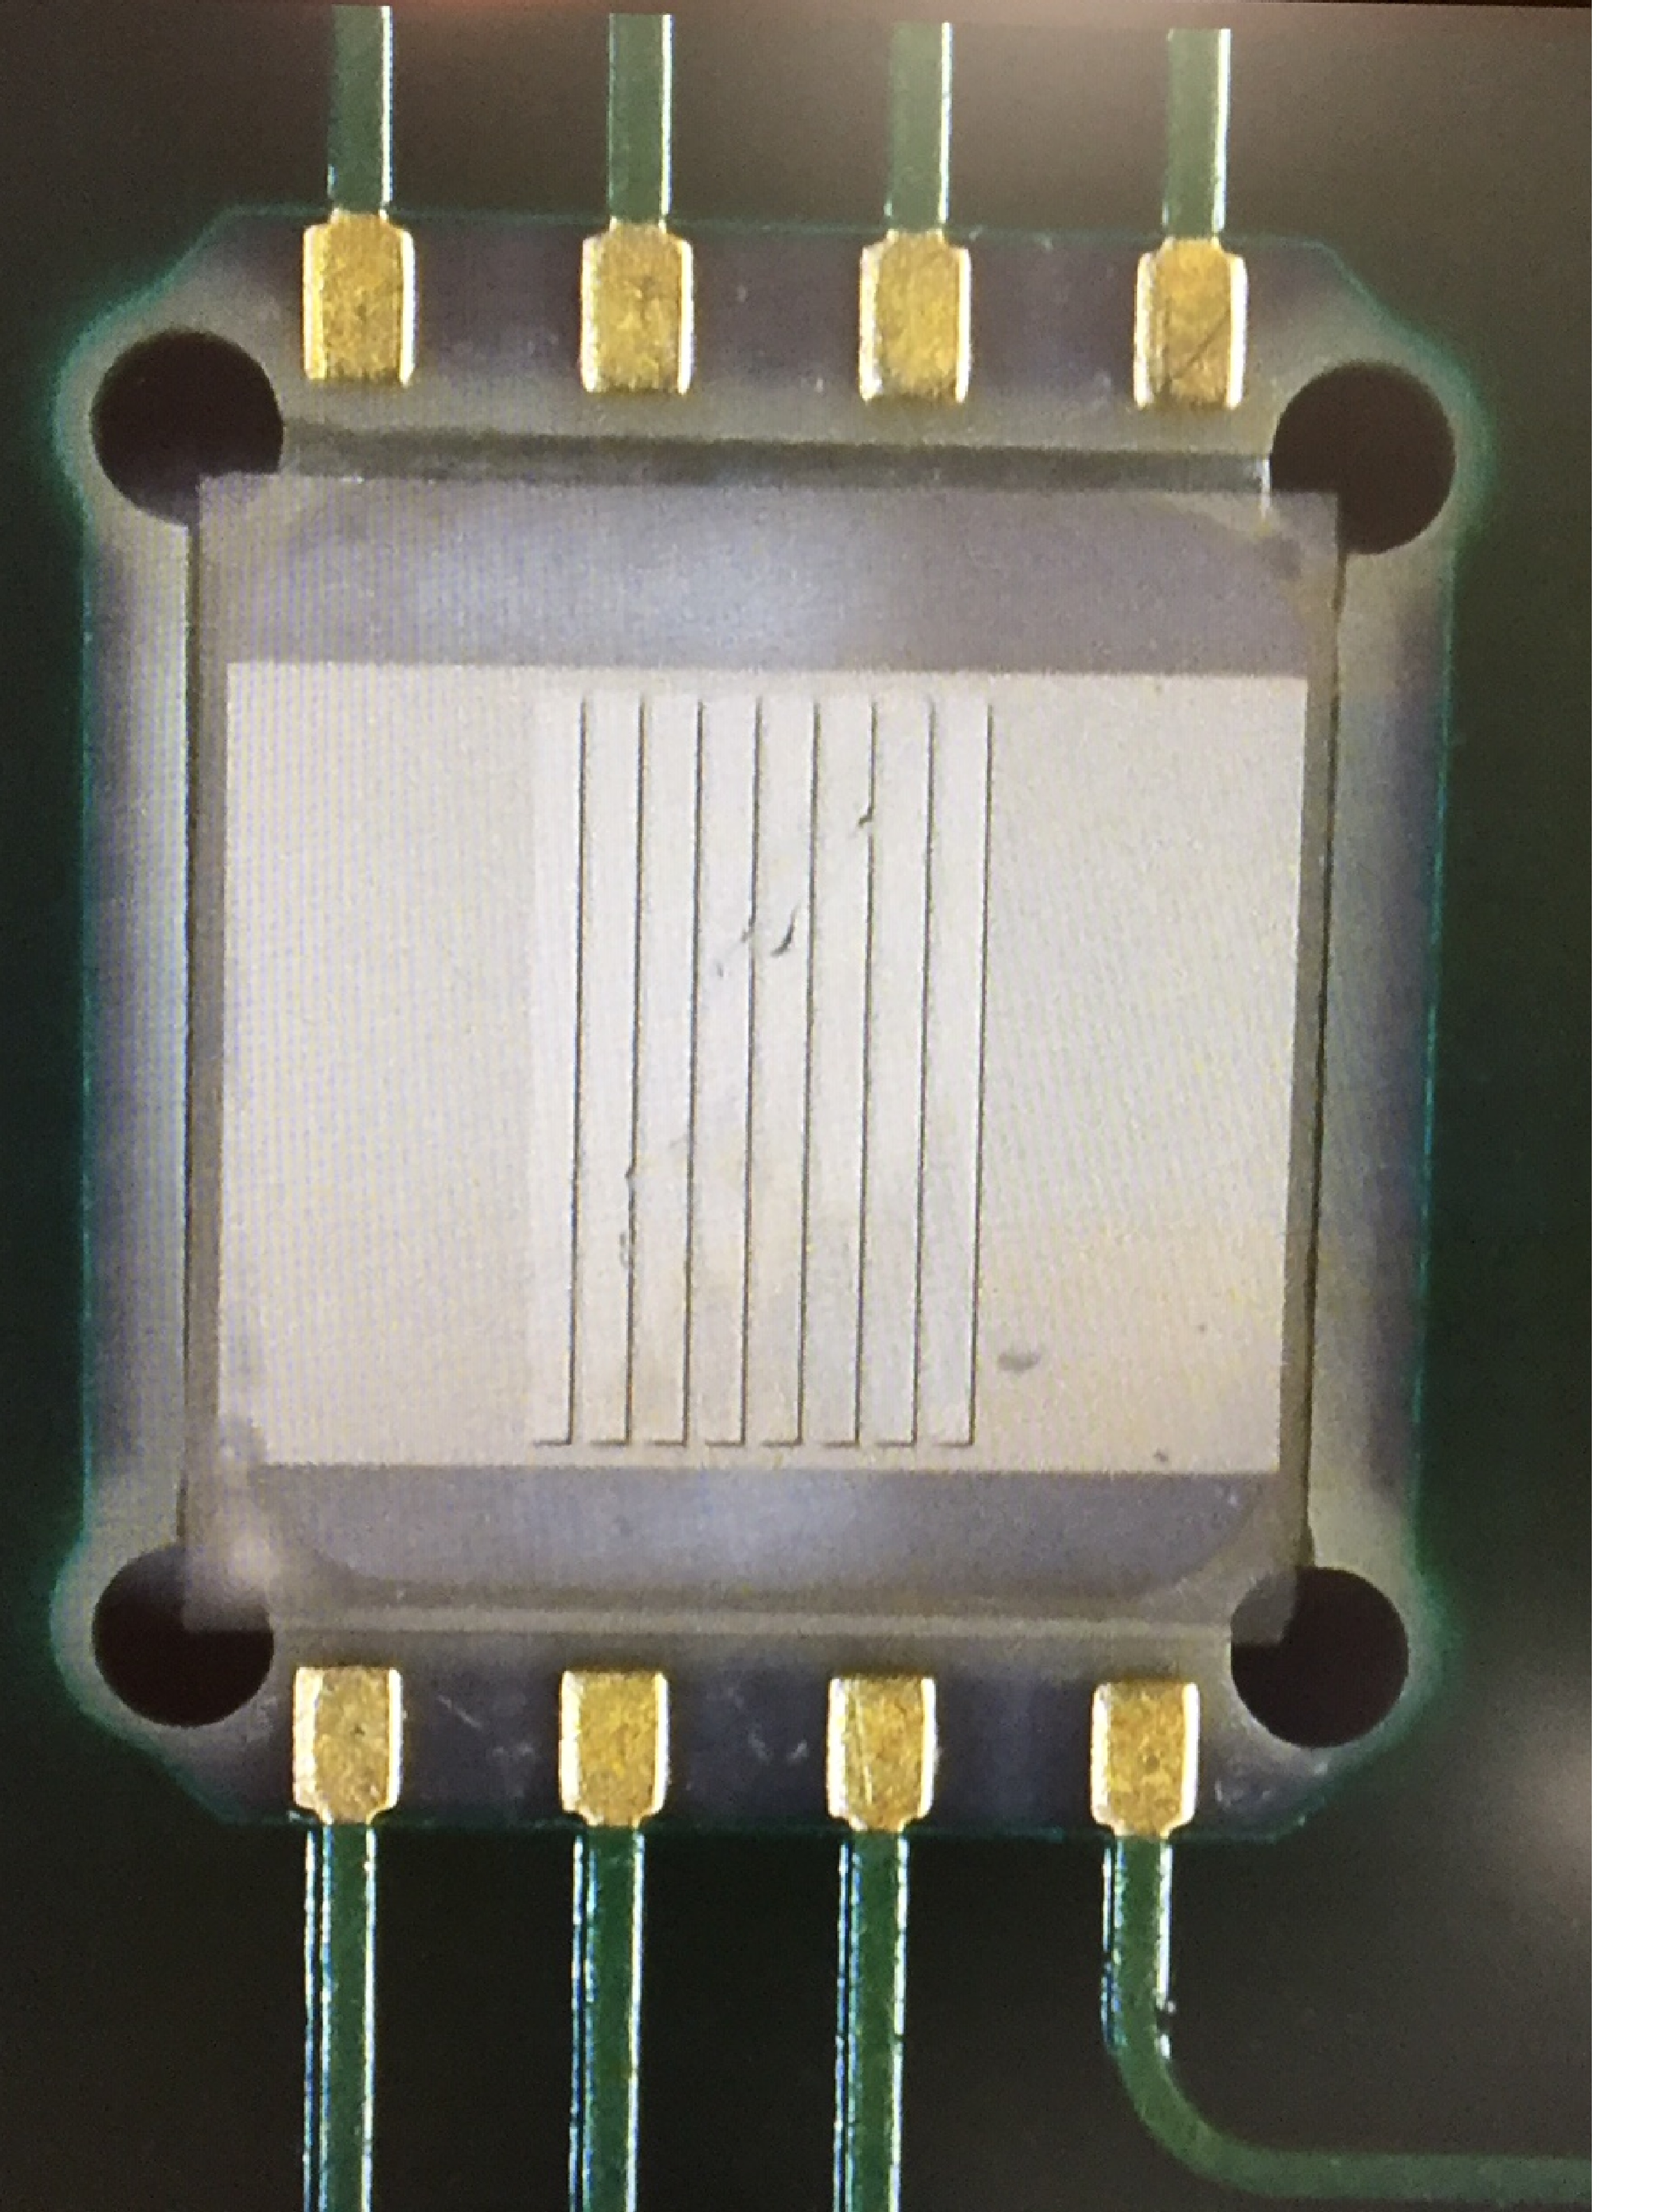
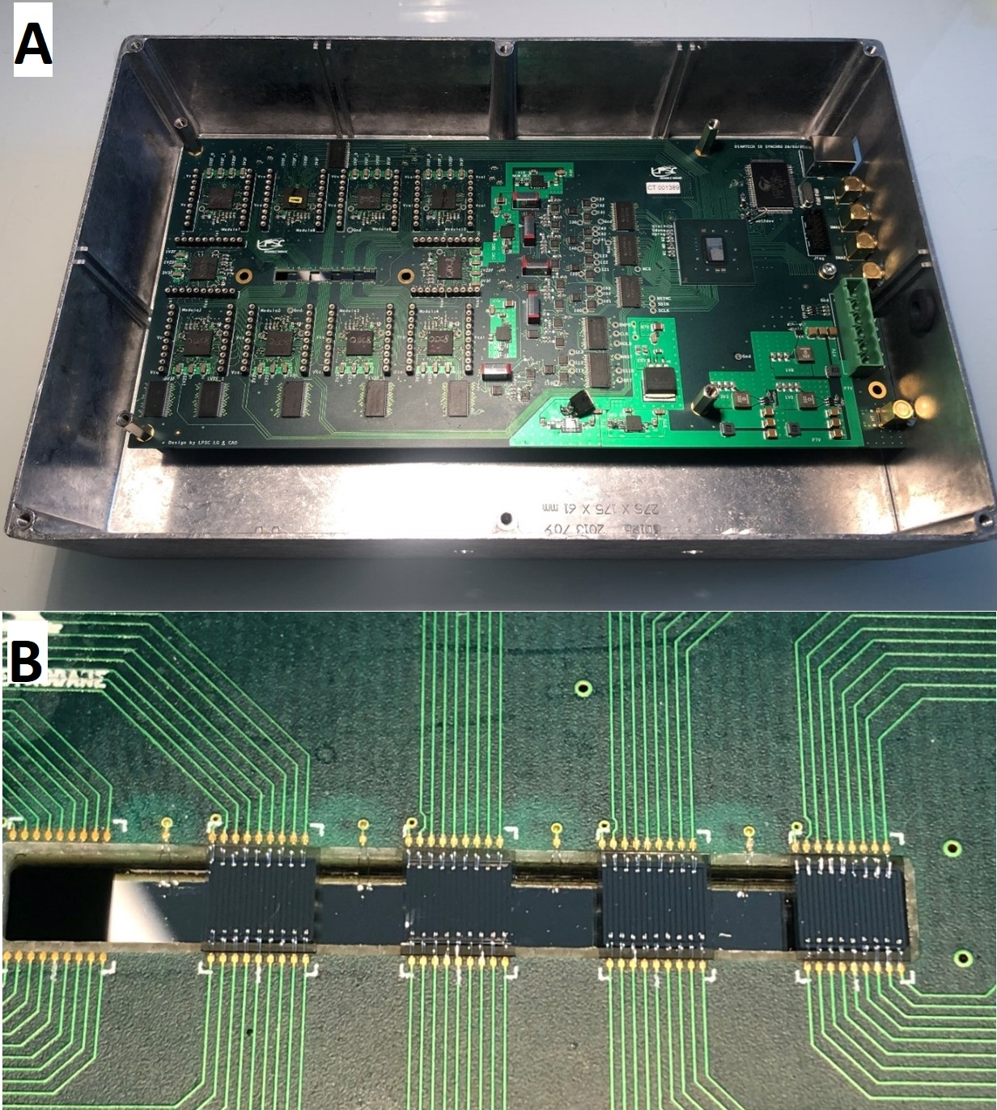
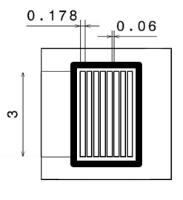
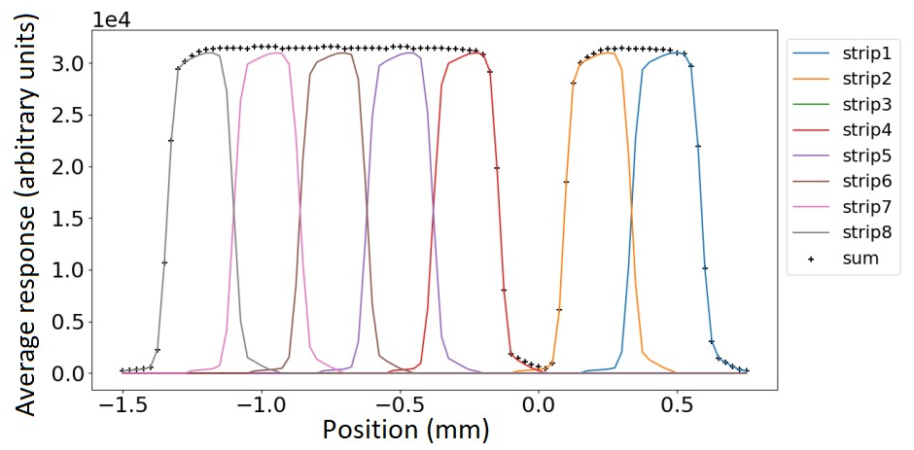
IDSYNCHRO: Diamond-based Microstrip detector for MRT monitoring
PhD: Candice Milewski (1st year)

Slide 16
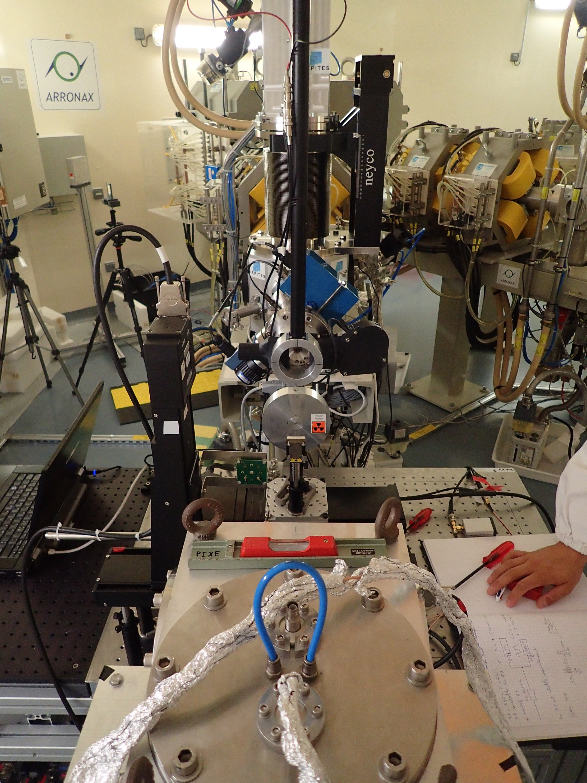
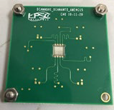
DIAMMONI: Diamond-based beam monitor for proton flash therapy (arronax)
Diamond:
Rapid
Low leakage current
High SNR
Radiation resistant
Tissue equivalent
PhD: Robin Molle (3rd year)
sCVD vs pCVD
Dose rate linearity
Lifetime (radiation damage)
Electrical/charge transport properties
Measured and simulated (ECORCE)
GATE simulations
Internship: Nicolas André (commencing 5th of February)

