Slide 1



Zakariae EN-NAJI
New hybrid technology for thin film deposition of transparent conductive oxides -
photovoltaic applications
18/03/2024
Supervised by :
Ana LACOSTE (Thesis director, LPSC)
Alexandre BES (Co-supervisor, LPSC)
Perrine CARROY (Co-supervisor, Cea Liten)
Plasmas-Matériaux-Nanostructures team (CRMPN)
18/03/2023

Slide 2
Content
Context and objectives
Hybrid Plasma Deposition (HPD) technique presentation
  Plasma source
    Microwave simulation
    Plasma characterization
  Evaporation source
Deposition and characterization of Indium tungsten oxide (IWO) films
Conclusion and perspectives

Slide 3
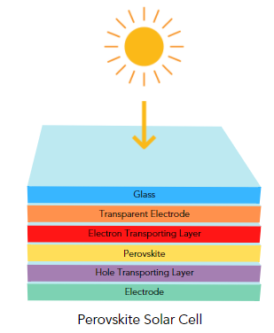
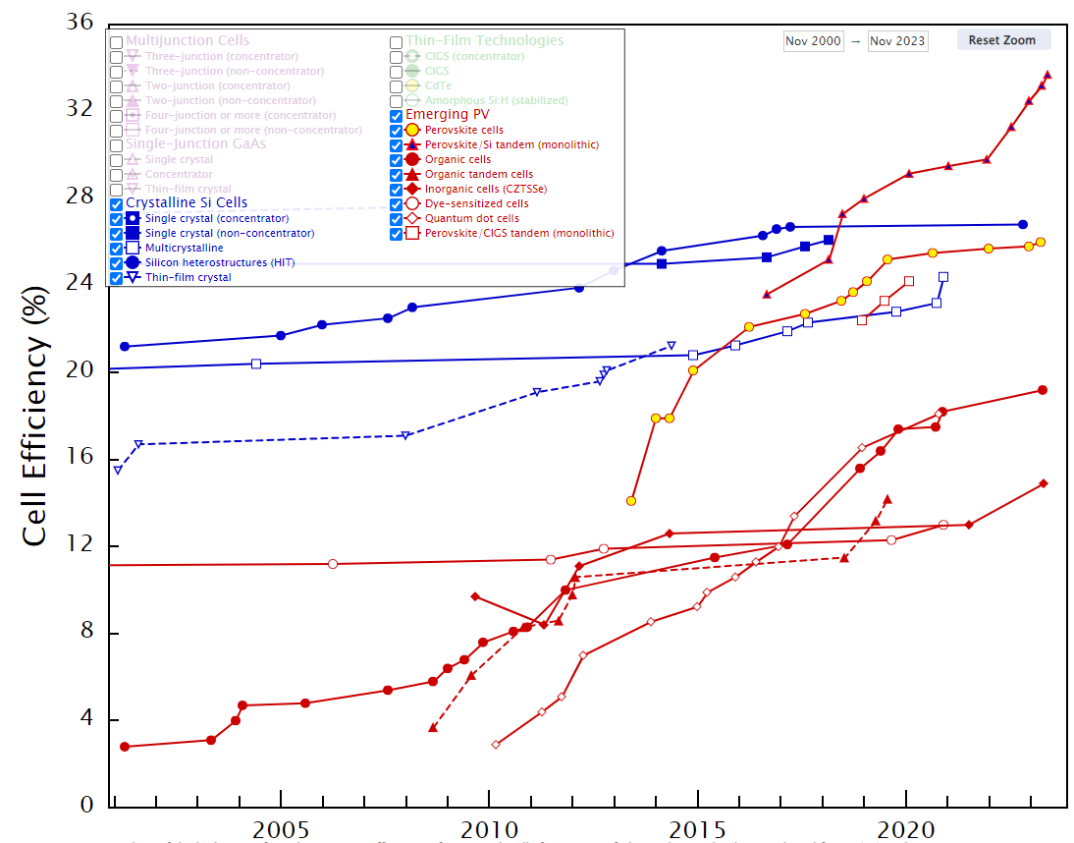
Context and objectives
Evolution of energy conversion efficiency over time.
Good electrical conductivity
Low resistivity
Transparency
Made up of transparent conductive oxides (TCOs)
.
TCOs thin films are deposited by different techniques
Chemical Vapor Deposition
Atomic Layer Deposition
Spin Coating
Spray Pyrolysis
Cathode sputtering (magnetron)
www.nrel.gov/pv/interactive-cell-efficiency.html

Slide 4
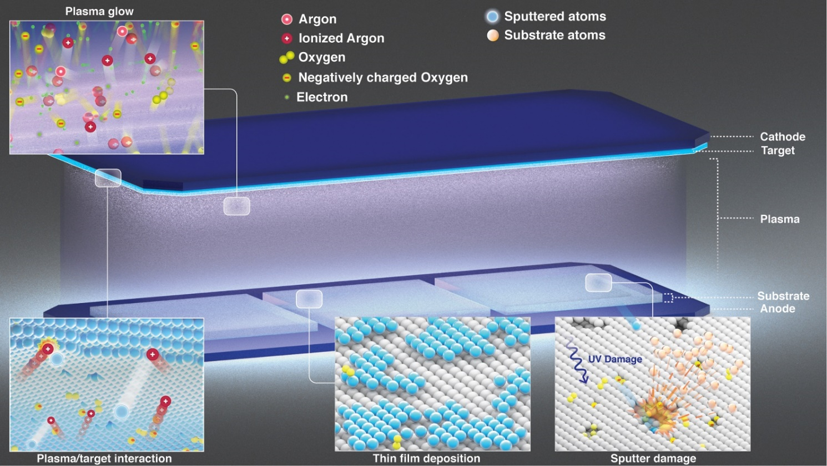
Context and objectives
Magnetron sputtering
High kinetic energy of plasma particles (up to 400 eV) can damage sensitive layers of cells.
Destruction of material properties, thereby limiting or degrading cell performance.
The sputtering process and possible damage mechanisms.
It is essential to suggest alternative technologies to overcome this problem
doi.org/10.1016/j.matt.2021.09.021

Slide 5
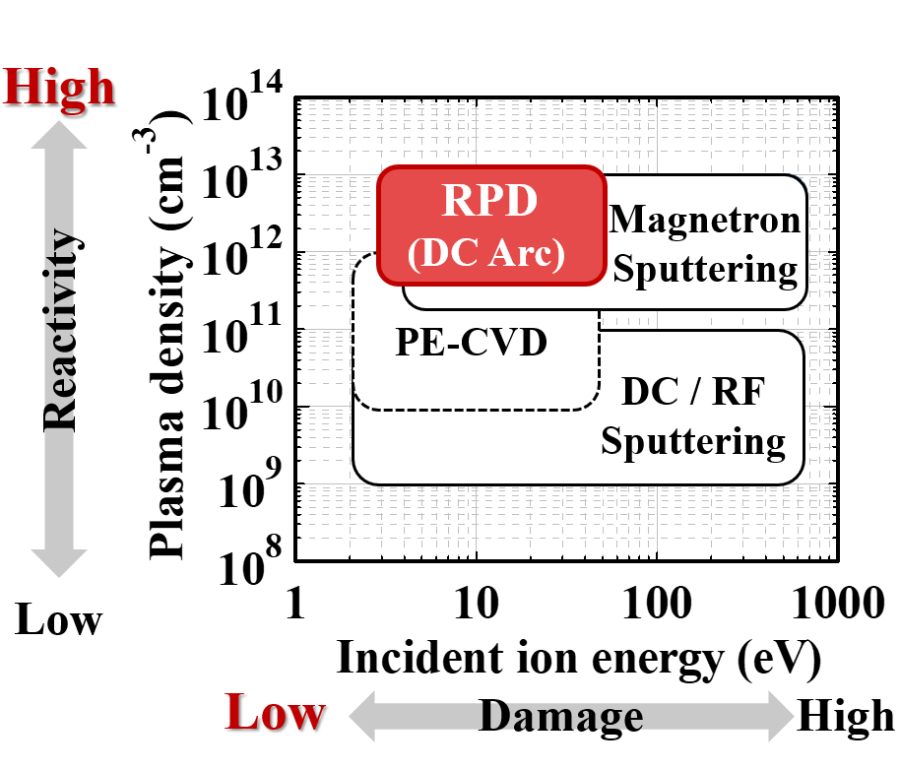
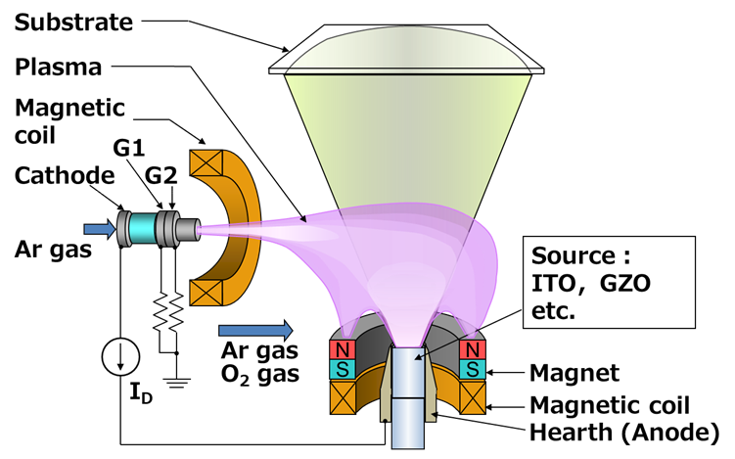
Context and objectives
Reactive Plasma Deposition
Schematic of Reactive Plasma Deposition RPD technique
Incident energy and plasma density distributions of various plasma deposition methods
Low damage to the substrate, incident energy of ions to the substrate is in the range of 3–70 eV
High-quality of TCO films ( Resistivity, transparency, …)
doi.org/10.1186/s11671-019-2948-4

Slide 6
Content
Context and objectives
Hybrid Plasma Deposition (HPD) technique presentation
  Plasma source
    Microwave simulation
    Plasma characterization
  Evaporation source
Deposition and characterization of IWO films
Conclusion and perspectives

Slide 7
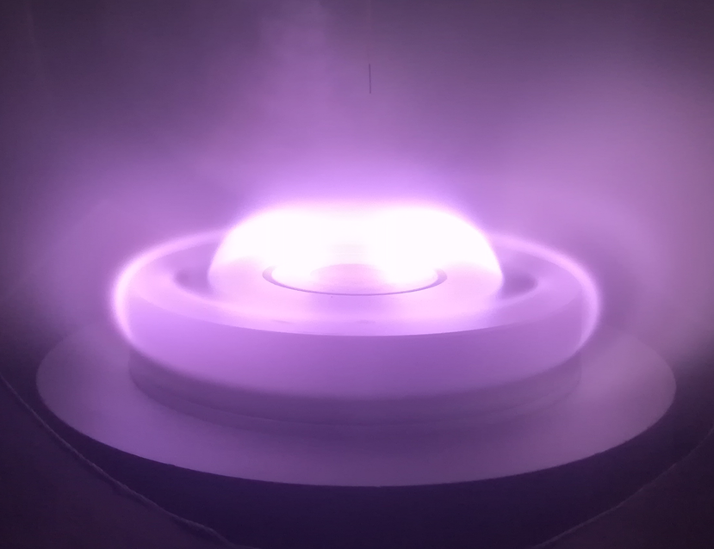
Hybrid Plasma Deposition technique
Hybrid Plasma Deposition = Plasma source + Evaporation system
Process parameters :
Pressure
Gas composition
Microwave power
Heating current
Source – substrate distance
Length (mm)
N
TCO
N
S
S
Evaporated atoms
S
S
N
N
ECR Zone
Head to head magnet
DC Heater
Solid material
Microwave injection
Schematic of HPD experimental setup.

Slide 8
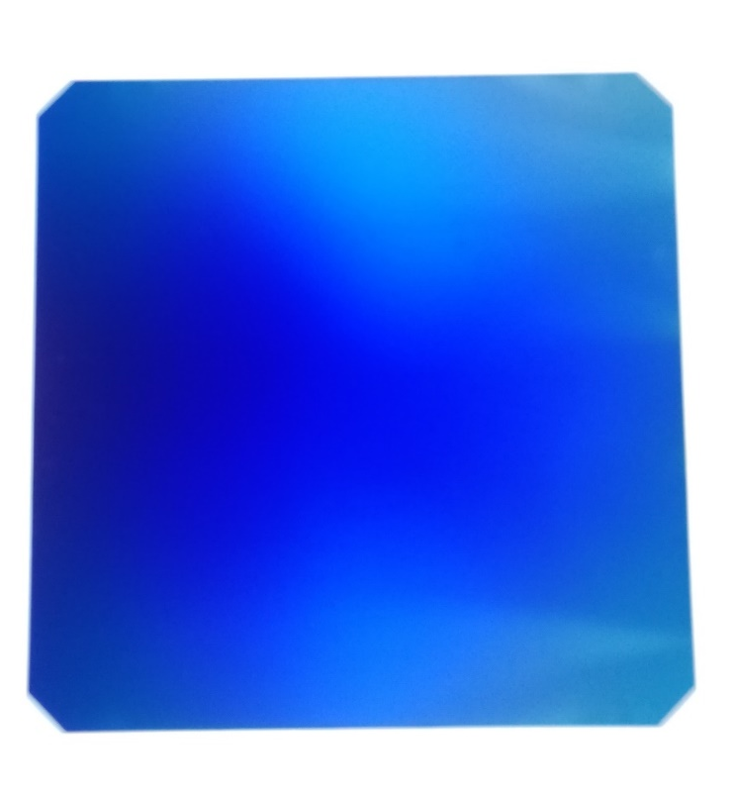
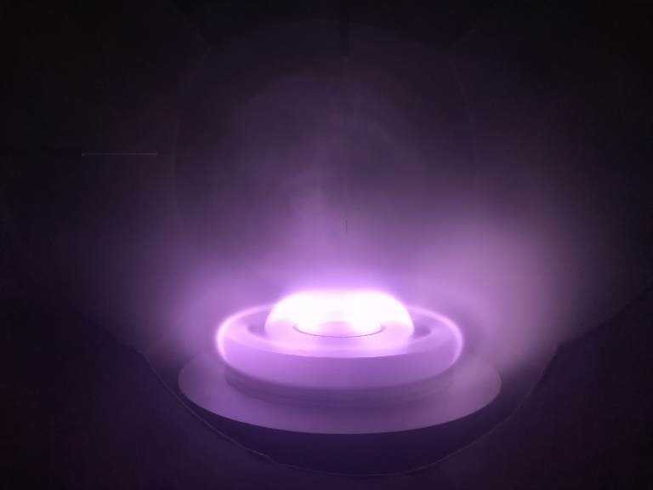
Hybrid Plasma Deposition technique
The need for the simulation of the microwave applicator to understand the problem
Plasma source and the non-uniformity of plasma
The non-uniformity of the thin film

Slide 9
Content
Context and objectives
Hybrid Plasma Deposition (HPD) presentation
  Plasma source
    Microwave simulation
    Plasma characterization
  Evaporation source
Deposition and characterization of IWO films
Conclusion and perspectives

Slide 10
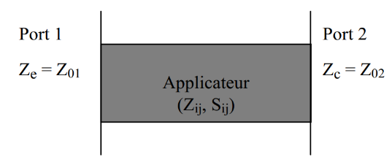
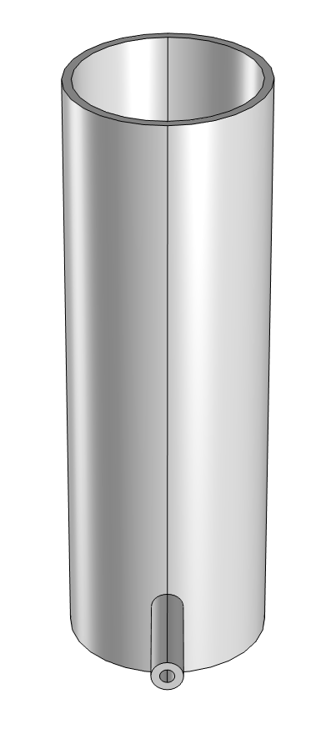
Microwave simulation: Current Microwave applicator configuration (2,45 GHz)
Geometry/material definition → Simulation using Comsol multiphysics → Data processing
5,71 Ω
Port 2
D_{ext}
D_{int}
Principle of the 2-port model.
 | Existing configuration
D_{int} | 60mm
D_{ext} | 66 mm
Connector position (z) | 26 mm
Applicator length | 201 mm
Connecteur D_{int} | 10,5 mm
Connecteur D_{ext} | 4,85 mm
Propagation medium | Air
L
Configuration dimensions: Existing at LPSC.
Objective of the COMSOL simulation:
Understand the source of the non-uniformity of the electromagnetic field
Port 1
D_{ext} connecteur
D_{int} connecteur

Slide 11

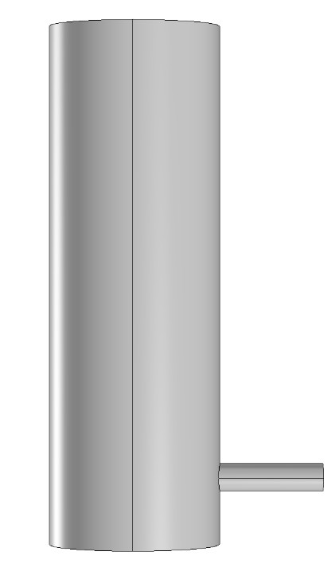
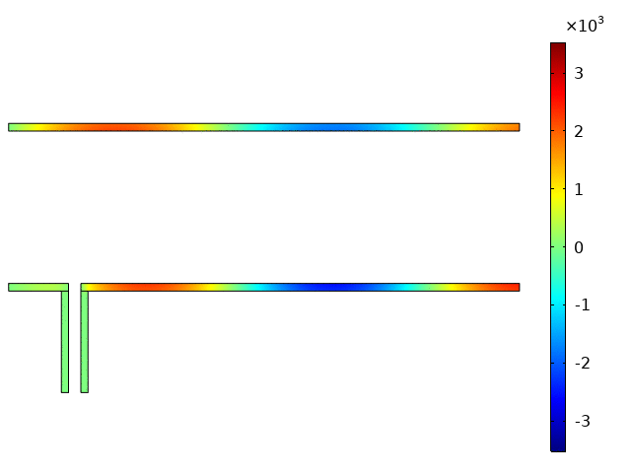
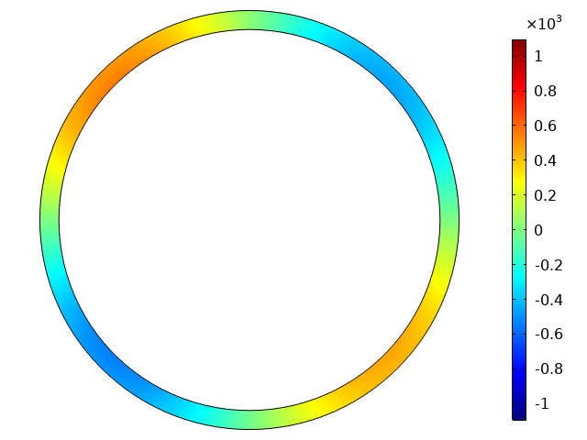
Microwave simulation: Current Microwave applicator configuration (2,45 GHz)
Port 2
Reflection of -7 dB (20%)
5,71 Ω
f (GHz)
NormE
S11 reflection as a function of frequency.
Port 1
50 Ω
Current configuration
Ex component
Ey component

Slide 12
Microwave simulation: Current Microwave applicator configuration (2,45 GHz)
Length (mm)
Schematic of HPD experimental setup.
N
TCO
N
S
S
Evaporated atoms
S
S
N
N
ECR Zone
Head to head magnet
DC Heater
Solid material
Microwave injection
Objective of the simulation:
Improve the geometry in order to allow microwaves to propagate in a symmetrical way
Obtain the lowest possible reflection coefficient

Slide 13
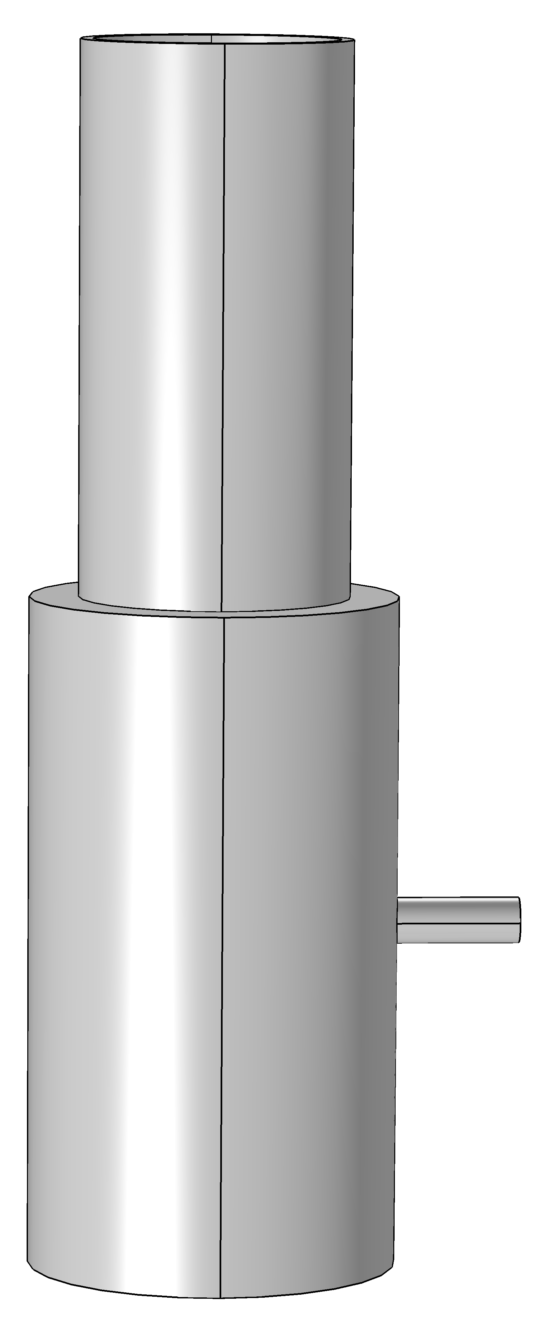
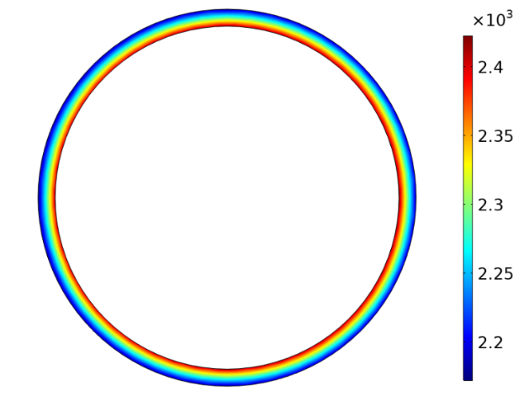
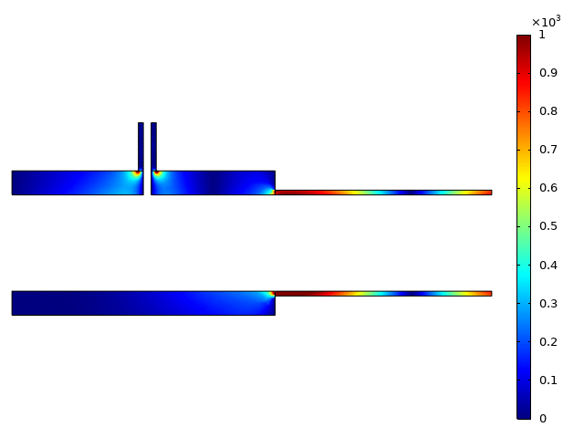
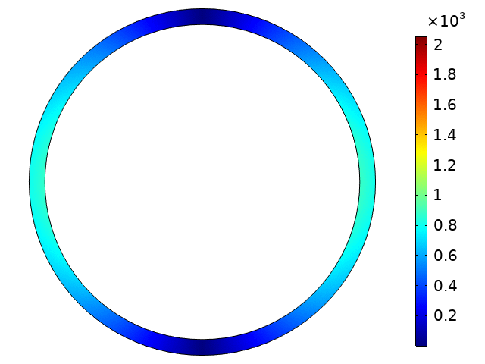
Microwave simulation : 2-section model with a fixed inside diameter ( Frequency: 915 MHz )
 | Dint | Dext | Characteristical impedance | Length | Total length
2nd section | 60 mm | 66 mm | 5,71 Ω | 135 mm | 299 mm
1st section |  | 90 mm | 24,31 Ω | 164 mm
Model characteristics
5.71 Ω
Reflection of -31 dB (~ 0%)
135 mm
Symmetrical EM
field
NormE
S11 reflection as a function of charge ( 2 ports simulation).
164 mm
24,31 Ω
50 Ω
Ex component
~ 100% power transmission
Symmetrical propagation of the Electromagnetic field
Ex component

Slide 14
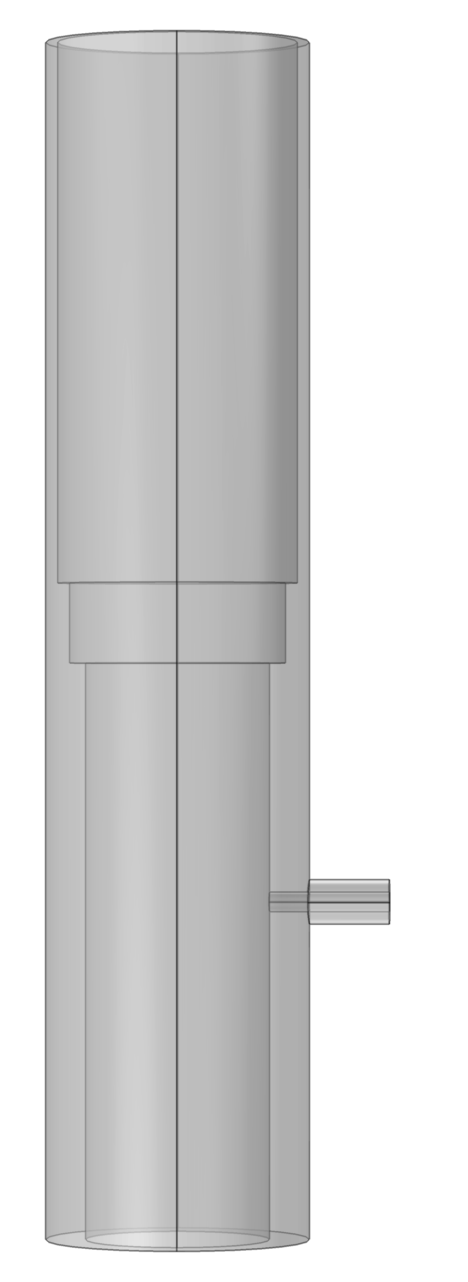
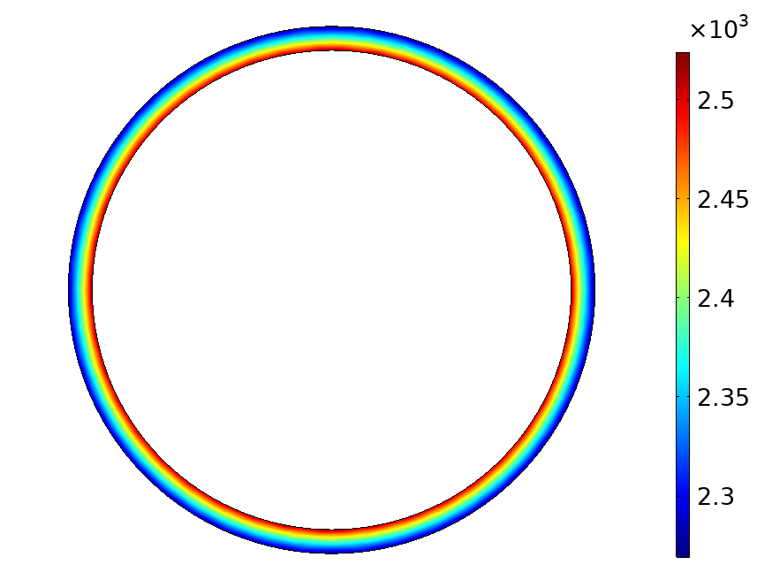
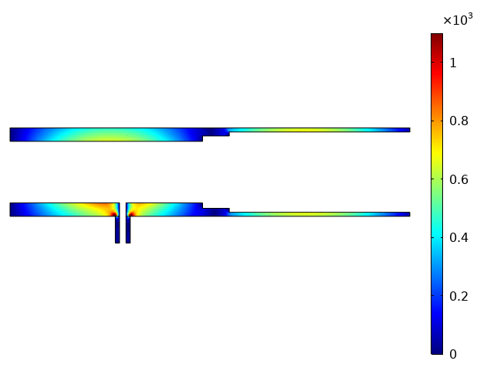
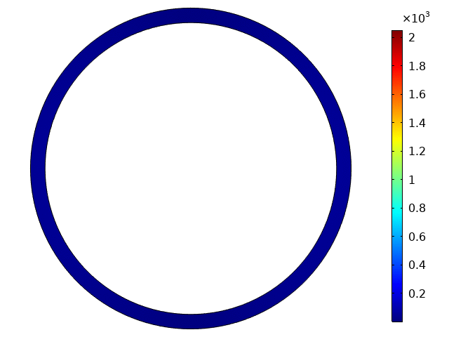
Microwave simulation : 3-section model with a fixed outside diameter (Frequency : 915 MHz)
 | Dint | Dext | Characteristical impedance | Length | Total length
1st section | 46 mm | 66 mm | 21,64 Ω | 144 mm | 299 mm
2nd section | 54 mm | 66 mm | 12,03 Ω | 20 mm
3rd section | 60 mm | 66 mm | 5,71 Ω | 135 mm
Port 2
Model characteristics
5,71 Ω
Reflection of -25 dB (~ 0%)
Symmetrical EM
field
12,31 Ω
S11 reflection as a function of charge ( 2 ports simulation).
NormE
Port 1
50 Ω
Ex component
24,31 Ω
Ex
~ 100% power transmission
Symmetrical propagation of the Electromagnetic field

Slide 15
Content
Context and objectives
Hybrid Plasma Deposition (HPD) presentation
  Plasma source
    Microwave simulation
    Plasma characterization
  Evaporation source
Deposition and characterization of IWO films
Conclusion and perspectives

Slide 16
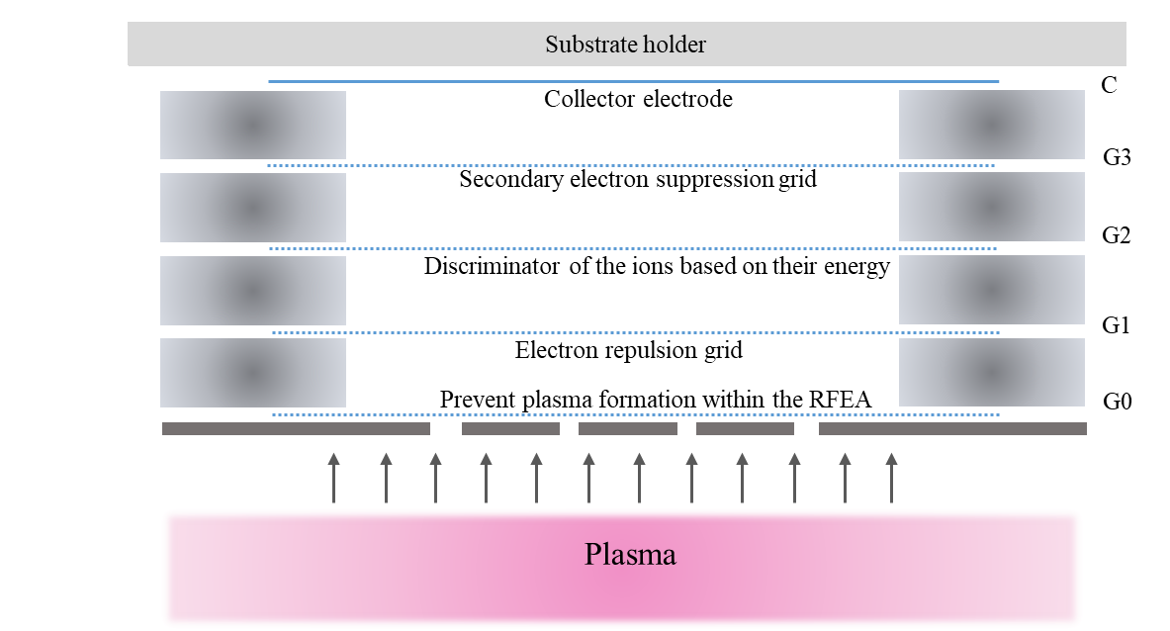
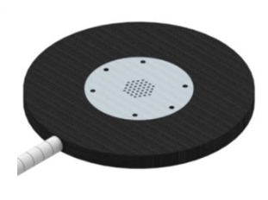
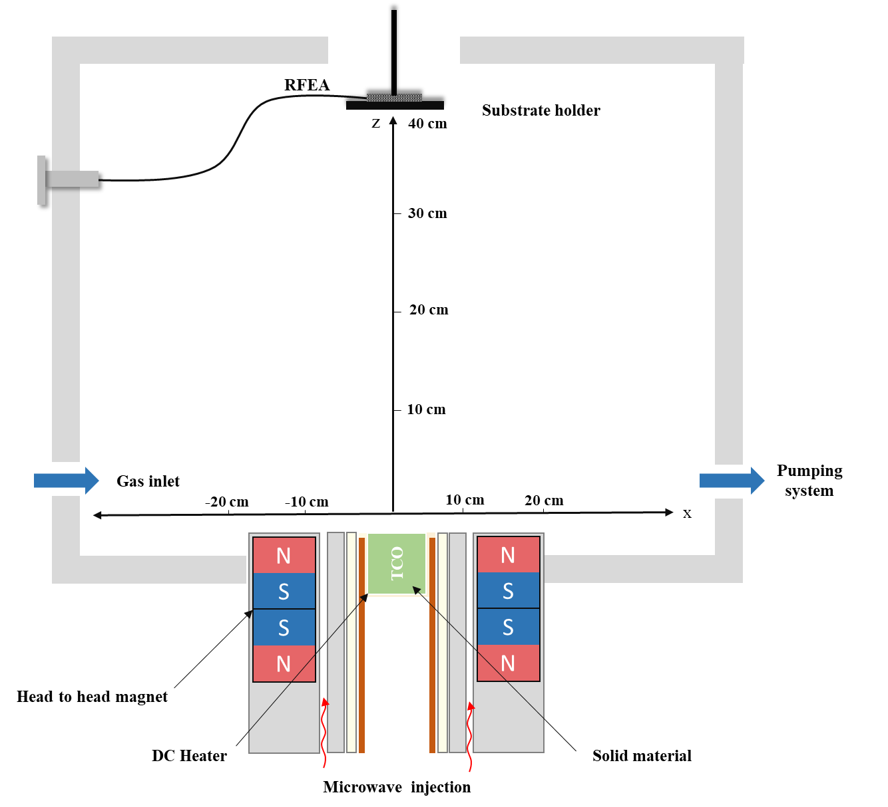
Plasma characterization : Ion energy distribution measurements
Ion energy distribution functions
300 W, 1 mTorr, Argon and gas mixture (84% Ar, 14% O₂, 2% H₂).
Energy of ions and neutral particles less than 30 eV

Slide 17
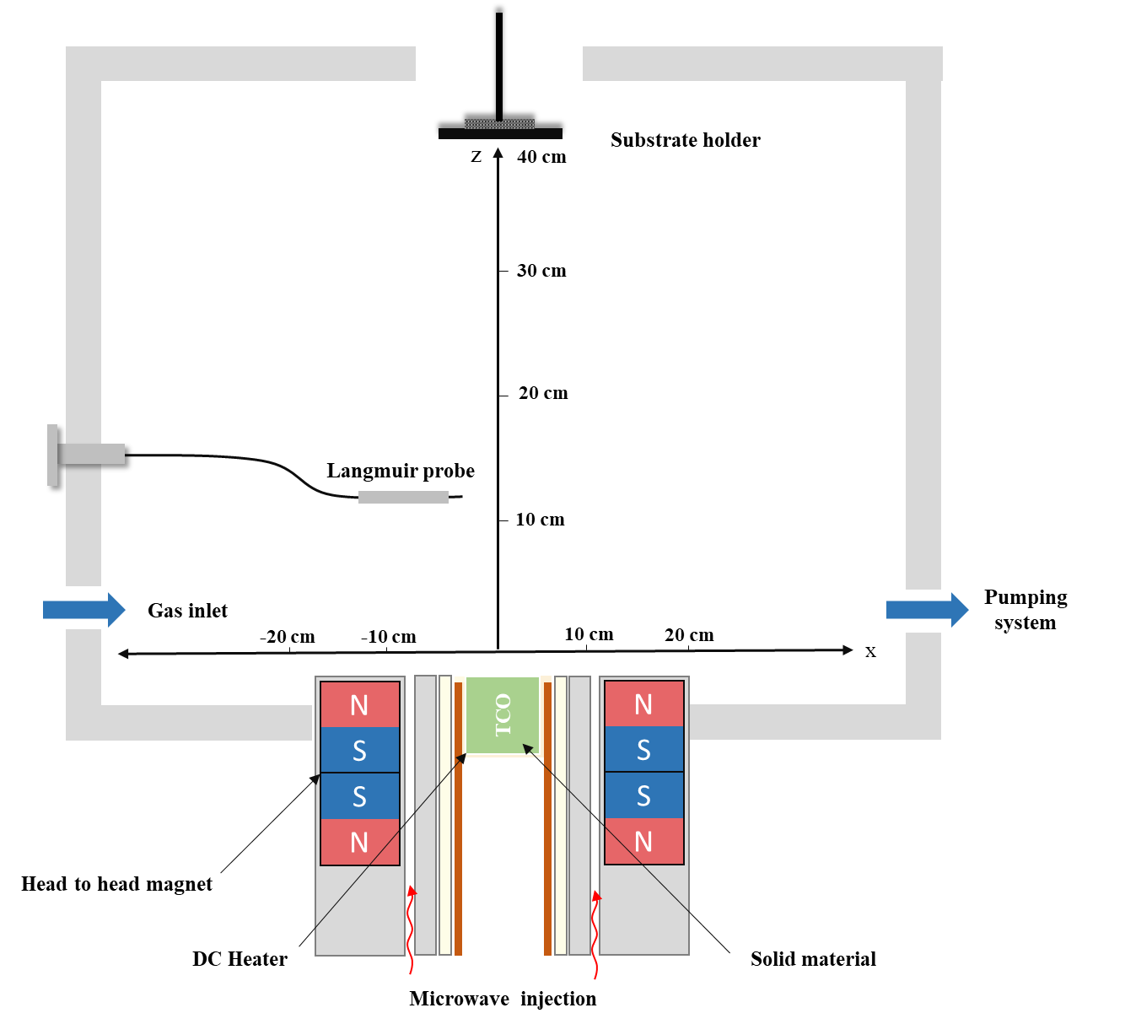
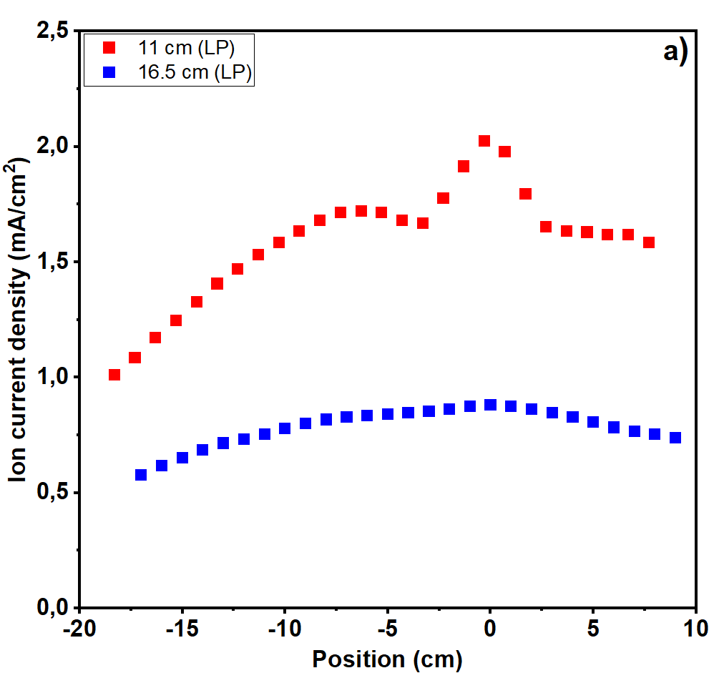
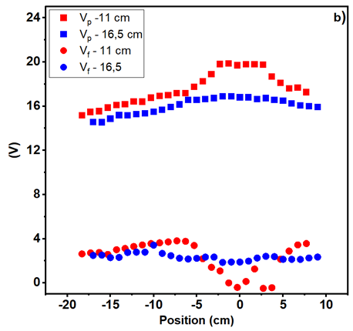
Plasma characterization : Langmuir Probe Measurements
(a) Ion current density measured at various distances (11 and 16.5 cm)
(b) Plasma and floating potential
Langmuir Probe Measurements of Argon Plasma at 1 mTorr gas pressure
and 300W microwave Power.
Positioning of Langmuir probe.
The uniformity of ionic current and plasma distribution enhances as the source-probe distance increases
From the plasma potential and the energy of ions, we can deduce that the energy of particles involved in the process doesn’t surpass 50 eV

Slide 18
Content
Context and objectives
Hybrid Plasma Deposition (HPD) presentation
  Plasma source
    Microwave simulation
    Plasma characterization
  Evaporation source
Deposition and characterization of IWO films
Conclusion and perspectives

Slide 19
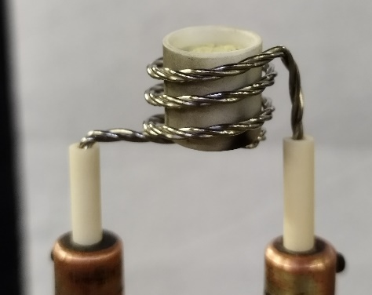
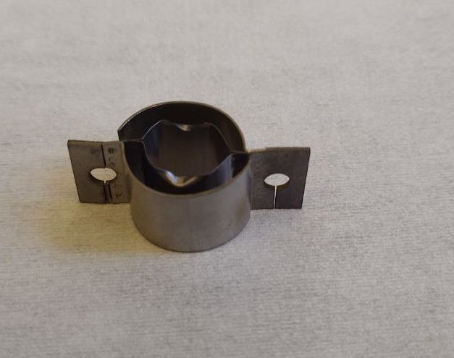
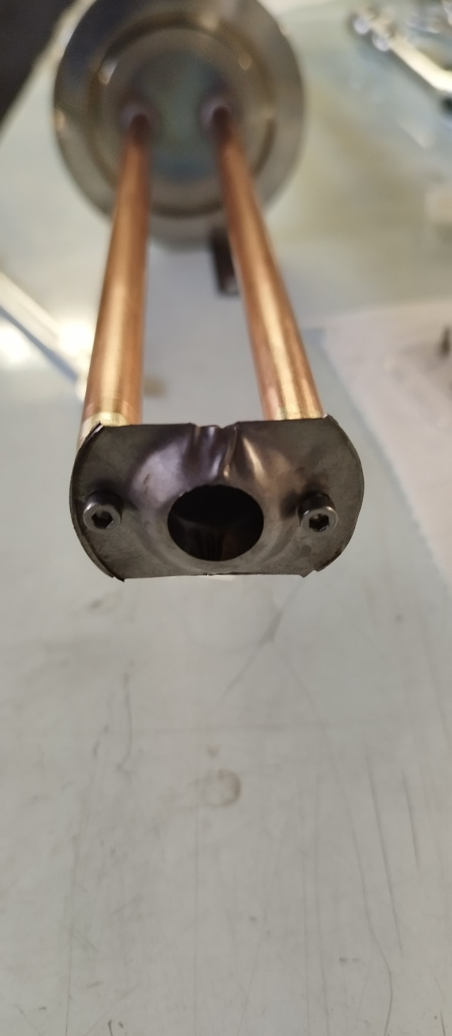
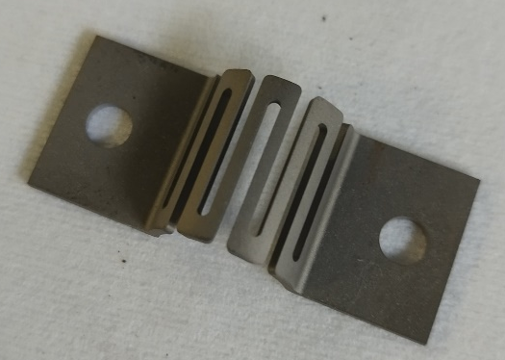
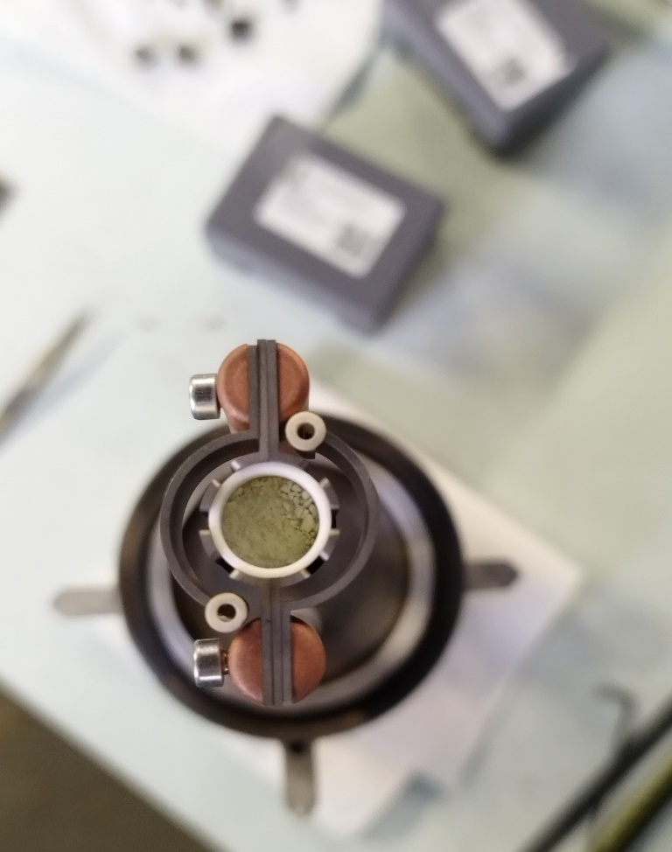
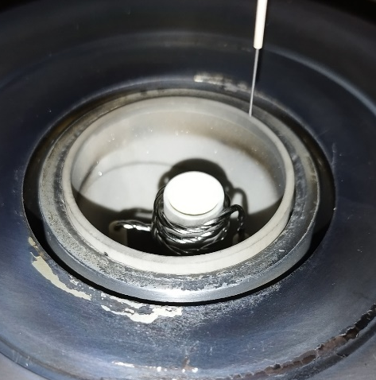
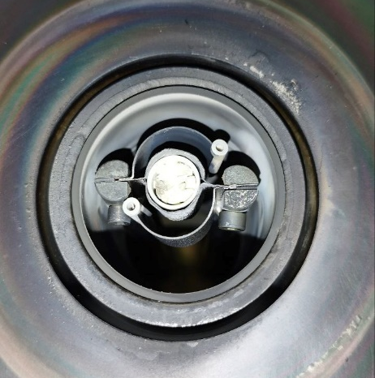
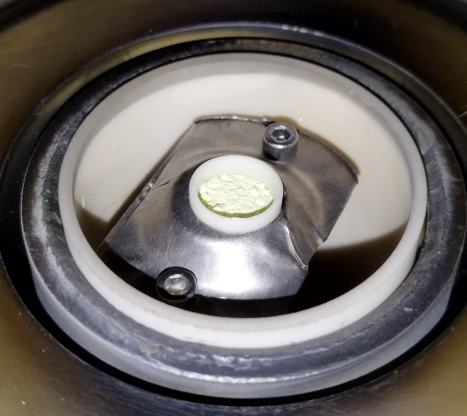
Evaporation source : Heating elements
Commercial
Designed
Heating elements used for evaporation.
Deformation of the structure after few processes
Limited durability (~ 4 processes)
Around 350 W of power for a deposition rate of 0,5 A°/s
Easily mounted
Limited durability (~ 10 processes)
Around 550 W of power consumption for a deposition rate of 0,5A°/s
No vaporization occurs throughout the process, even at a power of 1300W.
Brittleness during handling and mounting, with limited durability under stress and temperature (3 deposition processes)
Around 300 W of power consumption for a deposition rate of 0,5A°/s

Slide 20
Content
Context and objectives
Hybrid Plasma Deposition (HPD) presentation
  Plasma source
    Microwave simulation
    Plasma characterization
  Evaporation source
Deposition and characterization of IWO films
Conclusion and perspectives

Slide 21
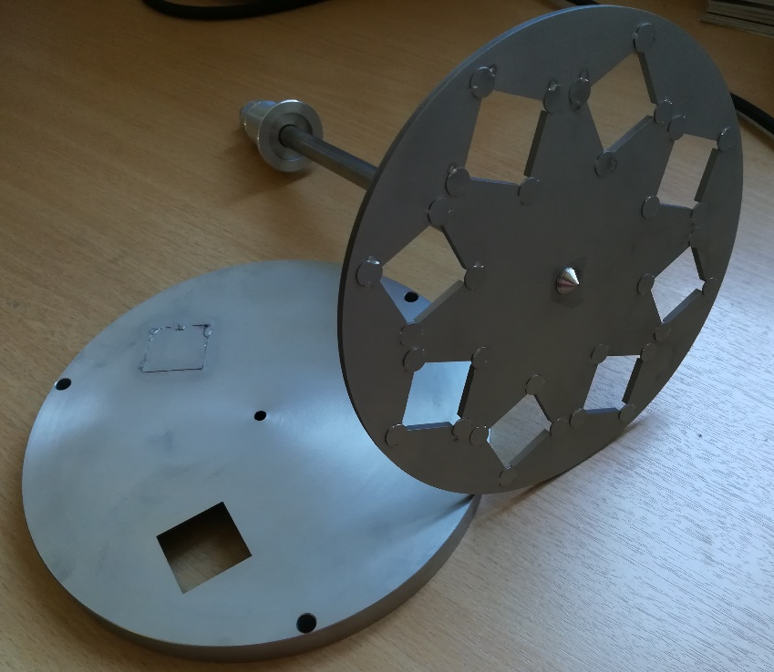
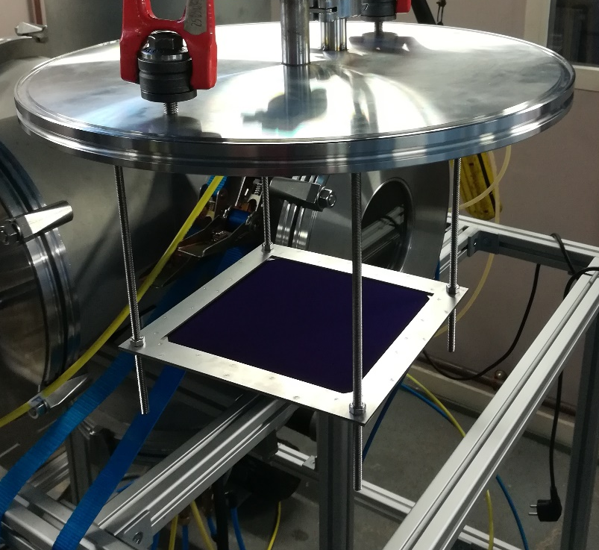
Deposition and characterization of IWO films : Substrate holder types
25mm*25mm substrates holder for Si/ glass substrates.
150mm*150 mm substrates holder for M2 industrial size wafers.

Slide 22
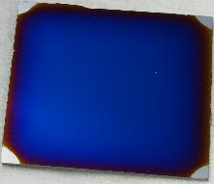
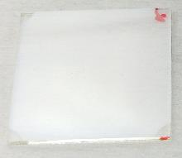
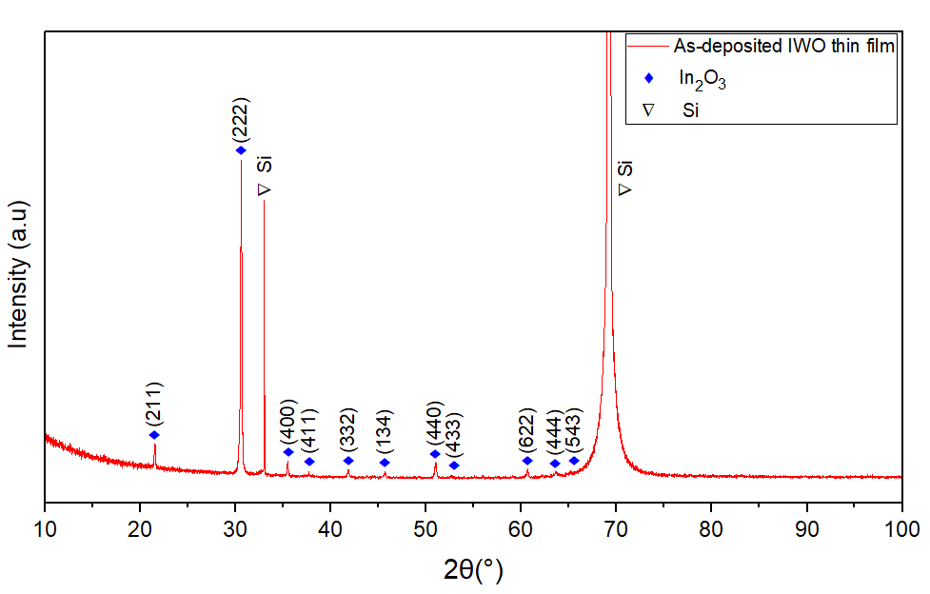
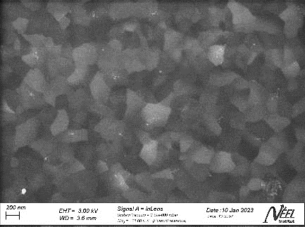
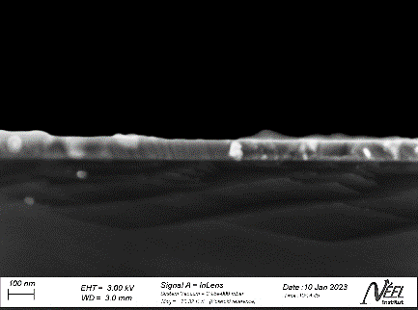
Deposition and characterization of IWO films
a)
b)
IWO films a) on Si (b) on glass.
84% Ar, 14% O₂, and 2% H₂ - 300 W - 30 min.
a)
b)
X-ray diffraction spectrum of IWO film deposited on a Si substrate.
SEM images of an IWO thin film deposited on Si, (a) side view (b) top view.
 | Si | Glass
Average resistance | 15,49 Ω | 13,25 Ω
Resistivity | 1,3E-04 Ω.cm | 1.15E-4 Ω.cm
Average resistance and resistivity of thin films deposited on Si and glass.
Dense, homogeneous structure ; grain size = 200 - 250 nm
Polycrystalline structure with In₂O₃, dominant orientation (222)
Resistivity with values required for PV application

Slide 23
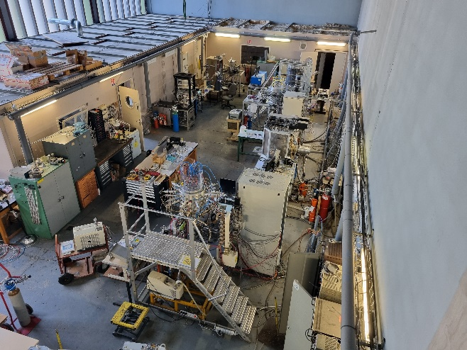
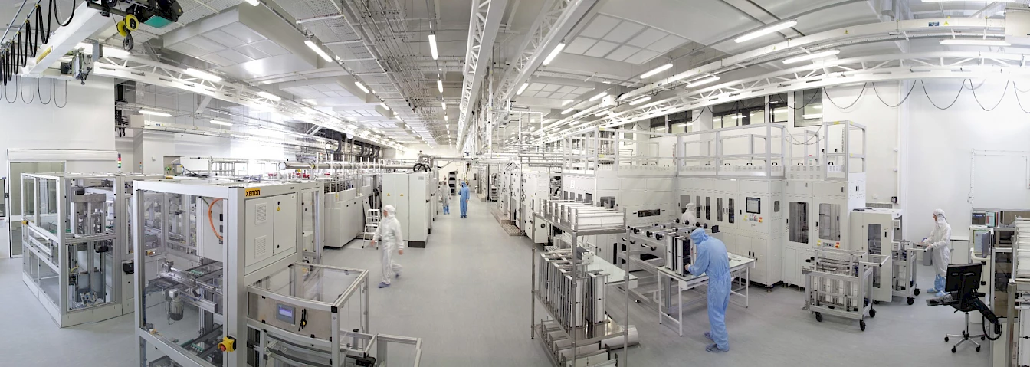
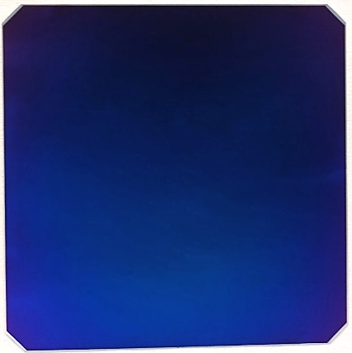
Deposition and characterization of IWO films: Solar cell performance
LPSC – Hall 4
CEA's inline production for solar cells
Cell characteristic | Values LPSC (IWO) | Values LPSC (ITO) | Ref Values. CEA (ITO)
Voltage open circuit | 744 mV | 746 mV | 746 mV
Fill factor | 82,57% | 79.4% | 82.1%
Efficiency | 23,89% | 22.88% | 23.63%
Solar cells performance.
IWO Solar cell.

Slide 24
Conclusion and Perspectives
Conclusion
Existing configuration : 2,45 GHz - Reflection of -7 dB (20%), asymmetry of the EM field
Alternative configurations – 915 MHz – 100% power transmission, symmetrical EM field
Confirmation of the low energy (< 50 eV) of the particles involved in the deposition process
Deposition of IWO (Indium Tungsten Oxide) films with conformal properties
Perspectives
Implementation of the 915 MHz optimized configuration of the applicator and plasma performance analysis
Fine-tuning of deposition process with optimized configuration
Transposition of process to photovoltaic cells and performance evaluation
Testing new TCOS materials (SnO₂, ….)

