Slide 1


Multiphysics Modeling of the Production, Transport and Separation of the Fission Products Existing in the Fuel Salt of a Molten Salt Reactor
Martin G. MARONE
Directeur de thèse:
Pablo RUBIOLO
Co-encadrante de thèse:
Veronique GHETTA

Slide 2



PhD Context
It is based at LPSC of the CNRS, in Grenoble, within the framework of the Équipe Physique des Réacteurs.
The researck work is supported by the Innovative System for Actinides Conversion (ISAC) project of the France Relance initiative.
The PhD is registered at the I-MEP² doctoral school of the UGA.
Experimental support of the Fluids Experiments and Simulations in Temperature (FEST) platform of the LPSC
1
Martin Marone – PhD seminars LPSC – 25/03/2024
Notes:
1

Slide 3
Introduction: Molten Salt Reactors
Class of generation IV nuclear reactors in which a molten salt performs a key function in its core.
Fuel loop with transport of fission products (FPs) and connected to a possible on-line separation and reprocessing unit
Liquid Fuel
(salt serves as fuel and coolant)
Molten Salt Reactors
Solid Fuel
(salt serves only as coolant)
Out of scope
This PhD addresses specifically the problem of modeling the distribution of the concentration of the FPs in the fuel circuit of a liquid fuel MSR. This distribution is affected by the Production, Transport and Separation of the FPs.
2
Martin Marone – PhD seminars LPSC – 25/03/2024
Notes:
2

Slide 4
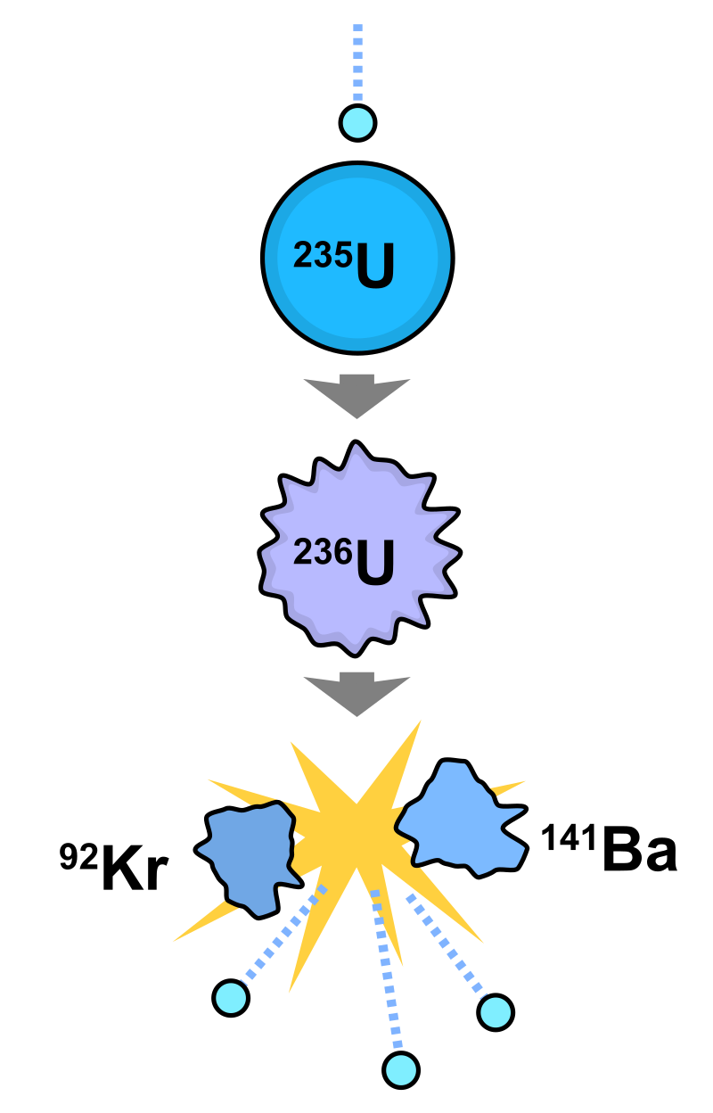
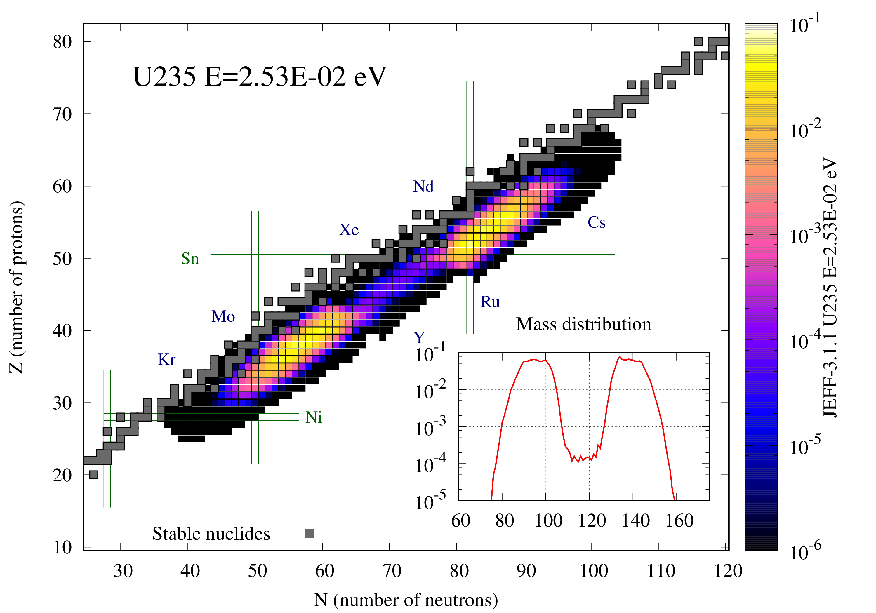
Introduction: Fission Products
[1]
[2]
3
[1] https://fr.wikipedia.org/wiki/Fission_nucléaire
[2] https://fispact.ukaea.uk/nuclear-data/fission-yields/
Martin Marone – PhD seminars LPSC – 25/03/2024
Notes:
3

Slide 5
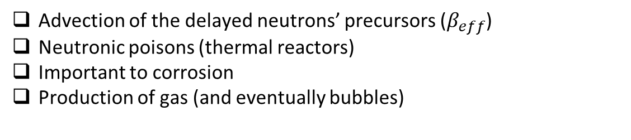
Introduction: Why Study the FPs in a MSR?
Impact in the reactor’s design
Advection of the delayed neutrons’ precursors ($β_{eff}$)
Neutronic poisons (thermal reactors)
Important to corrosion
Production of gas (and eventually bubbles)
Possibility of FPs removal
Reactivity control
Corrosion control
Radioactive waste management → Partitioning of waste
Safety → Reduction of source term of the reactor in a severe accident
4
Martin Marone – PhD seminars LPSC – 25/03/2024
Notes:
5

Slide 6
Thesis objectives
Identify the main phenomena that need to be included in a FPs transport model
Develop a model capable of describing the distribution of the concentration of FPs in the fuel circuit of a MSR.
Implement the model on a numerical multiphysics tool (MPT) so that this distribution can be predicted and studied.
Use the MPT to study the effects of a He bubbling system on the concentration of FPs in a MSR using a parametric approach.
Evaluate the accuracy of the hydraulics and physico-chemical models used in the newly implemented modules with the experimental arrange built at FEST.
5
Martin Marone – PhD seminars LPSC – 25/03/2024
Notes:
6

Slide 7
Phenomena Identification and Ranking Table (PIRT)
Phenomenon | Importance | State of knowledge
Production of FP by fission of U235 and U238 | High | High
Phase separation due to pressure gradients in the fluid | High | High
Migration of gases with high partial pressure to bubbles | High | Low
Chemical interactions between the FPs and the molten salt | Medium | Medium
Changes on the bubble size due to incorporation of FG | Medium | High
Changes of solubility along de circuit | Low | Medium
Interactions between bubbles | Low | Medium
(…)
6
Martin Marone – PhD seminars LPSC – 25/03/2024
Notes:
8

Slide 8
Phenomena description
Soluble
Fission
Bubble
Volatile
FP¹_{liquid}
FG_{liquid}
FP³_{liquid}
FP¹_{bubble}
FP²_{liquid}
Radioactive decay
FG_{bubble}
Soluble
Chemical reaction
Precipitate
Neutron capture
He_{bubble}
FP²_{bubble}
Migration
He_{liquid}
Particles in suspension
7
Notes:
9

Slide 9
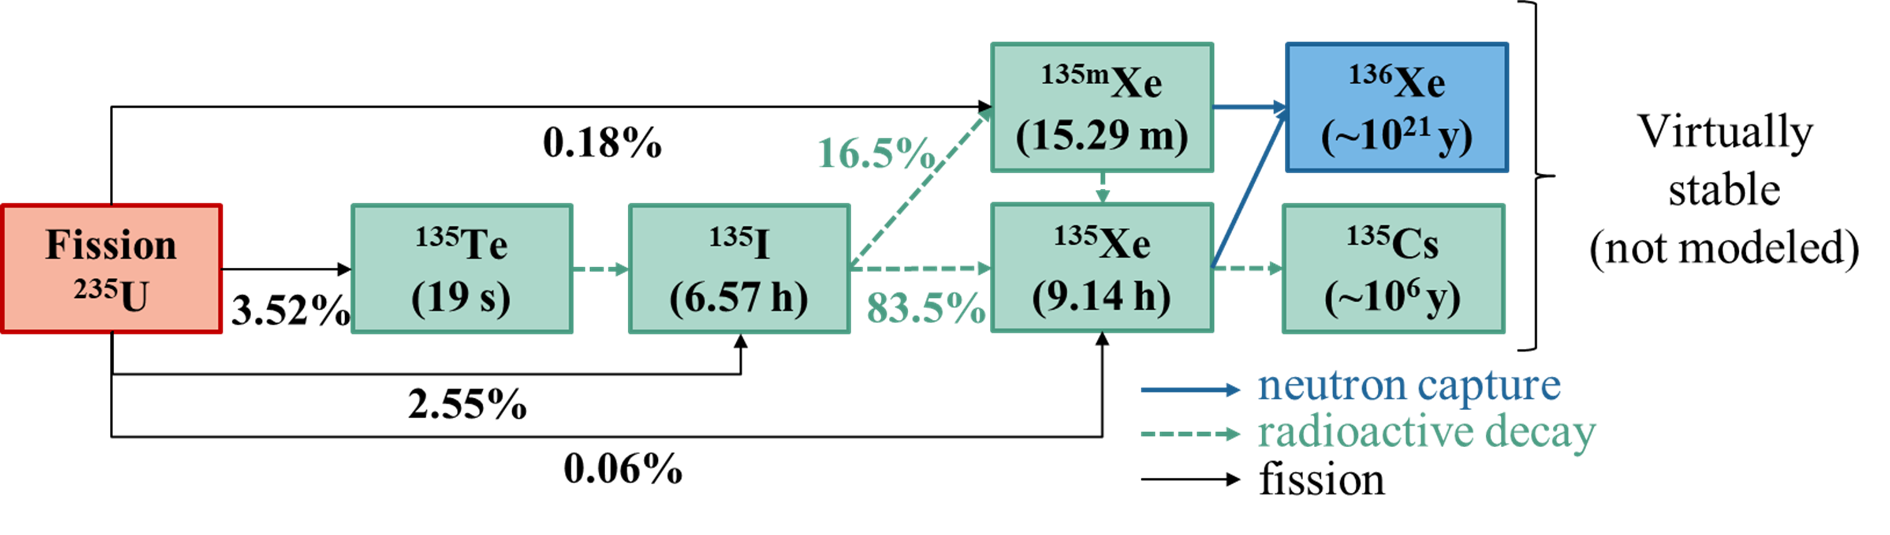
Example: ¹³⁵Xe and its decay chain
* FP with half-lives shorter than 2s are assumed to decay instantaneously
*
Representative case
Important for both reactivity and corrosion control
Rich phenomenology
Possibility of on-line extraction of the gas
Simplified chemical behavior
8
Martin Marone – PhD seminars LPSC – 25/03/2024
Notes:
10

Slide 10
Schema of the phenomena associated to ¹³⁵Xe
Xe produced directly by fission
Progenitor produced by fission
Fission
yield
Radioactive decay
Xenon dissolved in liquid phase
Xenon in circulating bubbles
Production of FPs by fission and radioactive decay
Transmutation due to radioactive decay and neutron capture
Transport of gas FPs disolved in fuel salt
Migration of gas FPs to bubbles
Separation and gas removal from the liquid fuel
Migration
Radioactive decay and neutron capture in liquid phase
Radioactive decay and neutron capture in gaseous phase
Separation
mechanisms
Transmutation
Gas removal
9
Martin Marone – PhD seminars LPSC – 25/03/2024
Notes:
11

Slide 11
Model development stages
Identification of important phenomena (PIRT).
Implementation of the FPs transport equations with the removal efficiency as a parameter to be able to perform a study on how the total efficiency affects the concentration of FPs in a MSR.
Implementation of the physico-chemical equations that describe the migration using a scalar field to describe the bubble’s distribution to incorporate the migration term to the efficiency calculation.
Implementation of a two-phase Eulerian model to properly describe the bubbles’ distribution.
10
Martin Marone – PhD seminars LPSC – 25/03/2024
Notes:
12

Slide 12
Main assumptions and simplifications of the FP model
No chemical reactions affecting the transport of I or Te.
Te and I stay in-solution (completely dissolved in the fuel salt).
Negligible effect of neutron capture in ¹³⁵I and ¹³⁵Te.
No interactions between the FP and the structure of the fuel loop.
Extra considerations (for the first stage of the model only)
Total migration of Xe (only present in gaseous phase).
Homogeneous model for two-phase flow.
Low impact in reactivity and neutron flux distribution (only for fast spectrum MSR)
11
Martin Marone – PhD seminars LPSC – 25/03/2024
Notes:
13

Slide 13
Fission Product’s Transport Equation
Distribution of the concentration of the species k in the phase i:
$$\frac{∂α_{i}C_{k,i}}{∂t}+∇∙\left(α_{i}\vec{U_{i}}C_{k,i}\right)−∇∙\left(α_{i}D_{k,i}∇C_{k,i}\right)={\dot{m}}_{k,i}+S_{k,i}$$
Time evolution
Advection term
Diffusion term
Migration between
phases
Sources
and sinks
Distribution of the concentration of FP k (perfect migration case):
Fission
Radioactive Decay (sink)
Radioactive Decay (source)
Neutron Capture (sink)
Neutron Capture (source)
12
Martin Marone – PhD seminars LPSC – 25/03/2024
Notes:
14

Slide 14



Multiphysics Tool (MPT)
Fuel burn-up
Shielding
Porous media
Neutron precursors
Fission products’ transport
Heat transfer
Two-phase flow
Steady-state calculations
Transient calculations
Power
distribution
Laminar and turbulent flow
Compressible and incompressible flow
Neutronics
Thermal-hydraulics
Fuel temperature reactivity feedback
Precursors and fission products advection
Compressibility Phase changes
Phase changes
Thermal-mechanics
Temperature, density and velocity fields
Power distribution
Thermal expansion
Phase change
Fluid-structure interaction
13
Martin Marone – PhD seminars LPSC – 25/03/2024
Notes:
16

Slide 15
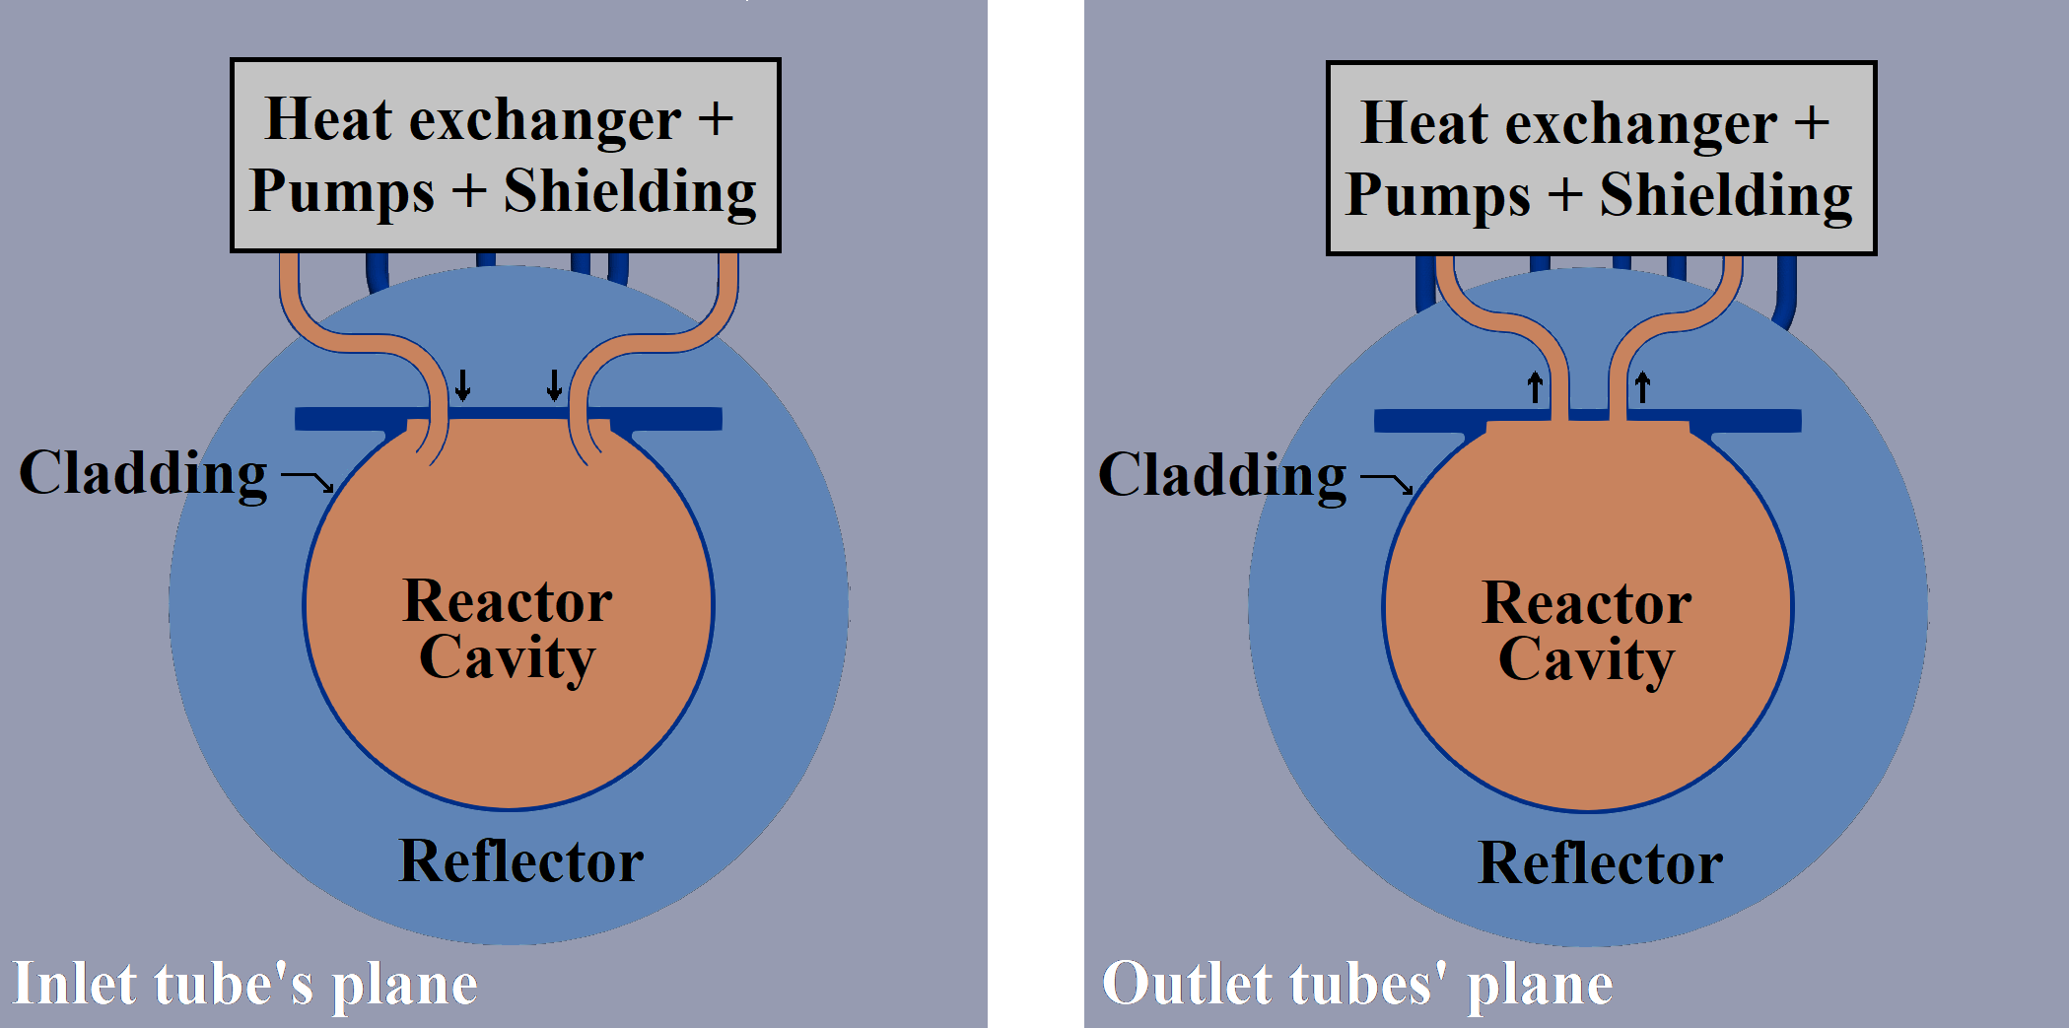
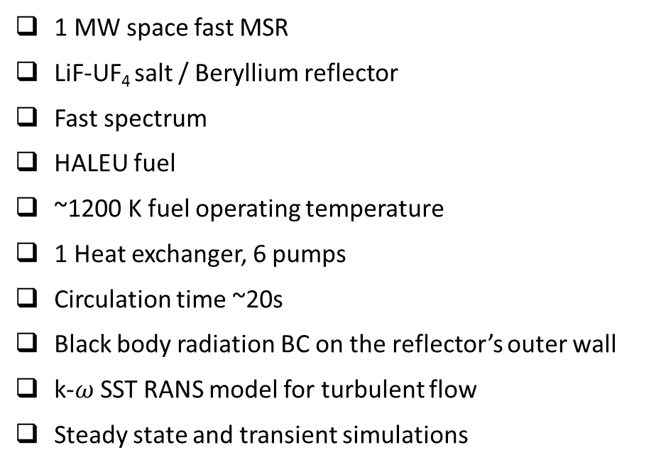
Case of application
1 MW space fast MSR
LiF-UF₄ salt / Beryllium reflector
Fast spectrum
HALEU fuel
~1200 K fuel operating temperature
1 Heat exchanger, 6 pumps
Circulation time ~20s
Black body radiation BC on the reflector’s outer wall
k-$ω$ SST RANS model for turbulent flow
Steady state and transient simulations
14
Martin Marone – PhD seminars LPSC – 25/03/2024
Notes:
17

Slide 16
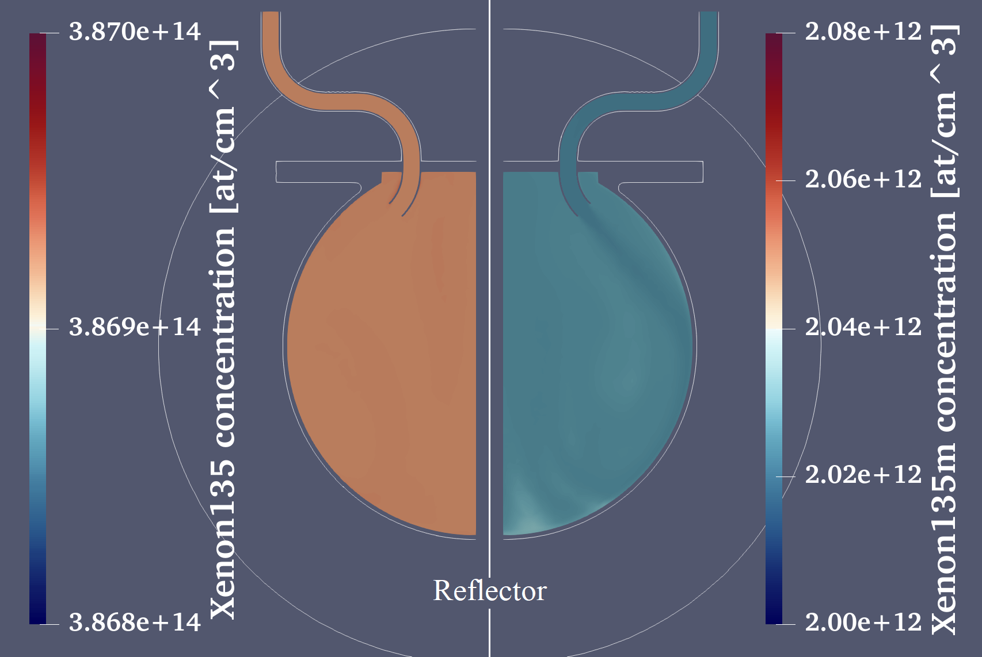
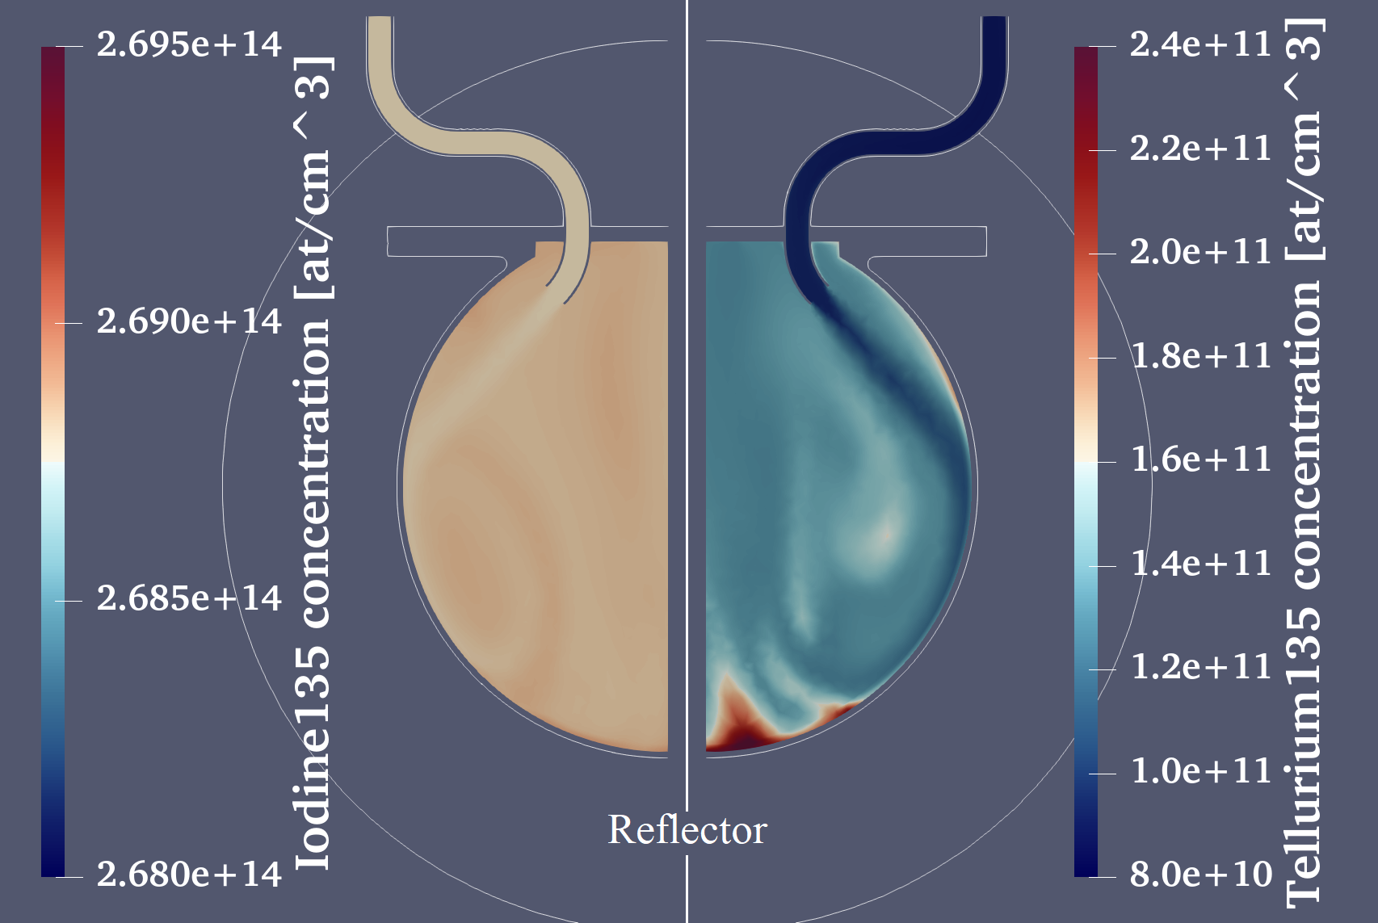
MPT results: No Xe removal
FPs distribution in the core cavity
¹³⁵Xe (9.14 hs)
^{135m}Xe (15.3 min)
¹³⁵I (6.57 hs)
¹³⁵Te (19 s)
M. Marone et al. Development of a Gaseous Fission Products' Model for a Molten Salt Reactor (MSR): Analysis of the Effect of the Gas Removal System's Efficiency on the Concentration of Xenon in the Fuel Circuit. PHYSOR 2024
15
Martin Marone – PhD seminars LPSC – 25/03/2024
Notes:
19

Slide 17
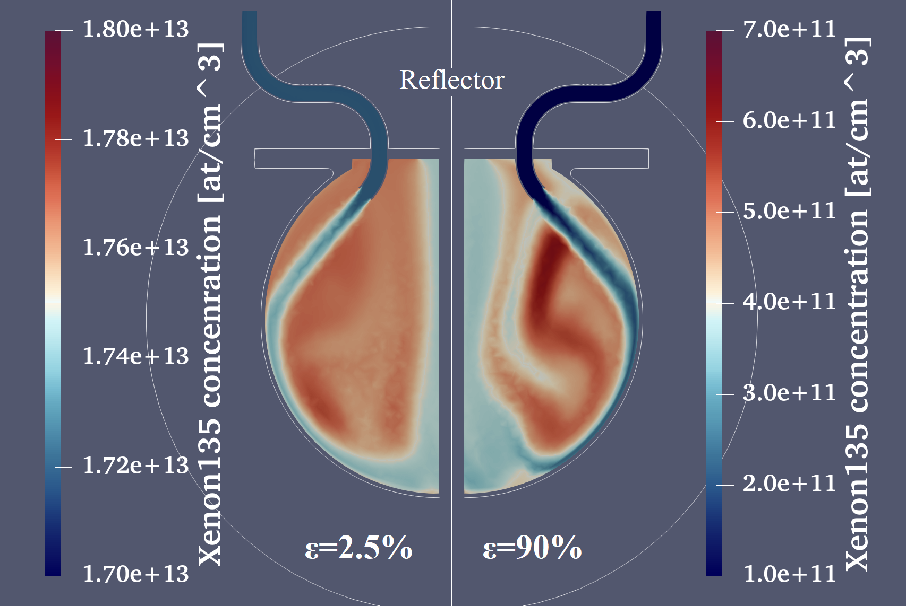
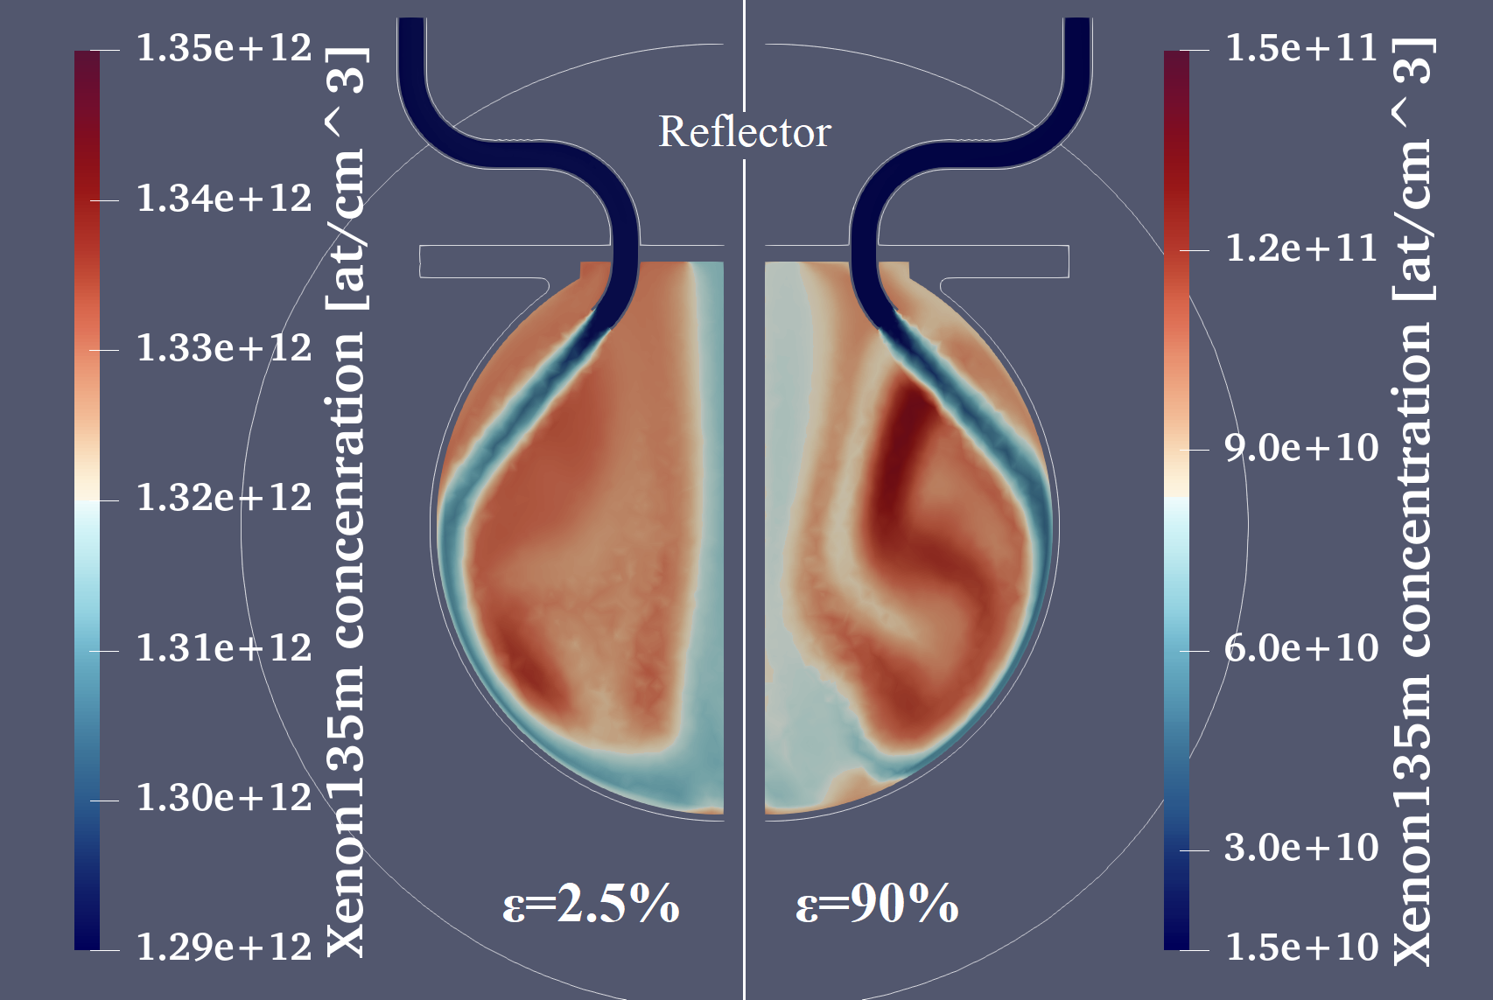
MPT results: Including Xe removal
Half-lives:
¹³⁵Xe 9.14 hs
^{135m}Xe 15.3 min
135Xe and 135mXe distribution for different extraction efficiencies ($ε$)
¹³⁵Xe
^{135m}Xe
M. Marone et al. Development of a Gaseous Fission Products' Model for a Molten Salt Reactor (MSR): Analysis of the Effect of the Gas Removal System's Efficiency on the Concentration of Xenon in the Fuel Circuit. PHYSOR 2024
16
Martin Marone – PhD seminars LPSC – 25/03/2024
Notes:
20

Slide 18
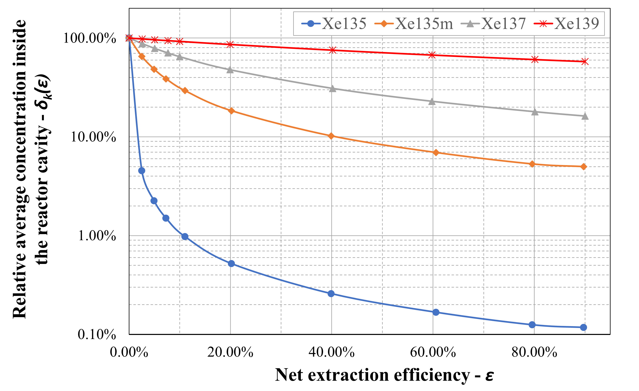

MPT results: Parametric study
M. Marone et al. Development of a Gaseous Fission Products' Model for a Molten Salt Reactor (MSR): Analysis of the Effect of the Gas Removal System's Efficiency on the Concentration of Xenon in the Fuel Circuit. PHYSOR 2024
Isotope | Half-life
¹³⁵Xe | 9.14 hs
^{135m}Xe | 917 s
¹³⁷Xe | 230 s
¹³⁹Xe | 40 s
17
Martin Marone – PhD seminars LPSC – 25/03/2024
Notes:
21

Slide 19
Key findings of the study
When Xe is not removed:
isotopes with half-lives longer than the circulation time present constant distributions due to fuel mixing.
When Xe removal is present:
Even with low efficiency, the isotopes with long half-lives decrease their concentration in one or more orders of magnitude.
Even with high efficiency, the isotopes with very short half-lives do not change their concentration significantly. This is do to the fact that they decay before reaching the separator.
For the isotopes that have a half-live comparable to the circulation time of the reactor, the efficiency of the removal system plays a significant role in their concentration.
To accurately describe the removal efficiency, migration to bubbles is key, and depends on the 3D distribution of both FP and bubbles along the circuit. → Second stage of the model
18
Martin Marone – PhD seminars LPSC – 25/03/2024
Notes:
22

Slide 20

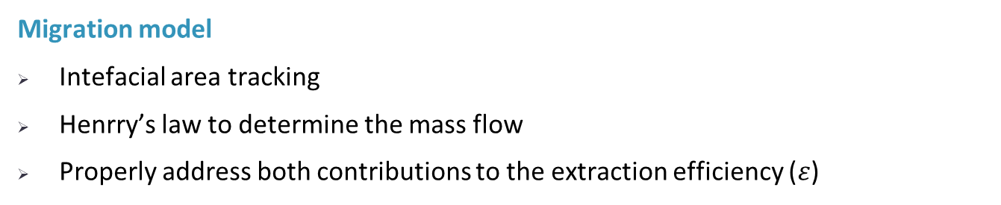
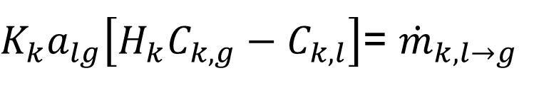
Second and third stages of the model
$K_{k}a_{lg}\left[H_{k}C_{k,g}−C_{k,l}\right]$= ${\dot{m}}_{k,l→g }$
Migration model
Intefacial area tracking
Henrry’s law to determine the mass flow
Properly address both contributions to the extraction efficiency ($ε$)
Two-phase flow
Dispersed phase (bubbles) distribution
Different velocities of phases
Eulerian approach
EulerFOAM
19
Martin Marone – PhD seminars LPSC – 25/03/2024
Notes:
23

Slide 21
Design of the experiences to be done at FEST
Objectives for the experimental work
Comfort the results of the two-phase flow model
Observe (some of) the physico-chemical phenomena for dissolved gases
Study (some of) the operational regimes of the separator
Requirements for the proposed experiments
Steady state or long transients (order of hs)
Be able to characterize the bubbles present in the system
  Low void fraction (bubbles as dispersed phase)
  Be ready for the experimental campaign (summer 2024)
20
Martin Marone – PhD seminars LPSC – 25/03/2024

Slide 22
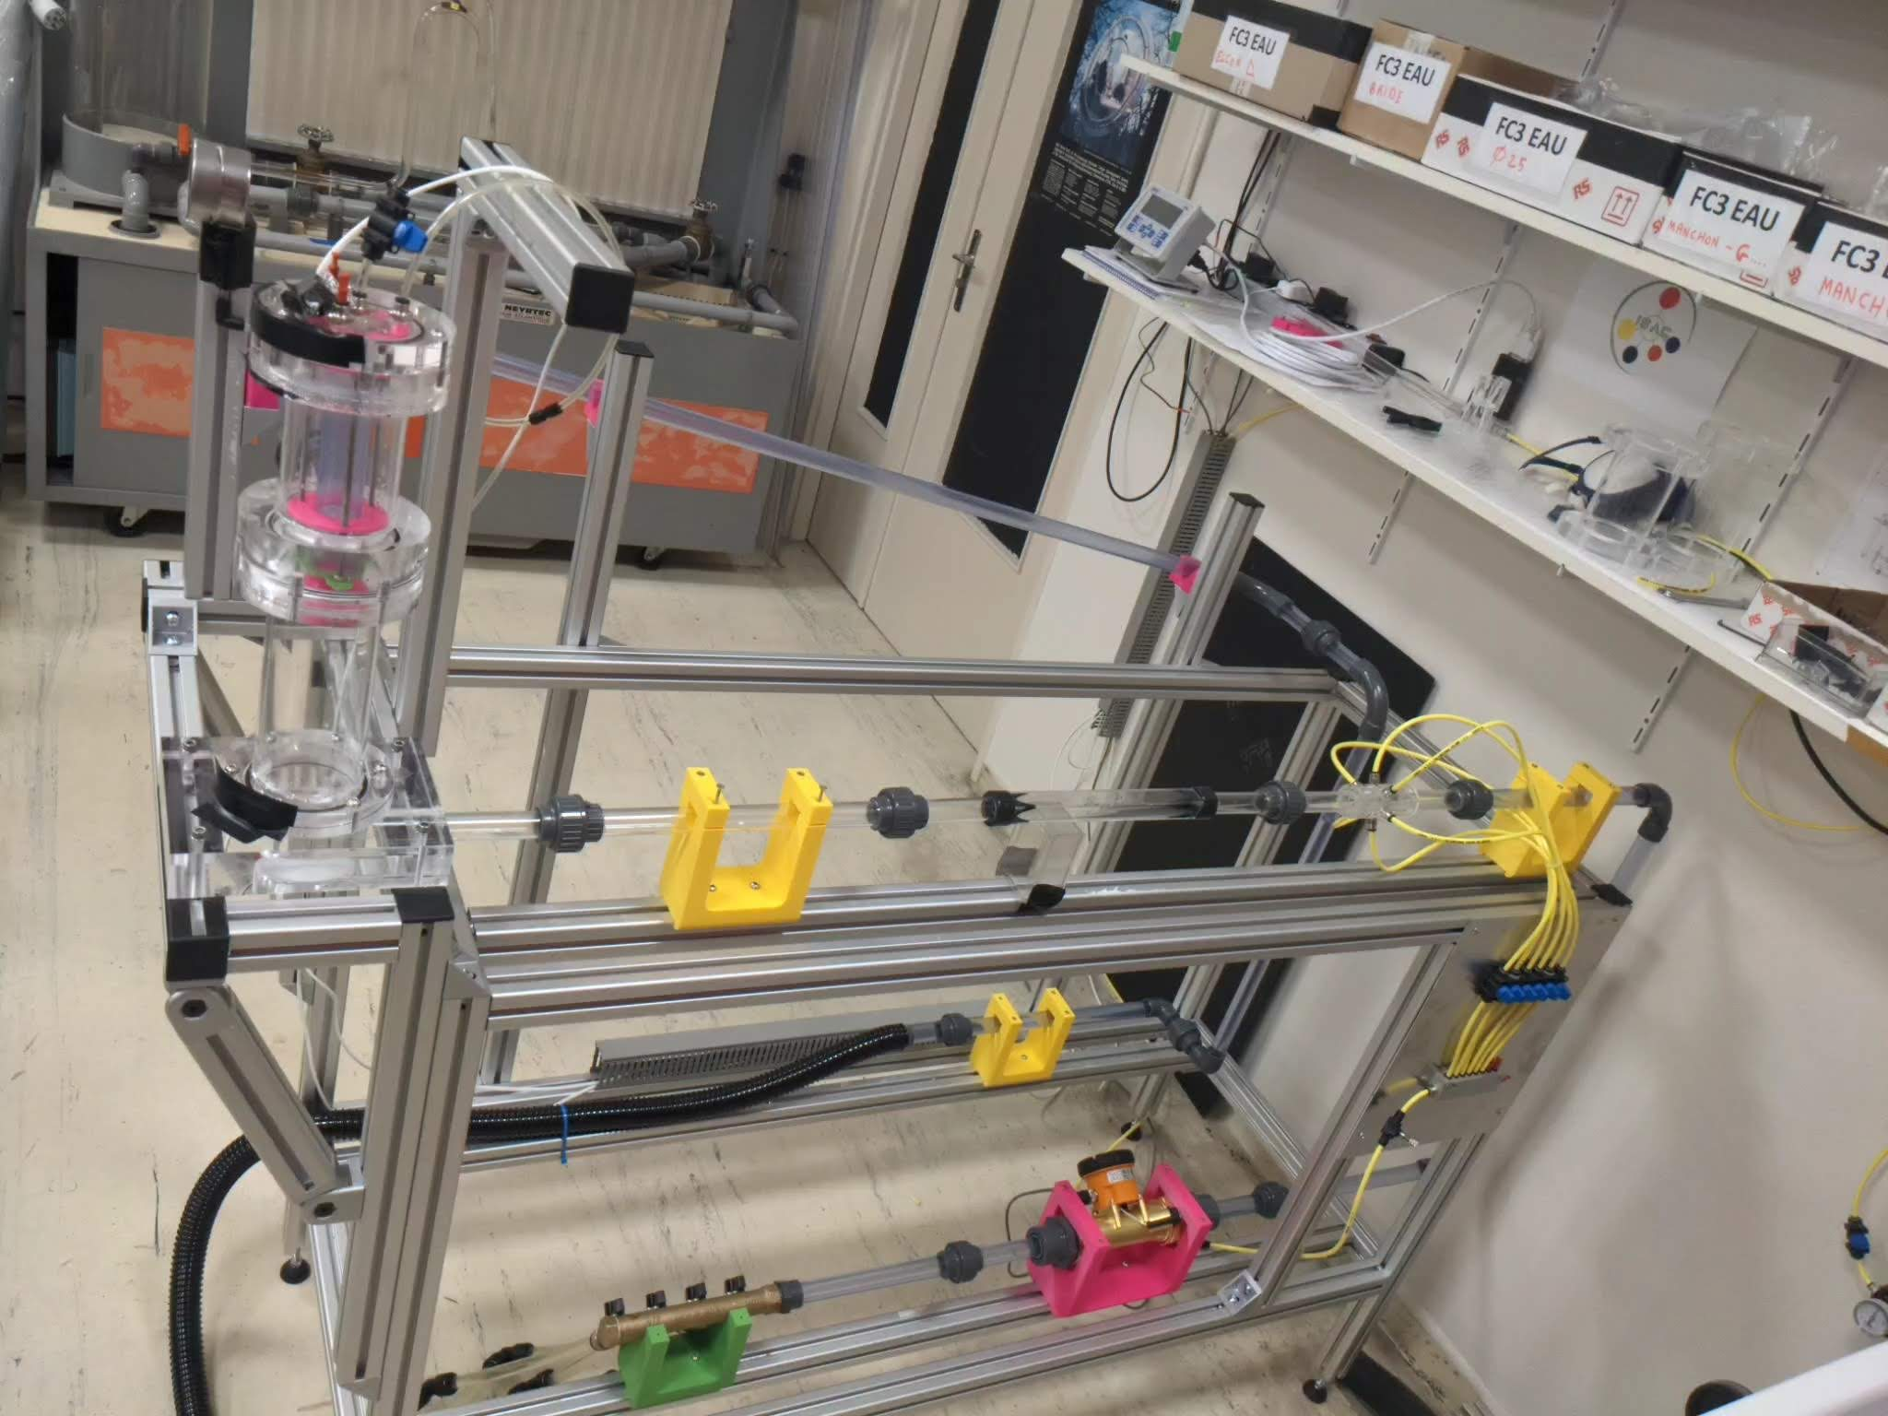
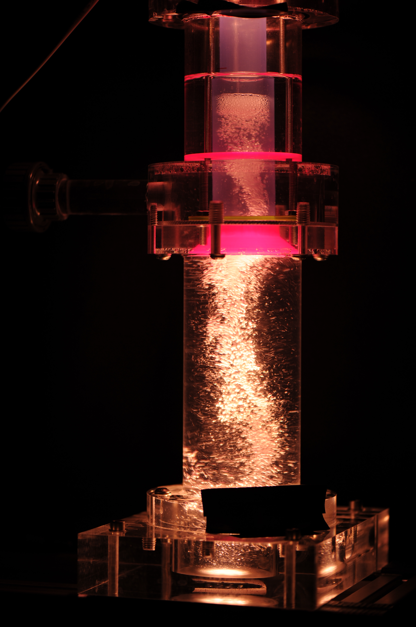
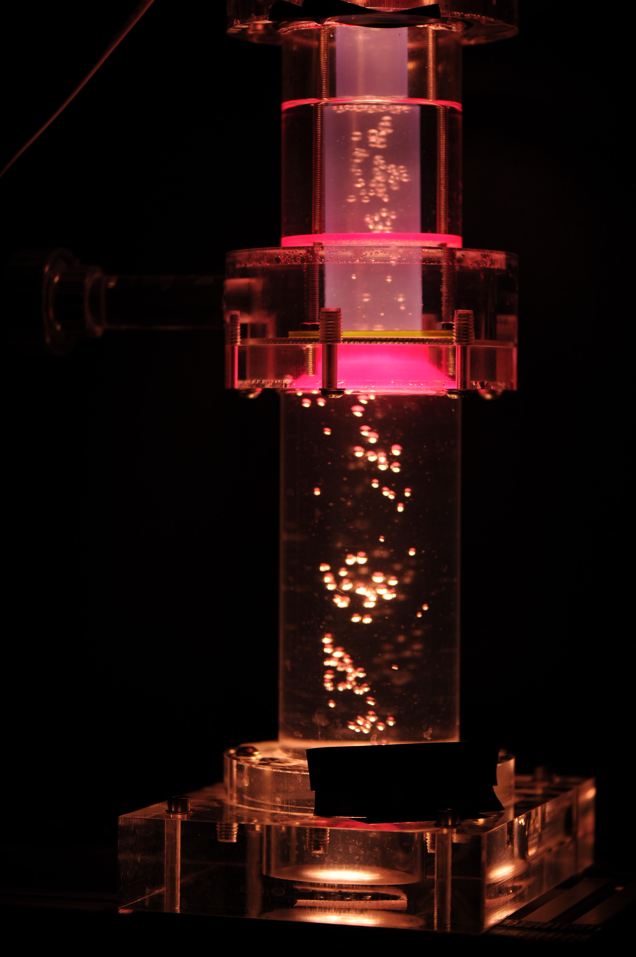
Scheme of the water loop (built at FEST)
Water flow
Release valve
Pressure gauge
Water
reservoir
Separator
Pump
Square section
Air injection
Water
flowmeter
Air flowmeter
Pressurized air flow
21
Martin Marone – PhD seminars LPSC – 25/03/2024

Slide 23
Planning for the second half of the PhD
Reference
Work in progress
Next step
Tasks
Development and implementation of migration model. (April – May 2024)
Definition of the experimental campaign to be performed with the water loop. (April – May 2024)
Integrate two-phase flow solver EulerFOAM to the MPT. (June – Aug 2024)
Perform the experiments at FEST (July – Sep 2024) and compare them with model predictions. (Sep – Oct 2024)
Parametric study of a MSR using the full model. (Nov 2024 – Jan 2025)
Thesis writing. (Fev – Aug 2025)
23
Martin Marone – PhD seminars LPSC – 25/03/2024

Slide 24
Conclusions and perspectives
The main phenomena associated with the mobility of FPs in a MSR were identified.
The water-loop is already operational and quick tests are being done to assist the experiment-design process.
The first stage of the model development/implementation was completed successfully (with the publication of the results in PHYSOR 2024).
It was found that to properly address the removal efficiency of the FG separator a 3D model that includes the migration and bubble distribution is required.
The development of the second stage of the model together with the design of the experimental campaign has been started.
Publications
P. Rubiolo, F. Quinteros, N. Capellan, M. Marone, V. Ghetta, J. Giraud, F. Szmandiuk, "Molten Salt Reactor Concepts for Advanced Nuclear Electric Propulsion (NEP) Systems", 75th International Astronautical Congress (IAC), 14-18 October 2024, Milan.
M. Marone, P. Rubiolo, V. Ghetta, J. Giraud, F. Quinteros. Development of a Gaseous Fission Products' Model for a Molten Salt Reactor (MSR): Analysis of the Effect of the Gas Removal System's Efficiency on the Concentration of Xenon in the Fuel Circuit. International Conference on Physics of Reactors (PHYSOR 2024), 21-24 April , 2024, San Francisco.
Special issue of the ANS journal Nuclear Science and Engineering → Summer 2024
An additional publication (journal or ANS 2025 meeting) is expected for the first half of 2025
24
Martin Marone – PhD seminars LPSC – 25/03/2024

Slide 25

Thank you!
Martin G. MARONE
martin.marone@lpsc.in2p3.fr
martingmarone

