Slide 1
DEVELOPMENT OF A NUMERICAL TOOL FOR THE DESIGN OF NUCLEAR ELECTRIC PROPULSION SYSTEMS CST Presentation
PhD Student: Francisco Szmandiuk
Director: Pablo Rubiolo
Co-encadrant: Nicolas Capellan
CNES referent: Fabien Castanet
CNRS-CNES-IN2P3
LPSC-Grenoble 24 March 2024
Notes:
Good morning, everyone.
I’m Francisco Szmandiuk, and in this presentation, I’ll introduce my PhD thesis topic and show the progress made so far. The work focuses on development a numerical tool for the design of Nuclear Electric Propulsion systems.
I’m under the direction of Pablo Rubiolo as my director and Nicolas Capellan as mi co-encadrant. This project is being developed under a collaboration between the CNES, the French National Centre for Space Studies and the LPSC laboratory.

Slide 2
Outline
Nuclear Electric Propulsion (NEP) – Context
NEP Design
PRESTO (NEP Rocket Design Tool )
NEP Subsystem modelling
Preliminary results
Perspectives and conclusions
Notes:
First I’m going to give some context about nuclear electric propulsion
Then we are going to see the main challenges in designing NEP systems
Then I’ll introduce PRESTO, the design tool we are developing, wich is the main topic of this thesis.
Following by showing some of the modelling progress.
Showing some preliminary optimization results.
And finishing with perspectives and conclusions.
30seg

Slide 3
Nuclear Electric Propulsion - Context
Notes:
So first lets set some context of nuclear electric propulsion.
10seg

Slide 4



Propulsion Modes in Space Applications
2 000 to 4 500 m/s
High thrust, Low specific impulse
Rocket engines
Oxidant
Fuel
$$V_{exaust}$$
-Chemical
-Nuclear Thermal Propulsion (NTP)
-Electrothermal Thrusters
$$I_{sp}=\frac{Ft}{{mg}_{0}}=\frac{V_{exaust}}{g_{0}}$$
Electric propulsion
-Solar
-Nuclear Electric Propulsion (NEP)
-Fuel cells
Low thrust, high specific impulse
Electric Source
Propellant
$$V_{exaust}$$
15 000 to 30 000 m/s
Notes:
In space there are two main propulsion modesm, Rocket engines and Electric propulsion systems (bottom diagram):
Rocket engines
-Include the classical and most common Chemical propulsion rockets, Nuclear Thermal Propulsion (NTP), and Electrothermal thrusters
In rocket engines thrust is generated by expelling hot gases at very high speeds. The gases are either produced by a chemical reaction or by heating a propellant (as in NTP or electrothermal)
Electric propulsion systems are powered by an external energy source (Solar, Nuclear, Fuel Cells)
The thrust is produced by accelearating ions at very high speed with electric and magnetic fields produced by the electric energy source.
Rocket engines deliver way more thrust than electric propulsion, but electric propulsion achieve greater specific impulse. Greater specific impulse is translated in a more efficient consumption of propellant. Rocket engines are then more suitable for quick maneuvers that need high thrust whereas Electric propulsion find its application in long duration missions providing efficiency in the propellant consumption.

Slide 5
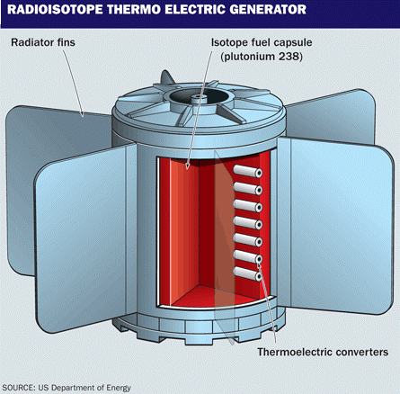
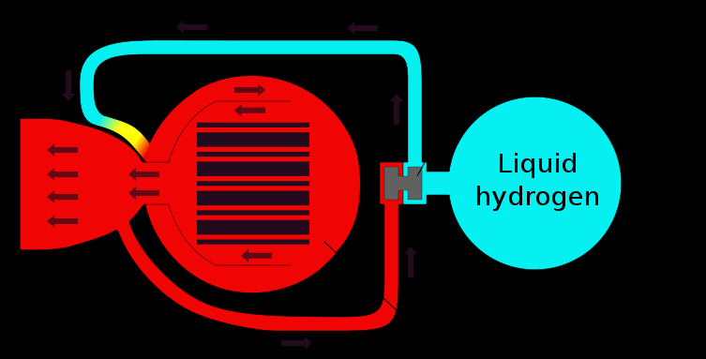
Space Nuclear Energy Systems: Applications and Readiness
RTG ✔ High TRL ✔ Proven system (Mars Rovers) ✘ Pu-238 production, launch risk
✘ Low power
NEP ✔ Efficient long-duration propulsion
✔ Suitable for cargo missions ✘ Medium TRL (SNAP-10, TOPAZ)
✘ Complex integration of subsystems
NTP ✔ High thrust (good for manned missions) ✘ Fuel instability at high temperatures ✘ Medium TRL (NERVA)
Notes:
In terms of nuclear energy in space there are three main technologies: RTGs, NEP, and NTP
-RTGs have great TRL since they been used in many different missions, but they have the disadvantage of using Pu-238 which is limited in production and presents radiotoxicity concerns.
-NEP is a high power energy source with high specific impulse suitable for cargo and interplanetary missions with medium TRL since some of this reactors were built and sent into space in the 70s and 80s.
-NTP is a high thrust technology suitable for quick maneuvers or orbital changes. It’s been developed and tested in terrestrial experiments showing some troubles with fuel instability at high temperatures.

Slide 6
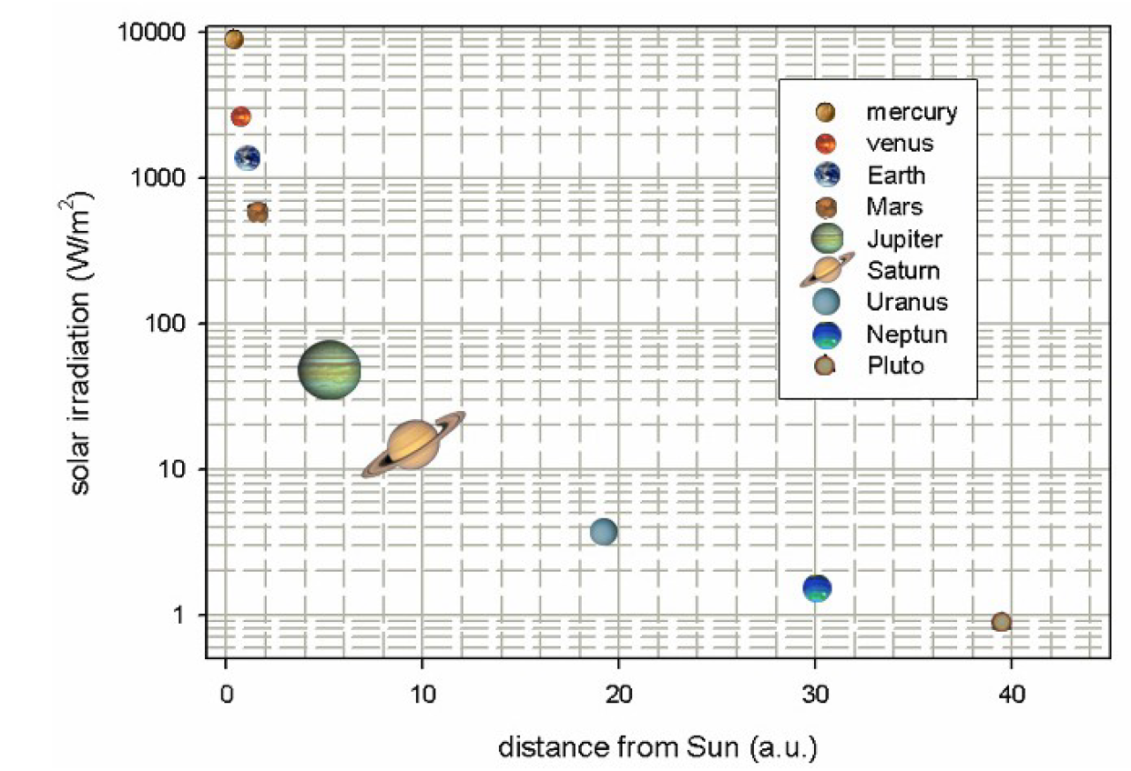






Space Energy Sources
High Power & Long Duration
Nuclear power enables high-power, long-duration, and deep space missions.
NTP
$${10}^{4}$$
Nuclear Reactors
$${10}^{3}$$
NEP
Power Level (kW)
$${10}^{2}$$
Solar works well here
Nuclear or Solar
$${10}^{1}$$
Chemical
Solar only
$${10}^{0}$$
Solar or radioisotopes
Solar
$${10}^{−1}$$
1 Hr
1 Day
1 Month
1 Yr
10 Yr
Duration of use
[1]
Notes:
-Moving now to the general panorama of space energy sources, it is important to match the energy source to the mission profile.
-Chemical propulsion: deliver high power but for short periods wich is ideal for launch and quick transfers.
-RTGs can work for very long time, but deliver low power.
-Solar power works for long-duration missions with moderate power needs, but only close to the Sun.
-NTP as well as chemical is suitable for quick maneuvers but can deliver higher powers.
-NEP provide high power for long-duration missions, even in deep space.
-These technologies can be concurrent in some ranges of power and duration as well as complementary for others.
-Explain graphic in the left.

Slide 7

Architecture of a Nuclear Electric Propulsion (NEP) System
Shielding
Converter
Radiator
Reactor
Electric thrusters
$$V_{exaust}$$
Thermal power source
Shields neutron and gamma radiation
Converts thermal energy into electricity
Rejects non converted thermal energy into space
Accelerate ions to produce thrust
Notes:
And now that we've seen the different energy sources and their role in space missions, let’s focus on Nuclear Electric Propulsion systems. How do they work?
First of all there is the reactor, which is thermal energy source and delivers thermal power to conversion system, who generates electricity to power the thrusters. The thrusters accelerate ions at a great spreed producing thrust. The energy that was not converted into electricity is rejected into space by the radiator. All the systems are protected from the reactor’s neutron and gamma irradiation by the shielding.
This is basically the overall composition and operating way of a NEP system.

Slide 8
NEP Design
Notes:
We will now discuss the main differences between the conventional reactor design process and that of NEP systems, as well as the challenges to face.
10seg

Slide 9


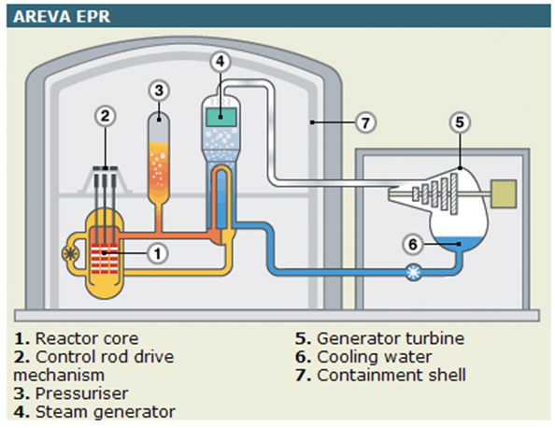
NEP design process – Main differences against PWR design
On Earth
On spacecrafts
Mass not a critical factor
Safety focuses on protecting people and the environment
Scaling up means more fuel, larger components
Must be as lightweight as possible
Safety ensures system reliability
Scaling requires optimization rather than simple enlargement
Notes:
So is important to state that the design criteria of a NEP is very different from the terrestrial reactors ones.
-First of all on earth reactor mass is not a strict constrain in the design, whereas in NEP design mass is the primary constraint, since it is related to the competitiveness of the mission.
-In earth reactors, safety of the reactor focuses mainly in protecting the surrounding environment from accidental events, whereas in NEP safety measurements should be taken in the launching of the system to space and the eventual re-entry. Then in space operation it is very important the system reliability.
-For terrestrial reactors, the process of scaling up the reactor is translated mainly in adding more fuel assemblies and increasing components size, whereas in a NEP scaling requires optimization rather than simple enlargement.
This highlights the fact that design must be approached differently than traditional methods.

Slide 10







NEP Design challenges
Design Limits:
- Maximum enrichment
- Melting points
- Irradiation damage
- Mechanical stresses
- Etc.
Multidisciplinary and Interdependency
-Criticality
-Power
-Neutronic
-Thermohydraulic
-Materials
$$P_{react}$$
$$Spec$$
$$P_{react}$$
-Particle-matter interaction
$$T_{react}$$
$$P_{react}$$
-Thermodynamic
-Mechanic
$$T_{rad}$$
$$η_{conv}$$
$$η_{conv}$$
-Radiative heat transfer
-Electromagnetism
Notes:
One of the biggest challenges of NEP design is the Multidisciplinary and Interdependency.
-Systems encompass a variety of very different disciplines. These include neutronics, thermohydraulics, mechanics, electromagnetism, among others.
-In terms of interdependence, the systems are tightly coupled, so that design decisions in one directly affect the others.
-For example the size of the reactor depends on the imposed criticality criteria and the required power. The shielding size depends on reactor power; the conversion system efficiency depends on reactor and radiator temperatures. The radiator size depends on the conversion system efficiency, reactor power, and its own temperature. The power delivered to the thrusters depends on reactor power and conversion system efficiency.
-Again, a very multidisciplinary system with many interdependencies.

Slide 11
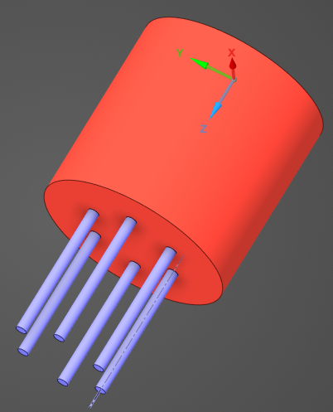
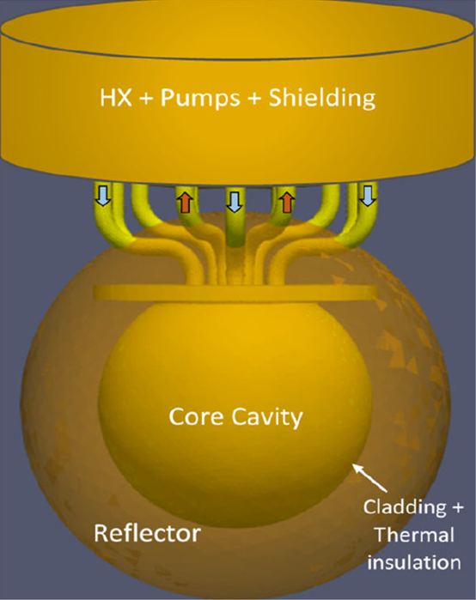
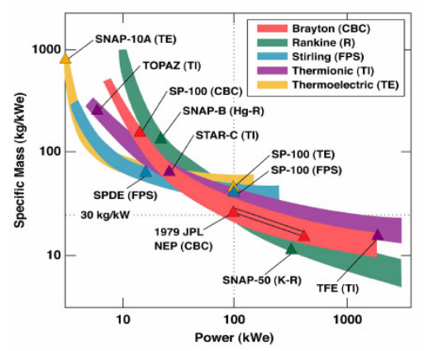
NEP Design challenges
Heat Pipe Reactor
Molten Salt Reactor
Need to Evaluate Multiple Technological Concepts
Thermoelectric
Generator
Stirling
K-Rankine cycle
Heat Pipe Radiator
Pumped Heat Pipe Radiator
Specific Mass vs Power [2]
Notes:
Second, there are multiple technological options for each subsystem. Each choice involves different trade-offs in terms of mass, efficiency, and operating conditions. We can see in this graphic here that is specific mass of NEP, which is the ratio of Mass to Power, vs NEP output power for different conversion technologies. It shows that, depending on the level power, one technology is more suitable than the others, and highlights the importance of the evaluation of different technologies in the design process.

Slide 12
NEP Design challenges
NEP Competitiveness.
Specific Mass (kg/kWe) (1/α)
Crucial to minimize specific mass to improve competitiveness
Competitiveness can be measured in terms of Mission Cost or Mission Duration
Specific Mass vs Power [2]
Notes:
Third, we need to maximize the power-to-mass ratio, or minimize the mass to power ratio, to make the system competitive and viable for the mission. The power to mass ratio impacts directly on parameters such as the mission total cost or the mission total duration. In order to be competitive, specific power or specific mass should be optimized,

Slide 13
PRESTO (NEP Rocket Design Tool ) metamodeling approach
Notes:
Therefore, understanding the major challenges posed by the design of NEP systems, we propose in this thesis to develop PRESTO (NEP Rocket design tool) a numerical tool that allows us to design NEP systems addressing these main challenges and optimizing at the same time.

Slide 14
PRESTO (NEP Rocket Design Tool )
-Mass
-Specific power
-Size
Approach: Metamodeling + Optimization
Figure of merit
-Criticality
-Power
-Irradiation damage
Design values
space
Constraints
Data Base
Systems models
Optimal NEP
Interpolator
Optimizer
-Reactor
-Shielding
-Converter
-Radiator
-Simulations for a wide range of subsystems dimensions, and operating conditions
-Interpolate the performance parameters such as system mass, power and efficiencies
-Optimize a chosen figure of merit like mass or specific power by setting constraints
-Returns the NEP optimal design values
Notes:
Our tool follows a metamodeling approach.
With the models of the different NEP subsystems, we generate data bases with simulation of the systems performances for a wide range of dimensions and operating conditions. Over the data base we run interpolations of the main performance parameters, like mass, power and efficiency, as function of the design variables. We then set a figure of merit to optimize and the different constrains applied. Then an optimizer evaluate thousands of combinations of the variables in the design values space and find the configuration that optimizes the chosen figure of merit while standing with restrictions.

Slide 15






PRESTO (NEP Rocket Design Tool )
DATA BASES
INTERPOLATION
RESTRICTION
EVALUATION
OPTIMUM FINDING
Reactor
m(kg)
Minimizing mass
Criticality restriction
r
$$M_{NEP, min}$$
Length(cm)
M(kg)
radius(cm)
Shielding
m(kg)
Neutron and gamma fluence
restriction + Thermal power
L
$$\vec{x}$$
Converter
Length(cm)
P(We)
Maximizing $α$
T hot
$${α_{max}=}_{ }\frac{P_{elec}}{M_{NEP}}$$
T cold
A(m²)
T cold(K)
$α$(kg)
Radiator
$$\vec{x}$$
T rad
T rad(K)
Notes:
Lets see it in amore graphic way. Over the data bases of the subsystems we interpolate the main parameters, we set the restriction, for example on the reactor we are setting a criticality restriction to ensure the reactor will get critical or critical with some reactivity excess. That will give us a minimum dimensions of the reactor. We can also set neutron damage restrictions in materials, that will set a minimum shielding size. Then the optimizer, given the figure of merit, will evaluate thousands of substystems design combinations in the design values space and chose the one that standing with the restrictions optimize the figure of merit chosen.

Slide 16
NEP Subsystem modelling
Notes:
Now that we have introduced our design tool, it is important to discuss what the proposed subsystems are and what some of their models look like.
30seg

Slide 17
Reactor Modelling
Heat Pipe Reactor
Fast Spectrum
Thermal Spectrum
Including different moderators to evaluate performances
Currently modelling two types of reactors (HPR and MSR) but will also include GCR and LMR.
Several geometries and materials proposed (fuel, cladding, reflector, moderator, etc.)
Fast and thermal spectrums
Heat Pipe Reactor
Molten Salt Reactor
Notes:
It’sbeen proposed to model two different types of reactors, the heat pipe reactor and the molten salt reactor, investigating different geometries and materials of the fuel, reflector and cladding and considering fast and thermal spectrums.
30 seg

Slide 18
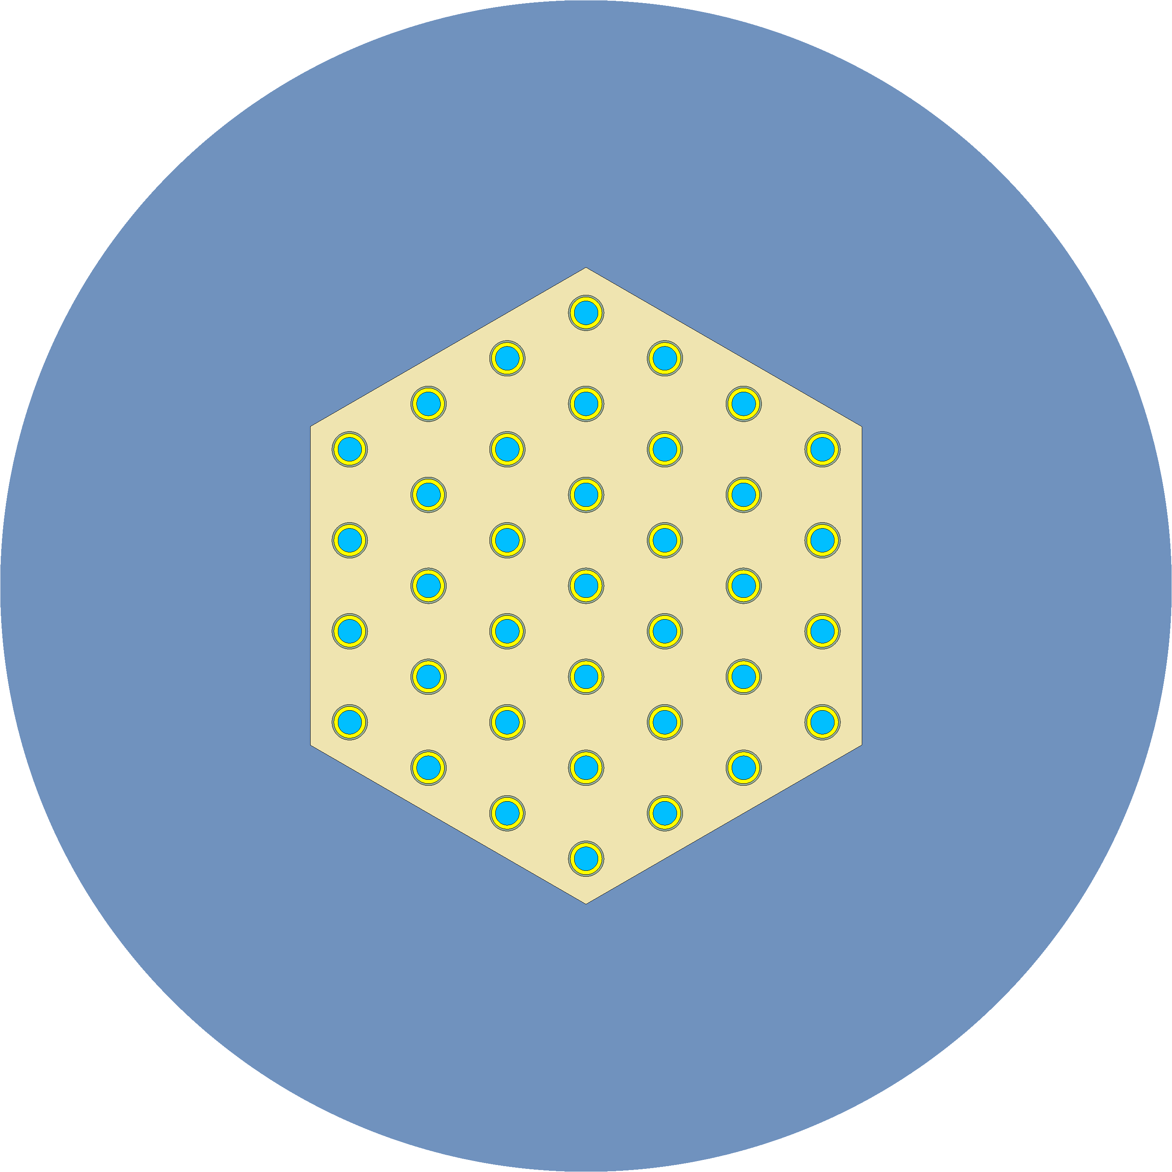

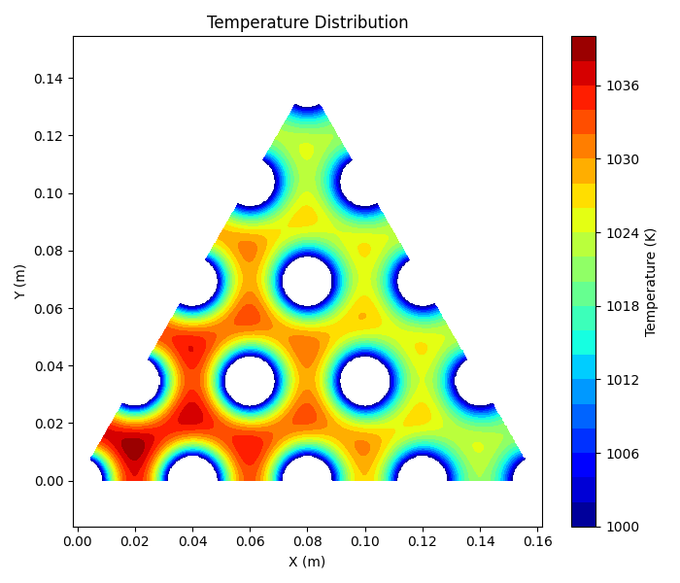

Reactor Modelling – Fast Heat Pipe Reactor
Reflector
Heat
Pipe
Fuel
Modelling Approach:
Simplified, scalable geometries
Neutronics
3D Montecarlo code: SERPENT
Thermal hydraulics
1D Model to predict heat flux limits in heat pipes
2D Finite difference method to solve heat equation in the core: $\frac{∂^{2}T}{∂x^{2}}+\frac{∂^{2}T}{∂y^{2}}+\frac{{\dot{q}}_{v}}{k}=0$
Based on KRUSTY reactor
Inputs:
Materials
Dimensions
Number of heat pipes
Outputs:
Criticality, reactor mass
Power Limits
Maximum temperature
Notes:
The diagram on the right shows the core configuration, with heat pipes distributed in the fuel region and surrounded by a reflector. This simple design is based on an experimental NEP reactor called Krusty, developed by NASA.
-To model sw use simple but flexible geometries allowing an easy scale up of the reactor.
-Our modeling is based on neutronics and thermohydraulic. For neutronics modeling, we use a 3D Monte Carlo code called Serpent, while for thermohydraulic calculations, we implemented a 1D model to estimate the maximum power of the Heat Pipes and a 2D finite difference model to estimate the temperature and fuel profiles.
These models are fundamental, as mentioned, for generating an extensive data base of reactors, which are then used to build the metamodels that feed the PRESTO optimization tool.

Slide 19



Conversion systems Modelling
Three converter system proposed according to the power level and radiator
Dynamic and static conversion systems are considered
Thermoelectric (TEG) Generator
Stirling Engine Generator
K-Rankine Cycle
($η \sim 5\%−10\%$)
($η \sim 20\%−25\%$)
($η \sim 25\%−30\%$)
Hot Side
Generator
Boiler
Cold Side
Turbine
Condenser
Notes:
Three different conversion technologies are proposed, in order or conversion effiency we are modelling the passive thermoelectric generator for low power applications, and two active generators, the Stirling compact reliable but working at very low cold temperatures, and the potassium rankine generators suitable for high power.

Slide 20



Conversion systems Modelling
Two power level models
-Low Power level (NASA’s RE-1000)
-High Power level (NASA’s CTPC)
Stirling Generator:
System of two oscillating masses.
Mechanical power is converted into electricity.
Heat in
(Reactor)
Stirling Modelling approach:
Simplified two-mass coupled dynamic model
Md
Heat out
(Radiator)
$$m_{d}\frac{d^{2}x_{d}}{{dt}^{2}}=\sum{F_{d}(P,T_{H},T_{C})}$$
Mp
Predict Power and efficiency
out of the operating point.
$$m_{p}\frac{d^{2}x_{p}}{{dt}^{2}}=\sum{F_{p}(P,T_{H},T_{C})}$$
Inputs
Charge pressure
Temperatures
Outputs
Power
Efficiency
$$P_{elec}$$
Notes:
-Today, I'll briefly introduce the Stirling system. This generator operates based on the oscillation of two masses caused by the expansion and compression of gases due to the heat exchange. One of these masses, called the piston, is connected to an electric generator which produces the electric power.
-The modeling approach is based on the dynamics of the masses, which depend on the pressure forces applied to them. Solving the coupled system allows us to determine the generator's operating point and estimate the power and efficiency as a function of the reactor and radiator temperatures.
-We have two models based on NASA-built generators, one for low and one for high power. In both models, the inputs are gas charge pressure and operating temperatures, and the outputs are electrical power and efficiency.

Slide 21
Radiator Modelling
Three radiators concepts proposed
Passive Radiator
Heat Pipe Radiator
Heat Pipe Pumped Radiator
Radiator Fin
Radiator Fin
Pump
Sticked to a Thermoelectric
generator
Heat Pipe
Increasing power
Notes:
Three radiators are proposed in our study scope. The passive radiator which is basically a fin sticked to a thermoelectric generator. The heat pipe radiator, that uses a heat pipe to transport heat through the panel, and the Heat Pipe Pumped radiator, in which a liquid metal is pumped to distribute heat over the different heat pipe radiators.

Slide 22



Radiator Modelling
Stirling Generator
Radiator Fin Heat rejection model
1D Model to predict heat flux limits in heat pipes
1D model based on heat equation and Stephan Boltzmann Black body radiation equation:
$\frac{∂^{2}T}{∂x^{2}}= − \frac{q_{v}}{k}$
$$dQ=dx dy σ ε ({T\left(x\right)}^{4}−T_{space}^{4})$$
$Q=σ ε L_{y}\int_{0}^{L_{x}}{\left({T\left(x\right)}^{4}−T_{space}^{4}\right)dx}$
$$Q_{waste}$$
Heat Pipe
$$Q_{rad}$$
Radiator
T(x)
inputs
Dimensions
Heat Pipe temperature
Outputs
Heat released
Radiator mass
x
Notes:
In this slide, I present the heat pipe radiator.
As we see in the diagram on the right, the Stirling's waste heat is transported to the radiator directly using a heat pipe.
For this a 1D model has been implemented to estimate the maximum power of the heat pipe, and a 1D model based on the heat equation and Stephan Boltzmann's blackbody radiation equation to solve the temperature field in the radiator and estimate the power that can be rejected to space.
Importante to state that when power gets really high, radiator gets one of the most massive systems.
This simple modeling allows us to quickly generate metamodeling databases for radiators of different sizes and operating at different temperatures.

Slide 23
Preliminary Results
Notes:
Put description here
20seg

Slide 24
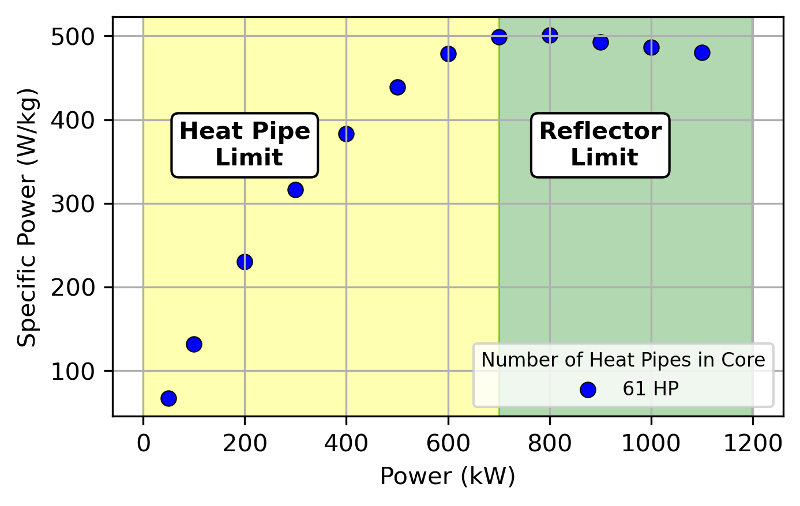
Example of single subsystem optimization – The core
Reflector
Fuel: UMo (20% enrichment)
Reflector: BeO
Heat Pipe working fluid: Na
Heat Pipe temperature: 1000 K
Main Power Constraints:
Heat Pipe Heat Flux
Reflector irradiation swelling
Core
Optimization variables
Core Radius
Reflector thickness
Heat Pipe radius
Heat
Pipe
Each dot represents the optimized reactor for a certain thermal power level.
Figure of Merit
Specific Power
Szmandiuk, F., et al. (2025, marzo). Optimization of the specific power of a NEP system integrating neutronics and the thermal aspects of a heat pipe reactor (HPR) core design. Paper presented at the NETS 2025 Conference, Huntsville, Alabama, USA.
Notes:
In this slide we present the optimization of specific power for a heat pipe reactor. We applied the Data Base + Optimization methodology mentioned before.
-This a fast 61 heat pipe reactor
-The optimization was carried out using the fuel region radius, reflector thickness, and heat pipe radius as optimization variables.
-The specific power (reactor thermal power over reactor mass) was selected as figure of merit.
-The maximum specific power was calculated for different power levels. Each point represents the maximum specific power associated with a given optimal reactor radius, reflector thickness, and heat pipe radius.
-The optimization process takes into account power-limiting restrictions, such as maximum energy transfer in the heat pipes, maximum irradiation damage to materials, and maximum fuel temperature.
-The graph shows the regions limited by different phenomena. In this particular case, the specific power is limited by the maximum energy transfer of the heat pipes up to a certain power level, where reflector damage becomes the predominant limiting factor.
-These results were published in our conference paper for Nuclear Emerging Technologies for Space 2025.

Slide 25
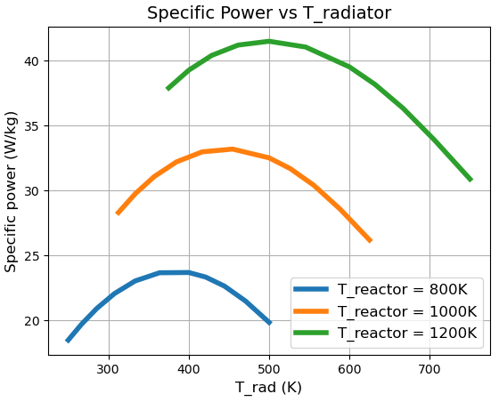
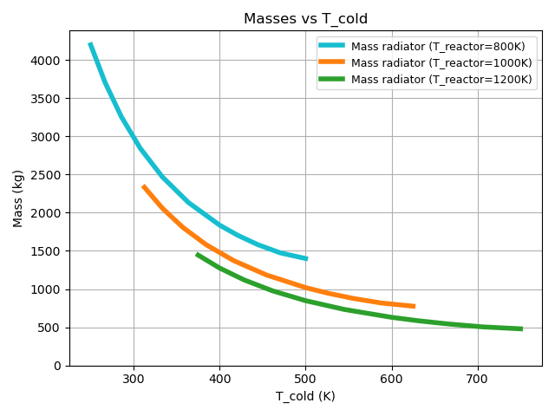
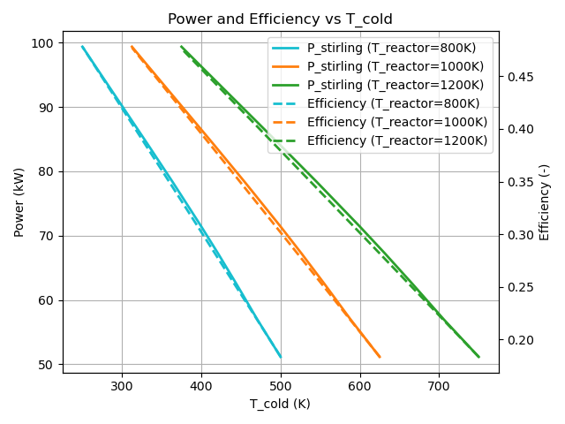





Example of full system optimization - preliminary results
Reactor
Optimum Radiator Temperatures
$$P_{elec}=f(\frac{T_{reactor}}{T_{radiator}})$$
Stirling Generator
$$Q_{rad}=f(T_{radiator}^{4})$$
$$Q_{rad}$$
-5 Stirlings
-Single Stirling mass: 87,5 kg
-Reactor mass: 740 kg
$$P_{elec}$$
Heat Pipe
$$Q_{rad}$$
Notes:
We also managed to do some preliminary coupling simulations to understand the behaviour of the Stirling-Radiator system. Here the Stirling works between the reactor and radiator temperatures, and basically increasing or decreasing this temperature differences makes the Stirling generate greater or lower power. On the other hand the radiator rejects the waste energy from the Stirling in relation to its temperature to the fourth. We obtained results of the specific power of this coupled system vs the radiator temperature for different fixed reactor temperatures. What we see here is that low radiator temperatures allows to generate great electric power, but needs a bigger radiator. High radiator temperatures on the other hand make the radiator small but the stilring electric output power is low. Therefore for each reactor temperature we can find an optimal radiator temperature that maximizes the ratio between electric output power and system mass.

Slide 26
Perspectives and conclusions
Notes:
Moving on with perspectives and conclusions
10seg

Slide 27
Conclusions and Perspectives
Conclusions
Perspectives
NEP strong subsystem interdependence requires integrated design
PRESTO is being built to design the full NEP system optimizing a figure of merit and with design constraints
Subsystem models already developed: reactor, conversion, shield and radiators
Ongoing work: adding technologies and performing full-system optimizations
Complete subsystem modelling
Perform Experiments in MARGUERITE platform (TEG)
Develop optimization methodology
Perform optimization studies
Complete the benchmarks against existing designs
Notes:
-In conclusion, Nuclear Electric Propulsion systems represent a promising solution for high-power, long-duration space missions. But their design remains challenging due to the strong interdependence between subsystems and the variety of technologies available.
To address this, we are developing PRESTO—an integrated optimization tool that designs NEP systems as a whole.
So far, we’ve modeled some concepts of reactors, power conversion systems, and radiator, and demonstrated how PRESTO can optimize individual substytems.
Perspectives
Our next steps focus on continuing the subsystem modelling, performing some experimental validations in our MARGUERITE platform. Develop the optimization methodologies and perform optimization studies and benchmarking.

Slide 28
Bibliography

Slide 29
Bibliography
[1]-Leopold Summerer, Bruno Gardini, and Giacinto Gianfiglio. Esa’s approach to nuclear power sources for space applications. In Proceedings of ICAPP, volume 13, page 18, 2007.
[2] K. R. Supak. Reduced gravity Rankine cycle system design and optimization study with passive vortex phase separation. PhD thesis, Texas A&M University, 2008

Slide 30
Appendix

Slide 31
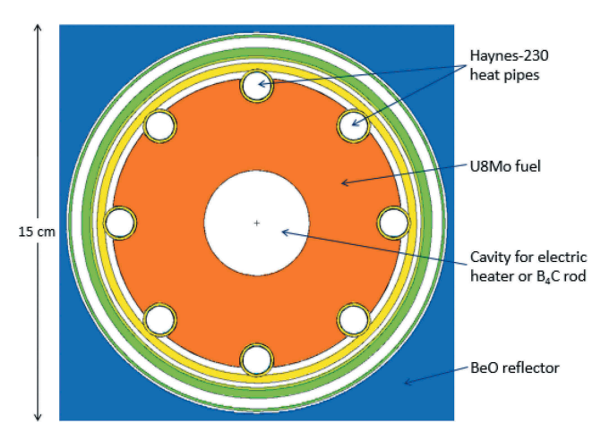
KRUSTY

Slide 32
Shielding
Neutron Shielding
Slowing down (light materials) and absorbing them (high neutron abortion materials).
Photon Shielding
Using dense materials with a high atomic. They enhance interactions like the photoelectric effect, Compton scattering, and pair production.
Selected Layout and Materials
LiH (Lithium Hydride) + W (Tungsten) are seen as good candidates for neutron an gamma shielding respectively.
Neutron
Shielding
Reactor
$$α$$
gap
D
$$L_{γ}$$
$$L_{n}$$
H
Gamma
Shielding

Slide 33
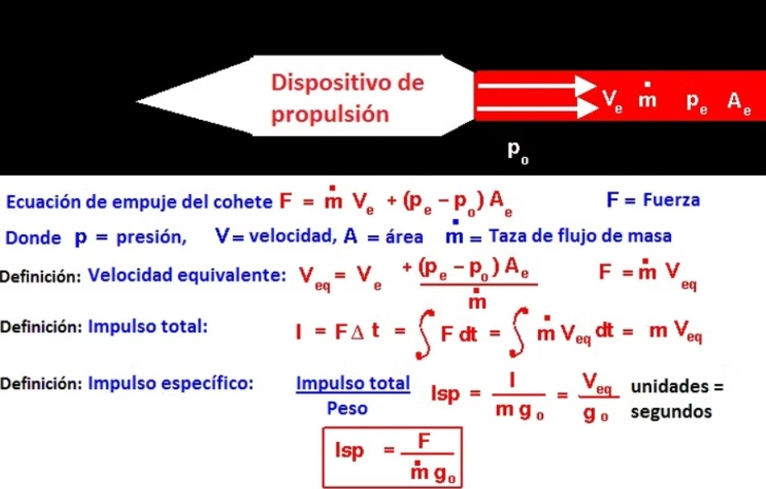
Specific Impulse

