Slide 1



Measuring magnetic fields with mercury vapor for the search of the neutron Electric Dipole Moment
Katia Michielsen, LPSC Grenoble, Ultra Cold Neutrons
10 April 2025

Slide 2
Outline
Context
Overview of the n2EDM experiment
Deriving the precession frequency and its precision (PSI)
Understanding the mercury-light interaction more deeply (LPSC)

Slide 3


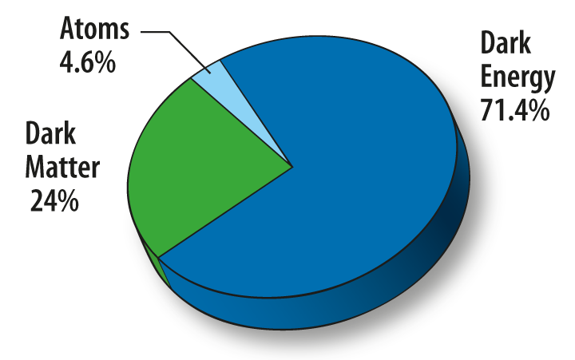
I - Context
I - Context
Particle physicists have come up with “the Standard Model”.
very successful!!
but flaws (gravity, 5% of the energy density of the universe , matter-antimatter asymmetry)
-> There is new physics. Beyond Standard Model
Physicists pushing the high energy frontier
Physicists pushing the precision frontier at low energy
[1] Energy density content of the universe
neutron Electric Dipole Moment (nEDM)
[1] https://wmap.gsfc.nasa.gov/universe/uni_matter.html

Slide 4
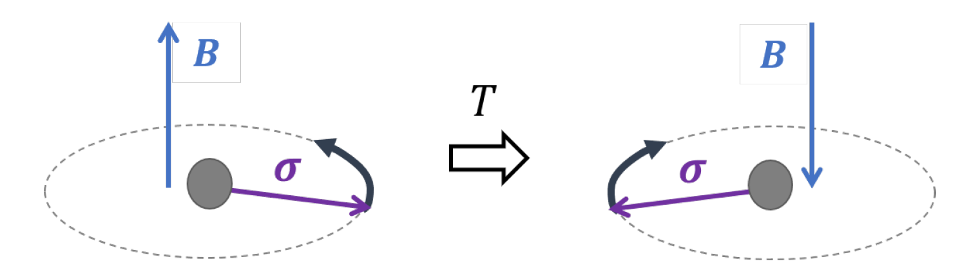


What is the magnetic moment?
I - Context
Spins couple to magnetic fields with strength $μ$
Non-relativistic limit of the fermion-photon interaction:
$$H=−μ σB$$
Results is a “torque” on the spin, resulting in Larmor precession
$$\frac{d\vec{s}}{dt}=γ\vec{s}×\vec{B}$$
Larmor precession of a spin in a magnetic field
[1] https://physicsworld.com/a/how-the-stern-gerlach-experiment-made-physicists-believe-in-quantum-mechanics/

Slide 5
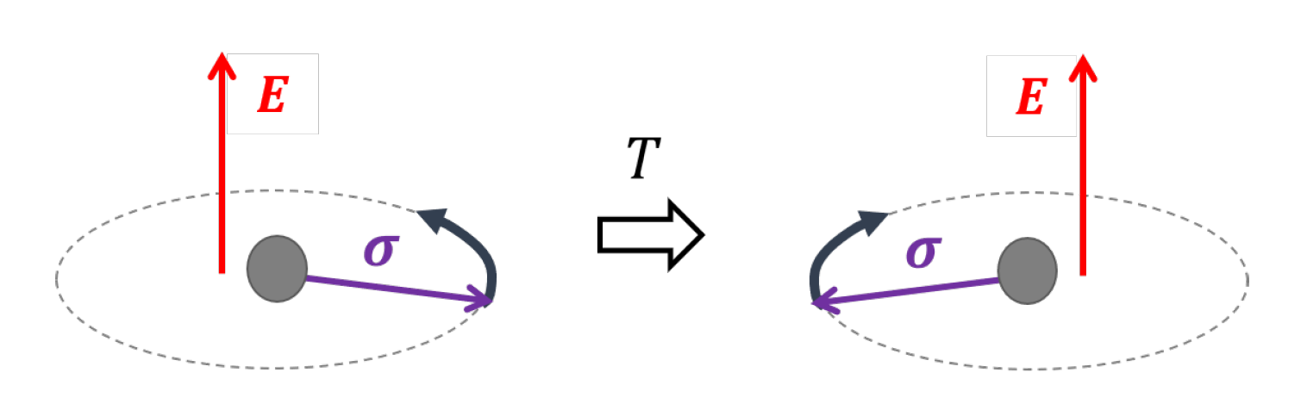


What is an Electric Dipole Moment?
I - Context
Spins couple to magnetic fields with strength $μ$
Spins could couple to electric fields. The electric dipole moment (EDM) is this coupling strength $d$.
Non-relativistic limit of the fermion-photon interaction:
$$H=−μ σB −d σE$$
Larmor precession of a spin in a magnetic field
Precession of a spin in an electric field?

Slide 6





An EDM violates time reversal symmetry.
I - Context
CPT symmetry: Lorentz invariance of the theory (imposed).
T violation <-> CP violation
Observable = magnetic moment $μ$
Observable = electric moment d
$$μ>0$$
$$μ>0$$
$$d>0$$
$$d<0$$
T-invariant
not T-invariant
CP violation is one of the Sakharov criteria for matter anti-matter asymmetry during baryogenesis.

Slide 7
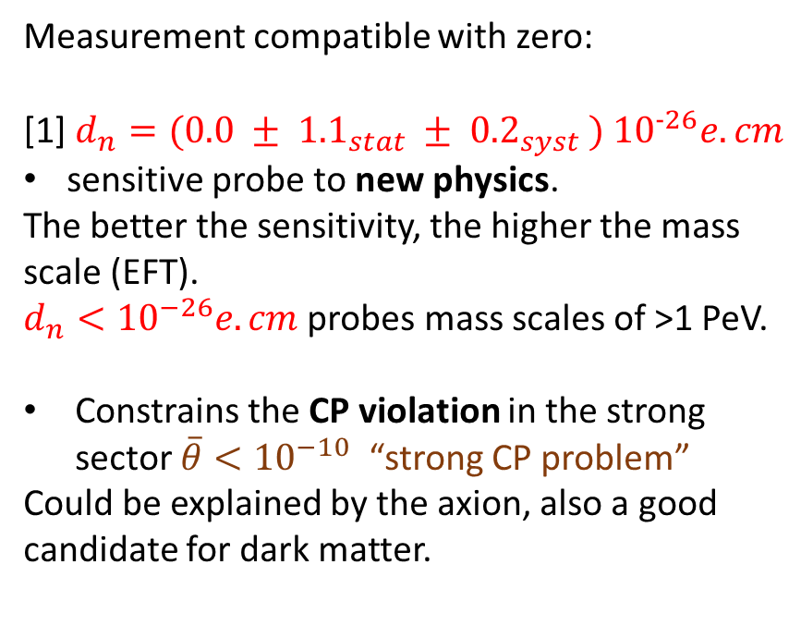
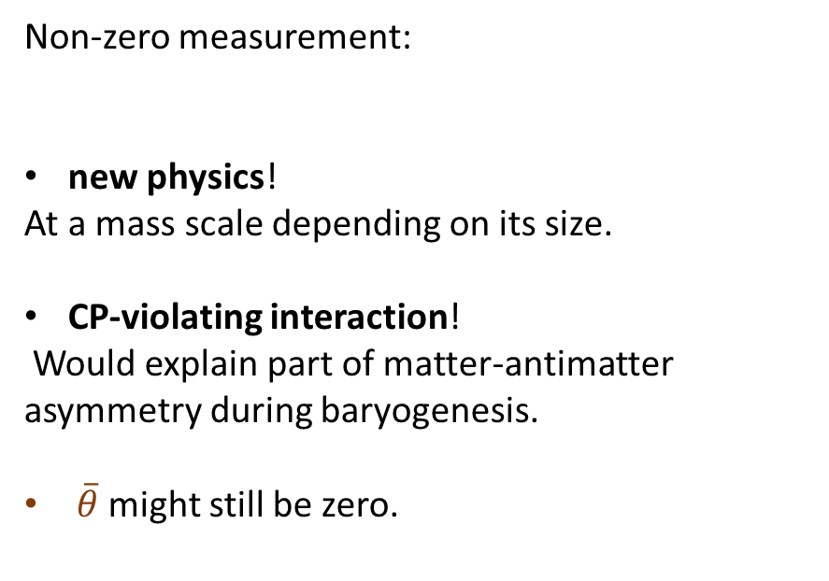
Scenarii for the nEDM
I - Context
From the Standard Model we expect $d_{n}= {10}^{−32} + \overline{θ }∙{10}^{−16} e.cm$
weak interaction
strong interaction
new physics?
Measurement compatible with zero:
[1] $d_{n}=(0.0 ± {1.1}_{stat} ± {0.2}_{syst} ) {10}^{−26}e.cm$
sensitive probe to new physics.
The better the sensitivity, the higher the mass scale (EFT).
$d_{n}<{10}^{−26}e.cm$ probes mass scales of >1 PeV.
Constrains the CP violation in the strong sector $\overline{θ}<{10}^{−10}$ “strong CP problem”
Could be explained by the axion, also a good candidate for dark matter.
Non-zero measurement:
new physics!
At a mass scale depending on its size.
CP-violating interaction!
Would explain part of matter-antimatter asymmetry during baryogenesis.
$\overline{θ}$ might still be zero.
[1] Measurement of the Permanent Electric Dipole Moment of the Neutron, nEDM collaboration, 2020

Slide 8


II- How do we measure the neutron EDM at
I – Context II – n2EDM

Slide 9
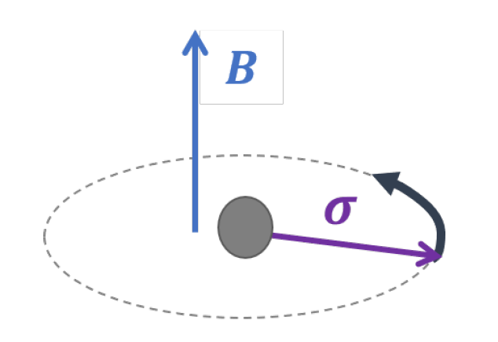

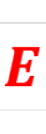
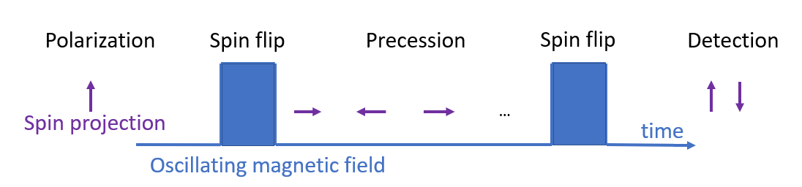
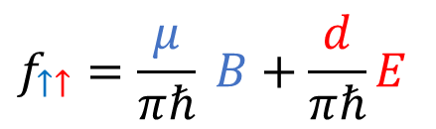
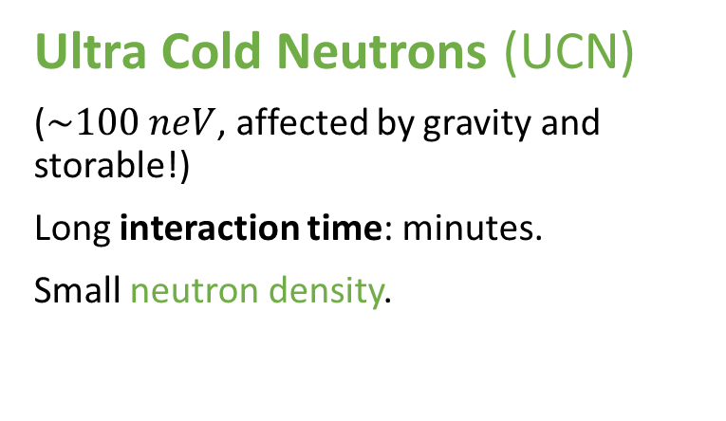
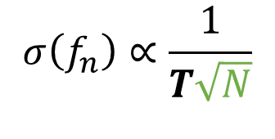


How do you measure the coupling of the spin to the electric field?
I – Context II – n2EDM
Larmor precession frequency measurement.
in a known magnetic field and strong electric field.
Ramsey method of oscillatory fields to count the number of spin up or down after precession.
$$f_{↑↑}=\frac{μ}{πℏ} B+\frac{d}{πℏ}E$$
Requires control of the magnetic field !!
$$σ\left(f_{n}\right)∝\frac{1}{T\sqrt{N}}$$
Ultra Cold Neutrons (UCN)
($\sim 100 neV$, affected by gravity and storable!)
Long interaction time: minutes.
Small neutron density.
$$B$$
$$T$$

Slide 10
I – Context II – n2EDM
Active magnetic shield
Passive magnetic shield
Vacuum vessel with
Precession chambers
Superconducting
magnet
UCN source
Deuterium
Pb target
UCN spin detectors
Proton beam

Slide 11
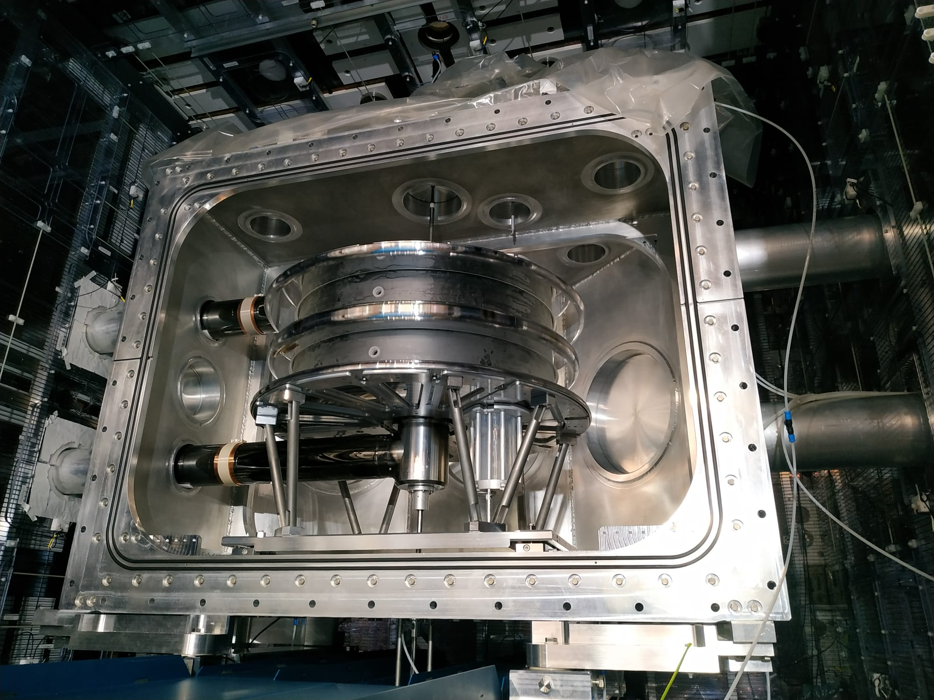
I – Context II – n2EDM

Slide 12
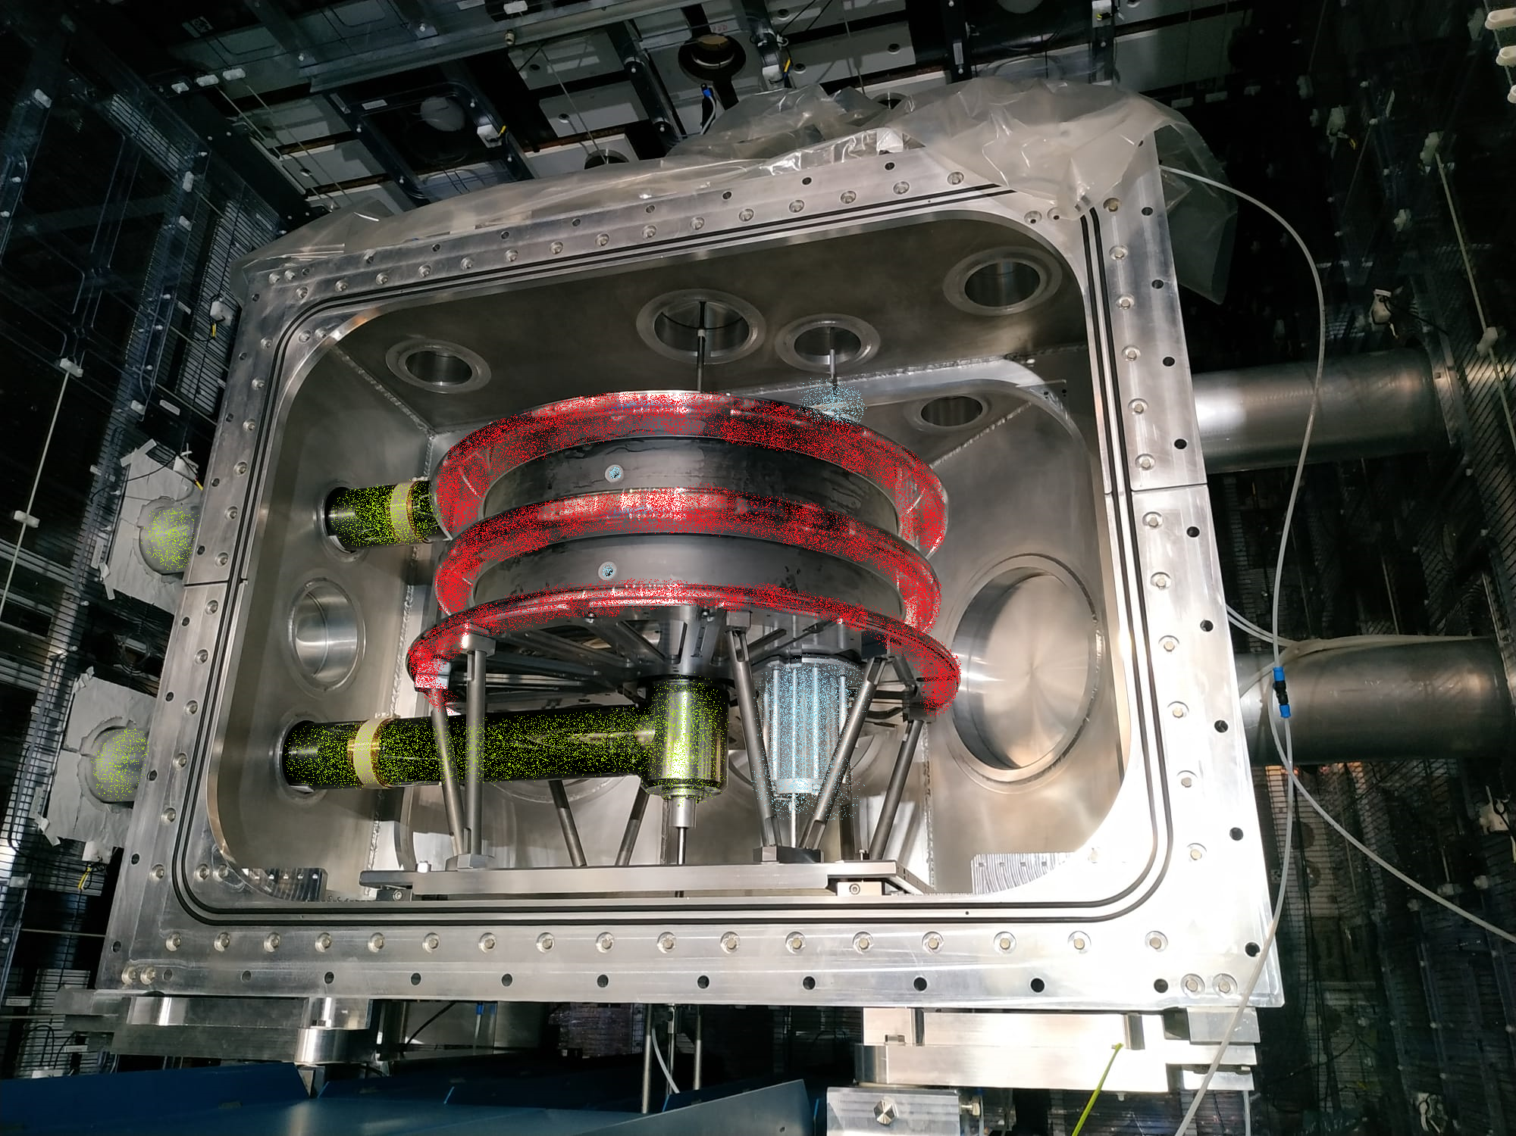
I – Context II – n2EDM
Coil generating B field
Top ground electrode
HV electrode
Bottom ground electrode
UCN guide
Vacuum vessel

Slide 13
I – Context II – n2EDM
Coil generating B field
B
E
Top ground electrode
E
HV electrode
Bottom ground electrode
UCN guide
Polarization cell
Vacuum vessel

Slide 14
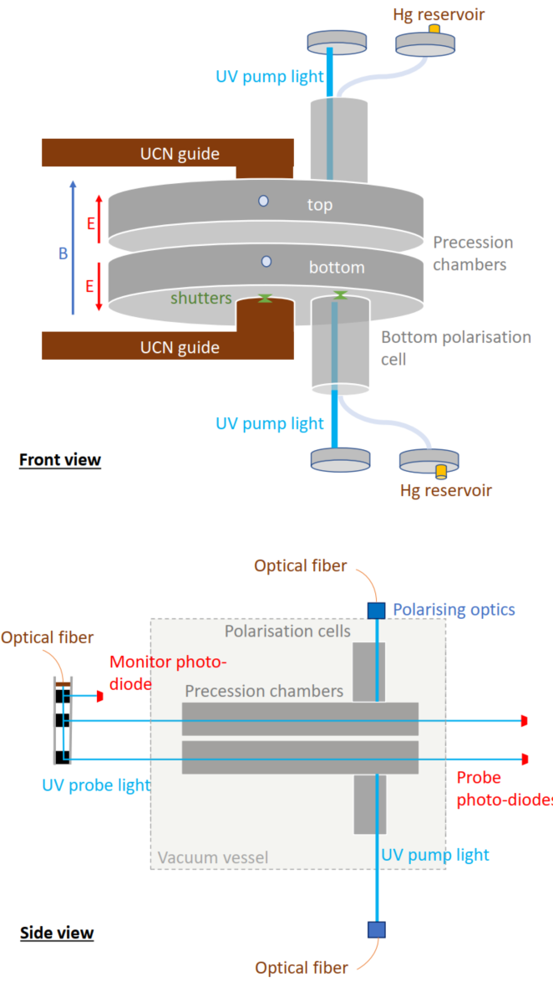

Control the magnetic field: quantum co-magnetometry
I – Context II – n2EDM
Neutrons and mercury are stored in the same volume, at the same time.
Optical (continuous!) reading of the mercury spin precession by 254 nm laser light.
Mercury has a better limit on its EDM.
neutrons
$$B$$
mercury

Slide 15
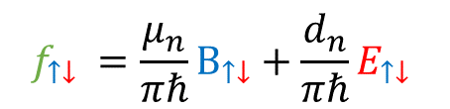

I – Context II – n2EDM
E
B
E
neutrons
$$f_{↑↓} =\frac{μ_{n}}{πℏ}B_{↑↓}+\frac{d_{n}}{πℏ}E_{↑↓}$$
Bottom chamber
mercury
$$f_{↑↓} =\frac{μ_{Hg}}{πℏ}B_{↑↓}$$

Slide 16
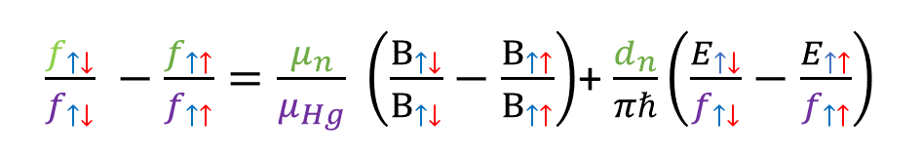
I – Context II – n2EDM
E
B
E
neutrons
mercury
$\frac{f_{↑↓}}{f_{↑↓}} −\frac{f_{↑↑}}{f_{↑↑}}=\frac{μ_{n}}{μ_{Hg}} \left(\frac{B_{↑↓}}{B_{↑↓}}−\frac{B_{↑↑}}{B_{↑↑}}\right)$+ $\frac{d_{n}}{πℏ}\left(\frac{E_{↑↓}}{f_{↑↓}}−\frac{E_{↑↑}}{f_{↑↑}}\right)$

Slide 17
III - How to assert the uncertainty of the precession frequency in the mercury co-magnetometer?
I – Context II – n2EDM III- Hg magnetometer
mercury

Slide 18
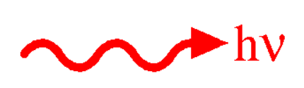
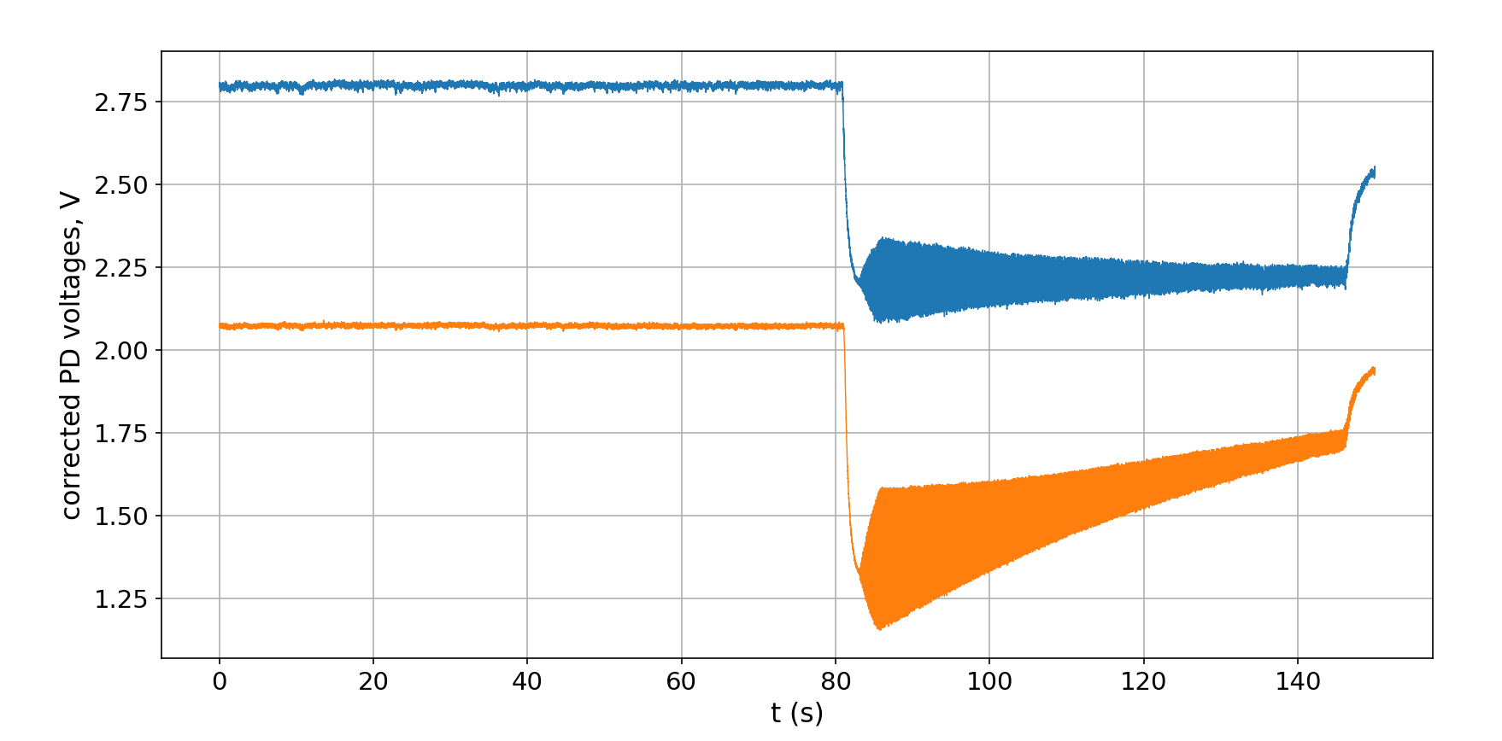



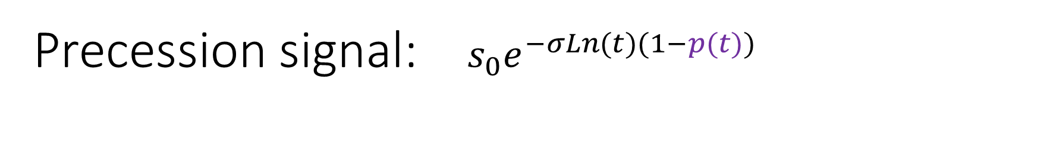
Precession signal: $s_{0}e^{−σLn(t)(1−p(t))}$
I – Context II – n2EDM III- Hg magnetometer
$^{199}Hg$ spin during precession
Excited states
-1/2
1/2
Hg density
Vapour spin polarisation along light propagation axis
$p$ oscillates at Larmor frequency, so does the transmitted power.
spin 1
Hg in the polarization chamber
Precession
Ground states
1/2
Emptying
-1/2
Zoomed in
Spin flip
Zoomed in

Slide 19
Precession signal: $s_{0}e^{−σLn(t)(1−p(t))}$
I – Context II – n2EDM III- Hg magnetometer
$^{199}Hg$ spin during precession
Excited states
-1/2
1/2
Hg density
Vapour spin polarisation along light propagation axis
$p$ oscillates at Larmor frequency, so does the transmitted power.
spin 1
Hg in the polarization chamber
Precession
Ground states
1/2
Emptying
-1/2
Zoomed in
Spin flip
Zoomed in

Slide 20
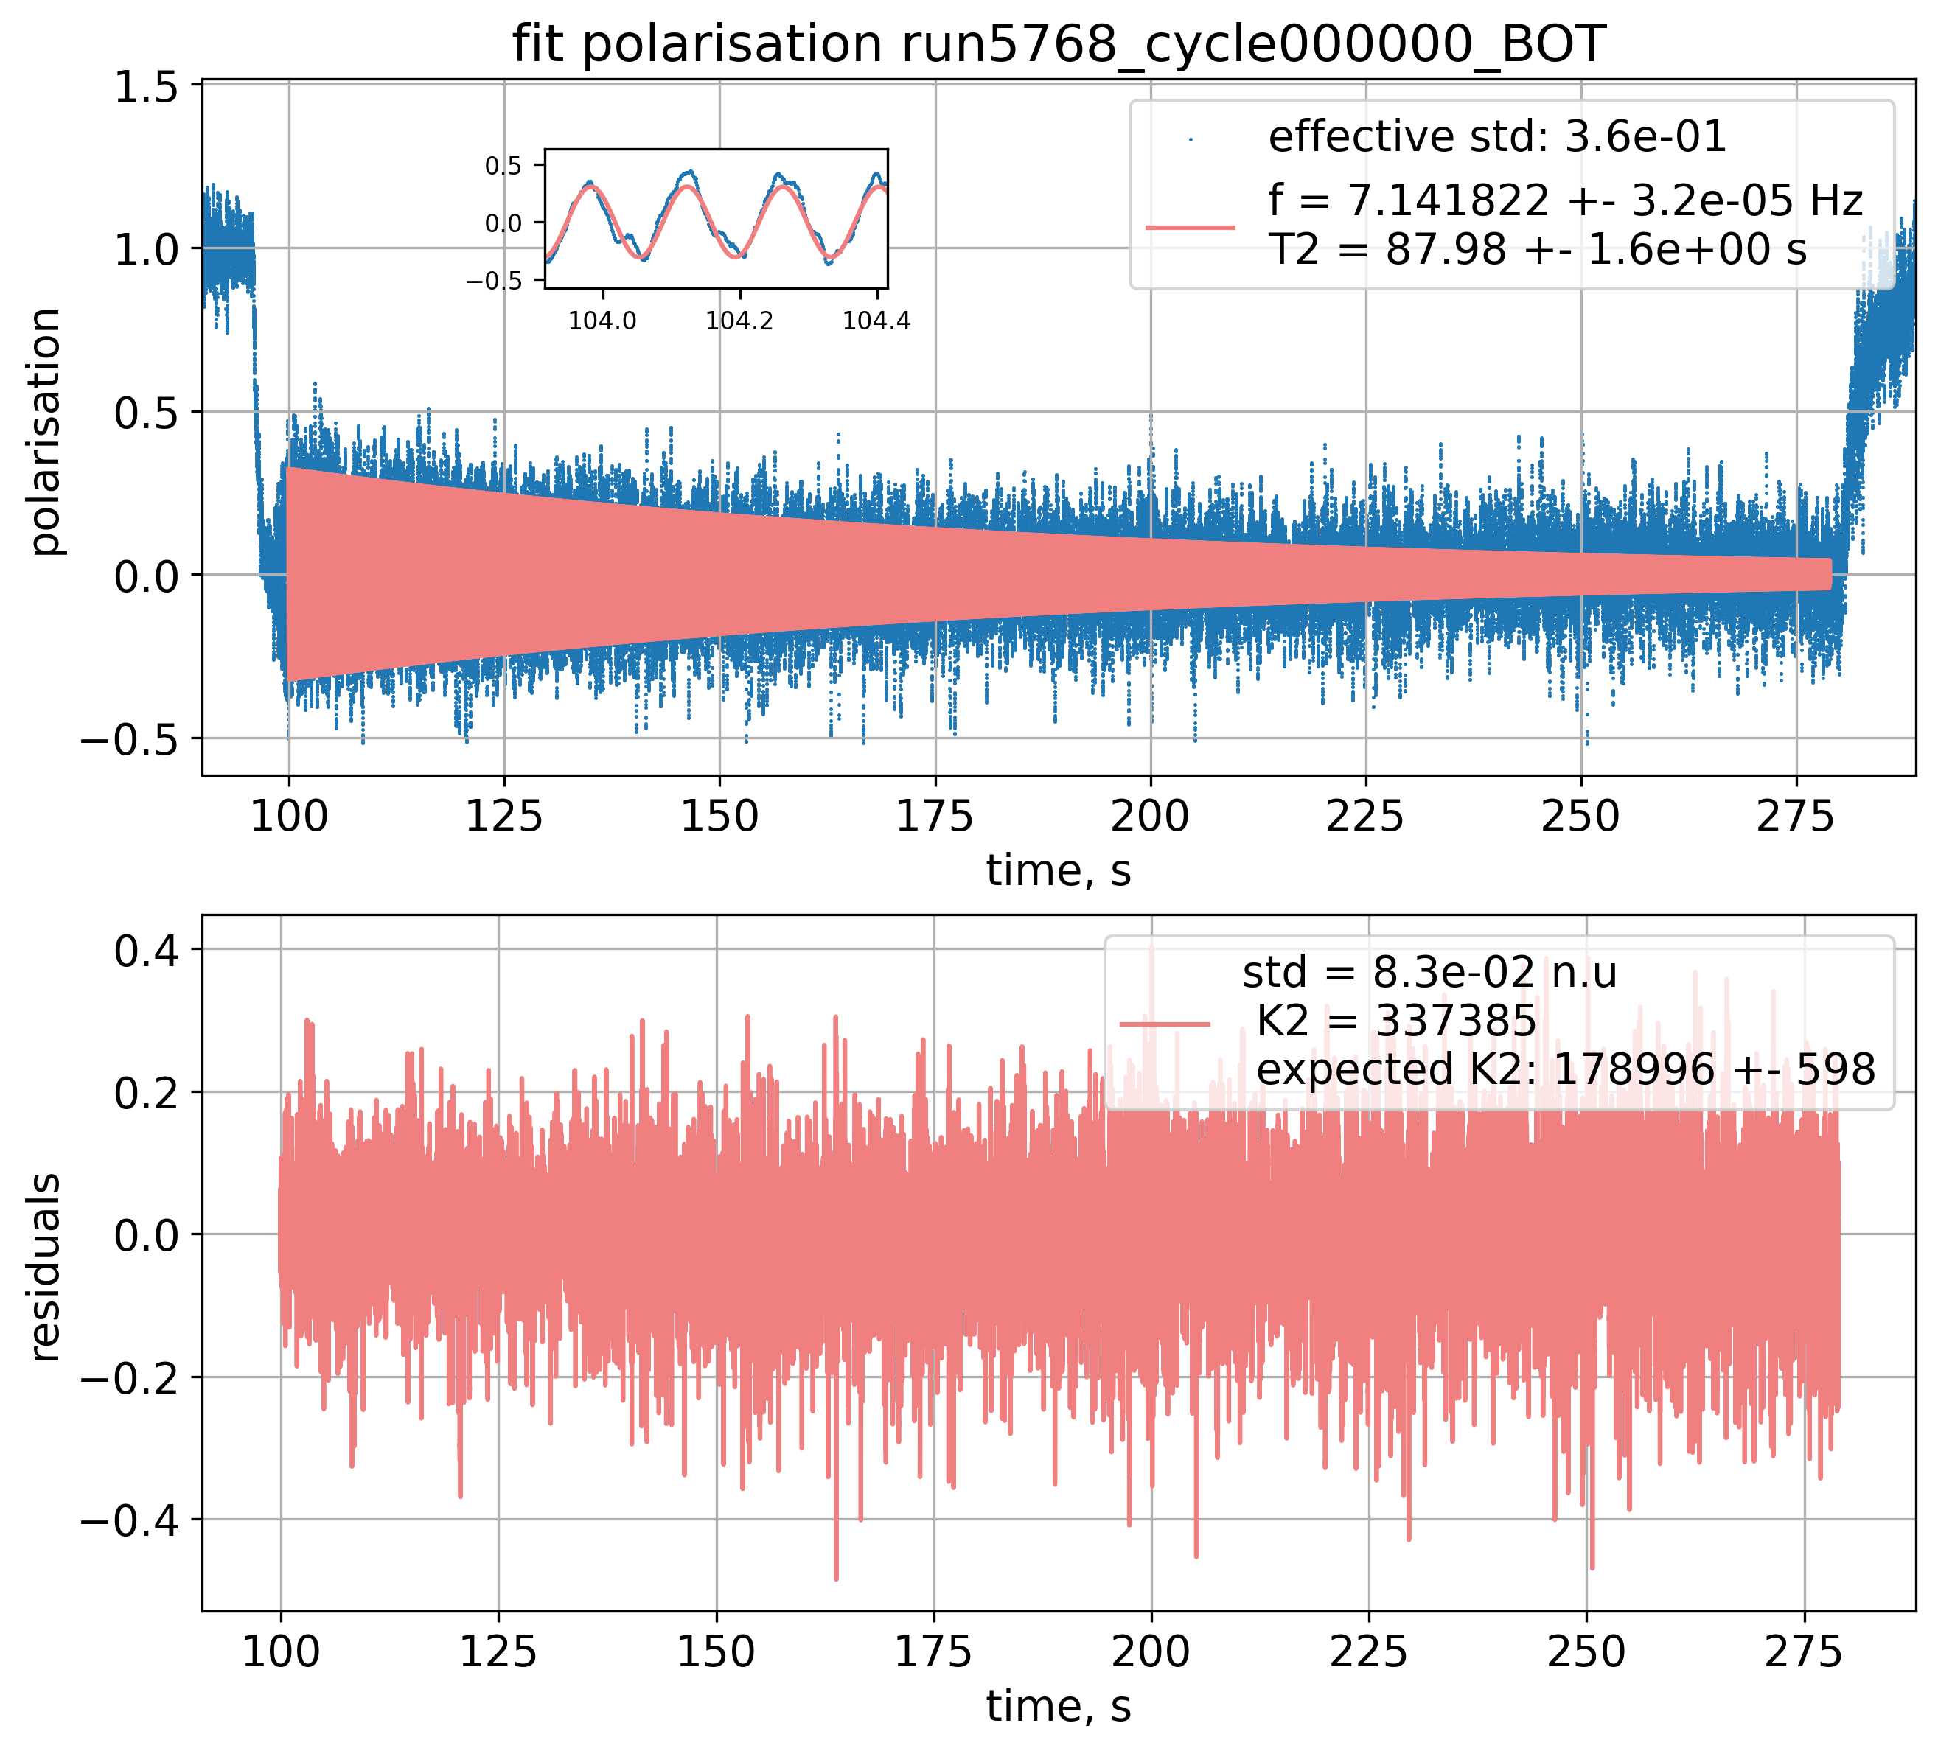
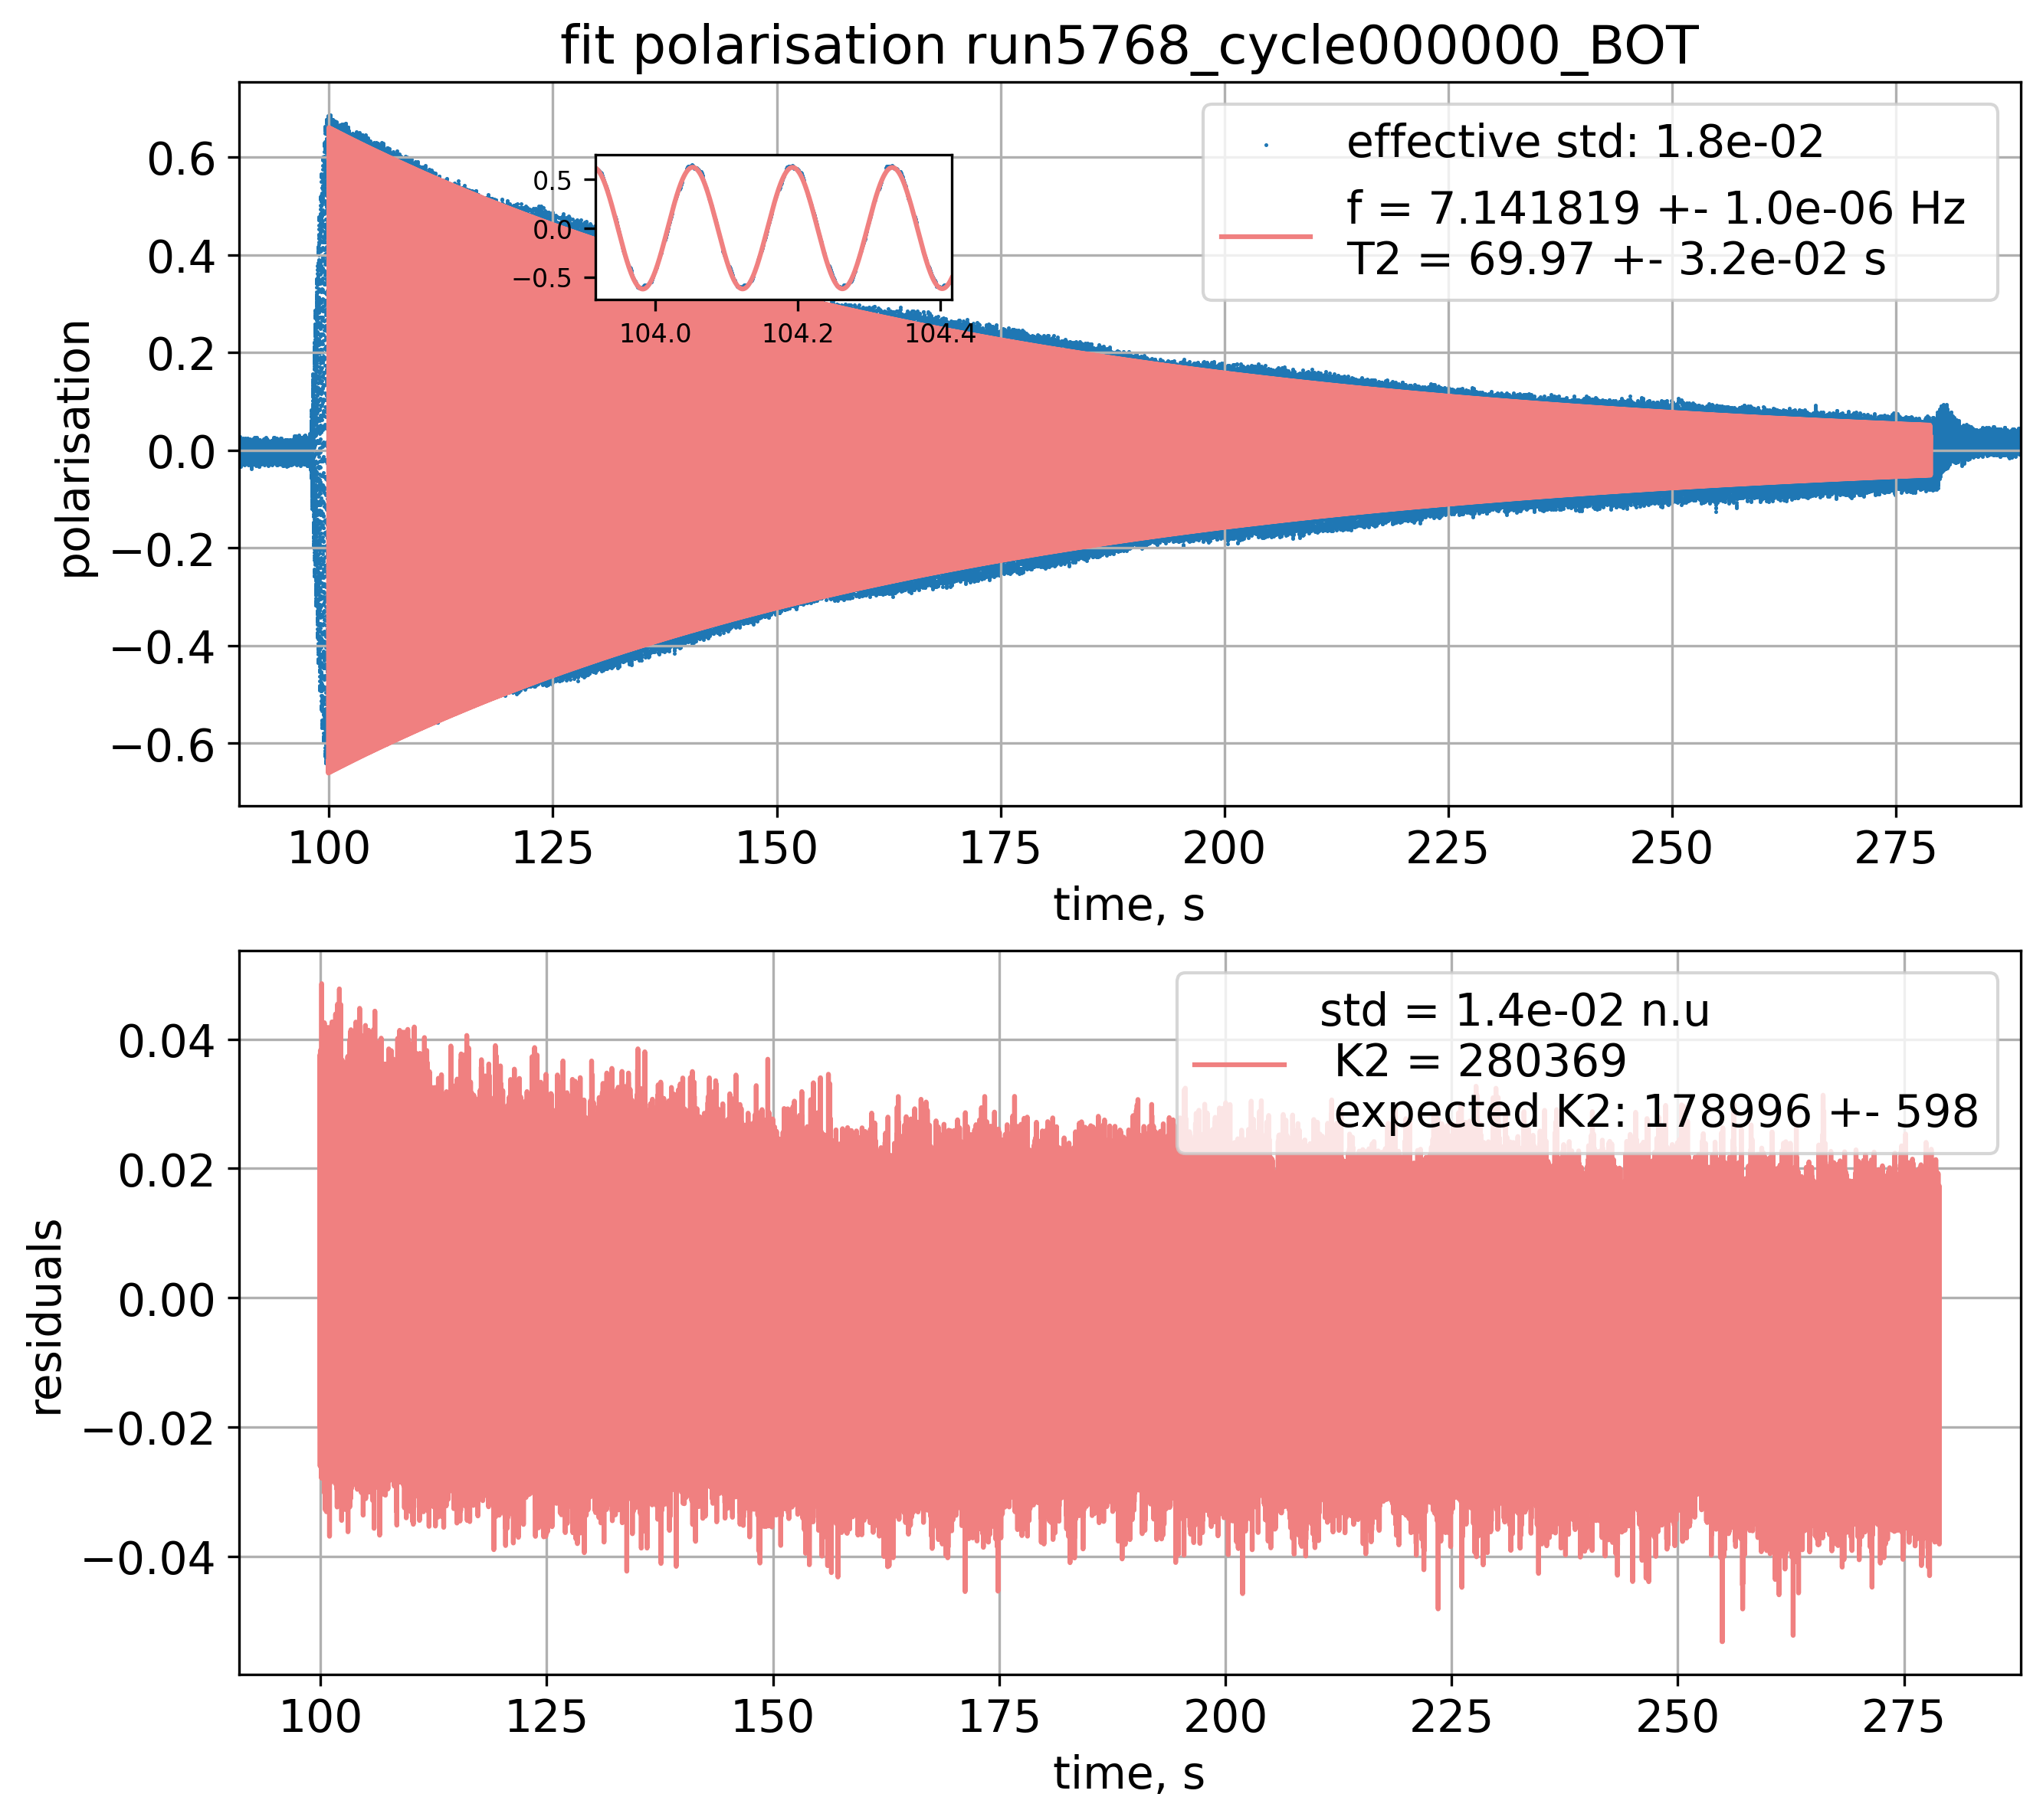
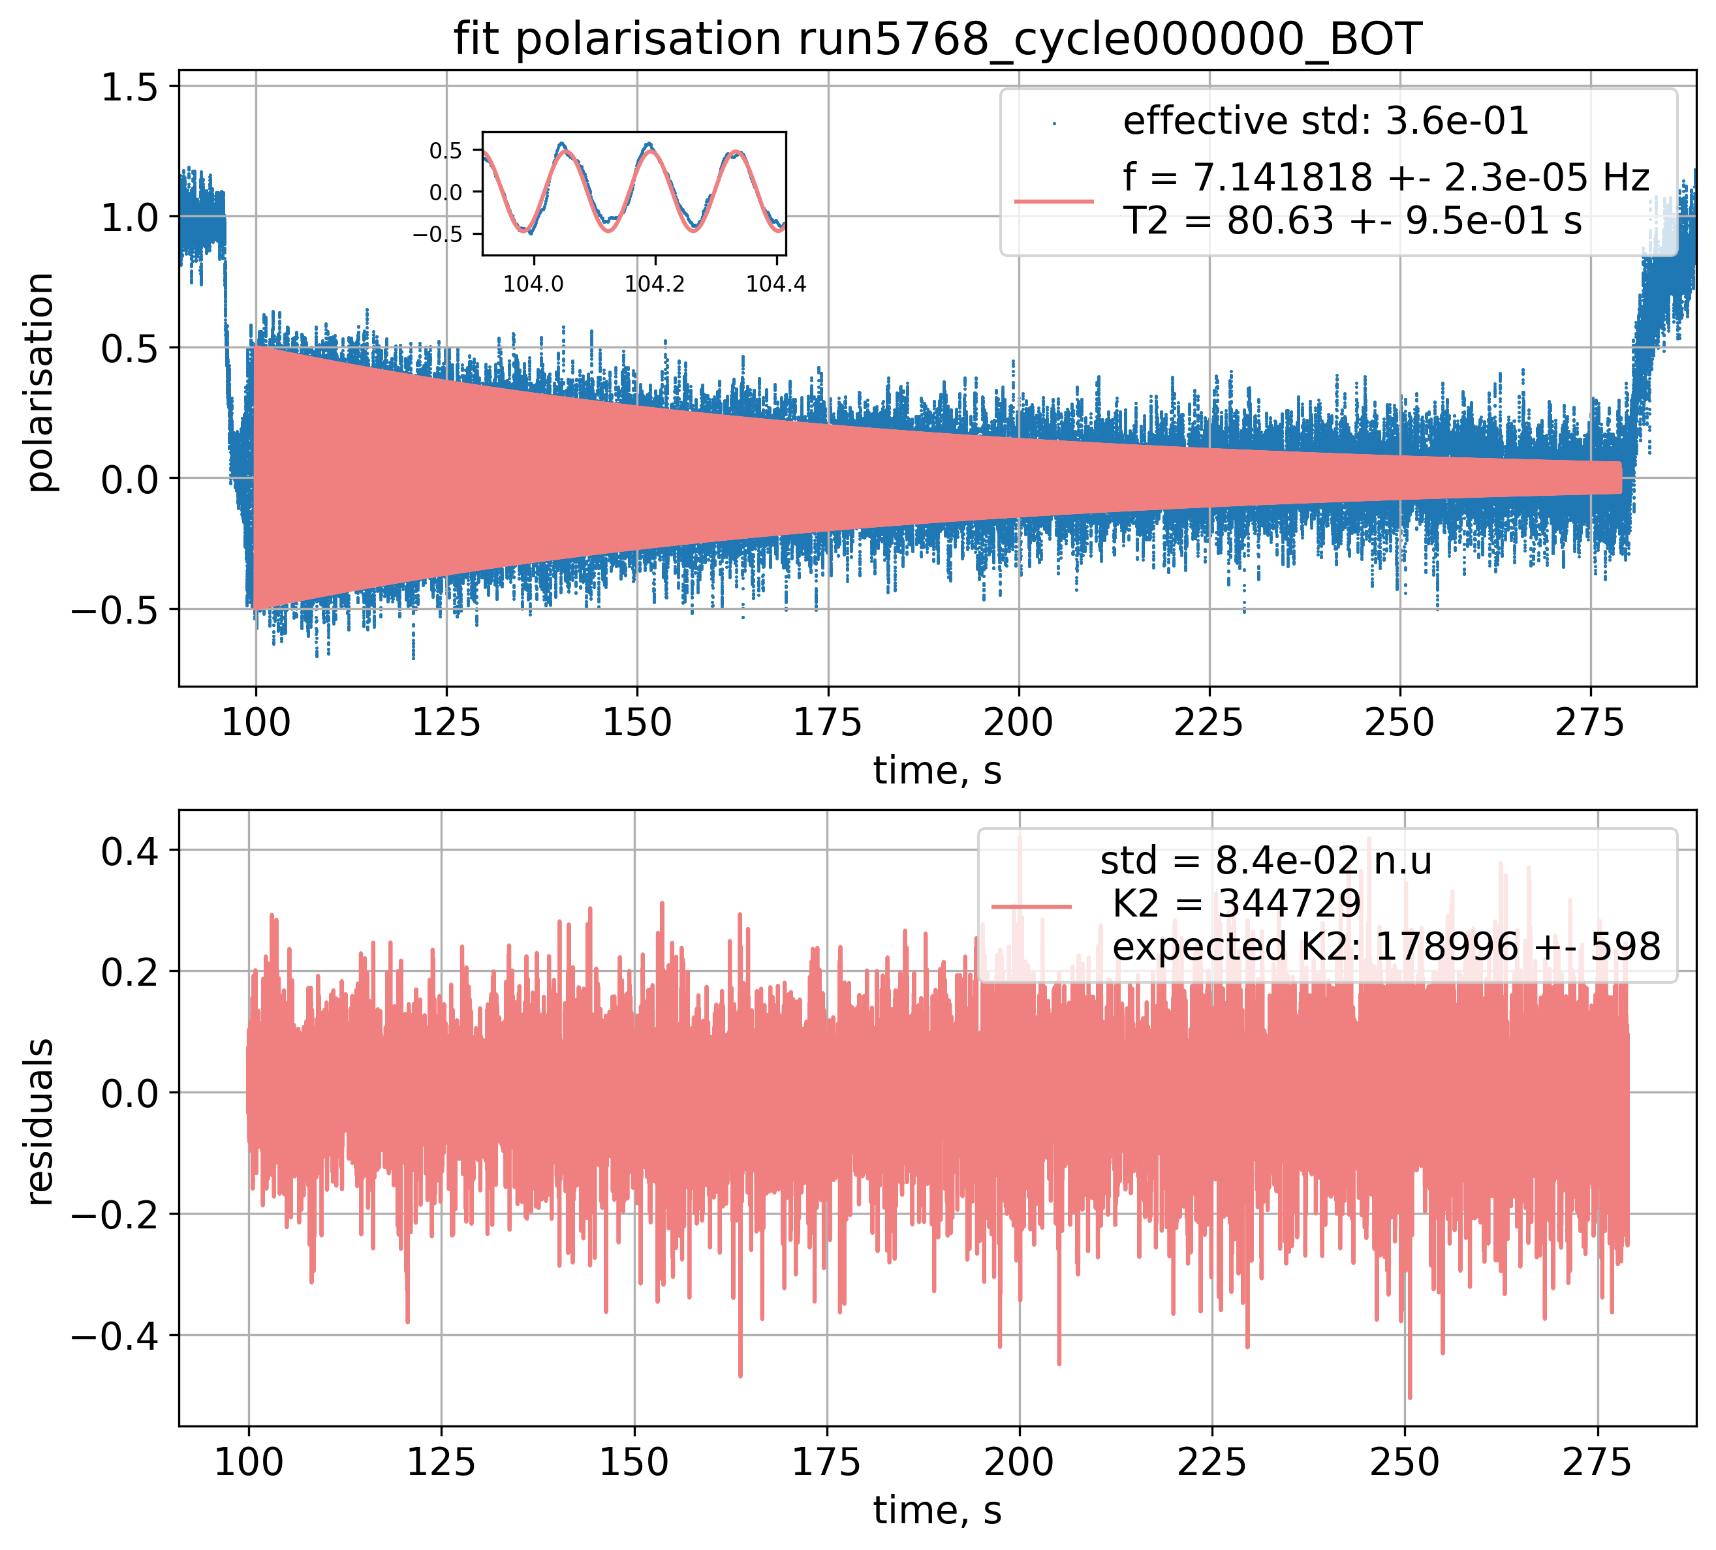
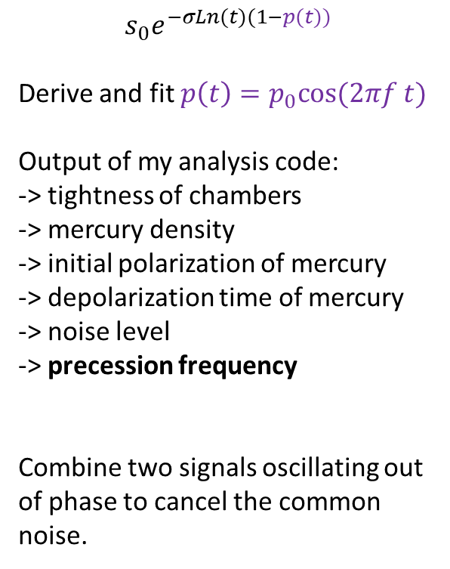
Fitting the polarization over the full precession time (minutes!)
$$s_{0}e^{−σLn(t)(1−p(t))}$$
Derive and fit $p\left(t\right)=p_{0}cos⁡(2πf t)$
Output of my analysis code:
-> tightness of chambers
-> mercury density
-> initial polarization of mercury
-> depolarization time of mercury
-> noise level
-> precession frequency
Combine two signals oscillating out of phase to cancel the common noise.

Slide 21
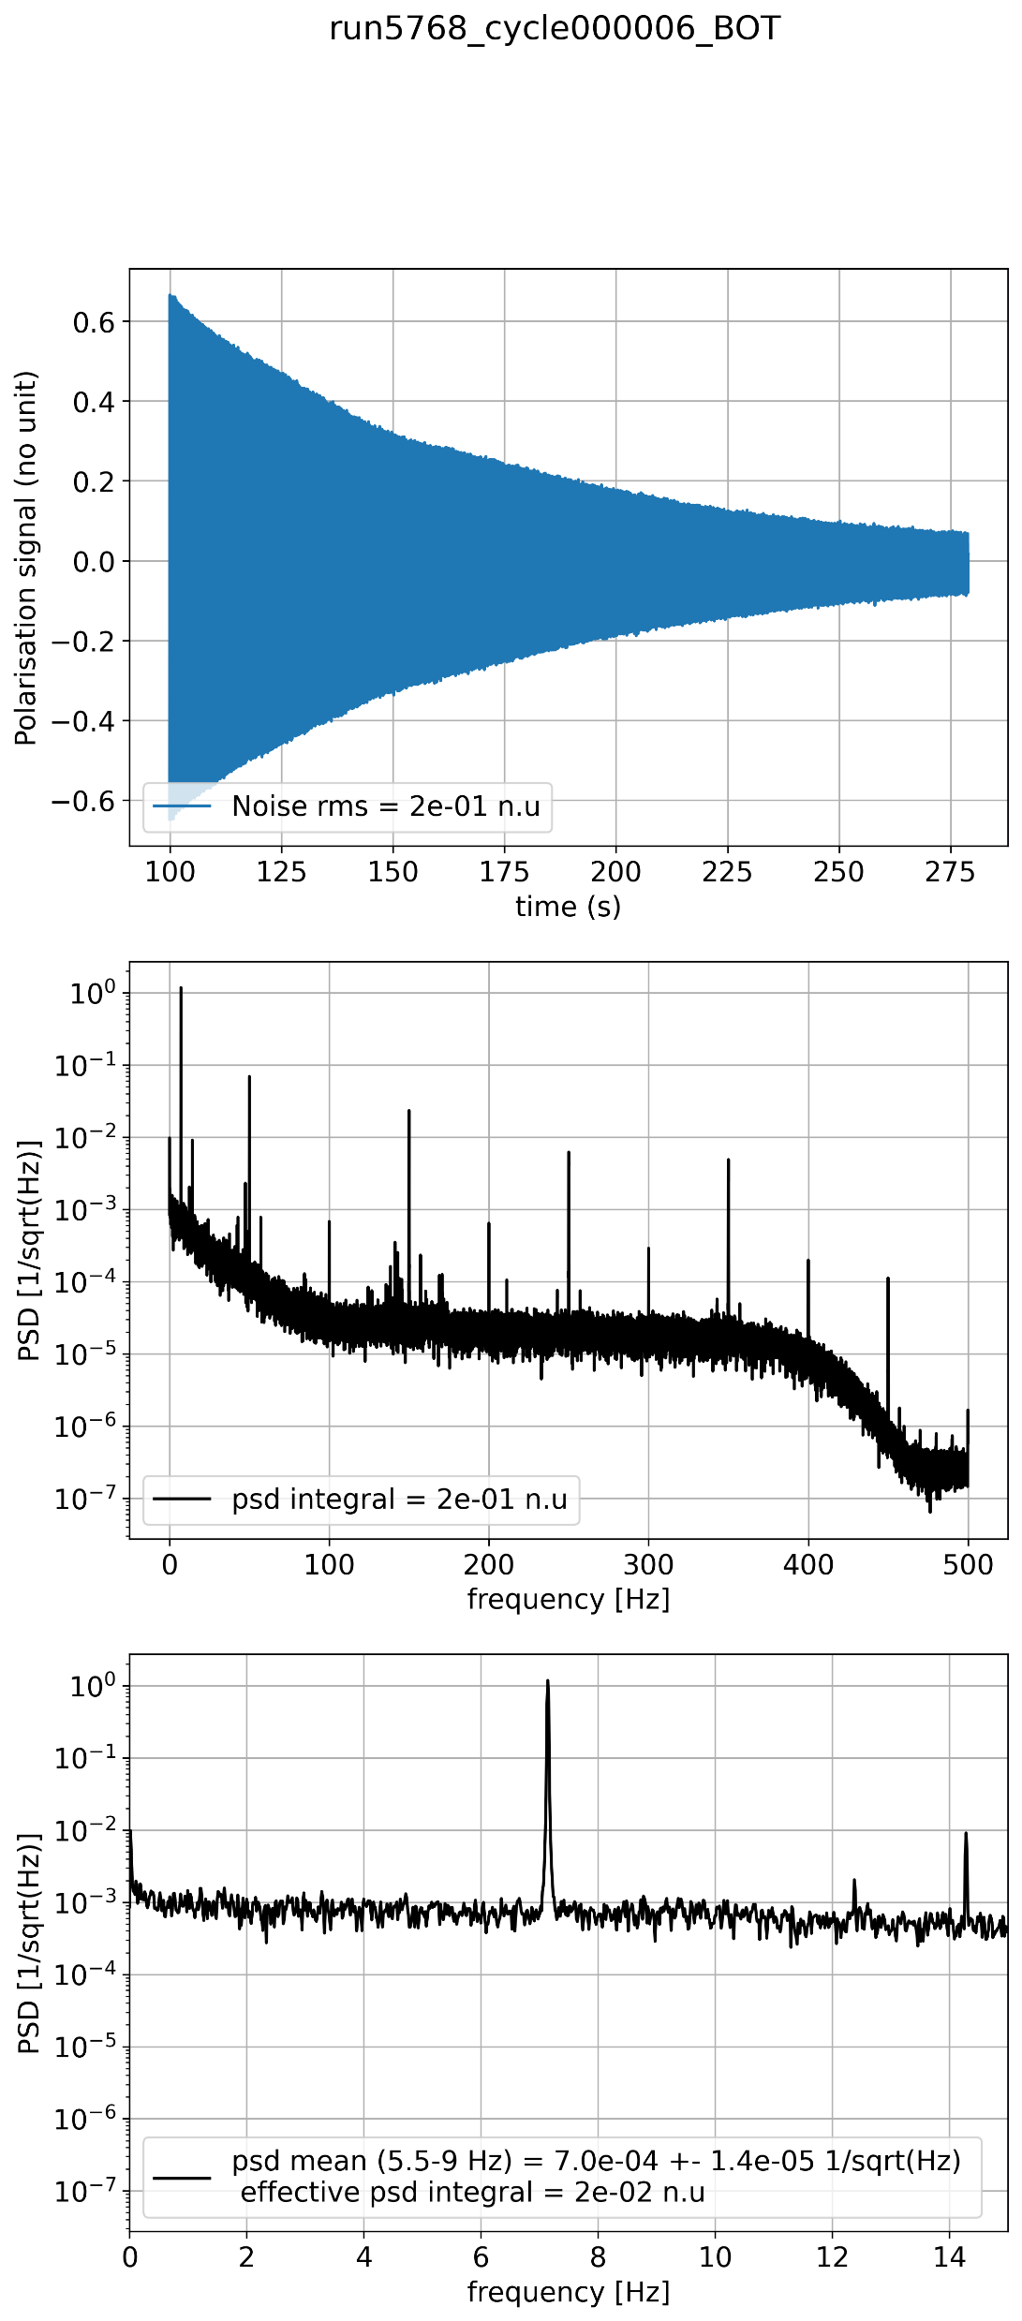

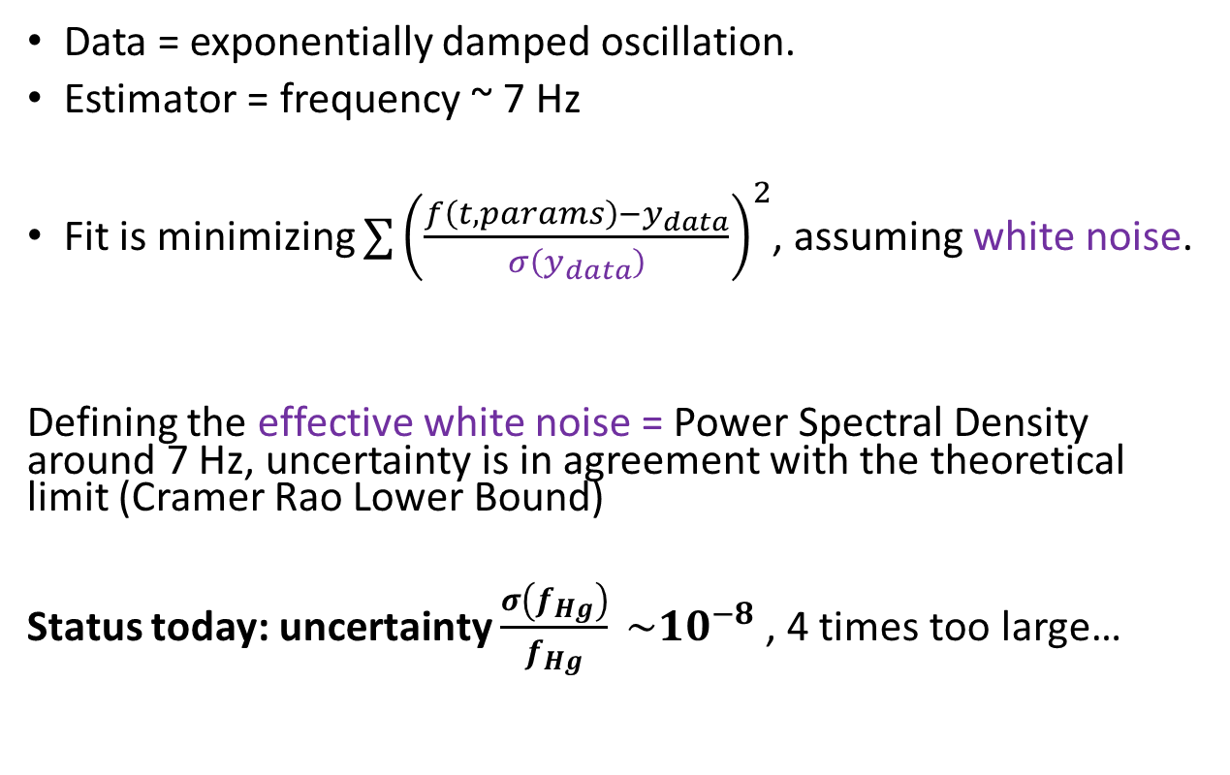
What is the precision of the frequency measurement?
I – Context II – n2EDM III- Hg magnetometer
$$f_{Hg}$$
Data = exponentially damped oscillation.
Estimator = frequency ~ 7 Hz
Fit is minimizing $∑{\left(\frac{{f\left(t, params\right)−y}_{data}}{σ\left(y_{data}\right)}\right)}^{2}$, assuming white noise.
Defining the effective white noise = Power Spectral Density around 7 Hz, uncertainty is in agreement with the theoretical limit (Cramer Rao Lower Bound)
Status today: uncertainty $\frac{σ\left(f_{Hg}\right)}{f_{Hg}} \sim {10}^{−8}$, 4 times too large…
Fourier transform
Noise is not white
Fourier transform, zoom

Slide 22

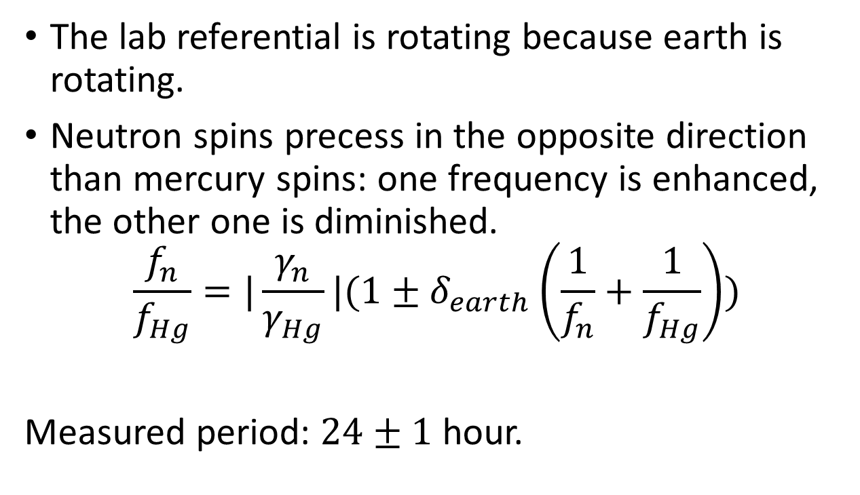

Challenge: can we measure the earth rotation?
I – Context II – n2EDM III- Hg magnetometer
$$B$$
The lab referential is rotating because earth is rotating.
Neutron spins precess in the opposite direction than mercury spins: one frequency is enhanced, the other one is diminished.
$$\frac{f_{n}}{f_{Hg}}=|\frac{γ_{n}}{γ_{Hg}}|(1±δ_{earth}\left(\frac{1}{f_{n}}+\frac{1}{f_{Hg}}\right))$$
Measured period: $24±1$ hour.
neutrons
mercury
$B$ in the lab!
Earth rotation

Slide 23
IV - Deeper understanding of the mercury-light absorption at L4M, LPSC
I – Context II – n2EDM III- Hg magnetometer IV – Hg-light interaction

Slide 24
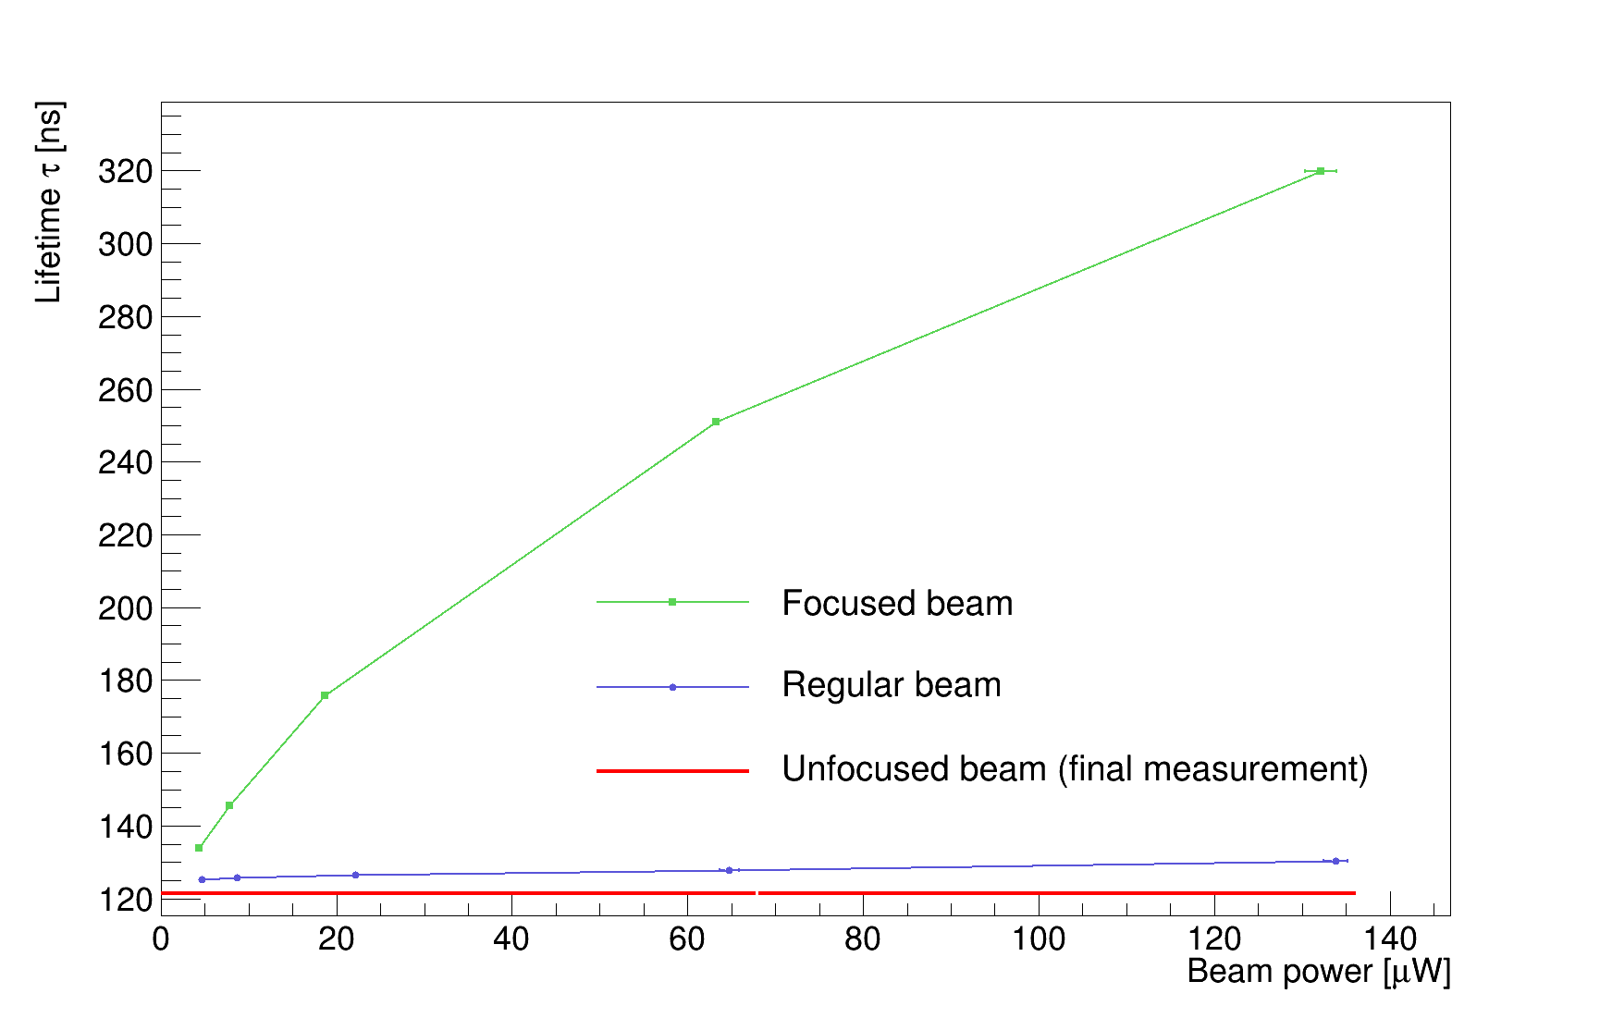





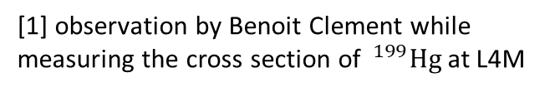
Atom-light interaction
I – Context II – n2EDM III- Hg magnetometer IV – Hg-light interaction
$$s_{0}e^{−σLn(t)(1−p(t))}$$
With constant unpolarized cross section $σ$, but…
  Affected by light intensity (saturated absorption)
  Affected by the laser beam diameter
[1] observation by Benoit Clement while measuring the cross section of $^{199}Hg$ at L4M
Excited states
-1/2
1/2
Three time constants:
Lifetime of the excited state
(Excitation rate${) }^{−1}$
Beam crossing time
6 regimes...
$$Γ′$$
Laser beam
spin 1
$$\frac{Γ}{3}$$
$$\frac{2}{3}Γ+Γ′$$
Ground states
-1/2
1/2
Quarz cell containing mercury vapor
Dark state

Slide 25
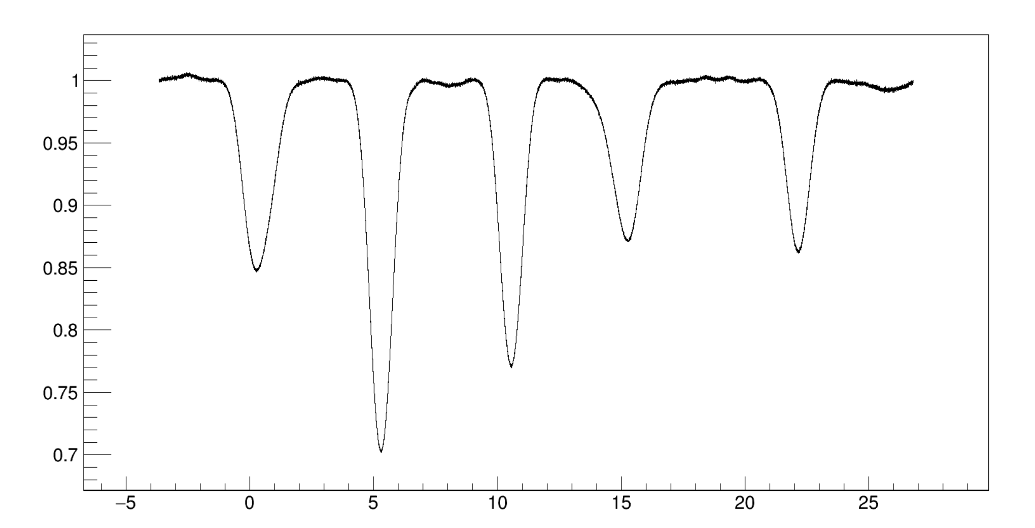
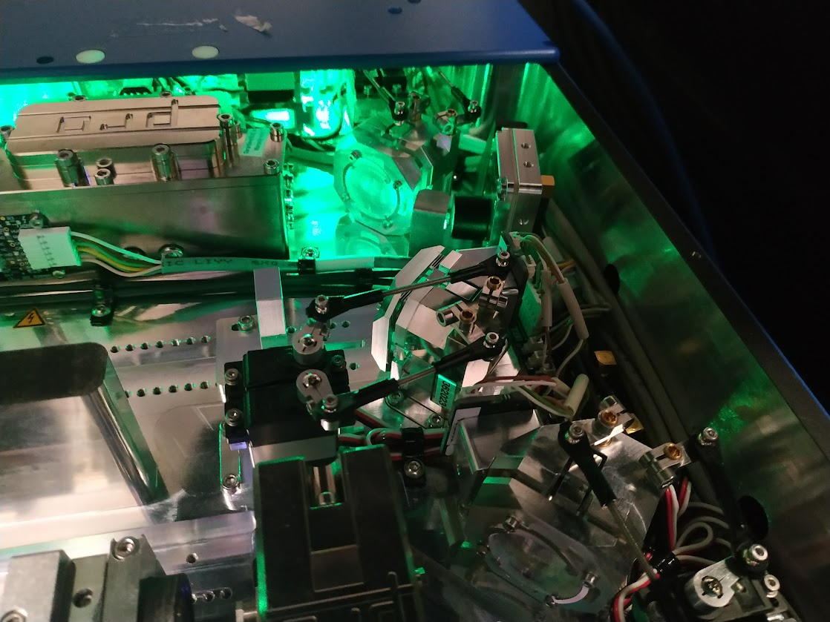
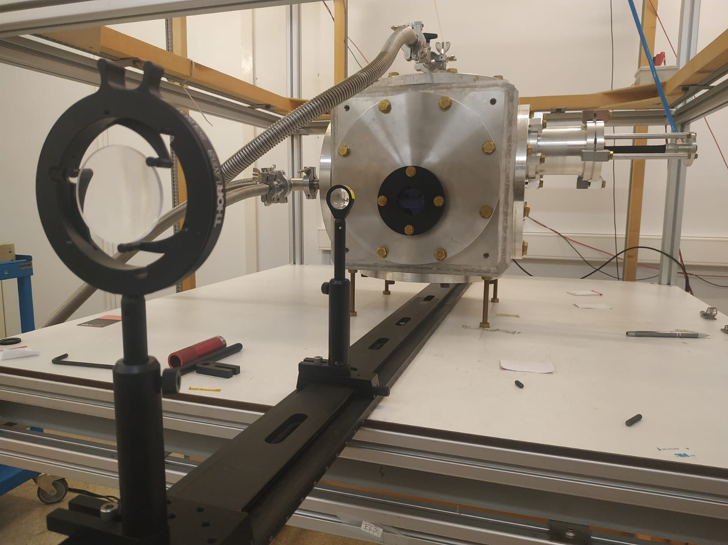



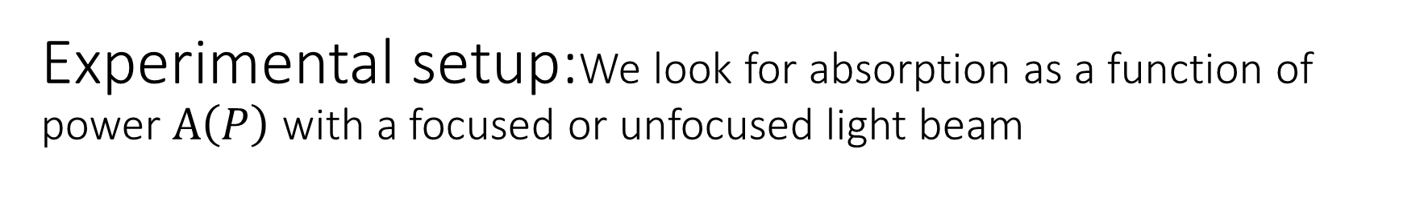

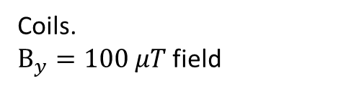





Experimental setup:We look for absorption as a function of power $A\left(P\right)$ with a focused or unfocused light beam
$$s=s_{0 } e^{−σnL(1−p)}$$
$s_{0}$
x axis, light propagation
PD
Polarised light
Lens
199Hg cell
Coils.
$B_{y}=100 μT$ field
Variable light attenuation
$$196$$
Relative transmitted light
$$198$$
$$201 b$$
$$201 a$$
$$199 b$$
$$204$$
$$201 c$$
$$199 a$$
$$202$$
$$200$$
$Δf$ (GHz), frequency difference to the resonance frequency of the transition $199 a$
UV laser, scanning frequency
Lens and Hg cell

Slide 26
Experimental setup:We look for absorption as a function of power $A\left(P\right)$ with a focused or unfocused light beam
$$s=s_{0 } e^{−σnL(1−p)}$$
$s_{0}$
x axis, light propagation
PD
Polarised light
Lens
199Hg cell
Coils.
$B_{y}=100 μT$ field
Variable light attenuation
$$196$$
Relative transmitted light
$$198$$
$$201 b$$
$$201 a$$
$$199 b$$
$$204$$
$$201 c$$
$$199 a$$
$$202$$
$$200$$
$Δf$ (GHz), frequency difference to the resonance frequency of the transition $199 a$
UV laser, scanning frequency
Lens and Hg cell

Slide 27
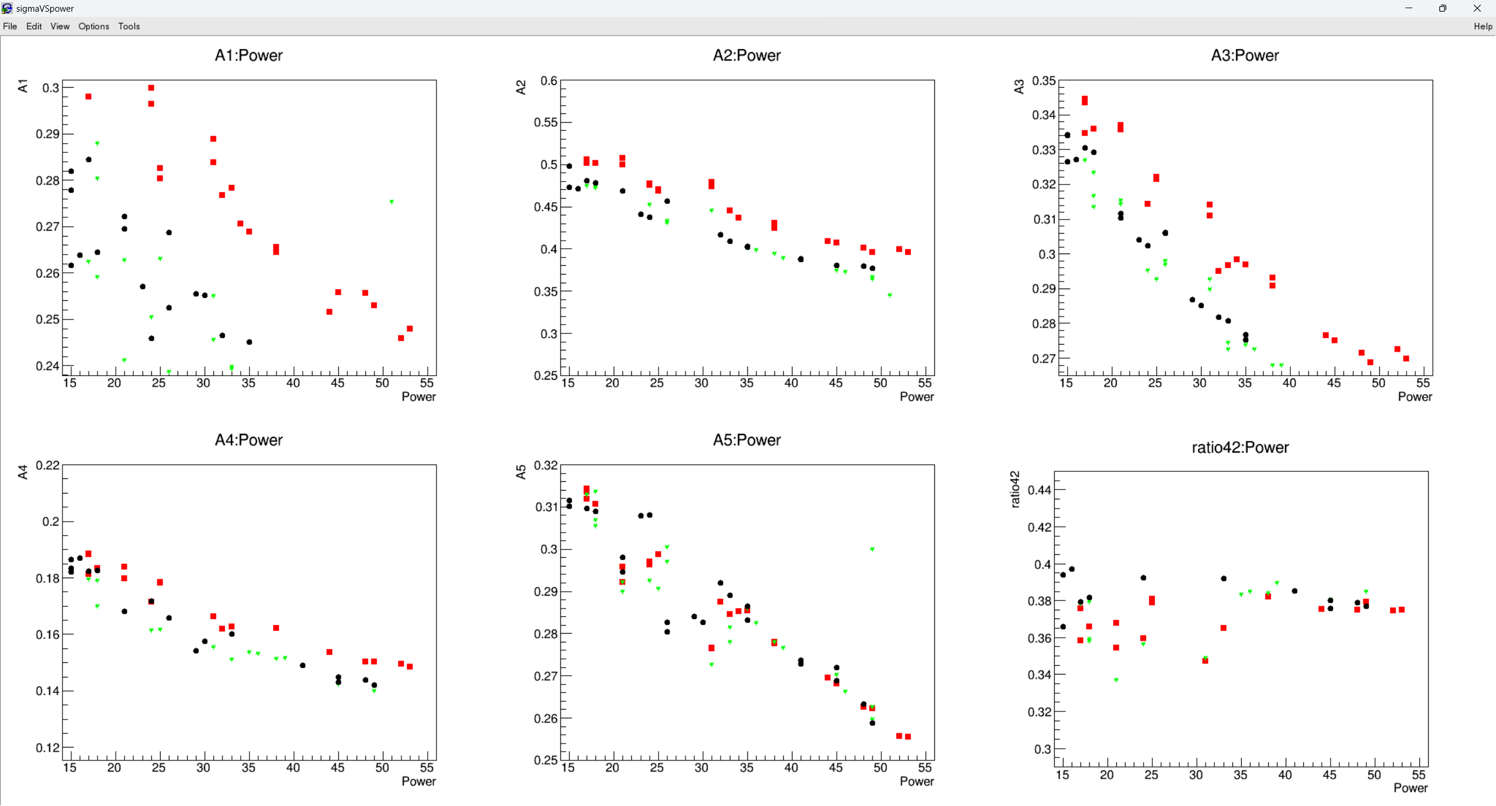
Experimental setup:We look for absorption as a function of power $A\left(P\right)$ with a focused or unfocused light beam
$$s=s_{0 } e^{−σnL(1−p)}$$
$s_{0}$
x axis, light propagation
PD
Polarised light
Lens
199Hg cell
Coils.
$B_{y}=100 μT$ field
Variable light attenuation
$$196$$
Relative transmitted light
$$198$$
$$201 b$$
$$201 a$$
$$199 b$$
$$204$$
$$201 c$$
$$199 a$$
$$202$$
$$200$$
$Δf$ (GHz), frequency difference to the resonance frequency of the transition $199 a$
UV laser, scanning frequency
Lens and Hg cell
Need a better understanding of saturated absorption: analytical computation.

Slide 28
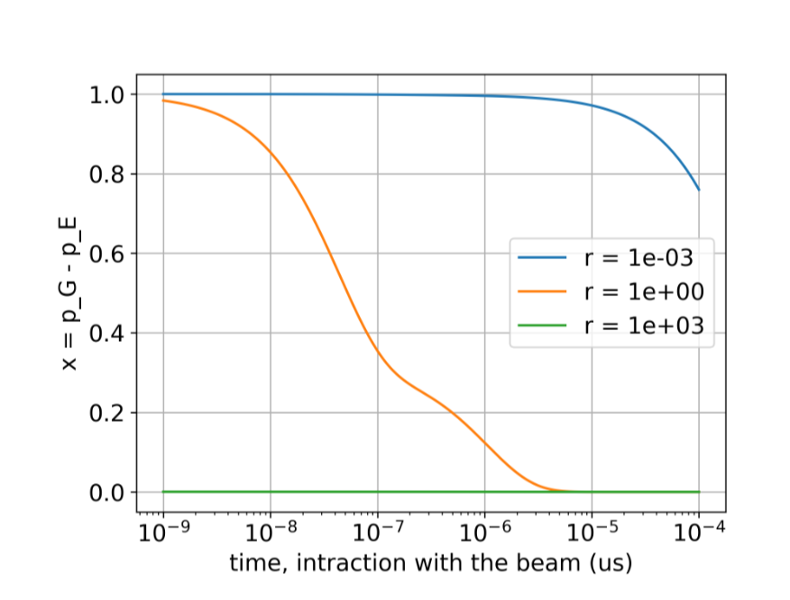
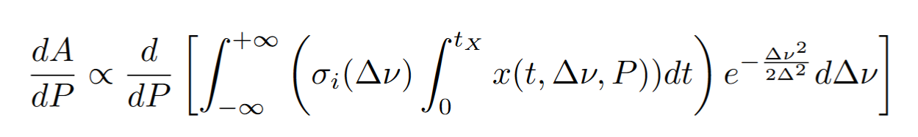
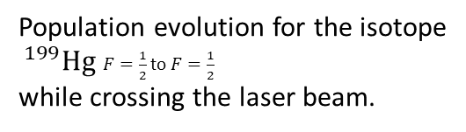

Saturated absorption…
I – Context II – n2EDM III- Hg magnetometer IV – Hg-light interaction
Link the population evolution of Hg atoms to the absorption of light
Take into account the intrinsic absorption cross section, the Doppler shift due to the atoms’ velocity, the beam crossing history
Derive with respect to power…
Population evolution for the isotope
$^{199}Hg$ $F=\frac{1}{2}$ to $F=\frac{1}{2}$
while crossing the laser beam.
Stimulated excitation
Stimulated de-excitation
Excited states
Excited states
-1/2
1/2
-1/2
1/2
$$Γ′$$
$$Γ′$$
OR
spin 1
spin 1
$$\frac{Γ}{3}$$
spin 1
$$\frac{Γ}{3}$$
$$\frac{2}{3}Γ+Γ′$$
$$\frac{2}{3}Γ+Γ′$$
Ground states
spin 1
Ground states
-1/2
1/2
-1/2
1/2

Slide 29
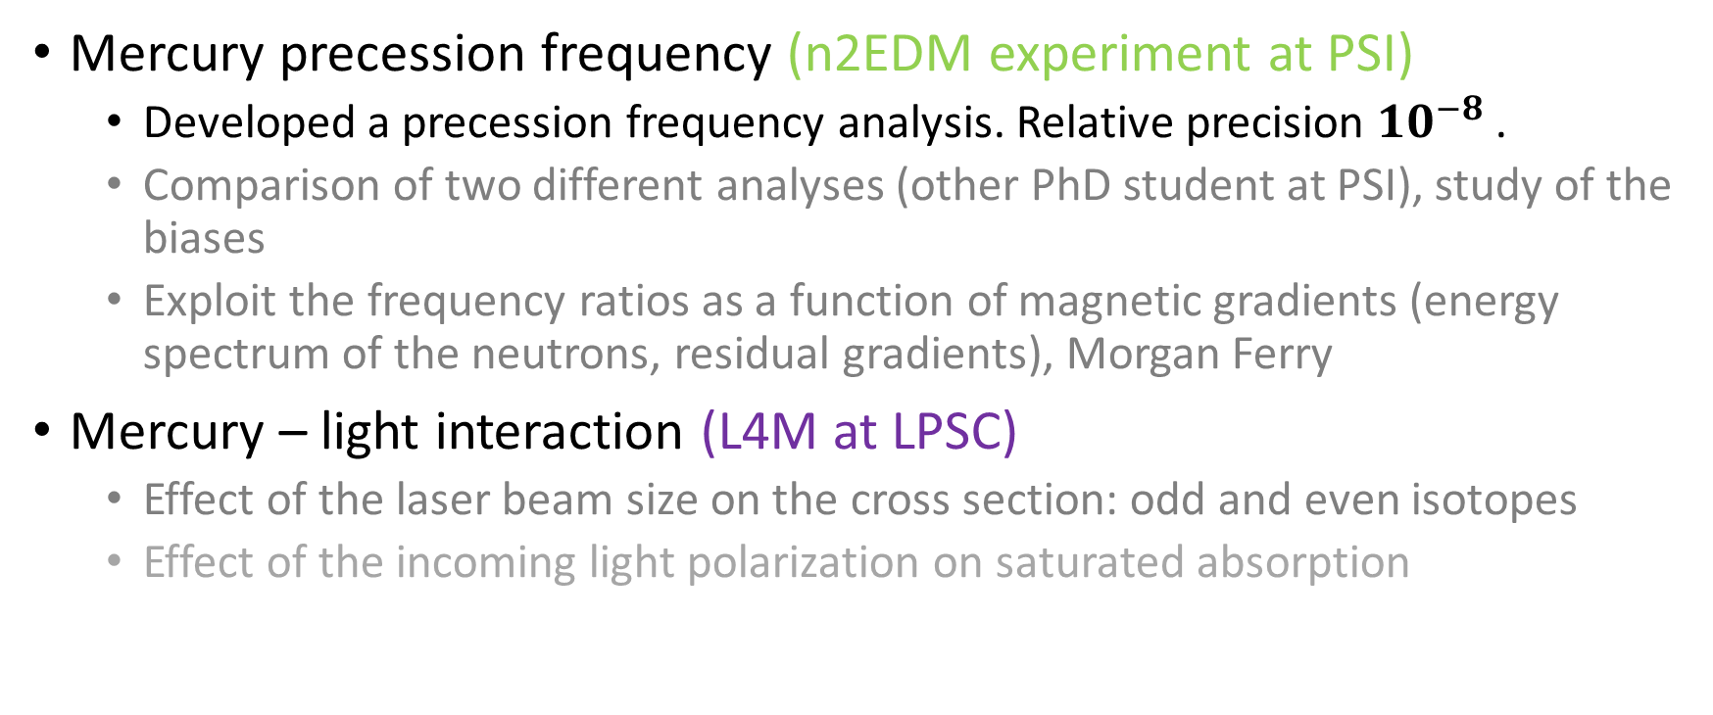
Summary, ongoing work and perspectives
I – Context II – n2EDM III- Hg magnetometer IV – Hg-light interaction
Mercury precession frequency (n2EDM experiment at PSI)
  Developed a precession frequency analysis. Relative precision ${10}^{−8}$.
  Comparison of two different analyses (other PhD student at PSI), study of the biases
  Exploit the frequency ratios as a function of magnetic gradients (energy spectrum of the neutrons, residual gradients), Morgan Ferry
Mercury – light interaction (L4M at LPSC)
  Effect of the laser beam size on the cross section: odd and even isotopes
  Effect of the incoming light polarization on saturated absorption

Slide 30
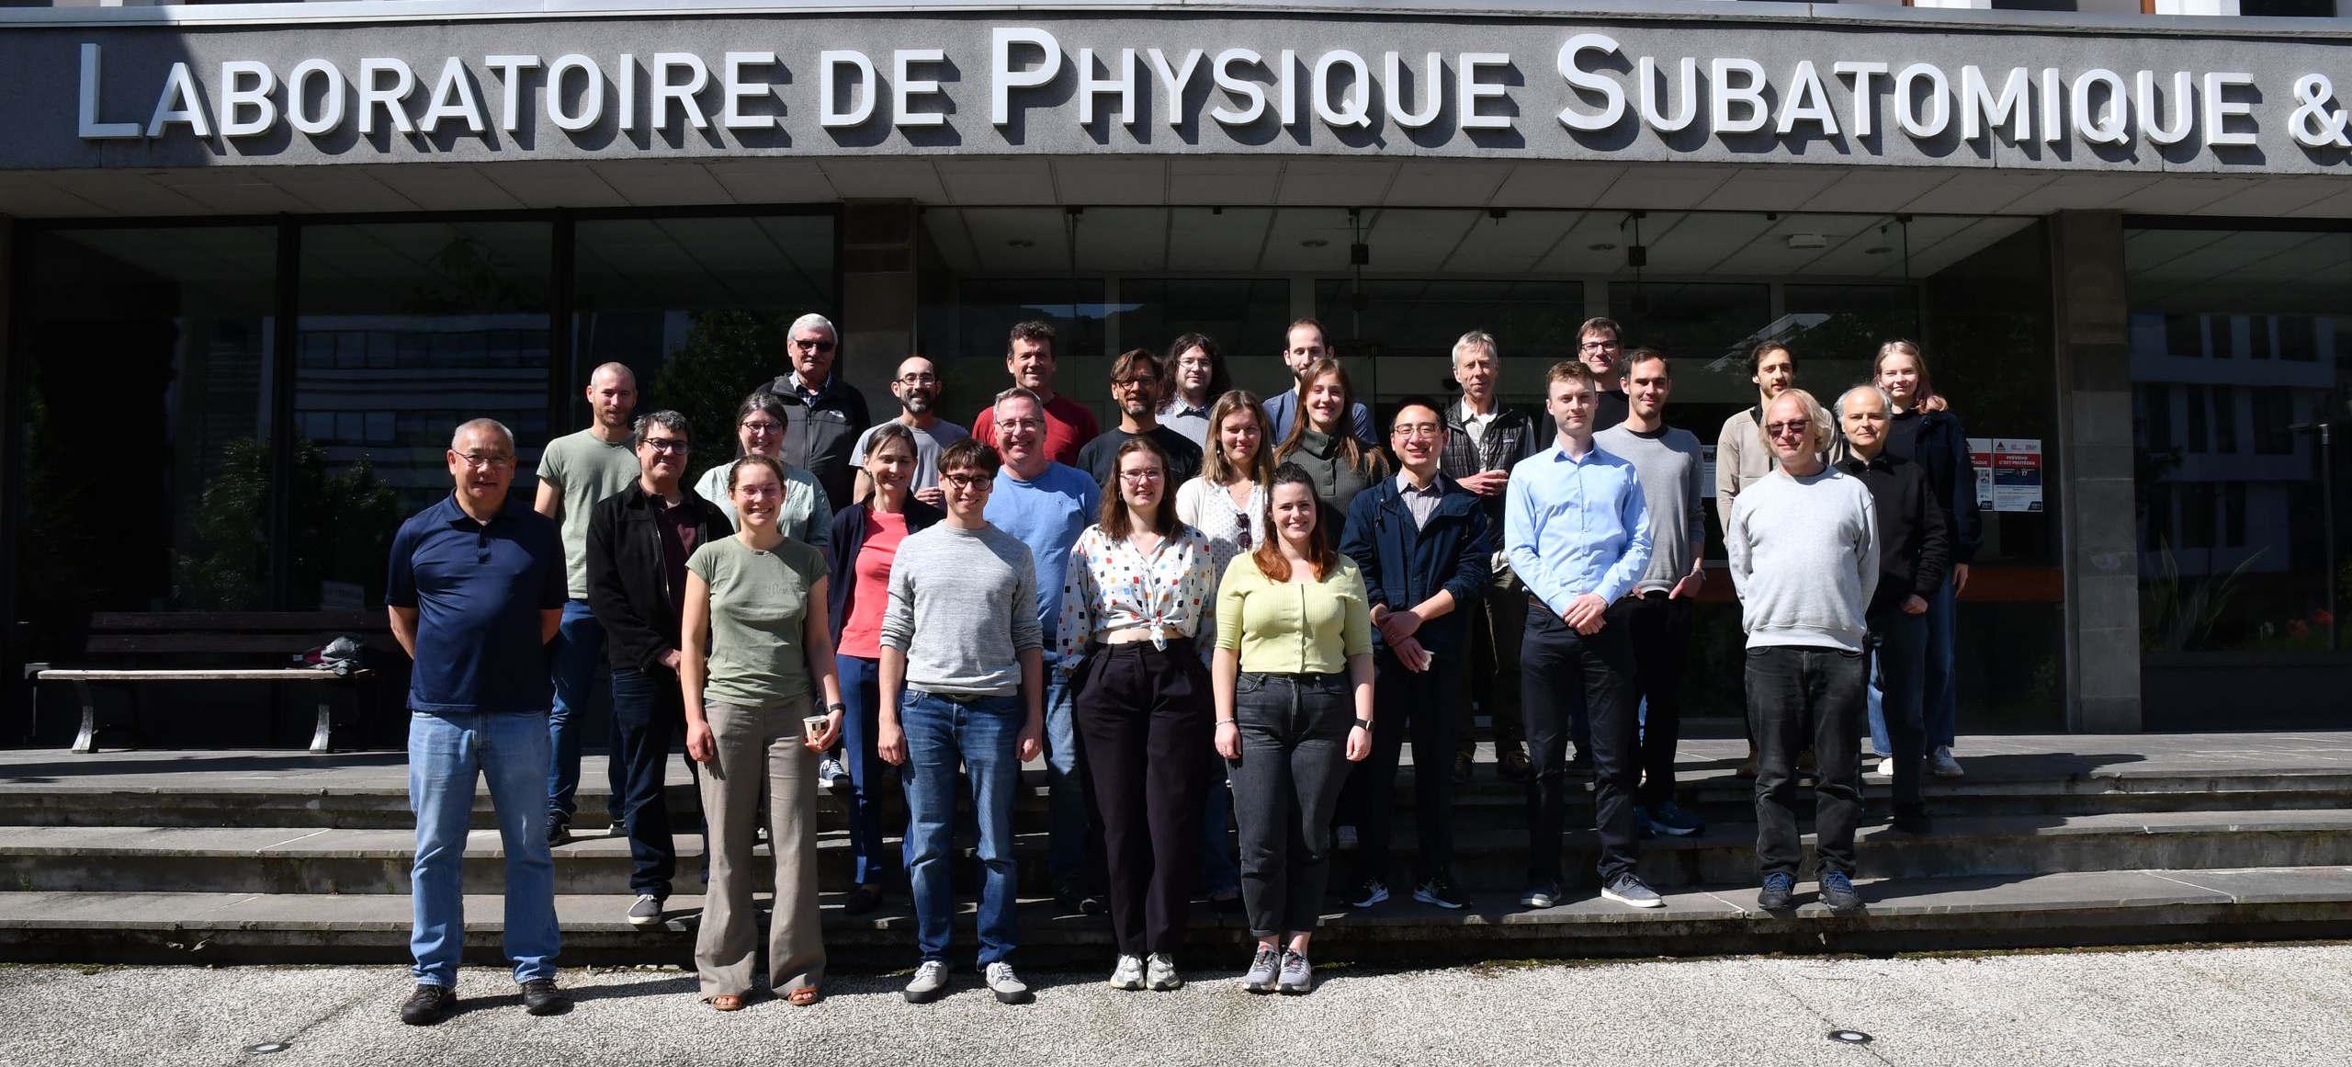
Thank you for your attention!
Questions?
Many thanks to
Francis Vezzu, Johann Menu, Julien Marpaud, Jérome Fulachier
Stéphanie Roccia, Benoit Clément, Dominique Rebreyand, Guillaume Pignol, Valentin Czalmer and Morgan Ferry

Slide 31
Additional slides

Slide 32


Experimental investigation at L4M (LPSC)
Absorption as a function of power, regular beam
$$196$$
Linear
Circular +
Circular -
Relative transmitted light
$$198$$
$$201 b$$
$$201 a$$
$$199 b$$
$$204$$
$$201 c$$
$$199 a$$
$$202$$
$$200$$
$Δf$ (GHz), frequency difference to the resonance frequency of the transition $199 a$
Looking two different peaks, with and without a dark state,
effect of the dark state on the absorption? (expected stronger effect for smaller laser beam).
Nothing clear… But we noticed that
The power dependence is different for different beam diameters
We will not get rid of saturated absorption
Computed the analytical expression for saturated absorption

Slide 33


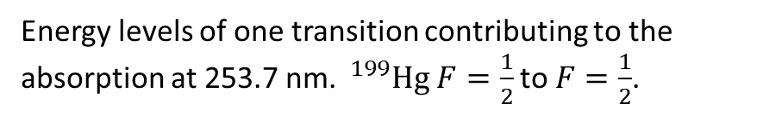
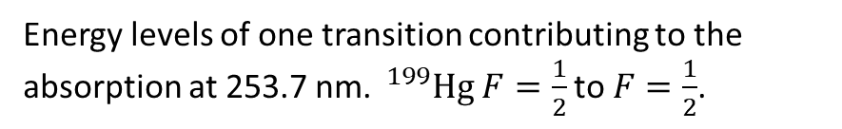



Saturated absorption…
I – Context II – n2EDM III- Hg magnetometer IV – Hg-light interaction
${ ^{3}P}_{1}$ $F=\frac{1}{2}$
${{ }^{3}P}_{1}$ $F=\frac{1}{2}$
-1/2
1/2
-1/2
1/2
$$Γ′$$
$$Γ′$$
OR
spin 1
$$\frac{Γ}{3}$$
spin 1
$$\frac{Γ}{3}$$
spin 1
$$\frac{2}{3}Γ+Γ′$$
$$\frac{2}{3}Γ+Γ′$$
spin 1
${ ^{1}S}_{0}$ $F=\frac{1}{2}$
${ ^{1}S}_{0}$ $F=\frac{1}{2}$
-1/2
1/2
-1/2
1/2
Energy levels of one transition contributing to the absorption at 253.7 nm. $^{199}Hg$ $F=\frac{1}{2}$ to $F=\frac{1}{2}$.
Energy levels of one transition contributing to the absorption at 253.7 nm. $^{199}Hg$ $F=\frac{1}{2}$ to $F=\frac{1}{2}$.

Slide 34
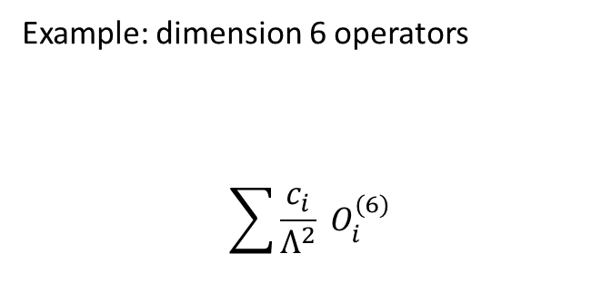
But also one of the most sensitive probes to new physics
Comparison of the sensitivity of different observables with the Standard Model Effective Field Theory: all coupling constants to one.
Example: dimension 6 operators
$$\sum{\frac{c_{i}}{Λ^{2}}} O_{i}^{(6)}$$
Set to 1
measured
derived
Figure by Adam Falkowski, Lectures on SMEFT EPJC (2023)

Slide 35
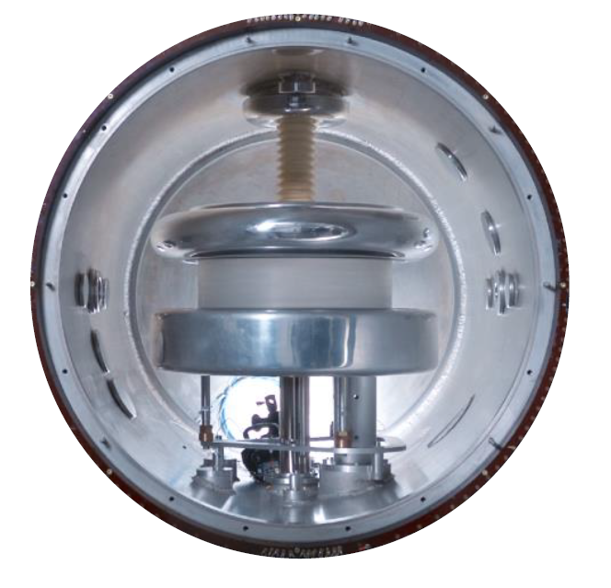


Current most sensitive measurement: nEDM at PSI
Measurement of the Permanent Electric Dipole Moment of the Neutron, nEDM collaboration, 2020
$$d_{n}=\left(0.0±{1.1}_{stat}±{0.2}_{syst}\right)×{10}^{−26} e cm$$
In n2EDM:
Increase satistics in larger volume with a better controlled magnetic field: simultaneous measure is two chambers for both electric polarities.
Same principle of co-magnetometry: Hg and Cs.
B
E
Number of neutrons
Homogeneity of B

Slide 36




Neutron spin gymnastics: Ramsey.
Ramsey method of oscillatory fields, counting spin up and down to derive the precession frequency:
$$\frac{{N_{up}−N}_{down}}{N_{up}+N_{down}}=−αcos⁡[π\left(f_{RF}−f\right)\left(2T+\frac{8τ}{π}\right)]$$
The nEDM is derived from the frequency difference in opposite electric fields.
$$σ\left(f_{n}\right)=\frac{ℏ}{2παT\sqrt{N}}$$

Slide 37


Goal precision VS performances
Mercury frequency error should not impact the nEDM error more than 2 percent: $σ\left(f_{Hg}\right)<0,05 σ(f_{n})$
And $σ\left(f_{n}\right)≥\frac{1}{2Tπ\sqrt{N}}$ , precession time T = 180s and number of neutrons ~30000 gives
$σ\left(f_{Hg}\right)<0,3 μHz$
Relative error $\frac{σ\left(f_{Hg}\right)}{f_{Hg}} \sim {4×10}^{−8}$

Slide 38


Photographs of the L4M setup

Slide 39


I – Context II – n2EDM
E
B
E
neutrons
mercury
$$f_{↑↓} −f_{↑↑}=\frac{μ_{Hg}}{πℏ} \left(B_{↑↓}−B_{↑↑}\right)$$

Slide 40
Magnetic field measurements
Classes of magnetometers:
Need something that interacts with the magnetic field: pick-up coils, resistance (Hall effect)
-> charge, ferromagnetic materials, spins
Atoms, polarize their spins. Observe their Larmor precession.
Atom-Light interaction spin dependent.

Slide 41


How to measure the magnetic field: mercury precession
UV light at 254 nm.
Transmission is affected by the spin orientation.
Intensity is oscillating if the spin precesses.
This frequency is proportional to the magnetic field.

Slide 42


Neutron frequency measurement: magnetic field stability.
$f_{↑↓} −f_{↑↑}=\frac{μ}{πℏ} \left(B_{↑↓}−B_{↑↑}\right)+\frac{d}{πℏ} \left(E_{↑↓}−E_{↑↑}\right)$
Co-magnetometry technique to correct for magnetic field fluctuations, mercury.
Neutron: destructive spin measurement.
Mercury: non destructive spin measurement.
Measurement of the Permanent EDM of the Neutron, 2020

Slide 43

Cramer Rao Lower Bound vs fitted uncertainty

Slide 44
Formation of matter in the early universe: the mystery of baryon asymmetry.
I - Context
Our surrounding environment is made of matter. Charged particles have associated anti-matter particles with opposite charge (same mass, spin etc…).
Sakharov conditions
Baryon number violation
C violation and CP violation
Out of thermal equilibrium
A non-zero EDM would also be a source of CP violation.
Subatomic physics AND cosmology?!

Slide 45

Simultaneous precession signals in the top and bottom storage chambers.

Slide 46


Spin-dependent absorption
I – Context II – n2EDM III- Hg magnetometer
$$P_{t}=P_{0}e^{−σnL}$$
The cross section is characteristic of the atom-light interaction.
For circularly polarized light, and an atomic vapour with polarized spins
$$σ=σ_{u}(1−p)$$
With $σ_{u}$ the unpolarized cross-section.
Larmor precession: $p$ oscillates at Larmor frequency, so does the transmitted power.
Excited states
-1/2
1/2
spin 1
Ground states
-1/2
1/2
Energy levels of one transition contributing to the absorption at 253.7 nm. $^{199}Hg$ ${ ^{1}S}_{0} F=\frac{1}{2}$ to ${ ^{3}P}_{1}$ $F=\frac{1}{2}$ .

Slide 47








$$t_{e}<t_{s}<t_{X}$$
$$t_{s}<t_{e}<t_{X}$$
$${t_{e}< t}_{X}<t_{s}$$
$$t_{s}<t_{X}<t_{e}$$
$${t_{X}< t}_{e}<t_{s}$$
$${t_{X}< t}_{s}<t_{e}$$

Slide 48
Regular beam (no lens)
592: power-meter range 54 uW. (fixed wheel at 240 degrees)
594: power-meter range 540 uW. (fixed wheel at 300 degrees)
595: power-meter range 540 uW. (fixed wheel at 0 degrees)
596: same, with Sigma+ additionnally

Slide 49

Sigma-, Pi. Run 592, 30/09/24 Regular.

Slide 50

Sigma-, Pi and Sigma+ Run 596, 30/09/24, Regular.

Slide 51
Focused beam (lens, 300 mm focal length)
591: power-meter range 54 uW. (fixed wheel at 240 degrees)
597: power-meter range 540 uW. (fixed wheel at 300 degrees)

Slide 52

Sigma-, Pi Run 591, 26/09/24 Focused.

Slide 53

Sigma-, Pi , Sigma+ Run 597, 01/10/24, Focused

