Slide 1

Storage rings are the best
Philipp Schmidt-Wellenburg
EDMS2026| Les Houches | 01.-06.03.2026

Slide 2


Storing charged particles in storage rings
Alternating electric fields (e.g. Paul trap, JILA ion trap)
-
-
-
+
+
-
-
-
-
-
-
$$\vec{B}$$
$$\vec{E}$$
Storage in a radial electric field
Storage in a magnetic field

Slide 3
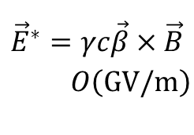
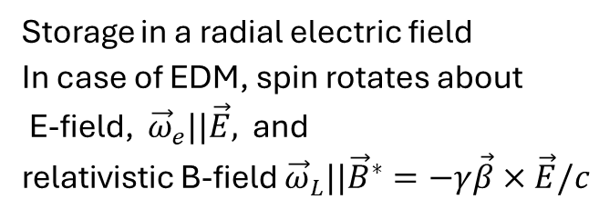



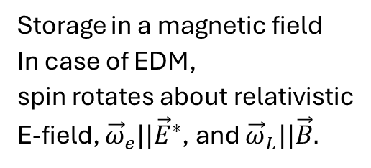

Storing charged particles in storage rings
Alternating electric fields (e.g. Paul trap, JILA ion trap)
$$\vec{v}=\vec{β}c$$
$$\vec{v}=\vec{β}c$$
-
$${\vec{E}}^{∗}=γc\vec{β}×\vec{B}$$
$O\left(GV/m\right)$
-
-
-
-
-
-
-
-
$$\vec{B}$$
$$O\left(10MV/m\right)$$
$$\vec{E}$$
Storage in a radial electric field
In case of EDM, spin rotates about E-field, ${\vec{ω}}_{e}||\vec{E},$ and
relativistic B-field ${{\vec{ω}}_{L}||\vec{B}}^{∗}=−γ\vec{β}×\vec{E}/c$
Storage in a magnetic field
In case of EDM,
spin rotates about relativistic E-field, ${\vec{ω}}_{e}||{\vec{E}}^{∗}$, and ${\vec{ω}}_{L}||\vec{B}.$

Slide 4

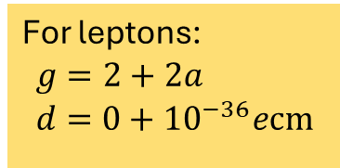





Lepton dipole moments (non-relativistic)
Non-relativistic Hamiltonian:
$$ℋ=−μ\vec{s}⋅\vec{B}−d\vec{s}⋅\vec{E}$$
$$\left|\vec{s}\right|=1$$
The magnetic $μ$ and electric $d$ dipole moment of a lepton are defined by
For leptons:
$$g=2+2a \\ d=0+{10}^{−36}ecm$$
$$μ=\frac{gq}{2m}\frac{ℏ}{2}$$
$$d=\frac{ηq}{2mc}\frac{ℏ}{2}$$
$${\vec{ω}}_{L}=\frac{gq}{2m} \vec{B}$$
$${\vec{ω}}_{E}=\frac{ηq}{2mc} \vec{E}$$

Slide 5
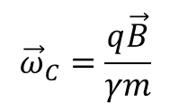
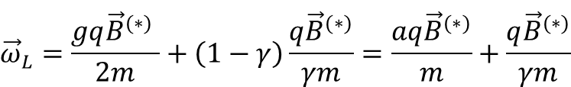
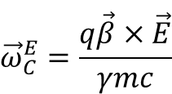
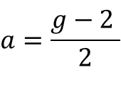

Lepton spin precession and motion in a B-field
Relativistic lepton spin precession in a perpendicular magnetic field
$${\vec{ω}}_{L}=\frac{gq{\vec{B}}^{(∗)} }{2m}+\left(1−γ\right)\frac{q{\vec{B}}^{(∗)}}{γm}=\frac{aq{\vec{B}}^{(∗)}}{m}+\frac{q{\vec{B}}^{(∗)}}{γm}$$
$$a=\frac{g−2 }{2}$$
Cyclotron frequency of a lepton in
Bfield
Efield
$${\vec{ω}}_{C}=\frac{q\vec{B}}{γm}$$
$${\vec{ω}}_{C}^{E}=\frac{q\vec{β}×\vec{E}}{γmc}$$
Momentum
Spin
Measurement of the anomalous magnetic moment by observing relative precession
$${\vec{ω}}_{a}={\vec{ω}}_{C}−{\vec{ω}}_{L}=−\frac{q}{m}a\vec{B}$$

Slide 6

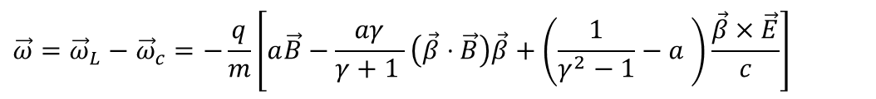


Thomas – BMT equation
The Thomas – Bargmann, Michel, Telegdi equation
$$\vec{ω}={\vec{ω}}_{L}−{\vec{ω}}_{c}=−\frac{q}{m}\left[a\vec{B}−\frac{aγ}{γ+1 }\left(\vec{β}⋅\vec{B}\right)\vec{β}+\left(\frac{1}{γ^{2}−1}−a \right)\frac{\vec{β}×\vec{E}}{c}\right]$$
$$=0$$
i.e. in g-2 $\vec{E}$is the quadrupole field for storage
As $\vec{β}⊥\vec{B}$for
stored particles
Typical particle beams or bunches are divergent and
require electric or magnetic
quadrupoles to keep particles
stored.
V. Bargmann, L. Michel, V. L. Telegdi Precession of the Polarization of Particles Moving in a Homogeneous Electromagnetic Field Physical Review Letters 2, 435 (1959)
L. H. Thomas The motion of the spinning electron Nature 117, 514 (1926).

Slide 7

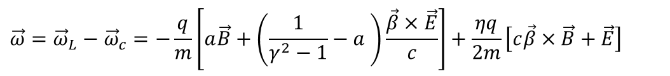
Thomas – BMT equation with EDM
The Thomas – Bargmann, Michel, Telegdi equation
$$\vec{ω}={\vec{ω}}_{L}−{\vec{ω}}_{c}=−\frac{q}{m}\left[a\vec{B}+\left(\frac{1}{γ^{2}−1}−a \right)\frac{\vec{β}×\vec{E}}{c}\right]+\frac{ηq}{2m}\left[c\vec{β}×\vec{B}+\vec{E}\right]$$
$${\vec{ω}}_{a}$$
EDM term, ${\vec{ω}}_{e}⊥{\vec{ω}}_{a}$
Typical particle beams or bunches are divergent and
require electric or magnetic
quadrupoles to keep particles
stored.
V. Bargmann, L. Michel, V. L. Telegdi Precession of the Polarization of Particles Moving in a Homogeneous Electromagnetic Field Physical Review Letters 2, 435 (1959)
L. H. Thomas The motion of the spinning electron Nature 117, 514 (1926).

Slide 8
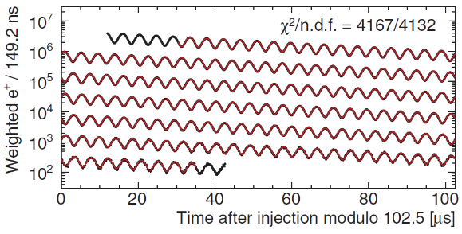
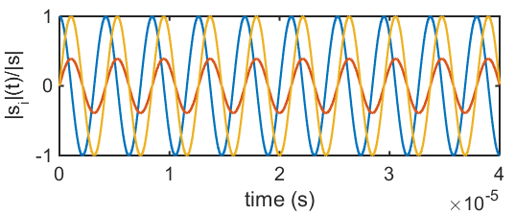

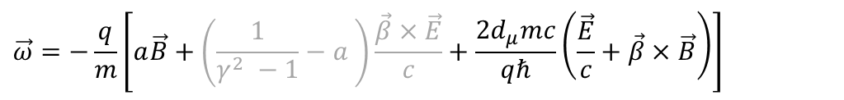


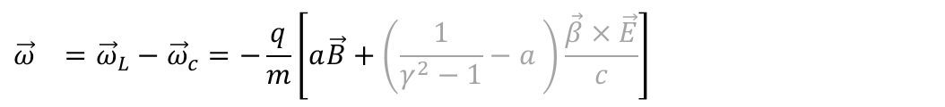








(Muon) dipole moments and frequencies
$$\vec{ω}=−\frac{q}{m}\left[a\vec{B}+\left(\frac{1}{γ^{2} −1}−a \right)\frac{\vec{β}×\vec{E}}{c}+\frac{2d_{μ}mc}{qℏ}\left(\frac{\vec{E}}{c}+\vec{β}×\vec{B}\right)\right]$$
$${\vec{ω}}_{}={\vec{ω}}_{L}−{\vec{ω}}_{c}=−\frac{q}{m}\left[a\vec{B}+\left(\frac{1}{γ^{2}−1}−a \right)\frac{\vec{β}×\vec{E}}{c}\right]$$
g-2 term $ω_{a}$
EDM term $ω_{e}$
B
$${\vec{ω}}_{a}$$
$$\sqrt{{\vec{ω}}_{a}^{2}+{\vec{ω}}_{e}^{2}}$$
$$ζ$$
$$R=7.114 m$$
$$ζ=\operatorname{atan}\left(\frac{2d_{μ}βcm}{aqℏ}\right)$$
$$\vec{s}$$
FNAL*:
JPARC**:
$$σ\left(d_{μ}\right)≈{10}^{−20}ecm$$
$${\vec{ω}}_{e}$$
$$σ\left(d_{μ}\right)≈{10}^{−21}ecm$$
[Abi et al., PRL126 141801(2021)]
[*D. Vasikova (MPI2025), **Abe et al., PTEP053C02 (2019)]
Notes:
Many of you probably know about the g-2 measurement of the muon at Fermilab. The principle physics are described in the equation. The difference between the Larmor frequency of the muon, essentially the precision due to the magnetic moment, and the cyclotron frequency of the muon moving in a magnetic and electric field.
The muon moves along its reference orbit perpendicular to the main magnetic field. Due to the small anomalous magnetic moment the difference is not exactly zero and one can observe the famous wiggle plot by measuring in the number of decay positrons per time.
The electric field is required for steering the muon inside the storage ring. By selecting the correct momentum the electric term can be set to zero and the observed oscillation frequency directly relates to the anomalous magnetic moment.
Now in the presence of a electric dipole moment the plane of oscillation tilts and one could observe a tiny vertical observation of the positron intensity, and the measured frequency would be a little bit larger.
The prospected sensitivity is about 10E-21 ecm for the EDM at Fermilab and JPARC.

Slide 9
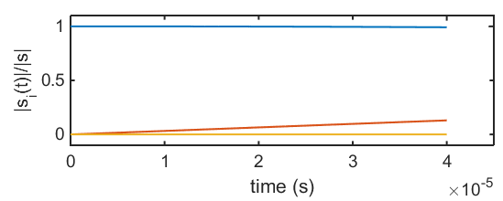






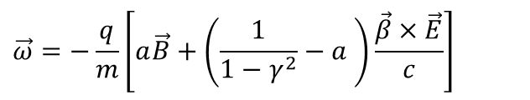

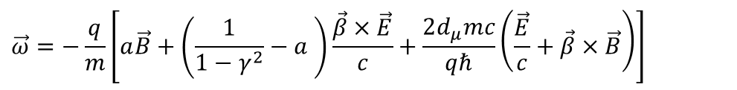


Muon dipole moments –freezing the spin at PSI
$$\vec{ω}=−\frac{q}{m}\left[a\vec{B}+\left(\frac{1}{1−γ^{2}}−a \right)\frac{\vec{β}×\vec{E}}{c}+\frac{2d_{μ}mc}{qℏ}\left(\frac{\vec{E}}{c}+\vec{β}×\vec{B}\right)\right]$$
$$\vec{ω}=−\frac{q}{m}\left[a\vec{B}+\left(\frac{1}{1−γ^{2}}−a \right)\frac{\vec{β}×\vec{E}}{c}\right]$$
g-2 term $ω_{a}$
EDM term $ω_{e}$
$$s_{z}$$
Frozen-spin potential at PSI:$σ\left(d_{μ}\right)<{6⋅10}^{−23}ecm$
B
$$s_{y}$$
$$R=30 mm$$
$${\vec{ω}}_{e}$$
E
$$s_{x}$$
set $E ≅aBcβγ^{2}$
Phase I: $σ\left(d_{μ}\right)<{4⋅10}^{−21}ecm$
[*Farley et al,, PRL93 042001 (2004) ] ,
Notes:
To further increase the sensitivity to a muon EDM we propose to use the frozen-spin technique to measure the electric dipole moment.
By applying a well tuned electric field this entire term can be canceled and the spin exactly follows the momentum, essentially it is frozen to the momentum.
The only term present is the one of the electric dipole moment which leads to a precession of the spin around the radial axis like a bicycle going in a circle.
This in turn leads to a build up of a asymmetry of positron decays along and against the direction of the magnetic field, the signal we are searching for.

Slide 10
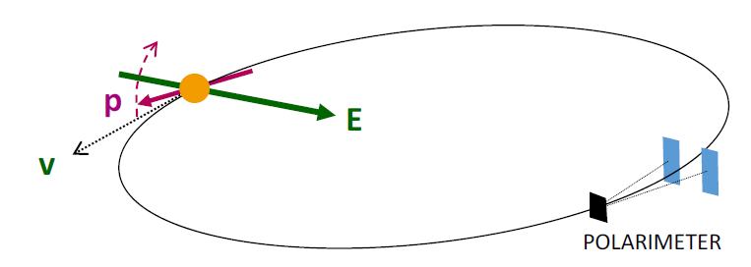
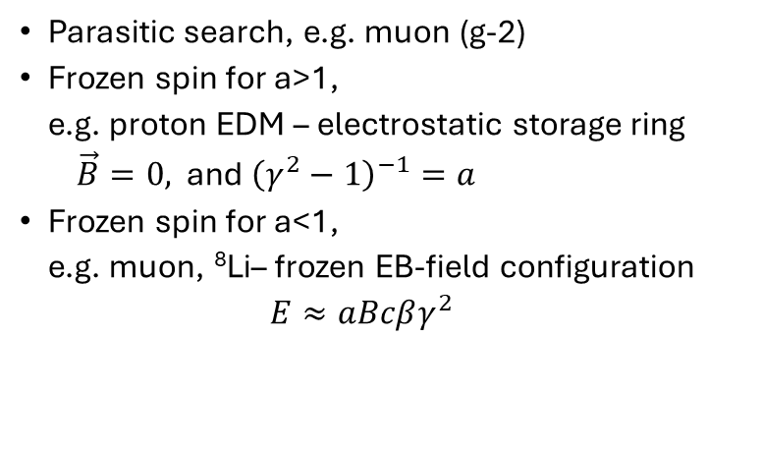

cpEDM searches in storage rings
$$\vec{ω}={\vec{ω}}_{L}−{\vec{ω}}_{c}=−\frac{q}{m}\left[a\vec{B}+\left(\frac{1}{γ^{2}−1}−a \right)\frac{\vec{β}×\vec{E}}{c}\right]+\frac{ηq}{2m}\left[c\vec{β}×\vec{B}+\vec{E}\right]$$
Parasitic search, e.g. muon (g-2)
Frozen spin for a>1, e.g. proton EDM – electrostatic storage ring
$\vec{B}=0,$ and ${\left(γ^{2}−1\right)}^{−1}=a$
Frozen spin for a<1, e.g. muon, ⁸Li– frozen EB-field configuration
$$E≈aBcβγ^{2}$$

Slide 11
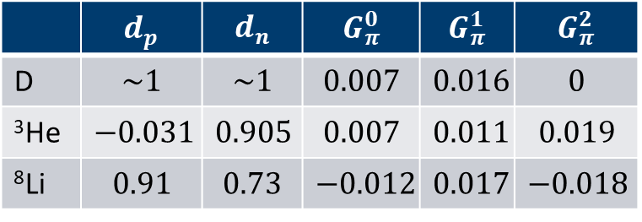

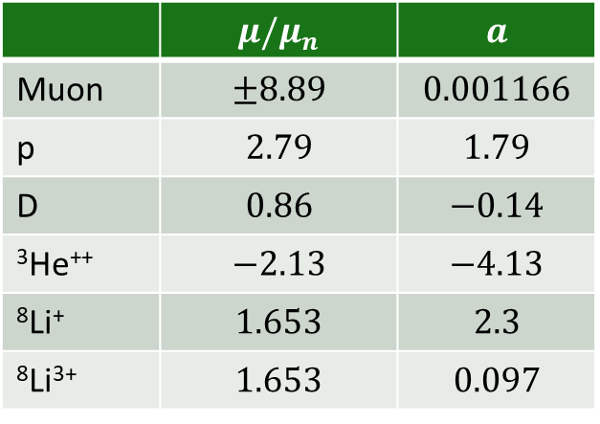
Possible hadronic candidates: proton & light nuclei
 | $$μ/μ_{n}$$ | $$a$$
Muon | $$±8.89$$ | $$0.001166$$
p | $$2.79$$ | $$1.79$$
D | $$0.86$$ | $$−0.14$$
³He⁺⁺ | $$−2.13$$ | $$−4.13$$
⁸Li⁺ | $$1.653$$ | $$2.3$$
⁸Li³⁺ | $$1.653$$ | $$0.097$$
$$d_{nucl}=d_{n}+d_{p}+d_{πNN}$$
 | $$d_{p}$$ | $$d_{n}$$ | $$G_{π}^{0}$$ | $$G_{π}^{1}$$ | $$G_{π}^{2}$$
D | $$\sim 1$$ | $$\sim 1$$ | $$0.007$$ | $$0.016$$ | $$0$$
³He | $$−0.031$$ | $$0.905$$ | $$0.007$$ | $$0.011$$ | $$0.019$$
⁸Li | $$0.91$$ | $$0.73$$ | $$−0.012$$ | $$0.017$$ | $$−0.018$$
Froese and Navratil, PRC 104(2021)025502 Navratil (2025) private communication Liu and Timmermans, PRC70(2004)055501

Slide 12
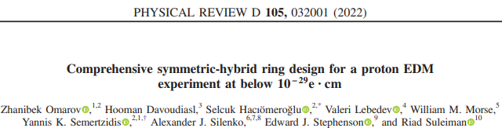
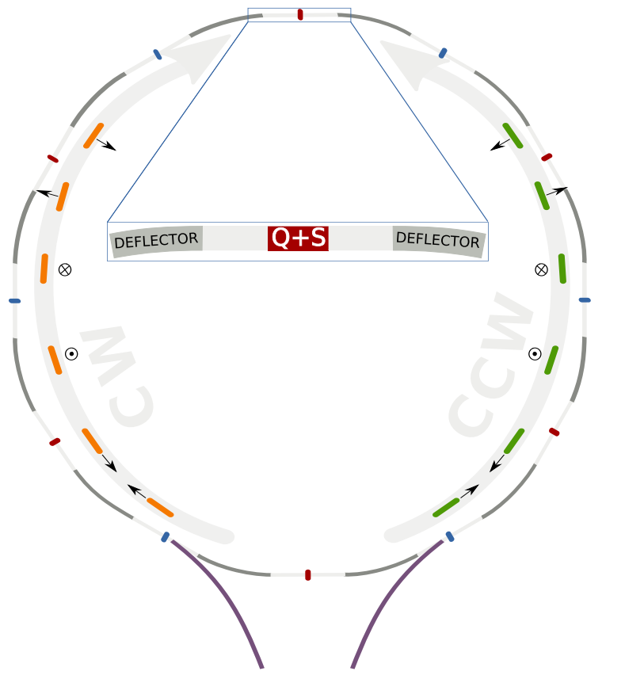

Proton EDM proposal
CW and CCW simultaneously
Magic momentum $p=700 MeV/c$ canceling all magnetic moment precession
Magnetic dipoles for beam storage
Ring circumference 800 m

Slide 13
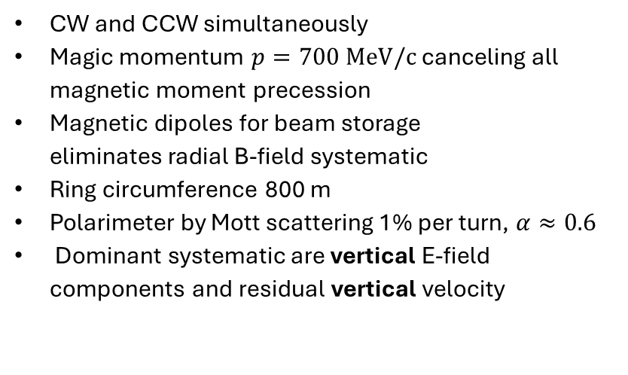
Proton EDM proposal
CW and CCW simultaneously
Magic momentum $p=700 MeV/c$ canceling all magnetic moment precession
Magnetic dipoles for beam storage eliminates radial B-field systematic
Ring circumference 800 m
Polarimeter by Mott scattering 1% per turn, $α≈0.6$
Dominant systematic are vertical E-field components and residual vertical velocity

Slide 14
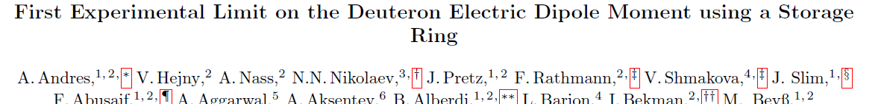
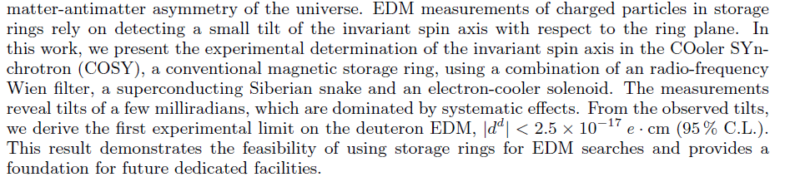
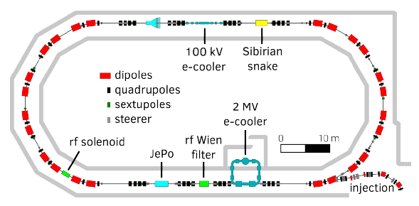
Deuteron – EDM measurement at COSY
COSY not operated anymore
Current result dominated by systematic effects:
magnet misalignment
beam deviations
field errors

Slide 15
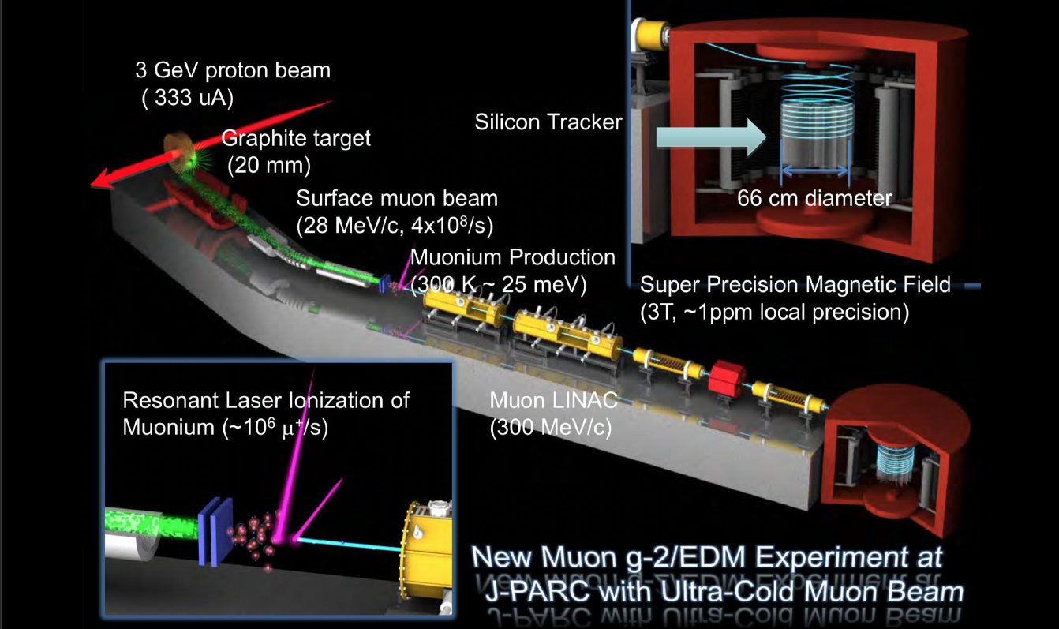

Slide 16
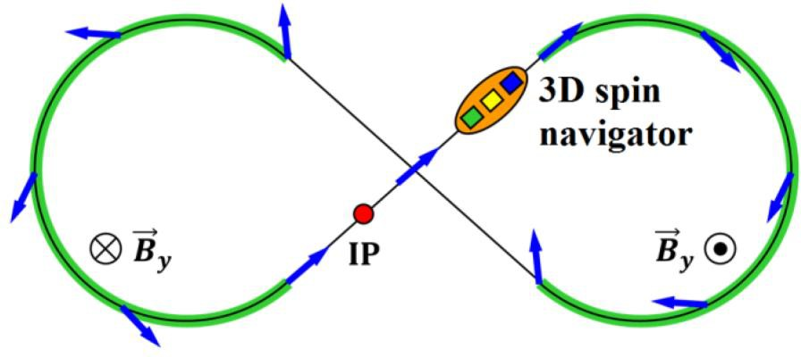



Spin transparent storage ring for an eEDM search
In ST mode, any spin direction repeats after a particle turn along periodic orbit in storage ring
Best example is a figure-8 magnetic or electric ring; here global spin tune is zero independent of particle energy https://doi.org/10.1103/PhysRevLett.124.194801 https://doi.org/10.3390/sym13030398
Prospected sensitivity
Electrons per Fill | 𝑁_{𝑒} | 1.2 ∙ 10¹⁰ 6 ∙ 10⁹ CW, 6 ∙ 10⁹ CCW
Polarimeter Efficiency | 𝜖 | 0.0024
Analyzing Power | 𝐴_{𝑦} | 0.45
Beam Polarization | 𝑃 | 0.9
Precession Frequency | ^{Ω}𝐸𝐷𝑀 | 0.48 nrad/s (calculated assuming 1 ∙ 10⁻²⁹ e·cm)
Spin Coherence Time | 𝑆𝐶𝑇 | 10000 s
$$∼1×{10}^{−29}ecm$$

Slide 17
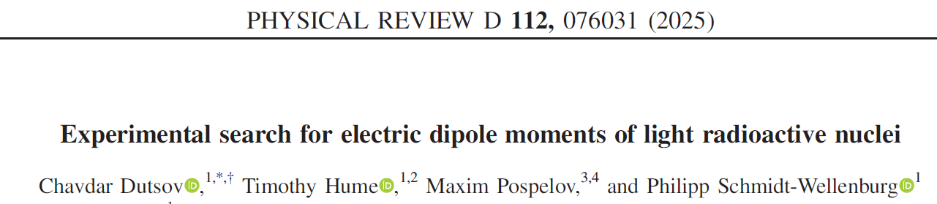
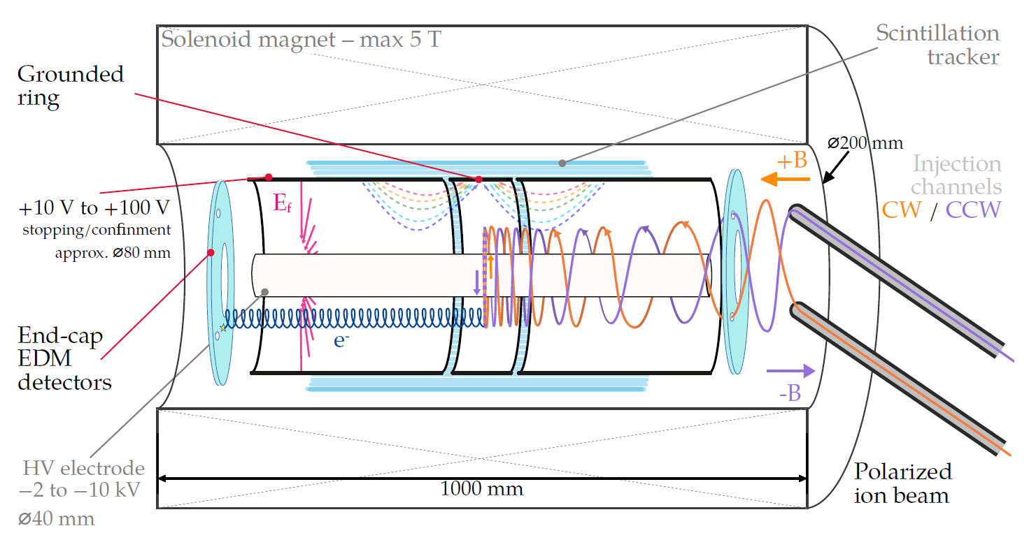
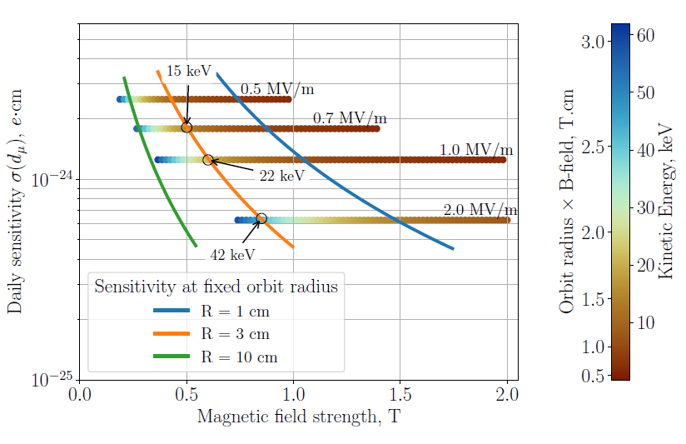
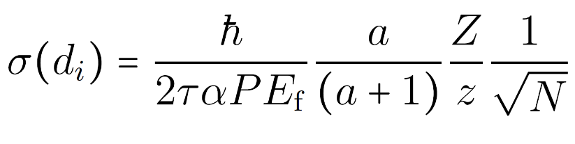

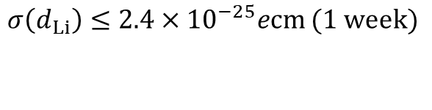
EDMs of $β$-decaying nuclei
$σ\left(d_{Li}\right)≤2.4×{10}^{−25}ecm$ $(1 week)$

Slide 18
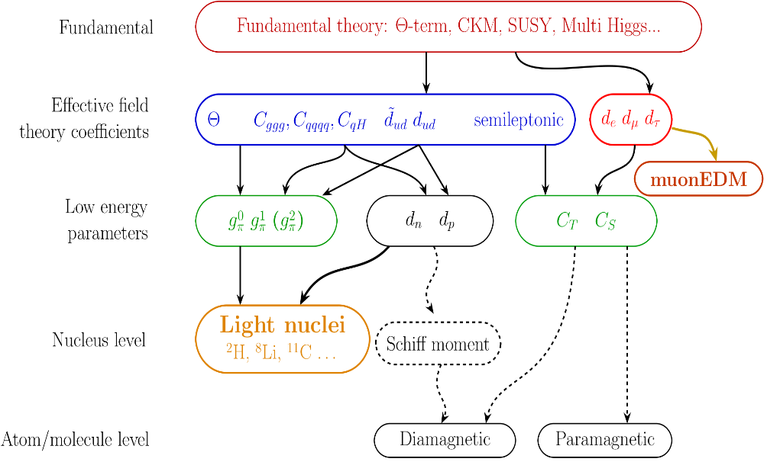
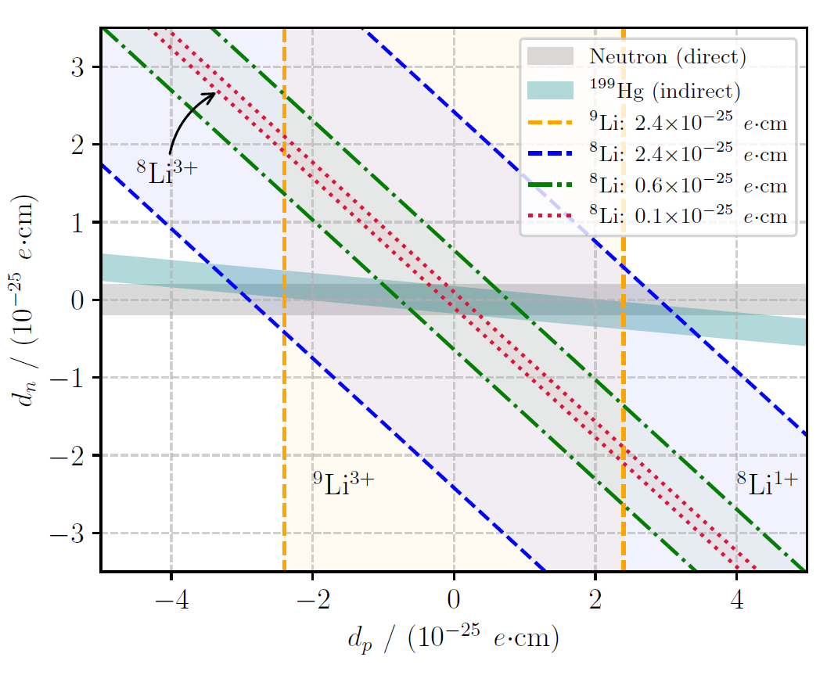
EDMs of $β$-decaying nuclei

Slide 19
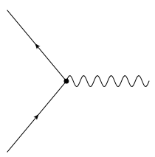



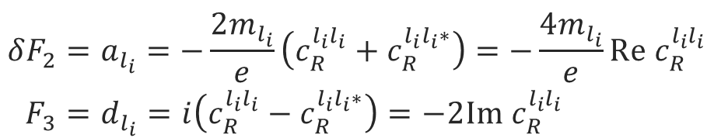
Lepton form factors and dipole moments
$$l_{f}$$
$$F^{μν}$$
$$l_{i}$$
magnetic-dipole
Anapole - moment
$$\left\langle p′ | J_{μ}^{EM} | p\right\rangle =\overline{Ψ}\left(p^{′}\right)\left[F_{1}γ_{μ}+\frac{iF_{2}}{2M}σ_{μν}q^{ν}+\frac{iF_{3}}{2M}σ_{μν}γ_{5}q^{ν}+\frac{F_{4}}{M^{2}}(q^{2}γ_{μ}−γ^{μ}q_{μ}q_{μ})\right]Ψ\left(p\right)$$
charge
electric-dipole
$${δF}_{2}=a_{l_{i}}=−\frac{2m_{l_{i}}}{e}\left(c_{R}^{l_{i}l_{i}}+c_{R}^{l_{i}l_{i}∗}\right)=−\frac{4m_{l_{i}}}{e}Re c_{R}^{l_{i}l_{i}} \\ F_{3}=d_{l_{i}}=i\left(c_{R}^{l_{i}l_{i}}−c_{R}^{l_{i}l_{i}∗}\right)=−2Im{ c}_{R}^{l_{i}l_{i}}$$
Notes:
For the purpose of a general discussion, effective field theories are particular useful, as no assumptions are needed for the exact realization of a high energy theory.
The most general form in which one can write down the interaction of a lepton current with an external electric/magnetic field is using this electro magnetic current with all possible bilinears.
In this case the first form factor is the electric charge, the second the magnetic and the third the electric dipole moment. The anapole moment I just depicted for completeness
Interestingly the anomalous magnetic moment is connected to the same Wilson coefficient in effective field theories. The real part of this Wilson coefficient is proportional to the anomalous magnetic momentum, while the imaginary part is related to the electric dipole moment.

Slide 20
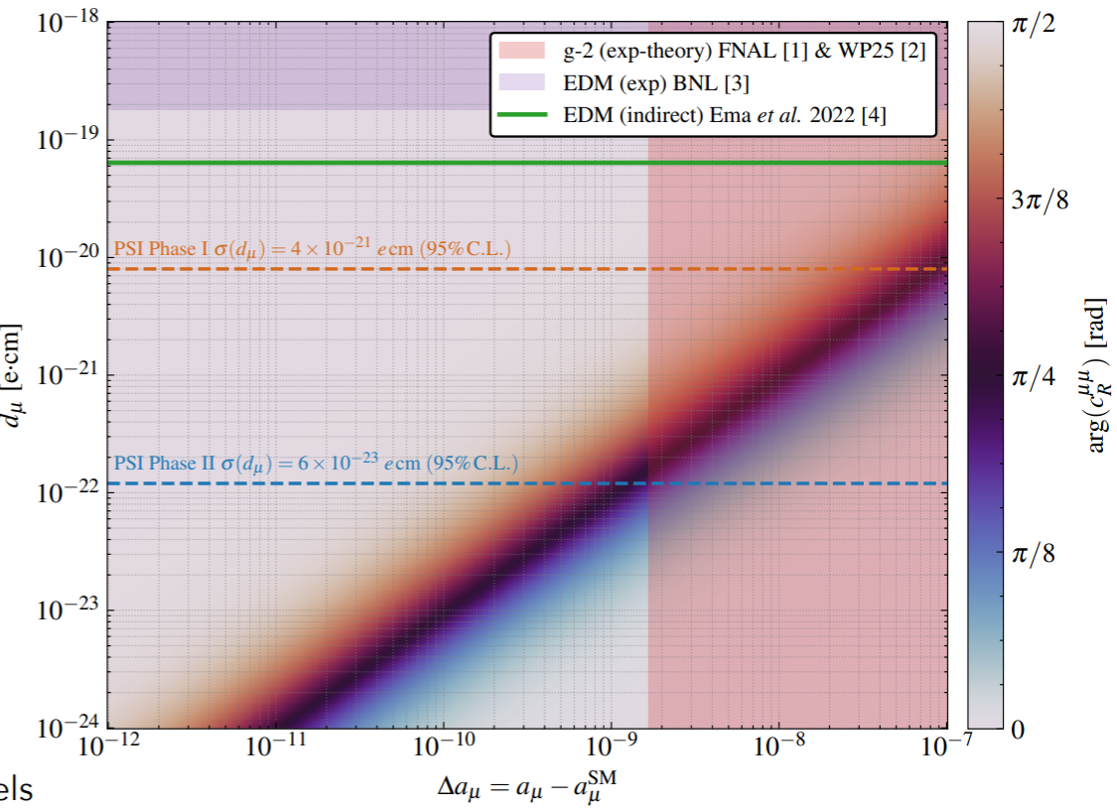
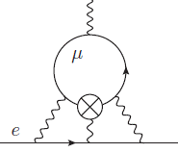
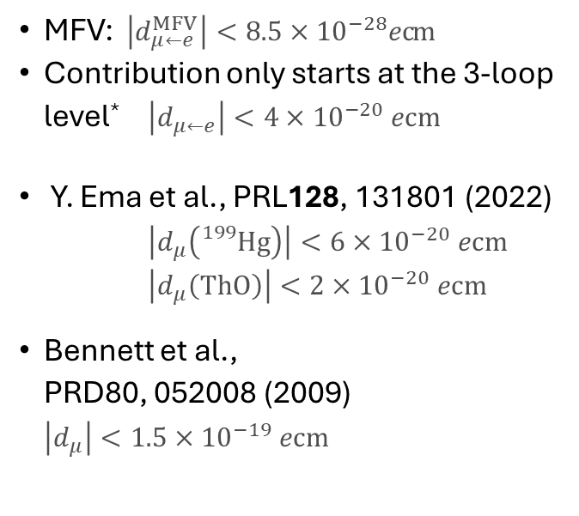
General limits on $μ$EDM
MFV: $\left|d_{μ←e}^{MFV}\right|<8.5×{10}^{−28}ecm$
Contribution only starts at the 3-loop level* $\left|d_{μ←e}\right|<4×{10}^{−20} ecm$
Y. Ema et al., PRL128, 131801 (2022)
$\left|d_{μ}\left({}_{}^{199}{Hg}\right)\right|<6×{10}^{−20} ecm$ $\left|d_{μ}\left(ThO\right)\right|<2×{10}^{−20} ecm$
Bennett et al., PRD80, 052008 (2009) $\left|d_{μ}\right|<1.5×{10}^{−19} ecm$
*A.Crivellin, M. Hoferichter, PSW PRD 98, 113002 (2018)
Page 20

Slide 21
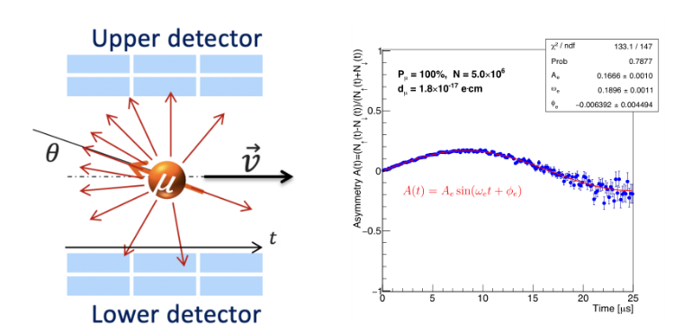

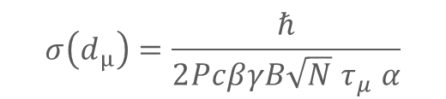

The search for a muon EDM at PSI
B
EDM ≠ 0 induces a vertical spin-precession out of the plane of the orbit.
Build-up of longitudinal asymmetry with time, observed by recording decay positrons.
If EDM = 0, spin “frozen” to the momentum change in asymmetry should be zero
Some change in asymmetry could still be observed due to systematic effects
$$R=30mm$$
$${\vec{ω}}_{e}$$
E
$$σ\left(d_{μ}\right)=\frac{ℏ}{2PcβγB{\sqrt{N} τ}_{μ} α}$$
A. Adelmann et al, EPJC85 (2025) 622

Slide 22














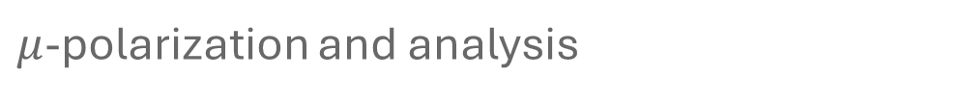



$μ$-polarization and analysis
Weak decay $π^{+}→μ^{+}+{\overline{ν}}_{μ}$ result in $P_{μ}>95\%$ for $p_{π}\sim 220MeV/c^{2}$ for backward decay.
Weak decay $μ^{+}→e^{+}+{\overline{ν}}_{e}+ν_{μ}$ results in decay asymmetry $\overline{α}≈0.3$
Detection of $e^{+}$ of decay (for EDM vertical resolution)
$$\vec{s}$$
$$\vec{s}$$
$$π$$
$${\overline{ν}}_{μ}$$
$$μ^{+}$$
$$\vec{s}$$
$$e^{+}$$
$${\overline{ν}}_{e}$$
$$μ$$
$$ν_{μ}$$
$$e^{+}$$
$$\vec{s}$$
$$\vec{B}$$
$$μ$$
Notes:
Before coming to the result from this measurement of the g-2 and the search for a muon EDM, I would like to explain how kind nature was for polarizing and analyzing muons.
The polarization is a direct consequence of the V-A structure of the weak interaction. Hence, when a pion decays the spin is aligned with the momentum of the muon in the rest frame of the decay.
Similar we also profit for the analysis of the muon spin. In this case again the positron or electron is ejected in the same direction as the spin. These properties were then used to measure the oscillation frequency of the muons inside the storage ring.
On the inner side tracking detector for positron were setup to detect the positron preferentially ejected in the direction of the muon spin. While the muons were circulating around the closed orbit the spin rotates in the rest frame of the muon. Whenever the spin point into the direction of the detectors you detected a higher count rate.
To detect an EDM the positron detectors need a vertical resolution.

Slide 23
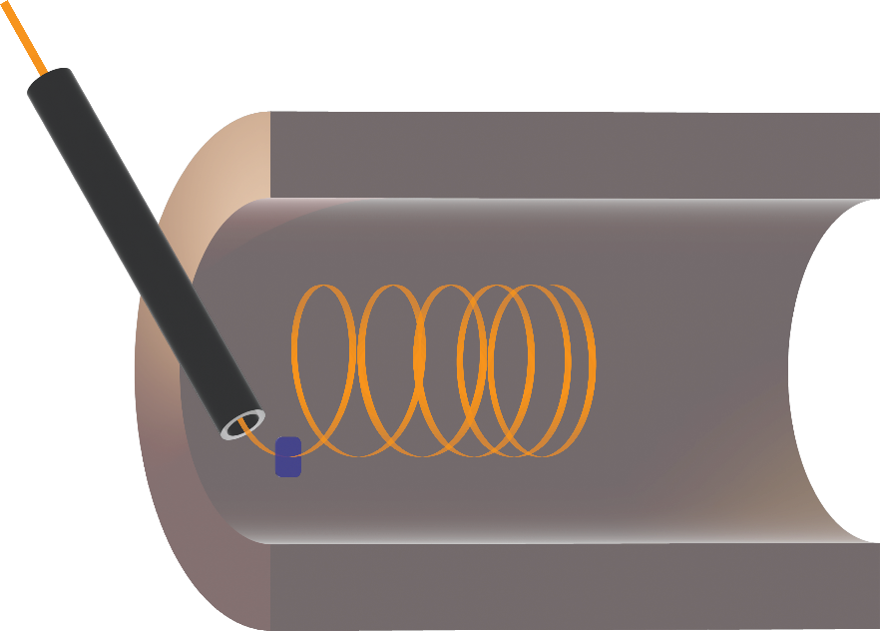









Search for a muon EDM using the frozen-spin technique with longitudinal injection
$$\vec{s}$$
$$\vec{s}$$
$$π$$
$μ^{+}$ from Pion-decay → high polarization $p≈95\%$
Injection through superconducting channel
Fast scintillator triggers pulse
Magnetic pulse stops longitudinal motion of $μ^{+}$
Weakly focusing field for storage
Thin electrodes provide electric field for frozen spin
Scintillating fiber detector (CHET) for$e^{+}$- tracking
$${\overline{ν}}_{μ}$$
$μ^{+} @ 125MeV/c$ or $28MeV/c$
$$μ^{+}$$
Superconducting Injection Chanel
Entrance Detector
(t=0 & trigger signal)
$$\vec{B}$$
Notes:
fringe fields, avoid deflection and divergence
why SC? they can induce persistent eddy currents to provide field-free region

Slide 24


Search for a muon EDM using the frozen-spin technique with longitudinal injection
$$\vec{s}$$
$$\vec{s}$$
$$π$$
$μ^{+}$ from Pion-decay → high polarization $p≈95\%$
Injection through superconducting channel
Fast scintillator triggers pulse
Magnetic pulse stops longitudinal motion of $μ^{+}$
Weakly focusing field for storage
Thin electrodes provide electric field for frozen spin
Scintillating fiber detector (CHET) for$e^{+}$- tracking
$${\overline{ν}}_{μ}$$
$μ^{+} @ 125MeV/c$ or $28MeV/c$
$$μ^{+}$$
Pulse Coils
(pulsed B field)
Superconducting Injection Chanel
Entrance Detector
(t=0 & trigger signal)
$$\vec{B}$$
Notes:
fringe fields, avoid deflection and divergence
why SC? they can induce persistent eddy currents to provide field-free region

Slide 25



Search for a muon EDM using the frozen-spin technique with longitudinal injection
$$\vec{s}$$
$$\vec{s}$$
$$π$$
$μ^{+}$ from Pion-decay → high polarization $p≈95\%$
Injection through superconducting channel
Fast scintillator triggers pulse
Magnetic pulse stops longitudinal motion of $μ^{+}$
Weakly focusing field for storage
Thin electrodes provide electric field for frozen spin
Scintillating fiber detector (CHET) for$e^{+}$- tracking
$${\overline{ν}}_{μ}$$
$μ^{+} @ 125MeV/c$ or $28MeV/c$
$$μ^{+}$$
Pulse Coils
(pulsed B field)
Superconducting Injection Chanel
$$\vec{B}$$
Entrance Detector
(t=0 & trigger signal)
Weakly-focusing Coil (static B field)
Notes:
fringe fields, avoid deflection and divergence
why SC? they can induce persistent eddy currents to provide field-free region

Slide 26



Search for a muon EDM using the frozen-spin technique with longitudinal injection
$$\vec{s}$$
$$\vec{s}$$
$$π$$
$μ^{+}$ from Pion-decay → high polarization $p≈95\%$
Injection through superconducting channel
Fast scintillator triggers pulse
Magnetic pulse stops longitudinal motion of $μ^{+}$
Weakly focusing field for storage
Thin electrodes provide electric field for frozen spin
Scintillating fiber detector (CHET) for$e^{+}$- tracking
$${\overline{ν}}_{μ}$$
$μ^{+} @ 125MeV/c$ or $28MeV/c$
$$μ^{+}$$
Pulse Coils
(pulsed B field)
Electrodes
(static E field)
Superconducting Injection Chanel
$$\vec{B}$$
Entrance Detector
(t=0 & trigger signal)
$$\vec{E}$$
Weakly-focusing Coil (static B field)
Notes:
fringe fields, avoid deflection and divergence
why SC? they can induce persistent eddy currents to provide field-free region

Slide 27


Search for a muon EDM using the frozen-spin technique with longitudinal injection
$$\vec{s}$$
$$\vec{s}$$
$$π$$
$μ^{+}$ from Pion-decay → high polarization $p≈95\%$
Injection through superconducting channel
Fast scintillator triggers pulse
Magnetic pulse stops longitudinal motion of $μ^{+}$
Weakly focusing field for storage
Thin electrodes provide electric field for frozen spin
Scintillating fiber detector (CHET) for$e^{+}$- tracking
$${\overline{ν}}_{μ}$$
$μ^{+} @ 125MeV/c$ or $28MeV/c$
$$μ^{+}$$
Pulse Coils
(pulsed B field)
Electrodes
(static E field)
Superconducting Injection Chanel
$$\vec{B}$$
Entrance Detector
(t=0 & trigger signal)
$$\vec{E}$$
Weakly-focusing Coil (static B field)
Notes:
fringe fields, avoid deflection and divergence
why SC? they can induce persistent eddy currents to provide field-free region

Slide 28


Slide 29

The Experiment - Technical overview
Vacuum box for services
Weakly-focusing field coil
4K cryo head
SC storage magnet
Fiber ports for
~ 2000 DAQ channels
Field correction coils
Positron tracker Scintillating fibers
Off-axis Injection tubes
Radial electrodes

Slide 30






Current status
The 2025 in a nutshell: Construction, assembly and integration of ALL items (whole/partially, prototype/final version)
A major milestone towards
the final assembly of the experimental setup, the proof of the frozen spin technique and base sensitivity (2026) muEDM data taking (2027)
•

Slide 31














Current status
The 2025 in a nutshell: Construction, assembly and integration of ALL items (whole/partially, prototype/final version)
A major milestone towards
the final assembly of the experimental setup, the proof of the frozen spin technique and base sensitivity (2026) muEDM data taking (2027)
16

Slide 32


Current status
The 2025 in a nutshell: Construction, assembly and integration of ALL items (whole/partially, prototype/final version)
A major milestone towards
the final assembly of the experimental setup, the proof of the frozen spin technique and base sensitivity (2026) muEDM data taking (2027)
17

Slide 33


Slide 34



Geant4 Implementation
Injection Tubes
Correction Coils
Weakly Focusing Coil
Kicker Coil
Solenoid
Entrance Trigger System
Positron Detectors
Electrodes
End Detector

Slide 35






Top Gate Detector
Run 451
Muon beam
$B_{SOL}=−2.5 T$
Anti-coincidence trigger
Gate Coincidence 5ns
PRELIMINARY
PRELIMINARY
PRELIMINARY

Slide 36



Exit Detector
Run 451
Muon beam
$B_{SOL}=−2.5 T$
Anti-coincidence trigger
PRELIMINARY
PRELIMINARY

Slide 37
Exit Detector
Run 451
Muon beam
$B_{SOL}=−2.5 T$
Anti-coincidence trigger
PRELIMINARY
PRELIMINARY
e+ only?

Slide 38
Exit Detector
Run 451
Muon beam
$B_{SOL}=−2.5 T$
Anti-coincidence trigger
PRELIMINARY
PRELIMINARY
e+ only?
Overlapping
e+ and mu+

Slide 39







Adjusting the $E−$Field to freeze the spin
Measure precession as function of E-Field
Tune spin with spin rotator
CW and CCW storage
Measure ToF of each stored muon
Momentum resolved measurement

Slide 40








Sources of Ey field: conical central electrode
anode
$$B$$
None constant radius of cylindrical anode (cone)
Ground electrode made of thin foil difficult to keep deviations from cylindricity below $30μm$
$$E_{v}$$
$$E$$
Will move orbit out of central plane until:
$$\left\langle B_{r}^{∗}\right\rangle =−\left\langle E_{v}/βγ\right\rangle$$
Relaxes by reversing $\vec{β}$ needs CW and CCW injection
G. Cavoto et al. EPJC84 (2024) 262

Slide 41





Cancelation due to CW and CCW storage
Cancellation depends on
Momentum difference of stored muons
Measure ToF of every stored muon
post select identical ensemble in data analysis
Difference in initial phase
measured by g-2 tuning versus E-field
Measure $E_{z}$ by measuring Orbit displacement as function of E-field
$$B$$
$$E_{z}$$
$$E$$

Slide 42





Geometric phases, and non-uniformities
Magnetic field
Electric field
$$ω_{a}$$
$$ω_{c}$$
Cavoto G., Chakraborty R., Doinaki A., et al., EJPC 84(2024)262

Slide 43




















open for participation
PSI proposal R-21-02.1

Slide 44



Conclusion and outlook
The frozen-spin technique in a compact trap has a unique sensitivity for cp EDMs
The PSI muEDM search demonstrates all essential techniques in a step-by-step approach first storage this December
In the first phase we will demonstrate a sensitivity to a muEDM of better than $4×{10}^{−21}ecm$
Phase II welcomes collaborators and aims for a sensitivity of $6×{10}^{−23}ecm$
Possibility to measure g-2 with a sensitivity comparable to the current result
Unique opportunity to explore hadronic CPV

Slide 45

Fine-Tuning?
Bigaran, Volkas, 2110.03707
No signifcant tuning necessary
8
Courtesy Andreas Crivellin

Slide 46




Cryostat setup
Temperature monitoring system
4 x ROX temperature sensors
4 x PT-1000 temperature sensors
1 x DT-670 sensor
2 x Lakeshore model 340
Reached p ≈1.7e-7 mBar
Injection channel holder T ≈ 5.8K
9 x THS119 used to record mag.fields

Slide 47





Superconducting injection channels test
Results are still preliminary, we need to verify Hall sensor calibration factor and positions w.r.t injection channel.
Succesfull shielding of transversal mag. field components up to 3T.
Shielding currents are stable better than 1 mT/Day
Manged to measure Tc ≈ 7 K.
T_support 111K

Slide 48




Radial magnetic field pulse to kick muons
Pulse generator
courtesy A.M. Rehman
Page 48

Slide 49





Longitudinal confinement
A static weakly-focusing field produced by a single circular coil will ensure confinement.
A longitudinal betatron oscillation of about 10MHz will persist during the measurement due to the remaining longitudinal momentum.
0.5MeV/c
0.14MeV/c
Kicker Coil
11

Slide 50




C1 demonstrator prototype: final details
US
DS
Total weight of the demonstrator prototype is 51.3 g
420 fibers are 27.5 g carbon fiber mylar

Slide 51


Coating the fibers with AL for light transmission

Slide 52




A phased approached
Phase I (small solenoid, surface muons)
Phase 2 (dedicated magnet muon momentum $≥125MeV/c$)
500 mm
100 mm
Existing solenoid at PSI (max 5T)
Bore diameters (200mm)
Field was measured in 2022 (found suitable for injection)
Large bore (at least 500 mm diameter)
Defined gradient $ΔB/B=1ppt$ at R=140mm, btw center and injection

Slide 53


courtesy: M. Seidel

Slide 54

HIPA – high intensity proton accelerator
Pion and Muon
research
Main cyclotron 590 MeV I_{p} = 2.4 mA
P=1.4 MW
Cockcroft-Walton 860 keV
nEDM
Injector cyclotron 72MeV
UCN area

Slide 55









$$p_{π}=220MeV$$
p -beam
pion decay channel (8m, 4-5T)
$$p_{μ}=125MeV/c$$
${10}^{8}μ^{+}/s$
$$μE1$$
muEDM

Slide 56




Injection and statistical sensitivity
Large phase space at exit of beam, collimated by passage through SC -shield
Due to adiabatic magnetic collimation large part of transmitted $μ^{+}$ are reflected.
Simulations show, only about $0.4×{10}^{−3}$ muons can be stored
$$σ\left(d_{μ}\right)=\frac{ℏ}{2PcβγB{\sqrt{N} τ}_{μ} α}$$
[A. Adelmann et al., EPJC85(2025)622]
Page 56
Notes:
At PSI we will profit from the highest muon fluxes in the world.
The two possible beamlines provide very different energies and phase spaces.
For the precursor experiment we will use low energy muons and profit from a high transmission through the collimation channel
As the solenoid is not optimized only a small fraction will be stored.
Already this precursor experiment will have a sensitivity better than 3E-23 ecm.
In the long run with a dedicated magnet, using higher energetic muons we expect a sensitivity better than 10E-23ecm.

Slide 57
Backup

Slide 58
Geometric phases, and non-uniformities
Magnetic field
Electric field
$$ω_{a}$$
$$ω_{c}$$
Cavoto G., Chakraborty R., Doinaki A., et al., EJPC 84(2024)262

Slide 59


Detection efficiency asymmetry
The EDM will be deduced from the accumulation of asymmetry between the upstream and downstream detectors that increases with time
Static differences in the detection efficiency of one detector compared to the other is not a problem
Change of the detection efficiency with time is a problem as it will introduce time dependent asymmetry
Positron detectors
y
$$n_{L}=κ_{L}N$$
py
-py
$$n_{R}=κ_{R}N$$

Slide 60



Constraints on the total detection efficiency
Assumption: Change of detection efficiency triggered by pulse, exponential decay
Detection efficiency of up and downstream detectors:
Change in measured asymmetry with time:

Slide 61

Finding New Physics with Flavor
At colliders one produces many (up to 10¹⁴) heavy quarks or leptons and measures their decays into light flavors
Experiment
SM
b→sµµ
PIONEER
New Physics
Mu3e
MEG
LHC
Flavor observables are sensitive to higher energy scales than collider searches
Courtesy Andreas Crivellin

Slide 62

Systematic study - overview

Slide 63
Leptoquark models with large muEDM
Bigaran PRD105(2022)015002
Dermisek PRD108(2023)055019
No signifcant tuning necessary
8

Slide 64


Phase 2 statistical sensitivity
$$σ\left(d_{μ}\right)=\frac{ℏ}{2PcβγB{\sqrt{N} τ}_{μ} α}$$
High-intensity muon beam with $p=125MeV/c$ collimated by passage through SC -shield
Small / no magnetic field gradient results in high injection rate
Simulations show, about 360k muons can be stored per second
100 mm
500 mm
$σ\left(d_{μ}\right)≤6×{10}^{−23}ecm$ (one year of data-taking)
[A. Adelmann et al., EPJC85(2025)622]
Page 64
Notes:
At PSI we will profit from the highest muon fluxes in the world.
The two possible beamlines provide very different energies and phase spaces.
For the precursor experiment we will use low energy muons and profit from a high transmission through the collimation channel
As the solenoid is not optimized only a small fraction will be stored.
Already this precursor experiment will have a sensitivity better than 3E-23 ecm.
In the long run with a dedicated magnet, using higher energetic muons we expect a sensitivity better than 10E-23ecm.

Slide 65




Phase 2 –magnet design
$$z=1.0m$$
$$z=0.5m$$
$$z=0$$
$$R=0.14m$$

Slide 66

$$B_{max}=6.61T$$

Slide 67


${\left(g−2\right)}_{μ}$ Prospects at PSI
Statistics as in muEDM phase 2 (one year data)
- blue: single muon
- red: 3 muons – how?
Same magnet, same detector, no electric field
Prospects with new beamline solenoid to go to $p=140 MeV/c$
Sensitivity: $∼0.1 ppm$ statistically (4 years)
Collaboration on magnet with JPARC and transport between institutes?

