Slide 1
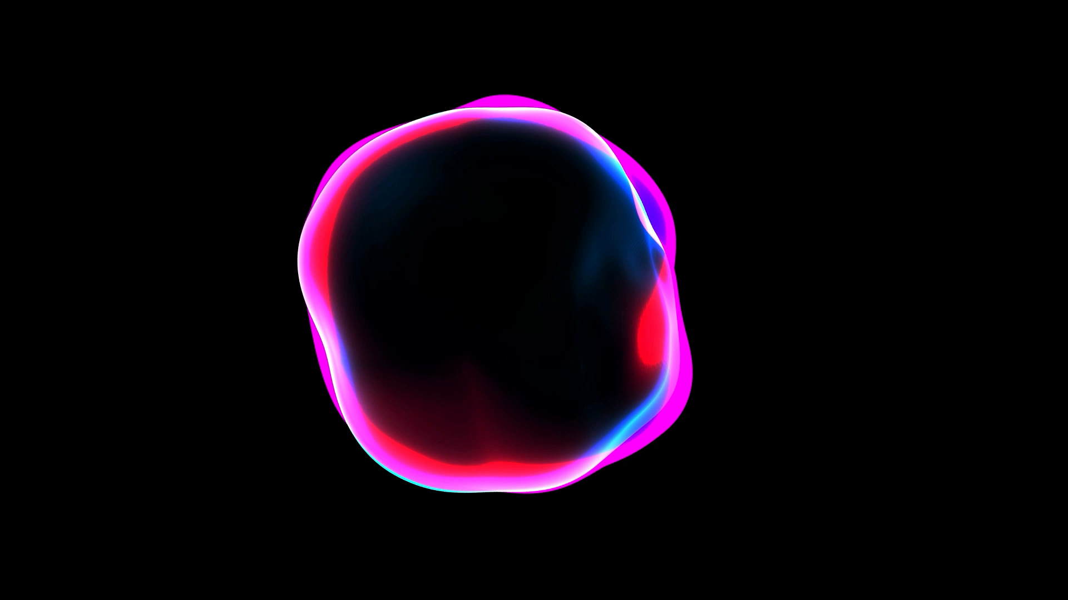
n(2)EDM and polarized ultracold neutrons
Efrain Segarra
Mar 5, 2026
EDMs 2026

Slide 2
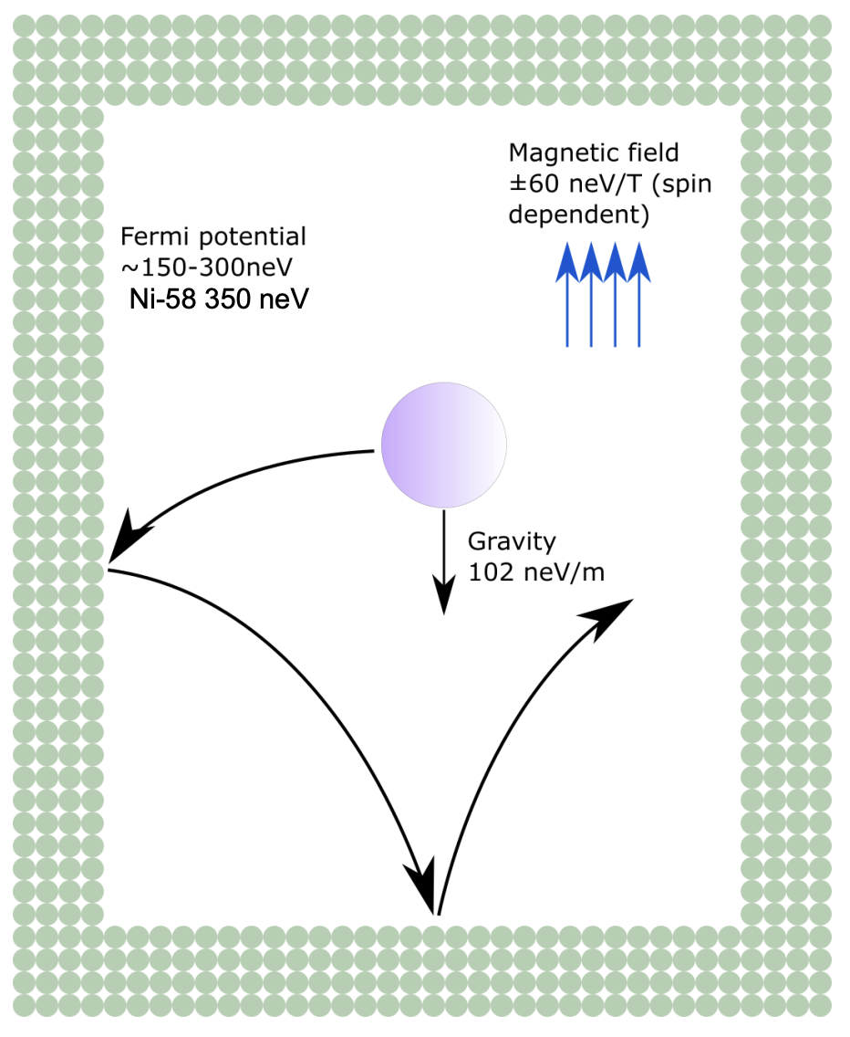
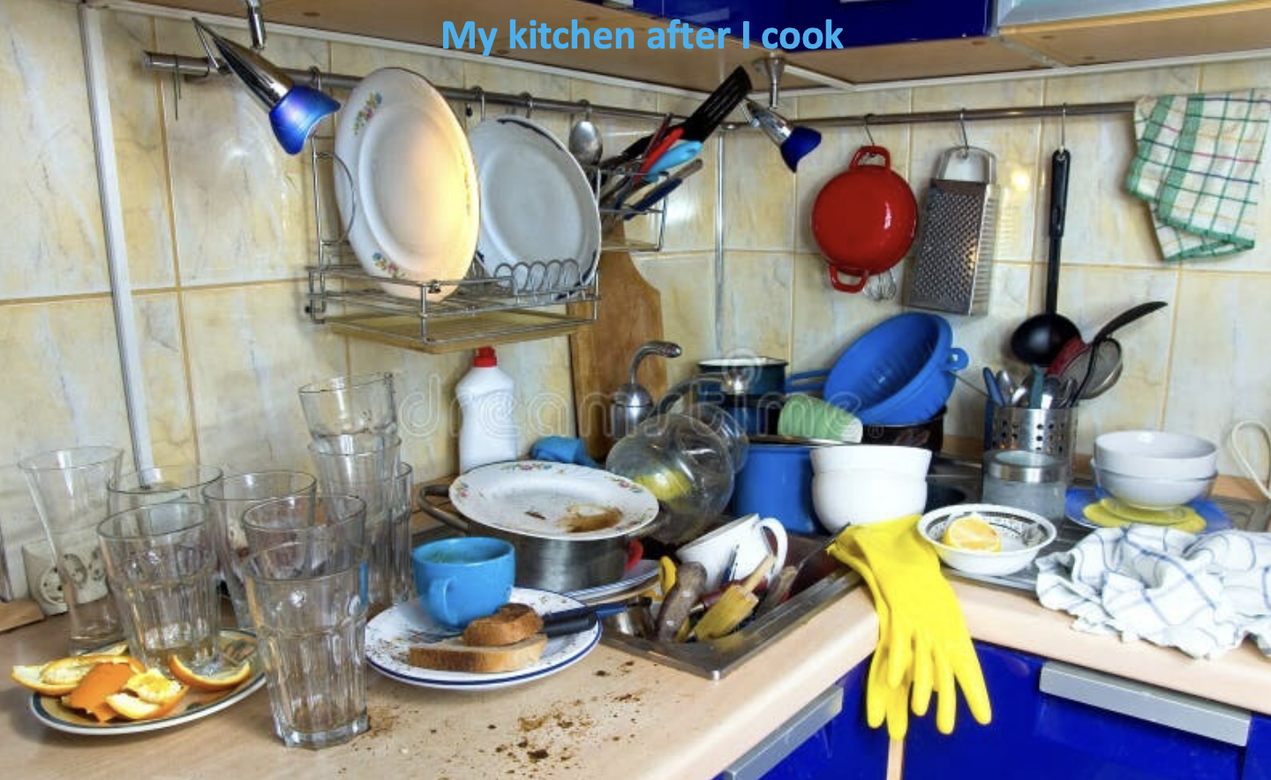
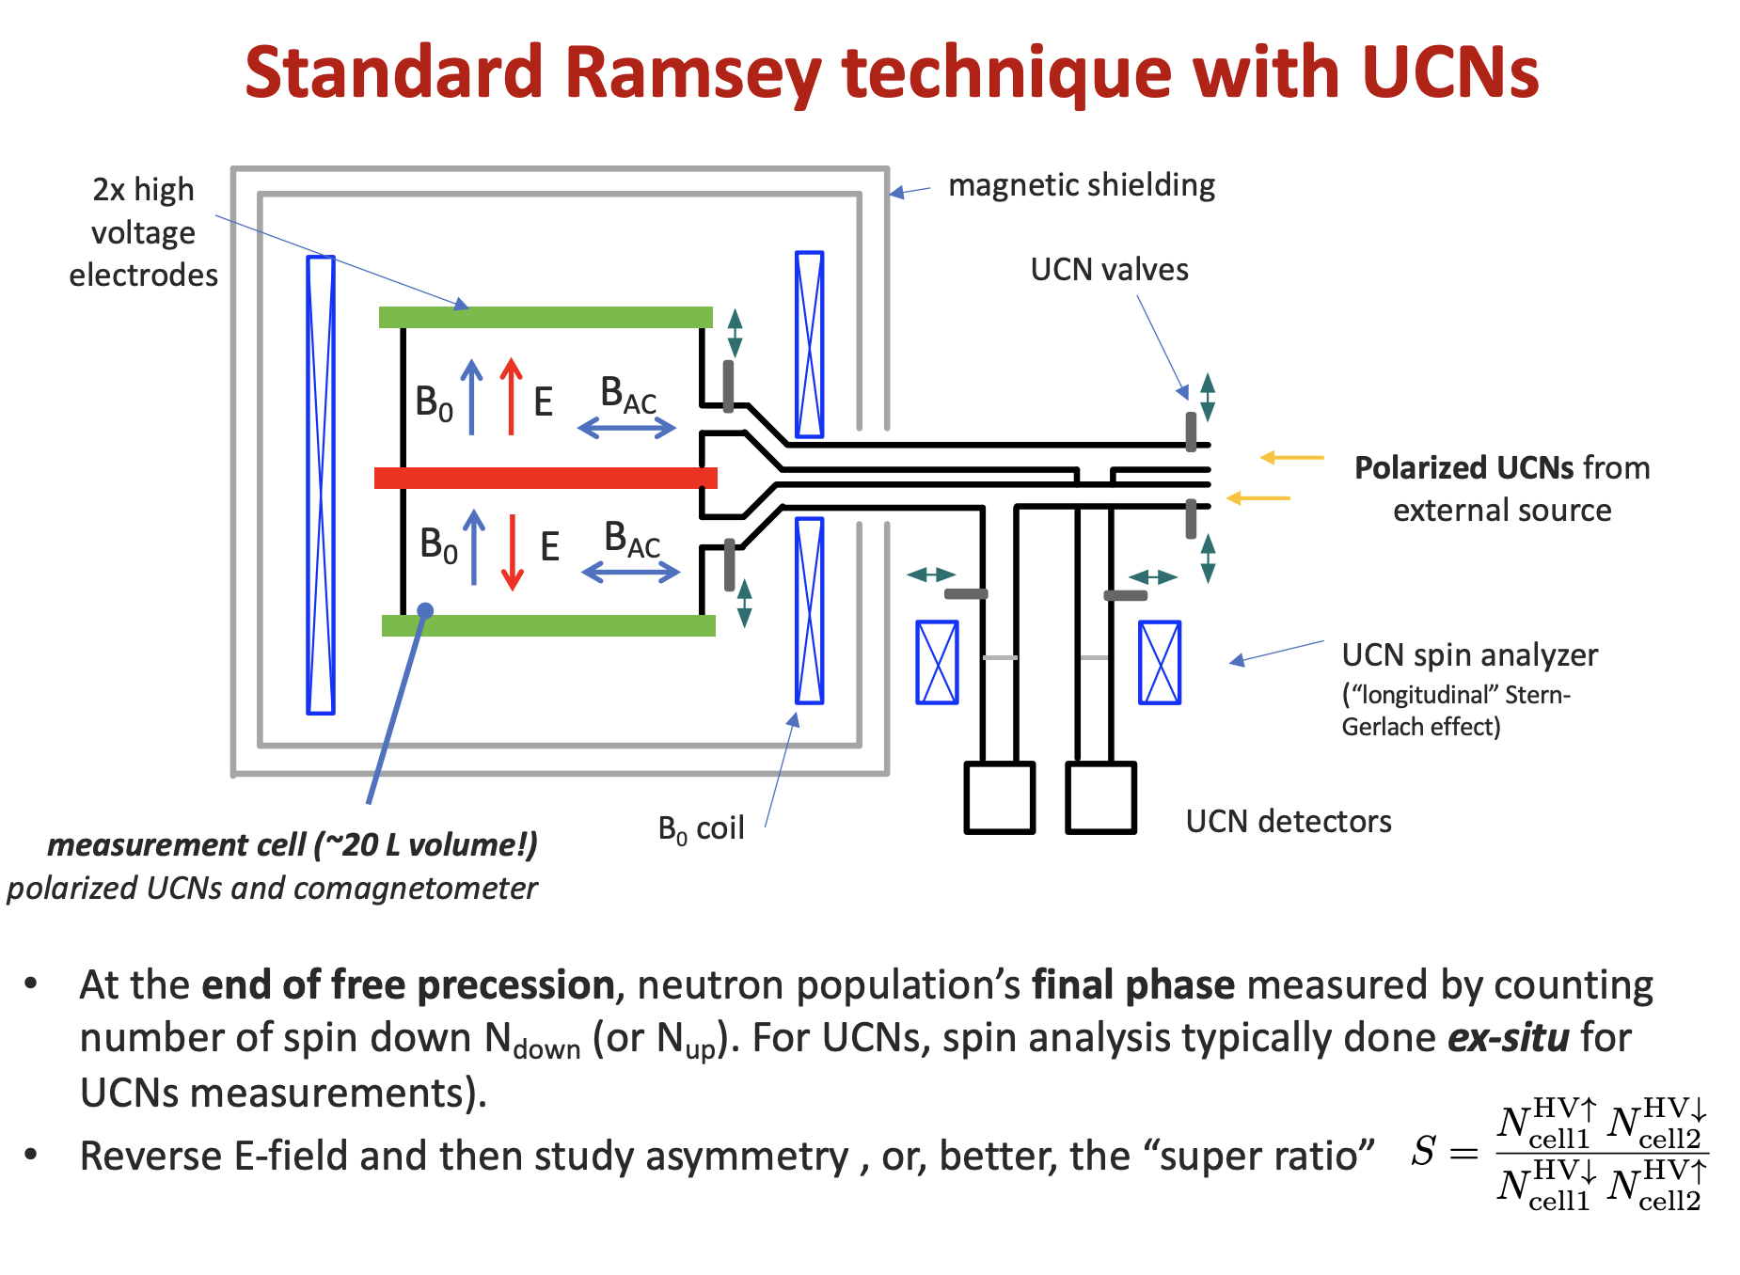
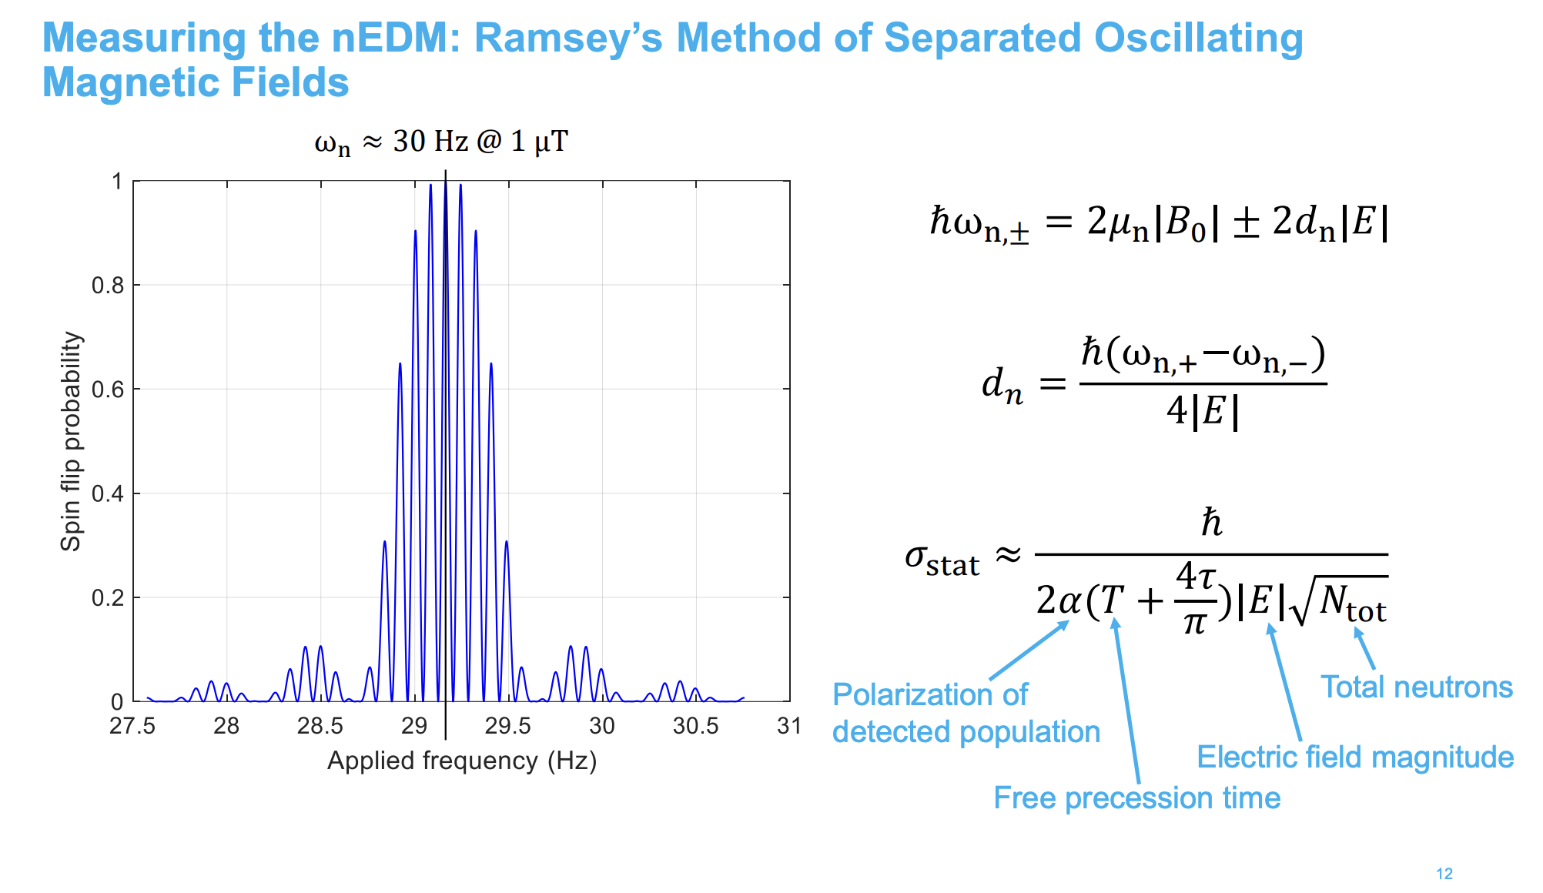
Previous speakers already reviewed a lot!

Slide 3
Previous speakers already reviewed a lot!
You’re all experts now!

Slide 4
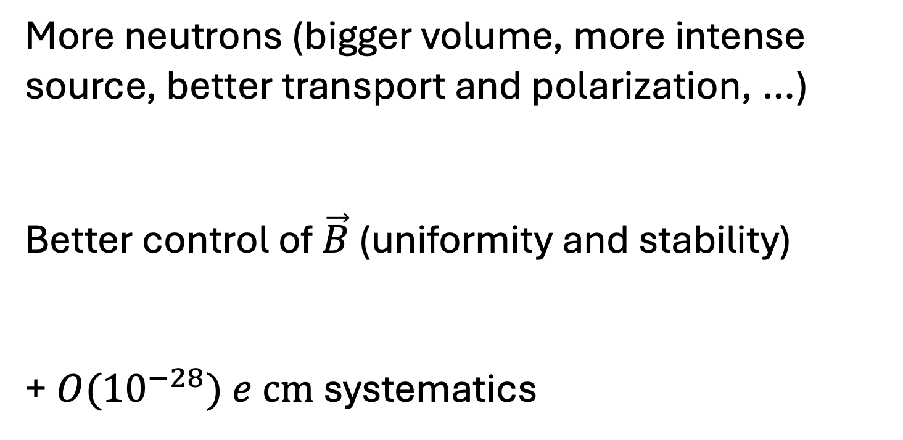
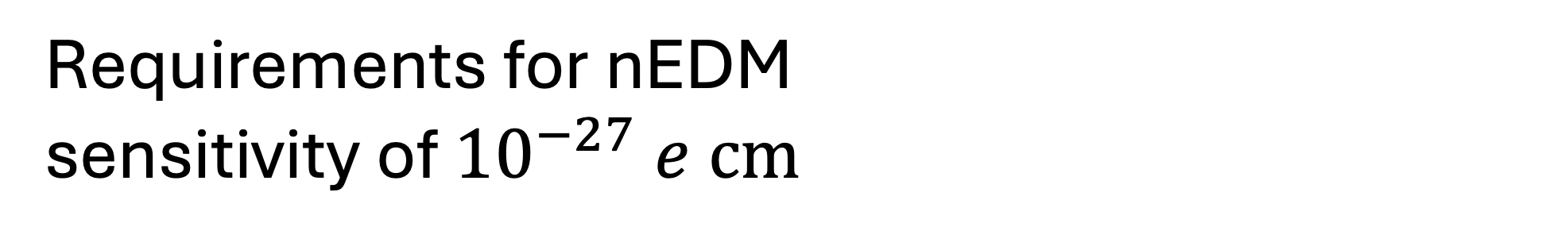
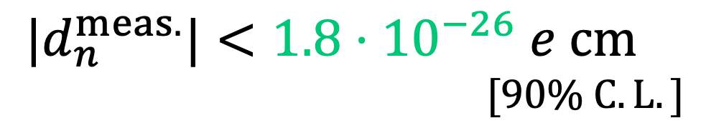
Requirements for nEDM sensitivity of ${10}^{−27} e cm$
$${|d}_{n}^{meas.}|<1.8⋅{10}^{−26} e cm$$
$$[90\% C. L.]$$
Phys. Rev. Lett. 124, 081803 (2020)
More neutrons (bigger volume, more intense source, better transport and polarization, …)
Better control of $\vec{B}$ (uniformity and stability)
+ ${O(10}^{−28}) e cm$systematics

Slide 5
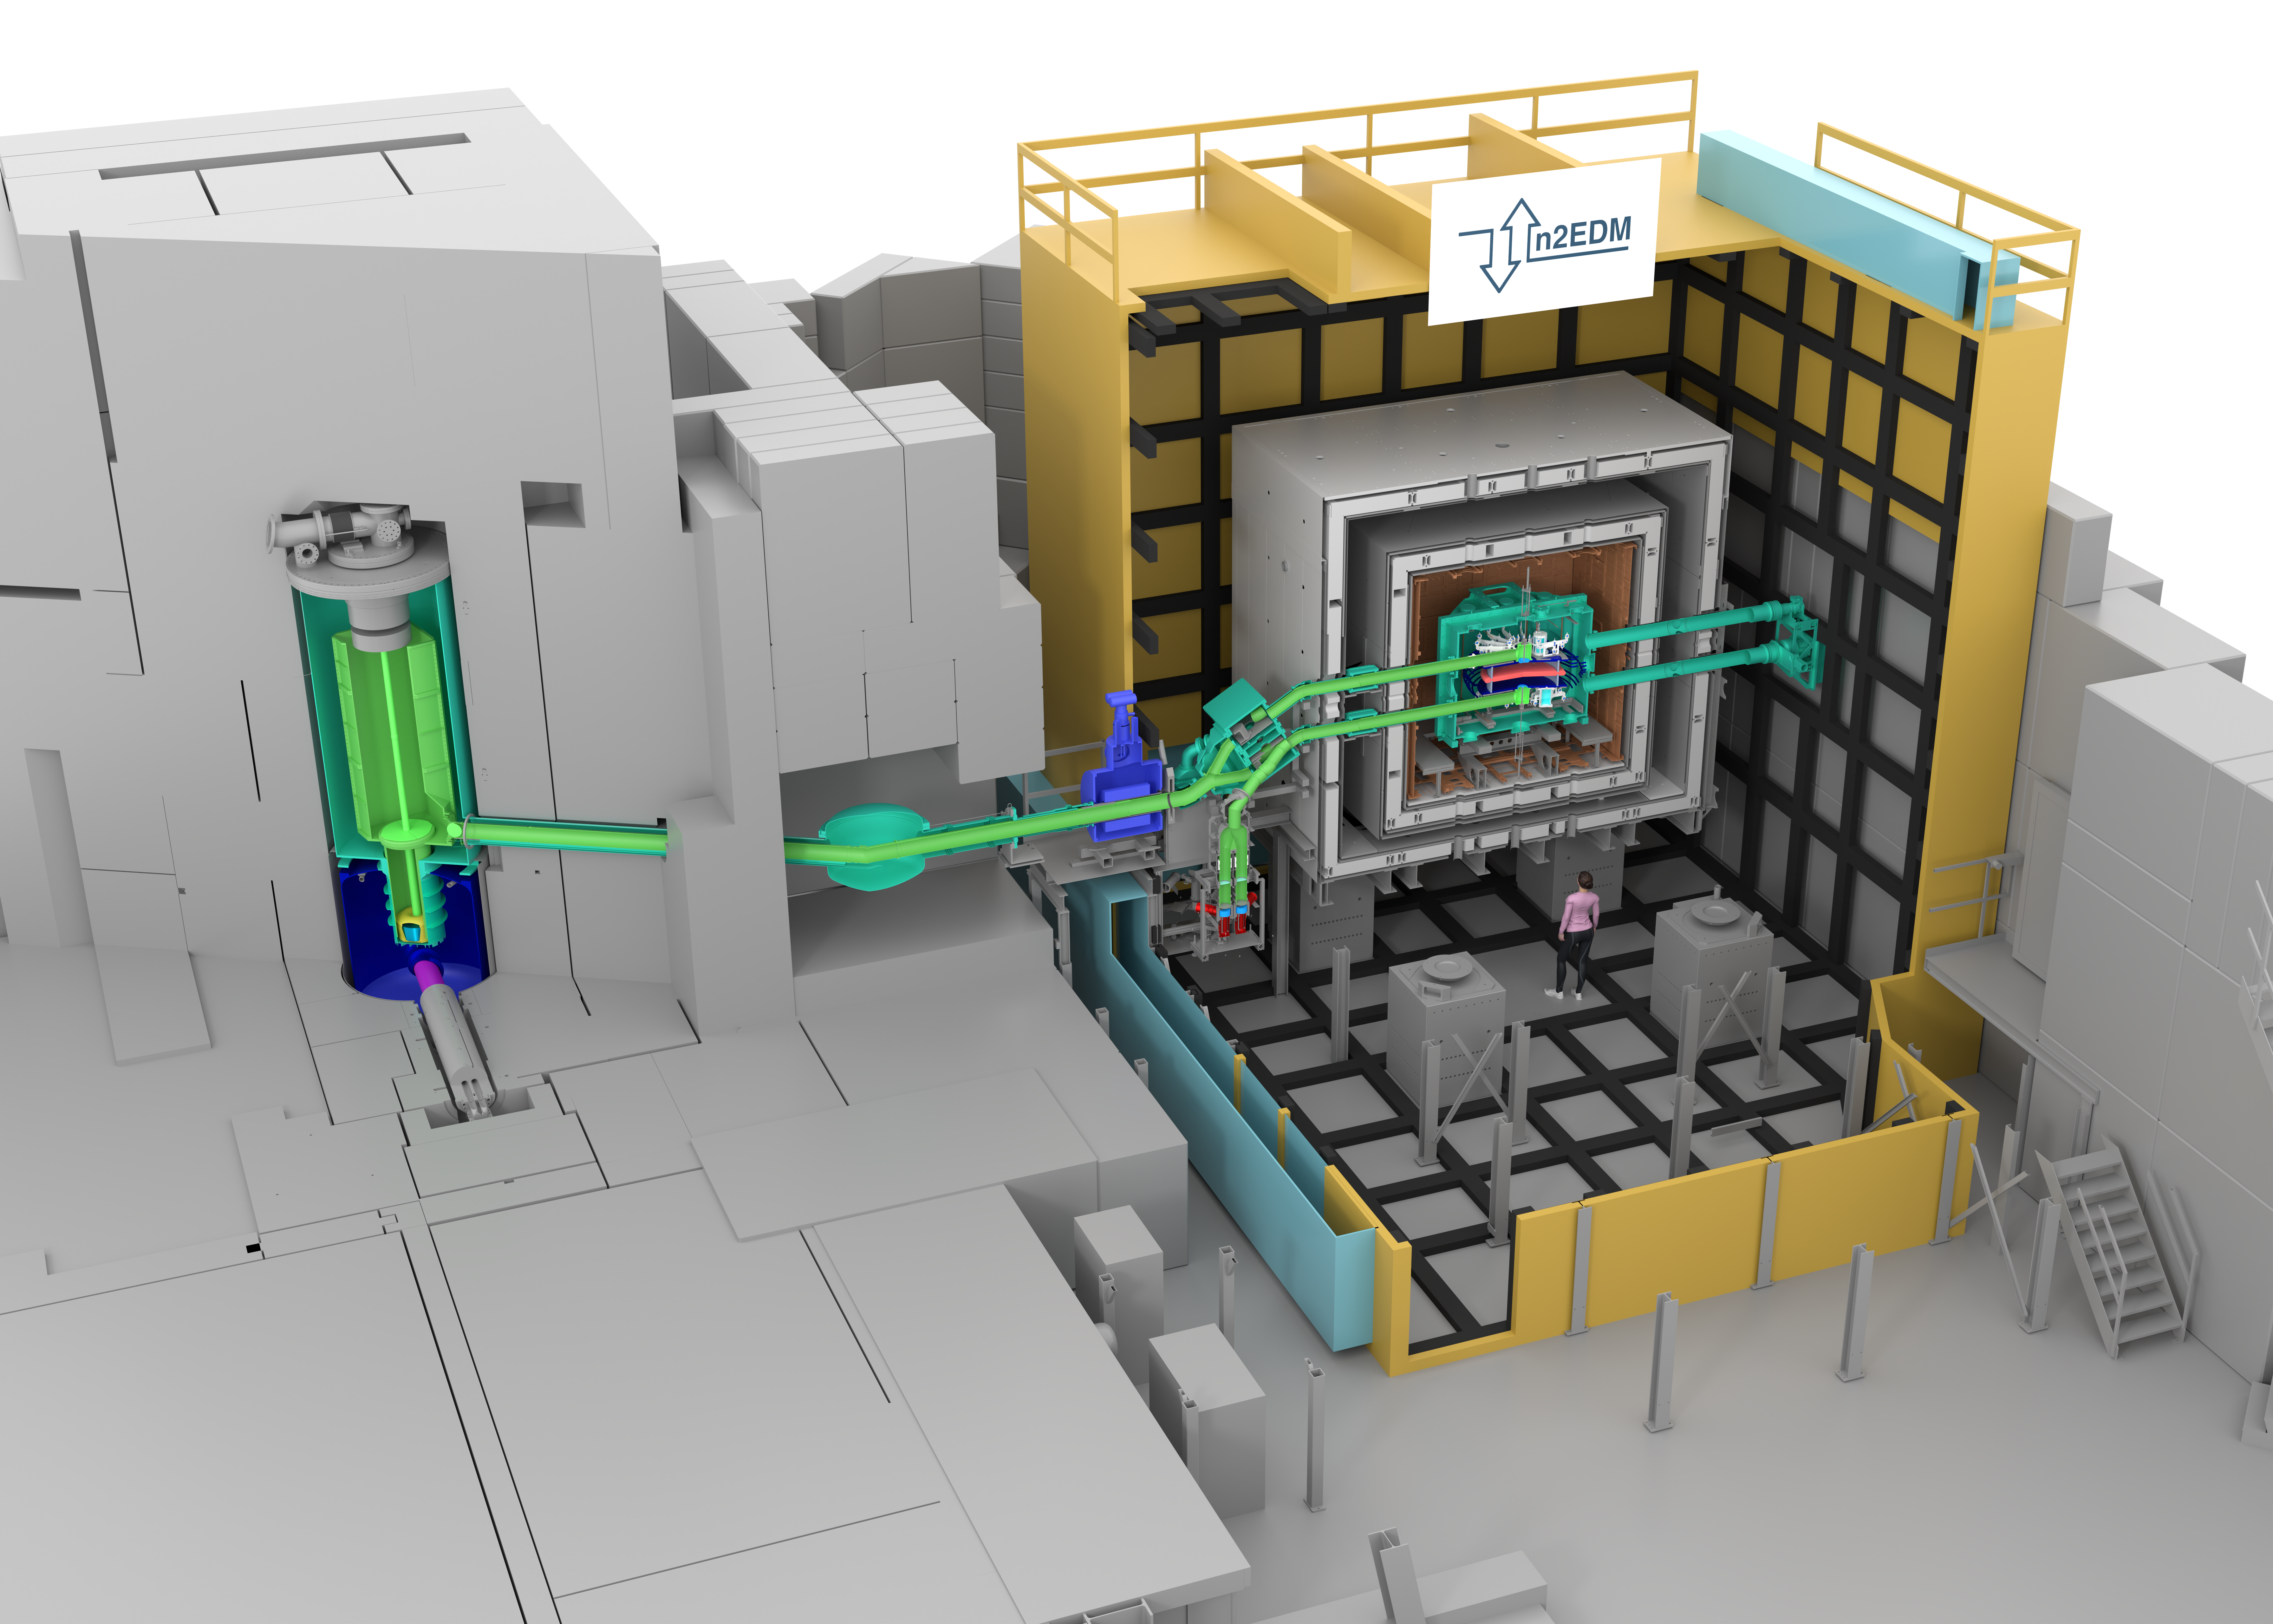
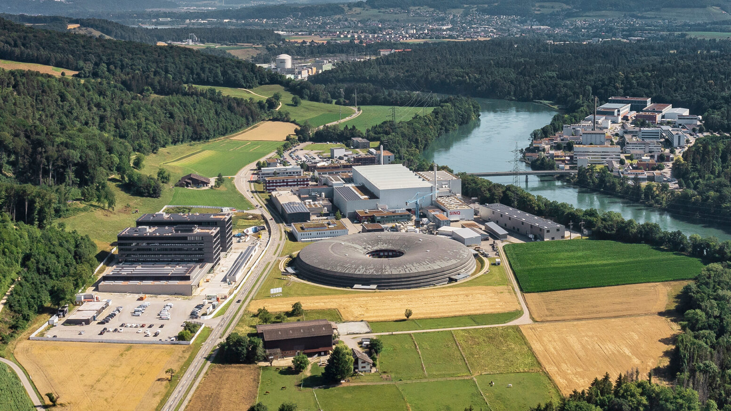
Overview of the n2EDM experiment
PSI (CH)

Slide 6
sD2 UCN source
5T superconducting magnet

Slide 7
Split UCN population to two chambers

Slide 8

Store in $\vec{E},\vec{B}$ fields (Ramsey sequence)

Slide 9
Spin-sensitive counting

Slide 10


Thermally controlled room
Passive $\vec{B}$ shielding
1 main coil + 63 correcting coils + transport coils
Active $\vec{B}$ shielding

Slide 11
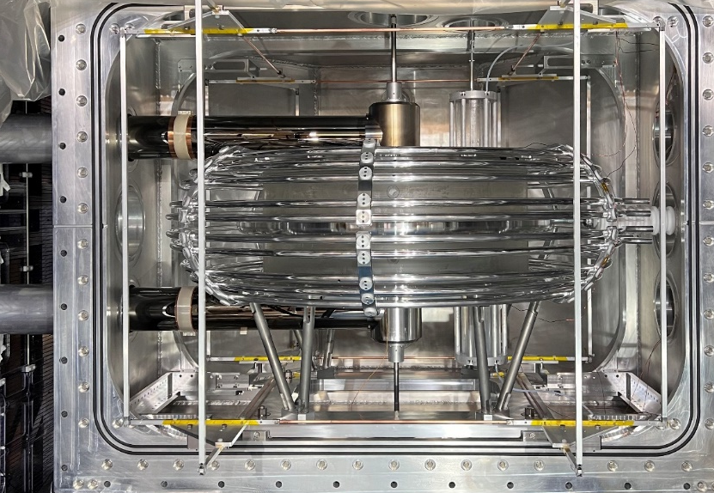
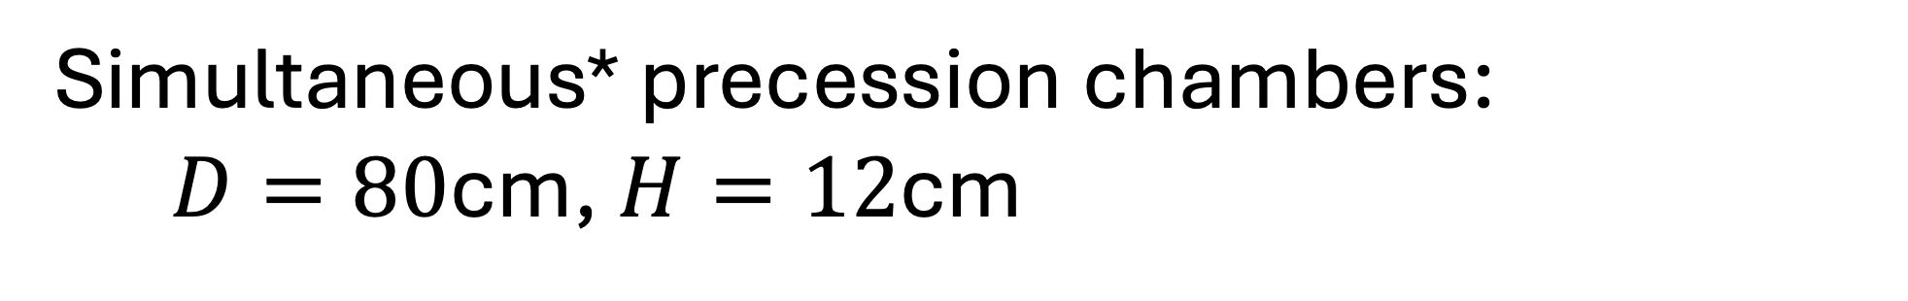
Simultaneous* precession chambers: $D=80$cm, $H=12$cm
Neutrons
*But slightly different energy spectrum!

Slide 12
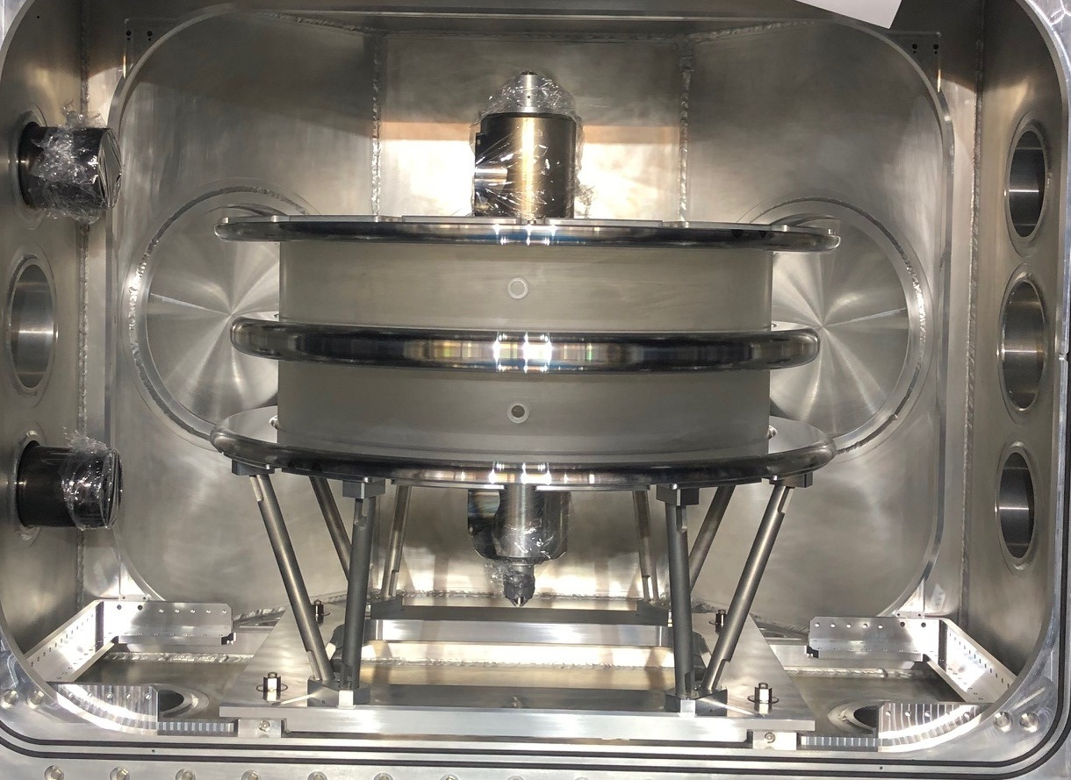
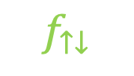
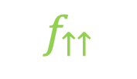
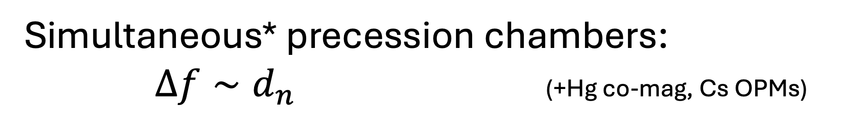
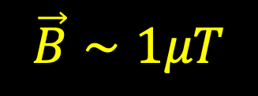
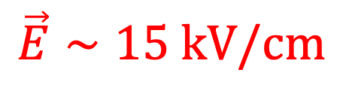
Simultaneous* precession chambers: $Δf∼d_{n}$ (+Hg co-mag, Cs OPMs)
$$\vec{B}∼1μT$$
Neutrons
$$f_{↑↑}$$
TOP
$$\vec{E}∼15 kV/cm$$
$$f_{↑↓}$$
BOT
*But slightly different energy spectrum!

Slide 13
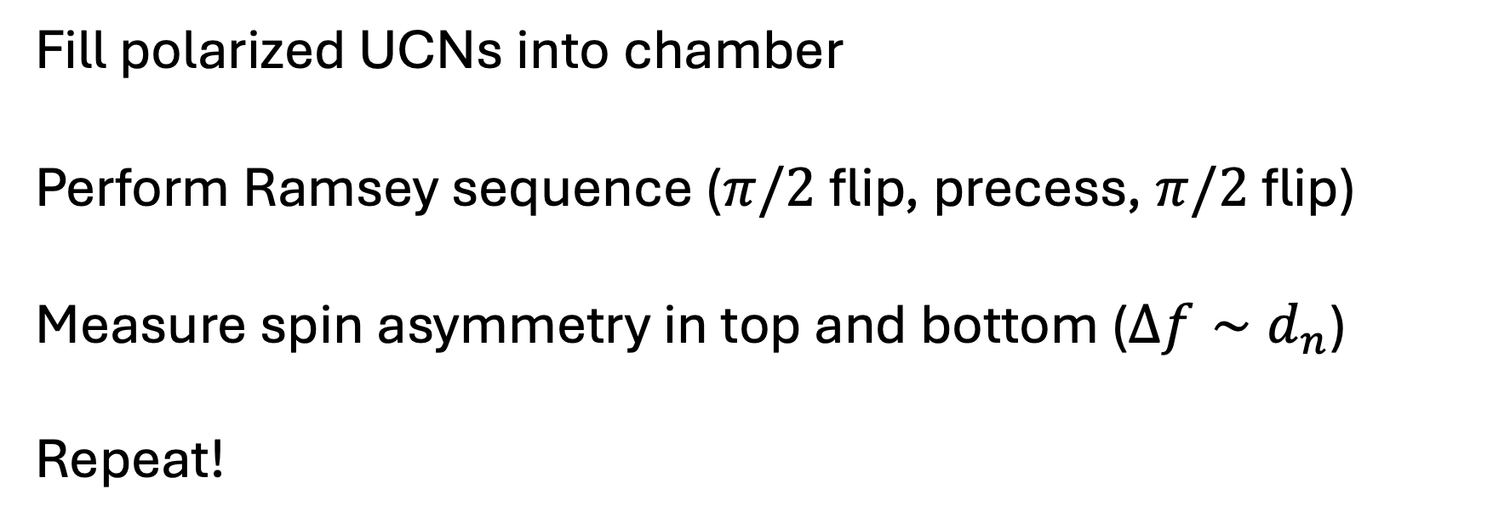
Measurement principle
Fill polarized UCNs into chamber
Perform Ramsey sequence ($π/2$ flip, precess, $π/2$ flip)
Measure spin asymmetry in top and bottom ($Δf∼d_{n}$)
Repeat!

Slide 14
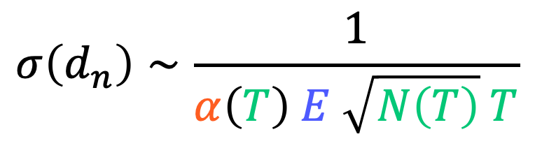
So what do we need?
High spin-polarization (and long coherence time)
Optimized statistics / interaction time
High electric field
+ control systematics…
$$σ\left(d_{n}\right)∼\frac{1}{α\left(T\right) E \sqrt{N\left(T\right)} T}$$

Slide 15

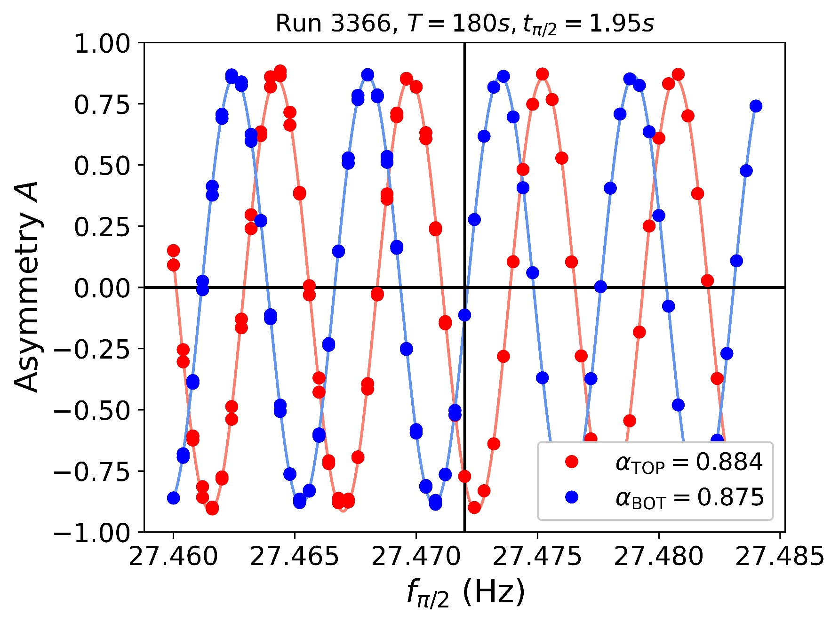

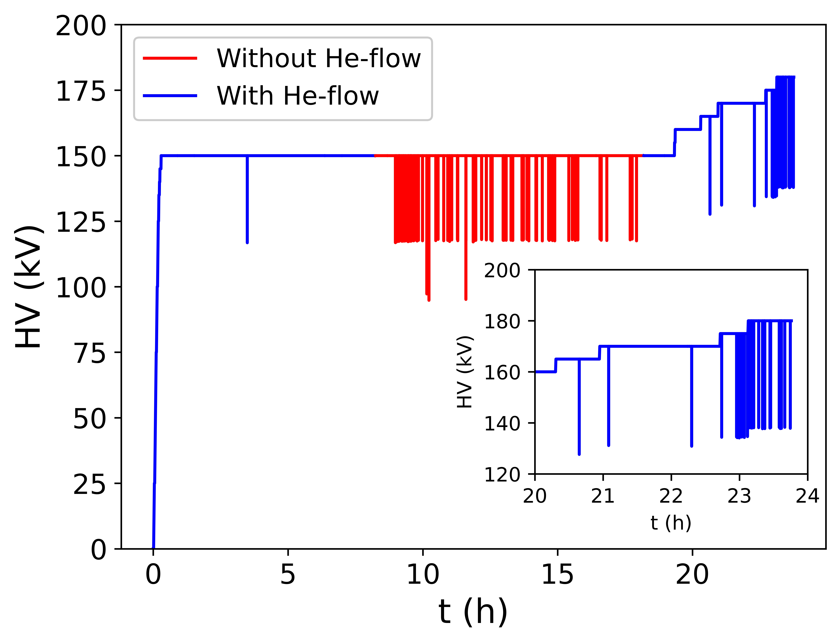
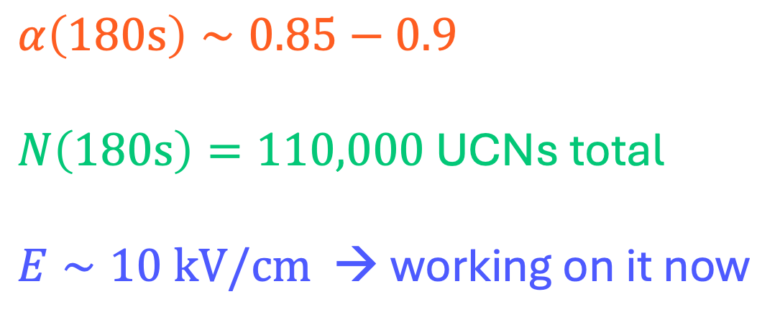
Today I’ll show the ingredients of n2EDM + new results
$α\left(180s\right)∼0.85−0.9$
$N\left(180s\right)=110,000$ UCNs total
$E∼10 kV/cm$ → working on it now

Slide 16
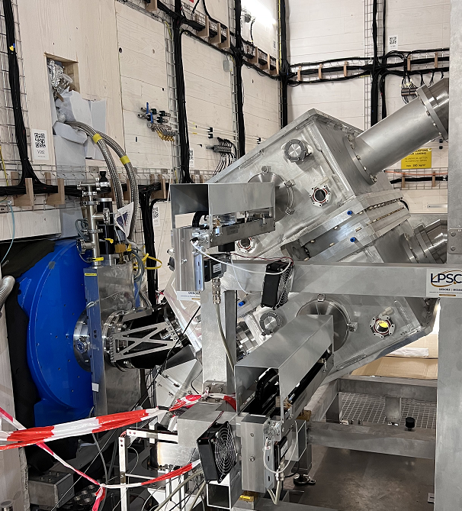
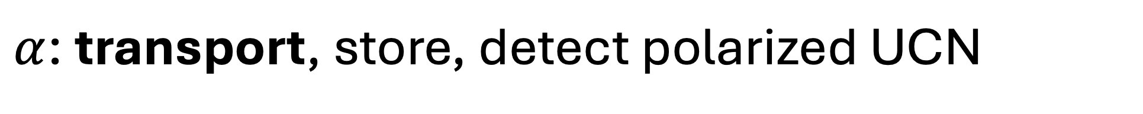
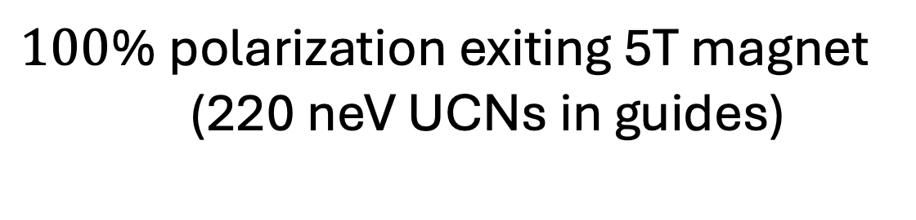
$α$: transport, store, detect polarized UCN
$100$% polarization exiting 5T magnet
(220 neV UCNs in guides)
5T

Slide 17
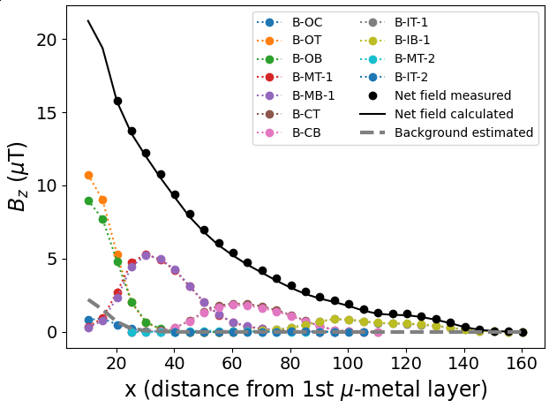


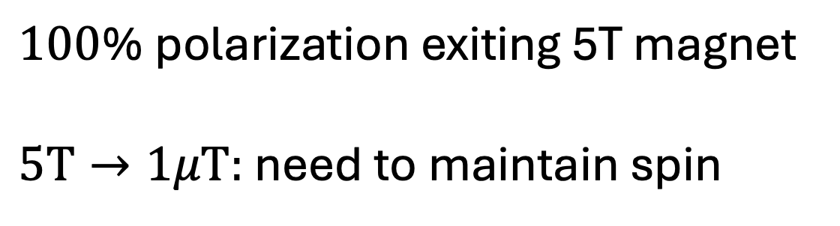
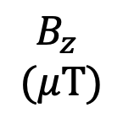
$α$: transport, store, detect polarized UCN
$100$% polarization exiting 5T magnet
$5T→1μT:$need to maintain spin
$$\vec{B}∼1μT$$
C. Crawford et al.
$$B_{z}$$
$$(μT)$$
$$\vec{S}$$

Slide 18
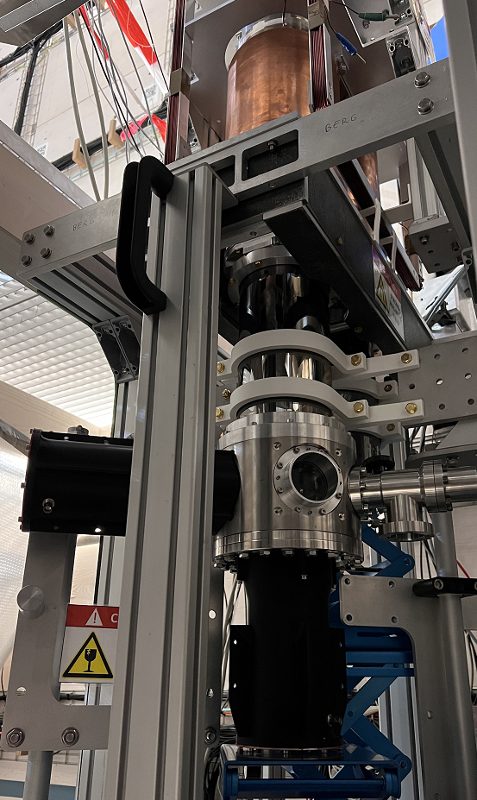
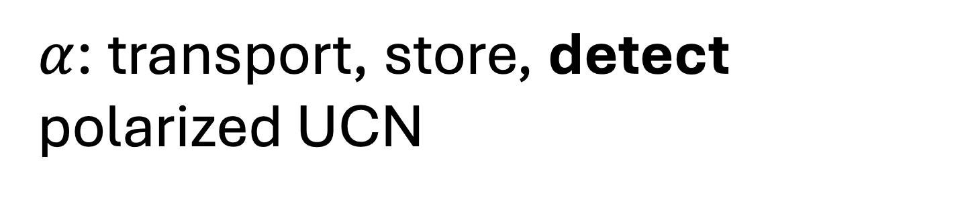
$α$: transport, store, detect polarized UCN
He3 + CF4 gas detector
3-PMT coincidence readout
PMT
PMT

Slide 19
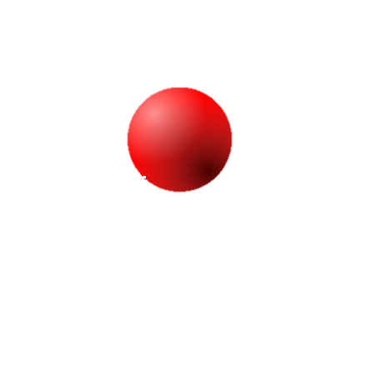
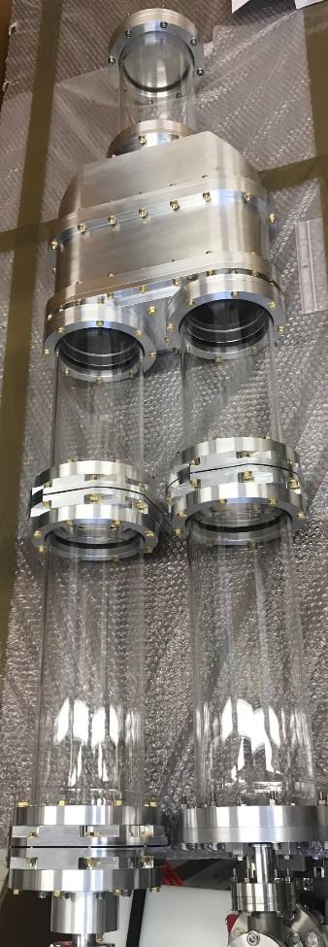
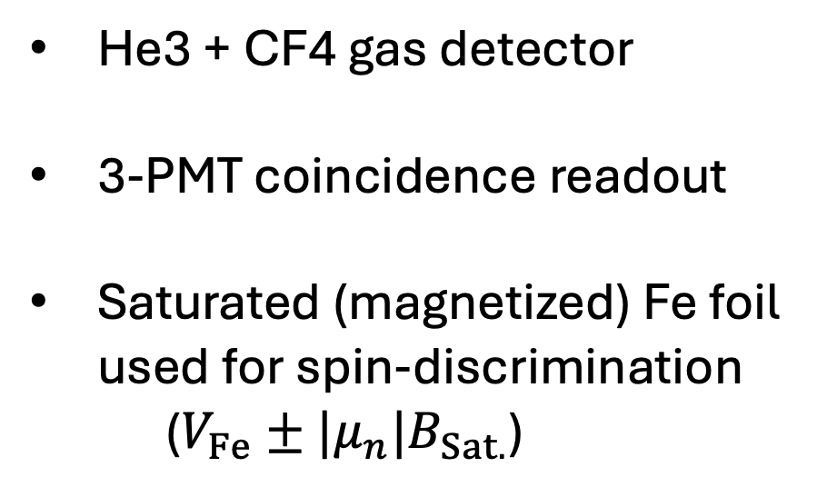
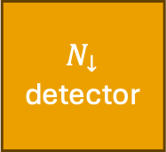
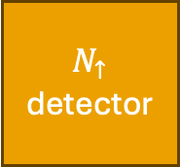
Simultaneous spin-sensitive detection
He3 + CF4 gas detector
3-PMT coincidence readout
Saturated (magnetized) Fe foil used for spin-discrimination
($V_{Fe}±{|μ}_{n}|B_{Sat.}$)
SF ON
SF OFF
Fe foil
Fe foil
$$N_{↑}$$
detector
$$N_{↓}$$
detector

Slide 20
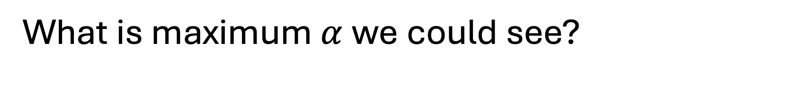
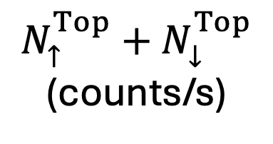
What is maximum $α$we could see?
“Direct dump” to detectors (no storage)
Integrate and calculate spin asymmetry
$N_{↑}^{Top}+N_{↓}^{Top}$ (counts/s)

Slide 21
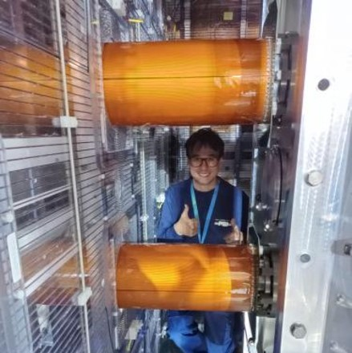
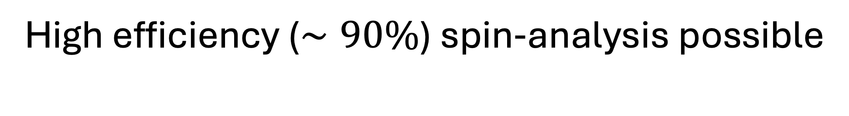
High efficiency ($∼90\%$) spin-analysis possible
“Direct dump” to detectors (no storage)
~90%
Top Detectors
Bot Detectors
Spin asymmetry
Integrating time bins

Slide 22
High efficiency ($∼90\%$) spin-analysis possible
“Direct dump” to detectors (no storage)
~90%
Top Detectors
Bot Detectors
Reliable spin-transport / no strong depolarization mechanisms
Limit of O(90%) ensemble polarization (measured up to 95%)
Spin asymmetry
Integrating time bins

Slide 23
High efficiency ($∼90\%$) spin-analysis possible
“Direct dump” to detectors (no storage)
Faster neutrons
that are not storable
~90%
Top Detectors
Bot Detectors
Reliable spin-transport / no strong depolarization mechanisms
Limit of O(90%) ensemble polarization (measured up to 95%)
Spin asymmetry
Integrating time bins

Slide 24
Can we maintain polarization during storage?
“Direct dump” to detectors (no storage)
Faster neutrons
that are not storable
~90%
Top Detectors
Bot Detectors
Reliable spin-transport / no strong depolarization mechanisms
Limit of O(90%) ensemble polarization (measured up to 95%)
Spin asymmetry
Integrating time bins

Slide 25
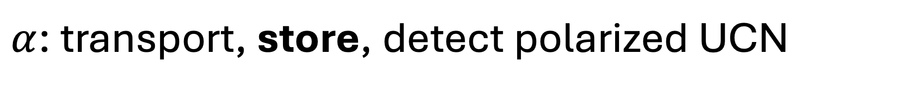
$α$: transport, store, detect polarized UCN
TOP
BOT

Slide 26
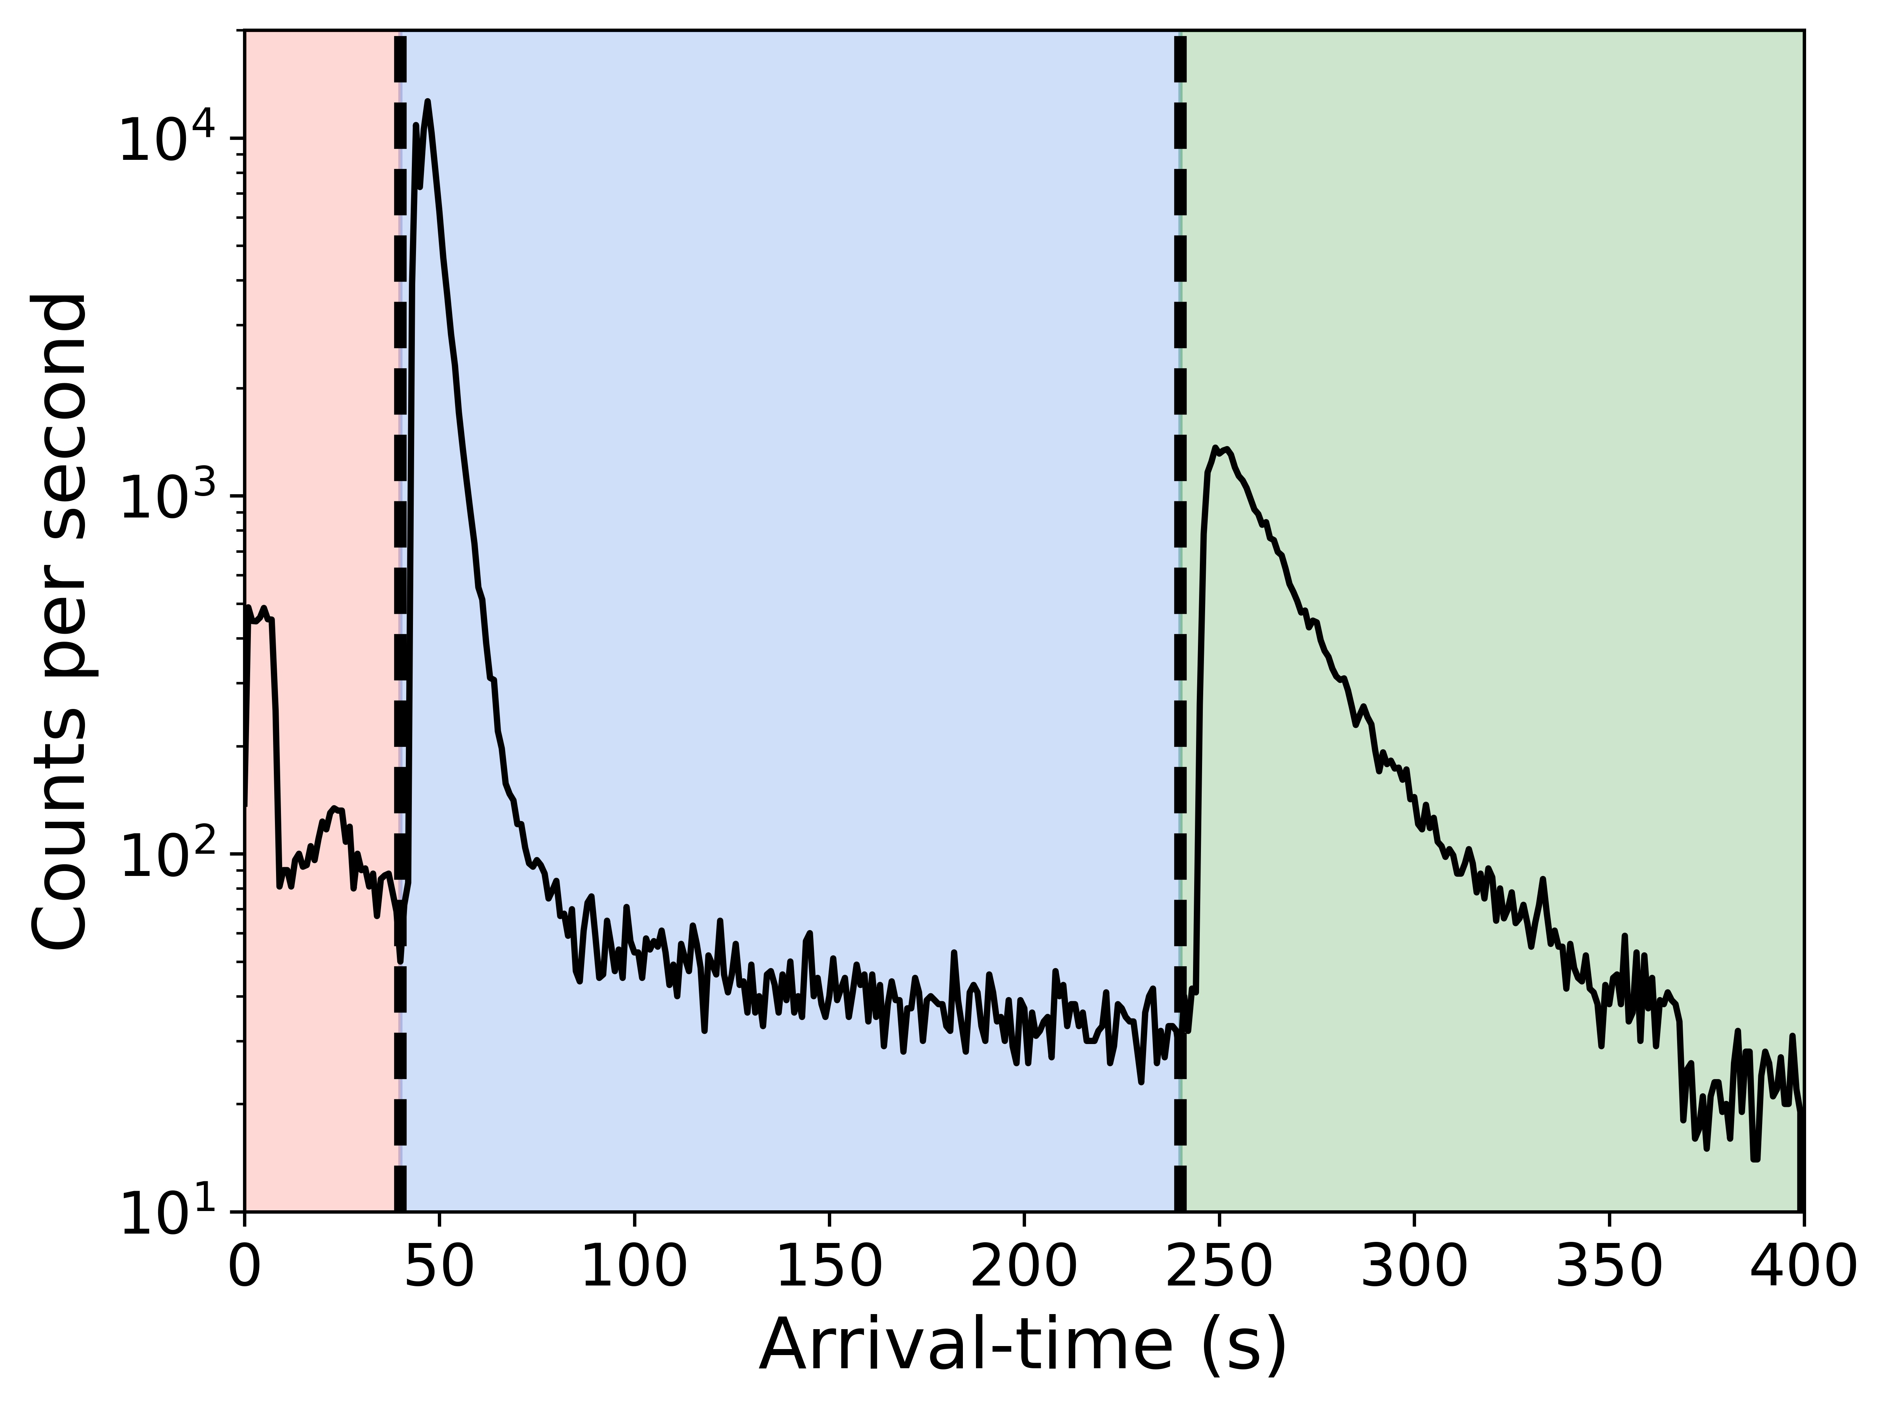



What detectors see in a measurement cycle
$$T_{fill}$$
$$T_{storage}$$
$$T_{count}$$
TOP
BOT

Slide 27
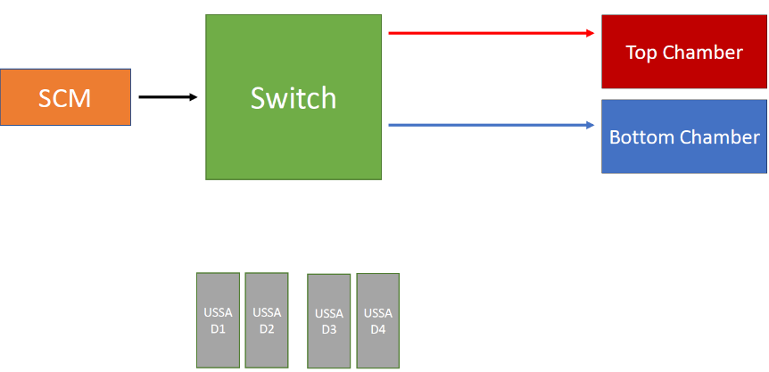
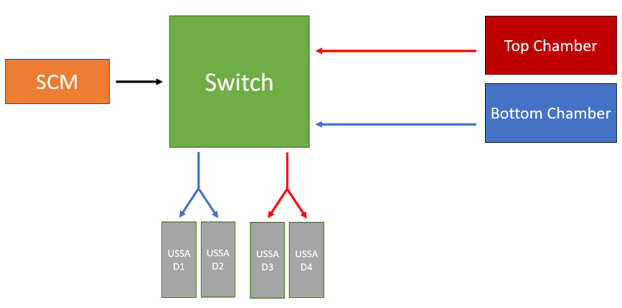
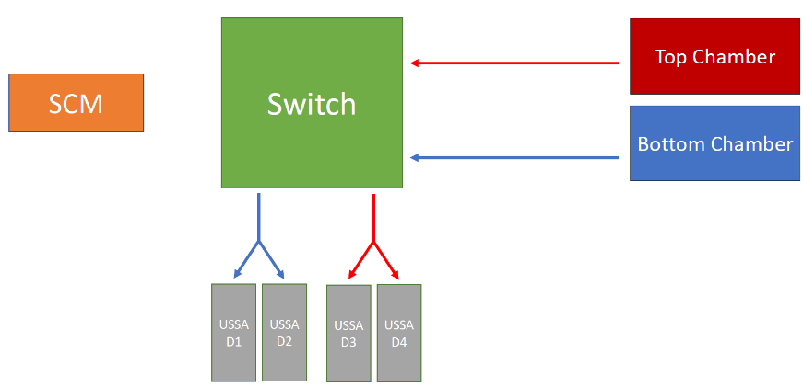



$$T_{fill}$$
$$T_{storage}$$
$$T_{count}$$
“FILLING”
Integrate for
spin asymmetry
“STORAGE”
“COUNTING”

Slide 28
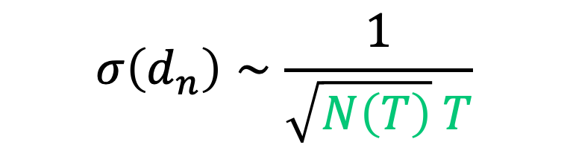
Storage time of UCN in our chambers
$$σ\left(d_{n}\right)∼\frac{1}{\sqrt{N\left(T\right)} T}$$
Normalized UCN counts
much shorter than lifetime

Slide 29
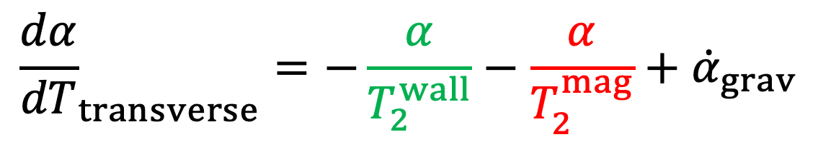
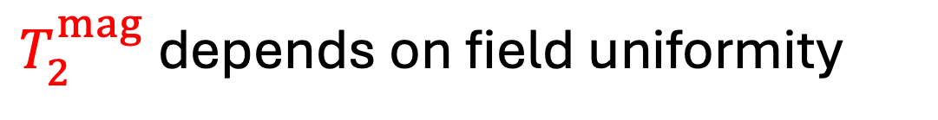
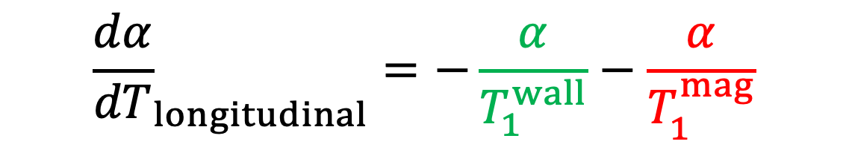
Depolarization mechanisms during storage
$${\frac{dα}{dT}}_{transverse}=−\frac{α}{T_{2}^{wall}}−\frac{α}{T_{2}^{mag}}+{\dot{α}}_{grav}$$
$${\frac{dα}{dT}}_{longitudinal}=−\frac{α}{T_{1}^{wall}}−\frac{α}{T_{1}^{mag}}$$
${1/T}_{1}^{wall}=βv→$ depends on material, $β∼{(10}^{−5},{10}^{−6})$
$T_{2}^{mag}$ depends on field uniformity

Slide 30
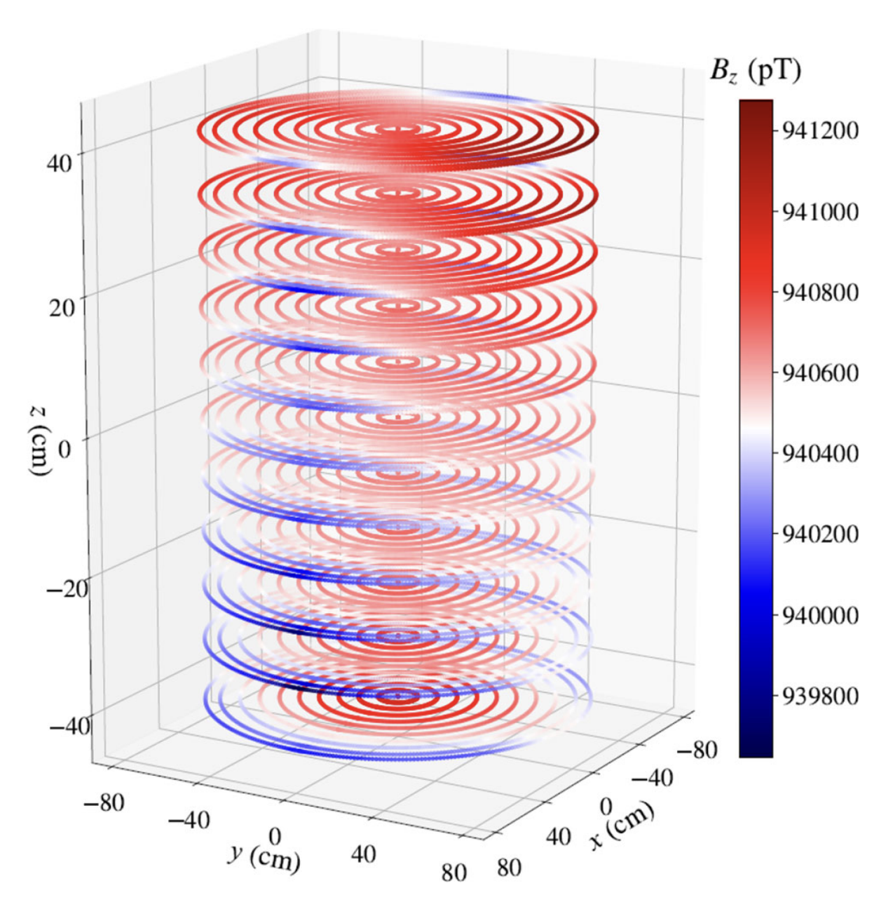



Magnetic-field uniformity of n2EDM (64 coils + ${10}^{6}$ quasistatic shielding from AMS+MSR + many PhDs, postdocs, …)
+ more for systematics…
See poster of Valentin
Rev. Sci. Instrum. (2022)
Eur. Phys. J. C 83, 1061 (2023)
Eur. Phys. J. C 84, 18 (2024)
Eur. Phys. J. C 85, 202 (2025)

Slide 31



Magnetic-field uniformity of n2EDM (64 coils + ${10}^{6}$ quasistatic shielding from AMS+MSR + many PhDs, postdocs, …)
Field requirements (for statistics)
Double-chamber measurement
$$\left|\frac{∂B_{z}}{∂z}\right|<0.6\frac{pT}{cm}$$
Intrinsic depolarization
$$σ\left(B_{z}\right)<170 pT$$
Field stability over minutes
$$<30 fT$$
+ more for systematics…
See poster of Valentin
Rev. Sci. Instrum. (2022)
Eur. Phys. J. C 83, 1061 (2023)
Eur. Phys. J. C 84, 18 (2024)
Eur. Phys. J. C 85, 202 (2025)

Slide 32
Longitudinal depolarization time in our chambers negligible for reasonable storage times
(TOP suffered from magnetic contam. of Hg)

Slide 33
Transverse depolarization also small!
First Ramsey measurement in n2EDM in 2023
Polarization after 180s storage and detection still O(90%)!

Slide 34
Transverse depolarization also small!
First Ramsey measurement in n2EDM in 2023
Polarization after 180s storage and detection still O(90%)!
Visible Ramsey curve from overnight measurement without any co-magnetometer!

Slide 35


Repeat for other precession times to extract $T_{2}$
(TOP suffered from magnetic contam. of Hg)

Slide 36

High visibility thanks to robust $\vec{B}$ control
$α\left(180s\right)∼0.85−0.9$
$N\left(180s\right)=110,000$ UCNs total
$E∼10 kV/cm$ → working on it now
$$σ\left(d_{n}\right)∼\frac{1}{α\left(T\right) E \sqrt{N\left(T\right)} T}$$

Slide 37
Distracting side-quest about depolarization
$${\frac{dα}{dT}}_{transverse}=−\frac{α}{T_{2}^{wall}}−\frac{α}{T_{2}^{mag}}+{\dot{α}}_{grav}$$
$${\frac{dα}{dT}}_{longitudinal}=−\frac{α}{T_{1}^{wall}}−\frac{α}{T_{1}^{mag}}$$

Slide 38


We can leverage depolarization as a tool to learn about stored UCN energy spectrum
$α_{int}\left(G\right)=$
$α_{0}\int{e^{−T/T_{2}^{mag}(ε,G)} n\left(ε\right)dε }$
$$∂B_{z}/∂x$$

Slide 39





Measure depolarization rate from many gradients and simultaneously fit data
$$α_{grav}$$
$$α_{int}$$
$$∂B_{z}/∂z$$
$+G_{2,0}, G_{1,−1}$ fits
$$∂B_{z}/∂x$$

Slide 40
Can extract stored spectrum and specularity of storage chambers
Specular (0)
Diffuse (1)
Publication under review at PRL; arXiv 2511.06884

Slide 41



Can use to calculate systematic frequency shift from $\vec{B}$ sampling difference in top, bottom
Specular (0)
See poster of Morgan
Diffuse (1)
Publication under review at PRL; arXiv 2511.06884

Slide 42
Back to the main questline…
$α\left(180s\right)∼0.85−0.9$
$N\left(180s\right)=110,000$ UCNs total
$E∼10 kV/cm$ → working on it now
$$σ\left(d_{n}\right)∼\frac{1}{α\left(T\right) E \sqrt{N\left(T\right)} T}$$

Slide 43

Issues with coatings in storage chamber ($V_{F}$)
n2EDM Design
End of 2024
Initial

Slide 44

Now we are close to design! (from a lot of redesign and effort)
n2EDM Design
2025
issue with O-ring and HV event
End of 2024
Initial
Changed from rexolite to quartz and recoated electrodes

Slide 45
Now we are close to design! (from a lot of redesign and effort)
35s filling time

Slide 46




Goals of n2EDM to reach ${10}^{−27} e cm$
$α\left(180s\right)∼0.85−0.9$
$N\left(180s\right)=110,000$ UCNs total
$E∼10 kV/cm$ → working on it now
For n2EDM, optimal statistical measurement at $T>300$s
(does not consider
co-magnetometer performance)
$$σ\left(d_{n}\right)∼\frac{1}{α\left(T\right) E \sqrt{N\left(T\right)} T}$$

Slide 47

So what about the electric field? Goal of 15 kV/cm
$α\left(180s\right)∼0.85−0.9$
$N\left(180s\right)=110,000$ UCNs total
$E∼10 kV/cm$ → working on it now
$$σ\left(d_{n}\right)∼\frac{1}{α\left(T\right) E \sqrt{N\left(T\right)} T}$$

Slide 48





Magnetic field as seen by Hg co-magnetometer
$$f_{Hg}−f_{0} (μHz)$$
$$B_{Hg}−B_{0} (pT)$$
10
60
8
40
6
4
20
2
0
0
HV spark event

Slide 49

Magnetic field as seen by Hg co-magnetometer
$$f_{Hg}−f_{0} (μHz)$$
$$B_{Hg}−B_{0} (pT)$$
10
Can stably run up to $∼8$ kV/cm
$8−10$ kV/cm issues with leakage current
$>10$ kV/cm issues with sparks & leakage current
60
8
40
6
4
20
2
0
0
HV spark event

Slide 50
Working on it ☺
$α\left(180s\right)∼0.85−0.9$
$N\left(180s\right)=110,000$ UCNs total
$E∼10 kV/cm$ → working on it now
$$σ\left(d_{n}\right)∼\frac{1}{α\left(T\right) E \sqrt{N\left(T\right)} T}$$

Slide 51


Still took unblinded nEDM dataset in 2025
Statistical sensitivity
$$2⋅{10}^{−26} e cm$$
Issue of HV performance
Concern of magnetizable material
Incomplete monitoring of $\vec{B}$ gradients

Slide 52


What we see with neutrons … but no $\vec{E}$ ☺
nEDM?!

Slide 53

What we see with neutrons … but no $\vec{E}$ ☺
Talk by Katia about co-magnetometry

Slide 54



But $Δf_{n}∼d_{n}$, so we can look at difference
$f_{n}^{Top}−f_{n}^{Bot}$ (mHz)
$G_{TB}$ (pT/cm)

Slide 55

Outlook for 2026
Address HV performance
Finish commissioning of external (Cs) magnetometers for systematic control
Start blinded data-taking in June

Slide 56
Thank you!
Efrain Segarra
Mar 5, 2026
EDMs 2026

