Slide 1



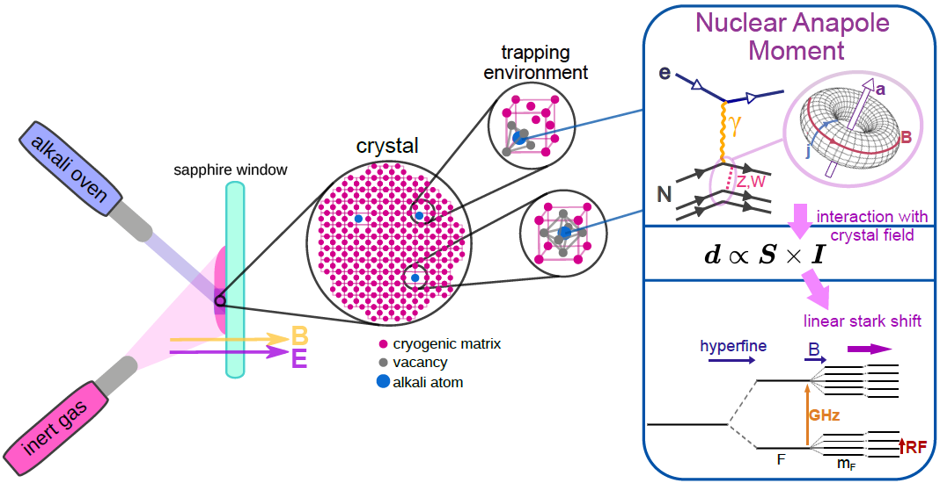
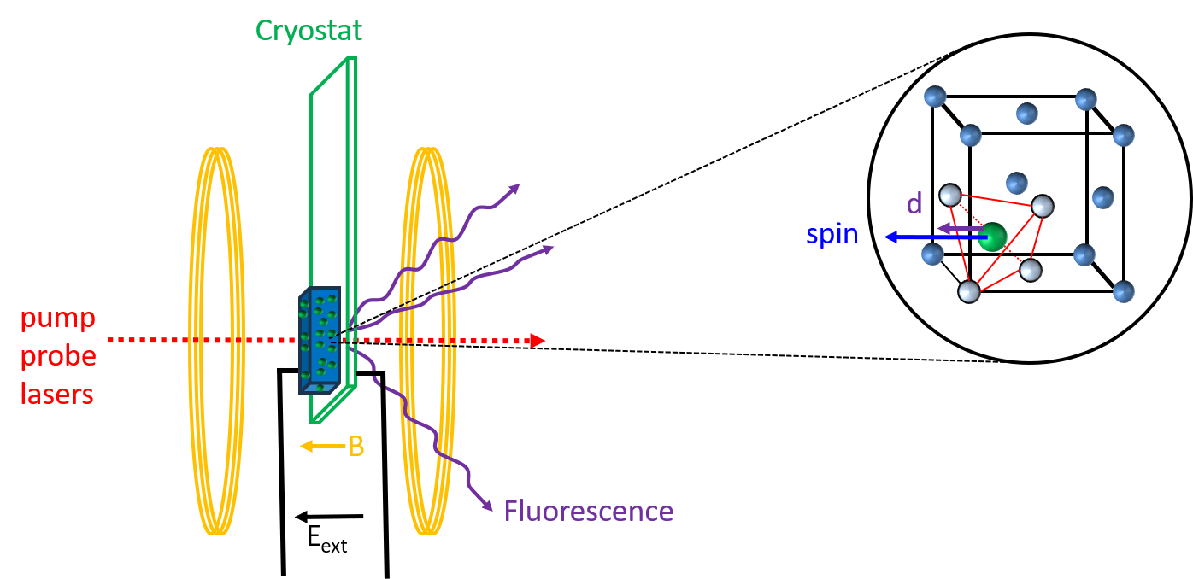

Atoms on ice
Daniel Comparat
Laboratoire Aimé Cotton, Orsay, FRANCE

Slide 2
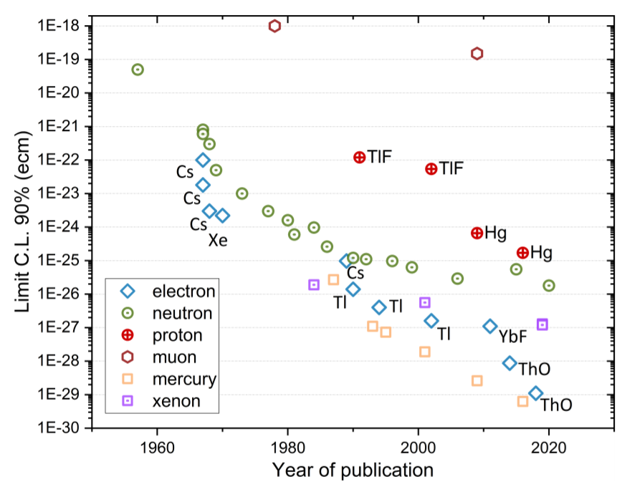
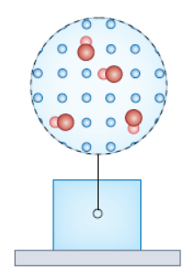

EDM status and project (for electron)
Some EDM history
Kirch, K., & Schmidt-Wellenburg, P.
Search for electric dipole moments.
Particle | N_{T} time integrated | Time τ [s] | Polarization ε | Eff. Field E_{eff} (V/cm) | EDM e.cm
Cs | 10¹⁴ | 0.015 | 0.7 | 5 10⁵ | 1 10⁻²⁶
ThO | 10¹³ | 0.002 | 0.1 | 10¹¹ | 10⁻²⁹
HgF⁺ | 10⁷ | 3 | 0.8 | 2 10¹⁰ | 4 10⁻³⁰
Ni–Zn
ferrite
GdIG
GGG
Eu_{0.5}Ba_{0.5}TiO₃
Ideal
N big
τ long
HgF⁺
Beyond Standard Models
Supersymmetry (SUSY),
Multi-Higgs,
Symmetrical Left-Right
Leptoquarks,
Additional dimensions,
Technicolor and Composite Models,
Axion Models,
Neutrino Mass Models,
Grand Unification Theories (GUT),
CP-Violant QED Sector Extensions,
Mirror Matter Models
Atoms (Cs) in matrix | 10¹⁶ | 0.01 | 0.1 | 10⁶ | 6 10⁻²⁷
 | 10²⁰ | 1 | 1 | 10⁹ | 6 10⁻³⁵
Molecule in matrix | 10¹⁸ | 0.1 | 0.1 | 10¹⁰ | 6 10⁻³³
 | 10²¹ | 1 | 1 | 10¹¹ | 10⁻³⁷
Standard Model : atomic EDM ~10⁻³⁵ e.cm
Standard Model electron EDM ~10⁻³⁸ e.cm

Slide 3
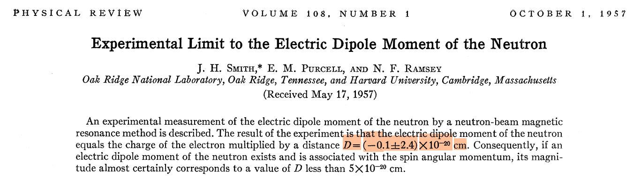
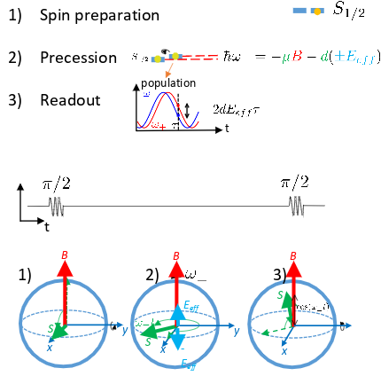
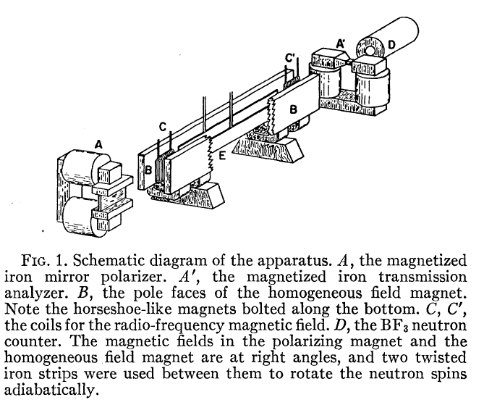
How to measure —> Ramsey spectroscopy

Slide 4
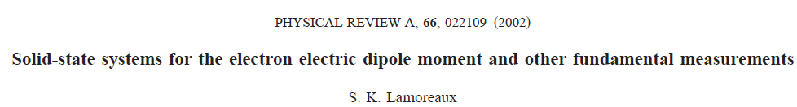
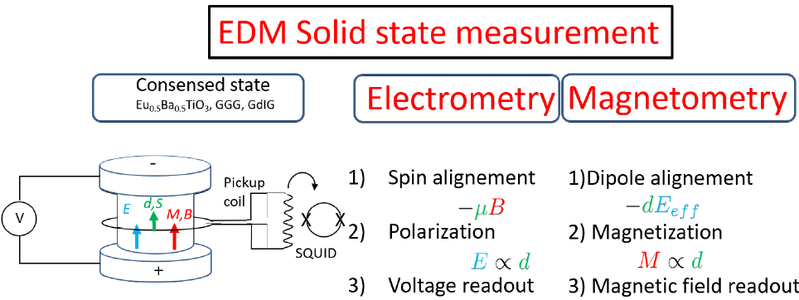
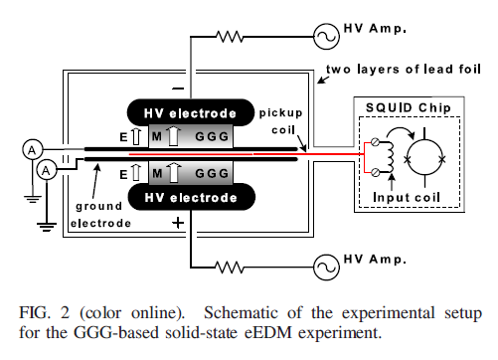
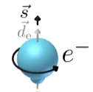
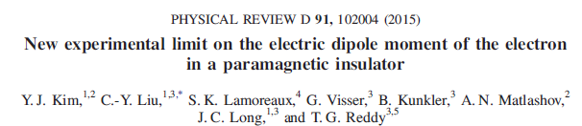
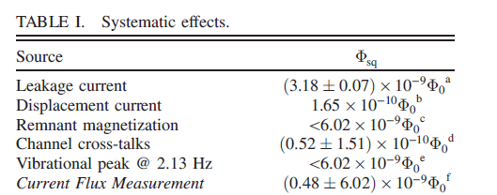
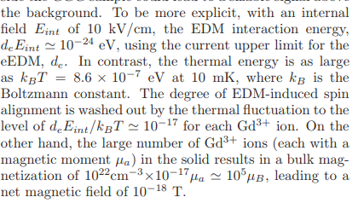
d_{e} aligned
along S
Very small polarization ε =

Slide 5
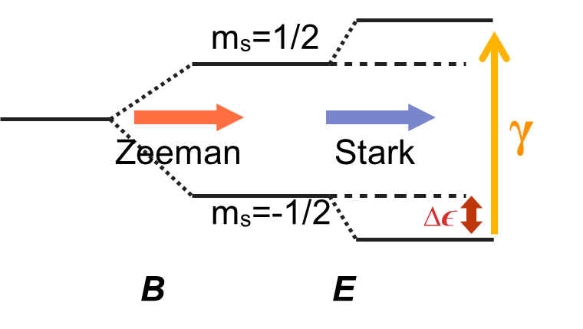

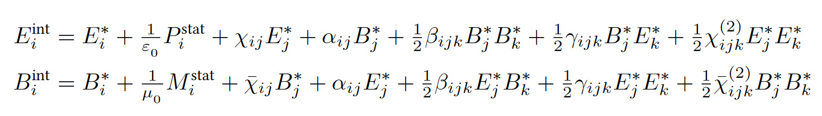
History of eEDM in solid state systems
year | sample | eEDM limit in e·cm | method
1961 | KCr- & NH₄-(SO₄)₂ 12H₂O | d_{e} < 10⁻¹³ | EPR spectroscopy | Δ Energy = -d.E_{eff}
1963 | Al₂O₃:Cr & MgO:Cr | d_{e} = (1 ± 4.6)x10⁻¹⁶ | EPR spectroscopy
1979 | Nickel-Zink-Ferrite | d_{e} = (8.1 ± 11.6)x10⁻²³ | Magnetometry
2004 | GdIG | d_{e} = (2 ± 3)x10⁻²⁴ | Voltage measurement | B field, align spin → dipole→ Create +/- charges
2011 | GGG | d_{e} = (-5.57 ± 7.98_{stat} ± 0.12_{syst})x10⁻²⁵ | Magnetometry | E field, align dipole→ Spin → Create B field
2012 | Eu_{0.5}Ba_{0.5}TiO₃ | d_{e} = (-1.07 ± 3.06_{stat} ± 1.74_{syst})x10⁻²⁵ | Magnetometry
d_{e} // µ
d_{e} aligned
along S
Broken symmetry -> magnetoelectric

Slide 6



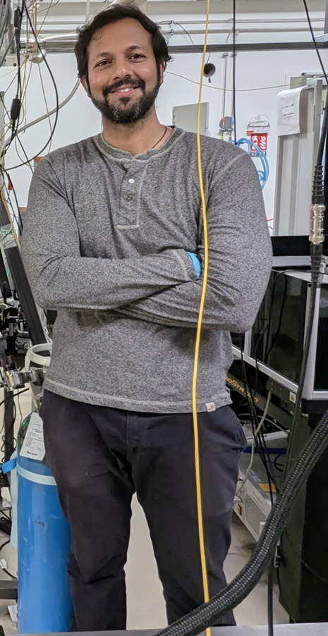

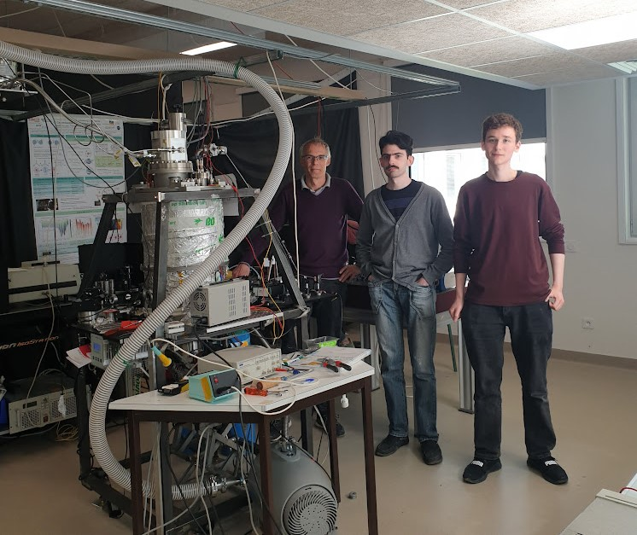

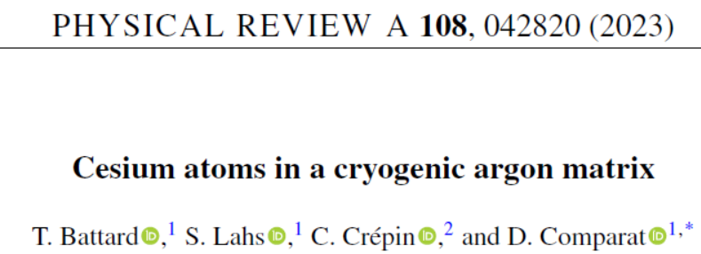
EDM in matrix
Wutharath Chin, Claudine Crépin-Gilbert
Benoit Gervais
Hemanth Dinesan (Post-Doc) Subham Mahapatra (M2)
Daniel Comparat
Thomas Battard (PhD)
Sébastian Lahs (PhD)
More are needed

Slide 7
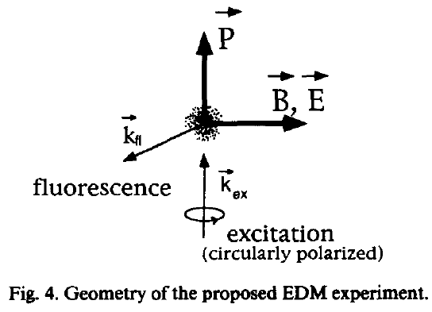
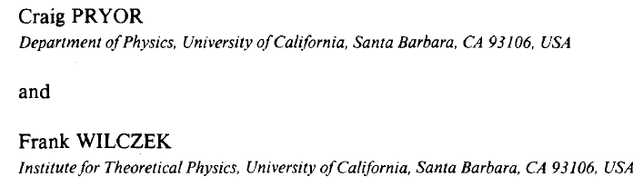
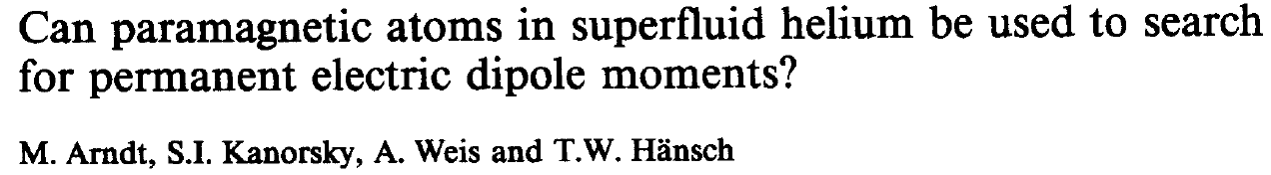
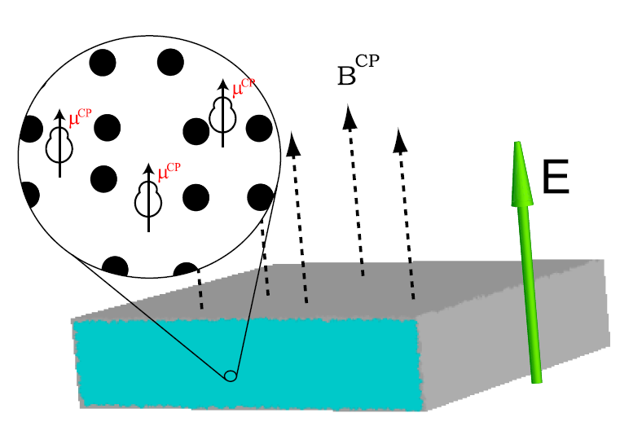
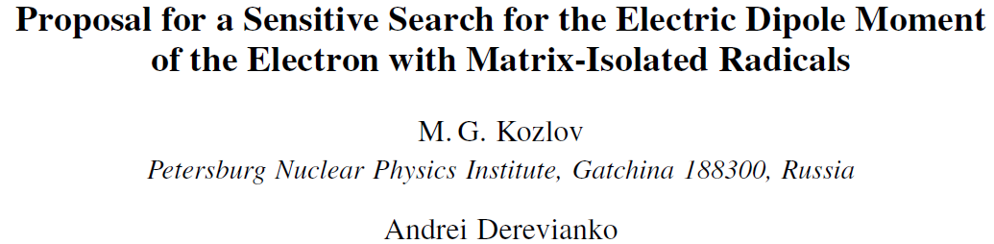

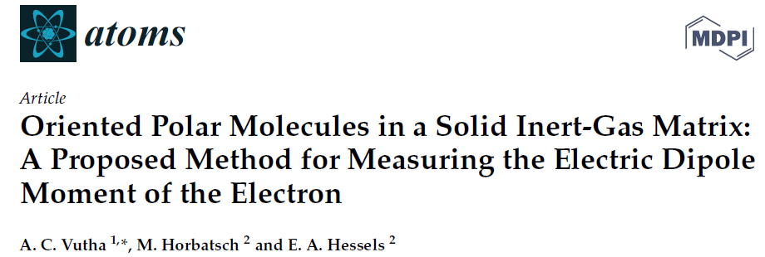
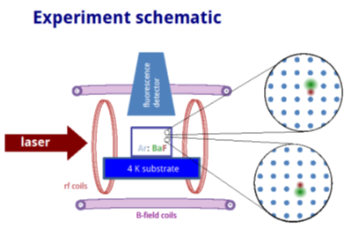
Using cryogenic matrix: An old idea
1987
BaF
…

Slide 8
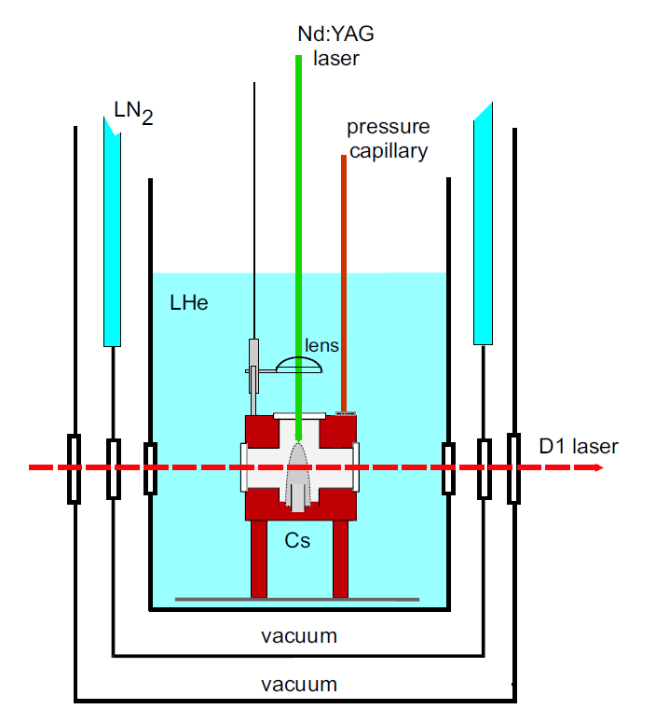
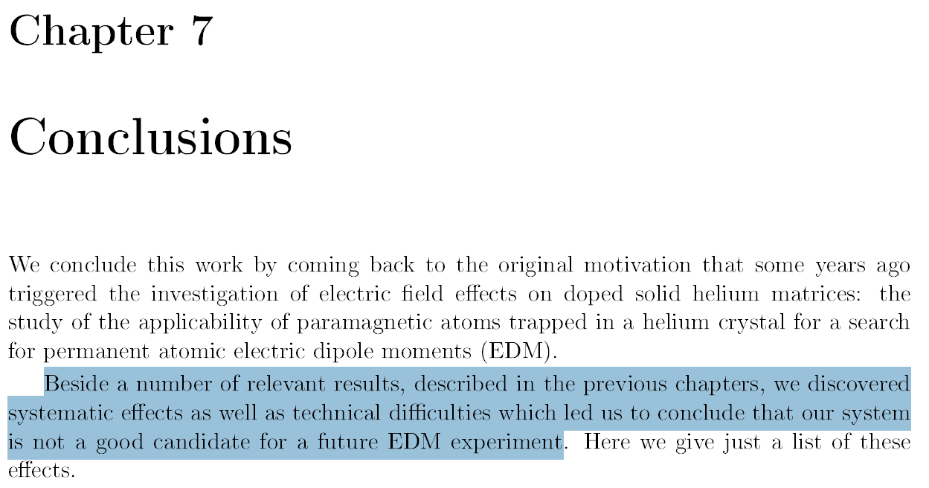
2006 Simone Ulzega’s PhD thesis (Antoine Weis) Cesium in solid Helium

Slide 9
Several (possible) advantages
Huge statistics: very high molecule densities in a solid → high statistics = high sensitivity.
Long interrogation/accumulation: spins are immobilized; coherence can be extended by cryogenic, quiet environment.
Easy polarization & orientation: lattice/site fields + possible external fields align molecules.
Low systematics from fields: precession can occur with no applied E-field → no leakage-current artifacts
Suppressed motional effects: molecules don’t move → eliminate v×E motional magnetic fields and geometric phases from trajectories.
Compact, well-shielded sample: small crystal → excellent electric/magnetic congtrol (+ shielding and thermal stability)
State control & readout: optical pumping + fluorescence/cycling transitions for high-SNR detection.
Co-molecule options: embed auxiliary species (e.g., diamagnetic references) for co-magnetometry and systematics checks.
Broad atoms (Rb, Cs, BaF, Ba, …) + sample choices (Ne, Ar, K, Xe, p-H₂ ?) + easy to change
Polarizabilities as probes for P, T, PT violation
Sebastian Lahs and Daniel Comparat 2024
New J. Phys. 26 125001
Internal crystal field —> Enhancement + quadrupole field —> New observables
Problems :
Magneto-electric effects
Matrix putiry : spins + isotopes
Polycrystal

Slide 10
EDM in Matrix
atoms (Rb, Cs, Tm, Yb, Ba, ...)
molecules (BaF, RaF, ..)
in rare-gas (Ne,Ar mainly) or parahydrogen
Lambo R, Xu CY, Pratt S, Xu H, Zappala J, Bailey K, Lu ZT, et al.. High-resolution spectroscopy of neutral Yb atoms in a solid Ne matrix. PRA 104, 062809.
Braggio C, Calabrese R, Carugno G, Fiscelli G, Guarise M, Khanbekyan A, Noto A, Passante R, Rizzuto L, Ruoso G et al.. 2022 Spectroscopy of Alkali Atoms in Solid Matrices of Rare Gases: Experimental Results and Theoretical Analysis. Applied Sciences 12, 6492.
Alessandro Lippi, Giovanni Carugno, Roberto Calabrese, Federico Chiossi, Marco Guarise, Madiha M. Makhdoom, Giuseppe Messineo, Jacopo Pazzini Neutral Barium in Solid Neon: Optical Spectroscopy and First Excited State Lifetime: https://arxiv.org/abs/2512.11140
Gaire V, Parker C, Raman C, Li J, Pei Y. 2022 Excitation of magnetic dipole transition of Thulium atoms trapped in rare gas crystals. In APS Division of Atomic, Molecular and Optical Physics Meeting Abstracts vol. 2022 pp. H04–009.
Crystal Fields and Zeeman Effect for Thulium in Solid Argon Jason Marfey,∗ Anthony Semenova,† and Colin V. Parker (https://arxiv.org/pdf/2507.08140)
Li S, Ramachandran H, Anderson R, Vutha A. 2023 Optical control of BaF molecules trapped in neon ice. New Journal of Physics.
Lambo R, Koyanagi G, Horbatsch M, Fournier R, Hessels E. 2023 Calculation of the local environment of a barium monofluoride molecule in a neon matrix. arXiv preprint arXiv:2305.10667 + Molecular Physics 121, e2198044 + Severals (cf Eric Hessels’ talk)
Ballof J, Nusgart N, Lalain P, Au M, Heinke R, Leimbach D, Stegemann S, Schutt M, Rothe S, Singh JT. 2023 Progress towards the FRIB-EDM3-Frontend: A tool to provide radioactive molecules from isotope harvesting for fundamental symmetry studies. Nuclear Instruments and Methods in Physics Research Section B: Beam Interactions with Materials and Atoms 541, 224–227.
Azevedo LO, Costa RJ, Wolff W, Oliveira AN, Sacramento RL, Silveira DM, Cesar CL. 2023 A platform for trapped cryogenic electrons, anions and cations for fundamental physics and chemical studies. arXiv preprint arXiv:2301.13248.
Impurities in cryogenic solids: a new platform for hybrid quantum systems, Andrew N. Kanagin, Nikolaus de Zordo, Andreas Angerer, Wenzel, Kersten, Nikolaos Lagos, Jörg Schmiedmayer, and Elena S. Redchenko, Na in Ne for hybrid quantum system

Slide 11
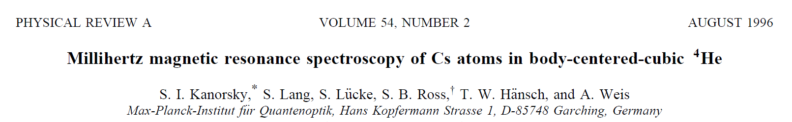
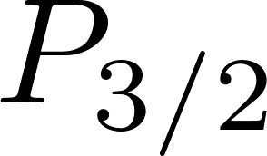
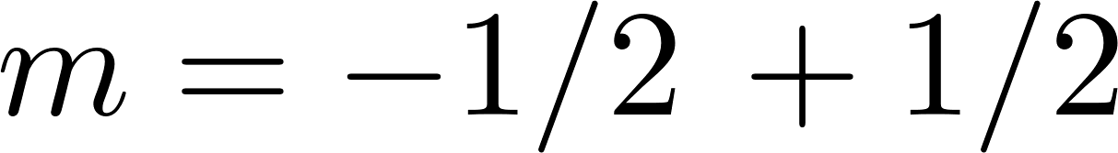
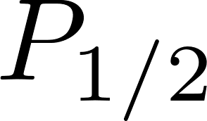
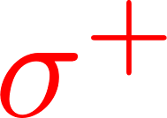
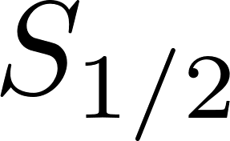

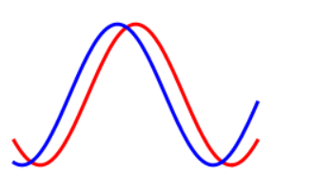

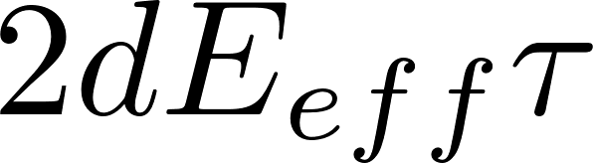


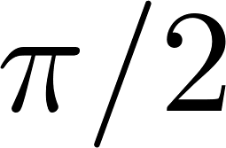
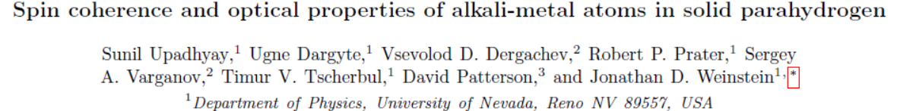

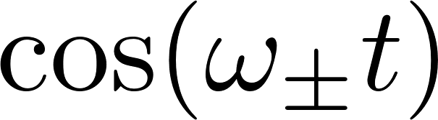

Spin precession
align by optical pumping + coherence
USE ATOMS (circular)
Optical pumping (alignement)
Precession
Readout
population
t
T₁ (population) ~1 s
T₂ (coherence, phase) ~0.1 s (for Cs)
t
B
B
B
1) 2) 3)
E_{eff}
S
Phys. Rev. A 100, 063419 (2019)
S
y
S
y
x
x
-E_{eff}
x

Slide 12
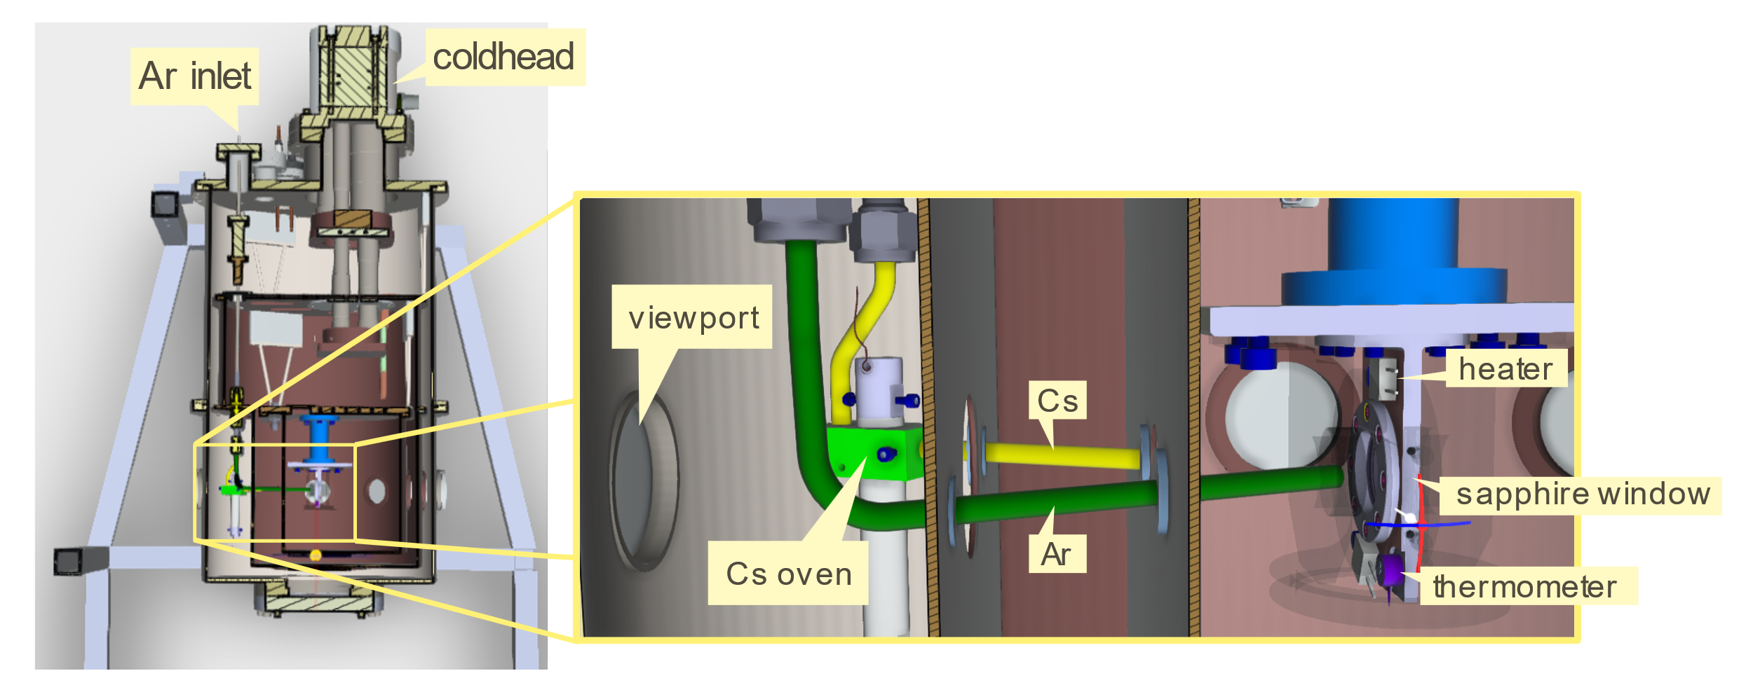
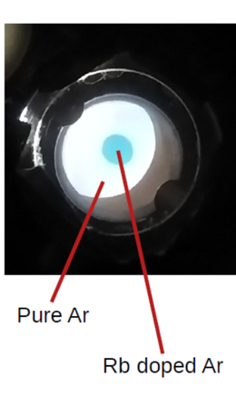
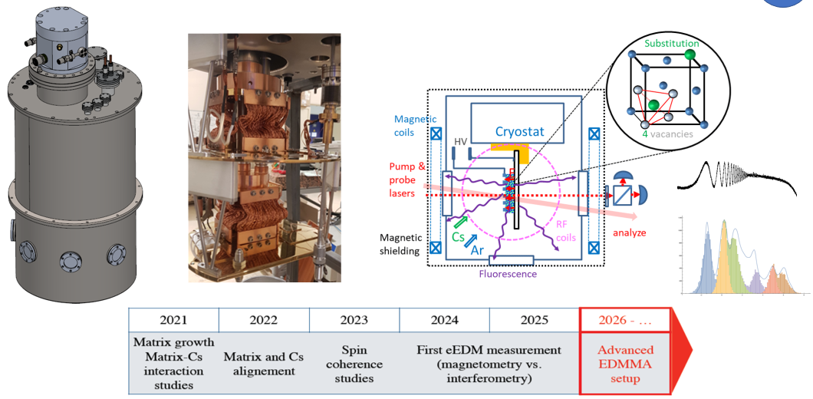
Experimental setup

Slide 13
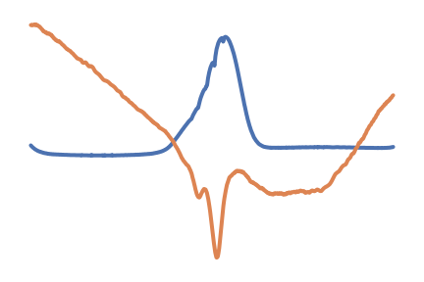
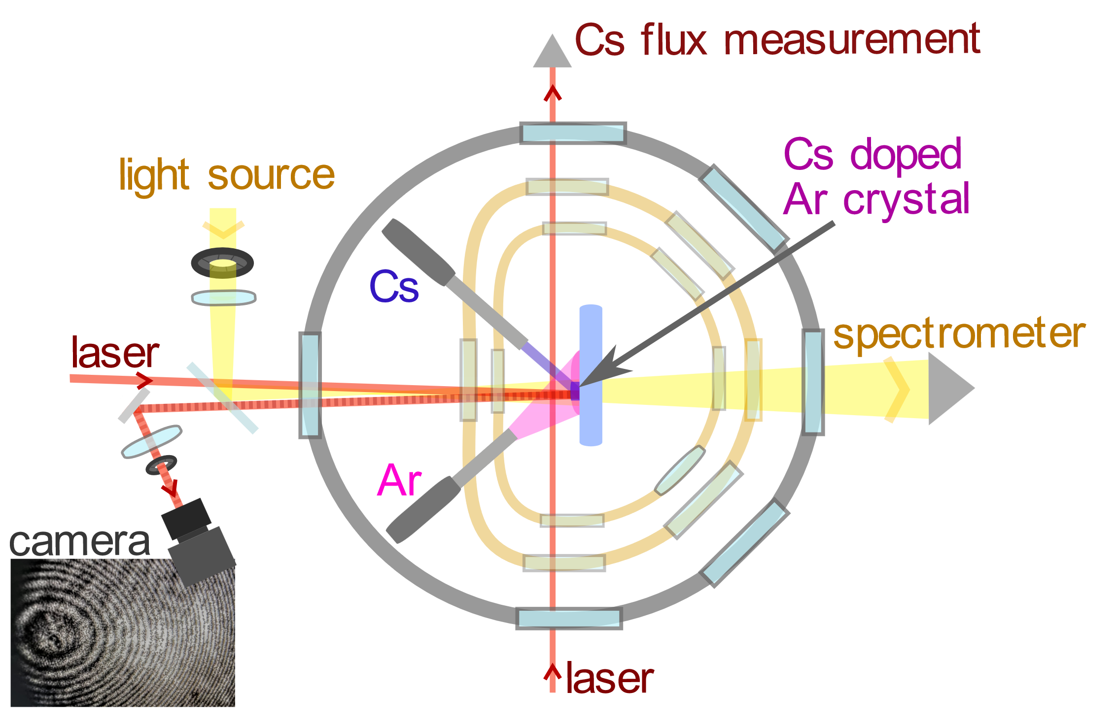
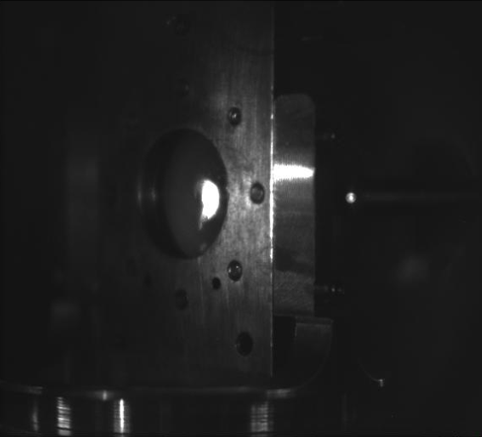
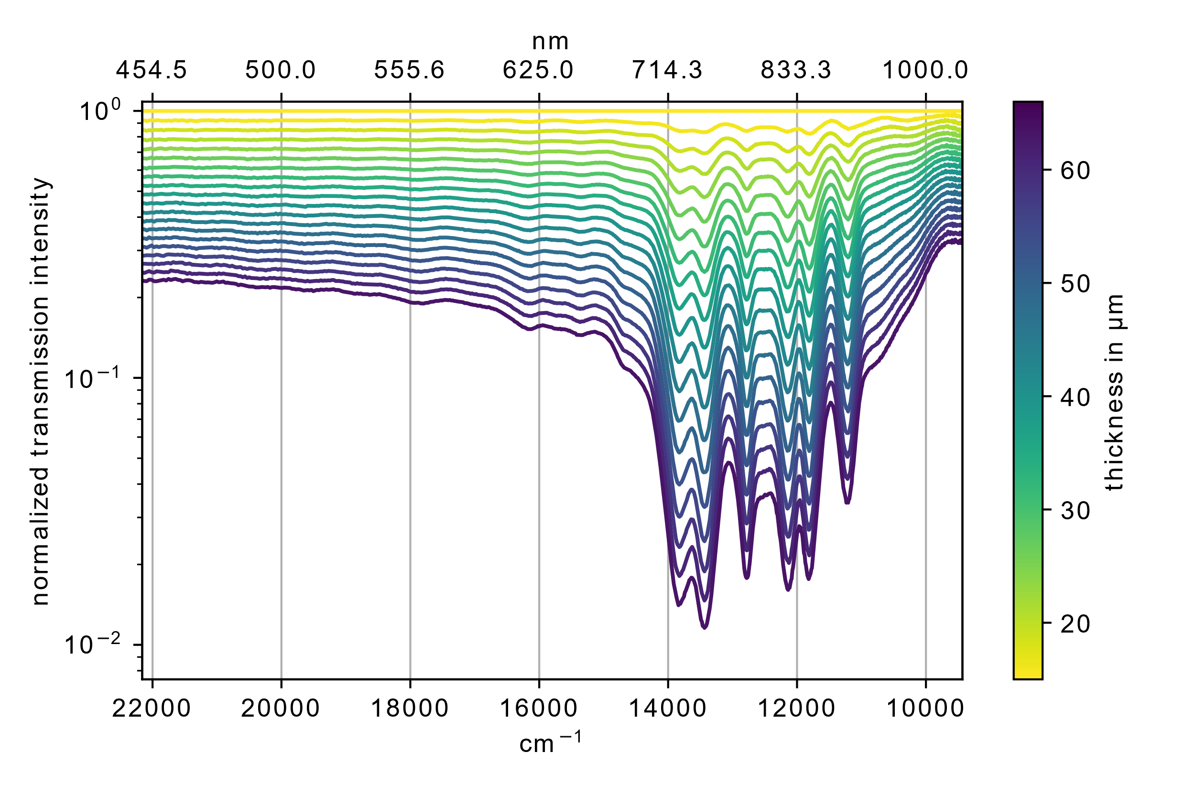
Oscilloscope
Transmission
Cs in argon
Fizeau interferometer
Matrix growth
λ/2 every fringes
In Ar crystal n~10¹⁸ per cm³
Cs in Ar at Similar distance (10nm) than dislocations

Slide 14
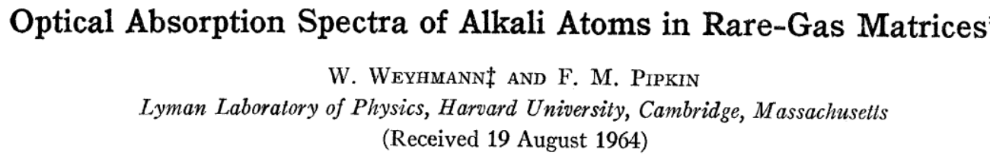
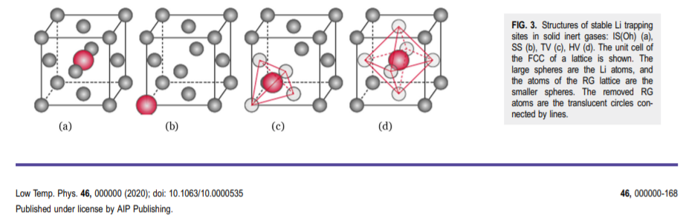

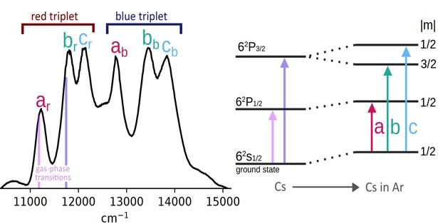
Probably 2 different
Trapping sites

Slide 15
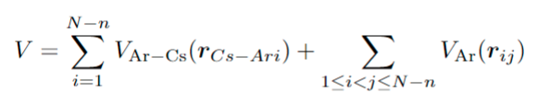


Stability diagram
X,Y,Z
Ar
4(T_{d}) 6 (O_{h})
Convex stability (ex: 5+5 → 4 +6) → 4 vacancies or 6 vacancies

Slide 16


Different magneto-electric couplings
α:
β & γ:
Orthogonal E-B-mixing
Orthogonal E-B-mixing
zero

Slide 17



But incorrect shape
(Reflexion approximation + Crystal Field theory)
Experiment
Need to quantize the motion
+ not pure pairwise interaction
third order effects
Theory
May need better approach → Pseudopotential (B. Gervais)

Slide 18



Absorption + Fluorescence
State mixing & One principal emission
Two principal trapping sites
Na is Ar
3s→3p

Slide 19







Test by laser depletion (bleaching)
Two principal trapping sites
2 Sets of correlated peaks
LASER
LASER
If irradiation at any peak of a triplet leads
to rearrangement of atoms, all
3 components should be lost
If irradiation at any peak of a triplet leads
to rearrangement of atoms, all
3 components should be lost
laser
All components of a triplet should be suppressed
All co
sho
triplet
ssed
No conclusive results:
Background/thermal effects ?

Slide 20







Test by Fluorescence
State mixing & One principal emission
Two principal trapping sites
Example CsAr valence electron eigen-energy curves
Example CsAr valence electron eigen-energy curves
_{6s} 6p
--- Stokes Shifted Fluorescence
~ few nanoseconds
6s
6p
--- Stokes Shifted Fluorescence
~ few nanoseconds
Matrix interactions should cause rapid
mixing of p-states
Cs-Ar distance
Matrix interactions should cause rapid
mixing of p-states
Single fluorescence
Single fluorescence
emission peak
emission peak
Unexpected
(non) relaxation p3/2 →p1/2
Time (ps)
B. Gervais calculation + non adiabatic coupling cf. Hg in Ar J. Phys. Chem. A 2003, 107, 8225-8231

Slide 21



Tests with polarized light
The redest line might be 6s—>6p1/2
excitation in a very
Symmmetric environnement
like Oh 6 (keep « spherical symetry)
Non symmetrical → keep crystal axis

Slide 22


Cs in Various Inert Gas Matrices
8K 10K
14K
3.2K
3.2K
3.2K

Slide 23




Towards spin manipulations
Optical Pumping Electron Spin Resonance (ESR)
Optical Pumping Electron Spin Resonance (ESR)

Slide 24



Cesium in matrix (anapole moment)
M.A. Bouchiat, C. Bouchiat Eur. Phys. J. D 15, 5{18 (2001)
An atomic linear Stark shift violating P but not T arising from the electroweak nuclear anapole moment
Nuclear Anapole Moment (NAM) of Cs
BSM-PM: NSF-ANR QISE: QUIC
Quantum Sensing with Cryocrystals for Fundamental Physics
Jonathan D Weinstein + Andrei Derevianko,

Slide 25


Conclusion
Cs in Ar seems promising for EDM measurment
Potential for new observables in such systems (anapole)
Energy
Magnetic circular dichroism (MCD)
g_Lande, spin-orbit, lattice structure
6p
In solid state systems, there can be dangerous mixing terms.
Multiple trapping sites are present at the same time
Td (4 vacancies) + Oh (6 vacancies), D3h, hcp phase ?
σ⁺ / σ⁻
6s
F=4
Electron spin resonance (ESR)
(hyperfine + Zeeman effect)
F=3
Nuclear coordinates
B field
Next steps
Magnetic circular dichroisme
Optical pumping
Electron Spin Resonance → Spin coherence
Magneto electric effects E/B coupling
7th Peak ??
Cs₂ ?
6s→5d transition ?
Other system (Rb,Cs, SrF, TlF, polyatomic, radioactive …)
In Ar, Ne, pH₂ ?

